Slide 1
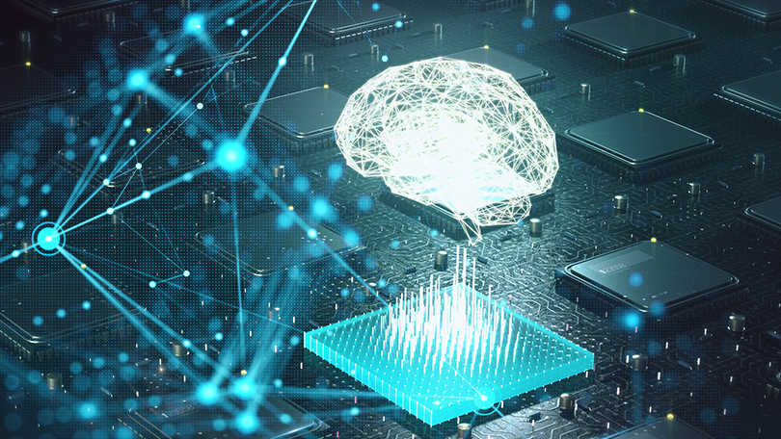
Inception V4
By Brett Tully

Slide 2
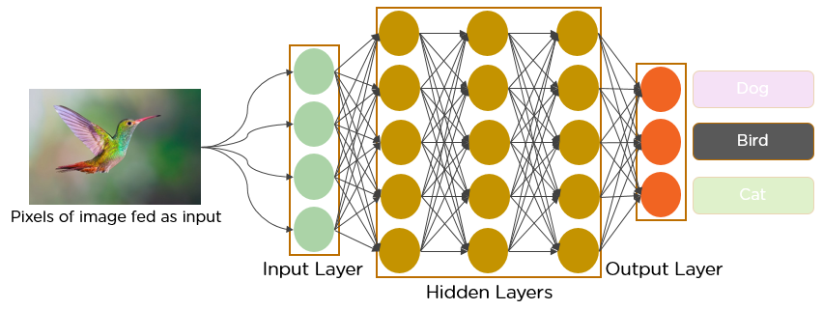
What is Inception V4?
Deep Convolutional Network
Image Classifier
Initialized using Keras and Pytorch
Name inspired from the Christopher Nolan movie, Inception
GoogLeNet is a variant
Inception made by Google
Inception architecture offers great performance with low computational cost

Slide 3
Network in Network
Uses 1 x 1 Convolutions
This reduces the dimensions of data passing through the network
Allows an increase in the width and depth of the network
Takes the element-wise product of all pixel values of an image
Convolution occurs between the input and the 1 x 1 filter
Creates an output with the dimensions of 1 x 1 x n---n is the number of filters
A 1 x 1 filter does not learn spatial patterns, but learns patterns across the depth of the image
Therefore, it provides a method of dimension reduction and enables the network to learn more

Slide 4
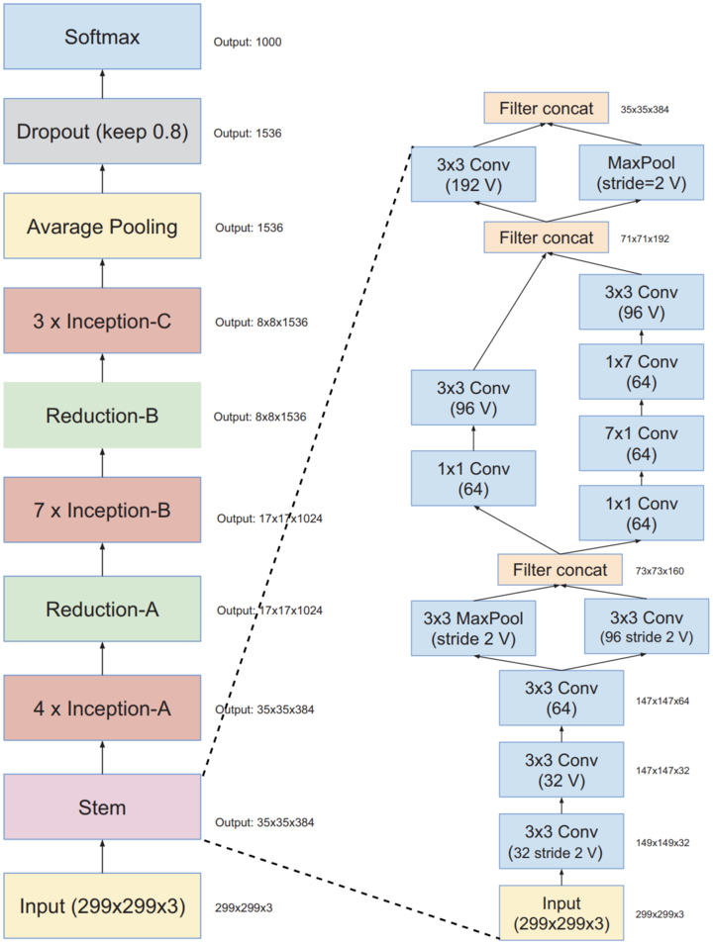
Schema

Slide 5
Continued
Inception can also go through 3 x 3 and 5 x 5 convolutions and simultaneously go through max pooling
Inception V4 is a pure inception variant without any residual connection
If the number of filters exceeded 1000, residual variants exhibits symptoms of instabilities and the network essentially dies in the early stages of training
Scaling down the residuals before adding the them to the last activation layer helps stabilize the training

Slide 6
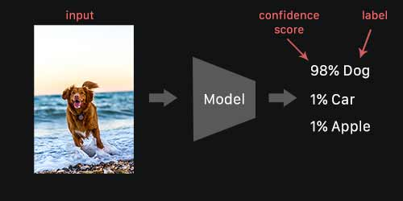
Use Case
Since Inception V4 is an image classification algorithm it can be used with:
Object Detection
Self-Driving cars
Facial Recognition
Healthcare image analysis

Slide 7
