Slide 1
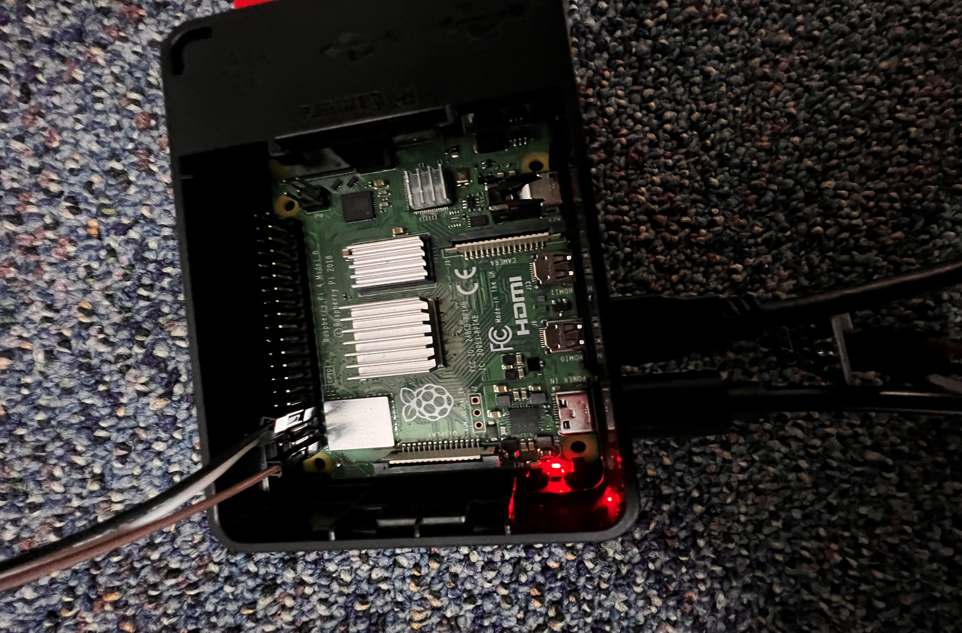
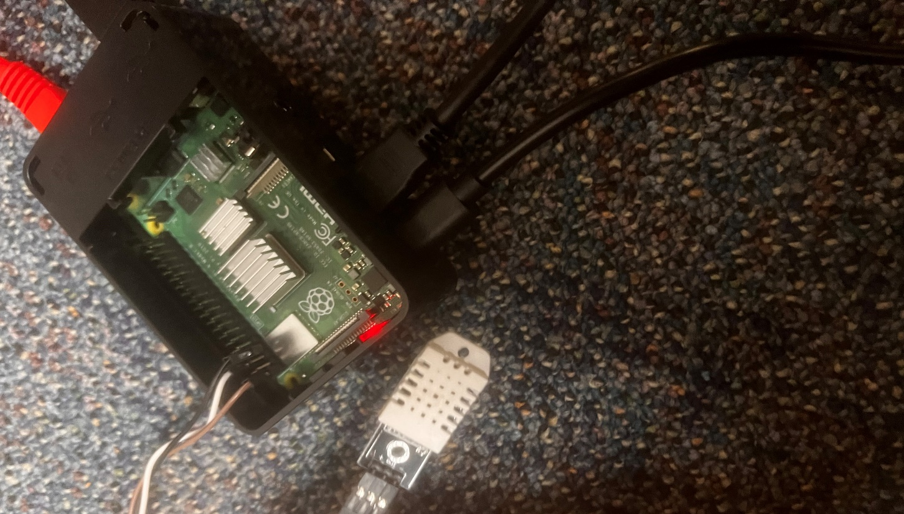



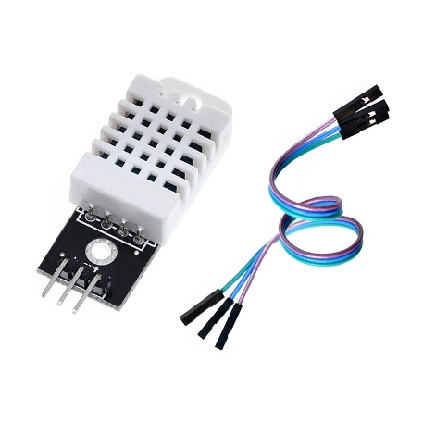
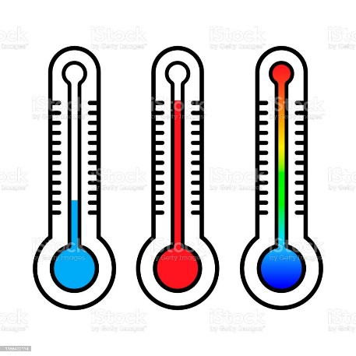

Classroom Climate: Predicting live classroom occupancy through ambient temperature changes from body heat
Brett Tully & Dr. Kelley
Bellarmine University Data Science Program
Abstract
Materials & Methods
Conclusions/Future Applications
Monitoring classroom occupancy is an important aspect of managing educational facilities. However, current methods for detecting occupancy are often cumbersome, expensive, and may not be accurate. In this study, we propose a low-cost and non-invasive method of detecting classroom occupancy by monitoring ambient temperature and humidity changes using Raspberry Pi and DHT22 temperature sensors. The Raspberry Pi is a small, affordable computer that can be used for a variety of projects. We used the Raspberry Pi to collect temperature and humidity data from DHT22 sensors placed inside classrooms. The sensors were set to record temperature data every 2 seconds, and the data is then pushed to an SQL server for later analysis. Machine learning algorithms are employed to analyze the temperature and humidity data and identify patterns of occupancy based on changes in temperature. The study seeks to explore the potential of temperature changes as an indicator of occupancy in classrooms. This research has important implications for educational institutions looking for a low-cost, non-invasive, yet innovative method of monitoring classroom occupancy. By using Raspberry Pi and DHT22 temperature sensors, schools can save money on expensive occupancy sensors and ensure that their facilities are being used efficiently.
Raspberry Pi Model 3B+
DHT22 temperature sensors
Jumper wires
MySQL Server Database
PowerBI
Methods:
Setting up Raspberry Pi: Connected the Raspberry Pi to a monitor, keyboard, and mouse, and then installed the operating system (Raspbian). We also connected the DHT22 temperature sensors to the Raspberry Pi using jumper wires.
Collecting temperature data: Programmed the Raspberry Pi to collect temperature data from the DHT22 sensors every 2 seconds, using the Python programming language. The data was stored on an SD card for later analysis.
Data analysis: Used machine learning algorithms to analyze the temperature data and identify patterns of occupancy based on changes in temperature. We employed data cleaning, feature selection, and machine learning algorithms to develop a predictive model.
Real-time data visualization: Used Microsoft PowerBI to create a data visualization dashboard that displays the live occupancy in the classrooms. We connected the dashboard to the Raspberry Pi and configured it to update every 2 seconds.
Model evaluation: Evaluated the accuracy and effectiveness of the proposed method of predicting classroom occupancy using temperature changes. We compared the results with the actual occupancy data collected using manual observation.
Comparison with current methods: Compared the proposed method with current methods of detecting classroom occupancy in terms of cost, accuracy, and efficiency.
Potential applications: Explored the potential applications of the proposed method in educational institutions and other settings.
Energy Efficiency: One potential application for this project is in building automation and energy management. With accurate real-time occupancy detection, it is possible to optimize heating, ventilation, and air conditioning (HVAC) systems in buildings to save energy and reduce greenhouse gas emissions.
Security: Another potential application of this project is in security systems, particularly in monitoring access to restricted areas. By installing the system at entrances or exits to a building, you can detect the presence of individuals and trigger alerts when unauthorized access is detected.
Healthcare: This project can also be applied in healthcare facilities to monitor patient rooms, labs, and other areas. This can help to ensure that patients receive the care they need when they need it, and that staff can respond promptly to any emergencies that may arise.
Retail Analytics: Retail stores can use the project to monitor customer traffic and behavior. This can help to optimize store layouts, staffing levels, and product placement.
Smart Homes: Smart homes are becoming increasingly popular, and your project can be used to automate home heating and cooling systems based on occupancy, saving energy and reducing utility bills.
Overall, this project has significant potential to be applied in a wide range of industries and settings. As the Internet of Things (IoT) continues to evolve, there will be even more opportunities to use this technology to improve efficiency, safety, and quality of life.
Objectives
Investigate the potential of using ambient temperature and humidity changes to predict classroom occupancy.
Develop a low-cost and non-invasive method of detecting classroom occupancy using Raspberry Pi and DHT22 temperature sensors.
Collect and analyze temperature data from DHT22 sensors placed inside classrooms to identify patterns of occupancy based on changes in temperature.
Use machine learning algorithms to analyze temperature data and predict classroom occupancy based on temperature and humidity changes.
Evaluate the accuracy and effectiveness of the proposed method of predicting classroom occupancy using temperature and humidity changes.
Compare the proposed method with current methods of detecting classroom occupancy in terms of cost, accuracy, and efficiency.
Explore the potential applications of the proposed method in educational institutions and other settings, such as office buildings
References
Stackoverflow.com
CircuitBasics.com
Github.com
Results
In this project, I aimed to predict classroom usage based on temperature, humidity, and the day of the week. To do so, I used a dataset that was collected by Raspberry Pi sensors installed in classrooms. However, setting up the Raspberry Pi sensors and sending the data to an SQL database was complex and time-consuming. Additionally, identifying whether a class was in session or not was challenging, but I was able to create a loop that iterated through the main data frame and compared it to another data frame containing all the times when a class was in session, then marked a 1 or 0 in a new column to identify if it was in session.
Next, I used three classification models: Logistic Regression, Decision Tree, and Random Forest, to predict classroom usage. I used a grid search to tune the hyperparameters for each model and found that the Random Forest model had the best performance with an accuracy score of 0.9487. The best parameters for the Random Forest model were: {'clf__max_depth': 50, 'clf__min_samples_leaf': 1, 'clf__n_estimators': 50}. The Decision Tree model also performed well with an accuracy score of 0.9305, and the best parameters were: {'clf__criterion': 'entropy', 'clf__max_depth': 15, 'clf__min_samples_leaf': 1}. The Logistic Regression model had the lowest accuracy score of 0.9275, and the best parameters were: {'clf__C': 1, 'clf__penalty': 'l2', 'clf__solver': 'lbfgs'}.
In conclusion, the Random Forest model was the most accurate in predicting classroom usage, with an accuracy score of 0.9487. However, it's worth noting that the Decision Tree model also had good performance, with an accuracy score of 0.9305.
Contact
Brett Tully – 5027596159 – btully@bellarmine.edu

