Slide 1
Designing High Throughput Message Bus

Slide 2




HELLO!
Burak TUNGUT
Software Development Team Delivery Lead @boyner
www.buraktungut.com
btungut
btungut
btungut

Slide 3

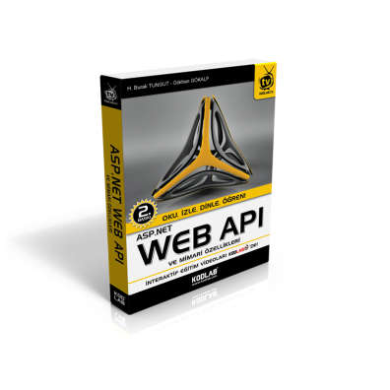
PUBLICATIONS
Algoritma ve Programlama Mantığı
Asp.Net Web API ve Mimari Özellikleri

Slide 4
Our Topics
Difference between Bus and Queue
First look at architecture
Right choice of message broker, Kafka vs RabbitMQ
On-site demo with logstash -> kafka -> elasticsearch

Slide 5
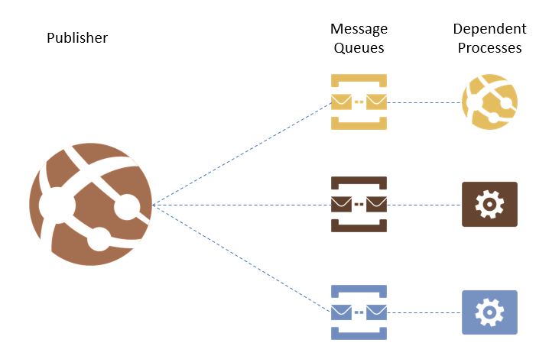
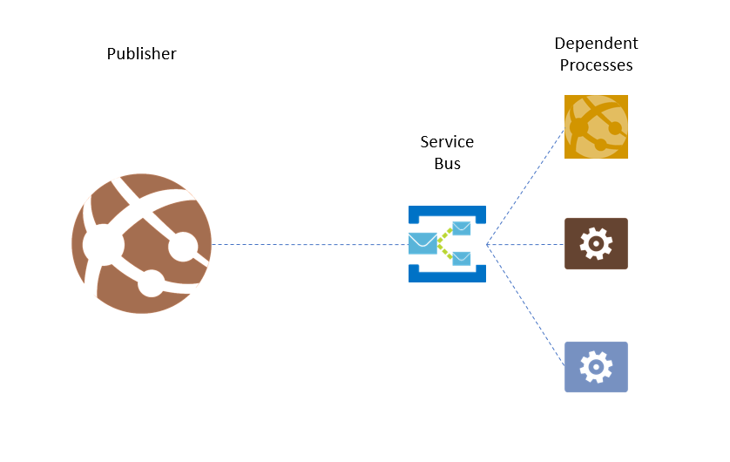

Slide 6
Queue
- FIFO
- Decoupling
Bus
- No guarantee for FIFO
- Pub/Sub
- Any one can produce & consume without knowledge of any business (We hope!)

Slide 7



Slide 8


Slide 9


Slide 10

Queue / Bus

Slide 11
Queue / Bus
?
?

Slide 12
RIGHT CHOICE OF BROKER
RabbitMQ
Kafka
Anyone?

Slide 13
LET THE FIGHT BEGIN!
RabbitMQ
- Is a Message Queue System
- AMQP
- Powerful Routing
- Plugins & Supports
- Just High Availability
- Easy to learn, hard to master
Kafka
- Is a Streaming Platform or,
- Distributed
- Replicated
- Commit Log
- High Availability
- Hard to learn, easy to master

Slide 14
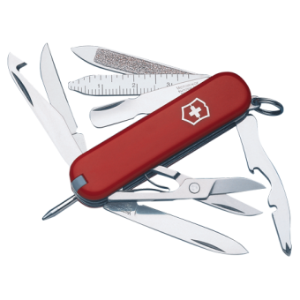

LET THE FIGHT BEGIN!
RabbitMQ
- Is a Message Queue System
- AMQP
- Powerful Routing
- Plugins & Supports
- Just High Availability
- Easy to learn, hard to master
Kafka
- Is a Streaming Platform or,
- Distributed
- Replicated
- Commit Log
- High Availability
- Hard to learn, easy to master

Slide 15


Slide 16

1 publisher -> 1 consumer

Slide 17
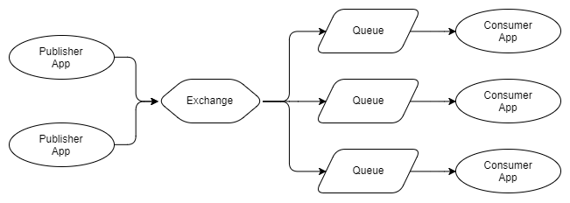
n Publisher -> n independent Consumer

Slide 18
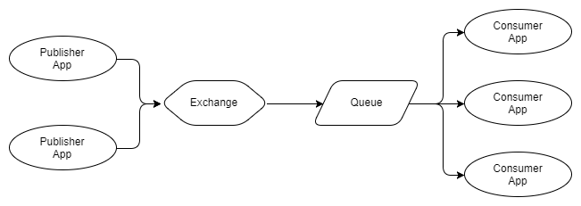
n Publisher -> n competing Consumer

Slide 19

Using competing consumers to high scaling, it is ok!
How about the order of the messages?

Slide 20
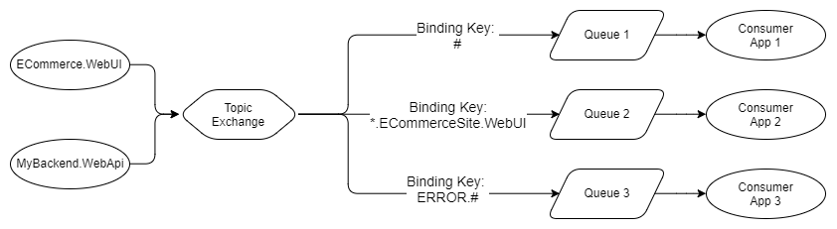
Exchange Types

Slide 21


Slide 22
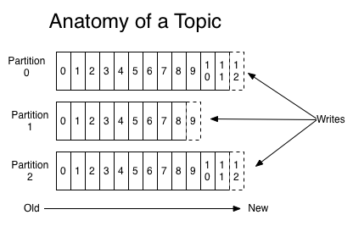

Slide 23
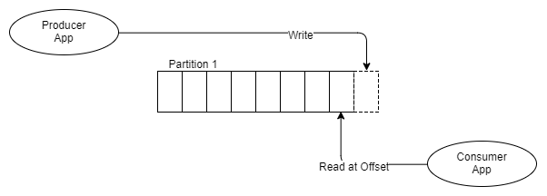
1 producer -> 1 partition -> 1 consumer

Slide 24
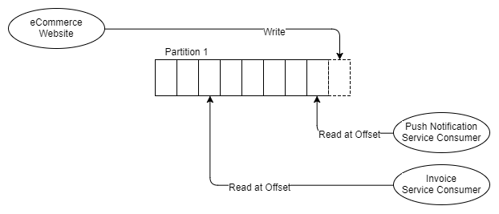
1 producer -> 1 partition ->2 independent consumer

Slide 25
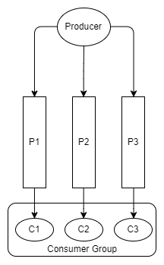

Slide 26
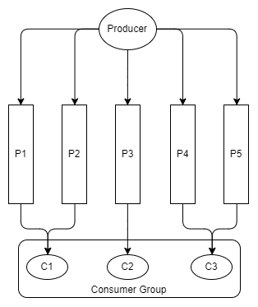

Slide 27
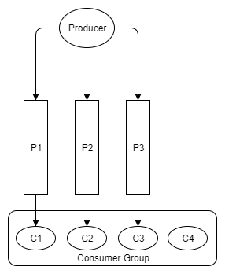

Slide 28
Using competing consumers to high scaling, it is ok!
How about the order of the messages?

Slide 29

On-Site Demo
.Net Core
Logstash
Elasticsearch
Zookeeper
Kafka
RabbitMQ

Slide 30
Queue / Bus
?
?

Slide 31



Slide 32


Slide 33

THANKS!
Photos added from jack-vanlightly.com

