Slide 1

The Agile Process
Taming Your Process To Work For You

Slide 2
Who Am I?
  My name is Nowell Strite, and I live in Huntington, VT
  Lead Tech Solutions at PBS Education for the past 6 years
  Love to solve problems with innovative software solutions
  Used to work in a traditional Waterfall workplace

Slide 3
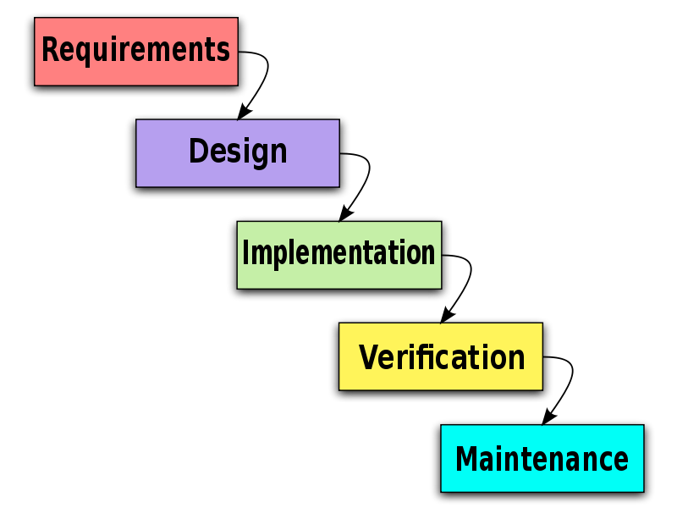
Traditional Waterfall Workflow

Slide 4
Problems with Waterfall Approach
  Contracts tend to require a fixed scope of work, however:
    Requirements change over the lifespan of a project
    Time spent upfront determining requirements for a feature that might change by the time it is implemented is wasteful
    Client do not see results until it is too late to change

Slide 5
Agile Approach

Slide 6
Agile Software Development Is:
  building blocks - a series of guiding principles and constructs, not a rigid set of rules, that focus on building working software
  people and relationships - a focus on establishing a strong, trustworthy, and cohesive team that spans business, technical and client roles
  working as one - success and failure happen as a team, when the project is in trouble, everyone is responsible and engaged to right the ship

Slide 7
The Agile Manifesto
We are uncovering better ways of developing software by doing it and helping others do it. Through this work we have come to value:
Individuals and interactions over processes and tools
Working software over comprehensive documentation
Customer collaboration over contract negotiation
Responding to change over following a plan
That is, while there is value in the items on the right, we value the items on the left more.

Slide 8
The Agile Principles
  The Working Product Is King
    This is the only real measure of progress
    Embrace and adapt to changing requirements
    Deliver useful, working software frequently and rapidly
    Continuous attention to technical excellence and design
    Simplicity
  Projects succeed because of strong, motivated people
    Face-to-face daily interactions and communication across all disciplines
    Self-organizing teams with no silos of knowledge
    Sustainable pace

Slide 9
Agile Provides
  Transparent communication and demonstration of the progression of the project
  Keeps time and cost estimates in check by breaking projects into small chunks
  The ability to adapt to changing requirements and avoid time and money typically spent in producing detailed requirements too early in the process

Slide 10
SCRUM
One flavor of the Agile process tailored towards software

Slide 11
People
  Product Owner
    Responsible for maintaining the Product Backlog
    Ensure the most important stories are developed first
  Scrum Master
    Leads the team meetings
    Resolves roadblocks and keeps the team on track
  Scrum Team
    Less than 10 people
    Work closely to complete the Sprint Backlog
    Cross functional, self organized group

Slide 12
Components
  Sprint - typically a two to four week iteration that produces working and tested software
  Product Backlog - A list of all stories that the product will ultimately include, sorted by priority. As features are added and priorities change this list stays ordered
  Spring Backlog - The list of stories that have been agreed upon for the current iteration. Requirements are frozen during a sprint
  Points and Velocity - The amount of work that can be done in any sprint (size of stories and availability of the team)

Slide 13
Goals
  The Product Owner knows how much the Sprint will cost, and what to expect at the end of the sprint
  At the end of every Sprint a potentially shippable product has been developed that resolved the most important features requested by the Product Owner
  The Product Owner has seen and provided User Acceptance Testing on each Story in the Sprint while it was being completed, allowing the team to iterate and refine each feature

Slide 14
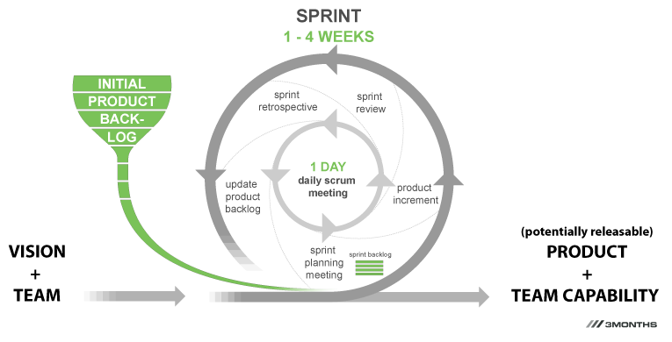
Sprint Life-cycle

Slide 15
Sprint Planning Meeting
  A one day meeting at the beginning of every Sprint
    Determine how many points are available
    Product Owner creates the Sprint Backlog from the Product Backlog based on available points and story sizes
    Development Team discusses design and creates required tasks for each story in the Sprint Backlog
    Scrum Master attempts to identify any obstacles

Slide 16
Daily StandUp Meeting
  Happens every single day and is no longer than 15 minutes
  Every team member answers three questions:
    What have I done since yesterday?
    What am I planning on doing today?
    What is standing in my way?
  Everyone can attend, but only the team speaks
  All questions and discussions must happen after the meeting, and are facilitated by the Scrum Master

Slide 17
Sprint Review Meeting
  Review all stories from the Sprint Backlog. Place any stories that could NOT be completed back into the Product Backlog
  Demonstrate every story that has been completed during the Sprint
  Meant to be a time for celebration and to highlight the work of all team members
  Each team member is responsible for demonstrating and talking about observations of each story they completed

Slide 18
Sprint Retrospective Meeting
  Takes place on the last day of the Sprint after the Review Meeting
  Agile is an iterative and evolutionary process for both the product and the team
  All team members should reflect on the sprint, sharing:
    What went well?
    What can we improve?
  Agree as a team what the most important challenges were, and create a plan to improve upon those the next iteration

Slide 19
User Stories
  Typical construction
    AS A <role>, I WANT <goal>, SO THAT <benefit>
    AS A new user, I WANT a welcome email, SO THAT I can look up my credentials for the service
  Should be testable
  Should describe one unit of functionality
  Should be user focused and concise
  Detailed requirements are extracted during Sprint

Slide 20
Other Parts of the Puzzle
  Continuous Integration
  Version Control
  Testing
  Deployment
  Documentation
  Communication

Slide 21
Questions?
  Get In Touch
    Nowell Strite
    @nowells
    http://nowell.strite.org

