Slide 1
AVIATION DATABASE

Slide 2
AGENDA
Problem Statement
Data preparation
​Data visualization
Machine learning
Conclusion

Slide 3
Problem Statement
Predict the number of uninjured based on the variable of the aircraft that crashed

Slide 4
Data Preparation

Slide 5
Data cleaning
Raw dataset had many columns that were not useful and they needed to be removed.
As we were only interested in airplanes only and our country of interest being only America, we had to filter out rows containing data pertaining to these 2 as well
Unknowns present in raw data also had to be removed
Strings in columns will not be helpful hence they had to be replaced with integers

Slide 6
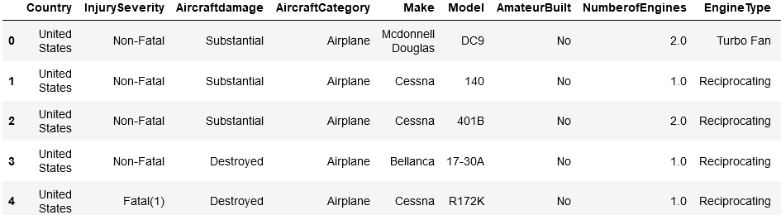
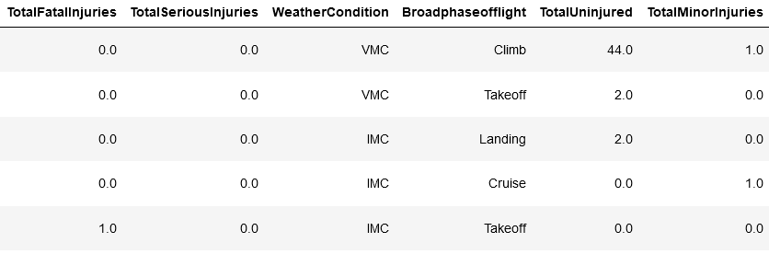
Data with filtered out columns

Slide 7
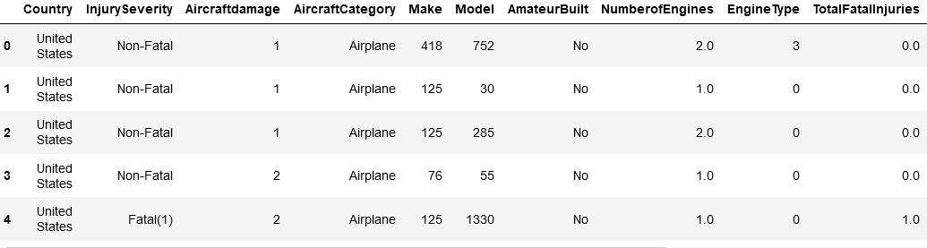
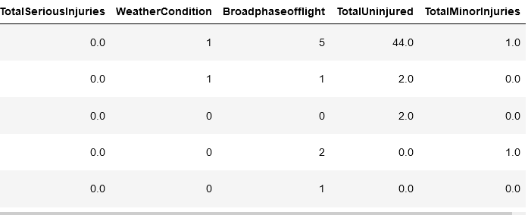
Data strings replaced

Slide 8
Data visualization

Slide 9
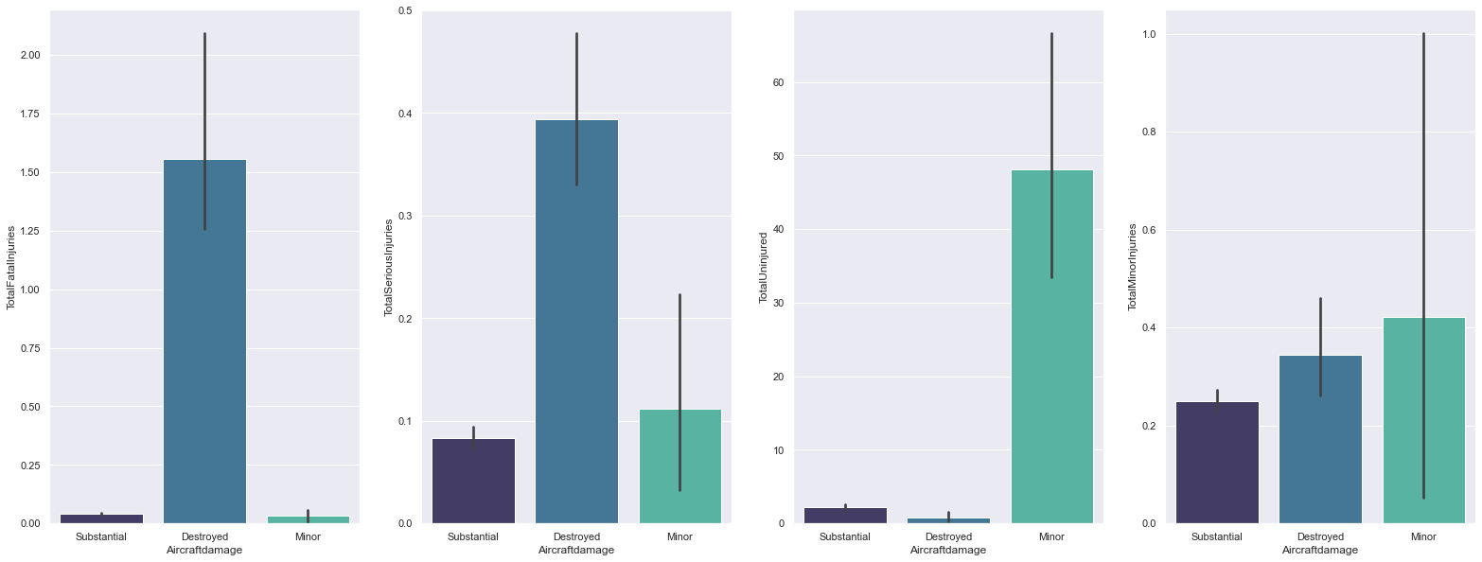
Data visualization

Slide 10
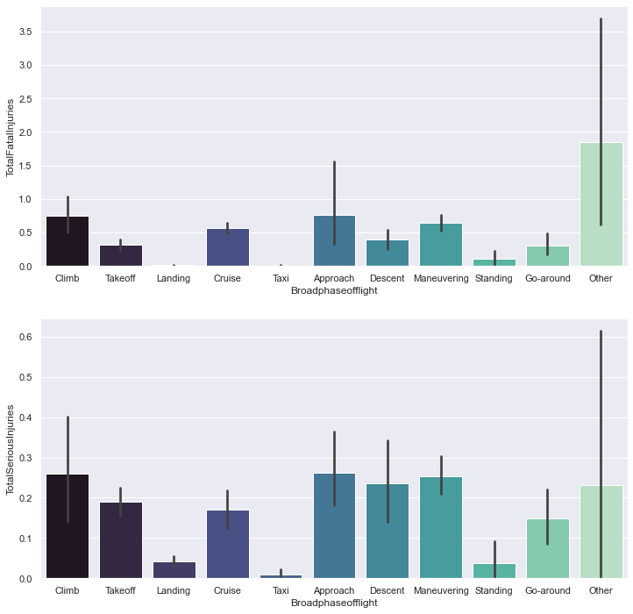
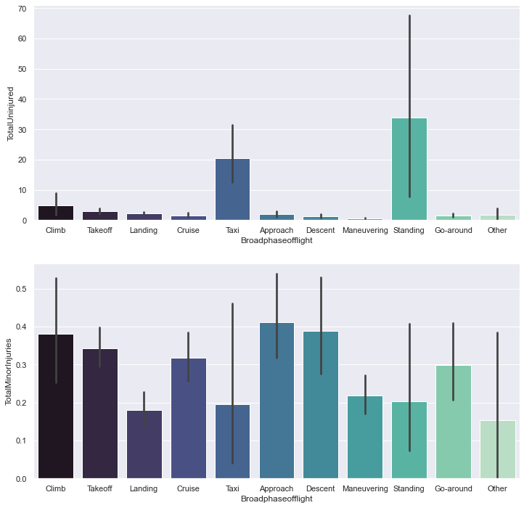
Data visualization

Slide 11
Data visualization

Slide 12
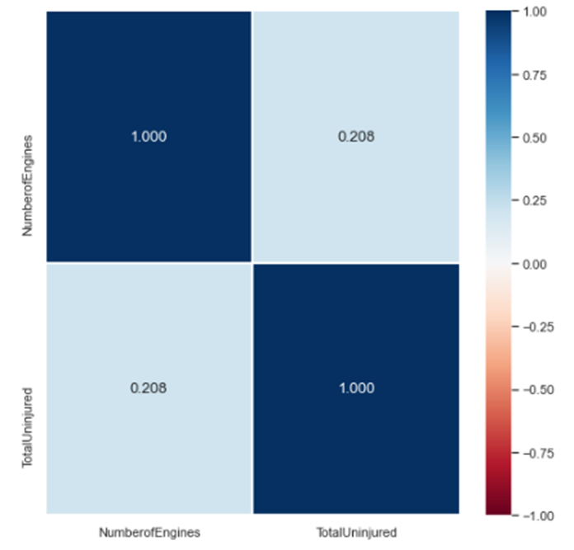
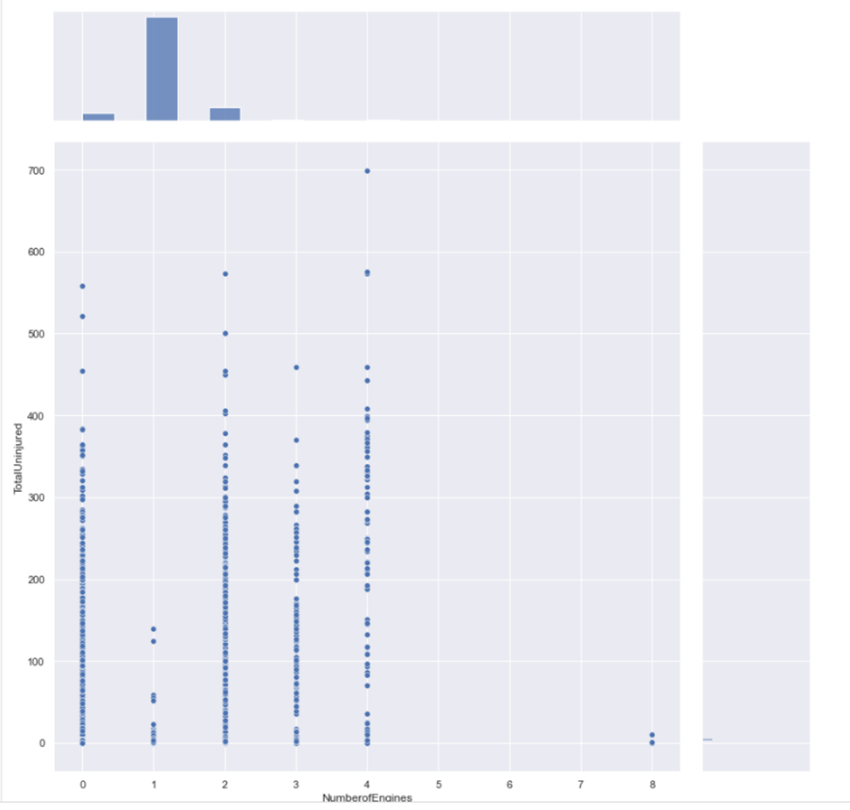
Data visualization

Slide 13
Machine learning

Slide 14
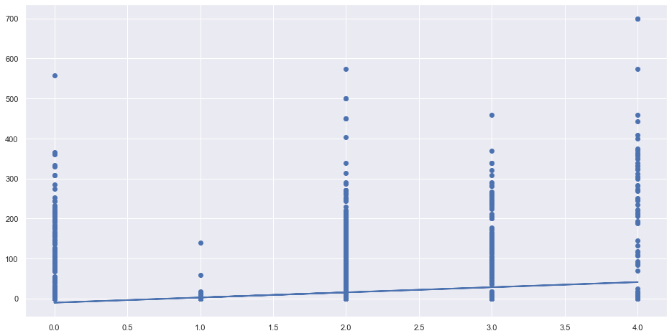
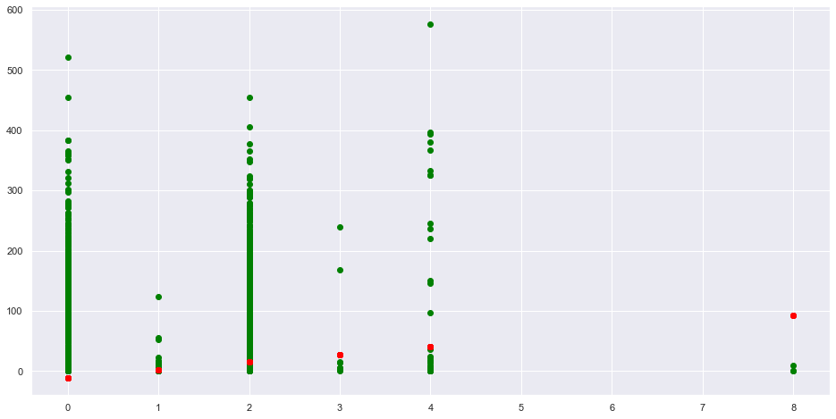
Linear regression

Slide 15
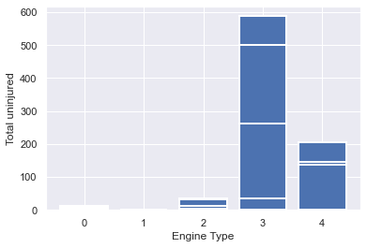
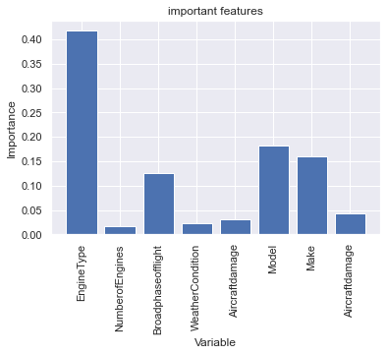
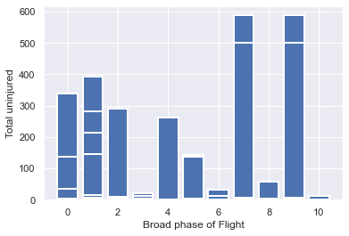
Random forest regressor
3 = turbofan
4 = turbojet
7 = taxi
9 - standing

Slide 16
Conclusion

Slide 17
THANK YOU

