Slide 1


Instagram Analytics Dashboard Using SQL & Power BI

Slide 2
Project About
This project focuses on analyzing Instagram performance using SQL and Power BI.
The goal is to understand how different content types, traffic sources, and posting patterns influence engagement, reach, impressions, and follower growth

Slide 3

Skills
Data loading, KPI calculation, analytical queries, and view creation
MYSQL
Dashboard development and visualization
Power Bi

Slide 4




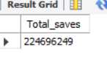

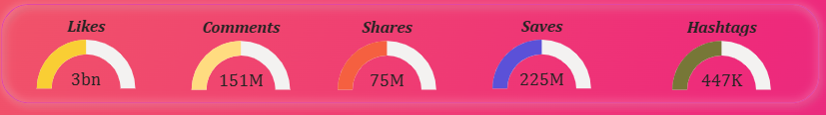
KPI Development
Total Likes
Total comments
Total Shares
Total Saves
Total Hashtags

Slide 5
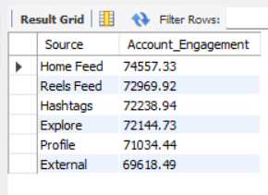
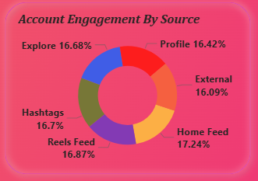
Engagement analysis by Traffic source

Slide 6
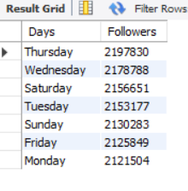
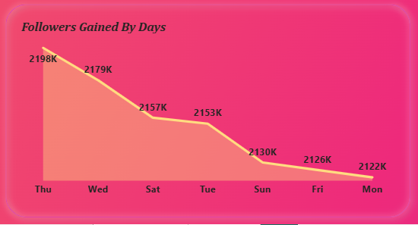
Follower growth analysis by day & month
Days

Slide 7
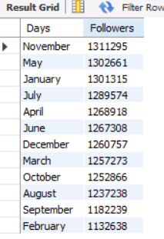
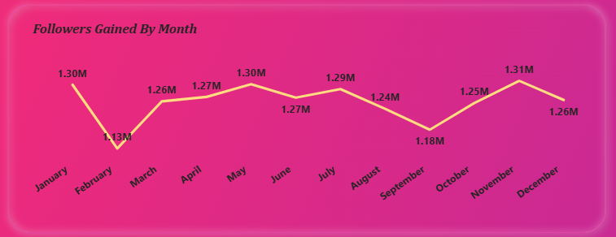
Follower growth analysis by day & month
Month

Slide 8
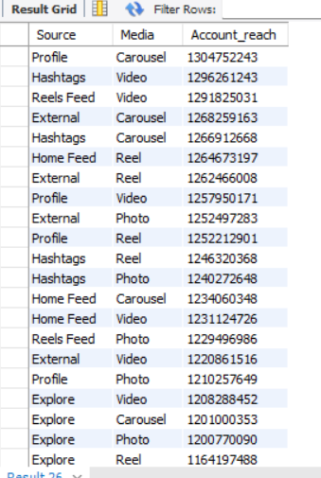
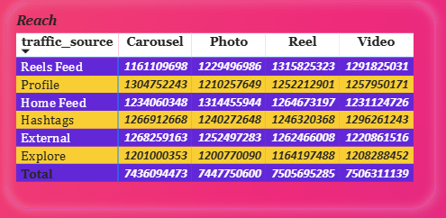
Reach vs Impression analysis
Account Reach

Slide 9
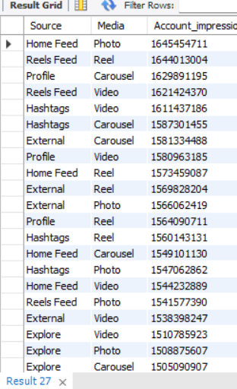
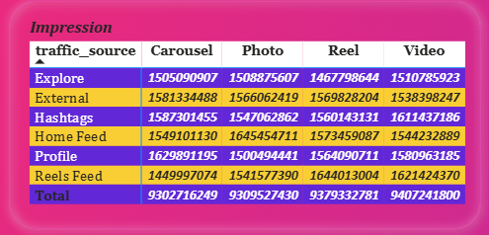
Reach vs Impression analysis
Account Impressions

Slide 10
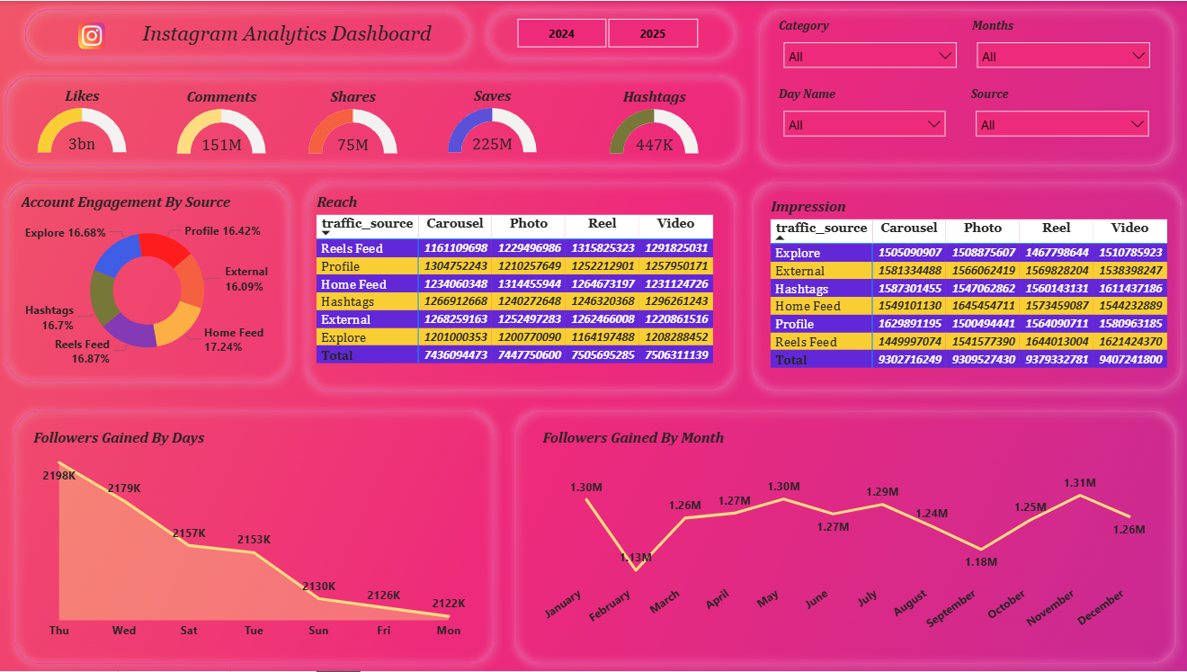
DashBoard

Slide 11
Business Recommendations
Post mid-week — Thursday & Wednesday give highest follower growth.
Create more Reels — Reels + Video deliver top reach & impressions.
Focus on Home Feed — Highest engagement; use strong thumbnails & captions.
Use Carousel posts — Multi-slide content performs consistently well.
Optimize hashtags — Use 10–15 niche & relevant tags.
Fix February dip — Increase posting frequency & try new formats.
Boost Explore visibility — Use trending audio & high-contrast visuals.
Improve profile conversion — Strong bio + highlight optimization.

