Slide 1
C++ Programming
Intermediate Level

Slide 2

About ME!
Benjamin
NUS (Year 3)
Major in Electrical Engineering
Specialising in Internet of Things
Love sports such as badminton and gym!

Slide 3

Ground Rules
Always be respectful with each other
Never talk during lessons unless there is a discussion
Be pro-active in class!
Enjoy programming!

Slide 4
What you’ll be learning in this course
30 lessons
Lesson 1-5 (recap of C++ basics)
Lesson 5-15 (Learning of SFML basics)
Lesson 15-22 (Game 1: Tetris !)
Lesson 23 – 30 (Game 2: Race Car !)
Note: Lesson plan may change due to students’ pace or due to unforeseen circumstances. Student will, at the end of the course, take home a minimum of 1 game where they can edit further to make the game more comprehensive.

Slide 5

IDE
Visual Studio 2019
This is to ensure debugging will be easier for everyone!
https://code.visualstudio.com/updates/v1_46
Notes:
Using the latest IDE would ensure that we’ll have the most updated libraries, interface etc.

Slide 6
Recap of basic concepts

Slide 7
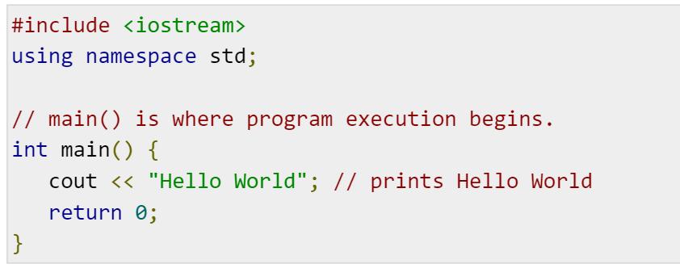
Hello World
Notes:
#include statements: to include necessary libraries
Namespaces: a declarative region that provides a scope to the identifiers (bring up std::cout)
Main body: indicates the start of the program
ALWAYS remember to comment!

Slide 8
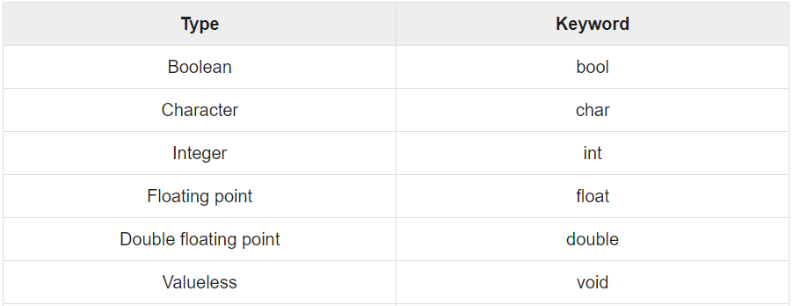
Primitive Built-in Types
Notes:
Bool: True/False
Char: a single octet (one byte)
Int: integer value
Float: up to 6 decimal places
Double: more than 6 decimal places
Void: valueless!

Slide 9
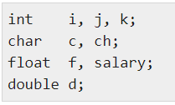
Variable Definition in C++
Notes:
Pretty self-explanatory yes?
After all these declarations, we can use them in our codes now.

Slide 10
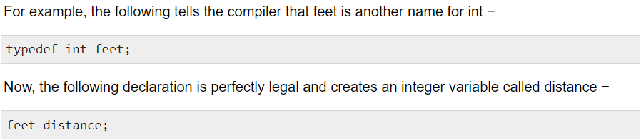
Typedef Declaration
Notes:
Useful when we want to declare our own type.
In this example, feet == int

Slide 11

Enumerated Types
Notes:
Enum is useful when we want to declare our own number type.
e.g. I want to use colour as a switch case, I can declare enum colour type and do a switch case!

Slide 12
Variables

Slide 13
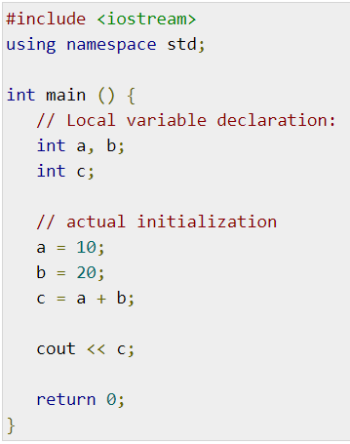
Local Variable
Notes:
What stays in Texas, stays in Texas.
Variable declared within a function can only be used within a function (see pass-by reference later)

Slide 14
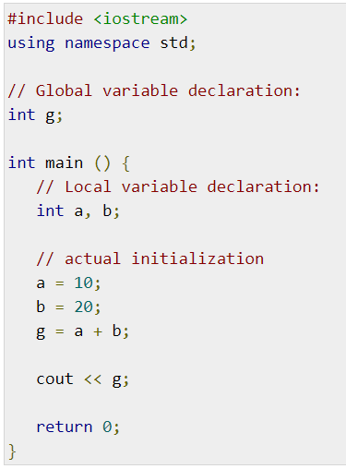
Global Variables
Notes:
Usually, not a good idea to use global variables, unless declaring constants.
When declaring constants, convention is to use CAPS.

Slide 15
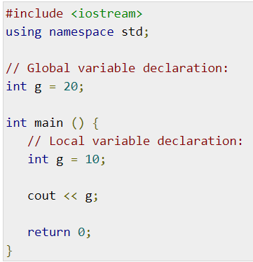
Pass-by Reference
Notes:
G = 10 or 20?
(ans: 10) why? Because a locally declared g is within the function.

Slide 16

Constants
Notes:
Both works the same way! Up to personal preference!
One key difference is define is outside of functions, const can be used both within or outside the function

Slide 17
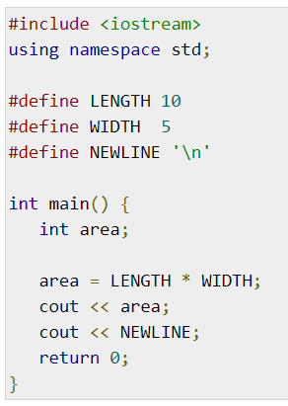
#Define Preprocessor
Notes:
Use CAPS!
Outside the function

Slide 18
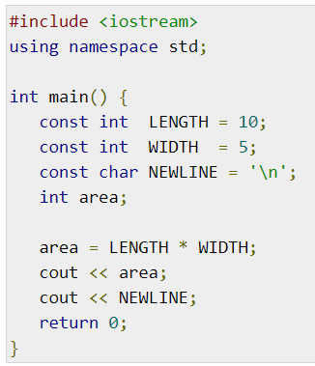
Const Keyword
Notes:
Within/outside function

Slide 19
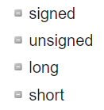
Modifier Type
Notes:
Signed (+ve or –ve number)
Unsigned (only +ve number)
Long (at least 32 bits)
Short (at least 16 bits)
Long long (at least 64 bits)

Slide 20
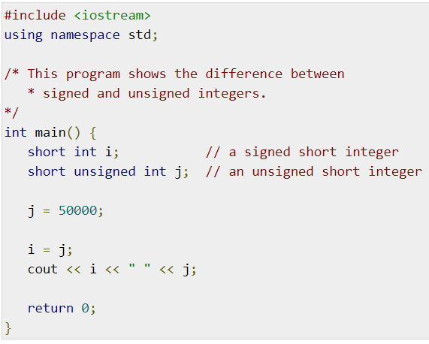
Signed vs Unsigned
Notes:
50,000 = 0b1100001101010000
When signed, the MSB (Most Significant Bit/Right-Most bit) = sign bit
1 == negative
0 == positive
Cover MSB, flip the next few bits, convert to decimal, multiply by -1
When unsigned, just convert bits to decimal
(ans: i = -15535, j = 50000)

Slide 21
Operators in C++

Slide 22
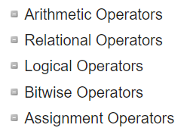
Operators in C++
Notes:
Arithmetic: add, minus, multiply, divide
Relational: Boolean comparison
Logical: AND / OR / NOT
Bitwise: AND / OR / XOR
Assignment: = / += / -= etc
https://www.tutorialspoint.com/cplusplus/cpp_operators.htm

Slide 23
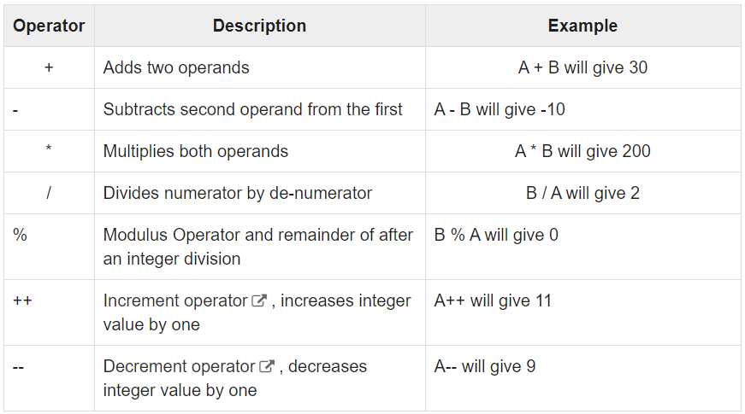
Arithmetic Operators
Notes:
Eg A = 10, B = 20

Slide 24
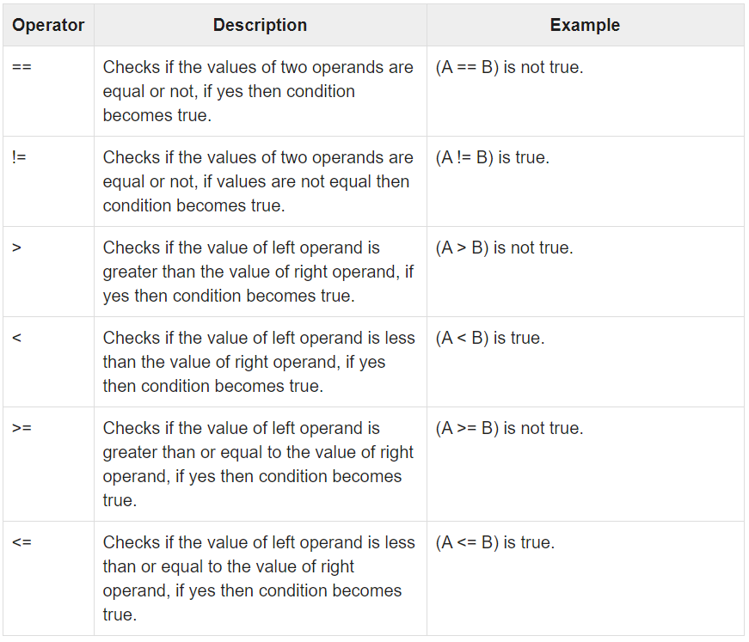
Relational Operators

Slide 25
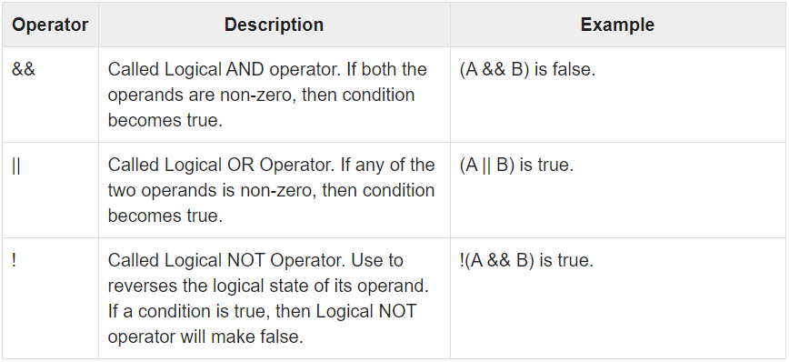
Logical Operators
Notes:
Don’t get mixed up with bitwise & and | (See next slide)

Slide 26
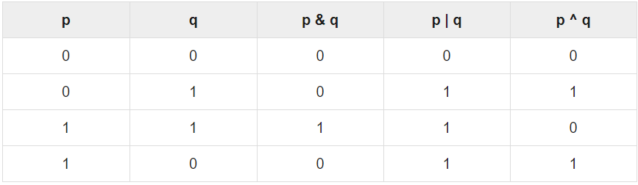
Bitwise Operator

Slide 27
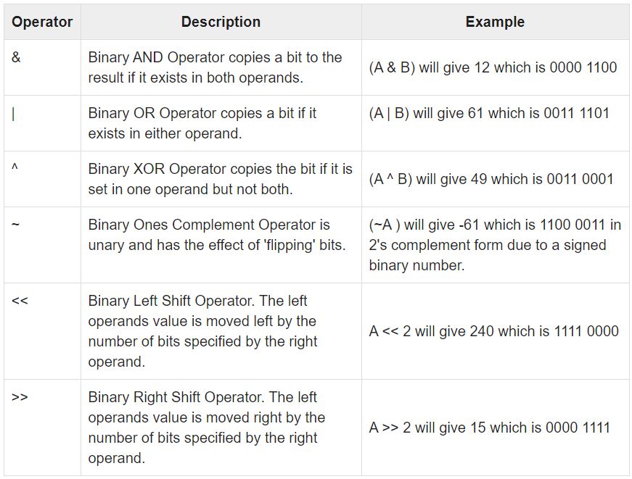
Notes:
e.g. A = 0011 1100
B = 0000 1101
Note: LSB/RSB are additional information, not necessary for our course and will not be used in our codes.

Slide 28
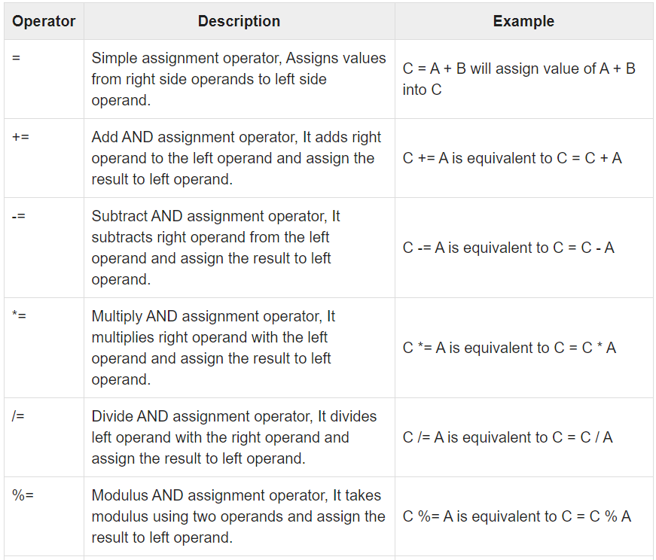
Assignment Operators

Slide 29
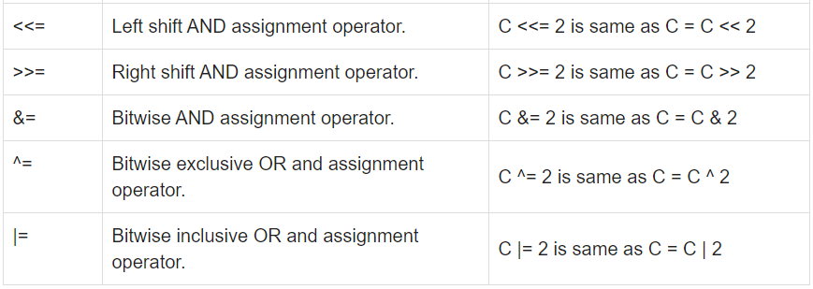
Notes:
Again, if you do not understand it is ok. Just letting you guys know there is such operations.

Slide 30
Looping Types

Slide 31
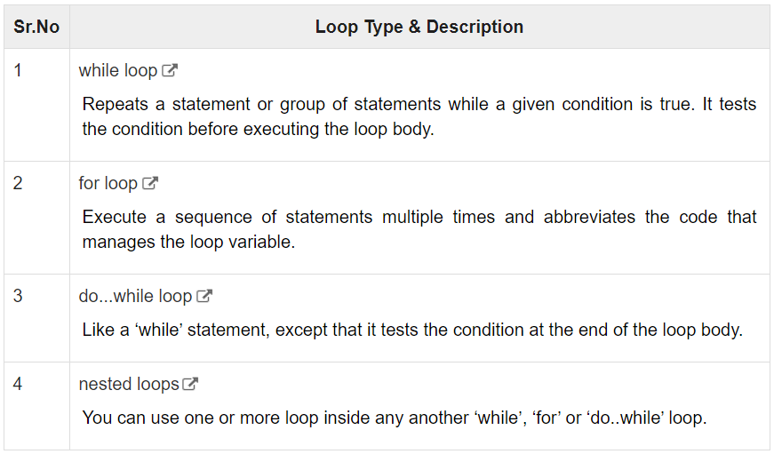
Loop Types

Slide 32
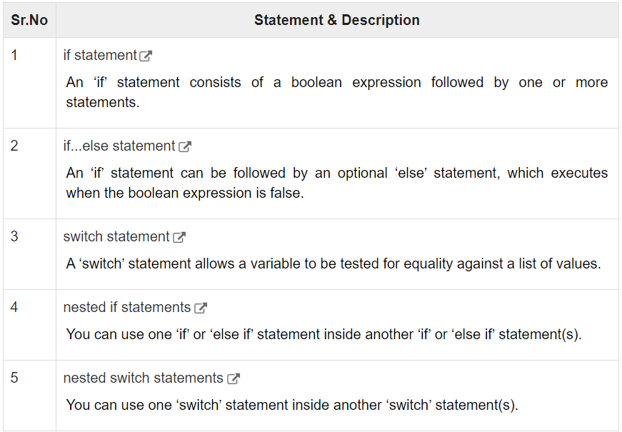
Decision Making

Slide 33
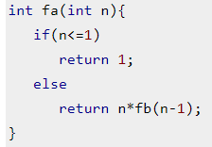
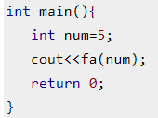
Recursion
Notes:
Fa calls itself until a terminating step is called.

Slide 34
Function

Slide 35
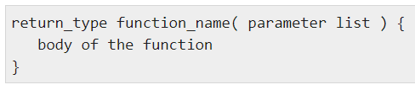
Defining a Function
Notes:
Return_type: return value of the function
Function_name: Name of the function
Parameter: or arguments/inputs
Body: where the magic happens, bulk of the code run

Slide 36
Array
Notes:
An array stores a fixed-size sequential collection of elements of the same type. It used to store a collection of data.

Slide 37


Declaring Array
Notes:
Example double balance[10]

Slide 38
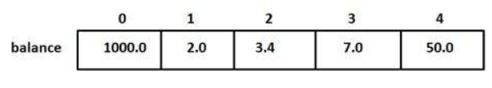
Initialise Array
Notes:
Passing in values/data into the declared array.
You can imagine arrays a bookshelf, and each box has a position.
Eg. Balance[0] = 1000.0
Balance[1] = 2.0
Balance[2] = 3.4, etc…

Slide 39

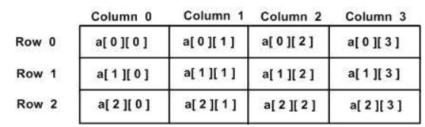
2D Array
Notes:
Every element can be accessed using arrayName[i][j]

Slide 40
Pointers

Slide 41
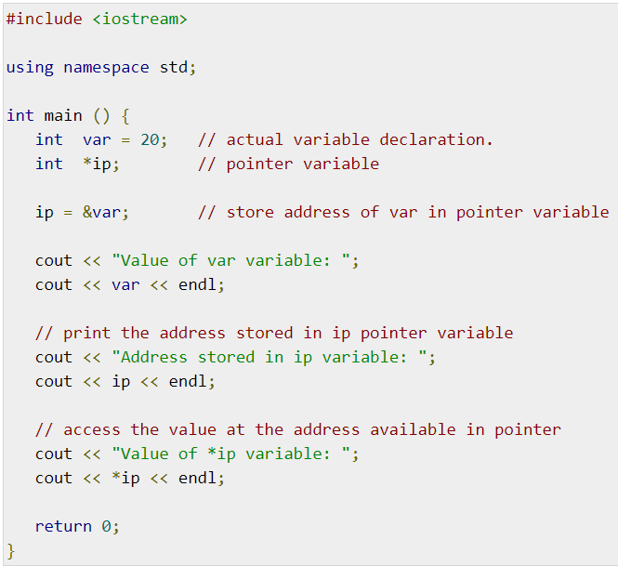
Pointers
Notes:
A pointer is a variable whose value is the address of another variable.
ip = 0xbfc601ac (memory address)
ip* = 20

Slide 42
Reference

Slide 43
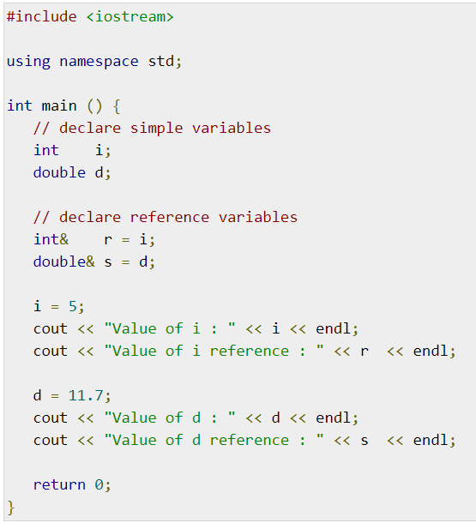
Reference
Notes:
Reference is a label to the memory location.
Ans: I = 5; r = 5
D = 11.7; s = 11.7

Slide 44
Data Structures

Slide 45
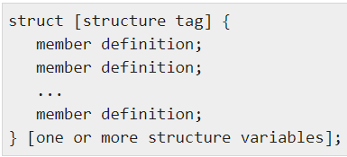
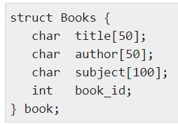
Structure
Notes:
Example on the right

Slide 46
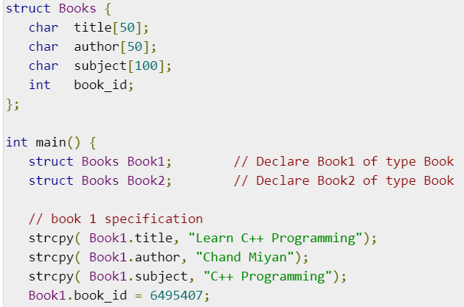
Example

Slide 47
Class

Slide 48
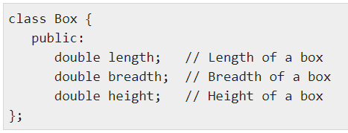
Class Definition
Notes:
A class is like a blueprint for a data type.
e.g. Box has length, breadth and height
Other than public, there is also private and protected.
Public: any public member can be assessed from other class
Private/Protected: can only be used within the class

Slide 49
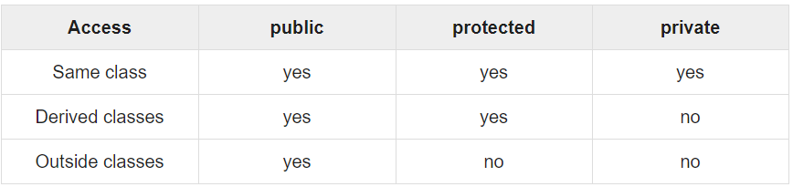
Access Control
Notes:
Protected > private > public

Slide 50
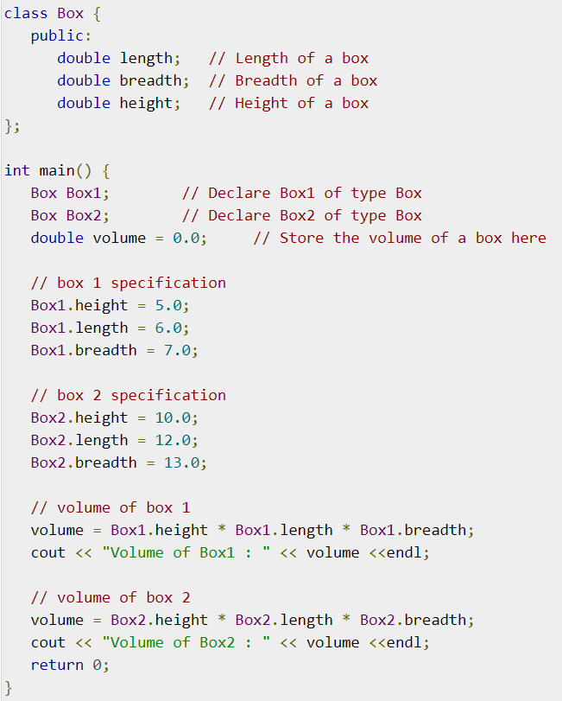
Example

Slide 51
Exception Handling

Slide 52
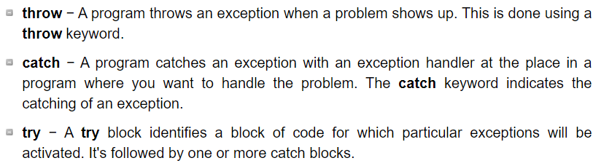
Exception Handling

Slide 53
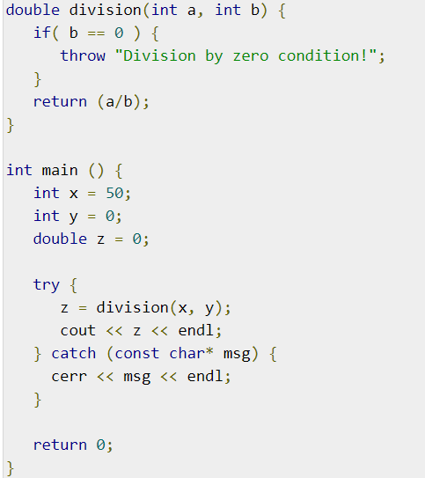
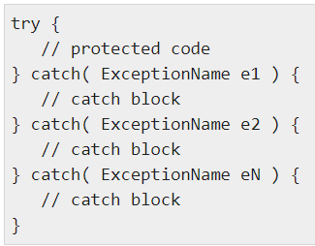
Try and Catch
Notes:
Example on the right.
Food for thought: can we divide by 0???

Slide 54
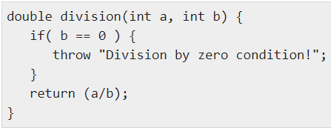
Throw
Notes:
Exceptions can be thrown anywhere within a code block using throw statement. The operand of the throw statement determines a type for the exception and can be any expression and the type of the result of the expression determines the type of exception thrown.
Example thrown when dividing by 0.

