Slide 1


Installation
SFML & CMake

Slide 2
Notes to students:
I’ve looked through the problems you guys were facing.
The issue is with dynamic linking of SFML to solution files. Some have issues with an outdated version of Visual Studio 2019.
If it is an issue with VS 2019, just uninstall and reinstall again.
If linking issue, since SFML could not be dynamically linked, we’ll build a static binary instead.
Do take note of where you save the files. As seen from today’s class, different systems have different paths, hence it is essential to link to the correct path!
I’ve highlighted the changes in red. Do try it and install them correctly so we can move ahead with using SFML for our games!

Slide 3
CMake
https://cmake.org/download/
Download version 3.17.3
Notes:
We’ll use 3.17.3 instead.

Slide 4
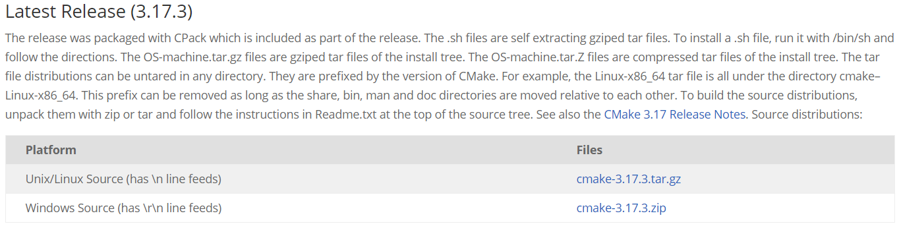
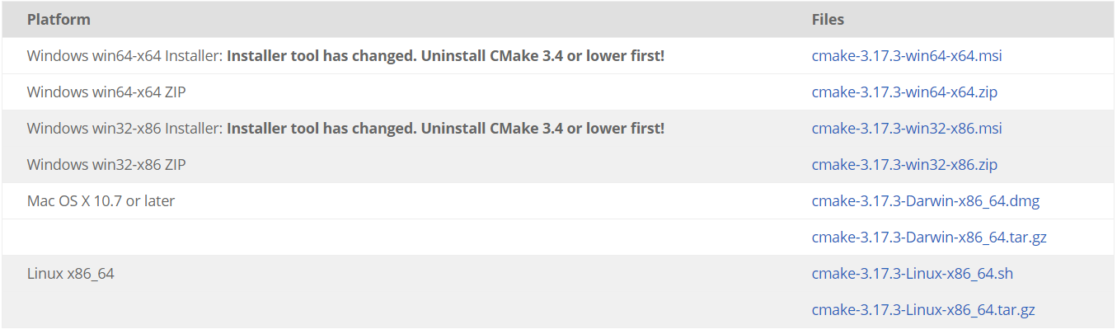
Notes:
Download .msi file

Slide 5
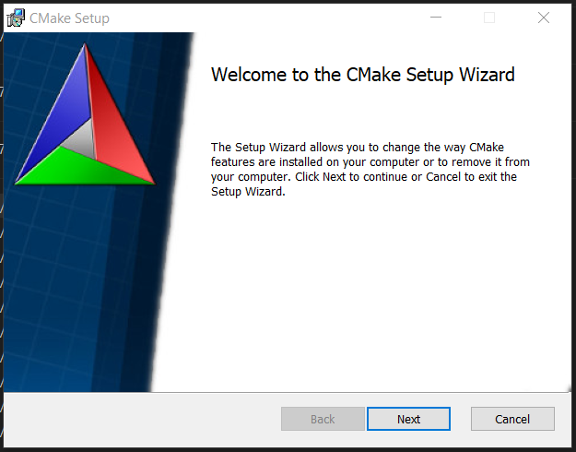
Notes:
Complete CMake setup

Slide 6
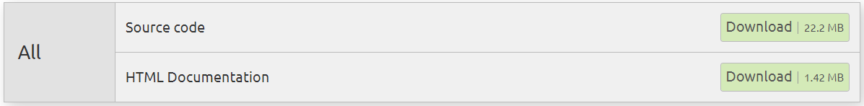
SFML
https://www.sfml-dev.org/download/sfml/2.5.1/
Download version ALL
Save to Downloads folder
Notes:
Once downloaded, extract .zip file

Slide 7
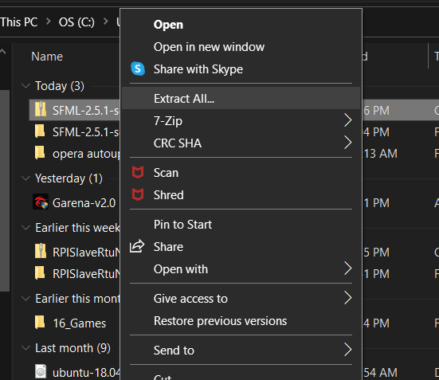
Extracting .zip file
Right-click .zip file
Click Extract All…

Slide 8
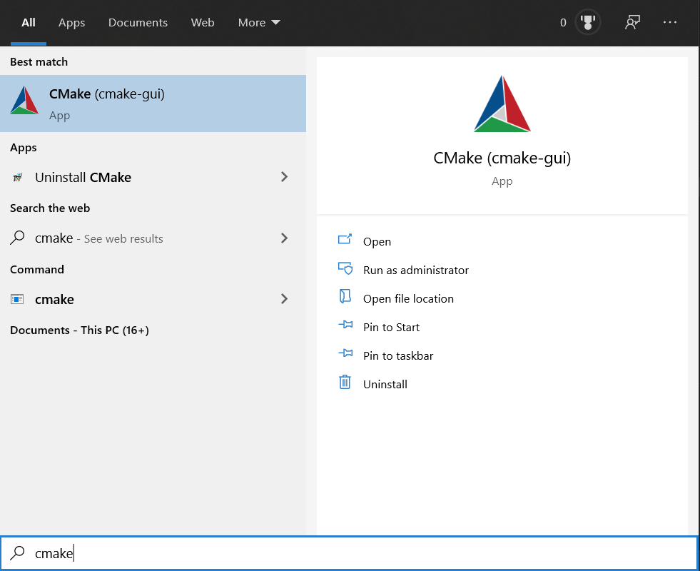
Open up Cmake-gui

Slide 9
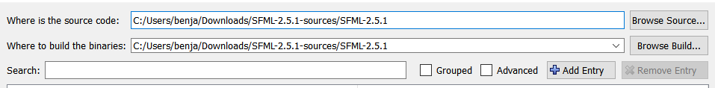
Generating of SFML binaries
Notes:
Source should be in Downloads Folder!!!

Slide 10
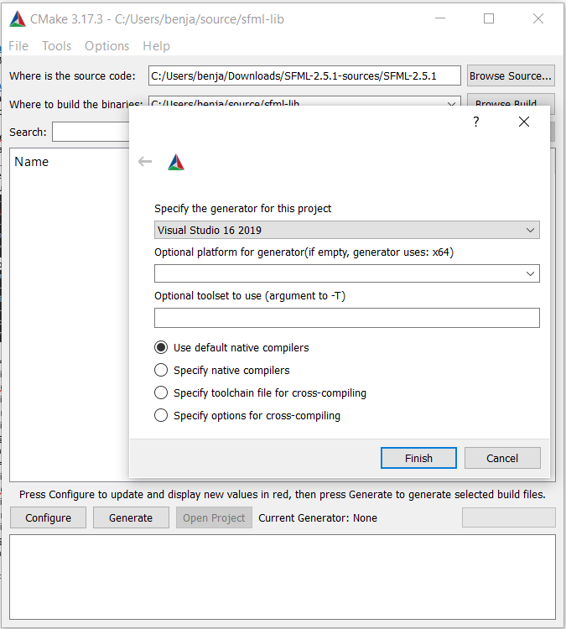
Configure
Notes:
Configure -> Finish. Make sure all the settings are done correctly.

Slide 11
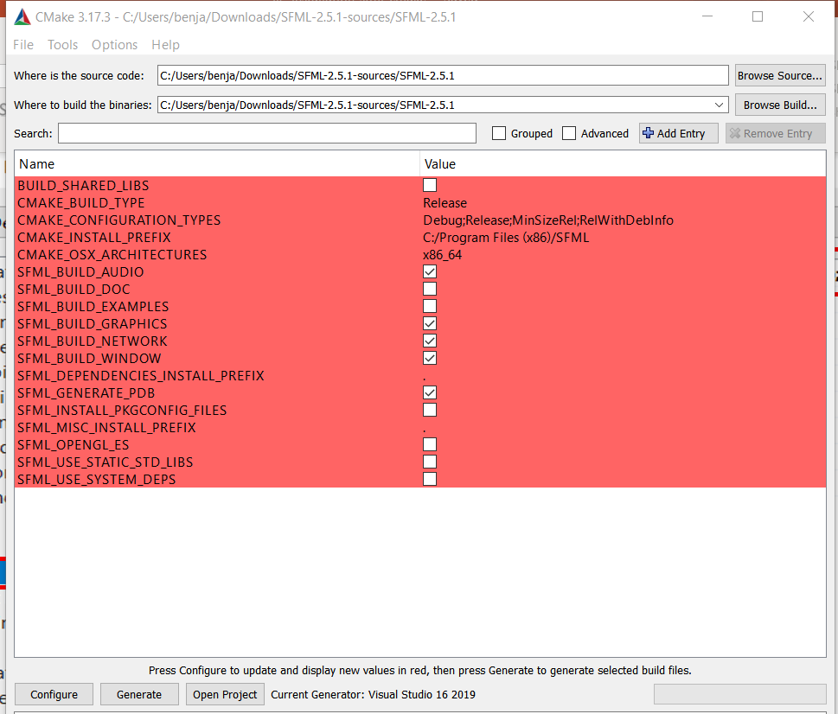
Generate libraries (STATIC Linking) -Uncheck BUILD_SHARED_LIBS
Notes:
Make sure BUILD_SHARED_LIBS is unchecked -> Generate
We’ll make static linking this time round

Slide 12
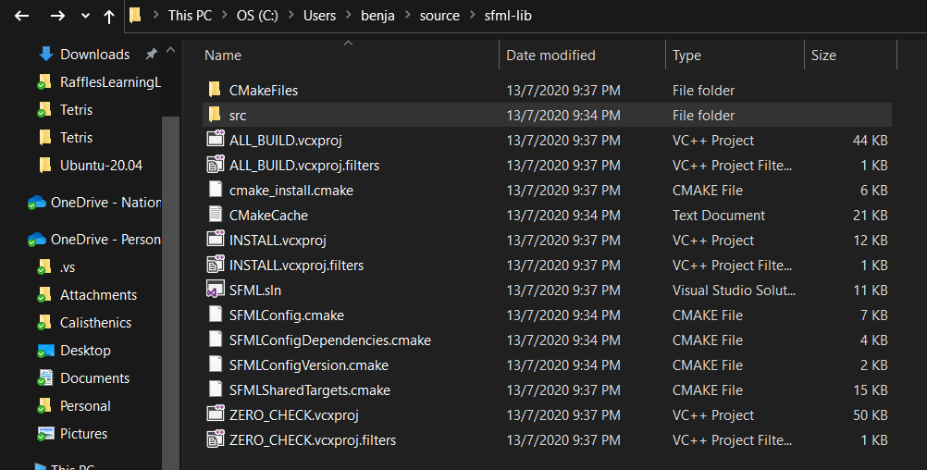
Build SFML.sln
Notes:
Still in Downloads folder.
Open SFML.sln

Slide 13
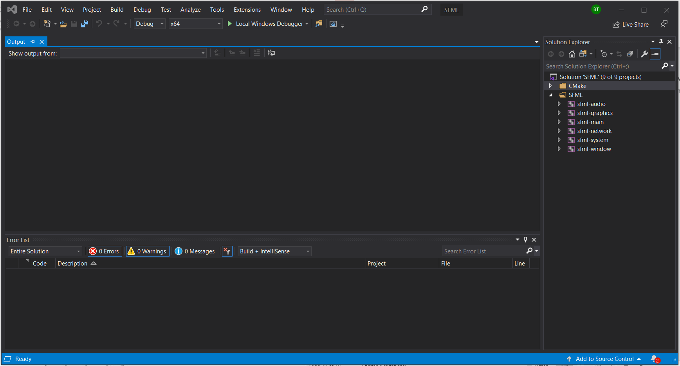
Build for Debug
Notes:
Check it is in “Debug” mode -> x64 Machine -> Build -> Build solution
We’ll not build for “Release” anymore since it is not necessary for this class but the configuration and build solution is the same as “Debug”.
Just change “Debug” to “Release” boxed in red.

Slide 14
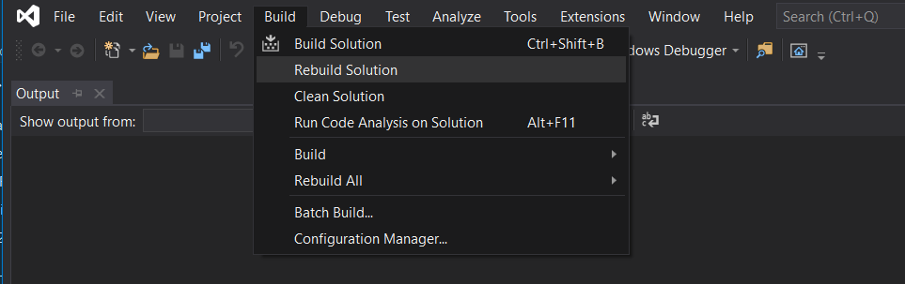
Build Solution

Slide 15
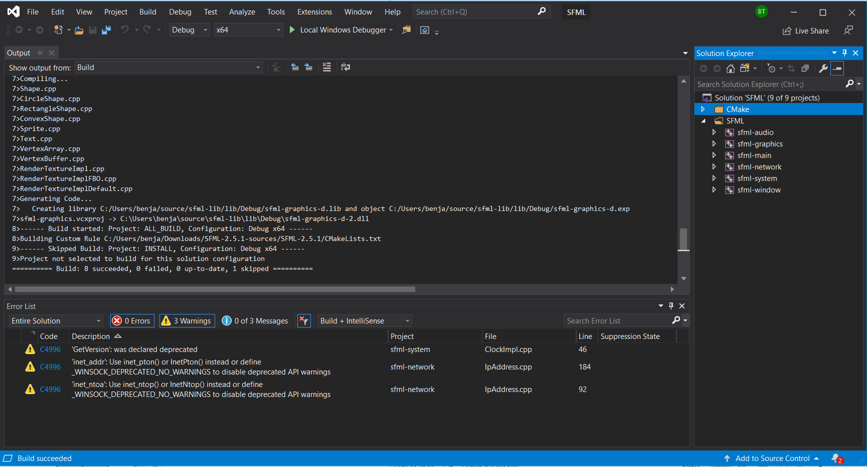
Build Success
Notes:
Build -> Build solution.
Make sure that are builds are successful!

Slide 16
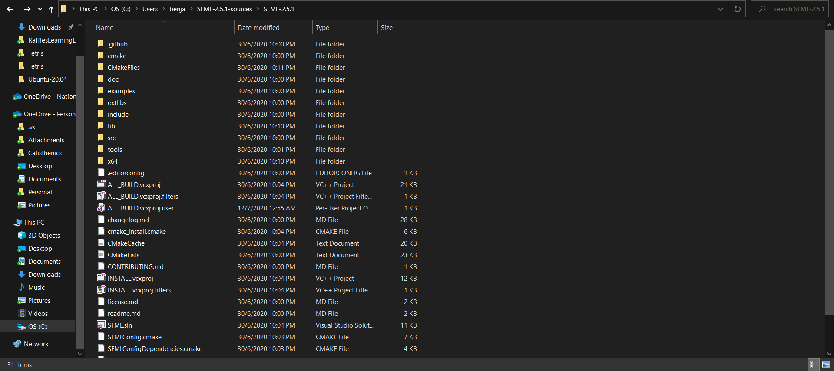
Final completion
Notes:
If done correctly, there should be lib and x64 folder appearing.

Slide 17
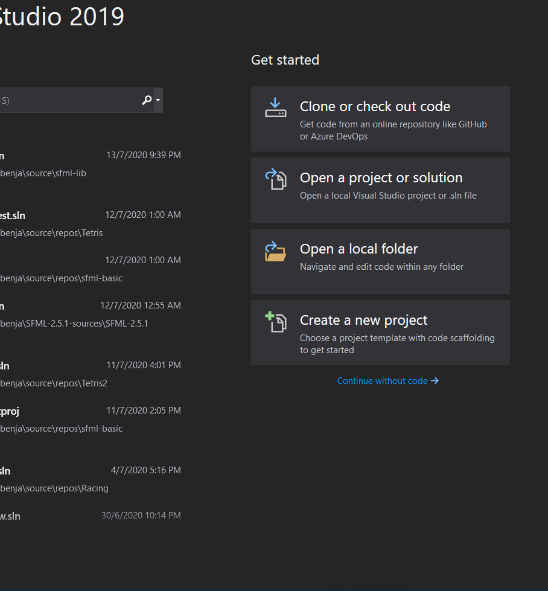
Linking of generated libraries with VS solution file
Create new solution.
Notes:
Name the solution with any name you want.

Slide 18
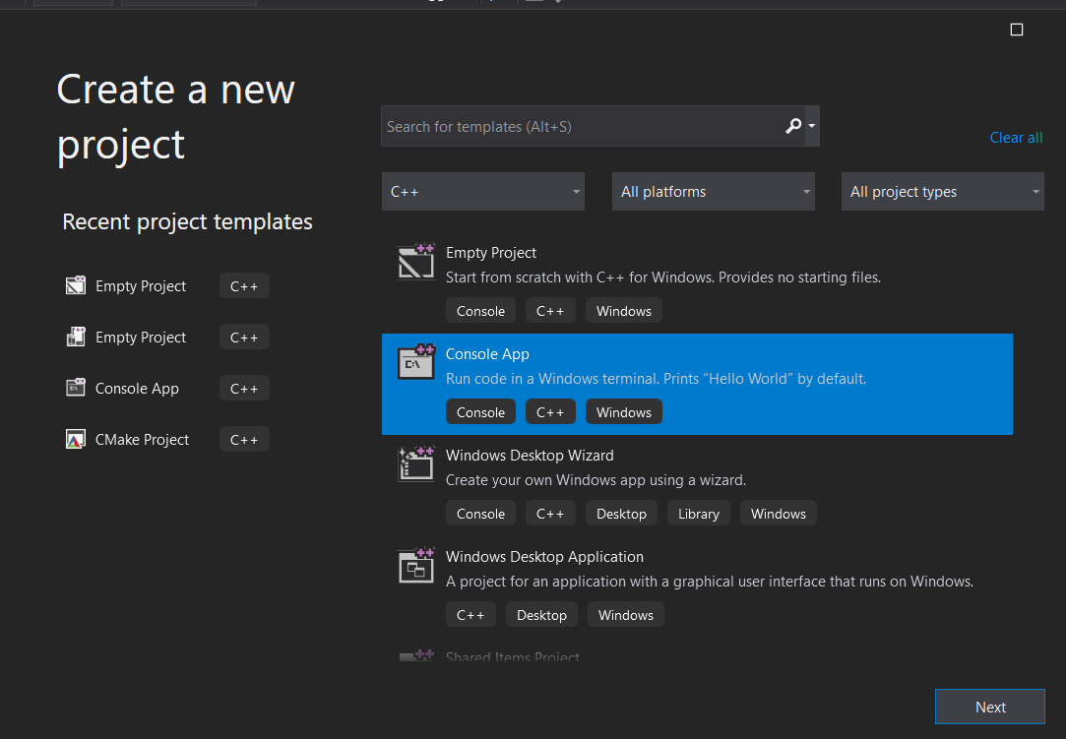
Notes:
Create console App

Slide 19
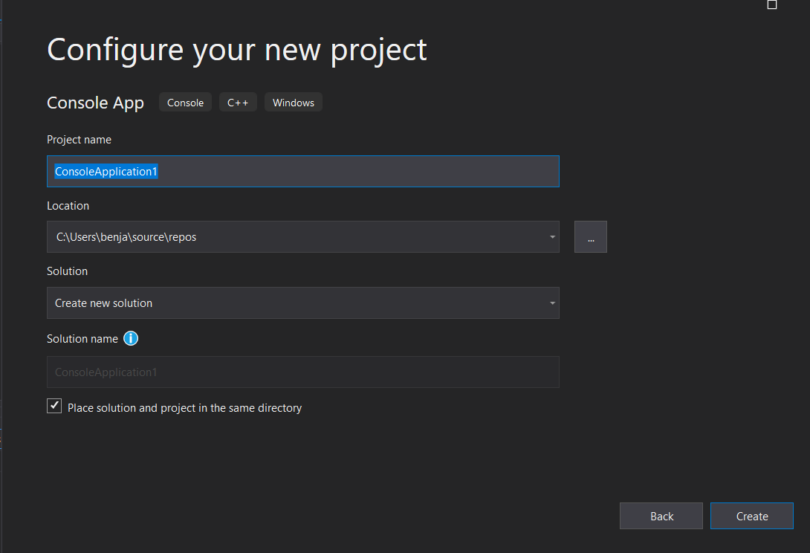
Notes:
Name your project. Name it whatever you like. But I suggest to save it as ‘SFML-Tuition’.
We WILL be using this solution for the rest of the sessions.

Slide 20
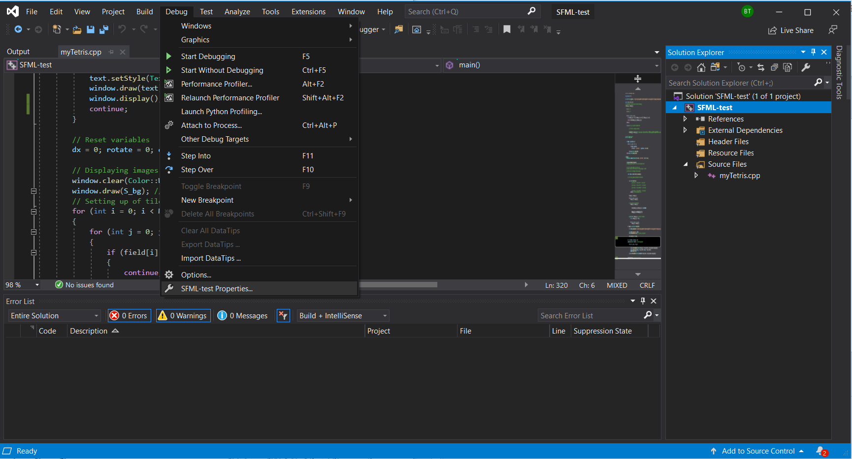
Notes:
Debug -> <solution name> Properties -> Configure the properties.

Slide 21
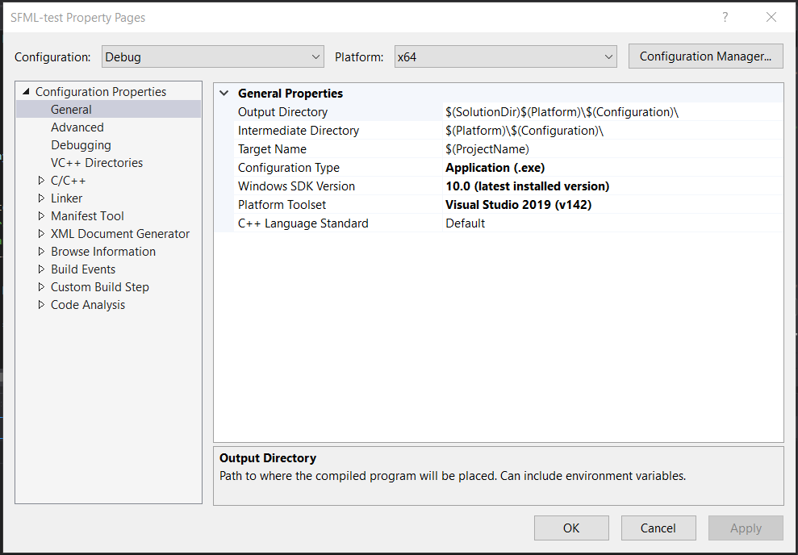
Notes:
2 main settings: C/C++ and Linker.
Make sure you’re in “Debug” and “x64” platform

Slide 22
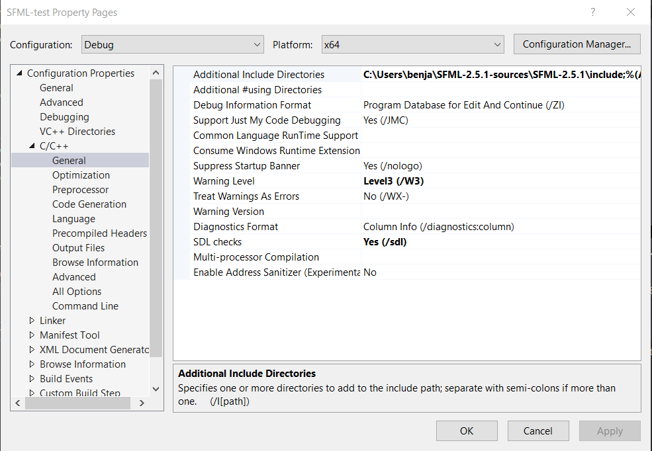
Notes:
Additional include directories:
1) [SFML parent directory]\SFML-2.5.1\include;

Slide 23
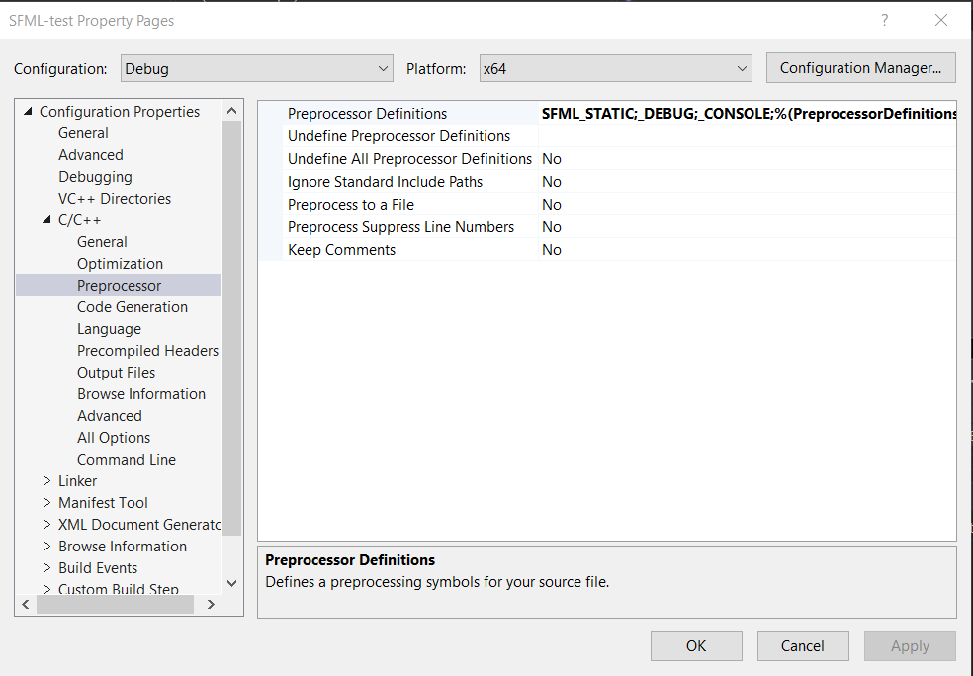
Notes:
Preprocessor:
1) SFML_STATIC;

Slide 24
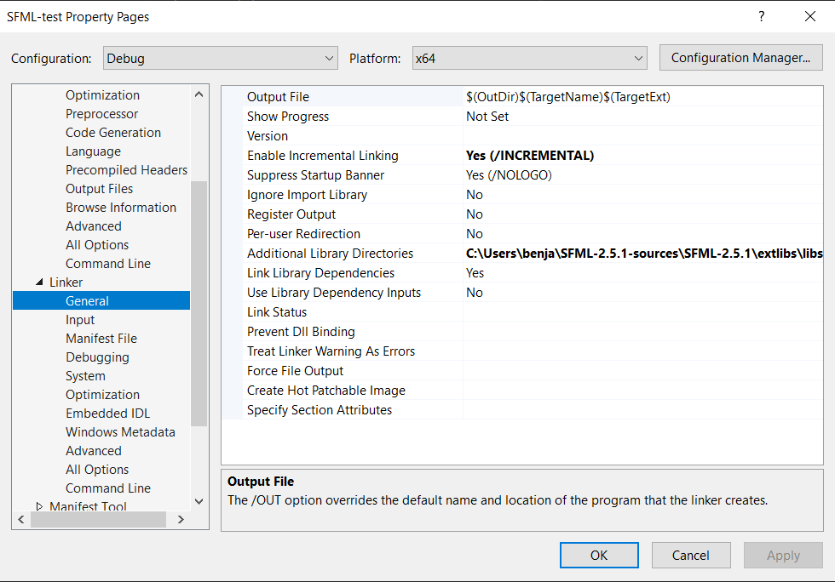
Notes:
Additional library directories:
1) [SFML parent directory]\SFML-2.5.1\lib\Debug;
2) [SFML parent directory]\SFML-2.5.1\extlibs\libs-msvc-universal\x64;

Slide 25
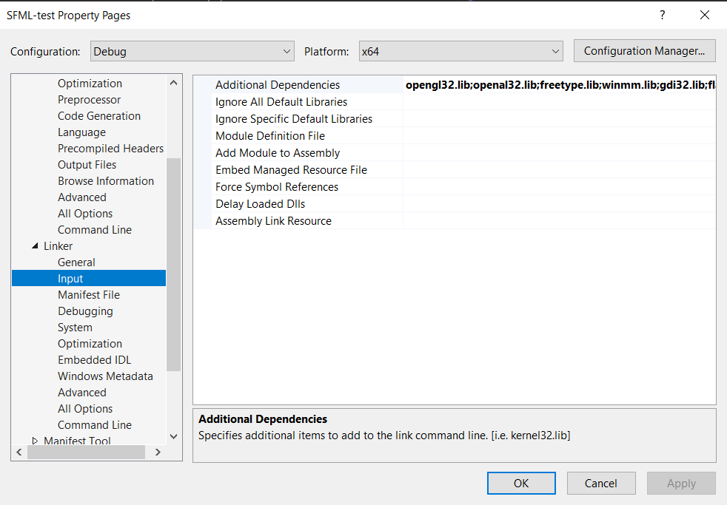
Notes:
Additional dependencies:
1) opengl32.lib;openal32.lib;freetype.lib;winmm.lib;gdi32.lib;flac.lib;vorbisenc.lib;vorbisfile.lib;vorbis.lib;ogg.lib;ws2_32.lib;sfml-graphics-s-d.lib;sfml-window-s-d.lib;sfml-system-s-d.lib;sfml-audio-s-d.lib;sfml-network-s-d.lib;

Slide 26
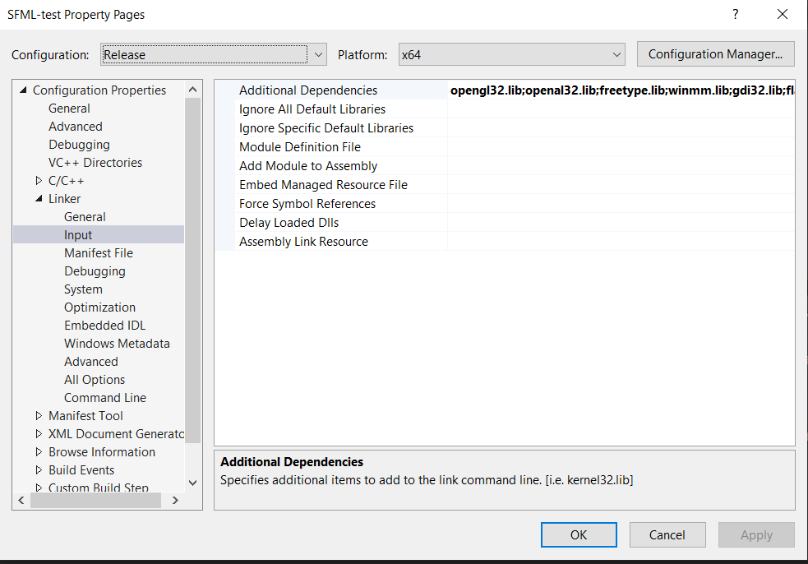
Can IGNORE but build step for “Release” is in the notes below
Notes:
FOR YOUR INFORMATION.
Additional include directories: [SFML parent directory]\SFML-2.5.1\include;
Preprocessor: SFML_STATIC;
Additional library directories: [SFML parent directory]\SFML-2.5.1\lib\Release;[SFML parent directory]\SFML-2.5.1\extlibs\libs-msvc-universal\x64;
Additional dependencies: opengl32.lib;openal32.lib;freetype.lib;winmm.lib;gdi32.lib;flac.lib;vorbisenc.lib;vorbisfile.lib;vorbis.lib;ogg.lib;ws2_32.lib;sfml-graphics-s.lib;sfml-window- s.lib;sfml-system-s.lib;sfml-audio-s.lib;sfml-network-s.lib;

Slide 27
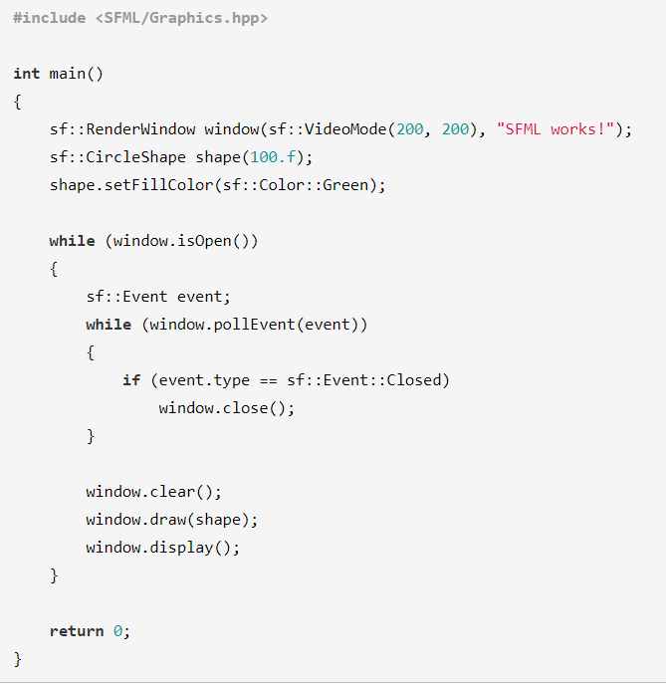
Notes:
Please TEST this code. Output is in the next slide.
Press F5 to debug.

Slide 28
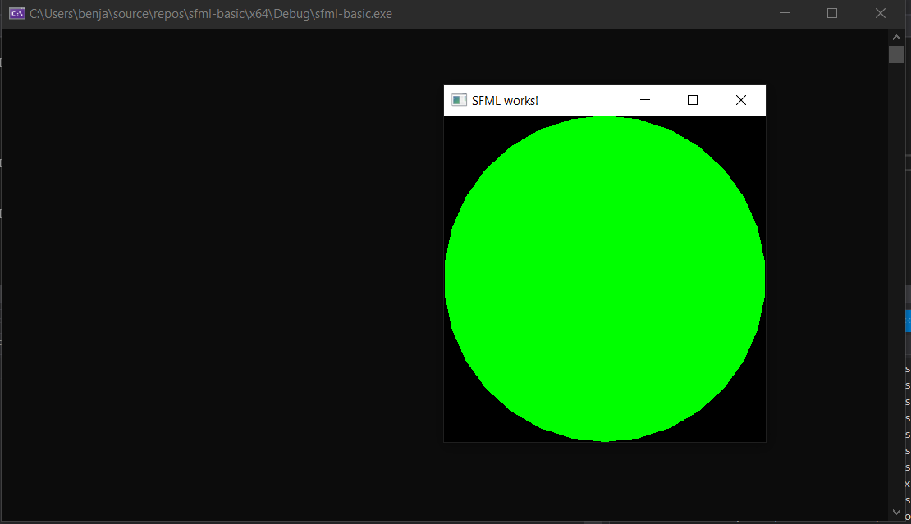
Output
Notes:
If you get this Green circle then you’re done configuring!
Please please be careful with the pathing this time round. I’ve tried it from scratch and it is working.
- Ben

