Slide 1
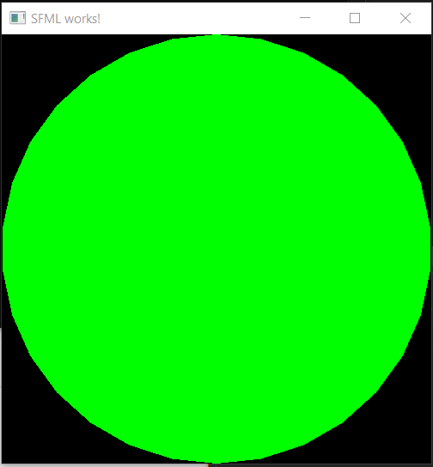
Before we begin…

Slide 2
SFML Window

Slide 3
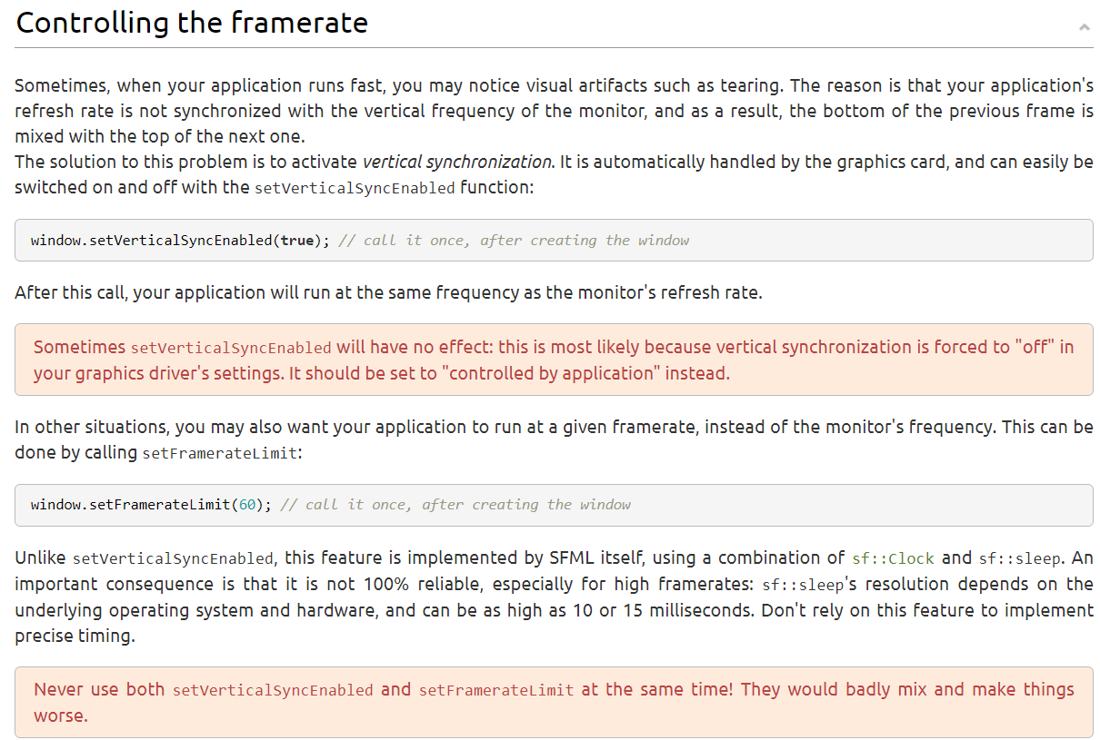
Notes:
Setting framerate: either to screen’s refresh rate or manually set; never use it together!
More information: https://www.sfml-dev.org/tutorials/2.5/window-window.php

Slide 4
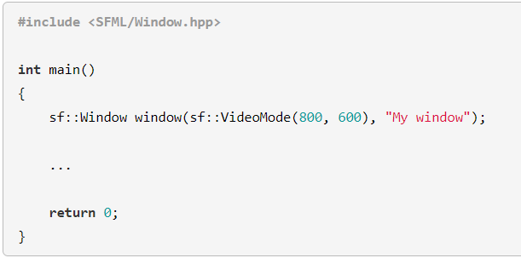
Outline
Notes:
First argument -> size of the window (Length x Height)
Second -> Title
Third (Optional) -> specify style of window

Slide 5
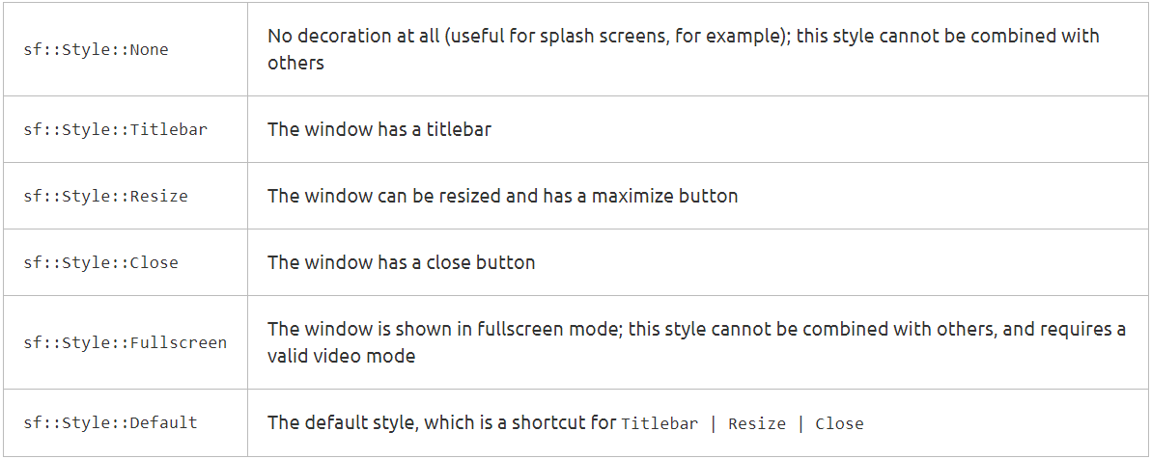
Different Styles
Notes:
3rd argument

Slide 6
SFML RenderWindow

Slide 7
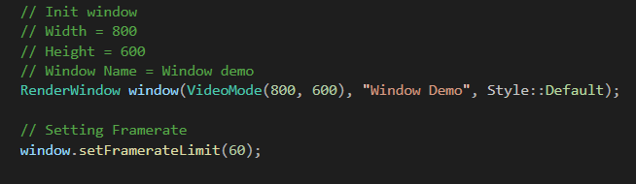
Render Window
Notes:
Sf::Window is mainly used for 2D drawings.
Sf::RenderWindow is derived from sf::window, but is the main class of the Graphics module.
https://www.sfml-dev.org/documentation/2.5.1/classsf_1_1RenderWindow.php
Our main driver for this course!

Slide 8


Buttt… Where is the window?!??!
Notes:
Yes, the window only manages to stay on for that while because it there was no instruction for it to remain open!

Slide 9
SFML Event

Slide 10
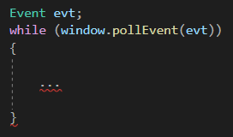
Outline
Notes:
Events occurs within the while loop when window is open.

Slide 11

Closed Event
Notes:
Event is triggered when user clicks on the cross on the window.

Slide 12
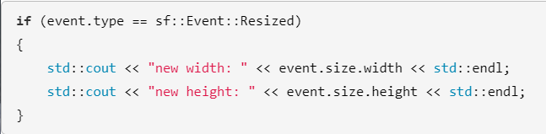
Resized Event
Notes:
Event is triggered when window is resized.

Slide 13
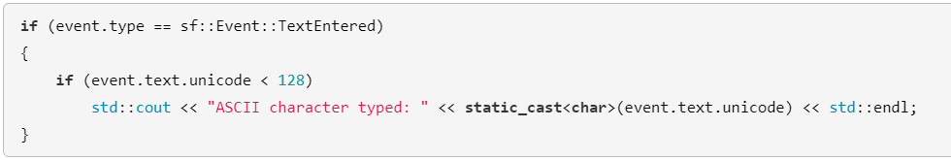
TextEntered Event
Notes:
Event is usually used when catching user input in a text field.
Do not be confused with KeyPressed Event which will be discussed in the next slide

Slide 14
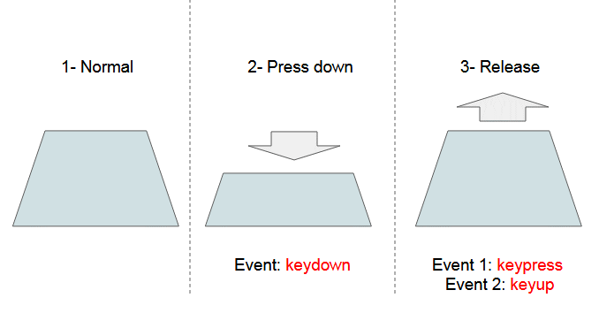
Pressed and Released Events
Pressed == holding down the key down
Released == letting go of the pressed key
Notes:
Introduce you to the concept of key presses and key releases events

Slide 15
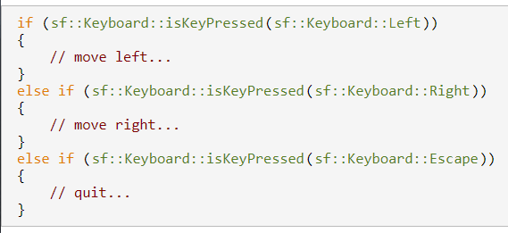
KeyPressed and KeyReleased Event

Slide 16
What are their differences?
KeyPressed | TextEntered
Every key pressed is seen as an individual state. | Every key pressed may be perceived as a combination of key presses.
If a key is held, multiple KeyPressed events are generated. | Do not register multiple TextEntered events.
Takes the whole spectrum of the Keyboard. | Takes ASCII range 0 - 127
Notes:
ASCII: https://learn.parallax.com/support/reference/ascii-table-0-127

Slide 17
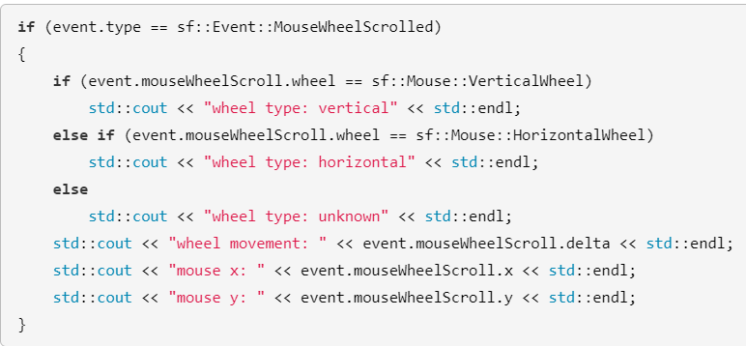
MouseWheelScrolled Event

Slide 18
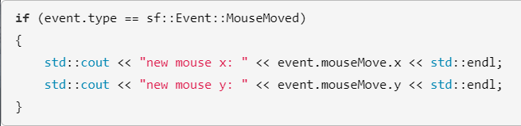
MouseMoved Event

Slide 19
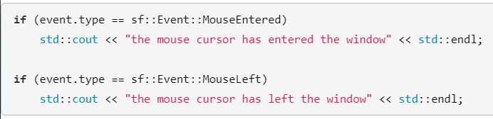
MouseEntered and MouseLeft Event

Slide 20
Setting of Window Position

Slide 21

Setting Position
Notes:
Usual screen is 1920 x 1080

Slide 22
Key Takeaways
when polling for events, we can use either if-else or switch statements
Differences between KeyPressed, KeyReleased and TextEntered.
From today onwards, we’ll only be using RenderWindow to draw our windows as it is easier for Sprite drawings

