Slide 1
Before we begin…
Recap on RenderWindow and Event
Basic outline of how to create and maintain a window
And how to poll for inputs from the computer

Slide 2
Summary of Event Types
Closed event
Resized Event
TextEnetered Event
KeyPressed Event
KeyReleased Event
Mouse Events
MouseWheelScrolled
MouseMoved
MouseEntered
MouseLeft
Notes:
Please refer to Lesson 4 Notes for details

Slide 3

Demonstration
RenderWindow and Polling for Event
Notes:
Usage of wrapper functions to encapsulate all the parameters → this gives us the ability to reuse the function over and over again.

Slide 4
Pop Quiz!

Slide 5
Question 1
What is a Source file?
A file that has an extension .h
A file that has an extension of .cpp
A file that has an extension of .txt
A file that has an extension of .py
None of the above
Notes:
Ans: 2

Slide 6
Question 2
What is a Header file?
A file that has an extension .h
A file that has an extension of .cpp
A file that has an extension of .txt
A file that has an extension of .py
None of the above
Notes:
Ans: 1

Slide 7
Question 3
What is the purpose of a Source file?
A file that stores all of our functions and its functionality.
A file to keep track of all of our functions.
A file for us to write our codes in.
A file for us to declare all our functions in so we can reuse those functions.
None of the above
Notes:
Ans: 1

Slide 8
Question 4
What is the purpose of a Header file?
A file that stores all of our functions and its functionality.
A file to keep track of all of our functions.
A file for us to write our codes in.
A file for us to declare all our functions in so we can reuse those functions.
None of the above
Notes:
Ans: 4

Slide 9
Question 5
What is the difference between TextEntered and KeyPressed Events?
TextEntered and KeyPressed Events have no notable differences.
TextEntered Event enable us to key in ASCII values (up to 128) while KeyPressed Event does not register ASCII value but rather, keys on the keyboard only.
TextEntered Event is suitable for when developers want its users to key in its Username, for example.
KeyPressed Event is suitable for when developers want its users to do repeated presses of key, for example, when moving a character.
None of the above.
Notes:
Ans: 2, 3, 4

Slide 10
SFML Thread
For simultaneous, parallel running of codes
Notes:
Today, we’ll be learning how

Slide 11

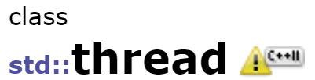
2 Types

Slide 12
Which to choose?
For those using Visual Studio 2019
Use std::thread
IDE supports C++11 and beyond.
We already have access to threads in the standard library by doing
#include <thread>

Slide 13
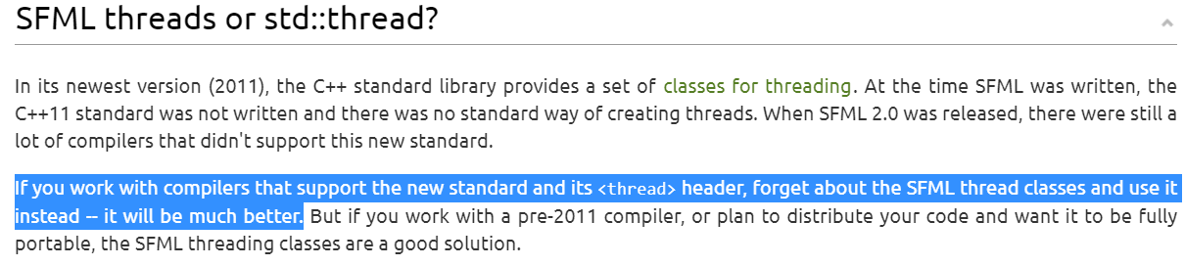
Notes:
Honestly I’m not too sure about the difference in performance, but if the developers of SFML said so, then we shall gladly oblige.

Slide 14
What is a thread?
A thread is basically a sequence of instructions that runs parallel to other threads.
Hence, if your program only runs in your main() function, then it is called a single-threaded program.
If there are more than one thread in the program, it is called a multi-threaded program.

Slide 15
How to make program threadsafe?
Mutex (MUTual EXclusive) is a very helpful library.
It synchronises primitives (variables) from being simultaneously accessed by multiple threads.
mutex offers exclusive and non-recursive ownership of the primitive type.
Notes:
https://en.cppreference.com/w/cpp/thread/mutex
Since we want our windows are threadsafe, we do not need to use Mutex. This is just good additional knowledge

Slide 16
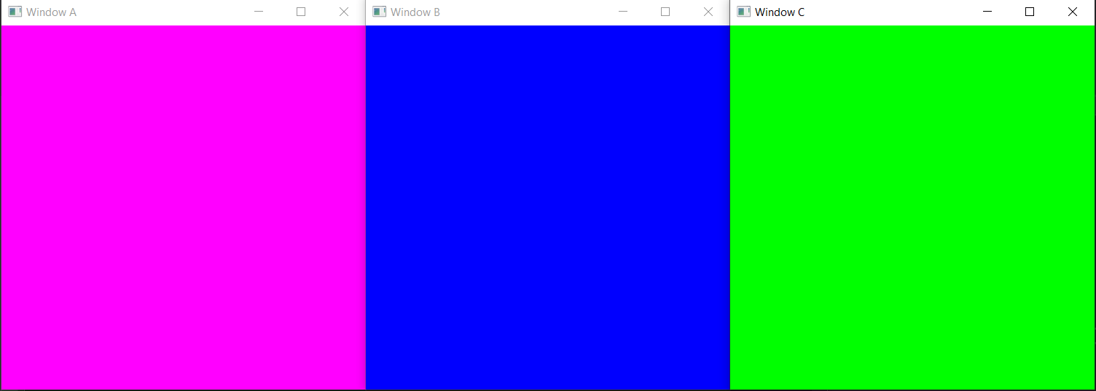
How is it applicable to SFML?
Multiple interactive windows!

