Slide 1
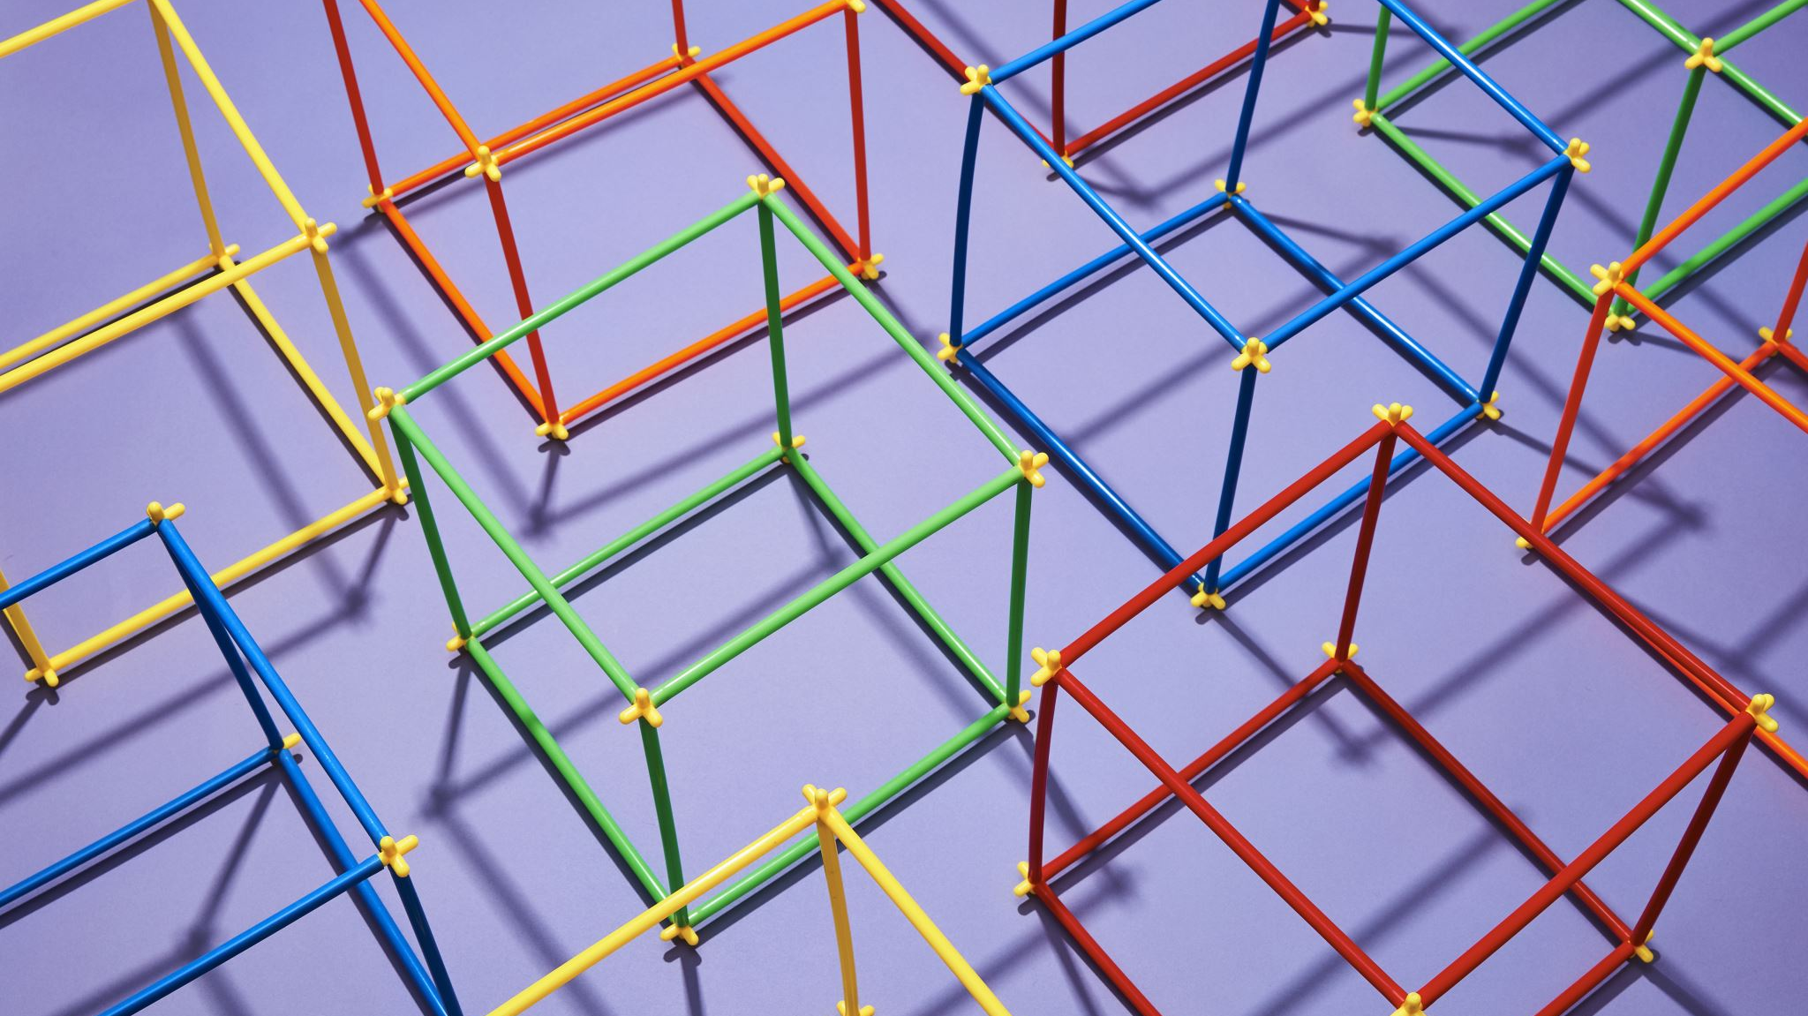
Shapes
Circles, Rectangles, Triangles, etc.
Notes:
Some written code in Shape.cpp and Shape.h
Shape:
https://www.sfml-dev.org/tutorials/2.5/graphics-shape.php
Transformation:
https://www.sfml-dev.org/tutorials/2.5/graphics-transform.php
Draw shape (circle, rectangle, polygon, convex, lines)
transforming entities (position, rotation, scale, bounding box) [basic only]
Antialiasing

Slide 2
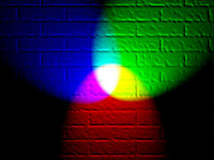
RGB
Stands for Red, Blue, Green.
Each colour has a maximum of (255, 255, 255).
Hence, in theory, there are 256*255*255 = 16, 581, 375 shades of colour!

Slide 3
Circle
Notes:
Radius

Slide 4
Ellipse
Notes:
Horizontal stretch vs Vertical stretch

Slide 5
Rectangle
Notes:
Length and Height

Slide 6
Triangle
Notes:
Sides length

Slide 7
Convex (Random Polygons)
You need to specify the number of points the shapes has.
Each side can be of different lengths, but you need to declare them in sequence, e.g. clockwise or anti-clockwise.
Notes:
Point 0 = (100,100)
Point1 = (200,200)
Point2
Point3
Point4 = (

