Slide 1
SFML Sprite
How to put images into window

Slide 2
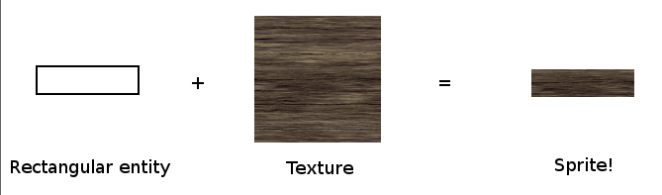
Recall
Last week, we have talked about shapes.
Today, we’ve delve deeper into the “texturizing” a shape, aka sprite.

Slide 3
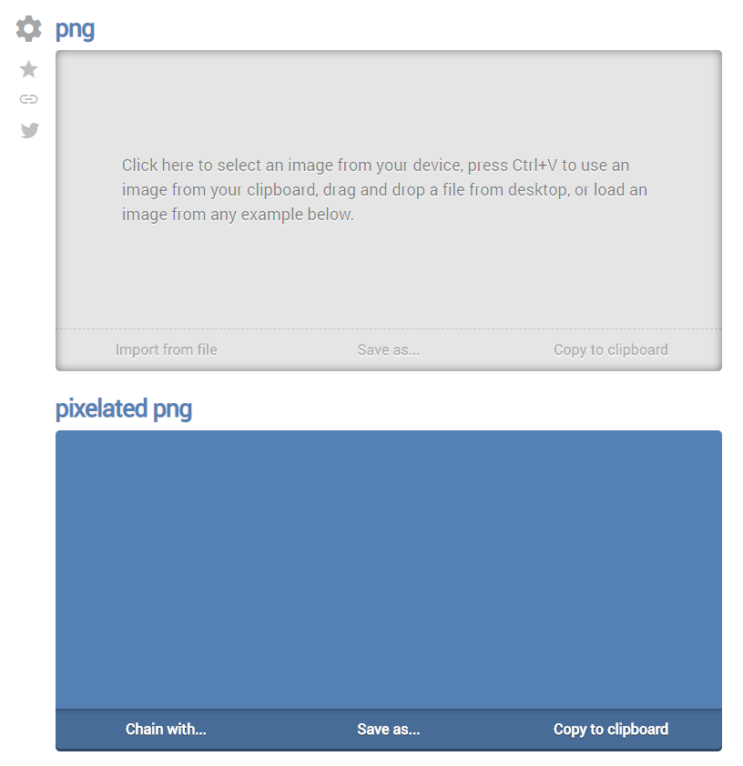
Usage of Online Tools to help us
https://onlinepngtools.com/pixelate-png

Slide 4
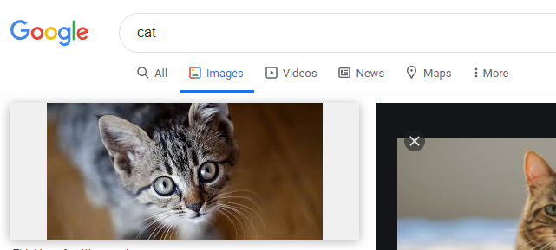
Step 1
Search for your favourite Image.

Slide 5
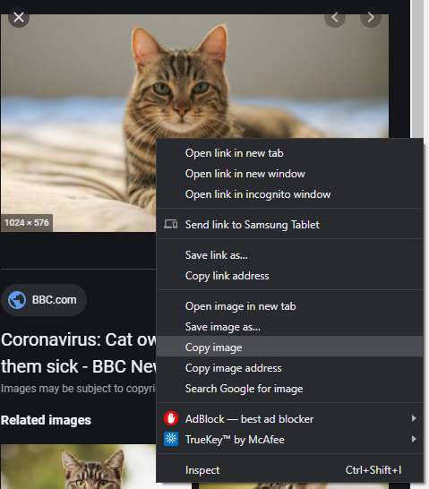
Step 2
Copy image.

Slide 6
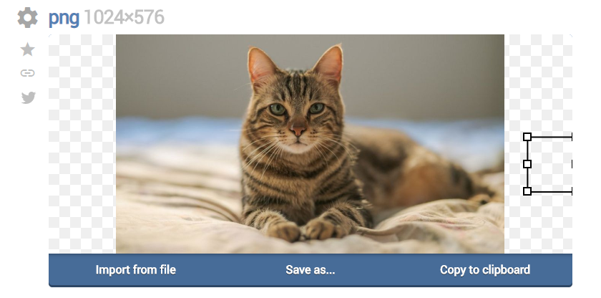
Step 3
Paste it.

Slide 7
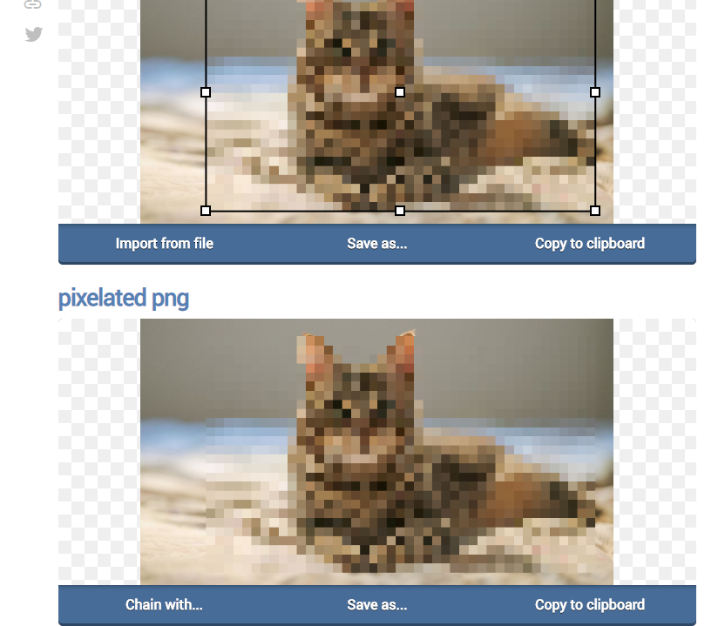
Step 4
Pixelate image.

Slide 8
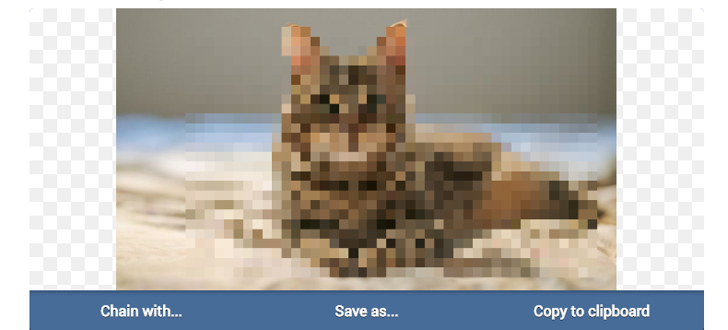
Step 5
Save file.

Slide 9
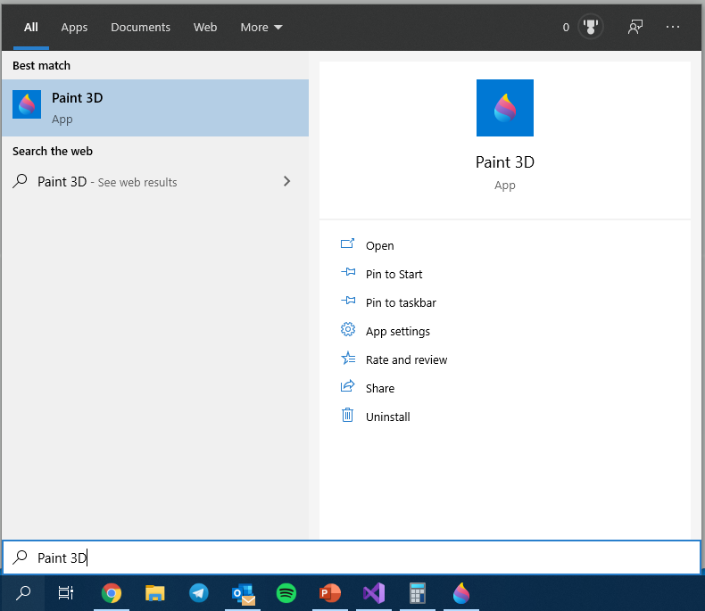
Step 6
Fire up Paint 3D

Slide 10
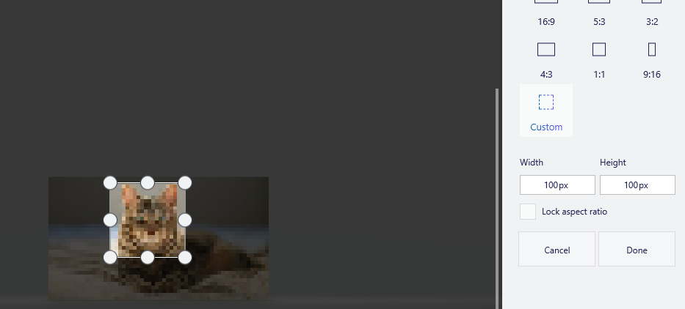
Step 7
Crop to 100 x 100

Slide 11
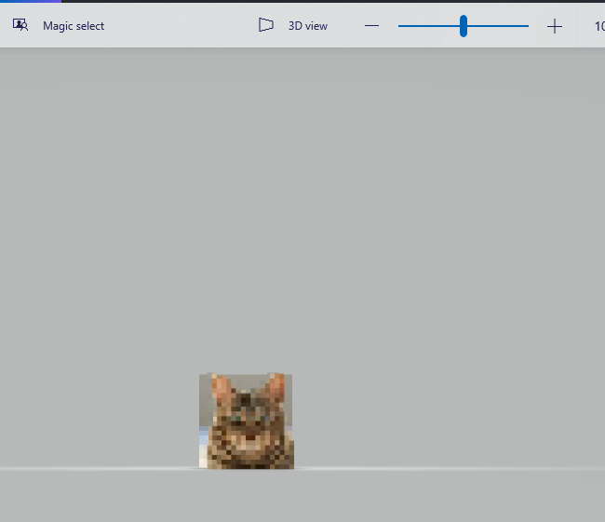
Step 8
Magic Select to remove background

Slide 12
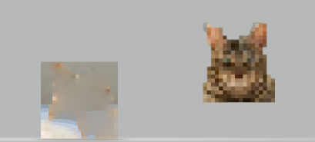
Step 9
Move the vector image around. Ctrl + X to cut it.

Slide 13
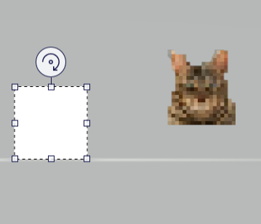
Step 10
Remove background. Drag mouse and select background. Press Del to delete.

Slide 14
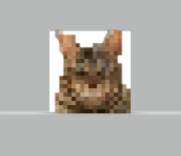
Step 11
Move vector image into cleared screen.

Slide 15
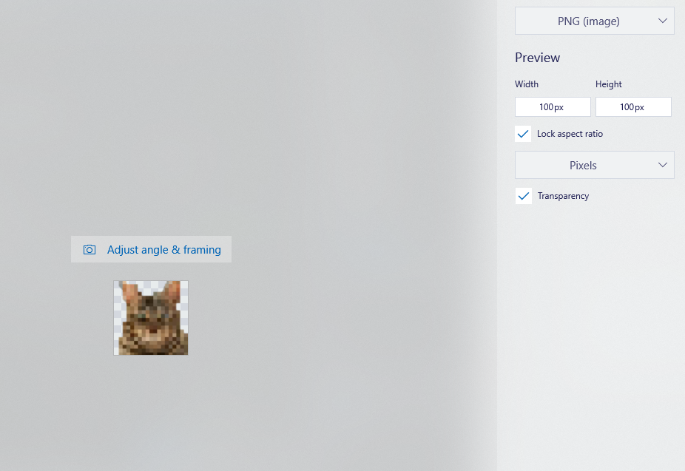
Step 12
Save as
Notes:
Make sure to click on transparency.

Slide 16
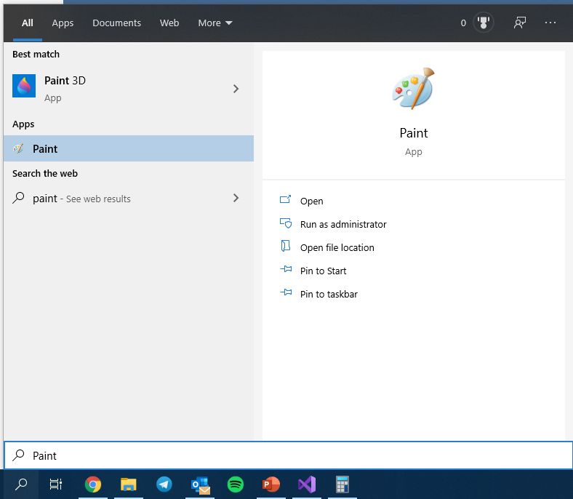
Usage of Paint to help us

Slide 17
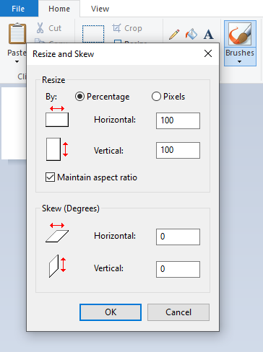
Step 1
Resize scale to 100 x 100.

Slide 18

Step 2
Using drawing tool, select pencil.

Slide 19
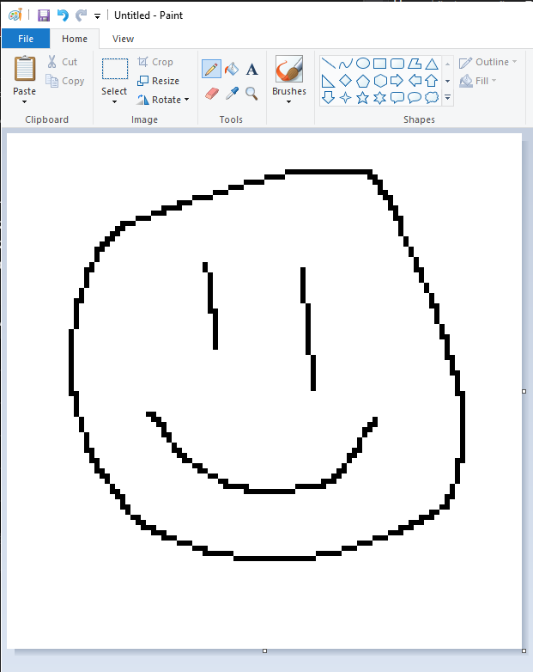
Step 3
Draw!

Slide 20
Step 4 onwards
Save as. Insert image into Paint 3D as per instructed in the previous few slides to create vector image.

Slide 21
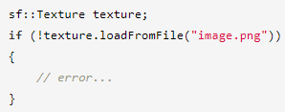
Loading of a Texture
Use class sf::Texture

Slide 22
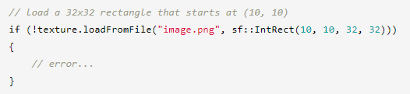
Load Image with optional arguments
Load a 32 x 32 rectangle that starts at (10,10)

Slide 23

Create Sprite

Slide 24
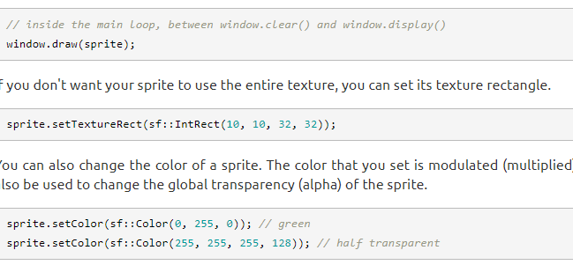
Draw Sprite

Slide 25
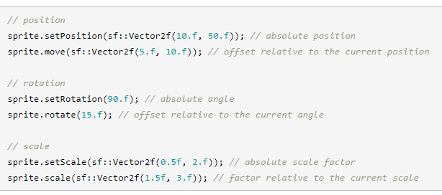
Sprite Transformation

Slide 26
White Square Problem
You successfully loaded a texture, constructed a sprite correctly, and... all you see on your screen now is a white square. What happened?
This is a common mistake. When you set the texture of a sprite, all it does internally is store a pointer to the texture instance. Therefore, if the texture is destroyed or moves elsewhere in memory, the sprite ends up with an invalid texture pointer.

Slide 27
Visualisation
Sf::Texture
0x00000001
Texture stored in Memory Heap
Return Sprite
0x00000014
NEW Texture stored in Memory Heap
Notes:
When setting a texture of a sprite, internally, a pointer is stored to a texture instance stored at memory location 0x12345678.
Now when you call it as a function, internally, the texture gets moved to somewhere else within the memory while the original one gets destroyed. Thus, there is an reference to an empty memory, producing the white box.

