Slide 1

SFML Audio
Playing Audio using SFML/Audio.hpp

Slide 2
2 main ways
Loading into a buffer and call it
Playing it directly from the source.

Slide 3
Pros and cons
Playing from source | Loading into buffer
Plays directly from source | Uses memory to store the buffer
Could be slower as we play directly from source | Faster as it has been pre-loaded (But depends on file size)
Better suited for large audio such as background music | Better suited for short bursts of audio such as gun shots

Slide 4
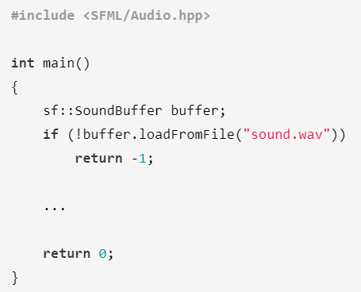
Loading a sound buffer

Slide 5
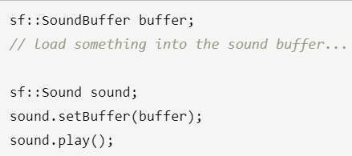
Playing is with sf::Sound

Slide 6
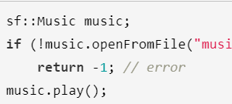
Playing directly from source

Slide 7
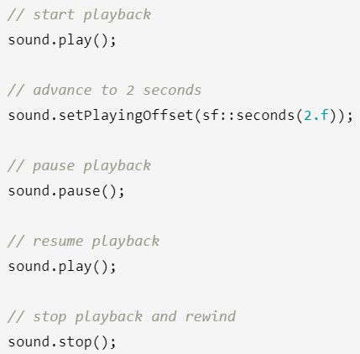
Addition Features

Slide 8
Problems
Recently, VS2019 just updated… So, there might be dependencies issues.
OpenAL32.dll not found
Go to extlibs > bin > x64 > copy .dll to repos > x64 > Debug
If corrupted, then we have no choice but to rebuild from CMake again to ensure dependencies…
We have gone through this in the 1st lesson! So let’s get this done within the first 30min of the lesson!

Slide 9
