Slide 1

T Template
Generic types in C++

Slide 2
They are special functions with generic types.
It allows developers to create function template whose functionality can be adapted to more than one type or class, without repeating the code for different types.
Think of templates as a blueprint, and the compiler “writes” the code for you, while following the parameters given by the developer.
PLEASE NOTE: typename and class can be used interchangeably.

Slide 3
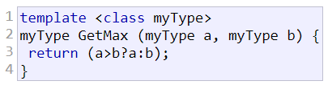
Example

Slide 4


How to use the function?

Slide 5
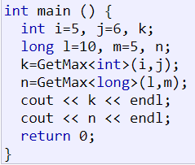
More examples
Notes:
K = 6
N = 10

Slide 6
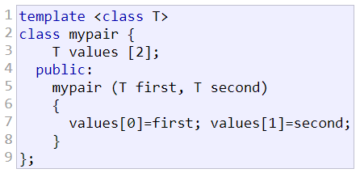
Class templates
Notes:
Storing an arr with “undeclared” type, aka T.

Slide 7

How to use the function?
Notes:
Declaring type + initialising a class object

Slide 8
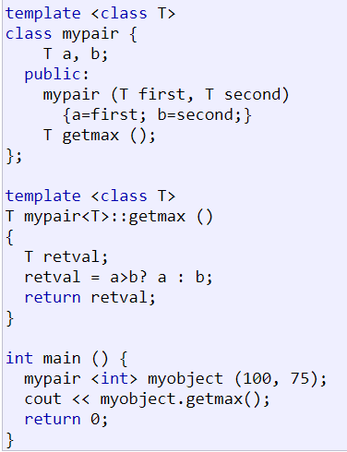
example
Notes:
We must always precede that definition with the template <...> prefix.
Initialise Class mypair with object myobject().
Output = 100

Slide 9

Still confused?
1st T is the template parameter (your set of rules)
2nd is the type returned by the function
3rd specifies the requirement when the template is called.
Notes:
If you go back to slide 7, mypair<int> is letting compiler know that you want to pass int as a parameter into the class template.

Slide 10

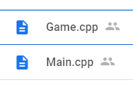
Making sure we’re all on the same page…

