Slide 1

RACE CAR 1.0
Retro-feel design

Slide 2
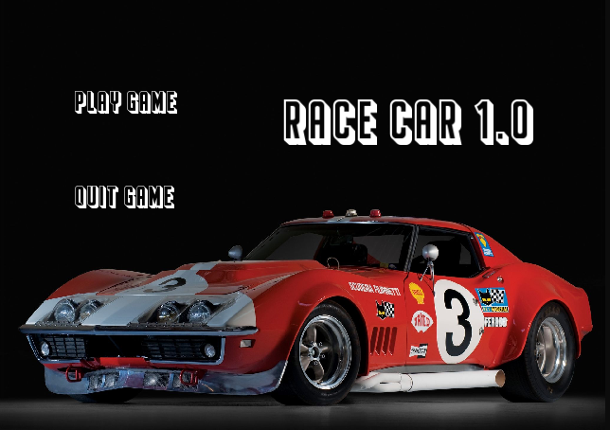

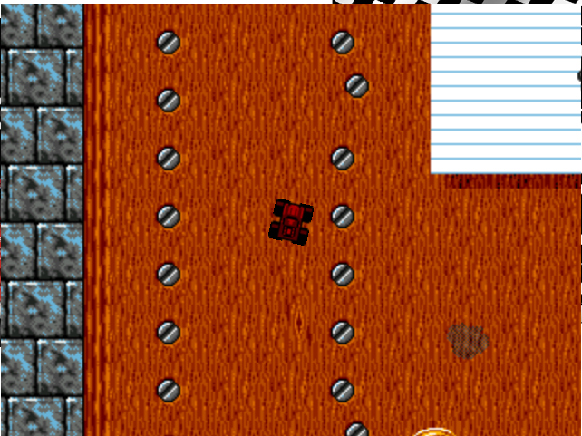

Slide 3
Disclaimer
The game is endless, but we have a mechanism to quit.
You could implement a pause/resume scenario, but I won’t be going through that in class.

Slide 4
Rules
No rules!
Unlike Tetris where we have to randomise falling tetrinos and line complete scenario, we have none here!
No rules best rules?

Slide 5
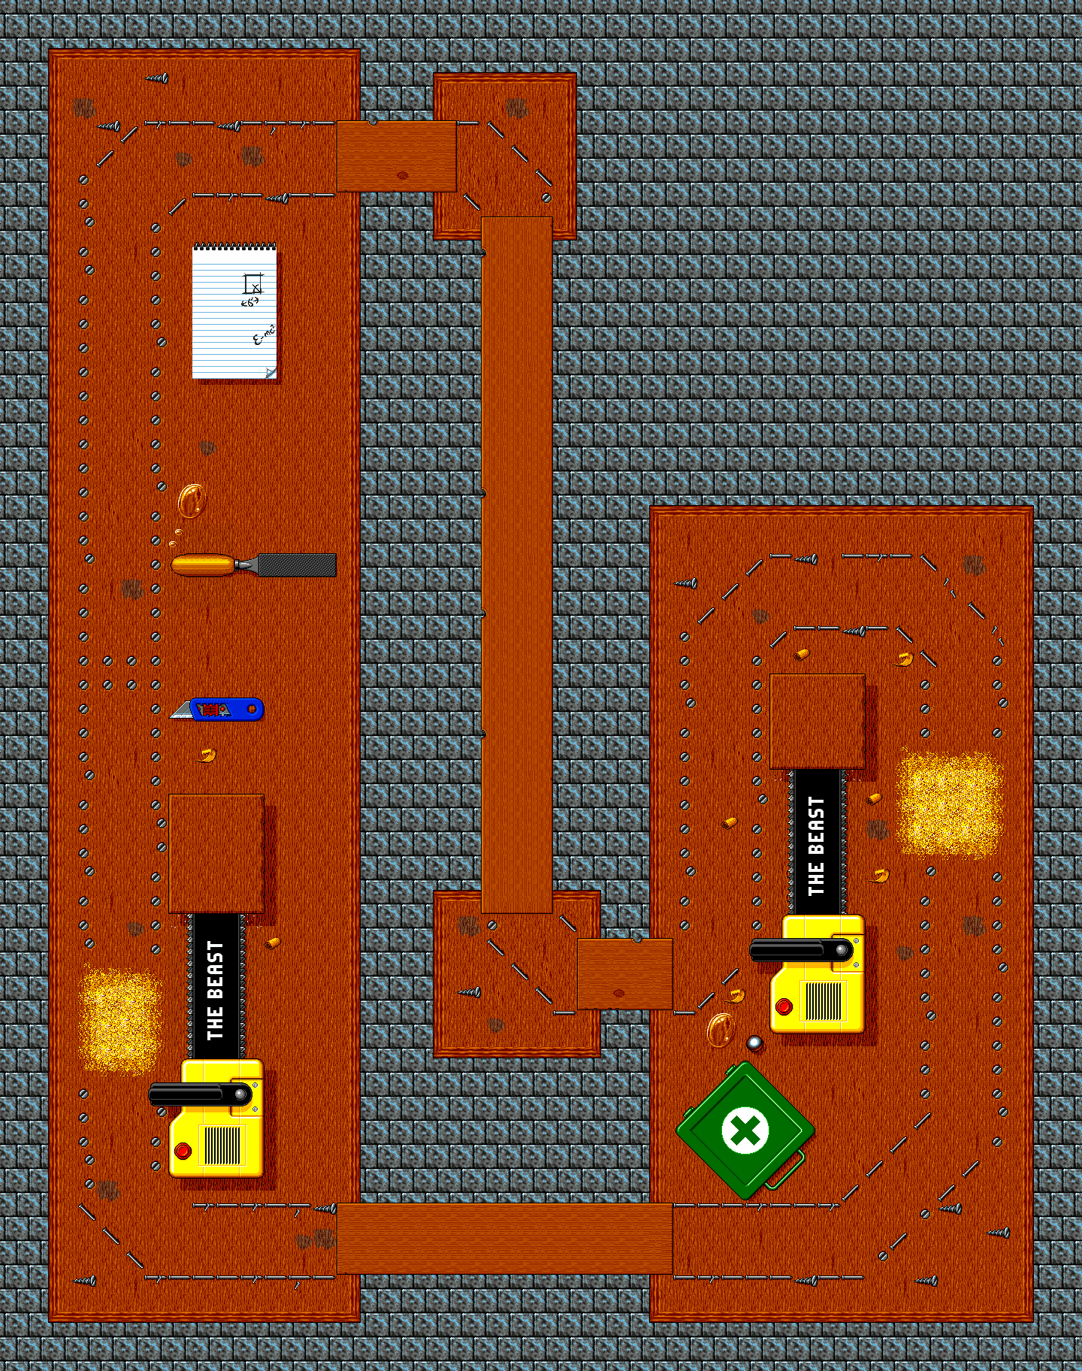
Route
Car would go in an endless loop around this track.
Car is able to move freely within this track.
There will be “AI” controlled cars.

Slide 6

Cars
Individual car.
Car’s colour can be changed using setcolor()
cars would not collide due to anti-collision logic.

Slide 7
Flow diagram
https://app.diagrams.net/

Slide 8
Questions?

