Slide 1

Trigonometry
a.k.a the dreaded trigo

Slide 2
The basic 3
sine
cosine
tangent

Slide 3
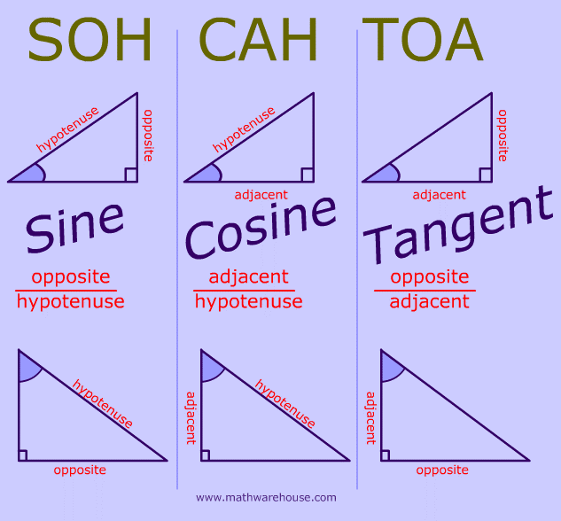
Notes:
Finding ratio

Slide 4
arc-sin/cos/tan

Slide 5
Notes:
Finding angle

Slide 6
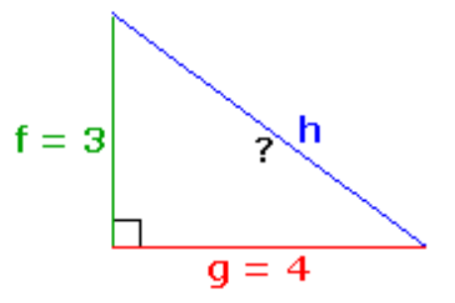
a
Example 1. Find angle bac.
What are the lengths given?
f = 3, g = 4
With respect to (wrt) angle bac, which is opposite and which is adjacent?
Opp = g, adj = f
Which trigo formula to use?
Ratio of opp/adj, hence we use tangent. Since we are finding angles, we’ll use arc-tan.
Answer:
Arctan(4/3)
b
c

Slide 7
Pythagoras’ Theorem
and perfect squares

Slide 8
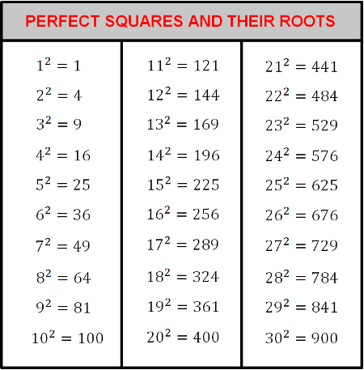
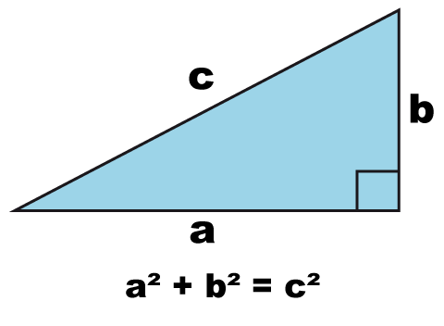
Notes:
Finding distance to calculate angle
a^2 = a * a
e.g a =3, 3^2 = 3*3 = 9

Slide 9
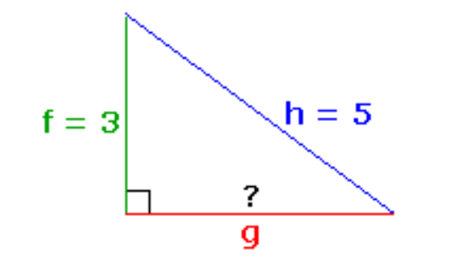
a
Example 2. Find g.
Where is the right angle?
Angle abc
Recall Pythagoras theorem
a^2 + b^2 = c^2
Hence,
3^2 + g^2 = 5^2
g^2 = 5^2 – 3^2
g = sqrt(25 – 9) = 4
Answer,
g = 4
b
c

Slide 10
QUIZ

Slide 11
a
*Q1. Find cos(angle bac).
5/3 (hypothenuse/adjacent)
3/5 (adj/hypo)
2/5 (wrong)
4/5 (wrong)
Not possible
b
c
Notes:
(2)

Slide 12
a
*Q2. Find angle acb.
arctan(3/5)
arcsin(5/3)
arccos(3/5)
arctan(5/3)
arcsin(3/5)
b
c
Notes:
(5)

Slide 13
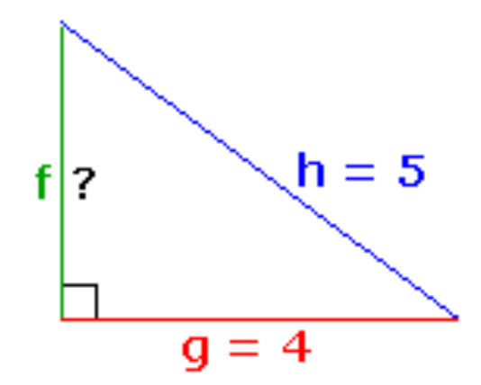
a
**Q3. Find f.
1
2
3
4
5
b
c
Notes:
(3)
5*5 – 4*4 = sqrt(9) = 3

Slide 14
a
***Q4. Find sin(angle bac).
5/3
3/5
2/5
4/5
Not possible
b
c
Notes:
(4)
1) need to fing what g is. G=4, using pythagoras
2) sin(angle) = opp/hypo = 4/5

