Slide 1

PlayState
Last and final component of Race Car!

Slide 2
Food for thought…
How to generate AI cars to play with us?
How to ensure cars can move as expected?
How to zoom into the individual car or set our car as the epicentre?

Slide 3

This is a car
Some small recap, a car has these following characteristics:
X coordinate
Y coordinate
Speed
Angle
N-counter (ranges from 0 – 7 for the points array)

Slide 4
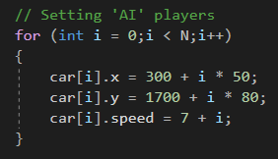
Creating “AI” Cars
Relatively simple as we have created a structure object called car -> call it and initialise all of the cars we need
Notes:
Simple initialisation and setting of x, y coordinates and speed

Slide 5
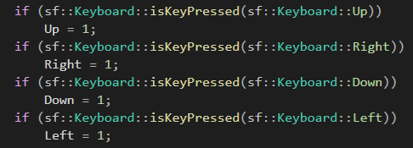
Updating Car’s Position
Using update to update directional flags
Up
Down
Left
Right
Notes:
1 == true
0 == false

Slide 6

Making Car as the Epicentre
Usually, we set targetSize and setScale to scale the background image to the desired size that fits the window width and height.

Slide 7
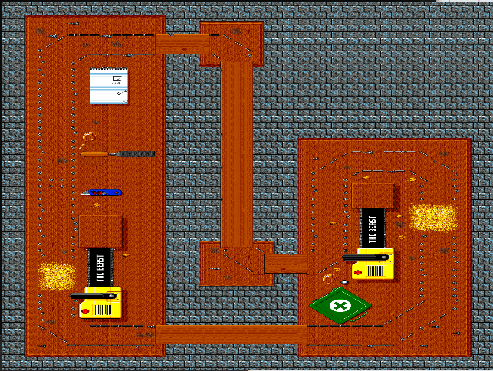
Making Car as the Epicentre
However by doing so…
Map is too huge
Difficult to navigate

Slide 8

Making Car as the Epicentre
Thus…
In constructor we set
In draw we set

