Slide 1
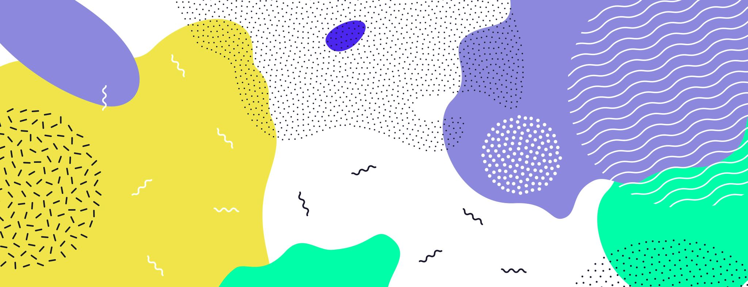
Pause
A critical concept in game design

Slide 2
What is Pause Functionality?
Used when developers want to allow users to pause their games
A simple and highly relevant design in most games nowadays

Slide 3
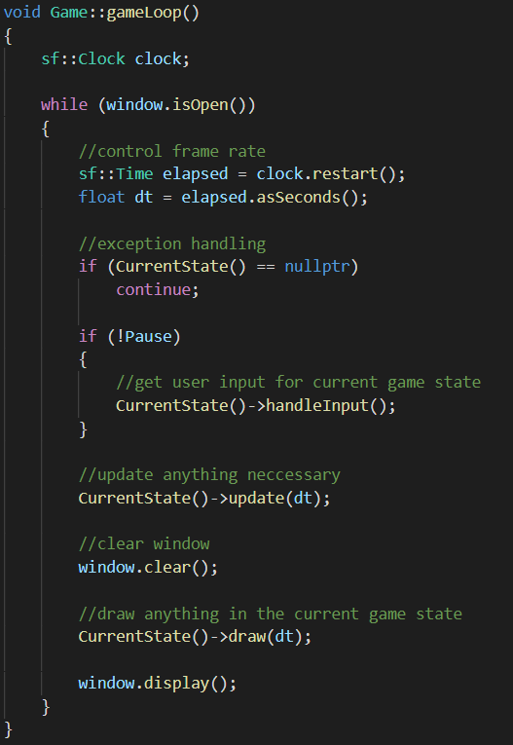
How?
handleInputs when game is not paused.
Skip handleInput if game is paused.
Food for thought…
Why do we not just pause everything i.e. update and draw?

Slide 4
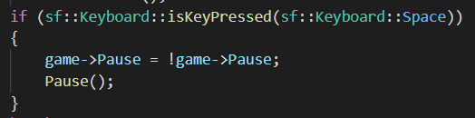
How?
Smart way of writing pause.
Pause = !pause
Pause | !Pause
True | False
False | True

