Slide 1
EE2033

Slide 3
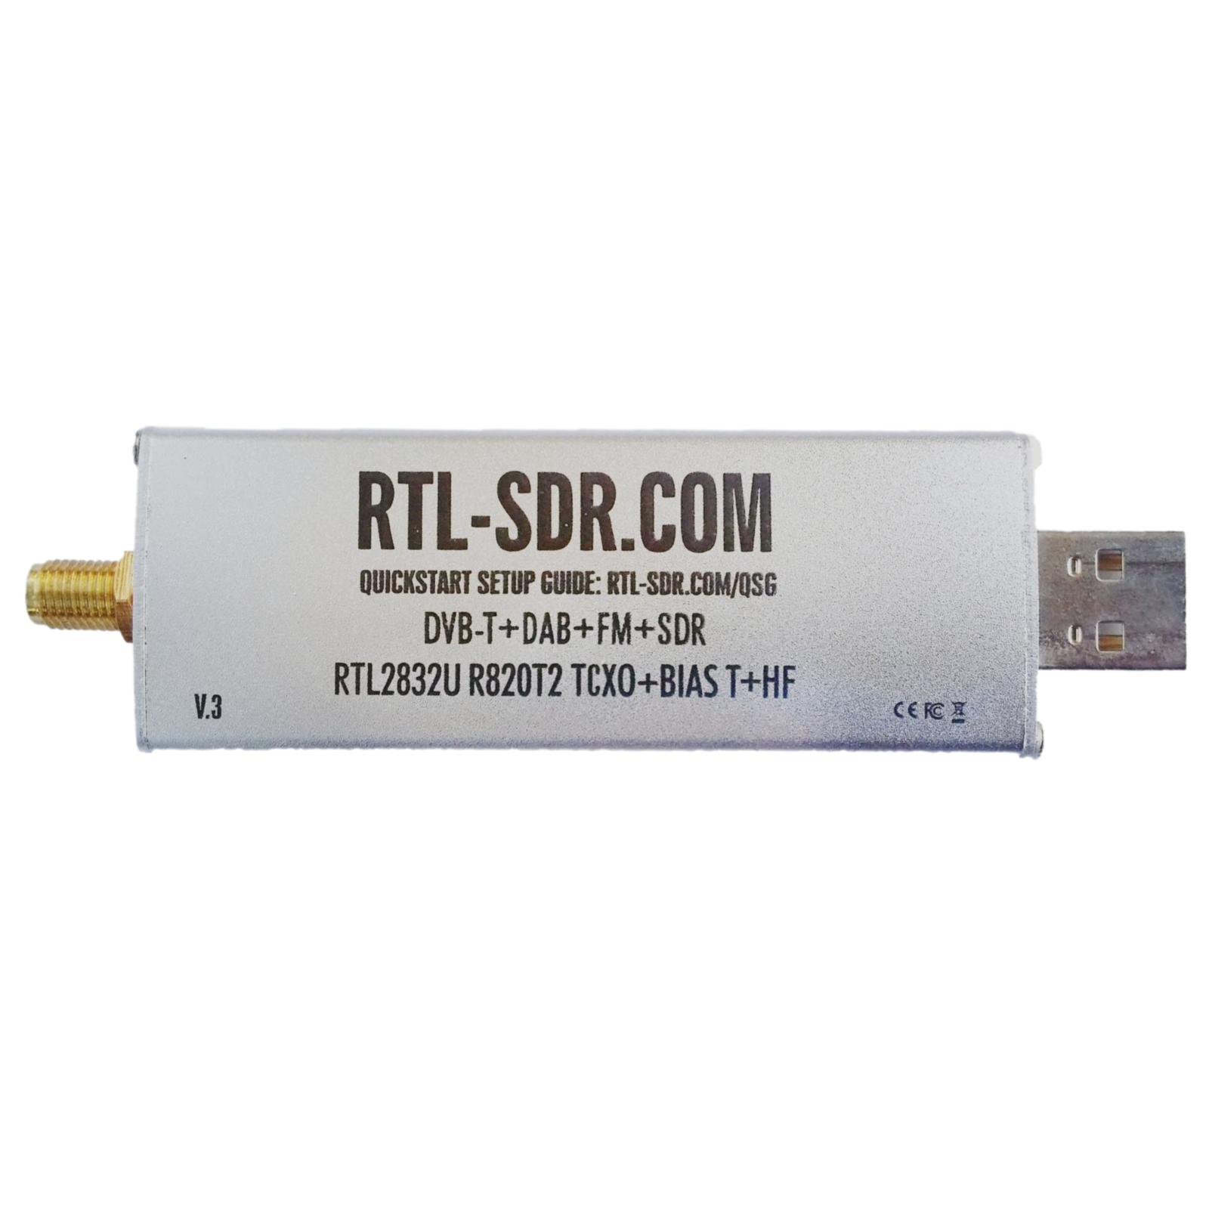
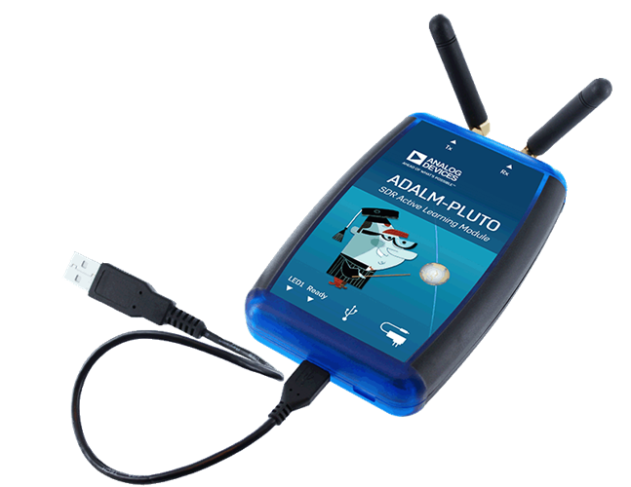

Slide 4

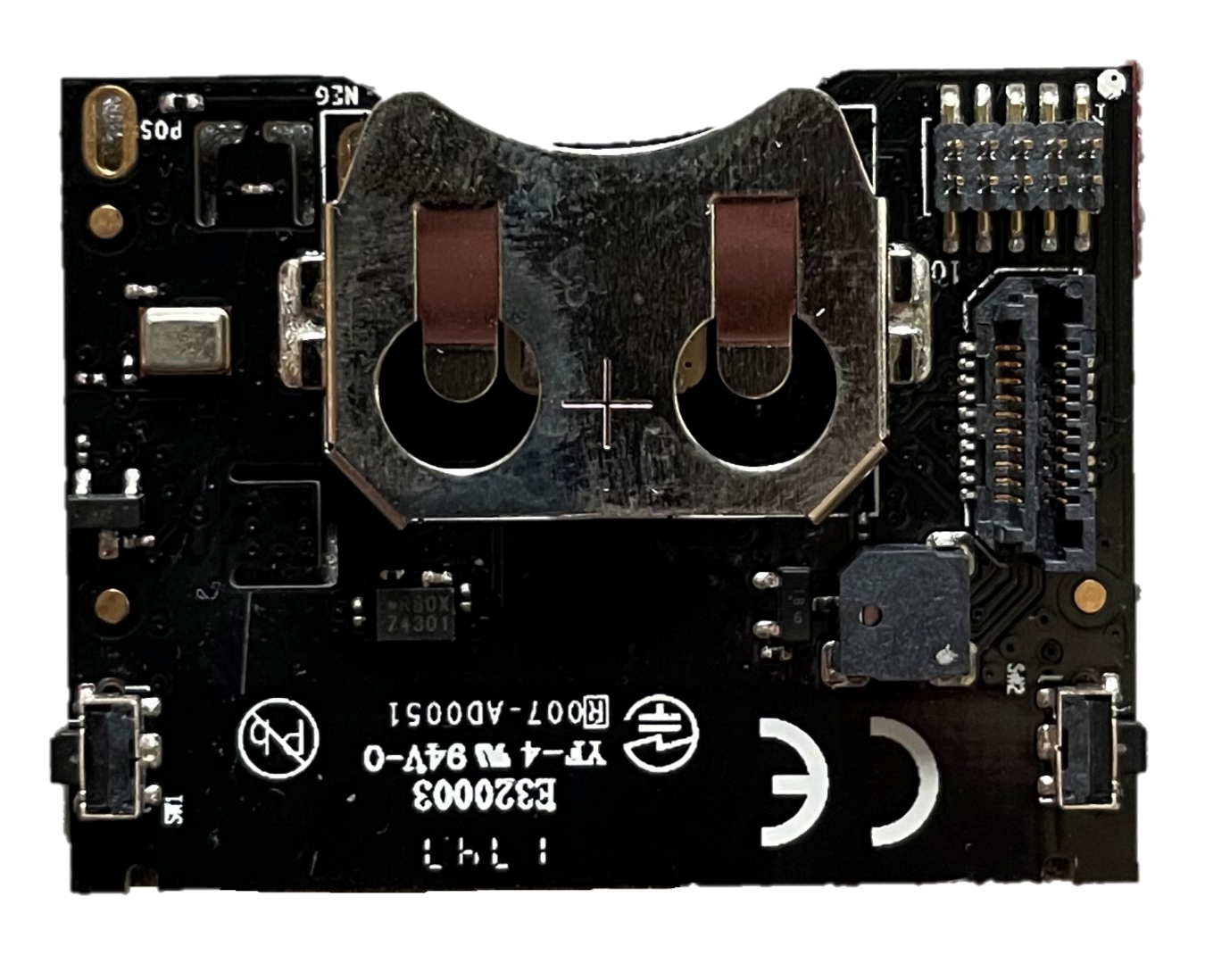

SensorTag CC2650
Laptop Gateway
Results displayed on laptop application
MQTT
Bluetooth

