Slide 1
DeadlineBook
Notes:
Good afternoon, fellow NUS students. Welcome to DeadlineBook. DeadlineBook is a cross-platform application that makes it quick and easy to manage your deadlines.
As an NUS student, you have at least 5 modules in every semester of your study. In each module, there are many deadlines.

Slide 2
≥5 modules
Notes:
Take this module as an example. You’ve had to submit meeting minutes by this Friday. Today, you need to present a project proposal pitch. In the next two weeks, you’ll have to prepare a group project presentation, but not only that – you’ll also need to remember when you’ll need to review another team, and when you’ll need to be part of the audience. I bet some of you have already forgotten some of these things.
In three weeks, I’ve already listed four deadlines – and that makes about 16 deadlines for this module over the course of the semester. So I’m sure you’ll agree that 10 deadlines per module is a rather conservative estimate.

Slide 3
≥10 deadlines per module
Notes:
That makes at least 50 deadlines for you to keep track of over the semester.

Slide 4
≥50 deadlines to keep track of
Notes:
Does that seem overwhelming? Fret no more, DeadlineBook will keep track of all your deadlines, and very much more.
DeadlineBook has all the usual features of a reminder app – you can add deadlines, it will notify you of approaching deadlines, and once you have completed them they will be removed from the app.
But DeadlineBook is so much more.

Slide 5

Notes:
You can group deadlines and share deadline groups with your classmates via a single tap of your phones or via any messaging application.

Slide 6
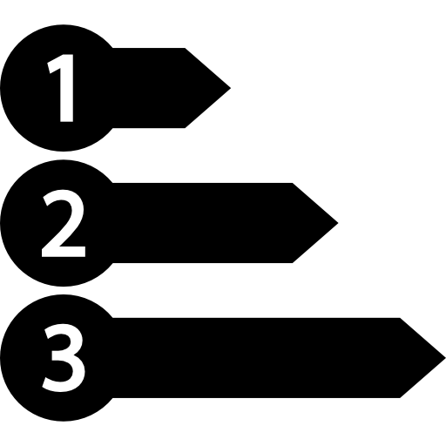
Notes:
You can prioritize any deadline, so that it appears above other deadlines and you get more reminder notifications for it.

Slide 7


Notes:
Lastly, all your deadlines are automatically saved into the cloud. You can access all your deadlines whether you’re using your phone, laptop, or tablet.
So vote for DeadlineBook – you’re helping yourself and all your friends to never miss a deadline again.

