Slide 1
Ceph RGW-Prefetching
Ali R., Amin M., Bissenbay D.

Slide 2
Ceph
A distributed storage systems
Open source
Provides interfaces for object, block and file level storage
Scalable to the exabyte level
Replicates data and makes it fault-tolerant (default 3 replicas)

Slide 3
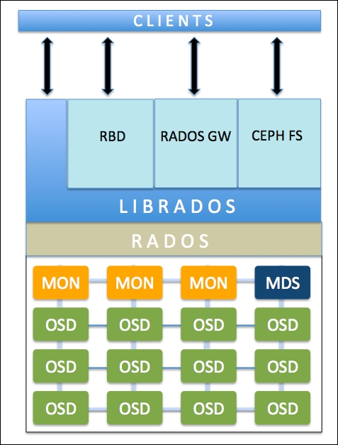
Ceph Architecture

Slide 4
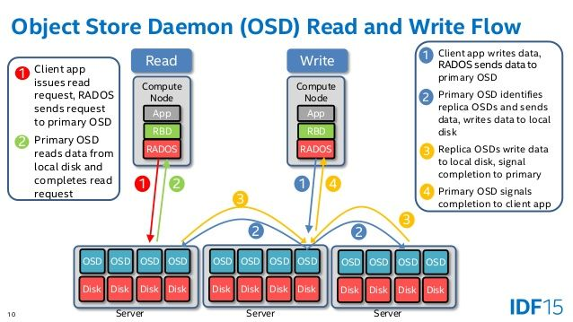
Ceph Flow

Slide 5
What is our project?
Develop a prefetching mechanism and add it to the existing caching layer
Implementing another API functions to expose the prefetching mechanism to the users
Developing evaluating mechanism for the system (testing)
Cache

Slide 6
What we are going to implement?
Prefetching mechanism:
Intercepting Ceph user requests to decide which file is requested and which blocks should be prefetched
Using Ceph functions to read files (data blocks) from OSDs to the cache
New Ceph API functions:
Users should be able to prefetch data manually
Users should be able to check the cache content
Evaluation
We need to make sure that prefetching is working correctly
Devise a method to check the performance of cache and prefetching system

Slide 7
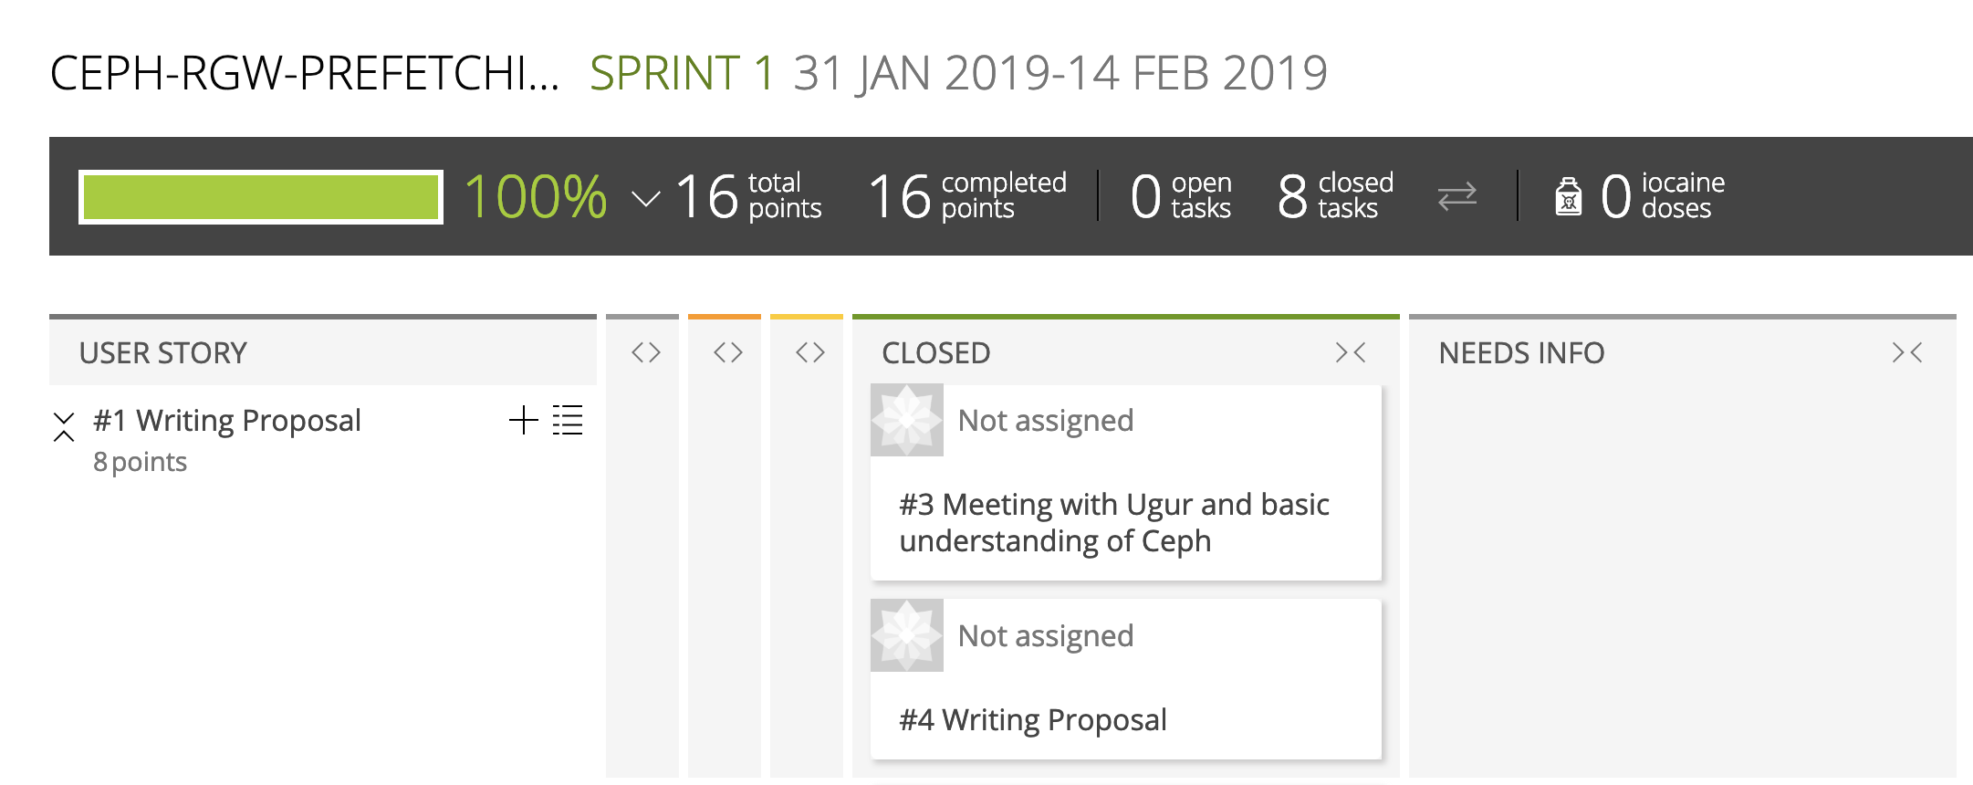
Sprint 1

Slide 8
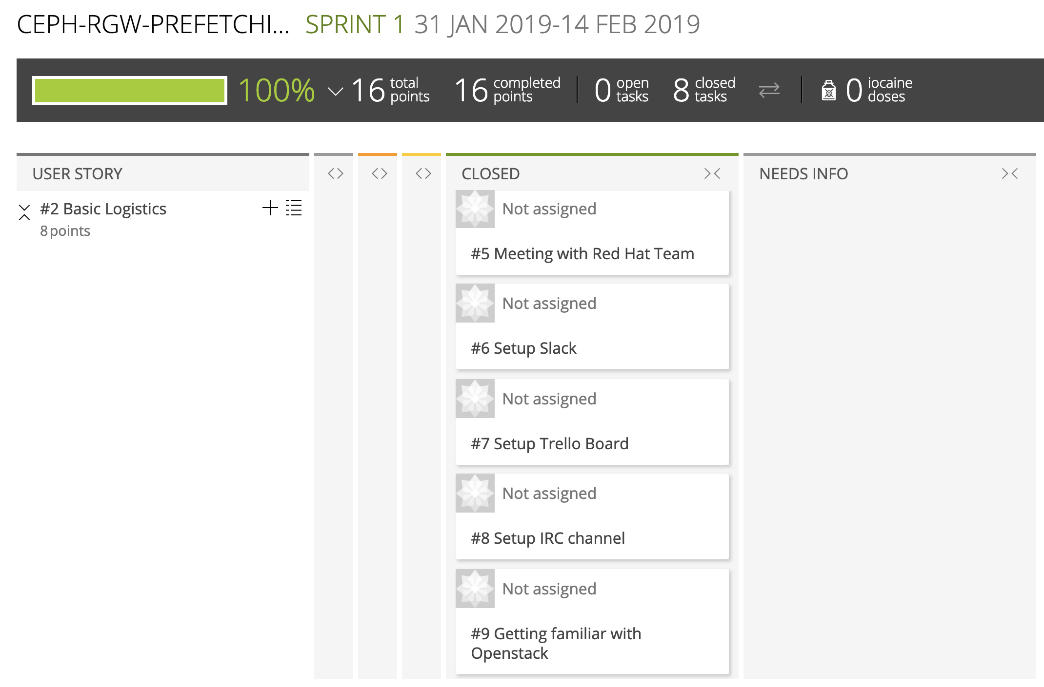
Sprint 1

Slide 9
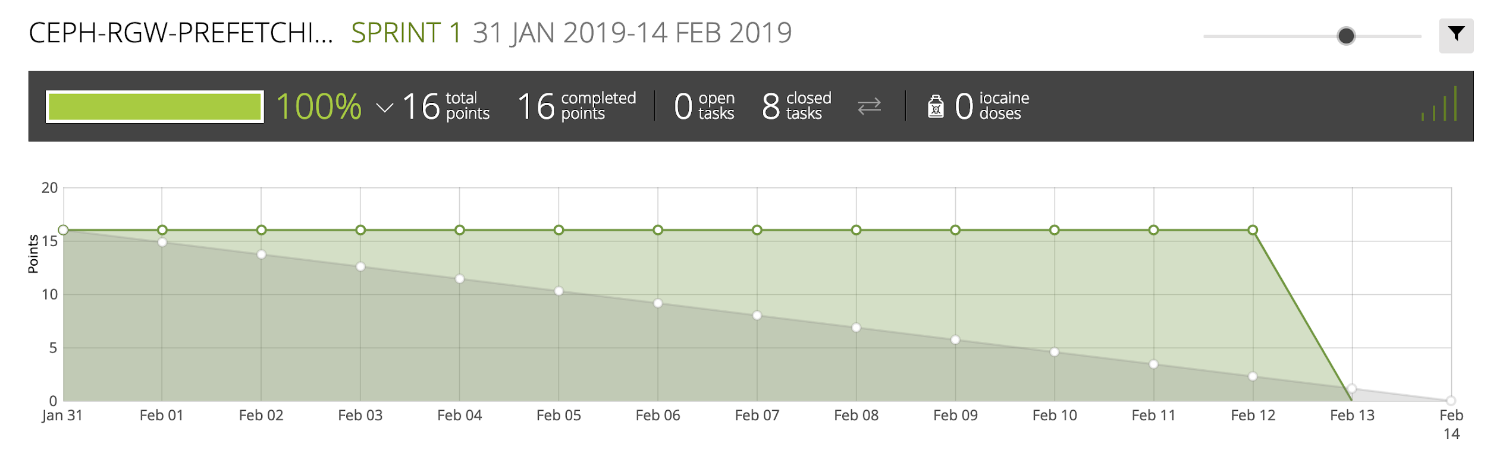
Burn down chart for Sprint 1

Slide 10
Progress so far ...
VMs set up on OpenStack
Three VM machines
Centos 7
Infrastructure is ready
Ceph is built
Next step:
Adding cache system to the existing Ceph
Understanding Ceph code
Implementing first API functions

