Slide 1
Ceph RGW-Prefetching
Ali R., Amin M., Bissenbay D.
Sprint 2 (Feb 14 - Feb 28)

Slide 2
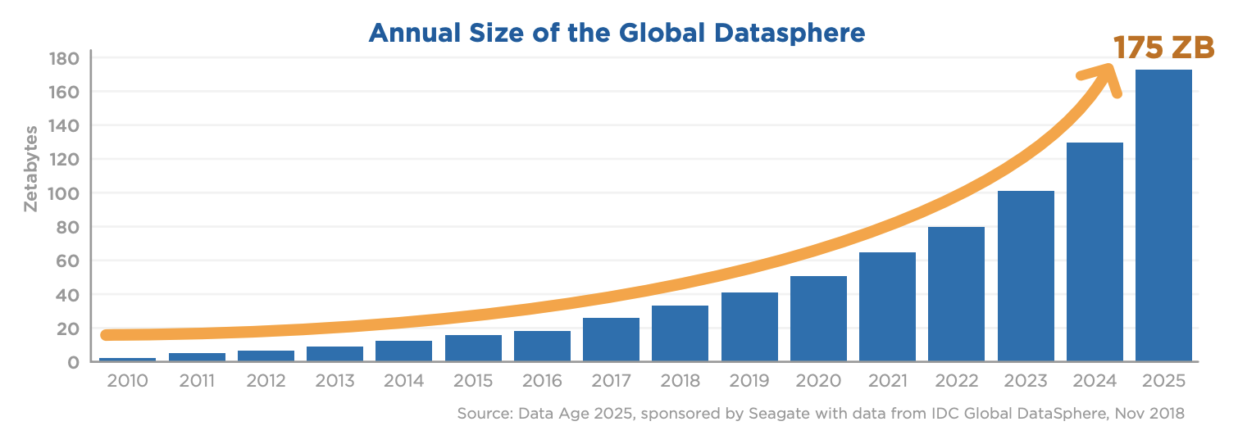

Slide 3
Ceph
A distributed storage systems
Open source
Provides interfaces for object, block and file level storage
Scalable to the exabyte level
Fault-tolerant, Self-healing

Slide 4
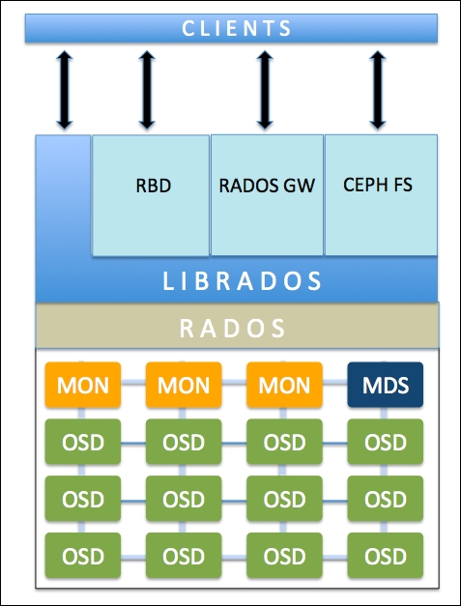
Ceph Architecture
RADOS
OSD
RADOS Gateway
CRUSH

Slide 5
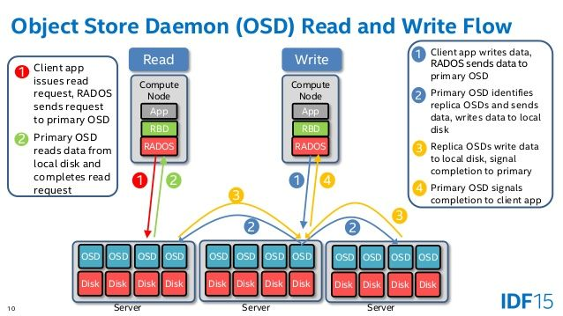
Ceph Flow

Slide 6
Challenges
Best place to implement prefetching (lower level vs higher level)
Being explicit or implicit (Using API)
Designing prefetching algorithm
Extracting the required object information
Ceph “limits” the client perceived bandwidth
We need to be careful about hurting the performance
Use of debugging tool i.e. gdb
Asynchronous functions
Code is not “well documented”

Slide 7
Implementation Plan
Previous implementation of cache in Ceph is helpful
Low Level Implementation
“ceph/src/rgw/rgw_rados.cc”
High Level Implementation
“ceph/src/rgw/rgw_op.cc”
Modify the request data structure being passed to lower level
Introduce a flag that indicates the “prefetching request”
Check the flag before replying to client and drop if the request was “prefetching request”
Evaluation: COSBench - Cloud Object Storage Benchmark

Slide 8
Sprint 2 - update
Code walk with caching team
Code walk with mentors
Deploy ceph with cache
Store and retrieve data

Slide 9
Taiga Updates
Installing Ceph. Storing & retrieving data | Code Walk | Brainstorming design and implementation of prefetching
Installing Standard Ceph | Code walks with RedHat Team | Team Meetings
Integrating Ceph with Cache code
Storing & retrieving data using S3 API (BOTO SDK)
Notes:
This Sprint, we have all successfully finished installing Ceph. We met with Ugur and Ali where we were looking at the parts of code which they have written for caching functionality. We could see where the major changes are happening in the code and it this code walk gave us this understanding where we can make the changes to prefetch. After, we us a team starting thinking about the right place to make prefetching, then we came with the idea to make it on the lower level. However, after talking to Red Hat team again, specifically Matt, we are convinced that making changes on the high level would be more useful. This week, we are currently trying to store and load data to ceph itself using BOTO S3 API.

Slide 10
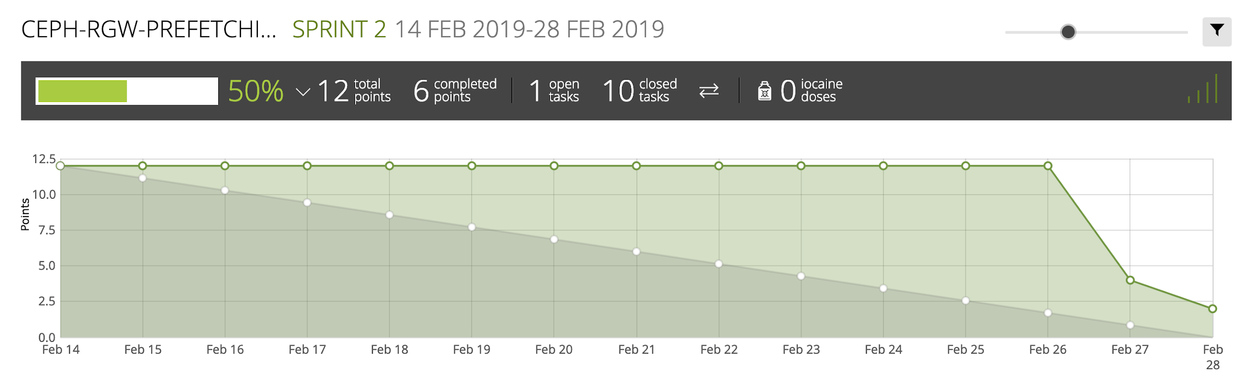
Burndown chart in Taiga (cont.)

