Slide 1
Exploring AWS Spot Instances within Kubernetes clusters Sprint 2
Under the guidance of Dan McPherson and Ravi Gudimetla
Aditya Kadam
Kevin Rodrigues
Nikhil Singh
Suryateja Gudiguntla
Notes:
Togoal
So in our previous demo, we talked about the creating clusters in aws using kops and also creating ec2 instances which was simulate the creation of spot instances.
Goal of the project is to provide a cost effective way of running an application on kubernetes cluster using spot instances which are more economical than on demand instances.

Slide 2
Defining SLA

Slide 3
SLA (Service Level Agreement)
A service-level agreement (SLA) is a commitment between a service provider and a client
For our controller:
SLA is defined for each application
SLA is defined in the config file
In our project, SLA is the availability expressed as a percentage of uptime, performance, reliability and other parameters
Notes:
SLA will typically have a technical definition in mean time between failures (MTBF), mean time to repair or mean time to recovery (MTTR); identifying which party is responsible for reporting faults or paying fees.

Slide 4

Spot Termination Notice Handler
It polls the EC2 Spot Instance Termination Notices.
So, it drains the node in advance before AWS takes it away.
Hence, you can be sure that your applications are gracefully re-scheduled to the other nodes in the cluster.
Notes:
When a node termination takes place, then the controller looks for a new spot instance or on-demand by maintaining the the SLA and also considering cost of spinning a instance

Slide 5
Mock AWS SDK Client in Go and Pricing API
Notes:
For sprint 1, i used a python library for mocking aws services. But as our controller in going to be written in go, it makes more sense to mock these services in Go lang.
For mocking in Go, i first created functions, with same type of inputs and outputs as the actual Aws sdk. SO the output of these mock functions is just the output I expect to get from my actual functions.
Now the controller is where we input the SLA. for now it can be uptime performance, number of ec2 instances to be used as spot
A controller is basically a infinite while loop which constantly looks for a better state. It will always look to spin up spot instances while maintaining SLS..
Now when i just put actual client instead of mock, this controller can be used for actual purposes

Slide 6
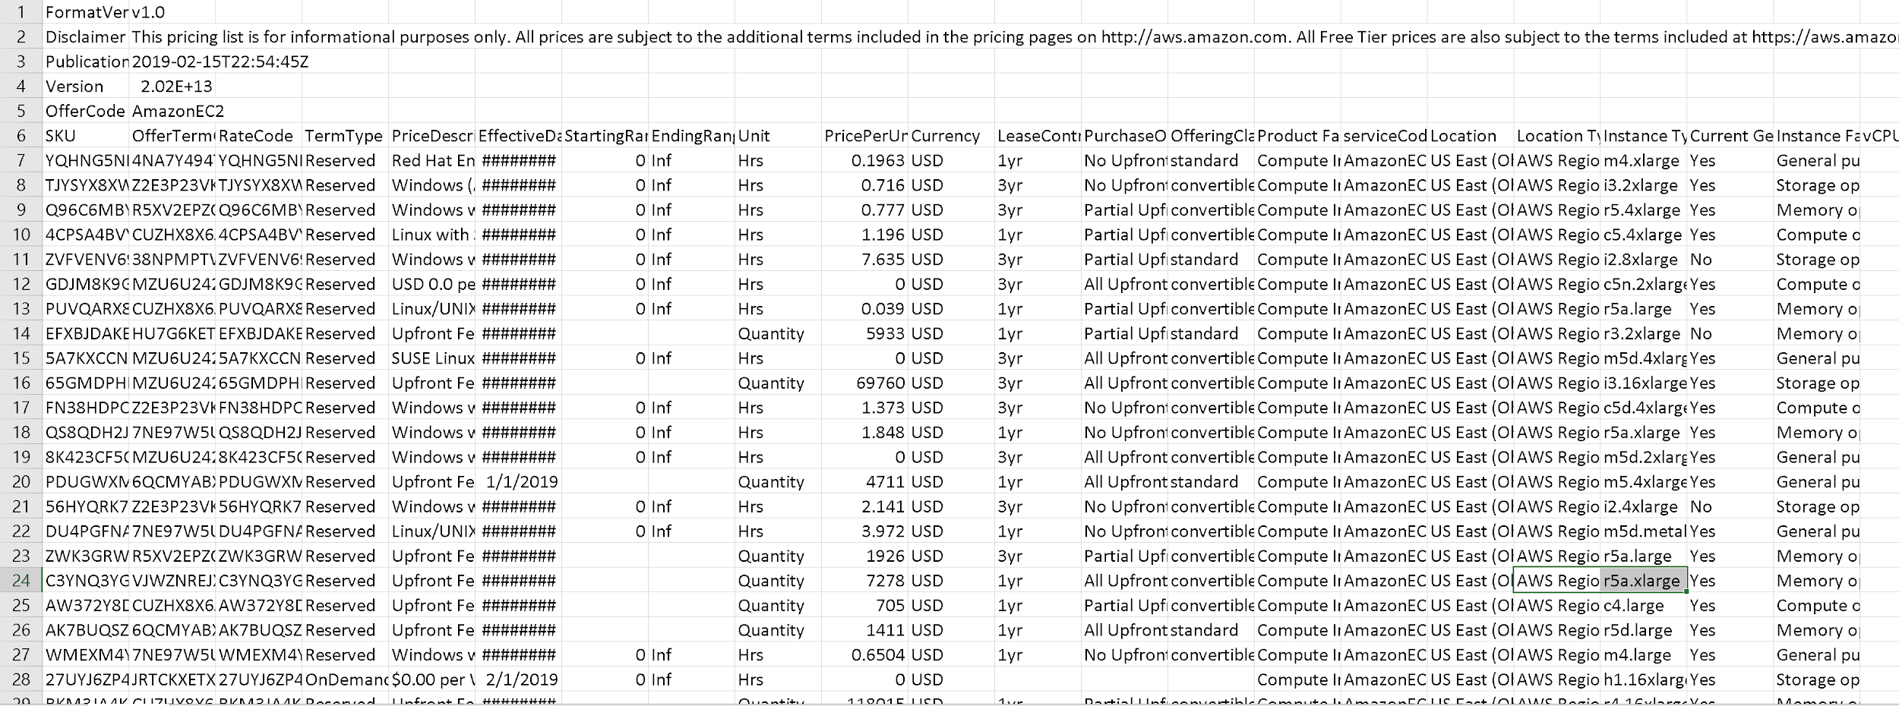
CSV file downloaded from AWS for US-EAST-2 region using Amazon’s Pricing API.
Notes:
Our project calculates the cost we save when running EC2 spot instances in kubernetes cluster. For that we have to get the prices for different instances using the pricing API provided by the AWS. As this file is very large, what I have done is, I created a mock pricing csv file , and I wrote some of the important attributes for 4-5 different types of instances.

Slide 7
Deploying demo App

Slide 8
Multiple deployments tested
Python application on Openshift
Python application on Google Cloud Platform
Created JBoss application’s Docker image and deployed to both Openshift and GCP
Stateless php application to Minikube

Slide 9
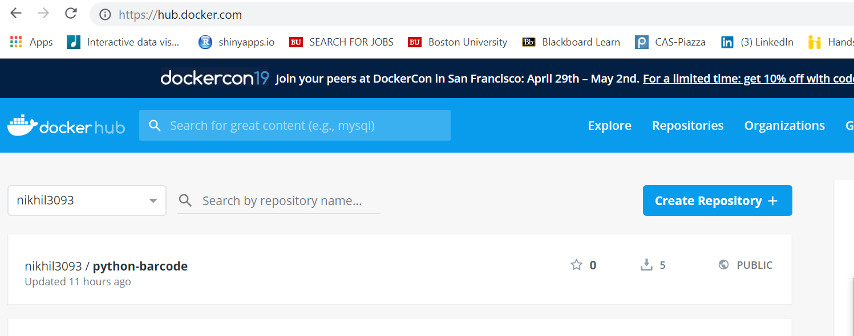
Dockerizing an Application
For this sprint we have already dockerized an application and pushed it to Docker Hub.

Slide 10
Minikube

Slide 11
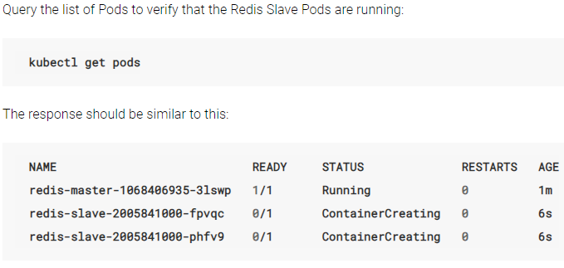
Redis Master and Slave nodes

Slide 12
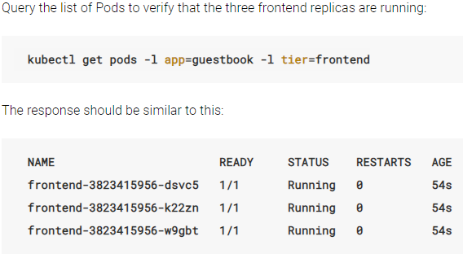
Frontend nodes

Slide 13
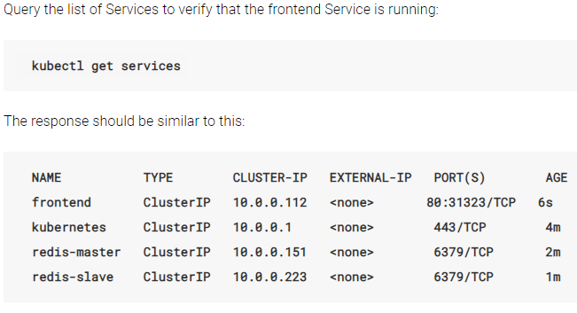
Verifying services running

Slide 14
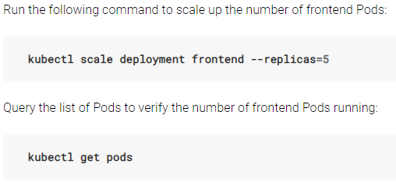
Scaling the application to multiple nodes

Slide 15
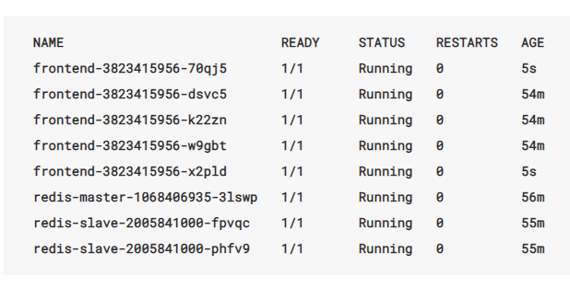
Verifying the replicas

Slide 16
Interfacing Go with kops to create a cluster
Creation through terminal
Creating the cluster through a go program (Project Block)
Notes:
Terminal
C4 large instance as master
T2 small as slave

Slide 17
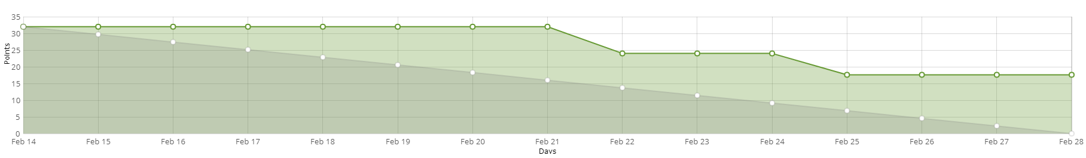
Burndown Chart

Slide 18
Sprint 3 tasks
Continue the task of interfacing Go and KOPs
Perform JMeter or AB Load testing on the applications deployed
Mocking out the spot instance fleet function of AWS SDK
Using the pricing API to get the price of spot instance and set pricing strategies for the controller to spin up new spot instances when an instance is terminated
Reduce the cost of master node of default Kubernetes cluster by using cheaper EC2 Instance
Notes:
We want to use pricing api to get prices of spot instances which is updated every 5 mins. Next we have to set up strategies for our controller. These strategies include the spot instance that is to be spined up is of lower price than the max bid price .

