Slide 1
Exploring AWS Spot Instances within Kubernetes clusters
Under the guidance of Dan McPherson and Ravi Gudimetla
Aditya Kadam
Kevin Rodrigues
Nikhil Singh
Suryateja Gudiguntla

Slide 2
Background

Slide 3
Amazon EC2 Spot Instances
Kubernetes
Amazon EC2 Spot Instances offer spare compute capacity available in the AWS cloud at steep discounts compared to On-Demand instances
Spot Instances enable you to optimize your costs on the AWS cloud and scale your application's throughput up to 10X for the same budget
The spot price is determined by temporary trends in supply and demand and the amount of On-Demand capacity on a particular instance size, family, Availability Zone, and AWS Region
Kubernetes is a portable, extensible open-source platform for managing containerized workloads and services, that facilitates both declarative configuration and automation
It has a large, rapidly growing ecosystem. Kubernetes services, support, and tools are widely available

Slide 4
Goal of the project

Slide 5
Goal/Vision
To provide a cost-effective way of running a Kubernetes cluster using spot instances which are more economical than the default On-Demand instances in AWS clusters
To reduce the cost in such a way that the Service Level Agreement (SLA) is maintained
To maximize the percentage of total Kubernetes clusters to be used as spot instances to reduce the overall cost
To recommend the client with an optimal number of Spot instances to be used in the Kubernetes cluster to maximise the savings

Slide 6
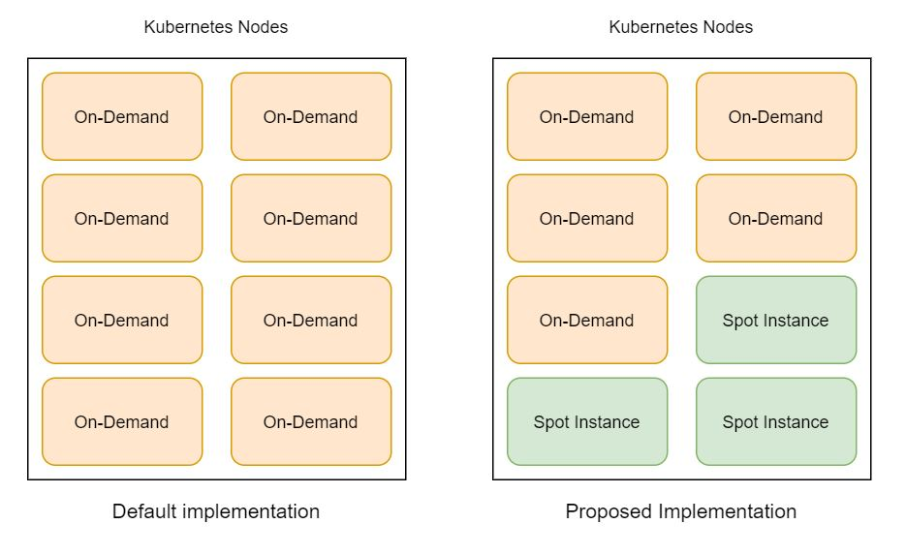
Proposed System

Slide 7
Features

Slide 8
Features and Scope
Reduce the cost of running any application by utilizing Spot Instances in place of On-Demand nodes
Dynamically scale the use of spot instances
Capable of handling various applications with sporadic or distributed workloads
Can recover from node termination gracefully while maintaining the SLA for all applications

Slide 9
Solution

Slide 10
Solution
The user defined config file provides the combination of On-Demand and Spot Instance nodes for the workload that the cluster is handling
The solution is a controller program that looks for a better state than it currently is in
Looks for available spot instances which are cheaper
Recovery from termination of a node
Looks from signals from nodes to decide when to transfer a load
The program will calculate the costs saved by using spot instances
The program can suggest an optimum percentage of workload to be run on Spot Instances

Slide 11
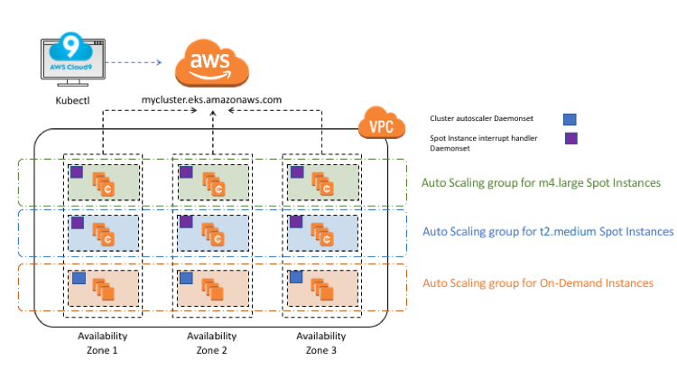
Kops
Detailed system concept

Slide 12
Sprint 1

Slide 13
EC2 Instances
Mock EC2 Instances
Kubernetes clusters
Used GoLang and Web Interface to create AWS Instances
Obtained status of the EC2 Instances using the GoLang
Created mock EC2 Instances using Moto library in Python
Checked the status of these instances
Simulated termination of a spot instance and created a new one to replace the existing one.
Set up Kops on a virtual machine with Ubuntu
Deployed 1 master node and 2 slave node on the Kubernetes cluster

Slide 14
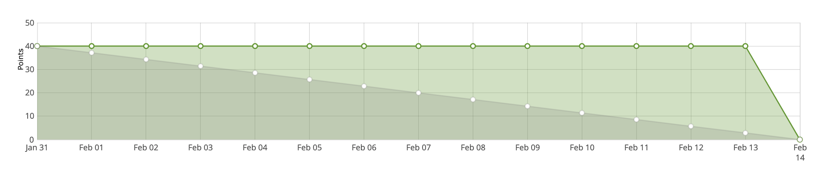
Burndown Chart

Slide 15
Sprint 2

Slide 16
Integrate AWS SDK and created K8s Cluster with EC2 instance nodes
Deploy test application on alternative Kubernetes implementation
Test instance functions on mock AWS SDK with GoLang
Interface AWS SDK with Kubernetes cluster using Go
Perform same instance functions on Kubernetes cluster
Use an online cluster environment to deploy a basic web application
Perform A-B load testing on the application

