Slide 1
Exploring AWS Spot Instances within Kubernetes clusters
Under the guidance of Dan McPherson and Ravi Gudimetla
Aditya Kadam
Kevin Rodrigues
Nikhil Singh
Suryateja Gudiguntla
Notes:
Togoal
So in our previous demo, we talked about the creating clusters in aws using kops and also creating mock ec2 instances which was simulate the creation of spot instances.
Goal of the project is to provide a cost effective way of running an application on kubernetes cluster using spot instances which are more economical than on demand instances.

Slide 2
Testing deployment on MiniKube using Jmeter

Slide 3
Deployed an application on Minikube
Created a Jmeter script for load testing
Scaled the deployed application and observed its impact on Response Times and Error Rates

Slide 4
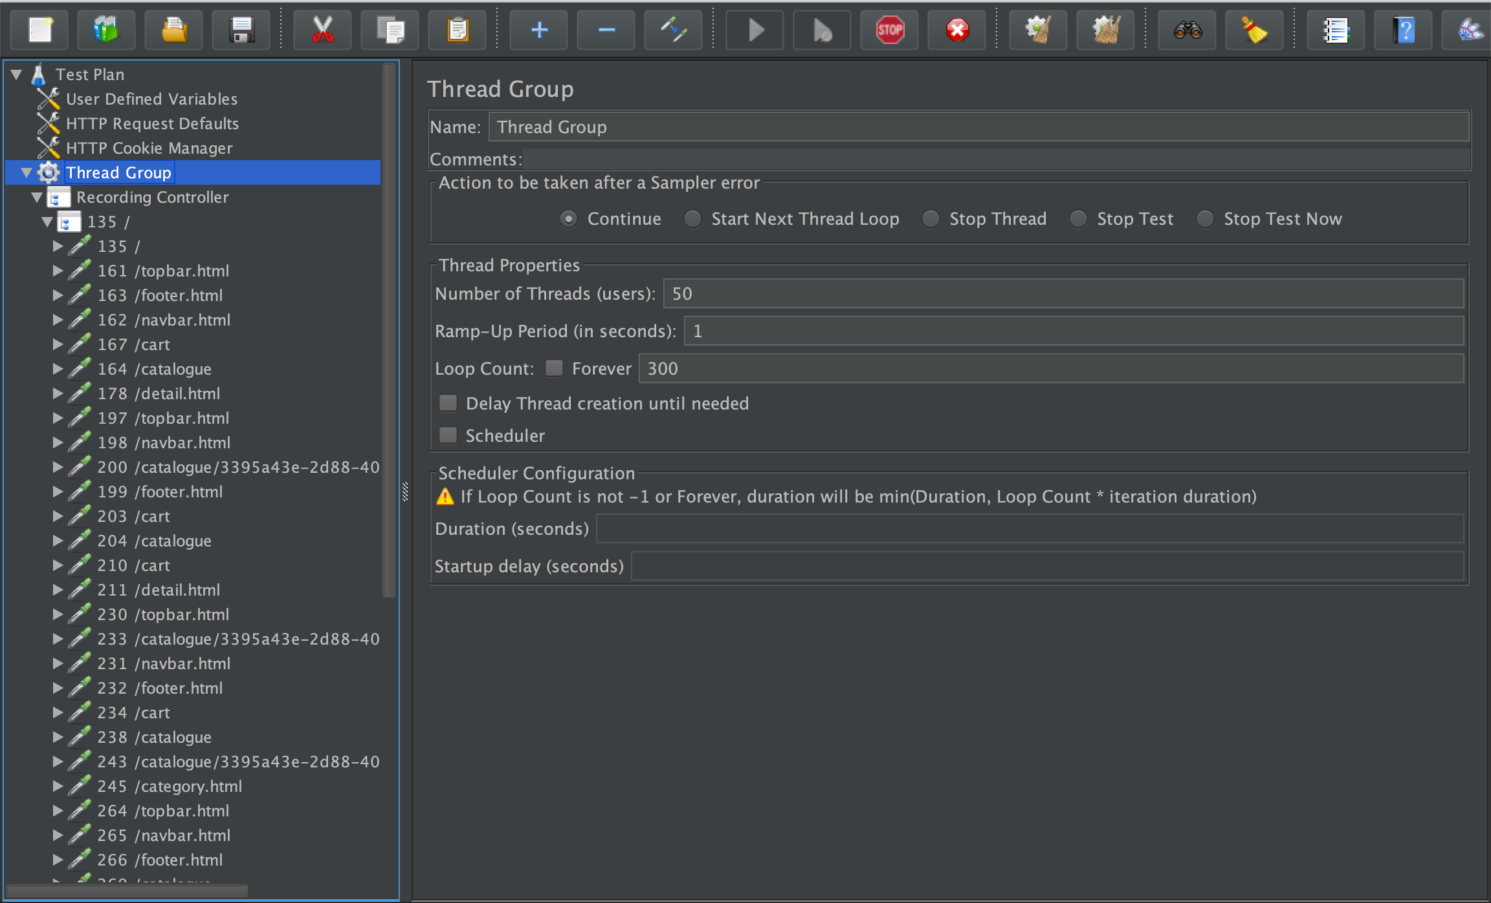
JMeter script to drive the load

Slide 5
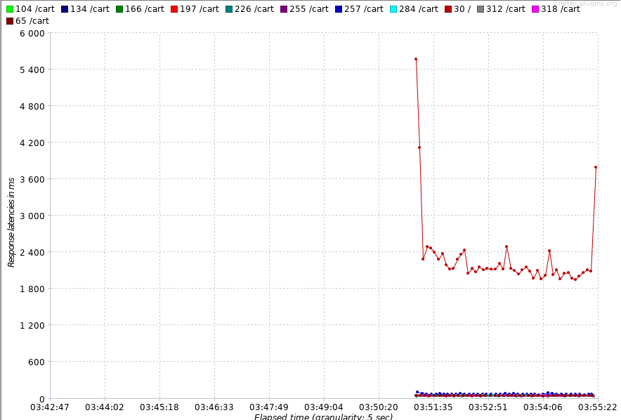
Errors plotted when scaling up the number of pods (Response time latencies)

Slide 6
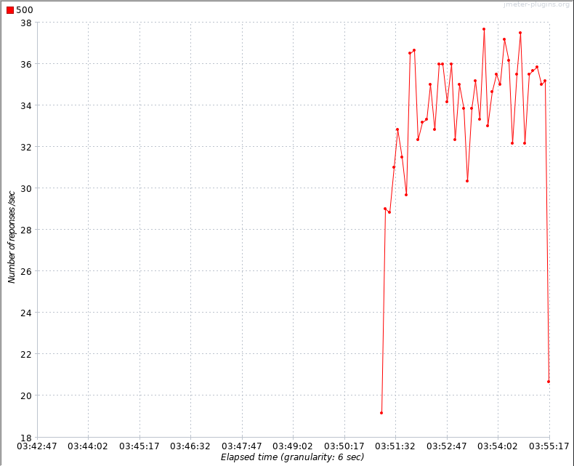
Errors plotted when scaling up the number of pods (Number of responses/sec)

Slide 7
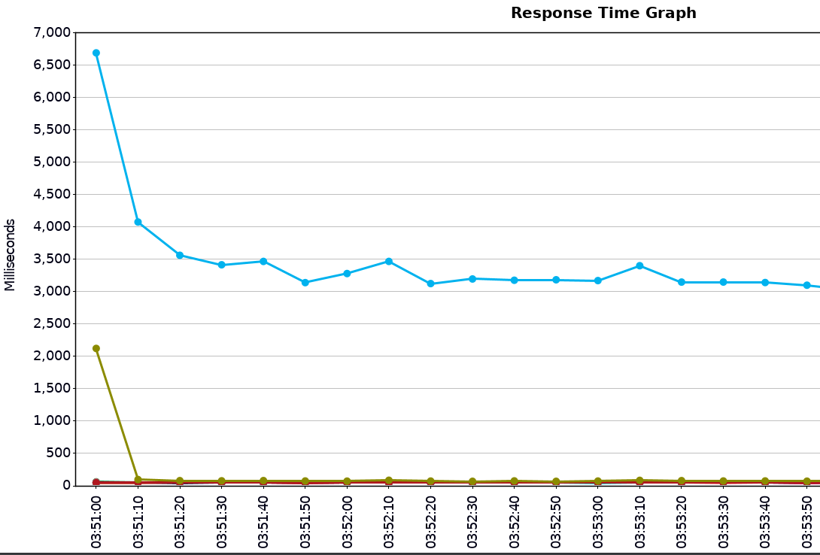
Response Time Graph showing spike in response times on scaling

Slide 8
Controller in GoLang to monitor Kubernetes cluster

Slide 9
Used Client-Go API to create a controller to monitor the cluster.
Deployed an application on AWS Kubernetes Cluster.
Used following metrics to monitor the cluster
For nodes:
1. CPU Usage - Percentage of allocated CPU currently in use
2. Node CPU capacity - Total CPU capacity of cluster’s nodes
3. Memory usage - Percentage of total memory in use
4. Node Memory capacity - Total memory capacity of cluster’s nodes
5. Requests - Minimum amount of a given resource required for containers to run (summed over a node)
6. Limits - Maximum amount of a given resource allowed to containers (summed over a node)
For pods:
1. Health of the pods - Number of running pods, health checks etc.
Notes:
So when we actually deploy an application on the cluster , we need some way to get to know how changes in our cluster affect the SLA. Like for example, if a spot instance (a node) goes away , it might affect the response times, or if load goes up, the cpu usage might shoot up and result in bad application perfromance. Also we observed in minukube , the performance goes down. So we needed some metrics to measure, from which we get to know how the SLA gets affected. We came up with some of the metrics and discussed it with our mentors . So here are the few metrics ….explain the metrics
1 core CPU = 1000 milli cores (depends on the type of cpu)
So cpu usage is measure in number of milli cores used

Slide 10
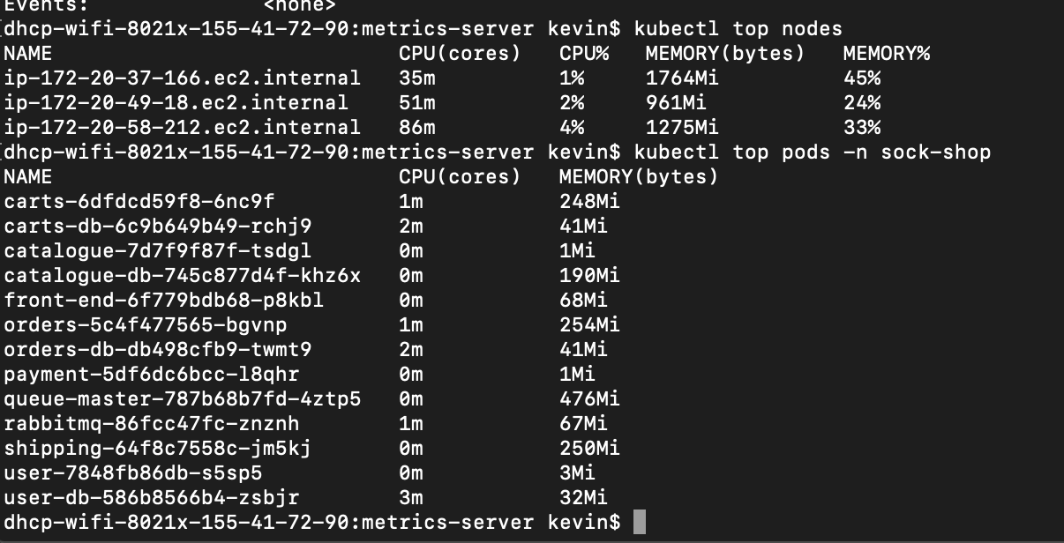
Idle Load CPU Usage
Notes:
So after deciding some of the metrics, we deployed an application on the running cluster having 2 nodes and one master.
As you can see, some of the memory being used on the nodes. And these are the deployments of our application. For the start there is no load .

Slide 11
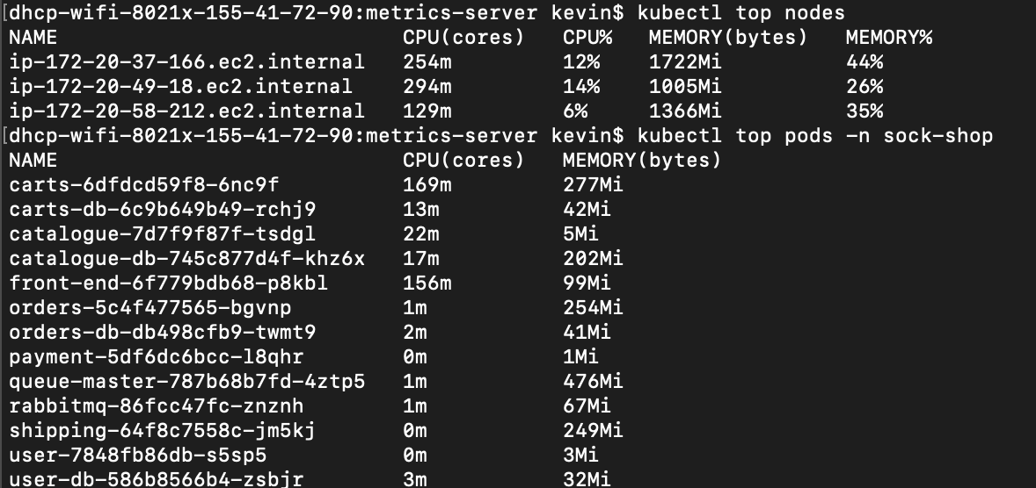
Small Load CPU Usage
Notes:
15 users in 1 second for 100 loops
Now we increase the load to a small value, and you can see the change in the cpu usage of nodes and pods as well , memory being the same.

Slide 12
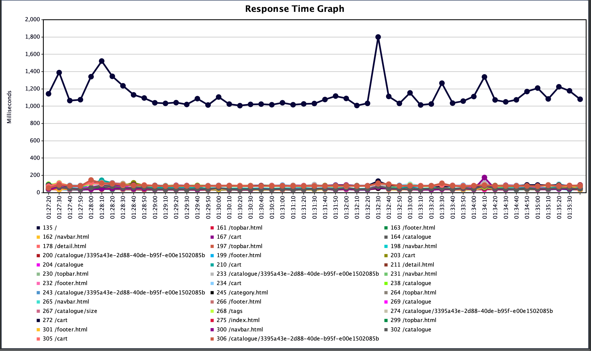
Response time graph showing spikes while scaling up pods
Notes:
Scaling up 15 users’ load to two replicas
Initially the response times are bad, and then it settles down
So now we scale up the replicas and you can see the spike in the response time graph, so this tells us that scalling up or down affects the response time. So need to keep this in mind. Cpu usage also increases for a small amount of time during the scaling

Slide 13
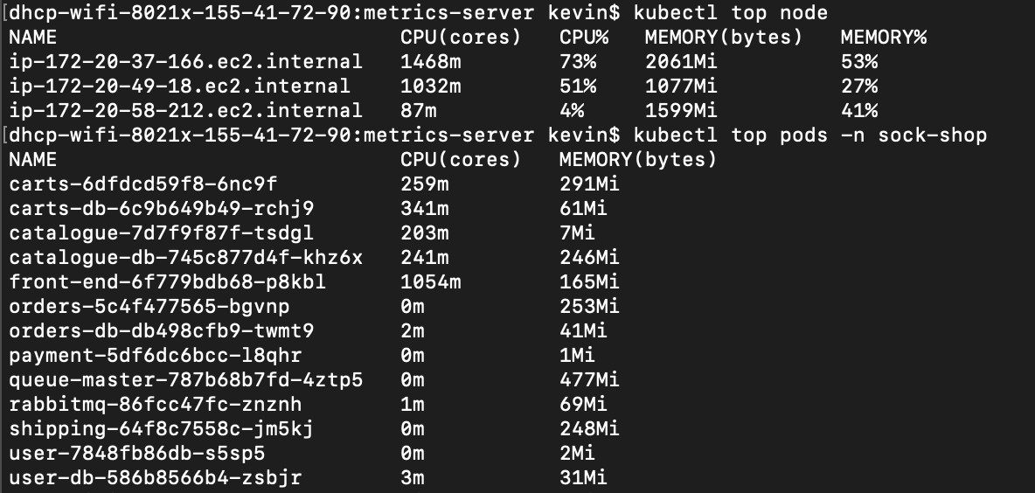
High Load CPU Usage
Notes:
230 users
Now the load is kept very high, and you can see the cpu usage shooting up. Front end pod of our web application, takes most of the load.

Slide 14
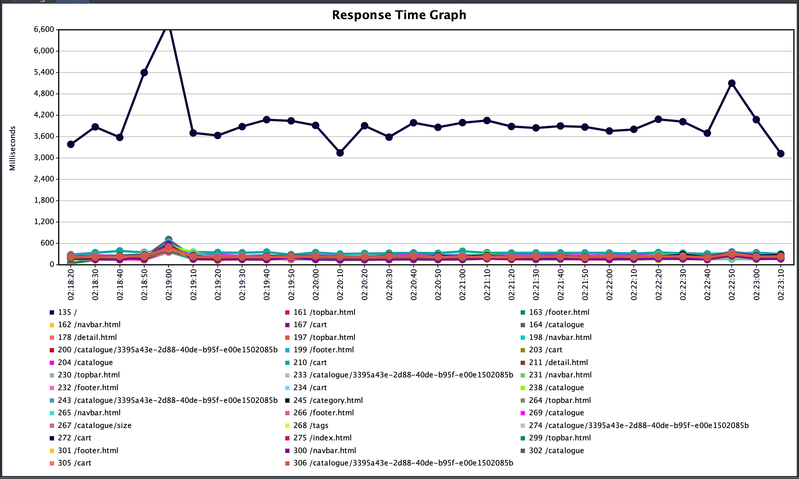
Response Time Graph with higher load shows larger response times
Notes:
Increased by 3-4 times
The initital spike is just becoz the jmeter initally creates 230 users in 1 sec so the response times are bad.
Load increased 3-4 times, you can see the response times going up .

Slide 15
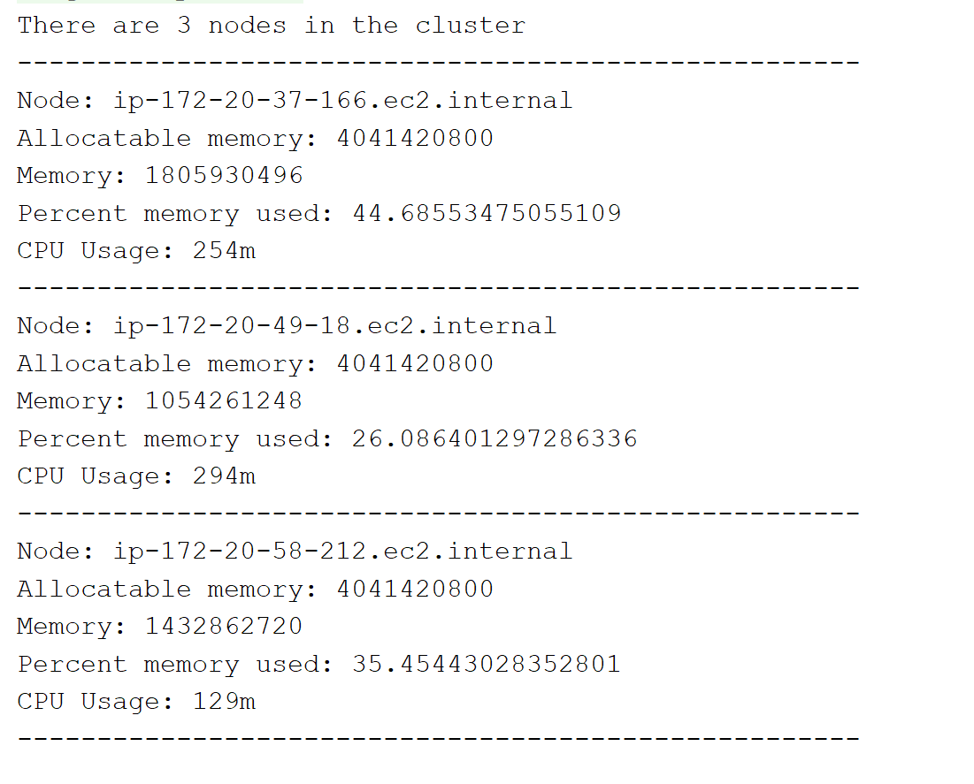
Output of Small Load from the Go program (metrics-server API)
Notes:
We need to check all the metrics mentioned from our go program controller, so that we can change the cluster .
We tried to spin up a new node to check the response times, but it turned out bad.
So basically we are doing these tests to see when our cluster can break, and what all things we can measure which affects the performance of our application

Slide 16
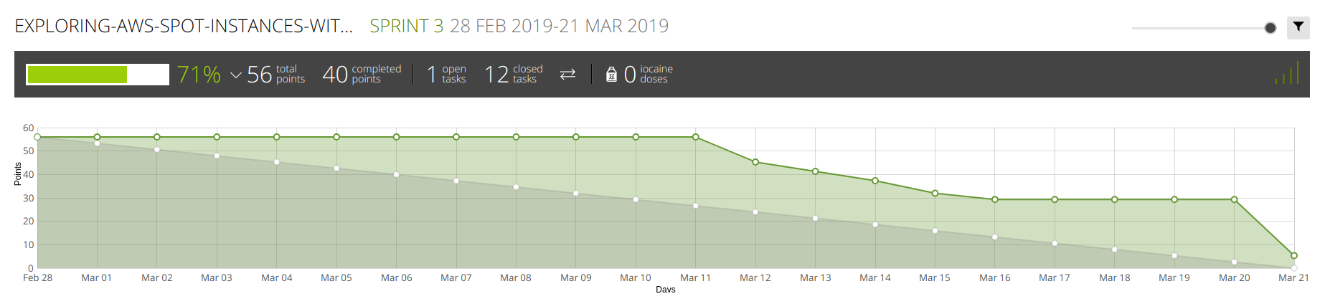
Burndown for Sprint 3

Slide 17
Sprint 4

Slide 18
To develop an algorithm to define calculate the SLA using metrics decided.
Check for different metrics which might affect the SLA
To look for a better way to spin up a new node
Scale up and down using go program
Notes:
We are using the various matrix to create an algorithm that will help us to validate the against SLA.
It can be possible that we may have missed some metrics that can affect SLA so we need to figure that out
When we tried adding a new node to the cluster, it deleted the original cluster and made up a new cluster with one extra node which took about 20 mins , so we need to figure out a new way to spin up a new node
Now scaling of applications has to be done by the controller using kops. So we have to figure that out too

