Slide 1
AMA 564 Deep Learning
2025 Spring
Tutorial 1
20 Jan 2023

Slide 2
Tensor
Tensor: the data type for deep learning

Slide 3
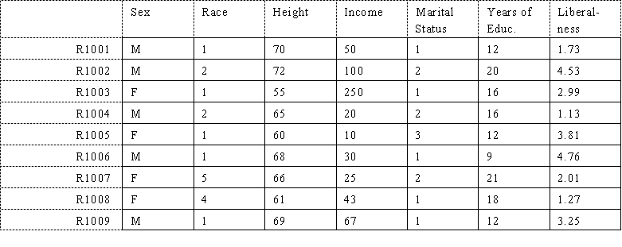
Tensor
Typical dataset: 2D matrix, 2D Array
Columns: Covariates
Row: Instances
Source: http://www.analytictech.com/networks/kindsofmatrices.htm

Slide 4
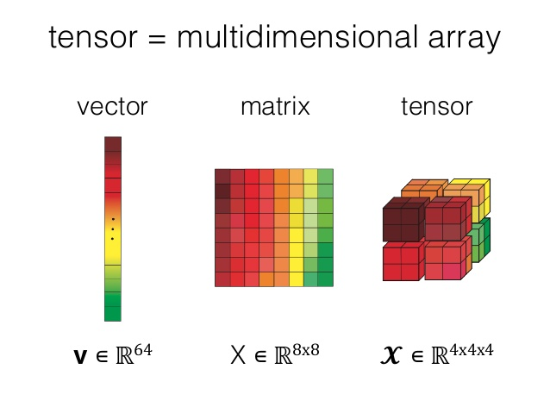
Tensor
Deep learning dataset: Tensor, Multi-dimensional Array
Source: https://www.i2tutorials.com/what-do-you-mean-by-tensor-and-explain-about-tensor-datatype-and-ranks/

Slide 5
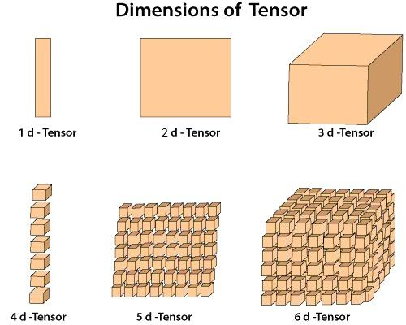
Tensor
Deep learning dataset: Tensor, Multi-dimensional Array

Slide 6
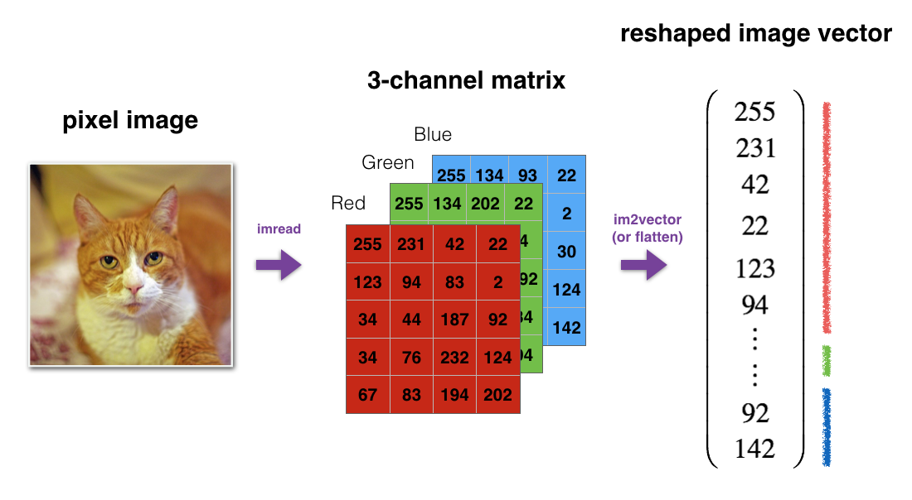
Tensor
Example: Colored Image is a 3D Tensor
Source: https://github.com/y33-j3T/Coursera-DeepLearning/tree/master/Neural%20Networks%20and%20Deep%20Learning/Week%202

Slide 7
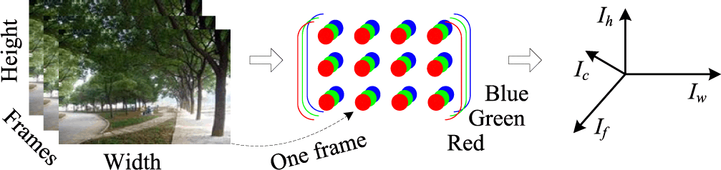
Tensor
Example: Colored Video is a 4D Tensor
Source:https://www.computer.org/csdl/journal/ec/2014/03/06832490/13rRUB7a15h

Slide 8
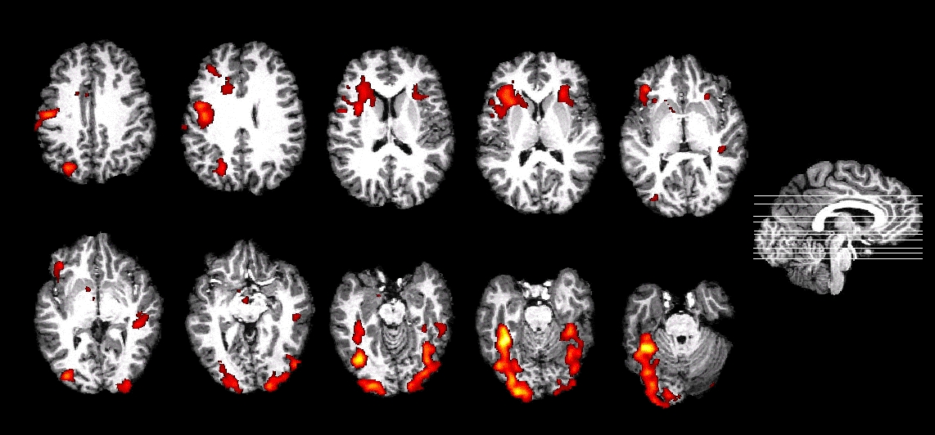
Tensor
Example: Brain fMRI data can be 4D Tensor (3D time-varying)
Source:https://med.nyu.edu/thesenlab/research-0/research-functional-magnetic-resonance-imaging-fmri/

Slide 9
Tensor
Can we reshape the tensor into a vector?
Source: https://github.com/y33-j3T/Coursera-DeepLearning/tree/master/Neural%20Networks%20and%20Deep%20Learning/Week%202

Slide 10
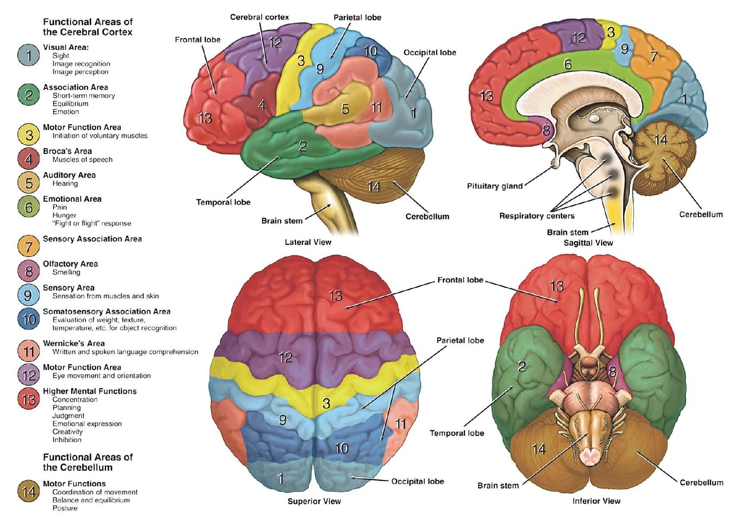
Tensor
Shall we reshape the tensor into a vector?

Slide 11
Tensor
Tensor Operations
Tensor has kinds of operations:
Addition, Entry-wise multiplication, Kronecker Product
Reshape, Squeeze, Unsqueeze, Stack
PyTorch documents: https://pytorch.org/docs/stable/tensors.html
It is important to understand the structure of Tensor
In practice, be careful when operating on Tensor.
Bug happens a lot !

