Slide 1
QA & RAG
COMP5423: Natural Language Processing
Dongding LIN
March 04, 2025

Slide 2
Outline:
Question Answering
Introduction
Knowledge Base Question Answering
Retrieval Base Question Answering
Retrieval-Augmented Generation (RAG)
Limitations of Large Language Model
RAG Components
NLP Project
Objective
NQ10K Dataset
Project Requirement
What to Hand In
Grading Scheme

Slide 3


Introduction to Question Answering (QA)
Brief overview of Question Answering in NLP
QA is a task in NLP where the goal is to automatically provide answers to questions posed in natural language.
Typically, the system processes a context or passage of text and extracts the correct answer.
Simple (Factoid) Questions vs. Complex Questions
Who is the tutor of COMP5423?
When is Easter 2025?
Where is the Hong Kong Polytechnic University?
Why do I want to take COMP5423?
What can we learn from COMP5423?
How to pass the exam without spending much time?

Slide 4
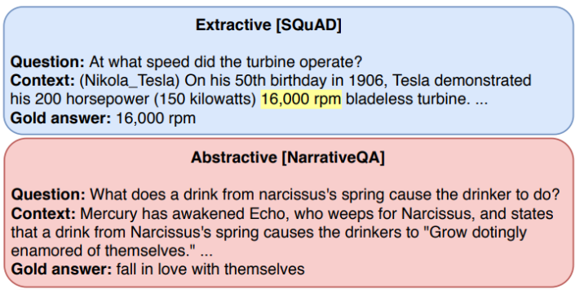
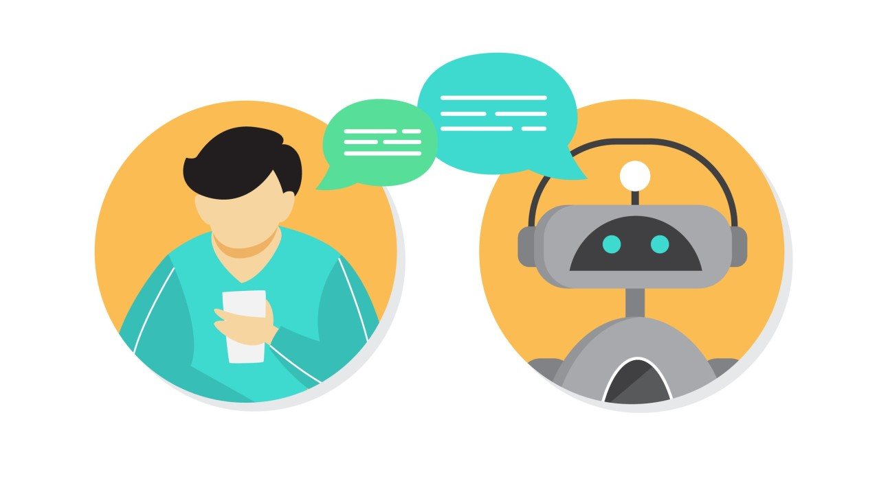
Types of Question Answering
Extractive QA: The system extracts a span of text directly from a given passage.
Abstractive QA: The system generates a new answer, potentially rephrasing or summarizing information from the passage.
Open-domain QA: Questions can come from any domain, and the system often queries external knowledge bases (e.g., Wikipedia).
Closed-domain QA: The system answers questions within a specific, predefined domain.

Slide 5
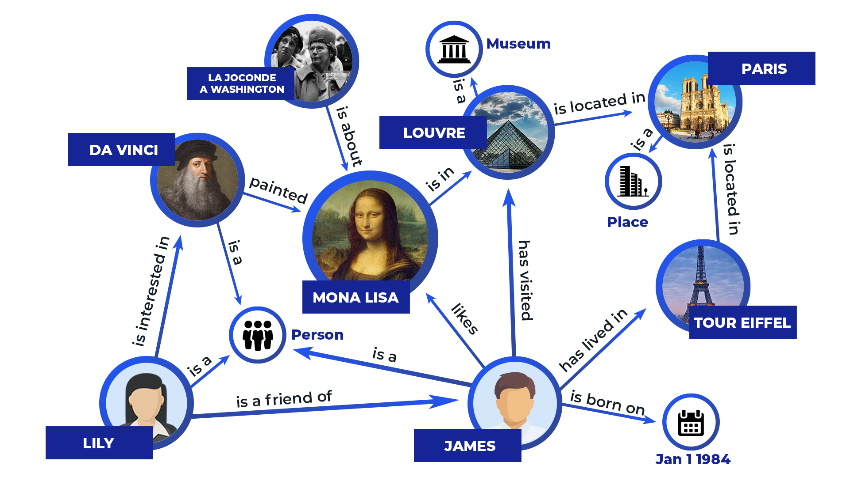
Knowledge Base Question Answering
What is Knowledge Base (KB)?
A structured collection of factual information.
Composed of entities, relations, and facts.
Commonly used for question answering tasks.

Slide 6


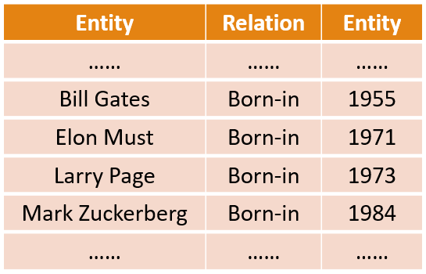
Knowledge Base Question Answering
KBQA Overview
A knowledge base QA (KBQA) system answers a natural language question by mapping it to a query over a structured knowledge base.
Knowledge Base
Question
Query Formulation
Answer Retrieval
Answer

Slide 7

Knowledge Base Question Answering
Structured Knowledge Base
Knowledge in form of fact triples
When was Bill Gates born?
Entity/Subject | Relation/ Predicate | Entity/ Object
…… | …… | ……
Bill Gates | Born-in | 1955
Elon Must | Born-in | 1971
Larry Page | Born-in | 1973
Mark Zuckerberg | Born-in | 1984
…… | …… | ……
1955

Slide 8
Knowledge Base Question Answering
Structured Knowledge Base
Entity Detection and Linking: Identify and associate an entity mention in text with the representation of some real-world entity in a knowledge base.
Question
When was Bill Gates born?
Entity Detection and Linking
Relation Detection and Linking
Mentioned Question Entity
Bill Gates
1955
Answer Entity
Born-in
Knowledge Base
Answer

Slide 9
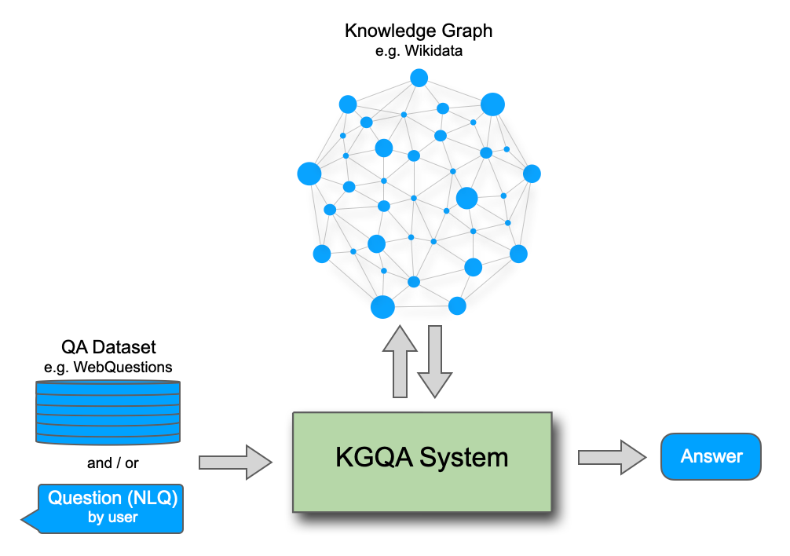
Knowledge Base Question Answering
Question Answering over Knowledge Graph
From Triples to Graph
Knowledge Graph Completion

Slide 10
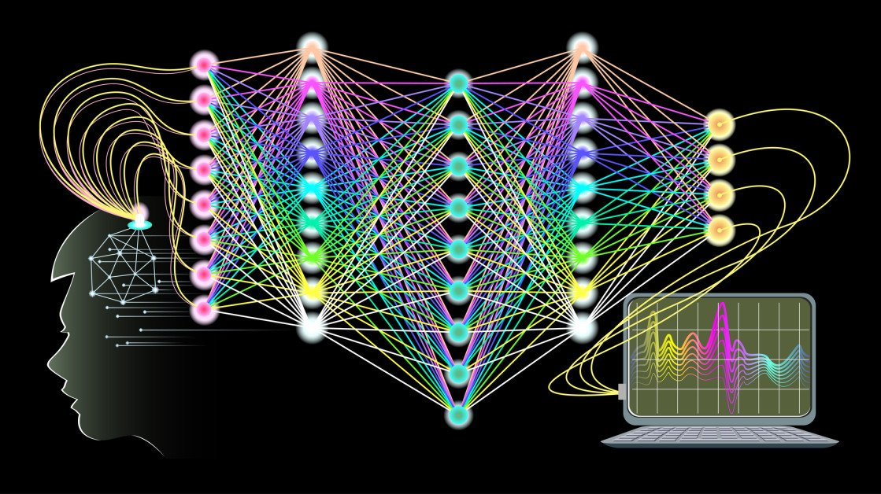
Knowledge Base Question Answering
Approaches to KBQA:
Rule-based Systems: Use predefined rules to query and extract answers.
Neural Networks: Leverage deep learning models to interpret and map questions to the knowledge base.
Hybrid Models: Combine rule-based methods and machine learning models for more effective retrieval.

Slide 11


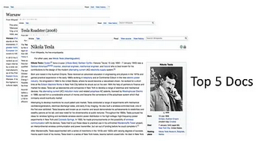
Retrieval Base Question Answering
RBQA:
IR-based QA or document based QA (DBQA) relies on the vast quantities of textual information on the Web or some other collection of documents to answer questions.
Question
Document Retrieval
Answer Extraction
Answer
Relevant Documents

Slide 12
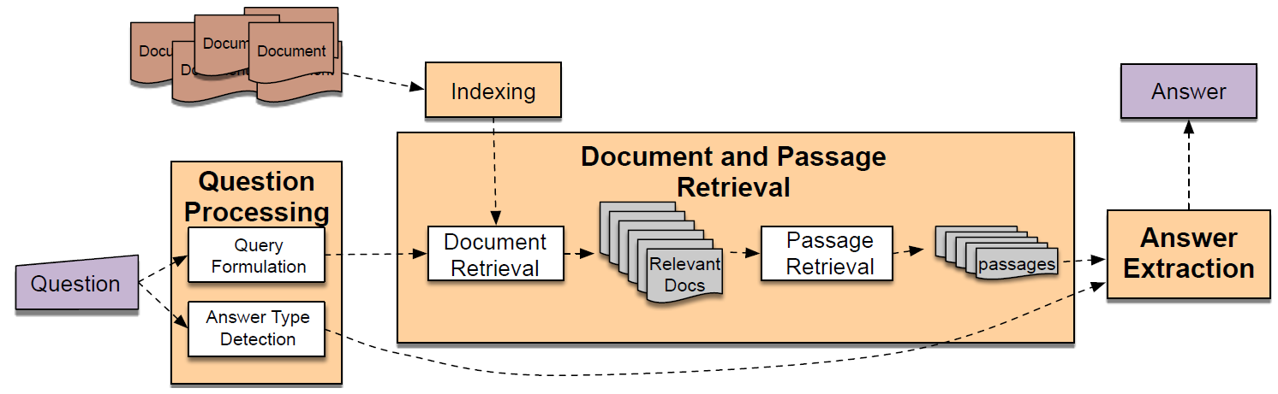
Retrieval Base Question Answering
RBQA:
IR-based factoid question answering has three stages: question processing, passage retrieval, and answer extraction.
Given a user question, information retrieval techniques first find relevant documents and passages. The QA system then reads these retrieved documents or passages and extracts the answer directly from text.
IR
Retrieve + Extract
IE
Target of Extraction

Slide 13
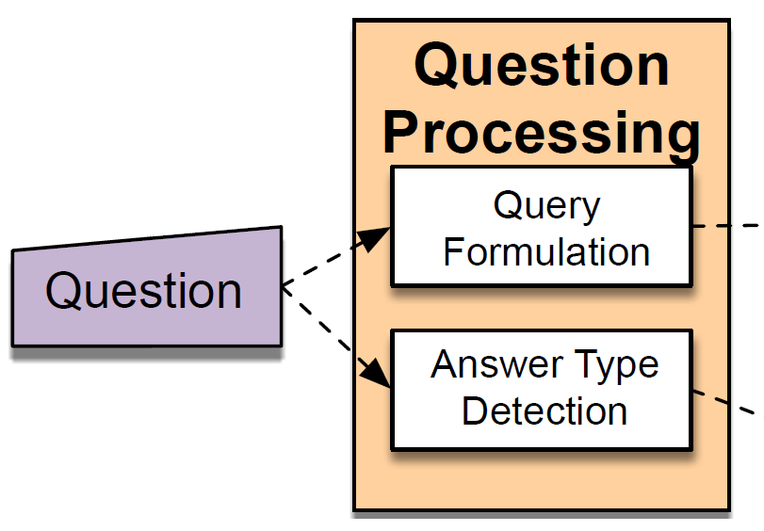





Retrieval Base Question Answering
Question Processing:
Answer Type: The entity type (person, location, time, etc.) of the answer. Answer types are determined by question classification methods, either feature-based or neural network based.
Keywords to be passed to the IR system to retrieve relevant documents.
Query
Expansion
Entity Type (Person, Location, Time, etc.) of the Answer
Which US state capital has the largest population?
Query: US state capital largest population
Answer Type: City

Slide 14

Retrieval Base Question Answering
Question Processing:
Query Term: The keywords passed to the IR system to match potential documents.
Query Formulation is the task of creating a query to send to an information retrieval system to retrieve documents that might contain answer strings.
Query Expansion: Add more terms in the original query. Synonyms, Relevance Feedback, etc.

Slide 15

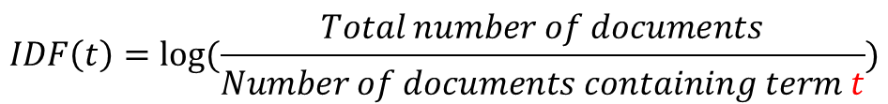
Retrieval Base Question Answering
Document Retrieval:
The standard TF-IDF cosine matching is often used to retrieve relevant documents.
TF (Term Frequency): Measures how frequently a term appears in a document.
IDF (Inverse Document Frequency): Measures how important a term is within the entire corpus.
$$TF−IDF\left(t,d\right)=TF(t,d)×IDF(t)$$
$$TF\left(t,d\right)=\frac{Number of times term t appears in document d}{Total number of terms in document d}$$
$$IDF\left(t\right)=log⁡(\frac{Total number of documents}{Number of documents containing term t})$$

Slide 16
Retrieval Base Question Answering
Example 1: Basic Document Ranking
Documents:
Document 1: "Machine learning is a field of artificial intelligence.“
Document 2: "Machine learning can help improve artificial intelligence.“
Document 3: "Artificial intelligence and machine learning are closely related.“
Query: "machine learning“
Step 1: Compute TF (Term Frequency)
For the term "machine learning," we calculate the term frequency in each document:
Document 1: "machine" appears 1 time, "learning" appears 1 time → TF("machine", D1) = 1/8, TF("learning", D1) = 1/8
Document 2: "machine" appears 1 time, "learning" appears 1 time → TF("machine", D2) = 1/7, TF("learning", D2) = 1/7
Document 3: "machine" appears 1 time, "learning" appears 1 time → TF("machine", D3) = 1/8, TF("learning", D3) = 1/8

Slide 17
Retrieval Base Question Answering
Example 1: Basic Document Ranking
Step 2: Compute IDF (Inverse Document Frequency)
Assume we have a total of 3 documents.
IDF("machine") = log(3 / 3) = 0 (since "machine" appears in all documents)
IDF("learning") = log(3 / 3) = 0 (since "learning" appears in all documents)
Step 3: Compute TF-IDF
Since the IDF values are 0 for both terms, the TF-IDF for each document will also be 0 for these terms. This indicates that the terms are too common to be considered important.
TF-IDF relies on both term frequency and inverse document frequency. If a term appears in all documents, its IDF becomes 0, resulting in a low TF-IDF score, indicating that it is not useful for distinguishing the relevance of documents.
This is why it's important to have a balance between the frequency of the term in a document and its rarity across the whole corpus.

Slide 18


Slide 19
Retrieval Base Question Answering
Example 2: Using TF-IDF for Question Answering
Documents:
Document 1: "The capital of France is Paris."
Document 2: "The Eiffel Tower is located in Paris, France."
Document 3: "Berlin is the capital of Germany.“
Query: "Where is the Eiffel Tower located?“
Step 1: Compute TF for the query term in each document
We break down the query and calculate the frequency of relevant terms in each document. For simplicity, let’s focus on the key terms in the query: "Eiffel," "Tower," "located".
Document 1: "Eiffel" = 0, "Tower" = 0, "located" = 0
Document 2: "Eiffel" = 1, "Tower" = 1, "located" = 1
Document 3: "Eiffel" = 0, "Tower" = 0, "located" = 0

Slide 20
Retrieval Base Question Answering
Example 2: Using TF-IDF for Question Answering
Documents:
Document 1: "The capital of France is Paris."
Document 2: "The Eiffel Tower is located in Paris, France."
Document 3: "Berlin is the capital of Germany.“
Query: "Where is the Eiffel Tower located?“
Step 2: Compute IDF for each term
Now, calculate the IDF for each of the query terms, assuming we have 3 documents in total.
IDF("Eiffel") = log(3 / 1) = 1.1 (appears in 1 document)
IDF("Tower") = log(3 / 1) = 1.1 (appears in 1 document)
IDF("located") = log(3 / 1) = 1.1 (appears in 1 document)

Slide 21
Retrieval Base Question Answering
Example 2: Using TF-IDF for Question Answering
Step 3: Compute TF-IDF for each document
Now, we compute the TF-IDF score for each document based on the query terms.
Document 1:
TF-IDF(“Eiffel”, D1) = 0 * 1.1 = 0; TF-IDF("Tower", D1) = 0 * 1.1 = 0; TF-IDF("located", D1) = 0 * 1.1 = 0
Total TF-IDF for D1 = 0
Document 2:
TF-IDF("Eiffel", D2) = 1/8 * 1.1 ≈ 0.138; TF-IDF("Tower", D2) = 1/8 * 1.1 ≈ 0.138; TF-IDF("located", D2) = 1/8 * 1.1 ≈ 0.138
Total TF-IDF for D2 ≈ 0.138 + 0.138 + 0.138 ≈ 0.413
Document 3:
TF-IDF("Eiffel", D3) = 0 * 1.1 = 0; TF-IDF("Tower", D3) = 0 * 1.1 = 0; TF-IDF("located", D3) = 0 * 1.1 = 0
Total TF-IDF for D3 = 0

Slide 22
Retrieval Base Question Answering
Example 2: Using TF-IDF for Question Answering
Step 4: Ranking Documents Based on Relevance
After calculating the TF-IDF scores, we rank the documents based on their scores. The document with the highest score is the most relevant to the query.
Document 1: 0
Document 2: 0.413 (most relevant)
Document 3: 0
Answer: The most relevant document is Document 2, which contains the answer "The Eiffel Tower is located in Paris, France."

Slide 23
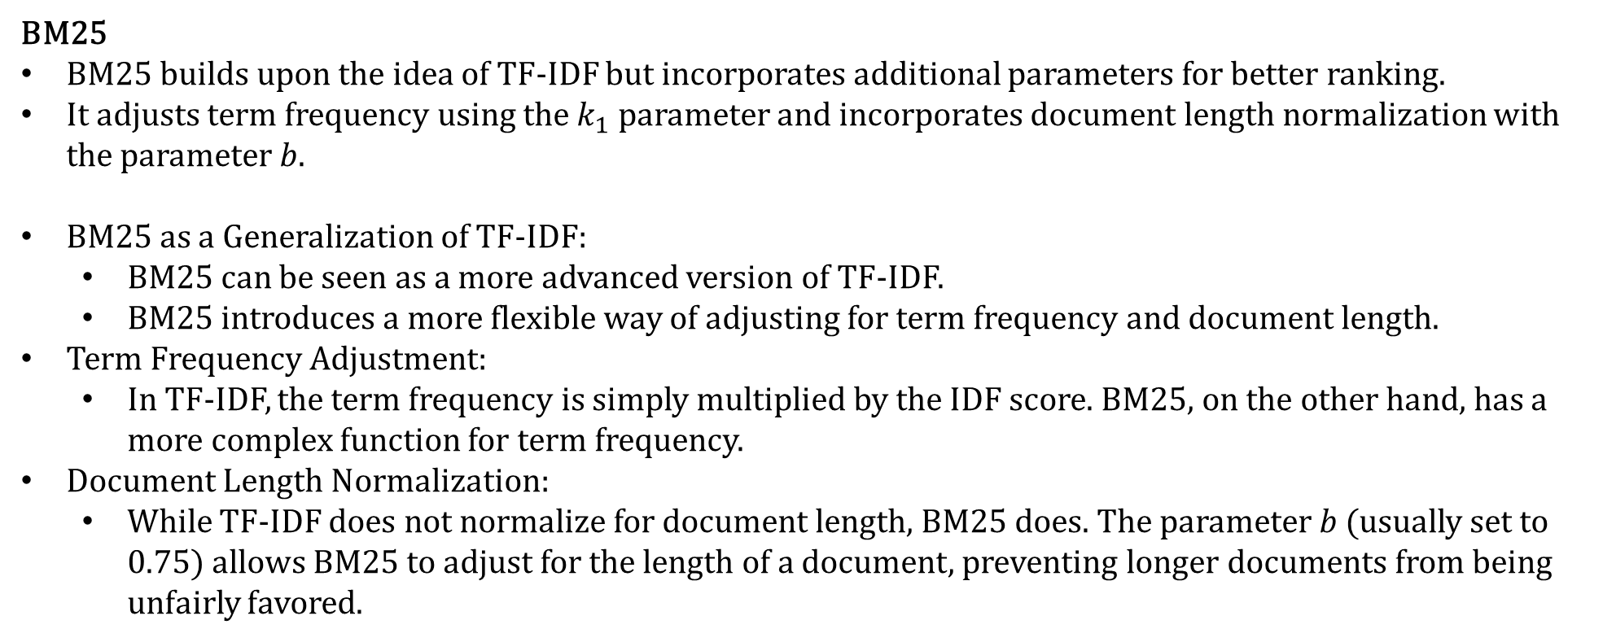
Retrieval Base Question Answering
BM25
BM25 builds upon the idea of TF-IDF but incorporates additional parameters for better ranking.
It adjusts term frequency using the $k_{1}$​ parameter and incorporates document length normalization with the parameter $b$.
BM25 as a Generalization of TF-IDF:
BM25 can be seen as a more advanced version of TF-IDF.
BM25 introduces a more flexible way of adjusting for term frequency and document length.
Term Frequency Adjustment:
In TF-IDF, the term frequency is simply multiplied by the IDF score. BM25, on the other hand, has a more complex function for term frequency.
Document Length Normalization:
While TF-IDF does not normalize for document length, BM25 does. The parameter $b$ (usually set to 0.75) allows BM25 to adjust for the length of a document, preventing longer documents from being unfairly favored.

Slide 24
Retrieval Base Question Answering
Vector Space Model-Based Retrieval (Take Fasttext as an example)
The Vector Space Model is a fundamental model in information retrieval, where text documents and queries are represented as vectors in a multi-dimensional space.
The goal is to measure the similarity between a query and a document to retrieve the most relevant results.
Documents and queries are transformed into vectors.
The similarity between vectors is typically measured using cosine similarity.
It treats each document as a bag of words, representing the presence of words but not their order.

Slide 25
Retrieval Base Question Answering
Vector Space Model-Based Retrieval (Take Fasttext as an example)
Fasttext:
Fasttext is a popular model developed by Facebook AI Research for learning word representations and performing text classification.
It improves upon traditional word embeddings like Word2Vec by considering subword information, which helps capture rare words or misspellings better.
Fasttext represents words as bags of character n-grams, allowing it to create representations for subwords.
This feature makes it particularly effective for languages with rich morphology or when dealing with rare words.
Steps:
In the VSM framework, Fasttext can be used to generate word embeddings for each document and query.
The resulting word vectors are then combined to form document vectors.
The cosine similarity between the query vector and document vectors is computed to retrieve the most relevant answers.

Slide 26

Retrieval Augmented Generation
Limitations of Large Language Model (LLM)
Knowledge Cutoff Date: Training LLMs is an expensive and time-consuming process. It requires vast amounts of data and can take weeks or even months. As a result, the data used to train LLMs is not up-to-date. For example, GPT-4’s knowledge cutoff date is October 2023, meaning any events occurring after this date are not reflected in the model.
Training Data Limitations: LLMs are trained on massive datasets from a variety of public sources. For instance, Llama 3 is trained on up to 150 trillion tokens (about 7 times more than Llama 2). However, they are unaware of non-public information. Public LLMs have not been trained on internal company documents, customer information, product documentation, and similar data. Therefore, they cannot be expected to respond to queries related to such information.

Slide 27
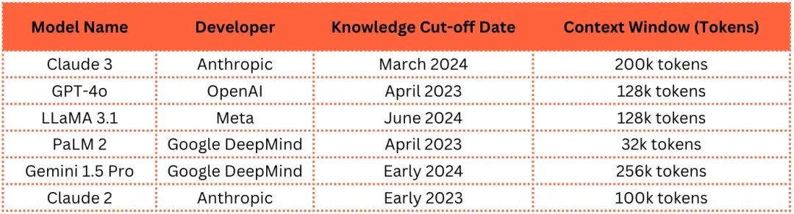
Retrieval Augmented Generation
Limitations of Large Language Model (LLM)
Hallucinations: LLMs are predictors of the next word. They are not trained to validate facts within their answers. As a result, LLMs sometimes provide answers that are factually incorrect but sound confident and plausible. This "confidently lying" characteristic is known as hallucination, which has been identified as one of the biggest criticisms of LLMs.
Context Window: Due to the nature of their architecture, each LLM can process a maximum number of tokens. This maximum token count is referred to as the model’s context window. If the input exceeds the context window, the part of the prompt that exceeds the limit will be discarded.

Slide 28
Retrieval Augmented Generation
RAG concept
Parameter Memory: The ability of an LLM to retain trained information is entirely dependent on its parameters. Thus, it can be said that an LLM stores factual information in its parameters. This memory within the LLM is referred to as parameter memory. This parameter memory is limited. It depends on the number of parameters and is a factor of the data used to train the LLM.
Non-parameter Memory: Information that is not stored in the LLM’s internal parameters but can be accessed through external retrieval mechanisms, such as search engines or databases. RAG allows the LLM to access this non-parameter memory.
Knowledge Base: The non-parameter memory created for RAG applications. It contains information from various predefined sources, which is processed and stored in persistent memory.

Slide 29
Retrieval Augmented Generation
RAG concept
User Query: The prompt that a user (or system) sends to the LLM in order to seek a response.
Retrieval: The process of searching and retrieving information from the knowledge base that is relevant to the user query.
Augmentation: The process of adding retrieved information to the user query.
Generation: The process in which the LLM generates results when provided with the augmented prompt.
Source Citation: The ability of a RAG system to indicate the sources in the knowledge base used to generate a response.
Unlimited Memory: The ability to add an arbitrary number of documents to the RAG knowledge base.

Slide 30
Retrieval Augmented Generation
Components
Retriever: The component responsible for finding relevant documents or passages.
Generator: A model, typically a pre-trained language model, that generates the answer based on the retrieved information.
Advantages of RAG:
Combines the strength of retrieval (high accuracy) and generation (flexible, fluent responses).
Reduces the dependency on training the model on large amounts of domain-specific data.

Slide 32
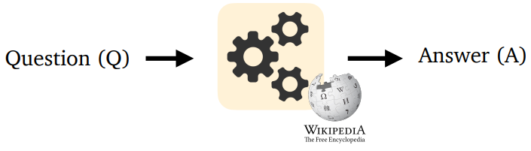
NLP Project Objective
This project aims to develop a Knowledge Base Question Answering (KBQA) system. The objective is to build a system capable of retrieving relevant information from a structured knowledge base and utilizing this information to generate accurate answers.
This is a team project, so you need to find your teammates first. Each team can only have up to 3 students.
Once you have found your teammates, please sign up on Blackboard. You can find your teammates in the course discussion on Blackboard or through other social means.
A Knowledge Base Question Answering System

Slide 33
NQ10K Dataset
Question: How many episodes in season 2 breaking bad?
We provide the NQ10K dataset for evaluating the performance of your systems. This dataset consists of 10k questions randomly sampled from the original 320K Natural Questions dataset.
The questions in NQ10K are designed to assess a system's ability to generate accurate, contextually relevant answers by leveraging both information retrieval and text generation methods. The dataset is divided into three parts: 8k samples for training, 1k samples for validation, and 1k samples for testing.
Each question is paired with relevant documents, which have been curated into a retrieval knowledge base for your system. This structure enables a comprehensive evaluation of question-answering systems in an open-domain context.
Short Answer: 13
https://ai.google.com/research/NaturalQuestions/visualization

Slide 34
NQ320K Dataset
Source of Questions: The questions in the dataset are real, anonymized, aggregated queries that were issued to the Google search engine.
Annotation Process:
Human annotators identify long and short answers for each question.
If no valid answer is found, both the long and short answers are marked as NULL.
The long answer is selected as the smallest bounding box that contains the information required to answer the question.
Focus on Wikipedia: The dataset uses Wikipedia pages as the source for answering questions, which are considered highly reliable factual documents.
Variability: There is significant variability in the answers, as different annotators might select different answers or passages. This is especially evident in the 25-way annotated data, where multiple valid answers can exist for a single question.
Evaluation Metrics: The dataset provides robust evaluation metrics, with high precision and recall for long and short answers (90%/84% precision for long answers and 79%/72% precision for short answers).

Slide 35
NQ10K Dataset Statistics and Data Format:
The data is stored in rows, with each row being in JSON format.
File Name | Count | Data Format
train.jsonl | 8,000 | {"question": str, "answer": str, "document_id": int}
val.jsonl | 1,000 | {"question": str, "answer": str, "document_id": int}
val_predict.jsonl | 1,000 | {"question": str, "answer": str, "document_id": List[int]}
test.jsonl | 1,000 | {"question": str, "answer": null, "document_id": null}
documents.jsonl | 12,138 | {“document_id”: int, “document_text”: str}

Slide 36
Example
train.jsonl
val.jsonl
test.jsonl
Expected test_predict.jsonl
{"question": "what did the huns do to the roman empire", "answer": "collapse", "document_id": 6205}
{"question": "who won women's singles australian open 2018", "answer": "Caroline Wozniacki", "document_id": 8985}
{"question": "when did the british first land in north america", "answer": "1607", "document_id": 11484}
{"question": "when did the 1st world war officially end", "answer": "11 November 1918", "document_id": 10722}
{"question": "what effect does the curvature of a mirror", "answer": null, "document_id": null}
{"question": "when did the movie jesus christ superstar come out", "answer": null, "document_id": null}
{"question": "when did the british first land in north america", "answer": "1974", "document_id": [9204, 11727, 6100, 5651, 11804]}
{"question": "when did the 1st world war officially end", "answer": "the optic head", "document_id": [5686, 1866, 8243, 3995, 5008]}

Slide 37
Example
documents.jsonl
{“document_id”: 0, “document_text”: “Email marketing - Wikipedia <H1> Email marketing </H1> Jump to : navigation , search <Table> <Tr> <Td> </Td> <Td> ( hide ) This article has multiple issues . Please help improve it or discuss these issues on the talk page . ( Learn how and when to remove these template messages ) <Table> <Tr> <Td> </Td> <Td> This article needs additional citations for verification . Please help improve this article by adding citations to reliable sources . Unsourced material may be challenged and removed . ( September 2014 ) ( Learn how and when to remove this template message ) </Td> </Tr> </Table> <Table> <Tr> <Td> </Td> <Td> This article possibly contains original research . Please improve it by verifying the claims made and adding inline citations . Statements consisting only of original research should be removed . ( January 2015 ) … ”}
{"document_id": 1, "document_text": "The Mother ( How I Met Your Mother ) - wikipedia <H1> The Mother ( How I Met Your Mother ) </H1> Jump to : navigation , search <Table> <Tr> <Th_colspan=\"2\"> Tracy McConnell </Th> </Tr> <Tr> <Td_colspan=\"2\"> How I Met Your Mother character </Td> </Tr> <Tr> <Td_colspan=\"2\"> The Mother appearing in `` The Locket '' </Td> </Tr> <Tr> <Th> First appearance </Th> <Td> `` Lucky Penny ( unseen ) '' `` Something New '' ( seen ) </Td> </Tr> <Tr> <Th> Last appearance </Th> <Td> `` Last Forever '' </Td> </Tr> <Tr> <Th> Created by </Th> <Td> Carter Bays Craig Thomas </Td> </Tr> <Tr> <Th> Portrayed by </Th> <Td> Cristin Milioti </Td> </Tr> <Tr> <Th_colspan=\"2\"> Information </Th> </Tr> <Tr> <Th> Aliases </Th> <Td> The Mother </Td> </Tr> <Tr> <Th> Gender </Th> <Td> Female </Td> </Tr> <Tr> <Th> Spouse ( s ) </Th> <Td> Ted Mosby …”}

Slide 38
Project Requirements
Basic Requirements:
To design a KBQA system, you are required to complete three main components: Knowledge Base Retrieval, Answer Generation, and UI Interface Design:
Knowledge Base Retrieval: You will need to implement two retrieval methods:
Keyword Matching-Based Retrieval: This is one of the simplest retrieval methods, where keywords or phrases are matched to identify documents relevant to the question. This typically utilizes traditional information retrieval algorithms such as BM25 or TF-IDF.
Vector Space Model-Based Retrieval: In this approach, both the question and documents are converted into vectors, and their similarity is computed to perform retrieval. This often uses pre-trained word embedding models like Word2Vec, GloVe, or FastText to represent words and calculate the similarity between question and document vectors.

Slide 39
Project Requirements
Basic Requirements:
To design a KBQA system, you are required to complete three main components: Knowledge Base Retrieval, Answer Generation, and UI Interface Design:
Answer Generation: You are required to implement a method for generating answers:
Answer Generation via Prompting Large Language Models (LLM): Using carefully designed instructions, along with the retrieved content and the question, a prompt is created to guide a LLM to generate an appropriate answer directly. To improve the quality of your generated answer, you may need to experiment with various prompts.
Hint: To ensure fairness and avoid potential biases introduced by the capabilities of different LLMs, we restrict the usage to Qwen/Qwen2.5-7B-Instruct as the LLM for generating answers via prompting. This model supports multiple languages and has a context length of 32k tokens, which provides sufficient capacity for handling complex questions and retrieval-based information. You have the option to deploy the model locally or use the free API provided in the Free API Resources section to conduct your experiments.

Slide 40
Project Requirements
Basic Requirements:
To design a KBQA system, you are required to complete three main components: Knowledge Base Retrieval, Answer Generation, and UI Interface Design:
UI Design: A user interface (UI) will be developed to allow users to interact with the KBQA system, such as a web interface or a Windows program. The UI should be intuitive and capable of displaying the retrieved documents and the generated answers clearly. This means that your interface should include at least three main components:
User Input for Questions: A section where users can enter their questions, allowing them to interact with the KBQA system by submitting queries.
Retrieved Documents: A display area where the system shows the documents retrieved based on the user’s question. This allows users to see the context or references that the system has used to generate the answer.
Answer Display: A dedicated area where the system presents the generated answer, providing users with the most relevant and accurate response to their query.

Slide 41
Project Requirements
Test your system:
You can use the 1,000 samples from the provided validation set to test the performance of your system. This will help you evaluate whether the retrieval methods and answer generation techniques you have implemented are both reasonable and accurate.
When submitting your result, you are required to provide a file that contains the results after testing on the test set. The file should contain 1,000 lines, with each line in JSON line format. Each line should include three key-value pairs: question, answer, and document_id. These correspond to the question, the generated answer, and the IDs of the five most relevant documents to the question (with the most relevant documents appearing first).
You can refer to the provided val_predict.jsonl file to better understand the required format and structure for the output. The evaluation script is provided in metrics_calculation.py.

Slide 42
Project Requirements
Advanced Requirements:
To further enhance the performance of your KBQA system, you can incorporate dense vector-based retrieval methods. By preprocessing the document corpus, you can map both documents and queries into a dense vector space. Common methods include Dense Passage Retrieval (DPR) and ColBERT. Once the documents and queries are transformed into dense vectors, you can perform efficient retrieval by utilizing Approximate Nearest Neighbor (ANN) search algorithms, such as FAISS, to find the most relevant documents based on their vector similarities. After identifying the relevant documents, you can proceed with the answer generation process.
You are encouraged to explore additional effective retrieval methods beyond the basic&advanced requirements, such as Hybrid Retrieval techniques, which combine different retrieval strategies for improved performance.
In your report, you should analyze the effectiveness of the new retrieval methods you explore. This includes providing a clear explanation of why the method is effective, detailing your exploration process, and comparing the performance of the new approach with the baseline methods (basic&advanced). Be sure to quantify the improvements in retrieval quality and discuss how the new method enhances the overall system performance.

Slide 43
What to Hand In
The Source Code of Your Program
The source files of all your code.
A readme file that describes the structure of your system, the environmental dependencies (the used packages and their versions), and how to run your system step by step.
Add annotations at the beginning of all code files to indicate their usage and any necessary explanatory comments.
Put all the files into a directory named “code”. To avoid submitting excessively large files, your model weight files do not need to be included. If necessary, please submit them in the form of a Google Drive link.

Slide 44
What to Hand In
The Source Code of Your Program
Place the results generated by your system on the NQ10K test set into a file named test_predict.jsonl in the root directory. Each line should contain a JSON-formatted entry with the fields question, answer, and document_id. The question and answer should be in string format, and document_id should be a list containing Five integer values. The TA will use the extract match method to evaluate your answers, and will assess the retrieval results using R@5 and MRR@5. The evaluation script is provided in metrics_calculation.py.
TAs will run the code. If there are problems, TAs will contact your group to demonstrate online. And if the submitted code cannot achieve the reported performance finally, there will be some deductions from your grade.

Slide 45
What to Hand In
Written Report (At least 6 pages with 12-point font size and single line spacing, excluding the cover page. Please submit the PDF file)
A cover page with project topic and group member’ names and student IDs.
The role and the contribution proportion of each group member. For example, student A 30%, student B 25%, student C 25%, student D 20%.
The method you used to design your system.
Flowchart diagram of your system.
Results analysis. You can analyze the differences in the results generated under different experimental parameter settings (e.g., different instructions).
The UI design of your system.
Anything else you would like to share with us (like the additional exploration).
At the end of the report, provide the electronic signatures of all group members to ensure the accuracy of the information.

Slide 46
What to Hand In
Demo Video (Less than ten minutes)
Demonstrate the real-time response capability of the KBQA system and highlight the key aspects of the project solution, such as the main challenges and primary achievements (you can use a PowerPoint presentation to showcase the work).
Provide an appropriate interpretation of the code, such as explaining which part of the code handles data preprocessing, which part is responsible for retrieval, and which part is used for question answering.
Pack all the submissions in one zipped file and submit to Blackboard. As described above, the file contains the “test_predict.jsonl” (file), “code” directory, the report (pdf), and the video file (mp4).
Remark: Please do remember to click the “Submit” button after you upload the file.

Slide 47
Grading Scheme
TAs will grade the project according to the following schemes:
System Implementation: 40%
Written Report: 20%
Demo Video: 20%
System Performance: 20%
The TA will compare your provided test_predict.jsonl file with the standard answers in test_ground_truth.jsonl (which is not publicly available) to calculate your system's ranking among all groups. The ranking will be determined based on both answer generation and retrieval performance, with each component contributing 50% to the final score. The final score will be assigned based on your ranking as follows:
Top 20% (including the 20%): Full score (100%).
Rank 20% to 40% (including the 40%): 3/4 of the total score.
Rank 40% to 90% (including the 90%): 1/2 of the total score.
Rank below 90%: 1/4 of the total score.
Blank submissions will not receive any score.
Assuming the total number of groups is 40, and your system's overall ranking is 16, you can earn 20 * 3/4 = 15 points in this part.
Note that we will assess your system implementation based on the written report and the code.

Slide 48
Due Date
April 20, 2025 (Sunday, 23:59)!!!
Please submit your document before the deadline, or points will be deducted!!!
Others:
The project encourages team collaboration, which means that even if you complete it individually, you will not receive a "solo completion" reward. You will only be graded based on the criteria outlined in the Grading Scheme.
Please clearly specify the proportion of each team member's contribution in the report. If the contributions are highly imbalanced, an official report must be provided to explain why the contributions are so uneven. Please note that such imbalances may affect the final evaluation and scoring.
At the end of the report, please include an electronic signature to confirm that the report is completed accurately and truthfully.

Slide 49


