Slide 1
Git for version control and collaboration Part 2
Katia Oleinik
Research Computing Services

Slide 2
Outline
Motivation
Using Git for version control
Collaboration using Git
GitHub and other remote repositories

Slide 3
Remote repository
To publish repository to a GitHub (or other place):
Create a repository in GitHub
In your working directory run:
git remote add origin https://github.com/<gitHubID>/<repo>.git
git push -u origin master

Slide 4
Collaboration
Create 2 directories - repo1 and repo2. In the first directory create a repo job_example
mkdir repo1
mkdir repo2
cd repo1
git init job_example
cd job_example

Slide 5
Collaboration
In the first directory (repo1/job_example) add a few file and make a commit. You can copy the file from the examples directory:
cp /project/scv/examples/git/job_example/* .
Make an initial commit:
git add .
git commit -m "Initial commit"

Slide 6
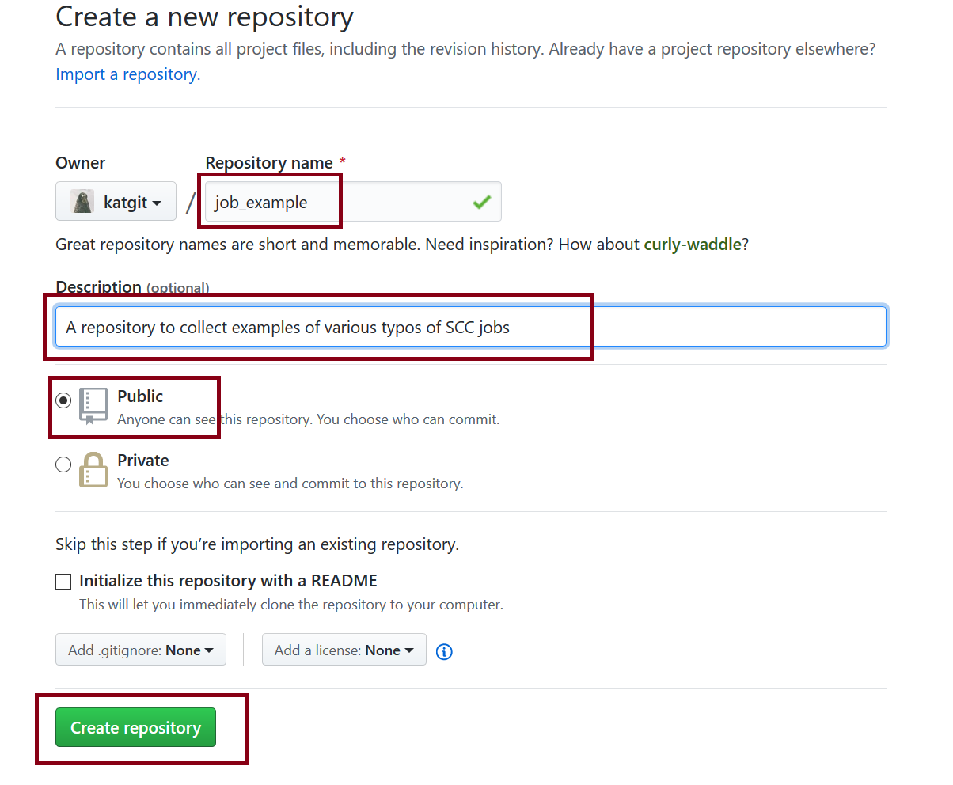
Collaboration
Create a remote repository on GitHub. We will be updating this repository from 2 different directories we created.

Slide 7
Collaboration
# In repo1:
git remote add origin https://github.com/<yourID>/job_example.git
git push -u origin master
# In repo2:
https://github.com/katgit/job_example.git
cd job_example
# To differentiate between 2 repositories, let’s change a local user-name
git config --local user.name "Some Alias"

Slide 8
Collaboration
# In repo2 modify job.qsub
git add job.qsub
git commit –m "modified job.qsub"
# Update Git Hub repository
git push origin master
# In repo1:
git pull origin master

Slide 9
Resolving Conflicts
# In repo1 further modify job.qsub and then commit it
git add job.qsub
git commit –m "added project flag to job.qsub"
# Update Git Hub repository
git push origin master

Slide 10
Resolving Conflicts
# In repo2 modify example.py file and then commit it
git add example.py
git commit –m "added some calculations to example.py"
# Now try to push the changes to the GitHub repo:
git push origin master
! [rejected] master -> master (fetch first)
error: failed to push some refs to 'https://github.com/katgit/job_example.git'
hint: Updates were rejected because the remote contains work that you do
hint: not have locally. This is usually caused by another repository pushing
hint: to the same ref. You may want to first integrate the remote changes
hint: (e.g., 'git pull ...') before pushing again.
hint: See the 'Note about fast-forwards' in 'git push --help' for details.

Slide 11
Resolving Conflicts
# In the repo where you got this errors (repo2) pull the updates from GitHub:
git pull origin master
If 2 different files were modified, git will resolve the conflict and will open an editor to record a commit message
# Update Git Hub repository
git push origin master

Slide 12
Branch
g
f
d
Git allows and encourages you to have multiple local branches that can be entirely independent of each other.
e
c
b
dev
a
master

Slide 13
Branch
g
f
d
Check all existing branches
git branch
or
git branch --list
e
c
b
dev
a
master
Notes:
#First let's create a new git repository
cd
# Create git repository branch
git init branch
cd branch
# Create a README file
echo "Repository to experiment with branches" > README
git add README
git commit -m "First commit
# Create second commit by adding .gitignore file
echo "*~" > .gitignore
git add .gitignore
git commit -m "Adding gitignore file"

Slide 14
Branch
g
f
d
Create a new branch "dev"
git branch dev
Check existing branches
git branch --list
e
c
b
dev
a
Note: Creating a new branch does not make it current!
master
Notes:
Create branch "dev" and list all the branches

Slide 15
Branch
g
f
d
Switch to a new "dev" branch
git checkout dev
Check existing branches
git branch --list
e
c
b
dev
a
master

Slide 16
Branch Checkout
g
f
d
Use checkout verb to switch between branches, i.e:
git checkout <branch>
Each branch can be modified independently
e
c
b
dev
a
master
Notes:
Now, let's create a couple of commits in each branch
git checkout dev
create a new file notes.txt
modify README file to include info about notes.txt file
git checkout master
create a new file hello.py
modify README file to include info about python file

Slide 17
Merging Branches
g
f
d
First checkout to the "receiving" branch:
git checkout master
Perform merge with the other branch
git merge dev
e
c
b
dev
a
master
Notes:
git checkout master
git merge dev
A conflict message will be given
Edit README file to resolve conflict
git commit -am "Resolve merge conflict in README file"
git log --graph

Slide 18
Rebase
d'
c'
f
d
f
e
d
c
e
c
b
dev
b
dev
a
a
master
master

Slide 19
Rebase
First checkout to the “development" branch:
git checkout dev
Perform rebase
git rebase master
Merging 2 branches
git checkout master
git merge dev
f
d
e
c
b
dev
a
master

Slide 20
Rebase vs. Merge
d'
c'
g
f
f
d
d
e
e
c
c
b
dev
b
dev
a
a
master
master

Slide 21
Rebase vs. Merge
Do not rebase commits that exist outside your repository and people may have based work on them!
The way to get the best of both worlds is to rebase local changes you’ve made but haven’t shared yet before you push them in order to clean up your story, but never rebase anything you’ve pushed somewhere.

Slide 22
Pushing Branches to Remote
To push a branch to a remote repository
git push origin dev
List all remote repositories
git branch –l -r
(In repo2 ) Get a particular branch from remote
git fetch origin dev
Get all branches from remote
git fetch origin
git branch –l -r

Slide 23
Git tools: Stashing
When you need to switch between the branches, but are not ready to push the changes you can use stashing area:
# push changes to the stashing area
git stash
# list stashes
git stash list
Now you can switch branches and do other work.

Slide 24
Git tools: Stashing
Once you are back to your master branch and are ready to continue your work you can pull stashed files back:
# pull stashed file into your working area
git stash apply

Slide 25
The End

