Slide 1

/ SIDEKICK
Sidekick is a web browser sidebar where you can easily save, organize and retrieve web content, such as links, photos, videos and web documents. It is the fastest way to save and navigate web search results, without back-and-forth clicking and repetitive web searches.
Sidekick seamlessly integrates with the browser and makes the workflow of web research more productive.
Have a look at our demo: www.youtube.com/watch?v=Ee4spl_7GSY
Sidekick lets you organize web content into collections on the fly. You can add relevant content into a collection anytime through drag-and-drop or a simple mouse click. Previously found web content shows up if relevant to the current web browser search. It enables using your bookmarks as you can effortlessly retrieve stored content. Sidekick lets you find what you’ve already found.
Sidekick participates in the Founder.org competition.

Slide 2
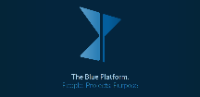
/ THE BLUE PLATFORM
The BluePlatform is an interactive online platform for universities and their students. Its goal is to facilitate the matching process between university projects and students to achieve a perfect connection between project topics and students’ interests and passion.
The BluePlatform provides a simple interface to publish, search and apply for university projects, such as bachelor or master theses or semester projects. Both user groups – university staff and students – are supported with our solution during their involvement in the process.
Our vision is to provide optimal matching of people and projects, such that the projects gain purpose and are executed with passion, conviction and ultimately success.
The BluePlatform will soon be online under www.theBluePlatform.ch.

Slide 3

/ THE LOOP
Thrown away shoes produce a huge amount of waste. Nowadays, around 300 million pairs of shoes are trashed annually, causing a massive environmental impact and a huge loss of valuable resources. Additionally, a lot of shoes are produced under insufficient social standards in third world countries and then shipped halfway around the world to reach the end consumer.
Our project tackles this problem through a circular and transparent approach by designing and locally producing shoes in Spain, which can be returned at the end of the product life cycle, and their parts will be reused or recycled.
The aim is not to sell our shoes to ecologically very conscious people, but to the common consumer. Accordingly, our approach does not only aim at reducing the environmental impact but guarantees customer retention through continued personal involvement.
We are first tackling the market of football shoes, as they have an extremely short lifecycle.

Slide 4
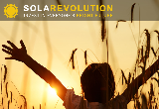
/ SOLAREVOLUTION
Our goal is it to make solar energy not only affordable and available but also generating sustainable income for every household, school, organisation and corporation, through an innovative leasing concept from individuals to individuals.
This is why we want to create SolaRevolution, an innovative crowdfunding and leasing concept for sustainable energy – the „Kickstarter for Solar“.
In cooperation with an installer, SolaRevolution will mount solar panels on roofs of households or small entities and at the same time provide them with a long-term loan to finance the installations. The loan will be paid back monthly and be lower than the initial monthly electricity bill.
The financing of the loans will be provided through a crowd-investment platform. This provides individuals with a transparent and secure investment opportunity and the chance to participate and support the clean energy revolution.

Slide 5
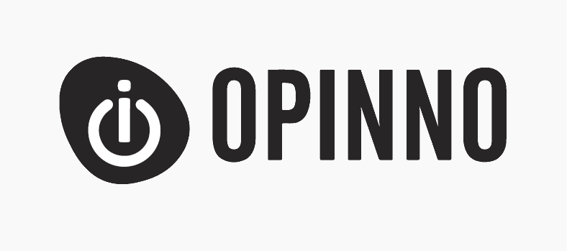
/ OPINNO
The management consulting project pioneered initiatives which bring together people of different generations to create highly beneficial combinations for the purpose of increasing the chance of entrepreneurial success.
The project researched, identified, analysed and created value propositions for intergenerational entrepreneurship and proposed initiatives and actions to deliver that value. Proposals included a communication and marketing strategy, event design and an online platform.
The project evolved along the vision to change public perception of entrepreneurs and entrepreneurship towards a concept and lifestyle which is independent of someone’s age, and which will have a positive impact on society through actively counteracting unemployment.

Slide 6

/ LIPS
Lips for iPhone lets you quickly create amazing movies with your own soundtrack. Record your experiences together with music you choose! Share them with family, friends, or in the public feed. Scroll through all movies and let them play instantly.
Lips will soon be available on Apple’s AppStore.

Slide 7

/ TEDXESCPMADRID
Europe - Home to great inventors, poets, merchants and artists. Home to great people. Home to great stories. We wanted to hear those stories.
From Madrid to Europe and the other way around, we provided a stage for these special stories, for these special ideas.
Check out www.TEDxESCPMadrid.com

Slide 8

/
Paradoxes in Knowledge Management for Envi-ronmental Sustainability in a Retail Supply Chain
Anonymized abstract - In an increasingly complex and dynamic organizational environment, management involves handling opposing forces at the same time. A paradox perspective provides a mindset for this ambiguity, plurality and even illogicality. The mindset helps explore how organizations can simultaneously meet multiple competing demands in order to ensure long-term survival without compromising short-term competitiveness. The paper applies a Grounded Theory approach to identify and examine surfacing paradox in the focal system, which consists of a knowledge sharing platform for increased environmental sustainability in a food retail supply chain. Specific emphasis lies on methodological rigor, since the author himself is an actor of the focal system and the research method is of investigative nature. As a result, the paper presents surfacing paradox together with real-world management strategies, applying a novel and comprehensive presentation approach. Existing literature is leveraged: paradoxes and management strategies are mapped to their counterparts in theory. The vast amount of data gathered for this study, together with a first analysis, build a fertile ground for advancing theory on KM paradox within organizations. The paper also offers practitioners a structured overview of paradox. Increased awareness and understanding may then enable decision making and action, which then supports sustainable, high performance.
A paper based on the thesis is currently in review by a major management magazine.

Slide 9

/ TBF & LEVI’S VIETNAM
The management consulting project looked at how TBF as official importer of Levi’s Jeans in Vietnam can reposition itself to create long-term, sustainable commercial success.
Central to the project’s central proposal was to move Levi’s from a worldwide pioneer of denim jeans to a pioneer of sustainability for the Vietnam market.
We identified and targeted key challenges of TBF and its mission, performed market research as well as an in-depth brand and subject analysis. We then formulated a general brand and marketing vision together with a short term marketing focus.
To facilitate implementation we listed in detail multiple action streams, integrated in a long-term and a short-term plan.

