Slide 1
25Spring: CAS CS506
Final Report
Loan Eligibility Prediction
Leyan Chen(U99402862)
Notes:
Hi, I will continue to talk about my project

Slide 2
The applicant's income does not affect loan approval.
Applicants with a credit history are more likely to be approved for loans.
Married applicants are more likely to be approved for loans than unmarried applicants.
The loan amount approved is positively correlated with the applicant’s income.
Done:
EDA and Visualization
Data Preprocessing: Handle missing values, outliers, and feature engineering.
Feature Engineering: Create new features. Encode categorical variables using label encoding. Normalize numerical features.
Notes:
In my previous work, I conducted a detailed analysis of the data and validated the proposed hypotheses through multivariate feature analysis.
I have processed the data, including processing feature columns, handling missing and outlier values, feature engineering like encoding feature, creating new feature total income and income bins.

Slide 3
CONTENTS
1
Project Overview
2
Modeling & Visualization
3
Results & Analysis
Notes:
Then I will focus on modeling and result. I used five models. For each model, I divided the data into an training set and a validation set, and trained the model using parameter tuning and K-Fold cross validation, then applying and evaluating the model with the best parameters.

Slide 4
PART 01
Logistic Regression

Slide 5
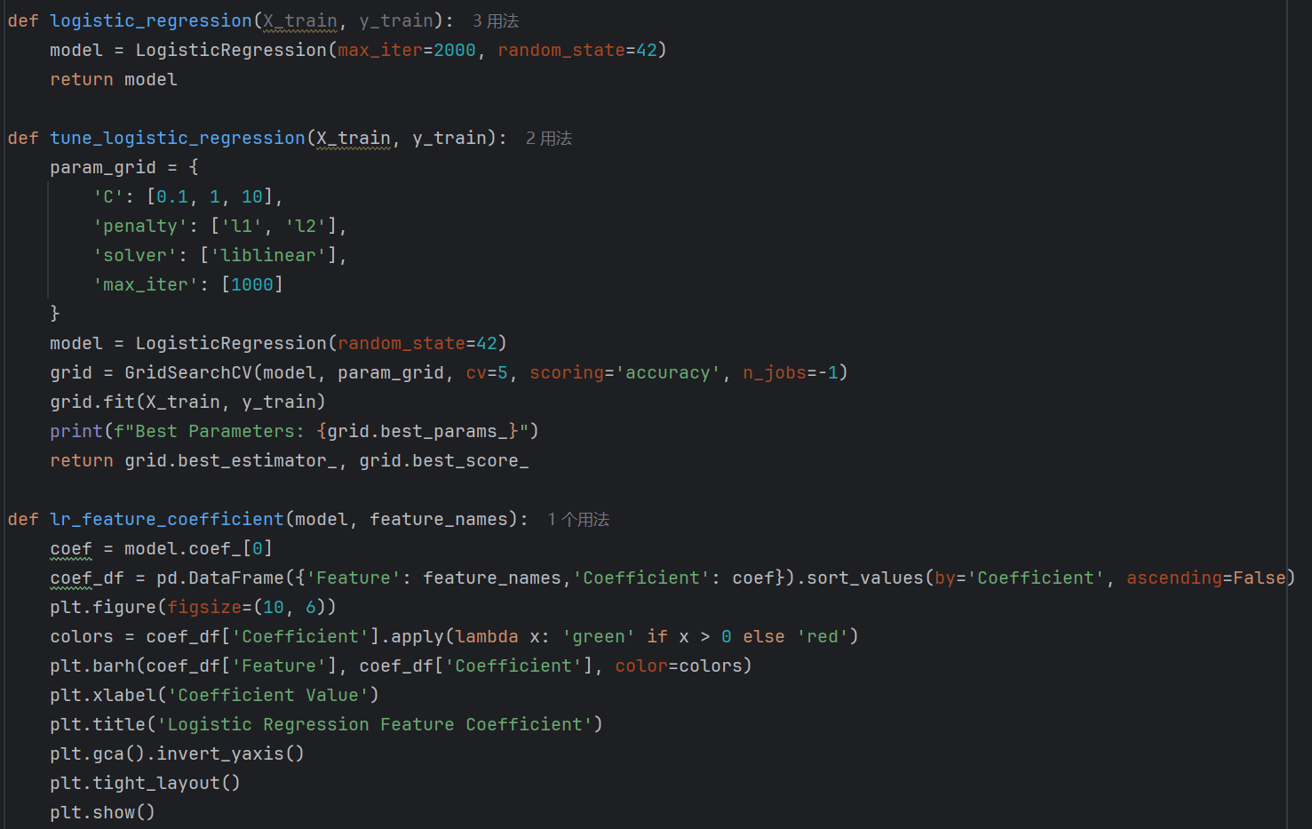
Notes:
Logistic Regression is a linear model, so the coefficients directly show how strongly and in which direction each feature influences the probability of approval.

Slide 6
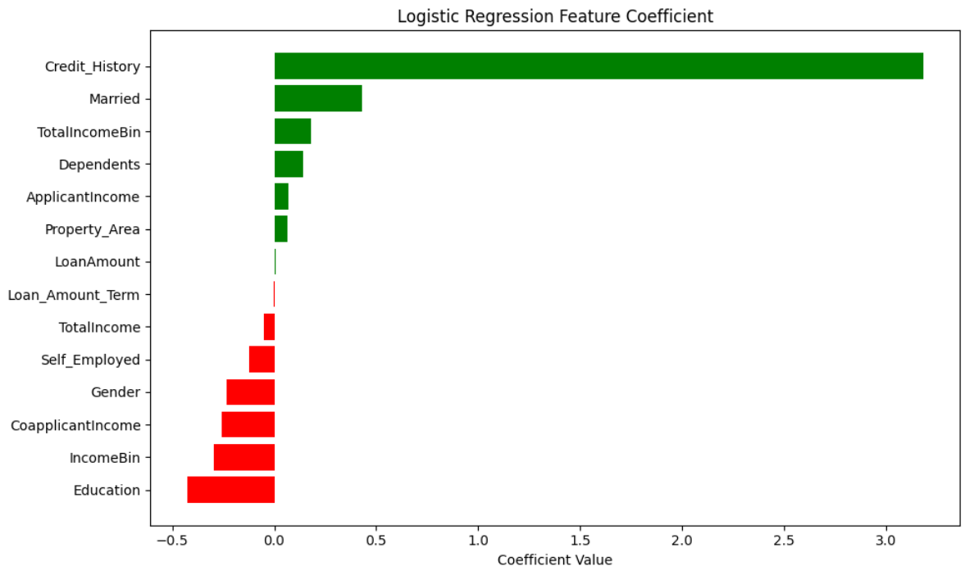
Notes:
In the results, Credit_History has the highest positive coefficient, confirming that applicants with a good credit history significantly increase the odds of loan approval. Married and TotalIncomeBin also show strong positive effects, suggesting lenders favor stable marital status and higher income brackets.
On the negative side, Loan_Amount_Term has the largest negative coefficient, indicating that longer loan terms reduce approval likelihood, perhaps due to greater uncertainty in long-term repayments. Surprisingly, Education negatively impacts approval, this could reflect dataset bias or confounding variables. for example, graduates might have higher debt.

Slide 7
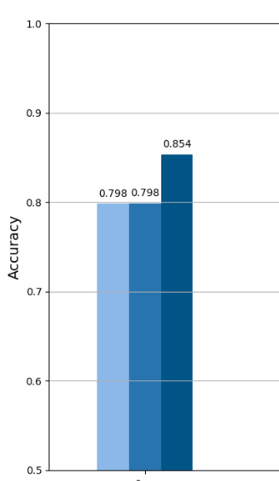
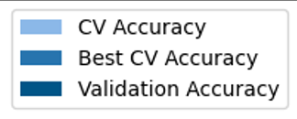
Notes:
I use GridSearchCV to find the best regularization strength and penalty type.
I calculated the accuracy of the base model and the improved model, and it can be inferred that the improved model did not improve model performance.

Slide 8
PART 02
Decision Tree
Notes:
So let’s move to Decision Tree next. It can capture non-linear relationships in the data.

Slide 9
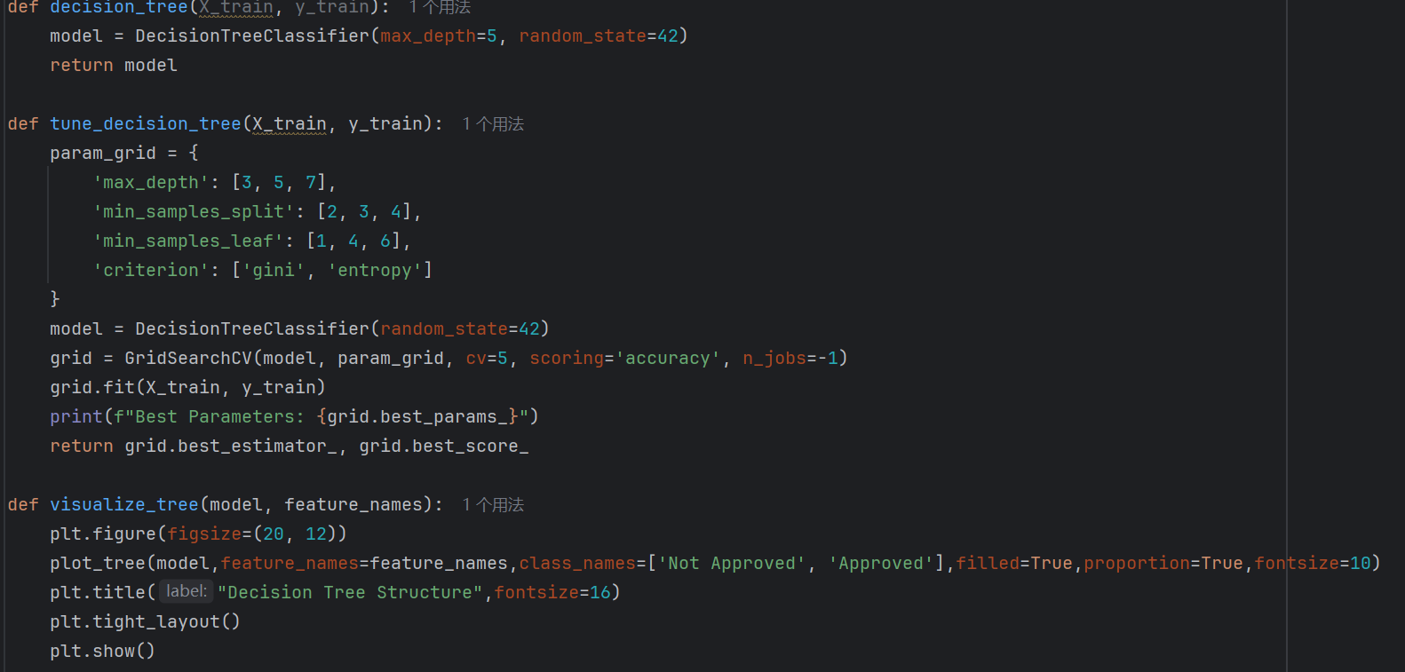
Notes:
I visualized the tree structure. It explains how decisions are made based on key financial attributes.

Slide 10
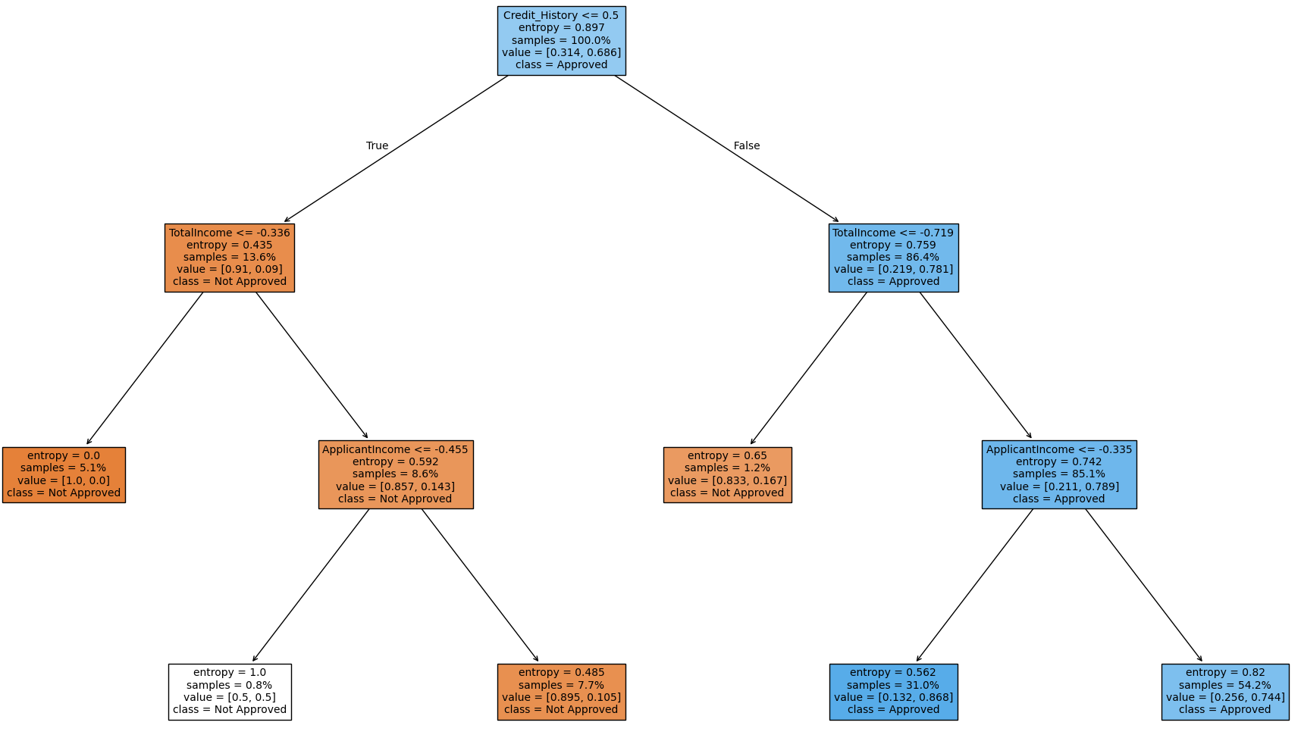
Notes:
The root node splits the dataset based on credit_history, reflecting its pivotal role in loan approval decisions.
The second layer introduces TotalIncome as a critical feature. The left subtree has low entropy and a stark value imbalance, shows that nearly all applicants in this segment are denied loans. This reflects that applicants with both poor credit and very low income are deemed high-risk.
At the third level, the tree introduces ApplicantIncome as the next criterion.
The nodes of the last layer represent the final decision points of the model. The low entropy at most leaves reflects confidence in classification.

Slide 11
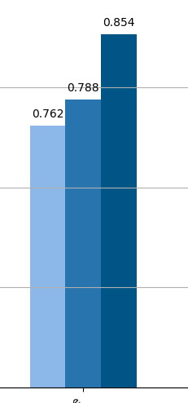
Notes:
Here is the accuracy of the decision tree, and then I built a random forest model based on the decision tree

Slide 12
PART 03
Random Forest
Notes:
Random Forests reduce the risk of overfitting and can handle a large number of input variables efficiently.

Slide 13
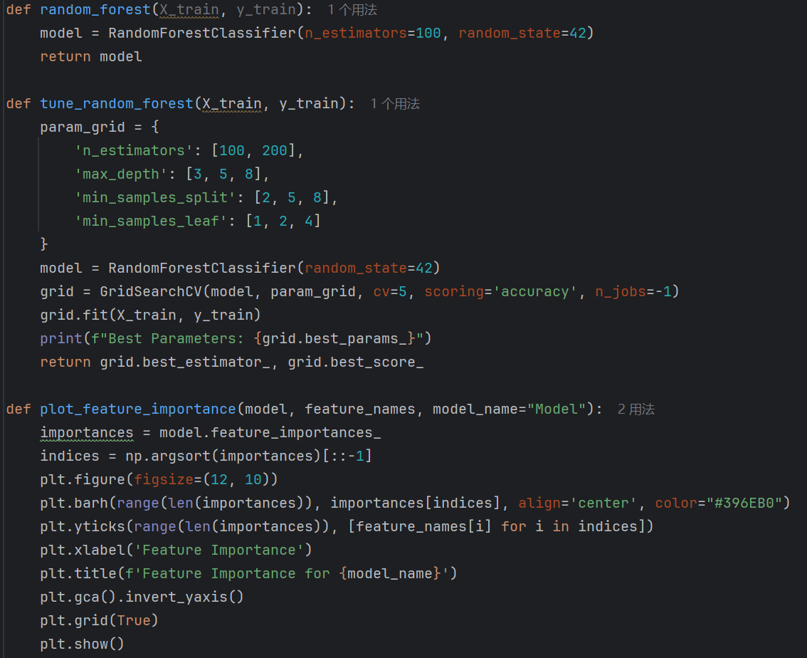
Notes:
Similarly, visualize the features importance

Slide 14
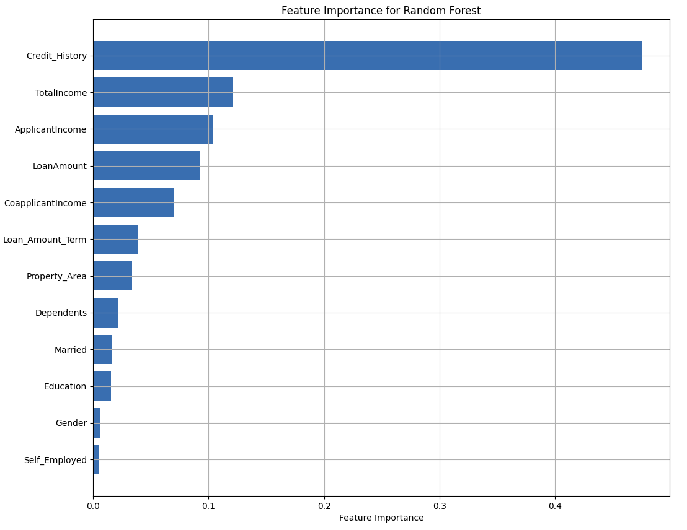
Notes:
Compared to logistic regression, the importance of marriage and education is lower here. This difference arises because random forests capture nonlinear interactions, for example, income and marriage combined might matter more than marriage alone, while logistic regression isolates linear effects.

Slide 15
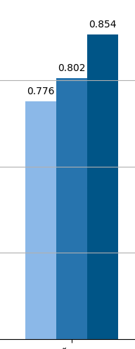
Notes:
Here is the accuracy of random forest.

Slide 16
PART 04
XGBoost
Notes:
XGBoost uses gradient boosting to build a sequence of optimized trees.

Slide 17
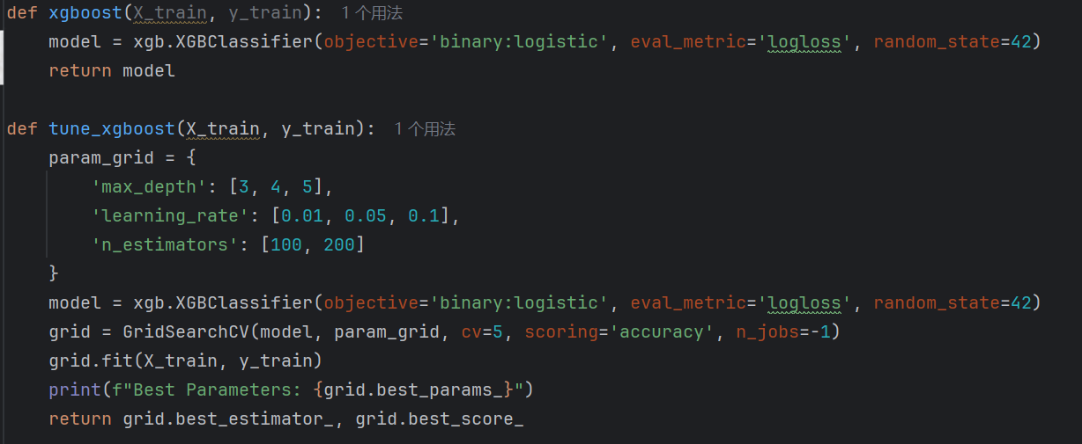
Notes:
It presents a more refined view of feature contribution.

Slide 18
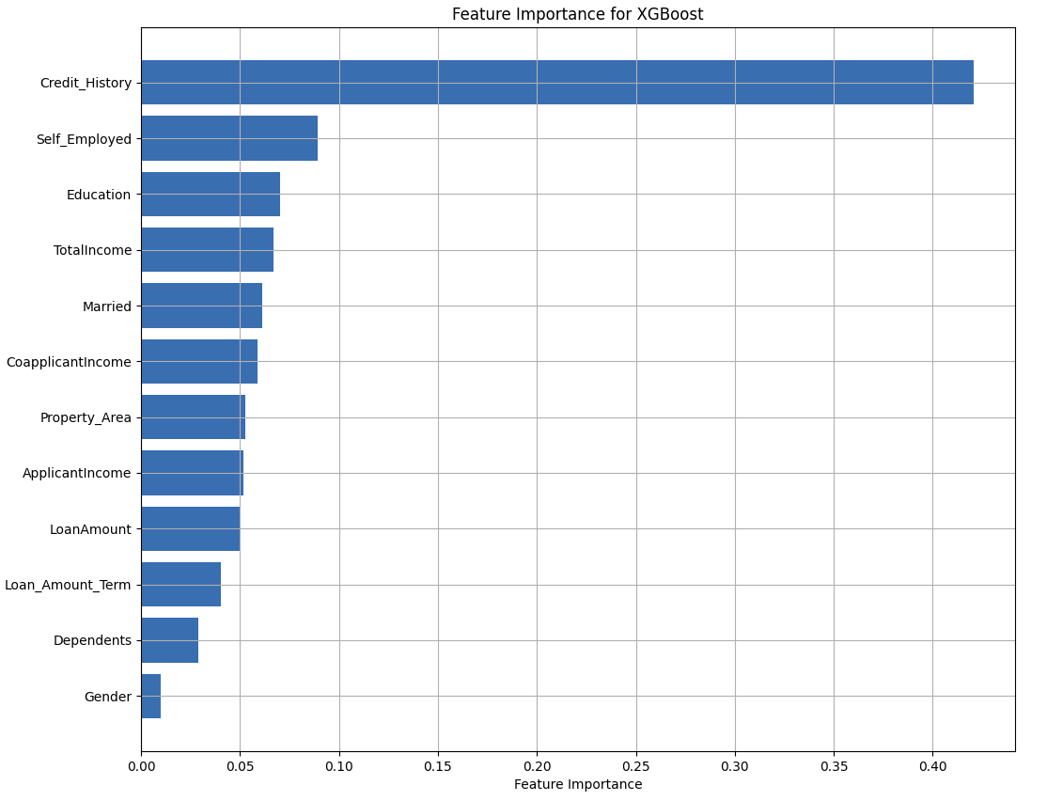
Notes:
XGBoost gives unexpected weight to Self_Employed. This could indicate that self-employment status interact strongly with other features, for example, self-employed applicants might need higher incomes to qualify.

Slide 19
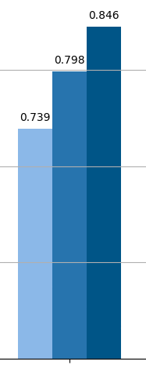
Notes:
Here is the accuracy of XGBoost.

Slide 20
PART 05
Support Vector Machine
Notes:
SVM works well for both linear and non-linear classification.

Slide 21
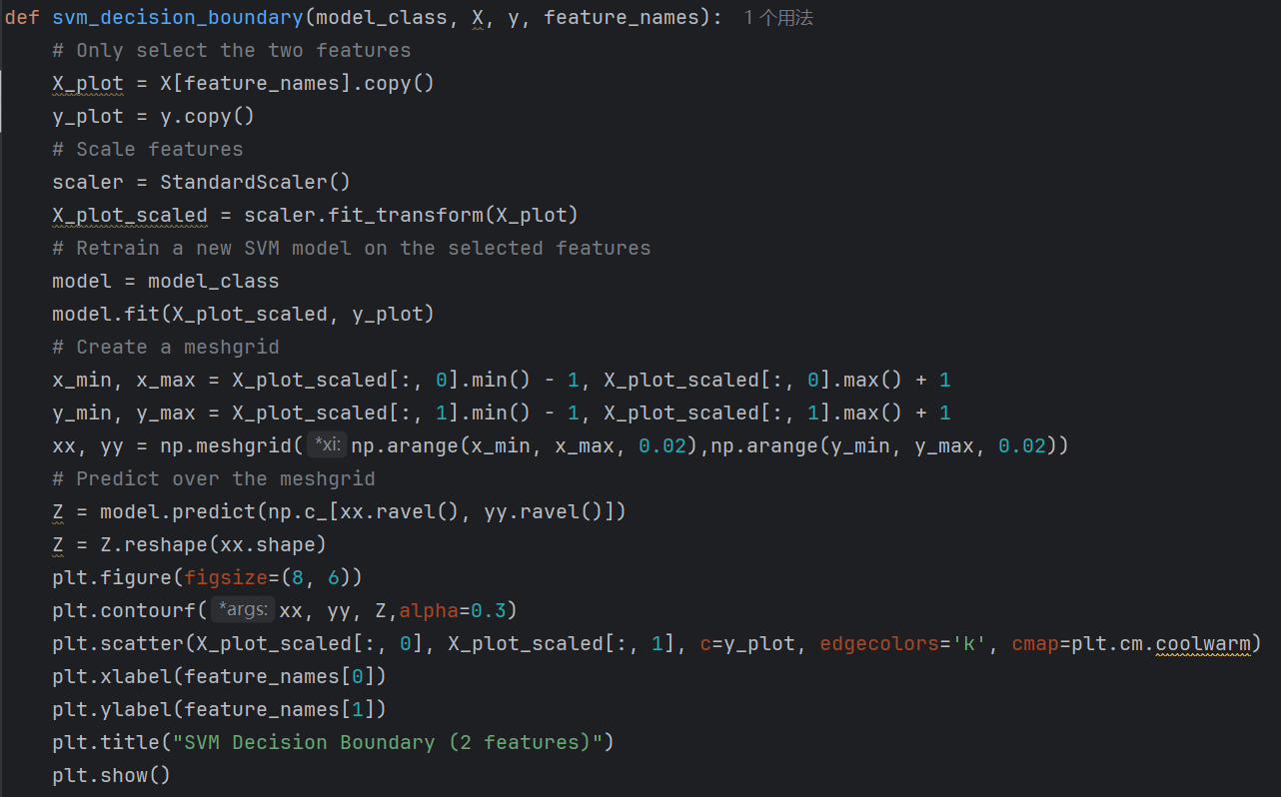
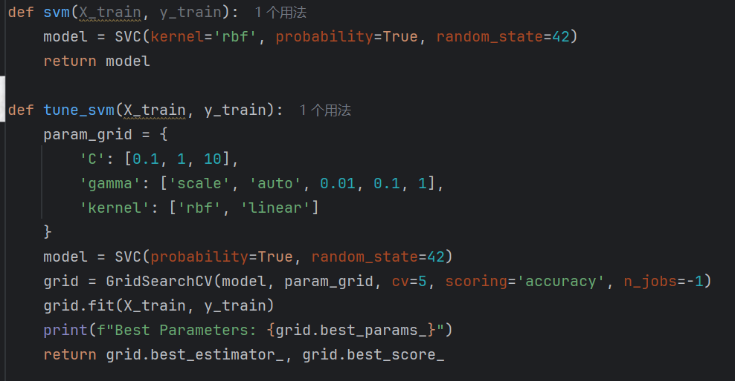
Notes:
Here is the code. For visualization, I select two important features (Credit_History" and "TotalIncome) and plot how SVM separates the classes

Slide 22
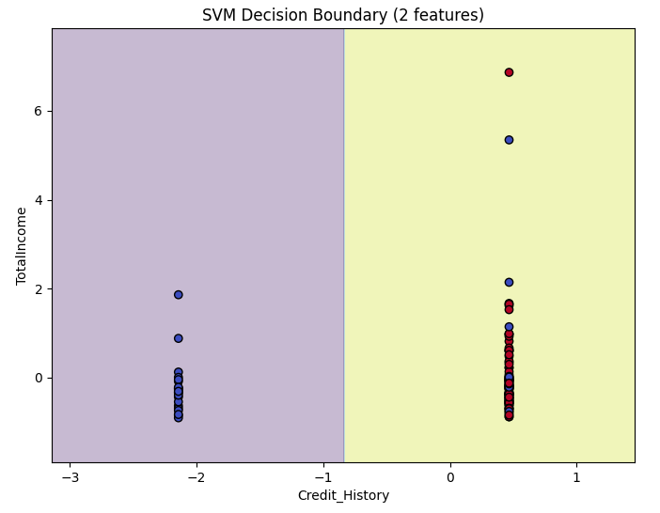
Notes:
Because Credit_History has only two unique values, so points are stacked vertically. SVM decision boundary mainly splits between Credit_History 0 and 1, rather than caring much about income.
The left region with blue dots shows mostly loan not approved. The right region with Credit_History shows mostly loan approved.

Slide 23
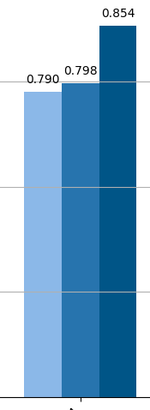
Notes:
Here is the accuracy of SVM.

Slide 24
PART 06
Performance Analysis
Notes:
The different order of feature importance indicates that the models have different decision-making mechanisms. Across all models, Credit_History remains the most important feature, reinforcing its foundational role in loan approval decisions.

Slide 25
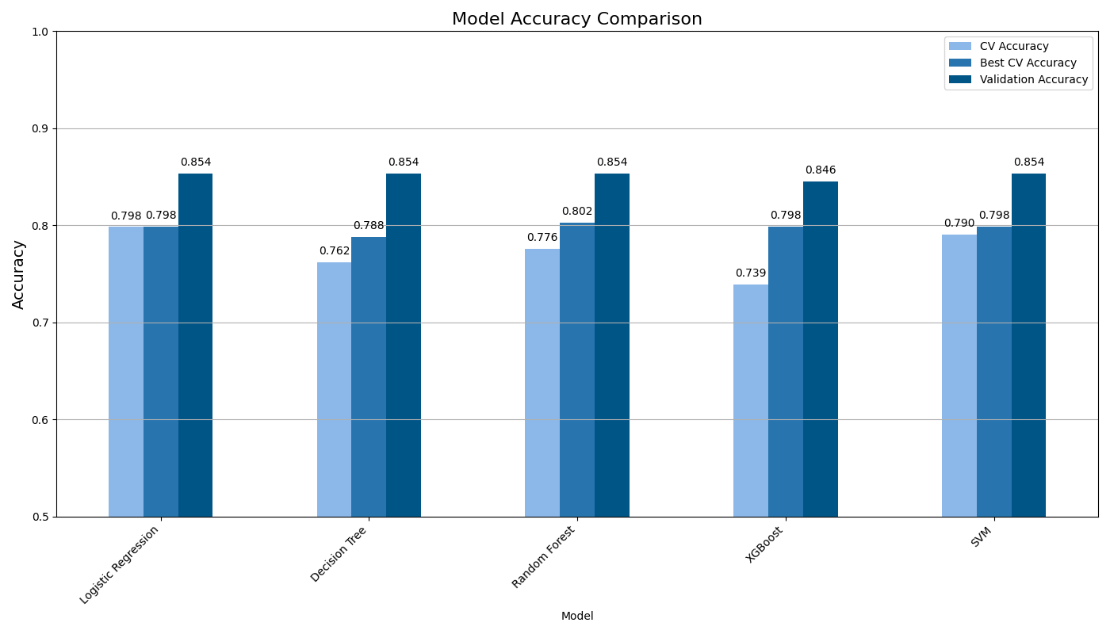
Notes:
We compare the performance of each model vertically first.
Logistic regression and SVM perform the best. This indicates that for this particular dataset, simpler linear models may generalize better to unseen data compared to more complex tree based models. This also indicates that feature engineering and data preprocessing steps effectively shape the data of the model. Other models showed lower performance, indicating possible slight overfitting or sensitivity to data segmentation. All models achieved a validation accuracy of over 84%, which confirms that the project has successfully achieved the goal of building a reliable loan eligibility predictor.

Slide 26
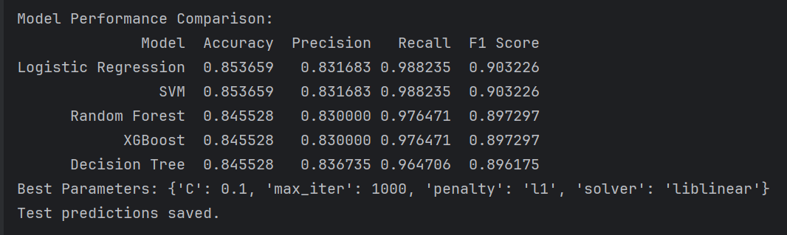
Notes:
Comparing different models, I focus on four indicators. Precision reflect Not granting loans to risky customers，recall reflect Not rejecting eligible customers。F1 Score balances both precision and recall，So I use F1 Score as the main metric to evaluate model.

Slide 27
The dataset likely contains the extremely strong predictive features (like Credit_History)
Data Preprocessing Effects: Common preprocessing steps (like filling missing values in Credit_History) might have homogenized the input space. The feature engineering (like creating TotalIncome) may have provided sufficient signal that all models exploit effectively.
Evaluation Set Limitations: The validation set might be too small or non-representative, causing all models to appear similarly capable.
Logistic Regression:
High and stable performance
Simplicity and interpretability
Computational efficiency
Notes:
We found that the model exhibited similar testing accuracy and metrics.
The reason may be that the dataset may contain very strong predictive features. For example, if the majority of the dataset has Credit_Sistory=1 and it predicts Loan_Status very well individually, then all models will 'agree' and achieve similar accuracy.
Common data processing might have homogenized the input space.
Evaluation Set Limitations: here we only have 20% of 614 samples, a few identical predictions can make models seem more alike than they truly are. The test set might reveal more differentiation in performance.
Finally, I chose logistic regression for the prediction and generated the prediction csv file. Because it performs well on all indicators and the coefficients directly indicate features. And it has lower computational costs, faster speed, and greater scalability.

Slide 28
25Spring: CAS CS506
Final Report
THANKS FOR WATCHING
Leyan Chen(U99402862)

