Slide 1
25Spring: CAS CS506
Midterm Report
Loan Eligibility &
Loan Amount Prediction
Leyan Chen(U99402862)

Slide 2
CONTENTS
1
Project Overview
2
Data Analysis
3
Data Processing
4
Data Modeling

Slide 3
PART 01
Project Overview

Slide 4
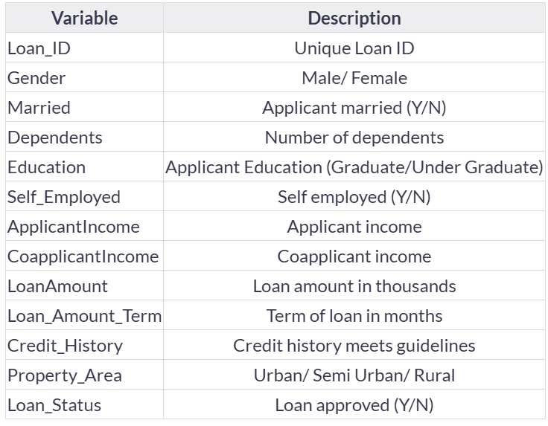
This project aims to build a predictive system for loan eligibility and loan amount estimation.
Loan Eligibility: Determine whether a customer should be approved for a loan based on their financial and demographic profile.
Loan Amount: Estimate the loan amount that can be safely approved for eligible customers.
Data Source: https://www.kaggle.com/datasets/altruistdelhite04/loan-prediction-problem-dataset?resource=download&select=train_u6lujuX_CVtuZ9i.csv

Slide 5
PART 02
Data Analysis

Slide 6
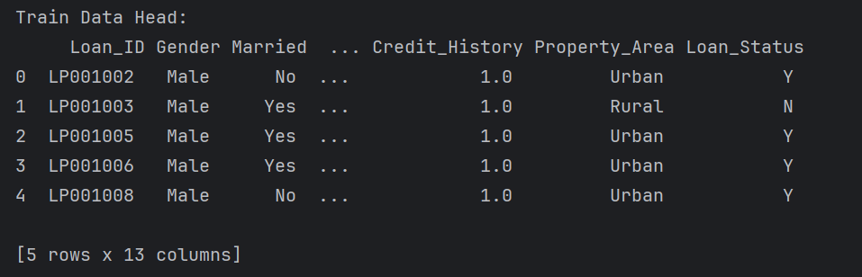
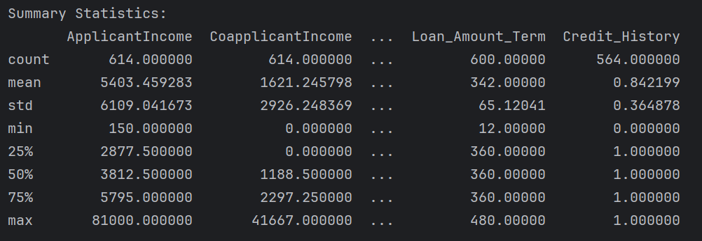

Slide 7
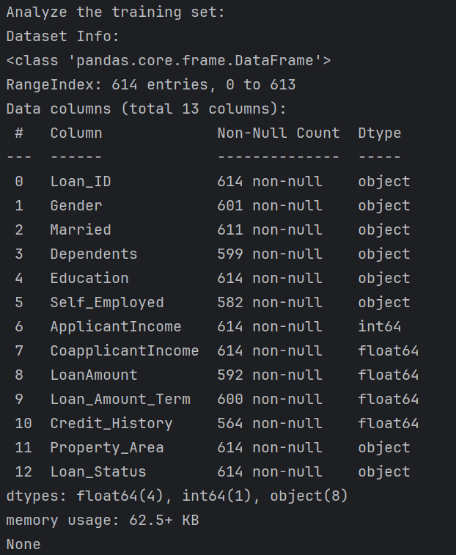
Categorical Features: These features have categories. (Gender, Married, Self_Employed, Credit_History, Loan Status).
Ordinal Features: Variables in categorical features having some order involved.(Dependents, Education, Property_Area).
Numerical Features: These features have numerical values. (ApplicantIncome，CoapplicantIncome, LoanAmount, Loan Amount Term)

Slide 8
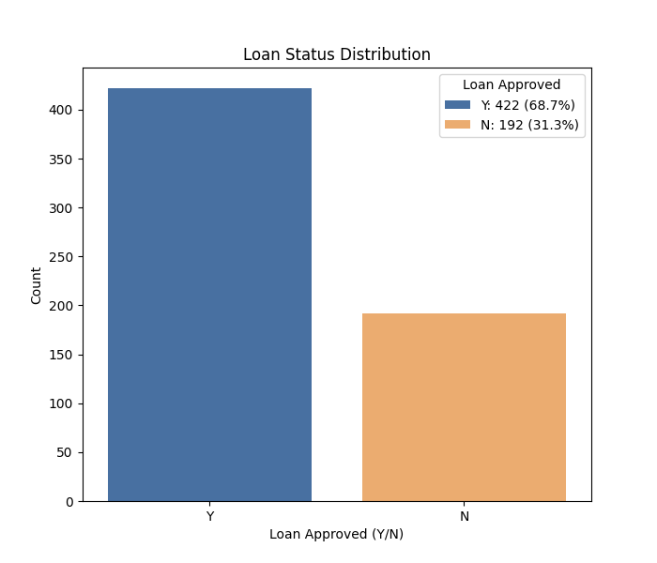
Target Variable (Loan_Status)
请在此处输入文本内容可根据需要修改文字的小和数字请在此处输入请在此处请在此处输入

Slide 9
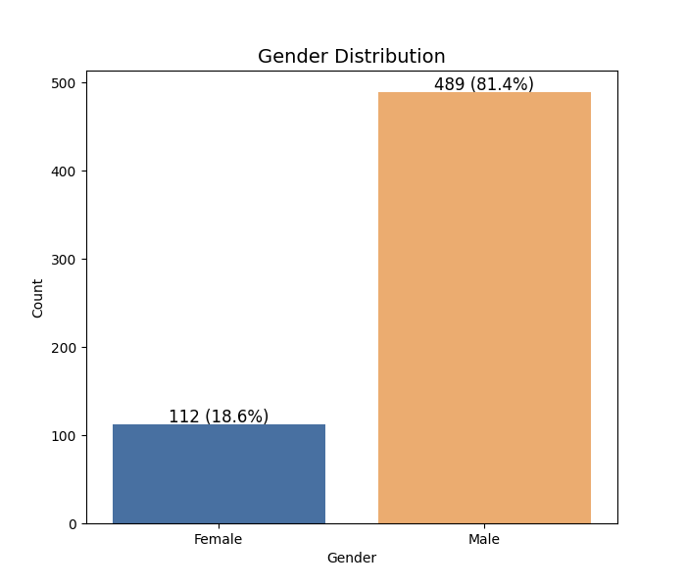
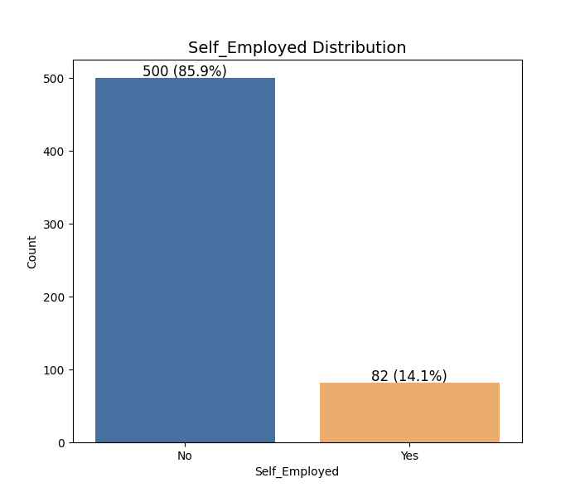
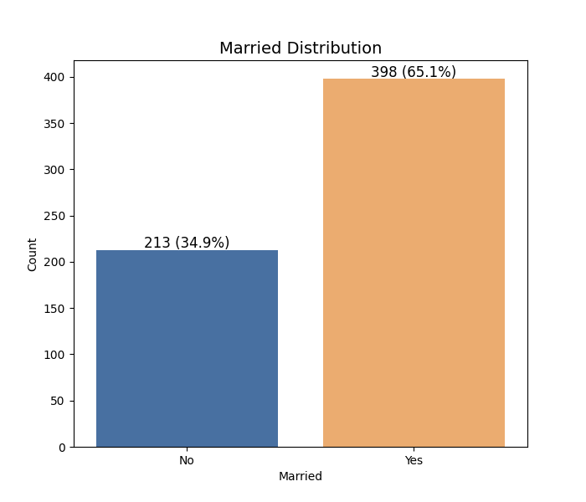
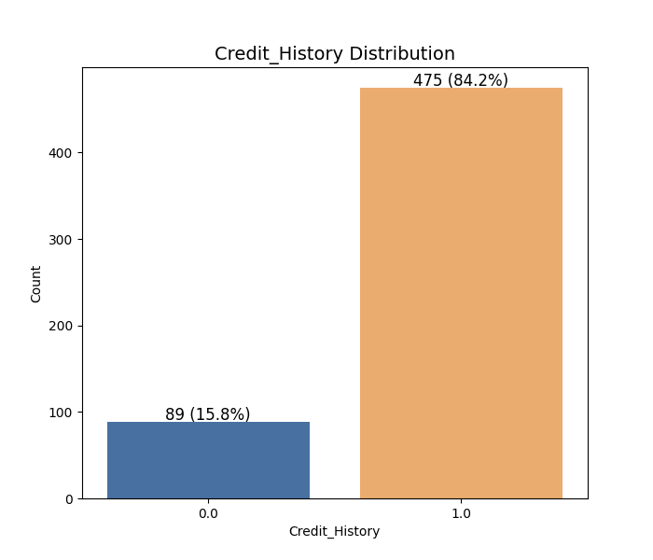
Categorical Feature
请在此处输入文本内容可根据需要修改文字的小和数字请在此处输入请在此处请在此处输入

Slide 10
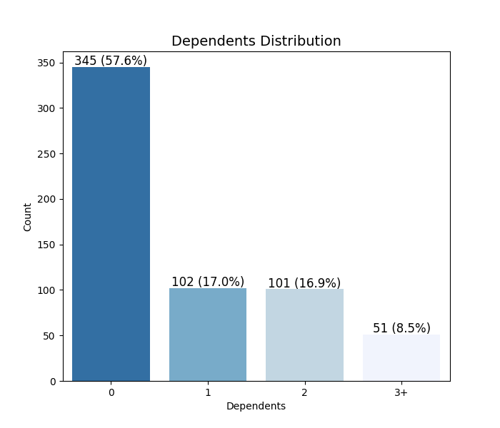
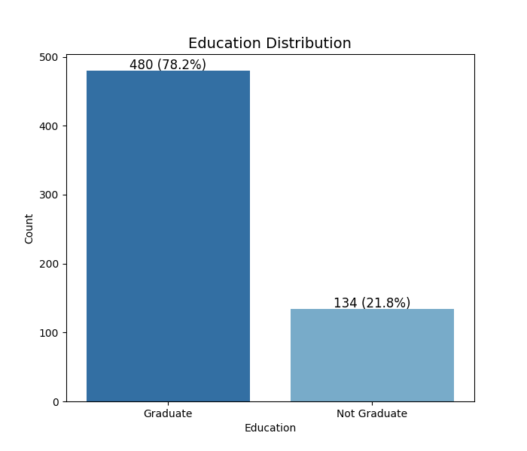
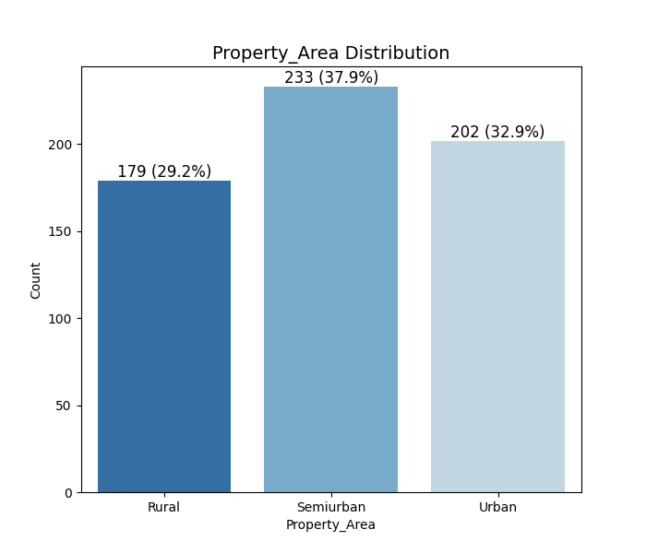
Ordinal Features
请在此处输入文本内容可根据需要修改文字的小和数字请在此处输入请在此处请在此处输入

Slide 11
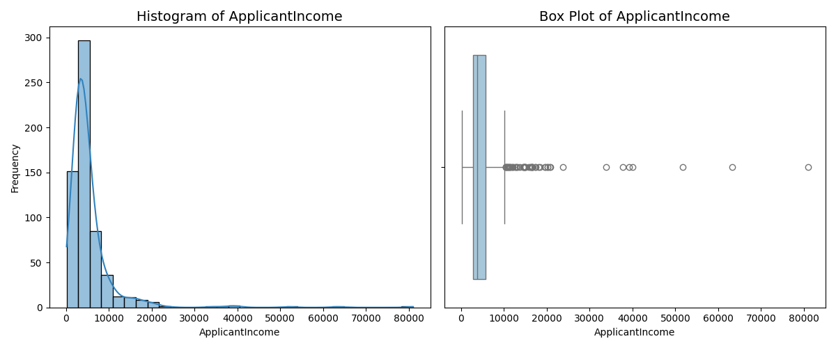
Numerical Features
请在此处输入文本内容可根据需要修改文字的小和数字请在此处输入请在此处请在此处输入

Slide 12
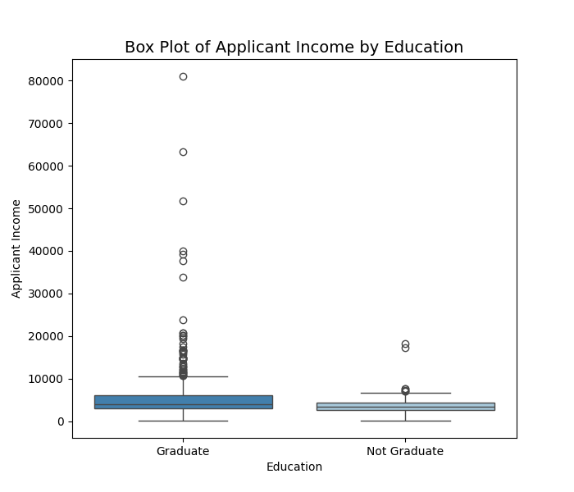
Numerical Features
请在此处输入文本内容可根据需要修改文字的小和数字请在此处输入请在此处请在此处输入

Slide 13
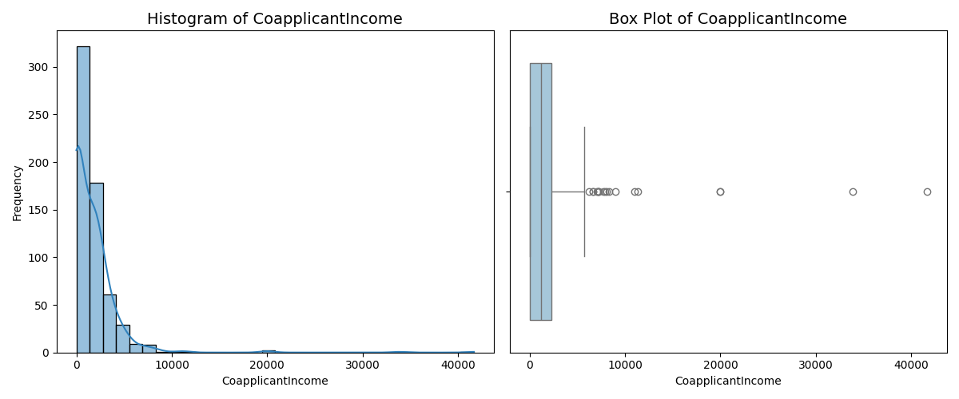
Numerical Features
请在此处输入文本内容可根据需要修改文字的小和数字请在此处输入请在此处请在此处输入

Slide 14
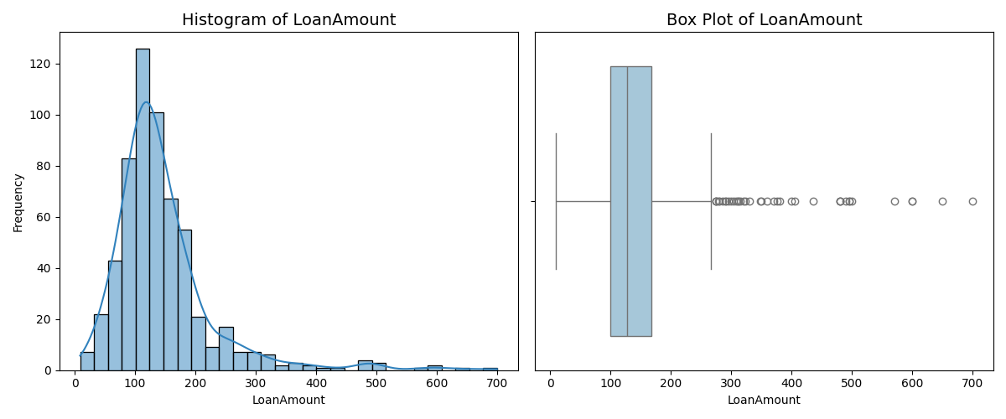
Numerical Features
请在此处输入文本内容可根据需要修改文字的小和数字请在此处输入请在此处请在此处输入

Slide 15
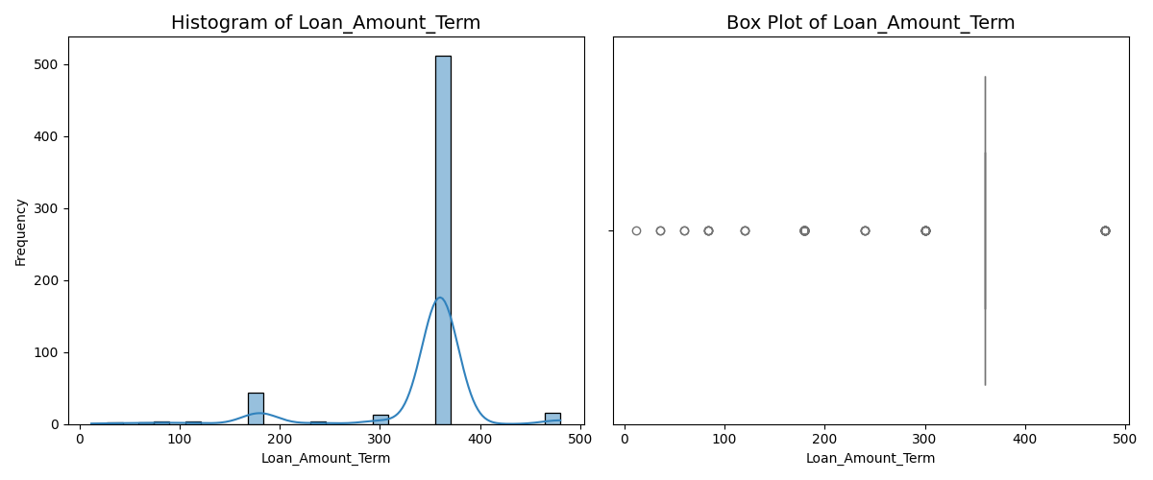
Numerical Features
请在此处输入文本内容可根据需要修改文字的小和数字请在此处输入请在此处请在此处输入

Slide 16
Hypothesis
Hypothesis 1: Applicants with higher incomes are more likely to be approved for loans.
Hypothesis 2: Applicants with a credit history are more likely to be approved for loans.
Hypothesis 3: Married applicants are more likely to be approved for loans than unmarried applicants.
Hypothesis 4: The loan amount approved is positively correlated with the applicant’s income.
请在此处输入文本内容可根据需要修改文字的小和数字请在此处输入请在此处请在此处输入

Slide 17
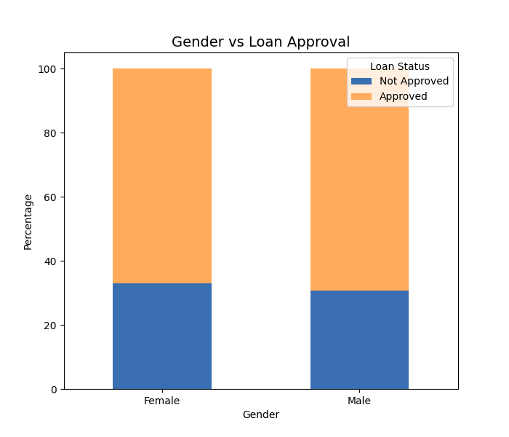
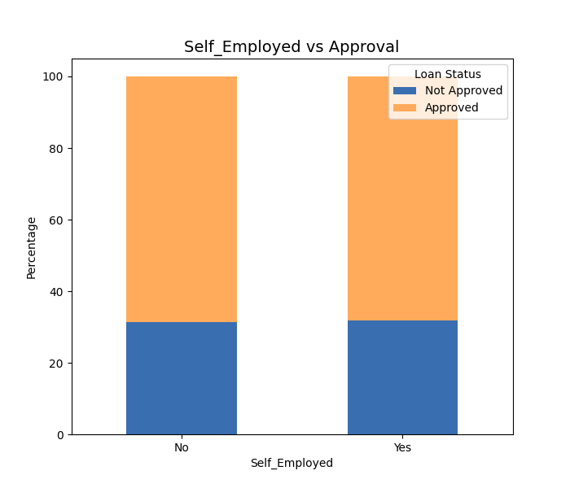
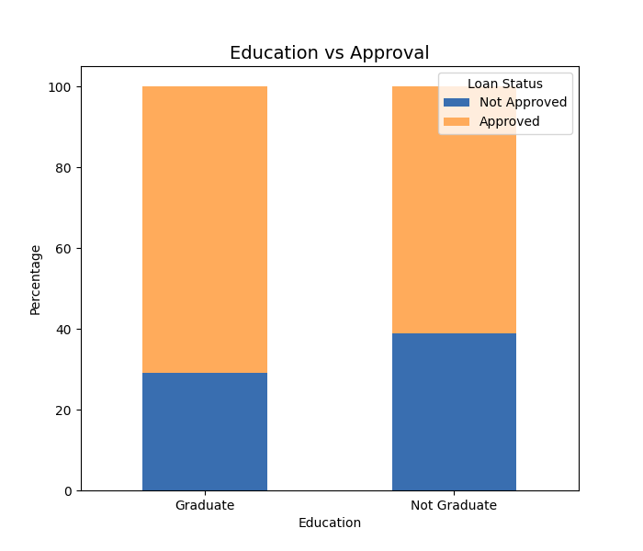
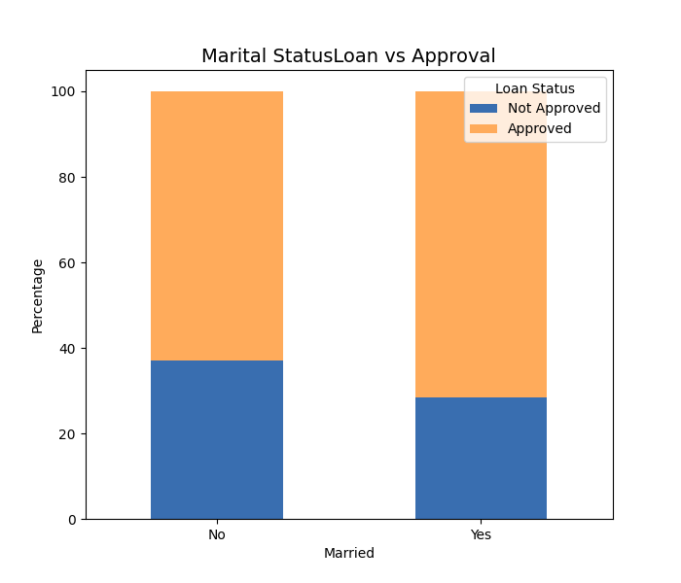
bivariate analysis
请在此处输入文本内容可根据需要修改文字的小和数字请在此处输入请在此处请在此处输入

Slide 18
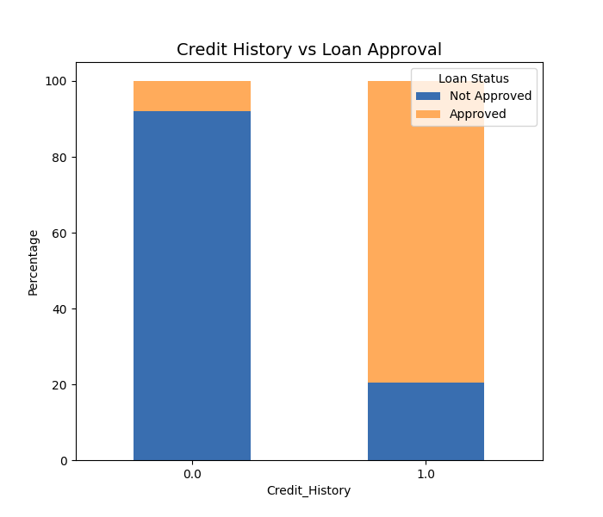
bivariate analysis
请在此处输入文本内容可根据需要修改文字的小和数字请在此处输入请在此处请在此处输入

Slide 19
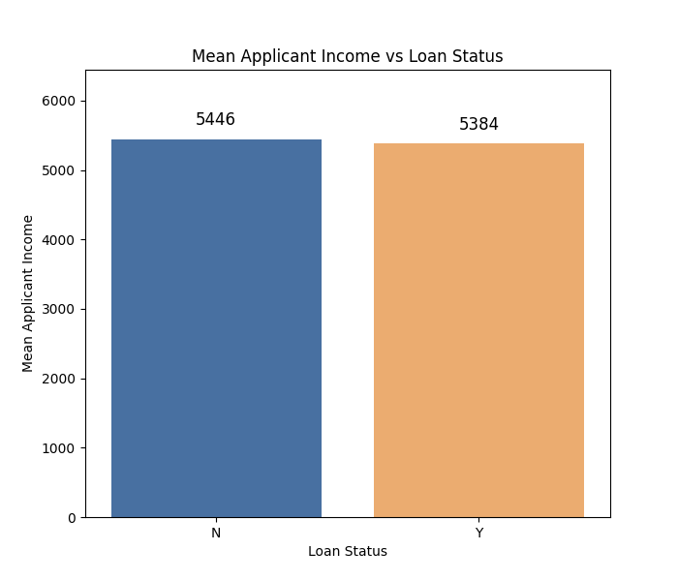
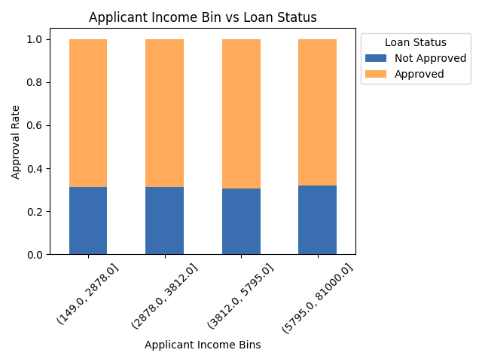
bivariate analysis
请在此处输入文本内容可根据需要修改文字的小和数字请在此处输入请在此处请在此处输入

Slide 20
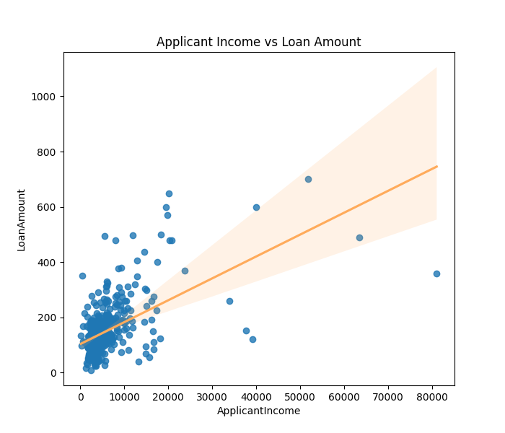
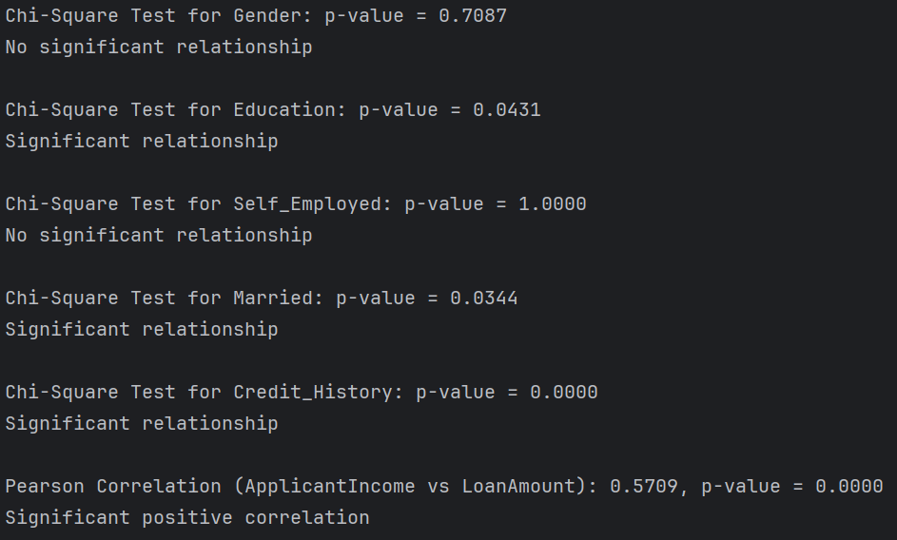
bivariate analysis
请在此处输入文本内容可根据需要修改文字的小和数字请在此处输入请在此处请在此处输入

Slide 21
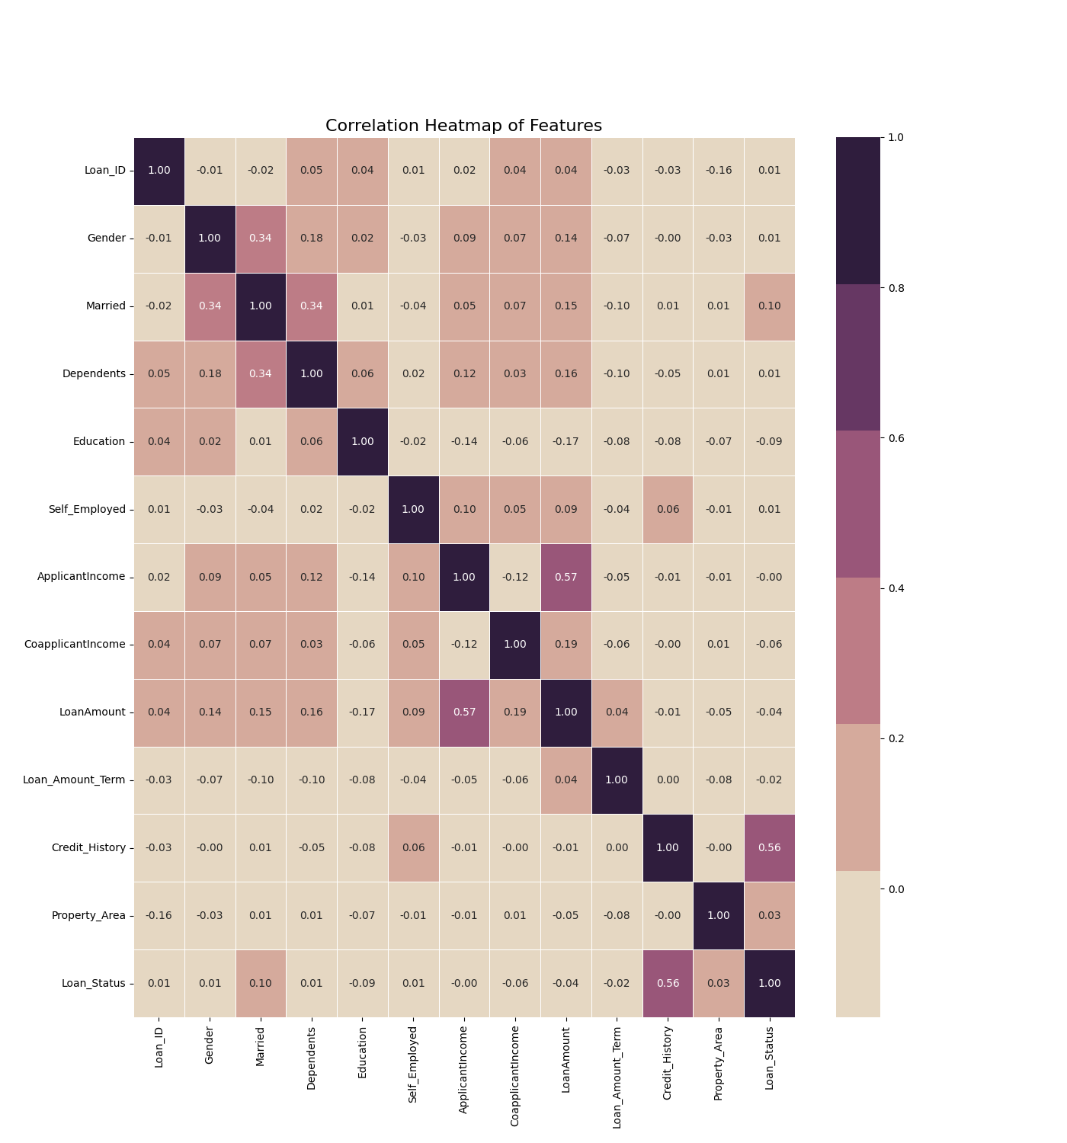
multivariate analysis
请在此处输入文本内容可根据需要修改文字的小和数字请在此处输入请在此处请在此处输入

Slide 22
PART 03
Data Processing

Slide 23
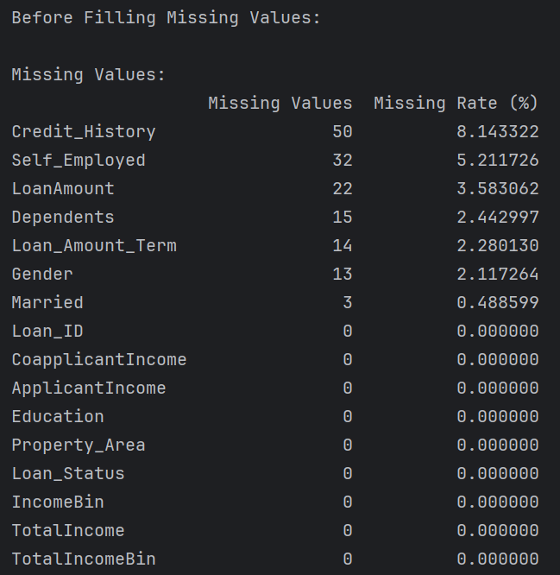
Missing Values
Used mode imputation for categorical features: Credit_Sistory with mode, Missing values for Self_Employed, Dependents, Loan_Amount_Term, Gender, Married.
Used median imputation for numerical feature Loan Amount. (The data distribution of LoanAmount indicates the presence of outliers in the loan amount, so mean imputation is not used because the mean is greatly affected by outliers)
请在此处输入文本内容可根据需要修改文字的小和数字请在此处输入请在此处请在此处输入

Slide 24
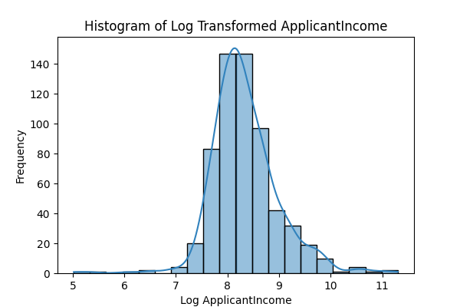
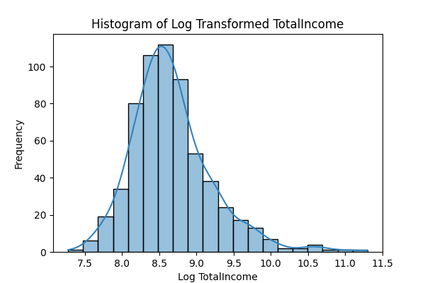
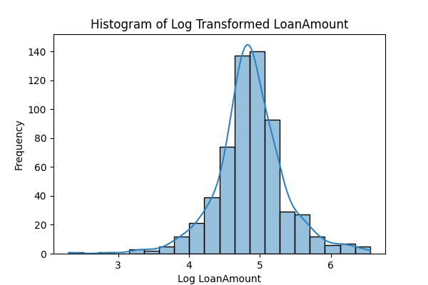
Outliers
请在此处输入文本内容可根据需要修改文字的小和数字请在此处输入请在此处请在此处输入

Slide 25
PART 04
Data Modeling

Slide 26
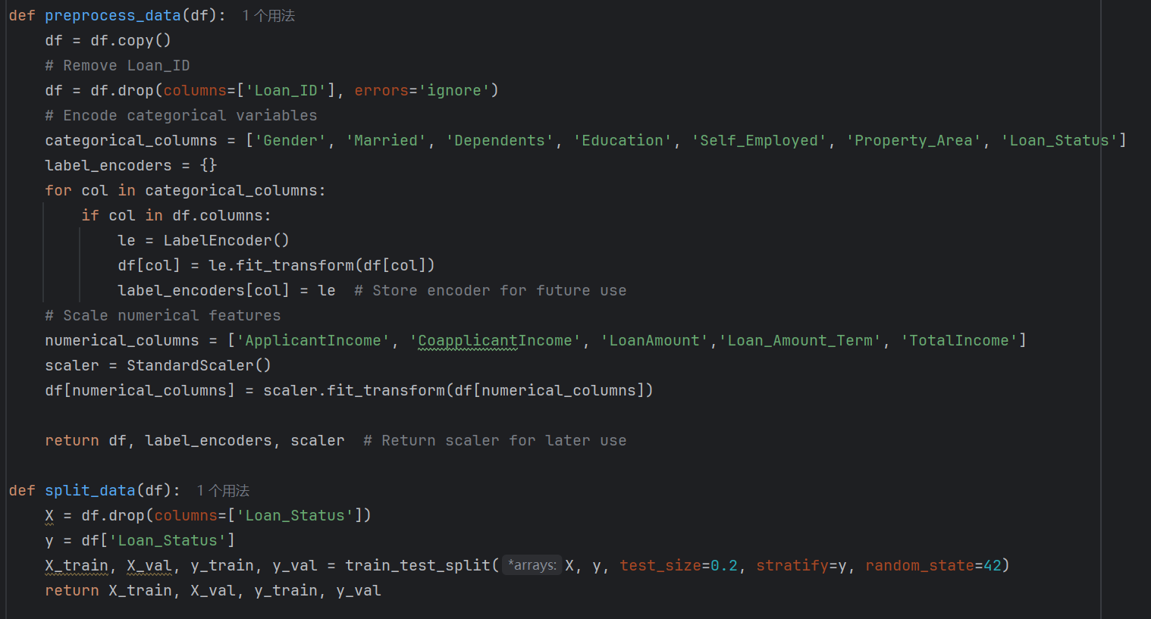

Slide 27
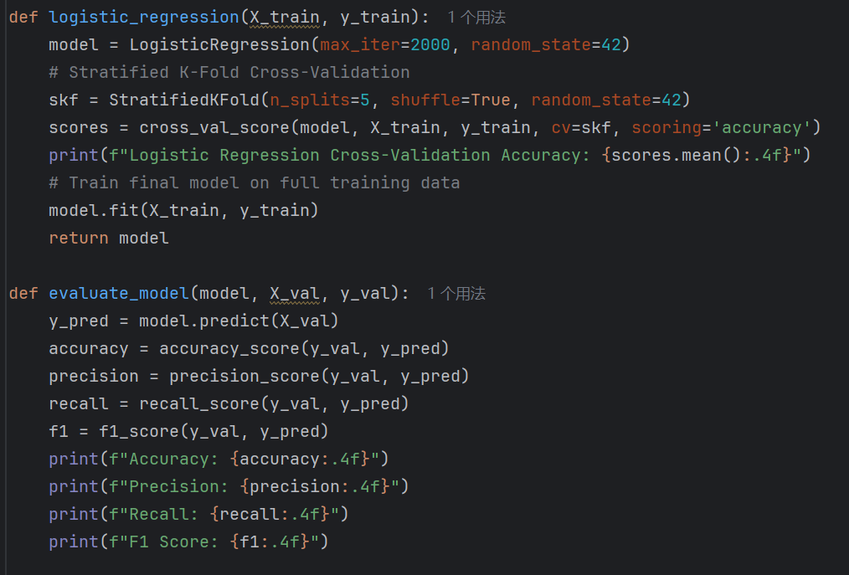
Logistic Regression

Slide 28
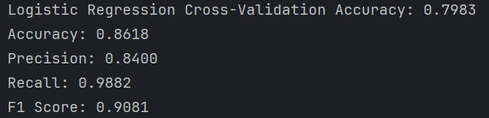
Result

Slide 29
Conclusion
Data analysis (univariate, bivariate, multivariate)
Data processing (missing values, outliers, categorical encoding, Normalization)
Hypothesis validation
Feature engineering (creating new variables)
Logistic regression model training

Slide 30
25Spring: CAS CS506
Midterm Report
THANKS FOR WATCHING
Leyan Chen(U99402862)

