Slide 1
Mathematical optimization ( programming)
algorithms ( terminate in a finite number of steps)
1.Simplex algorithm of George Dantzig, designed for linear programming.
2.Extensions of the simplex algorithm, designed for quadratic programming and for linear-fractional
programming.
3.Variants of the simplex algorithm that are especially suited for network optimization.
4.Combinatorial algorithms
Computational optimization techniques
5.Quantum optimization algorithms
iterative methods ( converge to a solution)
Newton's method in optimization, Quasi-Newton method, Finite difference, Approximation theory, and
Numerical analysis
Heuristics(may provide approximate solutions to some problems

Slide 2
system of linear equations
Richardson method
Jacobi method
Damped Jacobi method
Gauss–Seidel method
Successive over-relaxation method
Symmetric successive over-relaxation
nonlinear programming
iterative methods
Methods that evaluate Hessians (or approximate Hessians, using finite differences):
Newton's method
Sequential quadratic programming
(small-medium)
Interior point methods
Methods that evaluate gradients, or approximate gradients in some way (or even subgradients):
Coordinate descent methods：视作单变量处理
Conjugate gradient methods
(large )
Gradient descent:最速下降法
Quasi-Newton methods（Broyden族:(1-S)*BFGS+S*DFP）
Heuristic algorithm:
Simultaneous perturbation stochastic approximation (SPSA) method
Evolutionary algorithms
trust regions
Genetic algorithms,….
Ellipsoid method

Slide 3
computing contact forces: by solving a linear complementarity problem (quadratic programming)
linear complementarity problem (LCP)
A well-known algorithm for
computing a Nash equilibrium of a 2-player
game is the Lemke-Howson algorithm [13];
however, it has exponential worst-case running
time in the number of available pure strategies
most QP solvers work on the LCP formulation:
1.interior point method(IPM)
2.principal /complementarity pivoting: Lemke's algorithm :polynomial time
a variant of the simplex algorithm of Dantzig
3. active set methods:
Successive linear programming (SLP)
Sequential quadratic programming (SQP) : small-medium
Sequential linear-quadratic programming (SLQP): SLQP suitable to large-scale optimization
abandoned due to the presence of more competitive
methods for this class of problems (e.g. sequential quadratic programming).
The Lemke–Howson algorithm [1] is an algorithm that computes a Nash equilibrium of a bimatrix game, named after its inventors, Carlton E. Lemke and J. T. Howson. It is said to be “the best known among the combinatorial algorithms for finding a Nash equilibrium”.
Criss-Cross Pivoting Rules=Lemke's algorithm
constrained optimization problems
This algorithm can be interpreted
as Lemke’s algorithm [22] for the corresponding linear
complementarity problem (cf. Linear complementarity
problem) [23]. In the 1960s people realized
that pivot sequences through possibly infeasible basic
solutions might result in significantly shorter paths to
the optimum.
penalty methods :罚因子导致的Hessian矩阵病态问题
Lagrange multiplier :收敛慢，要求原函数强凸
Augmented Lagrangian method：罚因子不必趋于无穷

Slide 4
The algorithms for solving linear complementarity problems are of two major types:
1.pivoting (or, direct)
There are two main pivoting algorithms used in processing LCPs：
Lemke’s method
：more robust
principal pivoting method (PPM)
2.iterative (or, indirect).:for the solution of very large linear complementarity problems.
1.The older iterative LCP algorithms are based on equation-solving methods (e. g., Gauss–Seidel, Jacobi, and successive over-relaxation);
2.the more contemporary ones are varieties of the interior point type.
Not unexpectedly, the allowable analysis and applicability of iterative algorithms depend heavily on the matrix class to which M belongs

Slide 5
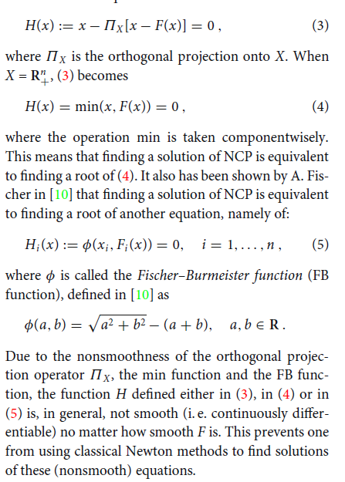
NCP-function method
nonlinear complementarity problem（NCP）
One application of the LCP is in algorithms for the nonlinear complementarity problem.
1.interior point method(IPM)
2.principal /complementarity pivoting:
Lemke‘s algorithm (徐师兄的线性化方法：可以构造LCP逼近NCP的形式)
a variant of the simplex algorithm of Dantzig
3. active set methods:
Successive linear programming (SLP)
Sequential quadratic programming (SQP) : small-medium
Sequential linear-quadratic programming (SLQP): SLQP suitable to large-scale optimization

