Slide 1

IS 042: FOUNDATION OF COMPUTING MATHEMATICS II LECTURE 01

Slide 2
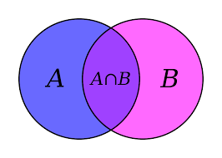
Unit I: Set Theory
Outline:
Introduction to sets

Slide 3
1.1 Introduction to Sets
Set
A set S is any collection of definite, distinguishable objects of our intuition or of our intellect to be conceived as a whole.
A set is a well-defined collection of distinct objects.
The theory of sets was developed by German Mathematician George Cantor (1845 -1918 A.D.)
The objects are called the elements or members of S
Objects, elements and members of a set are synonymous words
Sets are usually denoted by capital letters A, B, C,Y, Z etc.
The elements of a set are represented by small letters a, b, c, x, z etc.

Slide 4
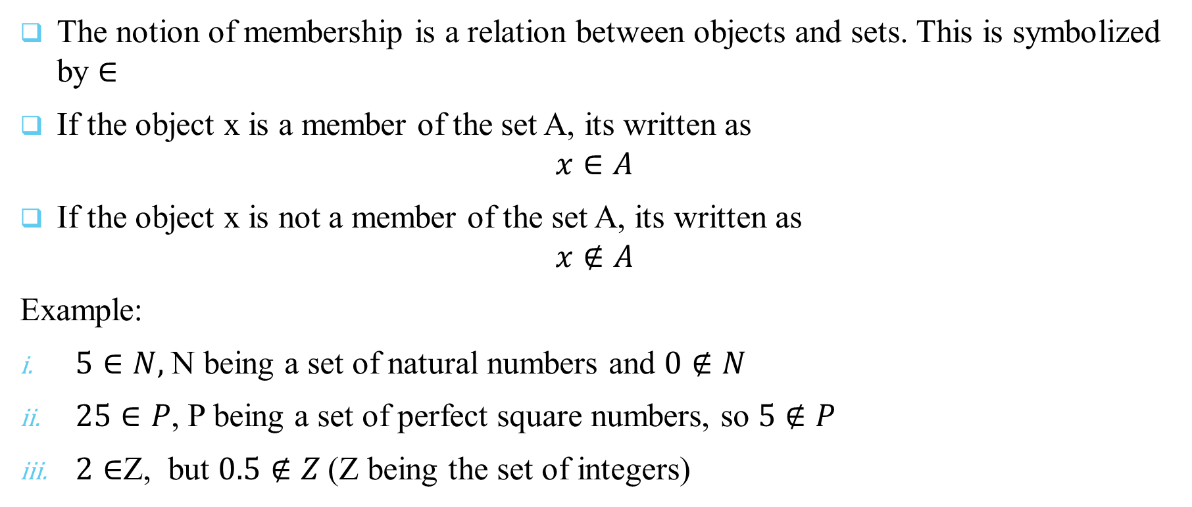
The Basis of Intuitive Set Theory
The notion of membership is a relation between objects and sets. This is symbolized by $∈$
If the object x is a member of the set A, its written as
$$x∈A$$
If the object x is not a member of the set A, its written as
$$x∉A$$
Example:
$5∈N,$N being a set of natural numbers and $0∉N$
$25∈P$, P being a set of perfect square numbers, so $5∉P$
$2∈$Z, but $0.5∉Z$(Z being the set of integers)

Slide 5
Representation of Sets
Sets are generally represented by the following two ways:
Roster or Tabular form
Rule Method or Set builder form

Slide 6
Representation of Sets
Roster or Tabular Form
In this form, all the elements of a set are listed, the elements are being separated by commas and are enclosed within braces { }.
E.g.
The set of all natural numbers less than 5 is represented as {1, 2, 3, 4}
The set of all factors of 50 is {1, 2, 5, 10, 25, 50}
The set of all distinct letters in the word FOUNDATION is {F, O, U, N, D, A, T, I}
The set of even natural numbers is {2, 4, 6, 8, …}

Slide 7
Representation of Sets
NOTE:
In a set notation, order is not important. Hence, example (ii) can also be written as {5, 1, 10, 2, 20, 25}
The elements of a set are generally not repeated in a particular set as in example (iii)
The dots in example (iv) reveal that the list is endless (continued)

Slide 8
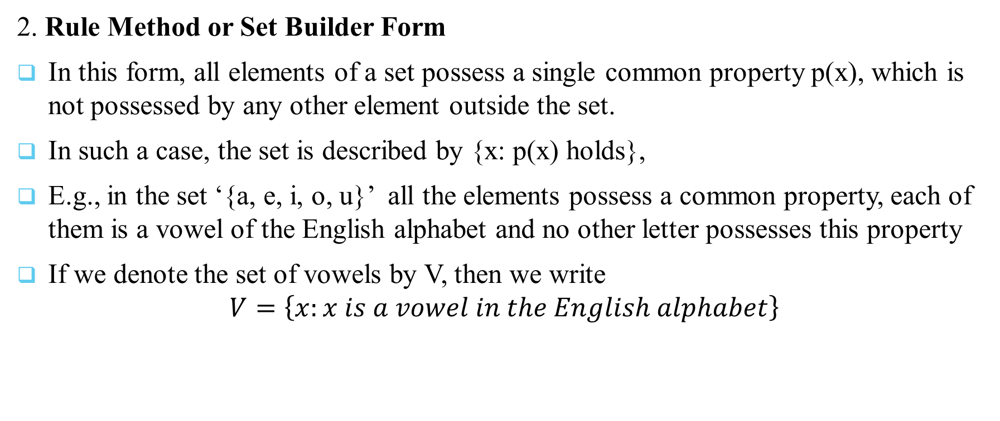
Representation of Sets
2. Rule Method or Set Builder Form
In this form, all elements of a set possess a single common property p(x), which is not possessed by any other element outside the set.
In such a case, the set is described by {x: p(x) holds},
E.g., in the set ‘{a, e, i, o, u}’ all the elements possess a common property, each of them is a vowel of the English alphabet and no other letter possesses this property
If we denote the set of vowels by V, then we write
$$V=\left\{x:x is a vowel in the English alphabet\right\}$$

Slide 9
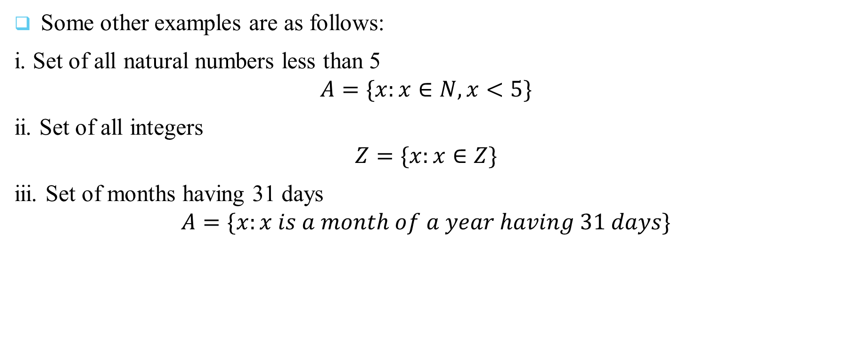
Representation of Sets
Some other examples are as follows:
i. Set of all natural numbers less than 5
$$A=\{x:x∈N, x<5\}$$
ii. Set of all integers
$$Z=\{x:x∈Z\}$$
iii. Set of months having 31 days
$$A=\{x:x is a month of a year having 31 days\}$$

Slide 10
THANK YOU:

