Slide 1
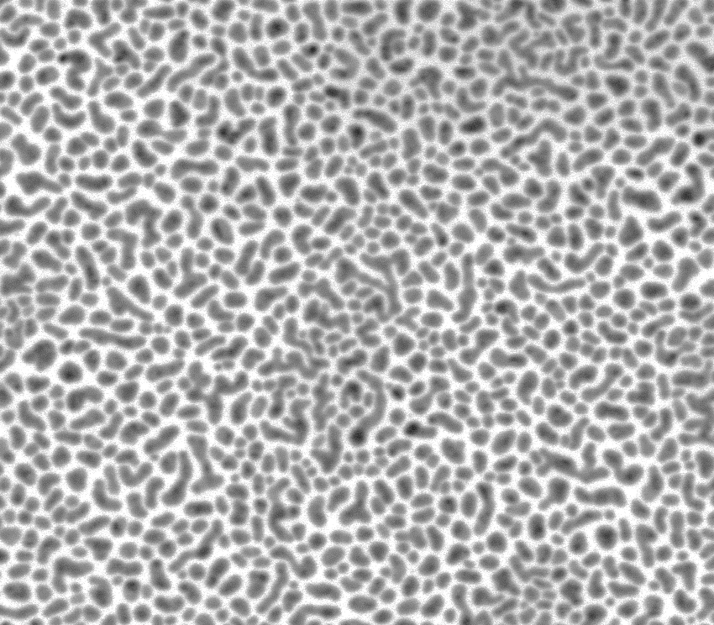
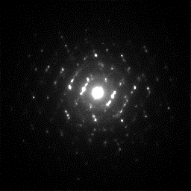
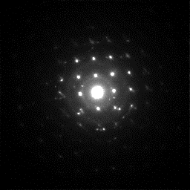
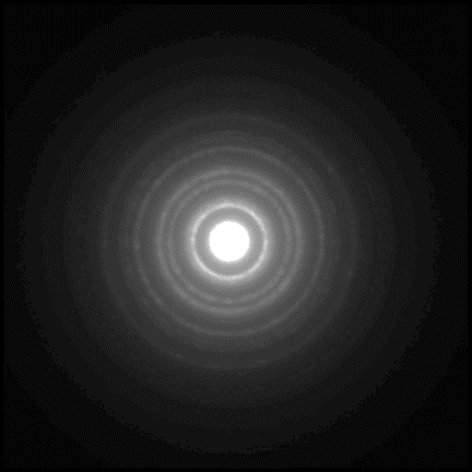
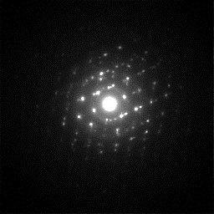

4D-STEM/PNBD method = powder electron diffraction in a SEM microscope
(1) STEM micrograph of
nanocrystals (black spots).
Here we define a 2D array
of beam positions for the
following data collection.
(2) 4D-STEM = a 2D-array of 2D-diffraction patterns; each beam position (represented by a red point on STEM) yields a diffractogram.
(3) 4D-STEM/PNBD: All
individual diffractograms
are combined into one
simple powder electron
diffraction pattern.
This is performed with SEM software.
This is done with STEMDIFF package.

