Slide 1

PROJECT REPORT
FOUNDATION OF AI APPLICATION LAB
Submitted By
SURYAVEER

Slide 2

E & D TOOL
A Python based encryption and decryption tool that encrypt and decrypt files with password.

Slide 3



We live in era of technology And we deal with lot of information every second

Slide 4

About 6000 tweets are tweeted every second and about 4500 snaps are posted every second

Slide 5


Are these information safe
We need to protect these information we need to encrypt it and to make it usable in public we need a secure system to decrypt it also.

Slide 6

In 2015 about 25% of global data required security but are not protected according to Statista
AS OF 2019, CYBER-ATTACKS ARE CONSIDERED AMONG THE TOP FIVE RISKS TO GLOBAL STABILITY ACCORDING TO WORLD ECONOMICS FORUM
OVER PAST 10YEARS , THERE HAVE 300 DATA BREACHESES ACCORDING TO FORBES
SO, WE NEED TO PROTECT ALL THESE DATAS BY ENCRYPTING THEM .

Slide 7

OUR PROJECT
It is a tool which encrypts and decrypts information using GUI. It is simple to use powerful and fast.

Slide 8
PYTHON
Python is an interpreted, object-oriented, high-level programming language with dynamic semantics. Its high-level built in data structures, combined with dynamic typing and dynamic binding, make it very attractive for Rapid Application Development, as well as for use as a scripting or glue language to connect existing components together. Python's simple, easy to learn syntax emphasizes readability and therefore reduces the cost of program maintenance.

Slide 9
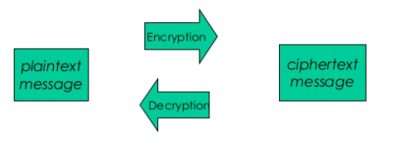
INTRODUCTION
Encryption
Encryption is the process of converting data to an unrecognizable or "encrypted" form.
Decryption
Decryption is a process of converting encrypted data to original data.

Slide 10


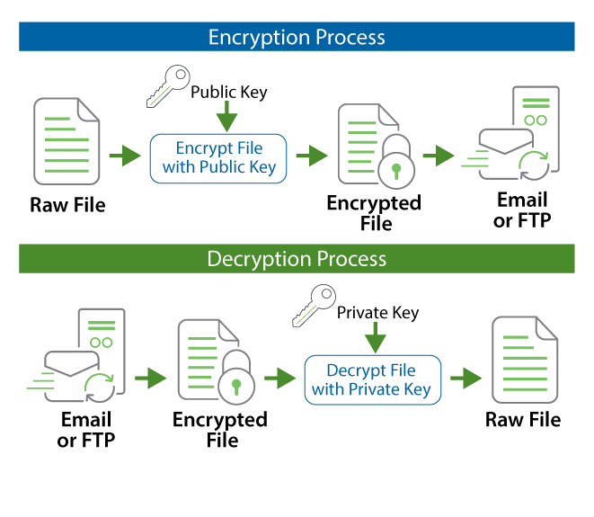

Slide 11
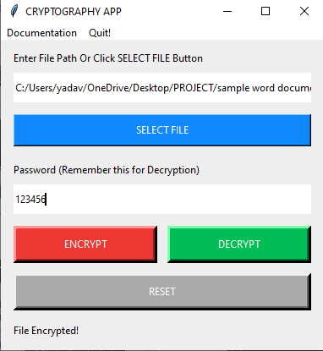
How program works
Encryption of File
STEP 1. Firstly we have to inset file path or have to select the file which we want to encrypt
STEP 2. Then we have to enter the secret key (password) which we have to remember for decryption.
STEP 3. Then we have to click on Encrypt button to encrypt the file.
After clicking encrypt button the file gets encrypted at the original place it located before.

Slide 12
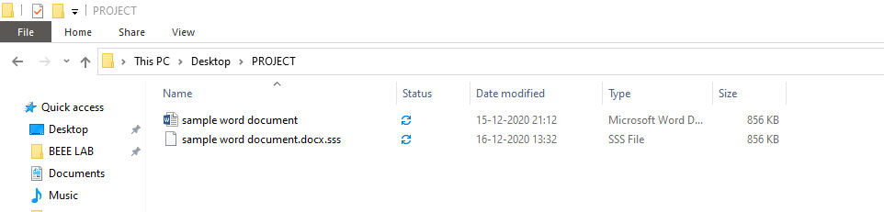
FILE AFTER ENCRYPTION
Original file
Encrypted file

Slide 13
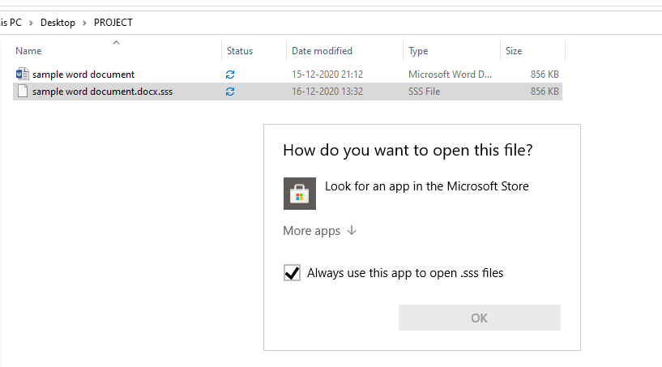
When we try to open that encrypted file
When we try to open that file it does not open windows does not find any compatible software to open that file.

Slide 14

DECRYPTION OF FILE
STEP 1. Firstly we have to insert file path or have to select the encrypted file which we want to decrypt
STEP 2. Then we have to enter the secret key (password) which we entered during encryption.
STEP 3. Then we have to click on Decrypt button to decrypt the file.
After clicking decrypt button the file gets decrypted and a new file generated with filename+_decrypted name.

Slide 15
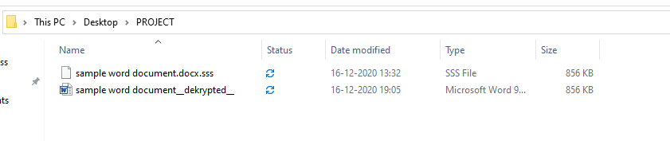
File After Decryption
Encrypted file
Decrypted file

Slide 16
Features of this Program
Easy to use exe with GUI (No prior programming required)
Works with Linux or Mac having python3.7
Cross platform Support
Use SHA256 Algorithm for encryption so it is secure
Can Encrypt or decrypt any type of file format
Fast and Responsive

Slide 17
Thank YOU

