Slide 1
Lab 7 – Singular Value Decomposition
CS 506

Slide 2
Feature Extraction
Uncovering relevant features for the task at hand
Typically desire high variance, low correlation data

Slide 3

Structure of dataset
$$A=\left(\begin{matrix}x_{11} & ⋯ & x_{1j} & ⋯ & x_{1m} \\ ⋮ & ⋱ & ⋮ & ⋱ & ⋮ \\ x_{i1} & ⋯ & x_{ij} & ⋯ & x_{im} \\ ⋮ & ⋱ & ⋮ & ⋱ & ⋮ \\ x_{n1} & ⋯ & x_{nj} & ⋯ & x_{nm}\end{matrix}\right)$$

Slide 4



Structure of dataset
$$\left(\begin{matrix}x_{11} & ⋯ & x_{1j} & ⋯ & x_{1m} \\ ⋮ & ⋱ & ⋮ & ⋱ & ⋮ \\ x_{i1} & ⋯ & x_{ij} & ⋯ & x_{im} \\ ⋮ & ⋱ & ⋮ & ⋱ & ⋮ \\ x_{n1} & ⋯ & x_{nj} & ⋯ & x_{nm}\end{matrix}\right)$$
$n$ data points
$m$ features

Slide 5
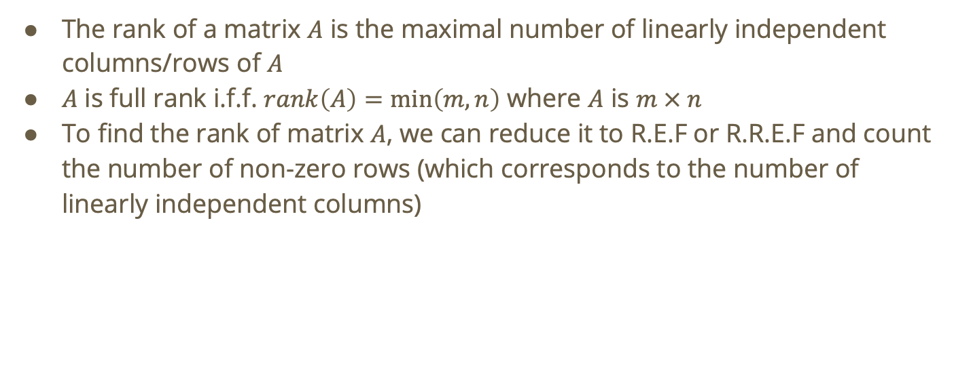
Recall: Rank
The rank of a matrix $A$ is the maximal number of linearly independent columns/rows of $A$
$A$ is full rank i.f.f. $rank\left(A\right)=\min\left(m,n\right)$ where $A$ is $m × n$
To find the rank of matrix $A$, we can reduce it to R.E.F or R.R.E.F and count the number of non-zero rows (which corresponds to the number of linearly independent columns)

Slide 6

Recall: Matrix Factorization
Any matrix $A$ of rank $k$ can be factored as
$$A = UV$$
Where $U$ is $n × k$ and $V$ is $k × m$

Slide 7
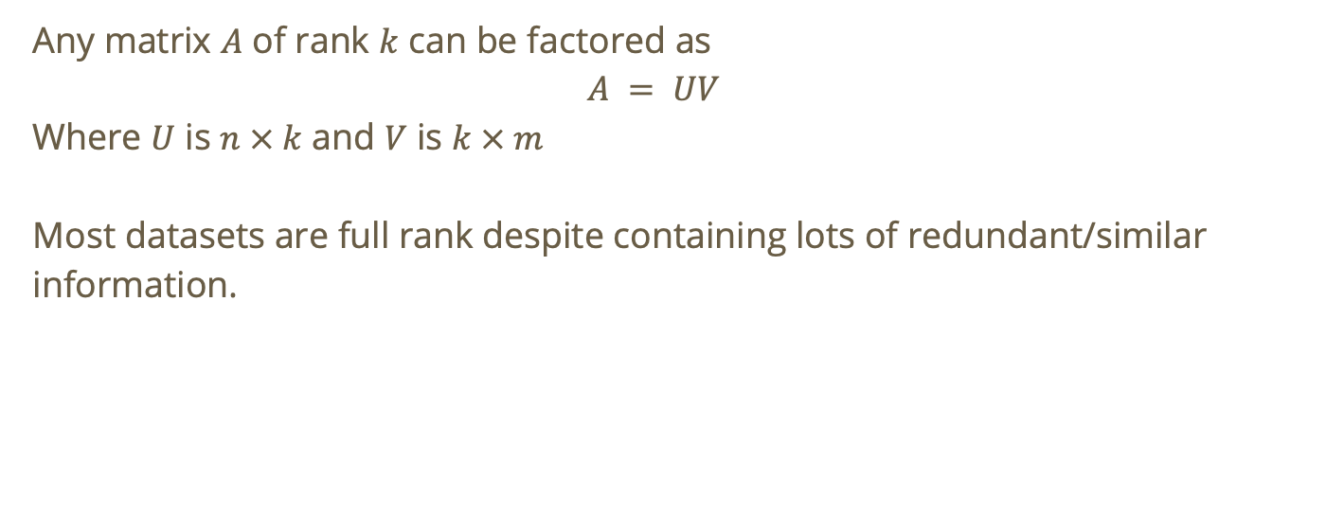
Recall: Matrix Factorization
Any matrix $A$ of rank $k$ can be factored as
$$A = UV$$
Where $U$ is $n × k$ and $V$ is $k × m$
Most datasets are full rank despite containing lots of redundant/similar information.

Slide 8
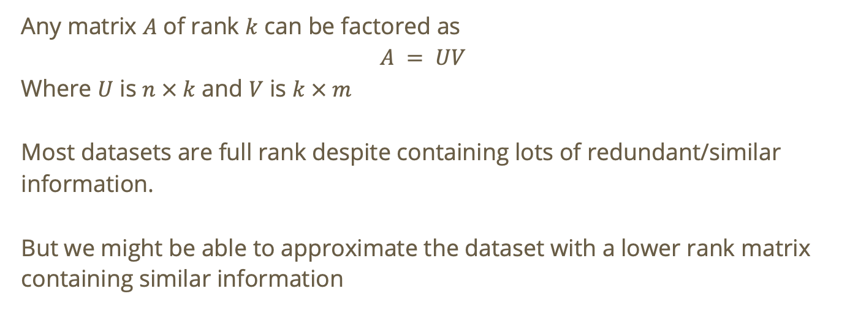
Recall: Matrix Factorization
Any matrix $A$ of rank $k$ can be factored as
$$A = UV$$
Where $U$ is $n × k$ and $V$ is $k × m$
Most datasets are full rank despite containing lots of redundant/similar information.
But we might be able to approximate the dataset with a lower rank matrix containing similar information

Slide 9
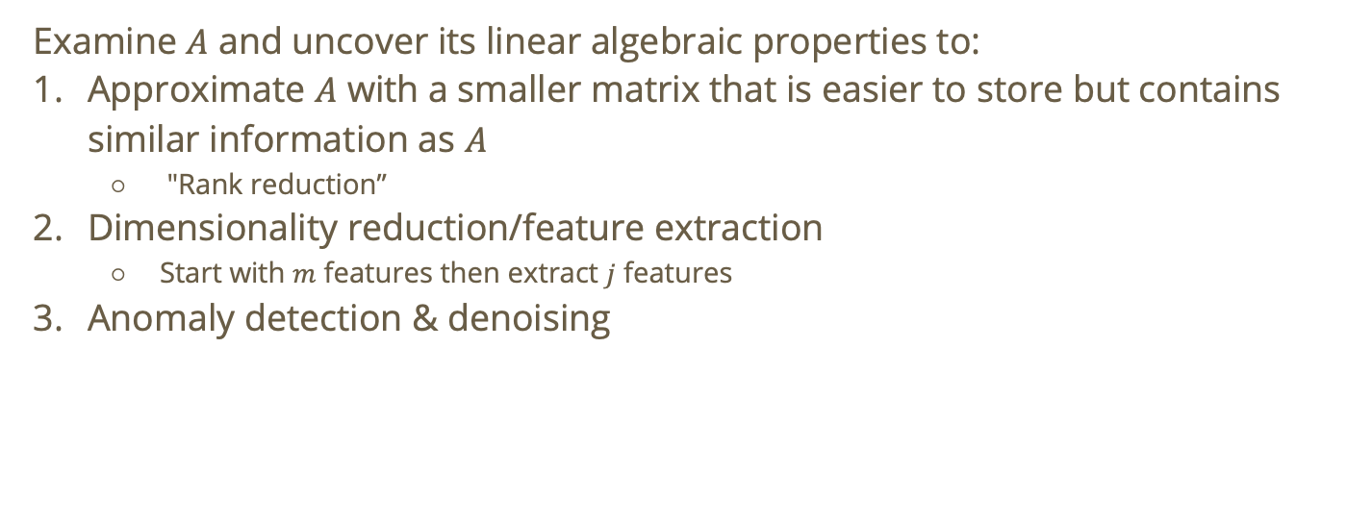
Goal
Examine $A$ and uncover its linear algebraic properties to:
Approximate $A$ with a smaller matrix that is easier to store but contains similar information as $A$
  "Rank reduction”
Dimensionality reduction/feature extraction
  Start with $m$ features then extract $j$ features
Anomaly detection & denoising

Slide 10
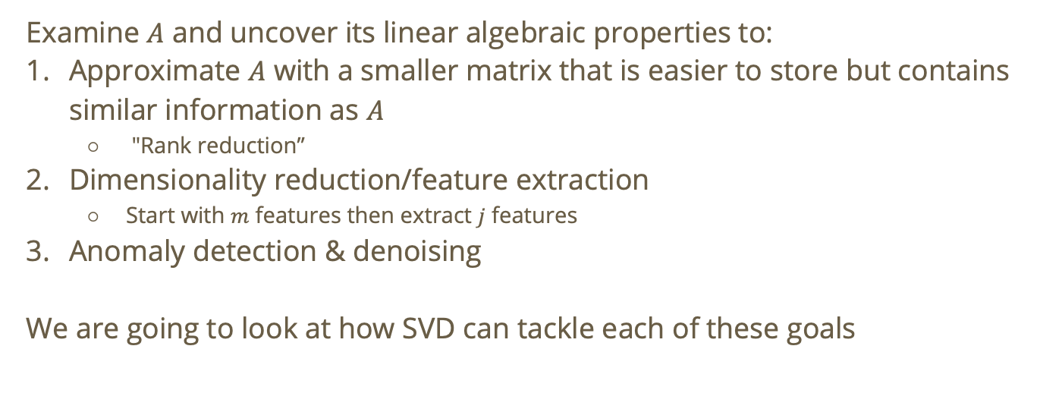
Goal
Examine $A$ and uncover its linear algebraic properties to:
Approximate $A$ with a smaller matrix that is easier to store but contains similar information as $A$
  "Rank reduction”
Dimensionality reduction/feature extraction
  Start with $m$ features then extract $j$ features
Anomaly detection & denoising
We are going to look at how SVD can tackle each of these goals

Slide 11
Singular Value Decomposition (SVD)
SVD is a tool for processing data to extract high variance and linearly independent features

Slide 12

Singular Value Decomposition (SVD)
SVD is a tool for processing data to extract high variance and linearly independent features
SVD can decompose any $n × m$ matrix $A$ of rank $r$ into

Slide 13

Singular Value Decomposition (SVD)
SVD is a tool for processing data to extract high variance and linearly independent features
SVD can decompose any $n × m$ matrix $A$ of rank $r$ into
$$A=UΣV^{T}$$

Slide 14
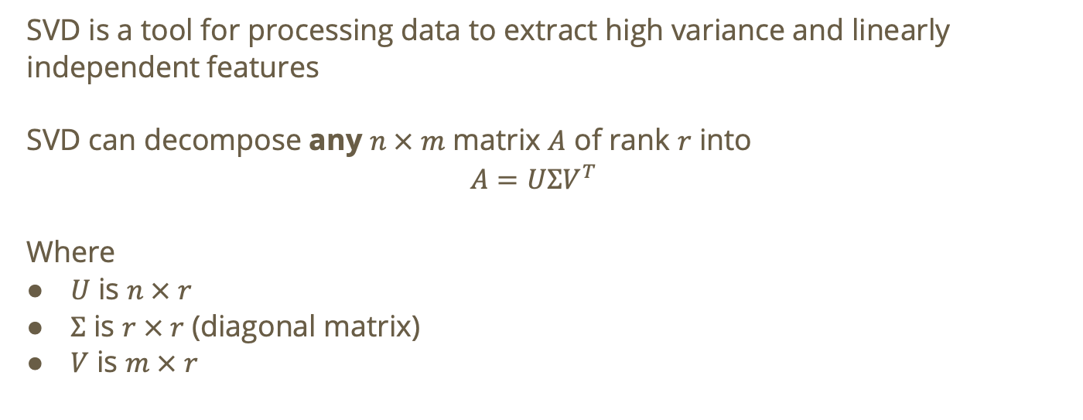
Singular Value Decomposition (SVD)
SVD is a tool for processing data to extract high variance and linearly independent features
SVD can decompose any $n × m$ matrix $A$ of rank $r$ into
$$A=UΣV^{T}$$
Where
$U$ is $n × r$
$Σ$ is $r × r$ (diagonal matrix)
$V$ is $m × r$

Slide 15

SVD Matrix Decomposition
$$A=UΣV^{T},U∈ℝ^{n×r},Σ∈ℝ^{r×r},V∈ℝ^{m×r}$$
$V$ encodes the principal directions and latent patterns in the original feature space
Notes:
Entries of V also tell us how much each original feature contributes to the latent features

Slide 16

SVD Matrix Decomposition
$$A=UΣV^{T},U∈ℝ^{n×r},Σ∈ℝ^{r×r},V∈ℝ^{m×r}$$
$V$ encodes the principal directions and latent patterns in the original feature space
  i.e., directions along which the data varies

Slide 17

SVD Matrix Decomposition
$$A=UΣV^{T},U∈ℝ^{n×r},Σ∈ℝ^{r×r},V∈ℝ^{m×r}$$
$V$ encodes the principal directions and latent patterns in the original feature space
Mathematically, columns of $V$ are orthonormal eigenvectors of $A^{T}A$

Slide 18
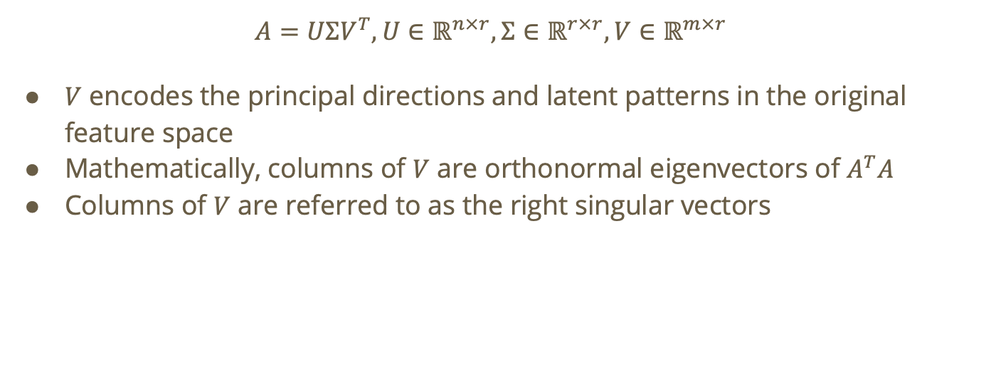
SVD Matrix Decomposition
$$A=UΣV^{T},U∈ℝ^{n×r},Σ∈ℝ^{r×r},V∈ℝ^{m×r}$$
$V$ encodes the principal directions and latent patterns in the original feature space
Mathematically, columns of $V$ are orthonormal eigenvectors of $A^{T}A$
Columns of $V$ are referred to as the right singular vectors

Slide 19

SVD Matrix Decomposition
$$A=UΣV^{T},U∈ℝ^{n×r},Σ∈ℝ^{r×r},V∈ℝ^{m×r}$$
Diagonal entries of $Σ$ are referred to as singular values and correspond to how much of the variance in the data is explained by corresponding right singular vectors (or columns) of $V$
  Also ordered $→σ_{1}≥σ_{2}≥⋯≥σ_{r}$

Slide 20
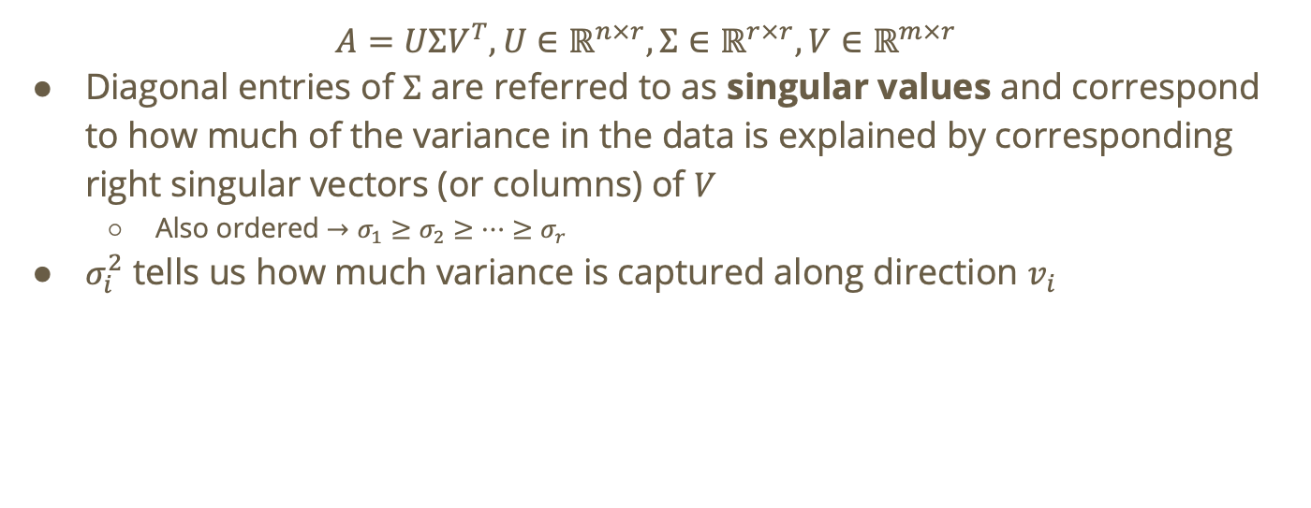
SVD Matrix Decomposition
$$A=UΣV^{T},U∈ℝ^{n×r},Σ∈ℝ^{r×r},V∈ℝ^{m×r}$$
Diagonal entries of $Σ$ are referred to as singular values and correspond to how much of the variance in the data is explained by corresponding right singular vectors (or columns) of $V$
  Also ordered $→σ_{1}≥σ_{2}≥⋯≥σ_{r}$
$σ_{i}^{2}$ tells us how much variance is captured along direction $v_{i}$

Slide 21
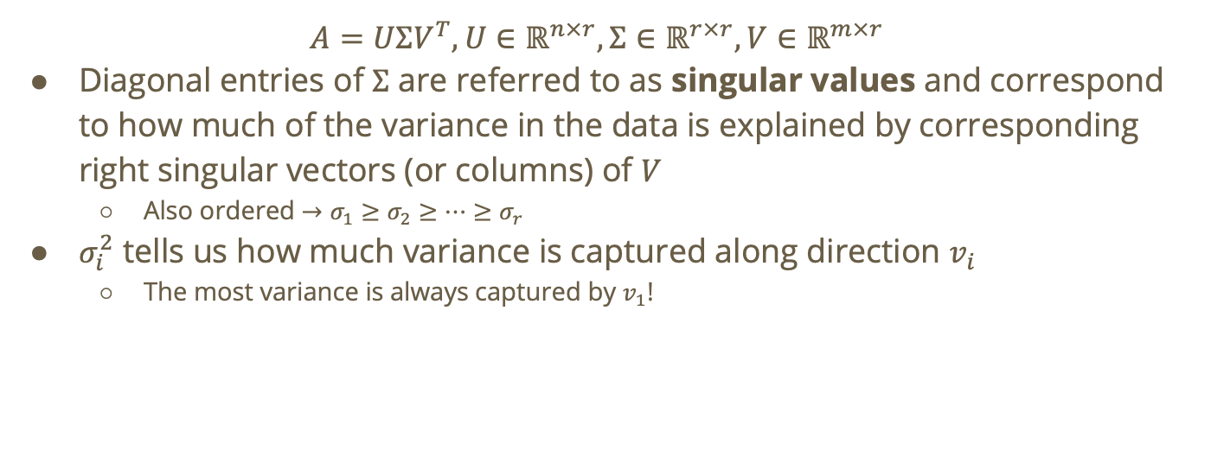
SVD Matrix Decomposition
$$A=UΣV^{T},U∈ℝ^{n×r},Σ∈ℝ^{r×r},V∈ℝ^{m×r}$$
Diagonal entries of $Σ$ are referred to as singular values and correspond to how much of the variance in the data is explained by corresponding right singular vectors (or columns) of $V$
  Also ordered $→σ_{1}≥σ_{2}≥⋯≥σ_{r}$
$σ_{i}^{2}$ tells us how much variance is captured along direction $v_{i}$
  The most variance is always captured by $v_{1}$!

Slide 22

SVD Matrix Decomposition
$$A=UΣV^{T},U∈ℝ^{n×r},Σ∈ℝ^{r×r},V∈ℝ^{m×r}$$
$U$ contains the normalized coordinates of samples with respect to the component directions in $V$

Slide 23

SVD Matrix Decomposition
$$A=UΣV^{T},U∈ℝ^{n×r},Σ∈ℝ^{r×r},V∈ℝ^{m×r}$$
$U$ contains the normalized coordinates of samples with respect to the component directions in $V$
$u_{i,j}$= normalized coordinate of data point $i$ to component $j$

Slide 24
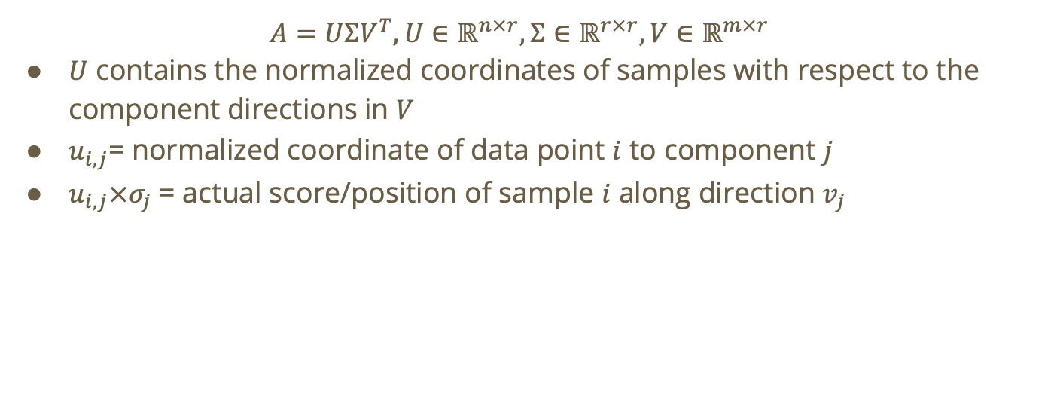
SVD Matrix Decomposition
$$A=UΣV^{T},U∈ℝ^{n×r},Σ∈ℝ^{r×r},V∈ℝ^{m×r}$$
$U$ contains the normalized coordinates of samples with respect to the component directions in $V$
$u_{i,j}$= normalized coordinate of data point $i$ to component $j$
$u_{i,j}×σ_{j}$ = actual score/position of sample $i$ along direction $v_{j}$

Slide 25
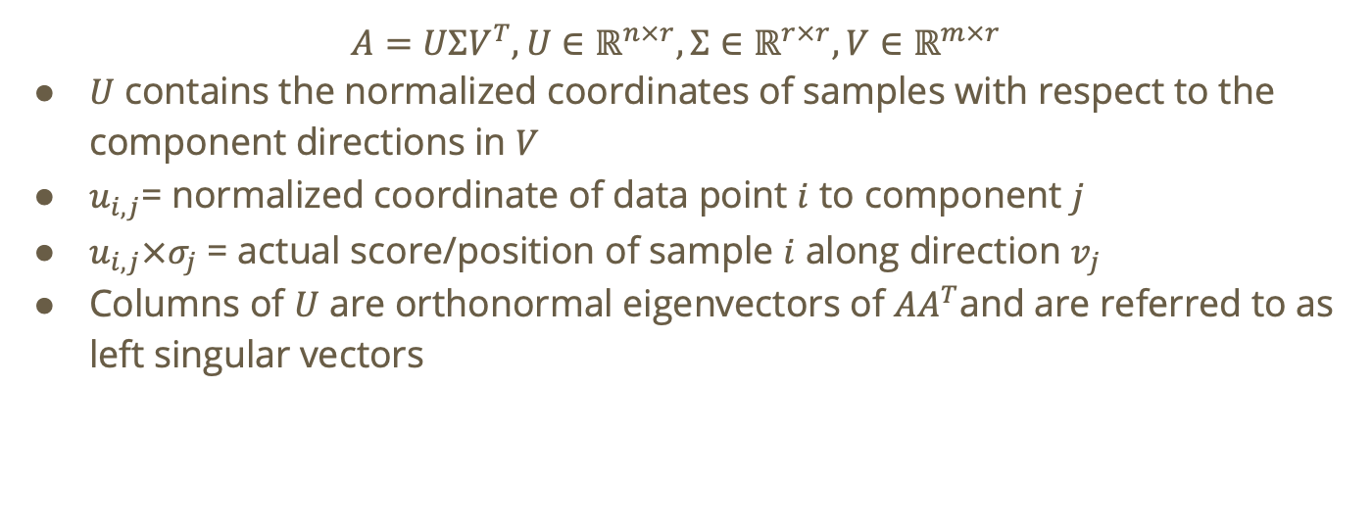
SVD Matrix Decomposition
$$A=UΣV^{T},U∈ℝ^{n×r},Σ∈ℝ^{r×r},V∈ℝ^{m×r}$$
$U$ contains the normalized coordinates of samples with respect to the component directions in $V$
$u_{i,j}$= normalized coordinate of data point $i$ to component $j$
$u_{i,j}×σ_{j}$ = actual score/position of sample $i$ along direction $v_{j}$
Columns of $U$ are orthonormal eigenvectors of $AA^{T}$and are referred to as left singular vectors

Slide 26
SVD for Rank Reduction

Slide 27

Approximation for A
Goal: Approximate $m × n$ matrix $A$ with rank-k matrix $A^{\left(k\right)}$ such that
$d_{F}\left(A,A^{\left(k\right)}\right)$ small
$k$ small compared to $m \& n$

Slide 28
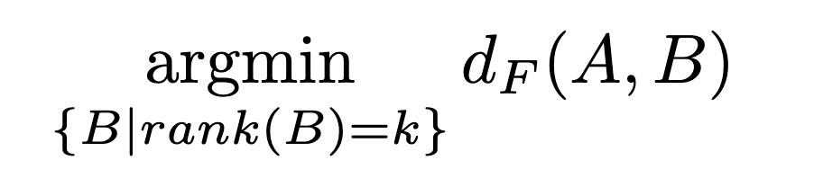
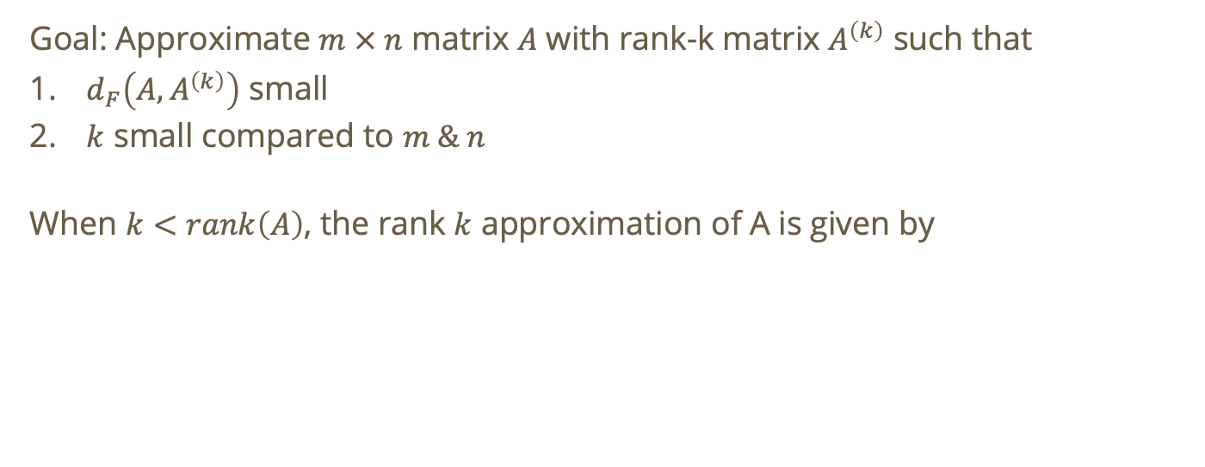
Approximation for A
Goal: Approximate $m × n$ matrix $A$ with rank-k matrix $A^{\left(k\right)}$ such that
$d_{F}\left(A,A^{\left(k\right)}\right)$ small
$k$ small compared to $m \& n$
When $k<rank\left(A\right)$, the rank $k$ approximation of A is given by

Slide 29
Approximation for A
Goal: Approximate $m × n$ matrix $A$ with rank-k matrix $A^{\left(k\right)}$ such that
$d_{F}\left(A,A^{\left(k\right)}\right)$ small
$k$ small compared to $m \& n$
When $k<rank\left(A\right)$, the rank $k$ approximation of A is given by
Frobenius distance

Slide 30

Rank-k approximation using SVD
$$A=UΣV^{T},U∈ℝ^{n×r},Σ∈ℝ^{r×r},V∈ℝ^{m×r}$$
To get a rank-$k$ approximation of $A$ ($k < r$) using the SVD decomposition, we compute the following
$$A^{(k)}= σ_{1}u_{1}v_{1}^{T}+σ_{2}u_{2}v_{2}^{T}+⋯+σ_{k}u_{k}v_{k}^{T}$$

Slide 31
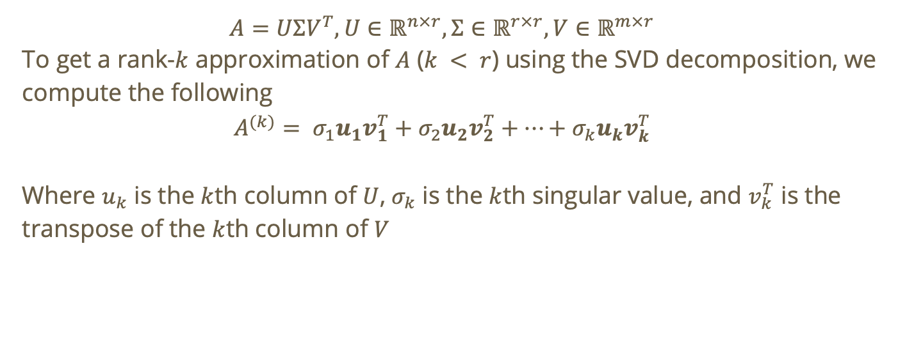
Rank-k approximation using SVD
$$A=UΣV^{T},U∈ℝ^{n×r},Σ∈ℝ^{r×r},V∈ℝ^{m×r}$$
To get a rank-$k$ approximation of $A$ ($k < r$) using the SVD decomposition, we compute the following
$$A^{(k)}= σ_{1}u_{1}v_{1}^{T}+σ_{2}u_{2}v_{2}^{T}+⋯+σ_{k}u_{k}v_{k}^{T}$$
Where $u_{k}$ is the $k$th column of $U$, $σ_{k}$ is the $k$th singular value, and $v_{k}^{T}$ is the transpose of the $k$th column of $V$

Slide 32
Do not edit
How to change the design
As k increases, the frobenius distance between a matrix and its rank-k approximation decreases
The Slido app must be installed on every computer you’re presenting from

Slide 33

Solution
What happens if $k = r$ (where $r$ is the rank of $A$)?
$$A^{(k)}= σ_{1}u_{1}v_{1}^{T}+σ_{2}u_{2}v_{2}^{T}+⋯+σ_{k}u_{k}v_{k}^{T}$$

Slide 34
Do not edit
How to change the design
The rank-k approximation of an (nxm) matrix also has dimension (nxm)
The Slido app must be installed on every computer you’re presenting from

Slide 35

Solution
Assume rank-2 approximation
$$A^{(k)}= σ_{1}u_{1}v_{1}^{T}+σ_{2}u_{2}v_{2}^{T}$$
$$=\left(n×1\right)×\left(1×m\right)+\left(n×1\right)×\left(1×m\right)$$
$$=\left(n×m\right)$$

Slide 36
Do not edit
How to change the design
What is the rank of the following dataset?
The Slido app must be installed on every computer you’re presenting from

Slide 37
SVD for Feature Extraction

Slide 38

Feature Extraction
Goal: pick number of latent features $k$ using our SVD

Slide 39

Feature Extraction
Goal: pick number of latent features $k$ using our SVD → pick $k$ using explained variance

Slide 40

Feature Extraction
Goal: pick number of latent features $k$ using our SVD → pick $k$ using explained variance
$$\text{variance} \text{explained} \text{by} \text{component} i=\frac{σ_{i}^{2}}{\sum_{j}{σ_{j}^{2}}}$$

Slide 41
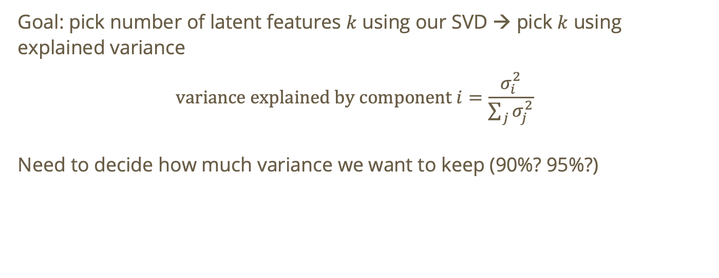
Feature Extraction
Goal: pick number of latent features $k$ using our SVD → pick $k$ using explained variance
$$\text{variance} \text{explained} \text{by} \text{component} i=\frac{σ_{i}^{2}}{\sum_{j}{σ_{j}^{2}}}$$
Need to decide how much variance we want to keep (90%? 95%?)

Slide 42
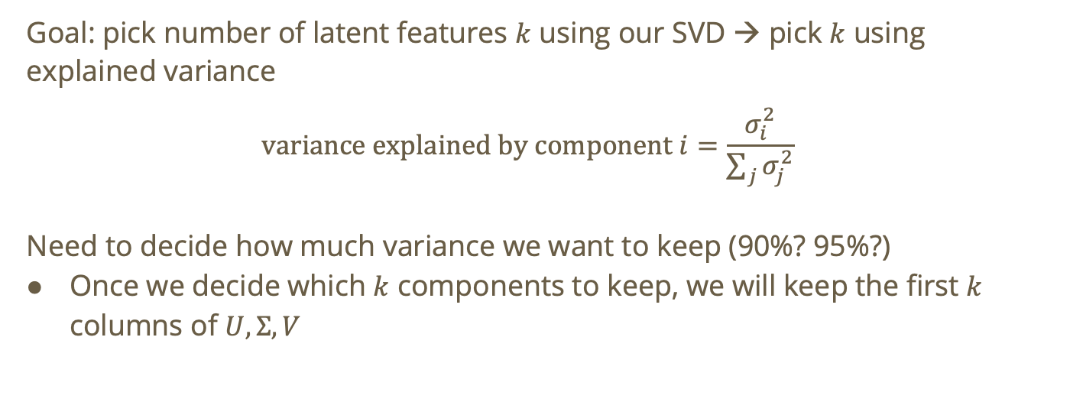
Feature Extraction
Goal: pick number of latent features $k$ using our SVD → pick $k$ using explained variance
$$\text{variance} \text{explained} \text{by} \text{component} i=\frac{σ_{i}^{2}}{\sum_{j}{σ_{j}^{2}}}$$
Need to decide how much variance we want to keep (90%? 95%?)
Once we decide which $k$ components to keep, we will keep the first $k$ columns of $U, Σ, V$

Slide 43

Feature Extraction
Once we decide which $k$ components to keep, we will keep the first $k$ columns of $U, Σ, V$
$$U_{k}∈ℝ^{n×k},Σ_{k}∈ℝ^{k×k},V_{k}∈ℝ^{m×k}$$

Slide 44
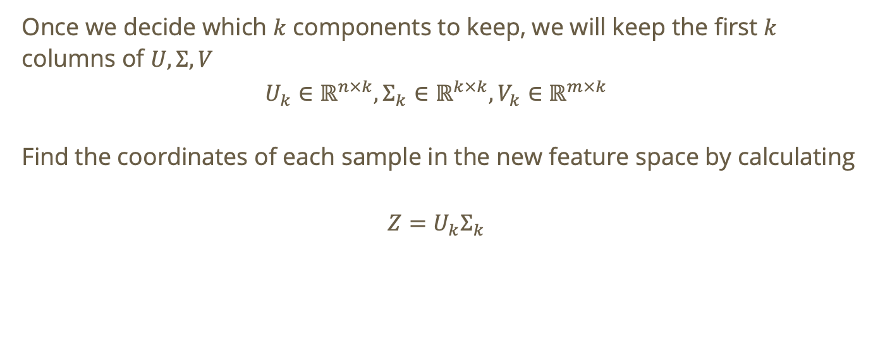
Feature Extraction
Once we decide which $k$ components to keep, we will keep the first $k$ columns of $U, Σ, V$
$$U_{k}∈ℝ^{n×k},Σ_{k}∈ℝ^{k×k},V_{k}∈ℝ^{m×k}$$
Find the coordinates of each sample in the new feature space by calculating
$$Z=U_{k}Σ_{k}$$

Slide 45
Do not edit
How to change the design
Let A be an m x n matrix of rank r. After using SVD for feature extraction, we will still have an m x n matrix
The Slido app must be installed on every computer you’re presenting from

Slide 46
SVD for Anomaly Detection

Slide 47
What is an anomaly in data science?
Anomaly detection, or outlier detection, is the identification of observations, events, or data points that deviate from what is usual, standard, or expected, making them inconsistent with the rest of the data set¹.
¹IBM - What is Anomaly Detection

Slide 48

Anomaly Detection in SVD
Let $O=A–A^{\left(k\right)}$ where $A^{\left(k\right)}$ is the rank-k approximation of $A$

Slide 49

Anomaly Detection in SVD
Let $O=A–A^{\left(k\right)}$ where $A^{\left(k\right)}$ is the rank-k approximation of $A$
$O$ is the residual matrix containing the part of the data that the top $k$ latent components failed to explain

Slide 50
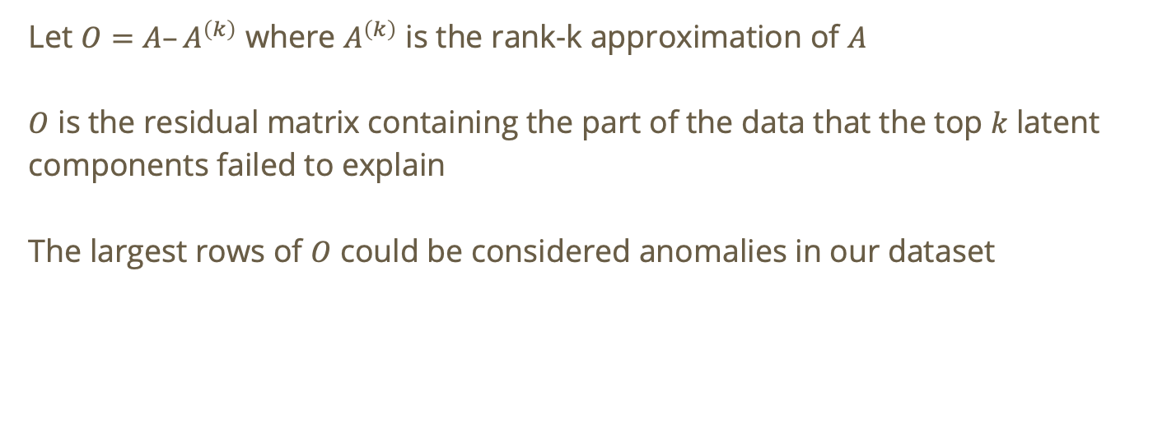
Anomaly Detection in SVD
Let $O=A–A^{\left(k\right)}$ where $A^{\left(k\right)}$ is the rank-k approximation of $A$
$O$ is the residual matrix containing the part of the data that the top $k$ latent components failed to explain
The largest rows of $O$ could be considered anomalies in our dataset

Slide 51
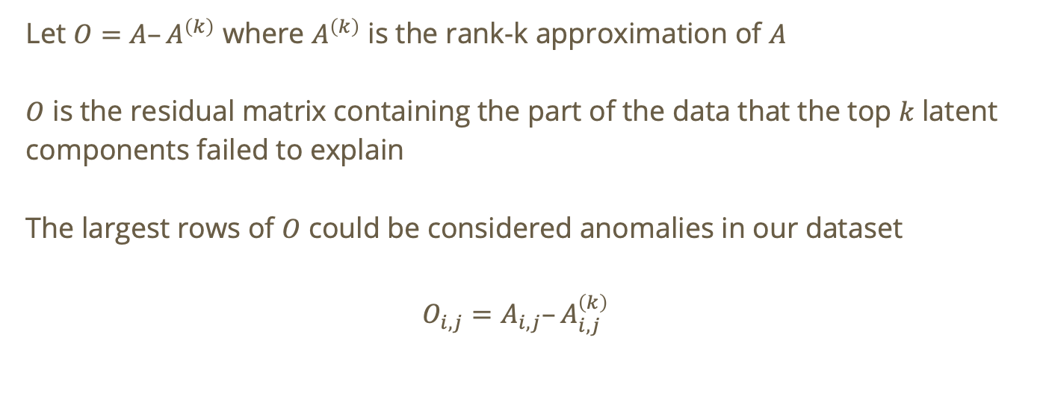
Anomaly Detection in SVD
Let $O=A–A^{\left(k\right)}$ where $A^{\left(k\right)}$ is the rank-k approximation of $A$
$O$ is the residual matrix containing the part of the data that the top $k$ latent components failed to explain
The largest rows of $O$ could be considered anomalies in our dataset
$$O_{i,j}=A_{i,j}–A_{i,j}^{\left(k\right)}$$

Slide 52
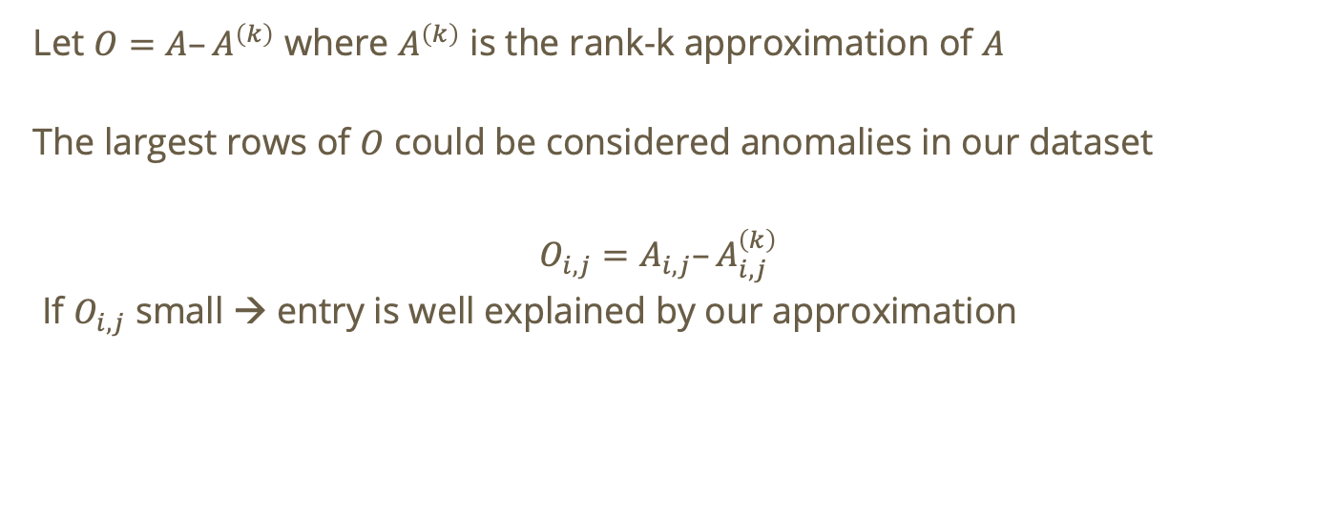
Anomaly Detection in SVD
Let $O=A–A^{\left(k\right)}$ where $A^{\left(k\right)}$ is the rank-k approximation of $A$
The largest rows of $O$ could be considered anomalies in our dataset
$$O_{i,j}=A_{i,j}–A_{i,j}^{\left(k\right)}$$
If $O_{i,j}$ small → entry is well explained by our approximation

Slide 53
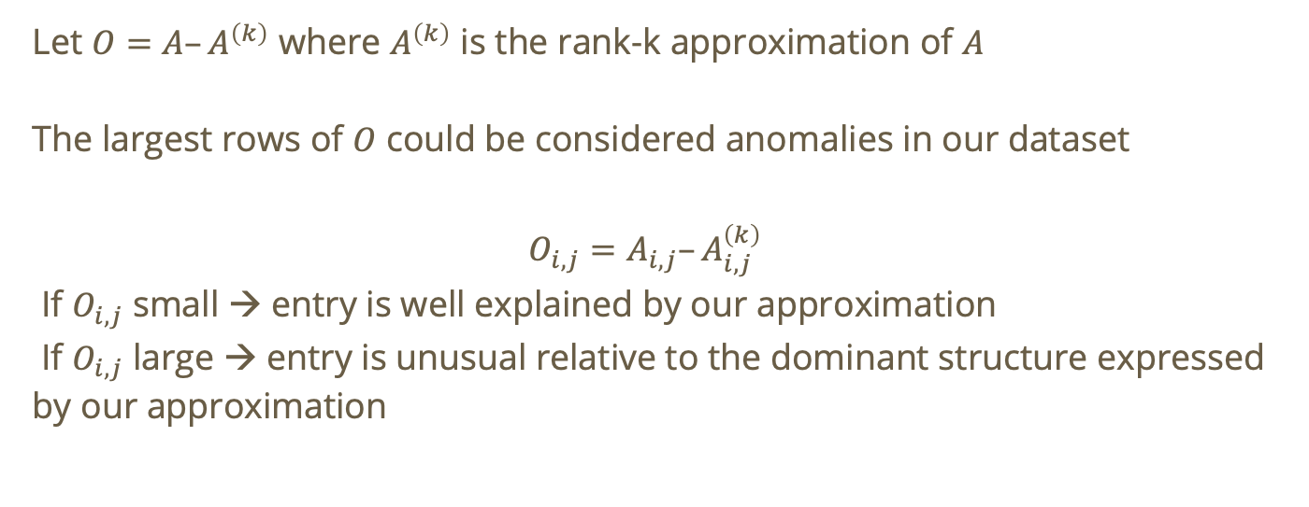
Anomaly Detection in SVD
Let $O=A–A^{\left(k\right)}$ where $A^{\left(k\right)}$ is the rank-k approximation of $A$
The largest rows of $O$ could be considered anomalies in our dataset
$$O_{i,j}=A_{i,j}–A_{i,j}^{\left(k\right)}$$
If $O_{i,j}$ small → entry is well explained by our approximation
If $O_{i,j}$ large → entry is unusual relative to the dominant structure expressed by our approximation

Slide 54
Latent Semantic Similarity (LSA)

Slide 55
Recall: LSA
The goal of LSA is to uncover hidden relationships between words and documents.
  i.e., group together words that are associated with a similar topic
Words that never appear together can end up close in reduced space
LSA is linear, deterministic, fast, and less expensive than using linear models

Slide 56
Recall: Dataset
 | data | information | retrieval | brain | lung
CS-paper-1 | 1 | 1 | 1 | 0 | 0
CS-paper-2 | 2 | 2 | 2 | 0 | 0
CS-paper-3 | 1 | 1 | 1 | 0 | 0
CS-paper-4 | 5 | 5 | 5 | 0 | 0
Med-paper-1 | 0 | 0 | 0 | 2 | 2
Med-paper-2 | 0 | 0 | 0 | 3 | 3
Med-paper-3 | 0 | 0 | 0 | 1 | 1

Slide 57
Recall: Embeddings
The goal of embeddings is to map words (in this case) onto a relatively small dimensional space where similar words are close to one another

Slide 58
Recall: Embeddings
The goal of embeddings is to map words (in this case) onto a relatively small dimensional space where similar words are close to one another
The idea is that we take representations of words that we have mapped to a high-dimensional space (using a term-document matrix) and project them into a lower-dimensional space.
Notes:
If needed, show what a one hot representation is

Slide 59
Recall: Embeddings
The goal of embeddings is to map words (in this case) onto a relatively small dimensional space where similar words are close to one another
The idea is that we take representations of words that we have mapped to a high-dimensional space (using a term-document matrix) and project them into a lower-dimensional space.
We accomplish this using SVD!
Notes:
If needed, show what a one hot representation is

Slide 60
 | data | information | retrieval | brain | lung
CS-paper-1 | 1 | 1 | 1 | 0 | 0
CS-paper-2 | 2 | 2 | 2 | 0 | 0
CS-paper-3 | 1 | 1 | 1 | 0 | 0
CS-paper-4 | 5 | 5 | 5 | 0 | 0
Med-paper-1 | 0 | 0 | 0 | 2 | 2
Med-paper-2 | 0 | 0 | 0 | 3 | 3
Med-paper-3 | 0 | 0 | 0 | 1 | 1

Slide 61



$$U$$
0.18 | 0
0.36 | 0
0.18 | 0
0.90 | 0
0 | 0.53
0 | 0.80
0 | 0.27
$$Σ$$
$$V^{T}$$
9.64 | 0
0 | 5.29
0.58 | 0.58 | 0.58 | 0 | 0
0 | 0 | 0 | 0.71 | 0.71
Notes:
This is an SVD for our dataset. Keep in mind, concepts here refer to latent concepts/hidden concepts

Slide 62
$$U$$
doc-to-concept similarity matrix
0.18 | 0
0.36 | 0
0.18 | 0
0.90 | 0
0 | 0.53
0 | 0.80
0 | 0.27
“strength” of each concept
$$V^{T}$$
$$Σ$$
term-to-concept similarity matrix
9.64 | 0
0 | 5.29
0.58 | 0.58 | 0.58 | 0 | 0
0 | 0 | 0 | 0.71 | 0.71
Notes:
This is an SVD for our dataset. Keep in mind, concepts here refer to latent concepts/hidden concepts

Slide 63
doc-to-concept similarity matrix
0.18 | 0
0.36 | 0
0.18 | 0
0.90 | 0
0 | 0.53
0 | 0.80
0 | 0.27
“strength” of each concept
term-to-concept similarity matrix
9.64 | 0
0 | 5.29
0.58 | 0.58 | 0.58 | 0 | 0
0 | 0 | 0 | 0.71 | 0.71
MD Concept

Slide 64
doc-to-concept similarity matrix
0.18 | 0
0.36 | 0
0.18 | 0
0.90 | 0
0 | 0.53
0 | 0.80
0 | 0.27
“strength” of each concept
term-to-concept similarity matrix
9.64 | 0
0 | 5.29
0.58 | 0.58 | 0.58 | 0 | 0
0 | 0 | 0 | 0.71 | 0.71
CS Concept

Slide 65
doc-to-concept similarity matrix
Similarity of document 2 to CS concept
0.18 | 0
0.36 | 0
0.18 | 0
0.90 | 0
0 | 0.53
0 | 0.80
0 | 0.27
“strength” of each concept
term-to-concept similarity matrix
9.64 | 0
0 | 5.29
0.58 | 0.58 | 0.58 | 0 | 0
0 | 0 | 0 | 0.71 | 0.71

Slide 66
doc-to-concept similarity matrix
0.18 | 0
0.36 | 0
0.18 | 0
0.90 | 0
0 | 0.53
0 | 0.80
0 | 0.27
“strength” of each concept
term-to-concept similarity matrix
9.64 | 0
0 | 5.29
0.58 | 0.58 | 0.58 | 0 | 0
0 | 0 | 0 | 0.71 | 0.71

Slide 67
doc-to-concept similarity matrix
CS Concept
0.18 | 0
0.36 | 0
0.18 | 0
0.90 | 0
0 | 0.53
0 | 0.80
0 | 0.27
“strength” of each concept
term-to-concept similarity matrix
9.64 | 0
0 | 5.29
0.58 | 0.58 | 0.58 | 0 | 0
0 | 0 | 0 | 0.71 | 0.71
MD Concept

Slide 68
doc-to-concept similarity matrix
0.18 | 0
0.36 | 0
0.18 | 0
0.90 | 0
0 | 0.53
0 | 0.80
0 | 0.27
“strength” of each concept
term-to-concept similarity matrix
9.64 | 0
0 | 5.29
0.58 | 0.58 | 0.58 | 0 | 0
0 | 0 | 0 | 0.71 | 0.71
Similarity of “brain” to MD concept

Slide 69
Good vs Bad Embeddings
SVD isn’t guaranteed to produce good embeddings so how can we identify good embeddings vs. bad ones?

Slide 70
Good Embeddings
Semantic similarity is preserved → similar words and documents are close in the embedding space

Slide 71
Good Embeddings
Semantic similarity is preserved → similar words and documents are close in the embedding space
Latent components become separable → semantically similar concepts cluster together

Slide 72
Good Embeddings
Semantic similarity is preserved → similar words and documents are close in the embedding space
Latent components become separable → semantically similar concepts cluster together
Filters out noise such as conjunctions and typos

Slide 73
Good Embeddings
Semantic similarity is preserved → similar words and documents are close in the embedding space
Latent components become separable → semantically similar concepts cluster together
Filters out noise such as conjunctions and typos
Typically, if you don’t satisfy these factors, you likely have a bad embedding

Slide 74

What causes bad embeddings?
$k$ too small → oversimplified approximation of the dataset

Slide 75

What causes bad embeddings?
$k$ too small → oversimplified approximation of the dataset
$k$ too large → noise is preserved and efficiency is not gained

Slide 76

What causes bad embeddings?
$k$ too small → oversimplified approximation of the dataset
$k$ too large → noise is preserved and efficiency is not gained
Frequent words dominate

Slide 77
What causes bad embeddings?
$k$ too small → oversimplified approximation of the dataset
$k$ too large → noise is preserved and efficiency is not gained
Frequent words dominate
We can use the elbow method by plotting singular values in descending order and finding the point of diminishing returns

Slide 78
What causes bad embeddings?
$k$ too small → oversimplified approximation of the dataset
$k$ too large → noise is preserved and efficiency is not gained
Frequent words dominate
Why is this a problem?

Slide 79
Term Frequency in LSA
Take these example “documents”:
”the dog plays in the park”
“the cat sleeps in the house”
”the government passed a law”

Slide 80
Term Frequency in LSA
Take these example “documents”:
”the dog plays in the park”
“the cat sleeps in the house”
”the government passed a law”
Here, “the” appears in every document but it carried no semantic meaning…

Slide 81
Term Frequency in LSA
Take these example “documents”:
”the dog plays in the park”
“the cat sleeps in the house”
”the government passed a law”
Here, “the” appears in every document but it carried no semantic meaning…
This means in our term-document matrix, “The” will have the highest frequency and as a result, SVD will detect that it contributes the most variance.

Slide 82
Term Frequency in LSA
Take these example “documents”:
”the dog plays in the park”
“the cat sleeps in the house”
”the government passed a law”
We see a clear semantic structure here. One “latent feature” could be pets, another could be politics.

Slide 83
Term Frequency in LSA
Take these example “documents”:
”the dog plays in the park”
“the cat sleeps in the house”
”the government passed a law”
We see a clear semantic structure here. One “latent feature” could be pets, another could be politics.
Because “the” contributes the highest variance, LSA might capture the latent features as documents which contribute many ”the” versus documents which contribute fewer “the” which is semantically useless!

Slide 84
Question: How do we handle frequent “useless” words?
What if we can reduce the weight of words that occur in every document?

Slide 85

Question: How do we handle frequent “useless” words?
What if we can reduce the weight of words that occur in every document?
$$TF\left(t,d\right)=\frac{\text{number} \text{of} \text{times} \text{t} \text{appears} \text{in} \text{d}}{\text{total} \text{number} \text{of} \text{unique} \text{terms} \text{in} \text{d}}$$
Term frequency

Slide 86
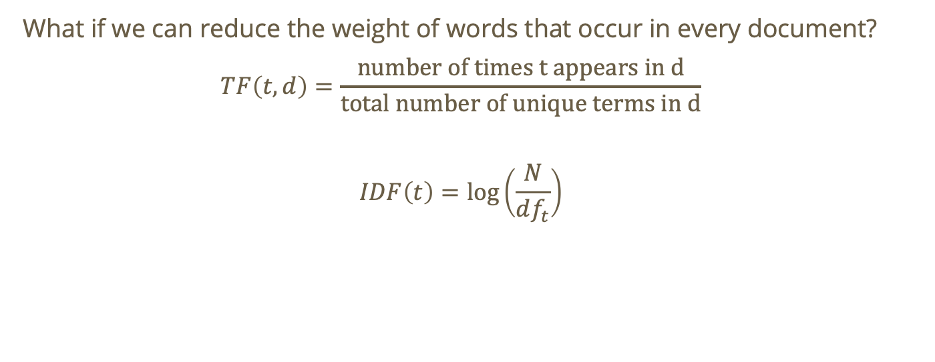
Question: How do we handle frequent “useless” words?
What if we can reduce the weight of words that occur in every document?
$$TF\left(t,d\right)=\frac{\text{number} \text{of} \text{times} \text{t} \text{appears} \text{in} \text{d}}{\text{total} \text{number} \text{of} \text{unique} \text{terms} \text{in} \text{d}}$$
$$IDF\left(t\right)=\log\left(\frac{N}{df_{t}}\right)$$
Total number of documents

Slide 87
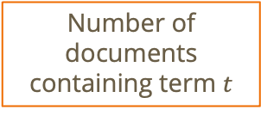
Question: How do we handle frequent “useless” words?
What if we can reduce the weight of words that occur in every document?
$$TF\left(t,d\right)=\frac{\text{number} \text{of} \text{times} \text{t} \text{appears} \text{in} \text{d}}{\text{total} \text{number} \text{of} \text{unique} \text{terms} \text{in} \text{d}}$$
$$IDF\left(t\right)=\log\left(\frac{N}{df_{t}}\right)$$
Total number of documents
Number of documents containing term $t$
Notes:
Note: with idf rarer words get higher weight

Slide 88
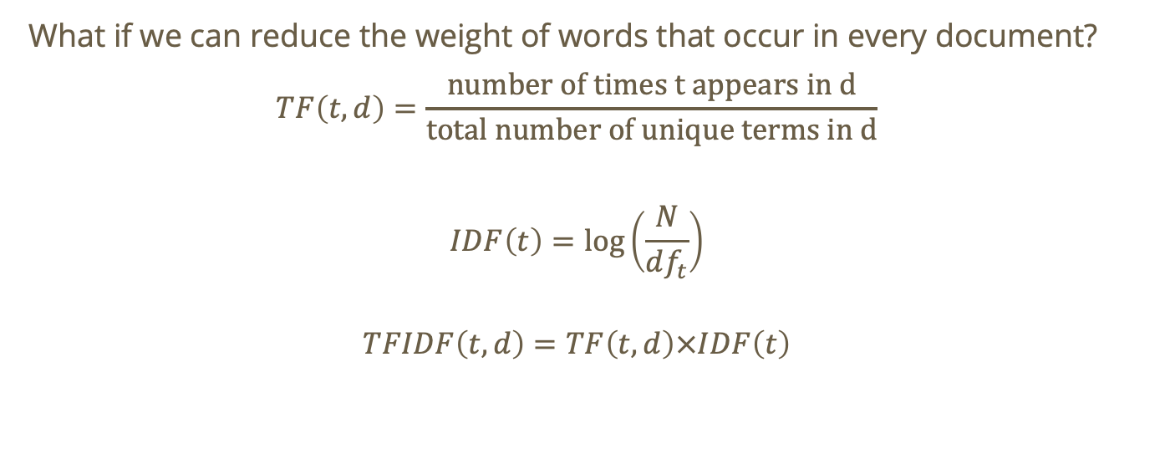
Question: How do we handle frequent “useless” words?
What if we can reduce the weight of words that occur in every document?
$$TF\left(t,d\right)=\frac{\text{number} \text{of} \text{times} \text{t} \text{appears} \text{in} \text{d}}{\text{total} \text{number} \text{of} \text{unique} \text{terms} \text{in} \text{d}}$$
$$IDF\left(t\right)=\log\left(\frac{N}{df_{t}}\right)$$
$$TFIDF\left(t,d\right)=TF\left(t,d\right)×IDF\left(t\right)$$
Notes:
Note: with idf rarer words get higher weight

Slide 89

TF-IDF
$$TFIDF\left(t,d\right)=TF\left(t,d\right)×IDF\left(t\right)$$
Downweighs common words (the, is, and)
Upweights rare words
Notes:
Read as “term frequency of word t in document d” times “inverse document frequency of term t”

Slide 90

TF-IDF
$$TFIDF\left(t,d\right)=TF\left(t,d\right)×IDF\left(t\right)$$
Downweighs common words (the, is, and)
Upweights rare words
If we use this to populate our term-document matrix, the values will reflect semantic importance enabling SVD to find meaningful latent topics
Notes:
Read as “term frequency of word t in document d” times “inverse document frequency of term t”

Slide 91
TF-IDF for term-document matrix
If we apply TF-IDF to find our term-document matrix before running SVD, we will be able to ignore some of the noise in our dataset.

Slide 92
TF-IDF for term-document matrix
If we apply TF-IDF to find our term-document matrix before running SVD, we will be able to ignore some of the noise in our dataset.
The reality is that most documents will contain conjunctions and linking verbs, many of which we don’t want to include! TF-IDF helps us work around that

Slide 93

Interpreting results of LSA
LSA produces the following embeddings for a rank-k approximation using SVD:
$$X_{k}=U_{k}Σ_{k}V_{k}^{T}$$

Slide 94

Interpreting results of LSA
LSA produces the following embeddings for a rank-k approximation using SVD:
$$X_{k}=U_{k}Σ_{k}V_{k}^{T}$$
Where $k$ is also the number of latent semantic features

Slide 95

Interpreting results of LSA
$$X_{k}=U_{k}Σ_{k}V_{k}^{T}$$
Using this approximation, we can calculate the following:

Slide 96

Interpreting results of LSA
$$X_{k}=U_{k}Σ_{k}V_{k}^{T}$$
Using this approximation, we can calculate the following:
Document vectors $Σ_{k}V_{k}^{T}$
Word vectors $U_{k}Σ_{k}$

Slide 97

Interpreting results of LSA
$$X_{k}=U_{k}Σ_{k}V_{k}^{T}$$
Using this approximation, we can calculate the following:
Document vectors $Σ_{k}V_{k}^{T}$
Word vectors $U_{k}Σ_{k}$
The document/word vectors will place each document as a vector in the latent feature space.

Slide 98

Interpreting results of LSA
$$X_{k}=U_{k}Σ_{k}V_{k}^{T}$$
Document vectors $Σ_{k}V_{k}^{T}$
Word vectors $U_{k}Σ_{k}$
Question: how can we measure the similarity of two document vectors?

Slide 99

Interpreting results of LSA
$$X_{k}=U_{k}Σ_{k}V_{k}^{T}$$
Document vectors $Σ_{k}V_{k}^{T}$
Word vectors $U_{k}Σ_{k}$
Question: how can we measure the similarity of two document vectors?
Cosine Similarity!

Slide 100





Interpreting results of LSA: Cosine Similarity
$$X_{k}=U_{k}Σ_{k}V_{k}^{T}$$
Example for $k=2$
$$p_{1}$$
Medical
$$p_{2}$$
$$p_{3}$$
$$p_{4}$$
Computer Science
Notes:
p_1 corresponds to paper 1

Slide 101
Interpreting results of LSA: Cosine Similarity
$$X_{k}=U_{k}Σ_{k}V_{k}^{T}$$
Example for $k=2$
$$p_{1}$$
Medical
Cosine similarity will correspond to semantic similarity!
$$p_{2}$$
$$p_{3}$$
$$p_{4}$$
Computer Science

Slide 102
Interpreting results of LSA: Cosine Similarity
$$X_{k}=U_{k}Σ_{k}V_{k}^{T}$$
Example for $k=2$
$$p_{1}$$
Medical
Cosine similarity will correspond to semantic similarity! → Each document exists in our latent semantic space and similar documents are close to one another!
$$p_{2}$$
$$p_{3}$$
$$p_{4}$$
Computer Science

Slide 103

Interpreting results of LSA: Cosine Similarity
$$X_{k}=U_{k}Σ_{k}V_{k}^{T}$$
Example for $k=2$
Wow!
$$p_{1}$$
Medical
$$p_{2}$$
$$p_{3}$$
$$p_{4}$$
Computer Science

