Slide 1
Support Vector Machines
CS 506

Slide 2
Recall: SVM
Find the widest street that separates our classes

Slide 3
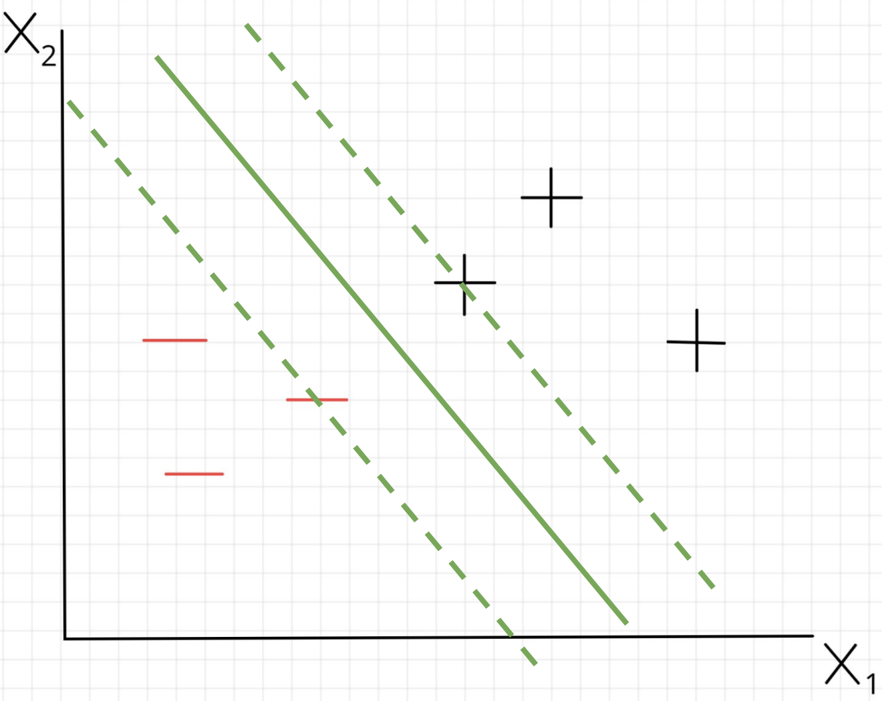
Recall: SVM

Slide 4

Recall: SVM
Decision boundary is equation of the form:
$w_{1}x_{1}+w_{2}x_{2}+b=0$

Slide 5

Recall: SVM
Decision boundary is equation of the form:
$w_{1}x_{1}+w_{2}x_{2}+b=0$
$${\vec{w}}^{T}\vec{x}+b=0$$

Slide 6

Recall: SVM
Decision boundary is equation of the form:
$w_{1}x_{1}+w_{2}x_{2}+b=0$
Edges of the street are of the form:
${\vec{w}}^{T}\vec{x}+b=−1$
$${\vec{w}}^{T}\vec{x}+b=0$$

Slide 7

Recall: SVM
Decision boundary is equation of the form:
$w_{1}x_{1}+w_{2}x_{2}+b=0$
Edges of the street are of the form:
${\vec{w}}^{T}\vec{x}+b=−1$
$${\vec{w}}^{T}\vec{x}+b=0$$
$${\vec{w}}^{T}\vec{x}+b=−1$$

Slide 8


Recall: SVM
Decision boundary is equation of the form:
$w_{1}x_{1}+w_{2}x_{2}+b=0$
Edges of the street are of the form:
${\vec{w}}^{T}\vec{x}+b=−1$
and
${\vec{w}}^{T}\vec{x}+b=1$
$${\vec{w}}^{T}\vec{x}+b=0$$
$${\vec{w}}^{T}\vec{x}+b=−1$$

Slide 9

Recall: SVM
Decision boundary is equation of the form:
$w_{1}x_{1}+w_{2}x_{2}+b=0$
Edges of the street are of the form:
${\vec{w}}^{T}\vec{x}+b=−1$
and
${\vec{w}}^{T}\vec{x}+b=1$
$${\vec{w}}^{T}\vec{x}+b=1$$
$${\vec{w}}^{T}\vec{x}+b=0$$
$${\vec{w}}^{T}\vec{x}+b=−1$$

Slide 10
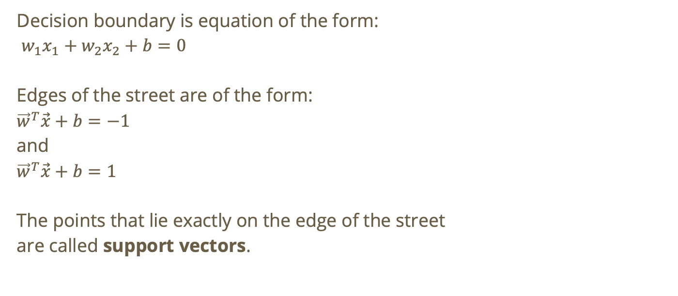

Recall: SVM
Decision boundary is equation of the form:
$w_{1}x_{1}+w_{2}x_{2}+b=0$
Edges of the street are of the form:
${\vec{w}}^{T}\vec{x}+b=−1$
and
${\vec{w}}^{T}\vec{x}+b=1$
The points that lie exactly on the edge of the street
are called support vectors.
$${\vec{w}}^{T}\vec{x}+b=1$$
$${\vec{w}}^{T}\vec{x}+b=0$$
$${\vec{w}}^{T}\vec{x}+b=−1$$

Slide 11
Recall: SVM
Decision boundary is equation of the form:
$w_{1}x_{1}+w_{2}x_{2}+b=0$
Edges of the street are of the form:
${\vec{w}}^{T}\vec{x}+b=−1$
and
${\vec{w}}^{T}\vec{x}+b=1$
The points that lie exactly on the edge of the street
are called support vectors.
$${\vec{w}}^{T}\vec{x}+b=1$$
$${\vec{w}}^{T}\vec{x}+b=0$$
$${\vec{w}}^{T}\vec{x}+b=−1$$

Slide 12
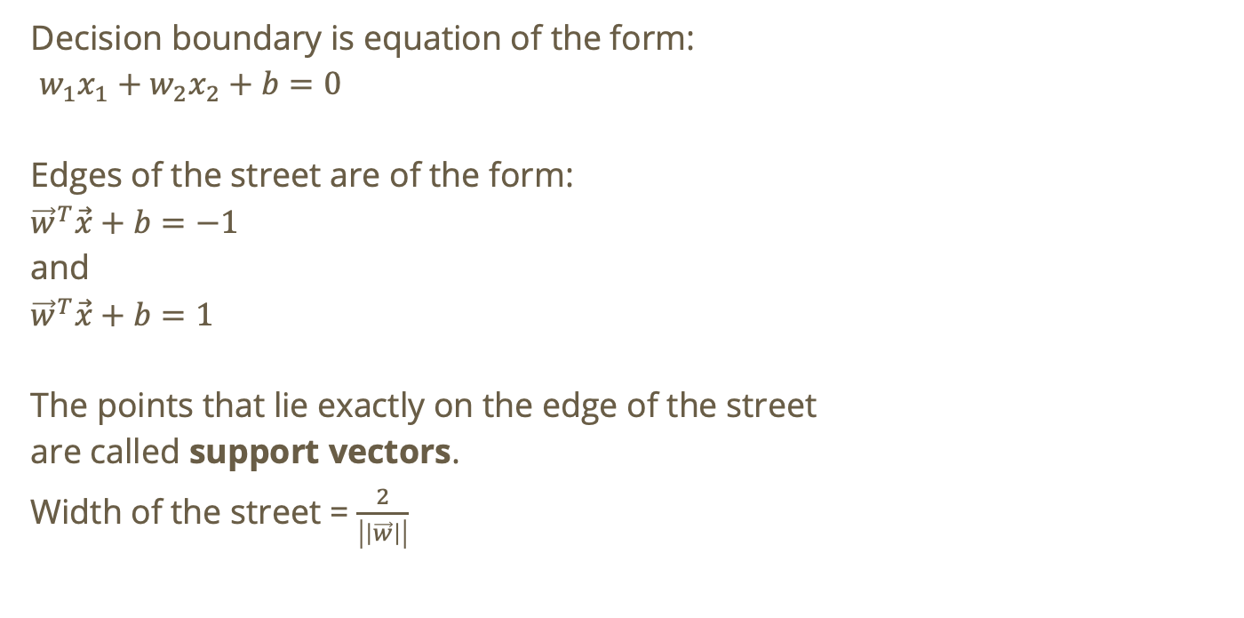
Recall: SVM
Decision boundary is equation of the form:
$w_{1}x_{1}+w_{2}x_{2}+b=0$
Edges of the street are of the form:
${\vec{w}}^{T}\vec{x}+b=−1$
and
${\vec{w}}^{T}\vec{x}+b=1$
The points that lie exactly on the edge of the street
are called support vectors.
Width of the street = $\frac{2}{\left|\left|\vec{w}\right|\right|}$
$${\vec{w}}^{T}\vec{x}+b=1$$
$${\vec{w}}^{T}\vec{x}+b=0$$
$${\vec{w}}^{T}\vec{x}+b=−1$$

Slide 13

Adjusting size of streets
Rewrite equations as
$$c×{\vec{w}}^{T}\vec{x}+c×b,c∈ℝ^{𝕟}$$

Slide 14

Adjusting size of streets
Rewrite equations as
$$c×{\vec{w}}^{T}\vec{x}+c×b,c∈ℝ^{𝕟}$$
if $c>1$, retract street width
if $0<c<1$ expand street width

Slide 15
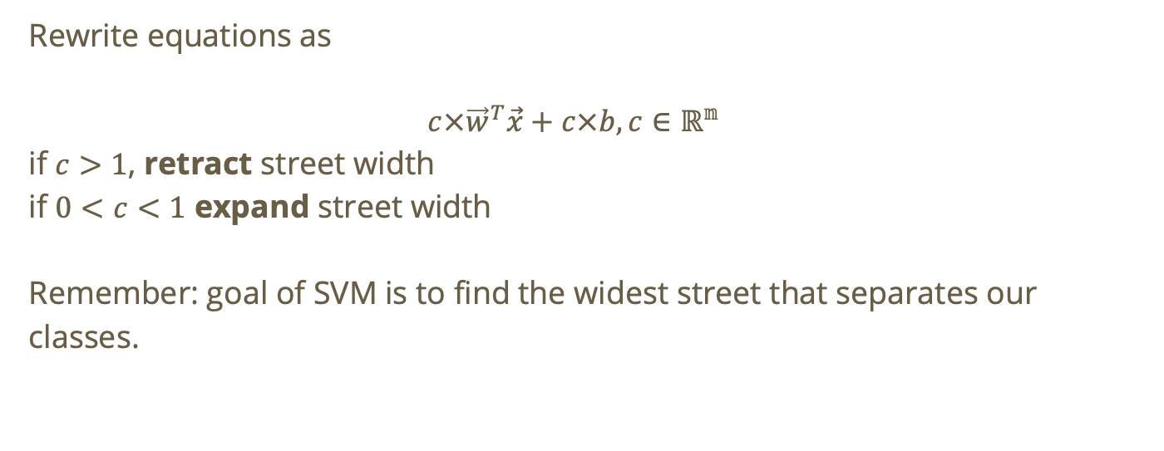
Adjusting size of streets
Rewrite equations as
$$c×{\vec{w}}^{T}\vec{x}+c×b,c∈ℝ^{𝕟}$$
if $c>1$, retract street width
if $0<c<1$ expand street width
Remember: goal of SVM is to find the widest street that separates our classes.

Slide 16

Moving the street in the direction of a point
If the current $\vec{w}$ and $b$ result in misclassification of a random point $x$ in our dataset, we can move the line toward $x$ by a step size $a$

Slide 17

Moving the street in the direction of a point
If the current $\vec{w}$ and $b$ result in misclassification of a random point $x$ in our dataset, we can move the line toward $x$ by a step size $a$
$$w_{\text{new}}=w_{\text{old}}+y_{i}×a×x_{i}$$

Slide 18

Moving the street in the direction of a point
If the current $\vec{w}$ and $b$ result in misclassification of a random point $x$ in our dataset, we can move the line toward $x$ by a step size $a$
$$w_{\text{new}}=w_{\text{old}}+y_{i}×a×x_{i}$$
$$b_{\text{new}}=b_{\text{old}}+y_{i}×a$$

Slide 19
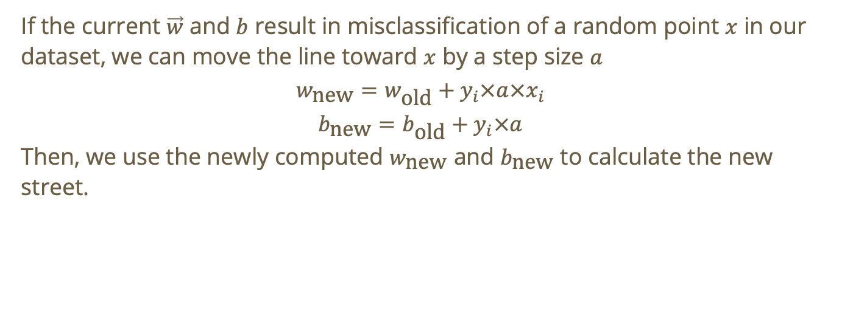
Moving the street in the direction of a point
If the current $\vec{w}$ and $b$ result in misclassification of a random point $x$ in our dataset, we can move the line toward $x$ by a step size $a$
$$w_{\text{new}}=w_{\text{old}}+y_{i}×a×x_{i}$$
$$b_{\text{new}}=b_{\text{old}}+y_{i}×a$$
Then, we use the newly computed $w_{\text{new}}$ and $b_{\text{new}}$ to calculate the new street.

Slide 20

Perceptron Algorithm
Start with random line ${\vec{w}}^{T}×\vec{x}+b=0$

Slide 21

Perceptron Algorithm
Start with random line ${\vec{w}}^{T}×\vec{x}+b=0$
Define:
a total # of iterations, $n$
a learning rate $a$
an expanding rate $c$

Slide 22

Perceptron Algorithm
Start with random line ${\vec{w}}^{T}×\vec{x}+b=0$
Define:
a total # of iterations, $n$
a learning rate $a$
an expanding rate $c$
Repeat $n$ times

Slide 23
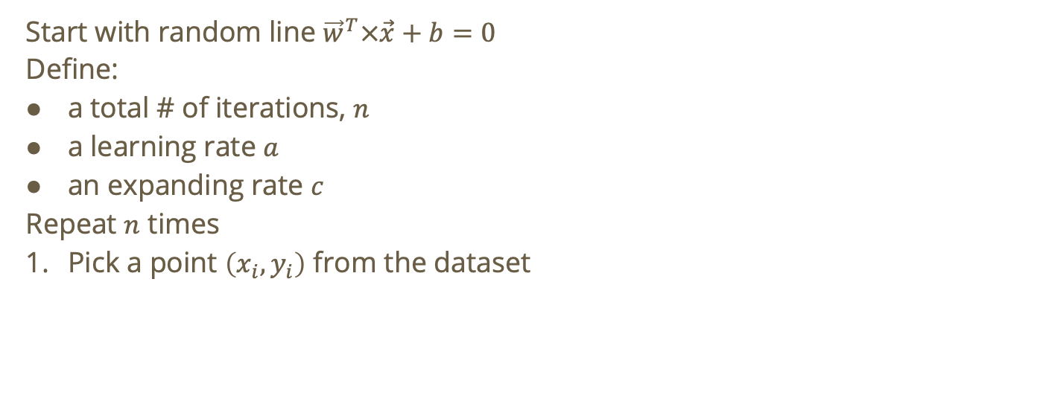
Perceptron Algorithm
Start with random line ${\vec{w}}^{T}×\vec{x}+b=0$
Define:
a total # of iterations, $n$
a learning rate $a$
an expanding rate $c$
Repeat $n$ times
Pick a point $\left(x_{i},y_{i}\right)$ from the dataset

Slide 24
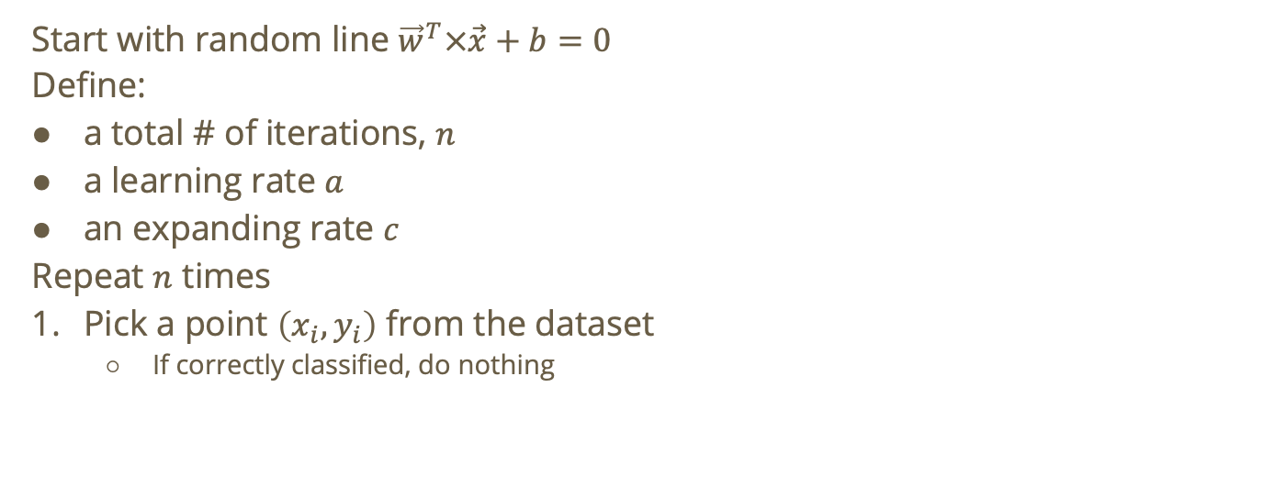
Perceptron Algorithm
Start with random line ${\vec{w}}^{T}×\vec{x}+b=0$
Define:
a total # of iterations, $n$
a learning rate $a$
an expanding rate $c$
Repeat $n$ times
Pick a point $\left(x_{i},y_{i}\right)$ from the dataset
  If correctly classified, do nothing

Slide 25

Perceptron Algorithm
Start with random line ${\vec{w}}^{T}×\vec{x}+b=0$
Repeat $n$ times
Pick a point $\vec{x}=\left(x_{i},y_{i}\right)$ from the dataset
  If correctly classified, do nothing
  If incorrectly classified

Slide 26
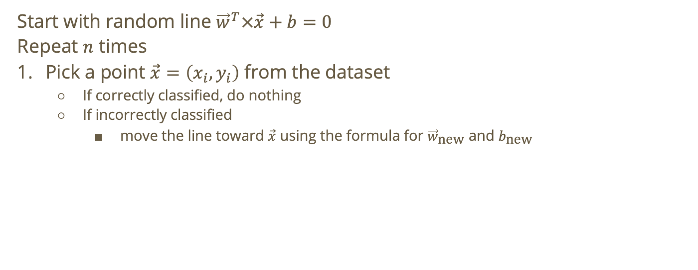
Perceptron Algorithm
Start with random line ${\vec{w}}^{T}×\vec{x}+b=0$
Repeat $n$ times
Pick a point $\vec{x}=\left(x_{i},y_{i}\right)$ from the dataset
  If correctly classified, do nothing
  If incorrectly classified
    move the line toward $\vec{x}$ using the formula for ${\vec{w}}_{\text{new}}$ and $b_{\text{new}}$

Slide 27
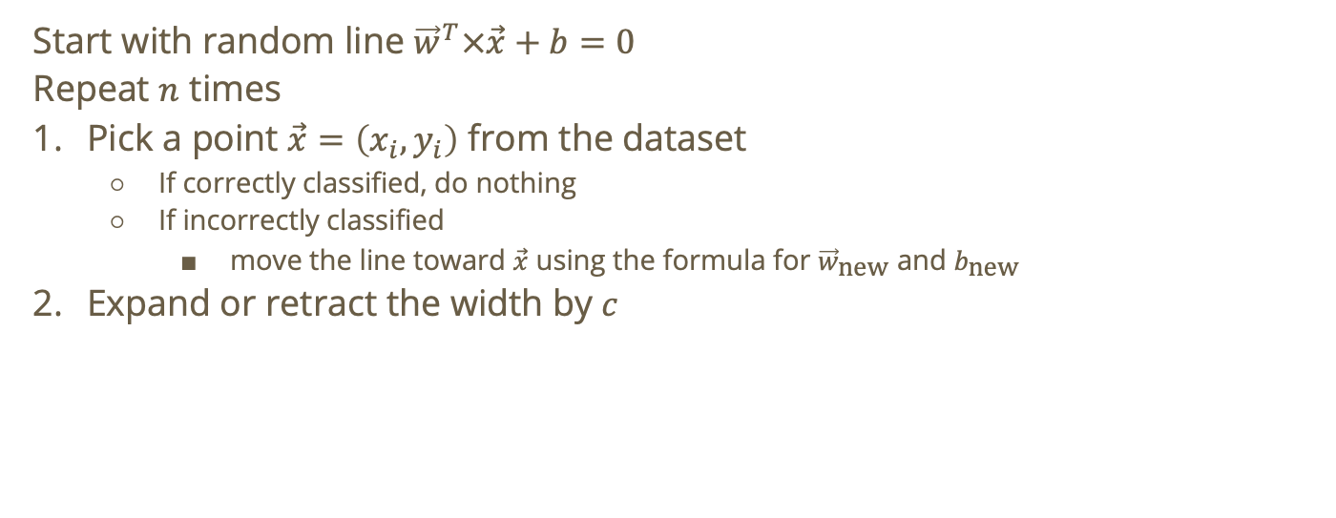
Perceptron Algorithm
Start with random line ${\vec{w}}^{T}×\vec{x}+b=0$
Repeat $n$ times
Pick a point $\vec{x}=\left(x_{i},y_{i}\right)$ from the dataset
  If correctly classified, do nothing
  If incorrectly classified
    move the line toward $\vec{x}$ using the formula for ${\vec{w}}_{\text{new}}$ and $b_{\text{new}}$
Expand or retract the width by $c$

Slide 28
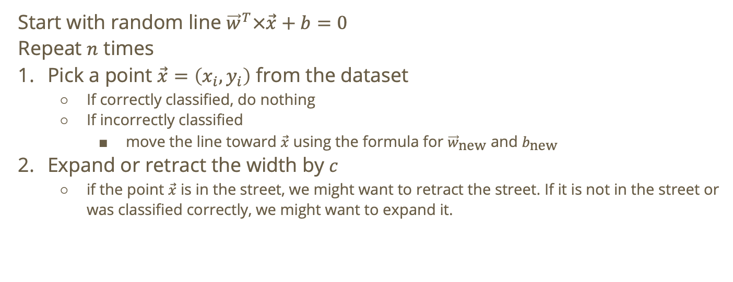
Perceptron Algorithm
Start with random line ${\vec{w}}^{T}×\vec{x}+b=0$
Repeat $n$ times
Pick a point $\vec{x}=\left(x_{i},y_{i}\right)$ from the dataset
  If correctly classified, do nothing
  If incorrectly classified
    move the line toward $\vec{x}$ using the formula for ${\vec{w}}_{\text{new}}$ and $b_{\text{new}}$
Expand or retract the width by $c$
  if the point $\vec{x}$ is in the street, we might want to retract the street. If it is not in the street or was classified correctly, we might want to expand it.

Slide 29
Do not edit
How to change the design
If correctly classified points far from the margin are moved farther from the margin, the SVM will always move (i.e., the street)
The Slido app must be installed on every computer you’re presenting from

Slide 30

$$p$$

Slide 31

$$p$$

Slide 32
$$p$$
Does the street change?
Notes:
No, still the widest street

Slide 33
Do not edit
How to change the design
Multiplying an SVM by a constant c > 1 will retract the margin of the SVM
The Slido app must be installed on every computer you’re presenting from

Slide 34
Do not edit
How to change the design
What is the width of the street for the following SVM: x_1 + x_2 + 1 = 0
The Slido app must be installed on every computer you’re presenting from

Slide 35

Solution
width of street = $\frac{2}{\left|\left|\vec{w}\right|\right|}$
$$\left|\left|\vec{w}\right|\right|=\sqrt{w_{1}^{2}+w_{2}^{2}}$$
$$=\sqrt{1^{2}+1^{2}}$$
$$=\sqrt{2}$$
width = $\frac{2}{\sqrt{2}}=\sqrt{2}$

Slide 36
Do not edit
How to change the design
Should we expand or retract this SVM?
The Slido app must be installed on every computer you’re presenting from

Slide 37
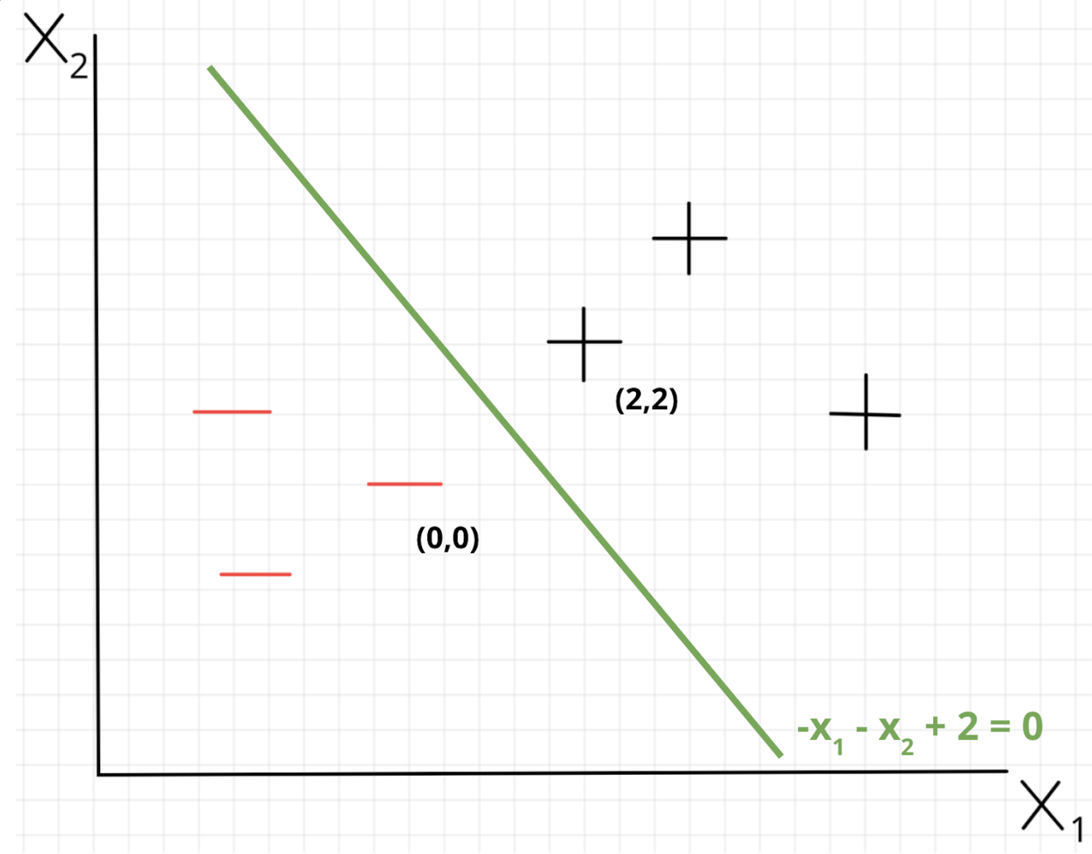

Solution
$\left(0,0\right)$ and $\left(2,2\right)$ are our support vectors.

Slide 38

Solution
$\left(0,0\right)$ and $\left(2,2\right)$ are our support vectors.
if width = $d\left(v_{1},v_{2}\right)$ then we have the widest
street. Otherwise, we will have to expand!

Slide 39

Solution
$\left(0,0\right)$ and $\left(2,2\right)$ are our support vectors.
if width = $d\left(v_{1},v_{2}\right)$ then we have the widest
street. Otherwise, we will have to expand!
$d\left(v_{1},v_{2}\right)=\sqrt{8}$
$\text{width}=\sqrt{2}$

Slide 40

Solution
$\left(0,0\right)$ and $\left(2,2\right)$ are our support vectors.
if width = $d\left(v_{1},v_{2}\right)$ then we have the widest
street. Otherwise, we will have to expand!
$d\left(v_{1},v_{2}\right)=\sqrt{8}$
$\text{width}=\sqrt{2}$
current width < $d\left(v_{1},v_{2}\right)$ → expand!

Slide 41
Do not edit
How to change the design
Should we expand or retract this SVM?
The Slido app must be installed on every computer you’re presenting from

Slide 42
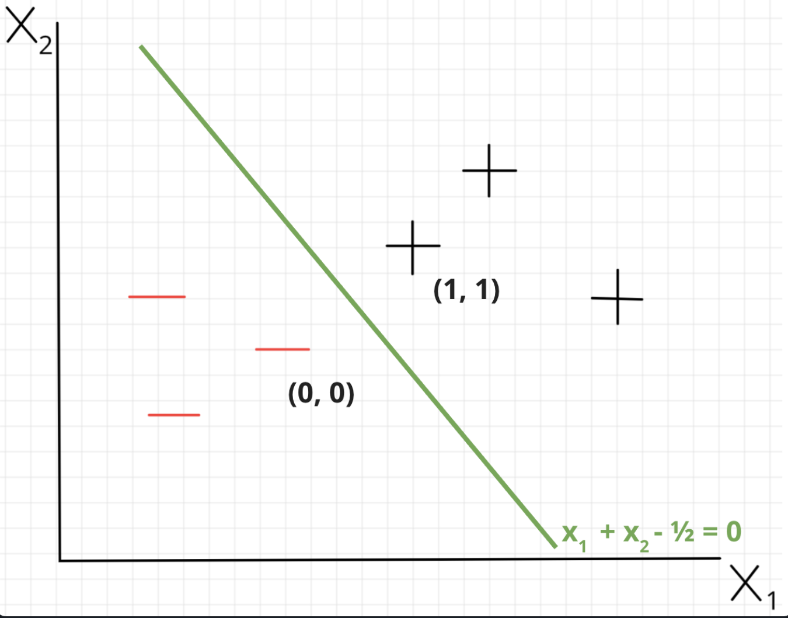

Solution
$d\left(v_{1},v_{2}\right)=\text{current}\text{_}\text{width}$ → widest street found!

Slide 43
Varying C
If C is too small:
model may get too complex to avoid misclassification → overfitting
If C is too large:
model may be too simple → underfitting

Slide 44
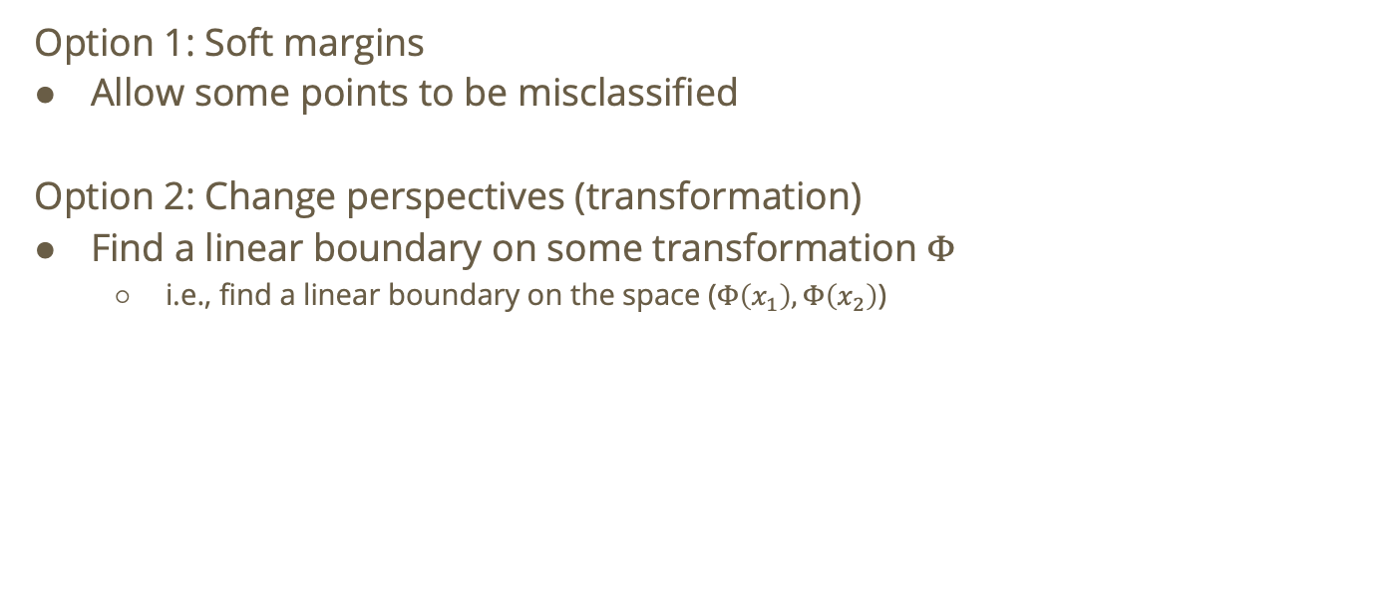
What if there is no linear boundary?
Option 1: Soft margins
Allow some points to be misclassified
Option 2: Change perspectives (transformation)
Find a linear boundary on some transformation $Φ$
  i.e., find a linear boundary on the space ($Φ\left(x_{1}\right),Φ\left(x_{2}\right)$)

Slide 45
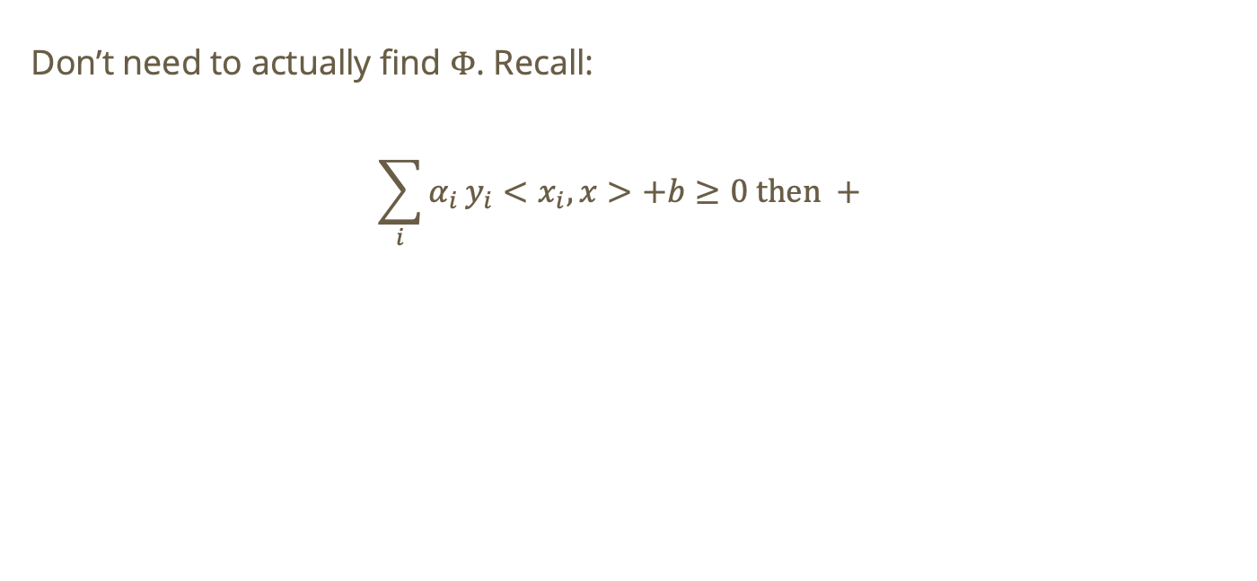
Finding $Φ$
Don’t need to actually find $Φ$. Recall:
$$\sum_{i}{α_{i}}y_{i}<x_{i},x>+b≥0 \text{then} +$$

Slide 46
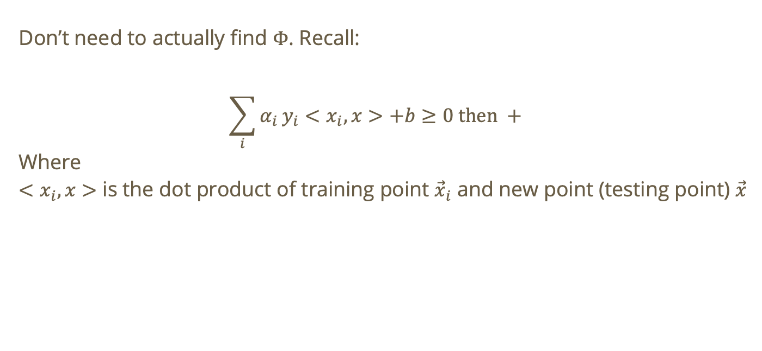
Finding $Φ$
Don’t need to actually find $Φ$. Recall:
$$\sum_{i}{α_{i}}y_{i}<x_{i},x>+b≥0 \text{then} +$$
Where
$<x_{i},x>$ is the dot product of training point ${\vec{x}}_{i}$ and new point (testing point) $\vec{x}$

Slide 47
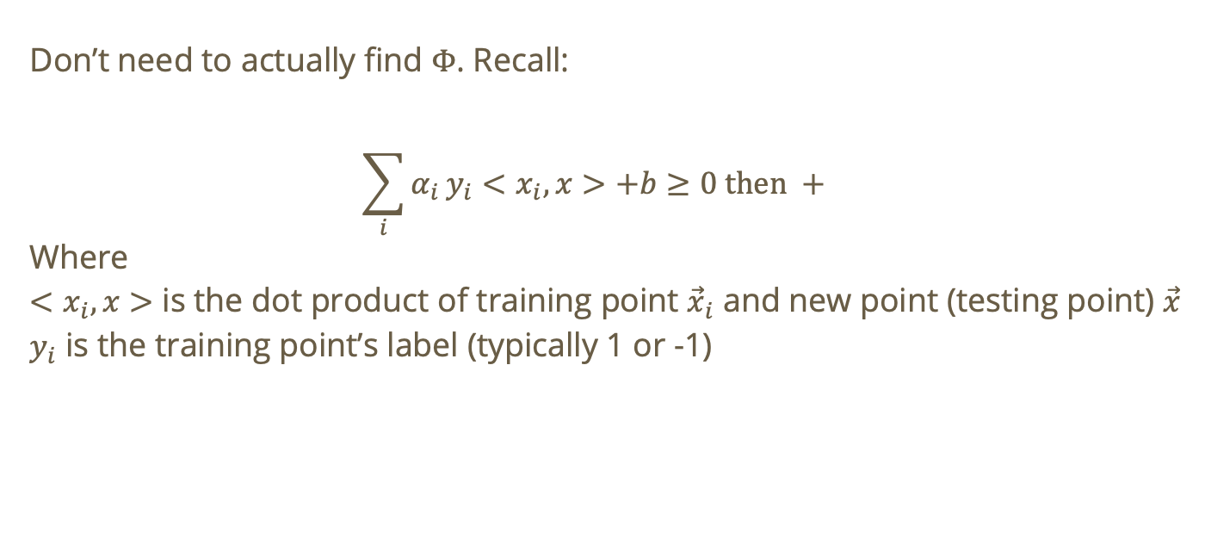
Finding $Φ$
Don’t need to actually find $Φ$. Recall:
$$\sum_{i}{α_{i}}y_{i}<x_{i},x>+b≥0 \text{then} +$$
Where
$<x_{i},x>$ is the dot product of training point ${\vec{x}}_{i}$ and new point (testing point) $\vec{x}$
$y_{i}$ is the training point’s label (typically 1 or -1)

Slide 48
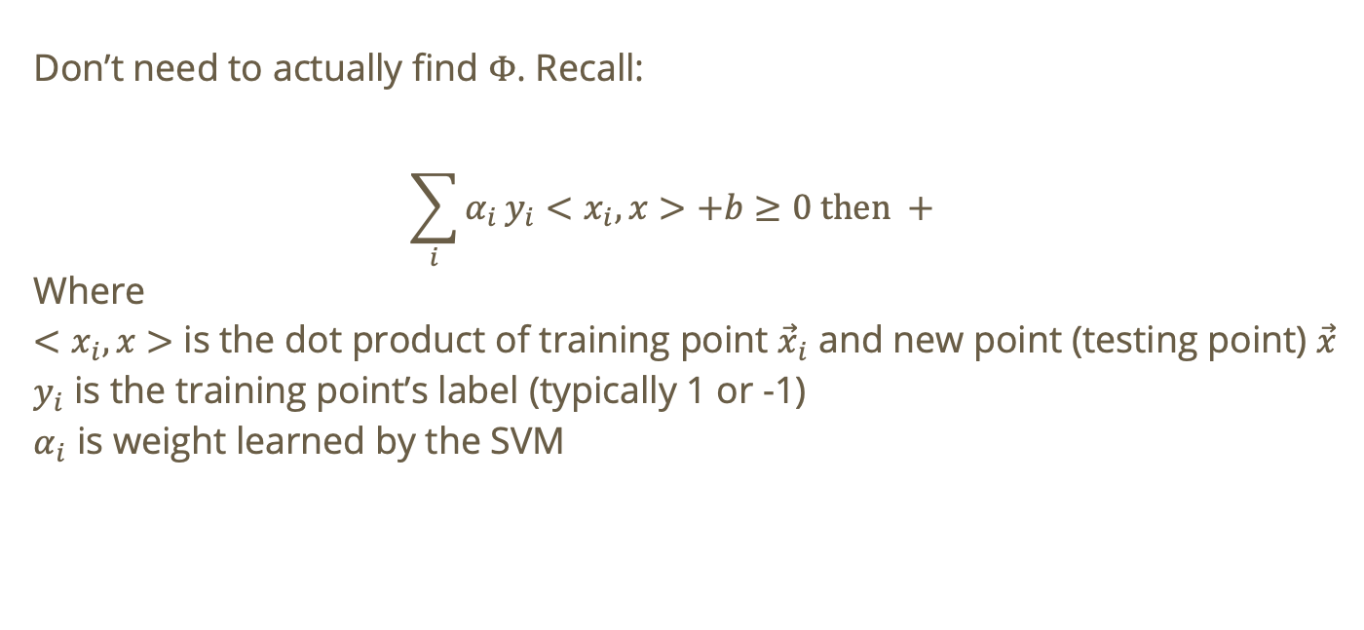
Finding $Φ$
Don’t need to actually find $Φ$. Recall:
$$\sum_{i}{α_{i}}y_{i}<x_{i},x>+b≥0 \text{then} +$$
Where
$<x_{i},x>$ is the dot product of training point ${\vec{x}}_{i}$ and new point (testing point) $\vec{x}$
$y_{i}$ is the training point’s label (typically 1 or -1)
$α_{i}$ is weight learned by the SVM

Slide 49
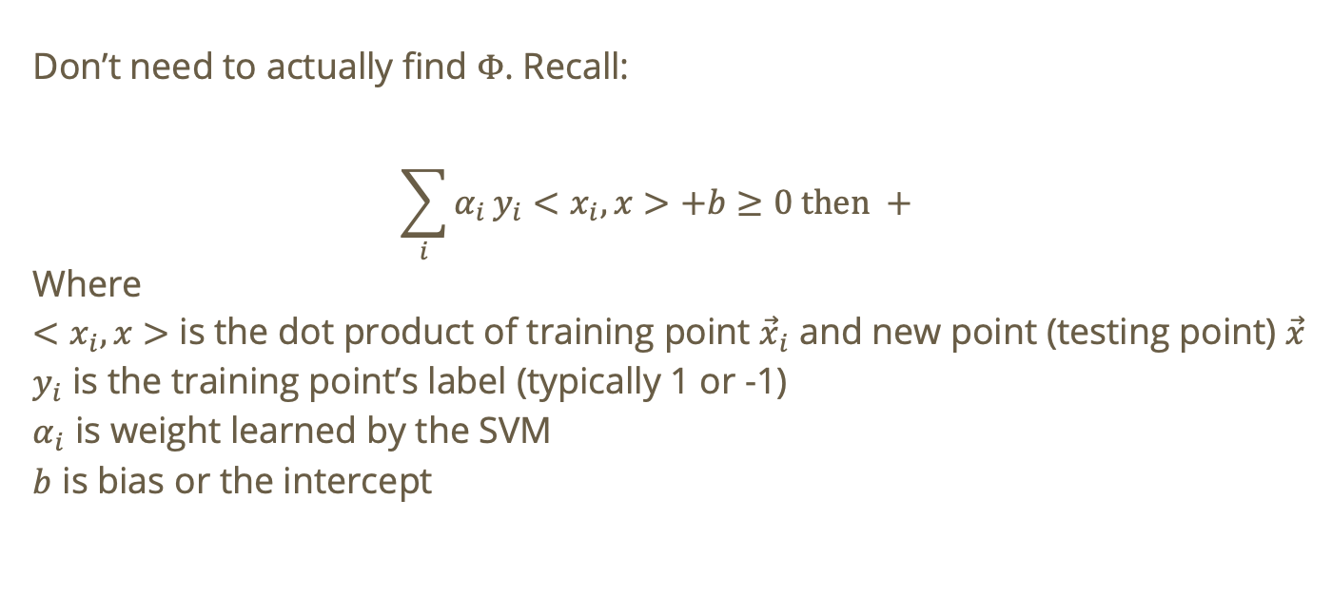
Finding $Φ$
Don’t need to actually find $Φ$. Recall:
$$\sum_{i}{α_{i}}y_{i}<x_{i},x>+b≥0 \text{then} +$$
Where
$<x_{i},x>$ is the dot product of training point ${\vec{x}}_{i}$ and new point (testing point) $\vec{x}$
$y_{i}$ is the training point’s label (typically 1 or -1)
$α_{i}$ is weight learned by the SVM
$b$ is bias or the intercept

Slide 50
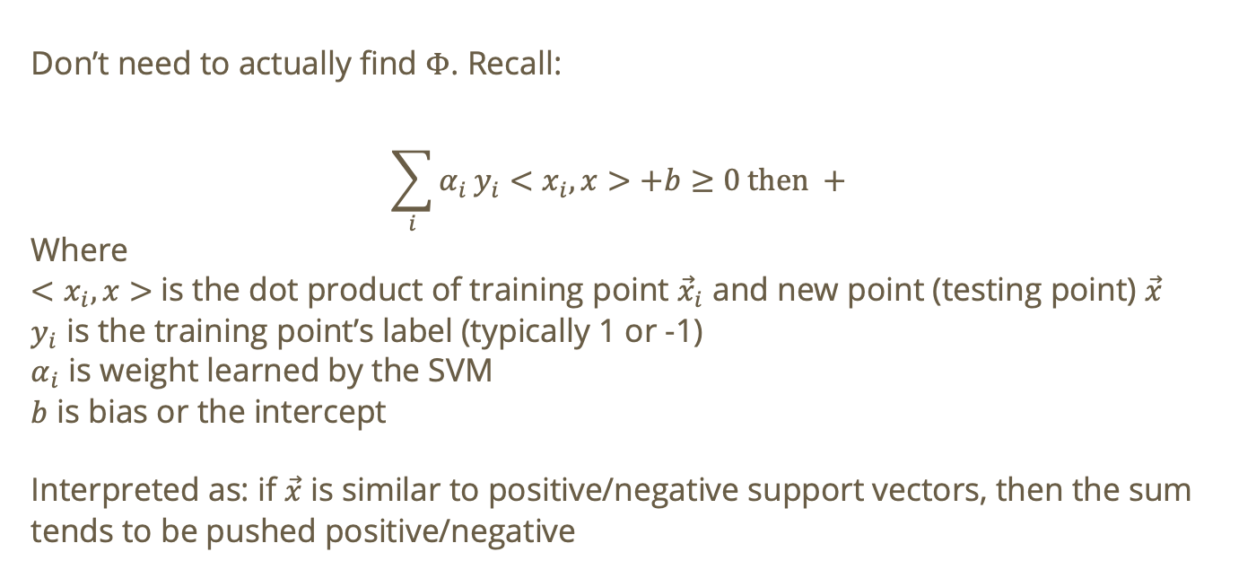
Finding $Φ$
Don’t need to actually find $Φ$. Recall:
$$\sum_{i}{α_{i}}y_{i}<x_{i},x>+b≥0 \text{then} +$$
Where
$<x_{i},x>$ is the dot product of training point ${\vec{x}}_{i}$ and new point (testing point) $\vec{x}$
$y_{i}$ is the training point’s label (typically 1 or -1)
$α_{i}$ is weight learned by the SVM
$b$ is bias or the intercept
Interpreted as: if $\vec{x}$ is similar to positive/negative support vectors, then the sum tends to be pushed positive/negative

Slide 51

Kernel functions
Define $K\left({\vec{x}}_{i},{\vec{x}}_{j}\right)=φ\left({\vec{x}}_{i}\right)⋅φ\left({\vec{x}}_{j}\right)$

Slide 52
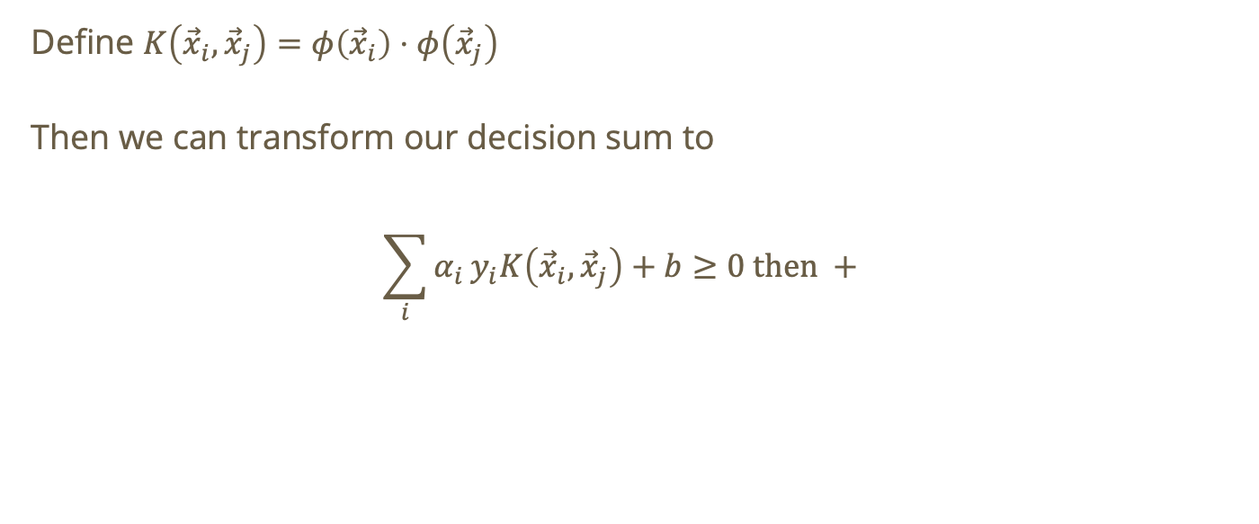
Kernel functions
Define $K\left({\vec{x}}_{i},{\vec{x}}_{j}\right)=φ\left({\vec{x}}_{i}\right)⋅φ\left({\vec{x}}_{j}\right)$
Then we can transform our decision sum to
$$\sum_{i}{α_{i}}y_{i}K\left({\vec{x}}_{i},{\vec{x}}_{j}\right)+b≥0 \text{then} +$$

Slide 53
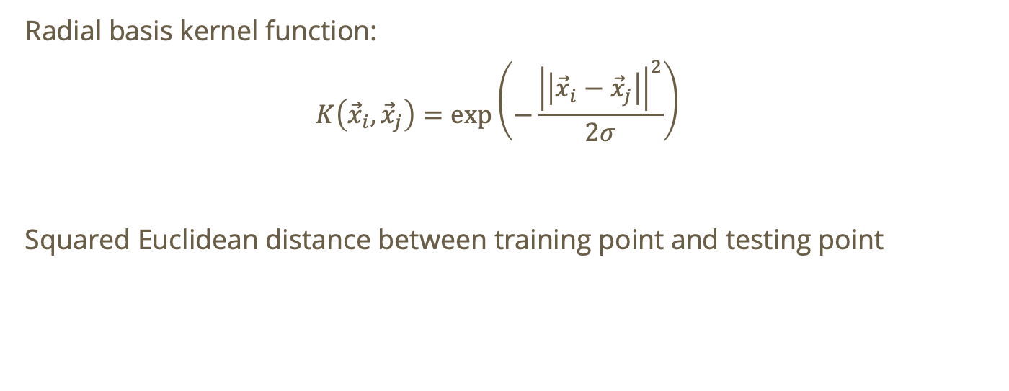
Example kernel function
Radial basis kernel function:
$$K\left({\vec{x}}_{i},{\vec{x}}_{j}\right)=\text{exp}\left(−\frac{{\left|\left|{\vec{x}}_{i}−{\vec{x}}_{j}\right|\right|}^{2}}{2σ}\right)$$
Squared Euclidean distance between training point and testing point

Slide 54
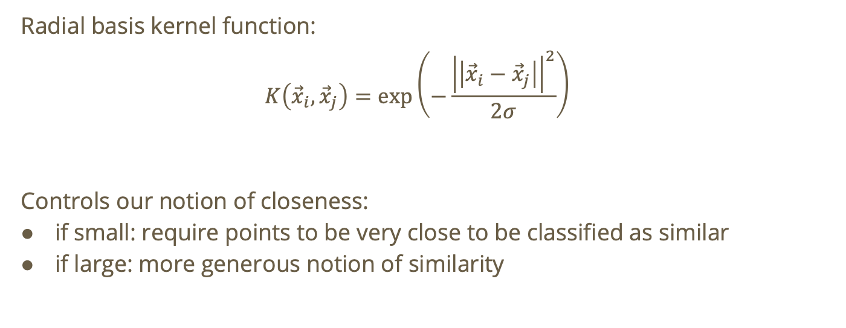
Example kernel function
Radial basis kernel function:
$$K\left({\vec{x}}_{i},{\vec{x}}_{j}\right)=\text{exp}\left(−\frac{{\left|\left|{\vec{x}}_{i}−{\vec{x}}_{j}\right|\right|}^{2}}{2σ}\right)$$
Controls our notion of closeness:
if small: require points to be very close to be classified as similar
if large: more generous notion of similarity

Slide 55
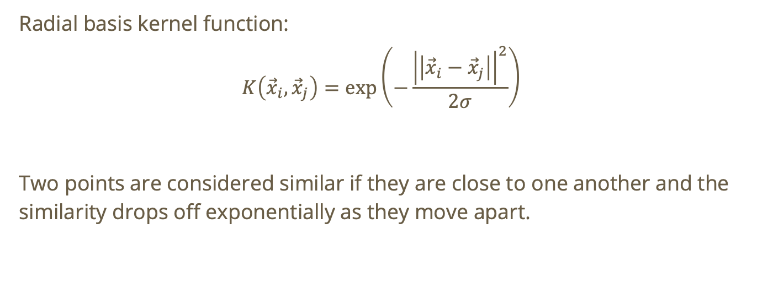
Example kernel function
Radial basis kernel function:
$$K\left({\vec{x}}_{i},{\vec{x}}_{j}\right)=\text{exp}\left(−\frac{{\left|\left|{\vec{x}}_{i}−{\vec{x}}_{j}\right|\right|}^{2}}{2σ}\right)$$
Two points are considered similar if they are close to one another and the similarity drops off exponentially as they move apart.

Slide 56
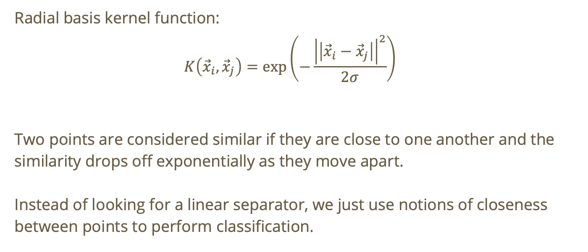
Example kernel function
Radial basis kernel function:
$$K\left({\vec{x}}_{i},{\vec{x}}_{j}\right)=\text{exp}\left(−\frac{{\left|\left|{\vec{x}}_{i}−{\vec{x}}_{j}\right|\right|}^{2}}{2σ}\right)$$
Two points are considered similar if they are close to one another and the similarity drops off exponentially as they move apart.
Instead of looking for a linear separator, we just use notions of closeness between points to perform classification.

Slide 57
Finding optimal parameters
Key parameters: regularization parameter, kernel, degree, gamma

Slide 58
Finding optimal parameters
Key parameters: regularization parameter, kernel, degree, gamma
Regularization parameter

Slide 59
Finding optimal parameters
Key parameters: regularization parameter, kernel, degree, gamma
Regularization parameter
  Larger → weaker regularization, model will try hard to classify all points correctly which could result in overfitting

Slide 60
Finding optimal parameters
Key parameters: regularization parameter, kernel, degree, gamma
Regularization parameter
  Larger → weaker regularization, model will try hard to classify all points correctly which could result in overfitting
  Smaller → stronger regularization, model will be tolerant of some error and could generalize better. If C is too small, risk underfitting.

Slide 61
Finding optimal parameters
Key parameters: regularization parameter, kernel, degree, gamma
Kernel: linear, polynomial, radial basis function (rbf), sigmoid, precomputed (custom)

Slide 62
Finding optimal parameters
Key parameters: regularization parameter, kernel, degree, gamma
Kernel: linear, polynomial, radial basis function (rbf), sigmoid, precomputed (custom)
  For TF-IDF/bag-of-words, typically try linear first

Slide 63
Finding optimal parameters
Key parameters: regularization parameter, kernel, degree, gamma
Kernel: linear, polynomial, radial basis function (rbf), sigmoid, precomputed (custom)
  For TF-IDF/bag-of-words, typically try linear first
  For general nonlinear data, typically try rbf

Slide 64
Finding optimal parameters
Key parameters: regularization parameter, kernel, degree, gamma
Kernel: linear, polynomial, radial basis function (rbf), sigmoid, precomputed (custom)
  For TF-IDF/bag-of-words, typically try linear first
  For general nonlinear data, typically try rbf
  When the data is nonlinear and there is significant interaction between features, try polynomial

Slide 65
Finding optimal parameters
Key parameters: regularization parameter, kernel, degree, gamma
Kernel: linear, polynomial, radial basis function (rbf), sigmoid, precomputed (custom)
  For TF-IDF/bag-of-words, typically try linear first
  For general nonlinear data, typically try rbf
  When the data is nonlinear and there is significant interaction between features, try polynomial
  Sigmoid is less common but can be useful for some sentiment analysis and is most comparable to a simple neural network.

Slide 66
Finding optimal parameters
Key parameters: regularization parameter, kernel, degree, gamma
Degree: only applicable for polynomial kernel

Slide 67
Finding optimal parameters
Key parameters: regularization parameter, kernel, degree, gamma
Degree: only applicable for polynomial kernel
  How do we decide what degree to use?

Slide 68
Finding optimal parameters
Key parameters: regularization parameter, kernel, degree, gamma
Gamma

Slide 69
Finding optimal parameters
Key parameters: regularization parameter, kernel, degree, gamma
Gamma
  Controls how local the influence is for each training point using rbf, polynomial, or sigmoid kernel.

Slide 70
Finding optimal parameters
Key parameters: regularization parameter, kernel, degree, gamma
Gamma
  Controls how local the influence is for each training point using rbf, polynomial, or sigmoid kernel.
  E.g., for rbf

Slide 71
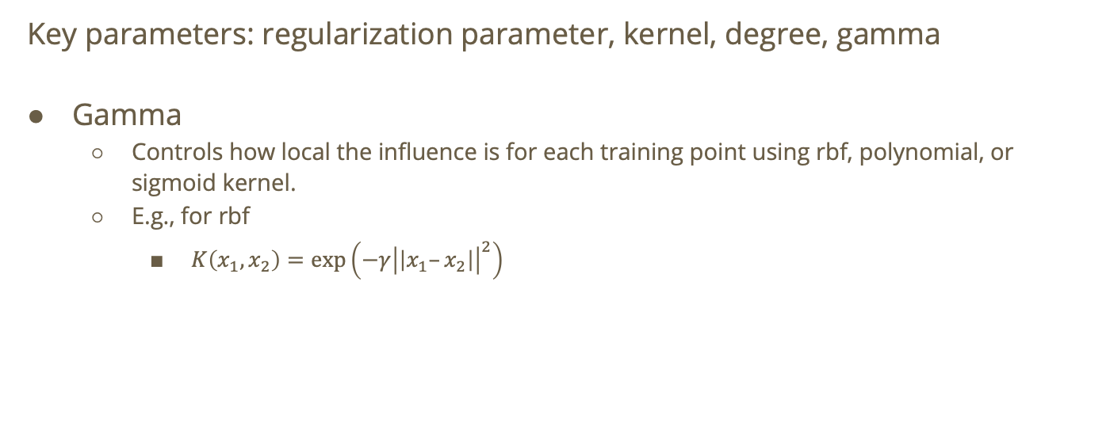
Finding optimal parameters
Key parameters: regularization parameter, kernel, degree, gamma
Gamma
  Controls how local the influence is for each training point using rbf, polynomial, or sigmoid kernel.
  E.g., for rbf
    $K\left(x_{1},x_{2}\right)=\text{exp}\left(−γ{\left|\left|x_{1}–x_{2}\right|\right|}^{2}\right)$

Slide 72
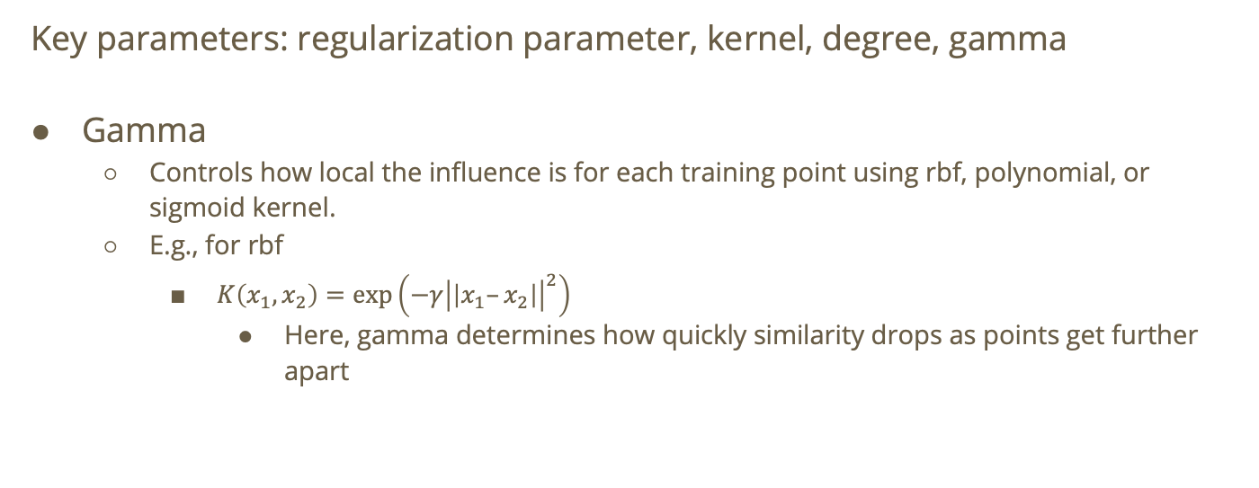
Finding optimal parameters
Key parameters: regularization parameter, kernel, degree, gamma
Gamma
  Controls how local the influence is for each training point using rbf, polynomial, or sigmoid kernel.
  E.g., for rbf
    $K\left(x_{1},x_{2}\right)=\text{exp}\left(−γ{\left|\left|x_{1}–x_{2}\right|\right|}^{2}\right)$
      Here, gamma determines how quickly similarity drops as points get further apart

Slide 73
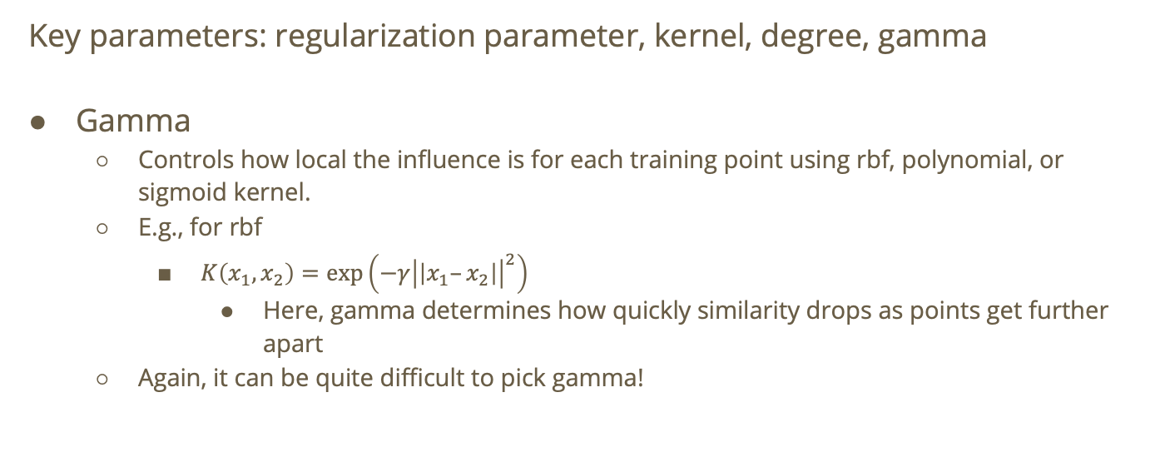
Finding optimal parameters
Key parameters: regularization parameter, kernel, degree, gamma
Gamma
  Controls how local the influence is for each training point using rbf, polynomial, or sigmoid kernel.
  E.g., for rbf
    $K\left(x_{1},x_{2}\right)=\text{exp}\left(−γ{\left|\left|x_{1}–x_{2}\right|\right|}^{2}\right)$
      Here, gamma determines how quickly similarity drops as points get further apart
  Again, it can be quite difficult to pick gamma!

Slide 74
So many parameters!
It can be tough to have to iterate over so many different parameters.

Slide 75
So many parameters!
It can be tough to have to iterate over so many different parameters.
Sometimes it’s hard to mathematically find good parameters so our best bet is likely to just try different parameters!

Slide 76
So many parameters!
It can be tough to have to iterate over so many different parameters.
Sometimes it’s hard to mathematically find good parameters so our best bet is likely to just try different parameters!
What if we could automate the process of iterating over different parameter sets and then choose the set of parameters that yields the best result?

Slide 77
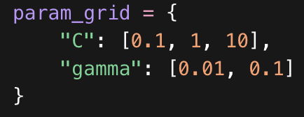
Grid search
Grid search will try every combination of parameter that we specify, scores each one with cross-validation, and returns the best performer with respect the provided scoring metric.
You provide a parameter grid:
E.g.,
Then grid search will take the cartesian product and test every possible combination.

Slide 78
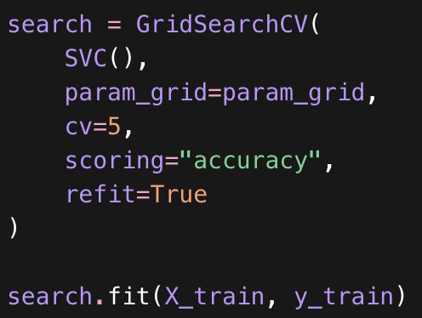
Grid search
cv = number of folds for the cross validation
scoring = scoring metric. e.g. precision, recall, f1, accuracy, RMSE, R2
refit = fit a final model on the full training set after finding the best parameters

