Slide 1
Intro to Linear Regression
CS 506

Slide 2

Recall: motivation for regression
In classification, we looked to predict on a set of classes $Y$ that are discrete given a set of data points.

Slide 3

Recall: motivation for regression
In classification, we looked to predict on a set of classes $Y$ that are discrete given a set of data points.
In regression, $Y$ is now a continuous variable.

Slide 4
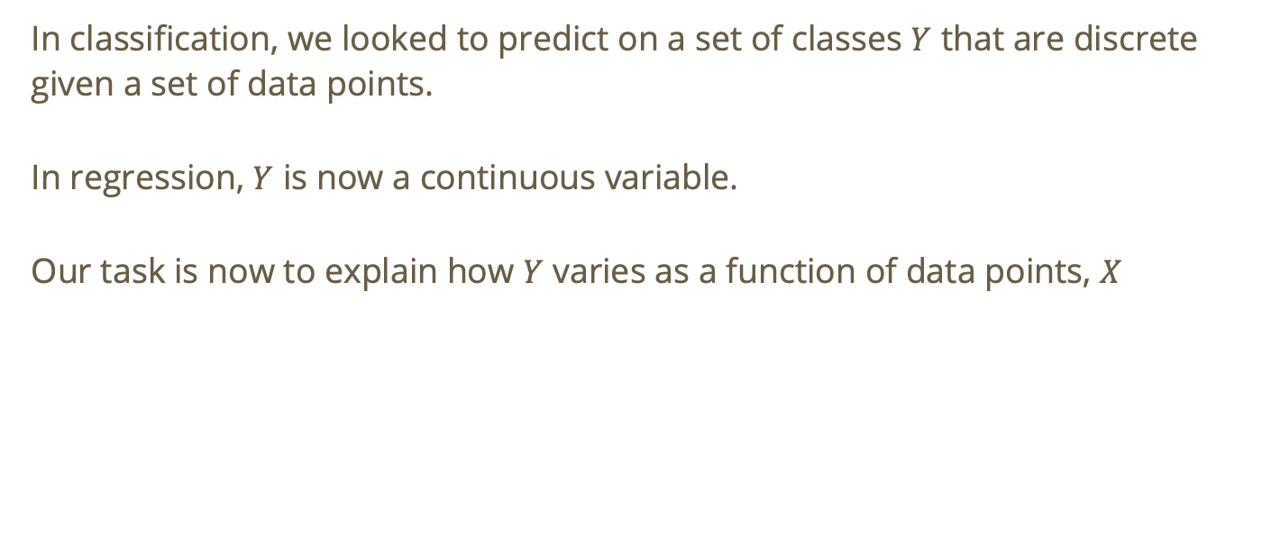
Recall: motivation for regression
In classification, we looked to predict on a set of classes $Y$ that are discrete given a set of data points.
In regression, $Y$ is now a continuous variable.
Our task is now to explain how $Y$ varies as a function of data points, $X$

Slide 5
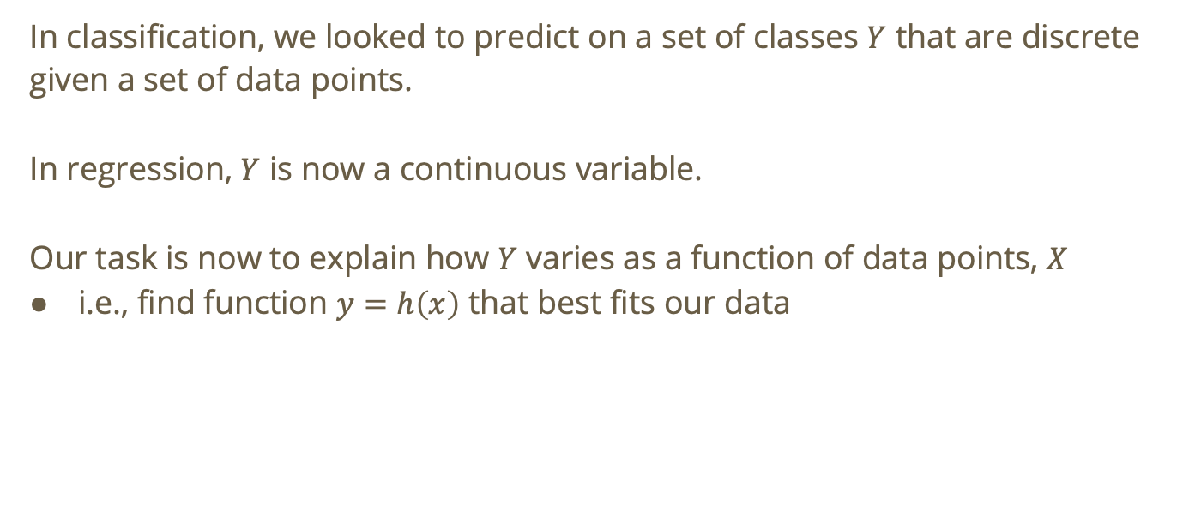
Recall: motivation for regression
In classification, we looked to predict on a set of classes $Y$ that are discrete given a set of data points.
In regression, $Y$ is now a continuous variable.
Our task is now to explain how $Y$ varies as a function of data points, $X$
i.e., find function $y=h\left(x\right)$ that best fits our data

Slide 6
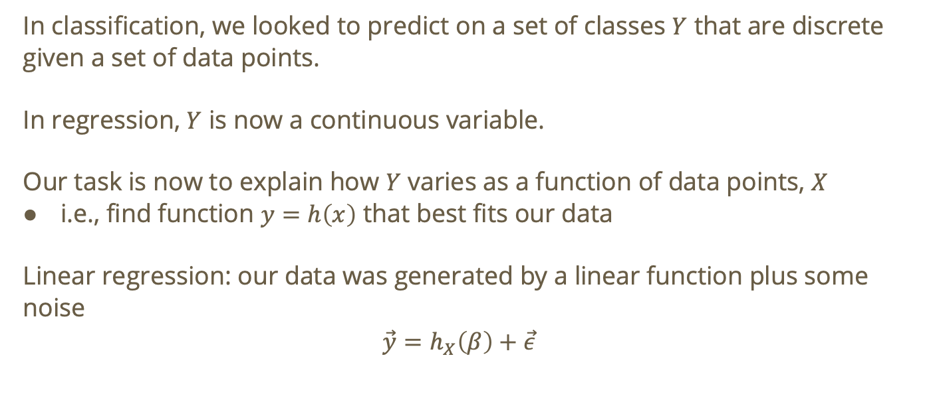
Recall: motivation for regression
In classification, we looked to predict on a set of classes $Y$ that are discrete given a set of data points.
In regression, $Y$ is now a continuous variable.
Our task is now to explain how $Y$ varies as a function of data points, $X$
i.e., find function $y=h\left(x\right)$ that best fits our data
Linear regression: our data was generated by a linear function plus some noise
$$\vec{y}=h_{X}\left(β\right)+\vec{ε}$$

Slide 7
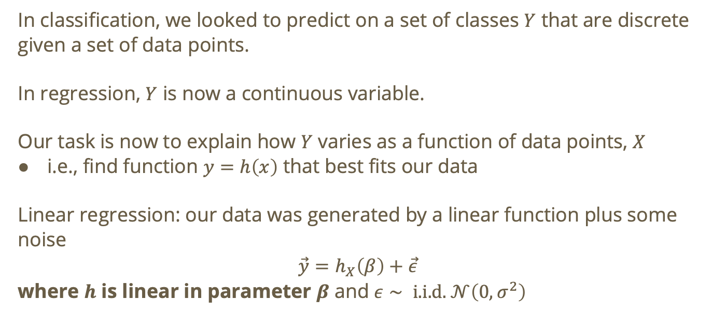
Recall: motivation for regression
In classification, we looked to predict on a set of classes $Y$ that are discrete given a set of data points.
In regression, $Y$ is now a continuous variable.
Our task is now to explain how $Y$ varies as a function of data points, $X$
i.e., find function $y=h\left(x\right)$ that best fits our data
Linear regression: our data was generated by a linear function plus some noise
$$\vec{y}=h_{X}\left(β\right)+\vec{ε}$$
where $h$ is linear in parameter $β$ and $ε∼ \text{i}\text{.}\text{i}\text{.}\text{d}\text{. }𝒩\left(0,σ^{2}\right)$

Slide 8

Recall: Linear regression at a high level
$$y=Xβ+ε,y∈ℝ^{n},X∈ℝ^{n×\left(k+1\right)},β∈ℝ^{k+1},ε∈ℝ^{n}$$
Where we have $n$ observations and $k$ predictors
Notes:
Note: the +1s are to account for the intercept ($β_{0}$)

Slide 9

Recall: Linear regression at a high level
$$y=Xβ+ε,y∈ℝ^{n},X∈ℝ^{n×\left(k+1\right)},β∈ℝ^{k+1},ε∈ℝ^{n}$$
Where we have $n$ observations and $k$ predictors
Predicts a continuous outcome $y$
Notes:
Note: the +1s are to account for the intercept ($β_{0}$)

Slide 10

Recall: Linear regression at a high level
$$y=Xβ+ε,y∈ℝ^{n},X∈ℝ^{n×\left(k+1\right)},β∈ℝ^{k+1},ε∈ℝ^{n}$$
Where we have $n$ observations and $k$ predictors
Predicts a continuous outcome $y$
Assumes the mean of $y$ is a linear function of the predictors $x_{1},…,x_{k}$
Notes:
Note: the +1s are to account for the intercept ($β_{0}$)

Slide 11
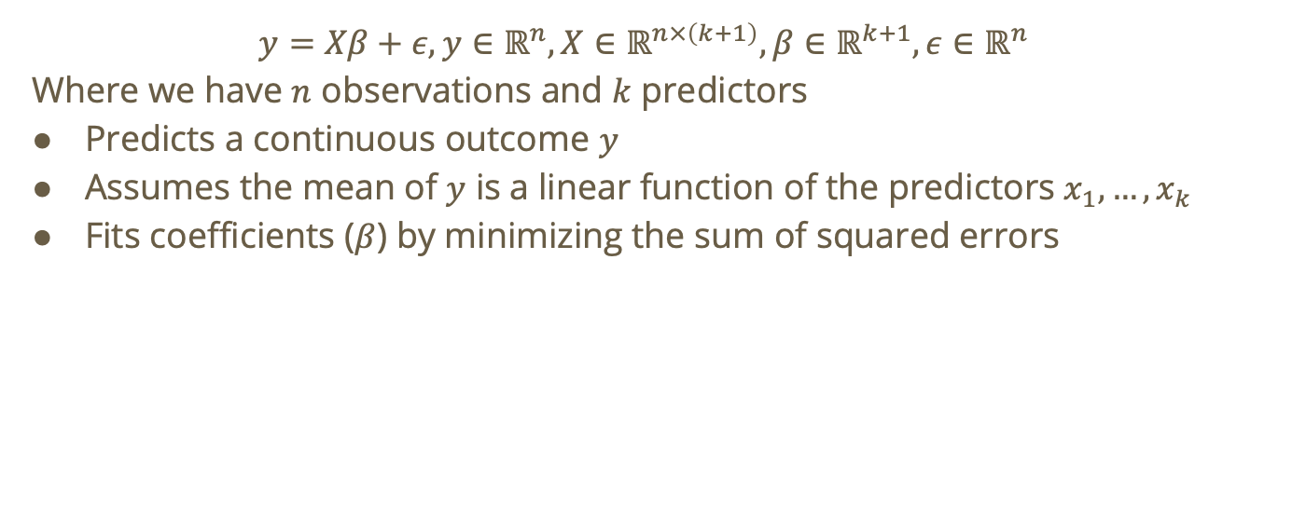
Recall: Linear regression at a high level
$$y=Xβ+ε,y∈ℝ^{n},X∈ℝ^{n×\left(k+1\right)},β∈ℝ^{k+1},ε∈ℝ^{n}$$
Where we have $n$ observations and $k$ predictors
Predicts a continuous outcome $y$
Assumes the mean of $y$ is a linear function of the predictors $x_{1},…,x_{k}$
Fits coefficients ($β$) by minimizing the sum of squared errors
Notes:
Note: the +1s are to account for the intercept ($β_{0}$)

Slide 12
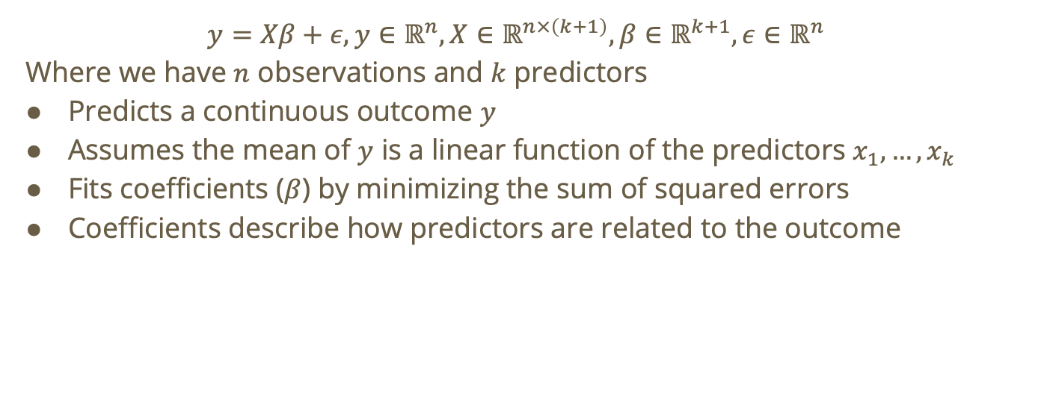
Recall: Linear regression at a high level
$$y=Xβ+ε,y∈ℝ^{n},X∈ℝ^{n×\left(k+1\right)},β∈ℝ^{k+1},ε∈ℝ^{n}$$
Where we have $n$ observations and $k$ predictors
Predicts a continuous outcome $y$
Assumes the mean of $y$ is a linear function of the predictors $x_{1},…,x_{k}$
Fits coefficients ($β$) by minimizing the sum of squared errors
Coefficients describe how predictors are related to the outcome
Notes:
Note: the +1s are to account for the intercept ($β_{0}$)

Slide 13
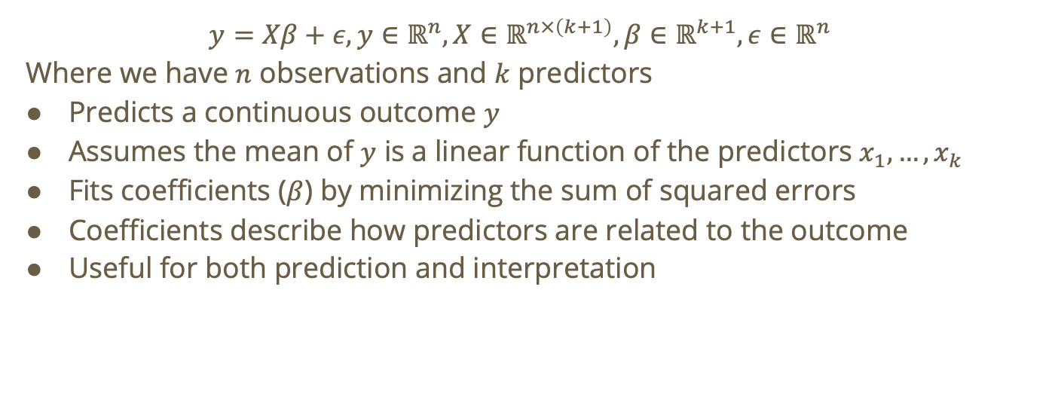
Recall: Linear regression at a high level
$$y=Xβ+ε,y∈ℝ^{n},X∈ℝ^{n×\left(k+1\right)},β∈ℝ^{k+1},ε∈ℝ^{n}$$
Where we have $n$ observations and $k$ predictors
Predicts a continuous outcome $y$
Assumes the mean of $y$ is a linear function of the predictors $x_{1},…,x_{k}$
Fits coefficients ($β$) by minimizing the sum of squared errors
Coefficients describe how predictors are related to the outcome
Useful for both prediction and interpretation
Notes:
Note: the +1s are to account for the intercept ($β_{0}$)

Slide 14
Linear Regression Cost Function

Slide 15

Linear regression cost function (single feature case)
Given data $𝒟=\{{\vec{x}}_{1},…,{\vec{x}}_{n}\}$where ${\vec{x}}_{i}=\left(x_{i},y_{i}\right)$

Slide 16

Linear regression cost function (single feature case)
Given data $𝒟=\{{\vec{x}}_{1},…,{\vec{x}}_{n}\}$where ${\vec{x}}_{i}=\left(x_{i},y_{i}\right)$
Suppose we have $y=h\left(x\right)$. Compare $h\left(x_{i}\right)$ to $y_{i}, ∀i$

Slide 17

Linear regression cost function (single feature case)
Given data $𝒟=\{{\vec{x}}_{1},…,{\vec{x}}_{n}\}$where ${\vec{x}}_{i}=\left(x_{i},y_{i}\right)$
Suppose we have $y=h\left(x\right)$. Compare $h\left(x_{i}\right)$ to $y_{i}, ∀i$
i.e., compare estimated value to true value

Slide 18
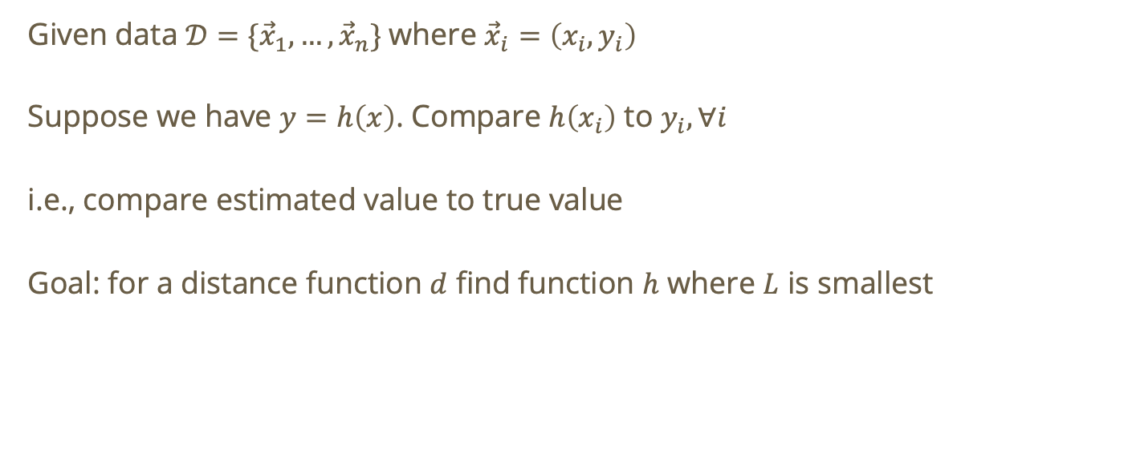
Linear regression cost function (single feature case)
Given data $𝒟=\{{\vec{x}}_{1},…,{\vec{x}}_{n}\}$where ${\vec{x}}_{i}=\left(x_{i},y_{i}\right)$
Suppose we have $y=h\left(x\right)$. Compare $h\left(x_{i}\right)$ to $y_{i}, ∀i$
i.e., compare estimated value to true value
Goal: for a distance function $d$ find function $h$ where $L$ is smallest

Slide 19
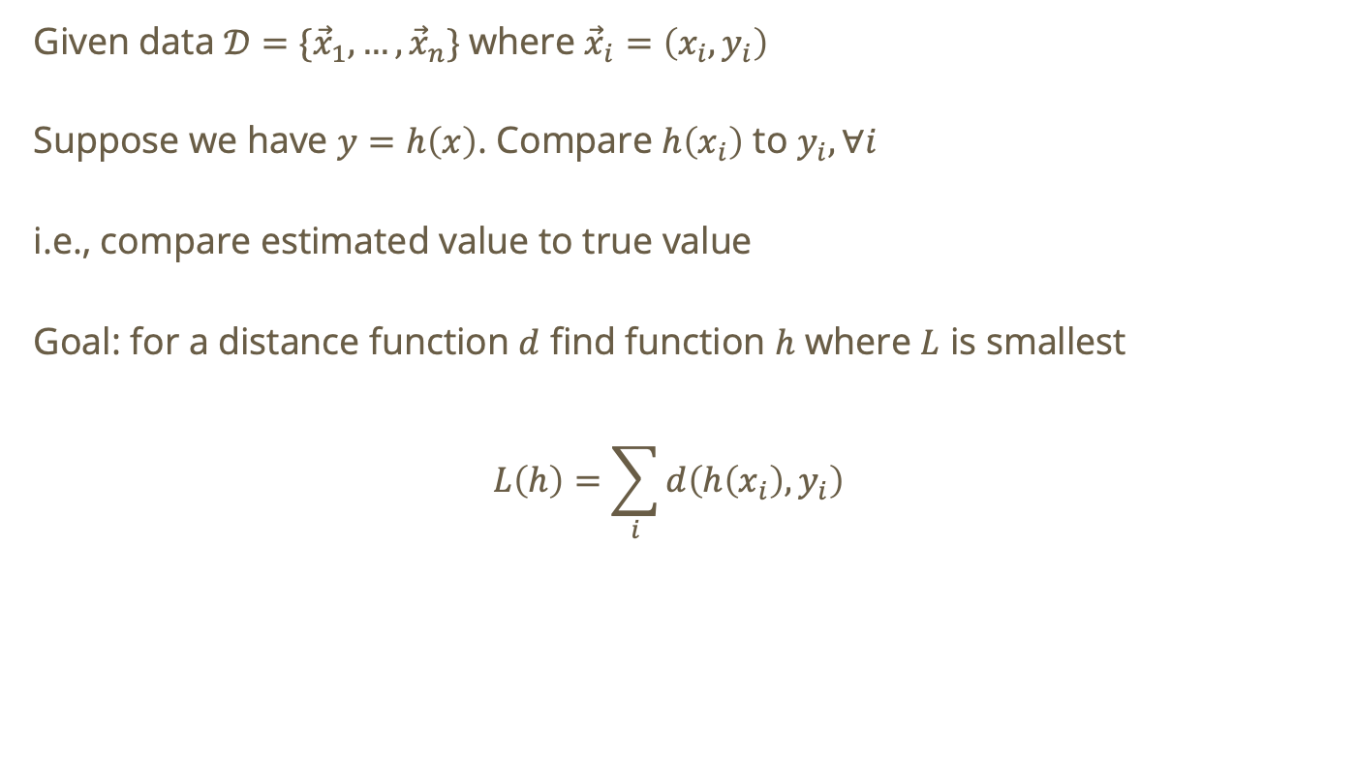
Linear regression cost function (single feature case)
Given data $𝒟=\{{\vec{x}}_{1},…,{\vec{x}}_{n}\}$where ${\vec{x}}_{i}=\left(x_{i},y_{i}\right)$
Suppose we have $y=h\left(x\right)$. Compare $h\left(x_{i}\right)$ to $y_{i}, ∀i$
i.e., compare estimated value to true value
Goal: for a distance function $d$ find function $h$ where $L$ is smallest
$$L\left(h\right)=\sum_{i}{d\left(h\left(x_{i}\right),y_{i}\right)}$$

Slide 20

Linear regression cost function
$h_{β\left(x_{i}\right)}=β_{0}+β_{1}x_{i}$ for one feature.

Slide 21

Linear regression cost function
$h_{β\left(x_{i}\right)}=β_{0}+β_{1}x_{i}$ for one feature.
If we had multiple features
$$h_{β\left(x_{i}\right)}=β_{0}+\sum_{j=1}^{p}{β_{j}x_{ij}}=β^{T}x_{i}$$
where $p$ is the number of features, $x_{i}∈ℝ^{p+1},β∈ℝ^{p+1}$
Notes:
Multiple features is also called MLR (multiple linear regression)
$x_{i}$is called the feature vector

Slide 22
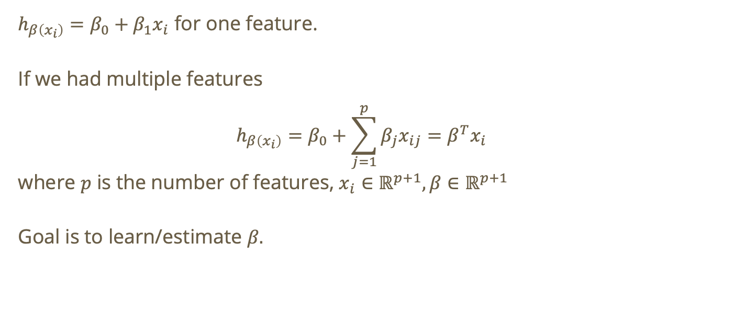
Linear regression cost function
$h_{β\left(x_{i}\right)}=β_{0}+β_{1}x_{i}$ for one feature.
If we had multiple features
$$h_{β\left(x_{i}\right)}=β_{0}+\sum_{j=1}^{p}{β_{j}x_{ij}}=β^{T}x_{i}$$
where $p$ is the number of features, $x_{i}∈ℝ^{p+1},β∈ℝ^{p+1}$
Goal is to learn/estimate $β$.
Notes:
Multiple features is also called MLR (multiple linear regression)

Slide 23
Least Squares Parameter Estimation

Slide 24
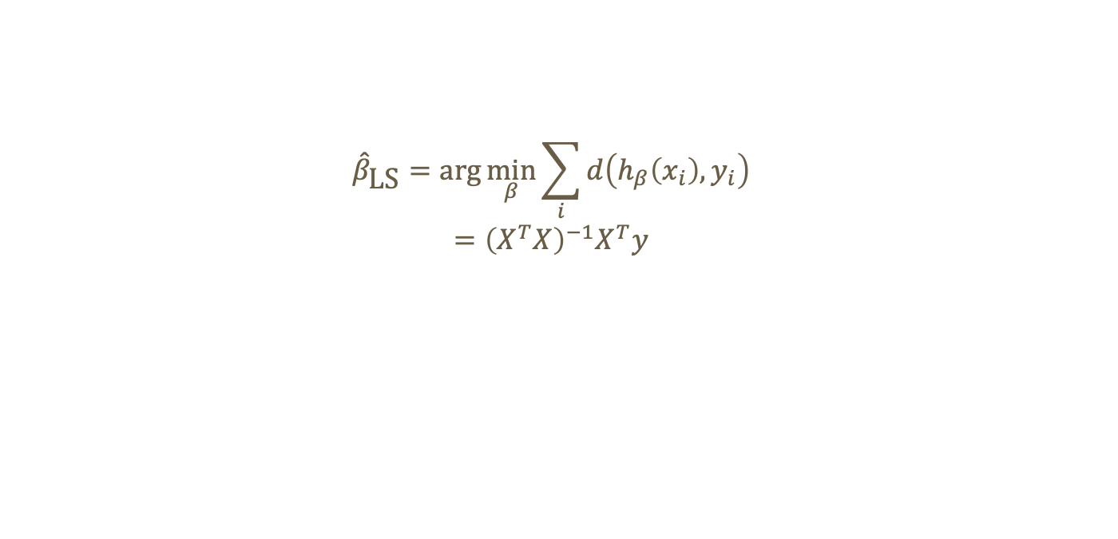
Least squares regression
$${\hat{β}}_{\text{LS}}=\text{arg}\min_{β}{\sum_{i}{d\left(h_{β}\left(x_{i}\right),y_{i}\right)}}$$
$$={\left(X^{T}X\right)}^{−1}X^{T}y$$

Slide 25
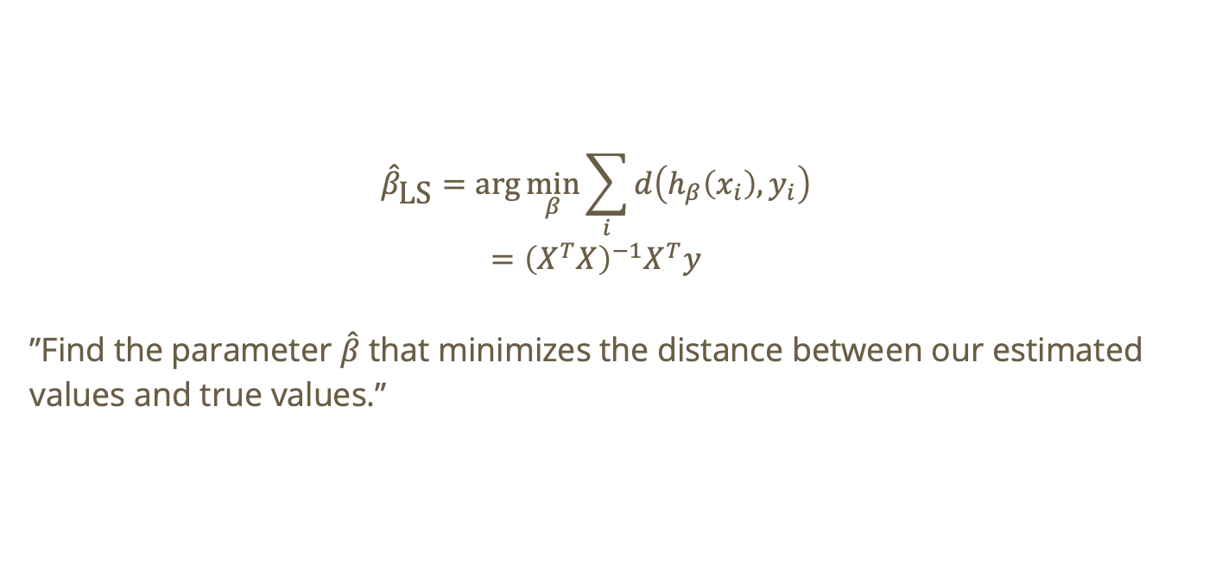
Least squares regression
$${\hat{β}}_{\text{LS}}=\text{arg}\min_{β}{\sum_{i}{d\left(h_{β}\left(x_{i}\right),y_{i}\right)}}$$
$$={\left(X^{T}X\right)}^{−1}X^{T}y$$
”Find the parameter $\hat{β}$ that minimizes the distance between our estimated values and true values.”

Slide 26
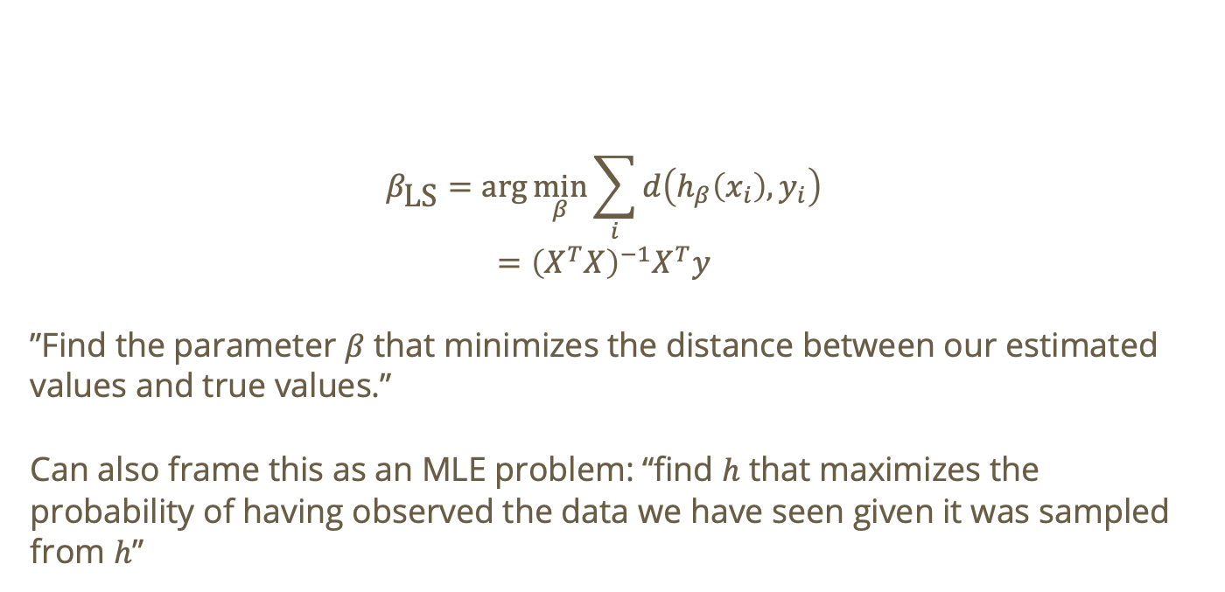
Least squares regression
$$β_{\text{LS}}=\text{arg}\min_{β}{\sum_{i}{d\left(h_{β}\left(x_{i}\right),y_{i}\right)}}$$
$$={\left(X^{T}X\right)}^{−1}X^{T}y$$
”Find the parameter $β$ that minimizes the distance between our estimated values and true values.”
Can also frame this as an MLE problem: “find $h$ that maximizes the probability of having observed the data we have seen given it was sampled from $h$”

Slide 27

Unbiased Estimator
$$𝔼\left({\hat{β}}_{\text{LS}}\right)=β$$

Slide 28

Unbiased Estimator
$$𝔼\left({\hat{β}}_{\text{LS}}\right)=β$$
This means that, on average, over many samples it does not over- or under-estimate the true value.

Slide 29
Do not edit
How to change the design
The estimate beta_hat is a random variable with mean beta
The Slido app must be installed on every computer you’re presenting from

Slide 30
Do not edit
How to change the design
According to linear regression, the following is a valid linear model
The Slido app must be installed on every computer you’re presenting from

Slide 31
Do not edit
How to change the design
According to linear regression, the following is a valid linear model
The Slido app must be installed on every computer you’re presenting from

Slide 32

Recall: Hypothesis Testing
The null hypothesis ($H_{0}$) is a fundamental assumption that no significant difference, relationship, or effect exists between variables.

Slide 33

Recall: Hypothesis Testing
The null hypothesis ($H_{0}$) is a fundamental assumption that no significant difference, relationship, or effect exists between variables.
The alternate hypothesis ($H_{a}$) contradicts $H_{0}$ claiming that there does exist a significant relationship between variables.

Slide 34
Example: predicting exam scores
Suppose we are trying to use an ordinary linear regression to predict student exam scores given a single feature study-time.

Slide 35
Example: predicting exam scores
Suppose we are trying to use an ordinary linear regression to predict student exam scores given a single feature study-time.
Here is our null hypothesis

Slide 36
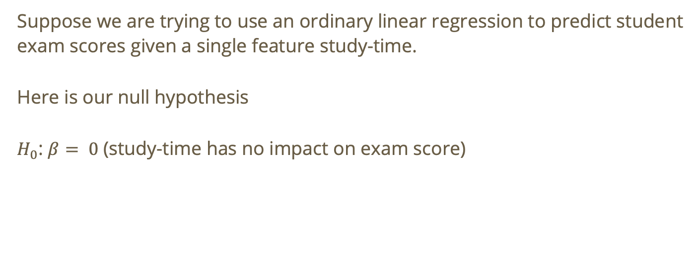
Example: predicting exam scores
Suppose we are trying to use an ordinary linear regression to predict student exam scores given a single feature study-time.
Here is our null hypothesis
$H_{0}$: $β= 0$ (study-time has no impact on exam score)

Slide 37

Predicting exam scores - formulating hypotheses
$H_{0}$: $β= 0$ (study-time has no impact on exam score)

Slide 38

Predicting exam scores - formulating hypotheses
$H_{0}$: $β= 0$ (study-time has no impact on exam score)
Now what are some possible alternate hypotheses?

Slide 39

Predicting exam scores - formulating hypotheses
$H_{0}$: $β= 0$ (study-time has no impact on exam score)
Now what are some possible alternate hypotheses?
$H_{a}:β>0$ (study-time has a positive impact on exam score)

Slide 40
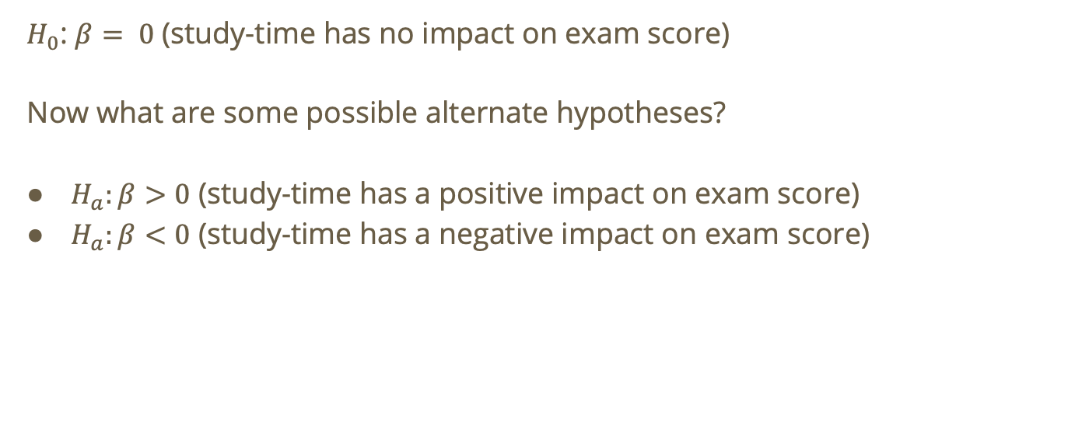
Predicting exam scores - formulating hypotheses
$H_{0}$: $β= 0$ (study-time has no impact on exam score)
Now what are some possible alternate hypotheses?
$H_{a}:β>0$ (study-time has a positive impact on exam score)
$H_{a}:β<0$ (study-time has a negative impact on exam score)

Slide 41
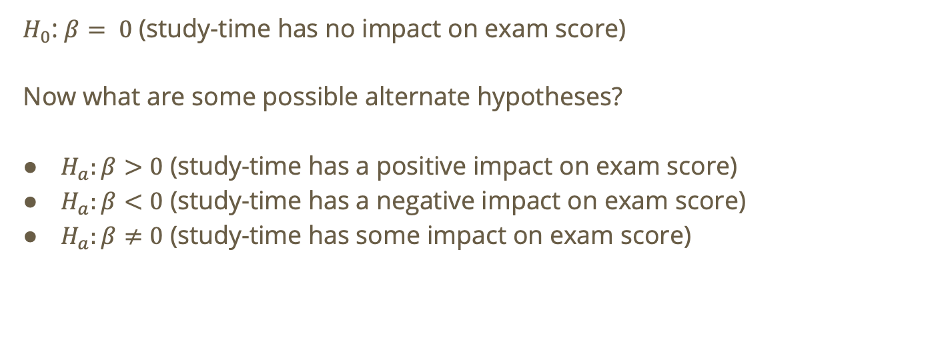
Predicting exam scores - formulating hypotheses
$H_{0}$: $β= 0$ (study-time has no impact on exam score)
Now what are some possible alternate hypotheses?
$H_{a}:β>0$ (study-time has a positive impact on exam score)
$H_{a}:β<0$ (study-time has a negative impact on exam score)
$H_{a}:β≠0$ (study-time has some impact on exam score)

Slide 42
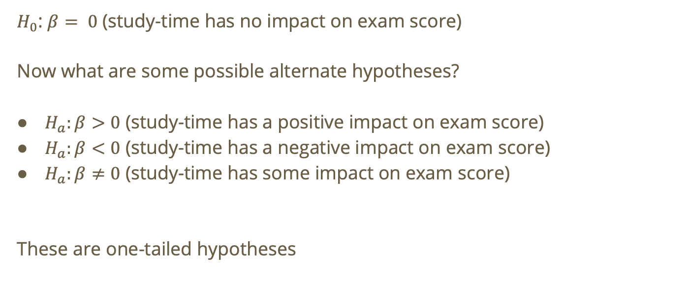
Predicting exam scores - formulating hypotheses
$H_{0}$: $β= 0$ (study-time has no impact on exam score)
Now what are some possible alternate hypotheses?
$H_{a}:β>0$ (study-time has a positive impact on exam score)
$H_{a}:β<0$ (study-time has a negative impact on exam score)
$H_{a}:β≠0$ (study-time has some impact on exam score)
These are one-tailed hypotheses

Slide 43
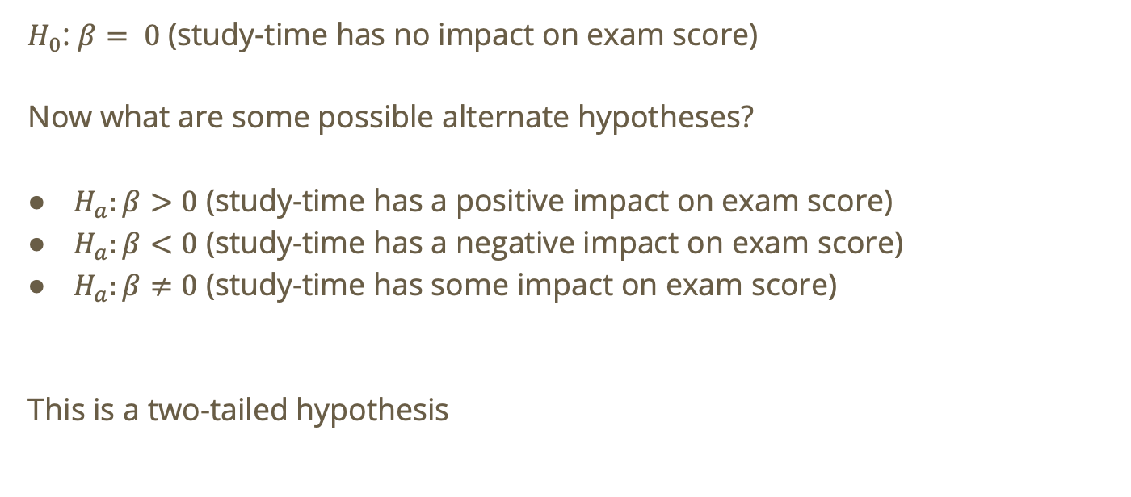
Predicting exam scores - formulating hypotheses
$H_{0}$: $β= 0$ (study-time has no impact on exam score)
Now what are some possible alternate hypotheses?
$H_{a}:β>0$ (study-time has a positive impact on exam score)
$H_{a}:β<0$ (study-time has a negative impact on exam score)
$H_{a}:β≠0$ (study-time has some impact on exam score)
This is a two-tailed hypothesis

Slide 44
Hypothesis testing
We want to find a quantitative metric to test our null hypothesis.

Slide 45
Hypothesis testing
We want to find a quantitative metric to test our null hypothesis.
We can either reject or fail to reject the null hypothesis.

Slide 46

Hypothesis testing
We want to find a quantitative metric to test our null hypothesis.
We can either reject or fail to reject the null hypothesis.
Fail to reject null hypothesis $≠$ null hypothesis is true!

Slide 47

Hypothesis testing – p values
The $p_{\text{val}}$ tells us the likelihood of seeing the data we saw (i.e., observations) under the assumption ($H_{0}$)

Slide 48
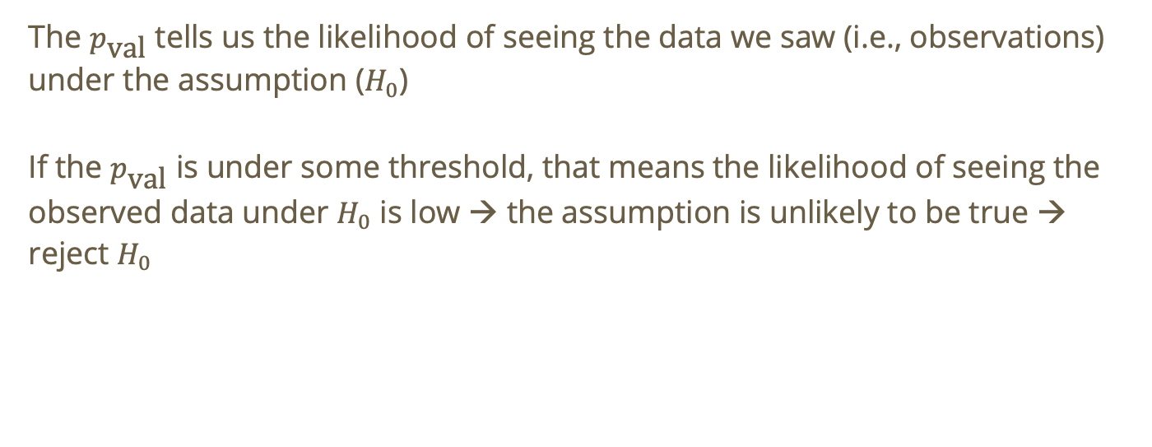
Hypothesis testing – p values
The $p_{\text{val}}$ tells us the likelihood of seeing the data we saw (i.e., observations) under the assumption ($H_{0}$)
If the $p_{\text{val}}$ is under some threshold, that means the likelihood of seeing the observed data under $H_{0}$ is low → the assumption is unlikely to be true → reject $H_{0}$
Notes:
Typically call this threshold the $α$ value

Slide 49
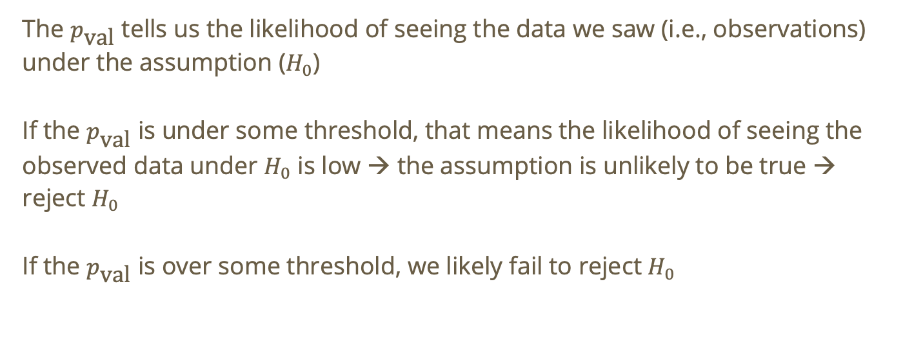
Hypothesis testing – p values
The $p_{\text{val}}$ tells us the likelihood of seeing the data we saw (i.e., observations) under the assumption ($H_{0}$)
If the $p_{\text{val}}$ is under some threshold, that means the likelihood of seeing the observed data under $H_{0}$ is low → the assumption is unlikely to be true → reject $H_{0}$
If the $p_{\text{val}}$ is over some threshold, we likely fail to reject $H_{0}$

Slide 50
Hypothesis testing - Deriving the p value
We typically conduct hypothesis testing in linear regression using a t-distribution.
Notes:
n is sample size, k is number of predictors/features
dof = how many values are still free to vary after imposing constraints or estimate parameters

Slide 51

Hypothesis testing - Deriving the p value
We typically conduct hypothesis testing in linear regression using a t-distribution.
Usual steps for obtaining $p_{\text{val}}$
Notes:
n is sample size, k is number of predictors/features
dof = how many values are still free to vary after imposing constraints or estimate parameters

Slide 52

Hypothesis testing - Deriving the p value
We typically conduct hypothesis testing in linear regression using a t-distribution.
Usual steps for obtaining $p_{\text{val}}$
Estimate $\hat{β}$
Notes:
n is sample size, k is number of predictors/features
dof = how many values are still free to vary after imposing constraints or estimate parameters

Slide 53
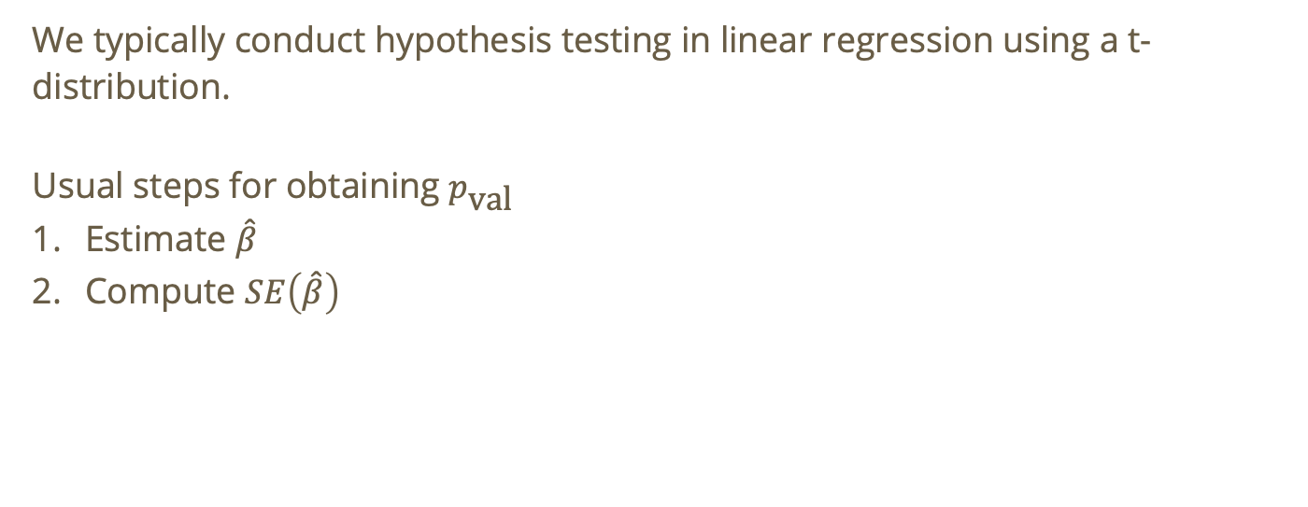
Hypothesis testing - Deriving the p value
We typically conduct hypothesis testing in linear regression using a t-distribution.
Usual steps for obtaining $p_{\text{val}}$
Estimate $\hat{β}$
Compute $SE\left(\hat{β}\right)$
Notes:
n is sample size, k is number of predictors/features
dof = how many values are still free to vary after imposing constraints or estimate parameters

Slide 54
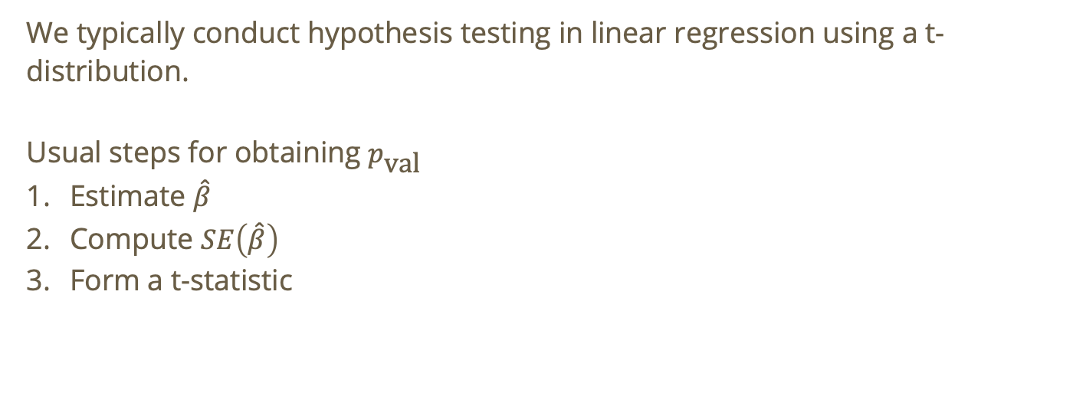
Hypothesis testing - Deriving the p value
We typically conduct hypothesis testing in linear regression using a t-distribution.
Usual steps for obtaining $p_{\text{val}}$
Estimate $\hat{β}$
Compute $SE\left(\hat{β}\right)$
Form a t-statistic
Notes:
n is sample size, k is number of predictors/features
dof = how many values are still free to vary after imposing constraints or estimate parameters

Slide 55
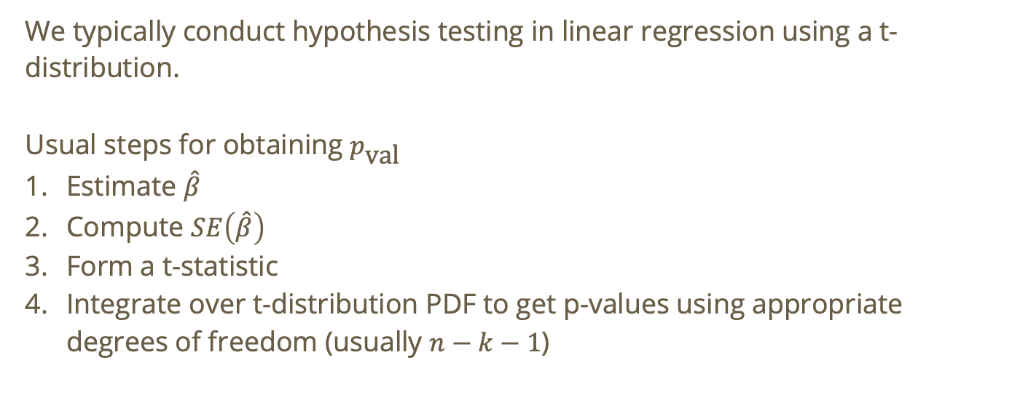
Hypothesis testing - Deriving the p value
We typically conduct hypothesis testing in linear regression using a t-distribution.
Usual steps for obtaining $p_{\text{val}}$
Estimate $\hat{β}$
Compute $SE\left(\hat{β}\right)$
Form a t-statistic
Integrate over t-distribution PDF to get p-values using appropriate degrees of freedom (usually $n−k−1$)
Notes:
n is sample size, k is number of predictors/features
dof = how many values are still free to vary after imposing constraints or estimate parameters

Slide 56

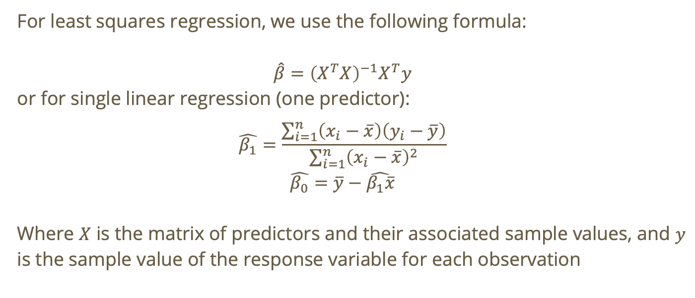
Deriving the p value - estimate $\hat{β}$
For least squares regression, we use the following formula:
$$\hat{β}={\left(X^{T}X\right)}^{−1}X^{T}y$$
or for single linear regression (one predictor):
$$\hat{β_{1}}=\frac{\sum_{i=1}^{n}{\left(x_{i}−\overline{x}\right)\left(y_{i}−\overline{y}\right)}}{\sum_{i=1}^{n}{{\left(x_{i}−\overline{x}\right)}^{2}}}$$
$$\hat{β_{0}}=\overline{y}−\hat{β_{1}\overline{x}}$$
Where $X$ is the matrix of predictors and their associated sample values, and $y$ is the sample value of the response variable for each observation

Slide 57

Deriving the p value – compute $SE\left(\hat{β}\right)$
The standard error tells us how much coefficients may shift if we repeatedly collected new samples from the same population and refit the model

Slide 58
Deriving the p value – compute $SE\left(\hat{β}\right)$
The standard error tells us how much coefficients may shift if we repeatedly collected new samples from the same population and refit the model
We calculate standard error by square rooting the diagonal entries of the covariance matrix given by

Slide 59
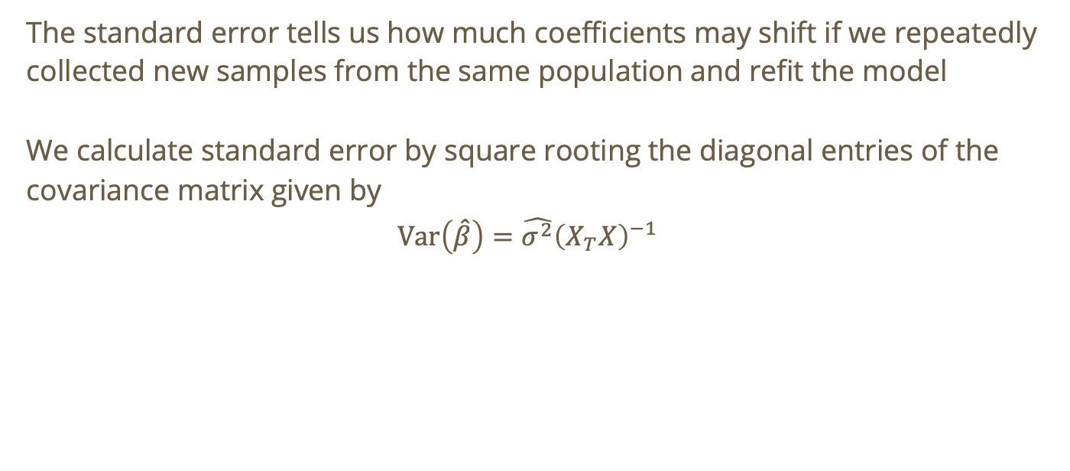
Deriving the p value – compute $SE\left(\hat{β}\right)$
The standard error tells us how much coefficients may shift if we repeatedly collected new samples from the same population and refit the model
We calculate standard error by square rooting the diagonal entries of the covariance matrix given by
$$\text{Var}\left(\hat{β}\right)=\hat{σ^{2}}{\left(X_{T}X\right)}^{−1}$$

Slide 60
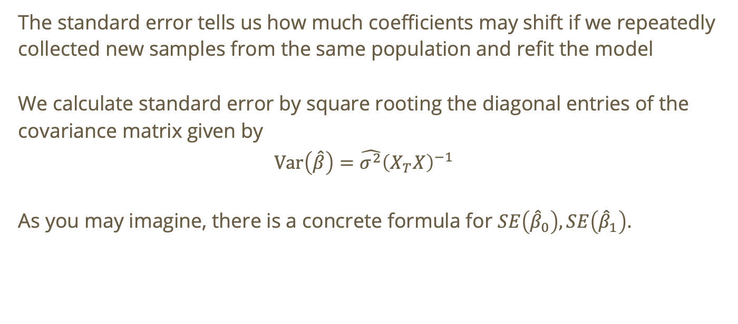
Deriving the p value – compute $SE\left(\hat{β}\right)$
The standard error tells us how much coefficients may shift if we repeatedly collected new samples from the same population and refit the model
We calculate standard error by square rooting the diagonal entries of the covariance matrix given by
$$\text{Var}\left(\hat{β}\right)=\hat{σ^{2}}{\left(X_{T}X\right)}^{−1}$$
As you may imagine, there is a concrete formula for $SE\left({\hat{β}}_{0}\right),SE\left({\hat{β}}_{1}\right)$.

Slide 61

Deriving the p value – form a t-statistic
$$t_{\text{stat}}=\frac{\hat{β}−0}{SE\left(\hat{β}\right)}$$
Note: the ”- 0” portion varies based on the $H_{0}$ value for $β$
Notes:
You compute the t stat using beta hat for a particular predictor. For an SLR, you’d use beta hat 1

Slide 62
Deriving the p value – integrate over t-distribution PDF
We’ll skip the integration ;-)

Slide 63

Deriving the p value – integrate over t-distribution PDF
We’ll skip the integration ;-)
If our p value is less than 5%, that means (under perfect assumptions) we will falsely reject $H_{0}$ 5% of the time.
Notes:
If we have $α$ = 0.05

Slide 64
Do not edit
How to change the design
Let’s say alpha = 5%. What are we likely to conclude if we get a p-value of 0.03?
The Slido app must be installed on every computer you’re presenting from

Slide 65
Linear Regression Assumptions

Slide 66

Assumptions for Linear Regression
The relationship between $x$ (independent variable) and $y$ (dependent variable) is linear in parameter $β$
Notes:
Non-example: Y = beta_0 + beta_1^2x_1

Slide 67

Assumptions for Linear Regression
The relationship between $x$ (independent variable) and $y$ (dependent variable) is linear in parameter $β$
$ε_{i}∼ \text{i}\text{.}\text{i}\text{.}\text{d}\text{. }𝒩\left(0,σ^{2}\right)$

Slide 68

Assumptions for Linear Regression
The relationship between $x$ (independent variable) and $y$ (dependent variable) is linear in parameter $β$
$ε_{i}∼ \text{i}\text{.}\text{i}\text{.}\text{d}\text{. }𝒩\left(0,σ^{2}\right)$
Independent observations

Slide 69

Assumptions for Linear Regression
The relationship between $x$ (independent variable) and $y$ (dependent variable) is linear in parameter $β$
$ε_{i}∼ \text{i}\text{.}\text{i}\text{.}\text{d}\text{. }𝒩\left(0,σ^{2}\right)$
Independent observations
Homoscedasticity (constant variance of residuals/error term)

Slide 70

Assumptions for Linear Regression
The relationship between $x$ (independent variable) and $y$ (dependent variable) is linear in parameter $β$
$ε_{i}∼ \text{i}\text{.}\text{i}\text{.}\text{d}\text{. }𝒩\left(0,σ^{2}\right)$
Independent observations
Homoscedasticity (constant variance of residuals/error term)
No/low multicollinearity (independent variables are uncorrelated)

Slide 71
How do we check the assumptions?
Linearity relationship between predictors and outcome: examine the residual vs. fitted plot

Slide 72
How do we check the assumptions?
Linearity relationship between predictors and outcome: examine the residual vs. fitted plot
  Goal is to have no observable pattern in the residual plot.

Slide 73


Slide 74
Ideally the line of best fit is something like this. Just a horizontal line!

Slide 75


Slide 76
This is no good! We can discern a parabolic structure → we may not have linearity.

Slide 77
How do we check the assumptions?
Linearity relationship between predictors and outcome: examine the residual vs. fitted plot
Independence of observations

Slide 78
How do we check the assumptions?
Linearity relationship between predictors and outcome: examine the residual vs. fitted plot
Independence of observations
  This can be understood qualitatively

Slide 79
How do we check the assumptions?
Linearity relationship between predictors and outcome: examine the residual vs. fitted plot
Independence of observations
  This can be understood qualitatively
  We can also create a residual vs. observation order plot

Slide 80

How do we check the assumptions?
Linearity relationship between predictors and outcome: examine the residual vs. fitted plot
Independence of observations
  This can be understood qualitatively
  We can also create a residual vs. observation order plot
    Since we expect $ε_{i}$ to be independent from $ε_{i+1}$, you would expect there to be no discernable relationship between residuals for neighboring observations.

Slide 81

How do we check the assumptions?
Linearity relationship between predictors and outcome: examine the residual vs. fitted plot
Independence of observations
  This can be understood qualitatively
  We can also create a residual vs. observation order plot
    Since we expect $ε_{i}$ to be independent from $ε_{i+1}$, you would expect there to be no discernable relationship between residuals for neighboring observations.
    Caveat: this only applies for ordered observations (e.g., observations are ordered by time)!

Slide 82


Slide 83
This is what we expect from independent observations. The residuals just look like noise distributed around mean 0!

Slide 84


Slide 85
There appears to be some oscillating behavior here! We may have some autocorrelation → non-independent observations ☹

Slide 86
How do we check the assumptions?
Linearity relationship between predictors and outcome: examine the residual vs. fitted plot
Independence of observations: residual vs. observation order plot
Homoscedasticity (constant variance of residuals):

Slide 87
How do we check the assumptions?
Linearity relationship between predictors and outcome: examine the residual vs. fitted plot
Independence of observations: residual vs. observation order plot
Homoscedasticity (constant variance of residuals): residual vs. fitted plot

Slide 88
How do we check the assumptions?
Linearity relationship between predictors and outcome: examine the residual vs. fitted plot
Independence of observations: residual vs. observation order plot
Homoscedasticity (constant variance of residuals): residual vs. fitted plot
  We expect residuals to be randomly scattered around 0
  Roughly constant “thickness” of residual distribution from left to right
Notes:
Scattered around 0 because assumption is $ε_{i}∼\text{i}\text{.}\text{i}\text{.}\text{d} 𝒩\left(0,σ^{2}\right)$. This is a consequence of the fact that OLS regression minimizes the sum of squared residuals
Constant thickness because the variance $σ^{2}$ is constant, not a function

Slide 89
Do not edit
How to change the design
Does the following plot indicate homoscedasticity?
The Slido app must be installed on every computer you’re presenting from

Slide 90


Slide 91
Centered at 0 is good!

Slide 92
Bowtie shape indicates varying residuals!
Centered at 0 is good!

Slide 93

How do we check the assumptions?
Linearity relationship between predictors and outcome: examine the residual vs. fitted plot
Independence of observations: residual vs. observation order plot
Homoscedasticity (constant variance of residuals): residual vs. fitted plot
Normality of residuals ($ε_{i}∼i.i.d.𝒩\left(0,σ^{2}\right)$)

Slide 94

How do we check the assumptions?
Linearity relationship between predictors and outcome: examine the residual vs. fitted plot
Independence of observations: residual vs. observation order plot
Homoscedasticity (constant variance of residuals): residual vs. fitted plot
Normality of residuals ($ε_{i}∼i.i.d.𝒩\left(0,σ^{2}\right)$): normal quantile-quantile plot

Slide 95

How do we check the assumptions?
Linearity relationship between predictors and outcome: examine the residual vs. fitted plot
Independence of observations: residual vs. observation order plot
Homoscedasticity (constant variance of residuals): residual vs. fitted plot
Normality of residuals ($ε_{i}∼i.i.d.𝒩\left(0,σ^{2}\right)$): normal quantile-quantile plot
  A quantile is the value for which a particular percentage of values are contained below it. E.g., the 50% quantile of a $𝒩\left(0,1\right)$ is $0$ since 50% of values would be below $0$ for a large sample.

Slide 96

How do we check the assumptions?
Linearity relationship between predictors and outcome: examine the residual vs. fitted plot
Independence of observations: residual vs. observation order plot
Homoscedasticity (constant variance of residuals): residual vs. fitted plot
Normality of residuals ($ε_{i}∼i.i.d.𝒩\left(0,σ^{2}\right)$): normal quantile-quantile plot
  A quantile is the value for which a particular percentage of values are contained below it. E.g., the 50% quantile of a $𝒩\left(0,1\right)$ is $0$ since 50% of values would be below $0$ for a large sample.
  Plot sample residual quantiles versus $𝒩\left(0,σ^{2}\right)$ theoretical quantiles

Slide 97
Do not edit
How to change the design
Does this NQQ plot support the normality of residuals assumption?
The Slido app must be installed on every computer you’re presenting from

Slide 98


Slide 99

This is essentially $y = x$!
i.e., sample distribution = known ☺

Slide 100

How do we check the assumptions?
Linearity relationship between predictors and outcome: examine the residual vs. fitted plot
Independence of observations: residual vs. observation order plot
Homoscedasticity (constant variance of residuals): residual vs. fitted plot
Normality of residuals ($ε_{i}∼i.i.d.𝒩\left(0,σ^{2}\right)$): normal quantile-quantile plot
Low/no multicollinearity: correlation matrix
Notes:
Multicollinearity → feature to feature (k features) dependence whereas assumption 2 here is referring to the observations themselves (n observations)

Slide 101

How do we check the assumptions?
Linearity relationship between predictors and outcome: examine the residual vs. fitted plot
Independence of observations: residual vs. observation order plot
Homoscedasticity (constant variance of residuals): residual vs. fitted plot
Normality of residuals ($ε_{i}∼i.i.d.𝒩\left(0,σ^{2}\right)$): normal quantile-quantile plot
Low/no multicollinearity: correlation matrix
  We don’t want our features to be related to one another!

Slide 102

How do we check the assumptions?
Linearity relationship between predictors and outcome: examine the residual vs. fitted plot
Independence of observations: residual vs. observation order plot
Homoscedasticity (constant variance of residuals): residual vs. fitted plot
Normality of residuals ($ε_{i}∼i.i.d.𝒩\left(0,σ^{2}\right)$): normal quantile-quantile plot
Low/no multicollinearity: correlation matrix
  We don’t want our features to be related to one another!
  There are many ways to test this. Constructing a correlation matrix is only one of them.

Slide 103

How do we check the assumptions?
Linearity relationship between predictors and outcome: examine the residual vs. fitted plot
Independence of observations: residual vs. observation order plot
Homoscedasticity (constant variance of residuals): residual vs. fitted plot
Normality of residuals ($ε_{i}∼i.i.d.𝒩\left(0,σ^{2}\right)$): normal quantile-quantile plot
Low/no multicollinearity: correlation matrix
  We don’t want our features to be related to one another!
  There are many ways to test this. Constructing a correlation matrix is only one of them.
  We can also look at variance inflation factor (VIF)

Slide 104
Do not edit
How to change the design
The following correlation matrix is indicative of high multicollinearity
The Slido app must be installed on every computer you’re presenting from

Slide 105


Slide 106
This is insane!

Slide 107

That’s more like it!

