Slide 1
Backpropagation and Optimization
CS 506

Slide 2
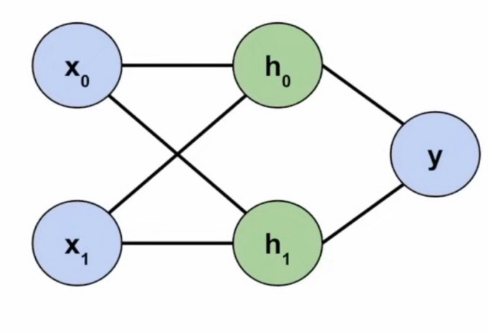
Recall: neural networks
A neural network is a model that transforms input through multiple layers of neurons to learn patterns and make predictions.

Slide 3
Recall: neural networks
A neural network is a model that transforms input through multiple layers of neurons to learn patterns and make predictions.
Activation functions: Determines how strongly a neuron/latent feature should be activated based on the weighted sum of inputs and a bias term.

Slide 4
Recall: neural networks
A neural network is a model that transforms input through multiple layers of neurons to learn patterns and make predictions.
Activation functions: Determines how strongly a neuron/latent feature should be activated based on the weighted sum of inputs and a bias term.
Input

Slide 5
Recall: neural networks
A neural network is a model that transforms input through multiple layers of neurons to learn patterns and make predictions.
Activation functions: Determines how strongly a neuron/latent feature should be activated based on the weighted sum of inputs and a bias term.
Input
Hidden layers/latent features

Slide 6
Recall: neural networks
A neural network is a model that transforms input through multiple layers of neurons to learn patterns and make predictions.
Activation functions: Determines how strongly a neuron/latent feature should be activated based on the weighted sum of inputs and a bias term.
Output
Input
Hidden layers/latent features

Slide 7










Recall: hidden layers in neural networks
The output of each hidden layer is given by a linear combination of weights $\left(w_{i}\right)$ plus some bias term $\left(b_{i}\right)$.
$$b_{0}$$
$$w_{1}$$
$$w_{5}$$
$$w_{2}$$
$$w_{3}$$
$$w_{6}$$
$$w_{4}$$
$$b_{2}$$
$$b_{1}$$
Notes:
For example, the weights w1 tells us the strength and direction of x0’s contribution to the latent feature h0 (before considering the activation function). The bias tells us the neuron’s baseline tendency to activate. The bias basically controls how easy it is for the neuron to activate.

Slide 8

Recall: computing hidden layers
$h_{0}=w_{1}x_{0}+w_{3}x_{1}+b_{0}$
$h_{1}=w_{2}x_{0}+w_{4}x_{1}+b_{1}$
$$b_{0}$$
$$w_{1}$$
$$w_{5}$$
$$w_{2}$$
$$w_{3}$$
$$w_{6}$$
$$w_{4}$$
$$b_{2}$$
$$b_{1}$$

Slide 9

Recall: computing output layer
$y=w_{5}h_{0}+w_{6}h_{1}+b_{2}$
$$b_{0}$$
$$w_{1}$$
$$w_{5}$$
$$w_{2}$$
$$w_{3}$$
$$w_{6}$$
$$w_{4}$$
$$b_{2}$$
$$b_{1}$$

Slide 10
Do not edit
How to change the design
Consider a binary classification task requiring 2 input neurons, 4 total hidden neurons, and 1 output neuron. There will be fewer total parameters (i.e. weights and biases) if all the hidden neurons are placed into one hidden layer as opposed to two hidden layers
The Slido app must be installed on every computer you’re presenting from

Slide 11
Solution
Option 1: 1 hidden layer
Each black line is a weight
Each orange line is a bias

Slide 12
Solution
Option 2: 2 hidden layers

Slide 13
Do not edit
How to change the design
Consider a binary classification task requiring 1 input neuron, 5 total hidden neurons, and 1 output neuron. There are fewer total parameters in a network where all hidden neurons are in a single hidden layer compared to a network where the neurons are split into two hidden layers where layer 1 has 2 neurons and layer 2 has 3 neurons respectively.
The Slido app must be installed on every computer you’re presenting from

Slide 14









Typical NN training loop
$$b_{0}$$
$$w_{1}$$
Forward pass: make a prediction
$$w_{5}$$
$$w_{2}$$
$$w_{3}$$
$$w_{6}$$
$$w_{4}$$
$$b_{2}$$
$$b_{1}$$

Slide 15

Typical NN training loop
$$b_{0}$$
$$w_{1}$$
Forward pass: make a prediction
Compute loss: compare predicted $y$ to true $y$
$$w_{5}$$
$$w_{2}$$
$$w_{3}$$
$$w_{6}$$
$$w_{4}$$
$$b_{2}$$
$$b_{1}$$

Slide 16
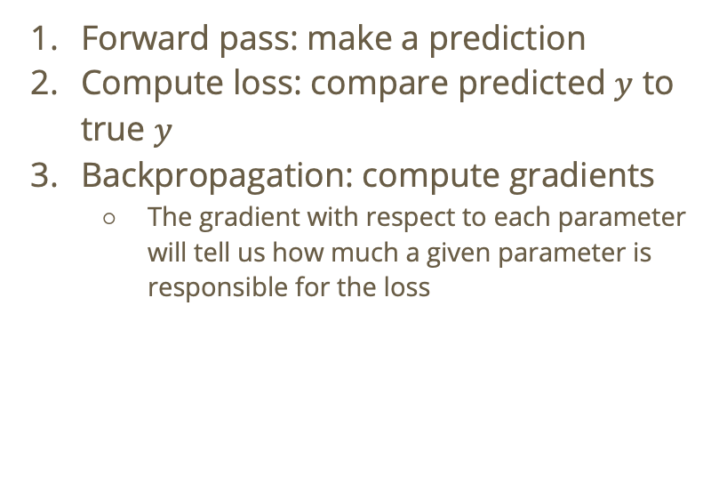
Typical NN training loop
$$b_{0}$$
$$w_{1}$$
Forward pass: make a prediction
Compute loss: compare predicted $y$ to true $y$
Backpropagation: compute gradients
  The gradient with respect to each parameter will tell us how much a given parameter is responsible for the loss
$$w_{5}$$
$$w_{2}$$
$$w_{3}$$
$$w_{6}$$
$$w_{4}$$
$$b_{2}$$
$$b_{1}$$

Slide 17
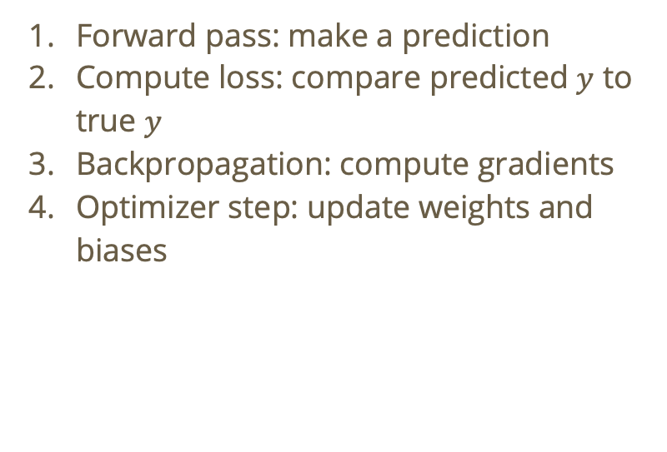
Typical NN training loop
$$b_{0}$$
$$w_{1}$$
Forward pass: make a prediction
Compute loss: compare predicted $y$ to true $y$
Backpropagation: compute gradients
Optimizer step: update weights and biases
$$w_{5}$$
$$w_{2}$$
$$w_{3}$$
$$w_{6}$$
$$w_{4}$$
$$b_{2}$$
$$b_{1}$$
Notes:
The gradient with respect to each parameter will tell us how much a given parameter is responsible for the loss
We can update the weights using an algorithm like gradient descent which will take the gradients (which we calculate using backpropagation) and update every weight and bias in the direction which reduces our loss (with respect to some learning rate). You subtract the gradient because the gradient points in the direction of steepest increase and we are trying to minimize loss!

Slide 18
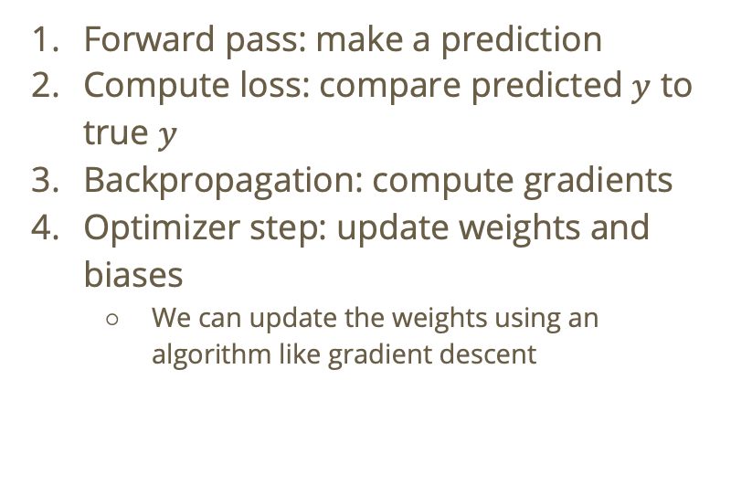
Typical NN training loop
$$b_{0}$$
$$w_{1}$$
Forward pass: make a prediction
Compute loss: compare predicted $y$ to true $y$
Backpropagation: compute gradients
Optimizer step: update weights and biases
  We can update the weights using an algorithm like gradient descent
$$w_{5}$$
$$w_{2}$$
$$w_{3}$$
$$w_{6}$$
$$w_{4}$$
$$b_{2}$$
$$b_{1}$$
Notes:
We can update the weights using an algorithm like gradient descent which will take the gradients (which we calculate using backpropagation) and update every weight and bias in the direction which reduces our loss (with respect to some learning rate). You subtract the gradient because the gradient points in the direction of steepest increase and we are trying to minimize loss!
Skip to slide 51

Slide 19
Backpropagation

Slide 20










Recall: Backpropagation
After making a prediction (let’s say $\hat{y}$) and computing the error (let’s say MSE = ${\left(y−\hat{y}\right)}^{2}$), we will try to find out which weights and biases contributed most to the error.
$$b_{0}$$
$$w_{1}$$
$$w_{5}$$
$$w_{2}$$
$$w_{3}$$
$$w_{6}$$
$$w_{4}$$
$$b_{2}$$
$$b_{1}$$

Slide 21








Backpropagation starts at the output and moves backward
$$b_{0}$$
$$w_{1}$$
$$w_{5}$$
$$w_{2}$$
$$w_{3}$$
$$w_{6}$$
$$w_{4}$$
$$b_{2}$$
$$b_{1}$$

Slide 22
Backpropagation starts at the output and moves backward
$$b_{0}$$
$$w_{1}$$
$$w_{5}$$
$$w_{2}$$
$$w_{3}$$
$$w_{6}$$
$$w_{4}$$
$$b_{2}$$
$$b_{1}$$

Slide 23
Backpropagation starts at the output and moves backward
We start by computing the error term for the output.
$$b_{0}$$
$$w_{1}$$
$$w_{5}$$
$$w_{2}$$
$$w_{3}$$
$$w_{6}$$
$$w_{4}$$
$$b_{2}$$
$$b_{1}$$

Slide 24

Output error term
Let $δ_{y}=\frac{∂{\left(y−\hat{y}\right)}^{2}}{∂\left(w_{5}h_{0}+w_{6}h_{1}+b_{2}\right)}$.

Slide 25

Output error term
Let $δ_{y}=\frac{∂{\left(y−\hat{y}\right)}^{2}}{∂\left(w_{5}h_{0}+w_{6}h_{1}+b_{2}\right)}$.
Using the chain rule:
$$δ_{y}=\frac{∂{\left(y−\hat{y}\right)}^{2}}{\hat{y}}×\frac{∂\hat{y}}{∂\left(w_{5}h_{0}+w_{6}h_{1}+b_{2}\right)}=\left(\hat{y}–y\right)A’_{\text{out}}\left(w_{5}h_{0}+w_{6}h_{1}+b_{2}\right)$$

Slide 26
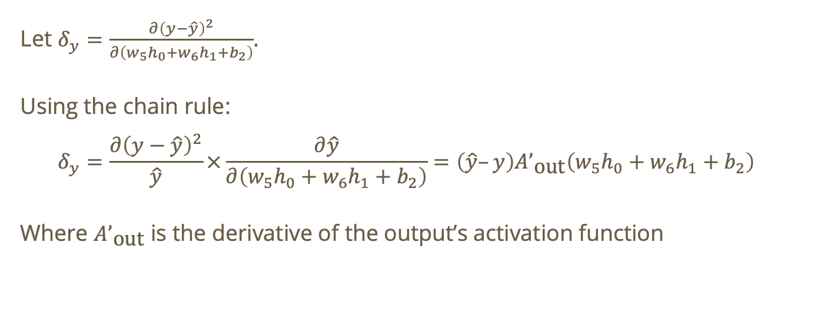
Output error term
Let $δ_{y}=\frac{∂{\left(y−\hat{y}\right)}^{2}}{∂\left(w_{5}h_{0}+w_{6}h_{1}+b_{2}\right)}$.
Using the chain rule:
$$δ_{y}=\frac{∂{\left(y−\hat{y}\right)}^{2}}{\hat{y}}×\frac{∂\hat{y}}{∂\left(w_{5}h_{0}+w_{6}h_{1}+b_{2}\right)}=\left(\hat{y}–y\right)A’_{\text{out}}\left(w_{5}h_{0}+w_{6}h_{1}+b_{2}\right)$$
Where $A’_{\text{out}}$ is the derivative of the output’s activation function

Slide 27
Backpropagation starts at the output and moves backward
We start by computing the error term for the output. Now, using the error term for the output, we can calculate gradients for the output weights and biases.
$$b_{0}$$
$$w_{1}$$
$$w_{5}$$
$$w_{2}$$
$$w_{3}$$
$$w_{6}$$
$$w_{4}$$
$$b_{2}$$
$$b_{1}$$
Notes:
The gradients will tell us how MSE changes when a parameter changes. Helps answer the question ”which direction should I move a parameter to reduce MSE” and ”how sensitive is MSE to this parameter”. If the gradient is large, this indicates high sensitivity to the parameter. If the gradient is positive, that means increasing the parameter will increase MSE (which is bad!)

Slide 28










Gradients for output weights and biases
$$b_{0}$$
Let $J=\left(y−\hat{y}\right)$. Then,
$$w_{1}$$
$$w_{5}$$
$$w_{2}$$
$$w_{3}$$
$$w_{6}$$
$$w_{4}$$
$$b_{2}$$
$$b_{1}$$

Slide 29
Gradients for output weights and biases
$$b_{0}$$
Let $J=\left(y−\hat{y}\right)$. Then,
$$w_{1}$$
$$w_{5}$$
$$w_{2}$$
$$w_{3}$$
$$w_{6}$$
$$w_{4}$$
$$b_{2}$$
$$b_{1}$$

Slide 30

Gradients for output weights and biases
$$b_{0}$$
Let $J=\left(y−\hat{y}\right)$. Then,
$\frac{∂J}{∂w_{5}}=δ_{y}h_{0}$
$$w_{1}$$
$$w_{5}$$
$$w_{2}$$
$$w_{3}$$
$$w_{6}$$
$$w_{4}$$
$$b_{2}$$
$$b_{1}$$

Slide 31
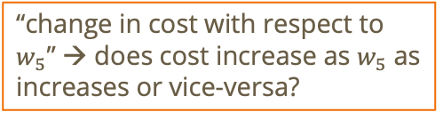
Gradients for output weights and biases
$$b_{0}$$
Let $J=\left(y−\hat{y}\right)$. Then,
$\frac{∂J}{∂w_{5}}=δ_{y}h_{0}$
$$w_{1}$$
$$w_{5}$$
$$w_{2}$$
$$w_{3}$$
$$w_{6}$$
$$w_{4}$$
$$b_{2}$$
$$b_{1}$$
“change in cost with respect to $w_{5}$” → does cost increase as $w_{5}$ as increases or vice-versa?

Slide 32

Gradients for output weights and biases
$$b_{0}$$
Let $J=\left(y−\hat{y}\right)$. Then,
$\frac{∂J}{∂w_{5}}=δ_{y}h_{0}$
$\frac{∂J}{∂w_{6}}=δ_{y}h_{1}$
$\frac{∂J}{∂b_{2}}=δ_{y}$
$$w_{1}$$
$$w_{5}$$
$$w_{2}$$
$$w_{3}$$
$$w_{6}$$
$$w_{4}$$
$$b_{2}$$
$$b_{1}$$
“change in cost with respect to $w_{5}$” → does cost increase as $w_{5}$ as increases or vice-versa?

Slide 33
Backpropagation starts at the output and moves backward
We start by computing the error term for the output. Now, using the error term for the output, we can calculate gradients for the output weights and biases.
Now that we have the gradients for the output weights and biases, we can propagate this information backwards to calculate the gradients for the hidden layer weights and biases!
$$b_{0}$$
$$w_{1}$$
$$w_{5}$$
$$w_{2}$$
$$w_{3}$$
$$w_{6}$$
$$w_{4}$$
$$b_{2}$$
$$b_{1}$$
Notes:
The gradients will tell us how MSE changes when a parameter changes. Helps answer the question ”which direction should I move a parameter to reduce MSE” and ”how sensitive is MSE to this parameter”. If the gradient is large, this indicates high sensitivity to the parameter. If the gradient is positive, that means increasing the parameter will increase MSE (which is bad!)

Slide 34

Error terms for hidden layer
Let $z_{h_{0}}=w_{1}x_{0}+w_{3}x_{1}+b_{0}$ and $z_{h_{1}}=w_{2}x_{0}+w_{4}x_{1}+b_{1}$

Slide 35

Error terms for hidden layer
Let $z_{h_{0}}=w_{1}x_{0}+w_{3}x_{1}+b_{0}$ and $z_{h_{1}}=w_{2}x_{0}+w_{4}x_{1}+b_{1}$
Then,
$$δ_{h_{0}}=\frac{∂J}{∂z_{h_{0}}}$$

Slide 36

Error terms for hidden layer
Let $z_{h_{0}}=w_{1}x_{0}+w_{3}x_{1}+b_{0}$ and $z_{h_{1}}=w_{2}x_{0}+w_{4}x_{1}+b_{1}$
Then,
$$δ_{h_{0}}=\frac{∂J}{∂z_{h_{0}}}$$
$$δ_{h_{1}}=\frac{∂J}{∂z_{h_{1}}}$$

Slide 37
Gradients for hidden layer weights and biases
Now, use the error terms to calculate the hidden layer weights and biases…

Slide 38

Gradients for hidden layer weights and biases
Now, use the error terms to calculate the hidden layer weights and biases…
For $h_{0}$:

Slide 39

Gradients for hidden layer weights and biases
Now, use the error terms to calculate the hidden layer weights and biases…
For $h_{0}$:
$$\frac{∂J}{∂w_{1}}=δ_{h_{0}}x_{0}$$

Slide 40

Gradients for hidden layer weights and biases
Now, use the error terms to calculate the hidden layer weights and biases…
For $h_{0}$:
$$\frac{∂J}{∂w_{1}}=δ_{h_{0}}x_{0}$$
$$\frac{∂J}{∂w_{3}}=δ_{h_{0}}x_{1}$$

Slide 41

Gradients for hidden layer weights and biases
Now, use the error terms to calculate the hidden layer weights and biases…
For $h_{0}$:
$$\frac{∂J}{∂w_{1}}=δ_{h_{0}}x_{0}$$
$$\frac{∂J}{∂w_{3}}=δ_{h_{0}}x_{1}$$
$$\frac{∂J}{∂b_{0}}=δ_{h_{0}}$$

Slide 42
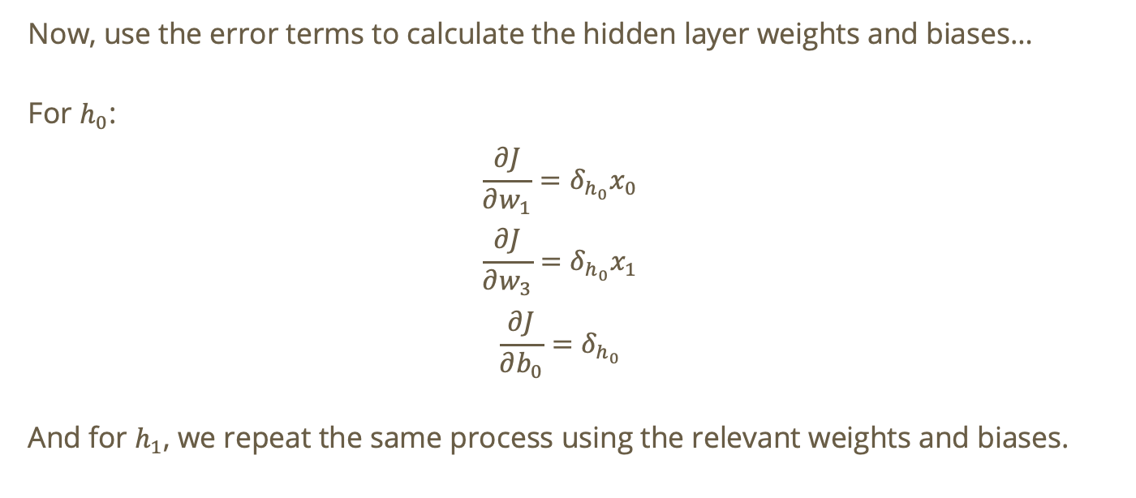
Gradients for hidden layer weights and biases
Now, use the error terms to calculate the hidden layer weights and biases…
For $h_{0}$:
$$\frac{∂J}{∂w_{1}}=δ_{h_{0}}x_{0}$$
$$\frac{∂J}{∂w_{3}}=δ_{h_{0}}x_{1}$$
$$\frac{∂J}{∂b_{0}}=δ_{h_{0}}$$
And for $h_{1}$, we repeat the same process using the relevant weights and biases.

Slide 43
Backpropagation starts at the output and moves backward
We start by computing the error term for the output. Now, using the error term for the output, we can calculate gradients for the output weights and biases.
Now that we have the gradients for the output weights and biases, we can propagate this information backwards to calculate the gradients for the hidden layer weights and biases!
Ok, now we have the gradients for all weights and biases!

Slide 44
Backpropagation starts at the output and moves backward
We start by computing the error term for the output. Now, using the error term for the output, we can calculate gradients for the output weights and biases.
Now that we have the gradients for the output weights and biases, we can propagate this information backwards to calculate the gradients for the hidden layer weights and biases!
Ok, now we have the gradients for all weights and biases!
Now, we use gradient descent to update each parameter

Slide 45
Gradient descent for parameter optimization
In many cases, our gradients will be given as functions.
Notes:
the weird n is “eta”

Slide 46
Gradient descent for parameter optimization
In many cases, our gradients will be given as functions.
Remember, our goal is to update the parameter set such that it minimizes the cost.
Notes:
the weird n is “eta”

Slide 47
Gradient descent for parameter optimization
In many cases, our gradients will be given as functions.
Remember, our goal is to update the parameter set such that it minimizes the cost.
Thus, gradient descent will simultaneously update all parameters to nudge the full parameter set toward a local minimum of the overall cost function!
Notes:
the weird n is “eta”

Slide 48
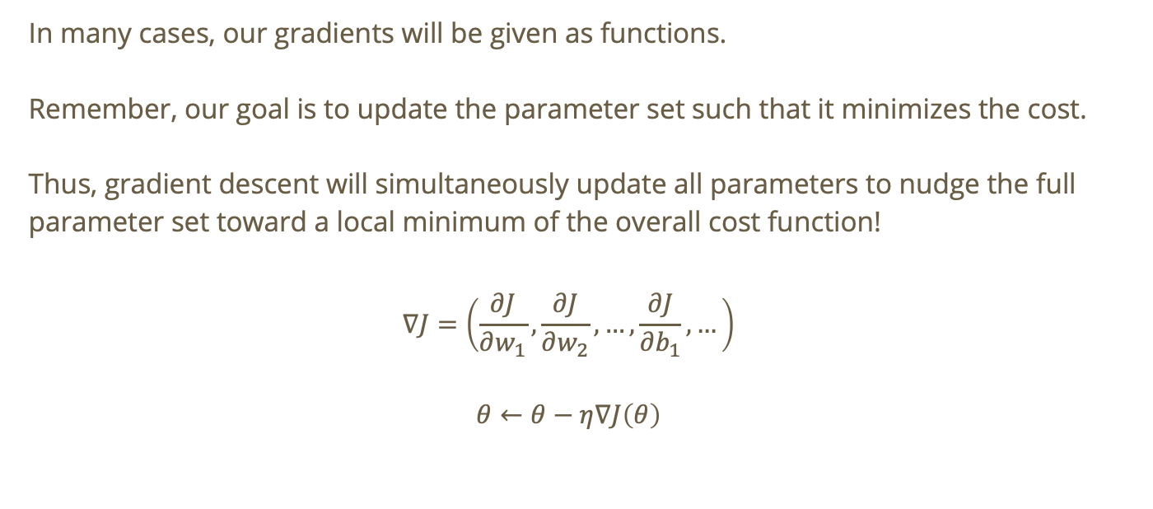
Gradient descent for parameter optimization
In many cases, our gradients will be given as functions.
Remember, our goal is to update the parameter set such that it minimizes the cost.
Thus, gradient descent will simultaneously update all parameters to nudge the full parameter set toward a local minimum of the overall cost function!
$$∇J=\left(\frac{∂J}{∂w_{1}},\frac{∂J}{∂w_{2}},…,\frac{∂J}{∂b_{1}},…\right)$$
$$θ←θ−η∇J\left(θ\right)$$
Notes:
the weird n is “eta”

Slide 49
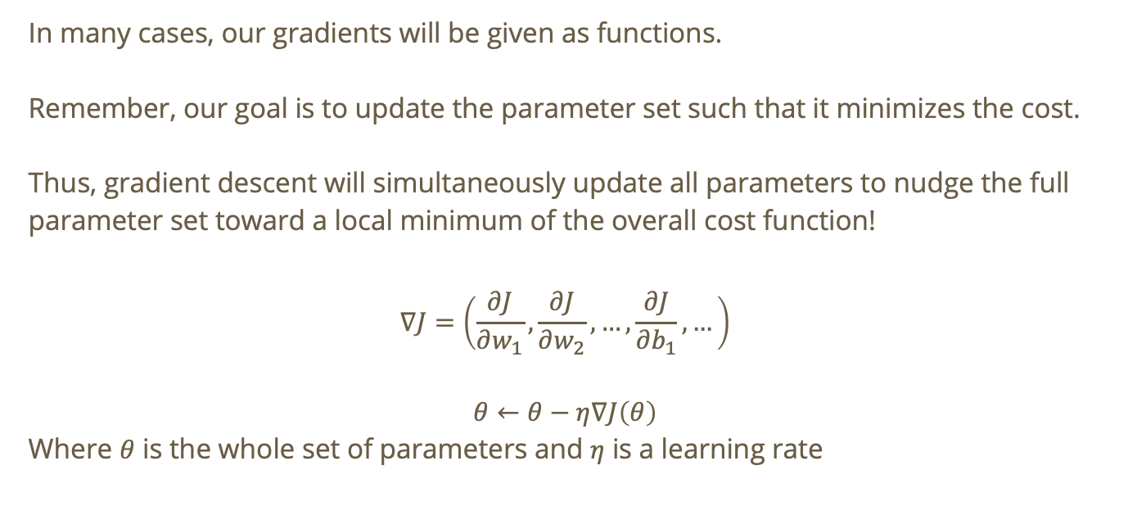
Gradient descent for parameter optimization
In many cases, our gradients will be given as functions.
Remember, our goal is to update the parameter set such that it minimizes the cost.
Thus, gradient descent will simultaneously update all parameters to nudge the full parameter set toward a local minimum of the overall cost function!
$$∇J=\left(\frac{∂J}{∂w_{1}},\frac{∂J}{∂w_{2}},…,\frac{∂J}{∂b_{1}},…\right)$$
$$θ←θ−η∇J\left(θ\right)$$
Where $θ$ is the whole set of parameters and $η$ is a learning rate
Notes:
the weird n is “eta”

Slide 50
Backpropagation starts at the output and moves backward
We start by computing the error term for the output. Now, using the error term for the output, we can calculate gradients for the output weights and biases.
Now that we have the gradients for the output weights and biases, we can propagate this information backwards to calculate the gradients for the hidden layer weights and biases!
Ok, now we have the gradients for all weights and biases!
Now, we use gradient descent to update each parameter
After using gradient descent to update each parameter toward a local minimum of the cost function, we can restart our training loop.

Slide 51
Activation Functions

Slide 52
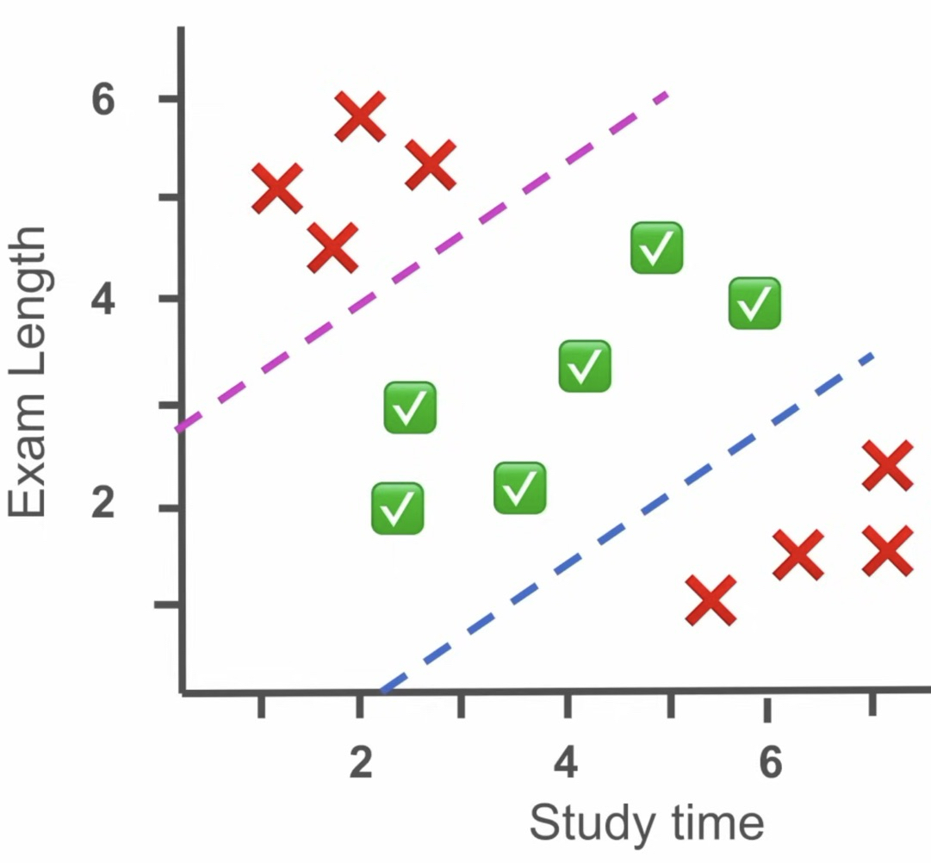
Recall: activation functions
Activation functions allow us to introduce non-linearity which enables the model to learn and represent complex data patterns
Activation functions enable curved decision boundaries!

Slide 53
Do not edit
How to change the design
The activation function A(x) = x applies a non-linear transformation to the hidden layers
The Slido app must be installed on every computer you’re presenting from

Slide 54
Do not edit
How to change the design
Even with a complex architecture, a neural network with no activation function in hidden layers is the same as a neural network with no hidden layers.
The Slido app must be installed on every computer you’re presenting from

Slide 55








Solution
Without an activation function, each hidden layer is just doing a linear transformation. A composition of linear transformations is just a linear transformation!
$$b_{0}$$
$$w_{1}$$
$$w_{5}$$
$$w_{2}$$
$$w_{3}$$
$$w_{6}$$
$$w_{4}$$
$$b_{2}$$
$$b_{1}$$

Slide 56

Solution
$h_{0}=w_{1}x_{0}+w_{3}x_{1}+b_{0}$
$h_{1}=w_{2}x_{0}+w_{4}x_{1}+b_{1}$
$y=w_{5}h_{0}+w_{6}h_{1}+b_{2}$
  $=w_{5}\left(w_{1}x_{0}+w_{3}x_{1}+b_{0}\right)+w_{6}\left(w_{2}x_{0}+w_{4}x_{1}+b_{1}\right)+b_{2}$
  $=w_{5}w_{1}x_{0}+w_{5}w_{3}x_{1}+w_{5}b_{0}+w_{6}w_{2}x_{0}+w_{6}w_{4}x_{1}+w_{6}b_{1}+b_{2}$
  $=w_{1}^{∗}x_{0}+w_{2}^{∗}x_{1}+w_{3}^{∗}x_{0}+w_{4}^{∗}x_{1}+w_{5}b_{0}+w_{6}b_{1}+b_{2}$
  $=\left(w_{1}^{∗}+w_{3}^{∗}\right)x_{0}+\left(w_{2}^{∗}+w_{4}^{∗}\right)x_{1}+w_{5}b_{0}+w_{6}b_{1}+b_{2}$
  $={\vec{w}}^{T}\vec{x}+w_{5}b_{0}+w_{6}b_{1}+b_{2}$
  $=w^{T}x+b^{∗}$
  where $\vec{w}=\left(w_{1}^{∗}+w_{3}^{∗},w_{2}^{∗}+w_{4}^{∗}\right)$ and $b^{∗}=w_{5}b_{0}+w_{6}b_{1}+b_{2}$

Slide 57
Choosing activation functions
How can our model learn increasingly complex non-linear relationships between inputs and predicted outputs?

Slide 58
Choosing activation functions
How can our model learn increasingly complex non-linear relationships between inputs and predicted outputs?
The choice of activation function can affect

Slide 59
Choosing activation functions
How can our model learn increasingly complex non-linear relationships between inputs and predicted outputs?
The choice of activation function can affect
Convergence speed

Slide 60
Choosing activation functions
How can our model learn increasingly complex non-linear relationships between inputs and predicted outputs?
The choice of activation function can affect
Convergence speed
Gradient flow

Slide 61
Choosing activation functions
How can our model learn increasingly complex non-linear relationships between inputs and predicted outputs?
The choice of activation function can affect
Convergence speed
Gradient flow
Model complexity

Slide 62
Nonlinear function – Sigmoid $σ\left(x\right)$
Outputs range between 0 and 1 → typically used for binary classification tasks (e.g., pass/fail, happy/sad, etc.)

Slide 63
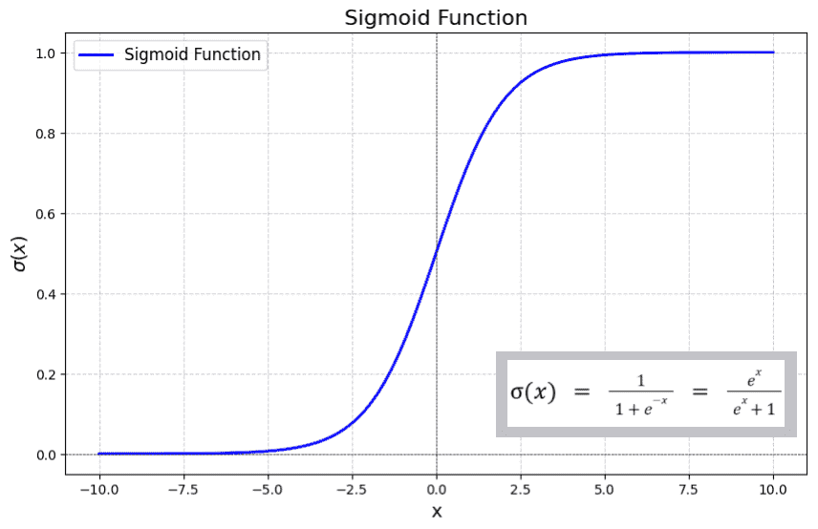
Nonlinear function – Sigmoid $σ\left(x\right)$
Outputs range between 0 and 1 → typically used for binary classification tasks (e.g., pass/fail, happy/sad, etc.)

Slide 64

Nonlinear function – Sigmoid $σ\left(x\right)$
Outputs range between 0 and 1 → typically used for binary classification tasks (e.g., pass/fail, happy/sad, etc.)
When inputs are in the range $\left(−2,2\right)$, we have a particularly steep gradient → small changes in input can cause significant output changes

Slide 65
Pros and cons of sigmoid
If we have a deep network, then during backpropagation, the earlier layers may stop learning (vanishing gradient) → ☹

Slide 66
Pros and cons of sigmoid
If we have a deep network, then during backpropagation, the earlier layers may stop learning (vanishing gradient) → ☹
Smooth and continuously differentiable → ☺

Slide 67
Pros and cons of sigmoid
If we have a deep network, then during backpropagation, the earlier layers may stop learning (vanishing gradient) → ☹
Smooth and continuously differentiable → ☺
Bounded between 0 and 1 which prevents activations from blowing up → ☺

Slide 68
Pros and cons of sigmoid
If we have a deep network, then during backpropagation, the earlier layers may stop learning (vanishing gradient) → ☹
Smooth and continuously differentiable → ☺
Bounded between 0 and 1 which prevents activations from blowing up → ☺
Not zero-centered which can lead to oscillations during gradient descent → ☹

Slide 69
Pros and cons of sigmoid
If we have a deep network, then during backpropagation, the earlier layers may stop learning (vanishing gradient) → ☹
Smooth and continuously differentiable → ☺
Bounded between 0 and 1 which prevents activations from blowing up → ☺
Not zero-centered which can lead to oscillations during gradient descent → ☹
Computationally expensive (compared to a linear function or ReLU) → ☹

Slide 70
Do not edit
How to change the design
In deep networks with tanh or sigmoid activations, early layers struggle to learn because gradients become too small by the time they reach the first layer
The Slido app must be installed on every computer you’re presenting from

Slide 71
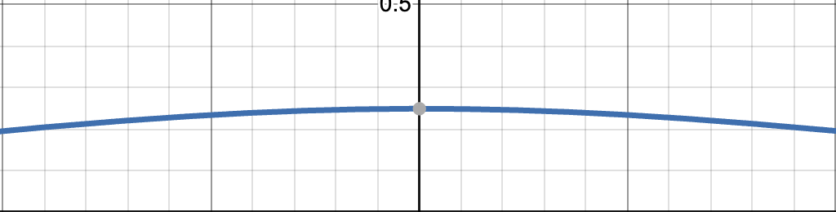

Solution
In backpropagation, the error signal is sent back through the network multiplicatively → as the gradient moves from the output layer toward the first layer, it keeps getting multiplied by terms from each layer
$σ‘\left(x\right)$:
(0, 0.25)
Notes:
$σ‘\left(x\right)=σ\left(x\right)\left(1−σ\left(x\right)\right)$

Slide 72
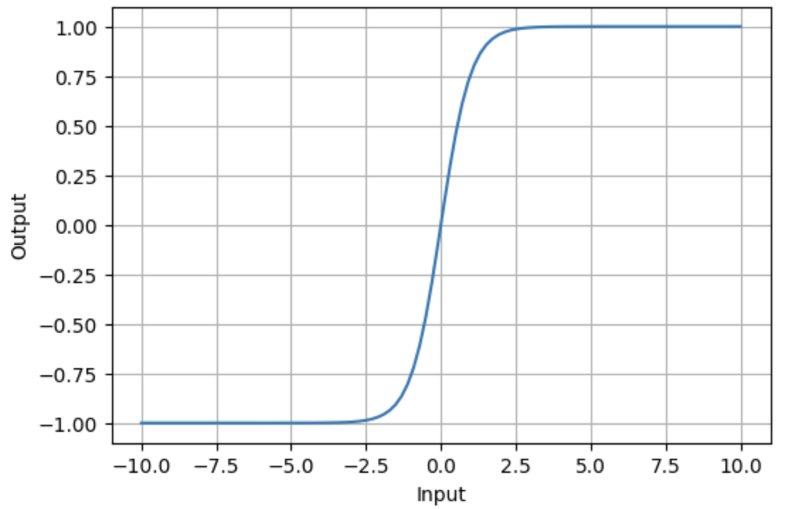

Nonlinear function - $\tanh\left(x\right)$
Output ranges between $\left(−1,1\right)$
Commonly used in hidden layers due to its zero-centered output

Slide 73
Pros and cons of hyperbolic tangent
Zero-centered output: helps keeps gradients balanced which can facilitate faster convergence of gradient descent → ☺
Notes:
Sparse representation means that only some subset of neurons will be activated at a given time which helps reduce computational overhead → efficiently handle really large models

Slide 74
Pros and cons of hyperbolic tangent
Zero-centered output: helps keeps gradients balanced which can facilitate faster convergence of gradient descent → ☺
Vanishing gradient → ☹
Notes:
Sparse representation means that only some subset of neurons will be activated at a given time which helps reduce computational overhead → efficiently handle really large models

Slide 75
Pros and cons of hyperbolic tangent
Zero-centered output: helps keeps gradients balanced which can facilitate faster convergence of gradient descent → ☺
Vanishing gradient → ☹
Lack of sparsity: neurons will never truly be deactivated which means no truly sparse representation → ☹
Notes:
Sparse representation means that only some subset of neurons will be activated at a given time which helps reduce computational overhead → efficiently handle really large models

Slide 76
Pros and cons of hyperbolic tangent
Zero-centered output: helps keeps gradients balanced which can facilitate faster convergence of gradient descent → ☺
Vanishing gradient → ☹
Lack of sparsity: neurons will never truly be deactivated which means no truly sparse representation → ☹
Bounded output → ☺
Notes:
Sparse representation means that only some subset of neurons will be activated at a given time which helps reduce computational overhead → efficiently handle really large models

Slide 77
Do not edit
How to change the design
You train a fully-connected network with tanh activation and sigmoid output. Input features have large positive means. What will happen?
The Slido app must be installed on every computer you’re presenting from

Slide 78

Solution
Input very positive or very negative → $\text{tanh}\left(x\right)=1 \text{or} −1$
$σ‘\left(x\right)=σ\left(x\right)\left(1−σ\left(x\right)\right)$
$σ‘\left(1\right)≈0.197$

Slide 79
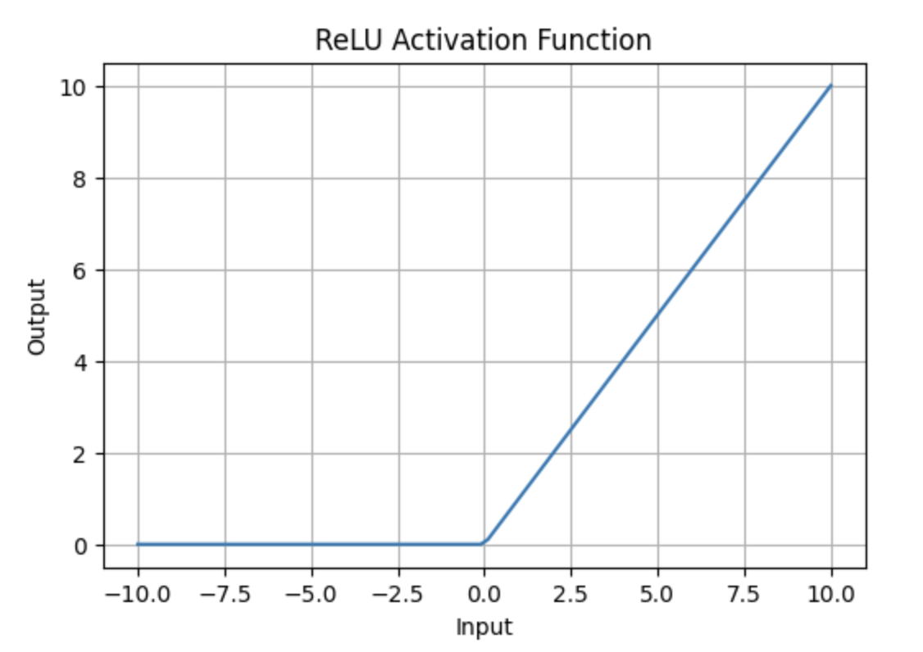

Nonlinear function - $\text{ReLU}\left(x\right)$
$$\text{ReLU}\left(x\right)=\max{\{}0,x\}$$
Output ranges between $\left(0,∞\right)$
If the input is positive, ReLU returns the input, otherwise it returns 0.
Notes:
Not differentiable at 0 (because not continuous at 0) but most libraries like pytorch and tensorflow just define a gradient at x = 0 to be 1 or 0 to solve the problem

Slide 80
Pros and cons of ReLU
Computational efficiency → ☺
Notes:
briefly mention leaky relu which confronts the dying relu problem by replacing zero with some small constant $α$ times x

Slide 81
Pros and cons of ReLU
Computational efficiency → ☺
Faster convergence: the gradient does not saturate for positive inputs → ☺
Notes:
briefly mention leaky relu which confronts the dying relu problem by replacing zero with some small constant $α$ times x

Slide 82
Pros and cons of ReLU
Computational efficiency → ☺
Faster convergence: the gradient does not saturate for positive inputs → ☺
Gradient for positive inputs is a constant 1 so no vanishing gradient in the positive region → ☺
Notes:
briefly mention leaky relu which confronts the dying relu problem by replacing zero with some small constant $α$ times x

Slide 83
Pros and cons of ReLU
Computational efficiency → ☺
Faster convergence: the gradient does not saturate for positive inputs → ☺
Gradient for positive inputs is a constant 1 so no vanishing gradient in the positive region → ☺
Sparse activation: All negative inputs are set to zero → ☺
Notes:
briefly mention leaky relu which confronts the dying relu problem by replacing zero with some small constant $α$ times x

Slide 84
Pros and cons of ReLU
Computational efficiency → ☺
Faster convergence: the gradient does not saturate for positive inputs → ☺
Gradient for positive inputs is a constant 1 so no vanishing gradient in the positive region → ☺
Sparse activation: All negative inputs are set to zero → ☺
Dying ReLU: If a large negative gradient updates the weights, a neuron may always produce an output of 0 which means it has stopped learning (dead neuron) → ☹
Notes:
briefly mention leaky relu which confronts the dying relu problem by replacing zero with some small constant $α$ times x

Slide 85
Pros and cons of ReLU
Computational efficiency → ☺
Faster convergence: the gradient does not saturate for positive inputs → ☺
Gradient for positive inputs is a constant 1 so no vanishing gradient in the positive region → ☺
Sparse activation: All negative inputs are set to zero → ☺
Dying ReLU: If a large negative gradient updates the weights, a neuron may always produce an output of 0 which means it has stopped learning (dead neuron) → ☹
Non-zero centered: output of ReLu is always at least 0 which can lead to oscillations during gradient descent → ☹
Notes:
briefly mention leaky relu which confronts the dying relu problem by replacing zero with some small constant $α$ times x

Slide 86
Do not edit
How to change the design
Consider a single ReLU neuron with weights initialized from a symmetric distribution and data centered at 0. If the bias b is initialized to a small positive value (e.g. 0.01), then more than 50% of data points will make the neuron activate.
The Slido app must be installed on every computer you’re presenting from

Slide 87
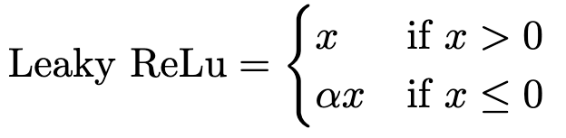
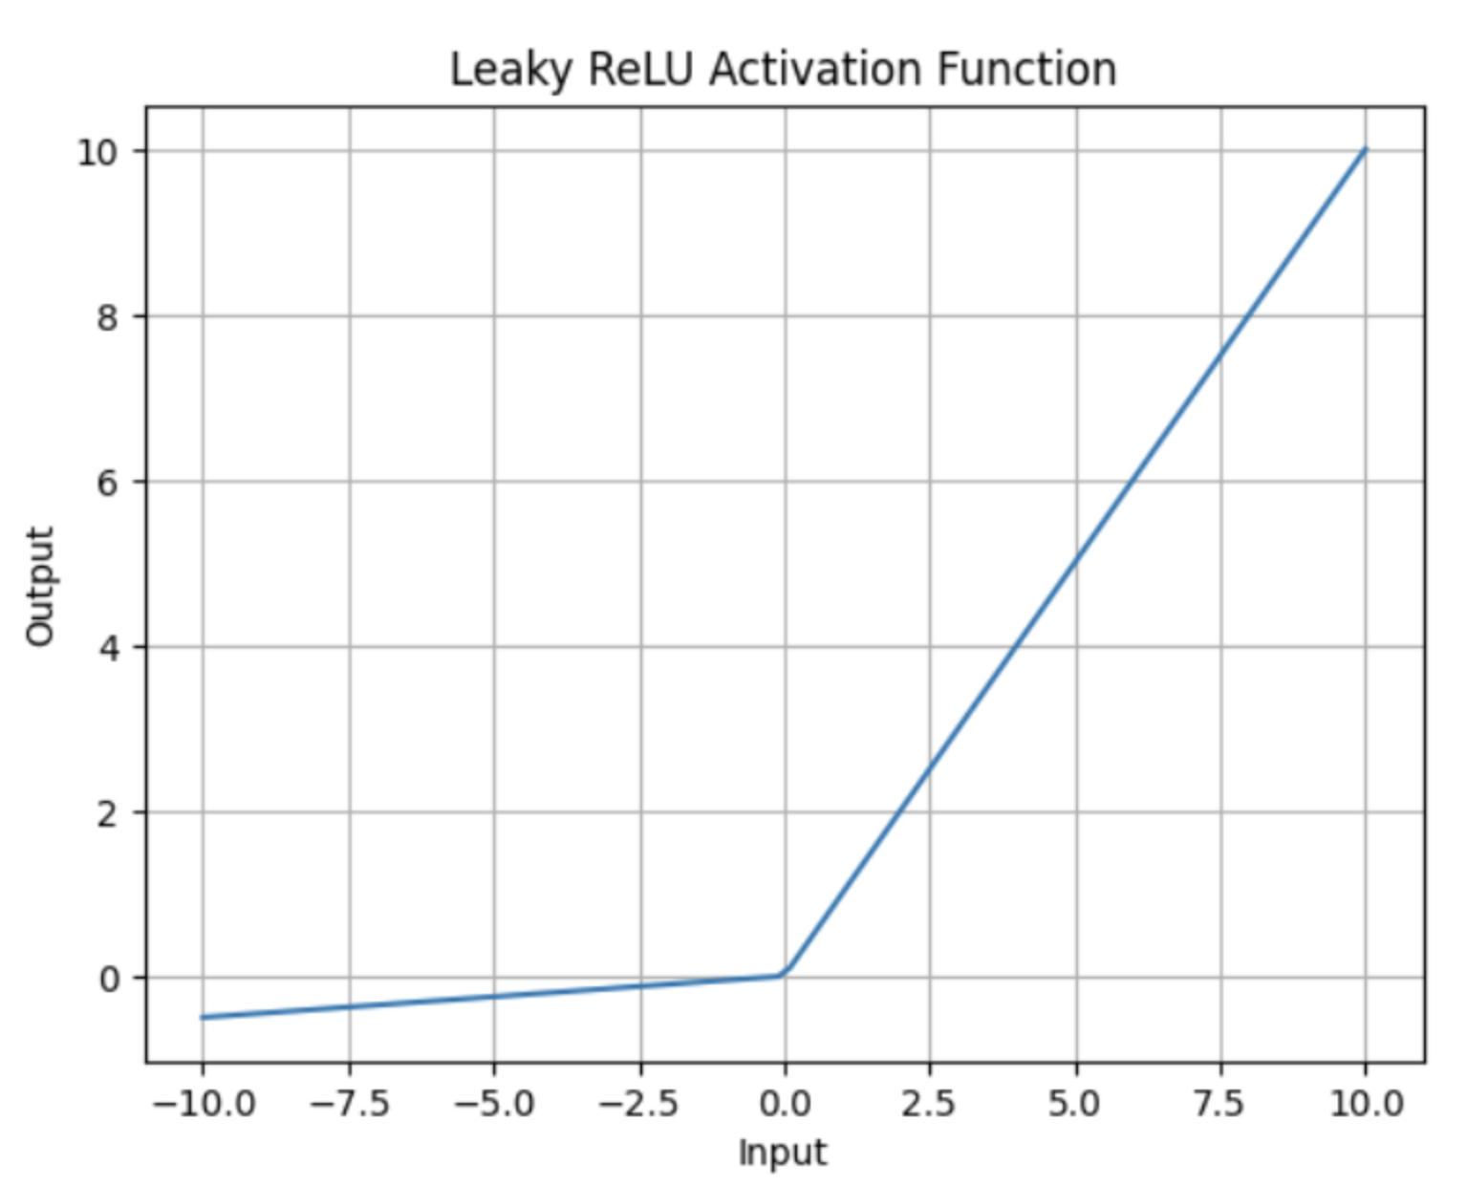
Leaky ReLU
Notes:
Skip to slide 103

Slide 88
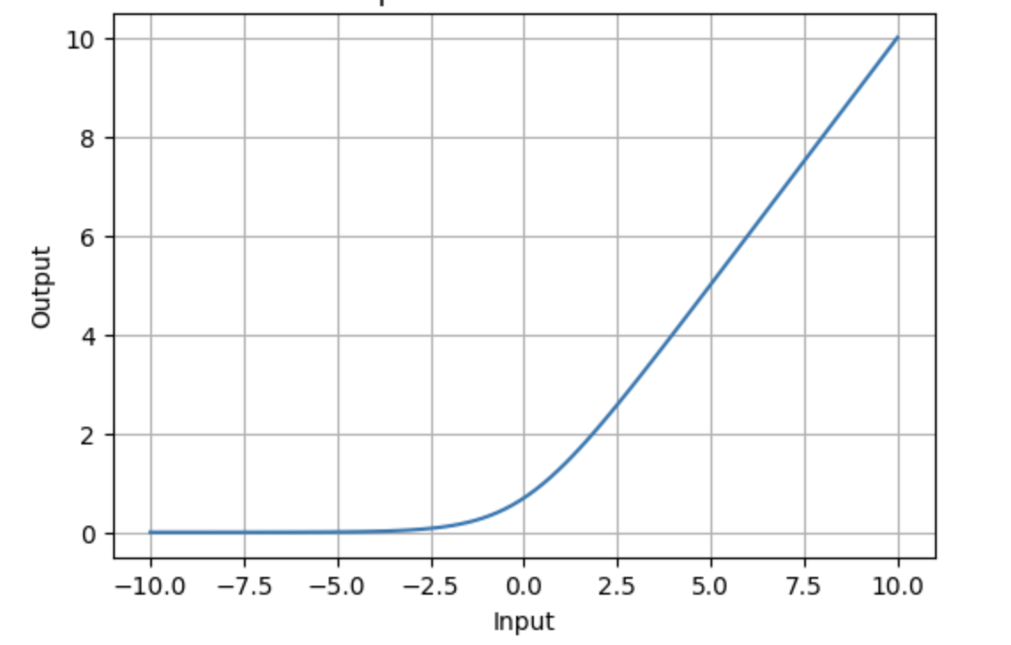

Nonlinear function - SoftPlus
$$\text{SoftPlus}\left(x\right)=\log\left(1+e^{x}\right)$$
Output is strictly positive and continuously differentiable
Output is in the range $\left(1,∞\right)$
Notes:
Note: log as in natural log (ln)

Slide 89
Pros and cons of SoftPlus
Smooth everywhere: stable gradient → ☺

Slide 90
Pros and cons of SoftPlus
Smooth everywhere: stable gradient → ☺
No dying neurons: function is non-zero for all input values → ☺

Slide 91
Pros and cons of SoftPlus
Smooth everywhere: stable gradient → ☺
No dying neurons: function is non-zero for all input values → ☺
Computationally expensive → ☹

Slide 92
Pros and cons of SoftPlus
Smooth everywhere: stable gradient → ☺
No dying neurons: function is non-zero for all input values → ☺
Computationally expensive → ☹
Slower convergence despite smoothness → ☹

Slide 93
Pros and cons of SoftPlus
Smooth everywhere: stable gradient → ☺
No dying neurons: function is non-zero for all input values → ☺
Computationally expensive → ☹
Slower convergence despite smoothness → ☹
Not-zero centered → ☹

Slide 94
Pros and cons of SoftPlus
Smooth everywhere: stable gradient → ☺
No dying neurons: function is non-zero for all input values → ☺
Computationally expensive → ☹
Slower convergence despite smoothness → ☹
Not-zero centered → ☹
Vanishing gradient for negative inputs: as inputs become increasingly negative, the gradient will approach zero leading to vanishing gradients in those regions → ☹

Slide 95
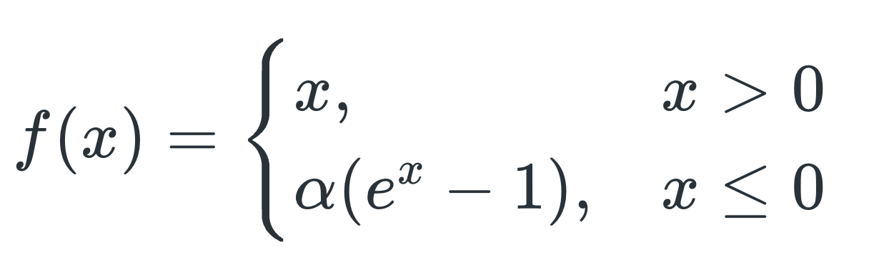
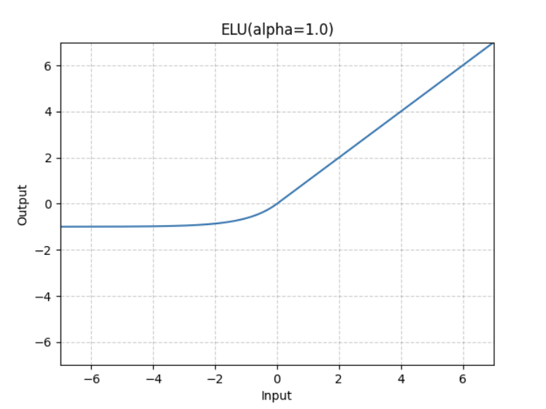

Exponential Linear Unit - ELU
Output ranges from $\left(−α,∞\right)$
Smooth and continuously differentiable

Slide 96
Pros and cons of ELU
No dying neurons: ELU does not bound negative inputs to an output of zero → ☺

Slide 97
Pros and cons of ELU
No dying neurons: ELU does not bound negative inputs to an output of zero → ☺
Smooth gradient → ☺

Slide 98
Pros and cons of ELU
No dying neurons: ELU does not bound negative inputs to an output of zero → ☺
Smooth gradient → ☺
Pushes mean activations closer to 0 which results in faster convergence of gradient descent → ☺

Slide 99
Pros and cons of ELU
No dying neurons: ELU does not bound negative inputs to an output of zero → ☺
Smooth gradient → ☺
Pushes mean activations closer to 0 which results in faster convergence of gradient descent → ☺
Computationally expensive → ☹

Slide 100
Pros and cons of ELU
No dying neurons: ELU does not bound negative inputs to an output of zero → ☺
Smooth gradient → ☺
Pushes mean activations closer to 0 which results in faster convergence of gradient descent → ☺
Computationally expensive → ☹
Not strictly zero-centered → ☹

Slide 101
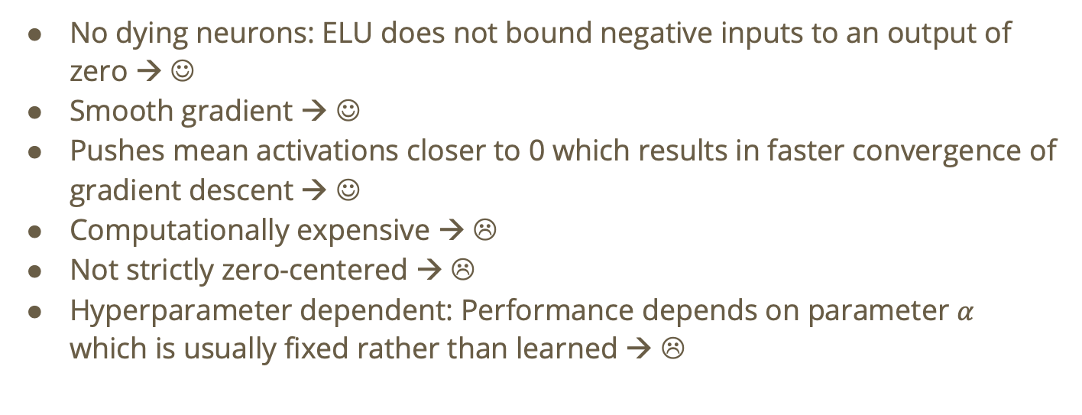
Pros and cons of ELU
No dying neurons: ELU does not bound negative inputs to an output of zero → ☺
Smooth gradient → ☺
Pushes mean activations closer to 0 which results in faster convergence of gradient descent → ☺
Computationally expensive → ☹
Not strictly zero-centered → ☹
Hyperparameter dependent: Performance depends on parameter $α$ which is usually fixed rather than learned → ☹

Slide 102
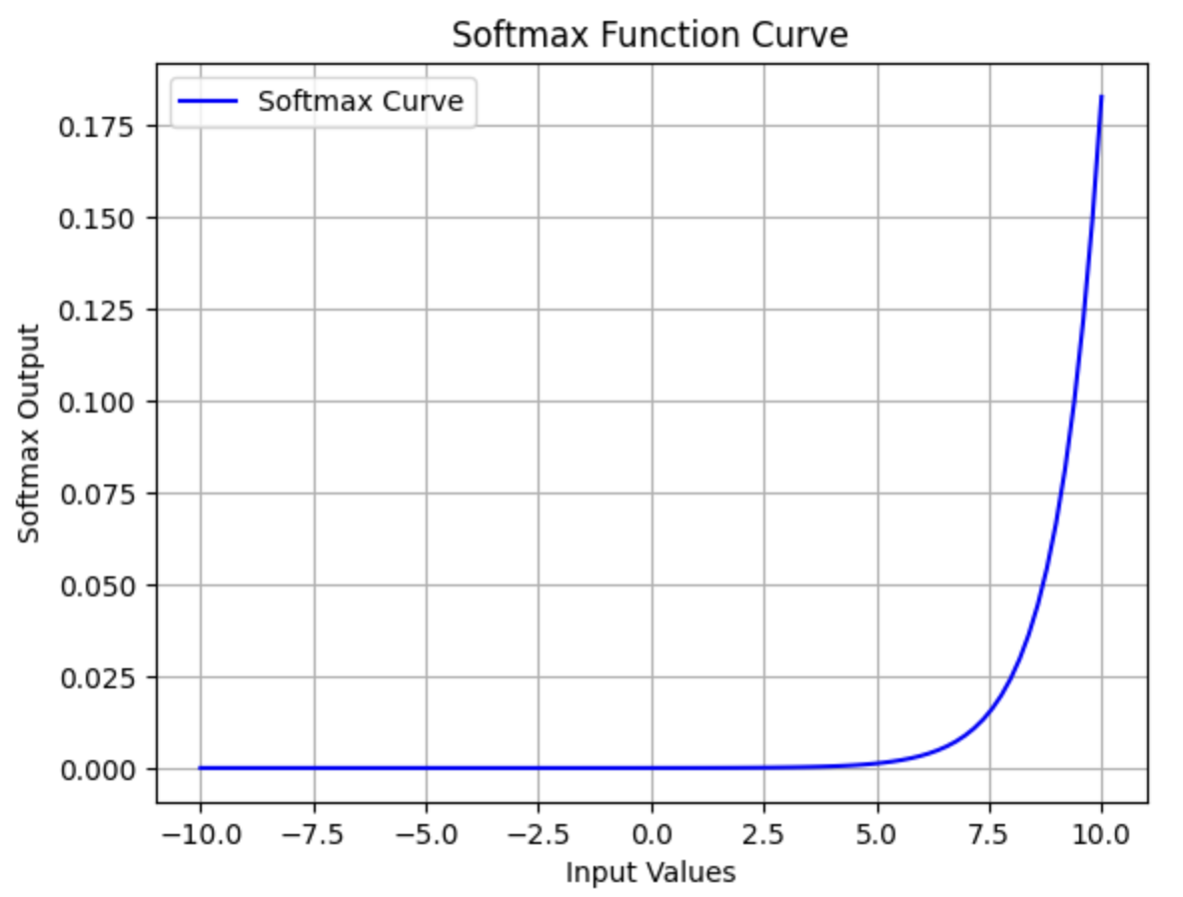
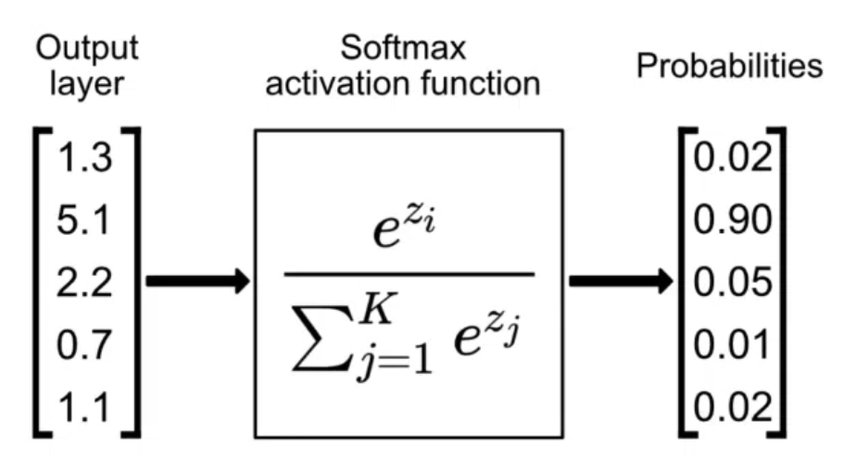

Output layer activation functions - softmax
Designed to handle multi-class classification problems
Squashes raw output layer scores into the range $(0,1)$ producing probabilities ensuring that the probabilities all sum to 1.

Slide 103
Optimization

Slide 104
Minimal architecture
Can we make the network smaller, simpler, or computationally cheaper while keeping most of its performance?

Slide 105
Minimal architecture
Can we make the network smaller, simpler, or computationally cheaper while keeping most of its performance?
Strategies include:

Slide 106
Minimal architecture
Can we make the network smaller, simpler, or computationally cheaper while keeping most of its performance?
Strategies include:
  Pruning

Slide 107
Minimal architecture
Can we make the network smaller, simpler, or computationally cheaper while keeping most of its performance?
Strategies include:
  Pruning
  Knowledge distillation

Slide 108
Minimal architecture
Can we make the network smaller, simpler, or computationally cheaper while keeping most of its performance?
Strategies include:
  Pruning
  Knowledge distillation
  Low-rank factorization

Slide 109
Pruning
Process of removing redundant or less important neurons or weights from a neural network, without significantly impacting its performance.

Slide 110
Pruning
Process of removing redundant or less important neurons or weights from a neural network, without significantly impacting its performance.
We can prune individual weights, entire neurons, or even entire layers

Slide 111
Pruning
Process of removing redundant or less important neurons or weights from a neural network, without significantly impacting its performance.
We can prune individual weights, entire neurons, or even entire layers
We will discuss two types of pruning:

Slide 112
Pruning
Process of removing redundant or less important neurons or weights from a neural network, without significantly impacting its performance.
We can prune individual weights, entire neurons, or even entire layers
We will discuss two types of pruning:
Iterative pruning

Slide 113
Pruning
Process of removing redundant or less important neurons or weights from a neural network, without significantly impacting its performance.
We can prune individual weights, entire neurons, or even entire layers
We will discuss two types of pruning:
Iterative pruning
One-shot pruning

Slide 114
Iterative pruning
Iterative pruning refines neural network architectures by progressively removing less important parameters or structures while fine-tuning the network to maintain performance.¹
¹Janusz, Wojnar, et.al One Shot vs. Iterative: Rethinking Pruning Strategies for Model Compression
Notes:
Iterative constant pruning is where you remove a constant number of parameters every iteration and geometric pruning is where you prune a fixed percentage of the remaining parameters per step

Slide 115
Iterative pruning
Iterative pruning refines neural network architectures by progressively removing less important parameters or structures while fine-tuning the network to maintain performance.¹
Iterative magnitude pruning:
¹Janusz, Wojnar, et.al One Shot vs. Iterative: Rethinking Pruning Strategies for Model Compression
Notes:
Iterative constant pruning is where you remove a constant number of parameters every iteration and geometric pruning is where you prune a fixed percentage of the remaining parameters per step

Slide 116
Iterative pruning
Iterative pruning refines neural network architectures by progressively removing less important parameters or structures while fine-tuning the network to maintain performance.¹
Iterative magnitude pruning:
Train the model to convergence or for a fixed number of epochs
¹Janusz, Wojnar, et.al One Shot vs. Iterative: Rethinking Pruning Strategies for Model Compression
Notes:
Iterative constant pruning is where you remove a constant number of parameters every iteration and geometric pruning is where you prune a fixed percentage of the remaining parameters per step

Slide 117
Iterative pruning
Iterative pruning refines neural network architectures by progressively removing less important parameters or structures while fine-tuning the network to maintain performance.¹
Iterative magnitude pruning:
Train the model to convergence or for a fixed number of epochs
Compute parameter importance (weight magnitude, gradients, etc.)
¹Janusz, Wojnar, et.al One Shot vs. Iterative: Rethinking Pruning Strategies for Model Compression
Notes:
Iterative constant pruning is where you remove a constant number of parameters every iteration and geometric pruning is where you prune a fixed percentage of the remaining parameters per step

Slide 118
Iterative pruning
Iterative pruning refines neural network architectures by progressively removing less important parameters or structures while fine-tuning the network to maintain performance.¹
Iterative magnitude pruning:
Train the model to convergence or for a fixed number of epochs
Compute parameter importance (weight magnitude, gradients, etc.)
Prune a fraction of the least important parameters by setting them to zero (or removing them.)
¹Janusz, Wojnar, et.al One Shot vs. Iterative: Rethinking Pruning Strategies for Model Compression
Notes:
Iterative constant pruning is where you remove a constant number of parameters every iteration and geometric pruning is where you prune a fixed percentage of the remaining parameters per step

Slide 119
Iterative pruning
Iterative pruning refines neural network architectures by progressively removing less important parameters or structures while fine-tuning the network to maintain performance.¹
Iterative magnitude pruning:
Train the model to convergence or for a fixed number of epochs
Compute parameter importance (weight magnitude, gradients, etc.)
Prune a fraction of the least important parameters by setting them to zero (or removing them.)
Retrain on the remaining weights, either from the latest state or after “rewinding” to an earlier checkpoint.
¹Janusz, Wojnar, et.al One Shot vs. Iterative: Rethinking Pruning Strategies for Model Compression
Notes:
Iterative constant pruning is where you remove a constant number of parameters every iteration and geometric pruning is where you prune a fixed percentage of the remaining parameters per step

Slide 120
Iterative pruning
Iterative pruning refines neural network architectures by progressively removing less important parameters or structures while fine-tuning the network to maintain performance.¹
Iterative magnitude pruning:
Train the model to convergence or for a fixed number of epochs
Compute parameter importance (weight magnitude, gradients, etc.)
Prune a fraction of the least important parameters by setting them to zero (or removing them.)
Retrain on the remaining weights, either from the latest state or after “rewinding” to an earlier checkpoint.
Repeat 2-4 until desired sparsity is reached
¹Janusz, Wojnar, et.al One Shot vs. Iterative: Rethinking Pruning Strategies for Model Compression
Notes:
Iterative constant pruning is where you remove a constant number of parameters every iteration and geometric pruning is where you prune a fixed percentage of the remaining parameters per step

Slide 121
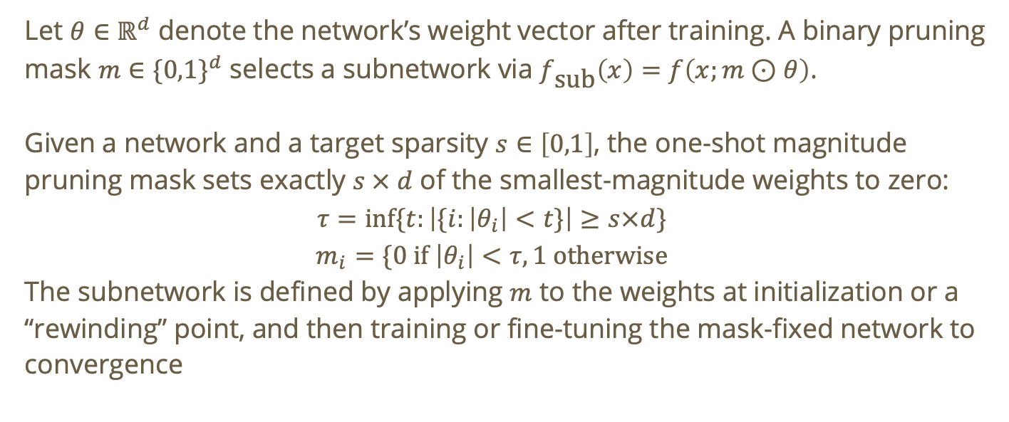
One-shot pruning
Let $θ∈ℝ^{d}$ denote the network’s weight vector after training. A binary pruning mask $m∈\{0,1\}^{d}$ selects a subnetwork via $f_{\text{sub}}\left(x\right)=f\left(x;m⊙θ\right)$.
Given a network and a target sparsity $s∈\left[0,1\right]$, the one-shot magnitude pruning mask sets exactly $s × d$ of the smallest-magnitude weights to zero:
$$τ=\inf{\{t:\left|\{i:\left|θ_{i}\right|<t\}\right|≥s×d\}}$$
$$m_{i}=\{0 \text{if} \left|θ_{i}\right|<τ,1 \text{otherwise}$$
The subnetwork is defined by applying $m$ to the weights at initialization or a “rewinding” point, and then training or fine-tuning the mask-fixed network to convergence
Notes:
https://www.emergentmind.com/topics/one-shot-magnitude-pruning

Slide 122
One-shot pruning
Identify a sparse subnetwork by directly zeroing the smallest-magnitude weights in a single pruning step

Slide 123
One-shot pruning
Identify a sparse subnetwork by directly zeroing the smallest-magnitude weights in a single pruning step
Typical steps:

Slide 124

One-shot pruning
Identify a sparse subnetwork by directly zeroing the smallest-magnitude weights in a single pruning step
Typical steps:
Initialize weights $θ_{0}$

Slide 125

One-shot pruning
Identify a sparse subnetwork by directly zeroing the smallest-magnitude weights in a single pruning step
Typical steps:
Initialize weights $θ_{0}$
Train dense network to convergence → $θ_{T}$

Slide 126

One-shot pruning
Identify a sparse subnetwork by directly zeroing the smallest-magnitude weights in a single pruning step
Typical steps:
Initialize weights $θ_{0}$
Train dense network to convergence → $θ_{T}$
Compute $\left|θ_{T}\right|$ and prune the $s ×d$ smallest entries, forming mask $m$

Slide 127

One-shot pruning
Identify a sparse subnetwork by directly zeroing the smallest-magnitude weights in a single pruning step
Typical steps:
Initialize weights $θ_{0}$
Train dense network to convergence → $θ_{T}$
Compute $\left|θ_{T}\right|$ and prune the $s ×d$ smallest entries, forming mask $m$
Optionally rewind to $θ_{0}$ (or $θ_{t }\text{for} t<T$)

Slide 128

One-shot pruning
Identify a sparse subnetwork by directly zeroing the smallest-magnitude weights in a single pruning step
Typical steps:
Initialize weights $θ_{0}$
Train dense network to convergence → $θ_{T}$
Compute $\left|θ_{T}\right|$ and prune the $s ×d$ smallest entries, forming mask $m$
Optionally rewind to $θ_{0}$ (or $θ_{t }\text{for} t<T$)
Train $f\left(x;m⊙θ\right)$ to convergence

Slide 129

One-shot pruning
Identify a sparse subnetwork by directly zeroing the smallest-magnitude weights in a single pruning step
Typical steps:
Initialize weights $θ_{0}$
Train dense network to convergence → $θ_{T}$
Compute $\left|θ_{T}\right|$ and prune the $s ×d$ smallest entries, forming mask $m$
Optionally rewind to $θ_{0}$ (or $θ_{t }\text{for} t<T$)
Train $f\left(x;m⊙θ\right)$ to convergence
Evaluate performance

Slide 130
Knowledge distillation
Aims to transfer the learnings of a large pre-trained model, the “teacher” model, to a smaller “student” model.

Slide 131
Knowledge distillation
Aims to transfer the learnings of a large pre-trained model, the “teacher” model, to a smaller “student” model.
  Used as a form of model compression and knowledge transfer

Slide 132
Knowledge distillation
Aims to transfer the learnings of a large pre-trained model, the “teacher” model, to a smaller “student” model.
  Used as a form of model compression and knowledge transfer
  Particularly useful for massive neural networks

Slide 133
Knowledge distillation
Aims to transfer the learnings of a large pre-trained model, the “teacher” model, to a smaller “student” model.
  Used as a form of model compression and knowledge transfer
  Particularly useful for massive neural networks
We want to train the student network to match the predictions and thought process of the teacher network

Slide 134
Knowledge distillation
Aims to transfer the learnings of a large pre-trained model, the “teacher” model, to a smaller “student” model.
  Used as a form of model compression and knowledge transfer
  Particularly useful for massive neural networks
We want to train the student network to match the predictions and thought process of the teacher network
  Introduce a new type of cost function to see how the student’s reasoning deviates from the teacher: distillation loss

Slide 135
Knowledge distillation
Aims to transfer the learnings of a large pre-trained model, the “teacher” model, to a smaller “student” model.
  Used as a form of model compression and knowledge transfer
  Particularly useful for massive neural networks
We want to train the student network to match the predictions and thought process of the teacher network
  Introduce a new type of cost function to see how the student’s reasoning deviates from the teacher: distillation loss
  Soft targets: instead of using the actual predictions of the teacher to train the student, use the class-probabilities produced by the teacher

Slide 136
Types of knowledge distillation
Offline distillation: freeze the teacher network and only alter the student

Slide 137
Types of knowledge distillation
Offline distillation: freeze the teacher network and only alter the student
Online distillation: simultaneously train the teacher and student networks

Slide 138
Types of knowledge distillation
Offline distillation: freeze the teacher network and only alter the student
Online distillation: simultaneously train the teacher and student networks
Self-distillation: one network acts as both the student and teacher

Slide 139
Types of knowledge distillation
Offline distillation: freeze the teacher network and only alter the student
Online distillation: simultaneously train the teacher and student networks
Self-distillation: one network acts as both the student and teacher
  Transfer of knowledge from a network’s “deeper” layers to its “shallow” layers

Slide 140
Types of knowledge distillation
Offline distillation: freeze the teacher network and only alter the student
Online distillation: simultaneously train the teacher and student networks
Self-distillation: one network acts as both the student and teacher
  Transfer of knowledge from a network’s “deeper” layers to its “shallow” layers
We will focus on offline distillation today.

Slide 141

Offline distillation
Typical steps to conduct offline distillation:

Slide 142
Offline distillation
Typical steps to conduct offline distillation:
Pre-train teacher model and freeze its weights

Slide 143
Offline distillation
Typical steps to conduct offline distillation:
Pre-train teacher model and freeze its weights
Generate soft labels (probabilities) from the teacher

Slide 144
Offline distillation
Typical steps to conduct offline distillation:
Pre-train teacher model and freeze its weights
Generate soft labels (probabilities) from the teacher
Train student model

Slide 145
Offline distillation
Typical steps to conduct offline distillation:
Pre-train teacher model and freeze its weights
Generate soft labels (probabilities) from the teacher
Train student model
  A smaller student model is trained on the same data. It learns using a combined loss function: distillation loss and student loss (soft target loss and predicted outcome loss, respectively)

Slide 146
Low-rank factorization
Similar idea to SVD where we are looking for the largest singular values which represent the most important directions in how the layer transforms inputs into outputs.

Slide 147
Low-rank factorization
Similar idea to SVD where we are looking for the largest singular values which represent the most important directions in how the layer transforms inputs into outputs.
The smaller singular values represent weaker directions, which may be removable with little effect

Slide 148
Low-rank factorization
Similar idea to SVD where we are looking for the largest singular values which represent the most important directions in how the layer transforms inputs into outputs.
The smaller singular values represent weaker directions, which may be removable with little effect
Especially useful when when one layer is much larger than others

Slide 149
Low-rank factorization
Similar idea to SVD where we are looking for the largest singular values which represent the most important directions in how the layer transforms inputs into outputs.
The smaller singular values represent weaker directions, which may be removable with little effect
Especially useful when when one layer is much larger than others
  Compression in general should be targeted! You get the greatest payoff by compressing layers that dominate the parameter count.

Slide 150
Low-rank factorization
Similar idea to SVD where we are looking for the largest singular values which represent the most important directions in how the layer transforms inputs into outputs.
The smaller singular values represent weaker directions, which may be removable with little effect
Especially useful when when one layer is much larger than others
  Compression in general should be targeted! You get the greatest payoff by compressing layers that dominate the parameter count.
This factorization can be built into the architecture before training

Slide 151

Low-rank factorization
Let $A∈ℝ^{m×n}$ be a large and low-rank weight matrix. We will replace $A$ with two matrices:

Slide 152

Low-rank factorization
Let $A∈ℝ^{m×n}$ be a large and low-rank weight matrix. We will replace $A$ with two matrices:
$$A= BC$$

Slide 153

Low-rank factorization
Let $A∈ℝ^{m×n}$ be a large and low-rank weight matrix. We will replace $A$ with two matrices:
$$A= BC$$
where $B∈ℝ^{m×r}$ and $C∈ℝ^{r×n}$. The original matrix has $mn$ parameters. The factored version has
$$mr+rn=r\left(m+n\right)$$
parameters.

Slide 154

Low-rank factorization
Let $A∈ℝ^{m×n}$ be a large and low-rank weight matrix. We will replace $A$ with two matrices:
$$A= BC$$
where $B∈ℝ^{m×r}$ and $C∈ℝ^{r×n}$. The original matrix has $mn$ parameters. The factored version has
$$mr+rn=r\left(m+n\right)$$
parameters. So the model is smaller when
$$r\left(m+n\right)<mn$$

Slide 155

Low-rank factorization
Let $A∈ℝ^{m×n}$ be a large and low-rank weight matrix. We will replace $A$ with two matrices:
$$A= BC$$
where $B∈ℝ^{m×r}$ and $C∈ℝ^{r×n}$. The original matrix has $mn$ parameters. The factored version has
$$mr+rn=r\left(m+n\right)$$
parameters. So the model is smaller when
$$r\left(m+n\right)<mn$$
The rank $r$ is a compression knob. Smaller $r$ means fewer parameters.

Slide 156

Low-rank factorization
Let $A∈ℝ^{m×n}$ be a large and low-rank weight matrix. We will replace $A$ with two matrices:
$$A= BC$$
where $B∈ℝ^{m×r}$ and $C∈ℝ^{r×n}$. The original matrix has $mn$ parameters. The factored version has
$$mr+rn=r\left(m+n\right)$$
parameters. So the model is smaller when
$$r\left(m+n\right)<mn$$
The rank $r$ is a compression knob. Smaller $r$ means fewer parameters.
If many singular values are small, then the matrix may be approximately low-rank → we may be able to compress it without losing too much

Slide 157
Low-rank factorization
Original:

Slide 158

Low-rank factorization
Original:
n-dimensional input $x$ → weight matrix $A$ → m-dimensional output $z$

Slide 159

Low-rank factorization
Original:
n-dimensional input $x$ → weight matrix $A$ → m-dimensional output $z$
Reduced:

Slide 160

Low-rank factorization
Original:
n-dimensional input $x$ → weight matrix $A$ → m-dimensional output $z$
Reduced:
$x$ → C → bottleneck $q$ → B → Z

Slide 161

Low-rank factorization
Original:
n-dimensional input $x$ → weight matrix $A$ → m-dimensional output $z$
Reduced:
$x$ → C → bottleneck $q$ → B → Z
Where
$$q=Cx∈ℝ^{r}$$
$q$ is called a bottleneck because it is forced to squeeze its higher dimensional input information into $r$ dimensions.

