Slide 1
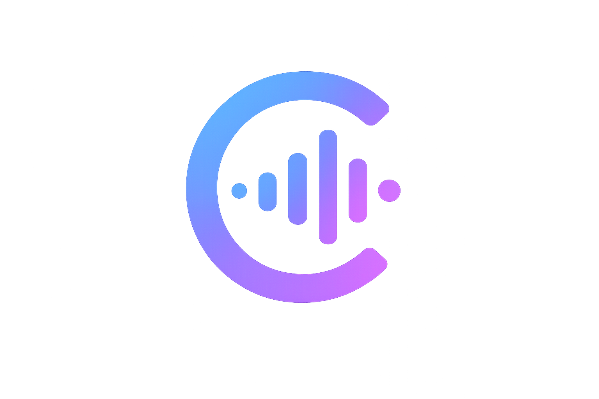
Calibra
Agent Evaluation & Observability Platform
The problem with AI agent evaluation is not building the eval tool.
It's knowing when to trust what the tool tells you.
Built by Riyanna · Summer 2026

Slide 2
The problem
AI agents fail silently. They don't crash — they confidently return wrong answers.
✗
Can't read every trace
?
LLM-as-judge looks easy
!
The judge can lie to you
At scale, manual review is impossible.
You need automated scoring.
Ask another LLM to grade the output.
Simple. But is it accurate?
A calibrated judge reported 75%→100%.
Reality: 75%→75%. Flat.
`
The core insight: "We calibrated our judge" means nothing without specifying who wrote the labels.

Slide 3
How Calibra works
Every component feeds the next. Tracing without calibration is noise.
01
02
03
04
05
Instrument
Store
Judge
Calibrate
Detect
@traced decorator
captures every step
→
SQLite traces.db
runs + spans tables
→
LLM scores each run
pass/fail + category
→
Cohen's kappa vs
human labels
→
Regression tests +
consistency checks
Key design choice: calibration step happens before trusting any automated metric.

Slide 4
Failure taxonomy
Four categories discovered by running the agent repeatedly and diagnosing every failure.
FIXED
query_reformulation_thrashing
Fix: Step-budgeting instruction: give best-effort answer after 2-3 failed attempts.
Agent issues near-duplicate searches, burns step budget without committing.
PARTIALLY FIXED
stale_latest_claim
Fix: Date injection into system prompt. Dominant failure — appears in majority of fails.
Agent searches with wrong year despite knowing the current date.
FIXED
ungrounded_synthesis
Fix: Cross-referencing instruction: check multiple sources before committing to superlatives.
Correct source retrieved, wrong conclusion drawn. Conflated "fastest-growing" with "most popular."
ARCHITECTURAL
ambiguous_metric_inconsistency
Fix: Unfixable by prompting. Requires repeated sampling — the consistency checker.
Same question, different confident answers across runs. Evidence is locally valid per trace.

Slide 5
The main finding
A well-calibrated judge manufactured a false improvement on real regression data.
What the judge reported
What human labels showed
75%
→
100%
75%
→
75%
+25pp improvement
Flat. No improvement.
Two independent reasons the false improvement was caught:
1. Judge blind spot
2. Fisher's exact test
The judge had a documented blind spot on exactly the two new failure categories that appeared post-fix.
p = 0.467. Not significant at p < 0.05 — the difference could easily be noise at this sample size.

Slide 6
Calibration: kappa tells the real story
Three experiments. One number that keeps changing depending on who's doing the labeling.
SONNET JUDGE · CLAUDE LABELS
SONNET JUDGE · HUMAN LABELS
HAIKU JUDGE · HUMAN LABELS
0.600
0.161
0.241
"Good" agreement — but labeler and judge are the same model. Shared blind spots inflate the number.
Barely better than chance. Human applies stricter process-over-outcome standard the judge consistently ignores.
Better than Sonnet as judge despite being a smaller model. More literal — applies rules without rationalizing exceptions.
The gap that matters: 0.600 → 0.161
When labeler and judge share the same model, kappa looks good because they make the same mistakes. The 0.439 point drop reveals how much apparent accuracy was circularity — not calibration.
Secondary finding: for structured eval with explicit rules, a cheaper/smaller judge (Haiku) outperforms a more capable one (Sonnet) because literalness > reasoning.

Slide 7
What the judge can't catch
Some failures look perfectly fine from inside a single trace. The evidence is locally valid.
"Who is the CEO of the airline with the most domestic routes in the US?"
Bob Jordan
Robert Isom
MAX_STEPS_REACHED
3/5 runs
1/5 runs
1/5 runs
Why a judge can't catch this
The consistency checker
Each individual trace looks well-supported. The agent finds a source, cites it, commits to an answer. That's correct process — within that run.
Only cross-run comparison reveals that the premise itself is contested across different search results.
Run the same question N times. Extract the core claim from each answer. Flag it as INCONSISTENT if the claims don't converge.
This is a structurally different check — not "is this answer good?" but "does the agent even have a stable answer?"

Slide 8
The Calibra platform
A complete evaluation harness — from agent run to calibrated verdict to regression detection.
◎
Live labeling
≡
All Runs
▷
Batch testing
Click any run to expand its full trace. Label pass/fail inline with category and notes.
Search and filter 100+ runs by verdict, failure category, date, or batch group.
Run all test questions at once. Name your batch. Watch results stream in live.
⚙
Tools
◈
Summary
♟
Admin panel
Calibrate, consistency check, regression check — all from the UI, no terminal needed.
Pass rate over time chart. Failure category breakdown. Regression history.
Multi-user labeling with inter-rater agreement tracking. See where labelers disagree.

Slide 9
Why this matters
Most teams shipping agents are not doing this. They trust their judge. They shouldn't.
01
"We calibrated our judge" is meaningless without labeler attribution
Kappa against Claude labels: 0.600. Kappa against human labels: 0.161. The gap is the finding. Same-model calibration inflates the number because labeler and judge share the same blind spots.
02
Some failures need repeated sampling — not a smarter judge
Ambiguous metric inconsistency resisted three separate fix attempts across two layers (judge prompt, agent prompt). The only detection mechanism is running the question multiple times and checking answer stability.
03
A cheaper judge can outperform a smarter one on structured tasks
Haiku (kappa 0.241) beat Sonnet (kappa 0.161) as a judge against human labels. More capable models rationalize exceptions to explicit rules. Literalness beats reasoning for calibration tasks.

Slide 10
Calibra
Agent evaluation you can actually trust.
Built with: Python · Flask · SQLite · Claude API (Sonnet + Haiku) · Tavily · Chart.js
github.com/riyan / calibra

