Slide 1
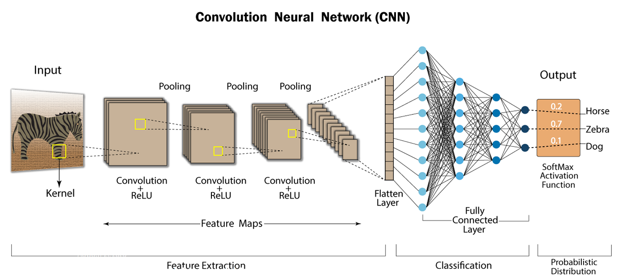

Slide 2
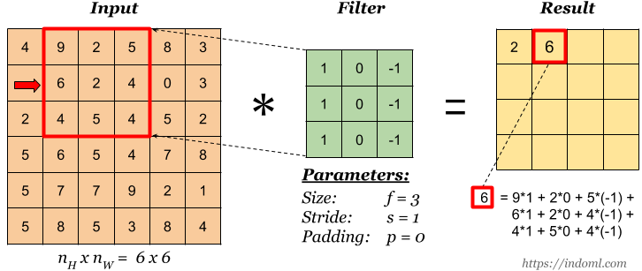
convolution operation

Slide 3
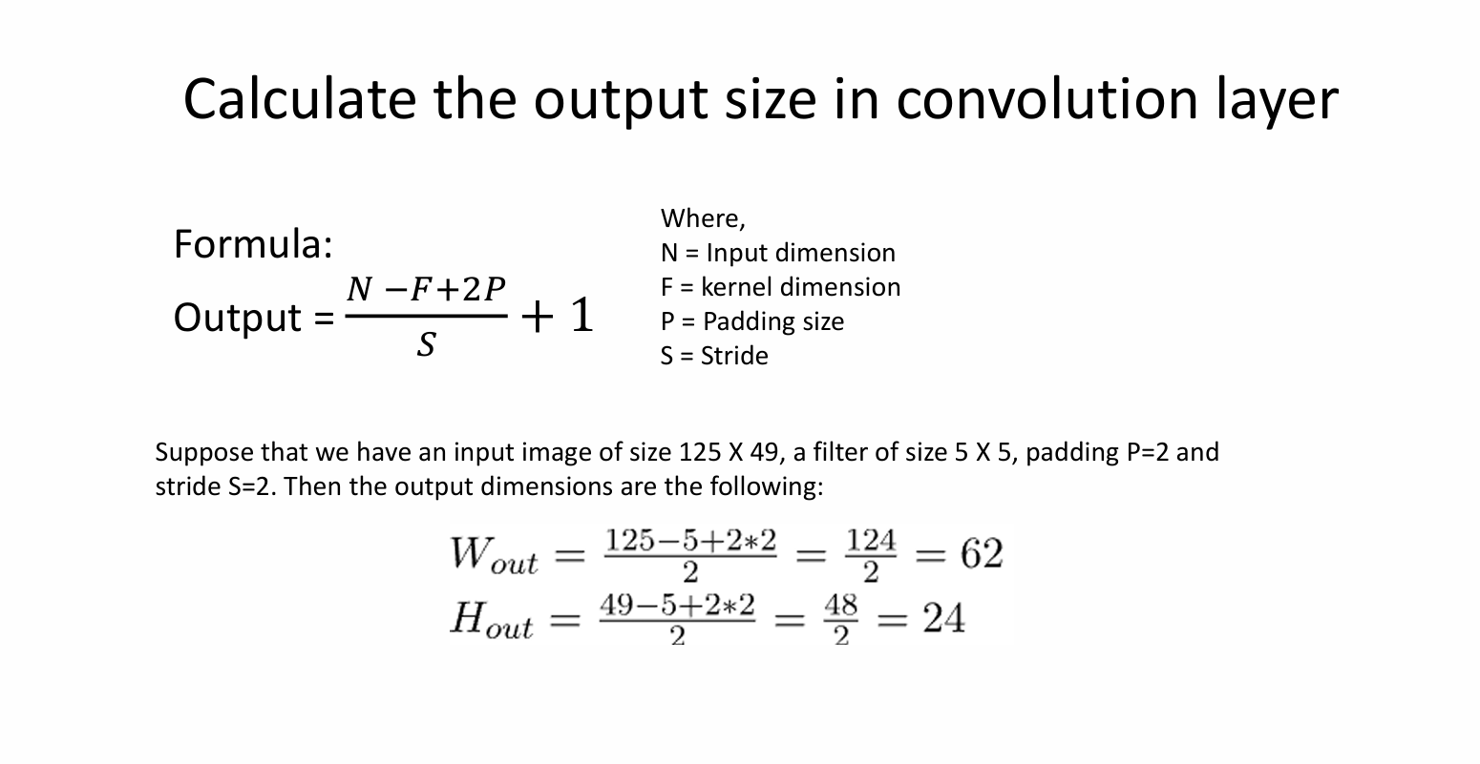

Slide 4
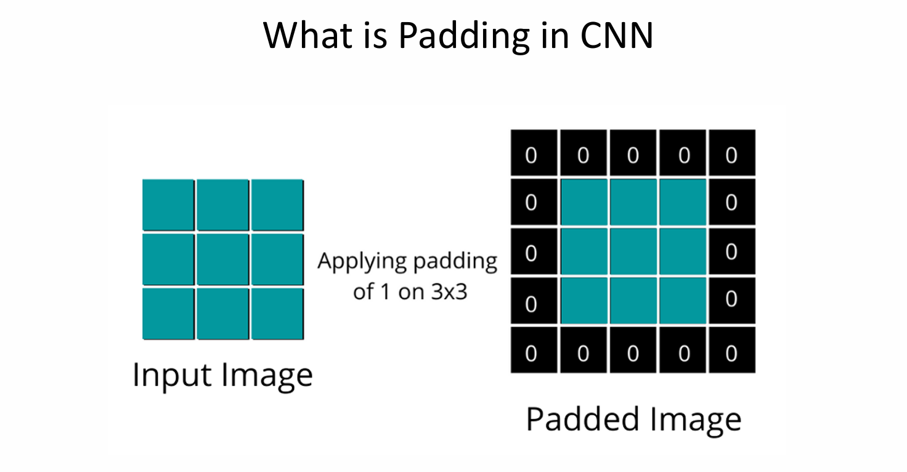

Slide 5
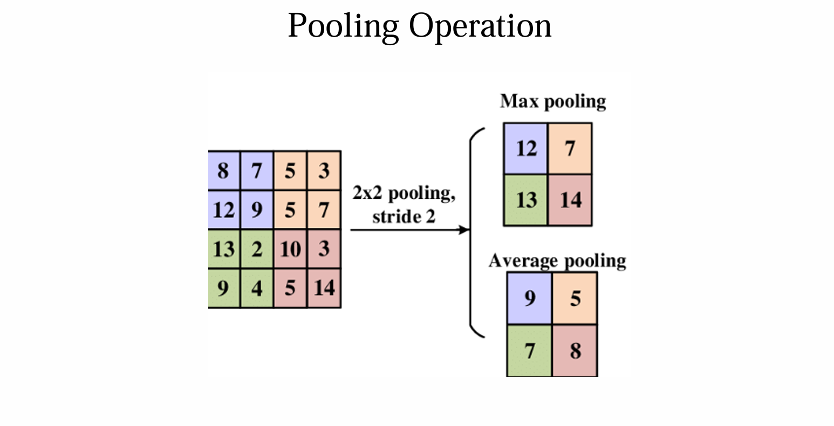

Slide 6
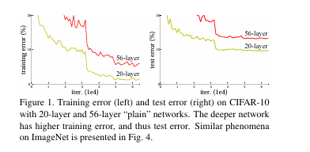
Error in deeper networks

Slide 7
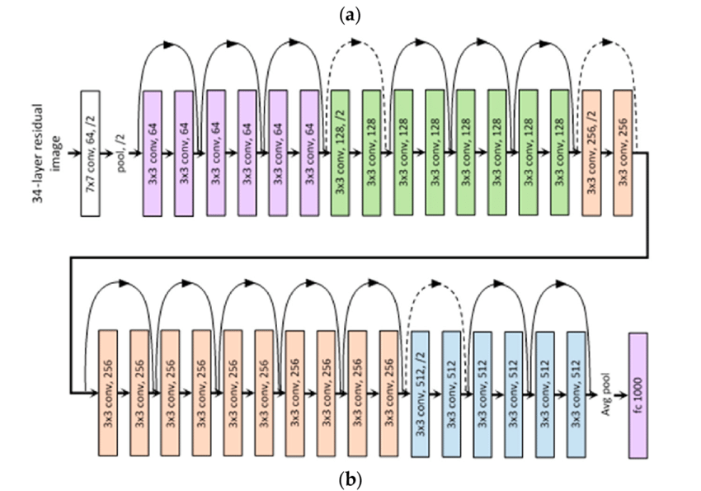
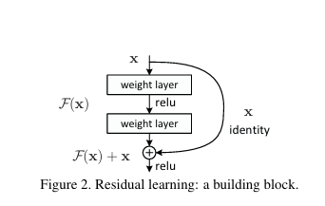
Resnet Architecture

Slide 8
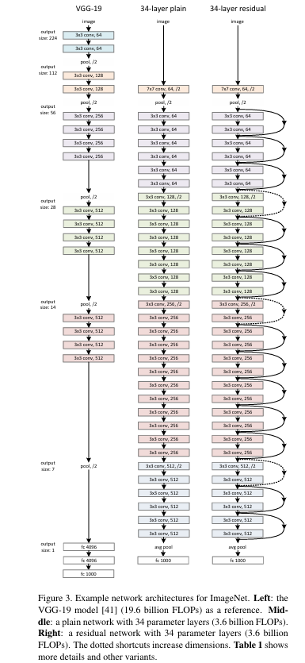
1.Vanishing Gradient Problem
As deep networks grow in depth, gradients tend to shrink (during backpropagation), making it difficult for earlier layers to learn. ResNet's shortcut connections help gradients flow more easily, mitigating this issue.
2.Deeper Networks Improve Accuracy
Deeper networks can learn more complex features, but traditional deep networks often suffer from degradation problems (i.e., deeper networks sometimes perform worse than shallow ones). ResNet enables training of extremely deep networks (e.g., 50, 101, 152 layers) while maintaining high accuracy.
3.Residual Learning for Easier Optimization
Instead of learning a direct mapping H(x), ResNet learns the residual function: F(x)=H(x)−x So, the network actually learns the difference (or "residual") between the input and output, making optimization easier.
4.Skip Connections for Efficient Training
The identity shortcut connection ensures that information is not lost, preventing degradation in accuracy.Even if certain layers do not learn useful features, the shortcut ensures that at least the original input is preserved

Slide 9
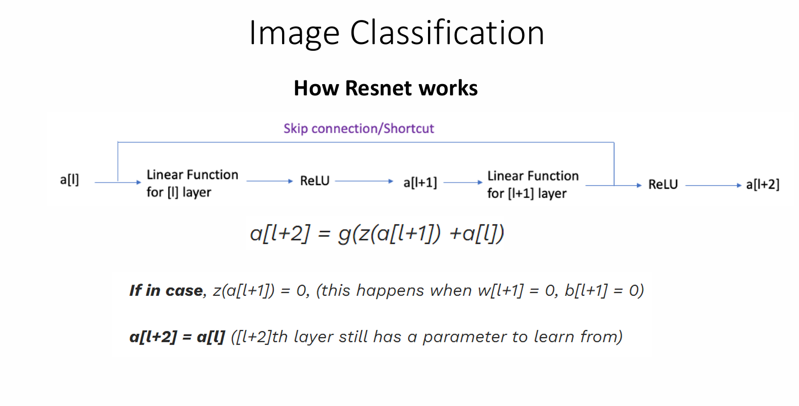

Slide 10
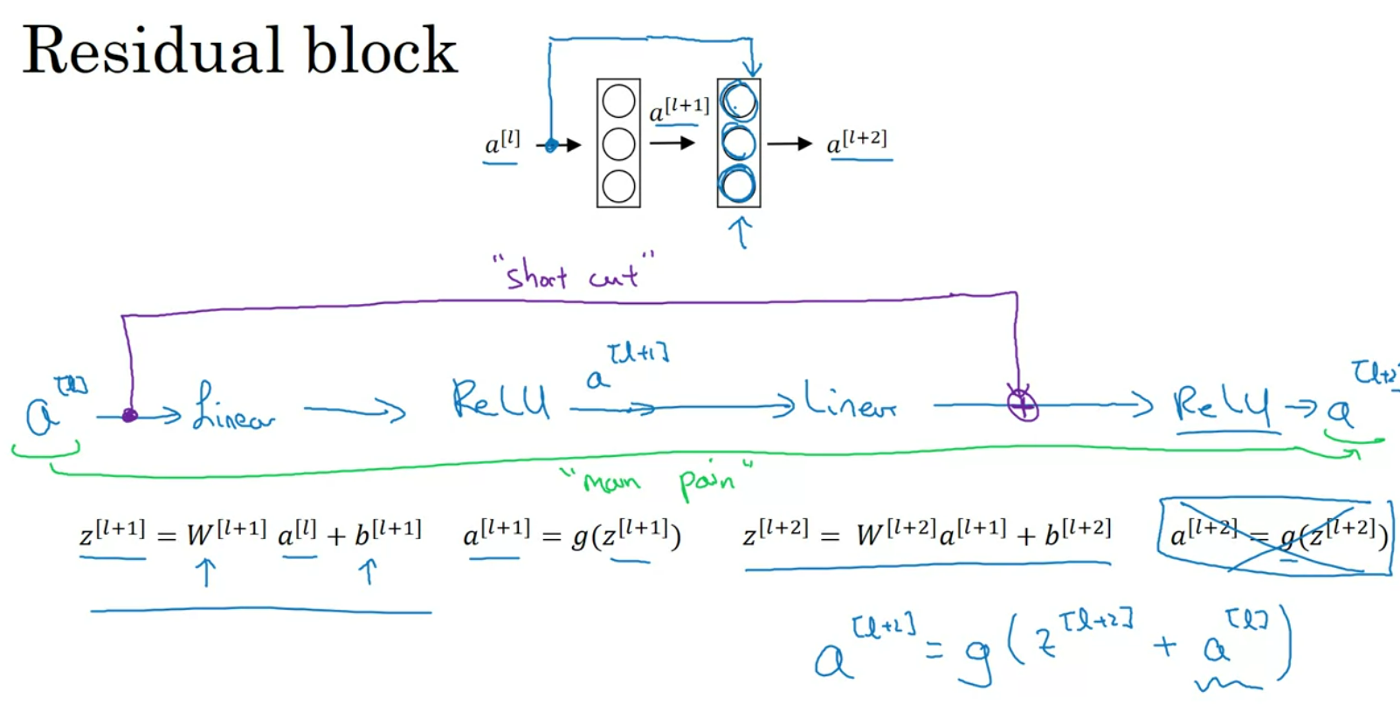

Slide 11
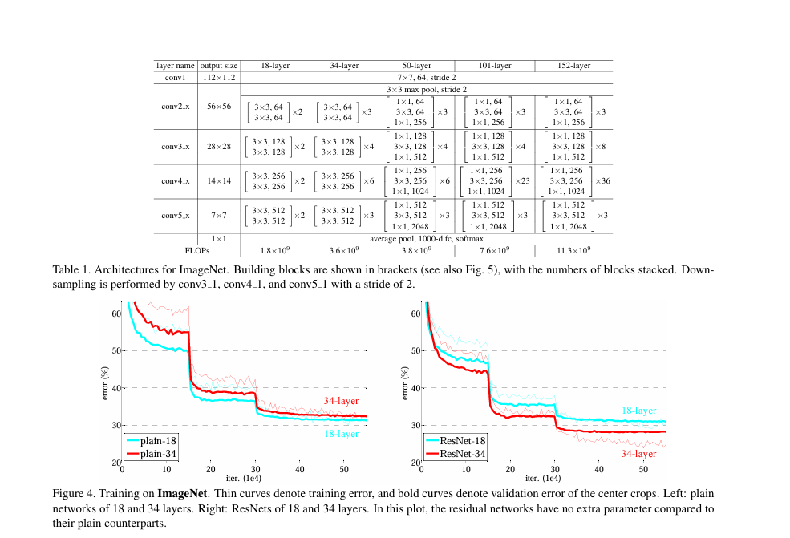
Architectures for Imagenet

Slide 12
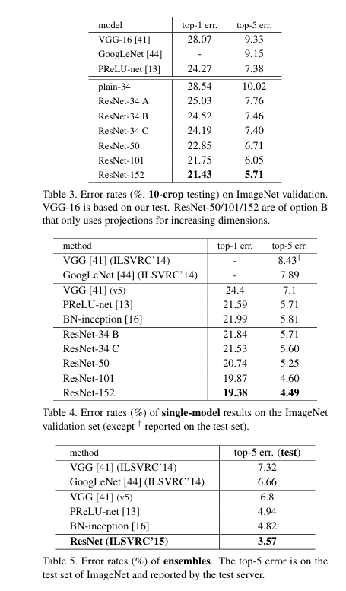
Comparisons with Imagenet,
VGG on deeper systems.

Slide 13
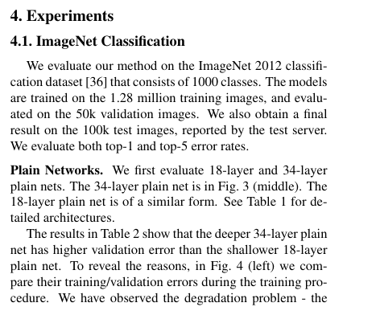
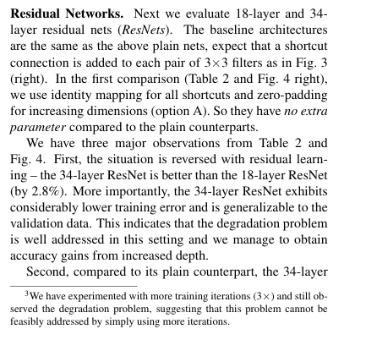
System Configuration

