Slide 1

Microeconomics –ECO402 VU
Lesson 1
ECONOMICS
 Economics is the study of how societies use scarce resources to produce valuable
commodities and distribute them among different people.
 Microeconomics deals with:
• Behavior of individual units
• When Consuming; How we choose what to buy
• When Producing; How we choose what to produce
• Markets: The interaction of consumers and producers
• Analysis of aggregate issues:
y Economic growth
y Inflation
y Unemployment
Microeconomics vs. Macroeconomics
Microeconomics is the foundation of macroeconomic analysis.
Themes of Microeconomics
 According to Mick Jagger & the Rolling Stones, “You can’t always get what you want”.
Why Not?
 Limited Resources
 Unlimited Wants
 Allocation of Scarce Resources and Trade-offs
 In a planned economy
 In a market economy
 Microeconomics and Optimal Trade-offs
1. Consumer Theory
2. Workers
3. Theory of the Firm
 Microeconomics and Prices
– The role of prices in a market economy
– How prices are determined
Theories and Models
 Microeconomic Analysis
– Theories are used to explain observed phenomena in terms of a set of basic
rules and assumptions. For example
– The Theory of the Firm
– The Theory of Consumer Behavior
– Models:
A mathematical representation of a theory used to make a prediction.
– Validating a Theory
The validity of a theory is determined by the quality of its prediction, given
the assumptions.
– Evolving the Theory
Testing and refining theories is central to the development of the science of
economics.
Positive versus Normative Economics
 Positive Economics
Positive economics deals with the observations or predictions of the facts of
economic life. For example:
What will be the impact of an increase in wages on the price of a product?
© Copyright Virtual University of Pakistan 1

Slide 2

Microeconomics –ECO402 VU
 Normative Economics
Normative Economics is the value judgments about how economics should
operate, based on certain moral principles or preferences?” For example:
What wage rate should be paid to the auto workers to make them an active
member of the society?
What is a Market?
 Markets
A geographically defined area where buyers and sellers interact to determine the
price of a product or a set of products.
 Markets vs. Industries
Industries are the supply side of the market.
 Defining the Market
The market parameters must be set before an analysis of the market can take
place.
 Arbitrage
Buying a product at a low price in one location and selling at a high price in
another.
 Competitive vs. Noncompetitive Markets
– Competitive Markets
 Because of the large number of buyers and sellers, no individual buyer
or seller can influence the price.
 Example: Most agricultural markets
– Noncompetitive Markets
 Markets where individual producers can influence the price.
 Example: OPEC
 Market Price
– Competitive markets establish one price.
– Noncompetitive markets may set many prices for the same product.
 Market Definition - The Extent of a Market
– Market Definition
Which buyers and sellers should be included in a given market?
– Market Extent
Defines the boundaries of the market
 Geographic
 Range of products
– Examples
– Geographic boundaries
 Gold: Lahore vs. Karachi
 Housing: Islamabad vs. Rawalpindi
– Range of Products
 Gasoline: regular, super, & diesel
 Cameras: Polaroid, point & shoot, digital
– Markets for Prescription Drugs
 Well-defined markets - therapeutic drugs
 Ambiguous markets – painkillers
© Copyright Virtual University of Pakistan 2

Slide 3
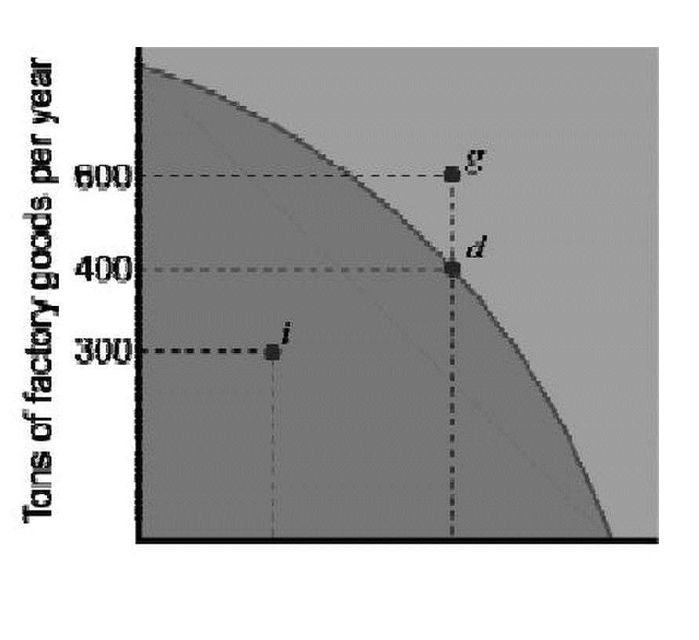
Microeconomics –ECO402 VU
Lesson 2
Economics; Another Perspective
 Economics is the study of the choices made by people who are faced with scarcity.
 Scarcity is a situation in which resources are limited but can be used in different ways;
so one good or service must be sacrificed for another.
Society’s Choices
 The decisions of producers, consumers and government determine how an economic
system answers three fundamental questions:
1. What products do we produce?
2. How do we produce these products?
3. Who consumes the products?
Factors of Production
Factors of production are the resources that are used to produce goods and services:
1. Natural resources:
The things created by acts of nature such as land, water, mineral, oil and gas
deposits, renewable and nonrenewable resources.
2. Labor:
The human effort, physical and mental, used by workers in the production of goods
and services.
3. Physical capital.
All the machines, buildings, equipment, roads and other objects made by human
beings to produce goods and services.
4. Human capital:
The knowledge and skills acquired by a worker through education and experience.
5. Entrepreneurship:
The effort to coordinate the production and sale of goods and services.
Entrepreneurs take risk and commit time and money to a business without any
guarantee of profit.
The Production Possibilities Frontier
(PPF)
The PPF curve shows the possible
combinations of goods and services
available to an economy, given that all
productive resources are fully and efficiently
employed.
When the economy is at point i, resources
are not fully employed and/or they are not
used efficiently. Point g is desirable because
it yields more of both goods, but not
attainable given the amount of resources
available. Point d is one of the possible
combinations of goods produced when
resources are fully and efficiently employed.
© Copyright Virtual University of Pakistan 3

Slide 4
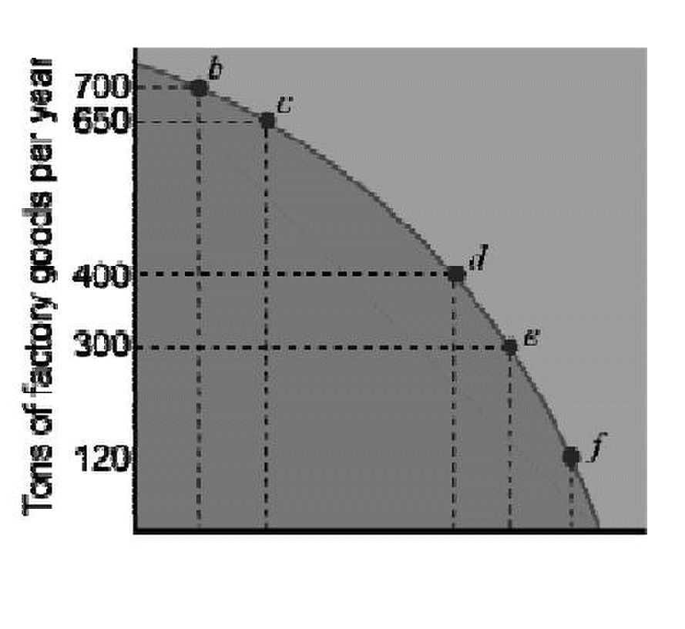

Microeconomics –ECO402 VU
Scarcity and the PPF
To increase the amount of farm goods by
10 tons, we must sacrifice 100 tons of
factory goods.
The PPF curve is bowed out because
resources are not perfectly adaptable to the
production of the two goods. As we
increase the production of one good, we
sacrifice progressively more of the other.
Shifting the PPF Curve
To increase the production of one good
without decreasing the production of the
other, the PPF curve must shift outward.
The PPF curve shifts outward as a result of
an increase in the economy’s resources OR
a technological innovation that increases
the output obtained from a given amount of
resources. From point d, an additional 200
tons of factory goods or 20 tons of farm
goods are now possible (or any
combination in between).
© Copyright Virtual University of Pakistan 4

Slide 5





Microeconomics –ECO402 VU
Lesson 3
REAL VERSUS NOMINAL PRICES
 Nominal price is the absolute or current dollar price of a good or service when it is sold.
 Real price is the price relative to an aggregate measure of prices or constant dollar
price.
 The Consumer Price Index (CPI) is an aggregate measure. Real prices are
emphasized to permit the analysis of relative prices.
 Calculating Real Prices
Real Price = x
current year
Calculating the Real Price of Milk
Nominal Price Real Price of Milk
Year of Milk CPI in 1970 dollars
1970 .40 38.8 .40=38.8/38.8x .40
1980 .65 82.4 .31=38.8/82.4x .65
1999 1.05 167.0 .24=38.8/167.0x 1.05
Calculating Real Prices: An Example - Eggs & College
Real Price
Real Price of
College Education
1970 1975 1980 1985 1990 1998
Consumer
Price Index 38.3 53.8 82.4 107.6 130.7 163.0
(1983 = 100)
Nominal Prices ($)
Grade A
Large Eggs
College
Education
Real Prices ($1970)
Grade A
Large Eggs
College
Education
© Copyright Virtual University of Pakistan 5
CPI
CPI
of Eggs
1998 (1970 = 100)
1998 (1970 = 100)
0.61 0.77 0.84 0.80 0.98 1.04
2530 3403 4912 8156 12800 19213
0.61 0.56 0.40 0.29 0.30 0.25
2530 2454 2313 2941 3800 4573
base year
current year
= x 1.04
=
Nominal Price
38.8
163
38.8
163.0
x $19,213 $4,573
=

Slide 6
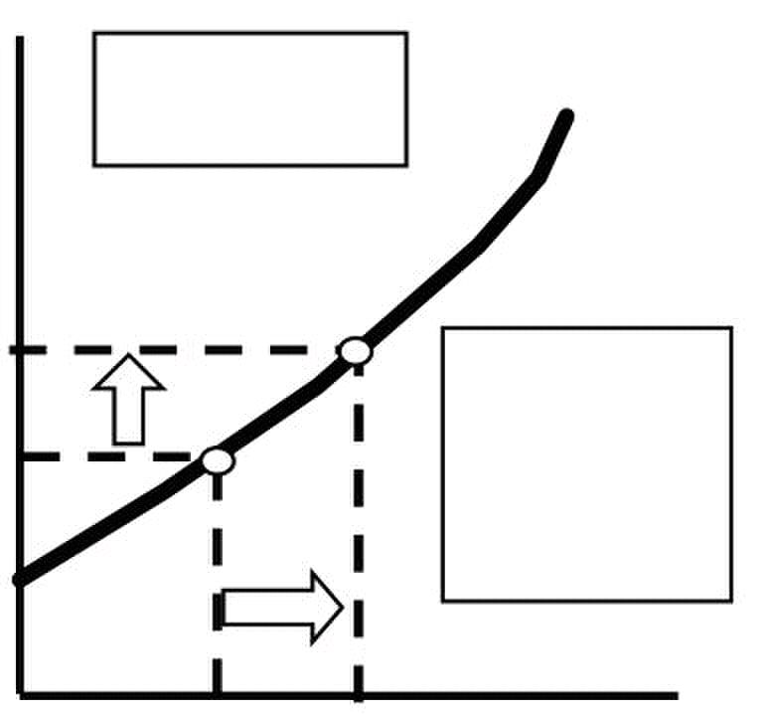

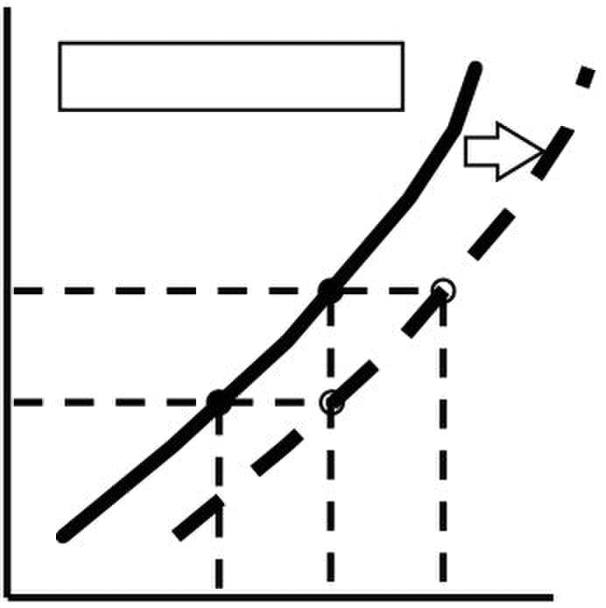
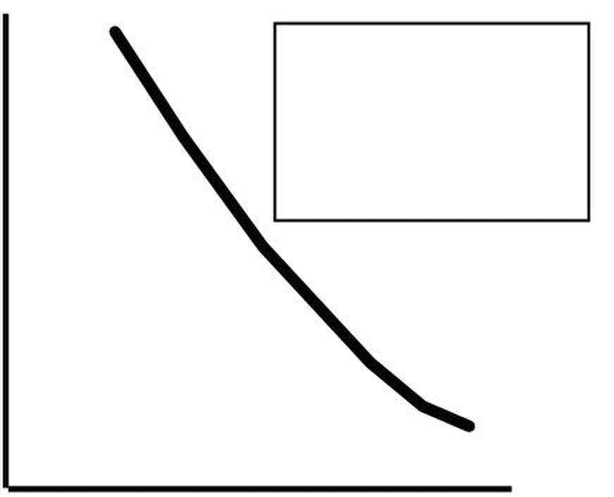

Microeconomics –ECO402 VU
SUPPLY AND DEMAND
 The Supply Curve
– The supply curve shows how much of a per unit)
good producers are willing to sell at a
given price, holding constant other
factors that might affect quantity supplied
– This price-quantity relationship can be
shown by the equation:
Q s = Q ( P
output.
Q1 Q2 Quantit
P
 Non-price Determining Variables of Supply Change in Supply
– Costs of Production
• Labor
• Capital
• Raw Materials
 The cost of raw materials falls
– At P1, produce Q2
– At P2, produce Q1
– Supply curve shifts right to S’
– More produced at any price on S’ than on S
Q0 Q1 Q
Supply - A Review
– Supply is determined by non-price supply-determining variables as such as the cost of
labor, capital, and raw materials.
– Changes in supply are shown by shifting the entire supply curve.
– Changes in quantity supplied are shown by movements along the supply curve and are
caused by a change in the price of the product.
 The Demand Curve
– The demand curve shows how much of a good
consumers are willing to buy as the price per unit
changes holding non-price factors constant.
– This price-quantity relationship can be shown by the product becomes relatively
equation: real income increases
Q D = Q (P)
D
Quantity
© Copyright Virtual University of Pakistan 6
Price ($
Curve
Graphically
P2
slopes upward
S
S
P1
P2
Q
Price ($
per
unit)
more at a lower price as
cheaper and the consumer’s
D
The Supply S
The supply curve
)
S’
The demand curve slopes
downward demonstrating that
consumers are willing to buy
demonstrating
that at higher
P1
irms will increase

Slide 7
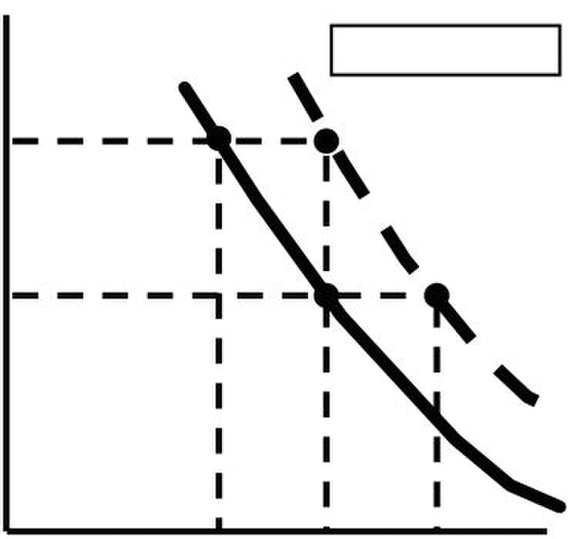
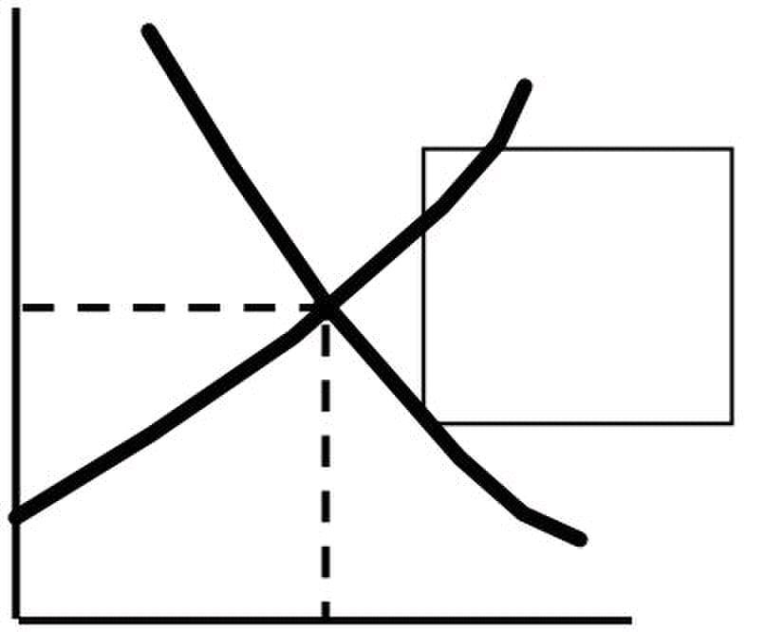
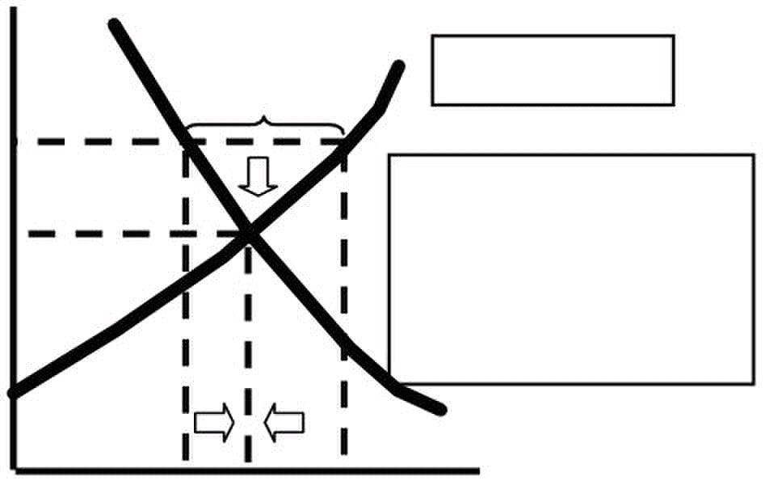
Microeconomics –ECO402 VU
 Non-price Determining Variables of P
Demand D
– Income
– Consumer Tastes
– Price of Related Goods
• Substitutes
• Complements
 Income Increases
– At P1, produce Q2
– At P2, produce Q1
– Demand Curve shifts right
– More purchased at any price on D’
than on D
 Demand - A Review
– Demand is determined by non-price demand-determining variables, such as,
income, price of related goods, and tastes.
– Changes in demand are shown by shifting the entire demand curve.
– Changes in quantity demanded are shown by movements along the demand
curve.
The Market Mechanism Price
 Characteristics of the equilibrium or market
clearing price:
– QD = QS The curves intersect
– No shortage
– No excess supply
– No pressure on the price to change
demanded at Q0 .
D
Q0 Quantity
 The market price is above equilibrium
– There is excess supply
– Producers lower prices
– Quantity demanded increases and
quantity supplied decreases 1) Qs : Q1 > Qd : Q2
– The market continues to adjust until
the equilibrium price is reached. 4) Quantity supplied decreases
increases.
5) Equilibrium at P2Q3
D
Q1
© Copyright Virtual University of Pakistan 7
Change in Demand
Q2 Q
S
price. At P0 the
quantity supplied is
S
2) Excess supply is Q1:Q2.
Q2
D’
P2
P1
Q0 Q1
($ per
unit)
at equilibrium, or
market clearing,
P0
equal to the quantity
Price
($ per
unit)
Surplus
P1
Assume the price is P1,then:
P2
3) Producers lower price.
and quantity demanded
Q3
A Surplus
Quantity

Slide 8
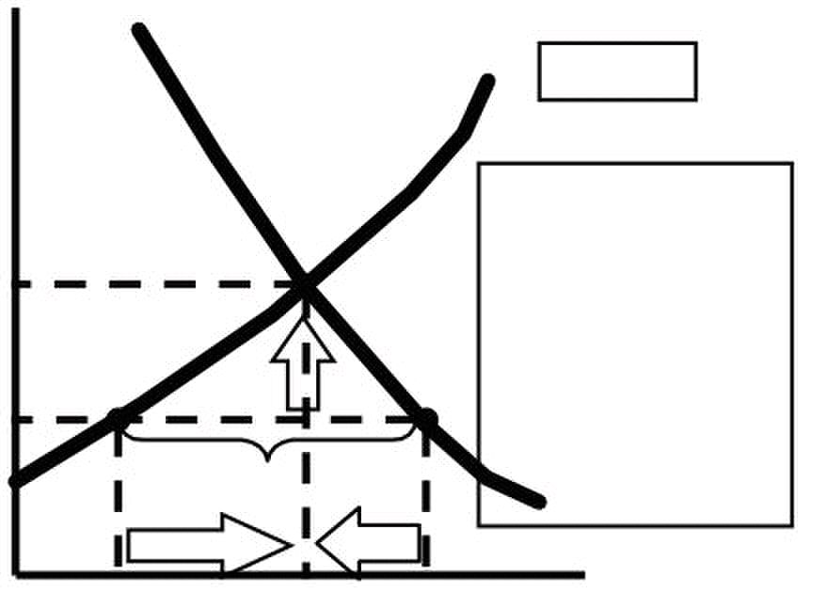
Microeconomics –ECO402 VU
 The market price is below equilibrium:
– There is a shortage ($ per
– Producers raise prices
– Quantity demanded decreases and
quantity supplied increases
– The market continues to adjust until the
new equilibrium price is reached. 3) Producers raise
price.
4) Quantity supplied
P2 increases and quantity
demanded decreases.
Shortage
Q1 Q3 Q2
 Market Mechanism Summary
1) Supply and demand interacts to determine the market-clearing price.
2) When not in equilibrium, the market will adjust to alleviate a shortage or
surplus and return the market to equilibrium.
3) Markets must be competitive for the mechanism to be efficient.
© Copyright Virtual University of Pakistan 8
Price
unit)
Assume the price is
P2,:
P3
5) Equilibrium at P
Quantity
S
1) Qd : Q2 > Qs : Q1
2) Shortage is Q1:Q2.
D
Shortage
3 3
, Q

Slide 9
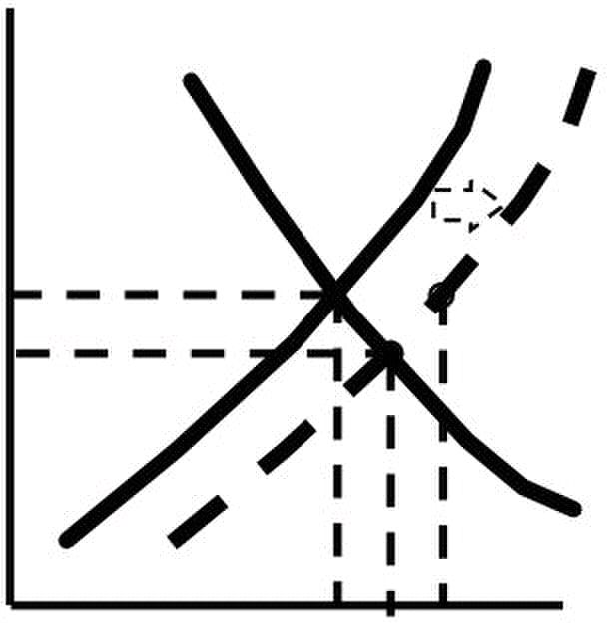
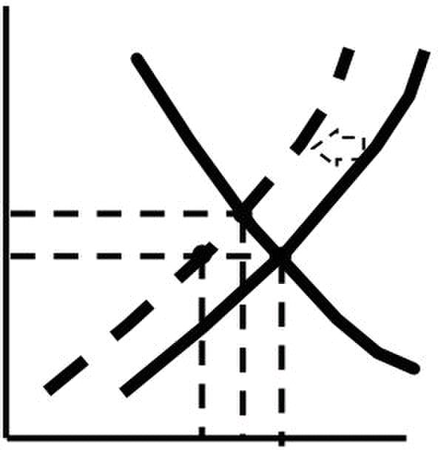
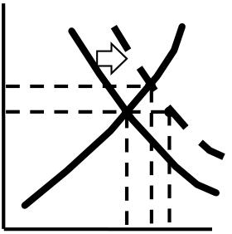
Microeconomics –ECO402 VU
Lesson 4
Changes in Market Equilibrium
 Equilibrium prices are determined by the relative level of supply and demand.
 Supply and demand are determined by particular values of supply and demand
determining variables.
 Changes in any one or combination of these variables can cause a change in the
equilibrium price and/or quantity.
P
 Raw material prices fall
– S shifts to S’
– Surplus @ P1 of Q1, Q2
– Equilibrium @ P3, Q3
P1
P3
Q1 Q3 Q2 Q
P
Raw material prices Rise
– S shifts to S’
– Shortage @ P1 of Q1, Q2
– Equilibrium @ P3, Q3
P3
P1
Q2 Q3 Q1 Q
Income Increases
– Demand shifts to D’ Shortage @ P1 of
Q1, Q2
– Equilibrium @ P3, Q3
P3
P1
Q1 Q3 Q2 Q
© Copyright Virtual University of Pakistan 9
D
D S
P
S’
S’
D D’ S

Slide 10
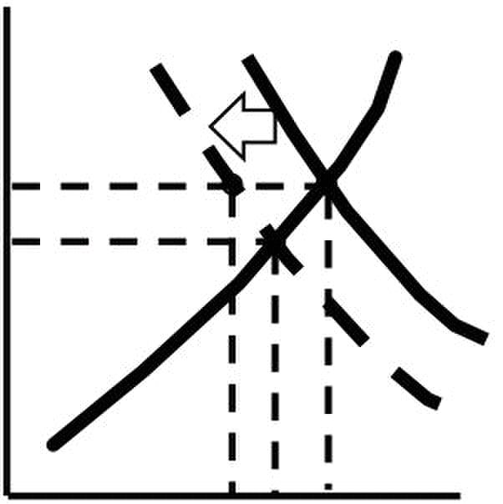
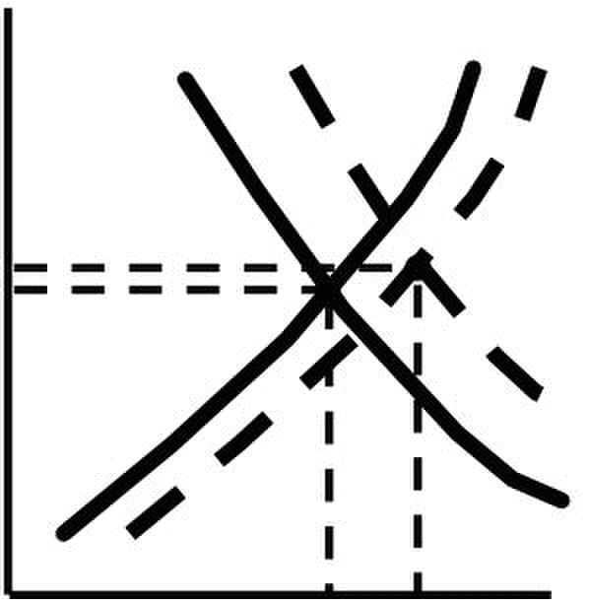
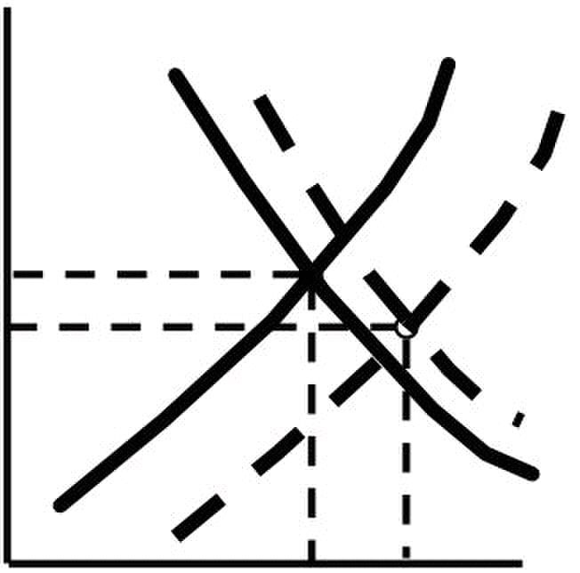
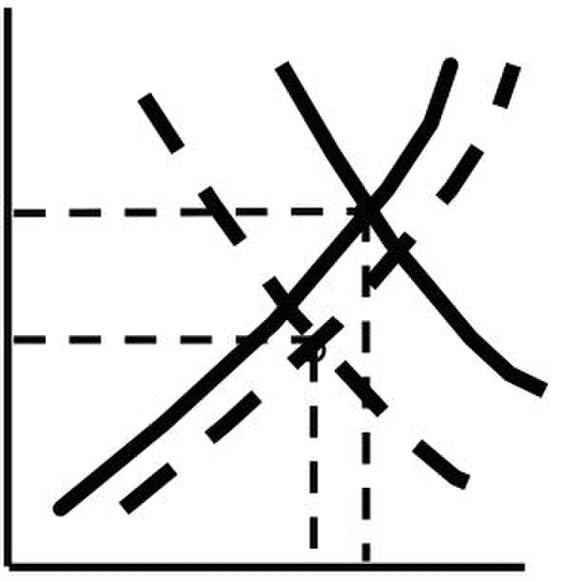
Microeconomics –ECO402 VU
Income Decreases
– Demand shifts to D’
– Surplus @ P1 of Q1, Q2
– Equilibrium @ P3, Q3 P1
P3
Q2 Q3 Q1 Q
Income Increases & raw material prices fall
– The increase in D is greater than the increase
in S
– Equilibrium price and quantity increase to P2,
Q2
P2
P1
Q1 Q2 Q
 Income Increases & raw material prices fall
– The increase in D is less than the increase in
S
– Equilibrium price decrease to P2and quantity
increase to Q2
P2
Q1
 Income Decreases & raw material prices Fall D
– The decrease in D is greater than the
increase in S
– Equilibrium price and quantity decrease to P2
Q2
P2
Q2 Q1
© Copyright Virtual University of Pakistan 10
P
P
P
D’ S’
P1
Q2
P
D’
P1
Q
D’ D S
D D’ S S’
D S
Q
S S’

Slide 11
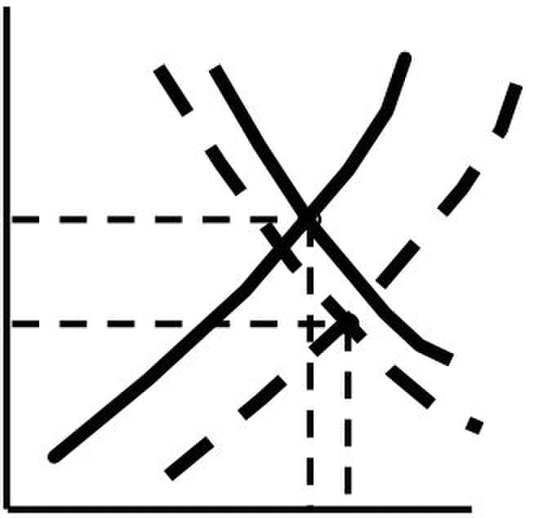
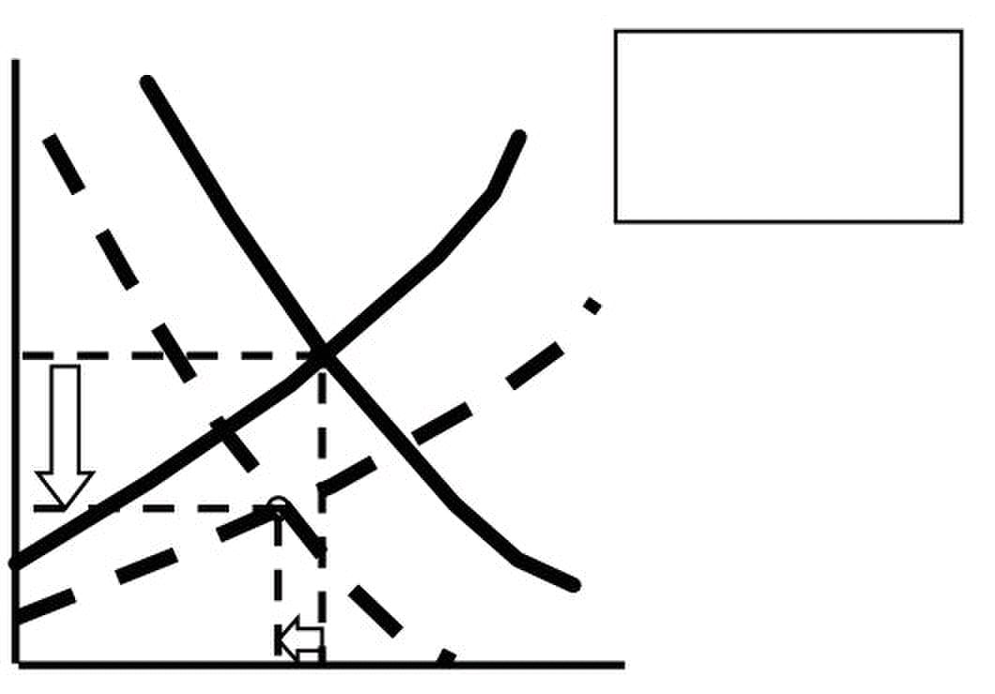
Microeconomics –ECO402 VU
 Income decreases & raw material prices fall
– The decrease in D is less than the S’
increase in S
– Equilibrium price decrease to P2 and
quantity increase to Q2
P1
P2
Shifts in Supply and Demand
 When supply and demand change simultaneously, the impact on the equilibrium price
and quantity is determined by:
1) The relative size and direction of the change
2) The shape of the supply and demand curves
The Prices of Eggs & Education Revisited
 The real price of eggs fell 59% from 1970 to 1998.
 Supply increased due to the increased mechanization of poultry farming and the
reduced cost of production.
 Demand decreased due to the increasing consumer concern over the health and
cholesterol consequences of eating eggs.
Market for Eggs
P
(1970
dollars per
dozen)
S1998
$0.61
$0.26
D1970
D1998
5,300 5,500 Q (million dozens)
Price of College Education
 The real price of a college education rose 68 percent from 1970 to 1995.
 Supply decreased due to higher costs of equipping and maintaining modern
classrooms, laboratories and libraries, and higher faculty salaries.
 Demand increased due a larger percentage of a larger number of high school
graduates attending college.
© Copyright Virtual University of Pakistan 11
P
Q1 Q2 Q
Prices fell until
S1970 a new equilibrium
and a quantity
of 5,300 million dozen
D’ S
was reached at $0.26
D

Slide 12
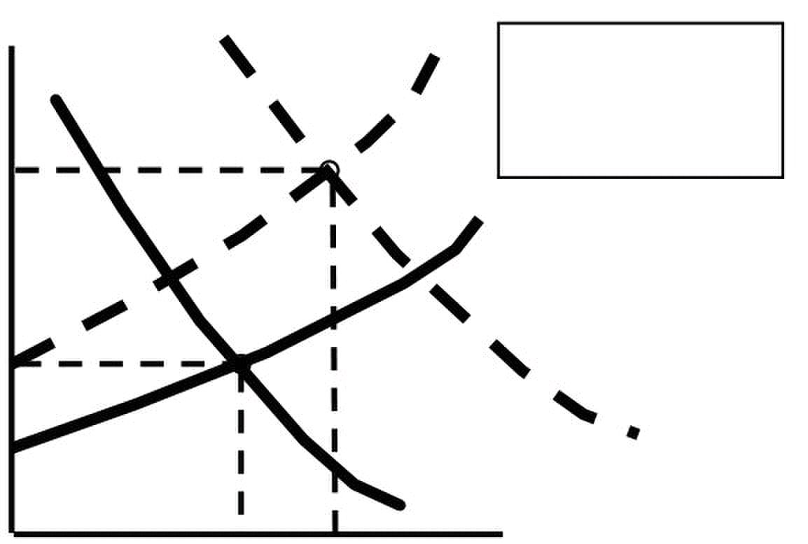
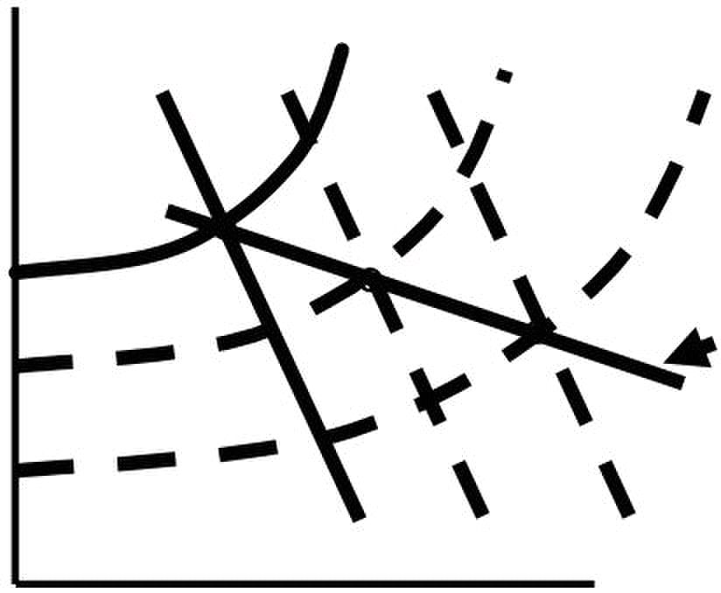
Microeconomics –ECO402 VU
Market for College Education
(annual cost
in 1970 a new equilibrium
dollars) was reached at $4,573
and a quantity
$4,573
S1970
$2,530
D1995
D1970
8.6 12.3
The Long-Run Behavior of Natural Resource Prices
 Observations
– Consumption of copper has increased about a hundred fold from 1880 through
1998 indicating a large increase in demand.
– The real price for copper has remained relatively constant.
Changes in Market Equilibrium
Price S1900
Long-Run Path of
Price and
D1900 D1950 D1998
Quantity
 Conclusion
– Decreases in the costs of production have increased the supply by more than
enough to offset the increase in demand.
© Copyright Virtual University of Pakistan 12
P
of 12.3 million students
Q (millions of students enrolled)
S1950
S1995
S1998
Prices rose until

Slide 13





Microeconomics –ECO402 VU
Factors Shifting Demand Curve
Factors Changing Effect on Direction of Effect on Effect on
Demand Demand Shift in Equilibrium Equilibrium
Demand Curve Price Quantity
Increase in income Increase Rightward Increase Increase
(normal good)
Decrease in Decrease Leftward Decrease Decrease
income(normal good)
Increase in income Decrease Rightward Decrease Decrease
(inferior good)
Decrease in Increase Rightward Increase Increase
income(inferior good)
Increase in price of Increase Rightward Increase Increase
Substitute
Decrease in price of Decrease Rightward Decrease Decrease
substitute
Increase in price of Decrease Leftward Decrease Decrease
complement
Decrease in price of Increase Rightward Increase Increase
complement
Increase in taste and Increase Rightward Increase Increase
preference for good
Decrease in taste and Decrease Leftward Decrease Decrease
preference for good
Increase in number of Increase Rightward Increase Increase
consumers
Decrease in number of Decrease Leftward Decrease Decrease
consumers
Factors Shifting Supply Curve
Factors Changing Effect on Direction of Effect on Effect on
Supply Supply Shift in Supply Equilibrium Equilibrium
Curve Price Quantity
Increase in resource Decrease Leftward Increase Decrease
price
Decrease in resource Increase Rightward Decrease Increase
price
Improved technology Increase Rightward Decrease Increase
Decline in technology Decrease Leftward Increase Decrease
Expect a price increase Decrease Leftward Increase Decrease
Expect a price decrease Increase Rightward Decrease Increase
Increase in number of Increase Rightward Decrease Increase
suppliers
Decrease in number of Decrease Leftward Increase Decrease
suppliers
© Copyright Virtual University of Pakistan 13

Slide 14

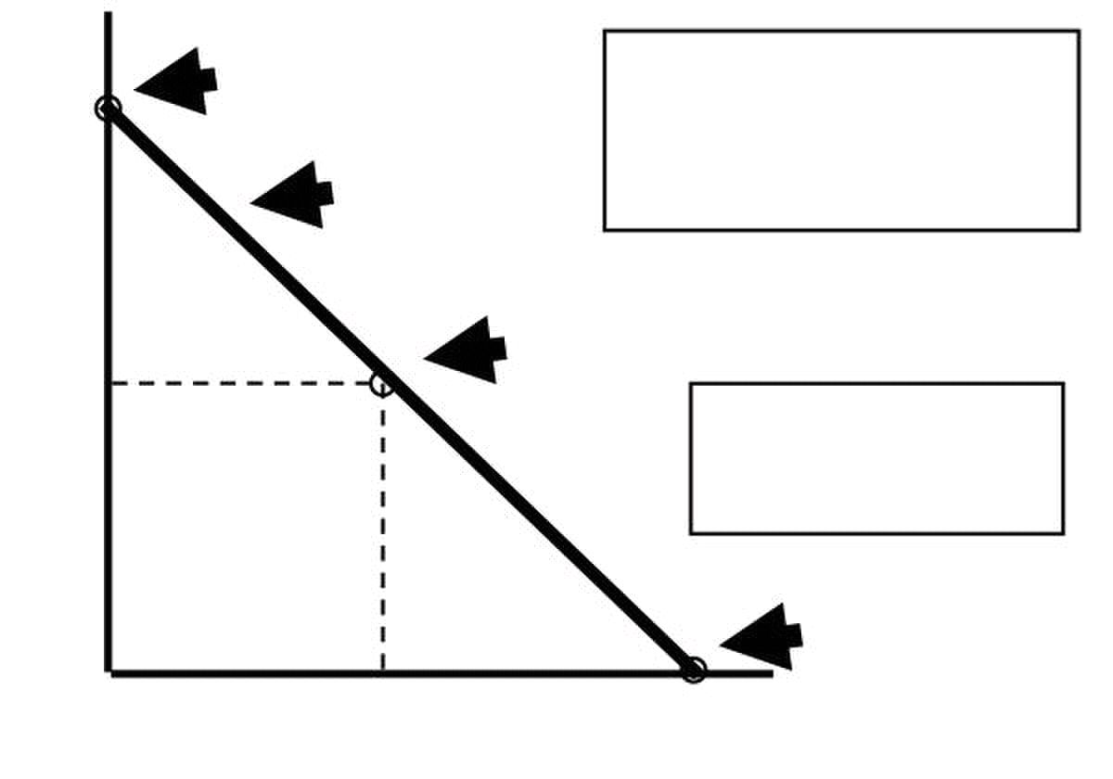
Microeconomics –ECO402 VU
ELASTICITIES OF SUPPLY AND DEMAND
 Generally, elasticity is a measure of the sensitivity of one variable to another.
 It tells us the percentage change in one variable in response to a one percent change
in another variable.
 Price Elasticity of Demand
 Measures the sensitivity of quantity demanded to price changes.
 It measures the percentage change in the quantity demanded for a good or
services that results from a one percent change in the price of that good or
service.
 The price elasticity of demand is:
Percentage change in Quantity Demanded
Percentage change in Price
E P = (% Δ Q)/(% Δ P)
– The percentage change in a variable is the absolute change in the variable
divided by the original level of the variable.
– So the price elasticity of demand is also:
E
 Interpreting Price Elasticity of Demand Values
1) Because of the inverse relationship between P and Q; EP is negative.
2) If IEPI > 1, the percent change in quantity is greater than the percent
change in price. We say the demand is price elastic.
3) If IEPI < 1, the percent change in quantity is less than the percent
change in price. We say the demand is price inelastic.
 The primary determinant of price elasticity of demand is the availability of substitutes.
– Many substitutes demand is price elastic
– Few substitutes demand is price inelastic
–
Price Elasticities of Demand
Price
4
curve is less elastic than the
Q = 8 - 2P
Ep = -1
2
Q = a - bP
Q = 8 - 2P
Ep = 0
4 8
© Copyright Virtual University of Pakistan 14
Δ P Q
Δ P/P Q Δ P
Δ
Q/Q
P
Ep = ∞ The lower portion of a
_
downward sloping demand
upper portion.
Linear Demand Curve
Q
= =

Slide 15
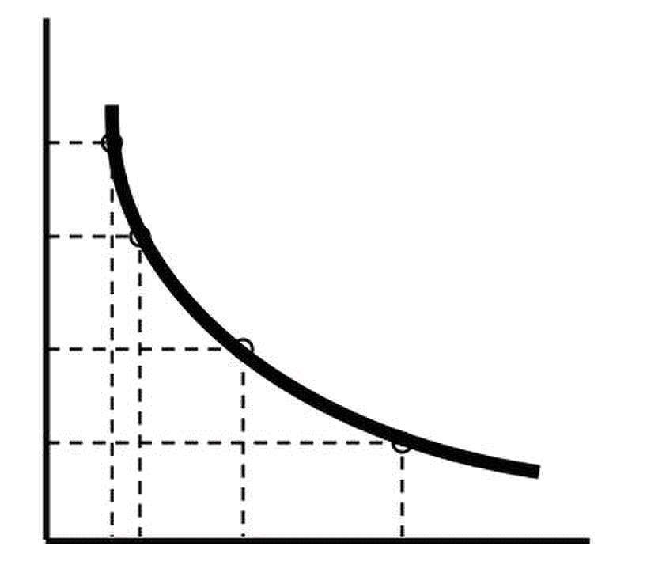

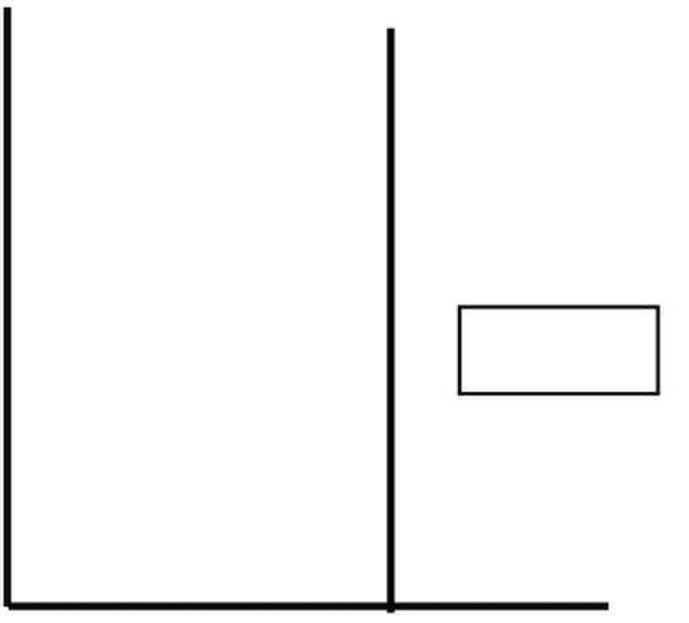
Microeconomics –ECO402 VU
Price
12
9
Ep = -1
6 Ep = -0.4
3 D
0 2 3 6 10
Price
Infinitely Elastic Demand
Quantity
Price
EP = 0
Q* Quantity
© Copyright Virtual University of Pakistan 15
A
B
C
D
Q
Completely Inelastic Demand
Ep = -3

Slide 16

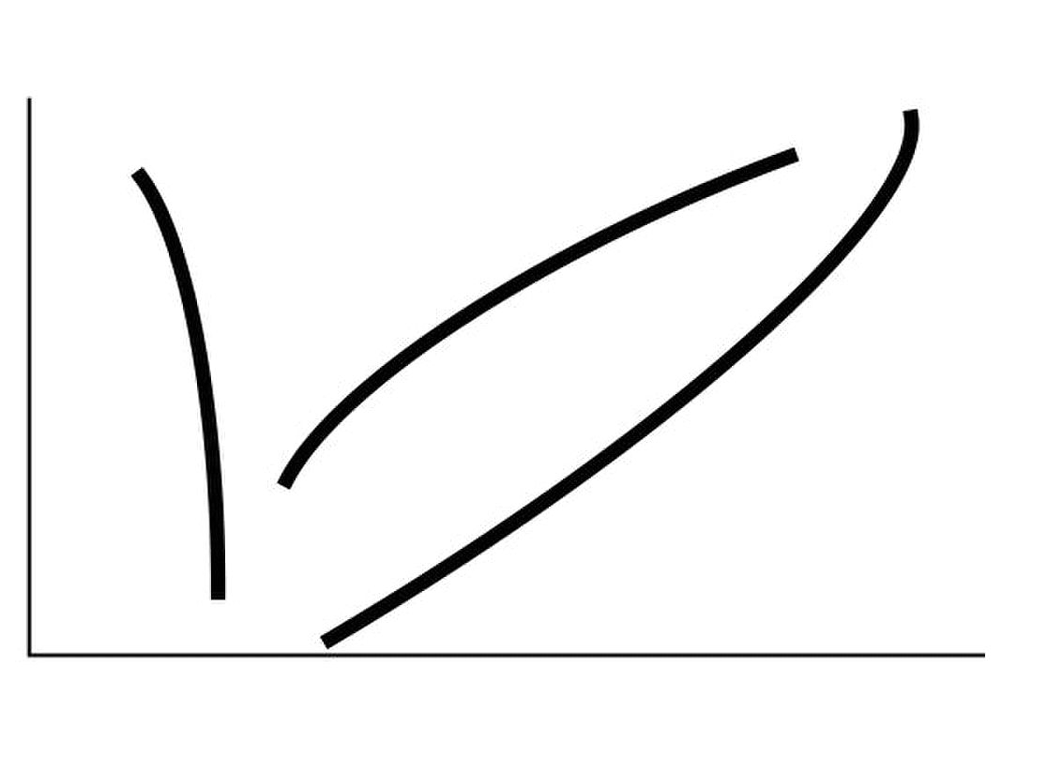
Microeconomics –ECO402 VU
LESSON 5
Elasticities of supply and demand
 Other Demand Elasticities
– Income elasticity of demand measures the percentage change in quantity
demanded resulting from a one percent change in income.
 The income elasticity of demand is:
E
 Income Elasticity of Demand
for:
– Normal goods less than 1 (but
– Superior goods greater than 0)
– Inferior goods
Negative
Income
Elasticity
Inferior
goods
goods
Money
Income
 Other Demand Elasticities
– Cross elasticity of demand measures the percentage change in the quantity
demanded of one good that results from a one percent change in the price of
another good.
– For example consider the substitute goods, butter and margarine.
 The cross elasticity of demand is:
E =
m m b
– Cross elasticity for substitutes is positive
– Cross elasticity for complements is negative
♦ Price elasticity of supply
– measures the percentage change in quantity supplied resulting from a 1
percent change in price.
– The elasticity is usually positive because price and quantity supplied are directly
related.
We can refer to elasticity of supply with respect to interest rates, wage rates,
and the cost of raw materials.
Price ($) Quantity Demanded Quantity Supplied
60 22 14
80 20 16
100 18 18
120 16 20
© Copyright Virtual University of Pakistan 16
ΔQ/Q I Δ
ΔI/I Q I
Income Elasticity
P
Q
b b m
=
ΔQ /Q
ΔP /P Q ΔP
I
Quantity
Demanded
Normal goods
Income
Elasticity
greater than 1
superior
Qb m
m
=
P ΔQ
b

Slide 17




Microeconomics –ECO402 VU
 Recall
E
 Elasticity of demand when price is $80 is
Ep = 80/20 x -2/20 = -0.40
 Elasticity of demand when price is $100 is
Ep = 100/18 x -2/20 = -0.56
 Elasticity of supply when price is $80 is
Ep = 80/16 x 2/20 = 0.50
 Elasticity of supply when price is $100 is
Ep = 100/18 x 2/20 = 0.56
 The Market for Wheat
– 1981 Supply Curve for Wheat
– QS = 1,800 + 240P
– 1981 Demand Curve for Wheat
– QD = 3,550 - 266P
– Equilibrium: Q S = Q D
1,800 + 240P = 3,550 − 266P
506P = 1,750
bushel
Q = 1,800 + (240)(3.46) = 2,630 million bushels
E
E
– Assume the price of wheat is $4.00/bushel
Q =
Q =
Supply (Qs) Demand (Qd) Equilibrium Price
Qs = Qd
1981 1800 + 240P 3550 – 266P 1800 + 240P = 3550 – 266P
506P = 1750
P1981 = $3.46 / bushel
1998 1944 + 207P 3244 – 283P 1944 +207P = 3244 – 283P
P1998 = $2.65 / bushel
Short-Run Versus Long-Run Elasticities
 Price elasticity of demand varies with the amount of time consumers have to respond
to a price.
 Most goods and services:
 Short-run elasticity is less than long-run elasticity. (e.g. gasoline, Drs.)
 Other Goods (durables):
 Short-run elasticity is greater than long-run elasticity (e.g. automobiles)
© Copyright Virtual University of Pakistan 17
ΔQ/Q P Q
ΔP/P Q ΔP
P Q
Q ΔP 2,630
P Q
Q P 2,630
− = −0.43
Δ
D
S
Δ
=
= =
=
3,550 (266)(4.00) = 2,486
4.00( 266)
2,486
=
Δ 3.46( 2.66)
Δ
P
P = 3.46/
D
P
S
P
D
D
P
− = −.035 Inelastic
=
3.46(2.40)
= .032 Inelastic

Slide 18
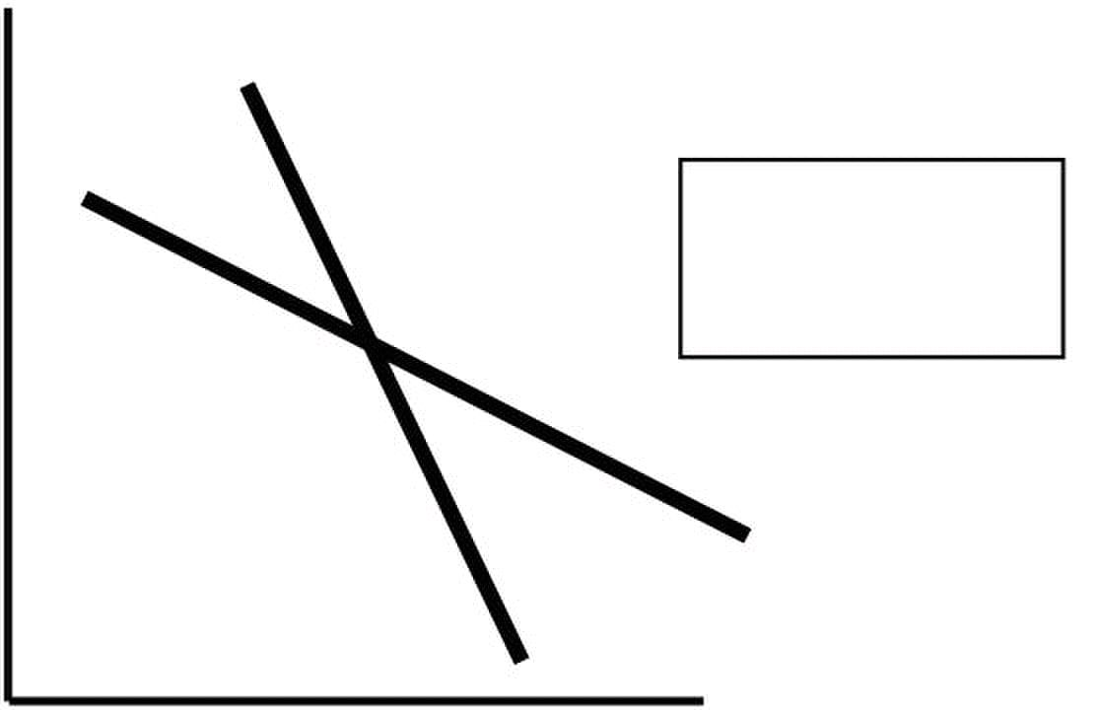
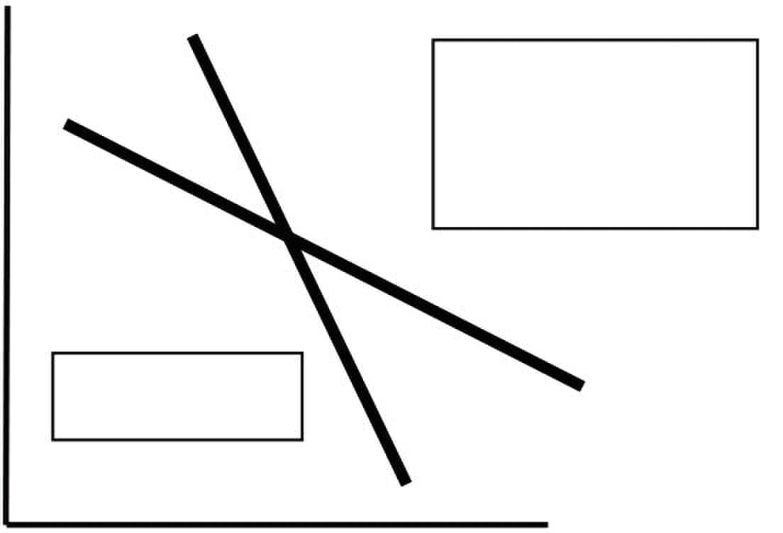
Microeconomics –ECO402 VU
Gasoline: Short-Run and Long-Run Demand Curves
Price DSR
People tend to
drive smaller and
more fuel efficient
cars in the long-run
Gasoline
Quantity
Automobiles: Short-Run and Long-Run Demand Curves
Price
immediate consumption,
but eventually older cars
must be replaced.
Automobiles
Quantity
 Income elasticity also varies with the amount of time consumers have to respond to an
income change.
 Most goods and services:
 Income elasticity is greater in the long-run than in the short run.
 Higher incomes may be converted into bigger cars so the income
elasticity of demand for gasoline increases with time.
 Other Goods (durables):
 Income elasticity is less in the long-run than in the short-run.
 Originally, consumers will want to hold more cars.
 Later, purchases will only to be to replace old cars.
 Gasoline and Automobiles are complementary goods.
 Gasoline
 The long-run price and income elasticities are larger than the short-run
elasticities.
 Automobiles
 The long-run price and income elasticities are smaller than the short-run
elasticities.
© Copyright Virtual University of Pakistan 18
DLR
DLR
People may put off
DSR

Slide 19

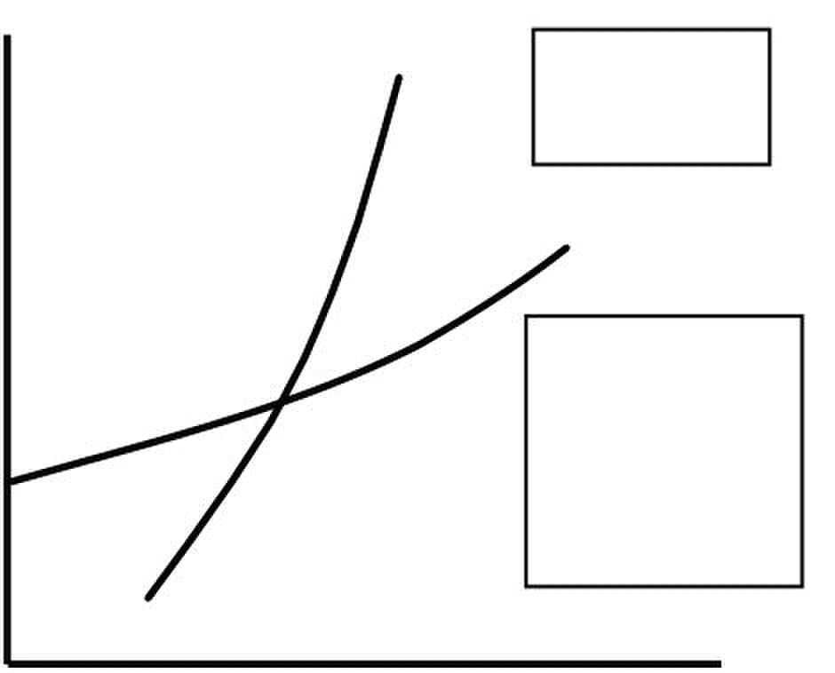
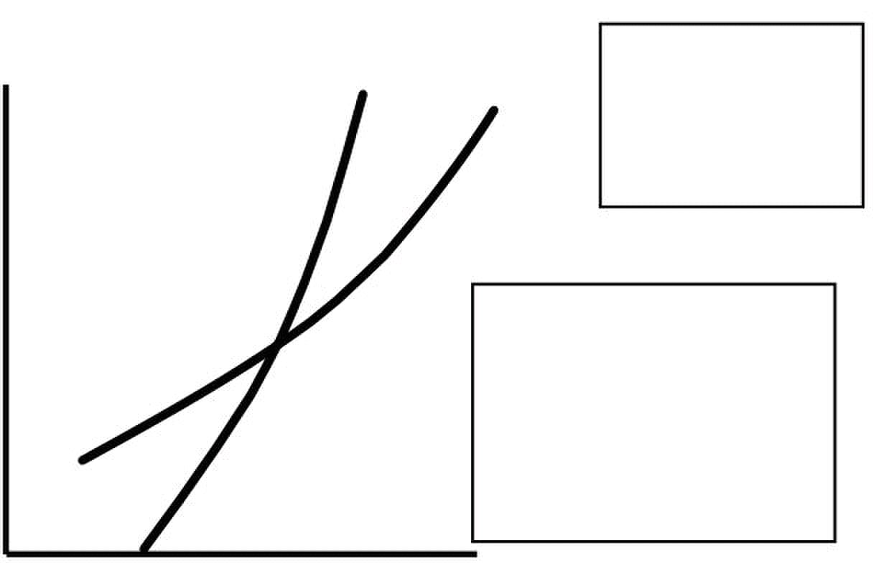
Microeconomics –ECO402 VU
The Demand for Gasoline
Years Following price or income change
Elasticity 1 2 3 4 5 6
Price -0.11 -0.22 -0.32 -0.49 -0.82 -1.17
Income 0.07 0.13 0.20 0.32 0.54 0.78
The Demand for Automobiles
Years Following price or income change
Elasticity 1 2 3 4 5 6
Price -1.20 -0.93 -0.75 -0.55 -0.42 -0.40
Income 3.00 2.33 1.88 1.38 1.02 1.00
 Supply
– Most goods and services:
• Long-run price elasticity of supply is greater than short-run price
elasticity of supply.
– Other Goods (durables, recyclables):
• Long-run price elasticity of supply is less than short-run price elasticity of
supply
Price SSR Primary Copper:
Long-Run
Supply Curves
SLR
Due to limited
capacity, firms are
limited by output
constraints in the
short-run. In the
long-run, they can
expand.
Quantity
Pric
Long-Run Supply
Curves
Price increases
provide an incentive
to convert scrap
copper into new supply.
In the long-run, this
stock of scrap copper
begins to fall.
Quantity
© Copyright Virtual University of Pakistan 19
Short-Run and
SL
and
Secondary
SS Copper: Short-Run

Slide 20

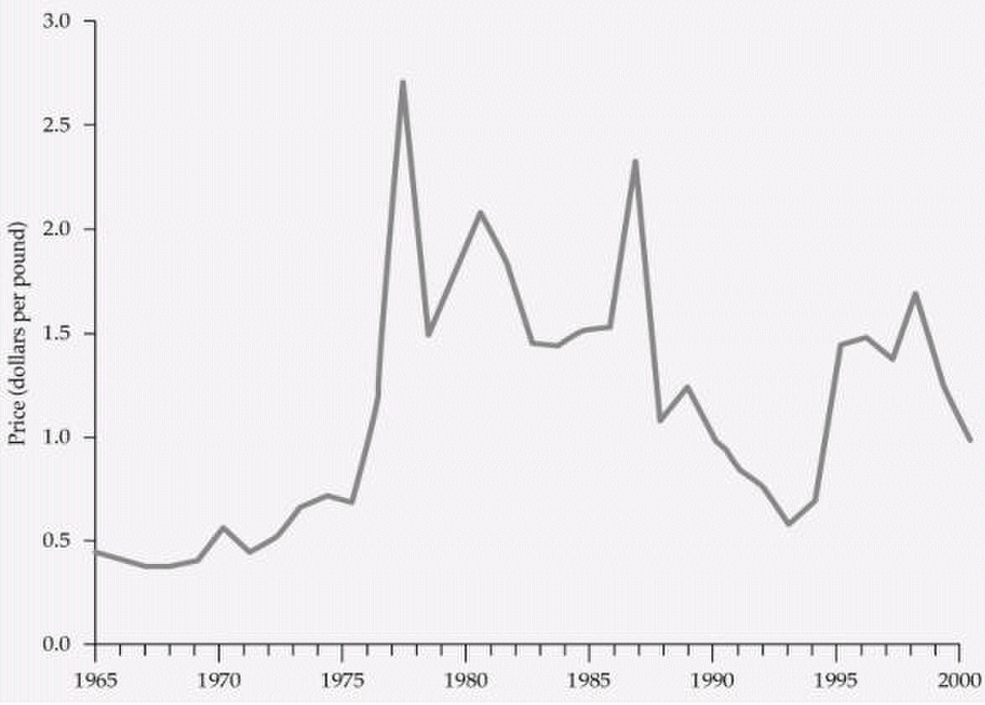
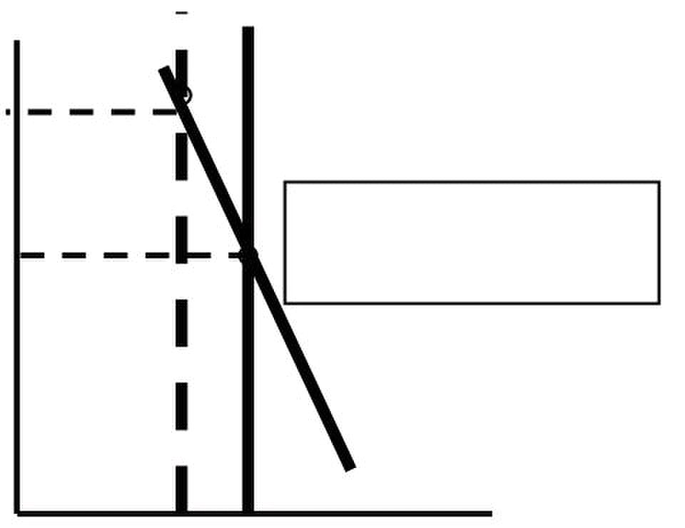
Microeconomics –ECO402 VU
Supply of Copper
Price Elasticity of: Short Run Long run
Primary Supply 0.20 1.60
Secondary Supply 0.43 0.31
Total Supply 0.25 1.50
Weather in Brazil and the price of Coffee in New York
 Elasticity explains why coffee prices are very volatile.
– Due to the differences in supply elasticity in the long-run and short run.
S’
Price
Coffee
P1
Short-Run
P0 2) Demand is relatively inelastic
D
Q1 Q0
© Copyright Virtual University of Pakistan 20
S
decreases the
supply
1) Supply is completely inelastic
3) Very large change in price
Quantity
A freeze or drought

Slide 21
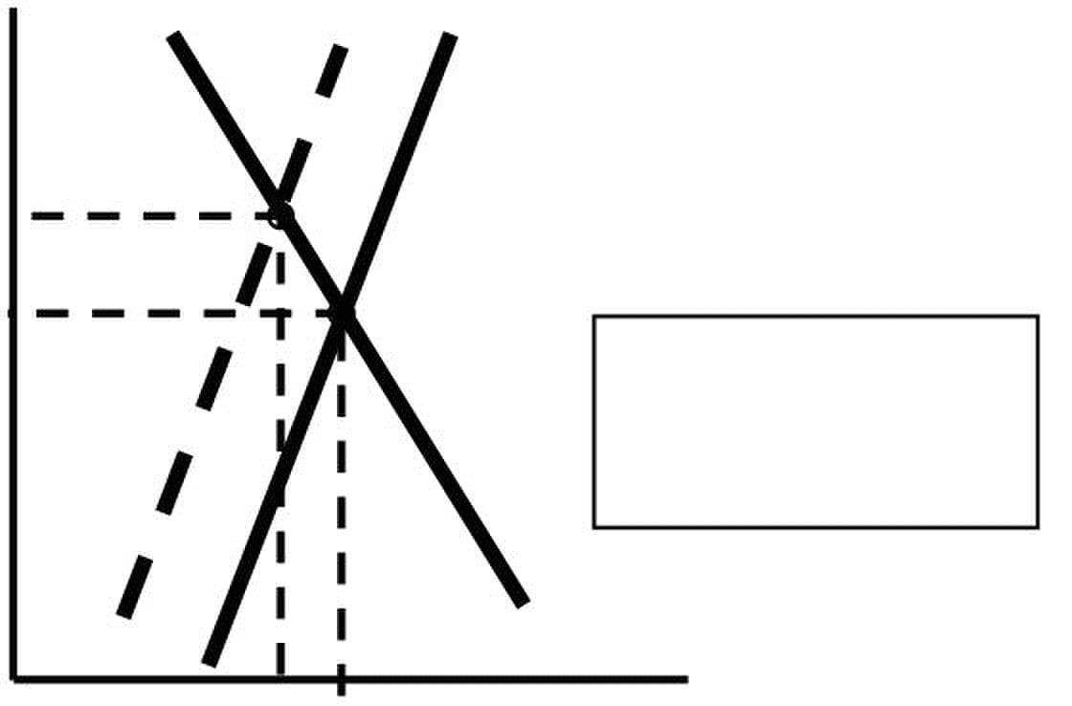
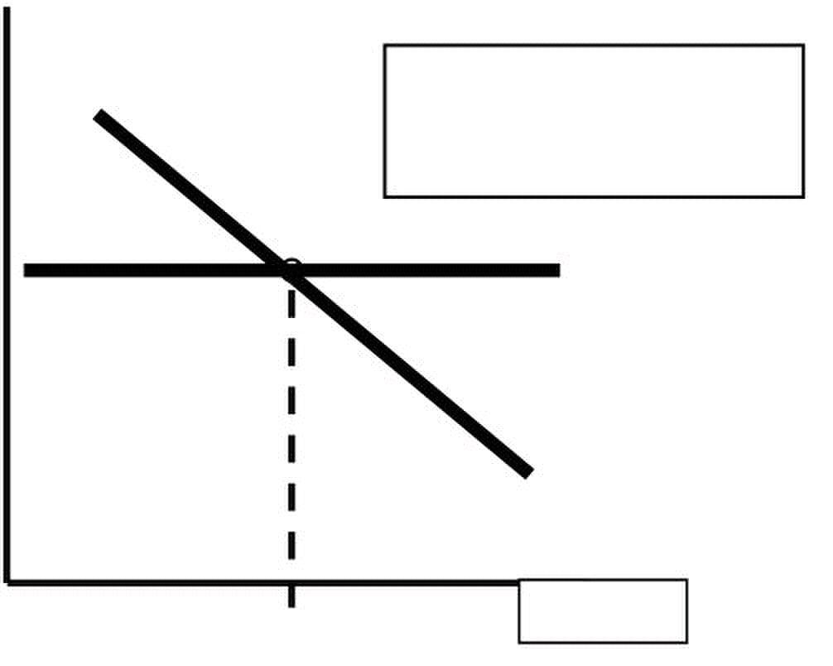
Microeconomics –ECO402 VU
Price
P2
P0
1) Supply and demand are
more elastic
2) Price falls back to P2.
3) Quantity falls to Q2
D
Q2 Q0
Price
Long-Run
1 Supply is extremely elastic.
2) Price falls back to P0.
3) Quantity increase to Q0.
P0 S
D
Q0 Quantity
© Copyright Virtual University of Pakistan 21
S’ S
Intermediate-Run
Quantity

Slide 22

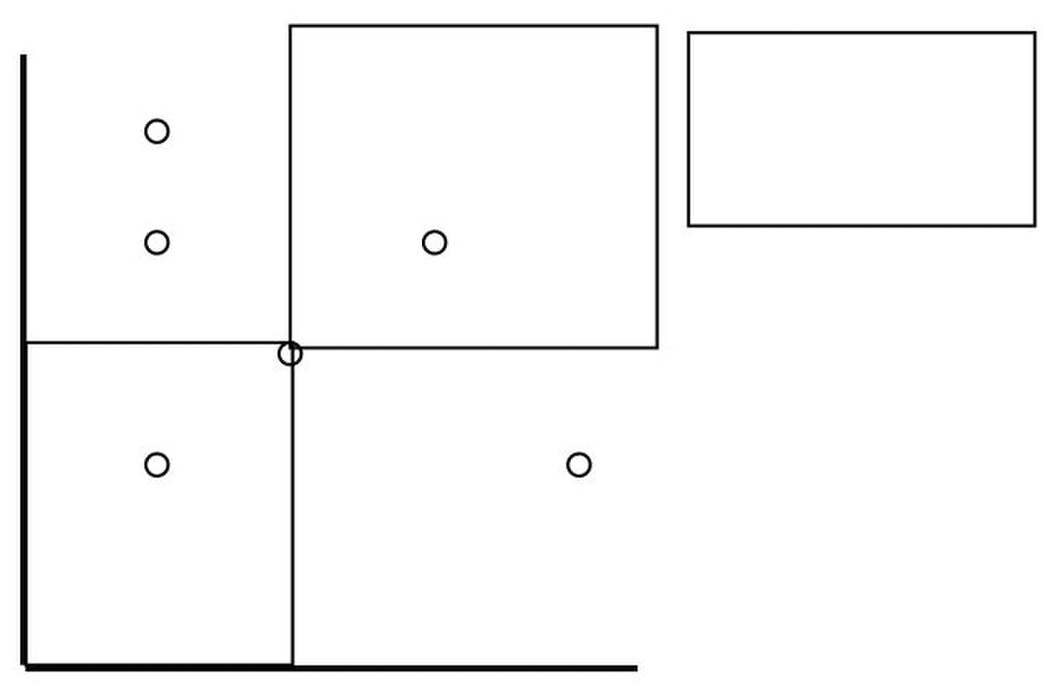
Microeconomics –ECO402 VU
Lesson 6
Consumer Behavior
 The explanation of how consumers allocate their resources (income) to the purchase of
different goods and services to maximize their well being.
 There are three steps involved in the study of consumer behavior.
1) We will study consumer preferences.
• To describe how and why people prefer one good to another.
2) Then we will turn to budget constraints.
• People have limited incomes.
3) Finally, we will combine consumer preferences and budget constraints
to determine consumer choices.
• What combination of goods will consumers buy to maximize their
satisfaction?
Consumer Preferences
• Market Baskets
• A market basket is a collection of one or more commodities.
• One market basket may be preferred over another market basket containing a
different combination of goods.
• Three Basic Assumptions
1) Preferences are complete.
2) Preferences are transitive.
3) Consumers always prefer more of any good to less.
Market Basket Units of Food Units of Clothing
A 20 30
B 10 50
D 40 20
E 30 40
G 10 20
H 10 40
 Indifference curves represent all combinations of market baskets that provide the
same level of satisfaction to a person.
Clothing
(units per week)
50
box are preferred to A.
40 H E
30
20 G
10
10 20 30 40
© Copyright Virtual University of Pakistan 22
The consumer prefers
B
A
D
Food
(units per week)
A to all combinations
all those in the yellow

Slide 23
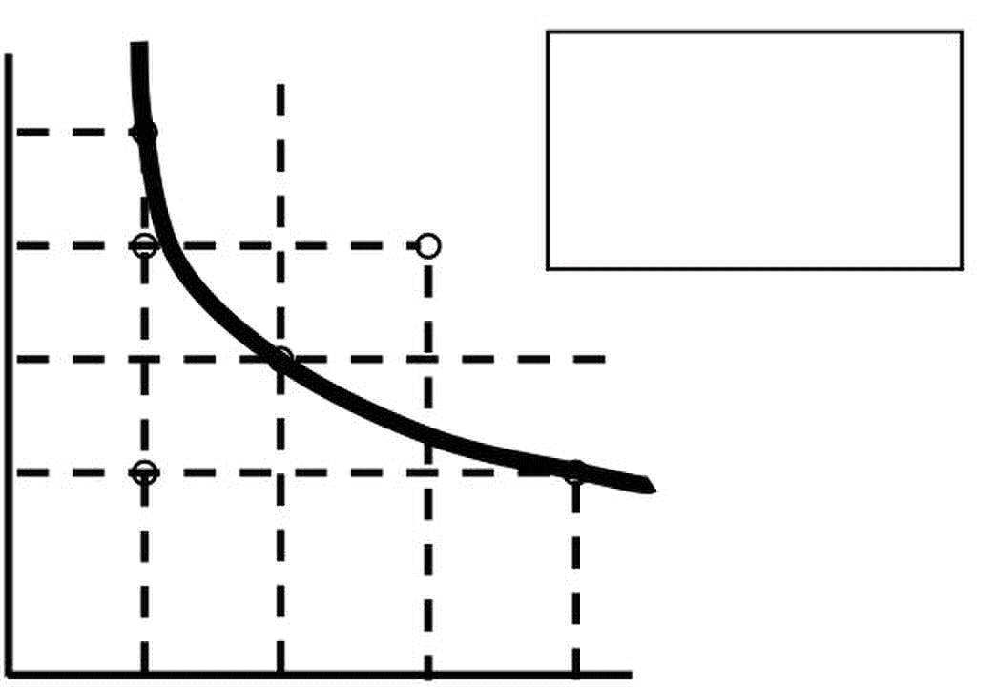
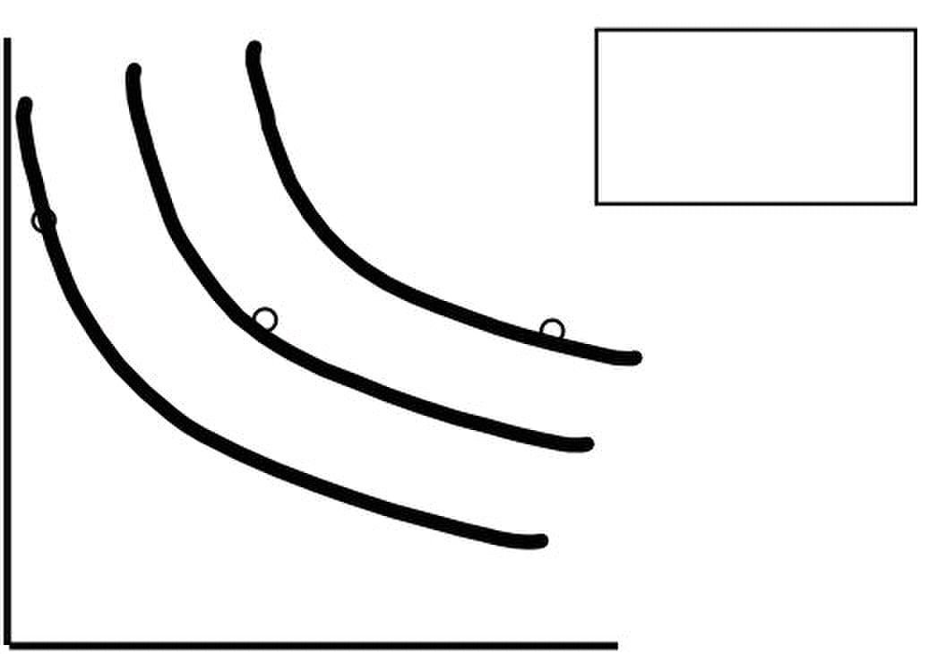
Microeconomics –ECO402 VU
Clothing
(units per
week) 50
40
30
20
10
10 20 30 40
 Indifference Curves
– Indifference curves slope downward to the right.
• If it sloped upward it would violate the assumption that more of any
commodity is preferred to less.
– Any market basket lying above and to the right of an indifference curve is
preferred to any market basket that lies on the indifference curve.
 An indifference map is a set of indifference curves that describes a person’s
preferences for all combinations of two commodities.
– Each indifference curve in the map shows the market baskets among which the
person is indifferent.
Clothing
(units per
week)
Market basket B is
D
B
U3
U2
U1
Food
(units per week)
© Copyright Virtual University of Pakistan 23
Combination B,A, & D
B
H
A
D
G
Food
(units per week)
Market basket A
is preferred to B.
preferred to D.
A
yield the same satisfaction
•E is preferred to U1
E
U1
•U1 is preferred to H & G

Slide 24
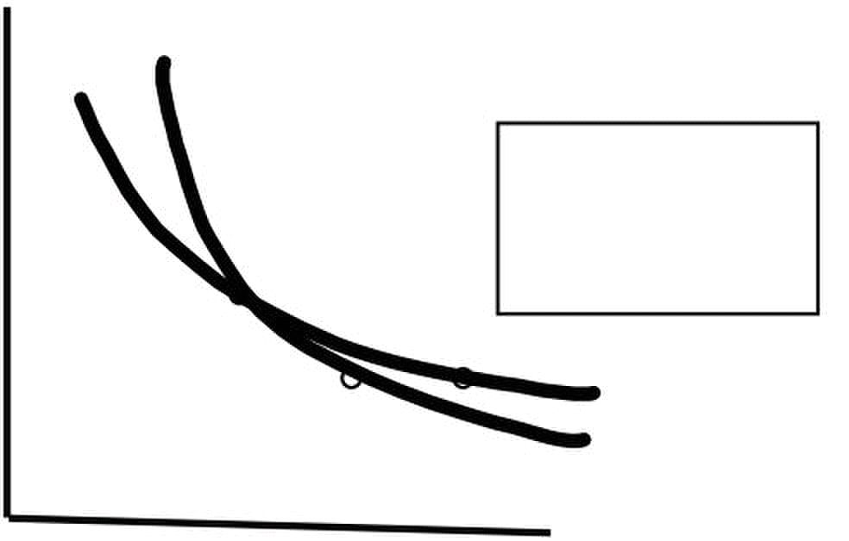
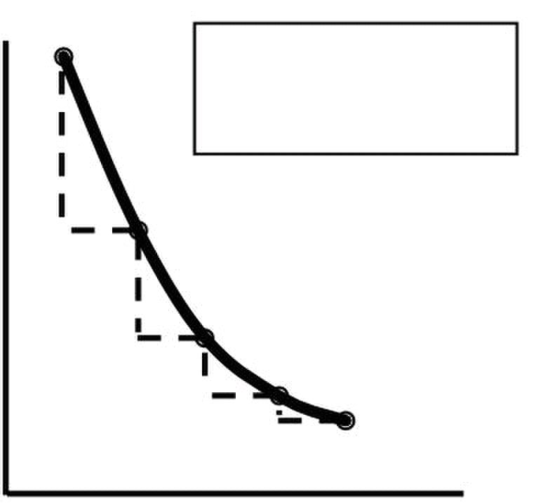
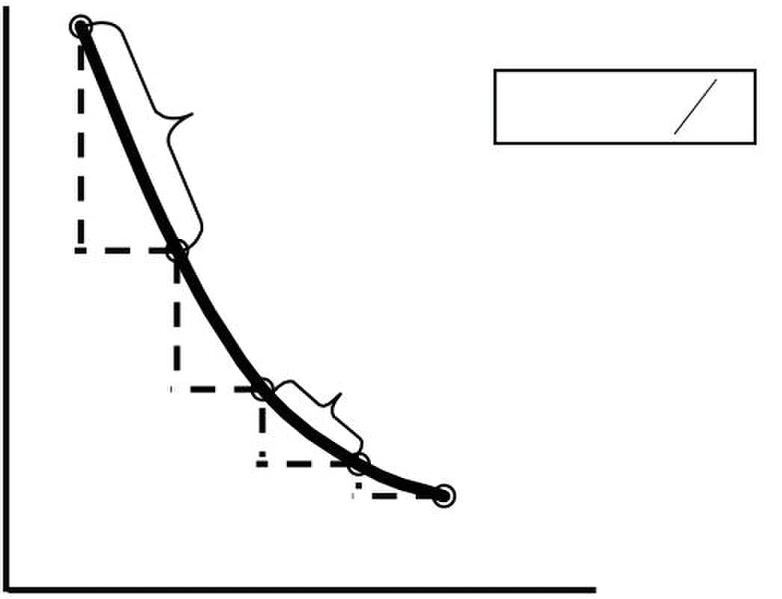
Microeconomics –ECO402 VU
 Indifference Curves
– Finally, indifference curves cannot cross.
• This would violate the assumption that more is preferred to less.
Clothing
(units per week)
U
The consumer should
be indifferent between
A, B and D. However,
A
B
D
Food
(units per week)
Clothing
(units
per week) 14
12
10 B
8 -4
6
4 G
2
1 2 3 4 5
 The marginal rate of substitution (MRS) quantifies the amount of one good a consumer
will give up to obtain more of another good.
– It is measured by the slope of the indifference curve.
Clothing
(units
per week)
12
10 B
8
6
4 G
2
1 2 3 4 5 (units per week)
© Copyright Virtual University of Pakistan 24
Indifference Curves
U
B contains more of
both goods than D.
16
a unit of food decreases
from 6 to 1
-6
1
D
1
-2
1 -1 1
Food
(units per week)
16
14 = −
-6
1
-4
MRS = 2
1
-2
1 -1
1
Food
Cannot Cross
A Observation: The amount
of clothing given up for
E
A
MRS = 6 MRS
D
E
ΔC
ΔF

Slide 25
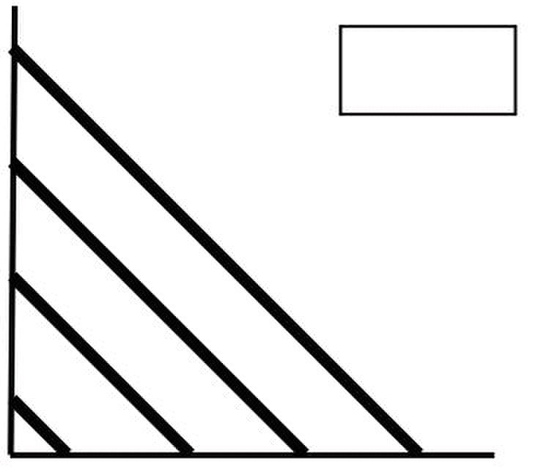


Microeconomics –ECO402 VU
 We will now add a fourth assumption regarding consumer preference:
– Along an indifference curve there is a diminishing marginal rate of substitution.
• Note the MRS for AB was 6, while that for DE was 2.
 Marginal Rate of Substitution
– Indifference curves are convex because as more of one good is consumed, a
consumer would prefer to give up fewer units of a second good to get additional
units of the first one.
– Consumers prefer a balanced market basket
– Perfect Substitutes and Perfect Complements
• Two goods are perfect substitutes when the marginal rate of substitution
of one good for the other is constant.
Apple
Juice
(glasses
)
3
2
1
Orange Juice
0 1 2 3 4
• Two goods are complements when the indifference curves for the goods
are shaped as right angles.
Left
Shoes 4
Perfect
3
2
1
0 1 2 3 4 Right Shoes
 BADS
– Things for which less is preferred to more
 Example
– Air pollution
 Designing New Automobiles
– Automobile executives must regularly decide when to introduce new models
and how much money to invest in restyling.
– An analysis of consumer preferences would help to determine when and if car
companies should change the styling of their cars.
© Copyright Virtual University of Pakistan 25
4
Substitutes
(glasses)
Complements
Perfect

Slide 26
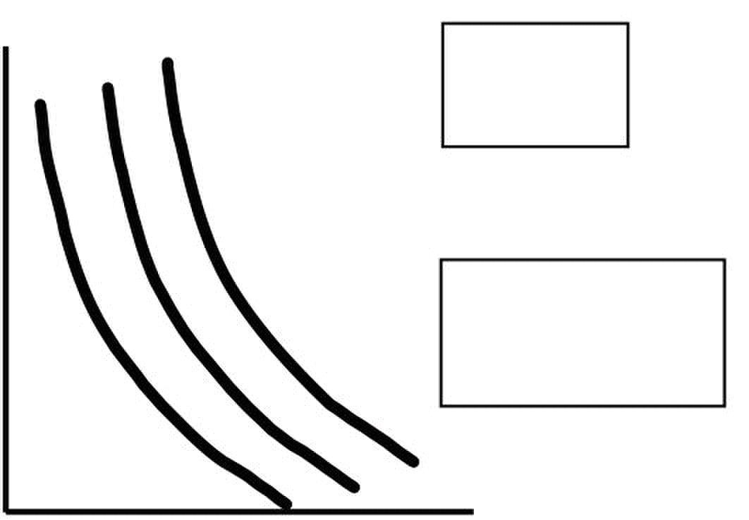
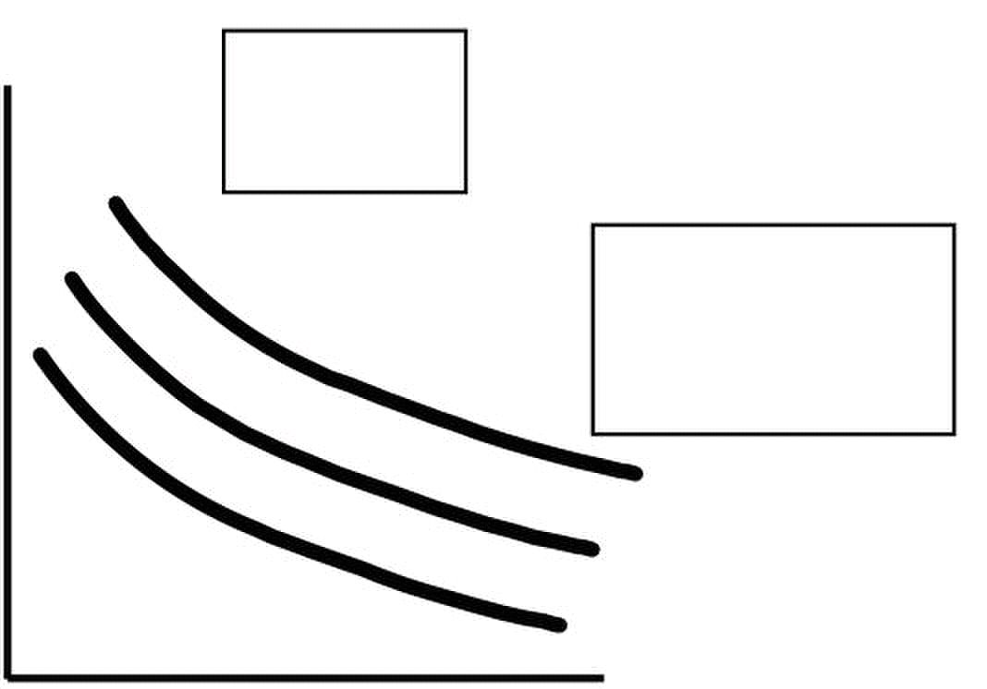
Microeconomics –ECO402 VU
Styling
High MRS
These consumers are
willing to give up
considerable
styling for additional
performance
Performance
Consumer
Styling Preference B:
Low MRS
These consumers are
willing to give up
considerable
performance for
additional styling
Performance
 Designing New Automobiles
– What Do You Think?
• How can we determine the consumers preference?
 Designing New Automobiles
– A recent study of automobile demand in the USA shows that over the past two
decades most consumers have preferred styling over performance.
 Growth of Japanese Imports
– 1970’s and 1980’s
• 15% of domestic cars underwent a style change each year
• This compares to 23% for imports
© Copyright Virtual University of Pakistan 26
Consumer
Preference A:

Slide 27
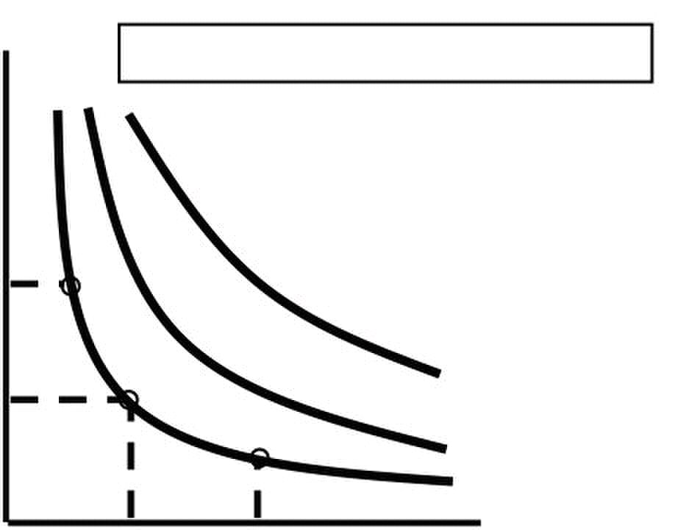
Microeconomics –ECO402 VU
LESSON 7
CONSUMER PREFERENCES
 Utility
– Numerical score representing the satisfaction that a consumer gets from a
given market basket.
– If buying 3 copies of Microeconomics makes you happier than buying one shirt,
then we say that the books give you more utility than the shirt.
 Utility Functions
– Assume: The utility function for food (F) and clothing (C)
U(F,C) = F + 2C
Market Baskets: F units C units U (F, C) = F + 2C
A 8 3 8 + 2(3) = 14
B 6 4 6 + 2(4) = 14
C 4 4 4 + 2(4) = 12
– The consumer is indifferent to A & B
– The consumer prefers A & B to C
Clothing
(units
per week) Assume: U = FC
15
A 25 = 5(5)
10
5
U1 = 25
0 5 10 15
 Ordinal Versus Cardinal Utility
– Ordinal Utility Function: places market baskets in the order of most preferred
to least preferred, but it does not indicate how much one market basket is
preferred to another.
– Cardinal Utility Function: utility function describing the extent to which one
market basket is preferred to another.
 Ordinal Versus Cardinal Rankings
– The actual unit of measurement for utility is not important.
– Therefore, an ordinal ranking is sufficient to explain how most individual
decisions are made.
Budget Constraints
 Preferences do not explain all of consumer behavior.
 Budget constraints also limit an individual’s ability to consume in light of the prices they
must pay for various goods and services.
 The Budget Line
 The budget line indicates all combinations of two commodities for which total
money spent equals total income.

© Copyright Virtual University of Pakistan 27
Utility Functions & Indifference Curves
Market Basket U = FC
C 25 = 2.5(10)
C
A
B
Food
(units per week)
B 25 = 10(2.5)
U3 = 100 (Preferred to

Slide 28

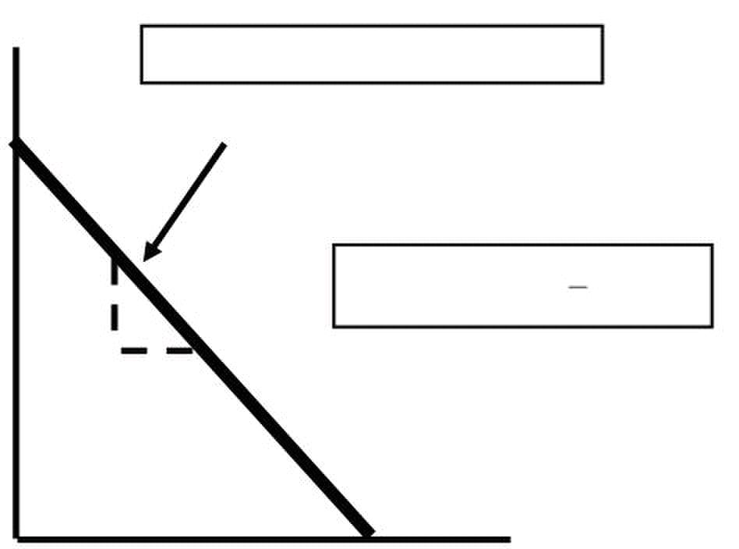
Microeconomics –ECO402 VU
 The Budget Line
 Let F equal the amount of food purchased, and C is the amount of clothing.
 Price of food = Pf and price of clothing = Pc
 Then Pf F is the amount of money spent on food, and Pc C is the amount of
money spent on clothing.
 The budget line then can be written:
P
Market Basket Food (F) Clothing (C) Total Spending
Pf = ($1) Pc = ($2) PfF + PcC = I
A 0 40 $80
B 20 30 $80
D 40 20 $80
E 60 10 $80
G 80 0 $80
Clothing
(units
per week)
(I/PC) = 40
30
1
20
10
G
0 20 40 60
 The Budget Line
– As consumption moves along a budget line from the intercept, the consumer
spends less on one item and more on the other.
– The slope of the line measures the relative cost of food and clothing.
– The slope is the negative of the ratio of the prices of the two goods.
– The slope indicates the rate at which the two goods can be substituted without
changing the amount of money spent.
– The vertical intercept (I/PC), illustrates the maximum amount of C that can be
purchased with income I.
– The horizontal intercept (I/PF), illustrates the maximum amount of F that can be
purchased with income I.
 The Effects of Changes in Income and Prices
– Income Changes
 An increase in income causes the budget line to shift outward, parallel
to the original line (holding prices constant).
 A decrease in income causes the budget line to shift inward, parallel to
the original line (holding prices constant).
© Copyright Virtual University of Pakistan 28
F + P C
1
2
Food
(units per week)
= I
F
Pc = $2 Pf = $1 I = $80
A Budget Line F + 2C = $80
B
Slope= ΔC/ΔF = - = - PF/P
D
2
E
80 = (I/PF)
C
C

Slide 29
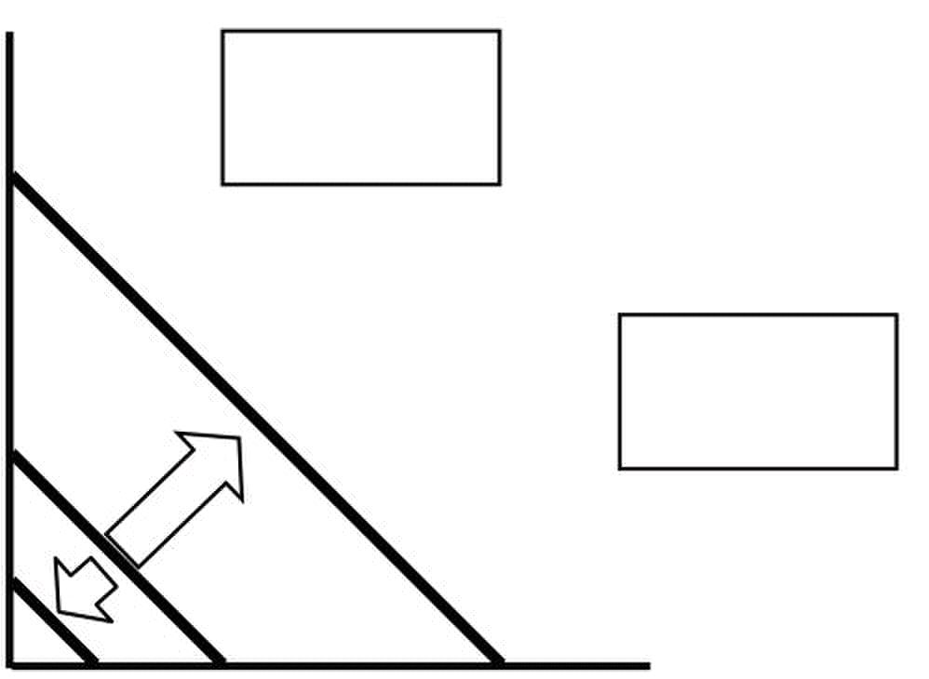
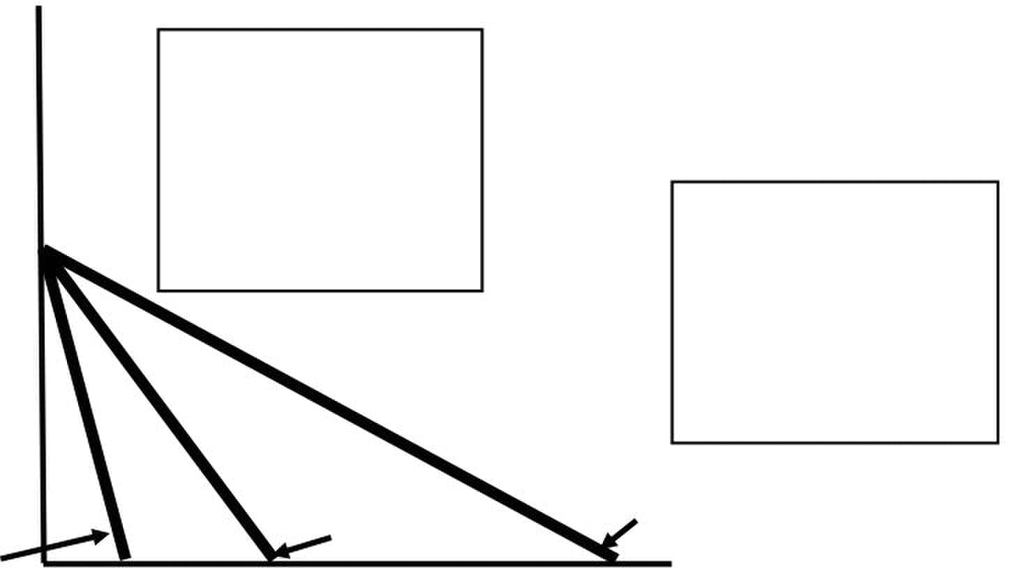
Microeconomics –ECO402 VU
Clothing
(units
per week)
80
60
A decrease in
income shifts
40
20
(I =
$40 (I =
0 40 80 120 160 (units per week)
– Price Changes
• If the price of one good increases, the budget line shifts inward, pivoting
from the other good’s intercept.
• If the price of one good decreases, the budget line shifts outward,
pivoting from the other good’s intercept.
Clothing
(units
per week)
the slope of the
budget line and
40
$.50 changes
the slope of the
budget line and
rotates it outward.
L3 L1 L2
(PF = 1) (PF = 1/2)
(PF = 2)
40 80 120 160
 The Effects of Changes in Income and Prices
– Price Changes
• If the two goods increase in price, but the ratio of the two prices is
unchanged, the slope will not change.
• However, the budget line will shift inward to a point parallel to the
original budget line.
• If the two goods decrease in price, but the ratio of the two prices is
unchanged, the slope will not change.
• However, the budget line will shift outward to a point parallel to the
original budget line.
Consumer Choice
 Consumers choose a combination of goods that will maximize the satisfaction they can
achieve, given the limited budget available to them.
 The maximizing market basket must satisfy two conditions:
1) It must be located on the budget line.
© Copyright Virtual University of Pakistan 29
A increase in
income shifts
the budget line
outward
the budget line
inward
L3
L1 L2
(I =
An increase in the
price of food to
$2.00 changes
rotates it inward.
Food
(units per week)
Food
A decrease in the

Slide 30

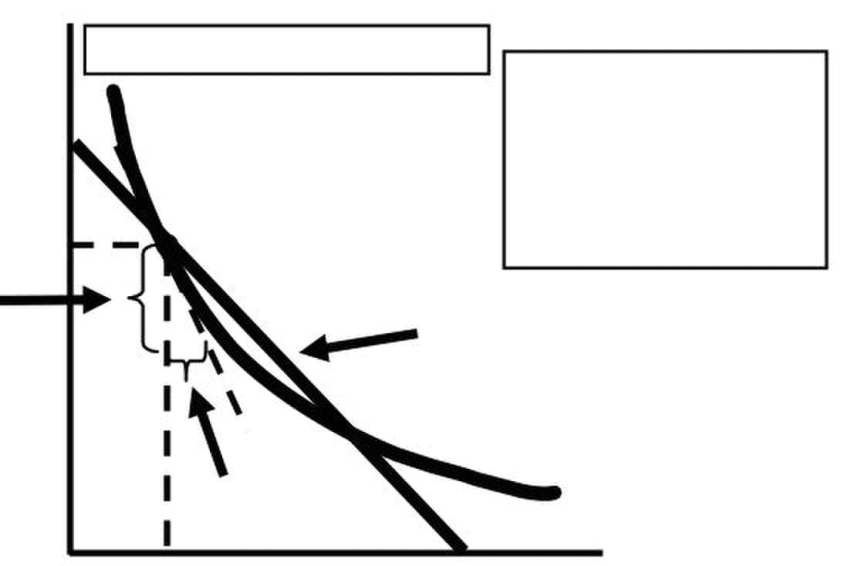
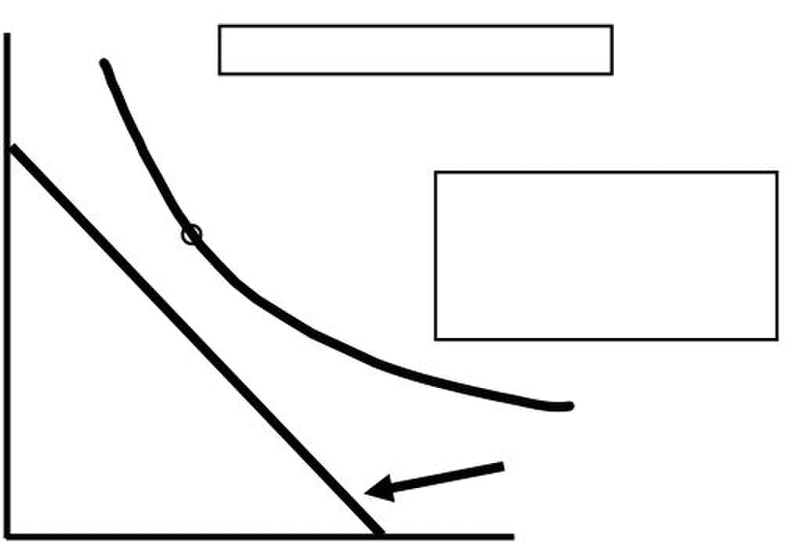
Microeconomics –ECO402 VU
2) Must give the consumer the most preferred combination of goods and
services.
Recall, the slope of an indifference curve is:
ΔC
MRS
Further, the slope of the budget line is:
Slope
C
 Therefore, it can be said that satisfaction is maximized where:
M R S =
C
 It can be said that satisfaction is maximized when marginal rate of substitution (of F
and C) is equal to the ratio of the prices (of F and C).
Clothing
(units per
week)
40
MRS (-(-10/10) = 1
30
-10C
20
+10
0
Clothing
(units per
week)
40
D Market basket D
30
budget constraint.
20
U3
Budget
0 20 40 80
© Copyright Virtual University of Pakistan 30
= −Δ
= −
P
P
Pc= $2 Pf = $1 I = $80
maximize satisfaction
because the
B
Budget
U1
20 40 80
Pc= $2 Pf = $1 I = $80
cannot be attained
given the current
Food (units per week)
F
P
P
F
Point B does not
is greater than the
price ratio (1/2).
Food (units per week)
F

Slide 31
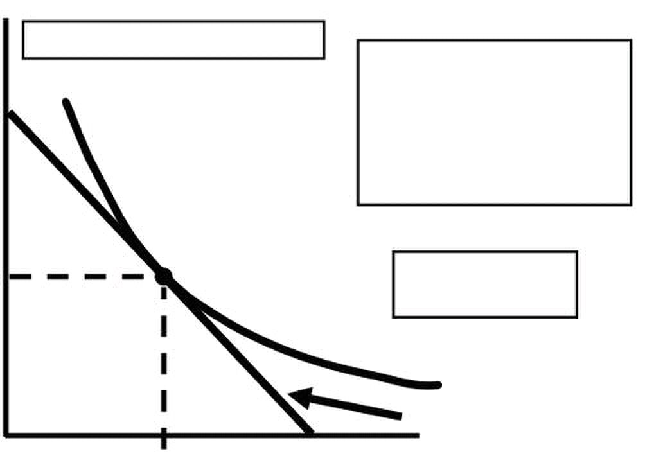
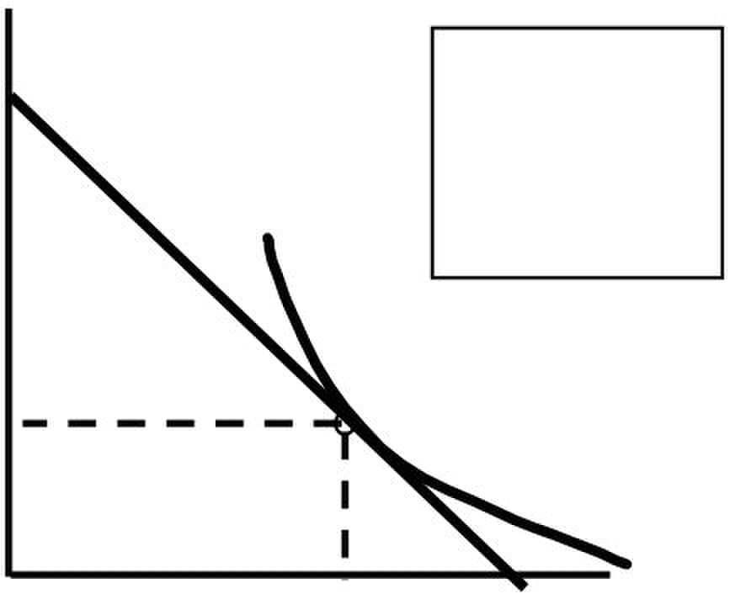
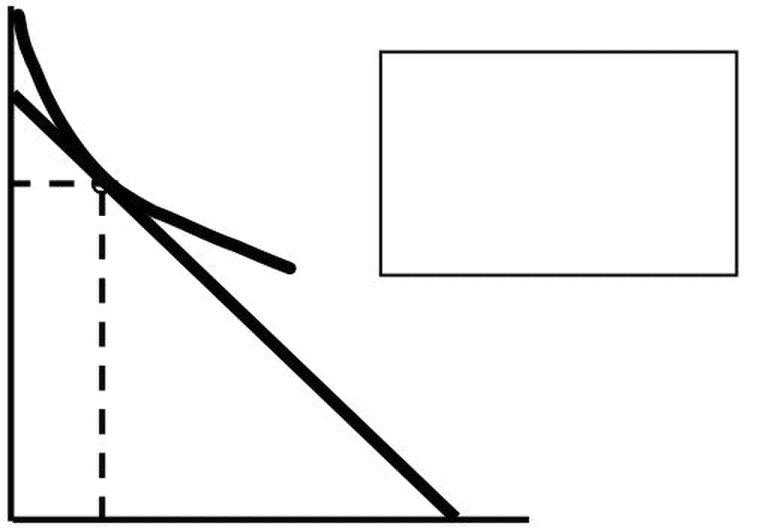
Microeconomics –ECO402 VU
Clothing
(units per
week)
40
tangent and no higher
level of satisfaction
30
A
20
U2
Budget
0 20 40 80
 Designing New Automobiles (II)
– Consider two groups of consumers, each wishing to spend $10,000 on the
styling and performance of cars.
– Each group has different preferences.
– By finding the point of tangency between a group’s indifference curve and the
– budget constraint auto companies can design a production and marketing plan.
Styling
$10,000
off a considerable
amount of styling
for some additional
performance
$3,000
$7,000 $10,000
Styling
$10,000
off a considerable
$7,000
some additional
styling
$3,000 $10,000
© Copyright Virtual University of Pakistan 31
Pc = $2 Pf = $1 I = $80
the budget line and the
indifference curve are
can be attained.
At A:
MRS =Pf/Pc = .5
Food (units per week)
These consumers
are willing to trade
Performance
These consumers
are willing to trade
amount of
performance for
Performance
At market basket A

Slide 32



Microeconomics –ECO402 VU
 Decision making & Public Policy
– Choosing between a non-matching and matching grant to fund police
expenditures
Private Non-matching Grant
Expenditures ($)
Before Grant
P
•A: Preference maximizing
market basket
R
U1
O S Q
Private
Expenditures ($)
T
After Grant
P
•B: Preference maximizing
U
R
U1
O S Z Q V
Private
Expenditures ($)
T
market basket
P
market basket
Expenditures
W
R
U1
O S X Q R Police ($)
© Copyright Virtual University of Pakistan 32
• Budget line: PQ
A
•OS: Police
Police
Expenditures ($)
Non-matching Grant
• Budget line: TV
B
A
•OZ: Police
Police
Expenditures ($)
Before Grant
Matching Grant
• A: Preference maximizing
After Grant
•C: Preference maximizing
•OW: Private
C
•Expenditure
•OR: Private
market basket
•Expenditure
U3 •OU: Private
• Budget line: PQ
U2
•OX: Police

Slide 33


Microeconomics –ECO402 VU
Private
Expenditures ($)
T
P
U
W A
U1
O X Q R Police ($)
 Corner Solution
– A corner solution exists if a consumer buys in extremes, and buys all of one
category of good and none of another.
• This exists where the indifference curves are tangent to the horizontal
and vertical axis.
• MRS is not equal to PA/PB
Frozen
Yogurt
(cups
monthly) A
U1 U2 U3
B Ice Cream (cup/month)
 A Corner Solution
– At point B, the MRS of ice cream for frozen yogurt is greater than the slope of the
budget line.
– This suggests that if the consumer could give up more frozen yogurt for ice cream
he would do so.
– However, there is no more frozen yogurt to give up!
– When a corner solution arises, the consumer’s MRS does not necessarily equal the
price ratio.
 In this instance it can be said that:
MRS ≥
© Copyright Virtual University of Pakistan 33
Matching Grant
Non-matching Grant
•Point B
•OU: Private expenditure
B
C 3
•OX: Police expenditure
A corner solution
exists at point B.
P P
•OZ: Police expenditure
Matching Grant
U
U
IceCream Frozen Yogurt
•Point C
2
/

Slide 34

Microeconomics –ECO402 VU
– If the MRS is, in fact, significantly greater than the price ratio, then a small
decrease in the price of frozen yogurt will not alter the consumer’s market
basket.
– A college Trust Fund
– Suppose Jane Doe’s parents set up a trust fund for her college education.
– Originally, the money must be used for education.
– If part of the money could be used for the purchase of other goods, her
consumption preferences change.
Other
Consumption
($)
The trust fund shifts the budget line
C
P
A
U
Q
© Copyright Virtual University of Pakistan 34
A College Trust Fund
A: Consumption before the trust fund
B: Requirement that the trust fund
must be spent on education
B
Education ($)
U C: If the trust could be spent on
U
other goods

Slide 35


Microeconomics –ECO402 VU
LESSON 8
Note it is repeated
Consumer Preferences
 Indifference curves represent all combinations of market baskets that provide the
same level of satisfaction to a person.
Consumer Preferences
Clothing
(units per week)
50
40
30
20
10
10 20 30 40
Budget Constraints
 The Budget Line
– The budget line indicates all combinations of two commodities for which total
money spent equals total income.
 The Budget Line
– Let F equal the amount of food purchased, and C is the amount of clothing.
– Price of food = Pf and price of clothing = Pc
– Then Pf F is the amount of money spent on food, and PcC is the amount of
money spent on clothing.
 The budget line then can be written:
P F P C I
Clothing
(units
per week)
(I/PC) = 40
30
10
20
E
10
G
0 20 40 60 80 = (I/PF)
© Copyright Virtual University of Pakistan 35
Combination B,A, & D
B
H
A
D
G
Food
(units per week)
+ =
Pc= $2 Pf = $1 I = $80
A Budget Line F + 2C = $80
B = ΔC/ΔF = - = - PF/P
D
20
Food
(units per week)
yield the same
satisfaction
E
G
U
Slope
•E is preferred to U1
•U1 is preferred to H &
1
2
C

Slide 36


Microeconomics –ECO402 VU
Consumer Choice
 Consumers choose a combination of goods that will maximize the satisfaction they can
achieve, given the limited budget available to them.
 The maximizing market basket must satisfy two conditions:
1) It must be located on the budget line.
2) Must give the consumer the most preferred combination of goods and
services.
Recall, the slope of an indifference curve is:
MRS = −
Further, the slope of the budget line is:
Slope = −
C
Therefore, it can be said that satisfaction is maximized where:
MRS =
C
Clothing
(units per
week)
40
indifference curve are
tangent and no higher
30
20
5
U
Budget Line
0 20 40 80
 Designing New Automobiles (II)
– Consider two groups of consumers, each wishing to spend $10,000 on the
styling and performance of cars.
– Each group has different preferences.
– By finding the point of tangency between a group’s indifference curve and the
budget constraint auto companies can design a production and marketing plan.
© Copyright Virtual University of Pakistan 36
Δ C
Δ F
P
P
P
P
Pc = $2 Pf = $1 I =
$80
At market basket A
the budget line and
the
level of satisfaction
can be attained.
A
MRS =Pf/Pc =
Food (units per week)
F
F
At A:

Slide 37



Microeconomics –ECO402 VU
Styling
$10,000
off a considerable
amount of styling
for some additional
performance
$3,000
$7,000 $10,000
Styling
$10,000
off a considerable
$7,000
some additional
styling
$3,00 $10,000
Consumer Choice
 Decision making & Public Policy
– Choosing between a non-matching and matching grant to fund police
expenditures
Private
Expenditures
($)
Before Grant
P
•A: Preference maximizing
market basket
R
U
O S Q
© Copyright Virtual University of Pakistan 37
These consumers
are willing to trade
Performance
These consumers
are willing to trade
amount of
performance for
Performance
Non-matching Grant
• Budget line: PQ
A
•OR: Private
•OS: Police
Police
Expenditures ($)

Slide 38



Microeconomics –ECO402 VU
Private
Expenditures
($)
T
After Grant
P
•B: Preference maximizing
U
R
U
O S Z Q V
Private
Expenditures ($)
T
After Grant
P •C: Preference maximizing
market basket
Expenditures
W
U1
O S X Q R Police ($)
Private
Expenditures ($)
T
Non-matching Grant
P
•OU: Private expenditure
U
W A
U2
U
O Z X Q R Police ($)
© Copyright Virtual University of Pakistan 38
Non-matching Grant
• Budget line: TV
B
A
•OZ: Police
Police
Expenditures ($)
Before Grant
Matching Grant
market basket
R
Matching Grant
•Point B
B
C •Point C
•OW: Private expenditure
•OX: Police expenditure
market basket
U •OU: Private
• Budget line: PQ
• A: Preference maximizing
A
•OZ: Police expenditure
U
•Expenditure
•OW: Private
C
Matching Grant
•OX: Police
U2

Slide 39

Microeconomics –ECO402 VU
Revealed Preferences
 If we know the choices a consumer has made, we can determine what her preferences
are if we have information about a sufficient number of choices that are made when
prices and incomes vary.
Revealed Preferences--Two Budget Lines
Clothing
(units per
month)
l
A
B
D
Food (units per month)
Clothing
(units per
month)
shaded area are
l preferred to A.
A
B
B is preferred to
all market baskets
in the pink area
Food (units per month)
Revealed Preferences--Four Budget Lines
© Copyright Virtual University of Pakistan 39
I1: Chose A over B
A is revealed preferred to B
l1
l2: Choose B over D
B is revealed preferred to D
l
All market baskets
in the blue
D

Slide 40


Microeconomics –ECO402 VU
I3: E revealed preferred to A
Clothing
(units per
month) All market baskets in the
blue area preferred to A
l1
l4
A
l2
B
A: preferred to all
market baskets in
the pink area
Food (units per month)
Scenario
Other
Recreational
($)
100
80
60 A combination B
40
20
l l
0 25 50 75 (hours)
© Copyright Virtual University of Pakistan 40
l3
E
G
I4: G revealed preferred to A
•Roberta’s recreation budget = $100/wk
Activities
C
$30/wk
•New budget line I2 &
B
U1 U2
profits increase?
Amount of Exercise
•Price of exercise = $4/hr/week
•Exercises 10 hrs/wk at A given U1 & I1
•The rate changes to $1/hr +
•Reveal preference of B to A
Would the Club’s

Slide 41


Microeconomics –ECO402 VU
Lesson 9
MARGINAL UTILITY AND CONSUMER CHOICE
 Marginal utility
– measures the additional satisfaction obtained from consuming one additional unit of a
good.
 Marginal Utility: An Example
– The marginal utility derived from increasing from 0 to 1 units of food might be 9
– Increasing from 1 to 2 might be 7
– Increasing from 2 to 3 might be 5
 Observation: Marginal utility is diminishing
 Diminishing Marginal Utility
– The principle of diminishing marginal utility states that as more and more of a good is
consumed, consuming additional amounts will yield smaller and smaller additions to
utility.
Relationship of Total and Marginal Utility
 Diminishing Marginal Utility: An Example
Quantity of good Total utility Marginal utility
consumed
0 0
1 4 4
2 7 3
3 9 2
4 10 1
5 10 0
Utility
10
2
the sum of the
5
Total utility increases
at a decreasing rate
4
0 1
© Copyright Virtual University of Pakistan 41
TU
1 Total utility of
consuming a certain
amount is equal to
3 to the point
2 3 4 5
marginal utilities up
Quantity

Slide 42

Microeconomics –ECO402 VU
Marginal Utility
5
4
3 curve
2
1
0 1 Quantity
Marginal Utility and
Consumer Choice
 Marginal Utility and the Indifference Curve
– If consumption moves along an indifference curve, the additional utility derived from an
increase in the consumption of one good, food (F), must balance the loss of utility from
the decrease in the consumption in the other good, clothing (C).
 Formally:
0 = MUF (ΔF) + MUC (ΔC)
 Rearranging:
- (ΔC/ ΔF) = MUF / MUC
Because:
− ΔC / ΔF = MRS of F for C
MRS MU /MU
 When consumers maximize satisfaction the:
MRS P /P
 Since the MRS is also equal to the ratio of the marginal utilities of consuming F and C, it
follows that:
MU/MU P/P
 Which gives the equation for utility maximization?
MU
 Total utility is maximized when the budget is allocated so that the marginal utility per dollar
of expenditure is the same for each good.
 This is referred to as the equal marginal principle.
© Copyright Virtual University of Pakistan 42
The fact that total utility
increases at a decreasing
rate is shown by negative
slope of marginal utility
MU
2 3 4 5
)
F C
F C
F C F C
F F
/ P = MU /
P
C C

Slide 43

Microeconomics –ECO402 VU
 Gasoline Rationing
– In 1974 and again in 1979, the government imposed price controls on gasoline.
– This resulted in shortages and gasoline was rationed.
– Non-price rationing is an alternative to market rationing.
– Under one form everyone has an equal chance to purchase a rationed good.
– Gasoline is rationed by long lines at the gas pumps.
 Rationing hurts some by limiting the amount of gasoline they can buy.
 This can be seen in the following model.
 It applies to a woman with an annual income of $20,000.
Spending
on other
goods ($) 20,000
18,00 D the consumer moves
15,00
U
U
B
2,00 5,00 20,00
COST-OF-LIVING INDEXES

 The CPI is calculated each year as the ratio of the cost of a typical bundle of consumer
goods and services today in comparison to the cost during a base period.
 Example
– Two sisters, Raheela and Sarah, have identical preferences.
– Sarah began college in 1987 with a $500 discretionary budget.
– In 1997, Raheela started college and her parents promised her a budget that was
equivalent in purchasing power.
Price of books $20/book $100/book
Number of books 15 6
Price of food $2.00/lb $2.20/lb
Pounds of food 100 300
Expenditure $500 $1,260
• Sarah’ Expenditure
• $500=100 lbs of food x $2.00/lb +15 books x $20/book
• Raheela’ Expenditure for Equal Utility
• $1,260=300 lbs of food x $2.20/lb +6 books x $100/book
© Copyright Virtual University of Pakistan 43
With a limit of
2,000 gallons,
to a lower
indifference curve
A
C
(lower level of utility).
Gasoline
(gallons per year)

Slide 44


Microeconomics –ECO402 VU
• The ideal cost-of-living adjustment for Raheela is $760.
• This implies a 152% increase in the cost of living.
Books
(per
quarter)
U1 the same level of utility
25 as Sarah, with the higher
20
15
10
5
l1
0 50 100 200 250 300 350 400 450 500 550 600
 The ideal cost of living index represents the cost of attaining a given level of utility at current
(1997) prices relative to the cost of attaining the same utility at base (1987) prices.
 To do this on an economy-wide basis would entail large amounts of information.
 Price indexes, like the CPI, use a fixed consumption bundle in the base period. Called a
Laspeyres price index.
 The Laspeyres index tells us:
– The amount of money at current year prices that an individual requires to purchase the
bundle of goods and services that was chosen in the base year divided by the cost of
purchasing the same bundle at base year prices.
 Calculating Raheela’s Laspeyres cost of living index
– Setting the quantities of goods in 1997 equal to what were bought by her sister, but
setting their prices at their 1997 levels result in an expenditure of
$1,720 (100 x 2.20 + 15 x $100)
 Her cost of living adjustment would now be $1,220.
 The Laspeyres index is: $1,720/$500 = 344.
 This overstates the true cost-of-living increase.
Books
(per quarter)
U1
25 budget line shifting
20
15
10
5
l1
0 50 100 200 250 300 350 400 450 500 550 600
© Copyright Virtual University of Pakistan 44
• The ideal cost-of-living index is $1,260/$500 = 2.52 or 252.
For Raheela to achieve
prices, her budget must
be sufficient to allow her
A
shown by point B.
B
l2
(lb./quarter)
Using the Laspeyres
index results in the
up from I2 to I3.
A
B
l2
(lb./quarter)
to consume the bundle
Food
l3
Food

Slide 45

Microeconomics –ECO402 VU
What Do You Think?
– Does the Laspeyres index always overstate the true cost-of-living index?
 Yes!
– The Laspeyres index assumes that consumers do not alter their consumption patterns
as prices change.
– By increasing purchases of those items that have become relatively cheaper, and
decreasing purchases of the relatively more expensive items consumers can achieve
the same level of utility without having to consume the same bundle of goods.
 The Paasche Index
– Calculates the amount of money at current-year prices that an individual requires to
purchase a current bundle of goods and services divided by the cost of purchasing the
same bundle in the base year.
 Comparing the Two Indexes
– Suppose:
– Two goods: Food (F) and Clothing (C)
 Comparing the Two Indexes
– Let:
• PFt & PCt be current year prices
• PFb & PCb be base year prices
• Ft & Ct be current year quantities
• Fb & Cb be base year quantities
– Both indexes involve ratios that involve today’s current year prices, PFt and PCt.
– However, the Laspeyres index relies on base year consumption, Fb and Cb.
– Whereas, the Paasche index relies on today’s current consumption, Ft and Ct .
 Then a comparison of the Laspeyres and Paasche indexes gives the following equations:
LI = -----------------------
Fb b
PI = ------------------------
– Sarah
(1990)
• Cost of base-year bundle at current prices equals
$1,720 (100 lbs x $2.20/lb + 15 books x $100/book)
• Cost of same bundle at base year prices is
$500 (100 lbs x $2.00/lb + 15 books x $20/book)
– Sarah (1990)
LI
• Cost of buying current year bundle at current year prices is
$1,260 (300 lbs x $2.20/lb + 6 books x $100/book)
© Copyright Virtual University of Pakistan 45
P F + P C
P F + P C
P Ft + PCt Ct
PFb
=
b Ct b
Cb b
Ft + PCb Ct
$1 720
$500
= 344

Slide 46

Microeconomics –ECO402 VU
• Cost of the same bundle at base year prices is
$720 (300 lbs x $2/lb + 6 books x $20/book)
PI = =
The Paasche index will understate the cost of living because it assumes that the individual
will buy the current year bundle in the base year.
© Copyright Virtual University of Pakistan 46
1 260
$720
175

Slide 47


Microeconomics –ECO402 VU
Lesson 10
Review of Consumer Equilibrium
 Consumer Preferences
 Budget Constraint
 Consumer Choices
INDIVIDUAL DEMAND
 Price Changes
– Using the figures developed in the previous chapter, the impact of a change in the price
of food can be illustrated using indifference curves.
Effect of a Price Change
Clothing
per
month)
6 A
5
4 U3 are tangent to
U2
Food (units
4 12 20
Effect of a Price Change
Clothing
(units per
month)
various prices for food.
6
5
4 U3
U2
4 12 20
© Copyright Virtual University of Pakistan 47
Assume:
•I = $20
D Three separate
Price-Consumption Curve
D
(units
•PC = $2
U1
B indifference curves
each budget line.
per month)
The price-consumption
curve traces out the
utility maximizing
market basket for the
A
U1
B
Food (units
per month)

Slide 48


Microeconomics –ECO402 VU
Effect of a Price Change
Price
of Food
$2.00
price of that good.
G
$1.00
Demand Curve
$.50
4 12 20
Individual Demand
 The Individual Demand Curve
– Two Important Properties of Demand Curves
– 1) The level of utility that can be attained changes as we move along the curve.
– 2) At every point on the demand curve, the consumer is maximizing utility by satisfying
the condition that the MRS of food for clothing equals the ratio of the prices of food and
clothing.
Effect of a Price Change
When the price falls: Pf /Pc & MRS also fall
Price
of Food
$2.00
•E: Pf /Pc = 2/2 = 1 = MRS
$1.00
Demand Curve
$.50
4 12 20
Individual Demand
 Income Changes
– Using the figures developed in the previous chapter, the impact of a change in the
income can be illustrated using indifference curves.
© Copyright Virtual University of Pakistan 48
Individual Demand relates
the quantity of a good that
•G: Pf /Pc = 1/2 = .5 = MRS
E
a consumer will buy to the
H
Food (units
per month)
E
G
•H:P f /Pc = .5/2 = .25 = MRS
H
Food (units
per month)

Slide 49


Microeconomics –ECO402 VU
Effects of Income Changes
Clothing
(units per
month)
$20, $30
Income-Consumption
Curve
7
5
3
A
Food (units
4 10 16 per month)
Effects of Income Changes
Price
of
food
shifts the consumer’s
demand curve to the right.
E G H
$100
D3
D2
D1
4 10 16
– The income-consumption curve traces out the utility-maximizing combinations of food
and clothing associated with every income level.
– An increase in income shifts the budget line to the right, increasing consumption along
the income-consumption curve.
– Simultaneously, the increase in income shifts the demand curve to the right.
 Normal Good vs. Inferior Good
– Income Changes
• When the income-consumption curve has a positive slope:
–The quantity demanded increases with income.
–The income elasticity of demand is positive.
–The good is a normal good.
• When the income-consumption curve has a negative slope:
© Copyright Virtual University of Pakistan 49
Assume: Pf = $1
Pc = $2
I = $10,
D
U2
B
U1 market basket.
An increase in income,
from $10 to $20 to $30,
with the prices fixed,
Food (units
per month)
An increase in income,
with the prices fixed,
U3
causes consumers to alter
their choice of

Slide 50



Microeconomics –ECO402 VU
–The quantity demanded decreases with income.
–The income elasticity of demand is negative.
–The good is an inferior good.
An Inferior Good
Coffee
(units per
month)
C
10
U3
…but Tea
becomes an inferior
5
bends backward
between B and C.
A
U1
5 10 20 30
Engel Curves
Engel Curves
–Engel curves relate the quantity of good consumed to income.
–If the good is a normal good, the Engel curve is upward sloping.
–If the good is an inferior good, the Engel curve is downward sloping.
Income
($ per month)
month)
Engel curves
20
normal
goods.
10 10
0 4 8 12 16 per month)
© Copyright Virtual University of Pakistan 50
15
Income-Consumption
Curve
and Coffee behave
as a normal good,
between A and B...
B
U2
Tea
(units per month)
Income
30
Inferior
Engel curves slope
slope
upward for
Normal
Food (units
0 4 8 12 16
Both Tea
good when the income
consumption curve
($ per
20 for inferior goods.
Food (units
per month)
30
backward bending

Slide 51

Microeconomics –ECO402 VU
Consumer Expenditures in US
Income Group (1997 $)
Expenditure Less than 1,000- 20,000- 30,000- 40,000- 50,000- 70,000-
($) on $10,000 19,000 29,000 39,000 49,000 69,000 and above
Entertainment 700 947 1274 1514 2054 2654 4300
Owned Res. 1116 1725 253 3243 4454 5793 9898
Rented Res. 1957 2170 2371 2536 2137 1540 1266
Health Care 1031 1697 1918 820 2052 2214 2642
Food 656 3385 4109 4888 5429 6220 8279
Clothing 859 978 1363 1772 1778 2614 3442
Individual Demand
Substitutes and Complements
1) Two goods are considered substitutes if an increase (decrease) in the price of one leads to
an increase (decrease) in the quantity demanded of the other.
•e.g. movie tickets and video rentals
2) Two goods are considered complements if an increase (decrease) in the price of one leads
to a decrease (increase) in the quantity demanded of the other.
•e.g. gasoline and motor oil
3) Two goods are independent when a change in the price of one good has no effect on the
quantity demanded of the other
–If the price consumption curve is downward-sloping, the two goods are considered
substitutes.
–If the price consumption curve is upward-sloping, the two goods are considered
complements.
They could be both!
© Copyright Virtual University of Pakistan 51

Slide 52

Microeconomics –ECO402 VU

Lesson 11
Income & Substitution Effects
A fall in the price of a good has two effects: Substitution & Income
–Substitution Effect
•Consumers will tend to buy more of the good that has become relatively cheaper,
and less of the good that is now relatively more expensive.
– Income Effect
• Consumers experience an increase in real purchasing power when the price of one
good falls.
Substitution Effect
– The substitution effect is the change in an item’s consumption associated with a
change in the price of the item, with the level of utility held constant.
– When the price of an item declines, the substitution effect always leads to an increase
in the quantity of the item demanded.
Income Effect
– The income effect is the change in an item’s consumption brought about by the
increase in purchasing power, with the price of the item held constant.
– When a person’s income increases, the quantity demanded for the product may
increase or decrease.
– Even with inferior goods, the income effect is rarely large enough to outweigh the
substitution effect.
Income & Substitution Effects: Normal Good
Clothing
(units per
month)
The substitution effect,F1E,
(from point A to D), changes the
C1
The income effect, EF2,
( from D to B) keeps relative
D
C2
Substitution
Effect
O F1 E S
© Copyright Virtual University of Pakistan 52
When the price of food falls,
R
A
B
U2
U1
Food (units
Total Effect
consumption increases by F1F2 as
the consumer moves from A to B.
relative prices but keeps real income
(satisfaction) constant.
prices constant but
increases purchasing power.
F2
T
per month)

Slide 53


Microeconomics –ECO402 VU
Clothing
(units per Since food is an
month)
negative. However,
A
income effect.
D
Substitution
Effect U1
O F1 E S F2 T
 A Special Case--The Giffen Good
– The income effect may theoretically be large enough to cause the demand curve for a
good to slope upward.
– This rarely occurs and is of little practical interest.
Effect of a Gasoline Tax with a Rebate
Assume
–Ped = -0.5
–Income = $9,000
– Price of gasoline = $1
Expenditures
On Other
Goods ($)
A
Gasoline = 900
• $450 REBATE
After
Gasoline
Tax
U
900 913.5 1200
© Copyright Virtual University of Pakistan 53
inferior good, the
income effect is
After Gasoline Tax
Plus Rebate
• New budget line
C
Other expenditures = $7800
Original Budget
Line
Gasoline Consumption
(gallons/year)
R
the substitution effect
is larger than the
Food (units
per month)
F
• $.50 Excise Tax
•
H
E
U2
U3
1
D J B
Gasoline = 1200 gallons

Slide 54



Microeconomics –ECO402 VU
Market Demand
Market Demand Curves
– A curve that relates the quantity of a good that all consumers in a market buy to the
price of that good.
Determining the Market Demand Curve
Price Individual A Individual B Individual C Market
($) (units) (units) (units) (units)
1 6 10 16 32
2 4 8 13 25
3 2 6 10 18
4 0 4 7 11
5 0 2 4 6
Summing to Obtain a Market Demand Curve
Price
4
3
2
1
0 5 10 15 20 25 30
Price
4
3
2
1
0 5 10 15 20 25 30
© Copyright Virtual University of Pakistan 54
5
DA
Quantity
5
DB
Quantity

Slide 55



Microeconomics –ECO402 VU
Price
4
3
2
1
0 5 10 15 20 25 30
Price
curve is obtained by
4
3
Market Demand
2
1
0 5 10 15 20 25 30
 Two Important Points
1) The market demand will shift to the right as more consumers enter
the market.
2) Factors that influence the demands of many consumers will also affect the market
demand.
Elasticity of Demand
Recall: Price elasticity of demand measures the percentage change in the quantity
demanded resulting from a 1-percent change in price.
E P =
© Copyright Virtual University of Pakistan 55
5
DC
Quantity
5 The market demand
summing the consumer’s
demand curves
DA DB DC
Quantity
Δ Q/Q
Δ P/P
=
Δ Q / Δ P
Q / P

Slide 56


Microeconomics –ECO402 VU
Price Elasticity and Consumer Expenditure
Demand If Price Increases, If Price Decreases,
Expenditures: Expenditures:
Inelastic(Ep <1) Increase Decrease
Unit Elastic (Ep = 1) Are unchanged Are unchanged
Elastic (Ep >1) Decrease Increase
Point Elasticity of Demand
– For large price changes (e.g. 20%), the value of elasticity will depend upon where the
price and quantity lie on the demand curve.
– Point elasticity measures elasticity at a point on the demand curve.
– Its formula is:
E (P/Q)(1/slope)
Problems Using Point Elasticity
– We may need to calculate price elasticity over portion of the demand curve rather than
at a single point.
– The price and quantity used as the base will alter the price elasticity of demand.
Point Elasticity of Demand: An Example
–Assume
Price increases from 8$ to $10 quantity demanded falls from 6 to 4
• Percent change in price equals: $2/$8 = 25% or $2/$10 = 20%
• Percent change in quantity equals: -2/6 = -33.33% or -2/4 = -50%
Elasticity equals:
-33.33/.25 = -1.33 or -.50/.20 = -2.54
–Which one is correct?
Arc Elasticity of Demand
– Arc elasticity calculates elasticity over a range of prices
– Its formula is:
E = ( ΔQ/ Δ P)( P / Q )
P = the averag e price
Q = the averag e quantity
© Copyright Virtual University of Pakistan 56
P
•

Slide 57

Microeconomics –ECO402 VU
 Arc Elasticity of Demand: An Example
E = ( ΔQ/ΔP)( P / Q)
P
P = 18 / 2 = 9 & Q = 10 / 2 = 5
p E = (−2 / $2)($9 / ) = − 8
© Copyright Virtual University of Pakistan 57
= , P = 10, Q =
, Q = 4
1 2
1 2

Slide 58


Microeconomics –ECO402 VU
Lesson 12
The Aggregate Demand For Wheat
The demand for U.S. wheat is comprised of domestic demand and export demand.
The domestic demand for wheat is given by the equation:
–QDD = 1700 - 107P
The export demand for wheat is given by the equation:
–QDE = 1544 - 176P
Domestic demand is relatively price inelastic (-0.2), while export demand is more price elastic
(-0.4).
Price
($/bushel)
18
16 A
14 domestic demand AB and
12
10
8
6
4 Export
2 Demand
0 1000 2000 3000
Consumer Surplus
Consumer Surplus
– The difference between the maximum amount a consumer is willing to pay for a good
and the amount actually paid.
Price
($ per
18
17
16
15
14
13
0 1 2 3 4 5 6 Rock Concert Tickets
© Copyright Virtual University of Pakistan 58
20
Total world demand is
the horizontal sum of the
export demand CD.
C E
Total Demand
Demand
D B
ticket)
each one individually.
Consumer Surplus
6 + 5 + 4 + 3 + 2 + 1 = 21
Domestic
F
4000
20
19
Market Price
Wheat(millio
n bushels/yr.)
The consumer surplus
of purchasing 6 concert
tickets is the sum of the
surplus derived from

Slide 59


Microeconomics –ECO402 VU
The stepladder demand curve can be converted into a straight-line demand curve by making
the units of the good smaller.
Price
($ per
ticket)
18
17
16 Consumer
15
14
13
Expenditur
0
Combining consumer surplus with the aggregate profits that producers obtain we can
evaluate:
1) Costs and benefits of different market structures
2) Public policies that alter the behavior of consumers and firms
An Example: The Value of Clean Air
Air is free in the sense that we don’t pay to breathe it.
Question: Are the benefits of cleaning up the air worth the costs?
People pay more to buy houses where the air is clean.
 Data for house prices among neighborhoods of Lahore and Rawalpindi were compared with
the various air pollutants.
2000
($Value
per puma
of reduction)
a cost of $1000 per
part reduced.
1000
NOX (pphm)
0 5 10 Reduction
© Copyright Virtual University of Pakistan 59
20
19
Surplus
1/2x(20−14)x6,500= $19,500
Actual
1 2 3 4 5 6
The shaded area gives the
consumer surplus generated
when air pollution is
reduced by 5 parts per 100
million of nitrous oxide at
A
Pollution
Consumer Surplus
for the Market Demand
Market
Demand
Rocket concert tickets

Slide 60


Microeconomics –ECO402 VU
NETWORK EXTERNALITIES
Up to this point we have assumed that people’s demands for a good are independent of one
another.
If fact, a person’s demand may be affected by the number of other people who have
purchased the good.
If this is the case, a network externality exists.
Network externalities can be positive or negative.
A positive network externality exists if the quantity of a good demanded by a consumer
increases in response to an increase in purchases by other consumers.
Negative network externalities are just the opposite.
 The Bandwagon Effect
– This is the desire to be in style, to have a good because almost everyone else
has it, or to indulge in a fad.
– This is the major objective of marketing and advertising campaigns (e.g. toys,
clothing).
Positive Network Externality: Bandwagon Effect
Price
($ per
unit)
further to the the right .
Quantity
20 40 60 80 100
Price
($ per
unit)
demand curves. It is relatively
more elastic.
Demand
Quantity
20 40 60 80 100
© Copyright Virtual University of Pakistan 60
D2 D4 D60 D8 D100 When consumers believe more
people have purchased the
product, the demand curve shifts
(thousands per month)
D20 D40 D60 D80 D100 The market demand
the points on the individual
(thousands per month)
curve is found by joining

Slide 61


Microeconomics –ECO402 VU
Price
($ per
unit)
were no bandwagon effect,
quantity demanded would
$30
$20
Pure Price
Effect
Quantity
(thousands per month)
20 40 48 60 80 100
Price
($ per
unit)
the quantity demanded
increases further.
$30
$20
Pure Price
Quantity
20 48 100
 The Snob Effect
– If the network externality is negative, a snob effect exists.
 The snob effect refers to the desire to own exclusive or unique goods.
 The quantity demanded of a “snob” good is higher the fewer the people who own it.
© Copyright Virtual University of Pakistan 61
D20 D40 D60 D80 D100
from $30 to $20. If there
only increase to 48,000
Demand
D20 D40 D60 D80 D100 But as more people buy
stylish to own it and
Demand
Effect
40 60 80
Suppose the price falls
the good, it becomes
Bandwagon
Effect
(thousands per month)

Slide 62


Microeconomics –ECO402 VU
Price
($ per
$30,000
However, if consumers think 4,000
people have bought the good,
demand shifts from D2 to D6 and its
snob value has been reduced.
$15,000
D2
D4
D8
2 4 6 8 14
Pure Price Effect
Price
($ per unit)
$30,000
it. Sales decrease as a result.
Examples: Rolex watches and long
lines at the ski lift.
Net Effect
$15,000
D2
D4
D8
2 4 6 8 14
Pure Price Effect
Network Externalities and the Demands
for Computers and Fax Machines
 Examples of Positive Feedback Externalities
– Mainframe computers: 1954 - 1965
– Microsoft Windows PC operating system
– Fax-machines and e-mail
© Copyright Virtual University of Pakistan 62
Originally demand is D2,
when consumers think 2000
Demand
people have bought a good.
The demand is less elastic and
unit)
D6
Quantity (thousands
per month)
Demand
as a snob good its value is greatly
reduced if more people own
Snob Effect
D6
Quantity (thousands
per month)

Slide 63
Microeconomics –ECO402 VU
Lesson 13
Introduction
 Choice with certainty is reasonably straightforward.
 How do we choose when certain variables such as income and prices are uncertain (i.e.
making choices with risk)?
Describing Risk
 To measure risk we must know:
1) All of the possible outcomes.
2) The likelihood that each outcome will occur (its probability).
 Interpreting Probability
– The likelihood that a given outcome will occur
– Objective Interpretation
• Based on the observed frequency of past events
– Subjective
• Based on perception or experience with or without an observed frequency
– Different information or different abilities to process the same information can
influence the subjective probability
 Expected Value
– The weighted average of the payoffs or values resulting from all possible outcomes.
• The probabilities of each outcome are used as weights
• Expected value measures the central tendency; the payoff or value expected on
average
– An Example
• Investment in drilling exploration:
• Two outcomes are possible
– Success -- the stock price increase from $30 to $40/share
– Failure -- the stock price falls from $30 to $20/share
• Objective Probability
– 100 explorations, 25 successes and 75 failures
– Probability (Pr) of success = 1/4 and the probability of failure = 3/4
EV = Pr(success)($40/share) + Pr(failure)($20/share)
E V = 1 4 ($ 4 0 /sh are) + 3 4 ($ 2 0 /sh are)
EV $25/share
 Given:
– Two possible outcomes having payoffs X1 and X2
– Probabilities of each outcome is given by Pr1 & Pr2
 Generally, expected value is written as:
E(X) PrX PrX
1 1
© Copyright Virtual University of Pakistan 63
=
+ + +
2 2 n n

Slide 64




Microeconomics –ECO402 VU
Variability
– The extent to which possible outcomes of an uncertain event may differ
 Variability: A Scenario
– Suppose you are choosing between two part-time sales jobs that have the same
expected income ($1,500)
– The first job is based entirely on commission.
– The second is a salaried position.
– There are two equally likely outcomes in the first job--$2,000 for a good sales job and
$1,000 for a modestly successful one.
– The second pays $1,510 most of the time (.99 probability), but you will earn $510 if the
company goes out of business (.01 probability).
Income from Sales Jobs
Outcome 1 Outcome 2
Probability Income($) probability Income($) Expected
income
Job 1: Commission .5 2000 .5 1000 1500
Job 2: Fixed salary .99 1510 .01 510 1500
E(X1 ) = .5($2000) + .5($1000) = $1500
Job 2 Expected Income
E(X2 = .99($1510) + .01($510) = $1500
 While the expected values are the same, the variability is not.
 Greater variability from expected values signals greater risk.
 Deviation
– Difference between expected payoff and actual payoff
Deviations from Expected Income ($)
Outcome 1 Deviation Outcome 2 Deviation
Job 1 $2,000 $500 $1,000 -$500
Job 2 1,510 10 510 -900
– Adjusting for negative numbers
– The standard deviation measures the square root of the average of the squares of the
deviations of the payoffs associated with each outcome from their expected value.
– The standard deviation is written:
σ=
© Copyright Virtual University of Pakistan 64
[ ]
[ ]
−E(X) + −
Pr X
1
2
1
Pr X
2
2
2
E(X)

Slide 65



Microeconomics –ECO402 VU
Calculating Variance ($)
Deviation Deviation Deviation Standard
Outcome 1 Squared Outcome 2 Squared Squared Deviation
Job 1 $2,000 $250,000 $1,000 $250,000 $250,000 $500.00
Job 2 1,510 100 510 980,100 9,900 99.50
 The standard deviations of the two jobs are:
σ
1
σ
σ
σ
σ
σ
 The standard deviation can be used when there are many outcomes instead of only two.
 An Example
– Job 1 is a job in which the income ranges from $1000 to $2000 in increments of $100
that are all equally likely.
– Job 2 is a job in which the income ranges from $1300 to $1700 in increments of $100
that, also, are all equally likely.
Probability Job 1 has greater
standard deviation
and greater risk
than Job 2.
0.2
0.1
$1000 $1500 $2000
 Outcome Probabilities of Two Jobs (unequal probability of outcomes)
– Job 1: greater spread & standard deviation
© Copyright Virtual University of Pakistan 65
= .5($250,00 0) .5($250,00 0
1
1
2
2
2
spread: greater
Job 2
Job 1
Income
+
= $ 250 , 000
= 500
= .99($100 .01($980,1 00)
= $ ,900
= 99 . 50
*Greater Risk
+

Slide 66


Microeconomics –ECO402 VU
– Peaked distribution: extreme payoffs are less likely
 Decision Making
– A risk avoider would choose Job 2: same expected income as Job 1 with less risk.
– Suppose we add $100 to each payoff in Job 1 which makes the expected payoff =
$1600.
Unequal Probability Outcomes
Probability
greater spread and standard
deviation than those with Job 2.
0.2
Job 2
0.1
$1000 $1500 $2000
Income from Sales Jobs--Modified ($)
Deviation Deviation Deviation Standard
Outcome 1 Squared Outcome 2 Squared Squared Deviation
Job 1 $2,100 $250,000 $1,100 $250,000 $1, 600 $500
Job 2 1510 100 510 980,100 1, 500 99.50
Recall: The standard deviation is the square root of the deviation squared.
 Decision making
– Job 1: expected income $1,600 and a standard deviation of $500.
– Job 2: expected income of $1,500 and a standard deviation of $99.50
– Which job?
• Greater value or less risk?
 Example
– Suppose a city wants to deter people from wrong parking.
– The alternatives …...
© Copyright Virtual University of Pakistan 66
associated with Job 1 has a
Job 1
Income

Slide 67
Microeconomics –ECO402 VU
 Assumptions:
1) Wrong parking saves a person $5 in terms of time spent searching for a parking space.
2) The driver is risk neutral.
3) Cost of apprehension is zero.
 A fine of $5.01 would deter the driver from double parking.
– Benefit of wrong parking ($5) is less than the cost ($5.01) equals a net benefit that is
less than 0.
 Increasing the fine can reduce enforcement cost:
– A $50 fine with a .1 probability of being caught results in an expected penalty of $5.
– A $500 fine with a .01 probability of being caught results in an expected penalty of $5.
 The more risk averse drivers are, the lower the fine needs to be in order to be effective.
© Copyright Virtual University of Pakistan 67

Slide 68
Microeconomics –ECO402 VU
Lesson 14
PREFERENCES TOWARD RISK
 Choosing Among Risky Alternatives
– Assume
– Consumption of a single commodity
– The consumer knows all probabilities
– Payoffs measured in terms of utility
– Utility function given
 Example
– A person is earning $15,000 and receiving 13 units of utility from the job.
– She is considering a new, but risky job.
 She has a .50 chance of increasing her income to $30,000 and a .50 chance of decreasing
her income to $10,000.
 She will evaluate the position by calculating the expected value (utility) of the resulting
income.
 The expected utility of the new position is the sum of the utilities associated with all her
possible incomes weighted by the probability that each income will occur.
 The expected utility can be written:
– E(u) = (1/2)u($10,000) + (1/2)u($30,000)
= 0.5(10) + 0.5(18)
= 14
– E(u) of new job is 14 which is greater than the current utility of 13 and therefore
preferred.
 Different Preferences Toward Risk
– People can be
• Risk averse
• Risk neutral or
• Risk loving
– Risk Averse:
– A person who prefers a certain given income to a risky income with the same expected
value.
– A person is considered risk averse if they have a diminishing marginal utility of income
– The use of insurance demonstrates risk aversive behavior.
 Risk Averse: A Scenario
– A person can have a $20,000 job with 100% probability and receive a utility level of 16.
– The person could have a job with a .5 chance of earning $30,000 and a .5 chance of
earning $10,000.
 Expected Income =
(0.5)($30,000) + (0.5) ($10,000) = $20,000
 Expected income from both jobs is the same -- risk averse may choose current job
 The expected utility from the new job is found:
– E(u) = (1/2)u ($10,000) + (1/2)u($30,000)
– E(u) = (0.5)(10) + (0.5)(18) = 14
– E(u) of Job 1 is 16 which is greater than the E(u) of Job 2 which is 14.
© Copyright Virtual University of Pakistan 68

Slide 69


Microeconomics –ECO402 VU
 This individual would keep their present job since it provides them with more utility than the
risky job.
 They are said to be risk averse.
Utility
18
16 of $10,000 and a .5
14
13
B
10
0
 Risk Neutral
– A person is said to be risk neutral if they show no preference between a certain
income, and an uncertain one with the same expected value.
Risk Neutral
Utility
The consumer is risk
C
12
with the same
expected income.
A
6
0 10 20 30
 Risk Loving
– A person is said to be risk loving if they show a preference toward an uncertain income
over a certain income with the same expected value.
• Examples: Gambling, some criminal activity
© Copyright Virtual University of Pakistan 69
Risk Averse
D gamble with a .5 probability
C probability of $30,000.
A
Income ($1,000)
10 15 16 20 30
E
18
neutral and is indifferent
between certain events
and uncertain events
Income ($1,000)
The consumer is risk
E averse because she
income of $20,000 to a
would prefer a certain

Slide 70


Microeconomics –ECO402 VU
Utility
18
The consumer is risk
loving because she
would prefer the gamble
to a certain income.
8
A
3
0 10 20 30
 Risk Premium
– The risk premium is the amount of money that a risk-averse person would pay to avoid
taking a risk.
 Risk Premium: A Scenario
– The person has a .5 probability of earning $30,000 and a .5 probability of earning
$10,000 (expected income = $20,000).
– The expected utility of these two outcomes can be found:
– E(u) = .5(18) + .5(10) = 14
 Question
– How much would the person pay to avoid risk?
Risk Premium
Utility
person the same expected
utility as the uncertain
G expected value of $20,000.
20
18
14
10
0
 Risk Aversion and Income
– Variability in potential payoffs increases the risk premium.
© Copyright Virtual University of Pakistan 70
Risk Loving E
C
Income ($1,000)
Risk Premium
income of $16,000gives the
income that has an
C
A
10 16
Here , the risk premium is
$4,000 because a certain
E
F
Income ($1,000)
30 40

Slide 71


Microeconomics –ECO402 VU
– Example:
• A job has a .5 probability of paying $40,000 (utility of 20) and a .5 chance of paying 0
(utility of 0).
 The expected income is still $20,000, but the expected utility falls to 10.
 Expected utility = .5u($) + .5u($40,000)
= 0 + .5(20) = 10
 The certain income of $20,000 has a utility of 16.
 If the person is required to take the new position, their utility will fall by 6.
 The risk premium is $10,000 (i.e. they would be willing to give up $10,000 of the $20,000
and have the same E(u) as the risky job.
 Therefore, it can be said that the greater the variability, the greater the risk premium.
 Indifference Curve
– Combinations of expected income & standard deviation of income that yield the
same utility.
Risk Aversion and Indifference Curves
U3
Expected
Income
large increase in
U1
Standard Deviation of Income
Expected Slightly Risk Averse:
Income A large increase in
standard
deviation requires only a
small increase in income
to maintain satisfaction.
U2
U1
© Copyright Virtual University of Pakistan 71
Highly Risk Averse: An
U2
income to maintain
satisfaction.
U3
increase in standard
deviation requires a

Slide 72
Microeconomics –ECO402 VU
Business Executives and the Choice of Risk
 Example
– Study of 464 executives found that:
• 20% were risk neutral
• 40% were risk takers
• 20% were risk averse
• 20% did not respond
 Those who liked risky situations did so when losses were involved.
 When risks involved gains the same, executives opted for less risky situations.
 The executives made substantial efforts to reduce or eliminate risk by delaying decisions
and collecting more information.
© Copyright Virtual University of Pakistan 72

Slide 73

Microeconomics –ECO402 VU

Lesson 15
Reducing Risk
 Three ways consumers attempt to reduce risk are:
1) Diversification
2) Insurance
3) Obtaining more information
 Diversification
– Suppose a firm has a choice of selling air conditioners, heaters, or both.
– The probability of it being hot or cold is 0.5.
– The firm would probably be better off by diversification.
Income from Sales of Appliances
Hot Weather Cold Weather
Air conditioner sales $30,000 $12,000
Heater sales 12,000 30,000
* 0.5 probability of hot or cold weather
 If the firm sells only heaters or air conditioners their income will be either $12,000 or
$30,000.
 Their expected income would be:
– 1/2($12,000) + 1/2($30,000) = $21,000
 If the firm divides their time evenly between appliances their air conditioning and heating
sales would be half their original values.
 If it were hot, their expected income would be $15,000 from air conditioners and $6,000
from heaters, or $21,000.
 If it were cold, their expected income would be $6,000 from air conditioners and $15,000
from heaters, or $21,000.
 With diversification, expected income is $21,000 with no risk
 Firms can reduce risk by diversifying among a variety of activities that are not closely
related.
 Stock Market
– How can diversification reduce the risk of investing in the stock market?
– Can diversification eliminate the risk of investing in the stock market?
 Insurance
– Risk averse are willing to pay to avoid risk.
– If the cost of insurance equals the expected loss, risk averse people will buy enough
insurance to recover fully from a potential financial loss.
© Copyright Virtual University of Pakistan 73

Slide 74
Microeconomics –ECO402 VU
The Decision to Insure
Insurance Burglary No Burglary Expected Standard
(Pr = .1) (Pr = .9) Wealth Deviation
No $40,000 $50,000 $49,000 $9,055
Yes 49,000 49,000 49,000 0
 While the expected wealth is the same, the expected utility with insurance is greater
because the marginal utility in the event of the loss is greater than if no loss occurs.
 Purchases of insurance transfers wealth and increases expected utility.
 The Law of Large Numbers
– Although single events are random and largely unpredictable, the average outcome of
many similar events can be predicted.
 Examples
– A single coin toss vs. large number of coins
– Whom will have a car wreck vs. the number of wrecks for a large group of drivers
 Assume:
– 10% chance of a $10,000 loss from a home burglary
– Expected loss = .10 x $10,000 = $1,000 with a high risk (10% chance of a $10,000 loss)
– 100 people face the same risk
 Then:
– $1,000 premium generates a $100,000 fund to cover losses
– Actuarial Fairness
• When the insurance premium = expected payout
The Value of Title Insurance When Buying a House
 A Scenario:
– Price of a house is $200,000
– 5% chance that the seller does not own the house
 Risk neutral buyer would pay:
(. 95 [ 200 , 000 ] + . 05 [ 0 ] = 190 , 000
 Risk averse buyer would pay much less
 By reducing risk, title insurance increases the value of the house by an amount far greater
than the premium.
 Value of Complete Information
– The difference between the expected value of a choice with complete information and
the expected value when information is incomplete.
 Suppose a store manager must determine how many fall suits to order:
– 100 suits cost $180/suit
– 50 suits cost $200/suit
– The price of the suits is $300
 Suppose a store manager must determine how many fall suits to order:
– Unsold suits can be returned for half cost.
– The probability of selling each quantity is .50.
© Copyright Virtual University of Pakistan 74

Slide 75

Microeconomics –ECO402 VU
The Decision to Insure
Expected
Sale of 50 Sale of 100 Profit
1. Buy 50 suits $5,000 $5,000 $5,000
2. Buy 100 suits 1,500 12,000 6,750
With incomplete information:
– Risk Neutral: Buy 100 suits
– Risk Averse: Buy 50 suits
 The expected value with complete information is $8,500.
– 8,500 = .5(5,000) + .5(12,000)
 The expected value with uncertainty (buy 100 suits) is $6,750.
 The value of complete information is $1,750, or the difference between the two (the amount
the store owner would be willing to pay for a marketing study).
 An Example
– Per capita packed milk consumption has fallen over the years
– The milk producers engaged in market research to develop new sales strategies to
encourage the consumption of packed milk.
 Findings
– Packed milk demand is seasonal with the greatest demand in the summer
– Ep is negative and small
– EI is positive and large
 Milk advertising increases sales most in the summer.
 Allocating advertising based on this information in Karachi increased sales by Rs. 400,000
and profits by 9%.
 The cost of the information was relatively low, while the value was substantial.
The Demand for Risky Assets
 Assets
– Something that provides a flow of money or services to its owner.
–The flow of money or services can be explicit (dividends) or implicit (capital gain).
 Capital Gain
– An increase in the value of an asset, while a decrease is a capital loss.
 Risky & Riskless Assets
– Risky Asset
• Provides an uncertain flow of money or services to its owner.
• Examples
– Apartment rent, capital gains, corporate bonds, stock prices
– Riskless Asset
• Provides a flow of money or services that is known with certainty.
• Examples
– Short-term government bonds, short-term certificates of deposit
© Copyright Virtual University of Pakistan 75

Slide 76


Microeconomics –ECO402 VU
 Asset Returns
– Return on an Asset
–The total monetary flow of an asset as a fraction of its price.
– Real Return of an Asset
–The simple (or nominal) return less the rate of inflation.
 Asset Returns
Asset Return =
Asset Return = = =
 Expected vs. Actual Returns
– Expected Return
• Return that an asset should earn on average
– Actual Return
• Return that an asset earns
– Higher returns are associated with greater risk.
– The risk-averse investor must balance risk relative to return
 Risk and Budget Line
Expected return, RP, increases as risk increases.
The slope is the price of risk or the risk-return trade-off.
Choosing Between Risk and Return
U2 is the optimal choice of those
Expected
Return, Rp
U2
Rm
R*
Rf
0
© Copyright Virtual University of Pakistan 76
Monetary Flow
Purchase Price
Flow $100/yr.
Bond Price $1,000
obtainable, since it gives the highest return
for a given risk and is tangent to the budget
U3
U1 Budget Line
σ∗
10%
line.
* m
σ
Standard Deviation of
σ
m
Return, σp

Slide 77

Microeconomics –ECO402 VU
The Choices of Two Different Investors
Expected
Return,Rp
UA
Rm
RB line, investor A chooses
while investor B
RA
Rf
0
© Copyright Virtual University of Pakistan 77
UB
Budget line
Given the same budget
low return-low risk,
chooses high return-
high risk.
σA σB σm
Standard Deviation
of Return σP

Slide 78
Microeconomics –ECO402 VU
Lesson 16
Introduction
 Our focus is the supply side.
 The theory of the firm will address:
– How a firm makes cost-minimizing production decisions
– How cost varies with output
– Characteristics of market supply
The Technology of Production
 The Production Process
– Combining inputs or factors of production to achieve an output
 Categories of Inputs (factors of production)
– Labor
– Materials
– Capital
 Production Function:
– Indicates the highest output that a firm can produce for every specified combination of
inputs given the state of technology.
– Shows what is technically feasible when the firm operates efficiently.
 The production functions for two inputs:
Q = F(K,L)
Q = Output, K = Capital, L = Labor
 For a given technology
Isoquants
 Assumptions
– Food producer has two inputs
• Labor (L) & Capital (K)
 Observations:
1) For any level of K, output increases with more L.
2) For any level of L, output increases with more K.
3) Various combinations of inputs produce the same output.
 Isoquants
– Curves showing all possible combinations of inputs that yield the same output
© Copyright Virtual University of Pakistan 78

Slide 79



Microeconomics –ECO402 VU
Production Function for Food
Labor Input
Capitan Input 1 2 3 4 5
1 20 40 55 65 75
2 40 60 75 85 90
3 55 75 90 100 105
4 65 85 100 110 115
5 75 90 105 115 120
Production with Two Variable Inputs (L,K)
Capital
per year
4
The isoquants are derived
from the production
3
2
Q3 = 90
1
Q1 = 55
1 2 3 4 5 Labor per year
 Input Flexibility
– The isoquants emphasize how different input combinations can be used to
produce the same output.
– This information allows the producer to respond efficiently to changes in the
markets for inputs.
 The Short Run vs. long Run
– Short-run:
• Period of time in which quantities of one or more production factors cannot be
changed.
• These inputs are called fixed inputs.
– Long-run
• Amount of time needed to make all production inputs variable.
© Copyright Virtual University of Pakistan 79
The Isoquant Map
E
function for output of
Q2 = 75
5
A B C of 55, 75, and 90.
D

Slide 80

Microeconomics –ECO402 VU
Production with One Variable Input (Labor)
Amount Amount Total Average Marginal
of Labor (L) of Capital (K) Output (Q) Product Product
0 10 0 --- ---
1 10 10 10 10
2 10 30 15 20
3 10 60 20 30
4 10 80 20 20
5 10 95 19 15
6 10 108 18 13
7 10 112 16 4
8 10 112 14 0
9 10 108 12 -4
10 10 100 10 -8
 Observations:
1) With additional workers, output (Q) increases, reaches a maximum, and then
decreases.
2) The average product of labor (AP), or output per worker, increases and then
decreases.
AP
3) The marginal product of labor (MP), or output of the additional worker,
increases rapidly initially and then decreases and becomes negative..
© Copyright Virtual University of Pakistan 80
Output Q
Labor Input L
= =

Slide 81



Microeconomics –ECO402 VU
MP L =
Output
per
Month
112
C
60
C: slope of OC= MP & AP
A
0 1 2 3 4 5 6 7 8 9 10
Output Observations:
per
Month
decreasing
30
Marginal
20
10
0 1 2 3 4 5 6 7 8 9 10
– When MP = 0, TP is at its maximum
– When MP > AP, AP is increasing
– When MP < AP, AP is decreasing
– When MP = AP, AP is at its maximum
© Copyright Virtual University of Pakistan 81
Δ Output Δ
Δ Labor Input Δ
D
Total Product
B
Labor per Month
Left of E: MP > AP & AP is
increasing
Right of E: MP < AP & AP is
E: MP = AP & AP is at its maximum
E
Labor per Month
 Observations:
Q
L
=
A: slope of tangent = MP (20)
B: slope of OB = AP (20)
Average Product

Slide 82



Microeconomics –ECO402 VU
AP = slope of line from origin to a point on TP, lines b, & c.
MP = slope of a tangent to any point on the TP line, lines a & c.
 The Law of Diminishing Marginal Returns
Output Output
per per
Month
112
C
E
60
A
0 1 2 3 4 5 6 7 8 9 10
– As the use of an input increases in equal increments, a point will be reached at which
the resulting additions to output decreases (i.e. MP declines).
– When the labor input is small, MP increases due to specialization.
– When the labor input is large, MP decreases due to inefficiencies.
 The Law of Diminishing Marginal Returns
– Can be used for long-run decisions to evaluate the trade-offs of different plant
configurations
– Assumes the quality of the variable input is constant
– Explains a declining MP, not necessarily a negative one
– Assumes a constant technology
The Effect of Technological Improvement
Output
per
time
period
100
O3
labor.
A
50
O1
Labor per
0 1 2 3 4 5 6 7 8 9 10
© Copyright Virtual University of Pakistan 82
Month
20
Labor
0 1 2 3 4 5 6 7 8 9 10
Labor productivity
are improvements in
any given production
process exhibits
D
30
B
10
Labor
per Month
C can increase if there
technology, even though
B
diminishing returns to
O2
time period
per Month

Slide 83

Microeconomics –ECO402 VU
Malthus and the Food Crisis
 Malthus predicted mass hunger and starvation as diminishing returns limited agricultural
output and the population continued to grow.
 Why did Malthus’ prediction fail?
Index of World Food Consumption Per Capita
Year Index
1948-1952 100
1960 115
1970 123
1980 128
1990 137
1995 135
1998 140
 The data show that production increases have exceeded population growth.
 Malthus did not take into consideration the potential impact of technology which has allowed
the supply of food to grow faster than demand.
 Technology has created surpluses and driven the price down.
 Question
– If food surpluses exist, why is there hunger?
 Answer
– The cost of distributing food from productive regions to unproductive regions and the low
income levels of the non-productive regions.
 Labor Productivity
Average Productivity =
 Labor Productivity and the Standard of Living
– Consumption can increase only if productivity increases.
– Determinants of Productivity
• Stock of capital
• Technological change
© Copyright Virtual University of Pakistan 83
Total Output
Total Labor Input

Slide 84

Microeconomics –ECO402 VU
Labor Productivity in Developed Countries
United United
France Germany Japan Kingdom States
Output per Employed Person (1997)
$54,507 $55,644 $46,048 $42,630 $60,915
Annual Rate of Growth of Labor Productivity (%)
1960-1973 4.75 4.04 8.30 2.89 2.36
1974-1986 2.10 1.85 2.50 1.69 0.71
1987-1997 1.48 2.00 1.94 1.02 1.09
 Trends in Productivity
1) U.S. productivity is growing at a slower rate than other countries.
2) Productivity growth in developed countries has been decreasing.
 Explanations for Productivity Growth Slowdown
1) Growth in the stock of capital is the primary determinant of the growth in
productivity.
2) Rate of capital accumulation in the U.S. was slower than other
developed countries because the others were rebuilding after WWII.
3) Depletion of natural resources
4) Environment regulations
© Copyright Virtual University of Pakistan 84

Slide 85


Microeconomics –ECO402 VU
Lesson 17
Production with Two Variable Inputs
 There is a relationship between production and productivity.
 Long-run production K& L are variable.
 Isoquants analyze and compare the different combinations of K & L and output
The Shape of Isoquants
Capital
per year
4
variable and both
3
2
1
Q1 = 55
1 2 3 4 5 Labor per year
 Diminishing Marginal Rate of Substitution
– Reading the Isoquant Model
1) Assume capital is 3 and labor increases from 0 to 1 to 2 to 3.
– Notice output increases at a decreasing rate (55, 20, 15) illustrating diminishing
returns from labor in the short-run and long-run.
2) Assume labor is 3 and capital increases from 0 to 1 to 2 to 3.
– Output also increases at a decreasing rate (55, 20, 15) due to diminishing returns
from capital.
 Substituting Among Inputs
– Managers want to determine what combination if inputs to use.
– They must deal with the trade-off between inputs.
– The slope of each isoquant gives the trade-off between two inputs while keeping output
constant.
– The marginal rate of technical substitution equals:
MRTS = Changein capital/Change in labor input
MRTS
© Copyright Virtual University of Pakistan 85
E
returns.
Q2 = 75
− ΔK
5
In the long run both
labor and capital are
experience diminishing
A B C
Q3 = 90
D
=
ΔL
(for fixed level of Q)

Slide 86


Microeconomics –ECO402 VU
Marginal Rate of Technical Substitution
Capital
per year
4
3
1
2
2/
1
Q1 =55
1 2 3 4 5
 Observations:
1. Increasing labor in one unit increments from 1 to 5 results in a decreasing MRTS from
1 to 1/2.
2. Diminishing MRTS occurs because of diminishing returns and implies isoquants are
convex.
MRTS and Marginal Productivity
• The change in output from a change in labor equals:
(MP L )( Δ L)
• The change in output from a change in capital equals:
(MP )(
• If output is constant and labor is increased, then:
(MP )(
(MP
Isoquants When Inputs are perfectly substitutable
A
B
C
Q1 Q2 Q3 Labor per month
© Copyright Virtual University of Pakistan 86
5
Isoquants are downward
2
curves.
1
1
1
1/
Labor per month
K
L
L
sloping and convex
like indifference
Q3 =90
1
Δ K)
Δ L) + (MP )( Δ K)
)(MP
Q2 =75
K
K
= 0
= ( Δ K/ Δ L) = MRTS

Slide 87

Microeconomics –ECO402 VU
 Perfect Substitute
 Observations when inputs are perfectly substitutable:
1) The MRTS is constant at all points on the isoquant.
2) For a given output, any combination of inputs can be chosen (A, B, or C) to
generate the same level of output (e.g. toll booths & musical instruments).
Fixed-Proportions Production Function
Capital
per
month
C
Q2
B
K1
Labor
L1
Fixed-Proportions Production Function
– Observations when inputs must be in a fixed-proportion:
(e.g. labor and jackhammers).
2)To increase output requires more labor and capital (i.e. moving from A to B to C
which is technically efficient).
A Production Function for Wheat
 Farmers must choose between a capital intensive or labor intensive technique of
production.
© Copyright Virtual University of Pakistan 87
Q3
A
per month
Q1

Slide 88

Microeconomics –ECO402 VU
Isoquant Describing the Production of Wheat
Capital
(Machine
hour per
year)
100
90
80
per year
40
250 500 760 1000 (hours per year)
 Observations:
1) Operating at A:
• L = 500 hours and K = 100 machine hours.
2) Operating at B
• Increase L to 760 and decrease K to 90 the MRTS < 1:
MRTS = −
3) MRTS < 1, therefore the cost of labor must be less than capital in order for the
farmer substitute labor for capital.
4) If labor is expensive, the farmer would use more capital (e.g. U.S.).
5) If labor is inexpensive, the farmer would use more labor (e.g. India).
© Copyright Virtual University of Pakistan 88
Point A is more
120
∆K = -10
∆L = 260
Labor
- K
capital-intensive, and
A
B
Output = 13,800 bushels
ΔL
B is more labor-intensive.
(10/260) = 0.04

Slide 89



Microeconomics –ECO402 VU
Returns to Scale
Measuring the relationship between the scale (size) of a firm and output
1. Increasing returns to scale: output more than doubles when all inputs are doubled
– Larger output associated with lower cost (autos)
– One firm is more efficient than many (utilities)
– The isoquants get closer together
Capital
(machine
hours)
4
30
2
10
Labor (hours)
0 5 10
2. Constant returns to scale: output doubles when all inputs are doubled.
• Size does not affect productivity
• May have a large number of producers
• Isoquants are equidistant apart
Capital
(machine
hours) A
Decreasing returns to scale: output less than doubles when all inputs are doubled
30
4 Constant Returns:
Isoquants are
20
2
10
0 5 10 15
© Copyright Virtual University of Pakistan 89
Increasing Returns:
The isoquants move closer
together
20
equally spaced
Labor (hours)
A

Slide 90


Microeconomics –ECO402 VU
3. Decreasing returns to scale: output less than doubles when all inputs are doubled
• Decreasing efficiency with large size
• Reduction of entrepreneurial abilities
• Isoquants become farther apart
Capital A
(machine
hours)
Decreasing Returns:
Isoquants get further
4
30
2
10
0 5 10
Returns to Scale in the Carpet Industry
 The carpet industry has grown from a small industry to a large industry with some very large
firms.
 Question
– Can the growth be explained by the presence of economies to scale?
The U.S. Carpet Industry
Carpet Shipments, 1996
(Millions of Dollars per Year)
1. Shaw Industries $3,202 6. World Carpets $475
2. Mohawk Industries 1,795 7. Burlington Industries 450
3. Beaulieu of America 1,006 8. Collins & Aikman 418
4. Interface Flooring 820 9. Masland Industries 380
5. Queen Carpet 775 10. Dixied Yarns 280
 Are there economies of scale?
– Costs (percent of cost)
• Capital -- 77%
• Labor -- 23%
 Large Manufacturers
– Increased in machinery & labor
– Doubling inputs has more than doubled output
– Economies of scale exist for large producers
 Small Manufacturers
– Small increases in scale have little or no impact on output
– Proportional increases in inputs increase output proportionally
© Copyright Virtual University of Pakistan 90
apart
20
Labor (hours)

Slide 91
Microeconomics –ECO402 VU
– Constant returns to scale for small producers
© Copyright Virtual University of Pakistan 91

Slide 92
Microeconomics –ECO402 VU
–
Introduction
The production technology measures the relationship between input and output.
Given the production technology, managers must choose how to produce.
To determine the optimal level of output and the input combinations, we must convert from
the unit measurements of the production technology to dollar measurements or costs.
Measuring Cost: Which Costs Matter?
Accounting Cost vs. Economic Cost
– Accounting Cost
• Actual expenses plus depreciation charges for capital equipment
– Economic Cost
• Cost to a firm of utilizing economic resources in production, including opportunity cost
Opportunity cost.
– Cost associated with opportunities that are foregone when a firm’s resources are not put
to their highest-value use.
An Example
– A firm owns its own building and pays no rent for office space
– Does this mean the cost of office space is zero?
Sunk Cost
– Expenditure that has been made and cannot be recovered
– Should not influence a firm’s decisions.
An Example
– A firm pays $500,000 for an option to buy a building.
– The cost of the building is $5 million or a total of $5.5 million.
– The firm finds another building for $5.25 million.
– Which building should the firm buy?
Fixed and Variable Costs
– Total output is a function of variable inputs and fixed inputs.
– Therefore, the total cost of production equals the fixed cost (the cost of the fixed inputs)
plus the variable cost (the cost of the variable inputs), or…
– Fixed Cost
• Does not vary with the level of output
– Variable Cost
• Cost that varies as output varies
Fixed Cost
– Cost paid by a firm that is in business regardless of the level of output
Sunk Cost
– Cost that have been incurred and cannot be recovered
Personal Computers: most costs are variable
– Components, labor
Software: most costs are sunk
– Cost of developing the software
© Copyright Virtual University of Pakistan 92
Lesson 18
TC = FC + VC

Slide 93




Microeconomics –ECO402 VU
Pizza
– Largest cost component is fixed
A Firm’s Short-Run Costs ($)
Rate Fixed Variable Total Marginal Average Average Average
of cost cost cost cost fixed variable total
output FC VC TC MC cost cost cost
AFC AVC ATC
0 50 0 50
1 50 50 100 50 50 50 100
2 50 78 128 28 25 39 64
3 50 98 148 20 16.5 32.7 49.3
4 50 112 162 14 12.5 28 40.5
5 50 130 180 18 10 26 36
6 50 150 200 20 8.3 25 33.3
7 50 175 225 25 7.1 25 32.1
8 50 204 254 29 6.3 25.5 31.8
9 50 242 292 38 5.6 26.9 32.4
10 50 300 350 58 5 30 35
11 50 385 435 85 4.5 35 39.5
Cost in the Short Run
Marginal Cost (MC) is the cost of expanding output by one unit. Since fixed costs have no
impact on marginal cost, it can be written as:
MC =
Average Total Cost (ATC) is the cost per unit of output, or average fixed cost (AFC) plus
average variable cost (AVC). This can be written:
ATC =
Average Total Cost (ATC) is the cost per unit of output, or average fixed cost (AFC) plus
average variable cost (AVC). This can be written:

The Determinants of Short-Run Cost
– The relationship between the production function and cost can be exemplified by either
increasing returns and cost or decreasing returns and cost.
– Increasing returns and cost
•With increasing returns, output is increasing relative to input and variable cost and total cost
will fall relative to output.
– Decreasing returns and cost
•With decreasing returns, output is decreasing relative to input and variable cost and total cost
will rise relative to output.
For Example: Assume the wage rate (w) is fixed relative to the number of workers hired.
Then:
MC
© Copyright Virtual University of Pakistan 93
Δ VC Δ TC
Δ Q Δ Q
TFC
Q
ATC AFC AVC or
ΔVC
ΔQ
=
+
= +
TVC
Q
TC
Q

Slide 94

Microeconomics –ECO402 VU
VC L
MC
ΔMP
ΔL for a 1 unit Q =
L
In conclusion:
w
MC MP
© Copyright Virtual University of Pakistan 94
wΔL
ΔQ
Q
L
ΔL 1
ΔQ ΔMP
L
Δ
ΔL

Slide 95




Microeconomics –ECO402 VU
Lesson 19
A Firm’s Short-Run Costs ($)
Rate Fixed Variable Total Marginal Average Average Average
of cost cost cost cost fixed variable total
output FC VC TC MC cost cost cost
AFC AVC ATC
0 50 0 50
1 50 50 100 50 50 50 100
2 50 78 128 28 25 39 64
3 50 98 148 20 16.5 32.7 49.3
4 50 112 162 14 12.5 28 40.5
5 50 130 180 18 10 26 36
6 50 150 200 20 8.3 25 33.3
7 50 175 225 25 7.1 25 32.1
8 50 204 254 29 6.3 25.5 31.8
9 50 242 292 38 5.6 26.9 32.4
10 50 300 350 58 5 30 35
11 50 385 435 85 4.5 35 39.5
 Consequently (from the table):
– MC decreases initially with increasing returns
• 0 through 4 units of output
– MC increases with decreasing returns
• 5 through 11 units of output
Total cost
Cost
($ per
year)
Variable cost
300
the rate varies with
increasing &
200
100
50
0 1 2 3 4 5 6 7 8 9 10 11 12 13
© Copyright Virtual University of Pakistan 95
TC
and VC.
is the vertical
400 sum of FC
increases with
production and
decreasing returns.
Fixed cost does not
vary with output
FC
Output
VC

Slide 96

Microeconomics –ECO402 VU
Cost
($ per
unit)
75
50 ATC
AVC
25
AFC
0 1 2 3 4 5 6 7 8 9 10 11
 The line drawn from the origin to the tangent of the variable cost curve:
– Its slope equals AVC
– The slope of a point on VC equals MC
 Unit Costs
– AFC falls continuously
– When MC < AVC or MC < ATC, AVC & ATC decrease
– When MC > AVC or MC > ATC, AVC & ATC increase
– MC = AVC and ATC at minimum AVC and ATC
– Minimum AVC occurs at a lower output than minimum ATC due to FC
 The User Cost of Capital
 User Cost of Capital = Economic Depreciation + (Interest Rate)(Value of Capital)
– Example
• An Airline buys a Boeing 737 for $150 million with an expected life of 30 years
– Annual economic depreciation = $150 million/30 = $5 million
– Interest rate = 10%
• User Cost of Capital = $5 million + (.10) ($150 million – depreciation)
– Year 1 = $5 million + (.10)($150 million) = $20 million
– Year 10 = $5 million + (.10) ($100 million) = $15 million
– Rate per dollar of capital
• r = Depreciation Rate + Interest Rate
– Airline Example
• Depreciation Rate = 1/30 = 3.33/yr
• Rate of Return = 10%/yr
– User Cost of Capital
• r = 3.33 + 10 = 13.33%/yr
© Copyright Virtual University of Pakistan 96
100
MC
Output (units/yr.)
– Therefore, MC = AVC at 7 units of output (point A)

Slide 97


Microeconomics –ECO402 VU
 The Cost Minimizing Input Choice
– Assumptions
• Two Inputs: Labor (L) & capital (K)
• Price of labor: wage rate (w)
• The price of capital
– R = depreciation rate + interest rate
– Question
• If capital was rented, would it change the value of r ?
 The Isocost Line
– C = wL + rK
– Isocost: A line showing all combinations of L & K that can be purchased for the same
cost
– Rewriting C as linear:
• K = C/r - (w/r)L
• Slope of the Isocost:
K
is the ratio of the wage rate to rental cost of capital.
This shows the rate at which capital can be substituted for labor with no
change in cost.
Choosing Inputs
• We will address how to minimize cost for a given level of output.
• We will do so by combining Isocosts with Isoquants
Producing a Given Output at Minimum Cost
Capital Q1 is an isoquant
per for output Q1.
year Isocost curve C0 shows
K2
CO C1 C2 are
three
Isocost lines
K1
K3
C0 C1 C2
L2 L1 L3 Labor per year
© Copyright Virtual University of Pakistan 97
( )
Δ
all combinations of K and L
that can not produce Q1 at
this
Q1 can be produced with
A
are higher cost combinations
Q1
= −
w
ΔL r
Isocost C2 shows quantity
combination K2L2 or K3L3.
However, both of these
than K1L1.

Slide 98





Microeconomics –ECO402 VU
Input Substitution When an Input Price Change
 Isoquants and Isocosts and the Production Function
Capital If the price of labor
per
year
This yields a new combination
of K and L to produce Q1.
Combination B is used in place
K2
the higher cost of labor relative
K1 is substituted for labor.
Q1
C2 C1
L2 L1 Labor per year
MRTS
Slope of isocost line
and =
K
 The minimum cost combination can then be written as:
MP MP
– Minimum cost for a given output will occur when each dollar of input added to the
production process will add an equivalent amount of output.
 Question
– If w = $10, r = $2, and MPL = MPK, which input would the producer use more of? Why?
The Effect of Effluent Fees on Firms’ Input Choices
The Effect of Effluent Fees on Firms’ Input Choices
 Firms that have a by-product to production produce an effluent.
 An effluent fee is a per-unit fee that firms must pay for the effluent that they emit.
 How would a producer respond to an effluent fee on production?
 The Scenario: Steel Producer
© Copyright Virtual University of Pakistan 98
changes, the Isocost curve
becomes steeper due to
the change in the slope -(w/L).
B
The new combination represents
A
-ΔK MP
ΔK w
MP
MP
L
of combination A.
to capital and therefore capital
ΔL
ΔL r
L
w
=
= −
w
=
L
K
r
K
MP
r

Slide 99


Microeconomics –ECO402 VU
1) Located on a river: Low cost transportation and emission disposal (effluent).
2) EPA imposes a per unit effluent fee to reduce the environmentally harmful
effluent.
3) How should the firm respond?
The Cost-Minimizing Response to an Effluent Fee
Capital
(machine
hours per
month) 5,000 = -0.25
4,000
3,000
2,000
1,000
0 5,000 10,000 12,000 18,000 20,000
Capital
(machine
hours per
month)
5,000
F
4,000
3,500
3,000
capital so now combination B
is selected.
2,000
1,000
E C
0
 Observations:
– The more easily factors can be substituted; the more effective the fee is in reducing the
effluent.
The greater the degree of substitutes, the less the firm will have to pay (e.g.: $50,000 with
combination B instead of $100,000 with combination A).
© Copyright Virtual University of Pakistan 99
Slope of
Isocost = -10/40
A
Output of 2,000
Tons of Steel per Month
Waste Water
(gal./month)
Slope of
Isocost = -
20/40
= -0.50
B Following the imposition
the slope of the Isocost changes
which the higher cost of water to
A
Output of 2,000
Tons of Steel per Month
5,000
Prior to regulation the
firm chooses to produce
an output using 10,000
gallons of water and 2,000
machine-hours of capital at A.
of the effluent fee of $10/gallon
Waste Water
10,000 12,000 18,000 20,000
(gal./month)

Slide 100


Microeconomics –ECO402 VU
Lesson 20
Cost in the Long Run
Cost minimization with Varying Output Levels
–A firm’s expansion path shows the minimum cost combinations of labor and capital at each
level of output.
A Firm’s
Capital
per
year
150
$2000
100
C
75
B
50
A
25
Isoquan
50 100 150 200 300
Expansion Path
Cost
per
Year
Expansion Path
3000
E
2000
run total cost curve
1000
© Copyright Virtual University of Pakistan 100
100 200 300
The expansion path illustrates
the least-cost combinations of
labor and capital that can be
used to produce each level of
$3000 Isocost Line
Expansion Path
Isocost Line
300 Unit Isoquant
200 Unit
Labor per year
F
A firm’s Long
D
Output, Units/yr
output in the long-run.

Slide 101
Microeconomics –ECO402 VU
Long-Run Versus Short-Run Cost Curves
What happens to average costs when both inputs are variable (long run) versus only having
one input that is variable (short run)?
© Copyright Virtual University of Pakistan 101

Slide 102


Microeconomics –ECO402 VU
The Inflexibility of Short-Run Production
Capital
per The long-run expansion
year
Long-Run
A
K2
K1
Q1
L1 L2 L3
Labor per year
Long-Run Average Cost (LAC)
–Constant Returns to Scale
•If input is doubled, output will double and average cost is constant at all levels of output.
–Increasing Returns to Scale
•If input is doubled, output will more than double and average cost decreases at all levels
of output.
–Decreasing Returns to Scale
•If input is doubled, the increase in output is less than twice as large and average cost
increases with output.
–In the long-run:
•Firms experience increasing and decreasing returns to scale and therefore long-run
average cost is “U” shaped.
–Long-run marginal cost leads long-run average cost:
•If LMC < LAC, LAC will fall
•If LMC > LAC, LAC will rise
•Therefore, LMC = LAC at the minimum of LAC
Long-Run Average and Marginal Cost
Cost($
per unit
of
output
A
Output
© Copyright Virtual University of Pakistan 102
E
C
Expansion Path
P
Q2
B D F
LM
LA
path is drawn as before..
Short-Run
Expansion Path

Slide 103

Microeconomics –ECO402 VU
Question
–What is the relationship between long-run average cost and long-run marginal cost when
long-run average cost is constant?
Economies and Diseconomies of Scale
–Economies of Scale
•Increase in output is greater than the increase in inputs.
–Diseconomies of Scale
•Increase in output is less than the increase in inputs.
Measuring Economies of Scale
c E = Cost output elasticity
= %Δ in cost from a 1% increase
in output
Therefore, the following is true:
–EC< 1: MC < AC
•Average cost indicate decreasing economies of scale
–EC = 1: MC = AC
•Average cost indicate constant economies of scale
–EC > 1: MC > AC
•Average cost indicate increasing economies of scale
The Relationship Between Short-Run and Long-Run Cost
–We will use short and long-run cost to determine the optimal plant size
Long-Run Cost with Constant Returns to Scale
Cost
($ per unit
of output
SAC1 SAC2 SAC3
SMC
LAC =
LMC
Q1 Q2 Q3 Output
Observation
–The optimal plant size will depend on the anticipated output (e.g. Q1 choose SAC1,etc).
–The long-run average cost curve is the envelope of the firm’s short-run average cost curves.
Question
–What would happen to average cost if an output level other than that shown is chosen?
© Copyright Virtual University of Pakistan 103
With many plant sizes with SAC = $10
the LAC = LMC and is a straight line
SMC2 SMC3

Slide 104

Microeconomics –ECO402 VU
Long-Run Cost with Economies & Diseconomies of Scale
Cost
($ per unit
of output
$10
$8
SMC1 If the output is Q1 a
manager
LMC
SAC1 and SAC $8.
Q1
What is the firms’ long-run cost curve?
–Firms can change scale to change output in the long-run.
–The long-run cost curve is the dark blue portion of the SAC curve which represents the
minimum cost for any level of output.
Observations
–The LAC does not include the minimum points of small and large size plants? Why not?
–LMC is not the envelope of the short-run marginal cost. Why not?
Measuring Economies of Scale
c E = ΔC/ )/( / )
c E = Δ Δ =
 Therefore, the following is true:
– EC< 1: MC < AC
• Average cost indicate decreasing economies of scale
– EC = 1: MC = AC
• Average cost indicate constant economies of scale
– EC > 1: MC > AC
• Average cost indicate increasing economies of scale
 The Relationship Between Short-Run and Long-Run Cost
– We will use short and long-run cost to determine the optimal plant size
© Copyright Virtual University of Pakistan 104
SAC1
A
B
SMC3
would chose the small
SMC2 plant
Output
Δ
SAC3
SAC2

Slide 105


Microeconomics –ECO402 VU
Long-Run Cost with Constant Returns to Scale
Cost
($ per unit
of output
SAC1 SAC2 SAC3
SMC
LAC =
LMC
Q1 Q2 Q3 Output
 Observation
– The optimal plant size will depend on the anticipated output (e.g. Q1 choose SAC1,etc).
– The long-run average cost curve is the envelope of the firm’s short-run average cost
curves.
 Question
– What would happen to average cost if an output level other than that shown is chosen?
Long-Run Cost with Economies & Diseconomies of Scale
Cost
($ per unit
of output
SAC2
$10
$8
If the output is Q1 a
SMC1
LMC
Q1
 What is the firms’ long-run cost curve?
– Firms can change scale to change output in the long-run.
– The long-run cost curve is the dark blue portion of the SAC curve which represents the
minimum cost for any level of output.
 Observations
– The LAC does not include the minimum points of small and large size plants? Why not?
– LMC is not the envelope of the short-run marginal cost. Why not?
© Copyright Virtual University of Pakistan 105
With many plant sizes with SAC = $10
the LAC = LMC and is a straight line
SMC2 SMC3
SAC1
A
B
SMC3
plant
SMC2
Output
SAC3
manager
would chose the small
SAC1 and SAC $8.

Slide 106


Microeconomics –ECO402 VU
Lesson 21
Production with Two Outputs--Economies of Scope
 Economies of scope exist when the joint output of a single firm is greater than the output
that could be achieved by two different firms each producing a single output.
 Examples:
– Chicken farm--poultry and eggs
– Automobile company--cars and trucks
– University--Teaching and research
 What are the advantages of joint production?
– Consider an automobile company producing cars and tractors
 Advantages
1) Both use capital and labor.
2) The firms share management resources.
3) Both use the same labor skills and type of machinery.
 Production:
– Firms must choose how much of each to produce.
– The alternative quantities can be illustrated using product transformation curves.
Product Transformation Curve
Number
of tractors
combination
of L & K.
O2 O1 illustrates a low
illustrates a higher level
of output with two times
O1
Number of cars
 Observations
– Product transformation curves are negatively sloped
– Constant returns exist in this example
– Since the production transformation curve is concave is joint production desirable?
– There is no direct relationship between economies of scope and economies of scale.
– May experience economies of scope and diseconomies of scale
– May have economies of scale and not have economies of scope
 The degree of economies of scope measures the savings in cost and can be written:
SC =
, 2
© Copyright Virtual University of Pakistan 106
Each curve shows
combinations of output
with a given
level of output. O2
as much labor and
capital.
C( Q )
C ( Q Q )
C ( Q ) C ( Q Q
)
1 2
, 2

Slide 107

Microeconomics –ECO402 VU
– C(Q1) is the cost of producing Q1
– C(Q2) is the cost of producing Q2
– C(Q1Q2) is the joint cost of producing both products
 Interpretation:
– If SC > 0 -- Economies of scope
– If SC < 0 -- Diseconomies of scope
 Issues
– Truckload versus less than truck load
– Direct versus indirect routing
– Length of haul
Economies of Scope in the Trucking Industry
 Questions:
– Economies of Scope
– Are large-scale, direct hauls cheaper and more profitable than individual hauls by
small trucks?
– Are there cost advantages from operating both direct and indirect hauls?
 Empirical Findings
– An analysis of 105 trucking firms examined four distinct outputs.
– Short hauls with partial loads
– Intermediate hauls with partial loads
– Long hauls with partial loads
– Hauls with total loads
– Results
– SC = 1.576 for reasonably large firm
– SC = 0.104 for very large firms
– Interpretation
– Combining partial loads at an intermediate location lowers cost management
difficulties with very large firms.
Dynamic Changes in Costs--The Learning Curve
 The learning curve measures the impact of worker’s experience on the costs of
production.
 It describes the relationship between a firm’s cumulative output and amount of inputs
needed to produce a unit of output.
Hours of labor
per machine lot
10
8
6
4
2
Cumulative number of
0 10 20 30 40 50
© Copyright Virtual University of Pakistan 107
machine lots produced

Slide 108


Microeconomics –ECO402 VU
 The horizontal axis measures the cumulative number of hours of machine tools the firm has
produced
 The vertical axis measures the number of hours of labor needed to produce each lot.
 The learning curve in the figure is based on the relationship:
L = A + BN-β
 If N=1
– L equals A + B and this measures labor input to produce the first unit of output
– If β = 0
– Labor input remains constant as the cumulative level of output increases, so there is no
learning
 If β > 0 and N increases
– L approaches A, and A represent minimum labor input/unit of output after all learning
has taken place.
– The larger β:
– The more important the learning effect.
Hours of labor
per
machine lot
higher levels.
8
Doubling cumulative output causes
6
minimum attainable input
4
2
Cumulative number
0 10 20 30 40 50
 Observations
1) New firms may experience a learning curve, not economies of scale.
2) Older firms have relatively small gains from learning.
Economies of Scale Versus Learning
Cost
($ per unit
of output)
Economies of Scale
A
AC1
Learning
Output
© Copyright Virtual University of Pakistan 108
The chart shows a sharp drop
10
a 20% reduction in the difference
between the input required and
β = 0.31
of machine lots
produced
B
C
in lots to a cumulative amount of
20, then small savings at
requirement
AC2

Slide 109

Microeconomics –ECO402 VU
Predicting the Labor Requirements of Producing a Given Output
Cumulative Output Per-Unit Labor Requirement Total Labor
(N) for each 10 units of Output (L) Requirement
10 1.00 10.0
20 .80 18.0 (10.0 + 8.0)
30 .70 25.0 (18.0 + 7.0)
40 .64 31.4 (25.0 + 6.4)
50 .60 37.4 (31.4 + 6.0)
60 .56 43.0 (37.4 + 5.6)
70 .53 48.3 (43.0 + 5.3)
80 and over .51 53.4 (48.3 + 5.1)
 The learning curve implies:
1) The labor requirement falls per unit.
2) Costs will be high at first and then will fall with learning.
3) After 8 years the labor requirement will be 0.51 and per unit cost will be half what
it was in the first year of production?
Learning Curve in Practice
 Scenario
– A new firm enters the chemical processing industry.
 Do they:
1) Produce a low level of output and sell at a high price?
2) Produce a high level of output and sell at a low price?
 How would the learning curve influence your decision?
 The Empirical Findings
– Study of 37 chemical products
– Average cost fell 5.5% per year
– For each doubling of plant size, average production costs fall by 11%
– For each doubling of cumulative output, the average cost of production falls by 27%
 Which is more important, the economies of scale or learning effects?
 Other Empirical Findings
– In the semi-conductor industry a study of seven generations of DRAM semiconductors
from 1974-1992 found learning rates averaged 20%.
– In the aircraft industry the learning rates are as high as 40%.
 Applying Learning Curves
© Copyright Virtual University of Pakistan 109

Slide 110


Microeconomics –ECO402 VU
1) To determine if it is profitable to enter an industry.
2) To determine when profits will occur based on plant size and cumulative
output.
Estimating and Predicting Cost
 Estimates of future costs can be obtained from a cost function, which relates the cost of
production to the level of output and other variables that the firm can control.
 Suppose we wanted to derive the total cost curve for automobile production.
Total Cost Curve for the Automobile Industry
Variable
cost
Nissa
Hond
Volvo
For
Chrysle
Quantity of Cars
Estimating and Predicting Cost
 A linear cost function (does not show the U-shaped characteristics) might be:
VC = β Q
 The linear cost function is applicable only if marginal cost is constant.
– Marginal cost is represented by β.
 If we wish to allow for a U-shaped average cost curve and a marginal cost that is not
constant, we might use the quadratic cost function:
VC = β Q + γ Q
 If the marginal cost curve is not linear, we might use a cubic cost function:
VC = βQ + γ Q +
Cost
($ per unit) = β+ 2 Q 3 Q
AVC = β + γQ + δQ
Output
(per time period)
© Copyright Virtual University of Pakistan 110
General Motors
Toyot
2
2
MC
2
δQ
2
3

Slide 111

Microeconomics –ECO402 VU
Cubic Cost Function
 Difficulties in Measuring Cost
1) Output data may represent an aggregate of different type of products.
2) Cost data may not include opportunity cost.
3) Allocating cost to a particular product may be difficult when there is more than one
product line.
 Cost Functions and the Measurement of Scale Economies
– Scale Economy Index (SCI)
• EC = 1, SCI = 0: no economies or diseconomies of scale
• EC > 1, SCI is negative: diseconomies of scale
• EC < 1, SCI is positive: economies of scale
Cost Functions for Electric Power
Scale Economies in the Electric Power Industry
Output (million kwh) 43 338 1109 2226 5819
Value of SCI, 1955 .41 .26 .16 .10 .04
Average Cost of Production in the Electric Power Industry
Average
Cost
(dollar/1000
kwh)
6.5
6.0
5.5
5.0
6 12 18 24 30 36
 Findings
– Decline in cost
• Not due to economies of scale
• Was caused by:
– Lower input cost (coal & oil)
– Improvements in technology
A Cost Function for the Savings and Loan Industry
 The empirical estimation of a long-run cost function can be useful in the restructuring of the
savings and loan industry in the wake of the savings and loan collapse in the 1980s.
 Data for 86 savings and loans for 1975 & 1976 in six western states
© Copyright Virtual University of Pakistan 111
1955
A
1970
Output (billions of kwh)

Slide 112
Microeconomics –ECO402 VU
– Q = total assets of each S&L
– LAC = average operating expense
– Q & TC are measured in hundreds of millions of dollars
– Average operating cost are measured as a percentage of total assets.
 A quadratic long-run average cost function was estimated for 1975:
LAC 2.38 0.6153Q 0.0536Q
 Minimum long-run average cost reaches its point of minimum average total cost when total
assets of the savings and loan reach $574 million.
 Average operating expenses are 0.61% of total assets.
 Almost all of the savings and loans in the region being studied had substantially less than
$574 million in assets.
 Questions
1) What are the implications of the analysis for expansion and mergers?
2) What are the limitations of using these results?
© Copyright Virtual University of Pakistan 112
= +
2

Slide 113
Microeconomics –ECO402 VU
Lesson 22
Perfectly Competitive Markets
 Characteristics of Perfectly Competitive Markets
1) Price taking
2) Product homogeneity
3) Free entry and exit
 Price Taking
– The individual firm sells a very small share of the total market output and, therefore,
cannot influence market price.
– The individual consumer buys too small a share of industry output to have any impact on
market price.
 Product Homogeneity
– The products of all firms are perfect substitutes.
– Examples
• Agricultural products, oil, copper, iron, lumber
 Free Entry and Exit
– Buyers can easily switch from one supplier to another.
– Suppliers can easily enter or exit a market.
 Discussion Questions
– What are some barriers to entry and exit?
– Are all markets competitive?
– When is a market highly competitive?
 Do firms maximize profits?
– Possibility of other objectives
• Revenue maximization
• Dividend maximization
• Short-run profit maximization
– Implications of non-profit objective
• Over the long-run investors would not support the company
• Without profits, survival unlikely
– Long-run profit maximization is valid and does not exclude the possibility of altruistic
behavior.
Marginal Revenue, Marginal Cost & Profit Maximization
 Determining the profit maximizing level of output
– Profit (π ) = Total Revenue - Total Cost
– Total Revenue (R) = Pq
– Total Cost (C) = Cq
– Therefore:
© Copyright Virtual University of Pakistan 113
π( ) = R( ) − C( )

Slide 114



Microeconomics –ECO402 VU
Profit Maximization in the Short Run
Cost,
Revenue,
Profit
($s per
year)
0
C(q)
Cost,
Revenue,
Profit
$ (per
year)
Why is cost positive when q is zero?
0
Marginal Revenue, Marginal Cost & Profit Maximization
 Marginal revenue is the additional revenue from producing one more unit of output.
 Marginal cost is the additional cost from producing one more unit of output.
Cost,
Revenue,
Profit
($s per
year)
B
0
Output (units per year)
© Copyright Virtual University of Pakistan 114
R(q)
R(q)
q*
Total Revenue
Slope of R(q) = MR
Output (units per year)
Total Cost
Slope of C(q) = MC
Output (units per year)
C(q)
A
q0
π (q)

Slide 115

Microeconomics –ECO402 VU
 Comparing R(q) and C(q)
– Output levels: 0- q0:
• C(q)> R(q)
Negative profit
• FC + VC > R(q)
• MR > MC
Indicates higher profit at higher output
– Question: Why is profit negative when output is zero?
– Output levels: q0 - q*
• R(q)> C(q)
• MR > MC
Indicates higher profit at higher output while Profit is increasing
– Output level: q*
• R(q)= C(q)
• MR = MC
• Profit is maximized
• Question
–Why is profit reduced when producing more or less than q*?
– Output levels beyond q*:
• R(q)> C(q)
• MC > MR
• Profit is decreasing
 Therefore, it can be said:
– Profits are maximized when MC = MR.
π = R - C MC =
Profits are maximized when :
Δ π
Δ q
 The Competitive Firm
– Price taker
– Market output (Q) and firm output (q)
– Market demand (D) and firm demand (d)
– R(q) is a straight line
© Copyright Virtual University of Pakistan 115
ΔR
Δq
Δ R Δ C
Δ q q
MR
= −
ΔC
Δq
Δ
= or
MR − MC = 0 so that
MR(q) = MC(q)

Slide 116


Microeconomics –ECO402 VU
Demand & Marginal Revenue Faced by a Competitive Firm
Price Price
$ per
$ d $
D
100 200 100
– The
competitive firm’s demand
• Individual producer sells all units for $4 regardless of the producer’s level of output.
• If the producer tries to raise price, sales are zero.
• If the producers tries to lower price he cannot increase sales
• P = D = MR = AR
– Profit Maximization
• MC(q) = MR = P
Choosing Output in Short Run
 We will combine production and cost analysis with demand to determine output and
profitability.
A Competitive Firm Making a Positive Profit
Price
($ per
unit)
40
C
30 AVC
q1 : MR > MC and
q2: MC > MR and
q0: MC = MR but
MC falling
10 or ABCD
0 1 2 3 7 8 9
© Copyright Virtual University of Pakistan 116
Firm
(millions
of bushels)
M
Lost profit for Lost profit for
qq < q* q2 > q*
*
4 5 6
*
A
q q q
Industry
Output
bushel
Output Output
(bushels)
60
50
D
ATC
B
At q*: MR = MC
and P > ATC
=π (P AC)x q
q
bushel
AR=MR=

Slide 117


Microeconomics –ECO402 VU
Lesson 23
A Competitive Firm Incurring Losses
Price
($ per
unit)
C
At q*: MR = MC
and P < ATC
Losses = P- AC) x q*
or ABCD
F
continue to produce
with a loss?
q
*
Choosing Output in Short Run
 Summary of Production Decisions
– Profit is maximized when MC = MR
– If P > ATC the firm is making profits.
– If AVC < P < ATC the firm should produce at a loss.
– If P < AVC < ATC the firm should shut-down.
The Short-Run Output of an Aluminum Smelting Plant
Cost Observations
(dollars per item) •Price between $1140 & $1300: q = 600
1400
1300
P
1200
1140
1100
0
Some Cost Considerations for Managers
 Three guidelines for estimating marginal cost:
© Copyright Virtual University of Pakistan 117
M
B
D
AV
E
Output
•Price > $1300: q = 900
•Price < $1140: q = 0
Question
Should the firm stay in business
when P < $1140?
Output
300 600 (tons per day)
AT
A
Would this producer
P
P =

Slide 118


Microeconomics –ECO402 VU
1) Average variable cost should not be used as a substitute for marginal cost.
2) A single item on a firm’s accounting ledger may have two components, only one of
which involves marginal cost.
3) All opportunity cost should be included in determining marginal cost.
A Competitive Firm’s Short-Run Supply Curve
Price
($ per
unit)
is able to cover its variable cost of
production.
P2
P1
P = AVC
q1 q2 Output
 Observations:
– P = MR
– MR = MC
– P = MC
 Supply is the amount of output for every possible price. Therefore:
– If P = P1, then q = q1
– If P = P2, then q = q2
Price
($ per
unit)
P2
P1
P = AVC
Shut-down
q1 q2

 Observations:
– Supply is upward sloping due to diminishing returns.
– Higher price compensates the firm for higher cost of additional output and increases
total profit because it applies to all units.
 Firm’s Response to an Input Price Change
© Copyright Virtual University of Pakistan 118
The firm chooses the output level
where MR = MC, as long as the firm
MC
ATC
AVC
What happens
if P < AVC?
S = MC above AVC
MC
ATC
AVC
Output

Slide 119


Microeconomics –ECO402 VU
– When the price of a firm’s product changes, the firm changes its output level, so that the
marginal cost of production remains equal to the price.
Price
($ per
unit)
from reducing output
MC1
and q falls to q2.
$5
q2 q Output
The Short-Run Production of Petroleum Products
($ per
barrel) crude oil increases sharply at
several levels of output as
26
P = $24-$25?
25
24
23
8,000 9,000 10,000 11,000
 Stepped SMC indicates a different production (cost) process at various capacity levels.
 Observation:
– With a stepped MC function, small changes in price may not trigger a change in output.
 The short-run market supply curve shows the amount of output that the industry will
produce in the short-run for every possible price.
 Consider, for simplicity, a competitive market with three firms:
© Copyright Virtual University of Pakistan 119
MC2
Savings to the firm
and MC shifts to
MC2
Cost
the refinery shifts from one
processing unit to another.
Output
(barrels/day)
Input cost
increases
27 The MC of producing a mix
How much would
be produced if
P = $23?
of petroleum products from
SMC

Slide 120

Microeconomics –ECO402 VU
Industry Supply in Short Run
$ per
summation of the supply
P3
P2
P1 Question: If increasing
costs, what impact
would it have on
market supply?
0
© Copyright Virtual University of Pakistan 120
The short-run
industry supply curve
MC1 MC2 MC3
is the horizontal
Quantity
S S
unit
curves of the firms.
output raises input
2 4 5 7 8 10 15 21

Slide 121

Microeconomics –ECO402 VU
Lesson 24
Elasticity of Market Supply
E s = ( Δ Q / Q ) /( Δ P / P )
• Perfectly inelastic short-run supply arises when the industry’s plant and equipment are so
fully utilized that new plants must be built to achieve greater output.
• Perfectly elastic short-run supply arises when marginal costs are constant.
The World Copper Industry (1999)
Annual Production Marginal Cost
Country (thousand metric tons) (dollars/pound)
Australia 600 0.65
Canada 710 0.75
Chile 3660 0.50
Indonesia 750 0.55
Peru 450 0.70
Poland 420 0.80
Russia 450 0.50
United States 1850 0.55
The Short-Run World Supply of Copper
Price
($ per pound)
0.90
0.80
0.70
0.60
0.50
0.40
0 2000 4000 6000 8000
 Producer Surplus in the Short Run
– Firms earn a surplus on all but the last unit of output.
– The producer surplus is the sum over all units produced of the difference between the
market price of the good and the marginal cost of production.
© Copyright Virtual University of Pakistan 121
MCP
MCC
MC
MCJ,MC
MCC,MC
Production (thousand metric tons)
MCP,MCU

Slide 122


Microeconomics –ECO402 VU
At q* MC = MR.
Between 0 and q ,
Price
($ per
unit of
output)
B B
A A P P
Alternatively, VC is the
sum of MC or ODCq* .
D D
0 0
 Producer Surplus in the Short-Run
Producer Surplus PS R - VC
Profit = π - R - VC - FC
 Observation
– Short-run with positive fixed cost
PS > π
Producer Surplus for a Market
Price
($ per
unit of
output)
P
* and S from 0 to Q*.
Produce
r
Q Output
*
Choosing Output in Long Run
 In the long run, a firm can alter all its inputs, including the size of the plant.
 We assume free entry and free exit.
© Copyright Virtual University of Pakistan 122
MR > MC for all units.
Producer
Surplus
R is P x q* or OABq*.
C C
q q* *
= =
S
Market producer surplus is
the difference between P*
D
MC AVC
Producer surplus =
R - VC or ABCD.
Output

Slide 123


Microeconomics –ECO402 VU
Price In the long run, the plant size will be
($ per
unit of
output)
SMC
D
$40
C
G
$30
In the short run, the
firm is faced with fixed
inputs. P = $40 > ATC.
Profit is equal to ABCD.
q1 q2 q3 Output
Price
($ per
unit of
output)
SMC
D
$40
C
G
$30
q1 q2 q3 Output
 Accounting Profit & Economic Profit
– Accounting profit (π) = R - wL
– Economic profit (π) = R - wL - rK
• wL = labor cost
• rk = opportunity cost of capital
 Long-Run Competitive Equilibrium
– Zero-Profit
• If R > wL + rk, economic profits are positive
• If R = wL + rk, zero economic profits, but the firms is earning a normal rate of return;
indicating the industry is competitive
• If R < wl + rk, consider going out of business
– Entry and Exit
© Copyright Virtual University of Pakistan 123
increased and output increased to q3.
Long-run profit, EFGD > short run
profit ABCD.
SAC
A
P = MR
B
Question: Is the producer making
a profit after increased output
lowers the price to $30?
LAC
SAC
A
P = MR
B
LMC
LAC
E
F
LMC
E
F

Slide 124

Microeconomics –ECO402 VU
• The long-run response to short-run profits is to increase output and profits.
• Profits will attract other producers.
• More producers increase industry supply which lowers the market price.
Long-Run Competitive Equilibrium
•Profit attracts firms
$ per
unit of
output
LMC
$40 P
$3 P
0
D
q2 Output
 Long-Run Competitive Equilibrium
1) MC = MR
2) P = LAC
• No incentive to leave or enter
• Profit = 0
3) Equilibrium Market Price
 Questions
1) Explain the market adjustment when P < LAC and firms have identical costs.
2) Explain the market adjustment when firms have different costs.
3) What is the opportunity cost of land?
 Economic Rent
– Economic rent is the difference between what firms are willing to pay for an input less
the minimum amount necessary to obtain it.
 An Example
– Two firms A & B
– Both own their land
– A is located on a river which lowers A’s shipping cost by $10,000 compared to B
–
© Copyright Virtual University of Pakistan 124
•Supply increases until profit = 0
$ per
Firm
unit of
output
LAC S
2
Q Q2 Output
Industry
S

Slide 125


Microeconomics –ECO402 VU
– The demand for A’s river location will increase the price of A’s land to $10,000
– Economic rent = $10,000
• $10,000 - zero cost for the land
– Economic rent increases
– Economic profit of A = 0
Firms Earn Zero Profit in Long-Run Equilibrium
Ticket
Price
tickets so that price
LMC LAC
(profit = 0).
$7
Season Tickets
1.0
Ticket
Price
Economic Rent
$ $1 10 0
$ $7 7
sells tickets for $10.
Season Tickets
1 1. .3 3 Sales
(millions)
 With a fixed input such as a unique location, the difference between the cost of production
(LAC = 7) and price ($10) is the value or opportunity cost of the input (location) and
represents the economic rent from the input.
 If the opportunity cost of the input (rent) is not taken into consideration it may appear that
economic profits exist in the long-run.
© Copyright Virtual University of Pakistan 125
A baseball team
in a moderate-sized
city sells enough
is equal to marginal
and average cost
Sales (millions)
LMC LAC
A team with the same
cost in a larger city

Slide 126
Microeconomics –ECO402 VU

Lesson 26
The Industry’s Long-Run Supply Curve
 Long-Run Elasticity of Supply
1) Constant-cost industry
• Long-run supply is horizontal
• Small increase in price will induce an extremely large output increase
• Long-run supply elasticity is infinitely large
• Inputs would be readily available
2) Increasing-cost industry
• Long-run supply is upward-sloping and elasticity is positive
• The slope (elasticity) will depend on the rate of increase in input cost
• Long-run elasticity will generally be greater than short-run elasticity of supply
The Industry’s Long-Run Supply Curve
 Question:
– Describe the long-run elasticity of supply in a decreasing -cost industry.
The Long-Run Supply of Housing
 Scenario 1: Owner-occupied housing
– Suburban or rural areas
– National market for inputs
 Questions
– Is this an increasing or a constant-cost industry?
– What would you predict about the elasticity of supply?
 Scenario 2: Rental property
– Urban location
– High-rise construction cost
 Questions
– Is this an increasing or a constant-cost industry?
– What would you predict about the elasticity of supply?
The Industry’s Long-Run Supply Curve
 The Effects of a Tax
– In an earlier chapter we studied how firms respond to taxes on an input.
– Now, we will consider how a firm responds to a tax on its output.
© Copyright Virtual University of Pakistan 126

Slide 127


Microeconomics –ECO402 VU
Effect of an Output Tax on a Competitive Firm’s Output
Price The firm will
($ per
unit of
output)
amount of the tax.
t t
P
AVC
q q
Effect of an
Output Tax on Industry Output
Price
($ per
unit of
output)
P
P output falls to Q2. Price
increases to P2.
D
Q Q
Evaluating
the Gains & Losses from Government Policies:
Consumer & Producer Surplus
 Review
– Consumer surplus is the total benefit or value that consumers receive beyond what
they pay for the good.
– Producer surplus is the total benefit or revenue that producers receive beyond what it
cost to produce a good.
© Copyright Virtual University of Pakistan 127
MC2 = MC1 + tax
An output tax
raises the firm’s
marginal cost by the
the price.
AVC
Output
S2 = S1 + t
S
t
Tax shifts S1 to S2 and
Output
MC
the point at which
the marginal cost
plus the tax equals
reduce output to

Slide 128


Microeconomics –ECO402 VU
Price
Consumer
Surplus
5
Producer
Surplus
D
0
Consumer
 To determine the welfare effect of a governmental policy we can measure the gain or loss in
consumer and producer surplus.
 Welfare Effects
– Gains and losses caused by government intervention in the market.
Suppose the government
Price imposes a price ceiling Pmax
Market-clearing price P0.
Deadweight
the difference between
the rectangle A and the
triangle B.
B
P0
Pmax triangle C. Triangle
D
Q1 Q0 Q2
Quantity
Change in
consumer & producer surplus from price controls
 Observations:
– The total loss is equal to area B + C.
– The total change in surplus = (A - B) + (-A - C) = -B - C
– The deadweight loss is the inefficiency of the price controls or the loss of the producer
surplus exceeds the gain from consumer surplus.
© Copyright Virtual University of Pakistan 128
S
Between 0 and Q0
producers receive
a net gain from
selling each product--
producer surplus.
Q
which is below the
S
The gain to consumers is
A
the sum of rectangle A and
B and C togethermeasure
the deadweight loss.
Quantity
C
The loss to producers is

Slide 129


Microeconomics –ECO402 VU
 Observation
– Consumers can experience a net loss in consumer surplus when the demand is
sufficiently inelastic
Effect of Price Controls When Demand Is Inelastic
If demand is sufficiently
Price D
A and the consumer
suffers a net loss from
price controls.
P0
Pmax
and gasoline shortages
Q1 Q2
Price
($/mcf) D S
The gain to consumers
2.4
triangle B, and the loss
2.0
(Pmax)1.0
0 5 10 15 1 20 25 30
Price Controls and Natural Gas Shortages
© Copyright Virtual University of Pakistan 129
inelastic, triangle B can
be larger than rectangle
S
A
Quantity
is
rectangle A minus
B
A
Quantity (Tcf)
C
to
producers is rectangle
C A plus triangle C.
Oil price controls

Slide 130
Microeconomics –ECO402 VU
The Efficiency of a Competitive Market
 When do competitive markets generate an inefficient allocation of resources or market
failure?
1) Externalities
• Costs or benefits that do not show up as part of the market price (e.g. pollution)
2) Lack of Information
• Imperfect information prevents consumers from making utility-maximizing decisions.
 Government intervention in these markets can increase efficiency.
 Government intervention without a market failure creates inefficiency or deadweight loss.
© Copyright Virtual University of Pakistan 130

Slide 131


Microeconomics –ECO402 VU
Lesson 27
Welfare loss if price is held below market-clearing level
Price
S
When price is
B regulated to be no
P
P
D
Q Q
When price is
Price regulated to be no
will be demanded. The
deadweight loss is given
by triangles B and C
P
A
P
D
Q Q Q
Welfare loss if price is held above market-clearing level
© Copyright Virtual University of Pakistan 131
higher than P1, the
A
Quantity
lower than P2 only Q3
S
B
C loss be if QS = Q2?
Quantity
deadweight loss given by
triangles B and C results.
C
What would the deadweight

Slide 132

Microeconomics –ECO402 VU
Minimum Prices
 Periodically government policy seeks to raise prices above market-clearing levels.
 We will investigate this by looking at a price floor and the minimum wage.
Price Minimum
Price
S
The change in producer
Pmin
P0
D
D
Q3 Q0 Q2
© Copyright Virtual University of Pakistan 132
If producers produce Q2, the amount
Q2 - Q3 will go unsold.
surplus will be
A
C
Quantity
A - C - D. Producers
B
may be worse off.

Slide 133


Microeconomics –ECO402 VU
The Minimum Wage
w
results in unemployment.
S
wmin
w
Unemploymen
L L L
Airline Regulation
 During 1976-1981 the airline industry in the U.S. changed dramatically.
 Deregulation lead to major changes in the industry.
 Some airlines merged or went out of business as new airlines entered the industry.
Effect of Airline Regulation by the Civil Aeronautics Board
Prior to deregulation
Price price was at Pmin and
QD = Q1 and Qs = Q2.
Pmin
P0
C
change in consumer
surplus is A + B.
D
D
Q1 Q3 Q0 Q2
© Copyright Virtual University of Pakistan 133
Firms are not allowed to
pay less than wmin. This
A
B
C
D
L
S
Area D is the cost
A
B
After deregulation:
Prices fell to PO. The
Quantity
The deadweight loss
is given by
triangles B and C.
of unsold output.

Slide 134


Microeconomics –ECO402 VU
Lesson 28
Price Supports
Price
Q
the government buys
P
P
D +
D
Q Q Q Quantity
The cost to the
government is the
Price
Q
Ps
P0
Total
Welfare
Loss
D
Q1 Q0 Q2 Quantity
 Question:
– Is there a more efficient way to increase farmer’s income by A + B + D?
Price Supports and Production Quotas
 Production Quotas
– The government can also cause the price of a good to rise by reducing supply.
 What is the impact of controlling entry into the taxicab market?
© Copyright Virtual University of Pakistan 134
S
To maintain a price Ps
quantity Qg . The change in
A D
B
speckled rectangle
Ps(Q2-Q1) S
A D D-(Q2-Q1)ps
B
D +
consumer surplus = -A - B,
and the change in producer
surplus is A + B + D
Total welfare loss

Slide 135


Microeconomics –ECO402 VU
Supply Restrictions
Price
Q1
P
S
D
P
D
Q Q
Price S •Ps is maintained with
and incentive
•Cost to government = B + C + D
P
B
P
D
Q Q
=A + B + D.
 The change in consumer and producer surplus is the same as with price supports.
 ∆welfare = -A - B + A + B + D - B - C - D = -B - C.
 Questions:
– How could the government reduce the cost and still subsidize the farmer?
– Which is more costly: supports or acreage limitations?
© Copyright Virtual University of Pakistan 135
S •
’
S
C
Quantity
S
A
C
Quantity
Supply restricted to
• Supply shifts to S’ @
•CS reduced by A + B
•Change in PS = A - C
D
Q1
 ∆PS =A - C + B + C + D

Slide 136


Microeconomics –ECO402 VU
The Wheat Market in 1981
Pric
e
By buying 122
Q
P0 = $3.70
P0 = $3.46
D + Qg
D
1,800 2,56 2,6302,68
Supporting the Price of Wheat
 1981
– Change in consumer surplus=(-A -B)
A = (3.70 - 3.46)(2,566) = $616 million
B = (1/2)(3.70 - 3.46)(2,630 - 2,566)
= $8 million
• Change in consumer surplus: -$624 million.
– Cost to the government:
$3.70 x 122 million bushels = $452 million
– Total cost = $624 + 452 = $1,076 million
– Total gain = A + B + C = $638 million
– Government also paid 30 cents/bushel = $806 million
The Wheat Market in 1985
Price
S
Q To increase the
P0 =
$3.20
a production quota
of 2,425 bushels.
P0 =
$1.80
D
1,80 1,95 2,23 2,42 Quantity
© Copyright Virtual University of Pakistan 136
•AB consumer loss
•ABC producer gain
million bushels
the government
A
Quantity
S
price to $3.20, the
government bought
466 million bushels
and imposed
D +
S
increased the
B
C
price.
market-clearing

Slide 137

Microeconomics –ECO402 VU
1985
– Government Purchase:
• Government cost = $3.20 x 466 = $1,491million
• 80 cent subsidy = .80 x 2,425 = $1,940 million
• Total cost = $3.5 billion
Import Quotas and Tariffs
 Many countries use import quotas and tariffs to keep the domestic price of a product above
world levels
Import Tariff or Quota That Eliminates Imports
Price
world price PW.
S
By eliminating imports,
the price is increased to
PO. The gain is area A. The
P0
A
PW
D
Import to be to get the
QS Q0 QD
 The increase in price can be achieved by a quota or a tariff.
 Area A is again the gain to domestic producers.
 The loss to consumers is A + B + C + D.
 If a tariff is used the government gains D, so the net domestic product loss is B + C.
 If a quota is used instead, rectangle D becomes part of the profits of foreign producers, and
the net domestic loss is B + C + D.
 Question:
– Would a country be better off or worse off with a quota instead of a tariff?
© Copyright Virtual University of Pakistan 137
In a free market, the
domestic price equals the
loss to consumers A + B + C,
so the deadweight loss
is B + C.
B C
How high would
a tariff have
same result?
Quantity

Slide 138


Microeconomics –ECO402 VU
–
The Sugar Quota
 The world price of sugar has been as low as 4 cents per pound, while in the U.S. the price
has been 20-25 cents per pound.
 The Impact of a Restricted Market (1997)
– U.S. production = 15.6 billion pounds
– U.S. consumption = 21.1 billion pounds
– U.S. price = 22 cents/pound
– World price = 11 cents/pound
Sugar Quota in 1997
SUS DUS
Price
(cents/lb.) D
20
16
11
8
4
0 5 10 15 20 25 30
QS = 4.0 Q’S = 15.6 Q’d = 21.1 (billions of pounds)
Price
(cents/lb.)
20
16
$800 million.
11
8
4
0 5 10 15 20 25 30
QS = 4.0 Q’S = 15.6 Q’d = 21.1
© Copyright Virtual University of Pakistan 138
Lesson 29
PUS = 21.9
The cost of the quotas
A
The gain to producers
B C
PW = 11
Qd = 24.2
Quantity
SUS DUS
D
A
allotments, or $600 million.
B C
PW = 11
Qd = 24.2
Quantity
(billions of pounds)
to consumers was
A + B + C + D, or $2.4b.
was area A, or $1b.
PUS = 21.9
Rectangle D was the
gain to foreign producers
who obtained quota
Triangles B and C represent
the deadweight loss of

Slide 139


Microeconomics –ECO402 VU
The Impact of a Tax or Subsidy
 The burden of a tax (or the benefit of a subsidy) falls partly on the consumer and partly on
the producer.
 We will consider a specific tax which is a tax of a certain amount of money per unit sold.
Incidence of a Specific Tax
Pb is the price (including
Price
net of the tax. The burden
of the tax is split evenly.
S
Pb
P0 the government earns A + D
D
PS
D
Q1 Q0 Quantity
 Four conditions that must be satisfied after the tax is in place:
1. Quantity sold and Pb must be on the demand line: QD = QD(Pb)
2. Quantity sold and PS must be on the supply line: QS = QS(PS)
3. QD = QS
4. Pb - PS = tax
Impact of Tax Depends on Elasticities of Supply & Demand
Burden on Buyer Burden on Seller
Price
P
t
P
P
t
D
P
Q1 Q0
© Copyright Virtual University of Pakistan 139
the tax) paid by buyers.
PS is the price sellers receive,
A
B
t
D
S
P
Quantity
Buyers lose A + B, and
sellers lose D + C, and
C
Price S
P
Q1 Q0
in revenue. The deadweight
loss is B + C.
Quantity

Slide 140


Microeconomics –ECO402 VU
The Impact of a Tax or Subsidy
 Pass-through fraction
– ES/(ES - Ed)
– For example, when demand is perfectly inelastic (Ed = 0), the pass-through fraction is 1,
and all the tax is borne by the consumer.
 A subsidy can be analyzed in much the same way as a tax.
 It can be treated as a negative tax.
 The seller’s price exceeds the buyer’s price.
Subsidy
Price
PS
P0
upon the elasticities of
Pb supply and demand.
D
Q0 Q1
 With a subsidy (s), the selling price Pb is below the subsidized price PS so that:
– s = PS - Pb
 The benefit of the subsidy depends upon Ed /ES.
– If the ratio is small, most of the benefit accrues to the consumer.
– If the ratio is large, the producer benefits most.
Impact of a $0.50 Gasoline Tax
Price
($ per
gallon)
Consumer
Pb = 1.22
A
P0 = 1.00 pays 22 cents of the tax, and
D t = 0.50
PS = .72
.50
1
0 50 60 89 100 150
© Copyright Virtual University of Pakistan 140
S
Like a tax, the benefit
of a subsidy is split
s
Quantity
D S
1.50
Lost
The annual revenue
from the tax is .50(89)
or $44.5 billion. The buyer
the producer pays 28 cents.
Lost Producer
Surplus
Quantity (billion
gallons per year)
between buyers and
sellers, depending

Slide 141

Microeconomics –ECO402 VU
Price
($ per
gallon)
Consumer
Pb = 1.22
P0 = 1.00
PS = .72
.50
1
0 50 60 89 100 150
© Copyright Virtual University of Pakistan 141
D S
1.50
Lost
A
D t = 0.50
Lost
Producer
Quantity (billion
gallons per year)
Deadweight loss = $2.75 billion/yr

Slide 142

Microeconomics –ECO402 VU
Lesson 30
Perfect Competition
 Review of Perfect Competition
– P = LMC = LRAC
– Normal profits or zero economic profits in the long run
– Large number of buyers and sellers
– Homogenous product
– Perfect information
– Firm is a price taker
P Market P Individual Firm
D S
LMC LRAC
P0 P0
D = MR = P
Q0 Q
Monopoly
 Monopoly
1) One seller - many buyers
2) One product (no good substitutes)
3) Barriers to entry
 The monopolist is the supply-side of the market and has complete control over the amount
offered for sale.
 Profits will be maximized at the level of output where marginal revenue equals marginal
cost.
 Finding Marginal Revenue
– As the sole producer, the monopolist works with the market demand to determine output
and price.
– Assume a firm with demand:
• P = 6 - Q
© Copyright Virtual University of Pakistan 142
q0
Q

Slide 143


Microeconomics –ECO402 VU
Total, Marginal, and Average Revenue
Total Marginal Average
Price Quantity Revenue Revenue Revenue
P Q R MR AR
$6 0 $0 --- ---
5 1 5 $5 $5
4 2 8 3 4
3 3 9 1 3
2 4 8 -1 2
1 5 5 -3 1
$ per
unit of
output
5
4
3
2
1
0 1 2 3 4 5 6 7 Output
 Observations
1) To increase sales the price must fall
2) MR < P
3) Compared to perfect competition
• No change in price to change sales
• MR = P
 Monopolist’s Output Decision
1) Profits maximized at the output level where MR = MC
2) Cost functions are the same
π(Q ) = R (Q ) − C (Q )
Δπ / Δ Q = Δ R / Δ Q − Δ C / Δ Q = 0 = MC − MR
or MC = MR
7
6
Average Revenue (Demand)
Marginal
Revenue
© Copyright Virtual University of Pakistan 143

Slide 144


Microeconomics –ECO402 VU
Maximizing Profit When Marginal Revenue Equals Marginal Cost
 The Monopolist’s Output Decision
– At output levels below MR = MC the decrease in revenue is greater than the decrease in
cost (MR > MC).
– At output levels above MR = MC the increase in cost is greater than the decrease in
revenue (MR < MC)
$ per
unit of
output
P1
P*
A
P2
Lost
profit
D = AR
M
Q Q Q Quantity
Monopoly
 The Monopolist’s Output Decision
– An Example
• By setting marginal revenue equal to marginal cost, it can be verified that profit is
maximized at P = $30 and Q = 10.
• This can be seen graphically:
Example of Profit Maximization
$ C
400
300
c
200 t
150
100
50


© Copyright Virtual University of Pakistan 144
MC
Lost
profit
t
Profits
c
0 5 10 15 20
R
Quantity

Slide 145

Microeconomics –ECO402 VU

 Observations
– Slope of rr’ = slope cc’ and they are parallel at 10 units
– Profits are maximized at 10 units
– P = $30, Q = 10, TR = P x Q= $300
– AC = $15, Q = 10, TC = AC x Q = 150
– Profit = TR - TC
• $150 = $300 - $150
$/Q
40
30
20
15
10
MR
0 5 10 15 20
Quantity
 Observations
– AC = $15, Q = 10, TC = AC x Q =150
– Profit = TR = TC = $300 - $150= $150 or
– Profit = (P-AC) x Q = ($30 -$15)(10) = $150
© Copyright Virtual University of Pakistan 145
MC
Profit
AR
AC

Slide 146







Microeconomics –ECO402 VU
Lesson 31
 A Rule of Thumb for Pricing
– We want to translate the condition that marginal revenue should equal marginal cost into
a rule of thumb that can be more easily applied in practice.
– This can be demonstrated using the following steps:
. MR
. MR P Q P P ⎜ ⎟
. E =
4 .
5 . M R = P + P ⎜ ⎟
d
6 π is maximized @ MR = MC
P + P = −
D D
P =
D
= the markup over MC as a percentage of price (P-MC)/P
d
8. The markup should equal the inverse of the elasticity of demand.
9. P =
1
d
Assume
E
P $12
1
 Monopoly pricing compared to perfect competition pricing:
– Monopoly
P > MC
– Perfect Competition
P = MC
 Monopoly pricing compared to perfect competition pricing:
© Copyright Virtual University of Pakistan 146
Δ R Δ ( PQ )
Δ Q Δ Q
Δ P Q ⎛ Δ
Δ Q P Q
⎛
Q
1
1
E
( )
1
E
(
= −4 MC = 9
(
= =
= + = +
d
(
⎛
⎝ E ⎠
⎡ ⎤
⎢
MC
1 + 1 E
7 . −
MC
+
d
=
+
P
Δ
Q
Δ P
E
)
)
⎛ ⎞
⎝ ⎠⎝
⎜
P
⎞
⎥
1
9 9
1
⎜ ⎟
P
)( )
1
E
E
= =
−4
⎠
⎞⎛
1
Δ Q
.75
Q ⎞
⎟⎜ ⎟
=
d
Δ P

Slide 147



Microeconomics –ECO402 VU
– The more elastic the demand the closer price is to marginal cost.
– If Ed is a large negative number, price is close to marginal cost and vice versa.
A Monopolist’s Pricing
 The Monopolist’s Output Decision
– Price of Medicine A = $3.50/daily dose
– Price of Medicine B and Medicine C = $1.50 - $2.25/daily dose
– MC of Medicine A = 30 - 40 cents/daily dose
♦The Monopolist’s Output Decision
P =
MC
1 + − . 91 . 09
♦Price of $3.50 is consistent with “the rule of thumb pricing”
 Shifts in Demand
– In perfect competition, the market supply curve is determined by marginal cost.
– For a monopoly, output is determined by marginal cost and the shape of the demand
curve.
Shift in Demand Leads to Change in Price but Same Output
$/Q
P1
P2 D2
D1
MR2
MR1
Q1= Q2
$/Q
P1 = P2
MR2
D
MR1
Q1 Q
© Copyright Virtual University of Pakistan 147
MC .
1 + E 1 +
( )
MC
Quantity
MC
D2
Quantity
35
= =
D
. 35
[ ]
= =
[ − 1 . 1
$ 3 . 89
]

Slide 148



Microeconomics –ECO402 VU
Monopoly
 Observations
– Shifts in demand usually cause a change in both price and quantity.
– A monopolistic market has no supply curve.
– Monopolist may supply many different quantities at the same price.
– Monopolist may supply the same quantity at different prices.
 The Effect of a Tax
– Under monopoly price can sometimes rise by more than the amount of the tax.
 To determine the impact of a tax:
– t = specific tax
– MC = MC + t
– MR = MC + t : optimal production decision
Effect of Excise Tax on Monopolist
$/Q
P1
ΔP
P0
t
MR
Q1 Q0 Quantity
 Question
– Suppose: Ed = -2
– How much would the price change?
 Answer
P =
1 +
If E
If MC increases to MC + t
Δ P = 2 ( MC + t ) = 2 MC + 2 t
Price increases by twice the tax.
 What would happen to profits?
© Copyright Virtual University of Pakistan 148
Increase in P: P0 to P1 > increase in tax
MC + tax
D = AR
MC
MC
⎛
d
1
d
⎞
⎜
= − 2 → P = 2 MC
E
⎟

Slide 149


Microeconomics –ECO402 VU
Lesson 32
Monopoly
 The Multiplant Firm
– For many firms, production takes place in two or more different plants whose operating
cost can differ.
– Choosing total output and the output for each plant:
• The marginal cost in each plant should be equal.
• The marginal cost should equal the marginal revenue for each plant.
– Algebraically:
Q
1
Q &
– Total Output = = +
– Algebraically:
Δ π Δ ( PQ
Δ Q
( MR ) −
1 1
MR = MC
MR − MC
MR = MC
MR = MC = MC
$/Q
MCT
P*
MR*
MR
Q1 Q Q
© Copyright Virtual University of Pakistan 149
&
2 2
Q Q Q
T 1 2
π = PQ − C
=
1 1
Δ ( PQ )
Δ Q Δ Q
1
1
2
1 2
MC1 MC2
D = AR
Quantity
⇒ Output & Cost for Plant 1
( Q ) − C ( Q )
)
1
( MC )
C
1
C ⇒ Output & Cost for Plant 2
T 1 1
T
Δ Q Δ Q
T 1
2 2
−
Δ C
Δ C
= 0
1
= 0

Slide 150


Microeconomics –ECO402 VU
 Observations:
2) Profit maximizing
output:
• MR = MR* MCT
•
• MC1 + MC2 = MCT, Q1 +
Q2 = QT,
and MR =MC1+MC2
MR*
MR
Q1 Q2 QT
Monopoly Power
 Monopoly is rare.
 However, a market with several firms, each facing a downward sloping demand curve will
produce so that price exceeds marginal cost.
 Scenario:
– Four firms with equal share (5,000) of a market for 20,000 toothbrushes at a price of
$1.50.
The Demand for Toothbrushes
$/Q $/Q
2.00 At a market price
demand is -1.5.
1.60
1.50 1.50
1.40
Market
Deman
1.00 1.00
10,000 20,000 30,000 3,000
© Copyright Virtual University of Pakistan 150
1) MCT = MC1 + MC2
•
MR* = MC1 at Q1, MR*
= MC2 at Q2
D = AR
Quantity
of $1.50, elasticity of
their product differs, and
how the firms compete.
Quantity QA
$/Q
The demand curve for
Firm A
MCT = MR at QT and P *
P*
2.00
depends on how much
5,000 7,000
MC1 MC2

Slide 151



Microeconomics –ECO402 VU
$/Q $/Q
2.00
demand is -1.5. power and charges a price
which exceeds MC.
1.60
1.50 1.50
1.40
Market
Demand
1.00 1.00
10,000 20,000 30,000
 Measuring Monopoly Power
– In perfect competition: P = MR = MC
– Monopoly power: P > MC
 Lerner’s Index of Monopoly Power
– L = (P - MC)/P
• The larger the value of L (between 0 and 1) the greater the monopoly power.
– L is expressed in terms of Ed
• L = (P - MC)/P = -1/Ed
• Ed is elasticity of demand for a firm, not the market
 Monopoly power does not guarantee profits.
 Profit depends on average cost relative to price.
 The Rule of Thumb for Pricing
P =
– Pricing for any firm with monopoly power
• If Ed is large, markup is small
• If Ed is small, markup is large
Elasticity of Demand and Price Markup
$/Q
demand, the less the
markup.
M M
P*
A
M
A
M
Q* Quantity Q* Quantity
© Copyright Virtual University of Pakistan 151
Firm A sees a much more
At a market price
of $1.50, elasticity of
MC
DA
MR
Quantity QA
MC
1 +
The more elastic is
P*
P*-MC
elastic demand curve due to
2.00
3,000 5,000 7,000
( )
$/Q
competition--Ed = -.6. Still
d
Firm A has some monopoly

Slide 152

Microeconomics –ECO402 VU
Markup Pricing: Supermarkets to Designer Jeans
 Supermarkets
– Several firms
– Similar product
–
– P = = =
Prices set about 10 – 11% above MC.
 Convenience Stores
– Higher prices than supermarkets
– Convenience differentiates them
– Ed = -5
– P 1.25(
– Prices set about 25% above MC.
– Convenience stores have more monopoly power.
– Question:
• Do convenience stores have higher profits than supermarkets?
– Designer jeans
Ed = -3 to -4
• Price 33 - 50% > MC
• MC = $12 - $18/pair
• Wholesale price = $18 - $27
Sources of Monopoly Power
 Why do some firm’s have considerable monopoly power, and others have little or none?
 A firm’s monopoly power is determined by the firm’s elasticity of demand.
 The firm’s elasticity of demand is determined by:
1) Elasticity of market demand
2) Number of firms
3) The interaction among firms
© Copyright Virtual University of Pakistan 152
Ed = -10 for individual stores
MC MC
1 + 1 .1 0.9
–
=
1.11(MC)
+
( )
MC MC
1 1 5 0.8
( )
= = MC)

Slide 153

Microeconomics –ECO402 VU
Lesson 33
The Social Costs of Monopoly Power
 Monopoly power results in higher prices and lower quantities.
 However, does monopoly power make consumers and producers in the aggregate better or
worse off?
Deadweight Loss from Monopoly Power
$/Q Lost Consumer
price, consumers
Deadweight
Pm
PC
AR
MR
Qm QC Quantity
 Rent Seeking
– Firms may spend to gain monopoly power
• Lobbying
• Advertising
• Building excess capacity
 The incentive to engage in monopoly practices is determined by the profit to be gained.
 The larger the transfer from consumers to the firm, the larger the social cost of monopoly.
 Price Regulation
– Recall that in competitive markets, price regulation created a deadweight loss.
 Question:
– What about a monopoly?
© Copyright Virtual University of Pakistan 153
Because of the
higher
MC
Loss
A
B
C
lose
A+B and producer
gains A-C.

Slide 154


Microeconomics –ECO402 VU
Price Regulation
Marginal revenue curve
$/Q
Pm
P1
P2 = PC
AC
P3
If price is lowered to P3 output
decreases and a shortage exists. AR
If left alone, a monopolist
produces Qm and charges Pm. Quantity
 Natural Monopoly
– A firm that can produce the entire output of an industry at a cost lower than what it would
be if there were several firms.
Regulating the Price
$/Q
Natural monopolies occur
because of extensive
economies of scale
Quantity
© Copyright Virtual University of Pakistan 154
when price is regulated
MR
MC
Qm Q1 Q3 Qc Q’3
of a Natural Monopoly
to be no higher that P1.

Slide 155


Microeconomics –ECO402 VU
Unregulated, the monopolist
$/Q
If the price were regulate to be PC,
the firm would lose money
and go out of business.
Pm
yields the largest possible
output;excess profit is zero.
Pr
PC
AR
MR
Qm Qr QC
 Regulation in Practice
– It is very difficult to estimate the firm's cost and demand functions because they change
with evolving market conditions
– An alternative pricing technique---rate-of-return regulation allows the firms to set a
maximum price based on the expected rate or return that the firm will earn.
• P = AVC + (D + T + sK)/Q, where
– P = price, AVC = average variable cost
– D = depreciation, T = taxes
– s = allowed rate of return, K = firm’s capital stock
Monopsony
 A monopsony is a market in which there is a single buyer.
 Monopsony power is the ability of the buyer to affect the price of the good and pay less than
the price that would exist in a competitive market.
 Competitive Buyer
– Price taker
– P = Marginal expenditure = Average expenditure
– D = Marginal value
Competitive Buyer: Compared to Competitive Seller
$/Q $/
ME = AE AR = MR
P* P*
MR = MC
ME = MV at P* = MR
Q*
ME = P*
P* = MV
Q*
© Copyright Virtual University of Pakistan 155
would produce Qm and
charge Pm.
Setting the price at Pr
AC
MC
Quantity
Buyer
D = MV
Quantity Quantity
Seller
MC
Q
P* = MC
Q*

Slide 156



Microeconomics –ECO402 VU
Monopsonist Buyer
The market supply curve is the monopsonist’s
average expenditure curve
$/Q
Monopsony
•ME > P & above
S
PC
Competitiv
e
•P = PC
•Q = QC
Q*m QC Quantity
$/Q Monopoly
Note: MR = MC;
AR > MC; P > MC
P*
PC
AR
MR
Q* Quantity
Monopoly and Monopsony
$/Q
ME > AE; MV > P
S = AE
PC
P*
MV
Q* QC Quantity
© Copyright Virtual University of Pakistan 156
ME
S = AE
P*m
MV
MC
QC
ME
Monopsony
Note: ME = MV;

Slide 157
Microeconomics –ECO402 VU
 Monopoly  Monopsony
– MR < P – ME > P
– P > MC – P < MV
– Qm < QC
© Copyright Virtual University of Pakistan 157
– Pm > PC
– Qm < QC
– Pm < PC

Slide 158


Microeconomics –ECO402 VU
Lesson 34
Monopsony Power
A few buyers can influence price (e.g. automobile industry).
Monopsony power gives them the ability to pay a price that is less than marginal value.
The degree of monopsony power depends on three similar factors.
1) Elasticity of market supply
•The less elastic the market supply, the greater the monopsony power.
2) Number of buyers
•The fewer the number of buyers, the less elastic the supply and the greater the monopsony
power.
3) Interaction Among Buyers
•The less the buyers compete, the greater the monopsony power.
Monopsony Power:
If the Elastic versus Inelastic Supply
ME
$/Q $/Q
MV - P* S = AE
ME
P*
P*
MV MV
Q*
Deadweight Loss from Monopsony Power in the
$/Q
Deadweight Loss
S = AE
PC
P*
MV
Q* QC
© Copyright Virtual University of Pakistan 158
MV - P*
S = AE
Quantity
ME
B
A
Quantity
Q*
C

Slide 159

Microeconomics –ECO402 VU
 Determining the deadweight loss in monopsony
– Change in seller’s surplus = -A-C
– Change in buyer’s surplus = A - B
– Change in welfare = -A - C + A - B = -C - B
– Inefficiency occurs because less is purchased
 The Social Cost of Monopsony Power
– Bilateral Monopoly
• Bilateral monopoly is rare, however, markets with a small number of sellers with
monopoly power selling to a market with few buyers with monopsony power is more
common.
– Question
• In this case, what is likely to happen to price?
Limiting Market Power: The Antitrust Laws
 Antitrust Laws:
– Promote a competitive economy
– Rules and regulations designed to promote a competitive economy by:
• Prohibiting actions that restrain or are likely to restrain competition
• Restricting the forms of market structures that are allowable
Pricing With Market Power
 Pricing without market power (perfect competition) is determined by market supply and
demand.
 The individual producer must be able to forecast the market and then concentrate on
managing production (cost) to maximize profits.
 Pricing with market power (imperfect competition) requires the individual producer to know
much more about the characteristics of demand as well as manage production.
Capturing Consumer Surplus
Between 0 and Q*,
$/Q
P1
P*
P2
If price is raised above
PC P*, the firm will lose
Beyond Q*, price will
have to fall to create a
consumer surplus (B).
M
Q* Quantity
© Copyright Virtual University of Pakistan 159
Pma A
P*--consumer surplus (A).
PC is the price
B
competitive
M
sales and reduce profit.
D
will pay more than
that would exist in
a perfectly

Slide 160


Microeconomics –ECO402 VU
Capturing Consumer Surplus
•P*Q*: single P & Q @ MC=MR
•A: consumer surplus with P*
•B: P>MC & consumer would buy
at a lower price
•P1: less sales and profits
•P2 : increase sales & and reduce
revenue and profits
•PC: competitive price
Question How can the firm capture the consumer surplus in A and sell profitably in B?
Answer Price discrimination Two-part tariffs Bundling
 Price discrimination is the charging of different prices to different consumers for similar
goods.
Price Discrimination
 First Degree Price Discrimination
– Charge a separate price to each customer: the maximum or reservation price they are
willing to pay.
Additional Profit From Perfect First-Degree Price Discrimination
Without price discrimination,
$/Q
0 and Q* output.
P*
consumer pays the maximum
PC
D = AR
Output expands to Q** and price
falls to PC where MC = MR = AR
= D.Profits increase by the area
MR above MC
Q* Q** Quantity
© Copyright Virtual University of Pakistan 160
output is Q* and price is P*.
Pmax
above P* and between
MC
With perfect discrimination, each
price they are willing to pay.
between old MR and D to output
Q**
Variable profit is the area
between the MC & MR.
Consumer surplus is the area

Slide 161


Microeconomics –ECO402 VU
With perfect discrimination
$/Q
Variable profit when a
single price P* is charged.
P*
Additional profit from
PC
D = AR
MR
Q* Q** Quantity
 Question
– Why would a producer have difficulty in achieving first-degree price discrimination?
 Answer
1) Too many customers (impractical)
2) Could not estimate the reservation price for each customer
 First Degree Price Discrimination
– The model does demonstrate the potential profit (incentive) of practicing price
discrimination to some degree.
– Examples of imperfect price discrimination where the seller has the ability to segregate
the market to some extent and charge different prices for the same product:
– Lawyers, doctors, accountants
– Car salesperson (15% profit margin)
– Colleges and universities
First-Degree Price Discrimination in Practice
$/Q
P1 P*4, there are few consumers and
P2
P3
P*4
P5
P6
D
MR
Q Quantity
© Copyright Virtual University of Pakistan 161
single price P* is charged.
• Each customer pays their
reservation price
•Profits increase
Pmax
MC
perfect price discrimination
Six prices exist resulting
in higher profits. With a single price
those who pay P5 or P6 may have a
surplus.
MC

Slide 162

Microeconomics –ECO402 VU
Second-Degree Price Discrimination
Second-degree price
$/Q
P1
P0
discrimination there are three
prices P1, P2, and P3.
P2 (e.g. electric utilities)
AC
P3 MC
D
MR
Q1 Q0 Q2 Q3
1st 2nd 3rd
Economies of scale permit:
•Increase consumer welfare
•Higher profits
© Copyright Virtual University of Pakistan 162
discrimination is pricing
according to quantity
consumed--or in blocks.
Without discrimination: P = P0
and Q = Q0. With second-
degree
Quantity

Slide 163




Microeconomics –ECO402 VU
•
 Third Degree Price Discrimination
1) Divides the market into two-groups.
2) Each group has its own demand function.
3) Most common type of price discrimination.
– Examples: airlines, vegetables, discounts to students and senior citizens.
4) Third-degree price discrimination is feasible when the seller can separate his/her
market into groups who have different price elasticities of demand.
(e.g. business air travelers versus vacation air travelers)
– Objectives
– MR1 = MR2
– MC1 = MR1 and MC2 = MR2
– MR1 = MR2 = MC
– P1: price first group
– P2: price second group
– C(Qr) = total cost of QT = Q1 + Q2
– Profit ( π ) = P1Q1 + P2Q2 - C(Qr)
– Set incremental π for sales to group 1=0
Δπ (PQ Δ
ΔQ
Δ(PQ ) ΔC
ΔQ Δ
– Second group of customers: MR2 = MC
– MR1 = MR2 = MC
– Determining relative prices
Recall: MR = P (1 + 1/Ed)
Then : MR1 = P1 (1 + 1/E1) = MR2 = P2 (1 + 1/E2)
– Determining relative prices
And
2
– Pricing: Charge higher price to group with a low demand elasticity
– Example: E1 = -2 & E
1
P
– P1 should be 1.5 times as high as P2
© Copyright Virtual University of Pakistan 163
Lesson 35
= −
1 1 1
1
1 1
P
P
P
3 4 1 2 1 5
2
Δ
ΔQ Q
= MR − = MC
1
2
= = =
C
Q
1 + 1 E
1 + 1 E
1 − 1 4 )
1)
Δ
1
=
= -4
1 − 1 2 )
= 0
2
1
)
)

Slide 164



Microeconomics –ECO402 VU
$/Q Consumers are divided into
demand curves for each
group.
MRT = MR1 + MR2
D2 = AR2
MRT
MR2
MR1
Quantity
$/Q MC = MR1 at Q1 and P1
P1
inelastic
P2
D2 = AR2
MRT
MR2
MR1
Q1 Q2 QT Quantity
No Sales to Smaller Market
Even if third-degree price discrimination is feasible, it doesn’t always pay to sell to both groups
of consumers if marginal cost is rising.
$/Q
MC willing to pay enough
for the good to
P make price
discrimination profitable.
D2
MR2
D1
MR1 Q* Quantity
© Copyright Virtual University of Pakistan 164
two groups, with separate
D1 = AR1
•QT: MC = MRT
•Group 1: P1Q1 ; more elastic
•Group 2: P2Q2; more
•MR1 = MR2
•QT control MC
D1 = AR1
Group one, with
demand D1, are not
= MC
MC

Slide 165


Microeconomics –ECO402 VU
THE ECONOMICS OF COUPONS AND REBATES
 Price Discrimination
– Those consumers who are more price elastic will tend to use the coupon/rebate more
often when they purchase the product than those consumers with a less elastic demand.
– Coupons and rebate programs allow firms to price discriminate.
Price Elasticities of Demand for Users Versus Nonusers of Coupons
Price Elasticity
Product Nonusers Users
Toilet tissue -0.60 -0.66
Stuffing/dressing -0.71 -0.96
Shampoo -0.84 -1.04
Cooking/salad oil -1.22 -1.32
Dry mix dinner -0.88 -1.09
Cake mix -0.21 -0.43
Cat food -0.49 -1.13
Frozen entrée -0.60 -0.95
Gelatin -0.97 -1.25
Spaghetti sauce -1.65 -1.81
Crème rinse/conditioner -0.82 -1.12
Soup -1.05 -1.22
Hot dogs -0.59 -0.77
 Cake Mix
– Nonusers of coupons: PE = -0.21
– Users: PE = -0.43
 Cake Mix Brand A
– PE: 8 to 10 times cake mix PE
 Example
– PE Users: -4
– PE Nonusers: -2
 Using:
P
1
P
© Copyright Virtual University of Pakistan 165
(1 1 E
(1 1 E )
=
2 1
)
2

Slide 166
Microeconomics –ECO402 VU
 Price of nonusers should be 1.5 times users
– Or, if cake mix sells for $1.50, coupons should be 50 cents
© Copyright Virtual University of Pakistan 166

Slide 167

Microeconomics –ECO402 VU
–
Airline Fares
 Differences in elasticities imply that some customers will pay a higher fare than others.
 Business travelers have few choices and their demand is less elastic.
 Casual travelers have choices and are more price sensitive.
Elasticities of Demand for Air Travel
Elasticity First-Class Economy Plus Economy
Price -0.3 -0.4 -0.9
Income 1.2 1.2 1.8
 The airlines separate the market by setting various restrictions on the tickets.
– Less expensive: notice, stay over the weekend, no refund
– Most expensive: no restrictions
Intertemporal Price Discrimination and Peak-Load Pricing
 Separating the Market With Time
– Initial release of a product, the demand is inelastic
–Book
–Movie
–Computer
– Once this market has yielded a maximum profit, firms lower the price to appeal to a
general market with a more elastic demand
–Paper back books
–Dollar Movies
–Discount computers
$/Q
P1
in a price of P1 . to appeal to the mass
market.
P2
AC = MC
MR1
Q1 Q2 Quantity
© Copyright Virtual University of Pakistan 167
Lesson 36
Consumers are divided
into groups over
time.Initially, demand
is less elastic resulting and price is reduced
D2 = AR2
D1 = AR1
Over time, demand
becomes more elastic
MR2

Slide 168

Microeconomics –ECO402 VU
 Peak-Load Pricing
– Demand for some products may peak at particular times.
–Rush hour traffic
–Electricity - summer season
–Restaurants on weekends
– Capacity restraints will also increase MC.
– Increased MR and MC would indicate a higher price.
– MR is not equal for each market because one market does not impact the other market.
$/Q
P1
D1 = AR1
Off- load
price = P2 . P2
MR1
MR2
Q Q
How to Price a Best Selling Novel
 What Do You Think?
1) How would you arrive at the price for the initial release of the hardbound
edition of a book?
2) How long do you wait to release the paperback edition? Could the
popularity of the book impact your decision?
3) How do you determine the price for the paperback edition?
The Two-Part Tariff
 The purchase of some products and services can be separated into two decisions, and
therefore, two prices.
 Examples
1)Amusement Park
–Pay to enter
–Pay for rides and food within the park
© Copyright Virtual University of Pakistan 168
MC
price = P1 .
D2 = AR2
Quantity
Peak-load

Slide 169


Microeconomics –ECO402 VU
2)Tennis Club
–Pay to join
–Pay to play
3) Safety Razor
–Pay for razor
–Pay for blades
4) Polaroid Film
–Pay for the camera
–Pay for the film
 Pricing decision is setting the entry fee (T) and the usage fee (P).
 Choosing the trade-off between free-entry and high use prices or high-entry and zero use
prices.
Two-Part Tariff with a Single Consumer
$/Q
Usage price P*is set
T
is equal to the entire
consumer surplus.
P
D
Quantity
$/Q
at the surplus value of D2.
A
π more than twice ABC
P*
B
C
D2 = consumer 2
Q2 Q1 Quantity
© Copyright Virtual University of Pakistan 169
where
MC = D. Entry price T*
M
T*
π= 2T (
MC
D1 = consumer 1
The price, P*, will be
greater than MC. Set T*
* *
+ P MC)x(Q Q )
− +
1 2

Slide 170

Microeconomics –ECO402 VU
Two-Part Tariff with Two Consumers
 The Two-Part Tariff With Many Different Consumers
– No exact way to determine P* and T*.
– Must consider the trade-off between the entry fee T* and the use fee P*.
–Low entry fee: High sales and falling profit with lower price and more entrants.
– To find optimum combination, choose several combinations of P,T.
– Choose the combination that maximizes profit.
Profit
n=entrants
Total profit is the sum of the
profit from the entry fee and
the profit from sales. Both
depend on T.
π Total
πa: entry fee
πS: sales
T*
 Rule of Thumb
– Similar demand: Choose P close to MC and high T
– Dissimilar demand: Choose high P and low T.
 Two-Part Tariff With A Twist
– Entry price (T) entitles the buyer to a certain number of free units
–Razors with several blades
–Amusement parks with some tokens
–On-line with free time
© Copyright Virtual University of Pakistan 170
π=π+π=n(T)T+(P−MCQ(n)
T

Slide 171
Microeconomics –ECO402 VU
–
Bundling
 Bundling is packaging two or more products to gain a pricing advantage.
 Conditions necessary for bundling
– Heterogeneous customers
– Price discrimination is not possible
– Demands must be negatively correlated
 An example: Leasing Movie X & Movie Y
– The reservation prices for each theater and movie are:
Movie X Movie Y
Theater A $12,000 $3,000
Theater B $10,000 $4,000
 Renting the movies separately would result in each theater paying the lowest reservation
price for each movie:
– Maximum price X = $10,000
– Maximum price Y = $3,000
 Total Revenue = $26,000
 If the movies are bundled:
– Theater A will pay $15,000 for both
– Theater B will pay $14,000 for both
 If each were charged the lower of the two prices, total revenue will be $28,000.
 Relative Valuations
– Negative Correlated: Profitable to Bundle
–A pays more for X ($12,000) than B ($10,000).
–B pays more for Y ($4,000) than A ($3,000).
– If the demands were positively correlated (Theater A would pay more for both films as
shown) bundling would not result in an increase in revenue.
Movie X Movie Y
Theater A $12,000 $4,000
Theater B $10,000 $3,000
 If the movies are bundled:
– Theater A will pay $16,000 for both
– Theater B will pay $13,000 for both
 If each were charged the lower of the two prices, total revenue will be $26,000, the same as
by selling the films separately.
 Bundling Scenario: Two different goods and many consumers
– Many consumers with different reservation price combinations for two goods
© Copyright Virtual University of Pakistan 171
Lesson 37

Slide 172




Microeconomics –ECO402 VU
Reservation Prices
r2
(reservation Consumer
price Good 2) C
$10
willing to pay up to
Consumer
$6 A
$5
$3.25
r1
(reservation price
$3.25 $5
Consumption Decisions When Products are Sold Separately
r2
R
II I
Consumers Consumers
buy buy
P2
R <
III IV
Consumers Consumers
buy buy
P1
Consumption Decisions When Products are Bundled
r2
I when r1 + r2 > PB
Consumers PB = r1 + r2 or r2 = PB - r1
buy bundle
r2 = PB - r1
I
Consumers do
not buy bundle
(r < PB)
r1
© Copyright Virtual University of Pakistan 172
Consumer A is
$3.25 for good 1 and
up to $6 for good 2.
Consumer
B
$8.25
R
2 2
price.
R
2 2
r1
Consumers buy the bundle
(PB = bundle price).
(r > PB)
Good 1)
< P R
2 2
< P R
2
$10
1
> P R > P
1
P R
Region 1: r > PB
> P
> P
2
Consumers fall into
four categories based
1 1
on their reservation
1 1
< P
1
1

Slide 173



Microeconomics –ECO402 VU
 The effectiveness of bundling depends upon the degree of negative correlation between the
two demands.
Reservation Prices
r2
If the demands are
perfectly positively
correlated, the firm
will not gain by bundling.
It would earn the same
profit by selling the
P2
P1
Reservation Prices
r2 If the demands are
correlated bundling is the
ideal strategy--all the
consumer surplus can
be extracted and a higher
profit results.
r1
Movie Example
(Movie X)
10,000
to
negative correlation
5 000
4,000
3,000
5,000 10,000 12,00 14,000
(Movie Y)
© Copyright Virtual University of Pakistan 173
goods separately.
r1
perfectly negatively
r2
Bundling pays due
B
A
r1

Slide 174

Microeconomics –ECO402 VU
Lesson 38
Bundling
 Mixed Bundling
– Selling both as a bundle and separately
 Pure Bundling
– Selling only a package
Mixed Versus Pure Bundling

100
90
80
70 a reservation price for good 1
60 With mixed bundling, consumer A
50
40
30
20
10
10 20 30 40 50 60 70 80 90 100
 Mixed vs. Pure Bundling
– Scenario
–Perfect negative correlation
–Significant marginal cost
– Observations
–Reservation price is below MC for some consumers
–Mixed bundling induces the consumers to buy only goods for which their reservation
price is greater than MC
Bundling Example
 Sell Separately
– Consumers B,C, and D buy 1 and A buys 2
 Pure Bundling
– Consumers A, B, C, and D buy the bundle
 Mixed Bundling
– Consumer D buys 1, A buys 2, and B & C buys the bundle
© Copyright Virtual University of Pakistan 174
C1 = MC1
C1 = 20 With positive marginal
costs, mixed bundling
may be more profitable
consumer D is induced to buy only good 1,
r2
A
than pure bundling.
Consumer A, for example, has
that is below marginal cost c1.
B is induced to buy only good 2, while
C reducing the firm’s cost.
C2 = MC2
C2 = 30
D
r1

Slide 175

Microeconomics –ECO402 VU
P1 P2 PB Profit
Sell separately $50 $90 ---- $150
Pure bundling ---- ---- $100 $200
Mixed bundling $89.95 $89.95 $100 $229.90
C1 = $20
C2 = $30
 Sell Separately
– 3($50 - $20) + 1($90 - $30) = $150
 Pure Bundling
– 4($100 - $20 - $30) = $200
 Mixed Bundling
– ($89.95 - $20) + ($89.95 - $30) - 2($100 - $20 - $30) = $229.90
– C1 = $20 C2 = $30
 Question
– If MC = 0, would mixed bundling still be the most profitable strategy with perfect negative
correlation?
Mixed Bundling with Zero Marginal Costs
r2 120
are willing to pay $20 more for the bundle
100
9
80
60
C
40
20
1
1 20 40 60 80 9 100 120
P1 P2 PB Profit
Sell separately $80 $80 ---- $320
Pure bundling ---- ---- $100 $400
Mixed bundling $90 $90 $120 $420
© Copyright Virtual University of Pakistan 175
In this example, consumers B and C
than are consumers A and D. With
A
D
r1
mixed bundling, the price of the bundle
B
can be increased to $120. A & D can be
charged $90 for a single good.

Slide 176
Microeconomics –ECO402 VU
 Bundling in Practice
– Automobile option packages
– Vacation travel
– Cable television
 Mixed Bundling in Practice
– Use of market surveys to determine reservation prices
– Design a pricing strategy from the survey results
r2
PB representative sample of
consumers.
The firm can first choose a price
P2
is roughly maximized.
P1 PB
The Complete Dinner vs. a la Carte:
A Restaurant’s Pricing Problem
 Pricing to match consumer preferences for various selections
 Mixed bundling allows the customer to get maximum utility from a given expenditure by
allowing a greater number of choices.
Bundling
 Tying
– Practice of requiring a customer to purchase one good in order to purchase another.
– Examples
–Xerox machines and the paper
–IBM mainframe and computer cards
– Allows the seller to meter the customer and use a two-part tariff to discriminate against
the heavy user
– McDonald’s
–Allows them to protect their brand name.
Advertising
 Assumptions
– Firm sets only one price
– Firm knows Q(P,A)
–How quantity demanded depends on price and advertising
© Copyright Virtual University of Pakistan 176
The dots are estimates of
reservation prices for a
for the bundle and then try individual
prices P1 and P2 until total profit
r1

Slide 177

Microeconomics –ECO402 VU
Effects of Advertising
AR and MR are If the firm advertises, its average
average and marginal and marginal revenue curves shift
revenue when the firm to the right -- average costs
doesn’t advertise. rise, but marginal cost
does not.
$/Q
MC
P1
AC’
P0 AC
π0
AR
MR
Q0 Q1
Advertising
π = PQ ( P , A ) − C (Q ) − A
MR
 Choosing Price and Advertising Expenditure
 A Rule of Thumb for Advertising
( A Q)(ΔQ ΔA) = E = Adv. elasticity of demand
(P MC P = −1
A PQ = −(E
– To maximize profit, the firm’s advertising-to-sales ratio should be equal to minus the
ratio of the advertising and price elasticities of demand.
– R(Q) = $1 million/yr
– $10,000 budget for A (advertising--1% of revenues)
– EA = .2 (increase budget $20,000, sales increase by 20%
– EP = -4 (markup price over MC is substantial)
 Question
– Should the firm increase advertising?
© Copyright Virtual University of Pakistan 177
π1
AR’
MR’
Quantity
Δ
Ads
A
E
P
A P
Q Δ
Δ A
Q
Δ A
= P =
E ) = Rule of Thumb
1 + MC =
full MC of adv.

Slide 178
Microeconomics –ECO402 VU
 YES
– A/PQ = -(2/-.4) = 5%
– Increase budget to $50,000
 Questions
– When EA is large, do you advertise more or less?
– When EP is large, do you advertise more or less?
 Advertising: In Practice
– Estimate the level of advertising for each of the firms
–Supermarkets
–Convenience stores EP= -5; EA = very small
–Designer jeans EP= -3 to -4; EA= 0.3 to 1
– Laundry detergents EP= -3 to -4; EA= very large
© Copyright Virtual University of Pakistan 178
EP= -10; EA = 0.1 to 0.3

Slide 179
Microeconomics –ECO402 VU
Lesson 39
MONOPOLISTIC COMPETITION
 Characteristics
1) Many firms
2) Free entry and exit
3) Differentiated product
 The amount of monopoly power depends on the degree of differentiation.
 Examples of this very common market structure include:
– Toothpaste
– Soap
– Cold remedies
 Toothpaste
– Brand J and monopoly power
• Suppose an MNC is the sole producer of Brand J
• Consumers can have a preference for Brand J---taste, reputation, decay preventing
efficacy
• The greater the preference (differentiation) the higher the price.
 The Makings of Monopolistic Competition
– Two important characteristics
• Differentiated but highly substitutable products
• Free entry and exit
A Monopolistically Competitive Firm in the Short and Long Run
$/Q Short Run
AC AC
PSR
PLR
DSR
DLR
MRSR
QSR
 Observations (short-run)
– Downward sloping demand--differentiated product
– Demand is relatively elastic--good substitutes
– MR < P
– Profits are maximized when MR = MC
© Copyright Virtual University of Pakistan 179
QLR Quantity
MC
MRLR
Quantity
MC

Slide 180
Microeconomics –ECO402 VU
– This firm is making economic profits
 Observations (long-run)
– Profits will attract new firms to the industry (no barriers to entry)
– The old firm’s demand will decrease to DLR
– Firm’s output and price will fall
– Industry output will rise
– No economic profit (P = AC)
– P > MC -- some monopoly power
Monopolistically Competitive vs. Perfectly Competitive Equilibrium
Perfect Competition Monopolistic Competition
$/Q $/Q
MC AC MC
P
PC
DLR
MRLR
QC Quantity QMC Quantity
 Monopolistic Competition and Economic Efficiency
– The monopoly power (differentiation) yields a higher price than perfect competition. If
price was lowered to the point where MC = D, consumer surplus would increase by the
shaded triangle.
– With no economic profits in the long run, the firm is still not producing at minimum AC
and excess capacity exists.
 Questions
1) If the market became competitive, what would happen to output and price?
2) Should monopolistic competition be regulated?
Monopolistic Competition in the Market for Colas and Coffee
 The markets for soft drinks and coffee illustrate the characteristics of monopolistic
competition.
© Copyright Virtual University of Pakistan 180
Deadweight
loss
D =
AC

Slide 181
Microeconomics –ECO402 VU
Elasticities of Demand for Brands of Colas and Coffee
Colas: Brand X -2.4
Brand Y - 5.2 to -5.7
Ground Coffee: Hills Brothers -7.1
Maxwell House -8.9
Chase and Sanborn -5.6
 Questions
1) Why is the demand for Brand X more price inelastic than for Brand Y?
2) Is there much monopoly power in these two markets?
3) Define the relationship between elasticity and monopoly power.
© Copyright Virtual University of Pakistan 181

Slide 182
Microeconomics –ECO402 VU
Lesson 40
OLIGOPOLY
 Characteristics
– Small number of firms
– Product differentiation may or may not exist
– Barriers to entry
 Examples
– Automobiles
– Steel
– Aluminum
– Petrochemicals
– Electrical equipment
– Computers
 The barriers to entry are:
– Natural
• Scale economies
• Patents
• Technology
• Name recognition
– Strategic action
• Flooding the market
• Controlling an essential input
 Management Challenges
– Strategic actions
– Rival behavior
 Question
– What are the possible rival responses to a 10% price cut by an automobile company?
 Equilibrium in an Oligopolistic Market
– In perfect competition, monopoly, and monopolistic competition the producers did not
have to consider a rival’s response when choosing output and price.
– In oligopoly the producers must consider the response of competitors when choosing
output and price.
– Defining Equilibrium
• Firms doing the best they can and have no incentive to change their output or price
• All firms assume competitors are taking rival decisions into account.
 Nash Equilibrium
– Each firm is doing the best it can given what its competitors are doing.
 The Cournot Model
– Duopoly
• Two firms competing with each other
• Homogenous good
© Copyright Virtual University of Pakistan 182

Slide 183
Microeconomics –ECO402 VU
• The output of the other firm is assumed to be fixed
Firm 1’s Output Decision
If Firm 1 thinks Firm 2 will
P1
If Firm 1 thinks Firm 2 will produce
50 units, its demand curve is
shifted to the left by this amount.
If Firm 1 thinks Firm 2 will produce
D1(75)
MR1(75)
MR1(50) D1(50)
12. 5
The Reaction Curve
– A firm’s profit-maximizing output is a decreasing schedule of the expected output of Firm
2.
Q1
100
Firm 2’s reaction curve shows how
75
Curve Q*2(Q2)
50 x
Equilibrium
25
Curve Q*1(Q2)
x
25 50 75 100
Questions
1) If the firms are not producing at the Cournot equilibrium, will they adjust until the Cournot
equilibrium is reached?
2) When is it rational to assume that its competitor’s output is fixed?
 The linear Demand Curve
– An Example of the Cournot Equilibrium
• Duopoly
Market demand is P = 30 - Q
where Q = Q1 + Q2
MC1 = MC2 = 0
© Copyright Virtual University of Pakistan 183
produce nothing, its demand
demand curve.
75 units, its demand curve is
shifted to the left by this amount.
how much
each firm correctly
assumes how much its
competitors will produce
and thereby maximize its
x
D1(0) curve, D1(0), is the market
MR1(0)
MC1
What is the output of Firm 1
if Firm 2 produces 100 units?
25 Q1
Firm 1’s reaction curve shows how much
it will produce as a function of how much
it thinks Firm 2 will produce. The x’s
correspond to the previous model.
much itwill produce as a function of
Firm 2’s Reaction
In Cournot equilibrium,
Cournot
x
Firm 1’s Reaction
Q2
own profits.

Slide 184
Microeconomics –ECO402 VU
Duopoly Example
3
Q1 Firm 2’s
Reaction
Curve
1
1
Firm 1’s
Reaction
1 1 3
 Profit Maximization with Collusion
– Collusion Curve
• Q1 + Q2 = 15
–Shows all pairs of output Q1 and Q2 that maximizes total profits
• Q1 = Q2 = 7.5
–Less output and higher profits than the Cournot equilibrium
3
Q1 Firm 2’s
Reaction Curve
1
1
Firm 1’s
Reaction
Curve
1
0
First Mover Advantage- The Stackelberg Model
 Assumptions
– One firm can set output first
– MC = 0
– Market demand is P = 30 - Q where Q = total output
– Firm 1 sets output first and Firm 2 then makes an output decision
 Firm 1
– Must consider the reaction of Firm 2
 Firm 2
© Copyright Virtual University of Pakistan 184
The demand curve is P = 30 -
Q and
both firms have 0 marginal
cost.
Cournot
Q2
The demand curve is P = 30 -
Q and
both firms have 0 marginal
cost.
Cournot
E ilib i
1 3
Q2

Slide 185
Microeconomics –ECO402 VU
– Takes Firm 1’s output as fixed and therefore determines output with the Cournot
reaction curve
 Firm 1
– Choose Q1 so that:
MR MC, MC
R PQ 30
1 1 1 1 2 1
 Conclusion
– Firm 1’s output is twice as large as
firm 2’s
– Firm 1’s profit is twice as large as
firm 2’s
Price Competition
 Competition in an oligopolistic industry may occur with price instead of output.
 The Bertrand Model is used to illustrate price competition in an oligopolistic industry with
homogenous goods.
 Bertrand Model
– Assumptions
• Homogenous good
• Market demand is P = 30 - Q where Q = Q1 + Q2
• MC = $3 for both firms and MC1 = MC2 = $3
– Assumptions
• The Cournot equilibrium:
P = $12
π for both firms = $81
• Assume the firms compete with price, not quantity.
– How will consumers respond to a price differential?
• The Nash equilibrium:
–P = MC; P1 = P2 = $3
–Q = 27; Q1 & Q2 = 13.5
–π = 0
 Price Competition with Differentiated Products
– Market shares are now determined not just by prices, but by differences in the design,
performance, and durability of each firm’s product.
 Differentiated Products
– Assumptions
• Duopoly
• FC = $20
• VC = 0
• Firm 1’s demand is Q1 = 12 - 2P1 + P2
• Firm 2’s demand is Q2 = 12 - 2P1 + P1
–P1 and P2 are prices firms 1 and 2 charge respectively
© Copyright Virtual University of Pakistan 185
=
0 therefore MR 0

Slide 186
Microeconomics –ECO402 VU
–Q1 and Q2 are the resulting quantities they sell
Nash Equilibrium in Prices
P1
Collusive Equilibrium
$6
$4
Firm 1’s Reaction Curve
Nash Equilibrium
$4 $6
© Copyright Virtual University of Pakistan 186
Firm 2’s Reaction Curve
P2

Slide 187
Microeconomics –ECO402 VU
Lesson 41
Competition Versus Collusion:
The Prisoners’ Dilemma
 Why wouldn’t each firm set the collusion price independently and earn the higher profits that
occur with explicit collusion?
 Assume:
FC
Firm 1' s Demand Q 12 2 P P
Firm 2' s Demand Q 12 2
Nash Equilibrim P $ 4 $ 12
Collusion P $ 6 $ 16
 Possible Pricing Outcomes:
Firm P = $6 Firm 2 P $6 $16
P = $6 P = $4
π
= ) 12 − 2)( ) + 6 − 20 = $20
π = P
= ) 12 − 2)( ) + 4 − 20 = $4
Payoff Matrix for Pricing Game
Firm 2
Charge $4 Charge $6
Charge $4
Firm 1
Charge $6 $4, $16,
 These two firms are playing a non co-operative game.
– Each firm independently does the best it can taking its competitor into account.
 Question
– Why will both firms both choose $4 when $6 will yield higher profits?
 An example in game theory, called the Prisoners’ Dilemma, illustrates the problem
oligopolistic firms face.
© Copyright Virtual University of Pakistan 187
=
= − +
= −
= π =
= π =
= π=
2
Q
1
$12, $20,
=
+
2 2
− 20
and VC
1 2
P P
2 1
= P Q
1
[ ]
[ ]
− 20

Slide 188
Microeconomics –ECO402 VU
 Scenario
– Two prisoners have been accused of collaborating in a crime.
– They are in separate jail cells and cannot communicate.
– Each has been asked to confess to the crime.
Payoff Matrix for Prisoners’ Dilemma
Payoff Matrix for Pricing Game
Firm 2
Charge $4 Charge $6
Charge $4
Firm 1
Charge $6 $4, $16,
 Conclusions: Oligipolistic Markets
1) Collusion will lead to greater profits
2) Explicit and implicit collusion is possible
3) Once collusion exists, the profit motive to break and lower price is
significant
Implications of the Prisoners’
Dilemma for Oligipolistic Pricing
 Observations of Oligopoly Behavior
1) In some oligopoly markets, pricing behavior in time can create a
predictable pricing environment and implied collusion may occur.
 Observations of Oligopoly Behavior
2) In other oligopoly markets, the firms are very aggressive and collusion is not
possible.
• Firms are reluctant to change price because of the likely response of their
competitors.
• In this case prices tend to be relatively rigid.
© Copyright Virtual University of Pakistan 188
$12,

Slide 189
Microeconomics –ECO402 VU
•
• The Kinked Demand Curve
$/Q If the producer raises price the
demand will be elastic.
If the producer lowers price the
competitors will follow and the
demand will be inelastic.
D
Quantity
MR
$/Q So long as marginal cost is in the
revenue curve, price and output
will remain constant.
P* MC
D
Q* Quantity
MR
PRICE SIGNALING & PRICE LEADERSHIP
– Price Signaling
• Implicit collusion in which a firm announces a price increase in the hope that other
firms will follow suit
– Price Leadership
• Pattern of pricing in which one firm regularly announces price changes that other
firms then match
 The Dominant Firm Model
– In some oligopolistic markets, one large firm has a major share of total sales, and a
group of smaller firms supplies the remainder of the market.
– The large firm might then act as the dominant firm, setting a price that maximized its
own profits.
© Copyright Virtual University of Pakistan 189
competitors will not and the
vertical region of the marginal
MC’

Slide 190
Microeconomics –ECO402 VU
Price Setting by a Dominant Firm
Price D
market demand (D) and the
supply of the fringe firms (SF).
P1
P*
DD
P2
QF QD QT
CARTELS
 Characteristics
1) Explicit agreements to set output and price
2) May not include all firms
3) Most often international
– Examples of successful cartels
• OPEC
• International Bauxite Association
– Examples of unsuccessful cartels
• Copper
• Tin
• Coffee
• Tea
• Cocoa
4) Conditions for success
• Competitive alternative sufficiently deters cheating
• Potential of monopoly power--inelastic demand
© Copyright Virtual University of Pakistan 190
SF
curve is the difference between
MC
At this price, fringe
firms sell QF, so that
total sales are QT.
MR
The dominant firm’s demand
Quantity

Slide 191
Microeconomics –ECO402 VU
The OPEC Oil Cartel
Price
curve for oil, and SC is the
Competitive supply. OPEC’s
demand is the difference
between the two.
OPEC’s profits maximizing
P*
MC curves. At this quantity
OPEC charges price P*.
DOPEC
MCOPEC
MROPEC
QOPEC Quantity
Cartels
 About OPEC
– Very low MC
– TD is inelastic
– Non-OPEC supply is inelastic
– DOPEC is relatively inelastic
The OPEC Oil Cartel
Price
•Competitive price (PC) where
DOPEC = MCOPEC
P*
DOPEC
Pc
MROPEC
QC QOPEC QT Quantity
© Copyright Virtual University of Pakistan 191
TD SC
quantity is found at the
intersection of its MR and
TD SC
The price without the cartel:
MCOPEC
TD is the total world demand

Slide 192
Microeconomics –ECO402 VU
The CIPEC Copper Cartel
Price
•CIPEC has little monopoly power
S
MCCIPEC
P*
PC
MRCIPEC
QCIPEC QC QT
Cartels
 Observations
– To be successful:
• Total demand must not be very price elastic
• Either the cartel must control nearly all of the world’s supply or the supply of
noncartel producers must not be price elastic.
© Copyright Virtual University of Pakistan 192
•TD and SC are relatively elastic
•DCIPEC is elastic
TD
DCIPEC
Quantity

Slide 193
Microeconomics –ECO402 VU
•
Lesson 42
COMPETITIVE FACTOR MARKETS
 Characteristics
1) Large number of sellers of the factor of production
2) Large number of buyers of the factor of production
3) The buyers and sellers of the factor of production are price takers
 Demand for a Factor Input When Only One Input Is Variable
– Demand for factor inputs is a derived demand…
• Derived from factor cost and output demand
– Assume
• Two inputs: Capital (K) and Labor (L)
• Cost of K is r and the cost of labor is w
• K is fixed and L is variable
– Problem
• How much labor to hire?
– Measuring the Value of a Worker’s Output
• Marginal Revenue Product of Labor (MRPL)
• MRPL = (MPL)(MR)
– Assume perfect competition in the product market
• Then MR = P
– Question
• What will happen to the value of MRPL when more workers are hired?
Marginal Revenue Product
Wages
($ per Competitive Output Market (P = MR)
hour)
Monopolistic
Output
Market
Hours of Work
– Choosing the profit-maximizing amount of labor
• If MRPL > w (the marginal cost of hiring a worker): hire the worker
© Copyright Virtual University of Pakistan 193
•
MRPL = MPLx P
MRPL = MPL x MR

Slide 194
Microeconomics –ECO402 VU
• If MRPL < w: hire less labor
• If MRPL = w: profit maximizing amount of labor
Hiring by a Firm in the Labor Market (with Capital Fixed)
In a competitive labor market, a
Price
of
Labor
hire L* units of labor at the point
where the marginal revenue product
of labor is equal to the wage rate.
w S
Why not hire fewer
or more workers than L*.
MRPL =
L Quantity of Labor
Competitive Factor Markets
 Demand for a Factor Input When Only One Input Is Variable
– If the market supply of labor increased relative to demand (baby boomers or female
entry), a surplus of labor would exist and the wage rate would fall.
– Question
• How would this impact the quantity demanded for labor?
A Shift in the Supply of Labor
Price of
Labor
w1
w2 S2
MRPL = DL
L1 L2
© Copyright Virtual University of Pakistan 194
firm faces a perfectly elastic supply of labor
and can hire as many workers as it wants at w*.
The profit maximizing firm will
S1
Quantity of Labor

Slide 195

Microeconomics –ECO402 VU
 Comparing Input and Output Markets
MRP
and at profit maximizing
number of workers MRP = w
(MP
MR = w MP
– In both markets, input and output choices occur where MR = MC
• MR from the sale of the output
• MC from the purchase of the input
 Demand for a Factor Input When Several Inputs Are Variable
– Scenario
• Producing farm equipment with two variable inputs:
– Labor
– Assembly-line machinery
• Assume the wage rate falls
– Question
• How will the decrease in the wage rate impact the demand for labor?
Firm’s Demand Curve for Labor (with Variable Capital)
When two or more inputs are
Wages
($ per input depends on the marginal
hour) revenue product of both inputs.
When the wage rate is $20, A
represents one point on the firm’s
demand for labor curve.
20
C point C on the firm’s demand for
15 labor curve. Thus A and C are
10
5
0 40 80 120 160 Hours of Work
© Copyright Virtual University of Pakistan 195
= (MP )(MR)
)( MR) = w
L
When the wage rate falls to $15, the
B is not.
L L
L
L
L
w MP MC
variable, a firm’s demand for one
A
MRP curve shifts, generating a new
B on the demand for labor curve, but
D
MRPL MRPL
= of production

Slide 196
Microeconomics –ECO402 VU
Lesson 43
Competitive Factor Markets
 Industry Demand for Labor
– Assume that all firms respond to a lower wage
• All firms would hire more workers.
• Market supply would increase.
• The market price will fall.
• The quantity demanded for labor by the firm will be smaller.
The Industry Demand for Labor
Wage
($ per
hour)
15 15
10 10
MRPL MRPL Industry DL
5 5
0 50 100 12 150 L0
(worker-hours)
 Question
– How would a change to a non-competitive market impact the derivation of the market
demand for labor?
The Demand for Jet Fuel
 Observations
– Jet fuel is a factor (input) cost
– Cost of jet fuel
• 1971--Jet fuel cost equaled 12.4% of total operating cost
• 1980--Jet fuel cost equaled 30.0% of total operating cost
• 1990’s--Jet fuel cost equaled 15.0% of total operating cost
– The demand for jet fuel impacts the airlines and refineries alike
– The short-run price elasticity of demand for jet-fuel is very inelastic
 Question
– How would the long-run price elasticity of demand compare to the short-run?
© Copyright Virtual University of Pakistan 196
Firm
hour)
unchanged
Demand
Curve
Labor0
Industry
Horizontal sum if
Labor
($ per
product price
DL
L L
(worker-hours)

Slide 197
Microeconomics –ECO402 VU
The Short- and Long-Run
Price
MRPSR MRPLR
Quantity of Jet Fuel
 The Supply of Inputs to a Firm
– Determining how much of an input to purchase
• Assume a perfectly competitive factor market
A Firm’s Input Supply in a Competitive Factor Market
Price Price
($ per ($ per
yard)
of fabric
Supply of
Fabric Facing
Market
10
D Demand
for Fabric
100
 The Market Supply of Inputs
– The market supply for physical inputs is upward sloping
• Examples: jet fuel, fabric, steel
– The market supply for labor may be upward sloping and backward bending
 The Supply of Labor
– The choice to supply labor is based on utility maximization
– Leisure competes with labor for utility
– Wage rate measures the price of leisure
– Higher wage rate causes the price of leisure to increase
© Copyright Virtual University of Pakistan 197
Observations
1) The firm is a price taker at $10.
Market Supply S
Demand
MRP
Yards of Yards of
Fabric (thousands) Fabric (thousands)
yard)
10
50
2) S = AE = ME = $10
3) ME = MRP @ 50 units
ME = AE

Slide 198
Microeconomics –ECO402 VU
– Higher wages encourage workers to substitute work for leisure (i.e. the substitution
effect)
– Higher wages allow the worker to purchase more goods, including leisure which reduces
work hours (i.e. the income effect)
– If the income effect exceeds the substitution effect the supply curve is backward bending
Backward-Bending Supply of Labor
Wage
($ per
hour)
Substitution Effect
Income Effect <
Substitution Effect
Hours of Work per Day
Substitution and Income Effects of a Wage Increase
Income
($ per
day)
Suppose wages increase to $20
240
C
A
Q
0 8 12 20 24
Income
effect
© Copyright Virtual University of Pakistan 198
Supply of Labor
Income Effect >
480
w = $20
P
w = $10
income = $80
B
Substitution effect
Worker chooses point A:
•16 hours leisure, 8 hour work
Increase wage to $20 worker
chooses:
20 hour leisure, 4 hours work
Hours of Leisure

Slide 199
Microeconomics –ECO402 VU
• Lesson 44
Equilibrium in a Competitive Factor Market
 A competitive factor market is in equilibrium when the price of the input equates the quantity
demanded to the quantity supplied.
Labor Market Equilibrium
Wage
SL = AE
SL = AE
w A
DL = MRPL DL = MRPL
L
 Equilibrium in a Competitive Output Market
– DL(MRPL) = SL
– wC = MRPL
– MRPL = (P)(MPL)
– Markets are efficient
 Equilibrium in a Monopolistic Output Market
– MR < P
– MRP = (MR)(MPL)
– Hire LM at wage wM
– vM = marginal benefit to consumers
– wM = marginal cost to the firm
– Profits maximized
– Using less than efficient level of input
 Economic Rent
– For a factor market, economic rent is the difference between the payments made to a
factor of production and the minimum amount that must be spent to obtain the use of
that factor.
© Copyright Virtual University of Pakistan 199
Wage
B
L
Competitive Output Market
v
w
P * MPL
Number of Workers
Monopolistic Output Market

Slide 200
Microeconomics –ECO402 VU
Wage
employment of labor is the excess of wages
paid above the minimum amount needed
to hire workers.
A
w* Total expenditure (wage) paid
Economic Rent
B
Economic rent is ABW*
0 L*
 Question
– What would be the economic rent if SL is perfectly elastic or perfectly inelastic?
 Land: A Perfectly Inelastic Supply
– With land inelastically supplied, its price is determined entirely by demand, at least in the
short run.
Land Rent
Price
($ per
acre)
s2
Rent
s1
Rent
D1
Number of Acres
Pay in the Public Sector
 The percentage of personnel working in public sector has been declining
 Shortages of skilled personnel has occurred? Why?
– If there is a shortage, the wage must be below the competitive wage rate
The Shortage of Skilled Personnel
S
Wage
w*
w
Shortage
DL =
Number of Skilled Workers
© Copyright Virtual University of Pakistan 200
The economic rent associated with the
SL = AE
is 0w* x AL*
DL = MRPL
Number of Workers
Supply of Land
Economic
Economic
D2

Slide 201
Microeconomics –ECO402 VU
 Public sector pay is based on years of service not MRP.
 MRP increases and the private sector pay is greater than public sector pay.
 Many leave the public sector.
Factor Markets with Monopsony Power
 Assume
– The output market is perfectly competitive.
– Input market is pure monopsony.
Marginal and Average Expenditure
Price
(per unit 20
of input)
SL = Average
15
w* = 13
10
D = MRPL
5
0 1 2 3 4 5 6
L* Lc
Factor Markets with Monopsony Power
 Examples of Monopsony Power
– Government
• Soldiers
• Missiles
• B2 Bombers
– NASA
• Astronauts
– Company town
Monopsony Power in the Market for Baseball Players
 Baseball owners created a monopsonistic cartel
– Reserve clause prevented competition for players
– 1969--Average salary was $42,000
– 1997--Average salary was $1,383,578
– 1975 salaries were 25% of team expenditures
– 1980 salaries were 40% of team expenditures
© Copyright Virtual University of Pakistan 201
Why is marginal expenditure
greater than SL?
C
wc
Units of Input
Marginal
Expenditure (ME)
Expenditure (AE)

Slide 202
Microeconomics –ECO402 VU
–
Lesson 45
Factor Markets with Monopoly Power
 Just as buyers of inputs can have monopsony power, sellers of inputs can have monopoly
power.
 The most important example of monopoly power in factor markets involves labor unions.
Monopoly Power of Sellers of Labor
When a labor union is a monopolist, it
Wage
per
worker
workers hired, at L*, by agreeing that
workers will work at wage w*.
A
w*
DL
MR
L*
Monopoly Power of Sellers of Labor
Wage
per
worker union members receive a wage rate of w1.
w1
be employed at a wage rate of w2 because the
orginal revenue to the union will then be zero.
w2
w*
DL
MR
L1 L2 Number of Workers
 The primary determinant of controlling wage and economic rent is controlling the supply of
labor
 A Two-Sector Model of Labor Employment
– Union monopoly power impacts the nonunionized part of the economy.
© Copyright Virtual University of Pakistan 202
chooses among points on the buyer’s
demand for labor curve.
The seller can maximize the number of
SL
Number of Workers
The quantity of labor L1 that maximizes the rent that
employees earn is determined by the intersection of
the marginal revenue and supply or labor curves;
Finally, if the union wishes to maximize total wages
paid to workers, it should allow L2 union members to
Economic
Rent
L*
A
SL

Slide 203

Microeconomics –ECO402 VU
Wage Determination in Unionized & Nonunionized Sectors
Wage
per
worker
employment in that
sector falls.
w For the total supply of labor to
the nonunionized sector
w
wN
D
ΔLU ΔLMU
 Bilateral Monopoly
– Market in which a monopolist sells to a monopsonist.
Wage
per
worker
25
SL = AE
20
19
wC
Wage
Possibilitie
10
MR
5
10 20 25 40
 Observations
– Hiring without union monopoly power
• MRP = ME at 20 workers and w = $10/hr
– Union’s objective
• MR = MC at 25 workers and w = $19/hr
 Who Will Win?
The union will if its threat to strike is credible.
The firm will if its threat to hire non-union workers is credible.
If both make credible threats the wage will be
© Copyright Virtual University of Pakistan 203
S When a monopolistic union
unionized sector of the
economy from w* to wU,
remain unchanged, the wage in
must fall from w* to wNU..
DN
Number of Workers
ME
15
DL = MRPL
Number
of Workers
raises the wage rate in the
D

