Slide 1

Thoery of Automata
CS402

Slide 2

Theory of Automata (CS402)
Table of contents:
Lecture N0. 1..........................................................................................................................................................4
Summary............................................................................................................................................................4
What does automata mean? ...............................................................................................................................4
Introduction to languages...................................................................................................................................4
Alphabets...........................................................................................................................................................4
Strings................................................................................................................................................................4
Defining Languages...........................................................................................................................................5
Lecture N0. 2..........................................................................................................................................................9
Summary............................................................................................................................................................9
Kleene Star Closure...........................................................................................................................................9
Recursive definition of languages......................................................................................................................9
Lecture N0. 3........................................................................................................................................................11
Summary..........................................................................................................................................................11
Regular Expression..........................................................................................................................................11
Recursive definition of Regular Expression(RE).............................................................................................11
Method 3 (Regular Expressions) .....................................................................................................................11
Lecture N0. 4........................................................................................................................................................12
Equivalent Regular Expressions ......................................................................................................................12
Method 4 (Finite Automaton)..........................................................................................................................13
Lecture N0. 5........................................................................................................................................................15
Lecture N0. 6........................................................................................................................................................17
Equivalent FAs ................................................................................................................................................17
Lecture N0. 7........................................................................................................................................................20
FA corresponding to finite languages..............................................................................................................20
Method 5 (Transition Graph)...........................................................................................................................22
Lecture N0. 8........................................................................................................................................................23
Examples of TGs: accepting all strings, accepting none, starting with b, not ending in b, containing aa,
containing aa or bb...........................................................................................................................................23
Lecture N0. 9........................................................................................................................................................25
Generalized Transition Graphs........................................................................................................................27
Lecture N0. 10......................................................................................................................................................28
Nondeterminism...............................................................................................................................................29
Kleene’s Theorem............................................................................................................................................29
Lecture N0. 11......................................................................................................................................................30
Proof(Kleene’s Theorem Part II) .....................................................................................................................30
Lecture N0. 12......................................................................................................................................................34
Kleene’s Theorem Part III ...............................................................................................................................35
Lecture N0. 13......................................................................................................................................................38
Lecture N0. 14......................................................................................................................................................41
Lecture N0. 15......................................................................................................................................................44
Nondeterministic Finite Automaton (NFA)....................................................................................................44
Converting an FA to an equivalent NFA .........................................................................................................45
Lecture N0. 16......................................................................................................................................................47
NFA with Null String ......................................................................................................................................47
Lecture N0. 17......................................................................................................................................................50
NFA and Kleene’s Theorem............................................................................................................................50
Lecture N0. 18......................................................................................................................................................53
NFA corresponding to Concatenation of FAs..................................................................................................53
NFA corresponding to the Closure of an FA...................................................................................................55
Lecture N0. 19......................................................................................................................................................57
Memory required to recognize a language.......................................................................................................57
Distinguishable strings and Indistinguishable strings......................................................................................58
Lecture N0. 20......................................................................................................................................................60
Finite Automaton with output..........................................................................................................................60
Moore machine................................................................................................................................................60
Lecture N0. 21......................................................................................................................................................62
Mealy machine.................................................................................................................................................62
Lecture N0. 22......................................................................................................................................................65
2
© Copyright Virtual University of Pakistan

Slide 3
Theory of Automata (CS402)
Equivalent machines........................................................................................................................................65
Lecture N0. 23......................................................................................................................................................68
Lecture N0. 24......................................................................................................................................................70
Regular languages............................................................................................................................................70
Complement of a language ..............................................................................................................................71
Lecture N0. 25......................................................................................................................................................73
Nonregular languages ......................................................................................................................................76
Lecture N0. 26......................................................................................................................................................77
Pumping Lemma..............................................................................................................................................77
Lecture N0. 27......................................................................................................................................................80
Pumping Lemma version II .............................................................................................................................80
Lecture N0. 28......................................................................................................................................................82
Pseudo theorem................................................................................................................................................83
Lecture N0. 29......................................................................................................................................................84
Decidability......................................................................................................................................................84
Determining whether the two languages are equivalent or not ?.....................................................................85
Lecture N0. 30......................................................................................................................................................88
Lecture N0. 31......................................................................................................................................................92
Context Free Grammar (CFG).........................................................................................................................92
CFG terminologies...........................................................................................................................................92
Lecture N0. 32......................................................................................................................................................95
Trees ................................................................................................................................................................96
Lecture N0. 33......................................................................................................................................................98
Polish Notation (o-o-o)....................................................................................................................................99
Lecture N0. 34....................................................................................................................................................101
Total language tree.........................................................................................................................................101
Regular Grammar ..........................................................................................................................................102
Lecture N0. 35....................................................................................................................................................104
Null Production..............................................................................................................................................104
Lecture N0. 36....................................................................................................................................................107
Chomsky Normal Form (CNF)......................................................................................................................107
Lecture N0. 37....................................................................................................................................................110
A new format for FAs....................................................................................................................................110
Lecture N0. 38....................................................................................................................................................114
Nondeterministic PDA...................................................................................................................................116
Lecture N0. 39....................................................................................................................................................119
PDA corresponding to CFG...........................................................................................................................119
Lecture N0. 40....................................................................................................................................................123
Conversion form of PDA...............................................................................................................................124
Lecture N0. 41....................................................................................................................................................126
Lecture N0. 42....................................................................................................................................................129
Lecture N0. 43....................................................................................................................................................132
Non-Context-Free language...........................................................................................................................132
Pumping lemma for CFLs..............................................................................................................................133
Lecture N0. 44....................................................................................................................................................139
Decidablity.....................................................................................................................................................139
Parsing Techniques........................................................................................................................................142
Lecture N0. 45....................................................................................................................................................147
Turing machine..............................................................................................................................................147
3
© Copyright Virtual University of Pakistan

Slide 4

Theory of Automata (CS402)
Theory of Automata
Lecture N0. 1
Reading Material
Introduction to Computer Theory Chapter 2
Summary
Introduction to the course title, Formal and In-formal languages, Alphabets, Strings, Null string, Words, Valid
and In-valid alphabets, length of a string, Reverse of a string, Defining languages, Descriptive definition of
languages, EQUAL, EVEN-EVEN, INTEGER, EVEN, { an bn}, { an bn an }, factorial, FACTORIAL,
DOUBLEFACTORIAL, SQUARE, DOUBLESQUARE, PRIME, PALINDROME.
What does automata mean?
It is the plural of automaton, and it means “something that works automatically”
Introduction to languages
There are two types of languages
Formal Languages (Syntactic languages)
Informal Languages (Semantic languages)
Alphabets
Definition
A finite non-empty set of symbols (called letters), is called an alphabet. It is denoted by Σ ( Greek letter sigma).
Example
Σ = {a,b}
Σ = {0,1} (important as this is the language which the computer understands.)
Σ = {i,j,k}
Note Certain version of language ALGOL has 113 letters.
Σ (alphabet) includes letters, digits and a variety of operators including sequential operators such as GOTO and
IF
Strings
Definition
Concatenation of finite number of letters from the alphabet is called a string.
Example
If Σ = {a,b} then
a, abab, aaabb, ababababababababab
Note
Empty string or null string
Sometimes a string with no symbol at all is used, denoted by (Small Greek letter Lambda) λ or (Capital Greek
letter Lambda) Λ, is called an empty string or null string.
The capital lambda will mostly be used to denote the empty string, in further discussion.
Words
Definition
Words are strings belonging to some language.
Example
If Σ= {x} then a language L can be defined as
L={xn : n=1,2,3,…..} or L={x,xx,xxx,….}
Here x,xx,… are the words of L
Note
All words are strings, but not all strings are words.
4
© Copyright Virtual University of Pakistan

Slide 5
Theory of Automata (CS402)
Valid/In-valid alphabets
While defining an alphabet, an alphabet may contain letters consisting of group of symbols for example Σ1= {B,
aB, bab, d}.
Now consider an alphabet
Σ2= {B, Ba, bab, d} and a string BababB.
This string can be tokenized in two different ways
(Ba), (bab), (B)
(B), (abab), (B)
Which shows that the second group cannot be identified as a string, defined over
Σ = {a, b}.
As when this string is scanned by the compiler (Lexical Analyzer), first symbol B is identified as a letter
belonging to Σ, while for the second letter the lexical analyzer would not be able to identify, so while defining
an alphabet it should be kept in mind that ambiguity should not be created.
Remarks
While defining an alphabet of letters consisting of more than one symbols, no letter should be started with the
letter of the same alphabet i.e. one letter should not be the prefix of another. However, a letter may be ended in a
letter of same alphabet.
Conclusion
Σ1= {B, aB, bab, d}
Σ2= {B, Ba, bab, d}
Σ1 is a valid alphabet while Σ2 is an in-valid alphabet.
Length of Strings
Definition
The length of string s, denoted by |s|, is the number of letters in the string.
Example
Σ={a,b}
s=ababa
|s|=5
Example
Σ= {B, aB, bab, d}
s=BaBbabBd
Tokenizing=(B), (aB), (bab), (B), (d)
|s|=5
Reverse of a String
Definition
The reverse of a string s denoted by Rev(s) or sr, is obtained by writing the letters of s in reverse order.
Example
If s=abc is a string defined over Σ={a,b,c}
then Rev(s) or sr = cba
Example
Σ= {B, aB, bab, d}
s=BaBbabBd
Rev(s)=dBbabaBB
Defining Languages
The languages can be defined in different ways , such as Descriptive definition, Recursive definition, using
Regular Expressions(RE) and using Finite Automaton(FA) etc.
Descriptive definition of language
The language is defined, describing the conditions imposed on its words.
5
© Copyright Virtual University of Pakistan

Slide 6

Theory of Automata (CS402)
Example
The language L of strings of odd length, defined over Σ={a}, can be written as
L={a, aaa, aaaaa,…..}
Example
The language L of strings that does not start with a, defined over Σ ={a,b,c}, can be written as
L ={L, b, c, ba, bb, bc, ca, cb, cc, …}
Example
The language L of strings of length 2, defined over Σ ={0,1,2}, can be written as
L={00, 01, 02,10, 11,12,20,21,22}
Example
The language L of strings ending in 0, defined over Σ ={0,1}, can be written as
L={0,00,10,000,010,100,110,…}
Example
The language EQUAL, of strings with number of a’s equal to number of b’s, defined over Σ={a,b}, can be
written as
{Λ ,ab,aabb,abab,baba,abba,…}
Example
The language EVEN-EVEN, of strings with even number of a’s and even number of b’s, defined over Σ={a,b},
can be written as
{Λ, aa, bb, aaaa,aabb,abab, abba, baab, baba, bbaa, bbbb,…}
Example
The language INTEGER, of strings defined over Σ={-,0,1,2,3,4,5,6,7,8,9}, can be written as
INTEGER = {…,-2,-1,0,1,2,…}
Example
The language EVEN, of stings defined over Σ={-,0,1,2,3,4,5,6,7,8,9}, can be written as
EVEN = { …,-4,-2,0,2,4,…}
Example
The language {anbn }, of strings defined over Σ={a,b}, as
{an bn : n=1,2,3,…}, can be written as
{ab, aabb, aaabbb,aaaabbbb,…}
Example
The language {anbnan }, of strings defined over Σ={a,b}, as
{an bn an: n=1,2,3,…}, can be written as
{aba, aabbaa, aaabbbaaa,aaaabbbbaaaa,…}
Example
The language factorial, of strings defined over Σ={0,1,2,3,4,5,6,7,8,9} i.e.
{1,2,6,24,120,…}
Example
The language FACTORIAL, of strings defined over Σ={a}, as
{an! : n=1,2,3,…}, can be written as
{a,aa,aaaaaa,…}. It is to be noted that the language FACTORIAL can be defined over any single letter alphabet.
Example
The language DOUBLEFACTORIAL, of strings defined over Σ={a, b}, as
{an!bn! : n=1,2,3,…}, can be written as
{ab, aabb, aaaaaabbbbbb,…}
Example
The language SQUARE, of strings defined over Σ={a}, as
6
© Copyright Virtual University of Pakistan

Slide 7

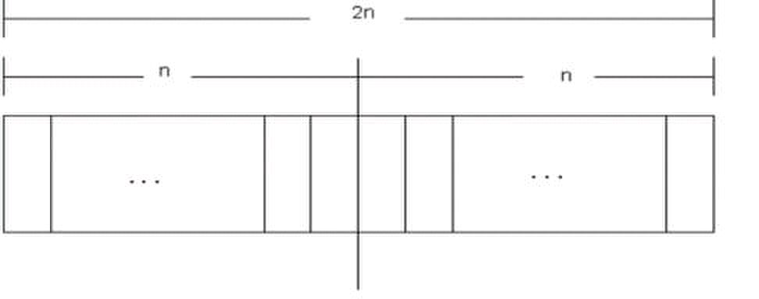
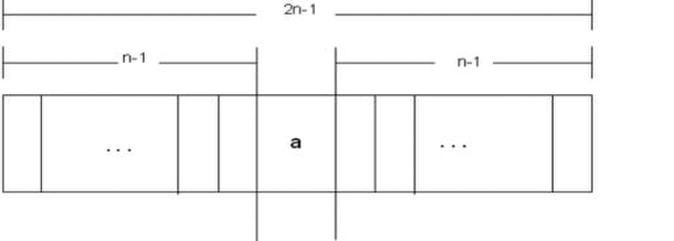
Theory of Automata (CS402)
{an 2 : n=1,2,3,…}, can be written as
{a, aaaa, aaaaaaaaa,…}
Example
The language DOUBLESQUARE, of strings defined over Σ={a,b}, as
{an 2 bn 2 : n=1,2,3,…}, can be written as
{ab, aaaabbbb, aaaaaaaaabbbbbbbbb,…}
Example
The language PRIME, of strings defined over Σ={a}, as
{ap : p is prime}, can be written as
{aa,aaa,aaaaa,aaaaaaa,aaaaaaaaaaa…}
An Important language
PALINDROME
The language consisting of Λ and the strings s defined over Σ such that Rev(s)=s.
It is to be denoted that the words of PALINDROME are called palindromes.
Example
For Σ={a,b},
PALINDROME={Λ , a, b, aa, bb, aaa, aba, bab, bbb, ...}
Remark
There are as many palindromes of length 2n as there are of length 2n-1.
To prove the above remark, the following is to be noted:
Note
Number of strings of length ‘m’ defined over alphabet of ‘n’ letters is nm.
Examples
The language of strings of length 2, defined over Σ={a,b} is L={aa, ab, ba, bb} i.e. number of strings = 22
The language of strings of length 3, defined over Σ={a,b} is L={aaa, aab, aba, baa, abb, bab, bba, bbb} i.e.
number of strings = 23
To calculate the number of palindromes of length(2n), consider the following diagram,
which shows that there are as many palindromes of length 2n as there are the strings of length n i.e. the required
number of palindromes are 2n.
To calculate the number of palindromes of length (2n-1) with ‘a’ as the middle letter, consider the following
diagram,
which shows that there are as many palindromes of length 2n-1 as there are the strings of length n-1 i.e. the
required number of palindromes are 2n-1.
7
© Copyright Virtual University of Pakistan

Slide 8
Theory of Automata (CS402)
Similarly the number of palindromes of length 2n-1, with ‘ b ’ as middle letter, will be 2n-1 as well. Hence the
total number of palindromes of length 2n-1 will be 2n-1 + 2n-1 = 2 (2n-1)= 2n .
8
© Copyright Virtual University of Pakistan

Slide 9

Theory of Automata (CS402)
Theory of Automata
Lecture N0. 2
Reading Material
Introduction to Computer Theory Chapter 3
Summary
Kleene Star Closure, Plus operation, recursive definition of languages, INTEGER, EVEN, factorial,
PALINDROME, {anbn}, languages of strings (i) ending in a, (ii) beginning and ending in same letters, (iii)
containing aa or bb (iv) containing exactly one a
Kleene Star Closure
Given Σ, then the Kleene Star Closure of the alphabet Σ, denoted by Σ*, is the collection of all strings defined
over Σ, including Λ.
It is to be noted that Kleene Star Closure can be defined over any set of strings.
Examples
If Σ = {x}
Then Σ* = {Λ, x, xx, xxx, xxxx, ….}
If Σ = {0,1}
Then Σ* = {Λ, 0, 1, 00, 01, 10, 11, ….}
If Σ = {aaB, c}
Then Σ* = {Λ, aaB, c, aaBaaB, aaBc, caaB, cc, ….}
Note
Languages generated by Kleene Star Closure of set of strings, are infinite languages. (By infinite language, it is
supposed that the language contains infinite many words, each of finite length).
PLUS Operation (+)
Plus Operation is same as Kleene Star Closure except that it does not generate Λ (null string), automatically.
Example
If Σ = {0,1}
Then Σ+ = {0, 1, 00, 01, 10, 11, ….}
If Σ = {aab, c}
Then Σ+ = {aab, c, aabaab, aabc, caab, cc, ….}
Remark
It is to be noted that Kleene Star can also be operated on any string i.e. a* can be considered to be all possible
strings defined over {a}, which shows that a* generates Λ, a, aa, aaa, …
It may also be noted that a+ can be considered to be all possible non empty strings defined over {a}, which
shows that a+ generates a, aa, aaa, aaaa, …
Recursive definition of languages
The following three steps are used in recursive definition
Some basic words are specified in the language.
Rules for constructing more words are defined in the language.
No strings except those constructed in above, are allowed to be in the language.
Example
Defining language of INTEGER
Step 1: 1 is in INTEGER.
Step 2: If x is in INTEGER then x+1 and x-1 are also in INTEGER.
Step 3: No strings except those constructed in above, are allowed to be in INTEGER.
Example
9
© Copyright Virtual University of Pakistan

Slide 10

Theory of Automata (CS402)
Defining language of EVEN
Step 1: 2 is in EVEN.
Step 2: If x is in EVEN then x+2 and x-2 are also in EVEN.
Step 3: No strings except those constructed in above, are allowed to be in EVEN.
Example
Defining the language factorial
Step 1: As 0!=1, so 1 is in factorial.
Step 2: n!=n*(n-1)! is in factorial.
Step 3: No strings except those constructed in above, are allowed to be in factorial.
Defining the language PALINDROME, defined over Σ = {a,b}
Step 1: a and b are in PALINDROME
Step 2:
Step 3: No strings except those constructed in above, are allowed to be in palindrome
Defining the language {anbn }, n=1,2,3,… , of strings defined over Σ={a,b}
Step 1: ab is in {anbn}
Step 2: if x is in {anbn}, then axb is in {anbn}
Step 3: No strings except those constructed in above, are allowed to be in {anbn}
Defining the language L, of strings ending in a , defined over Σ={a,b}
Step 1: a is in L
Step 2:
Step 3: No strings except those constructed in above, are allowed to be in L
Defining the language L, of strings beginning and ending in same letters , defined over Σ={a, b}
Step 1: a and b are in L
Step 2:
Step 3: No strings except those constructed in above, are allowed to be in L
Defining the language L, of strings containing aa or bb , defined over Σ={a, b}
Step 1: aa and bb are in L
Step 2:
Step 3: No strings except those constructed in above, are allowed to be in L
Defining the language L, of strings containing exactly one a, defined over Σ={a, b}
Step 1: a is in L
Step 2:
Step 3: No strings except those constructed in above, are allowed to be in L
10
© Copyright Virtual University of Pakistan
if x is in L then s(x) is also in L, where s belongs to Σ*
(a)s(a) and (b)s(b) are also in L, where s belongs to Σ*
s(aa)s and s(bb)s are also in L, where s belongs to Σ*
s(aa)s is also in L, where s belongs to b*

Slide 11

Theory of Automata (CS402)
Theory of Automata
Lecture N0. 3
Reading Material
Introduction to Computer Theory Chapter 4
Summary
RE, Recursive definition of RE, defining languages by RE, { x}*, { x}+, {a+b}*, Language of strings having
exactly one a, Language of strings of even length, Language of strings of odd length, RE defines unique
language (as Remark), Language of strings having at least one a, Language of strings having at least one a and
one b, Language of strings starting with aa and ending in bb, Language of strings starting with and ending in
different letters.
Regular Expression
As discussed earlier that a* generates Λ, a, aa, aaa, … and a+ generates a, aa, aaa, aaaa, …, so the language L1
= {Λ, a, aa, aaa, …} and L2 = {a, aa, aaa, aaaa, …} can simply be expressed by a* and a+, respectively.
a* and a+ are called the regular expressions (RE) for L1 and L2 respectively.
Note
Recursive definition of Regular Expression(RE)
Step 1: Every letter of Σ including Λ is a regular expression.
Step 2: If r1 and r2 are regular expressions then
(r1)
r1 r2
r1 + r2 and
r1*
are also regular expressions.
Step 3: Nothing else is a regular expression.
Method 3 (Regular Expressions)
Consider the language L={Λ, x, xx, xxx,…} of strings, defined over Σ = {x}.
We can write this language as the Kleene star closure of alphabet Σ or L=Σ*={x}* .
This language can also be expressed by the regular expression x*.
Similarly the language L={x, xx, xxx,…}, defined over Σ = {x}, can be expressed by the regular expression x+.
Now consider another language L, consisting of all possible strings, defined over Σ = {a, b}. This language can
also be expressed by the regular expression (a + b)*.
Now consider another language L, of strings having exactly one a, defined over Σ = {a, b}, then it’s regular
expression may be b*ab*.
Now consider another language L, of even length, defined over Σ = {a, b}, then it’s regular expression may be
((a+b)(a+b))*.
Now consider another language L, of odd length, defined over Σ = {a, b}, then it’s regular expression may be
(a+b)((a+b)(a+b))* or ((a+b)(a+b))*(a+b).
Remark
It may be noted that a language may be expressed by more than one regular expression, while given a regular
expression there exist a unique language generated by that regular expression.
Example
Consider the language, defined over
Σ = {a , b} of words having at least one a, may be expressed by a regular expression (a+b)*a(a+b)*.
Consider the language, defined over Σ = {a, b} of words having at least one a and one b, may be expressed by a
regular expression (a+b)*a(a+b)*b(a+b)*+ (a+b)*b(a+b)*a(a+b)*.
Consider the language, defined over Σ ={a, b}, of words starting with double a and ending in double b then its
regular expression may be aa(a+b)*bb
Consider the language, defined over Σ ={a, b} of words starting with a and ending in b OR
starting with b and ending in a, then its regular expression may be a(a+b)*b+b(a+b)*a
11
© Copyright Virtual University of Pakistan
a+, aa* and a*a generate L2.

Slide 12

Theory of Automata (CS402)
Theory of Automata
Lecture N0. 4
Reading Material
Introduction to Computer Theory Chapter 4, 5
Summary
Regular expression of EVEN-EVEN language, Difference between a* + b* and (a+b)*, Equivalent regular
expressions; sum, product and closure of regular expressions; regular languages, finite languages are regular,
introduction to finite automaton, definition of FA, transition table, transition diagram
An important example
The Language EVEN-EVEN
Language of strings, defined over Σ={a, b} having even number of a’s and even number of b’s. i.e.
EVEN-EVEN = {Λ, aa, bb, aaaa,aabb,abab, abba, baab, baba, bbaa, bbbb,…}, its regular expression can be
written as (aa+bb+(ab+ba)(aa+bb)*(ab+ba))*
Note
It is important to be clear about the difference of the following regular expressions
r1 = a*+b*
r2 = (a+b)*
Here r1 does not generate any string of concatenation of a and b, while r2 generates such strings.
Equivalent Regular Expressions
Definition
Two regular expressions are said to be equivalent if they generate the same language.
Example
Consider the following regular expressions
r1 = (a + b)* (aa + bb)
r2 = (a + b)*aa + ( a + b)*bb then both regular expressions define the language of strings ending in aa or bb.
Note
If r1 = (aa + bb) and r2 = ( a + b) then
r1+r2 = (aa + bb) + (a + b)
r1r2 = (aa + bb) (a + b)
= (aaa + aab + bba + bbb)
(r1)* = (aa + bb)*
Regular Languages
Definition
The language generated by any regular expression is called a regular language.
It is to be noted that if r1, r2 are regular expressions, corresponding to the languages L1 and L2
then the languages generated by r1+ r2, r1r2( or r2r1) and r1*( or r2*) are also regular
languages.
Note
It is to be noted that if L1 and L2 are expressed by r1and r2, respectively then the language expressed by
r1+ r2, is the language L1 + L2 or L1 « L2
r1r2, , is the language L1L2, of strings obtained by prefixing every string of L1 with every string of L2
r1*, is the language L1*, of strings obtained by concatenating the strings of L, including the null string.
Example
If r1 = (aa+bb) and r2 = (a+b) then the language of strings generated by r1+r2, is also a regular language,
expressed by (aa+bb) + (a+b)
If r1 = (aa+bb) and r2 = (a+b) then the language of strings generated by r1r2, is also a regular language, expressed
by (aa+bb)(a+b)
If r = (aa+bb) then the language of strings generated by r*, is also a regular language, expressed by (aa+bb)*
12
© Copyright Virtual University of Pakistan

Slide 13

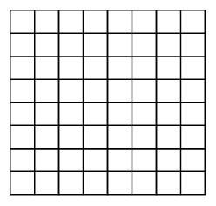
Theory of Automata (CS402)
All finite languages are regular
Example
Consider the language L, defined over Σ = {a,b}, of strings of length 2, starting with a, then
L = {aa, ab}, may be expressed by the regular expression aa+ab. Hence L, by definition, is a regular language.
Note
It may be noted that if a language contains even thousand words, its RE may be expressed, placing ‘ + ’ between
all the words.
Here the special structure of RE is not important.
Consider the language L = {aaa, aab, aba, abb, baa, bab, bba, bbb}, that may be expressed by a RE
aaa+aab+aba+abb+baa+bab+bba+bbb, which is equivalent to (a+b)(a+b)(a+b).
Introduction to Finite Automaton
Consider the following game board that contains 64 boxes
There are some pieces of paper. Some are of white colour while others are of black colour. The number of
pieces of paper are 64 or less. The possible arrangements under which these pieces of paper can be placed in the
boxes, are finite. To start the game, one of the arrangements is supposed to be initial arrangement. There is a
pair of dice that can generate the numbers 2,3,4,…12 . For each number generated, a unique arrangement is
associated among the possible arrangements.
It shows that the total number of transition rules of arrangement are finite. One and more arrangements can be
supposed to be the winning arrangement. It can be observed that the winning of the game depends on the
sequence in which the numbers are generated. This structure of game can be considered to be a finite automaton.
Method 4 (Finite Automaton)
Definition
A Finite automaton (FA), is a collection of the followings
Finite number of states, having one initial and some (maybe none) final states.
Finite set of input letters (Σ) from which input strings are formed.
Finite set of transitions i.e. for each state and for each input letter there is a transition showing how to move
from one state to another.
Example
Σ = {a,b}
States: x, y, z where x is an initial state and z is final state.
Transitions:
At state x reading a, go to state z
At state x reading b, go to state y
At state y reading a, b go to state y
At state z reading a, b go to state z
These transitions can be expressed by the following table called transition table
13
© Copyright Virtual University of Pakistan

Slide 14
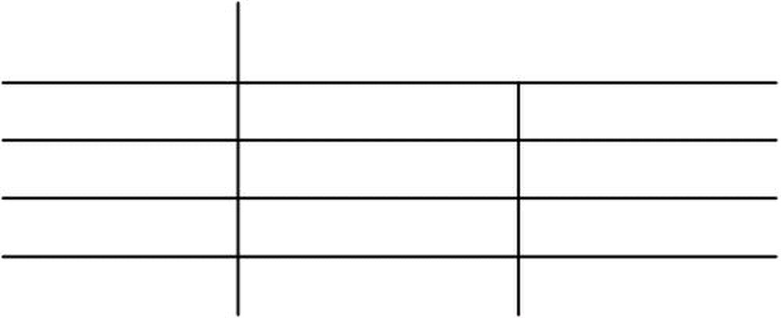
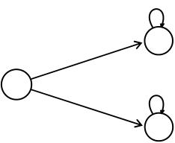
Theory of Automata (CS402)
Old States New States
Reading a Reading b
x - z y
y y y
z + z z
Note
It may be noted that the information of an FA, given in the previous table, can also be depicted by the following
diagram, called the transition diagram, of the given FA
b
x –
a
Remark
The above transition diagram is an FA accepting the language of strings, defined over Σ = {a, b}, starting with
a. It may be noted that this language may be expressed by the regular expression a(a + b)*
14
© Copyright Virtual University of Pakistan
a,b
y
a,b
Z+

Slide 15



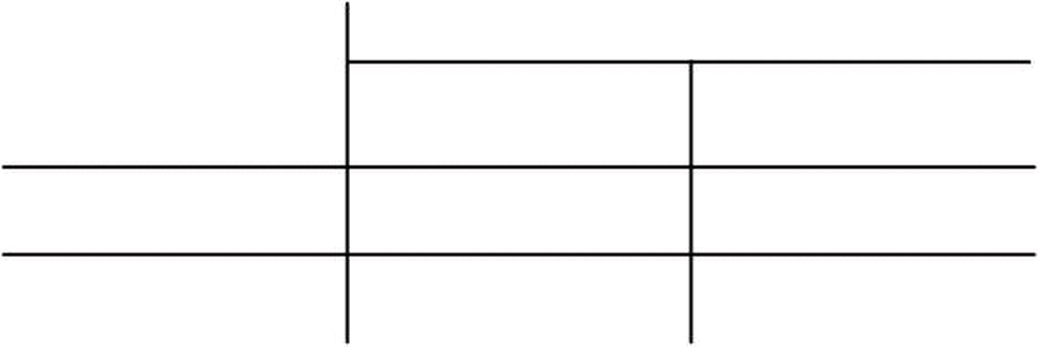

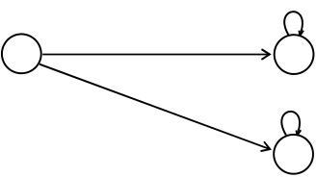
Theory of Automata (CS402)
Theory of Automata
Lecture N0. 5
Reading Material
Introduction to Computer Theory Chapter 5
Summary
Different notations of transition diagrams, languages of strings of even length, Odd length, starting with b,
ending in a, beginning with b, not beginning with b, beginning and ending in same letters
Note
It may be noted that to indicate the initial state, an arrow head can also be placed before that state and that the
final state with double circle, as shown below. It is also to be noted that while expressing an FA by its transition
diagram, the labels of states are not necessary.
a, b
Example
Σ = {a,b}
States: x, y, where x is both initial and final state.
Transitions:
At state x reading a or b go to state y.
At state y reading a or b go to state x.
These transitions can be expressed by the following transition table
New States
Old States
a b
x ± y y
y x x
It may be noted that the above transition table may be depicted by the following transition diagram.
a, b
x ±
a, b
The above transition diagram is an FA accepting the language of strings, defined over Σ={a, b} of even length.
It may be noted that this language may be expressed by the regular expression ((a+ b) (a + b))*
Example:
Consider the language L of strings, defined over Σ={a, b}, starting with b. The language L may be expressed
by RE b(a + b)* , may be accepted by the following FA a,b
––
a
1
Example
Consider the language L of strings, defined over Σ={a, b}, ending in a. The language L may be expressed by
RE (a+b)*a.
15
© Copyright Virtual University of Pakistan
a, b
Reading Reading
y
b
a,b

Slide 16


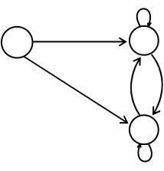
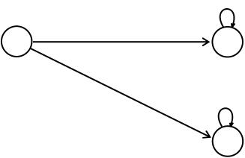
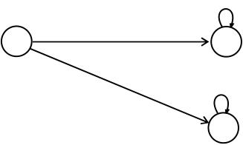
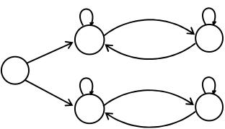
Theory of Automata (CS402)
This language may be accepted by the a
FA shown aside
– +
b
There may be another FA
corresponding to the given
language, as shown aside
b
Note
It may be noted that corresponding to a given language there may be more than one FA accepting that language,
but for a given FA there is a unique language accepted by that FA.
It is also to be noted that given the languages L1 and L2 ,where
L1 = The language of strings, defined over Σ ={a, b}, beginning with a.
L2 = The language of strings, defined over Σ ={a, b}, not beginning with b
The Λ does not belong to L1 while it does belong to L2 . This fact may be depicted by the corresponding
transition diagrams of L1 and L2.
FA1 Corresponding to L1 a,b
–
b
The language L1 may be expressed by the regular expression a(a + b)*
FA2 Corresponding to L2
±
b
The language L2 may be expressed by the regular expression a(a + b)* + Λ
Example
Consider the Language L of Strings of length two or more, defined over Σ = {a, b}, beginning with and
ending in same letters.
The language L may be expressed by the following regular expression a(a + b)*a + b(a + b)*b
It is to be noted that if the condition on the length of string is not imposed in the above language then
strings a and b will then belong to the language. a
This language L may be accepted by the FA as shown aside
a
–
b
a
16
© Copyright Virtual University of Pakistan
b
a
–
a b
b
a
a,b
a,b
a
a,b
b
b
a
+
a
a
+
+
a
+
b
+
the
b

Slide 17

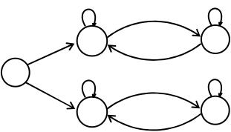






Theory of Automata (CS402)
Theory of Automata
Lecture N0. 6
Reading Material
Introduction to Computer Theory Chapter 5
Summary
Language of strings beginning with and ending in different letters, Accepting all strings, accepting non-
empty strings, accepting no string, containing double a’s, having double 0’s or double 1’s, containing
triple a’s or triple b’s, EVEN-EVEN
Example
Consider the Language L of Strings, defined over Σ = {a, b}, beginning with and ending in different letters.
The language L may be expressed by the following regular expression a(a + b)*b + b(a + b)*a
This language may be accepted by the following FA
a
1–
b
b
Example
Consider the Language L, defined over Σ = {a, b} of all strings including Λ. The language L may be accepted
by the following FA a,b
1±
The language L may also be accepted by the following FA
a,b
±
The language L may be expressed by the regular expression (a + b)*
Example
Consider the Language L , defined over Σ = {a, b} of all non empty strings
by the following FA
-
The above language may be expressed by the regular expression (a + b)+
Example
Consider the following FA, defined over Σ = {a, b}
a,b
-
It is to be noted that the above FA does not accept any string, even it does not accept the null string; as there is
no path starting from initial state and ending in final state.
Equivalent FAs
It is to be noted that two FAs are said to be equivalent, if they accept the same language, as shown in the
following FAs. a,b
FA1
17
© Copyright Virtual University of Pakistan
a b
2
b
3
a,b
a,b
a,b
a,b
–
b
a
a
5+
2+
+
+
4+
a

Slide 18





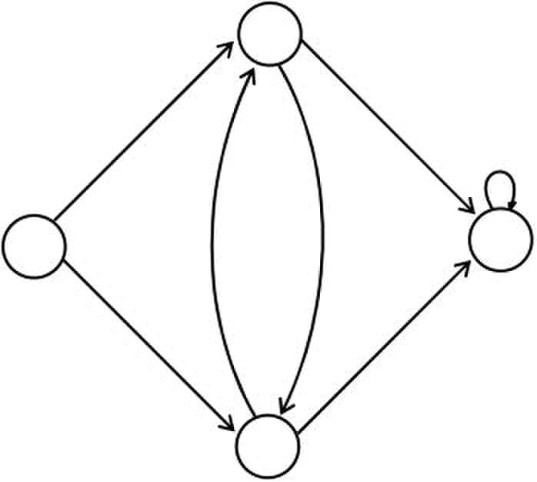
Theory of Automata (CS402)
a,b
FA2
a,b a,b
FA3
Note
FA1 has already been discussed, while in FA2, there is no final state and in FA3, there is a final state but FA3 is
disconnected as the states 2 and 3 are disconnected.
It may also be noted that the language of strings accepted by FA1, FA2 and FA3 is denoted by the empty set i.e.
{ } OR Ø
Example
Consider the Language L of strings , defined over Σ = {a, b}, containing double a.
The language L may be expressed by the regular expression (a+b)* (aa) (a+b)*. This language may be accepted
by the following FA.
1- 2
Example
Consider the language L of strings, defined over Σ={0, 1}, having double 0’s or double 1’s, The language L
may be expressed by the regular expression (0+1)* (00 + 11) (0+1)*
This language may be accepted by the following FA
x
0
0,1
- 0 +
1
y
18
© Copyright Virtual University of Pakistan
a,b
a,b
a
3+
1- 2
1- 2
b
a
b
0
1
1
3+

Slide 19

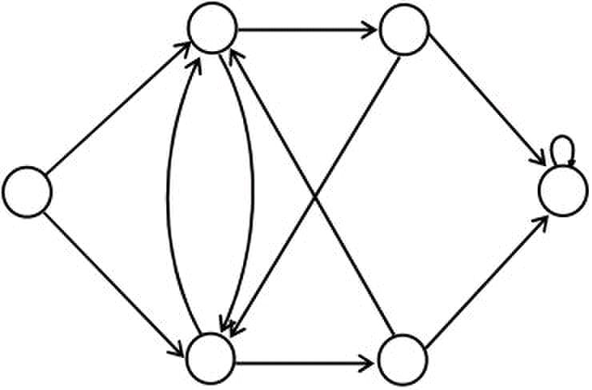
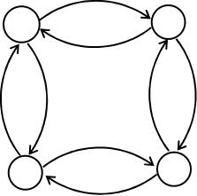
Theory of Automata (CS402)
Example
Consider the language L of strings, defined over Σ={a, b}, having triple a’s or triple b’s. The language L may
be expressed by RE (a+b)* (aaa + bbb) (a+b)*
This language may be accepted by the FA as shown aside
1–
b
3
b
1± 3
a a
b
2
Example
Consider the EVEN-EVEN language, defined over Σ = {a, b}. As discussed earlier that EVEN-EVEN
language can be expressed by the regular expression (aa+bb+(ab+ba)(aa+bb)*(ab+ba))*
EVEN-EVEN language may be accepted by the FA as shown aside
19
© Copyright Virtual University of Pakistan
a
b
6+
b
4
2
a
a b
a b
3
b
a a
b
4
a
5
a,b

Slide 20

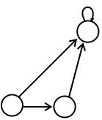

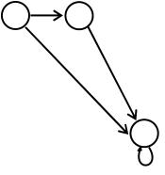
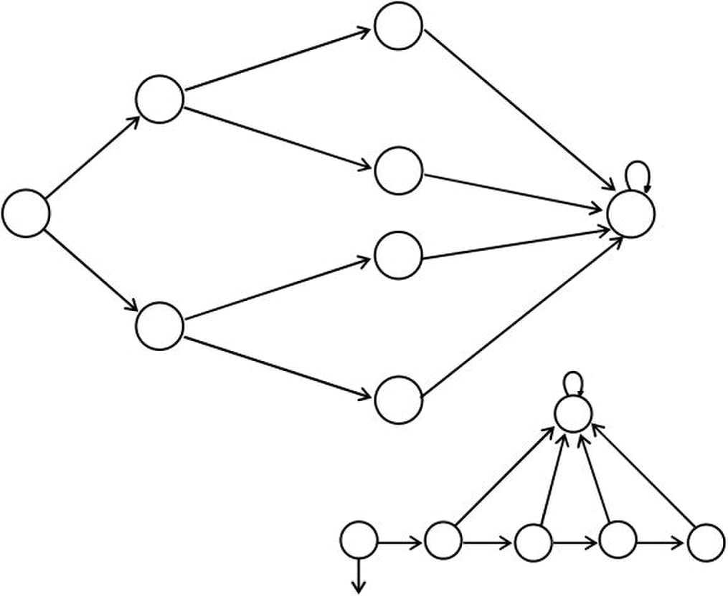
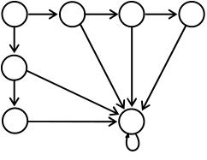
Theory of Automata (CS402)
Theory of Automata
Lecture N0. 7
Reading Material
Introduction to Computer Theory Chapter 5, 6
Summary
FA corresponding to finite languages(using both methods), Transition graphs.
FA corresponding to finite languages
Example
Consider the language
L = {Λ, b, ab, bb}, defined over Σ ={a, b}, expressed by Λ + b + ab + bb OR Λ + b (Λ + a + b).
The language L may be accepted by the FA as shown aside
y
a
1± 3
b
2+ 5+
It is to be noted that the states x and y are called
Dead States, Waste Baskets or Davey John Lockers, as the
moment one enters these states there is no way to leave it.
Note x
It is to be noted that to build an FA accepting the language having less number
of strings, the tree structure may also help in this regard, which can be observed
in the following transition diagram for the
Language L, discussed in the above example a
3
a
1± 8
b
2+
b
7+
b
Example
Consider the language 1– 2
L = {aa, bab, aabb, bbba}, defined over Σ ={a, b},
expressed by aa + bab + aabb + bbba
OR aa (Λ + bb) + b (ab + bba)
The above language may be accepted by the FA
as shown aside
b
11+
a,b
20
© Copyright Virtual University of Pakistan
a,b
a,b
a b
b
a
a,b
4
a,b
b
5+
a
a,b
a,b
x
a
a a
b
6
a
10
a,b
4+
a,b
a,b
6
a
3+
b
a
a
y
a,b
a,b
a,b
b
7
b
b
4
b a

Slide 21
Theory of Automata (CS402)
Example
Consider the language L = {w belongs to {a,b}*: length(w) ≥2 and w neither ends in aa nor bb}.
The language L may be expressed by the regular expression (a+b)*(ab+ba)
This language may be accepted by the following FA
21
© Copyright Virtual University of Pakistan

Slide 22
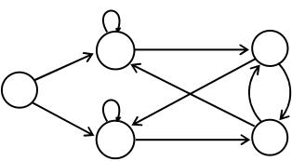
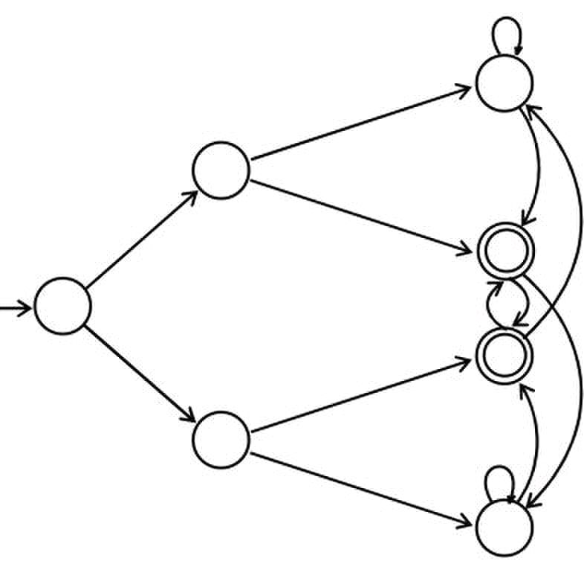
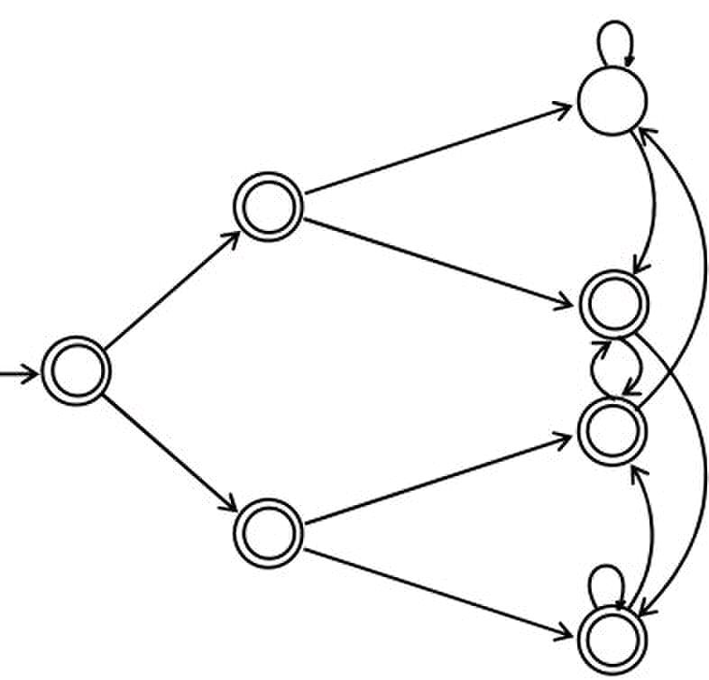
Theory of Automata (CS402)
a
a
1–
b
Note
It is to be noted that building an FA corresponding to the language L, discussed in the above example, seems to
be quite difficult, but the same can be done using tree structure along with the technique discussed in the book
Introduction to Languages and Theory of Computation, by J. C. Martin
so that the strings ending in aa, ab, ba and bb should end in the states labeled as aa, ab, ba and bb, respectively;
as shown in the following FA
a
a b
a
Λ a
b
b a
b
bb
Example
Consider the language FA corresponding to r1+r2 can be determined as
L = {w belongs to {a,b}*: w does not end in aa}.
The language L may be expressed by the regular expression Λ + a + b + (a+b)*(ab+ba+bb). This language may
be accepted by the following FA
a
a b
a
Λ a
b
b a
b
Method 5 (Transition Graph) bb
Definition:
A Transition graph (TG), is a collection of the followings
Finite number of states, at least one of which is start state and some (maybe none) final states.
Finite set of input letters (Σ) from which input strings are formed.
Finite set of transitions that show how to go from one state to another based on reading specified substrings of
input letters, possibly even the null string (Λ).
22
© Copyright Virtual University of Pakistan
b
b
b
a
ba
b
ba
b
2
a
b
3
a
aa
b a
ab
b
a
b
a
aa
b a
ab
b
a
b
a
5+

Slide 23


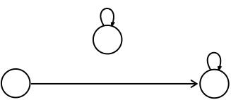



Theory of Automata (CS402)
Theory of Automata
Lecture N0. 8
Reading Material
Introduction to Computer Theory Chapter 6
Summary
Examples of TGs: accepting all strings, accepting none, starting with b, not ending in b, containing aa,
containing aa or bb
Note
It is to be noted that in TG there may exist more than one paths for certain string, while there may not exist any
path for certain string as well. If there exists at least one path for a certain string, starting from initial state and
ending in a final state, the string is supposed to be accepted by the TG, otherwise the string is supposed to be
rejected. Obviously collection of accepted strings is the language accepted by the TG.
Example
Consider the Language L , defined over Σ = {a, b} of all strings including Λ. The language L may be accepted
by the following TG a,b a,b
– +
The language L may also be accepted by the following TG
a,b
TG1
TG2 ± +
Example
Consider the following TGs
TG1
TG2 -
a,b
TG3
It may be observed that in the first TG, no transition has been shown. Hence this TG does not accept any string,
defined over any alphabet. In TG2 there are transitions for a and b at initial state but there is no transition at state
1. This TG still does not accept any string. In TG3 there are transitions at both initial state and state 1, but it does
not accept any string.
Thus none of TG1, TG2 and TG3 accepts any string, i.e. these TGs accept empty language. It may be noted that
TG1 and TG2 are TGs but not FA, while TG3 is both TG and FA as well.
It may be noted that every FA is a TG as well, but the converse may not be true, i.e. every TG may not be an
FA.
Example
Consider the language L of strings, defined over Σ={a, b}, starting with b. The language L may be expressed
by RE b(a + b)* , may be accepted by the following TG
æ +
23
© Copyright Virtual University of Pakistan
L
±
a, b
a, b
-
a,b
b
a,b
a, b
-
1

Slide 24

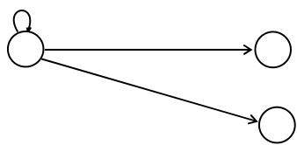

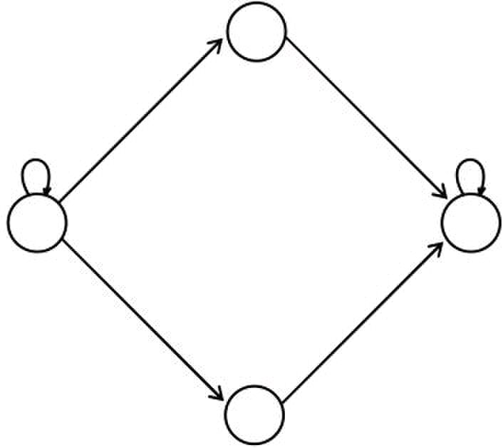



Theory of Automata (CS402)
Example
Consider the language L of strings, defined over Σ={a, b}, not ending in b. The language L may be expressed
by RE Λ + (a + b)*a , may be accepted by the following TG
a,b
–
Λ
+
Example
Consider the Language L of strings, defined over Σ = {a, b}, containing double a.
The language L may be expressed by the following regular expression (a+b)* (aa) (a+b)*. This language may be
accepted by the following TG
1- 2+
Example
Consider the language L of strings, defined over Σ={a, b}, having double a or double b.
The language L can be expressed by RE (a+b)* (aa + bb) (a+b)*.
The above language may also be expressed by the following TGs.
x
a a
a,b
– +
b
y
OR
-
OR
a,b a,b
1- 2+
a,b a,b
3- 4+
Note
In the above TG if the states are not labeled then it may not be considered to be a single TG
24
© Copyright Virtual University of Pakistan
a
b,a b,a
aa
a,b
b
a,b a,b
aa,bb
aa
bb
+

Slide 25

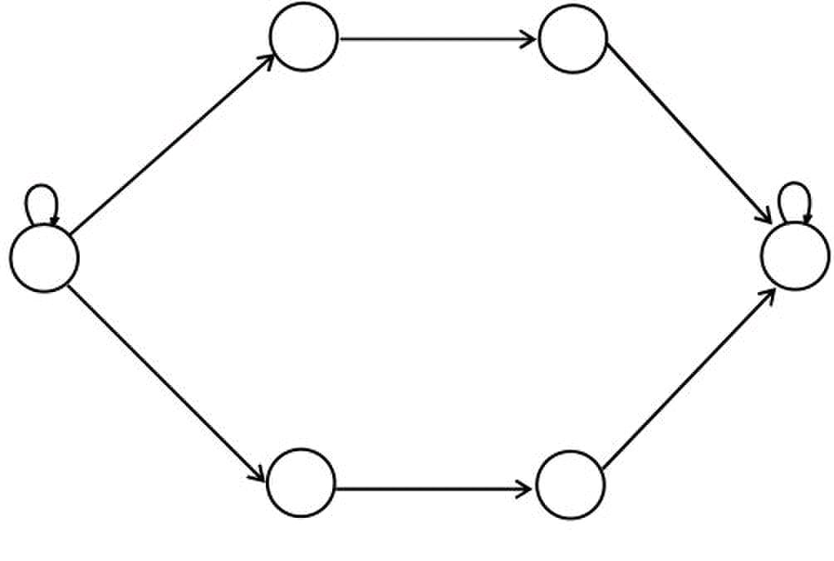
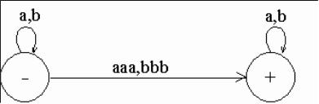
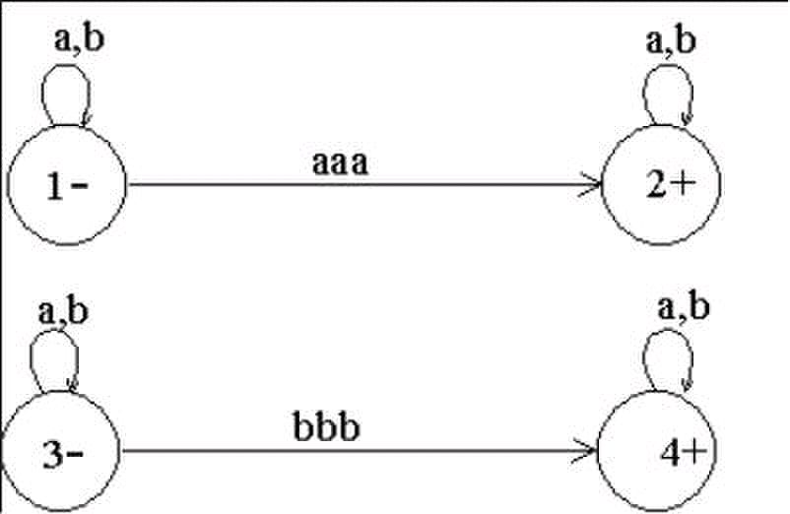
Theory of Automata (CS402)
Theory of Automata
Lecture N0. 9
Reading Material
Introduction to Computer Theory Chapter 6
Summary
TGs accepting the languages: containing aaa or bbb, beginning and ending in different letters,
beginning and ending in same letters, EVEN-EVEN, a’s occur in even clumps and ends in
three or more b’s, example showing different paths traced by one string, Definition of GTG
Example
Consider the language L of strings, defined over Σ = {a, b}, having triple a or triple b. The language L may
be expressed by RE (a+b)* (aaa + bbb) (a+b)*
This language may be accepted by the following TG
2
a a
a,b
1– 6+
b b
3 5
OR
OR
Example
Consider the language L of strings, defined over Σ = {a, b}, beginning and ending in different letters.
The language L may be expressed by RE a(a + b)*b + b(a + b)*a
The language L may be accepted by the following TG
25
© Copyright Virtual University of Pakistan
a
a,b
b

Slide 26

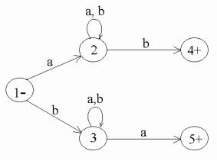
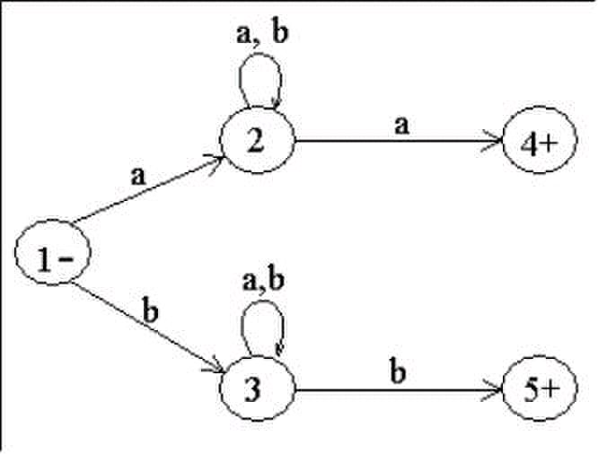
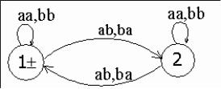
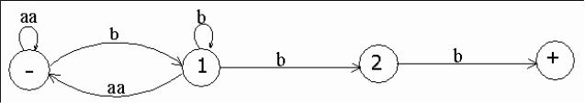
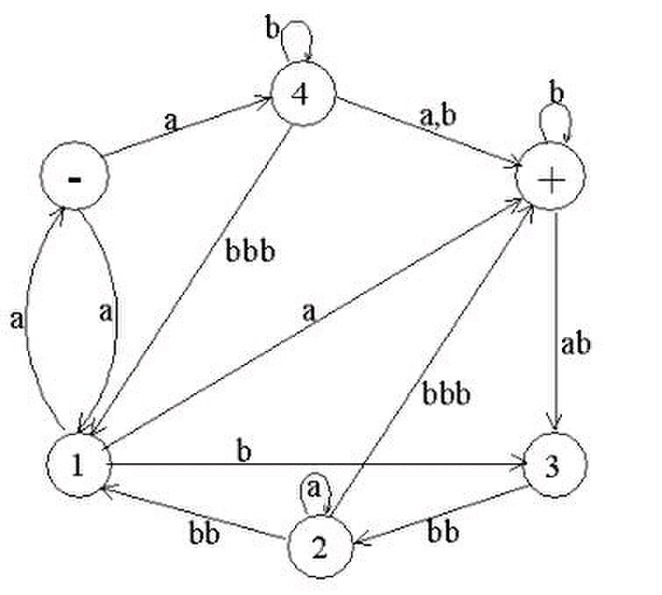
Theory of Automata (CS402)
Example
Consider the Language L of strings of length two or more, defined over Σ = {a, b}, beginning with and
ending in same letters.
The language L may be expressed by the following regular expression a(a + b)*a + b(a + b)*b
This language may be accepted by the following TG
Example
Consider the EVEN-EVEN language, defined over Σ = {a, b}. As discussed earlier that EVEN-EVEN
language can be expressed by a regular expression (aa+bb+(ab+ba)(aa+bb)*(ab+ba))*
The language EVEN-EVEN may be accepted by the following TG
Example
Consider the language L, defined over Σ={a, b}, in which a’s occur only in even clumps and that ends in
three or more b’s. The language L can be expressed by its regular expression
The language L may be accepted by the following TG
Example
Consider the following TG
26
© Copyright Virtual University of Pakistan
(aa)*b(b*+( (aa)+b)*) bb.

Slide 27
Theory of Automata (CS402)
Consider the string abbbabbbabba. It may be observed that the above string traces the following three paths,
(using the states)
(a)(b) (b) (b) (ab) (bb) (a) (bb) (a)
(-)(4)(4)(+)(+)(3)(2)(2)(1)(+)
(a)(b) ((b)(b)) (ab) (bb) (a) (bb) (a)
(-)(4)(+)(+)(+)(3)(2)(2)(1)(+)
(a)((b) (b)) (b) (ab) (bb) (a) (bb) (a)
(-) (4)(4)(4)(+) (3)(2)(2)(1)(+)
Which shows that all these paths are successful, (i.e. the path starting from an initial state and ending in a final
state).
Hence the string abbbabbbabba is accepted by the given TG.
Generalized Transition Graphs
A generalized transition graph (GTG) is a collection of three things
Finite number of states, at least one of which is start state and some (maybe none) final states.
Finite set of input letters (Σ) from which input strings are formed.
Directed edges connecting some pair of states labeled with regular expression.
It may be noted that in GTG, the labels of transition edges are corresponding regular expressions
27
© Copyright Virtual University of Pakistan

Slide 28

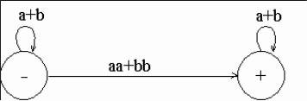
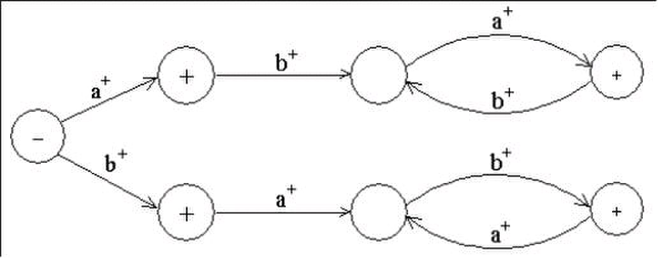
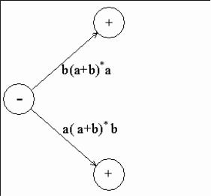

Theory of Automata (CS402)
Theory of Automata
Lecture N0. 10
Reading Material
Introduction to Computer Theory Chapter 6, 7
Summary
Examples of GTG accepting the languages of strings: containing aa or bb, beginning with and ending in same
letters, beginning with and ending in different letters, containing aaa or bbb,
Nondeterminism, Kleene’s theorem (part I, part II, part III), proof of Kleene’s theorem part I
Example
Consider the language L of strings, defined over Σ = {a,b}, containing double a or double b. The language L
can be expressed by the following regular expression (a+b)* (aa + bb) (a+b)*
The language L may be accepted by the following GTG.
Example
Consider the Language L of strings, defined over Σ = {a, b}, beginning with and ending in same letters.
The language L may be expressed by the following regular expression (a+b)+ a(a + b)*a + b(a + b)*b.
This language may be accepted by the following GTG
Example
Example
Consider the language L of strings of, defined over Σ = {a, b}, beginning and ending in different letters.
The language L may be expressed by RE a(a + b)*b + b(a + b)*a
The language L may be accepted by the following GTG
The language L may be accepted by the following GTG as well
Example
Consider the language L of strings, defined over Σ = {a, b}, having triple a or triple b. The language L may be
expressed by RE (a+b)* (aaa + bbb) (a+b)*
This language may be accepted by the following GTG
28
© Copyright Virtual University of Pakistan

Slide 29
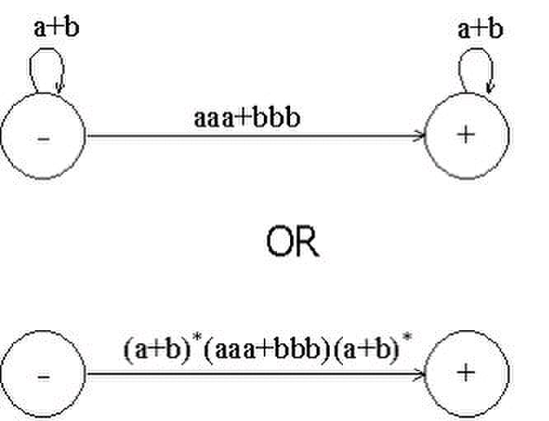
Theory of Automata (CS402)
Nondeterminism
TGs and GTGs provide certain relaxations i.e. there may exist more than one path for a certain string or there
may not be any path for a certain string, this property creates nondeterminism and it can also help in
differentiating TGs or GTGs from FAs. Hence an FA is also called a Deterministic Finite Automaton (DFA).
Kleene’s Theorem
If a language can be expressed by
FA or
TG or
RE
then it can also be expressed by other two as well.
It may be noted that the theorem is proved, proving the following three parts
Kleene’s Theorem Part I
If a language can be accepted by an FA then it can be accepted by a TG as well.
Kleene’s Theorem Part II
If a language can be accepted by a TG then it can be expressed by an RE as well.
Kleene’s Theorem Part III
If a language can be expressed by a RE then it can be accepted by an FA as well.
Proof(Kleene’s Theorem Part I)
Since every FA can be considered to be a TG as well, therefore there is nothing to prove.
29
© Copyright Virtual University of Pakistan

Slide 30

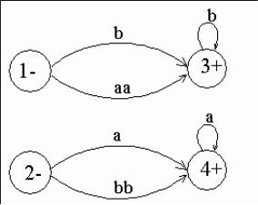
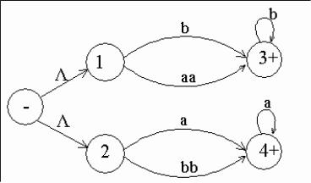
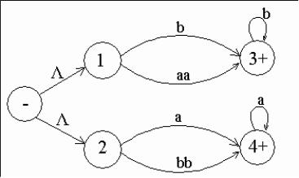
Theory of Automata (CS402)
Theory of Automata
Lecture N0. 11
Reading Material
Introduction to Computer Theory Chapter 7
Summary
proof of Kleene’s theorem part II (method with different steps), particular examples of TGs to determine
corresponding REs.
Proof(Kleene’s Theorem Part II)
To prove part II of the theorem, an algorithm consisting of different steps, is explained showing how a RE can
be obtained corresponding to the given TG. For this purpose the notion of TG is changed to that of GTG i.e. the
labels of transitions are corresponding REs.
Basically this algorithm converts the given TG to GTG with one initial state along with a single loop, or one
initial state connected with one final state by a single transition edge. The label of the loop or the transition edge
will be the required RE.
Step 1 If a TG has more than one start states, then introduce a new start state connecting the new state to the old
start states by the transitions labeled by Λ and make the old start states the non-start states. This step can be
shown by the following example
Example
The above TG can be converted to
Step 2:
If a TG has more than one final states, then introduce a new final state, connecting the old final states to the new
final state by the transitions labeled by Λ.
This step can be shown by the previous example of TG, where the step 1 has already been processed
Example
30
© Copyright Virtual University of Pakistan

Slide 31
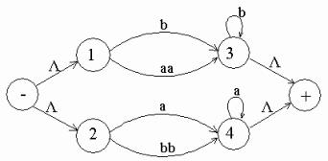
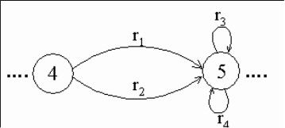
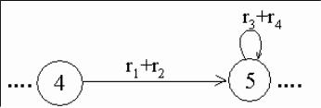
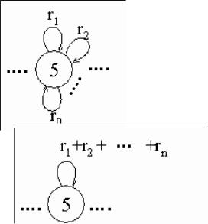


Theory of Automata (CS402)
The above TG can be converted to
Step 3:
If a state has two (more than one) incoming transition edges labeled by the corresponding REs, from the same
state (including the possibility of loops at a state), then replace all these transition edges with a single transition
edge labeled by the sum of corresponding REs.
This step can be shown by a part of TG in the following example
Example
The above TG can be reduced to
Note
The step 3 can be generalized to any finite number of transitions as shown below
The above TG can be reduced to
Step 4 (bypass and state elimination)
If three states in a TG, are connected in sequence then eliminate the middle state and connect the first state with
the third by a single transition (include the possibility of circuit as well) labeled by the RE which is the
concatenation of corresponding two REs in the existing sequence. This step can be shown by a part of TG in the
following example
Example
To eliminate state 5 the above can be reduced to
Consider the following example containing a circuit
31
© Copyright Virtual University of Pakistan
r3

Slide 32

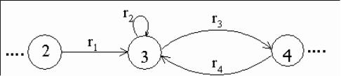
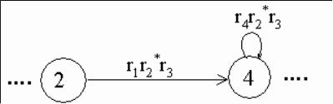
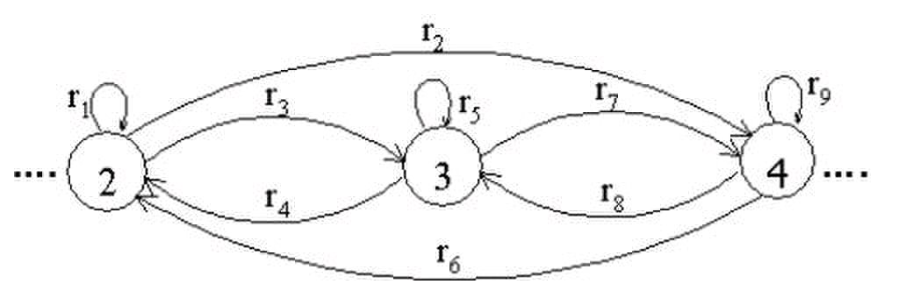
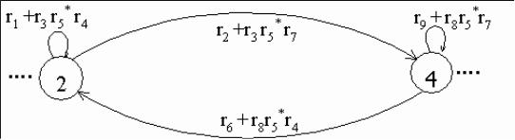
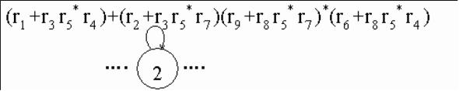
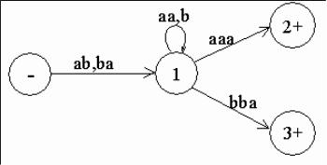

Theory of Automata (CS402)
Example
Consider the part of a TG, containing a circuit at a state, as shown below
To eliminate state 3 the above TG can be reduced to
Example
Consider a part of the following TG
To eliminate state 3 the above TG can be reduced to
To eliminate state 4 the above TG can be reduced to
Note
It is to be noted that to determine the RE corresponding to a certain TG, four steps have been discussed. This
process can be explained by the following particular examples of TGs
Example
Consider the following TG
To have single final state, the above TG can be reduced to the following
32
© Copyright Virtual University of Pakistan

Slide 33


Theory of Automata (CS402)
To eliminate states 2 and 3, the above TG can be reduced to the following
To eliminate state 1 the above TG can be reduced to the following
Hence the required RE is (ab+ba)(aa+b)*(aaa+bba)
33
© Copyright Virtual University of Pakistan

Slide 34






Theory of Automata (CS402)
Theory of Automata
Lecture N0. 12
Reading Material
Introduction to Computer Theory Chapter 7
Summary
Examples of writing REs to the corresponding TGs, RE corresponding to TG accepting EVEN-EVEN language,
Kleene’s theorem part III (method 1:union of FAs), examples of FAs corresponding to simple REs, example of
Kleene’s theorem part III (method 1) continued
Example
Consider the following TG
To have single initial and single final state the above TG can be reduced to the following
To obtain single transition edge between 1 and 3; 2 and 4, the above can be reduced to the following
To eliminate states 1,2,3 and 4, the above TG can be reduced to the following TG
OR
34
© Copyright Virtual University of Pakistan

Slide 35






Theory of Automata (CS402)
To connect the initial state with the final state by single transition edge, the above TG can be reduced to the
following
Hence the required RE is (b+aa)b*+(a+bb)a*
Example
Consider the following TG, accepting EVEN-EVEN language
1±
It is to be noted that since the initial state of this TG is final as well and there is no other final state, so to obtain
a TG with single initial and single final state, an additional initial and a final state are introduced as shown in the
following TG
To eliminate state 2, the above TG may be reduced to the following
To have single loop at state 1, the above TG may be reduced to the following
To eliminate state 1, the above TG may be reduced to the following
Hence the required RE is (aa+bb+(ab+ba)(aa+bb)*(ab+ba))*
Kleene’s Theorem Part III
Statement:
If the language can be expressed by a RE then there exists an FA accepting the language.
35
© Copyright Virtual University of Pakistan

Slide 36





Theory of Automata (CS402)
As the regular expression is obtained applying addition, concatenation and closure on the letters of an alphabet
and the Null string, so while building the RE, sometimes, the corresponding FA may be built easily, as shown in
the following examples
Example
Consider the language, defined over Σ = {a,b}, consisting of only b, then this language may be accepted by the
following FA
which shows that this FA helps in building an FA accepting only one letter
Example
Consider the language, defined over Σ = {a,b}, consisting of only Ÿ, then this language may be accepted by the
following FA
As, if r1 and r2 are regular expressions then their sum, concatenation and closure are also regular expressions, so
an FA can be built for any regular expression if the methods can be developed for building the FAs
corresponding to the sum, concatenation and closure of the regular expressions along with their FAs. These
three methods are explained in the following discussion
Method1 (Union of two FAs): Using the FAs corresponding to r1 and r2 an FA can be built, corresponding to
r1+ r2. This method can be developed considering the following examples
Example
Let r1 = (a+b)*b defines L1 and the FA1 be
and r2 = (a+b )*aa(a+b )* defines L2 and FA2 be
Let FA3 be an FA corresponding to r1+ r2, then the initial state of FA3 must correspond to the initial state of FA1
or the initial state of FA2.
Since the language corresponding to r1+ r2 is the union of corresponding languages L1 and L2, consists of the
strings belonging to L1or L2 or both, therefore a final state of FA3 must correspond to a final state of FA1 or FA2
or both.
Since, in general, FA3 will be different from both FA1 and FA2, so the labels of the states of FA3 may be
supposed to be z1,z2, z3, …, where z1 is supposed to be the initial state. Since z1 corresponds to the states x1 or y1,
so there will be two transitions separately for each letter read at z1. It will give two possibilities of states either z1
or different from z1. This process may be expressed in the following transition table for all possible states of
FA3.
36
© Copyright Virtual University of Pakistan

Slide 37



Theory of Automata (CS402)
New States after reading
Old States
a b
z1–∫(x1,y1) (x1,y2) ∫z2 (x2,y1) ∫ z3
z2 ∫(x1,y2) (x1,y3) ∫z4 (x2,y1) ∫ z3
z3+ ∫(x2,y1) (x1,y2) ∫ z2 (x2,y1) ∫ z3
z4+ ∫(x1,y3) (x1,y3) ∫ z4 (x2,y3) ∫ z5
z5+ ∫(x2,y3) (x1,y3) ∫ z4 (x2,y3) ∫ z5
RE corresponding to the above FA may be r1+r2 = (a+b)*b + (a+b )*aa(a+b )*.
Note: Further examples are discussed in the next lecture.
37
© Copyright Virtual University of Pakistan

Slide 38








Theory of Automata (CS402)
Theory of Automata
Lecture N0. 13
Reading Material
Introduction to Computer Theory Chapter 7
Summary
Examples of Kleene’s theorem part III (method 1) continued, Kleene’s theorem part III (method 2:
Concatenation of FAs), Example of Kleene’s theorem part III (method 2 : Concatenation of FAs)
Note
It may be noted that the example discussed at the end of previous lecture, FA1 contains two states while FA2
contains three states. Hence the total number of possible combinations of states of FA1 and FA2, in sequence,
will be six. For each combination the transitions for both a and b can be determined, but using the method in the
example, number of states of FA3 was reduced to five.
Example
Let r1 = (a+b)*a and the corresponding FA1 be
b
x1-
b
also r2 = (a+b)((a+b)(a+b))* or ((a+b)(a+b))*(a+b) and FA2 be
a,b
y1- y2+
FA corresponding to r1+r2 can be determined as
b
x1- x2+ y1-
b a,b
New States after reading
Old States
a b
z1-∫(x1,y1) (x2,y2) ∫z2 (x1,y2) ∫ z3
z2+∫(x2,y2) (x2,y1) ∫z4 (x1,y1) ∫ z1
z3+ ∫(x1,y2) (x2,y1) ∫z4 (x1,y1) ∫ z1
z4+ ∫(x2,y1) (x2,y ) ∫ z
z1- z2+
b b
a
z3+
Example
Let r1 = ((a+b)(a+b))* and the corresponding FA1 be a,b
x1±
38
© Copyright Virtual University of Pakistan
a
a
z4+
x2
a
x2+
a,b
a
y2+
2
b
a a
b
a,b
2
(x1,y2) ∫ z3

Slide 39








Theory of Automata (CS402)
also r2 = (a+b)((a+b)(a+b))* or ((a+b)(a+b))*(a+b) and FA2 be
a,b
y1-
FA corresponding to r1+r2 can be determined as
New States after reading
Old States
a b
z1±∫(x1,y1) (x2,y2) ∫z2 (x2,y2) ∫ z2
z2+∫(x2,y2) (x1,y1) ∫z1 (x1,y1) ∫ z1
Hence the required FA will be as follows
z1± z2+
Method2 (Concatenation of two FAs):
Using the FAs corresponding to r1 and r2, an FA can be built, corresponding to r1r2. This method can be
developed considering the following examples
Example
Let r1 = (a+b)*b defines L1 and FA1 be
x1- x2+
a
and r2 = (a+b )*aa (a+b )* defines L2 and FA2 be
b
y1-
Let FA3 be an FA corresponding to r1r2, then the initial state of FA3 must correspond to the initial state of FA1
and the final state of FA3 must correspond to the final state of FA2.Since the language corresponding to r1r2 is
the concatenation of corresponding languages L1 and L2, consists of the strings obtained, concatenating the
strings of L1 to those of L2 , therefore the moment a final state of first FA is entered, the possibility of the
initial state of second FA will be included as well.
Since, in general, FA3 will be different from both FA1 and FA2, so the labels of the states of FA3 may be
supposed to be z1,z2, z3, …, where z1 stands for the initial state. Since z1 corresponds to the states x1, so there
will be two transitions separately for each letter read at z1. It will give two possibilities of states which
correspond to either z1 or different from z1. This process may be expressed in the following transition table for
all possible states of FA3
a b
x1-
a
b
y1-
© Copyright Virtual University of Pakistan
y2+
a,b
a,b
a,b
a
a
a
b
b
x2+
a
b
y3+
a
b
a,b
y2
a,b
y2
39
y3+

Slide 40



Theory of Automata (CS402)
New States after reading
Old States
a b
z1-∫x1 x1∫z1 (x2,y1)∫ z2
z2∫(x2,y1) (x1,y2)∫z3 (x2,y1)∫ z2
z3∫(x1,y2) (x1,y3)∫z4 (x2,y1)∫ z2
z4+∫(x1,y3) (x1,y3)∫ z4 (x2,y1,y3)∫ z5
z5+∫(x2,y1,y3) (x1,y2 ,y3)∫ z6 (x2,y1,y3)∫ z5
z6+∫(x1,y2,y3) (x1,y3)∫ z4 (x2 ,y1,y3)∫ z5
Hence the required FA will be as follows
z2
b
a
a
b
z6+ z5+
a
Note: Another example is discussed in the next lecture.
40
© Copyright Virtual University of Pakistan
b
a
b
a
z1- z4+ a
b
b
z3

Slide 41






Theory of Automata (CS402)
Theory of Automata
Lecture N0. 14
Reading Material
Introduction to Computer Theory Chapter 7
Summary
Examples of Kleene’s theorem part III (method 1) continued ,Kleene’s theorem part III (method 2:
Concatenation of FAs), Examples of Kleene’s theorem part III(method 2:concatenation FAs) continued,
Kleene’s theorem part III (method 3:closure of an FA), examples of Kleene’s theorem part III(method 3:Closure
of an FA) continued
Example
Let r1 = ((a+b)(a+b))* and the corresponding FA1 be
x1±
also r2 = (a+b)((a+b)(a+b))* or ((a+b)(a+b))*(a+b) and FA2 be
a,b
y1-
a,b
FA corresponding to r1r2 can be determined as
New States after reading
Old States
a b
z1-∫(x1,y1) (x2,y2) ∫z2 (x2,y2) ∫ z2
z2+∫(x2,y2) (x1,y1) ∫z1 (x1,y1) ∫ z1
Hence the required FA will be as follows
a,b
y1-
Method3: (Closure of an FA)
Building an FA corresponding to r*, using the FA corresponding to r.
It is to be noted that if the given FA already accepts the language expressed by the closure of certain RE, then
the given FA is the required FA. However the method, in other cases, can be developed considering the
following examples
Closure of an FA, is same as concatenation of an FA with itself, except that the initial state of the required FA
is a final state as well. Here the initial state of given FA, corresponds to the initial state of required FA and a
non final state of the required FA as well.
Example
Let r = (a+b)*b and the corresponding FA be
a b
x1- x2+
a
© Copyright Virtual University of Pakistan
a,b
a,b
y2+
y2+
a,b
b
41

Slide 42








Theory of Automata (CS402)
then the FA corresponding to r* may be determined as under
a
x1-
a a
New States after reading
Old States
Final z1 ±∫x1 x1∫z2 (x2,x1)∫ z3
Non-final z2∫x1 x1∫z2 (x2,x1)∫z3
z3+∫(x2,x1) x1∫z2 (x2,x1)∫z3
The corresponding transition diagram may be as under
z1±
b a
b
z3+ z2
b
Example
Let r = (a+b)*aa(a+b)* and the corresponding FA be
b
y1-
then the FA corresponding to r* may be determined as under
New States after reading
Old States
Final z1±∫y1 y2∫z3 y1∫ z2
Non-Final z2∫y1 y2∫z3 y1∫ z2
z3∫y2 (y3,y1)∫z4 y1∫ z2
z4+∫(y3,y1) (y3 ,y1,y2)∫ z5 (y3,y1)∫ z4
z5+∫(y3,y1,y2) (y3,y1 ,y2)∫z5 (y3,y1)∫ z4
The corresponding transition diagram may be
b
z1±
b
z2
b 42
© Copyright Virtual University of Pakistan
b
z4+
x1- x2+
a,b
y2 y3+
z3
b
x2+
a b
a
a
a
a
b
a b
a
a
a
b
a
b

Slide 43






Theory of Automata (CS402)
Example
Consider the following FA, accepting the language of strings with b as second letter
y1-
y4
then the FA corresponding to r* may be determined as under
New States after reading
Old States
z1±∫y1 y2∫z2 y2∫ z2
z2∫y2 y4∫z3 (y3,y1)∫ z4
z3∫y4 y4∫z3 y4∫z3
z4+∫(y3,y1) (y3 ,y1 ,y2)∫ z5 (y3 ,y1 ,y2)∫ z5
z5+∫(y3,y1,y2) (y3,y1 ,y2 ,y4)∫ z6 (y3,y1,y2)∫ z5
z6∫(y1,y1 ,y2 ,y4) (y1,y1 ,y2 ,y4)∫z6 (y1,y1 ,y2 ,y4)∫z6
The corresponding transition diagram may be a,b
z1±
b
z4+ z5+
a
z6+ a,b
43
© Copyright Virtual University of Pakistan
a,b
a,b
a,b
a b
a,b
a,b
b
a
y2
a
z2
b
z3

Slide 44




Theory of Automata (CS402)
Theory of Automata
Lecture N0. 15
Reading Material
Introduction to Computer Theory Chapter 7
Summary
Examples of Kleene’s theorem part III (method 3), NFA, examples, avoiding loop using NFA, example,
converting FA to NFA, examples, applying an NFA on an example of maze
Note
It is to be noted that as observed in the examples discussed in previous lecture, if at the initial state of the given
FA, there is either a loop or an incoming transition edge, the initial state corresponds to the final state and a non-
final state as well, of the required FA, otherwise the initial state of given FA will only correspond to a single
state of the required FA (i.e. the initial state which is final as well).
Nondeterministic Finite Automaton (NFA)
Definition
An NFA is a TG with a unique start state and a property of having single letter as label of transitions. An NFA is
a collection of three things
Finite many states with one initial and some final states
Finite set of input letters, say, S = {a, b, c}
Finite set of transitions, showing where to move if a letter is input at certain state (Ÿ is not a valid transition),
there may be more than one transition for certain letters and there may not be any transition for certain letters.
Observations
It may be observed, from the definition of NFA, that the string is supposed to be accepted, if there exists at least
one successful path, otherwise rejected.
It is to be noted that an NFA can be considered to be an intermediate structure between FA and TG.
The examples of NFAs can be found in the following
Example a
1-
a
4
It is to be noted that the above NFA accepts the language consisting of a and ab.
Example
1-
It is to be noted that the above NFA accepts the language of strings, defined over Σ = {a, b}, containing aa.
Note
It is to be noted that NFA helps to eliminate a loop at certain state of an FA. This process is done converting the
loop into a circuit. But during this process the FA remains no longer FA and is converted to a corresponding
NFA, which is shown in the following example.
…
a b
Example
Consider a part of the following FA with an
alphabet Σ = {a,b,c,d} c
…
44
© Copyright Virtual University of Pakistan
2+
a
b
a,b
a
4
… 7
d
6 10
3
a,b
2 3+
a
5
…
5+
a
8
b
…

Slide 45







Theory of Automata (CS402)
To eliminate the loop at state 7, the corresponding NFA may be as follows
…
a
…
… 6
Converting an FA to an equivalent NFA
It is to be noted that according to the Kleene’s theorem, if a language can be accepted by an FA, then there
exists a TG accepting that language. Since, an NFA is a TG as well, therefore there exists an NFA accepting the
language accepted by the given FA. In this case these FA and NFA are said to be equivalent to each others.
Following are the examples of FAs to be converted to the equivalent NFAs
Example
Consider the following FA corresponding to (a+b)*b
a
-
The above FA may be equivalent to the following NFA
a,b
–
Can the structure of above NFA be compared with the corresponding RE ?
Example
Consider the following FA
–
The above FA may be equivalent to the following NFA
a, b
–
Can the structure of above NFA be compared with the corresponding RE ?
Application of an NFA
There is an important application of an NFA in artificial intelligence, which is discussed in the following
example of a maze
- 1 2 3
4 L 5 O
6 M 7 P
8 N 9 +
45
© Copyright Virtual University of Pakistan
b
c
a
b b
7 10
b
+
a
1 +
1 +
a
c
…
a,b
4 8
5
c d
b
a
b
b
a
b
a, b
a a
d
9
+

Slide 46
Theory of Automata (CS402)
46
© Copyright Virtual University of Pakistan

Slide 47



Theory of Automata (CS402)
Theory of Automata
Lecture N0. 16
Reading Material
Introduction to Computer Theory Chapter 7
Summary
Applying an NFA on an example of maze, NFA with null string, examples, RE corresponding to NFA with null
string (task), converting NFA to FA (method 1,2,3) examples
Application of an NFA
There is an important application of an NFA in artificial intelligence, which is discussed in the following
example of a maze
- 1 2 3
4 L 5 O
6 M 7 P
8 N 9 +
- and + indicate the initial and final states respectively. One can move only from a box labeled by other then L,
M, N, O, P to such another box. To determine the number of ways in which one can start from the initial state
and end in the final state, the following NFA using only single letter a, can help in this regard
a a a
- 1 2 3
a a a
a
4 5
a
a
6
a a a
It can be observed that the shortest path which leads from the initial state and ends in the final state, consists of
six steps i.e. the shortest string accepted by this machine is aaaaaa. The next larger accepted string is aaaaaaaa.
Thus if this NFA is considered to be a TG then the corresponding regular expression may be written as
aaaaaa(aa)*
Which shows that there are infinite many required ways
Note
It is to be noted that every FA can be considered to be an NFA as well , but the converse may not true.
It may also be noted that every NFA can be considered to be a TG as well, but the converse may not true.
It may be observed that if the transition of null string is also allowed at any state of an NFA then what will be
the behavior in the new structure. This structure is defined in the following
NFA with Null String
Definition
If in an NFA, Ÿ is allowed to be a label of an edge then the NFA is called NFA with Ÿ (NFA-Ÿ).
An NFA-Ÿ is a collection of three things
Finite many states with one initial and some final states.
Finite set of input letters, say, S = {a, b, c}.
Finite set of transitions, showing where to move if a letter is input at certain state.
47
© Copyright Virtual University of Pakistan
a
a
9 +
a
a a
a a
8 7

Slide 48






Theory of Automata (CS402)
There may be more than one transitions for certain letter and there may not be any transition
for a certain letter. The transition of Ÿ is also allowed at any state.
Example
Consider the following NFA with Null string
a,b
–
The above NFA with Null string accepts the language of strings, defined over Σ = {a, b}, ending in b.
Example
Consider the following NFA with Null string
a,b
–
The above NFA with Null string accepts the language of strings, defined over Σ = {a, b}, ending in a.
Note
It is to be noted that every FA may be considered to be an NFA-Ÿ as well, but the converse may not true.
Similarly every NFA-Ÿ may be considered to be a TG as well, but the converse may not true.
NFA to FA
Two methods are discussed in this regard.
Method 1: Since an NFA can be considered to be a TG as well, so a RE corresponding to the given NFA can be
determined (using Kleene’s theorem). Again using the methods discussed in the proof of Kleene’s theorem, an
FA can be built corresponding to that RE. Hence for a given NFA, an FA can be built equivalent to the NFA.
Examples have, indirectly, been discussed earlier.
Method 2: Since in an NFA, there may be more than one transition for a certain letter and there may not be any
transition for certain letter, so starting from the initial state corresponding to the initial state of given NFA, the
transition diagram of the corresponding FA, can be built introducing an empty state for a letter having no
transition at certain state and a state corresponding to the combination of states, for a letter having more than
one transitions. Following are the examples
Example 2
Consider the following NFA a b
1- 4+
b
3
Using the method discussed earlier, the above NFA may be equivalent to the following FA
1-
b
b
a a, b
3
48
© Copyright Virtual University of Pakistan
L, a a
a
a
4+ a
b
L
+
1 +
2
∆ a, b

Slide 49




Theory of Automata (CS402)
Example
A simple NFA that accepts the language of strings defined over S = {a,b}, consists of bb and bbb
b
1-
The above NFA can be converted to the following FA
1-
a
∆
a, b
Method 3: As discussed earlier that in an NFA, there may be more than one transition for a certain letter and
there may not be any transition for certain letter, so starting from the initial state corresponding to the initial
state of given NFA, the transition table along with new labels of states, of the corresponding FA, can be built
introducing an empty state for a letter having no transition at certain state and a state corresponding to the
combination of states, for a letter having more than one transitions. Further examples are discussed in the next
lecture.
49
© Copyright Virtual University of Pakistan
b
b
a
b
b
a,b
2
a
(3,4)+
4+

Slide 50





Theory of Automata (CS402)
Theory of Automata
Lecture N0. 17
Reading Material
Introduction to Computer Theory Chapter 7
Summary
converting NFA to FA (method 3), example, NFA and Kleene’s theorem method 1, examples, NFA and
Kleene’s theorem method 2 , NFA corresponding to union of FAs, example
Method 3: As discussed earlier that in an NFA, there may be more than one transition for a certain letter and
there may not be any transition for certain letter, so starting from the initial state corresponding to the initial
state of given NFA, the transition table along with new labels of states, of the corresponding FA, can be built
introducing an empty state for a letter having no transition at certain state and a state corresponding to the
combination of states, for a letter having more than one transitions. Following are the examples
Example
Consider the following NFA which accepts the language of strings containing bb
a,b
x1-
Using the method discussed earlier, the transition table corresponding to the required FA may be constructed as
New States after reading
Old States
a b
z1-∫x1 x1∫z1 (x1,x2)∫z2
z2∫(x1,x2) (x1 , ∆)∫x1∫z1 (x1 ,x2,x3) ∫z3
z3+∫(x1,x2,x3) (x1,x3)∫z4 (x1 ,x2,x3)∫z3
z4+∫ (x1,x3) (x1,x3)∫z4 (x1 ,x2,x3)∫z3
The corresponding transition diagram follows as
a
z1-
NFA and Kleene’s Theorem
It has been discussed that, by Kleene’s theorem part III, there exists an FA corresponding to a given RE. If the
given RE is as simple as r = aa+bbb or r = a(a+b)*, the corresponding FAs can easily be constructed. However,
for a complicated RE, the RE can be decomposed into simple REs corresponding to which the FAs can easily be
constructed and hence, using the method, constructing the FAs corresponding to sum, concatenation and closure
of FAs, the required FA can also be constructed. It is to be noted that NFAs also help in proving Kleene’s
theorem part III, as well. Two methods are discussed in the following.
NFA and Kleene’s Theorem
Method 1:
The method is discussed considering the following example.
Example
To construct the FAs for the languages L1 = {a}, L2 = {b} and L3 = {Ÿ}
Step 1: Build NFA1, NFA2 and NFA3 corresponding to L1, L2 and L3 , respectively as shown in the following
diagram
50
© Copyright Virtual University of Pakistan
b b
b
a
b
x3+
a
b
a

Slide 51









Theory of Automata (CS402)
NFA1
NFA2 æ
NFA3
Step 2:
As discussed earlier for every NFA there is an FA equivalent to it, hence there must be FAs for the above
mentioned NFAs as well. The corresponding FAs can be considered as follows
–
FA1
1
a,b
a,b
±
FA3
NFA and Kleene’s Theorem method 2
It may be observed that if an NFA can be built corresponding to union, concatenation and closure of FAs
corresponding to the REs, then converting the NFA, thus, obtained into an equivalent FA, this FA will
correspond to the given RE.
Followings are the procedures showing how to obtain NFAs equivalent to union, concatenation and closure of
FAs
NFA corresponding to Union of FAs
Method
Introduce a new start state and connect it with the states originally connected with the old start state with the
same transitions as the old start state, then remove the –ve sign of old start state. This creates non-determinism
and hence results in an NFA.
Example
x1- x2
NFA1
a b
x4+
b
a
b
NFA2
51
© Copyright Virtual University of Pakistan
+
a
+
FA2
1
a
x3
æ
b
a
b
1
a,b
a,b
b
a
b
a
a,b
y1- y2+
+
±
b
a
– +
a,b
a,b

Slide 52

Theory of Automata (CS402)
a b
-
b
a
b
a a, b
y1
NFA equivalent to FA1«FA2
52
© Copyright Virtual University of Pakistan
a
b a
x4+
y2+
x2
a b
b
b
a
x3

Slide 53




Theory of Automata (CS402)
Theory of Automata
Lecture N0. 18
Reading Material
Introduction to Computer Theory Chapter 7
Summary
NFA corresponding to union of FAs, example, NFA corresponding to concatenation of FAs, examples, NFA
corresponding to closure of an FA, example
Example
FA1 p-
2 4
a
FA2 1–
b
3
b
p q
b
-
b
1 6+
b b
b
NFA equivalent to FA1«FA2
NFA corresponding to Concatenation of FAs
Method
Introduce additional transitions for each letter connecting each final state of the first FA with the states of
second FA that are connected with the initial state of second FA corresponding to each letter of the alphabet.
Remove the +ve sign of each of final states of first FA and –ve sign of the initial state of second FA. It will
create non-determinism at final states of first FA and hence NFA, thus obtained, will be the required NFA.
Note
It may be noted that if first FA accepts the Null string then every string accepted by second FA must be accepted
by the concatenation of FAs as well. This situation will automatically be accommodated using the method
discussed earlier. However if the second FA accepts Null string, then every string accepted by first FA must be
accepted by the required FA as well. This target can be achieved as, while introducing new transitions at final
states of first FA the +ve sign of these states will not be removed.
53
© Copyright Virtual University of Pakistan
b
b
a
b
a b
a b
3
a
b
a
a a
a a,b
a b
a
3 5
a
a,b
5
4
a
a
q
a
6+
b
a
+
2
b
+
a,b

Slide 54







Theory of Automata (CS402)
Lastly if both FAs accepts the Null string, then the Null string must be accepted by the required FA. This
situation will automatically be accommodated as the second FA accepts the Null string and hence the +ve signs
of final states of first FA will not be removed.
Example (No FA accepts Null string)
b
FA1
2
a
FA2
b
3
b
p- q
b
b
NFA equivalent to FA1FA2
Example (FA2 accepts Null string)
b
p-
FA1
x ±
FA2
b
p-
a, b
a, b
x +
a, b
54
© Copyright Virtual University of Pakistan
a,b
a
b
4
a
a b
b
2
a,b
r
a b
a,b
q
a, b
q
a
p-
a
b
1–
a b
3
a
a
b
b
3 5
a
a
b
a, b
y
a
a
b
y
q
a,b
6+
5
a
a
1
r+
a,b
r+
4
a
a
6+
b a,b
b

Slide 55





Theory of Automata (CS402)
NFA equivalent to FA1FA2
Example (Both FAs accept Null string)
FA1
a, b
b
1± 3
FA2
2
b
a, b
± y 3
a, b
a
b
NFA equivalent to FA1FA2 b
NFA corresponding to the Closure of an FA
Apparently, it seems that since closure of an FA accepts the Null string, so the required NFA may be obtained
considering the initial state of given FA to be final as well, but this may allow the unwanted string to be
accepted as well. For example, an FA, with two states, accepting the language of strings, defined over. S = {a,
b}, ending in a, will accept all unwanted strings, if the initial state is supposed to be final as well.
Method
Thus, to accommodate this situation, introduce an initial state which should be final as well (so that the Null
string is accepted) and connect it with the states originally connected with the old start state with the same
transitions as the old start state, then remove the –ve sign of old start state. Introduce new transitions, for each
letter, at each of the final states (including new final state) with those connected with the old start state.This
creates non-determinism and hence results in the required NFA.
Example
Consider the following FA b
1- 2
It may be observed that the FA* accepts only the additional string which is the Null string.
Considering the state 1 to be final as well, will allow the unwanted strings be accepted as well. Hence the
required NFA is constructed introducing the new initial state, shown below.
a
b
±
b
© Copyright Virtual University of Pakistan
a, b
x ±
b
a a
b
b
1+
a a a a
2
a
a
b
a
b
55
y
a a
4
b
b
4
a,b
3+
a
a,b
a
b

Slide 56


Theory of Automata (CS402)
Example
Consider the following FA b
1–
b
It may be observed that the FA* accepts only the additional string which is the Null string
As observed in the previous example the required NFA can be constructed only if the new initial state is
introduced as shown below. a
b a
±
b
56
© Copyright Virtual University of Pakistan
a
2 +
b
a
2 +

Slide 57






Theory of Automata (CS402)
Theory of Automata
Lecture N0. 19
Reading Material
Introduction to Computer Theory Chapter 7
Summary
NFA corresponding to Closure of FA, Examples, Memory required to recognize a language, Example,
Distinguishing one string from another, Example, Theorem, Proof
Example
Consider the following FA
It can be observed that FA*not only accepts the Null string but every other string as well.
Here we don’t need separate initial and final state. Hence an NFA corresponding to FA* may be
a,b a,b
Example
Consider the following FA
q
0
0,1
p-
1
The NFA corresponding to FA* may be as follows
0 0
±
1
1 1
r
Memory required to recognize a language
Memory required to recognize a language means to look at the machine which can recognize a language. As an
FA can be considered to be a machine which is simple model of computation and every regular language is
associated with certain FA, so to recognize a language there is a restriction that there is a single pass from left to
right for any string to decide whether it belongs to certain language ? This helps to remember the information
about the initial part of the string read so far.
By this process the input string is examined and the string is decided either to be in a certain language or not.
Consider L = {w Œ {a,b}*: w neither ends in ab nor in ba}. i.e. L is the language of strings, defined over Σ =
{a,b}, consisting of Λ, a, b and strings ending in aa or bb. L may be accepted by the following FA
57
© Copyright Virtual University of Pakistan
a,b
1±
1±
0
0 1 s+
1
r
q
0
p
1
a, b
a, b a, b
0
0
s+
2+ 3
0,1
1

Slide 58

Theory of Automata (CS402)
a
a
a b
a
Λ
b
b
b
bb
As seen in the above FA, seven states are required to recognize the language L, while on the other hand it is
very hard to recognize the language PALINDROME.
As seen in the above example of FA, seven states are required to recognize that language. Now consider another
language L3 of strings of length three or more, defined over Σ = {a,b}, and the third letter from the right is a.
As discussed by Martin, there is a straight forward method to build an FA recognizing L3 i.e. a distinct state for
every possible substring of length less then or equal to 3. It is obvious that for each length i, i=0,1,2,3, of
substring, the number of states are 2i and thus total number of states required to recognize the language L3 are
20+21+22+23 = 23+1-1=15 (using 20+21+22+…+ 2n= 2n+1-1)
Remark: Let L20 be the language of strings of length 20 or more, defined over Σ = {a,b}, and the 20th letter
from the right is 1, then following the previous method, number of states for the corresponding FA is
220+1-1=2,097,151.
However, it may be noted that any portion of memory of a computer that can accommodate 21 bits can be in 221
possible states i.e. 221 possible choices for the informational content.
Distinguishable strings and Indistinguishable strings
Two strings x and y, belonging to Σ*, are said to be distinguishable w.r.t a language L ⊆ Σ* if there exists a
string z belonging to Σ* s.t. xz Œ L but yz œ L or xz œ L but yz Œ L .
Two strings x and y, belonging to Σ*, are said to be indistinguishable with respect to a language L ⊆ Σ* if for
every string z belonging to Σ*, either both xz or yz Œ L or both don’t belong to L.
Example
Let L be the language of strings, defined over Σ = {0,1}, ending in 01.
The strings 110 and 010011 are distinguishable w.r.t L, as there exists 1 belonging to Σ* s.t. 1101 belongs to L
but 0100111 doesn’t belong to L.
But 111 and 010011 are indistinguishable, for 1 belonging to Σ* s.t. both 1111 and 010011 don’t belong to L
i.e. for every z belonging to Σ*, either both 111z and 01001z belong to L, or both don’t belong to L.
Theorem
Statement
If L is a language over an alphabet Â and for integer n there are n strings from Â*, any two of which are
distinguishable w.r.t. language L, then any FA recognizes L must have at least n states.
(Note: There may not exist any FA which recognizes the given language.)
Proof
Let S be set of strings, any two of which are distinguishable w.r.t. language L. Let F1 be the FA which
recognizes the language L. To prove the theorem, it is sufficient to show that any two strings under F1 must be
ended in different states i.e. corresponding to each string x belonging to S, F1 ends in distinct states.
Thus if S has n strings then it is to be shown that F1 has at least n states.
58
© Copyright Virtual University of Pakistan
aa
b a
ab
b
a
b
a
ba
b
a

Slide 59
Theory of Automata (CS402)
Let x and y be any two strings from S. By supposition any two strings of S are distinguishable w.r.t. L, so there
exists a string z belonging to Â*such that only one of xz and yz belongs to L i.e.F1 ends in a final state either for
xz or yz which shows that F1 ends in distinct states for xz and yz.
Let F1 be ended in same state for both the strings x and y, which shows that F1ends in same state for both xz and
yz, a contradiction as x and y being distinguishable implies xz and yz are ended at distinct states of F1.
Hence F1 does not end in a same state for both strings x and y, which shows that each pair of strings belonging
to S ends in different states. Hence F1 must contain at least n states.
59
© Copyright Virtual University of Pakistan

Slide 60





Theory of Automata (CS402)
Theory of Automata
Lecture N0. 20
Reading Material
Introduction to Computer Theory Chapter 8
Summary
Example of previous Theorem, Finite Automaton with output, Moore machine, Examples
Example
Let L20={w Œ {0,1}*: |w| ≥ 20 and the 20th letter of w, from right is, 1}. Let S be the set of all strings of length
20, defined over Σ, any two of which are distinguishable w.r.t. L20. Obviously the number of strings belonging
to S, is 220. Let x and y be any two distinct strings i.e. they differ in ith letter, i=1,2,3,…20, from left. For i=1,
they differ by first letter from left.
Then by definition of L20, one is in L20 while other is not as shown below
0 . … .
1 . … .
So they are distinct w.r.t. L20 for z = L i.e. one of xz and yz belongs to L20.
Similarly if i=2 they differ by 2nd letter from left and are again distinguishable and hence for z belonging to Σ*,
|z|=1, either xz or yz belongs to L20 because in this case the 20th letter from the right of xz and yz is exactly the
2nd letter from left of x and y as shown below
. 0 … . z
. 1
Hence x and y will be distinguishable w.r.t. L20 for i=2, as well. Continuing the process it can be shown that any
pair of strings x and y belonging to S, will be distinguishable w.r.t. L20. Since S contains 220 strings, any two of
which are distinguishable w.r.t. L20, so using the theorem any FA accepting L20 must have at least 220 states.
Note
It may be observed from the above example that using Martin’s method, there exists an FA having
220+1-1=2,097,151 states. This indicates the memory required to recognize L20 will be the memory of a computer
that can accommodate 21-bits i.e.the computer can be in 221 possible states.
Finite Automaton with output
Finite automaton discussed so far, is just associated with the RE or the language.
There is a question whether does there exist an FA which generates an output string corresponding to each input
string ? The answer is yes. Such machines are called machines with output.
There are two types of machines with output. Moore machine and Mealy machine
Moore machine
A Moore machine consists of the following
A finite set of states q0, q1, q2, … where q0 is the initial state.
An alphabet of letters Σ = {a,b,c,…} from which the input strings are formed.
An alphabet G={x,y,z,…} of output characters from which output strings are generated.
A transition table that shows for each state and each input letter what state is entered the next.
An output table that shows what character is printed by each state as it is entered.
Note
It is to be noted that since in Moore machine no state is designated to be a final state, so there is no question of
accepting any language by Moore machine. However in some cases the relation between an input string and the
corresponding output string may be identified by the Moore machine. Moreover, the state to be initial is not
important as if the machine is used several times and is restarted after some time, the machine will be started
from the state where it was left off. Following are the examples
60
© Copyright Virtual University of Pakistan
…
.

Slide 61



Theory of Automata (CS402)
Example
Consider the following Moore machine having the states q0, q1, q2, q3 where q0 is the start state and
Σ = {a,b},
G={0,1}
the transition table follows as
Old States
a b
q0- q1 q3 1
q1 q3 q1 0
q2 q0 q3 0
q3 q3 q2 1
the transition diagram corresponding to the previous transition table may be
b
q0/1
a
q2/0
It is to be noted that the states are labeled along with the characters to be printed. Running the string abbabbba
over the above machine, the corresponding output string will be 100010101, which can be determined by the
following table as well
Input
State
output
It may be noted that the length of output string is l more than that of input string as the initial state prints out the
extra character 1, before the input string is read.
61
© Copyright Virtual University of Pakistan
New States after reading
to be printed
a
b a
b
b
a b b a b b b a
q0 q1 q1 q1 q3 q2 q3 q2 q0
1 0 0 0 1 0 1 0 1
Characters
q1/0
q3/1 a

Slide 62



Theory of Automata (CS402)
Theory of Automata
Lecture N0. 21
Reading Material
Introduction to Computer Theory Chapter 8
Summary
Example of Moore machine, Mealy machine, Examples, complementing machine, Incrementing machine.
Example
To identify the relation between the input strings and the corresponding output strings in the following Moore
machine,
a
q0/0
b
b
if the string bbbabaabbaa is run, the output string will be 000010000010, as shown below
Input b b b a b a a b b a a
State q0 q1 q2 q2 q3 q1 q0 q0 q1 q2 q3 q0
output 0 0 0 0 1 0 0 0 0 0 1 0
It can be observed from the given Moore machine that q3 is the only state which prints out the character 1 which
shows that the moment the state q3 is entered, the machine will print out 1. To enter the state q3, starting from q0
the string must contain bba. It can also be observed that to enter the state q3 once more the string must contain
another substirng bba. In general the input string will visit the state q3 as many times as the number of substring
bba occurs in the input string. Thus the number of 1’s in an output string will be same as the number of
substring bba occurs in the corresponding input string.
Mealy machine
A Mealy machine consists of the following
A finite set of states q0, q1, q2, … where q0 is the initial state.
An alphabet of letters Σ = {a,b,c,…} from which the input strings are formed.
An alphabet G={x,y,z,…} of output characters from which output strings are generated.
A pictorial representation with states and directed edges labeled by an input letter along with an output
character. The directed edges also show how to go from one state to another corresponding to every possible
input letter.
(It is not possible to give transition table in this case.)
Note
It is to be noted that since, similar to Moore machine, in Mealy machine no state is designated to be a final state,
so there is no question of accepting any language by Mealy machine. However in some cases the relation
between an input string and the corresponding output string may be identified by the Mealy machine. Moreover,
the state to be initial is not important as if the machine is used
several times and is restarted after some time, the machine
will be started from the state where it was left
a/0
off. Following are the examples
Example
Consider the Mealy machine shown aside, having the states q0, q1, q2, q3 , where q0 is the start state and
62
© Copyright Virtual University of Pakistan
a
b
a
q1
a/1
q0 b/0 q3 a/1
a
q2/0
q2
q1/0
b/1
b/1 a/0

Slide 63




Theory of Automata (CS402)
Σ = {a,b},
G={0,1}
Running the string abbabbba over the above machine, the corresponding output string will be 11011010, which
can be determined by the following table as well
Input a b b a b b b a
States q0 q1 q2 q3 q3 q0 q3 q0 q1
output 0 1 1 1 1 0 1 0
It may be noted that in Mealy machine, the length of output string is equal to that of input string.
Example
Consider the following Mealy machine having the states q0, q1, q2 , where q0 is the start state and
Σ = {a,b},
G={0,1}
a/0
q0
It is observed that in the above Mealy machine, if in the output string the nth character is 1, it shows that the nth
letter in the input string is the second in the pair of double letter.
For babaababba as input string the machine will print 0000100010.
Example
Consider the following Mealy machine having the only state q0 as the start state and
Σ = {0,1}, 0/1, 1/0
G= {0,1}
q0
If 0011010 is run on this machine then the corresponding output string will be 1100101.
This machine is called Complementing machine.
Constructing the incrementing machine
In the previous example of complementing machine, it has been observed that the input string and the
corresponding output string are 1’s complement of each other. There is a question whether the Mealy machine
can be constructed, so that the output string is increased, in magnitude, by 1 than the corresponding input string?
The answer is yes.
This machine is called the incrementing machine. Following is how to construct the incrementing machine.
Before the incrementing machine is constructed, consider how 1 is added to a binary number.
Since, if two numbers are added, the addition is performed from right to left, so while increasing the binary
number by 1, the string (binary number) must be read by the corresponding Mealy machine from right to left,
and hence the output string (binary number) will also be generated from right to left.
Consider the following additions
a) 100101110 b) 1001100111
+ 1 + 1
100101111 1001101000
It may be observed from the above that
If the right most bit of binary number, to be incremented, is 0, the output binary number can be obtained by
converting the right most bit to 1 and remaining bits unchanged.
If the right most bit of binary number is 1 then the output can be obtained, converting that 1 along with all its
concatenated 1’s to 0’s, then converting the next 0 to 1 and remaining bits unchanged.
The observations (a) and (b) help to construct the following Incrementing (Mealy) machine.
The Mealy machine have the states q0, q1, q2 , where q0 is the start state and
63
© Copyright Virtual University of Pakistan
b/0
a/0
q1
b/0
b/1

Slide 64

Theory of Automata (CS402)
Σ = {0,1},
G={0,1}
0/0,1/1
1/0
0/1 1/0
q0
It may be observed that, in the incrementing machine, if 0 is read at initial state q0, that 0 is converted to 1 and a
no change state q1 (no carry state) is entered where all 0’s and all 1’s remain unchanged. If 1 is read at initial
state, that 1 is converted to 0 and the state q2(owe carry state) is entered, where all 1’s are converted to 0’s and
at that state if 0 is read that 0 is converted to 1 and the machine goes to no change state.
If the strings 100101110 and 1001100111 are run over this machine, the corresponding output strings will be
100101111 and 1001101000 respectively.
Note
It is to be noted that if the string 111111 is run over the incrementing machine, the machine will print out
000000, which is not increased in magnitude by 1. Such a situation is called an overflow situation, as the length
of output string will be same as that of input string.
It may also be noted that there exists another incrementing machine with two states.
64
© Copyright Virtual University of Pakistan
0/1
q1

Slide 65

Theory of Automata (CS402)
Theory of Automata
Lecture N0. 22
Reading Material
Introduction to Computer Theory Chapter 8
Summary
Applications of complementing and incrementing machines, Equivalent machines, Moore equivalent to Mealy,
proof, example, Mealy equivalent to Moore, proof, example
Applications of Incrementing and Complementing machines
1’s complementing and incrementing machines which are basically Mealy machines are very much helpful in
computing.
The incrementing machine helps in building a machine that can perform the addition of binary numbers.
Using the complementing machine along with incrementing machine, one can build a machine that can perform
the subtraction of binary numbers, as shown in the following method
Subtracting a binary number from another
Method
To subtract a binary number b from a binary number a
Add 1’s complement of b to a (ignoring the overflow, if any)
Increase the result, in magnitude, by 1 (use the incrementing machine ). Ignoring the overflow if any.
Note: If there is no overflow in (1). Take 1’s complement once again in (2), instead. This situation occurs when
b is greater than a, in magnitude. Following is an example of subtraction of binary numbers
Example
To subtract the binary number 101 from the binary number 1110, let
a = 1110 and b = 101 = 0101.
(Here the number of digits of b are equated with that of a)
Adding 1’s complement (1010) of b to a.
1110
+1010
11000 which gives 1000 (ignoring the overflow)
Using the incrementing machine, increase the above result 1000, in magnitude, by 1
1000
+1
1001 which is the same as obtained by ordinary subtraction.
Note
It may be noted that the above method of subtraction of binary numbers may be applied to subtraction of
decimal numbers with the change that 9’s complement of b will be added to a, instead in step (1).
Equivalent machines
Two machines are said to be equivalent if they print the same output string when the same input string is run on
them.
Remark:
Two Moore machines may be equivalent. Similarly two Mealy machines may also be equivalent, but a Moore
machine can’t be equivalent to any Mealy machine. However, ignoring the extra character printed by the Moore
machine, there exists a Mealy machine which is equivalent to the Moore machine.
Theorem
Statement
For every Moore machine there is a Mealy machine that is equivalent to it (ignoring the extra character printed
by the Moore machine).
Proof:
Let M be a Moore machine, then shifting the output characters corresponding to each state to the labels of
corresponding incoming transitions, machine thus obtained will be a Mealy machine equivalent to M.
65
© Copyright Virtual University of Pakistan

Slide 66




Theory of Automata (CS402)
Note
It may be noted that while converting a Moore machine into an equivalent Mealy machine, the output character
of a state will be ignored if there is no incoming transition at that state. A loop at a state is also supposed to be
an incoming transition.
Following is the example of converting a Moore machine into an equivalent Mealy machine
Example
Consider the following Moore machine
b
a
Using the method described earlier, the above machine may be equivalent to the following Mealy machine
q0
b/0
a/0
Running the string abbabbba on both the machines, the output string can be determined by the following table
Input a b b a b b b a
States q0 q1 q2 q3 q3 q3 q3 q3 q3
Moore 0 1 0 1 1 1 1 1 1
Mealy 1 0 1 1 1 1 1 1
Theorem
Statement
For every Mealy machine there is a Moore machine that is equivalent to it (ignoring the extra character printed
the Moore machine).
Proof
Let M be a Mealy machine. At each state there are two possibilities for incoming transitions
The incoming transitions have the same output character.
The incoming transitions have different output characters.
If all the transitions have same output characters, then shift that character to the corresponding state.
If all the transitions have different output characters, then the state will be converted to as many states as the
number of different output characters for these transitions, which shows that if this happens at state qi then qi
will be converted to qi1 and qi for one
character and qi2 for other character.
Shift the output characters of the transitions to the corresponding new states q
and q
Moore machine equivalent to Mealy machine M.
Following is a note
Note
It may be noted that if there is no incoming transition at certain state then any of the output characters may be
associated with that state.
It may also be noted that if the initial state is converted into more than one new states then only one of these new
states will be considered to be the initial state. Following is an example
66
© Copyright Virtual University of Pakistan
a
b
q1
a/1
b/1 q3
1
i
1
i i
q0/0
b a
q2/0
a/1
b/0
q2
2 i.e. if at qi there are the transitions with two output characters then q
1
states q 2 should behave like qi as well. Continuing the process, the machine thus obtained, will be a
q3/1
a/1,b/1
i i
and q

Slide 67






Theory of Automata (CS402)
Example
Consider the following Mealy machine q1
a/0
q0
Shifting the output character 1 of transition b to q0
q1
a/0
q0/1
Shifting the output character 0 of transition a to q1
q1/0
a
q0/1
Shifting the output character 1 of transition b to q2
q1/0 q2/1
a
q0/1
Splitting q3 into q13 and q23
q1/0 q2/1
a
q0/1
b 3
b
q /0
Running the string abbabbba on both the machines, the output strings can be determined by the following table
Input a b b a b b b a
States q0 q1 q2 q3 q3 q0 q3 q0 q1
Mealy 0 1 1 1 1 0 1 0
Moore 1 0 1 1 1 1 0 1 0
67
© Copyright Virtual University of Pakistan
b/1
a/1
b/0 q3
b/1
b/1
a/1
b/0
b/1
a/1
b/0 q3
b
b
a/1
b/0 q3
b
b
a
a
b
q /1
a
2
3
q2
b/1 a/0
a/1
q2
b/1 a/0
b
q2
b/1 a/0
a/1
b/1 a/0
a/1
b
a
1
q3

Slide 68

Theory of Automata (CS402)
Theory of Automata
Lecture N0. 23
Reading Material
Introduction to Computer Theory Chapter 8
Summary
Mealy machines in terms of sequential circuit
Example
Consider the following sequential circuit
input
AND
The following four types of boxes are used in this circuit
NAND box (NOT AND): For the given input, it provides the complement of Boolean AND output.
DELAY box (Flip Flop box): It delays the transmission of signal along the wire by one step (clock pulse).
OR box: For the given input, it provides the Boolean OR output.
AND box: For the given input, it provides the Boolean AND output.
The current in the wire is indicated by 1 and 0 indicates the absence of the current.
There are two points A and B w.r.t. to which following four states of the machine are identified according to the
presence and absence of current at these points i.e.
q0(A=0, B=0) ∫ (0,0)
q1 (A=0, B=1) ∫ (0,1)
q2 (A=1, B=0) ∫ (1,0)
q3 (A=1, B=1) ∫ (1,1)
The operation of the circuit is such that the machine changes its state after reading 0 or 1. The
transitions are determined using the following relations
new B = old A
new A = (input) NAND (old A AND old B)
output = (input) OR (old B)
It is to be noted that old A and old B indicate the presence or absence of current at A and B before inputting any
letter. Similarly new A and new B indicate the presence or absence of current after reading certain letter.
At various discrete pulses of a time clock, input is received by the machine and the corresponding output string
is generated.
The transition at the state q0 after reading the letter 0, can be determined, along with the corresponding output
character as under
new B = old A = 0
new A = (input) NAND (old A AND old B)
= 0 NAND ( 0 AND 0) = 0 NAND 0
= 1
output = (input) OR (old B) = 0 OR 0 = 0
Thus after reading 0 at q0 new B is 0 and new A is 1 i.e. machine will be at state (1,0) ∫ q2 and during this
process it’s output character will be 0.
The remaining action of this sequential circuit can be determined as shown by the following suggested transition
table of the corresponding Mealy machine
68
© Copyright Virtual University of Pakistan
A
NAND

Slide 69





Theory of Automata (CS402)
Old state Inputting 0 Inputting 1
State Output State Output
q0 ∫(0,0) (1,0)∫q2 0 (1,0)∫q2 1
q1 ∫(0,1) (1,0)∫q2 1 (1,0)∫q2 1
q2 ∫(1,0) (1,1)∫q3 0 (1,1)∫q3 1
q3 ∫(1,1) (1,1)∫q3 1 (0,1)∫q1 1
The corresponding transition diagram may be as follows
q2
0/0, 1/1 0/0, 1/1
0/1
q0
1/1
q1
Note: It may be noted that if the string 00 is read at any state, it results in ending in state q3.
Running the string 01101110 on the previous machine, the output string can be determined by the following
table
Input 0 1 1 0 1 1 1 0
States q0 q2 q3 q1 q2 q3 q1 q2 q3
output 0 1 1 1 1 1 1 0
Following is a note regarding the sequential circuit under consideration
Note
input
AND
It is to be noted that in this sequential circuit, delay box plays an important role in introducing four states of the
machine.
69
© Copyright Virtual University of Pakistan
0/1 1/1
NAND
output

Slide 70










Theory of Automata (CS402)
Theory of Automata
Lecture N0. 24
Reading Material
Introduction to Computer Theory Chapter 9
Summary
Regular languages, complement of a language, theorem, proof, example, intersection of two regular languages
Regular languages
As already been discussed earlier that any language that can be expressed by a RE is said to be regular language,
so if L1 and L2 are regular languages then L1 + L2 , L1L2 and L1* are also regular languages. This fact can be
proved by the following two methods
By Regular Expressions
As discussed earlier that if r1, r2 are regular expressions, corresponding to the languages L1 and L2 then the
languages L1 + L2 , L1L2 and L1* generated by r1+ r2, r1r2 and r1*, are also regular languages.
By TGs
If L1 and L2 are regular languages then L1 and L2 can also be expressed by some REs as well and hence using
Kleene’s theorem, L1 and L2 can also be expressed by some TGs. Following are the methods showing that there
exist TGs corresponding to L1 + L2, L1L2 and L1*
If L1 and L2 are expressed by TG1 and TG2 then following may be a TG accepting L1 + L2
1-
TG1 TG2
n+ m+
If L1 and L2 are expressed by the following TG1 and TG2
1- TG1
then following may be a TG accepting L1L2
1- TG1
also a TG accepting L1* may be as under
1- TG1 n+
L
Example
Consider the following TGs
1± TG1 2
a,b a,b
p-
© Copyright Virtual University of Pakistan
L L
n+ p- m+
n
L
aa,bb
ab,ba
aaa,bbb
TG2
-
TG2
L
ab,ba
q+
p m+
aa,bb
70

Slide 71





Theory of Automata (CS402)
Following may be a TG accepting L1+L2
-
L
aa,bb
1± TG1 q+
ab,ba
also a TG accepting L1L2 may be
aa,bb
TG1
ab,ba
and a TG accepting L2*
p-
L
Complement of a language
Let L be a language defined over an alphabet Σ, then the language of strings, defined over Σ, not belonging to
L, is called Complement of the language L, denoted by Lc or L’.
Note
To describe the complement of a language, it is very important to describe the alphabet of that language over
which the language is defined.
For a certain language L, the complement of Lc is the given language L i.e. (Lc)c = L
Theorem
If L is a regular language then, Lc is also a regular language.
Proof
Since L is a regular language, so by Kleene’s theorem, there exists an FA, say F, accepting the language L.
Converting each of the final states of F to non-final states and old non-final states of F to final states, FA thus
obtained will reject every string belonging to L and will accept every string, defined over Σ, not belonging to L.
Which shows that the new FA accepts the language Lc. Hence using Kleene’s theorem Lc can be expressed by
some RE. Thus Lc is regular.
Example
Let L be the language over the alphabet Σ = {a, b}, consisting of only two words aba and abb, then the FA
accepting L may be
n-
b
r
71
© Copyright Virtual University of Pakistan
L
ab,ba
2 p-
L
ab,ba
2 p q+
a,b a,b
aaa,bbb
TG2
a
a
a,b
a,b
a,b
a,b a,b
b
aaa,bbb
TG2
aa,bb
aaa,bbb
TG2
L
q+
o p
a,b
q+

Slide 72

Theory of Automata (CS402)
Converting final states to non-final states and old non-final states to final states, then FA accepting Lc may be
n±
b
Theorem
Statement
If L1 and L2 are two regular languages, then L1 » L2 is also regular.
Proof
Using De-Morgan's law for sets
(L1 « L2
Since L1 and L2 are regular languages, so are L1
regular language and so (L1 « L2 » L2, being complement of regular language is regular language.
72
© Copyright Virtual University of Pakistan
a
a
a,b
r+
c
c
b a,b
c
o+ q
a,b
c)c = (L1c)c » (L2c)c = L1 » L2
c)c = L1
c. L1 c being regular provide that L1
c
c « L2c is also
and L2 and L2

Slide 73





Theory of Automata (CS402)
Theory of Automata
Lecture N0. 25
Reading Material
Introduction to Computer Theory Chapter 9,10
Summary
Intersection of two regular languages, examples, non regular language, example
Theorem
Statement
If L1 and L2 are two regular languages, then L1 » L2 is also regular.
Proof
Using De-Morgan's law for sets
(L1 « L2
Since L1 and L2 are regular languages, so are L1
regular language and so (L1
Remark
If L1 and L2 are regular languages, then these can be expressed by the corresponding FAs. Finding regular
expressions defining the language L1 » L2 is not so easy and building corresponding FA is rather harder.
Following are example of finding an FA accepting the intersection of two regular languages
Example
Consider two regular languages L1
= language of words with double a’s.
L2 = language of words containing even number of a’s.
FAs accepting languages L1 and L2 may be as follows
b
FA1
b
b
FA2
Their corresponding REs may be
r1 = (a+b)*aa(a+b)*
r2 = (b+ab*a)*
Now FAs accepting L1c and L2c , by definition, may be
b
FA1
b
b
FA2
a
Now FA accepting L1c « L2c , using the method described earlier, may be as follows
73
© Copyright Virtual University of Pakistan
c
c
Following is a remark
L1
a
p-
b
a
1± 2
a
a
c
a b
c
2+
c)c = (L1c)c » (L2c)c = L1 » L2
« L2c)c = L1 » L2, being complement of regular language is regular language.
and L2, defined over the alphabet Σ = {a, b}, where
a,b
q
a,b
p±
1-
c
a
q+
c. L1 c being regular provide that L1
r
c
c « L2c is also
and L2 and L2
r+
a

Slide 74





Theory of Automata (CS402)
New States after reading
Old States
z1±∫(p,1) (q,2)∫z4 (p,1)∫z1
z2+∫(p,2) (q,1)∫z3 (p,2)∫ z2
z3+∫(q,1) (r,2)∫z6 (p,1)∫ z1
z4+∫(q,2) (r,1)∫ z5 (p,2)∫ z2
z5∫(r,1)
z6+∫(r,2) (r,1)∫ z5 (r,2)∫ z6
Here all the possible combinations of states of FA1
b
a
z4+
a
b a
z5
An FA that accepts the language (L1
a
z4
a
b a b
z5+
Corresponding RE can be determined as follows
The regular expression defining the language L1 » L2 can be obtained, converting and reducing the previous FA
into a GTG as after eliminating states z2 and z6
z1-
a
b+abb*ab
a
z4
after eliminating state z3
b+ab*a
74
© Copyright Virtual University of Pakistan
a b
(r,2)∫ z6 (r,1)∫ z5
c and FA2care considered
z1±
b
b
b
a
c
b
b
a
a
b
b
z1-
a
z5+
a+bb*aab*a
z5+
b
z2+
a
z6+
« L2c)c=L1» L2may be
b
z2
z6
z4
ab*a+b
z3
z3
a
b z1-
a
bb*a
ab*a

Slide 75







Theory of Automata (CS402)
z4 can obviously be
eliminated as follows
z1-
eliminating the loops at z1 and z5
z1-
Thus the required RE may be (b+abb*ab)*a(a+bb*aab*a)(b+ab*a)*
FA corresponding to intersection of two regular languages (short method)
Let FA3 be an FA accepting L1 » L2, then the initial state of FA3 must correspond to the initial state of FA1 and
the initial state of FA2.
Since the language corresponding to L1 » L2 is the intersection of corresponding languages L1 and L2, consists
of the strings belonging to both L1and L2, therefore a final state of FA3 must correspond to a final state of FA1
and FA2. Following is an example regarding short method of finding an FA corresponding to the intersection of
two regular languages.
Example
Let r1 = (a+b)*aa(a+b)* and FA1 be
b
p- q
also r2 = (b+ab*a)* and FA2 be b
1± 2
a
An FA corresponding to L1 » L2 can be determined as follows
New States after reading
Old States
z1-∫(p,1) (q,2)∫z4 (p,1)∫z1
z2∫(p,2) (q,1)∫z3 (p,2)∫ z2
z3∫(q,1) (r,2)∫z6 (p,1)∫ z1
z4∫(q,2) (r,1)∫ z5 (p,2)∫ z2
z5+∫(r,1) (r,2)∫ z6 (r,1)∫ z5
z6∫(r,2) (r,1)∫ z5 (r,2)∫ z6
The corresponding transition diagram may be as follows
a
z4 z2
a
b
z5+
75
© Copyright Virtual University of Pakistan
b+abb*ab b+ab*a
a(a+bb*aab*a)
(b+abb*ab)*a(a+bb*aab*a)(b+ab*a)*
a
a
b
a
a b
b z1-
b
b
a b
a
z5+
a,b
r+
b
b
a
a
z6
z3

Slide 76


Theory of Automata (CS402)
Nonregular languages
The language that cannot be expressed by any regular expression is called a Nonregular language.
The languages PALINDROME and PRIME are the examples of nonregular languages.
Note: It is to be noted that a nonregular language, by Kleene’s theorem, can’t be accepted by any FA or TG.
Example
Consider the language L = {Λ, ab, aabb, aaabbb, …} i.e. {an bn : n=0,1,2,3,…}
Suppose, it is required to prove that this language is nonregular. Let, contrary, L be a regular language then by
Kleene’s theorem it must be accepted by an FA, say, F. Since every FA has finite number of states then the
language L (being infinite) accepted by F must have words of length more than the number of states. Which
shows that, F must contain a circuit.
For the sake of convenience suppose that F has 10 states. Consider the word a9 b9 from the language L and let
the path traced by this word be shown as under
1- 3 5
a a a a b b
2 4
But, looping the circuit generated by the states 3,4,6,5,3 with a-edges once more, F also accepts the word a9+4 b9,
while a13b9 is not a word in L. It may also be observed that, because of the circuit discussed above, F also
accepts the words a9(a4 )m b9, m = 1,2,3, …
Moreover, there is another circuit generated by the states 9,10,9. Including the possibility of looping this circuit,
F accepts the words a9(a4 )m b9(b2 )n where m,n=0,1,2,3,…(m and n not being 0 simultaneously).Which shows
that F accepts words that are not belonging to L.
76
© Copyright Virtual University of Pakistan
b
b
6 8 10
a
b
a

Slide 77



Theory of Automata (CS402)
Theory of Automata
Lecture N0. 26
Reading Material
Introduction to Computer Theory Chapter 10
Summary
Example of nonregular language, pumping lemma version I, proof, examples
Example
Consider the language L = {Λ, ab, aabb, aaabbb, …} i.e. {an bn : n=0,1,2,3,…}
Suppose, it is required to prove that this language is nonregular. Let, contrary, L be a regular language then by
Kleene’s theorem it must be accepted by an FA, say, F. Since every FA has finite number of states then the
language L (being infinite) accepted by F must have words of length more than the number of states. Which
shows that, F must contain a circuit.
For the sake of convenience suppose that F has 10 states. Consider the word a9 b9 from the language L and let
the path traced by this word be shown as under
1- 3 5
a a a a b
2 4
But, looping the circuit generated by the states 3,4,6,5,3 with a-edges once more, F also accepts the word a9+4 b9,
while a13b9 is not a word in L. It may also be observed that, because of the circuit discussed above, F also
accepts the words a9(a4 )m b9, m = 1,2,3, …
Moreover, there is another circuit generated by the states 9,10,9. Including the possibility of looping this circuit,
F accepts the words a9(a4 )m b9(b2 )n where m,n=0,1,2,3,…(m and n not being 0 simultaneously).Which shows
that F accepts words that are not belonging to L.
Similarly for finding FAs accepting other words from L, they will also accept the words which do not belong to
L.
Thus there is no FA which accepts the language L. which shows, by Kleene’s theorem, that the language L can’t
be expressed by any regular expression. It may be noted that apparently anbn seems to be a regular expression of
L, but in fact it is not. The observations made from this example, generalize the theorem (also called the
Pumping lemma) regarding the infinite regular language as follows
Pumping Lemma
Statement
Let L be any infinite regular language (that has infinite many words), defined over an alphabet Â then there exist
three strings x, y and z belonging to Â* (where y is not the null string) such that all the strings of the form xynz
for n=1,2,3, … are the words in L.
Proof
If L is a regular language, then according to Kleene’s theorem, there exists an FA, say, F that accepts this
language. Now F, by definition, must have finite no of states while the language has infinitely many words,
which shows that there is no restriction on the length of words in L, because if there were such restriction then
the language would have finite many words.
Let w be a word in the language L, so that the length of word is greater than the number of states in F. In this
case the path generated by the word w, is such that it cannot visit a new state for each letter i.e. there is a circuit
in this path.
The word w, in this case, may be divided into three parts
The substring which generates the path from initial state to the state which is revisited first while reading the
word w. This part can be called x and x can be a null string.
77
© Copyright Virtual University of Pakistan
a
b
a
9+
b b
6
8

Slide 78


Theory of Automata (CS402)
The substring which generates the circuit starting from the state which was lead by x. This part can be called as
y which cannot be null string.
The substring which is the remaining part of the word after y, call this part as z. It may be noted that this part
may be null string as the word may end after y or z part may itself be a circuit.
Thus the word may be written as w = xyz where x,y and z are the strings, also y can’t be a null string.
Now this is obvious that, looping the circuit successively, the words xyyz, xyyyz, xyyyz, … will also be
accepted by this FA i.e. xynz, n=1,2,3, … will be words in L.
Remark: In the above theorem, it is not affected if the z-part has circuit. To prove the theorem it is only to find a
circuit and then looping that circuit, is all that is needed. While looping the circuit the volume of the string y
(or z) is pumped, so the theorem is also called the Pumping lemma. Following are the examples
Example
Consider the following 5 states FA, say, F which accepts an infinite language
a
1-
a
a,b
4 5
Let the word w = bbbababa, belonging to the language L, so that the length of word is greater than 6 (the
number of states in F).
In this case the path generated by this word is such that it cannot visit a new state for each letter i.e. there is a
circuit in this path.
The word w, in this case, may be divided into three parts.
The substring which generates the path from initial state to the state which is revisited first while reading the
word w. This can be called as part x and this may be null string.
The substring which generates the circuit starting from the start state which was lead by x, this part can be called
as y and this cannot be null string.
The substring which is the remaining part of the word after y, this part can be called as z. It may be noted that
this part may be null string as the word may end after y or z-part may itself be a circuit.
Thus the word w may be written as w = xyz, where x,y,z are strings belonging to Â* and y cannot be null string.
The state 2 is such that it is revisited first while reading the word w. So the word w can be decomposed,
according to pumping lemma, as w = xyz = (b)(bba)(baba)
If y-part of w is continuously pumped, the resulting strings will be accepted by F and hence will be words in the
language accepted by F. Thus, by pumping lemma, the language accepted by F is regular.
Remark: If the pumping lemma is applied directly on the language L = {an bn : n=0,1,2,3,…}, it can be observed
that for the word w = (aaa)(aaaabbbb)(bbb)
where x = aaa, y = aaaabbbb and z = bbb
xyyz will contain as many number of a’s as there are b’s but this string will not belong to L because the
substring ab can occur at the most once in the words of L, while the string xyyz contains the substring ab twice.
On the other hand if y-part consisting of only a’s or b’s, then xyyz will contain number of a’s different from
number of b’s. This shows that pumping lemma does not hold and hence the language is not regular.
Example
Consider the language EQUAL, of strings, defined over Σ={a,b}, with number of a’s equal to number of b’s,
i.e. EQUAL = {Λ ,ab,aabb,abab,baba,abba,…}
From the definition of EQUAL, it is clear that {an bn } = a* b* » EQUAL
Obviously a* b* defines a regular language while {an bn } has been proved nonregular.
Using the theorem that intersection of two regular languages is, regular; it can be proved that the EQUAL is not
regular. Because if it is considered regular then the language {an bn } will, being intersection of regular
languages, be regular language, which is impossible.
78
© Copyright Virtual University of Pakistan
b
a b
b a
2+
b a
6+
b

Slide 79
Theory of Automata (CS402)
Following are the remarks regarding these examples
Remarks
In the previous examples, languages are proved to be regular or nonregular using pumping lemma. In fact to
prove a certain language to be regular, it is not needed to use the full force of pumping lemma i.e. for a word
with length greater than the number of states of the machine, decomposing the word into xyz and for a language
to be regular it is sufficient that xyyz is in L. The condition that xynz is in L for n>2, provides that the language
is infinite.
Consider the language PALINDROME and a word w = aba belonging to PALINDROME. Decomposing
w = xyz where x=a, y=b, z=a. It can be observed that the strings of the form xynz for n=1,2,3, …, belong to
PALINDROME. Which shows that the pumping lemma holds for the language PALINDROME (which is non
regular language). To overcome this drawback of pumping lemma, a revised version of pumping lemma is to be
introduced.
79
© Copyright Virtual University of Pakistan

Slide 80

Theory of Automata (CS402)
Theory of Automata
Lecture N0. 27
Reading Material
Introduction to Computer Theory Chapter 10
Summary
Pumping lemma version II, proof, examples, Myhill Nerode theorem, examples
Pumping Lemma version II
Statement
Let L be an infinite language accepted by a finite automaton with N states, then for all words w in L that have
langth more than N, there are strings x,y and z (y being non-null string) and length(x) + length(y)  N s.t.
w = xyz and all strings of the form xynz are in L for n = 1,2,3, …
Proof
The lemma can be proved, considering the following examples
Example
Consider the language PALINDROME which is obviously infinite language. It has already been shown that the
PALINDROME satisfies pumping lemma version I (previous version). To check whether the new version of
pumping lemma still holds in case of the PALINDROME, let the PALINDROME be a regular language and be
accepted by an FA of 78 states. Consider the word w = a85ba85.
Decompose w as xyz, where x,y and z are all strings belonging to Â* while y is non-null string, s.t.
length(x) + length(y)  78, which shows that the substring xy is consisting of a’s and xyyz will become
amore than 85ba85 which is not in PALINDROME. Hence pumping lemma version II is not satisfied for the
language PALINDROME. Thus pumping lemma version II can’t be satisfied by any non regular language.
Following is another example in this regard
Example
Consider the language PRIME, of strings defined over Σ = {a}, as {ap : p is prime}, i.e.
PRIME = {aa, aaa, aaaaa, aaaaaaa, …}
To prove this language to be nonregular, suppose contrary, i.e. PRIME is a regular language, then there exists
an FA accepts the language PRIME. Let the number of states of this machine be 345 and choose a word w from
PRIME with length more than 345, say, 347 i.e. the word w = a347
Since this language is supposed to be regular, therefore according to pumping lemma xynz, for n = 1,2,3,… are
all in PRIME.
Consider n=348, then xynz = xy348z = xy347yz. Since x,y and z consist of a’s, so the order of x, y, z does not
matter i.e. xy347yz = xyzy347 = a347 y347, y being non-null string and consisting of a’s it can be written y = am,
m=1,2,3,…,345.
Thus xy348z = a347 (am)347 = a347(m+1)
Now the number 347(m+1) will not remain PRIME for m = 1,2,3, …, 345. Which shows that the string xy348z is
not in PRIME. Hence pumping lemma version II is not satisfied by the language PRIME. Thus PRIME is not
regular.
Strings belonging to same class
Consider a regular language L, defined over an alphabet Â. If, two strings x and y, defined over Â, are run over
an FA accepting the language L, then x and y are said to belong to the same class if they end in the same state,
no matter that state is final or not.
Note: It is to be noted that this concept of strings x and y can be compared with indistinguishable strings w.r.t. L
(discussed earlier). Equivalently, the strings x and y are said to belong to same class if for all strings z, either xz
and yz belong to L or xz and yz don’t belong to L.
Myhill Nerode theorem
Statement
For a language L, defined over an alphabetÂ,
L partitions Â* into distinct classes.
If L is regular then, L generates finite number of classes.
80
© Copyright Virtual University of Pakistan

Slide 81


Theory of Automata (CS402)
If L generates finite number of classes then L is regular.
The proof is obvious from the following examples
Example
Consider the language L of strings, defined over Â = {a,b}, ending in a.
It can be observed that L partitions Â* into the following two classes
C1 = set of all strings ending in a.
C2 = set of all strings not ending in a.
Since there are finite many classes generated by L, so L is regular and hence following is an FA, built with the
help of C1 and C2, accepting L.
a
C2- C1+
Example
Consider the language L of strings, defined over Â = {a,b}, containing double a. It can be observed that L
partitions Â* into the following three classes
C1 = set of all strings without aa but ending in a.
C2 = set of L and all strings without aa but ending in b.
C3 = set of all strings containing aa.
Since there are finite many classes generated by L, so L is regular and hence following is an FA, built with the
help of C1, C2 and C3, accepting L.
b
C2- C3+
b
81
© Copyright Virtual University of Pakistan
b
b
a
C1
a,b
a

Slide 82


Theory of Automata (CS402)
Theory of Automata
Lecture N0. 28
Reading Material
Introduction to Computer Theory Chapter 10
Summary
Examples of Myhill Nerode theorem, Quotient of a language, examples, Pseudo theorem: Quotient of a
language is regular, prefixes of a language, example
Example
Consider the language L which is EVEN-EVEN, defined over S = {a,b}. It can be observed that L partitions S*
into the following four classes
C1 = set of all strings with even number of a’s and odd number of b’s.
C2 = set of all strings with odd number of a’s and odd number of b’s.
C3 = set of all strings with odd number of a’s and even number of b’s.
C4 = set of all strings with even number of a’s and even number of b’s. b
Since there are finite many classes generated
by L, so L is regular and hence following is
an FA, built with the help of C1, C2, C3
and C4, accepting L.
a a
b
Example
Consider the language L = {w Œ {a,b}*: length(w) ≥ 2, w ends in either ab or ba}.
It can be observed that L partitions S* into the following seven classes
C1 = set containing only null string.
C2 = set containing only letter a.
C3 = set containing only letter b. a
C4 = set of strings ending in aa.
C5 = set of strings ending in ab. b
C6 = set of strings ending in ba. b
C7 = set of strings ending in bb.
Since there are finite many classes generated by
L, so L is regular and hence FA shown
aside, is built with the help
of C1, C2, C3 , C4, C5 , C6 and
C7, accepting L
c3
b
a
Following is an FA equivalent to the above FA
a
1–
b
82
© Copyright Virtual University of Pakistan
C4±
a a
C3
a
c4
c2
a
c1 b a
b
b
a
b
2 4+
a
b
3
c6
c7
a
5+
b
C2
b
a
c5
a
b
b
b
a

Slide 83

Theory of Automata (CS402)
Note It can be noted, from the above two FAs accepting the same language, that if the language L, partitions S*
into n distinct classes, then L may partition S* into finite many distinct classes other than n.
Quotient of a language into another
Remark The theorem has been proved to show under what conditions a language is regular. It has also been
proved that the product of two regular languages is regular.
The question arises that whether there exists a theorem showing that quotient of regular languages is regular.
There is a problem in defining the quotient of two regular languages. There is an approach in defining the
quotient of regular languages i.e. the language Q is said to be quotient of two regular languages P and R,
denoted by Q=R/P if PQ=R.
It is to be noted that this definition does not determine a unique language e.g. for P=Q=R expressed by a* then
PQ=R and so Q=R/P i.e. a*=a* / a*. But for Q={Ÿ}, P=R expressed by a*, PQ=R is still true which shows that
Q={Ÿ}=R/P expressed by a* / a*
Similarly, for the same P and R, Q may be taken as {Ÿ},{a},{aaaa},{aaaaaaaa}, … Thus there exist infinite
many choices for defining the quotient language in this case of one-letter alphabet.
Pseudo theorem
Statement
For three languages P,Q and R, while PQ=R the language Q must be regular if both P and R are regular.
(Note: It is to be noted that since this theorem is not true, so the theorem is called pseudo theorem.)
Disproof
The theorem can be disproved by contradiction i.e. supposing that Q is regular.
Let P=a*, Q be the product of {anbn:n=0,1,2,…} and b* then PQ=a*{anbn}b*=a*b*=R which shows that R is
regular.
To disproof this theorem, it is sufficient to prove that Q is not regualr. By definition, the words in Q are of the
form axby where x  y. Let Q be regualr and hence there exists an FA that accepts Q. Suppose the number of
states in this machine be N. Now the word aNbN is also in Q and must be accepted by this FA.
Since the number of states in this machine is N, there must be a circuit in this machine to run the substring aN.
Thus while accepting the word aNbN, the machine looping the circuit once again, can accept the word
amore than NbN, which is not in Q. Hence it is impossible to find any FA that accepts exactly the language Q. Thus
Q is not regular and hence the theorem is disproved.
Prefixes of a language in another language
If two languages R and Q are given, then the language the prefixes of Q in R denoted by Pref(Q in R) is the set
of strings of letters that, when concatenated to the front of some word in Q to produce some word in R i.e.
Pref(Q in R) = the set of all strings p such that there exists words q in Q and w in R such that pq = w. Following
are the examples in this regard
Example
Let Q = {aa,abaaabb,bbaaaaa,bbbbbbbbbb} and R = {b,bbbb,bbbaaa,bbbaaaaa}
It can be observed that aa and bbaaaaa occur at the ending parts of some words of R, hence these words help in
defining the language pref(Q in R). Thus pref(Q in R) = {b,bbba,bbbaaa}
Note: The language of prefixes may be consisting of word L, while there is also a possibility that this language
may not contain any string (even not the null string).
83
© Copyright Virtual University of Pakistan

Slide 84

Theory of Automata (CS402)
Theory of Automata
Lecture N0. 29
Reading Material
Introduction to Computer Theory Chapter 10, 11
Summary
Example of prefixes of a language, Theorem: pref(Q in R) is regular, proof, example, Decidablity, deciding
whether two languages are regular or not ?, method 1, example, method 2, example
Example
Let Q and R be expressed by ab*a and (ba)* respectively i.e. Q={aa,aba,abba, …} and
R={Ÿ, ba, baba, bababa, …}. aba is the only word in Q which can make a word in R, because the words in R
don’t contain the double letter. Thus pref(Q in R) = {b, bab, babab, …}, which can be expressed by b(ab)* or
(ba)*b.
Remark
It may be noted that the language R cannot be factorized with the help of language Pref(Q in R) i.e.
Pref(Q in R)Q is not equal to R in general. However the following theorem shows that the language pref(Q in R)
is regular if R is regular, no matter whether the language Q is regular or not.
Theorem
Statement
If R is regular language and Q is any language (regular/ nonregular), then Pref(Q in R) is regular.
Proof
Since R is regular there exists an FA that accepts this language. Choose a state, say, s of this FA and see whether
this state can trace out a path ending up in a final state while running words from Q. If this state traces out a path
ending up in a final state for any of the words of Q, mark this state with certain colour.
Repeat this process for remaining states of the machine. If at least one state of this machine is marked then it can
be shown that the language Pref(Q in R) is non-empty. Now build a new FA with some marked states by
considering the initial state that of original FA and final states which are marked. The machine, thus obtained
accepts exactly the language Pref(Q in R). Thus Pref(Q in R) being accepted by an FA is regular.
Remark
There is a problem in deciding whether a state of FA should be marked or not when the language Q is infinite.
This proof just gives non constructive method to prove that Pref(Q in R) is regular.
Example
Consider the languages Q={aba, abb} and R = {w Œ {a,b}*: length(w) ≥ 2, w ends in either ab or ba}, where R
may be accepted by the following FA
b
a
1–
b
It can be observed that the string aba from Q make the words of R and hence the states 1,2,3,4 and 5 can easily
be marked. Thus from the given FA, making the states 1, 2 and 3 to be final as well, the resulting FA will accept
the language pref(Q in R). Moreover it can be observed that pref(Q in R) can be expressed by (a+b)*, which is
the RE corresponding to the resulting FA as well.
Decidability
Effectively solvable problem
84
© Copyright Virtual University of Pakistan
a
2 4+
a
b b
3
b
a
a

Slide 85





Theory of Automata (CS402)
A problem is said to be effectively solvable if there exists an algorithm that provides the solution in finite
number of steps e.g. finding solution for quadratic equation is effectively solvable problem, because the
quadratic formula provides an algorithm that determines the solution in a finite number of arithmetic operations,
(four multiplications, two subtractions, one square root and one division).
Decision procedure
If an effectively solvable problem has answer in yes or no, then this solution is called
decision procedure.
Decidable problem
A problem that has decision procedure is called decidable problem e.g. the following problems
The two regular expressions define the same language.
The two FAs are equivalent.
Determining whether the two languages are equivalent or not ?
If L1 and L2 are two regular languages, then they can be expressed by FAs. As shown earlier, L1
L1« L2 are regular languages and the methods have already been developed to build their corresponding FAs. It
can be observed that (L1» L2c ) « ( L1c » L2 ) is regular language that accepts the words which are in L1 but not
in L2 or else in L2 but not in L1 . The corresponding FA cannot accept any word which is in both L1 and L2 i.e. if
L1 and L2 are equivalent, then this FA accepts not even null string. Following are the methods that determine
whether a given FA accepts any words
Method 1
For FA corresponding to (L1»L2
language accepted by this FA. From that regular expression one can determine whether this regular expression
defines any word or not? Following are the steps to be followed
Remove all *s from the regular expression.
Separate the right part of + and the plus itself.
The regular expression thus obtained if contains atleast one word then the language is not empty otherwise the
language is empty.
Example
For (a+Ÿ)(a*b+ba*)(a*+Ÿ)* to be the regular expression of (L1»L2c ) « ( L1c» L2 ), it is required to find
whether this language accepts any string or not?
After removing all *s the RE will be (a+Ÿ)(ab+ba)(a+Ÿ)
After separating the right part from + and the + itself the RE will be aaba
As this language contains atleast aaba as its word, so this language is not empty.
Remark
Sometimes, while determining regular expression for a given FA, it is impossible to write its regular expression
e.g. b
FA1
b
a,b a,b
FA2 1-
a,b
FA3 1- 2
Method 2
To examine whether a certain FA accepts any words, it is required to seek the paths from initial to final state.
But in large FA with thousnads of states and millions of directed edges, without an effective procedure it is
impossible to find a path from initial to final state. Following are the steps of this procedure
85
© Copyright Virtual University of Pakistan
c , L2c , L1» L2 ,
c ) « ( L1c» L2 ), the regular expression can be determined that defines the
a
1-
2
a,b a,b
a
2
3+

Slide 86




Theory of Automata (CS402)
Mark the initial state.
For every marked state follow each edge that leads out of it and marked the concatenating states and delete these
edges.
Repeat step 2 until no new state is marked.
If any of the final states are marked then the FA accepts some word, otherwise not.
Example
Suppose it is required to test the FA, which is given below, whether it accepts any string or not? Applying
method 2 as
a
3 5
b
a,b a
2
a
3 5
b
a,b
b
a
3
a,b
2
a a
3 4 5 6+
b
3
2
2
86
© Copyright Virtual University of Pakistan
a
b a
4
a
b
b a
4
a
a
1 -
b a
b
1-
b
b a
b
a b
4
b a
1-
1-
b
1-
a
b
a
4
a
a
b
6+
b
6+
b
b
5
6+

Slide 87




Theory of Automata (CS402)
b
a
3 4 5
2 1-
This FA accepts no string as after applying method 2, the final state is not marked.
87
© Copyright Virtual University of Pakistan
b
a
6+

Slide 88






Theory of Automata (CS402)
Theory of Automata
Lecture N0. 30
Reading Material
Introduction to Computer Theory Chapter 11,12
Summary
Deciding whether two languages are equivalent or not, example, deciding whether an FA accept any string or
not, method 3, examples, finiteness of a language
Example
Consider two languages L1 and L2, expressed by the REs r1=a* and r2=Ÿ+aa* respectively. To determine
whether L1 and L2 are equivalent, let the corresponding FAs be
a a,b
a
FA1
a,b
b
As discussed earlier, the FA corresponding to the language (L1»L2c)«(L1c»L2) helps in this regard i.e. if this
FA accepts any word then L1 and L2 are not equivalent other wise L1 and L2 are equivalent.
Following are the FAs corresponding to L1c and L2c
a a,b
a
FA1 q1-
b
FAs corresponding to (FA1c « FA2)c and (FA2c « FA1)c may be as follows
(FA1 (FA2
a a
q1 , r1
a,b
b b
q2 , r2
Both the FAs have no final state, so these FAs accept nothing. This implies that their union will not also accept
any string. Hence FA corresponding to the language (L1»L2c)«(L1c»L2) accepts nothing. Thus both the
languages are equivalent.
Example
Following is an FA, for which it is required to decide whether it accepts any string or not? Using steps discussed
in method 2, the following FA can be checked whether it accepts any word or not.
88
© Copyright Virtual University of Pakistan
a
r3+
p1± b
r2
a
s3
c b c
a,b
s2+
c«FA2)c q1 , r3
-
p1 , s1
p2 , s2
q2+ FA2 s1-
a a
b
FA2 r1±
b
c«FA1)c
-
a,b
b
p1 , s3
b

Slide 89




Theory of Automata (CS402)
1-
b
a
a b
b
5
a
1-
b
a
2
a b
b
5
1-
b
2
a
b
5 6
1-
b
2
a
b
5
89
© Copyright Virtual University of Pakistan
b
2
4+ a
6
b b
a
4+ a
a
b
a
b
4+
a
a
b
4+ a
6
b
a
a,b
3
6
a,b
3
a
a,b
3
a,b
3

Slide 90




Theory of Automata (CS402)
1-
b
2
a
b
5
As no final state of the FA is marked, so the given FA accepts no word.
Method 3
If the FA has N states, then test the words of length less than N. If no word is accepted by this FA, then it will
accept no word.
Note: It is to be noted that all the methods discussed above, to determine whether an FA accepts certain word,
are effective procedures.
Example: To determine whether the following FA accepts certain word, using method 3, all the strings of length
less than 4 (i.e. less than the number of states of the FA) are sufficient to be tested
2
a
1-
b b
3 b
i.e. Ÿ, a, b, aa, ab, ba, bb, aaa, aab, aba, abb, baa, bab, bba, bbb are required to be tested.
It can be observed that the strings aa, baa, aaa are accepted by this FA, hence the language accepted by this FA
is not empty.
Example
Consider the following FA. To determine whether this FA accepts some word, all the strings of length less than
4 (i.e. less than the number of states of this FA) are to be tested
a
1-
It can be observed that none of the strings L, a, b, aa, ab, ba, bb, aaa, aab, aba, abb, baa, bab, bba, bbb, is
accepted by this FA. Thus the given FA cannot accept any word.
Observation
To find whether a regular expression defines an infinite language or not? The following possibilities are
required to be checked.
If a regular expression contains * then it may define an infinite language, with the exception Ÿ* as Ÿ* = Ÿ e.g.
(Ÿ+aŸ*)(Ÿ*+Ÿ)* defines finite language. While (Ÿ*+aŸ*)* (Ÿ*+Ÿ)* defines an infinite language.
90
© Copyright Virtual University of Pakistan
a
b
4+ a
6
a
a
a,b
b
2
a
3
a
b
b
4 +
3
a,b

Slide 91
Theory of Automata (CS402)
There are so many ways to decide whether an FA accepts a finite language or an infinite. Following is a theorem
in this regard
Theorem
Let F be an FA having N states
If F accepts a word w s.t. N  length(w) < 2N
then F accepts infinite language.
If F accepts an infinite language then there are some words w s.t. N  length(w) < 2N
The first part can be proved, using the pumping lemma version II.
Remark
There is an effective procedure to decide whether an FA accepts finite or infinite language. For a machine with
N number of states, the total number of strings to be tested, defined over an alphabet of m letters, is mN +mN+1
+ mN+2 +… +m2N-1. After testing all these strings on the machine, if any is accepted then the machine accepts
infinite language other wise not. e.g. for machine of three states and alphabet of two letters, 2 3 +2 4 +2 5 = 56
strings are to be tested.
91
© Copyright Virtual University of Pakistan

Slide 92


Theory of Automata (CS402)
Theory of Automata
Lecture N0. 31
Reading Material
Introduction to Computer Theory Chapter 12
Summary
Context Free Grammar, Terminals, non-terminals, productions, CFG, context Free language, examples.
Context Free Grammar (CFG)
The earliest computers accepted no instructions other then their own assembly language. Every procedure, no
matter how complicated , had to be encoded in the set of instructions, LOAD, STORE, ADD the contents of two
registers and so on. The major problem was to display mathematical formulas as follows
S
or 1
A =
4 +
2
So, it was necessary to develop a way of writing such expressions in one line of standard typewriter symbols, so
that in this way a high level language could be invented. Before the invention of computers, no one would ever
have dreamed of writing such complicated formula in parentheses e.g. the right side of formula can be written as
((1/2)+9)/(4+(8/21)+(5/(3+(1/2))))
The high level language is converted into assembly language codes by a program called compiler.
The compiler that takes the user’s programs as its inputs and prints out an equivalent program written in
assembly language.
Like spoken languages, high level languages for computer have also, certain grammar. But in case of computers,
the grammatical rules, don’t involve the meaning of the words.
It can be noted that the grammatical rules which involve the meaning of words are called Semantics, while
those don’t involve the meaning of the words are called Syntactics.
e.g. in English language, it can not be written “ Buildings sing ”, while in computer language one number is as
good as another.
e.g. X = B + 10, X = B + 999
Remark
In general, the rules of computer language grammar, are all syntactic and not semantic. A law of grammar is in
reality a suggestion for possible substitutions.
CFG terminologies
Terminals: The symbols that can’t be replaced by anything are called terminals.
Non-Terminals: The symbols that must be replaced by other things are called non-terminals.
Productions: The grammatical rules are often called productions.
CFG
CFG is a collection of the followings
An alphabet S of letters called terminals from which the strings are formed, that will be the words of the
language.
A set of symbols called non-terminals, one of which is S, stands for “start here”.
A finite set of productions of the form
non-terminal Æ finite string of terminals and /or non-terminals.
Note
The terminals are designated by small letters, while the non-terminals are designated by capital letters.
There is at least one production that has the non-terminal S as its left side.
92
© Copyright Virtual University of Pakistan
2
=
2
8 5
21
-
2
+ 9
+
3 +
-
1

Slide 93

Theory of Automata (CS402)
Context Free Language (CFL)
The language generated by CFG is called Context Free Language (CFL).
Example
S = {a}
productions:
S ÆaS
SÆŸ
Applying production (1) six times and then production (2) once, the word aaaaaa is generated as
S fi aS
fi aaS
fi aaaS
fi aaaaS
fi aaaaaS
fi aaaaaaS
fi aaaaaaL
= aaaaaa
It can be observed that prod (2) generates L, a can be generated applying prod. (1) once and then prod. (2), aa
can be generated applying prod. (1) twice and then prod. (2) and so on. This shows that the grammar defines the
language expressed by a*.
Example
S = {a}
productions:
SÆSS
SÆa
SÆL
This grammar also defines the language expressed by a*.
Note: It is to be noted that L is not considered to be terminal. It has a special status. If for a certain non-terminal
N, there may be a production NÆL. This simply means that N can be deleted when it comes in the working
string.
Example
S = {a,b}
productions:
SÆX
SÆY
XÆL
YÆaY
YÆbY
YÆa
YÆb
All words of this language are of either X-type or of Y-type. i.e. while generating a word the first production
used is SÆX or SÆY. The words of X-type give only L, while the words of Y-type are words of finite strings
of a’s or b’s or both i.e. (a+b)+. Thus the language defined is expressed by (a+b)*.
Example
S = {a,b}
productions:
SÆaS
SÆbS
SÆa
SÆb
SÆL
This grammar also defines the language expressed by (a+b)*.
93
© Copyright Virtual University of Pakistan

Slide 94
Theory of Automata (CS402)
Example
S = {a,b}
productions:
SÆXaaX
XÆaX
XÆbX
XÆL
This grammar defines the language expressed by (a+b)*aa(a+b)*.
94
© Copyright Virtual University of Pakistan

Slide 95

Theory of Automata (CS402)
Theory of Automata
Lecture N0. 32
Reading Material
Introduction to Computer Theory Chapter 12
Summary
Examples of CFL, EVEN-EVEN, EQUAL, Language of strings containing bbb,
PALINDROME, {anbn}, Language of strings beginning and ending in different letters,
Parsing tree, example
Example
Â = {a,b}
productions:
S Æ SS
S Æ XS
S Æ L
S Æ YSY
X Æ aa
X Æ bb
Y Æ ab
Y Æ ba
This grammar generates EVEN-EVEN language.
Example
Â = {a,b}
productions:
S Æ aB
S Æ bA
A Æ a
A Æ aS
A Æ bAA
B Æ b
B Æ bS
B Æ aBB
This grammar generates the language EQUAL(The language of strings, with number of a’s equal to number of
b’s).
Note
It is to be noted that if the same non-terminal have more than one productions, it can be written in single line
e.g. S Æ aS, S Æ bS, S Æ L can be written as S Æ aS|bS|L
It may also be noted that the productions S Æ SS|L always defines the language which is closed w.r.t.
concatenation i.e.the language expressed by RE of type r*. It may also be noted that the production S Æ SS
defines the language expressed by r+.
Example
Â = {a,b}
productions:
S Æ YXY
Y Æ aY|bY|L
X Æ bbb
It can be observed that, using prod.2, Y generates L. Y generates a. Y generates b. Y also generates all the
combinations of a and b. thus Y generates the strings generated by (a+b). It may also be observed that the above
95
© Copyright Virtual University of Pakistan

Slide 96


Theory of Automata (CS402)
CFG generates the language expressed by (a+b)*bbb(a+b)*. Following are four words generated by the given
CFG
S fi YXY S fi YXY
fi aYbbbL fi bYbbbaY
fi abYbbb fi bLbbbabY
fi abLbbb fi bbbbabbY
= abbbb fi bbbbabbaY
fi bbbbabbaL
= bbbbabba
S fi YXY S fi YXY
fi LbbbaY fi bYbbbaY
fi bbbabY fi bLbbbaL
fi bbbabaY = bbbba
fi bbbabaL
= bbbaba
Example
Consider the following CFG
S Æ SS|XaXaX|L
X Æ bX|L
It can be observed that, using prod.2, X generates L. X generates any number of b’s. Thus X generates the
strings generated by b*. It may also be observed that the above CFG generates the language expressed by
(b*ab*ab*)*.
Example
Consider the following CFG
Â = {a,b}
productions:
S Æ aSa|bSb|a|b|L
The above CFG generates the language PALINDROME. It may be noted that the CFG
S Æ aSa|bSb|a|b generates the language NON-NULLPALINDROME.
Example
Consider the following CFG
Â = {a,b}
productions:
S Æ aSb|ab|L
It can be observed that the CFG generates the language {anbn: n = 0,1,2,3, …}. It may also be noted that the
language {anbn: n=1,2,3, …} can be generated by the CFG, S Æ aSb|ab
Example
Consider the following CFG
S Æ aXb|bXa
X Æ aX|bX|L
The above CFG generates the language of strings, defined over Â={a,b}, beginning and ending in different
letters.
Trees
As in English language any sentence can be expressed by parse tree, so any word generated by the given CFG
can also be expressed by the parse tree, e.g. consider the following CFG
S Æ AA
A Æ AAA|bA|Ab|a
Obviously, baab can be generated by the above CFG. To express the word baab as a parse tree, start with S.
Replace S by the string AA, of nonterminals, drawing the downward lines from S to each character of this string
as follows
A A 96
© Copyright Virtual University of Pakistan
S

Slide 97












Theory of Automata (CS402)
Now let the left A be replaced by bA and the right one by Ab then the tree will be
S
A A
b A A b
Replacing both A’s by a, the above tree will be
A A
b A A b
a a
Thus the word baab is generated. The above tree to generate the word baab is called Syntax tree or Generation
tree or Derivation tree as well.
97
© Copyright Virtual University of Pakistan
S

Slide 98


















Theory of Automata (CS402)
Theory of Automata
Lecture N0. 33
Reading Material
Introduction to Computer Theory Chapter 12
Summary
Example of trees, Polish Notation, examples, Ambiguous CFG, example
Example
Consider the following CFG
S Æ S+S|S*S|number
where S and number are non-terminals and the operators behave like terminals.
The above CFG creates ambiguity as the expression 3+4*5 has two possibilities (3+4)*5=35 and 3+(4*5)=23
which can be expressed by the following production trees
S S
(i)
3 *
4 5 3 4
The expressions can be calculated starting from bottom to the top, replacing each nonterminal by the result of
calculation e.g.
S S
(i) fi 3 S
4
Similarly
(ii) fi
3
The ambiguity that has been observed in this example can be removed with a change in the CFG as discussed in
the following example
Example
S Æ (S+S)|(S*S)|number
where S and number are nonterminals, while (, *, +, ) and the numbers are terminals.
Here it can be observed that
S fi (S+S)
fi (S+(S*S))
fi (3+(4*5)) = 23
S fi (S*S)
fi ((S+S)*S)
98
© Copyright Virtual University of Pakistan
S
S S S S
+ +
*
S S
S
+
S
7 5
(ii)
3 20
+
+ 5
fi
5
*
4
*
fi 23
fi
*
fi 35

Slide 99




















Theory of Automata (CS402)
fi ((3+4)*5) = 35
Polish Notation (o-o-o)
There is another notation for arithmetic expressions for the CFG, SÆS+S|S*S|number. Consider the following
derivation trees
S S
(i) S
3
4 5 3 4
The arithmetic expressions shown by the trees (i) and (ii) can be calculated from the following trees,
respectively
S S
+
(i) 3
4 5
Here most of the S’s are eliminated.
The branches are connected directly with the operators. Moreover, the operators + and * are no longer terminals
as these are to be replaced by numbers (results).
To write the arithmetic expression, it is required to traverse from the left side of S and going onward around the
tree. The arithmetic expressions will be as under
(i) + 3 * 4 5 (ii) * +3 4 5
The above notation is called operator prefix notation.
To evaluate the strings of characters, the first substring (from the left) of the form operator-operand-operand
(o-o-o) is found and is replaced by its calculation e.g.
+3*4 5 = +3 20 = 23
*+3 4 5 = * 7 5 = 35
It may be noted that 4*5+3 is an infix arithmetic expression, while an arithmetic expression in (o-o-o) form is a
prefix arithmetic expression.
Example
To calculate the arithmetic expression of the following tree
*
+ 6
* 5
+ +
1 2 3 4
99
© Copyright Virtual University of Pakistan
(ii) S
*
(ii) + 5
+
S S
*
*
3 4
S
*
S S
5

Slide 100








Theory of Automata (CS402)
It can be written as *+*+1 2+3 4 5 6
The above arithmetic expression in (o-o-o) form can be calculated as
*+*+1 2+3 4 5 6 = *+*3+3 4 5 6
= *+*3 7 5 6 = *+21 5 6 = *26 6 = 156.
Note
The previous prefix arithmetic expression can be converted into the following infix arithmetic expression as
*+*+1 2+3 4 5 6
= *+*+1 2 (3+4) 5 6
= *+*(1+2) (3+4) 5 6
= *(((1+2)*(3+4)) + 5) 6
= (((1+2)*(3+4)) + 5)*6
Ambiguous CFG
The CFG is said to be ambiguous if there exists atleast one word of it’s language that can be
generated by the different production trees.
Example: Consider the following CFG
SÆaS|Sa|a
The word aaa can be generated by the following three different trees
S S S
a S a S
a S S a S
a a a
Thus the above CFG is ambiguous, while the CFG, SÆaS|a is not ambiguous as neither the word aaa nor any
other word can be derived from more than one production trees. The derivation tree for aaa is as follows
S
a S
a S
a
100
© Copyright Virtual University of Pakistan
S
a

Slide 101


Theory of Automata (CS402)
Theory of Automata
Lecture N0. 34
Reading Material
Introduction to Computer Theory Chapter 12,13
Summary
Example of Ambiguous Grammar, Example of Unambiguous Grammer (PALINDROME), Total Language tree
with examples (Finite and infinite trees), Regular Grammar, FA to CFG, Semi word and Word, Theorem,
Defining Regular Grammar, Method to build TG for Regular Grammar
Example
Consider the following CFG
S Æ aS | bS | aaS | L
It can be observed that the word aaa can be derived from more than one production trees. Thus, the above CFG
is ambiguous. This ambiguity can be removed by removing the production S Æ aaS
Example
Consider the CFG of the language PALINDROME
SÆaSa|bSb|a|b|L
It may be noted that this CFG is unambiguous as all the words of the language PALINDROME can only be
generated by a unique production tree.
It may be noted that if the production S Æ aaSaa is added to the given CFG, the CFG thus obtained will be no
more unambiguous.
Total language tree
For a given CFG, a tree with the start symbol S as its root and whose nodes are working strings of terminals and
non-terminals. The descendants of each node are all possible results of applying every production to the working
string. This tree is called total language tree.
Example
Consider the following CFG
S Æ aa|bX|aXX
X Æ ab|b
then the total language tree for the given CFG may be
S
aa
aXb
bab bb
aabX
aabab aabab
It may be observed from the above total language tree that dropping the repeated words, the language generated
by the given CFG is {aa, bab, bb, aabab, aabb, abab, abb}
Example
Consider the following CFG
S Æ X|b, X Æ aX
then following will be the total language tree of the above CFG
101
© Copyright Virtual University of Pakistan
aXX
abb
abb
abab
bX
abX
aabb
abab
aabb

Slide 102






Theory of Automata (CS402)
S
X b
Note: It is to be
noted that the
only word in
this language
is b. ∂
aaa …aX
Regular Grammar
All regular languages can be generated by CFGs. Some nonregular languages can be generated by CFGs but not
all possible languages can be generated by CFG, e.g. the CFG S Æ aSb|ab generates the language
{anbn:n=1,2,3, …}, which is nonregular.
Note: It is to be noted that for every FA, there exists a CFG that generates the language accepted by this FA.
Example
Consider the language L expressed by (a+b)*aa(a+b)* i.e.the language of strings, defined over Â ={a,b},
containing aa. To construct the CFG corresponding to L, consider the FA accepting L, as follows
b
S - A B+
b
CFG corresponding to the above FA may be
S Æ bS|aA
A Æ aB|bS
B Æ aB|bB|L
It may be noted that the number of terminals in above CFG is equal to the number of states of corresponding FA
where the nonterminal S corresponds to the initial state and each transition defines a production.
Semiword
A semiword is a string of terminals (may be none) concatenated with exactly one nonterminal on the right i.e. a
semiword, in general, is of the following form
(terminal)(terminal)… (terminal)(nonterminal)
word
A word is a string of terminals. L is also a word.
Theorem
If every production in a CFG is one of the following forms
Nonterminal Æ semiword
Nonterminal Æ word
then the language generated by that CFG is regular.
Regular grammar
Definition
A CFG is said to be a regular grammar if it generates the regular language i.e. a CFG is said to be a regular
grammar in which each production is one of the two forms
Nonterminal Æ semiword
Nonterminal Æ word
102
© Copyright Virtual University of Pakistan
aX
aaX
a a,b
a

Slide 103

Theory of Automata (CS402)
Examples
The CFG S Æ aaS|bbS|L is a regular grammar. It may be observed that the above CFG generates the language
of strings expressed by the RE (aa+bb)*.
The CFG S Æ aA|bB, A Æ aS|a, B Æ bS|b is a regular grammar. It may be observed that the above CFG
generates the language of strings expressed by RE (aa+bb)+.
Following is a method of building TG corresponding to the regular grammar.
TG for Regular Grammar
For every regular grammar there exists a TG corresponding to the regular grammar.
Following is the method to build a TG from the given regular grammar
Define the states, of the required TG, equal in number to that of nonterminals of the given regular grammar. An
additional state is also defined to be the final state. The initial state should correspond to the nonterminal S.
For every production of the given regular grammar, there are two possibilities for the transitions of the required
TG
If the production is of the form nonterminal Æ semiword, then transition of the required TG would start from the
state corresponding to the nonterminal on the left side of the production and would end in the state
corresponding to the nonterminal on the right side of the production, labeled by string of terminals in semiword.
If the production is of the form nonterminal Æ word, then transition of the TG would start from the state
corresponding to nonterminal on the left side of the production and would end on the final state of the TG,
labeled by the word.
Example
Consider the following CFG
S Æ aaS|bbS| L
The TG accepting the language generated by the above CFG is given below
aa
bb
The corresponding RE may be (aa+bb)*.
103
© Copyright Virtual University of Pakistan
L
S-

Slide 104



Theory of Automata (CS402)
Theory of Automata
Lecture N0. 35
Reading Material
Introduction to Computer Theory Chapter 13
Summary
Examples of building TG’s corresponding to the Regular Grammar, Null productions with examples, Nullable
productions with examples, Unit production with example, Chomsky Normal Form (Definition)
Example
Consider the following CFG
S Æ aA|bB
A Æ aS|a
B Æ bS|b
then the corresponding TG will be
a
S- +
b
The corresponding RE may be (aa+bb)+.
Example
Consider the following CFG
S Æ aaS|bbS|abX|baX|L
X Æ aaX|bbX|abS|baS,
then the corresponding TG will be
L
ab,ba
The corresponding language is EVEN-EVEN.
Null Production
Definition
The production of the form nonterminal Æ L is said to be null production.
Example: Consider the CFG, S Æ aA|bB|L, A Æ aa|L, B Æ aS
Here S Æ L and A Æ L are null productions.
Note
If a CFG has a null production, then it is possible to construct another CFG without null production accepting
the same language with the exception of the word L i.e. if the language contains the word L then the new
language cannot have the word L.
Following is a method to construct a CFG without null production for a given CFG
Method
Delete all the Null productions and add new productions e.g.
consider the productions of a certain CFG X Æ aNbNa, N Æ L, delete the production N Æ L and using the
production X Æ aNbNa, add the new productions X Æ aNba, X Æ abNa and X Æ aba
Thus the new CFG will contain the productions X Æ aNba|abNa|aba|aNbNa
Note: It is to be noted that X Æ aNbNa will still be included in the new CFG.
Nullable Production
104
© Copyright Virtual University of Pakistan
A
a
b
b
B
aa,bb aa,bb
ab,ba
S- X
a

Slide 105
Theory of Automata (CS402)
Definition
A production is called nullable production if it is of the form N Æ L
or
there is a derivation that starts at N and leads to L i.e. N1 Æ N2, N2 Æ N3, N3 Æ N4, …, Nn ÆL, where N, N1, N2,
…, Nn are non terminals.
Example
Consider the following CFG
S Æ AA|bB, A Æ aa|B, B Æ aS | L
Here S Æ AA and A Æ B are nullable productions, while B Æ L is null a production.
Following is an example describing the method to convert the given CFG containing null productions and
nullable productions into the one without null productions
Example
Consider the following CFG
S Æ XaY|YY|aX|ZYX
X Æ Za|bZ|ZZ|Yb
Y Æ Ya|XY|L
Z Æ aX|YYY
It is to be noted that in the given CFG, the productions S Æ YY, X Æ ZZ, Z Æ YYY are Nullable productions,
while Y Æ L is Null production.
Here the method of removing null productions, as discussed earlier, will be used along with replacing
nonterminals corresponding to nullable productions like nonterminals for null productions are replaced.
Thus the required CFG will be
S ÆXaY|Xa|aY|a|YY|Y|aX|ZYX|YX|ZX|ZY
X Æ Za|a|bZ|b|ZZ|Z|Yb
Y Æ Ya|a|XY|X|Y
Z Æ aX|a|YYY|YY|Y
Example
Consider the following CFG
S Æ XY, X Æ Zb, Y Æ bW
Z Æ AB, W Æ Z, A Æ aA|bA|L
B ÆBa|Bb|L.
Here A Æ L and B Æ L are null productions, while Z Æ AB, W Æ Z are nullable productions. The new CFG
after, applying the method, will be
S Æ XY
X Æ Zb|b
Y Æ bW|b
Z Æ AB|A|B
W Æ Z
A Æ aA|a|bA|b
B ÆBa|a|Bb|b
Note
While adding new productions all Nullable productions should be handled with care. All Nullable productions
will be used to add new productions, but only the Null production will be deleted.
Unit production
The productions of the form nonterminal Æ one nonterminal, is called the unit production.
Following is an example showing how to eliminate the unit productions from a given CFG.
Example
Consider the following CFG
S Æ A|bb
A Æ B|b
B Æ S|a
Separate the unit productions from the nonunit productions as shown below
105
© Copyright Virtual University of Pakistan

Slide 106
Theory of Automata (CS402)
unit prods. nonunit prods.
S Æ A S Æ bb
A Æ B A Æ b
B Æ S B Æ a
S Æ A gives S Æ b (using A Æ b)
S Æ A Æ B gives S Æ a (using B Æ a)
A Æ B gives A Æ a (using B Æ a)
A Æ B Æ S gives A Æ bb (using S Æ bb)
B Æ S gives B Æ bb (using S Æ bb)
B Æ S Æ A gives B Æ b (using A Æ b)
Thus the new CFG will be
S Æ a|b|bb, A Æ a|b|bb, B Æ a|b|bb.
Which generates the finite language {a,b,bb}.
Chomsky Normal Form
If a CFG has only productions of the form
nonterminal Æ string of two nonterminals
or
nonterminal Æ one terminal
then the CFG is said to be in Chomsky Normal Form (CNF).
106
© Copyright Virtual University of Pakistan

Slide 107
Theory of Automata (CS402)
Theory of Automata
Lecture N0. 36
Reading Material
Introduction to Computer Theory Chapter 13,14
Summary
Chomsky Normal Form, Theorem regarding CNF, examples of converting CFG to be in CNF, Example of an
FA corresponding to Regular CFG, Left most and Right most derivations, New format of FAs.
Chomsky Normal Form (CNF)
If a CFG has only productions of the form
nonterminal Æ string of two nonterminals
or
nonterminal Æ one terminal
then the CFG is said to be in Chomsky Normal Form (CNF).
Note
It is to be noted that any CFG can be converted to be in CNF, if the null productions and unit productions are
removed. Also if a CFG contains nullable productions as well, then the corresponding new production are also
to be added. Which leads the following theorem
Theorem
All NONNULL words of the CFL can be generated by the corresponding CFG which is in CNF i.e. the
grammar in CNF will generate the same language except the null string.
Following is an example showing that a CFG in CNF generates all nonnull words of corresponding CFL.
Example
Consider the following CFG
S Æ aSa|bSb|a|b|aa|bb
To convert the above CFG to be in CNF, introduce the new productions as
A Æ a, B Æ b, then the new CFG will be
S Æ ASA|BSB|AA|BB|a|b
A Æ a
B Æ b
Introduce nonterminals R1 and R2 so that
S Æ AR1|BR2|AA|BB|a|b
R1 Æ SA
R2 Æ SB
A Æ a
B Æ b
which is in CNF.
It may be observed that the above CFG which is in CNF generates the NONNULLPALINDROME, which does
not contain the null string.
Example
Consider the following CFG
S Æ ABAB
A Æ a|L
B Æ b|L
Here S Æ ABAB is nullable production and A Æ L, B Æ L are null productions. Removing the null productions
A Æ L and B Æ L, and introducing the new productions as
S Æ BAB|AAB|ABB|ABA|AA|AB|BA|BB|A|B
Now S Æ A|B are unit productions to be eliminated as shown below
S Æ A gives S Æ a (using A Æ a)
S Æ B gives S Æ b (using B Æ b)
Thus the new resultant CFG takes the form
107
© Copyright Virtual University of Pakistan

Slide 108


Theory of Automata (CS402)
S Æ BAB|AAB|ABB|ABA|AA|AB|BA|BB|a|b, A Æ a, B Æ b.
Introduce the nonterminal C where C Æ AB, so that
S Æ BAB|AAB|ABB|ABA|AA|AB|BA|BB|a|b
S Æ BC|AC|CB|CA|AA|C|BA|BB|a|b
A Æ a
B Æ b
C Æ AB
is the CFG in CNF.
Example
To construct an FA that accepts the grammar
SÆabA
AÆbaB
BÆaA|bb
The language can be identified by the three words generated as follows
S fi abA
fi abbaB (using AÆbaB)
fi abba bb (using BÆbb)
S fi abA
fi abbaB (using AÆbaB)
fi abbaaA (using BÆ aA)
fi abbaabaB (using AÆ baB)
fi abbaababb (using BÆ bb)
S fi abA
fi abbaB (using AÆbaB)
fi abbaaA (using BÆ aA)
fi abbaabaB (using AÆ baB)
fi abbaabaaA (using BÆ aA)
fi abbaabaabaB (using AÆ baB)
fi abbaabaababb (using BÆ bb)
which shows that corresponding language has RE abba(aba)*bb. Thus the FA accepting the given CFG may be
a
S-
b
Left most derivation
Definition
The derivation of a word w, generated by a CFG, such that at each step, a production is applied to the left most
nonterminal in the working string, is said to be left most derivation.
It is to be noted that the nonterminal that occurs first from the left in the working string, is said to be left most
nonterminal.
Example
Consider the following CFG
SÆXY
X Æ XX|a
YÆYY|b
then following are the two left most derivations of aaabb
108
© Copyright Virtual University of Pakistan
A B
b
+
a b b
a a
a
a,b
a
a,b
b b

Slide 109

Theory of Automata (CS402)
S fi XY S fi XY
fi XXY fi XXY
fi aXY fi XXXY
fi aXXY fi aXXY
fi aaXY fi aaXY
fi aaaY fi aaaY
fi aaaYY fi aaaYY
fi aaabY fi aaabY
= aaabb = aaabb
Theorem
Any word that can be generated by a certain CFG has also a left most derivation.
It is to be noted that the above theorem can be stated for right most derivation as well.
Example
Consider the following CFG
SÆYX
X Æ XX|b
YÆYY|a
Following are the left most and right most derivations of abbbb
S fi YX S fi YX
fi aX fi YXX
fi aXX fi YXb
fi abX fi YXXb
fi abXX fi YXbb
fi abbX fi YXXbb
fi abbXX fi YXbbb
fi abbbX fi Ybbbb
= abbbb = abbbb
A new format for FAs
A class of machines (FAs) has been discussed accepting the regular language i.e. corresponding to a regular
language there is a machine in this class, accepting that language and corresponding to a machine of this class
there is a regular language accepted by this machine. It has also been discussed that there is a CFG
corresponding to regular language and CFGs also define some nonregular languages, as well
There is a question whether there is a class of machines accepting the CFLs? The answer is yes. The new
machines which are to be defined are more powerful and can be constructed with the help of FAs with new
format.
To define the new format of an FA, some terms are defined in the next lecture.
109
© Copyright Virtual University of Pakistan

Slide 110




Theory of Automata (CS402)
Theory of Automata
Lecture N0. 37
Reading Material
Introduction to Computer Theory Chapter 14
Summary
New format for FAs, input TAPE, START, ACCEPT , REJECT, READ states Examples of New Format of FA,
PUSH Down STACK , PUSH and POP, Example of PDA
A new format for FAs
A class of machines (FAs) has been discussed accepting the regular language i.e. corresponding to a regular
language there is a machine in this class, accepting that language and corresponding to a machine of this class
there is a regular language accepted by this machine. It has also been discussed that there is a CFG
corresponding to regular language and CFGs also define some nonregular languages, as well
There is a question whether there is a class of machines accepting the CFLs? The answer is yes. The new
machines which are to be defined are more powerful and can be constructed with the help of FAs with new
format.
To define the new format of an FA, the following are to be defined
Input TAPE
The part of an FA, where the input string is placed before it is run, is called the input TAPE.
The input TAPE is supposed to accommodate all possible strings. The input TAPE is partitioned with cells, so
that each letter of the input string can be placed in each cell. The input string abbaa is shown in the following
input TAPE.
a b b a a ∆ ∆ .
The character ∆ indicates a blank in the TAPE. The input string is read from the TAPE starting from the cell (i).
It is assumed that when first ∆ is read, the rest of the TAPE is supposed to be blank.
The START state
This state is like initial state of an FA and is represented by
START
An ACCEPT state
This state is like a final state of an FA and is expressed by
ACCEPT
A REJECT state
This state is like dead-end non final state and is expressed by
REJECT
Note: It may be noted that the ACCEPT and REJECT states are called the halt states.
110
© Copyright Virtual University of Pakistan
Cell i Cell ii Cell iii

Slide 111





Theory of Automata (CS402)
A READ state
This state is to read an input letter and lead to some other state. The READ state is expressed by
a
b
READ
∆
Example
Before some other states are defined consider the following example of an FA along with its new format
b a
x- y+
Obviously the above FA accepts the language of strings, expressed by (a+b)*a. Following is the new format of
the above FA
START
b
b
∆
REJECT ACCEPT
Note
The ∆ edge should not be confused with Ÿ-labeled edge. The ∆-edges start only from READ boxes and lead to
halt states.
Example a
-
The above FA accepts the language expressed by (a+b)*bb(a+b)*
START
a
a
READ READ
∆
REJECT ACCEPT
111
© Copyright Virtual University of Pakistan
a
b
READ
a
a,b
b
1
a
a,b
b b
∆ ∆
REJECT
a
b
READ
∆
READ
+

Slide 112





Theory of Automata (CS402)
PUSHDOWN STACK or PUSHDOWN STORE
PUSHDOWN STACK is a place where the input letters can be placed until these letters are refered again. It can
store as many letters as one can in a long column.
Initially the STACK is supposed to be empty i.e. each of its storage location contains a blank.
PUSH
A PUSH operator adds a new letter at the top of STACK, for e.g. if the letters a, b, c and d are pushed to the
STACK that was initially blank, the STACK can be shown as
STACK
d
c
b
a
∆
Ä
POP and STACK
POP is an operation that takes out a letter from the top of the STACK. The rest of the letters are moved one
location up. POP state is expressed as
b
POP
Note
It may be noted that popping an empty STACK is like reading an empty TAPE, i.e. popping a blank character ∆.
It may also be noted that when the new format of an FA contains PUSH and POP states, it is called
PUSHDOWN Automata or PDAs. It may be observed that if the PUSHDOWN STACK (the memory structure)
is added to an FA then its language recognizing capabilities are increased considerably. Following is an example
of PDA
Example
Consider the following PDA
START
PUSH a
b
POP1
b, ∆ a,b
a
REJECT
REJECT
STACK
The string aaabbb is to be run on this machine. Before the string is processed, D
string is supposed to be placed on the TAPE and the STACK is supposed to Ω be
empty as shown below
112
© Copyright Virtual University of Pakistan
The PUSH state is expressed by
PUSH a
When a letter is pushed, it replaces the existing letter and pushes it one position below.
a
∆
a
b
a
∆
ACCEPT
the
Ω
Ω
∆
∆
READ1
READ2

Slide 113






Theory of Automata (CS402)
a a a b b b D D ∫
Reading first a from the TAPE we move from READ1State to PUSH a state, it causes the letter a deleted from
the TAPE and added to the top of the STACK, as shown below
TAPE / D D ∫
STACK
∆
Ω
Ω
Reading next two a’s successively, will delete further two a’s from STACK the TAPE and
add these letters to the top of the STACK, as shown below
TAPE / / / D D ∫
ª
Then reading the next letter which is b from the TAPE will lead to the POP1 state. The top letter at the STACK
is a, which is popped out and READ2 state is entered. Situation of TAPE and STACK is shown
below
TAPE / D D ∫
Ω
ª
Reading the next two b’s successively will delete two b’s from the TAPE, will lead to the
POP1 state and these b’s will be removed from the STACK as shown ∆ below
TAPE / / / / / /
Ω
ª
Now there is only blank character ∆ left, to be read from the TAPE, which leads to POP2 state. While the only
blank characters is left in the STACK to be popped out and the ACCEPT state is entered, which shows that the
string aaabbb is accepted by this PDA. It may be observed that the above PDA accepts the language
{anbn: n = 0,1,2, … }.
Since the null string is like a blank character, so to determine how the null string is accepted, it can be placed in
the TAPE as shown below
TAPE
Reading ∆ at state READ1 leads to POP2 state and POP2 state contains only ∆, hence it leads to ACCEPT state
and the null string is accepted.
Note: The process of running the string aaabbb can also be expressed in the table given in the next lecture.
113
© Copyright Virtual University of Pakistan
a
a
a
a
∆
STACK
a
a
/ / /
a a a b b b
D D D ∫
a
∆
D D ∫
Ω
Ω

Slide 114


Theory of Automata (CS402)
Theory of Automata
Lecture N0. 38
Reading Material
Introduction to Computer Theory Chapter 14
Summary
Example of PDA with table for running a string, Equivalent PDA, PDA for EVEN EVEN Language. Non-
Derterministic PDA, Example of Non-Derterministic PDA, Definition of PUSH DOWN Automata, Example of
Non-Derterministic PDA.
START
PUSH a
b
POP1
b, ∆
a
REJECT
REJECT
Note
The process of running the string aaabbb can also be expressed in the following table
STATE STACK TAPE
START ∆ … aaabbb∆ …
READ1 ∆ … aaabbb∆ …
PUSH a a∆ … aaabbb∆ …
READ1 a∆ … aaabbb∆ …
PUSH a aa∆ … aaabbb∆ …
READ1 aa∆ … aaabbb∆ …
PUSH a aaa∆ … aaabbb∆ …
READ1 aaa∆ … aaabbb∆ …
POP1 aa∆ … aaabbb∆ …
114
© Copyright Virtual University of Pakistan
∆
∆
a
b
a
a,b
ACCEPT
READ1
READ2
∆
POP2

Slide 115



Theory of Automata (CS402)
STATE STACK TAPE
READ2 aa∆ … aaabbb∆ …
POP1 a∆ … aaabbb∆ …
READ2 a∆ … aaabbb∆ …
POP1 ∆ … aaabbb∆ …
READ2 ∆ … aaabbb∆ …
POP2 ∆ … aaabbb∆ …
ACCEPT ∆ … aaabbb∆ …
It may be observed that the above PDA accepts the language {anbn : n=0,1,2,3, …}.
Note
It may be noted that the TAPE alphabet Σ and STACK alphabet G, may be different in general and hence the
PDA equivalent to that accepting {anbn: n=0,1,2,3…} discussed above may be
START
PUSH X
b
POP1
∆
a
REJECT
Following is an example of PDA corresponding to an FA
Example
Consider the following FA corresponding to the EVEN-EVEN language
a
±
b b
a
The corresponding PDA will be
115
© Copyright Virtual University of Pakistan
∆
READ1
X
a
b
X
∆
ACCEPT
a
b b
a
∆
POP2

Slide 116


Theory of Automata (CS402)
ACCEPT
D
START READ1
b
READ4
D
REJECT
REJECT
Nondeterministic PDA
Like TGs and NFAs, if in a PDA there are more than one outgoing edges at READ or POP states with one label,
then it creates nondeterminism and the PDA is called nondeterministic PDA.
In nondeterministic PDA no edge is labeled by string of terminals or nonterminals, like that can be observed in
TGs. Also if there is no edge for any letter to be read from the TAPE, the machine crashes and the string is
rejected.
In nondeterministic PDA a string may trace more than one paths. If there exists at least one path traced by a
string leading to ACCEPT state, then the string is supposed to be accepted, otherwise rejected.
Following is an example of nondeterministic PDA
START
a
PUSH a
POP2 READ2
PUSH b b
∆
POP3
∆
Here the nondeterminism can be observed at state READ . It can be observed that the above PDA accepts the
language
EVENPALINDROME={w reverse(w): wŒ{a, b}*}
={L, aa, bb, aaaa, abba, baab, bbbb, …}
Now the definition of PDA including the possibility of nondeterminism may be given as follows
PUSHDOWN AUTOMATON (PDA)
Pushdown Automaton (PDA), consists of the following
116
© Copyright Virtual University of Pakistan
REJECT
a
READ2
a
b
READ3
a
POP1
a
b
a
∆
1
D
a
D
a
READ1
ACCEPT
b
b
b

Slide 117



Theory of Automata (CS402)
An alphabet S of input letters.
An input TAPE with infinite many locations in one direction. Initially the input string is placed in it starting
from first cell, the remaining part of the TAPE is empty.
An alphabet G of STACK characters.
A pushdown STACK which is initially empty, with infinite many locations in one direction. Initially the
STACK contains blanks.
One START state with only one out-edge and no in-edge.
Two halt states i.e. ACCEPT and REJECT states, with in-edges and no out-edges.
A PUSH state that introduces characters onto the top of the STACK.
A POP state that reads the top character of the STACK, (may contain more than one out-edges with same label).
A READ state that reads the next unused letter from the TAPE, (may contain more than one out-edges with
same label).
Example: Consider the CFG
S Æ S+S|S*S|4
Following is the PDA accepting the corresponding CFL
4 +
READ1
READ2
START
S
PUSH1 S
S S
PUSH2 S
PUSH3 +
PUSH4 S
The string 4 + 4 * 4 traces the path shown in the following table
STATE STACK TAPE
START ∆ 4+4*4
PUSH1 S S 4+4*4
POP ∆ 4+4*4
PUSH2 S S 4+4*4
PUSH3 + +S 4+4*4
PUSH4 S S+S 4+4*4
POP +S 4+4*4
READ1 +S +4*4
POP S +4*4
117
© Copyright Virtual University of Pakistan
*
READ3
ACCEPT
+
POP
PUSH5 S
PUSH6 *
PUSH7 S
*
∆
∆
READ4

Slide 118

Theory of Automata (CS402)
STATE STACK TAPE
READ2 S 4*4
POP ∆ 4*4
PUSH5 S S 4*4
PUSH6 * *S 4*4
PUSH7 S S*S 4*4
POP *S 4*4
READ1 *S *4
POP S *4
READ3 S 4
POP ∆ 4
READ1 ∆ ∆
POP ∆ ∆
READ4 ∆ ∆
ACCEPT ∆ ∆
Note
It may be noted that the letters are deleted from the TAPE instead of underlined.
It may also be noted that the choice of path at POP state can be determined by the left most deviation of the
string belonging to the CFL.
118
© Copyright Virtual University of Pakistan

Slide 119


Theory of Automata (CS402)
Theory of Automata
Lecture N0. 39
Reading Material
Introduction to Computer Theory Chapter 15
Summary
PDA corresponding to CFG, Examples of PDA corresponding to CFG
PDA corresponding to CFG
Theorem
Corresponding to any CFG there exists a PDA accepting the language generated by the CFG.
Since an algorithm has already been discussed to convert the CFG in CNF, so the PDA can be constructed
corresponding to the CFG. As the CFG in CNF generates all the nonnull words of the corresponding CFL, so
accepting the null string (if it is contained in the CFL), can be managed separately.
Example
Consider the following CFG which is in CNF and does not generate the null string
S Æ SB|AB
A Æ CC
B Æ b
C Æ a
The corresponding PDA will be
a b
READ1
READ2
START
C
PUSH S POP
S
S
PUSH B
PUSH S
Here the STACK alphabet G= {S, A, B, C}, where the TAPE alphabet Â={a, b}
Note: It may be noted that when the POP state is entered either a nonterminal is replaced by two nonterminals at
the top of the STACK accommodating a production, or a nonterminal is popped out from the top of the stack
and a READ state is entered to read a specified letter from the TAPE or else the machine crashes.
The choice of path taken at POP state to accommodate the word belonging to the CFL can be determined by the
left most derivation of the word. Consider the word aab with its left most derivation, as follows
119
© Copyright Virtual University of Pakistan
ACCEPT
B
∆
A
PUSH B PUSH C
PUSH A PUSH C
∆
READ3

Slide 120






Theory of Automata (CS402)
Working-String Generation Production Used
S fi AB S Æ AB step 1
fi CCB A Æ CC step 2
fi aCB C Æ a step 3
fi aaB C Æ a step 4
fi aab B Æ b step 5
First of all the START state is entered
STACK TAPE
∆… aab∆…
The PUSH S state is entered
STACK TAPE
S aab∆…
The POP state is entered and to accommodate the production S Æ AB, PUSH B and PUSH A states are entered.
STACK TAPE
AB aab∆…
Then the POP state is entered and to accommodate the production A Æ CC, PUSH C, PUSH C states are entered
STACK TAPE
CCB aab
The POP state is entered and to accommodate the production C Æ a, READ1 is entered and the letter a is read
from the TAPE.
STACK TAPE
CB aab
The POP state is entered and to accommodate the production C Æ a, READ1 state is entered and the letter a is
read from the TAPE
STACK TAPE
B aab
The POP state is entered and to accommodate the production B Æ b, READ2 state is entered and the letter b is
read from the TAPE
D
The D shown in the STACK indicates that there are no nonterminals in the working string and D is read from the
STACK which leads to READ3 state where the D is read from the TAPE and the ACCEPT state is entered
which shows that the word aab is accepted by the PDA.
Following is the table showing all the observations discussed above, for the word aab
120
© Copyright Virtual University of Pakistan
STACK TAPE
aab

Slide 121

Theory of Automata (CS402)
Left most STATE STACK TAPE
derivation
START D aab
S PUSH S S aab
POP D aab
PUSH B B aab
fiAB PUSH A AB aab
POP B aab
PUSH C CB aab
fiCCB PUSH C CCB aab
POP CB aab
fiaCB READ1 CB aab
POP B aab
fiaaB READ1 B aab
POP D aab
fiaab READ2 D aab
POP D aab
READ3 D aab
ACCEPT D aab
Following is an example of building the PDA corresponding to the given CFG
Example
Consider the following CFG
S Æ XY
X Æ aX | bX |a
Y Æ Ya | Yb | a
First of all, converting the CFG to be in CNF, introduce the nonterminals A and B as
A Æ a
B Æ b
The following CFG is in CNF
S Æ XY
X Æ AX | BX |a
Y Æ YA | YB | a
A Æ a
B Æ b
121
© Copyright Virtual University of Pakistan

Slide 122



Theory of Automata (CS402)
The PDA corresponding to the above CFG will be
a a
READ1
READ2
START
X
PUSH S
S
PUSH Y
PUSH X
The word aaab can be generated as
Working-String Generation Production Used
S fi XY S Æ XY step 1
fi AXY X Æ AX step 2
fi aXY A Æ a step 3
fi aaY X Æ a step 4
fi aaYB Y Æ YB step 5
fi aaaB Y Æ a step 6
fi aaab B Æ b step 7
STACK TAPE STACK TAPE
(START) ∆ aaab (POP) Y aaab
(PUSH S) S aaab (READ1) Y aaab
(POP) ∆ aaab (POP) ∆ aabb
(PUSH Y) Y aaab (PUSH B) B aabb
(PUSH X) XY aaab (PUSH Y) YB aabb
(POP) Y aaab (POP) B aaab
(PUSH X) XY aaab (READ2) B aaab
(PUSH A) AXY aaab (POP) ∆ aaab
(POP) XY aaab (READ4) ∆ aaab
(READ3) XY aaab (POP) ∆ ∆
122
© Copyright Virtual University of Pakistan
a b
READ3 READ4
A
Y
POP
X
PUSH X
PUSH A
B
ACCEPT
∆
∆
X
PUSH X PUSH A PUSH B
READ5
Y
Y
PUSH Y PUSH Y

Slide 123



Theory of Automata (CS402)
Theory of Automata
Lecture N0. 40
Reading Material
Introduction to Computer Theory Chapter 15
Summary
Recap of example of PDA corresponding to CFG, CFG corresponding to PDA. Theorem, HERE state,
Definition of Conversion form, different situations of PDA to be converted into conversion form
Example
Consider the following CFG
S Æ XY
X Æ aX | bX |a
Y Æ Ya | Yb | a
First of all, converting the CFG to be in CNF, introduce the nonterminals A and B as
A Æ a
B Æ b
The following CFG is in CNF
S Æ XY
X Æ AX | BX |a
Y Æ YA | YB | a
A Æ a
B Æ b
The PDA corresponding to the above CFG will be
a a
READ1
READ2
START
X
PUSH S
S
X
PUSH Y
PUSH X
Theorem
Given a PDA that accepts the language L, there exists a CFG that generates exactly L.
Before the CFG corresponding to the given PDA is determined, the PDA is converted into the standard form
which is called the conversion form.
Before the PDA is converted into conversion form a new state HERE is defined which is placed in the middle of
any edge.
Like READ and POP states, HERE states are also numbered e.g.
READ7 READ9
123
© Copyright Virtual University of Pakistan
a b
READ3 READ4
A
Y
POP
X Y
Y
PUSH X
PUSH A
a b
B
ACCEPT
∆
∆
PUSH X PUSH B
READ5
PUSH A
PUSH Y PUSH Y

Slide 124








Theory of Automata (CS402)
becomes
READ7 HERE3
Conversion form of PDA
Definition
A PDA is in conversion form if it fulfills the following conditions:
There is only one ACCEPT state.
There are no REJECT states.
Every READ or HERE is followed immediately by a POP i.e. every edge leading out of any READ or HERE
state goes directly into a POP state.
No two POPs exist in a row on the same path without a READ or HERE between them whether or not there are
any intervening PUSH states (i.e. the POP states must be separated by READs or HEREs).
All branching, deterministic or nondeterministic occurs at READ or HERE states, none at POP states and every
edge has only one label.
Even before we get to START, a “bottom of STACK” symbol $ is placed on the STACK. If this symbol is ever
popped in the processing it must be replaced immediately. The STACK is never popped beneath this symbol.
Right before entering ACCEPT this symbol is popped out and left.
The PDA must begin with the sequence
START
The entire input string must be read before the machine can accept the word.
Different situations of a PDA to be converted into conversion form are discussed as follows
To satisfy condition 3,
READ7 READ8
b
becomes
a
READ7
$
b PUSH $
To satisfy condition 4,
POP4 POP5
becomes
POP4 HERE
To satisfy condition 5
READ1
a
READ3
124
© Copyright Virtual University of Pakistan
a b
POP
a b
PUSH a
a
a b
a b
a
$
POP
POP5
POP1
PUSH $
b
b
HERE
PUSH b
READ2
READ7
b

Slide 125




Theory of Automata (CS402)
becomes
READ1
a
POP3
To satisfy condition 5
a
READ1 POP
PUSH b
becomes
a
READ1 READ2
a
To satisfy condition 6, it is supposed that the STACK is initially in the position shown below
STACK
$
D
125
© Copyright Virtual University of Pakistan
a
a
PUSH a
a
b
POP1 PUSH a
POP2
b
PUSH b
READ2
POP2
READ3
READ2
a

Slide 126



Theory of Automata (CS402)
Theory of Automata
Lecture N0. 41
Reading Material
Introduction to Computer Theory Chapter 15
Summary
Recap of PDA in conversion form, example of PDA in conversion form, joints of the machine, new pictorial
representation of PDA in conversion form, summary table, row sequence, row language.
Conversion form of PDA
Definition
A PDA is in conversion form if it fulfills the following conditions:
There is only one ACCEPT state.
There are no REJECT states.
Every READ or HERE is followed immediately by a POP i.e. every edge leading out of any READ or HERE
state goes directly into a POP state.
No two POPs exist in a row on the same path without a READ or HERE between them whether or not there are
any intervening PUSH states (i.e. the POP states must be separated by READs or HEREs).
All branching, deterministic or nondeterministic occurs at READ or HERE states, none at POP states and every
edge has only one label.
Even before we get to START, a “bottom of STACK” symbol $ is placed on the STACK. If this symbol is ever
popped in the processing it must be replaced immediately. The STACK is never popped beneath this symbol.
Right before entering ACCEPT this symbol is popped out and left.
The PDA must begin with the sequence
START POP
The entire input string must be read before the machine can accept the word.
Example
Consider the following PDA accepting the language {a2nbn : n = 1,2,3, …}
START
READ1
a
PUSH a
$
Which may be converted to
126
© Copyright Virtual University of Pakistan
$
b
b
ACCEPT POP3
PUSH $
POP2 READ2
D

Slide 127



Theory of Automata (CS402)
PUSH $
READ1
a
a b
POP5 POP6
a
PUSH a PUSH $
PUSH a PUSH a
The above PDA accepts exactly the same language
Note
It may be noted that any PDA which is in conversion form can be considered to be the collection of path
segments, where each path segment is of the following form
FROM TO READ POP PUSH
START READ ONE or Exactly Any
or READ or HERE no input one string
or HERE or letter STACK onto the
ACCEPT character STACK
START, READ, HERE and ACCEPT states are called the joints of the machine. Between two consecutive
joints on a path exactly one character is popped and any number of characters can be pushed.
The PDA which is in the conversion form can be supposed to be the set of joints with path segments in
between, similar to a TG
START READ1 HERE
READ2
ACCEPT
127
© Copyright Virtual University of Pakistan
$
b
a
READ2
D
$
POP4 START
POP1
ACCEPT POP3
a
$
HERE POP2

Slide 128


Theory of Automata (CS402)
The above entire machine can be described as a list of all joint-to-joint path segments, called summary table.
The PDA converted to the conversion form has the following summary table
FROM TO READ POP PUSH ROW
Where Where What What What Number
START READ1 L $ $ 1
READ1 READ1 a $ a$ 2
READ1 READ1 a a aa 3
READ1 HERE b a -- 4
HERE READ2 L a -- 5
READ2 HERE b a -- 6
READ2 AT D $ -- 7
Consider the word aaaabb. This word is accepted by the above PDA through the following path
START-POP4-PUSH$-READ1-POP6-PUSH $-PUSH a-READ1-POP5-PUSH a-PUSH a- READ1-
POP5-PUSH a-PUSH a-READ1-POP5-PUSH a-PUSH a-READ1-POP1- HERE-POP2-READ2-POP1-
HERE-POP2-READ2-POP3-ACCEPT.
The above path can also be expressed by the following path in terms of sequence of rows
Row1 –Row2 –Row3 –Row3 –Row3 –Row4 –Row5 –Row6 –Row5 –Row7
It can be observed that the above path is not only joint-to-joint consistent but STACK consistent as well.
It may be noted that in FAs, paths correspond to strings of letters, while in PDAs, paths correspond to strings of
rows from the summary table.
Note
It may be noted that since the HERE state reads nothing from the TAPE, therefore L is kept in the READ what
column.
It may also be noted that the summary table contains all the information of the PDA which is in the pictorial
representation. Every path through the PDA is a sequence of rows of the summary table. However, not every
sequence of rows from the summary table represents a viable path, i.e. every sequence of rows may not be
STACK consistent.
It is very important to determine which sequences of rows do correspond to possible paths through the PDA,
because the paths are directly related to the language accepted, e.g. Row4 cannot be immediately followed by
Row6 because Row4 leaves in HERE, while Row6 begins in Read2. Some information must be kept about the
STACK before rows are concatenated.
To represent a path, a sequence of rows must be joint-consistent (the rows meet up end to end) and STACK-
consistent (when a row pops a character it should be there at the top of the STACK).
The next target is to define row language whose alphabet is Â = {Row1, Row2, …, Row7} i.e. the alphabet
consists of the letters which are the names of the rows in the summary table.
Note
It may be noted that the words of the row language trace joint-to-joint and STACK consistent paths, which
shows that all the words of this language begin with Row1 and end in Row7. Consider the following row
sequence Row5 Row5 Row3 Row6
This is string of 4 letters, but not word of the row language because
It does not represent a path starting from START and ending in ACCEPT state.
It is not joint consistent.
It is not STACK consistent.
Before the CFG that generates the language accepted by the given PDA, is determined, the CFG that generates
the row language is to be determined. For this purpose new nonterminals are to be introduced that contain the
information needed to ensure joint and STACK consistency.
It is not needed to maintain any information about what characters are read from the TAPE.
128
© Copyright Virtual University of Pakistan

Slide 129




Theory of Automata (CS402)
Theory of Automata
Lecture N0. 42
Reading Material
Introduction to Computer Theory Chapter 15
Summary
Row language, nonterminals defined from summary table, productions defined by rows, rules for defining
productions, all possible productions of CFG for row language of the example under consideration, CFG
corresponding to the given PDA
Note
As has already been discussed that the Row language is the language whose alphabet
Â = {Row1, Row2, …, Row7}, for the example under consideration, so to determine the CFG of Row language,
the nonterminals of this CFG are introduced in the form Net(X, Y, Z)
where X and Y are joints and Z is any STACK character. Following is an example of Net(X, Y, Z)
POP
If the above is the path segment between two joints then, the net STACK effect is same as POP Z.
For a given PDA, some sets of all possible sentences Net(X, Y, Z) are true, while other are false. For this
purpose every row of the summary table is examined whether the net effect of popping is exactly one letter.
Consider the Row4 of the summary table developed for the PDA of the language {a2nbn}
FROM
Where
READ1 HERE b a -- 4
The nonterminal corresponding to the above row may be written as Net (READ1, HERE, a) i.e.Row4 is a single
Net row.
Consider the following row from an arbitrary summary table
FROM
Where
READ9 READ3 b b abb 11
which shows that Row11 is not Net style sentence because the trip from READ9 to READ3 does not pop one
letter form the STACK, while it adds two letters to the STACK. However Row11 can be concatenated with some
other Net style sentences e.g. Row11Net(READ3, READ7, a)Net(READ7, READ1, b)Net(READ1, READ8, b)
Which gives the nonterminal
Net(READ9, READ8, b), now the whole process can be written as
Net(READ9, READ8, b) Æ Row11Net(READ3, READ7,a) Net(READ7, READ1, b)Net(READ1, READ8, b)
Which will be a production in the CFG of the corresponding row language.
In general to create productions from rows of summary table, consider the following row in certain summary
table
FROM
Where
READx READy u w m1m2…mn i
then for any sequence of joint states S1, S2, …Sn, the production in the row language can be included as
129
© Copyright Virtual University of Pakistan
a
Z
TO READ POP PUSH ROW
Where What What What Number
TO READ POP PUSH ROW
Where What What What Number
TO READ POP PUSH ROW
Where What What What Number
b

Slide 130



Theory of Automata (CS402)
Net(READx, Sn, w) Æ RowiNet(READy, S1, m1)…Net(Sn-1, Sn, mn)
It may be noted that in CFG, in general, replacing a nonterminal with string of some other nonterminals does not
always lead to a word in the corresponding CFL e.g. S Æ X|Y, X Æ ab, Y Æ aYY
Here Y Æ aYY does not lead to any word of the language.
Following are the three rules of defining all possible productions of CFG of the row language
The trip starting from START state and ending in ACCEPT state with the NET style
Net(START, ACCEPT, $) gives the production of the form S Æ Net(START, ACCEPT, $)
From the summary table the row of the following form
FROM
Where
X Y anything z -- i
Defines the productions of the form Net(X,Y,z) Æ Rowi
For each row that pushes string of characters on to the STACK of the form
FROM
Where
READx READy u w m1m2…mn i
then for any sequence of joint states S1, S2, …Sn, the production in the row language can be included as
Net(READX,Sn, w) Æ RowiNet(READY, S1,m1) …Net(Sn-1, Sn, mn)
It may be noted that this rule introduces new productions. It does not mean that each production of the form
Nonterminal Æ string of nonterminals, helps in defining some word of the language.
Note
Considering the example of PDA accepting the language {a2nbn:n=1, 2, 3, …}, using rule1, rule2 and rule3 the
possible productions for the CFG of the row language are
S Æ Net(START, ACCEPT, $)
Net(READ1, HERE, a) Æ Row4
Net(HERE, READ2, a) Æ Row5
Net(READ2, HERE, a) Æ Row6
Net(READ2, ACCEPT, $) Æ Row7
Net(START, READ1, $) Æ Row1Net(READ1, READ1, $)
Net(START, READ2, $) Æ Row1Net(READ1,READ2, $)
Net(START, HERE, $) Æ Row1Net(READ1, HERE, $)
Net(START, ACCEPT, $) Æ Row1Net(READ1, ACCEPT, $)
Net(READ1, READ1, $) Æ Row2Net( READ1, READ1, a)Net(READ1, READ1, $)
Net(READ1, READ1, $) Æ Row2Net( READ1, READ2, a)Net(READ2, READ1, $)
Net(READ1, READ1, $) Æ Row2Net( READ1, HERE, a)Net(HERE, READ1, $)
Net(READ1, READ2, $) Æ Row2Net( READ1, READ1, a)Net(READ1, READ2, $)
Net(READ1, READ2, $) Æ Row2Net( READ1, READ2, a)Net(READ2, READ2, $)
Net(READ1, READ2, $) Æ Row2Net( READ1, HERE, a)Net(HERE, READ2, $)
Net(READ1, HERE, $) Æ Row2Net( READ1, READ1, a)Net(READ1, HERE, $)
Net(READ1, HERE, $) Æ Row2Net( READ1, READ2, a)Net(READ2, HERE, $)
Net(READ1, HERE, $) Æ Row2Net( READ1, HERE, a)Net(HERE, HERE, $)
Net(READ1, ACCEPT, $) Æ Row2Net( READ1,READ1,a)Net(READ1,ACCEPT, $)
Net(READ1,ACCEPT, $) Æ Row2Net( READ1,READ2,a)Net(READ2,ACCEPT, $)
Net(READ1, ACCEPT, $) Æ Row2Net( READ1, HERE, a)Net(HERE, ACCEPT, $)
Net(READ1, READ1, a) Æ Row3Net( READ1, READ1, a)Net(READ1, READ1, a)
Net(READ1, READ1, a) Æ Row3Net( READ1, READ2, a)Net(READ2, READ1, a)
Net(READ1, READ1, a) Æ Row3Net( READ1, HERE, a)Net(HERE, READ1, a)
Net(READ1, READ2, a) Æ Row3Net( READ1, READ1, a)Net(READ1, READ2, a)
Net(READ1, READ2, a) Æ Row3Net( READ1, READ2, a)Net(READ2, READ2, a)
Net(READ1, READ2, a) Æ Row3Net( READ1, HERE, a)Net(HERE, READ2, a)
Net(READ1, HERE, a) Æ Row3Net( READ1, READ1, a)Net(READ1, HERE, a)
Net(READ1, HERE, a) Æ Row3Net( READ1, READ2, a)Net(READ2, HERE, a)
130
© Copyright Virtual University of Pakistan
TO READ POP PUSH ROW
Where What What What Number
TO READ POP PUSH ROW
Where What What What Number

Slide 131
Theory of Automata (CS402)
Net(READ1, HERE, a) Æ Row3Net( READ1, HERE, a)Net(HERE, HERE, a)
Net(READ1, ACCEPT, a) Æ Row3Net( READ1, READ1,a)Net(READ1,ACCEPT,a)
Net(READ1, ACCEPT, a) Æ Row3Net( READ1, READ2,a)Net(READ2,ACCEPT,a)
Net(READ1, ACCEPT, a) Æ Row3Net (READ1, HERE,a)Net(HERE,ACCEPT,a)
Following is a left most derivation of a word of row language
S fi Net(START, ACCEPT, $) … using 1
fi Row1Net(READ1, ACCEPT, $) … using 9
fi Row1Row2Net(RD1,RD2, a)Net(RD2,AT, $) … using 20
fi Row1Row2Row3Net(RD1, HERE,a)Net (RD2,HERE,a)Net(RD2,AT,$)… using 27
fi Row1Row2Row3Row4Net(HERE, RD2, a)Net(RD2, ACCEPT, $) … using 2
fi Row1Row2Row3Row4Row5Net(HERE, ACCEPT, $)
fi Row1Row2Row3Row4Row5Row7 … using 5
Which is the shortest word in the whole row language.
It can be observed that each left most derivation generates the sequence of rows of the summary table, which are
both joint- and STACK- consistent.
Note: So far the rules have been defined to create all possible productions for the CFG of the row language.
Since in each row in the summary table, the READ column contains L and D in addition to the letters of the
alphabet of the language accepted by the PDA, so each word of the row language generates the word of the
language accepted by the given PDA.
Thus the following rule 4 helps in completing the CFG corresponding to the given PDA
Each row of the summary table defines a production of the form Rowi Æ a where in Rowi the READ column
consists of letter a.
Application of rule 4 to the summary table for the PDA accepting {a2nbn : n=1,2,3,…} under consideration adds
the following productions
Row1 Æ L
Row2 Æ a
Row3 Æ a
Row4 Æ b
Row5 Æ L
Row6 Æ b
Row7 Æ D
Which shows that the word Row1Row2Row3Row4Row5Row7 of the row language is converted to LaabLD = abb
131
© Copyright Virtual University of Pakistan
… using 3

Slide 132


Theory of Automata (CS402)
Theory of Automata
Lecture N0. 43
Reading Material
Introduction to Computer Theory Chapter 16
Summary
Non-Context-Free-languages, Live Production, Dead Production, Theorem, self- embedded nonterminal,
Pumping lemma for CFLs, Examples
Non-Context-Free language
There arises a question, whether all languages are CFL? The answer is no.
Languages which are not Context-Free, are called Non-CFL.
To prove the claim that all languages are not Context-Free, the study of machines of word production from the
grammar is needed
Live production: A production of the form nonterminal Æ string of two nonterminals is called a live production.
Dead production: A production of the form nonterminal Æ terminal is called a dead production.
It may be noted that every CFG in CNF has only these types of productions.
Theorem
If a CFG is in CNF and if there is restriction to use the live production at most once each, then only the finite
many words can be generated.
It may be noted that every time a live production is applied during the derivation of a word it increases the
number of nonterminals by one.
Similarly applying dead production decreases the nonterminals by one. Which shows that to generate a word,
one more dead production are applied than the live productions e.g.
S fi XY
fiaY
fiaa
Here one live and two dead productions are used.
In general, if a CFG in CNF has p live and q dead productions then all words generated without repeating any
live production have at most (p+1) letters.
Theorem
If a CFG is in CNF with p live and q dead productions and if w is word generated by the CFG, having more than
2p letters then any derivation tree for w has a nonterminal z which is used twice, where the second z is the
descended from the first z.
It can be observed from the above theorem that generation tree of word w has more than p rows.
Self-embedded nonterminal
A nonterminal is said to be self-embedded, if in a given derivation
of a word, it ever occurs as a tree
descendant of itself, as shown in figure aside
a
A X a
a
b
132
© Copyright Virtual University of Pakistan
S
A X
S
S
a
A
A

Slide 133






Theory of Automata (CS402)
Here the nonterminal X is self-embedded.
Note
Consider the following CFG in CNF
S Æ AB
A Æ BC
C Æ AB
A Æ a
B Æ b
and the derivation tree of the word bbabbb B C
b
B C
b
Note
The part of tree enclosed in upper triangle is identical to that enclosed in lower triangle, there is still another
option of replacing A by the same sequence of production shown in lower triangle.
The above fact provides the following pumping lemma for the CFLs.
Pumping lemma for CFLs
Theorem
If G is any CFG in CNF with p live productions, then every word w of length more than 2p can be partitioned
into five substrings as w = uvxyz, where x is not null string and v and y are not both null string.
Then all the words of the form uvnxynz, n = 1,2,3,… can also be generated by G.
Example
Consider the following CFG which is in CNF
S Æ PQ
Q Æ QS|b
P Æ a
and a word abab generated by the above CFG with the
following derivation tree
P Q
a
u
b
x
a b
y
133
© Copyright Virtual University of Pakistan
S
A B
b
A B
b
A B
a b
S
Q S
P Q

Slide 134












Theory of Automata (CS402)
Then w can be broken up as w = uvxyz where u = a, v = L, x = b, y = ab, z = L
Repeating the triangle from the second Q just as it descends from the first Q, the corresponding tree may be
expressed as follows
S
P S
a
u
Q S P Q
b
x
a
y y
Which shows that uvvxyyz=aLLbababL=ababab belongs to the language generated by the given CFG.
So, it can be generalized that words of the form uvnxynz, n=1,2,3,… belong to the language generated by the
given CFG.
Note
It may be noted that the pumping lemma is satisfied by all CFLs and the languages which don’t hold this
pumping lemma, can’t be Context Free languages. Such languages are non-CFLs.
Example
Consider the language
L={anbncn :n=1,2,3,…}, let the language L be Context Free language and let the word w=a200b200c200 of length
more than 2p, where p is the number of live productions of its CFG in CNF.
Note
It can be observed that no matter what choices are made for the substrings u,v,x,y and z, uv2xy2z can’t belong to
L, as all the words in anbncn have
Only one substring ab
Only one substring bc
No substring ac
No substring ba
No substring ca
No substring cb
For any n=1,2,3,…
The above observations shows that if v or y is not single letter or L, then uv2xy2z may contain either two or
more substrings ab or bc or one or more substrings ac or ba or ca or cb i.e. these strings may be in the number
more than the number they are supposed to be.
Moreover, if v and y are either single letter or L, then one or two of letters a,b,c will be increased, where as the
other letter will not be increased in uv2xy2z, which shows uv2xy2z does not belong to L.
Thus pumping lemma is not satisfied. Hence L is non CFL.
It may be noted that the pumping lemma discussed for infinite regular language L, the word w can be
decomposed into three parts w=xyz, such that all words of the form xynz, n=1,2,3,…, belong to L.
Similarly, the pumping lemma discussed for CFLs can also stated as
134
© Copyright Virtual University of Pakistan
Q
P Q
b a b

Slide 135
Theory of Automata (CS402)
If w is a large enough word in a CF: then, w can be decomposed into w=uvxyz such that all words of the
form uvnxynz belong to L
It may be noted that proof of pumping lemma for regular languages needed that path of word w to be so large
enough so that it contains a circuit and circuit can be looped as many times as one can. The proof of the
pumping lemma for CFLs needs the derivation for w to be so large that it contains a sequence of productions
that can be repeated as many times as one can.
Moreover, the pumping lemma for regular languages does not hold for non regular language as that language
does not contain both xyz and xyyz.
Similarly pumping lemma for CFLs does not hold for non-CFL as that language does not contain both uvxyz
and uvvxyyz.
There is another difference between the pumping lemma for regular languages and that for CFLs that first one
acts on machines while other acts on algebraic structures i.e. grammar.
To achieve full power the pumping lemma for regular languages has modified by pumping lemma version II.
Similarly, full power for pumping lemma for CFLs is achieved by stating the following theorem
Theorem
If L is a CFL in CNF with p live productions then any word W in L of length more than 2p can be decomposed
as w=uvxyz s.t. length(vxy) ≤ 2p, length(x) > 0, length(v)+length(y) > 0
then the words of the form uvnxynz : n=1,2,3,… belong to L.
Example
Consider the language
L= {anbmanbm :m,n=1,2,3,…}
={abab,aabaab, abbabb, aabbaabb, aaabaaab,… }
The first version of pumping lemma for CFLs may be satisfied by L, but to apply the second version of pumping
lemma to L, let L be generated by CFG which is in CNF and has p live productions.
Consider the word decomposing w into uvxyz where length(vxy) < 2p which shows that v and y can’t be single
letters separated by clumps of other letter because the separator letter is longer than the length of whole
substring vxy, which shows that uvvxyyz is not contained in L. Thus pumping lemma is not satisfied and L is
non CFL.
135
© Copyright Virtual University of Pakistan

Slide 136

Theory of Automata (CS402)
Example
Consider the language EVENA i.e.
EVENA=(aa)n =a2n ={aa, aaaa, aaaaaa, …}
The grammar for this language must be
S Æ SS|aa and its CNF will be
S Æ SS|AA, A Æ a, the PDA for this grammar will be as under
PUSH S START
a
S
S
PUSH A PUSH S
PUSH A PUSH S
Its corresponding conversion form will be
136
© Copyright Virtual University of Pakistan
READ1 POP
D D
ACCEPT

Slide 137



Theory of Automata (CS402)
PUSH $
PUSH S
S
a a a
PUSH S
PUSH A A
POP
PUSH $
HERE
PUSH $
POP POP
S S
PUSH A PUSH S
PUSH A PUSH S
$
ACCEPT
The summary table corresponding to the above PDA in conversion form can be expressed as
FROM TO READ POP PUSH ROW
START HERE L $ S$ 1
HERE HERE L S SS 2
HERE HERE L S AA 3
HERE READ1 L A -- 4
READ1 HERE a S S 5
RAED1 HERE a $ $ 6
READ1 HERE a A A 7
HERE READ2 L $ $ 8
READ2 ACCEPT D $ -- 9
137
© Copyright Virtual University of Pakistan
$
A
POP POP POP
READ1
POP
READ2
D
POP
START
POP
$
$

Slide 138
Theory of Automata (CS402)
Following are the productions defined from the summary table
S Æ Net(START, ACCEPT, $)
Net(HERE, READ1, A) Æ Row4
Net(READ2, ACCEPT, $) Æ Row9
Net(START, X, $) Æ Row1 Net(HERE, Y, S)Net(Y, X, $)
Net(HERE, X, S) Æ Row2 Net(HERE, Y, S)Net(Y, X, S)
Net(START, X, S) Æ Row3 Net(HERE, Y, A)Net(Y, X, A)
Net(READ1, X, S) Æ Row5 Net(HERE, X, S) gives four productions
Net(READ1, X, $) Æ Row6 Net(HERE, X, $) gives four productions
Net(READ1, X, A) Æ Row7 Net(HERE, X, A) gives four productions
Net(HERE, ACCEPT, $) Æ Row8 Net(READ2, ACCEPT, $)
Where X and Y are the corresponding joints
In addition to 44 productions following 9 productions complete the required CFG
Row1 Æ L
Row2 Æ L
Row3 Æ L
Row4 Æ L
Row5 Æ a
Row6 Æ a
Row7 Æ a
Row8 Æ L
Row9 Æ L
138
© Copyright Virtual University of Pakistan

Slide 139

Theory of Automata (CS402)
Theory of Automata
Lecture N0. 44
Reading Material
Introduction to Computer Theory Chapter 18
Summary
Decidability, whether a CFG generates certain string (emptiness), examples, whether a nonterminal is used in
the derivation of some word (uselessness), examples, whether a CFL is finite (finiteness), example, whether the
given string is generated by the given CFG (membership), example, parsing techniques, top down parsing,
example
Decidablity
Following are the decidable problems w.r.t. CFG
Whether or not the given CFG generates any word? Problem of emptiness of CFL.
Whether or not the given CFG generates the finite language? Problem of finiteness.
Whether or not the given string w can be generated by the given CFG? Problem of membership.
Following are algorithms showing that the answers to the above three questions are yes.
Algorithm 1 (Emptiness)
If the given CFG contains a production of the form SÆL, then obviously the corresponding CFL is not empty. If
the CFG contains the production of the form SÆt, where t is a terminal or string of terminal then t is a word of
the corresponding CFL and CFL is not empty.
If the CFG contains no such production then
For each nonterminal N with NÆt, pick one production for N (if there are more than one) and replace N by t in
the right side of each production wherever it lies. Remove all such productions from the CFG. Doing so the
CFG will be changed, it will generate atleast one word of the old CFL.
Repeat the process until either it eliminates S or no new nonterminal is eliminated.
If S has been eliminated then CFG generates some words otherwise not.
Example
SÆAB, A ÆBSB, BÆCC
CÆSS
AÆa|b
C Æb|bb
Step (1). Picking AÆa, C Æb, it can be written as
SÆaB
AÆBSB
AÆbb
BÆaaS
BÆbb
CÆSS
Step (1). Picking BÆbb and AÆbb, it can be written as
SÆabb
AÆbbSbb
BÆaaS
CÆSS
Since SÆabb has been obtained so, abb is a word in the corresponding CFL.
To determine whether the nonterminal X is ever used in the derivation of word from the given CFG, following
algorithm is used
Algorithm 2 (Uselessness)
Find all unproductive nonterminals (the nonterminal is unproductive if it cannot produce a string of terminals).
Eliminate all productions involving unproductive nonterminals.
Paint all X’s blue.
139
© Copyright Virtual University of Pakistan

Slide 140
Theory of Automata (CS402)
If any nonterminal is in the left side of the production with any blue nonterminal in the right side, paint that
nonterminal blue and paint that nonterminal blue at all occurrences of it throughout the grammar.
Repeat step 4 until no new nonterminal is painted.
If S is blue then X is useful member of CFG, otherwise not.
Example
Consider the following CFG
SÆAba | bAZ | b
AÆXb | bZa
BÆbAA
XÆaZa|aaa
ZÆZAbA
To determine whether X is ever used to generate some words, unproductive nonterminals are determined. Z is
unproductive nonterminal, so eliminating the productions involving Z.
SÆAba|b
AÆXb
BÆbAA
XÆaaa
X is blue, so A is blue. Thus B and S are also blue. Since S is blue so X can be used to generate certain word
from the given CFG.
Note: It may be noted that a nonterminal is called useless if it cannot be used in a production of some word.
Following algorithm is used to determine whether the given CFG generate the finite language
Algorithm 3 (Finiteness)
Determine all useless nonterminals and eliminate all productions involving these nonterminals.
For each of the remaining nonterminals, determine whether they are self-embedded (using the following steps).
Stop if a self-embedded nonterminal is discovered.
To test whether X is self-embedded
Change all X’s on the left side of the productions into a Greek letter Ψ and keep all X’s on the right side as such.
Paint all X’s blue.
If Y is any nonterminal on the left side of the production with X in the right side, then paint Y blue.
Repeat step (c) until no new nonterminal is painted.
If Ψ is painted, then the X is self-embedded, otherwise not.
If any nonterminal, left in the grammar, after step 1, is self-embedded then the language generated is infinite,
otherwise finite.
Example
Consider the CFG
SÆABa|bAZ|b
AÆXb|bZa
BÆbAA
XÆaZa|bA|aaa
ZÆZAbA
Here the nonterminal Z is useless, while all other are used in the derivation of some word. So eliminating the
productions involving Z
SÆABa|b
AÆXb
BÆbAA
XÆbA|aaa
Starting with nonterminal X. Replacing X on left side of the production by Ψ
SÆABa|b
AÆXb
BÆbAA
Ψ ÆbA|aaa
X is blue so A is blue and so Ψ is blue. Since A is blue, so B is blue and so S is blue. Since Ψ is blue so X is
self-embedded and hence the CFG generates the infinite language.
To determine whether a string is generated by the given CFG, following algorithm is used
Algorithm 4 (The CYK algorithm)
140
© Copyright Virtual University of Pakistan

Slide 141



Theory of Automata (CS402)
This algorithm was invented by John Cocke and later was published by Tandao Kasami and Daniel H. Younger.
Convert the given CFG in CNF.
Let the string x under consideration has the form x=x1x2x3…xn where all xis may not be different. List all the
nonterminals in the given CFG, say, S, N1,N2, …
List the nonterminals that generates single letter substrings of x i.e.
Substring All producing nonterminals
x1 N…
x2 N…
x3 ∂
∂ ∂
xn N…
List the nonterminals that generates substrings of length 2 i.e.
Substring All producing nonterminals
x1 x2 N…
x2 x3 N…
x3 x4 ∂
∂ ∂
xn-1 xn N…
Similarly, list of nonterminals generating substring of x of length 3
Substring All producing nonterminals
x1 x2 x3 N…
x2 x3 x4 N…
x3 x4 x5 ∂
∂ ∂
xn-2 xn-1 xn N…
141
© Copyright Virtual University of Pakistan

Slide 142



Theory of Automata (CS402)
Continuing the process, the nonterminals that generate x1x2x3…xn can be determined as
Substring All producing nonterminals
x1 x2 x3…xn N…
If S is among the set of all producing nonterminals, then x can be generated by the CFG, otherwise not.
Example
Consider the following CFG in CNF
SÆAA
AÆAA
AÆa
Let x = aaa. To determine whether x can be generated from the given CFG let x = x1x2x3 where x1 = x2 = x3 = a
According to CYK algorithm, the list of nonterminals producing single letter double letter substrings of x and
the string x itself, can be determined as follows
Substring All producing nonterminals
x1 = a A
x2 = a A
x3 = a A
x1 x2 S, A
x2 x3 S, A
x = x1 x2 x3 S, A
Since S is in the list of producing nonterminals, so aaa can be generated by the given CFG.
Parsing Techniques
Recall the CFG for arithmetic expression
SÆS+S|S*S|number
It was observed that the word 3+4*5 created ambiguity by considering its value either 23 or 35. To remove this
ambiguity, the CFG was modified to
SÆ(S+S)|(S*S)|number
There arises a question that whether a new CFG can be defined without having parentheses with operator
hierarchy (i.e. * before +)? The answer is yes. Following is the required PLUS-TIMES grammar
SÆE, EÆT+E|T, TÆF*T|F, FÆ(E)|i
Where i stands for any identifier i.e. number or of storage location name (variable). Following is the derivation
of i+i*i
S fiE
fiT+E
fiF+E
fii+E
fii+T
fii+F*T
fii+i*T
fii+i*F
fii+i*i
Parsing of word
Definition
The process of finding the derivation of word generated by particular grammar is called parsing.
There are different parsing techniques, containing the following three
142
© Copyright Virtual University of Pakistan

Slide 143













Theory of Automata (CS402)
Top down parsing.
Bottom up parsing.
Parsing technique for particular grammar of arithmetic expression.
Top down parsing
Following is an example showing top down parsing technique
Example
Consider PLUS-TIMES grammar and a word i+i*i.
As can be observed from the name of top down parsing, the parsing starts from the nonterminal S and the
structure similar to that of total language tree is developed. The branches of the tree are extended till the
required word is found as a branch.
Some unwanted branches ( the branches that don't lead to the required word) are dropped. For the word i+i*i ,
the total language tree can be started as
S
Which can further be extended to
T+E
F*T+E F+E F
S
E
T+E T
F*T F
F*T+E
(E)*T i*T
(E)*T+E i*T+E
(1)
(E)+E i+E
(3)
Dropping the unwanted branches 1,3,5,7and 8
143
© Copyright Virtual University of Pakistan
E
T
F*T
F+E
(5) (6)
(2) (E) i
(7) (8)
(4)

Slide 144






Theory of Automata (CS402)
S
E
T+E T
F*T
F*T+E
i*T
(6)
i*T+E
(2)
Since first two letters in branches 2 and 6 are not that in i+i*i , so 2 and 6 can be dropped and using left most
derivation the nonterminal T is replaced as
S
E
T+E
F+E
i+E
i+T+E i+T
i+F*T+E
(9) (10)
144
© Copyright Virtual University of Pakistan
F+E
i+E
(4)
i+F+E
(11)
i+F*T
i+F
(12)

Slide 145





Theory of Automata (CS402)
since (9) gives more than five letters and (10) contains two + so (9) and (10) are dropped and left most
nonterminal F is replaced as
E
T+E
F+E
i+E
i+T
i+F*T i+F
i+(E)*T
(13) (14)
(13), (15) and (16) are again unwanted, so it can be written as
S
E
T+E
F+E
i+E
i+T
i+F*T
i+i*T
i+i*F*T i+i*F
i+i*(E)
The above tree confirms the required derivation
145
© Copyright Virtual University of Pakistan
S
i+i*T
(15)
i+i*i
i+i
i+(E)
(16)

Slide 146
Theory of Automata (CS402)
S fiE
fiT+E
fiF+E
fii+E
fii+T
fii+F*T
fii+i*T
fii+i*F
fii+i*i
Note
It can be noted that Bottom Up Parsing can be determined similar to that of Top Down Parsing with the change
that in this case, the process is started with the given string and the tree is extended till S is obtained.
146
© Copyright Virtual University of Pakistan

Slide 147

Theory of Automata (CS402)
Theory of Automata
Lecture N0. 45
Reading Material
Introduction to Computer Theory Chapter 19
Summary
Turing machine, examples, DELETE subprogram, example, INSERT subprogram, example.
Turing machine
The mathematical models (FAs, TGs, PDAs) that have been discussed so far can decide whether a string is
accepted or not by them i.e. these models are language identifiers. However, there are still some languages
which can’t be accepted by them e.g. there does not exist any FA or TG or PDA accepting any non-CFLs.
Alan Mathison Turing developed the machines called Turing machines, which accept some non-CFLs as well,
in addition to CFLs.
Definition
A Turing machine (TM) consists of the following
An alphabet Â of input letters.
An input TAPE partitioned into cells, having infinite many locations in one direction. The input string is placed
on the TAPE starting its first letter on the cell i, the rest of the TAPE is initially filled with blanks (D’s).
Input TAPE
i ii iii iv
a b a D µ
TAPE Head
A tape Head can read the contents of cell on the TAPE in one step. It can replace the character at any cell and
can reposition itself to the next cell to the right or to the left of that it has just read. Initially the TAPE Head is at
the cell i. The TAPE Head can’t move to the left of cell i. the location of the TAPE Head is denoted by .
An alphabet G of characters that can be printed on the TAPE by the TAPE Head. G may include the letters of Â.
Even the TAPE Head can print blank D, which means to erase some character from the TAPE.
Finite set of states containing exactly one START state and some (may be none) HALT states that cause
execution to terminate when the HALT states are entered.
A program which is the set of rules, which show that which state is to be entered when a letter is read form the
TAPE and what character is to be printed. This program is shown by the states connected by directed edges
labeled by triplet (letter, letter, direction). It may be noted that the first letter is the character the TAPE Head
reads from the cell to which it is pointing. The second letter is what the TAPE Head prints the cell before it
leaves. The direction tells the TAPE Head whether to move one cell to the right, R, or one cell to the left, L.
Note
It may be noted that there may not be any outgoing edge at certain state for certain letter to be read from the
TAPE, which creates nondeterminism in Turing machines. It may also be noted that at certain state, there can’t
be more than one out going edges for certain letter to be read from the TAPE. The machine crashes if there is
not path for a letter to be read from the TAPE and the corresponding string is supposed to be rejected.
To terminate execution of certain input string successfully, a HALT state must be entered and the corresponding
string is supposed to be accepted by the TM. The machine also crashes when the TAPE Head is instructed to
move one cell to the left of cell i.
Following is an example of TM
Example
Consider the following Turing machine
147
© Copyright Virtual University of Pakistan

Slide 148






Theory of Automata (CS402)
(a,a,R)
(b,b,R)
(a,a,R)
(b,b,R)
1 START
(b,b,R)
Let the input string aba be run over this TM
Input TAPE
i ii iii iv
a b a D µ
TAPE Head
Starting from the START state, reading a form the TAPE and according to the TM program, a will be printed
i.e. a will be replaced by a and the TAPE Head will be moved one cell to the right.
Which can be seen as
Input TAPE
a
This process can be expressed as
1 2
aba aba
At state 2 reading b, state 3 is entered and the letter b is replaced by b, i.e.
1 2 3
aba aba aba
At state 3 reading a, will keep the state of the TM unchanged. Lastly, the blank D is read and D is replaced by D
and the HALT state is entered. Which can be expressed as
1 2 3 3
aba aba aba abaD
Which shows that the string aba is accepted by this machine. It can be observed, from the program of the TM,
that the machine accepts the language expressed by (a+b)b(a+b)*.
Theorem
Every regular language is accepted by some TM.
Example
5 HALT
(a,a,R)
(b,b,R)
3
148
© Copyright Virtual University of Pakistan
(D,D,R)
2 4 HALT
i ii
TAPE Head
HALT
(b,b,R)
(D,D,R)
(b,b,R)
(a,a,R) (a,a,R)
(b,b,R)
2
b a
1 START
(a,a,R)
4
D µ

Slide 149






Theory of Automata (CS402)
Consider the EVEN-EVEN language. Following is a TM accepting the EVEN-EVEN language.
It may be noted that the above diagram is similar to that of FA corresponding to EVEN-EVEN language.
Following is another example
Example
Consider the following TM
2
(b,a,R)
(D,D,R)
9 HALT 1 START
(a,a,L)
(b,b,L)
8
The string aaabbbaaa can be observed to be accepted by the above TM. It can also be observed that the above
TM accepts the non-CFL {anbnan}.
INSERT subprogram
Sometimes, a character is required to be inserted on the TAPE exactly at the spot where the TAPE Head is
pointing, so that the character occupies the required cell and the other characters on the TAPE are moved one
cell right. The characters to the left of the pointed cell are also required to remain as such.
In the situation stated above, the part of TM program that executes the process of insertion does not affect the
function that the TM is performing. The subprogram of insertion is independent and can be incorporated at any
time with any TM program specifying what character to be inserted at what location. The subprogram of
insertion can be expressed as
INSERT a
INSERT b
INSERT #
The above diagrams show that the characters a,b and # are to be inserted, respectively. Following is an example
showing how does the subprogram INSERT perform its function
Example
If the letter b is inserted at the cell where the TAPE Head is pointing as shown below
µ b X a b b X D Dµ
then, it is expressed as
µ b X a b b X D Dµ
149
© Copyright Virtual University of Pakistan
(a,a,R)
(b,b,R) (a,a,L)
(a,*,R) (a,a,R)
5
(*,*,R)
(a,D,L)
4
(a,D,L)
3
(D,D,L)
7
6

Slide 150


Theory of Automata (CS402)
INSERT b
The function of subprogram INSERT b can be observed from the following diagram
µ b X b a b b X D Dµ
Following is the INSERT subprogram
The subprogram INSERT
Keeping in view the same example of inserting b at specified location, to determine the required subprogram,
first Q will be inserted as marker at the required location, so that the TAPE Head must be able to locate the
proper cell to the right of the insertion cell. The whole subprogram INSERT is given as
(a,a,R)
(a,Q,R) (b,a,R)
(a,b,R)
In
(b,X,R)
(X,Q,R)
(D, b,R)
7
Out
It is supposed that machine is at state 1, when b is to be inserted. All three possibilities of reading a, b or X are
considered by introducing the states 2,3 and 4 respectively. These states remember what letter displaced during
the insertion of Q.
Consider the same location where b is to be inserted
µ b X a b b X D Dµ
After reading a from the TAPE, the program replaces a by Q and the TAPE Head will be moved one step right.
Here the state 2 is entered. Reading b at state 2, b will be replaced by a and state 3 will be entered. At state 3, b
is read which is not replaced by any character and the state 3 will not be left.
At state 3, the next letter to be read is X, which will be replaced by b and the state 4 will be entered. At state 4,
D will be read, which will be replaced by X and state 5 will be entered. At state 5, D will be read and without
any change state 6 will be entered, while TAPE Head will be moved one step left. The state 6 makes no change
whatever (except Q) is read at that state. However at each step, the TAPE Head is moved one step left. Finally,
Q is read which is replaced by b and the TAPE Head is moved to one step right.
Hence, the required situation of the TAPE can be shown as
µ b X a b b X D Dµ
150
© Copyright Virtual University of Pakistan
2
1
(X,b,R) (D, b,R)
4
(X,X,R)
(Q, b,R)
(X,X,L)
(b,b,R) (D,a,R)
(b,Q,R)
(X,a,R)
(D, X,R)
(D, D,L)
6
(a,X,R)
3
5
(b,b,L)
(a,a,L)

Slide 151


Theory of Automata (CS402)
DELETE subprogram
Sometimes, a character is required to be DELETED on the TAPE exactly at the spot where the TAPE Head is
pointing, so that the other characters on the right of the TAPE Head are moved one cell left. The characters to
the left of the pointed cell are also required to remain as such.
In the situation stated above, the part of TM program that executes the process of deletion does not affect the
function that the TM is performing. The subprogram of deletion is independent and can be incorporated at any
time with any TM program specifying what character to be deleted at what location. The subprogram of deletion
can be expressed as
Example
If the letter a is to be deleted from the string bcabbc, shown below
µ b c a b b c D Dµ
then, it is expressed as
µ b c a b b X D Dµ
DELETE
The function of subprogram DELETE can be observed from the following diagram
µ b c b b c D D ◊ ◊ ◊
(a,a,R)
(b,b,R)
In
(b,D,R)
(a,D,R)
Following is the DELETE subprogram
(a,a,L)
(c,b,L)
4
(a,c,L)
(D,a,R)
Out
151
© Copyright Virtual University of Pakistan
(c,c,R)
(c,D,R) (D,D,L)
(c,D,L)
(b,b,L)
5
(D,b,R)
1
(b, D,L)
(c,c,L)
(b,a,L)
(a,b,L) (b,c,L)
(c,a,L)
7
6
(D,c,R)

Slide 152
Theory of Automata (CS402)
The process of deletion of letter a from the string bcabbc can easily be checked, giving the TAPE situation as
shown below
µ b c b b c D D ◊ ◊ ◊
152
© Copyright Virtual University of Pakistan

