Slide 1

Assembly Language Programming
Lec ture Notes
Delivered by
Belal Hashmi
Compiled by
Junaid Haroon

Slide 3
Preface
Assembly language programming develops a very basic and low level
understanding of the computer. In higher level languages there is a distance
between the computer and the programmer. This is because higher level
languages are designed to be closer and friendlier to the programmer,
thereby creating distance with the machine. This distance is covered by
translators called compilers and interpreters. The aim of programming in
assembly language is to bypass these intermediates and talk directly with the
computer.
There is a general impression that assembly language programming is a
difficult chore and not everyone is capable enough to understand it. The
reality is in contrast, as assembly language is a very simple subject. The
wrong impression is created because it is very difficult to realize that the real
computer can be so simple. Assembly language programming gives a
freehand exposure to the computer and lets the programmer talk with it in
its language. The only translator that remains between the programmer and
the computer is there to symbolize the computer’s numeric world for the ease
of remembering.
To cover the practical aspects of assembly language programming, IBM PC
based on Intel architecture will be used as an example. However this course
will not be tied to a particular architecture as it is often done. In our view
such an approach does not create versatile assembly language programmers.
The concepts of assembly language that are common across all platforms will
be developed in such a manner as to emphasize the basic low level
understanding of the computer instead of the peculiarities of one particular
architecture. Emphasis will be more on assembly language and less on the
IBM PC.
Before attempting this course you should know basic digital logic
operations of AND, OR, NOT etc. You should know binary numbers and their
arithmetic. Apart from these basic concepts there is nothing much you need
to know before this course. In fact if you are not an expert, you will learn
assembly language quickly, as non-experts see things with simplicity and the
basic beauty of assembly language is that it is exceptionally simple. Do not
ever try to find a complication, as one will not be there. In assembly language
what is written in the program is all that is there, no less and no more.
After successful completion of this course, you will be able to explain all
the basic operations of the computer and in essence understand the
psychology of the computer. Having seen the computer from so close, you
will understand its limitations and its capabilities. Your logic will become fine
grained and this is one of the basic objectives of teaching assembly language
programming.
Then there is the question that why should we learn assembly language
when there are higher level languages one better than the other; C, C++,
Java, to name just a few, with a neat programming environment and a
simple way to write programs. Then why do we need such a freehand with
the computer that may be dangerous at times? The answer to this lies in a
very simple example. Consider a translator translating from English to
Japanese. The problem faced by the translator is that every language has its
own vocabulary and grammar. He may need to translate a word into a
sentence and destroy the beauty of the topic. And given that we do not know

Slide 4

ii
Japanese, so we cannot verify that our intent was correctly conveyed or not.
Compiler is such a translator, just a lot dumber, and having a scarce
number of words in its target language, it is bound to produce a lot of
garbage and unnecessary stuff as a result of its ignorance of our program
logic. In normal programs such garbage is acceptable and the ease of
programming overrides the loss in efficiency but there are a few situations
where this loss is unbearable.
Think about a four color picture scanned at 300 dots per inch making
90000 pixels per square inch. Now a processing on this picture requires
360000 operations per square inch, one operation for each color of each
pixel. A few extra instructions placed by the translator can cost hours of
extra time. The only way to optimize this is to do it directly in assembly
language. But this doesn’t mean that the whole application has to be written
in assembly language, which is almost never the case. It’s only the
performance critical part that is coded in assembly language to gain the few
extra cycles that matter at that point.
Consider an arch just like the ones in mosques. It cannot be made of big
stones alone as that would make the arch wildly jagged, not like the fine arch
we are used to see. The fine grains of cement are used to smooth it to the
desired level of perfection. This operation of smoothing is optimization. The
core structure is built in a higher level language with the big blocks it
provides and the corners that need optimization are smoothed with the fine
grain of assembly language which allows extreme control.
Another use of assembly language is in a class of time critical systems
called real time systems. Real time systems have time bound responses, with
an upper limit of time on certain operations. For such precise timing
requirement, we must keep the instructions in our total control. In higher
level languages we cannot even tell how many computer instructions were
actually used, but in assembly language we can have precise control over
them. Any reasonable sized application or a serious development effort has
nooks and corners where assembly language is needed. And at these corners
if there is no assembly language, there can be no optimization and when
there is no optimization, there is no beauty. Sometimes a useful application
becomes useless just because of the carelessness of not working on these
jagged corners.
The third major reason for learning assembly language and a major
objective for teaching it is to produce fine grained logic in programmers. Just
like big blocks cannot produce an arch, the big thick grained logic learnt in a
higher level language cannot produce the beauty and fineness assembly
language can deliver. Each and every grain of assembly language has a
meaning; nothing is presumed (e.g. div and mul for input and out put of
decimal number). You have to put together these grains, the minimum
number of them to produce the desired outcome. Just like a “for” loop in a
higher level language is a block construct and has a hundred things hidden
in it, but using the grains of assembly language we do a similar operation
with a number of grains but in the process understand the minute logic
hidden beside that simple “for” construct.
Assembly language cannot be learnt by reading a book or by attending a
course. It is a language that must be tasted and enjoyed. There is no other
way to learn it. You will need to try every example, observe and verify the
things you are told about it, and experiment a lot with the computer. Only
then you will know and become able to appreciate how powerful, versatile,
and simple this language is; the three properties that are hardly ever present
together.
Whether you program in C/C++ or Java, or in any programming paradigm
be it object oriented or declarative, everything has to boil down to the bits
and bytes of assembly language before the computer can even understand it.
Virtual University of Pakistan ii

Slide 5

Table of Contents
Preface i
Table of Contents iii
1 Introduction to Assembly Language 1
1.1. Basic Computer Architecture 1
1.2. Registers 3
1.3. Instruction Groups 5
1.4. Intel iapx88 Architecture 6
1.5. History 6
1.6. Register Architecture 7
1.7. Our First Program 9
1.8. Segmented Memory Model 12
2 Addressing Modes 17
2.1. Data Declaration 17
2.2. Direct Addressing 17
2.3. Size Mismatch Errors 21
2.4. Register Indirect Addressing 22
2.5. Register + Offset Addressing 25
2.6. Segment Association 25
2.7. Address Wraparound 26
2.8. Addressing Modes Summary 27
3 Branching 31
3.1. Comparison and Conditions 31
3.2. Conditional Jumps 33
3.3. Unconditional Jump 36
3.4. Relative Addressing 37
3.5. Types of Jump 37
3.6. Sorting Example 38
4 Bit Manipulations 43
4.1. Multiplication Algorithm 43
4.2. Shifting and Rotations 43
4.3. Multiplication in Assembly Language 46
4.4. Extended Operations 47
4.5. Bitwise Logical Operations 50
4.6. Masking Operations 51
5 Subroutines 55
5.1. Program Flow 55
5.2. Our First Subroutine 57
5.3. Stack 59
5.4. Saving and Restoring Registers 62
5.5. Parameter Passing Through Stack 64
5.6. Local Variables 67
6 Display Memory 71

Slide 6

iv
6.1. ASCII Codes 71
6.2. Display Memory Formation 72
6.3. Hello World in Assembly Language 74
6.4. Number Printing in Assembly 76
6.5. Screen Location Calculation 79
7 String Instructions 83
7.1. String Processing 83
7.2. STOS Example – Clearing the Screen 85
7.3. LODS Example – String Printing 86
7.4. SCAS Example – String Length 87
7.5. LES and LDS Example 89
7.6. MOVS Example – Screen Scrolling 90
7.7. CMPS Example – String Comparison 92
8 Software Interrupts 95
8.1. Interrupts 95
8.2. Hooking an Interrupt 98
8.3. BIOS and DOS Interrupts 99
9 Real Time Interrupts and Hardware Interfacing 105
9.1. Hardware Interrupts 105
9.2. I/O Ports 106
9.3. Terminate and Stay Resident 111
9.4. Programmable Interval Timer 114
9.5. Parallel Port 116
10 Debug Interrupts 125
10.1. Debugger using single step interrupt 125
10.2. Debugger using breakpoint interrupt 128
11 Multitasking 131
11.1. Concepts of Multitasking 131
11.2. Elaborate Multitasking 133
11.3. Multitasking Kernel as TSR 135
12 Video Services 141
12.1. BIOS Video Services 141
12.2. DOS Video Services 144
13 Secondary Storage 147
13.1. Physical Formation 147
13.2. Storage Access Using BIOS 148
13.3. Storage Access using DOS 153
13.4. Device Drivers 158
14 Serial Port Programming 163
14.1. Introduction 163
14.2. Serial Communication 165
15 Protected Mode Programming 167
15.1. Introduction 167
15.2. 32bit Programming 170
15.3. VESA Linear Frame Buffer 172
15.4. Interrupt Handling 174
16 Interfacing with High Level Languages 179
Virtual University of Pakistan iv

Slide 7

TABLE OF CONTENTS v
16.1. Calling Conventions 179
16.2. Calling C from Assembly 179
16.3. Calling Assembly from C 181
17 Comparison with Other Processors 183
17.1. Motorolla 68K Processors 183
17.2. Sun SPARC Processor 184
Virtual University of Pakistan v

Slide 9

1
Introduction to Assembly
Language
1.1. BASIC COMPUTER ARCHITECTURE
Address, Data, and Control Buses
A computer system comprises of a processor, memory, and I/O devices.
I/O is used for interfacing with the external world, while memory is the
processor’s internal world. Processor is the core in this picture and is
responsible for performing operations. The operation of a computer can be
fairly described with processor and memory only. I/O will be discussed in a
later part of the course. Now the whole working of the computer is
performing an operation by the processor on data, which resides in memory.
The scenario that the processor executes operations and the memory
contains data elements requires a mechanism for the processor to read that
data from the memory. “That data” in the previous sentence much be
rigorously explained to the memory which is a dumb device. Just like a
postman, who must be told the precise address on the letter, to inform him
where the destination is located. Another significant point is that if we only
want to read the data and not write it, then there must be a mechanism to
inform the memory that we are interested in reading data and not writing it.
Key points in the above discussion are:
• There must be a mechanism to inform memory that we want to do the
read operation
• There must be a mechanism to inform memory that we want to read
precisely which element
• There must be a mechanism to transfer that data element from
memory to processor
The group of bits that the processor uses to inform the memory about
which element to read or write is collectively known as the address bus.
Another important bus called the data bus is used to move the data from the
memory to the processor in a read operation and from the processor to the
memory in a write operation. The third group consists of miscellaneous
independent lines used for control purposes. For example, one line of the bus
is used to inform the memory about whether to do the read operation or the
write operation. These lines are collectively known as the control bus.
These three buses are the eyes, nose, and ears of the processor. It uses
them in a synchronized manner to perform a meaningful operation. Although
the programmer specifies the meaningful operation, but to fulfill it the
processor needs the collaboration of other units and peripherals. And that
collaboration is made available using the three buses. This is the very basic
description of a computer and it can be extended on the same lines to I/O
but we are leaving it out just for simplicity for the moment.
The address bus is unidirectional and address always travels from
processor to memory. This is because memory is a dumb device and cannot
predict which element the processor at a particular instant of time needs.
Data moves from both, processor to memory and memory to processor, so
the data bus is bidirectional. Control bus is special and relatively complex,
because different lines comprising it behave differently. Some take

Slide 10

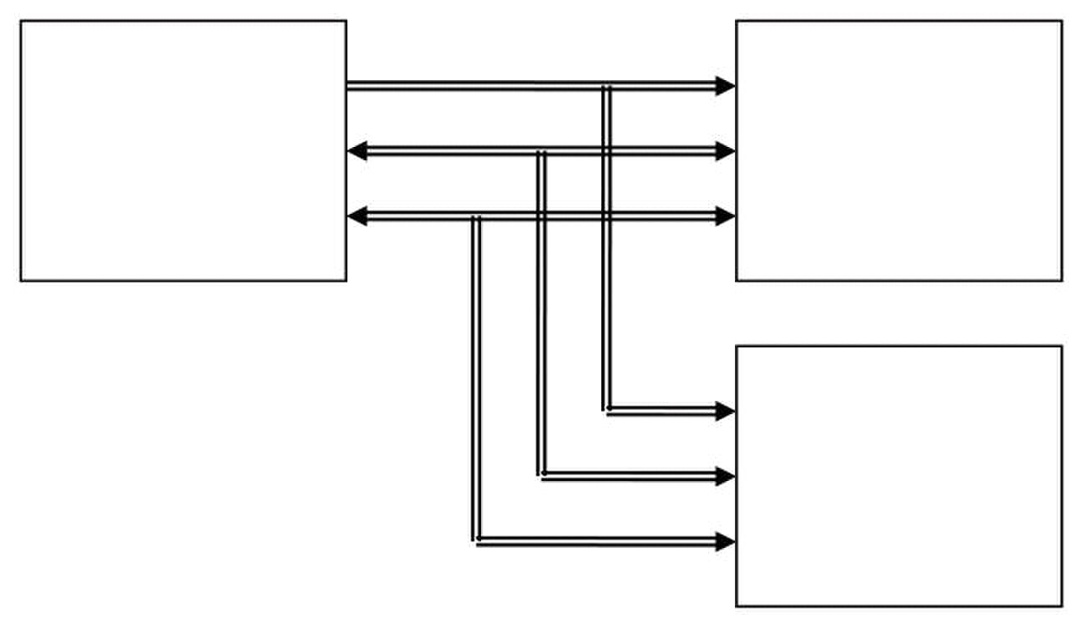
Computer Architecture & Assembly Language Programming Course Code: CS401
CS401@vu.edu.pk
information from the processor to a peripheral and some take information
from the peripheral to the processor. There can be certain events outside the
processor that are of its interest. To bring information about these events the
data bus cannot be used as it is owned by the processor and will only be
used when the processor grants permission to use it. Therefore certain
processors provide control lines to bring such information to processor’s
notice in the control bus. Knowing these signals in detail is unnecessary but
the general idea of the control bus must be conceived in full.
PROCESSOR MEMORY
PERIPHERALS
We take an example to explain the collaboration of the processor and
memory using the address, control, and data buses. Consider that you want
your uneducated servant to bring a book from the shelf. You order him to
bring the fifth book from top of the shelf. All the data movement operations
are hidden in this one sentence. Such a simple everyday phenomenon seen
from this perspective explains the seemingly complex working of the three
buses. We told the servant to “bring a book” and the one which is “fifth from
top,” precise location even for the servant who is much more intelligent then
our dumb memory. The dumb servant follows the steps one by one and the
book is in your hand as a result. If however you just asked him for a book or
you named the book, your uneducated servant will stand there gazing at you
and the book will never come in your hand.
Even in this simplest of all examples, mathematics is there, “fifth from
top.” Without a number the servant would not be able to locate the book. He
is unable to understand your will. Then you tell him to put it with the
seventh book on the right shelf. Precision is involved and only numbers are
precise in this world. One will always be one and two will always be two. So
we tell in the form of a number on the address bus which cell is needed out
of say the 2000 cells in the whole memory.
A binary number is generated on the address bus, fifth, seventh, eighth,
tenth; the cell which is needed. So the cell number is placed on the address
bus. A memory cell is an n-bit location to store data, normally 8-bit also
called a byte. The number of bits in a cell is called the cell width. The two
dimensions, cell width and number of cells, define the memory completely
just like the width and depth of a well defines it completely. 200 feet deep by
15 feet wide and the well is completely described. Similarly for memory we
define two dimensions. The first dimension defines how many parallel bits
are there in a single memory cell. The memory is called 8-bit or 16-bit for
this reason and this is also the word size of the memory. This need not
match the size of a processor word which has other parameters to define it.
In general the memory cell cannot be wider than the width of the data bus.
Best and simplest operation requires the same size of data bus and memory
cell width.
Virtual University of Pakistan 2

Slide 11

Computer Architecture & Assembly Language Programming Course Code: CS401
CS401@vu.edu.pk
As we previously discussed that the control bus carries the intent of the
processor that it wants to read or to write. Memory changes its behavior in
response to this signal from the processor. It defines the direction of data
flow. If processor wants to read but memory wants to write, there will be no
communication or useful flow of information. Both must be synchronized,
like a speaker speaks and the listener listens. If both speak simultaneously
or both listen there will be no communication. This precise synchronization
between the processor and the memory is the responsibility of the control
bus.
Control bus is only the mechanism. The responsibility of sending the
appropriate signals on the control bus to the memory is of the processor.
Since the memory never wants to listen or to speak of itself. Then why is the
control bus bidirectional. Again we take the same example of the servant and
the book further to elaborate this situation. Consider that the servant went
to fetch the book just to find that the drawing room door is locked. Now the
servant can wait there indefinitely keeping us in surprise or come back and
inform us about the situation so that we can act accordingly. The servant
even though he was obedient was unable to fulfill our orders so in all his
obedience, he came back to inform us about the problem. Synchronization is
still important, as a result of our orders either we got the desired cell or we
came to know that the memory is locked for the moment. Such information
cannot be transferred via the address or the data bus. For such situations
when peripherals want to talk to the processor when the processor wasn’t
expecting them to speak, special lines in the control bus are used. The
information in such signals is usually to indicate the incapability of the
peripheral to do something for the moment. For these reasons the control
bus is a bidirectional bus and can carry information from processor to
memory as well as from memory to processor.
1.2. REGISTERS
The basic purpose of a computer is to perform operations, and operations
need operands. Operands are the data on which we want to perform a certain
operation. Consider the addition operation; it involves adding two numbers
to get their sum. We can have precisely one address on the address bus and
consequently precisely one element on the data bus. At the very same instant
the second operand cannot be brought inside the processor. As soon as the
second is selected, the first operand is no longer there. For this reason there
are temporary storage places inside the processor called registers. Now one
operand can be read in a register and added into the other which is read
directly from the memory. Both are made accessible at one instance of time,
one from inside the processor and one from outside on the data bus. The
result can be written to at a distinct location as the operation has completed
and we can access a different memory cell. Sometimes we hold both
operands in registers for the sake of efficiency as what we can do inside the
processor is undoubtedly faster than if we have to go outside and bring the
second operand.
Registers are like a scratch pad ram inside the processor and their
operation is very much like normal memory cells. They have precise locations
and remember what is placed inside them. They are used when we need
more than one data element inside the processor at one time. The concept of
registers will be further elaborated as we progress into writing our first
program.
Memory is a limited resource but the number of memory cells is large.
Registers are relatively very small in number, and are therefore a very scarce
and precious resource. Registers are more than one in number, so we have to
precisely identify or name them. Some manufacturers number their registers
like r0, r1, r2, others name them like A, B, C, D etc. Naming is useful since
the registers are few in number. This is called the nomenclature of the
Virtual University of Pakistan 3

Slide 12
Computer Architecture & Assembly Language Programming Course Code: CS401
CS401@vu.edu.pk
particular architecture. Still other manufacturers name their registers
according to their function like X stands for an index register. This also
informs us that there are special functions of registers as well, some of which
are closely associated to the particular architecture. For example index
registers do not hold data instead they are used to hold the address of data.
There are other functions as well and the whole spectrum of register
functionalities is quite large. However most of the details will become clear as
the registers of the Intel architecture are discussed in detail.
Accumulator
There is a central register in every processor called the accumulator.
Traditionally all mathematical and logical operations are performed on the
accumulator. The word size of a processor is defined by the width of its
accumulator. A 32bit processor has an accumulator of 32 bits.
Pointer, Index, or Base Register
The name varies from manufacturer to manufacturer, but the basic
distinguishing property is that it does not hold data but holds the address of
data. The rationale can be understood by examining a “for” loop in a higher
level language, zeroing elements in an array of ten elements located in
consecutive memory cells. The location to be zeroed changes every iteration.
That is the address where the operation is performed is changing. Index
register is used in such a situation to hold the address of the current array
location. Now the value in the index register cannot be treated as data, but it
is the address of data. In general whenever we need access to a memory
location whose address is not known until runtime we need an index
register. Without this register we would have needed to explicitly code each
iteration separately.
In newer architectures the distinction between accumulator and index
registers has become vague. They have general registers which are more
versatile and can do both functions. They do have some specialized behaviors
but basic operations can be done on all general registers.
Flags Register or Program Status Word
This is a special register in every architecture called the flags register or
the program status word. Like the accumulator it is an 8, 16, or 32 bits
register but unlike the accumulator it is meaningless as a unit, rather the
individual bits carry different meanings. The bits of the accumulator work in
parallel as a unit and each bit mean the same thing. The bits of the flags
register work independently and individually, and combined its value is
meaningless.
An example of a bit commonly present in the flags register is the carry flag.
The carry can be contained in a single bit as in binary arithmetic the carry
can only be zero or one. If a 16bit number is added to a 16bit accumulator,
and the result is of 17 bits the 17th bit is placed in the carry bit of the flags
register. Without this 17th bit the answer is incorrect. More examples of flags
will be discussed when dealing with the Intel specific register set.
Program Counter or Instruction Pointer
Everything must translate into a binary number for our dumb processor to
understand it, be it an operand or an operation itself. Therefore the
instructions themselves must be translated into numbers. For example to
add numbers we understand the word “add.” We translate this word into a
number to make the processor understand it. This number is the actual
instruction for the computer. All the objects, inheritance and encapsulation
constructs in higher level languages translate down to just a number in
assembly language in the end. Addition, multiplication, shifting; all big
Virtual University of Pakistan 4

Slide 13

Computer Architecture & Assembly Language Programming Course Code: CS401
CS401@vu.edu.pk
programs are made using these simple building blocks. A number is at the
bottom line since this is the only thing a computer can understand.
A program is defined to be “an ordered set of instructions.” Order in this
definition is a key part. Instructions run one after another, first, second,
third and so on. Instructions have a positional relationship. The whole logic
depends on this positioning. If the computer executes the fifth instructions
after the first and not the second, all our logic is gone. The processor should
ensure this ordering of instructions. A special register exists in every
processor called the program counter or the instruction pointer that ensures
this ordering. “The program counter holds the address of the next instruction
to be executed.” A number is placed in the memory cell pointed to by this
register and that number tells the processor which instruction to execute; for
example 0xEA, 255, or 152. For the processor 152 might be the add
instruction. Just this one number tells it that it has to add, where its
operands are, and where to store the result. This number is called the
opcode. The instruction pointer moves from one opcode to the next. This is
how our program executes and progresses. One instruction is picked, its
operands are read and the instruction is executed, then the next instruction
is picked from the new address in instruction pointer and so on.
Remembering 152 for the add operation or 153 for the subtract operation
is difficult. To make a simple way to remember difficult things we associate a
symbol to every number. As when we write “add” everyone understands what
we mean by it. Then we need a small program to convert this “add” of ours to
152 for the processor. Just a simple search and replace operation to
translate all such symbols to their corresponding opcodes. We have mapped
the numeric world of the processor to our symbolic world. “Add” conveys a
meaning to us but the number 152 does not. We can say that add is closer to
the programmer’s thinking. This is the basic motive of adding more and more
translation layers up to higher level languages like C++ and Java and Visual
Basic. These symbols are called instruction mnemonics. Therefore the
mnemonic “add a to b” conveys more information to the reader. The dumb
translator that will convert these mnemonics back to the original opcodes is
a key program to be used throughout this course and is called the assembler.
1.3. INSTRUCTION GROUPS
Usual opcodes in every processor exist for moving data, arithmetic and
logical manipulations etc. However their mnemonics vary depending on the
will of the manufacturer. Some manufacturers name the mnemonics for data
movement instructions as “move,” some call it “load” and “store” and still
other names are present. But the basic set of instructions is similar in every
processor. A grouping of these instructions makes learning a new processor
quick and easy. Just the group an instruction belongs tells a lot about the
instruction.
Data Movement Instructions
These instructions are used to move data from one place to another. These
places can be registers, memory, or even inside peripheral devices. Some
examples are:
mov ax, bx
lad 1234
Arithmetic and Logic Instructions
Arithmetic instructions like addition, subtraction, multiplication, division
and Logical instructions like logical and, logical or, logical xor, or
complement are part of this group. Some examples are:
and ax, 1234
add bx, 0534
add bx, [1200]
Virtual University of Pakistan 5

Slide 14

Computer Architecture & Assembly Language Programming Course Code: CS401
CS401@vu.edu.pk
The bracketed form is a complex variation meaning to add the data placed
at address 1200. Addressing data in memory is a detailed topic and is
discussed in the next chapter.
Program Control Instructions
The instruction pointer points to the next instruction and instructions run
one after the other with the help of this register. We can say that the
instructions are tied with one another. In some situations we don’t want to
follow this implied path and want to order the processor to break its flow if
some condition becomes true instead of the spatially placed next instruction.
In certain other cases we want the processor to first execute a separate block
of code and then come back to resume processing where it left.
These are instructions that control the program execution and flow by
playing with the instruction pointer and altering its normal behavior to point
to the next instruction. Some examples are:
cmp ax, 0
jne 1234
We are changing the program flow to the instruction at 1234 address if the
condition that we checked becomes true.
Special Instructions
Another group called special instructions works like the special service
commandos. They allow changing specific processor behaviors and are used
to play with it. They are used rarely but are certainly used in any meaningful
program. Some examples are:
cli
sti
Where cli clears the interrupt flag and sti sets it. Without delving deep into
it, consider that the cli instruction instructs the processor to close its ears
from the outside world and never listen to what is happening outside,
possibly to do some very important task at hand, while sti restores normal
behavior. Since these instructions change the processor behavior they are
placed in the special instructions group.
1.4. INTEL IAPX88 ARCHITECTURE
Now we select a specific architecture to discuss these abstract ideas in
concrete form. We will be using IBM PC based on Intel architecture because
of its wide availability, because of free assemblers and debuggers available
for it, and because of its wide use in a variety of domains. However the
concepts discussed will be applicable on any other architecture as well; just
the mnemonics of the particular language will be different.
Technically iAPX88 stands for “Intel Advanced Processor Extensions 88.” It
was a very successful processor also called 8088 and was used in the very
first IBM PC machines. Our discussion will revolve around 8088 in the first
half of the course while in the second half we will use iAPX386 which is very
advanced and powerful processor. 8088 is a 16bit processor with its
accumulator and all registers of 16 bits. 386 on the other hand, is a 32bit
processor. However it is downward compatible with iAPX88 meaning that all
code written for 8088 is valid on the 386. The architecture of a processor
means the organization and functionalities of the registers it contains and
the instructions that are valid on the processor. We will discuss the register
architecture of 8088 in detail below while its instructions are discussed in
the rest of the book at appropriate places.
1.5. HISTORY
Intel did release some 4bit processors in the beginning but the first
meaningful processor was 8080, an 8bit processor. The processor became
Virtual University of Pakistan 6

Slide 15

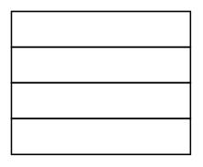
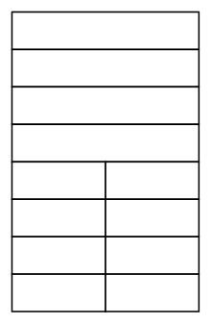

Computer Architecture & Assembly Language Programming Course Code: CS401
CS401@vu.edu.pk
popular due to its simplistic design and versatile architecture. Based on the
experience gained from 8080, an advanced version was released as 8085.
The processor became widely popular in the engineering community again
due to its simple and logical nature.
Intel introduced the first 16bit processor named 8088 at a time when the
concept of personal computer was evolving. With a maximum memory of 64K
on the 8085, the 8088 allowed a whole mega byte. IBM embedded this
processor in their personal computer. The first machines ran at 4.43 MHz; a
blazing speed at that time. This was the right thing at the right moment. No
one expected this to become the biggest success of computing history. IBM
PC XT became so popular and successful due to its open architecture and
easily available information.
The success was unexpected for the developers themselves. As when Intel
introduced the processor it contained a timer tick count which was valid for
five years only. They never anticipated the architecture to stay around for
more than five years but the history took a turn and the architecture is there
at every desk even after 25 years and the tick is to be specially handled every
now and then.
1.6. REGISTER ARCHITECTURE
The iAPX88 architecture consists of 14 registers.
CS SP
DS BP
SS SI
ES DI
AH AL (AX)
BH BL (BX)
CH CL (CX)
DH DL (DX)
General Registers (AX, BX, CX, and DX)
The registers AX, BX, CX, and DX behave as general purpose registers in
Intel architecture and do some specific functions in addition to it. X in their
names stand for extended meaning 16bit registers. For example AX means
we are referring to the extended 16bit “A” register. Its upper and lower byte
are separately accessible as AH (A high byte) and AL (A low byte). All general
purpose registers can be accessed as one 16bit register or as two 8bit
registers. The two registers AH and AL are part of the big whole AX. Any
change in AH or AL is reflected in AX as well. AX is a composite or extended
register formed by gluing together the two parts AH and AL.
The A of AX stands for Accumulator. Even though all general purpose
registers can act as accumulator in most instructions there are some specific
variations which can only work on AX which is why it is named the
accumulator. The B of BX stands for Base because of its role in memory
addressing as discussed in the next chapter. The C of CX stands for Counter
as there are certain instructions that work with an automatic count in the
CX register. The D of DX stands for Destination as it acts as the destination
in I/O operations. The A, B, C, and D are in letter sequence as well as depict
some special functionality of the register.
Virtual University of Pakistan 7
IP
FLAGS

Slide 16

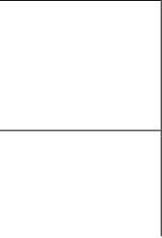
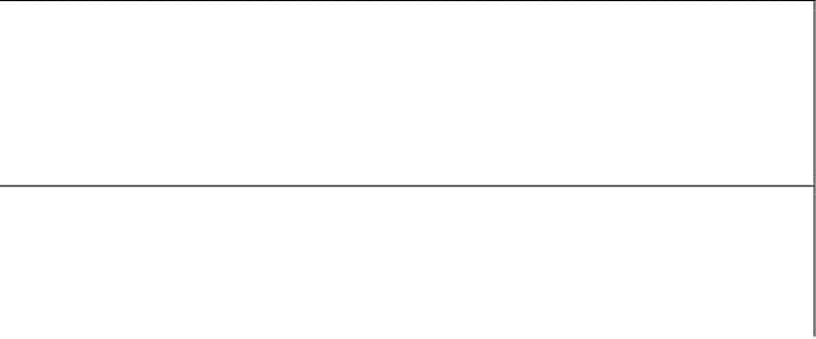

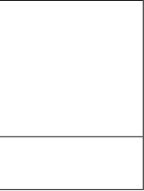
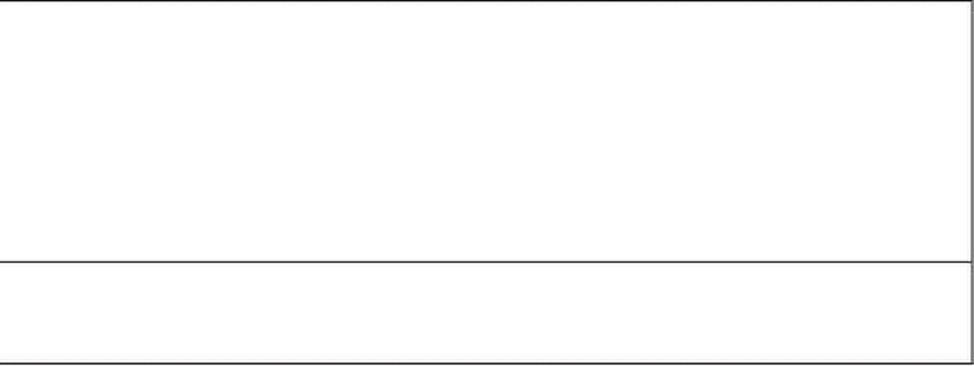
Computer Architecture & Assembly Language Programming Course Code: CS401
CS401@vu.edu.pk
Index Registers (SI and DI)
SI and DI stand for source index and destination index respectively. These
are the index registers of the Intel architecture which hold address of data
and used in memory access. Being an open and flexible architecture, Intel
allows many mathematical and logical operations on these registers as well
like the general registers. The source and destination are named because of
their implied functionality as the source or the destination in a special class
of instructions called the string instructions. However their use is not at all
restricted to string instructions. SI and DI are 16bit and cannot be used as
8bit register pairs like AX, BX, CX, and DX.
Instruction Pointer (IP)
This is the special register containing the address of the next instruction to
be executed. No mathematics or memory access can be done through this
register. It is out of our direct control and is automatically used. Playing with
it is dangerous and needs special care. Program control instructions change
the IP register.
Stack Pointer (SP)
It is a memory pointer and is used indirectly by a set of instructions. This
register will be explored in the discussion of the system stack.
Base Pointer (BP)
It is also a memory pointer containing the address in a special area of
memory called the stack and will be explored alongside SP in the discussion
of the stack.
Flags Register
The flags register as previously discussed is not meaningful as a unit
rather it is bit wise significant and accordingly each bit is named separately.
The bits not named are unused. The Intel FLAGS register has its bits
organized as follows:
15 14 13 12 11 10 9 8 7 6 5 4 3 2 1 0
O D I T S Z A P C
The individual flags are explained in the following table.
C Carry When two 16bit numbers are added the answer can be
17 bits long or when two 8bit numbers are added the
answer can be 9 bits long. This extra bit that won’t fit
in the target register is placed in the carry flag where it
can be used and tested.
P Parity Parity is the number of “one” bits in a binary number.
normally used in communications to verify the integrity
of data sent from the sender to the receiver.
A Auxiliary A number in base 16 is called a hex number and can be
Carry represented by 4 bits. The collection of 4 bits is called a
nibble. During addition or subtraction if a carry goes
from one nibble to the next this flag is set. Carry flag is
for the carry from the whole addition while auxiliary
carry is the carry from the first nibble to the second.
Z Zero Flag The Zero flag is set if the last mathematical or logical
instruction has produced a zero in its destination.
Virtual University of Pakistan 8
Parity is either odd or even. This information is

Slide 17




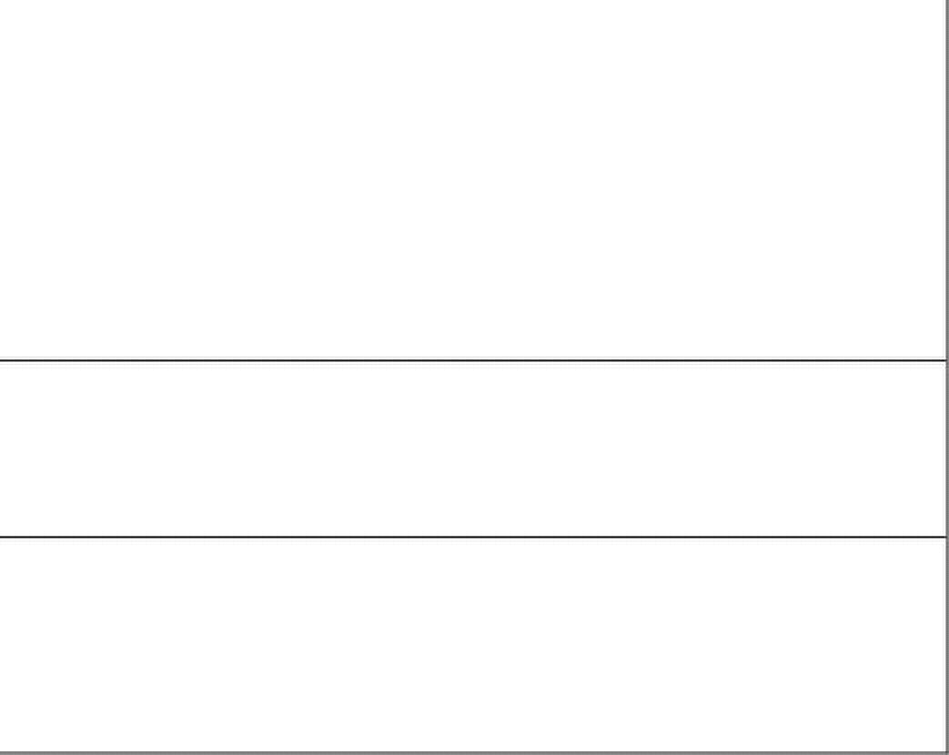
Computer Architecture & Assembly Language Programming Course Code: CS401
CS401@vu.edu.pk
S Sign Flag A signed number is represented in its two’s complement
form in the computer. The most significant bit (MSB) of
a negative number in this representation is 1 and for a
positive number it is zero. The sign bit of the last
mathematical or logical operation’s destination is
copied into the sign flag.
T Trap Flag The trap flag has a special role in debugging which will
I Interrupt Flag It tells whether the processor can be interrupted from
outside or not. Sometimes the programmer doesn’t
want a particular task to be interrupted so the
Interrupt flag can be zeroed for this time. The
programmer rather than the processor sets this flag
since the programmer knows when interruption is okay
and when it is not. Interruption can be disabled or
enabled by making this bit zero or one, respectively,
using special instructions.
D Direction Flag Specifically related to string instructions, this flag tells
whether the current operation has to be done from
bottom to top of the block (D=0) or from top to bottom
of the block (D=1).
O Overflow Flag The overflow flag is set during signed arithmetic, e.g.
addition or subtraction, when the sign of the
destination changes unexpectedly. The actual process
sets the overflow flag whenever the carry into the MSB
is different from the carry out of the MSB
Segment Registers (CS, DS, SS, and ES)
The code segment register, data segment register, stack segment register,
and the extra segment register are special registers related to the Intel
segmented memory model and will be discussed later.
1.7. OUR FIRST PROGRAM
The first program that we will write will only add three numbers. This very
simple program will clarify most of the basic concepts of assembly language.
We will start with writing our algorithm in English and then moving on to
convert it into assembly language.
English Language Version
“Program is an ordered set of instructions for the processor.” Our first
program will be instructions manipulating AX and BX in plain English.
move 5 to ax
move 10 to bx
add bx to ax
move 15 to bx
add bx to ax
Even in this simple reflection of thoughts in English, there are some key
things to observe. One is the concept of destination as every instruction has
a “to destination” part and there is a source before it as well. For example the
second line has a constant 10 as its source and the register BX as its
destination. The key point in giving the first program in English is to convey
that the concepts of assembly language are simple but fine. Try to
understand them considering that all above is everyday English that you
know very well and every concept will eventually be applicable to assembly
language.
Virtual University of Pakistan 9
be discussed later.

Slide 18
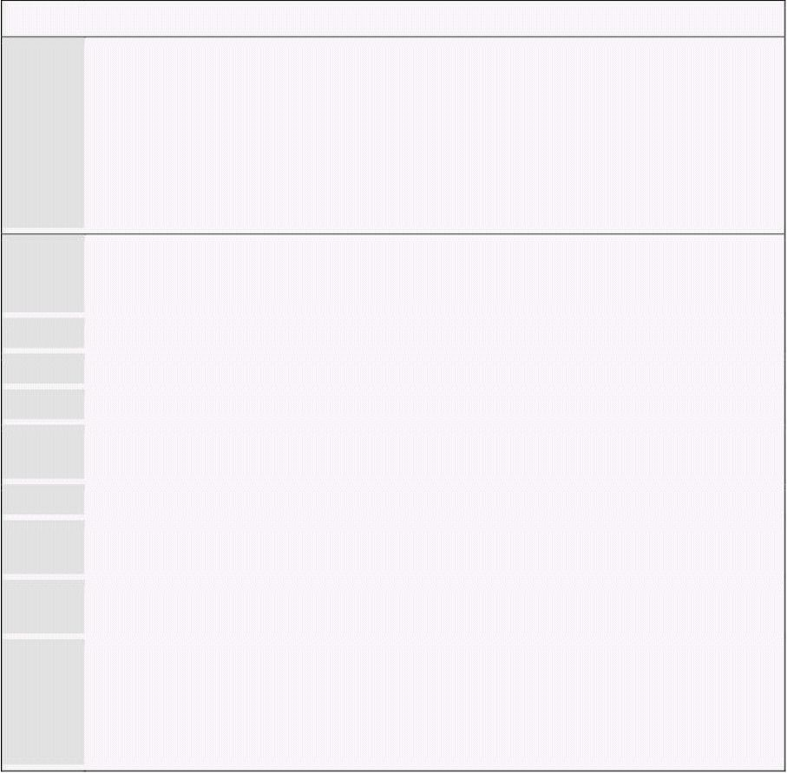
Computer Architecture & Assembly Language Programming Course Code: CS401
CS401@vu.edu.pk
Assembly Language Version
Intel could have made their assembly language exactly identical to our
program in plain English but they have abbreviated a lot of symbols to avoid
unnecessarily lengthy program when the meaning could be conveyed with
less effort. For example Intel has named their move instruction “mov” instead
of “move.” Similarly the Intel order of placing source and destination is
opposite to what we have used in our English program, just a change of
interpretation. So the Intel way of writing things is:
operation destination, source
operation destination
operation source
operation
The later three variations are for instructions that have one or both of their
operands implied or they work on a single or no operand. An implied operand
means that it is always in a particular register say the accumulator, and it
need not be mentioned in the instruction. Now we attempt to write our
program in actual assembly language of the iapx88.
Example 1.1
001 ; a program to add three numbers using registers
002 [org 0x0100]
003 mov ax, 5 ; load first number in ax
004 mov bx, 10 ; load second number in bx
005 add ax, bx ; accumulate sum in ax
006 mov bx, 15 ; load third number in bx
007 add ax, bx ; accumulate sum in ax
008
009 mov ax, 0x4c00 ; terminate program
010 int 0x21
001 To start a comment a semicolon is used and the assembler ignores
everything else on the same line. Comments must be extensively
used in assembly language programs to make them readable.
002 Leave the org directive for now as it will be discussed later.
003 The constant 5 is loaded in one register AX.
004 The constant 10 is loaded in another register BX.
005 Register BX is added to register AX and the result is stored in
register AX. Register AX should contain 15 by now.
006 The constant 15 is loaded in the register BX.
007 Register BX is again added to register AX now producing 15+15=30
in the AX register. So the program has computed 5+10+15=30.
008 Vertical spacing must also be used extensively in assembly language
programs to separate logical blocks of code.
009-010 The ending lines are related more to the operating system than to
assembly language programming. It is a way to inform DOS that our
program has terminated so it can display its command prompt
again. The computer may reboot or behave improperly if this
termination is not present.
Assembler, Linker, and Debugger
We need an assembler to assemble this program and convert this into
executable binary code. The assembler that we will use during this course is
“Netwide Assembler” or NASM. It is a free and open source assembler. And
the tool that will be most used will be the debugger. We will use a free
debugger called “A fullscreen debugger” or AFD. These are the whole set of
Virtual University of Pakistan 10

Slide 19


Computer Architecture & Assembly Language Programming Course Code: CS401
CS401@vu.edu.pk
weapons an assembly language programmer needs for any task whatsoever
at hand.
To assemble we will give the following command to the processor assuming
that our input file is named EX01.ASM.
nasm ex01.asm –o ex01.com –l ex01.lst
This will produce two files EX01.COM that is our executable file and
EX01.LST that is a special listing file that we will explore now. The listing file
produced for our example above is shown below with comments removed for
neatness.
1
2 [org 0x0100]
3 00000000 B80500 mov ax, 5
4 00000003 BB0A00 mov bx, 10
5 00000006 01D8 add ax, bx
6 00000008 BB0F00 mov bx, 15
7 0000000B 01D8 add ax, bx
8
9 0000000D B8004C mov ax, 0x4c00
10 00000010 CD21 int 0x21
The first column in the above listing is offset of the listed instruction in the
output file. Next column is the opcode into which our instruction was
translated. In this case this opcode is B8. Whenever we move a constant into
AX register the opcode B8 will be used. After it 0500 is appended which is
the immediate operand to this instruction. An immediate operand is an
operand which is placed directly inside the instruction. Now as the AX
register is a word sized register, and one hexadecimal digit takes 4 bits so 4
hexadecimal digits make one word or two bytes. Which of the two bytes
should be placed first in the instruction, the least significant or the most
significant? Similarly for 32bit numbers either the order can be most
significant, less significant, lesser significant, and least significant called the
big-endian order used by Motorola and some other companies or it can be
least significant, more significant, more significant, and most significant
called the little-endian order and is used by Intel. The big-endian have the
argument that it is more natural to read and comprehend while the little-
endian have the argument that this scheme places the less significant value
at a lesser address and more significant value at a higher address.
Because of this the constant 5 in our instruction was converted into 0500
with the least significant byte of 05 first and the most significant byte of 00
afterwards. When read as a word it is 0005 but when written in memory it
will become 0500. As the first instruction is three bytes long, the listing file
shows that the offset of the next instruction in the file is 3. The opcode BB is
for moving a constant into the BX register, and the operand 0A00 is the
number 10 in little-endian byte order. Similarly the offsets and opcodes of
the remaining instructions are shown in order. The last instruction is placed
at offset 0x10 or 16 in decimal. The size of the last instruction is two bytes,
so the size of the complete COM file becomes 18 bytes. This can be verified
from the directory listing, using the DIR command, that the COM file
produced is exactly 18 bytes long.
Now the program is ready to be run inside the debugger. The debugger
shows the values of registers, flags, stack, our code, and one or two areas of
the system memory as data. Debugger allows us to step our program one
instruction at a time and observe its effect on the registers and program
data. The details of using the AFD debugger can be seen from the AFD
manual.
After loading the program in the debugger observe that the first instruction
is now at 0100 instead of absolute zero. This is the effect of the org directive
at the start of our program. The first instruction of a COM file must be at
Virtual University of Pakistan 11

Slide 20

Computer Architecture & Assembly Language Programming Course Code: CS401
CS401@vu.edu.pk
offset 0100 (decimal 255) as a requirement. Also observe that the debugger is
showing your program even though it was provided only the COM file and
neither of the listing file or the program source. This is because the
translation from mnemonic to opcode is reversible and the debugger mapped
back from the opcode to the instruction mnemonic. This will become
apparent for instructions that have two mnemonics as the debugger might
not show the one that was written in the source file.
As a result of program execution either registers or memory will change.
Since our program yet doesn’t touch memory the only changes will be in the
registers. Keenly observe the registers AX, BX, and IP change after every
instruction. IP will change after every instruction to point to the next
instruction while AX will accumulate the result of our addition.
1.8. SEGMENTED MEMORY MODEL
Rationale
In earlier processors like 8080 and 8085 the linear memory model was
used to access memory. In linear memory model the whole memory appears
like a single array of data. 8080 and 8085 could access a total memory of
64K using the 16 lines of their address bus. When designing iAPX88 the Intel
designers wanted to remain compatible with 8080 and 8085 however 64K
was too small to continue with, for their new processor. To get the best of
both worlds they introduced the segmented memory model in 8088.
There is also a logical argument in favor of a segmented memory model in
additional to the issue of compatibility discussed above. We have two logical
parts of our program, the code and the data, and actually there is a third
part called the program stack as well, but higher level languages make this
invisible to us. These three logical parts of a program should appear as three
distinct units in memory, but making this division is not possible in the
linear memory model. The segmented memory model does allow this
distinction.
Mechanism
The segmented memory model allows multiple functional windows into the
main memory, a code window, a data window etc. The processor sees code
from the code window and data from the data window. The size of one
window is restricted to 64K. 8085 software fits in just one such window. It
sees code, data, and stack from this one window, so downward compatibility
is attained.
However the maximum memory iAPX88 can access is 1MB which can be
accessed with 20 bits. Compare this with the 64K of 8085 that were accessed
using 16 bits. The idea is that the 64K window just discussed can be moved
anywhere in the whole 1MB. The four segment registers discussed in the
Intel register architecture are used for this purpose. Therefore four windows
can exist at one time. For example one window that is pointed to by the CS
register contains the currently executing code.
To understand the concept, consider the windows of a building. We say
that a particular window is 3 feet above the floor and another one is 20 feet
above the floor. The reference point, the floor is the base of the segment
called the datum point in a graph and all measurement is done from that
datum point considering it to be zero. So CS holds the zero or the base of
code. DS holds the zero of data. Or we can say CS tells how high code from
the floor is, and DS tells how high data from the floor is, while SS tells how
high the stack is. One extra segment ES can be used if we need to access two
distant areas of memory at the same time that both cannot be seen through
the same window. ES also has special role in string instructions. ES is used
as an extra data segment and cannot be used as an extra code or stack
segment.
Virtual University of Pakistan 12

Slide 21

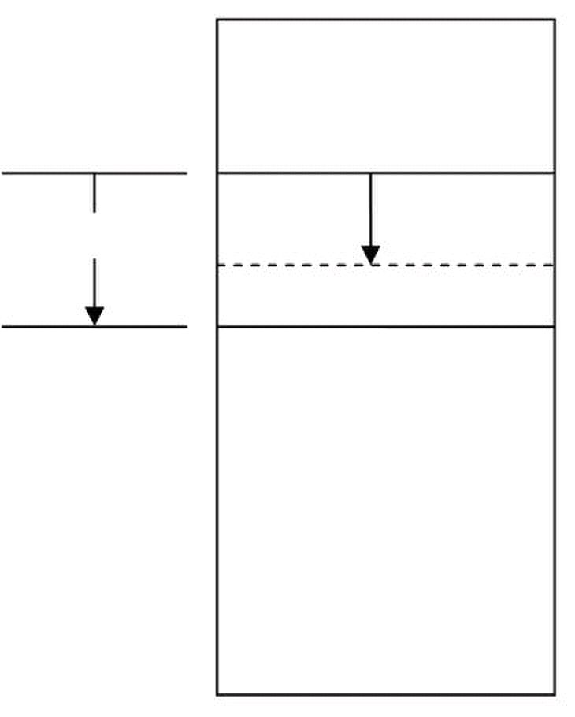
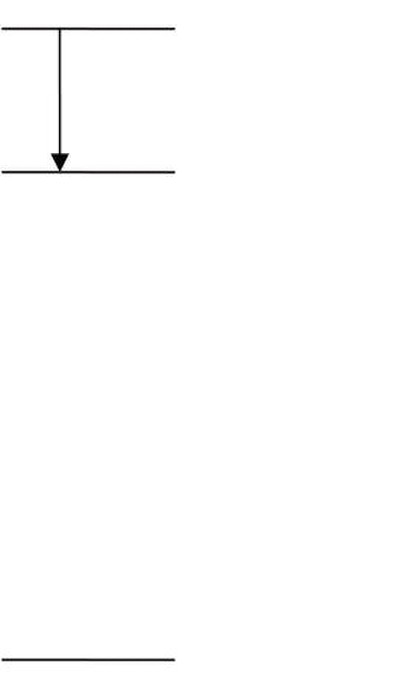
Computer Architecture & Assembly Language Programming Course Code: CS401
CS401@vu.edu.pk
Revisiting the concept again, like the datum point of a graph, the segment
registers tell the start of our window which can be opened anywhere in the
megabyte of memory available. The window is of a fixed size of 64KB. Base
and offset are the two key variables in a segmented address. Segment tells
the base while offset is added into it. The registers IP, SP, BP, SI, DI, and BX
all can contain a 16bit offset in them and access memory relative to a
segment base.
The IP register cannot work alone. It needs the CS register to open a 64K
window in the 1MB memory and then IP works to select code from this
window as offsets. IP works only inside this window and cannot go outside of
this 64K in any case. If the window is moved i.e. the CS register is changed,
IP will change its behavior accordingly and start selecting from the new
window. The IP register always works relatively, relative to the segment base
stored in the CS register. IP is a 16bit register capable of accessing only 64K
memory so how the whole megabyte can contain code anywhere. Again the
same concept is there, it can access 64K at one instance of time. As the base
is changed using the CS register, IP can be made to point anywhere is the
whole megabyte. The process is illustrated with the following diagram.
Physical Address
00000
Segment
Base
Offset
64K
FFFFF
Physical Address Calculation
Now for the whole megabyte we need 20 bits while CS and IP are both
16bit registers. We need a mechanism to make a 20bit number out of the two
16bit numbers. Consider that the segment value is stored as a 20 bit number
with the lower four bits zero and the offset value is stored as another 20 bit
number with the upper four bits zeroed. The two are added to produce a
20bit absolute address. A carry if generated is dropped without being stored
anywhere and the phenomenon is called address wraparound. The process is
explained with the help of the following diagram.
Virtual University of Pakistan 13
xxxx0
Paragraph
Boundary

Slide 22






Computer Architecture & Assembly Language Programming Course Code: CS401
CS401@vu.edu.pk
15----------------------------0
16bit Segment Register 0000 Segment Address
15----------------------------0
0000 16bit Logical Address Offset Address
19-----------------------------------0
20bit Physical Address
Therefore memory is determined by a segment-offset pair and not alone by
any one register which will be an ambiguous reference. Every offset register
is assigned a default segment register to resolve such ambiguity. For example
the program we wrote when loaded into memory had a value of 0100 in IP
register and some value say 1DDD in the CS register. Making both 20 bit
numbers, the segment base is 1DDD0 and the offset is 00100 and adding
them we get the physical memory address of 1DED0 where the opcode
B80500 is placed.
Paragraph Boundaries
As the segment value is a 16bit number and four zero bits are appended to
the right to make it a 20bit number, segments can only be defined a 16byte
boundaries called paragraph boundaries. The first possible segment value is
0000 meaning a physical base of 00000 and the next possible value of 0001
means a segment base of 00010 or 16 in decimal. Therefore segments can
only be defined at 16 byte boundaries.
Overlapping Segments
We can also observe that in the case of our program CS, DS, SS, and ES
all had the same value in them. This is called overlapping segments so that
we can see the same memory from any window. This is the structure of a
COM file.
Using partially overlapping segments we can produce a number of
segment, offset pairs that all access the same memory. For example
1DDD:0100 and IDED:0000 both point to the same physical memory. To test
this we can open a data window at 1DED:0000 in the debugger and change
the first three bytes to “90” which is the opcode for NOP (no operation). The
change is immediately visible in the code window which is pointed to by CS
containing 1DDD. Similarly IDCD:0200 also points to the same memory
location. Consider this like a portion of wall that three different people on
three different floors are seeing through their own windows. One of them
painted the wall red; it will be changed for all of them though their
perspective is different. It is the same phenomenon occurring here.
The segment, offset pair is called a logical address, while the 20bit address
is a physical address which is the real thing. Logical addressing is a
mechanism to access the physical memory. As we have seen three different
logical addresses accessed the same physical address.
Virtual University of Pakistan 14

Slide 23

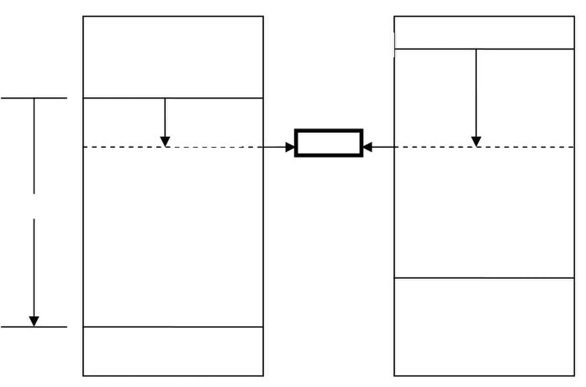

Computer Architecture & Assembly Language Programming Course Code: CS401
CS401@vu.edu.pk
00000
1DCD0
1DDD0 Offset
Offset 0200
0100
64K
FFFFF
EXERCISES
1. How the processor uses the address bus, the data bus, and the
control bus to communicate with the system memory?
2. Which of the following are unidirectional and which are bidirectional?
a. Address Bus
b. Data Bus
c. Control Bus
3. What are registers and what are the specific features of the
accumulator, index registers, program counter, and program status
word?
4. What is the size of the accumulator of a 64bit processor?
5. What is the difference between an instruction mnemonic and its
opcode?
6. How are instructions classified into groups?
7. A combination of 8bits is called a byte. What is the name for 4bits and
for 16bits?
8. What is the maximum memory 8088 can access?
9. List down the 14 registers of the 8088 architecture and briefly
describe their uses.
10. What flags are defined in the 8088 FLAGS register? Describe the
function of the zero flag, the carry flag, the sign flag, and the overflow
flag.
11. Give the value of the zero flag, the carry flag, the sign flag, and the
overflow flag after each of the following instructions if AX is initialized
with 0x1254 and BX is initialized with 0x0FFF.
a. add ax, 0xEDAB
b. add ax, bx
c. add bx, 0xF001
12. What is the difference between little endian and big endian formats?
Which format is used by the Intel 8088 microprocessor?
13. For each of the following words identify the byte that is stored at lower
memory address and the byte that is stored at higher memory address
in a little endian computer.
a. 1234
b. ABFC
c. B100
d. B800
Virtual University of Pakistan 15
1DED0
64K

Slide 24
Computer Architecture & Assembly Language Programming Course Code: CS401
CS401@vu.edu.pk
14. What are the contents of memory locations 200, 201, 202, and 203 if
the word 1234 is stored at offset 200 and the word 5678 is stored at
offset 202?
15. What is the offset at which the first executable instruction of a COM
file must be placed?
16. Why was segmentation originally introduced in 8088 architecture?
17. Why a segment start cannot start from the physical address 55555.
18. Calculate the physical memory address generated by the following
segment offset pairs.
a. 1DDD:0436
b. 1234:7920
c. 74F0:2123
d. 0000:6727
e. FFFF:4336
f. 1080:0100
g. AB01:FFFF
19. What are the first and the last physical memory addresses accessible
using the following segment values?
a. 1000
b. 0FFF
c. 1002
d. 0001
e. E000
20. Write instructions that perform the following operations.
a. Copy BL into CL
b. Copy DX into AX
c. Store 0x12 into AL
d. Store 0x1234 into AX
e. Store 0xFFFF into AX
21. Write a program in assembly language that calculates the square of
six by adding six to the accumulator six times.
Virtual University of Pakistan 16

Slide 25

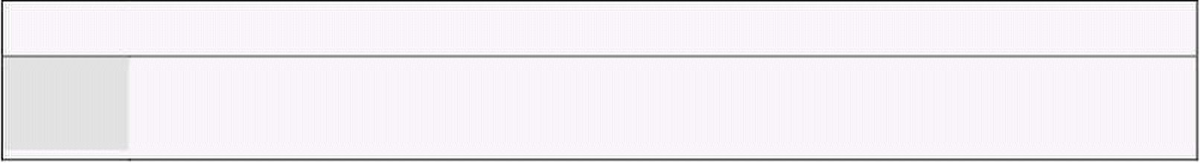
2
Addressing Modes
2.1. DATA DECLARATION
The first instruction of our first assembly language program was “mov ax,
5.” Here MOV was the opcode; AX was the destination operand, while 5 was
the source operand. The value of 5 in this case was stored as part of the
instruction encoding. In the opcode B80500, B8 was the opcode and 0500
was the operand stored immediately afterwards. Such an operand is called
an immediate operand. It is one of the many types of operands available.
Writing programs using just the immediate operand type is difficult. Every
reasonable program needs some data in memory apart from constants.
Constants cannot be changed, i.e. they cannot appear as the destination
operand. In fact placing them as destination is meaningless and illegal
according to assembly language syntax. Only registers or data placed in
memory can be changed. So real data is the one stored in memory, with a
very few constants. So there must be a mechanism in assembly language to
store and retrieve data from memory.
To declare a part of our program as holding data instead of instructions we
need a couple of very basic but special assembler directives. The first
directive is “define byte” written as “db.”
db somevalue
As a result a cell in memory will be reserved containing the desired value
in it and it can be used in a variety of ways. Now we can add variables
instead of constants. The other directive is “define word” or “dw” with the
same syntax as “db” but reserving a whole word of 16 bits instead of a byte.
There are directives to declare a double or a quad word as well but we will
restrict ourselves to byte and word declarations for now. For single byte we
use db and for two bytes we use dw.
To refer to this variable later in the program, we need the address occupied
by this variable. The assembler is there to help us. We can associate a
symbol with any address that we want to remember and use that symbol in
the rest of the code. The symbol is there for our own comprehension of code.
The assembler will calculate the address of that symbol using our origin
directive and calculating the instruction lengths or data declarations in-
between and replace all references to the symbol with the corresponding
address. This is just like variables in a higher level language, where the
compiler translates them into addresses; just the process is hidden from the
programmer one level further. Such a symbol associated to a point in the
program is called a label and is written as the label name followed by a colon.
2.2. DIRECT ADDRESSING
Now we will rewrite our first program such that the numbers 5, 10, and 15
are stored as memory variables instead of constants and we access them
from there.
Example 2.1
001 ; a program to add three numbers using memory variables
002 [org 0x0100]
003 mov ax, [num1] ; load first number in ax

Slide 26



Computer Architecture & Assembly Language Programming Course Code: CS401
CS401@vu.edu.pk
004 mov bx, [num2] ; load second number in bx
005 add ax, bx ; accumulate sum in ax
006 mov bx, [num3] ; load third number in bx
007 add ax, bx ; accumulate sum in ax
008 mov [num4], ax ; store sum in num4
009
010 mov ax, 0x4c00 ; terminate program
011 int 0x21
012
013 num1: dw 5
014 num2: dw 10
015 num3: dw 15
016 num4: dw 0
002 Originate our program at 0100. The first executable instruction
should be placed at this offset.
003 The source operand is changed from constant 5 to [num1]. The
bracket is signaling that the operand is placed in memory at address
num1. The value 5 will be loaded in ax even though we did not
specified it in our program code, rather the value will be picked from
memory. The instruction should be read as “read the contents of
memory location num1 in the ax register.” The label num1 is a
symbol for us but an address for the processor while the conversion
is done by the assembler.
013 The label num1 is defined as a word and the assembler is requested
to place 5 in that memory location. The colon signals that num1 is a
label and not an instruction.
Using the same process to assemble as discussed before we examine the
listing file generated as a result with comments removed.
1
2 [org 0x0100]
3 00000000 A1[1700] mov ax, [num1]
4 00000003 8B1E[1900] mov bx, [num2]
5 00000007 01D8 add ax, bx
6 00000009 8B1E[1B00] mov bx, [num3]
7 0000000D 01D8 add ax, bx
8 0000000F A3[1D00] mov [num4], ax
9
10 00000012 B8004C mov ax, 0x4c00
11 00000015 CD21 int 0x21
12
13 00000017 0500 num1: dw 5
14 00000019 0A00 num2: dw 10
15 0000001B 0F00 num3: dw 15
16 0000001D 0000 num4: dw 0
The first instruction of our program has changed from B80500 to A11700.
The opcode B8 is used to move constants into AX, while the opcode A1 is
used when moving data into AX from memory. The immediate operand to our
new instruction is 1700 or as a word 0017 (23 decimal) and from the bottom
of the listing file we can observe that this is the offset of num1. The
assembler has calculated the offset of num1 and used it to replace references
to num1 in the whole program. Also the value 0500 can be seen at offset
0017 in the file. We can say contents of memory location 0017 are 0005 as a
word. Similarly num2, num3, and num4 are placed at 0019, 001B, and
001D addresses.
When the program is loaded in the debugger, it is loaded at offset 0100,
which displaces all memory accesses in our program. The instruction
A11700 is changed to A11701 meaning that our variable is now placed at
0117 offset. The instruction is shown as mov ax, [0117]. Also the data
window can be used to verify that offset 0117 contains the number 0005.
Virtual University of Pakistan 18

Slide 27

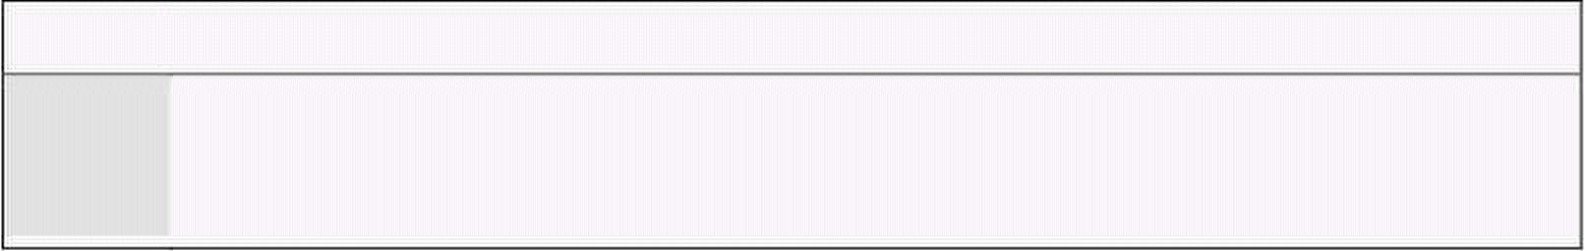
Computer Architecture & Assembly Language Programming Course Code: CS401
CS401@vu.edu.pk
Execute the program step by step and examine how the memory is read and
the registers are updated, how the instruction pointer moves forward, and
how the result is saved back in memory. Also observe inside the debugger
code window below the code for termination, that the debugger is
interpreting our data as code and showing it as some meaningless
instructions. This is because the debugger sees everything as code in the
code window and cannot differentiate our declared data from opcodes. It is
our responsibility that we terminate execution before our data is executed as
code.
Also observe that our naming of num1, num2, num3, and num4 is no
longer there inside the debugger. The debugger is only showing the numbers
0117, 0119, 011B, and 011D. Our numerical machine can only work with
numbers. We used symbols for our ease to label or tag certain positions in
our program. The assembler converts these symbols into the appropriate
numbers automatically. Also observe that the effect of “dw” is to place 5 in
two bytes as 0005. Had we used “db” this would have been stored as 05 in
one byte.
Given the fact that the assembler knows only numbers we can write the
same program using a single label. As we know that num2 is two ahead of
num1, we can use num1+2 instead of num2 and let the assembler calculate
the sum during assembly process.
Example 2.2
001 ; a program to add three numbers accessed using a single label
002 [org 0x0100]
003 mov ax, [num1] ; load first number in ax
004 mov bx, [num1+2] ; load second number in bx
005 add ax, bx ; accumulate sum in ax
006 mov bx, [num1+4] ; load third number in bx
007 add ax, bx ; accumulate sum in ax
008 mov [num1+6], ax ; store sum at num1+6
009
010 mov ax, 0x4c00 ; terminate program
011 int 0x21
012
013 num1: dw 5
014 dw 10
015 dw 15
016 dw 0
004 The second number is read from num1+2. Similarly the third
number is read from num1+4 and the result is accessed at num1+6.
013-016 The labels num2, num3, and num4 are removed and the data there
will be accessed with reference to num1.
Every location is accessed with reference to num1 in this example. The
expression “num1+2” comprises of constants only and can be evaluated at
the time of assembly. There are no variables involved in this expression. As
we open the program inside the debugger we see a verbatim copy of the
previous program. There is no difference at all since the assembler catered
for the differences during assembly. It calculated 0117+2=0119 while in the
previous it directly knew from the value of num2 that it has to write 0119,
but the end result is a ditto copy of the previous execution.
Another way to declare the above data and produce exactly same results is
shown in the following example.
Example 2.3
001 ; a program to add three numbers accessed using a single label
002 [org 0x0100]
003 mov ax, [num1] ; load first number in ax
004 mov bx, [num1+2] ; load second number in bx
Virtual University of Pakistan 19

Slide 28
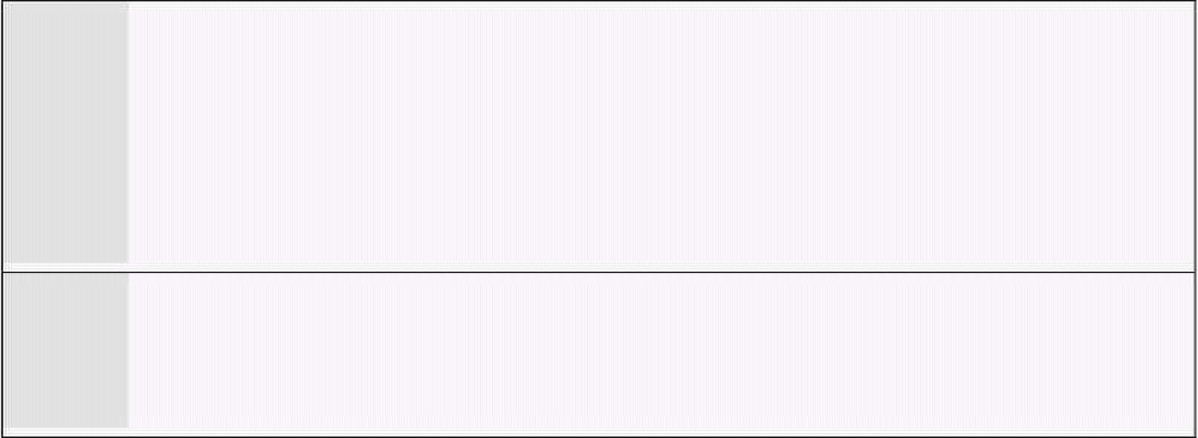
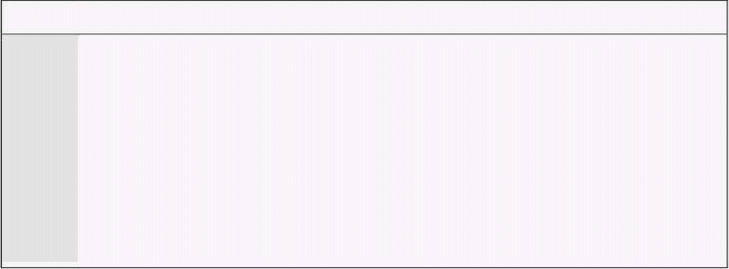

Computer Architecture & Assembly Language Programming Course Code: CS401
CS401@vu.edu.pk
005 add ax, bx ; accumulate sum in ax
006 mov bx, [num1+4] ; load third number in bx
007 add ax, bx ; accumulate sum in ax
008 mov [num1+6], ax ; store sum at num1+6
009
010 mov ax, 0x4c00 ; terminate program
011 int 0x21
012
013 num1: dw 5, 10, 15, 0
013 As we do not need to place labels on individual variables we can save
space and declare all data on a single line separated by commas.
This declaration will declare four words in consecutive memory
locations while the address of first one is num1.
The method used to access memory in the above examples is called direct
addressing. In direct addressing the memory address is fixed and is given in
the instruction. The actual data used is placed in memory and now that data
can be used as the destination operand as well. Also the source and
destination operands must have the same size. For example a word defined
memory is read in a word sized register. A last observation is that the data
0500 in memory was corrected to 0005 when read in a register. So registers
contain data in proper order as a word.
A last variation using direct addressing shows that we can directly add a
memory variable and a register instead of adding a register into another that
we were doing till now.
Example 2.4
01 ; a program to add three numbers directly in memory
02 [org 0x0100]
03 mov ax, [num1] ; load first number in ax
04 mov [num1+6], ax ; store first number in result
05 mov ax, [num1+2] ; load second number in ax
06 add [num1+6], ax ; add second number to result
07 mov ax, [num1+4] ; load third number in ax
08 add [num1+6], ax ; add third number to result
09
10 mov ax, 0x4c00 ; terminate program
11 int 0x21
12
13 num1: dw 5, 10, 15, 0
We generate the following listing file as a result of the assembly process
described previously. Comments are again removed.
1
2 [org 0x0100]
3 00000000 A1[1900] mov ax, [num1]
4 00000003 A3[1F00] mov [num1+6], ax
5 00000006 A1[1B00] mov ax, [num1+2]
6 00000009 0106[1F00] add [num1+6], ax
7 0000000D A1[1D00] mov ax, [num1+4]
8 00000010 0106[1F00] add [num1+6], ax
9
10 00000014 B8004C mov ax, 0x4c00
11 00000017 CD21 int 0x21
12
13 00000019 05000A000F000000 num1: dw 5, 10, 15, 0
The opcode of add is changed because the destination is now a memory
location instead of a register. No other significant change is seen in the
listing file. Inside the debugger we observe that few opcodes are longer now
and the location num1 is now translating to 0119 instead of 0117. This is
done automatically by the assembler as a result of using labels instead of
Virtual University of Pakistan 20

Slide 29

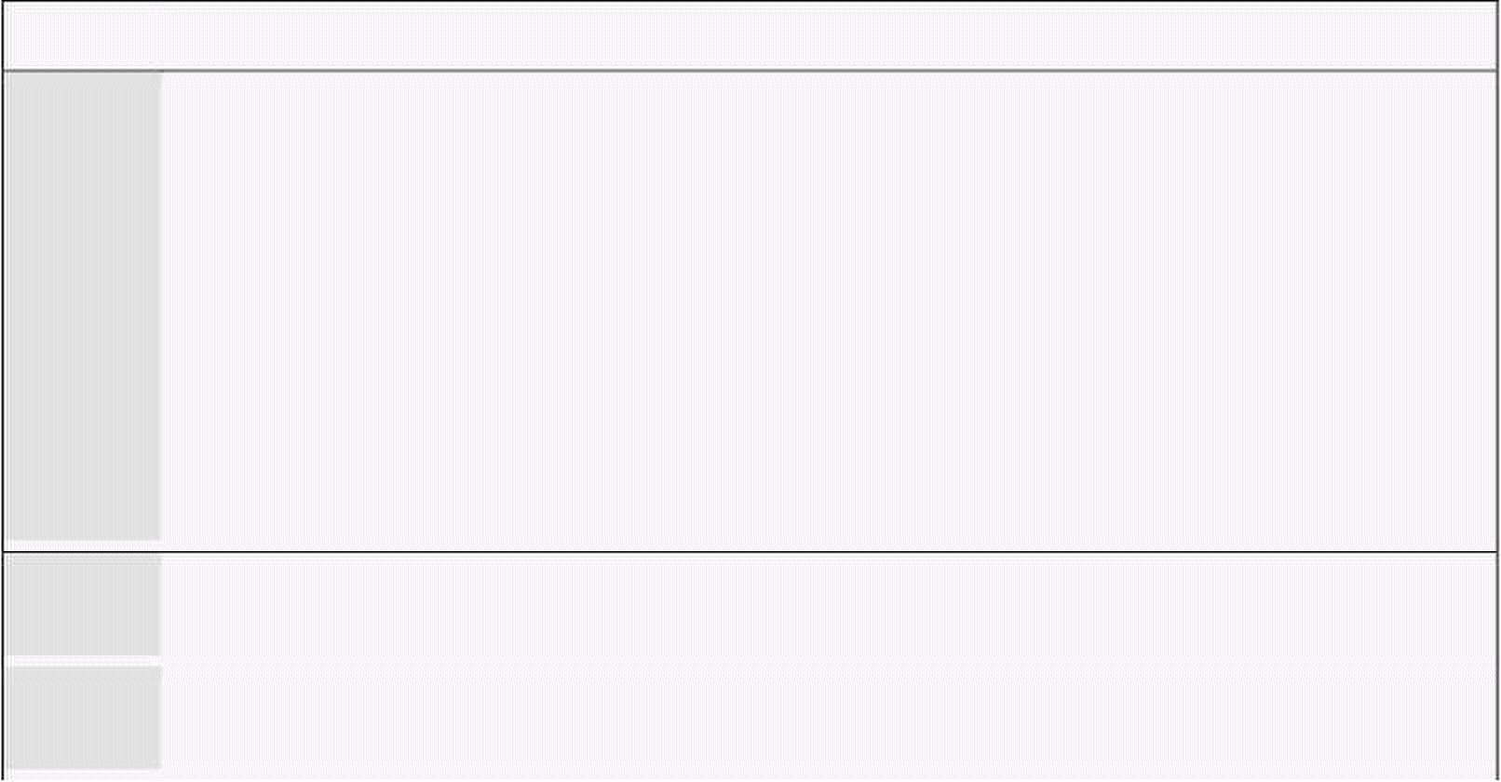
Computer Architecture & Assembly Language Programming Course Code: CS401
CS401@vu.edu.pk
hard coding addresses. During execution we observe that the word data as it
is read into a register is read in correct order. The significant change in this
example is that the destination of addition is memory. Method to access
memory is direct addressing, whether it is the MOV instruction or the ADD
instruction.
The first two instructions of the last program read a number into AX and
placed it at another memory location. A quick thought reveals that the
following might be a possible single instruction to replace the couple.
mov [num1+6], [num1] ; ILLEGAL
However this form is illegal and not allowed on the Intel architecture. None
of the general operations of mov add, sub etc. allow moving data from
memory to memory. Only register to register, register to memory, memory to
register, constant to memory, and constant to register operations are
allowed. The other register to constant, memory to constant, and memory to
memory are all disallowed. Only string instructions allow moving data from
memory to memory and will be discussed in detail later. As a rule one
instruction can have at most one operand in brackets, otherwise assembler
will give an error.
2.3. SIZE MISMATCH ERRORS
If we change the directive in the last example from DW to DB, the program
will still assemble and debug without errors, however the results will not be
the same as expected. When the first operand is read 0A05 will be read in the
register which was actually two operands place in consecutive byte memory
locations. The second number will be read as 000F which is the zero byte of
num4 appended to the 15 of num3. The third number will be junk depending
on the current state of the machine. According to our data declaration the
third number should be at 0114 but it is accessed at 011D calculated with
word offsets. This is a logical error of the program. To keep the declarations
and their access synchronized is the responsibility of the programmer and
not the assembler. The assembler allows the programmer to do everything he
wants to do, and that can possibly run on the processor. The assembler only
keeps us from writing illegal instructions which the processor cannot
execute. This is the difference between a syntax error and a logic error. So
the assembler and debugger have both done what we asked them to do but
the programmer asked them to do the wrong chore.
The programmer is responsible for accessing the data as word if it was
declared as a word and accessing it as a byte if it was declared as a byte. The
word case is shown in lot of previous examples. If however the intent is to
treat it as a byte the following code shows the appropriate way.
Example 2.5
001 ; a program to add three numbers using byte variables
002 [org 0x0100]
003 mov al, [num1] ; load first number in al
004 mov bl, [num1+1] ; load second number in bl
005 add al, bl ; accumulate sum in al
006 mov bl, [num1+2] ; load third number in bl
007 add al, bl ; accumulate sum in al
008 mov [num1+3], al ; store sum at num1+3
009
010 mov ax, 0x4c00 ; terminate program
011 int 0x21
012
013 num1: db 5, 10, 15, 0
003 The number is read in AL register which is a byte register since the
memory location read is also of byte size.
005 The second number is now placed at num1+1 instead of num1+2
because of byte offsets.
Virtual University of Pakistan 21

Slide 30

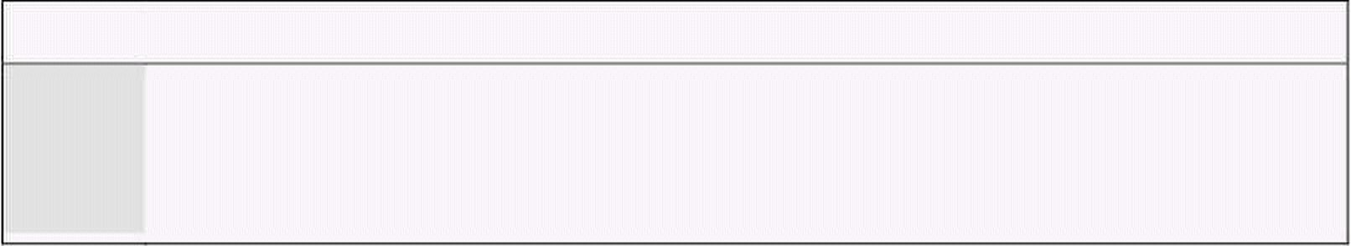
Computer Architecture & Assembly Language Programming Course Code: CS401
CS401@vu.edu.pk
013 To declare data db is used instead of dw so that each data declared
occupies one byte only.
Inside the debugger we observe that the AL register takes appropriate
values and the sum is calculated and stored in num1+3. This time there is
no alignment or synchronization error. The key thing to understand here is
that the processor does not match defines to accesses. It is the programmer’s
responsibility. In general assembly language gives a lot of power to the
programmer but power comes with responsibility. Assembly language
programming is not a difficult task but a responsible one.
In the above examples, the processor knew the size of the data movement
operation from the size of the register involved, for example in “mov ax,
[num1]” memory can be accessed as byte or as word, it has no hard and fast
size, but the AX register tells that this operation has to be a word operation.
Similarly in “mov al, [num1]” the AL register tells that this operation has to
be a byte operation. However in “mov ax, bl” the AX register tells that the
operation has to be a word operation while BL tells that this has to be a byte
operation. The assembler will declare that this is an illegal instruction. A 5Kg
bag cannot fit inside a 1Kg bag and according to Intel a 1Kg cannot also fit in
a 5Kg bag. They must match in size. The instruction “mov [num1], [num2]” is
illegal as previously discussed not because of data movement size but
because memory to memory moves are not allowed at all.
The instruction “mov [num1], 5” is legal but there is no way for the
processor to know the data movement size in this operation. The variable
num1 can be treated as a byte or as a word and similarly 5 can be treated as
a byte or as a word. Such instructions are declared ambiguous by the
assembler. The assembler has no way to guess the intent of the programmer
as it previously did using the size of the register involved but there is no
register involved this time. And memory is a linear array and label is an
address in it. There is no size associated with a label. Therefore to resolve its
ambiguity we clearly tell our intent to the assembler in one of the following
ways.
mov byte [num1], 5
mov word [num1], 5
2.4. REGISTER INDIRECT ADDRESSING
We have done very elementary data access till now. Assume that the
numbers we had were 100 and not just three. This way of adding them will
cost us 200 instructions. There must be some method to do a task repeatedly
on data placed in consecutive memory cells. The key to this is the need for
some register that can hold the address of data. So that we can change the
address to access some other cell of memory using the same instruction. In
direct addressing mode the memory cell accessed was fixed inside the
instruction. There is another method in which the address can be placed in a
register so that it can be changed. For the following example we will take 10
instead of 100 numbers but the algorithm is extensible to any size.
There are four registers in iAPX88 architecture that can hold address of
data and they are BX, BP, SI, and DI. There are minute differences in their
working which will be discussed later. For the current example, we will use
the BX register and we will take just three numbers and extend the concept
with more numbers in later examples.
Example 2.6
001 ; a program to add three numbers using indirect addressing
002 [org 0x100]
003 mov bx, num1 ; point bx to first number
004 mov ax, [bx] ; load first number in ax
005 add bx, 2 ; advance bx to second number
Virtual University of Pakistan 22

Slide 31

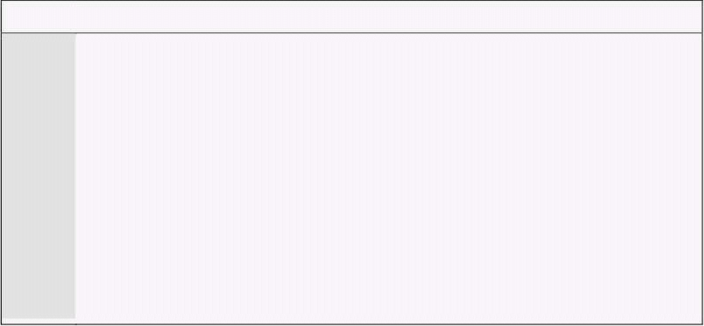
Computer Architecture & Assembly Language Programming Course Code: CS401
CS401@vu.edu.pk
006 add ax, [bx] ; add second number to ax
007 add bx, 2 ; advance bx to third number
008 add ax, [bx] ; add third number to ax
009 add bx, 2 ; advance bx to result
010 mov [bx], ax ; store sum at num1+6
011
012 mov ax, 0x4c00 ; terminate program
013 int 0x21
014
015 num1: dw 5, 10, 15, 0
003 Observe that no square brackets around num1 are used this time.
The address is loaded in bx and not the contents. Value of num1 is
0005 and the address is 0117. So BX will now contain 0117.
004 Brackets are now used around BX. In iapx88 architecture brackets
can be used around BX, BP, SI, and DI only. In iapx386 more
registers are allowed. The instruction will be read as “move into ax
the contents of the memory location whose address is in bx.” Now
since bx contains the address of num1 the contents of num1 are
transferred to the ax register. Without square brackets the meaning
of the instruction would have been totally different.
005 This instruction is changing the address. Since we have words not
bytes, we add two to bx so that it points to the next word in memory.
BX now contains 0119 the address of the second word in memory.
This was the mechanism to change addresses that we needed.
Inside the debugger we observe that the first instruction is “mov bx, 011C.”
A constant is moved into BX. This is because we did not use the square
brackets around “num1.” The address of “num1” has moved to 011C because
the code size has changed due to changed instructions. In the second
instruction BX points to 011C and the value read in AX is 0005 which can be
verified from the data window. After the addition BX points to 011E
containing 000A, our next word, and so on. This way the BX register points
to our words one after another and we can add them using the same
instruction “mov ax, [bx]” without fixing the address of our data in the
instructions. We can also subtract from BX to point to previous cells. The
address to be accessed is now in total program control.
One thing that we needed in our problem to add hundred numbers was the
capability to change address. The second thing we need is a way to repeat
the same instruction and a way to know that the repetition is done a 100
times, a terminal condition for the repetition. For the task we are introducing
two new instructions that you should read and understand as simple English
language concepts. For simplicity only 10 numbers are added in this
example. The algorithm is extensible to any size.
Example 2.7
001 ; a program to add ten numbers
002 [org 0x0100]
003 mov bx, num1 ; point bx to first number
004 mov cx, 10 ; load count of numbers in cx
005 mov ax, 0 ; initialize sum to zero
006
007 l1: add ax, [bx] ; add number to ax
008 add bx, 2 ; advance bx to next number
009 sub cx, 1 ; numbers to be added reduced
010 jnz l1 ; if numbers remain add next
011
012 mov [total], ax ; write back sum in memory
013
014 mov ax, 0x4c00 ; terminate program
015 int 0x21
016
017 num1: dw 10, 20, 30, 40, 50, 10, 20, 30, 40, 50
Virtual University of Pakistan 23

Slide 32

Computer Architecture & Assembly Language Programming Course Code: CS401
CS401@vu.edu.pk
018 total: dw 0
006 Labels can be used on code as well. Just like data labels they
remember the address at which they are used. The assembler does
not differentiate between code labels and data labels. The
programmer is responsible for using a data label as data and a code
label as code. The label l1 in this case is the address of the following
instruction.
009 SUB is the counterpart to ADD with the same rules as that of the
ADD instruction.
010 JNZ stands for “jump if not zero.” NZ is the condition in this
instruction. So the instruction is read as “jump to the location l1 if
the zero flag is not set.” And revisiting the zero flag definition “the
zero flag is set if the last mathematical or logical operation has
produced a zero in its destination.” For example “mov ax, 0” will not
set the zero flag as it is not a mathematical or logical instruction.
However subtraction and addition will set it. Also it is set even when
the destination is not a register. Now consider the subtraction
immediately preceding it. If the CX register becomes zero as a result
of this subtraction the zero flag will be set and the jump will be
taken. And jump to l1, the processor needs to be told each and
everything and the destination is an important part of every jump.
Just like when we ask someone to go, we mention go to this market
or that house. The processor is much more logical than us and
needs the destination in every instruction that asks it to go
somewhere. The processor will load l1 in the IP register and resume
execution from there. The processor will blindly go to the label we
mention even if it contains data and not code.
The CX register is used as a counter in this example, BX contains the
changing address, while AX accumulates the result. We have formed a loop
in assembly language that executes until its condition remains true. Inside
the debugger we can observe that the subtract instruction clears the zero flag
the first nine times and sets it on the tenth time. While the jump instruction
moves execution to address l1 the first nine times and to the following line
the tenth time. The jump instruction breaks program flow.
The JNZ instruction is from the program control group and is a conditional
jump, meaning that if the condition NZ is true (ZF=0) it will jump to the
address mentioned and otherwise it will progress to the next instruction. It is
a selection between two paths. If the condition is true go right and otherwise
go left. Or we can say if the weather is hot, go this way, and if it is cold, go
this way. Conditional jump is the most important instruction, as it gives the
processor decision making capability, so it must be given a careful thought.
Some processors call it branch, probably a more logical name for it, however
the functionality is same. Intel chose to name it “jump.”
An important thing in the above example is that a register is used to
reference memory so this form of access is called register indirect memory
access. We used the BX register for it and the B in BX and BP stands for
base therefore we call register indirect memory access using BX or BP,
“based addressing.” Similarly when SI or DI is used we name the method
“indexed addressing.” They have the same functionality, with minor
differences because of which the two are called base and index. The
differences will be explained later, however for the above example SI or DI
could be used as well, but we would name it indexed addressing instead of
based addressing.
Virtual University of Pakistan 24

Slide 33

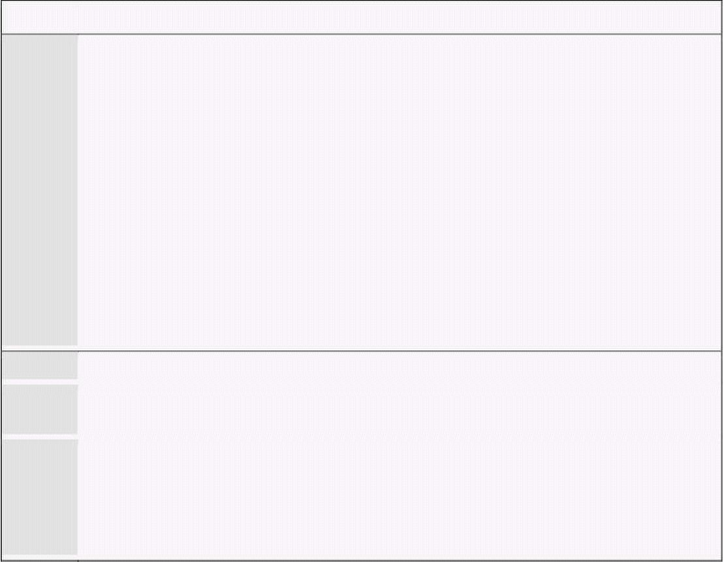
Computer Architecture & Assembly Language Programming Course Code: CS401
CS401@vu.edu.pk
2.5. REGISTER + OFFSET ADDRESSING
Direct addressing and indirect addressing using a single register are two
basic forms of memory access. Another possibility is to use different
combinations of direct and indirect references. In the above example we used
BX to access different array elements which were placed consecutively in
memory like an array. We can also place in BX only the array index and not
the exact address and form the exact address when we are going to access
the actual memory. This way the same register can be used for accessing
different arrays and also the register can be used for index comparison like
the following example does.
Example 2.8
001 ; a program to add ten numbers using register + offset addressing
002 [org 0x0100]
003 mov bx, 0 ; initialize array index to zero
004 mov cx, 10 ; load count of numbers in cx
005 mov ax, 0 ; initialize sum to zero
006
007 l1: add ax, [num1+bx] ; add number to ax
008 add bx, 2 ; advance bx to next index
009 sub cx, 1 ; numbers to be added reduced
010 jnz l1 ; if numbers remain add next
011
012 mov [total], ax ; write back sum in memory
013
014 mov ax, 0x4c00 ; terminate program
015 int 0x21
016
017 num1: dw 10, 20, 30, 40, 50, 10, 20, 30, 40, 50
018 total: dw 0
003 This time BX is initialized to zero instead of array base
007 The format of memory access has changed. The array base is added
to BX containing array index at the time of memory access.
008 As the array is of words, BX jumps in steps of two, i.e. 0, 2, 4.
Higher level languages do appropriate incrementing themselves and
we always use sequential array indexes. However in assembly
language we always calculate in bytes and therefore we need to take
care of the size of one array element which in this case is two.
Inside the debugger we observe that the memory access instruction is
shown as “mov ax, [011F+bx]” and the actual memory accessed is the one
whose address is the sum of 011F and the value contained in the BX
register. This form of access is of the register indirect family and is called
base + offset or index + offset depending on whether BX or BP is used or SI
or DI is used.
2.6. SEGMENT ASSOCIATION
All the addressing mechanisms in iAPX88 return a number called effective
address. For example in base + offset addressing, neither the base nor the
offset alone tells the desired cell in memory to be accessed. It is only after the
addition is done that the processor knows which cell to be accessed. This
number which came as the result of addition is called the effective address.
But the effective address is just an offset and is meaningless without a
segment. Only after the segment is known, we can form the physical address
that is needed to access a memory cell.
We discussed the segmented memory model of iAPX88 in reasonable detail
at the end of previous chapter. However during the discussion of addressing
modes we have not seen the effect of segments. Segmentation is there and
it’s all happening relative to a segment base. We saw DS, CS, SS, and ES
Virtual University of Pakistan 25

Slide 34

Computer Architecture & Assembly Language Programming Course Code: CS401
CS401@vu.edu.pk
inside the debugger. Everything is relative to its segment base, even though
we have not explicitly explained its functionality. An offset alone is not
complete without a segment. As previously discussed there is a default
segment associated to every register which accesses memory. For example
CS is associated to IP by default; rather it is tied with it. It cannot access
memory in any other segment.
In case of data, there is a bit relaxation and nothing is tied. Rather there is
a default association which can be overridden. In the case of register indirect
memory access, if the register used is one of SI, DI, or BX the default
segment is DS. If however the register used in BP the default segment used is
SS. The stack segment has a very critical and fine use and there is a reason
why BP is attached to SS by default. However these will be discussed in
detail in the chapter on stack. IP is tied to CS while SP is tied to SS. The
association of these registers cannot be changed; they are locked with no
option. Others are not locked and can be changed.
To override the association for one instruction of one of the registers BX,
BP, SI or DI, we use the segment override prefix. For example “mov ax,
[cs:bx]” associates BX with CS for this one instruction. For the next
instruction the default association will come back to act. The processor
places a special byte before the instruction called a prefix, just like prefixes
and suffixes in English language. No prefix is needed or placed for default
association. For example for CS the byte 2E is placed and for ES the byte 26
is placed. Opcode has not changed, but the prefix byte has modified the
default association to association with the desired segment register for this
one instruction.
In all our examples, we never declared a segment or used it explicitly, but
everything seemed to work fine. The important thing to note is that CS, DS,
SS, and ES all had the same value. The value itself is not important but the
fact that all had the same value is important. All four segment windows
exactly overlap. Whatever segment register we use the same physical memory
will be accessed. That is why everything was working without the mention of
a single segment register. This is the formation of COM files in IBM PC. A
single segment contains code, data, and the stack. This format is operating
system dependant, in our case defined by DOS. And our operating system
defines the format of COM files such that all segments have the same value.
Thus the only meaningful thing that remains is the offset.
For example if BX=0100, SI=0200, and CS=1000 and the memory access
under consideration is [cs:bx+si+0x0700], the effective address formed is
bx+si+0700 = 0100 + 0200 + 0700 = 0A00. Now multiplying the segment
value by 16 makes it 10000 and adding the effective address 00A00 forms
the physical address 10A00.
2.7. ADDRESS WRAPAROUND
There are two types of wraparounds. One is within a single segment and
the other is inside the whole physical memory. Segment wraparound occurs
when during the effective address calculation a carry is generated. This carry
is dropped giving the effect that when we try to access beyond the segment
limit, we are actually wrapped around to the first cell in the segment. For
example if BX=9100, DS=1500 and the access is [bx+0x7000] we form the
effective address 9100 + 7000 = 10100. The carry generated is dropped
forming the actual effective address of 0100. Just like a circle when we
reached the end we started again from the beginning. An arc at 370 degrees
is the same as an arc at 10 degrees. We tried to cross the segment boundary
and it pushed us back to the start. This is called segment wraparound. The
physical address in the above example will be 15100.
The same can also happen at the time of physical address calculation. For
example BX=0100, DS=FFF0 and the access under consideration is
[bx+0x0100]. The effective address will be 0200 and the physical address will
Virtual University of Pakistan 26

Slide 35

Computer Architecture & Assembly Language Programming Course Code: CS401
CS401@vu.edu.pk
be 100100. This is a 21bit answer and cannot be sent on the address bus
which is 20 bits wide. The carry is dropped and just like the segment
wraparound our physical memory has wrapped around at its very top. When
we tried to access beyond limits the actual access is made at the very start.
This second wraparound is a bit different in newer processor with more
address lines but that will be explained in later chapters.
2.8. ADDRESSING MODES SUMMARY
The iAPX88 processor supports seven modes of memory access. Remember
that immediate is not an addressing mode but an operand type. Operands
can be immediate, register, or memory. If the operand is memory one of the
seven addressing modes will be used to access it. The memory access
mechanisms can also be written in the general form “base + index + offset”
and we can define the possible addressing modes by saying that any one,
two, or none can be skipped from the general form to form a legal memory
access.
There are a few common mistakes done in forming a valid memory access.
Part of a register cannot be used to access memory. Like BX is allowed to
hold an address but BL or BH are not. Address is 16bit and must be
contained in a 16bit register. BX-SI is not possible. The only thing that we
can do is addition of a base register with an index register. Any other
operation is disallowed. BS+BP and SI+DI are both disallowed as we cannot
have two base or two index registers in one memory access. One has to be a
base register and the other has to be an index register and that is the reason
of naming them differently.
Direct
A fixed offset is given in brackets and the memory at that offset is
accessed. For example “mov [1234], ax” stores the contents of the AX
registers in two bytes starting at address 1234 in the current data segment.
The instruction “mov [1234], al” stores the contents of the AL register in the
byte at offset 1234.
Based Register Indirect
A base register is used in brackets and the actual address accessed
depends on the value contained in that register. For example “mov [bx], ax”
moves the two byte contents of the AX register to the address contained in
the BX register in the current data segment. The instruction “mov [bp], al”
moves the one byte content of the AL register to the address contained in the
BP register in the current stack segment.
Indexed Register Indirect
An index register is used in brackets and the actual address accessed
depends on the value contained in that register. For example “mov [si], ax”
moves the contents of the AX register to the word starting at address
contained in SI in the current data segment. The instruction “mov [di], ax”
moves the word contained in AX to the offset stored in DI in the current data
segment.
Based Register Indirect + Offset
A base register is used with a constant offset in this addressing mode. The
value contained in the base register is added with the constant offset to get
the effective address. For example “mov [bx+300], ax” stores the word
contained in AX at the offset attained by adding 300 to BX in the current
data segment. The instruction “mov [bp+300], ax” stores the word in AX to
the offset attained by adding 300 to BP in the current stack segment.
Virtual University of Pakistan 27

Slide 36

Computer Architecture & Assembly Language Programming Course Code: CS401
CS401@vu.edu.pk
Indexed Register Indirect + Offset
An index register is used with a constant offset in this addressing mode.
The value contained in the index register is added with the constant offset to
get the effective address. For example “mov [si+300], ax” moves the word
contained in AX to the offset attained by adding 300 to SI in the current data
segment and the instruction “mov [di+300], al” moves the byte contained in
AL to the offset attained by adding 300 to DI in the current data segment.
Base + Index
One base and one index register is used in this addressing mode. The
value of the base register and the index register are added together to get the
effective address. For example “mov [bx+si], ax” moves the word contained in
the AX register to offset attained by adding BX and SI in the current data
segment. The instruction “mov [bp+di], al” moves the byte contained in AL to
the offset attained by adding BP and DI in the current stack segment.
Observe that the default segment is based on the base register and not on
the index register. This is why base registers and index registers are named
separately. Other examples are “mov [bx+di], ax” and “mov [bp+si], ax.” This
method can be used to access a two dimensional array such that one
dimension is in a base register and the other is in an index register.
Base + Index + Offset
This is the most complex addressing method and is relatively infrequently
used. A base register, an index register, and a constant offset are all used in
this addressing mode. The values of the base register, the index register, and
the constant offset are all added together to get the effective address. For
example “mov [bx+si+300], ax” moves the word contents of the AX register to
the word in memory starting at offset attained by adding BX, SI, and 300 in
the current data segment. Default segment association is again based on the
base register. It might be used with the array base of a two dimensional array
as the constant offset, one dimension in the base register and the other in
the index register. This way all calculation of location of the desired element
has been delegated to the processor.
EXERCISES
1. What is a label and how does the assembler differentiates between
code labels and data labels?
2. List the seven addressing modes available in the 8088 architecture.
3. Differentiate between effective address and physical address.
4. What is the effective address generated by the following
instructions? Every instruction is independent of others. Initially
BX=0x0100, num1=0x1001, [num1]=0x0000, and SI=0x0100
a. mov ax, [bx+12]
b. mov ax, [bx+num1]
c. mov ax, [num1+bx]
d. mov ax, [bx+si]
5. What is the effective address generated by the following
combinations if they are valid. If not give reason. Initially
BX=0x0100, SI=0x0010, DI=0x0001, BP=0x0200, and SP=0xFFFF
a. bx-si
b. bx-bp
c. bx+10
d. bx-10
e. bx+sp
f. bx+di
6. Identify the problems in the following instructions and correct them
by replacing them with one or two instruction having the same
effect.
Virtual University of Pakistan 28

Slide 37
Computer Architecture & Assembly Language Programming Course Code: CS401
CS401@vu.edu.pk
a. mov [02], [ 22]
b. mov [wordvar], 20
c. mov bx, al
d. mov ax, [si+di+100]
7. What is the function of segment override prefix and what
changes it brings to the opcode?
8. What are the two types of address wraparound? What
physical address is accessed with [BX+SI] if FFFF is loaded in
BX, SI, and DS.
9. Write instructions to do the following.
a. Copy contents of memory location with offset 0025 in the
current data segment into AX.
b. Copy AX into memory location with offset 0FFF in the
current data segment.
c. Move contents of memory location with offset 0010 to
memory location with offset 002F in the current data
segment.
10. Write a program to calculate the square of 20 by using a loop
that adds 20 to the accumulator 20 times.
Virtual University of Pakistan 29

Slide 39

3
Branching
3.1. COMPARISON AND CONDITIONS
Conditional jump was introduced in the last chapter to loop for the
addition of a fixed number of array elements. The jump was based on the
zero flag. There are many other conditions possible in a program. For
example an operand can be greater than another operand or it can be
smaller. We use comparisons and boolean expressions extensively in higher
level languages. They must be available is some form in assembly language,
otherwise they could not possibly be made available in a higher level
language. In fact they are available in a very fine and purified form.
The basic root instruction for all comparisons is CMP standing for
compare. The operation of CMP is to subtract the source operand from the
destination operand, updating the flags without changing either the source
or the destination. CMP is one of the key instructions as it introduces the
capability of conditional routing in the processor.
A closer thought reveals that with subtraction we can check many different
conditions. For example if a larger number is subtracted from a smaller
number then borrow is needed. The carry flag plays the role of borrow during
the subtraction operation. And in this condition the carry flag will be set. If
two equal numbers are subtracted the answer is zero and the zero flag will be
set. Every significant relation between the destination and source is evident
from the sign flag, carry flag, zero flag, and the overflow flag. CMP is
meaningless without a conditional jump immediately following it.
Another important distinction at this point is the difference between signed
and unsigned numbers. In unsigned numbers only the magnitude of the
number is important, whereas in signed numbers both the magnitude and
the sign are important. For example -2 is greater than -3 but 2 is smaller
than 3. The sign has affected our comparisons.
Inside the computer signed numbers are represented in two’s complement
notation. In essence a number in this representation is still a number, just
that now our interpretation of this number will be signed. Whether we use
jump above and below or we use jump greater or less will convey our
intention to the processor. The jump above and greater operations at first
sight seem to be doing the same operation, and similarly below and less
operations seem to be similar. However for signed numbers JG and JL will
work properly and for unsigned JA and JB will work properly and not the
other way around.
It is important to note that at the time of comparison, the intent of the
programmer to treat the numbers as signed or unsigned is not clear. The
subtraction in CMP is a normal subtraction. It is only after the comparison,
during the conditional jump operation, that the intent is conveyed. At that
time with a specific combination of flags checked the intent is satisfied.
For example a number 2 is represented in a word as 0002 while the
number -2 is represented as FFFE. In a byte they would be represented as 02
and FE. Now both have the same magnitude however the different sign has
caused very different representation in two’s complement form. Now if the
intent is to use FFFE or decimal 65534 then the same data would be placed
in the word as in case of -2. In fact if -2 and 65534 are compared the
processor will set the zero flag signaling that they are exactly equal. As
regards an unsigned comparison the number 65534 is much greater than 2.

Slide 40


Computer Architecture & Assembly Language Programming Course Code: CS401
CS401@vu.edu.pk
So if a JA is taken after comparing -2 in the destination with 2 in the source
the jump will be taken. If however JG is used after the same comparison the
jump will not be taken as it will consider the sign and with the sign -2 is
smaller than 2. The key idea is that -2 and 65534 were both stored in
memory in the same form. It was the interpretation that treated it as a signed
or as an unsigned number.
The unsigned comparisons see the numbers as 0 being the smallest and
65535 being the largest with the order that 0 < 1 < 2 … < 65535. The signed
comparisons see the number -32768 which has the same memory
representation as 32768 as the smallest number and 32767 as the largest
with the order -32768 < -32767 < … < -1 < 0 < 1 < 2 < … < 32767. All the
negative numbers have the same representation as an unsigned number in
the range 32768 … 65535 however the signed interpretation of the signed
comparisons makes them be treated as negative numbers smaller than zero.
All meaningful situations both for signed and unsigned numbers than
occur after a comparison are detailed in the following table.
DEST = SRC ZF = 1 When the source is subtracted
equal the result is zero and
therefore the zero flag is set. This
works for both signed and
unsigned numbers.
UDEST < USRC CF = 1 When an unsigned source is
subtracted from an unsigned
destination and the destination is
smaller, borrow is needed which
sets the carry flag.
UDEST ≤ USRC ZF = 1 OR CF = 1 If the zero flag is set, it means
are equal and if the carry flag is
set it means a borrow was needed
in the subtraction and therefore
the destination is smaller.
UDEST ≥ USRC CF = 0 When an unsigned source is
destination no borrow will be
needed either when the operands
are equal or when the destination
is greater than the source.
UDEST > USRC ZF = 0 AND CF = 0 The unsigned source and
destination are not equal if the
zero flag is not set and the
destination is not smaller since
no borrow was taken. Therefore
the destination is greater than
the source.
SDEST < SSRC SF ≠ OF When a signed source is
destination and the answer is
negative with no overflow than
the destination is smaller than
the source. If however there is an
overflow meaning that the sign
has changed unexpectedly, the
meanings are reversed and a
Virtual University of Pakistan 32
from the destination and both are
that the source and destination
subtracted from an unsigned
subtracted from a signed

Slide 41




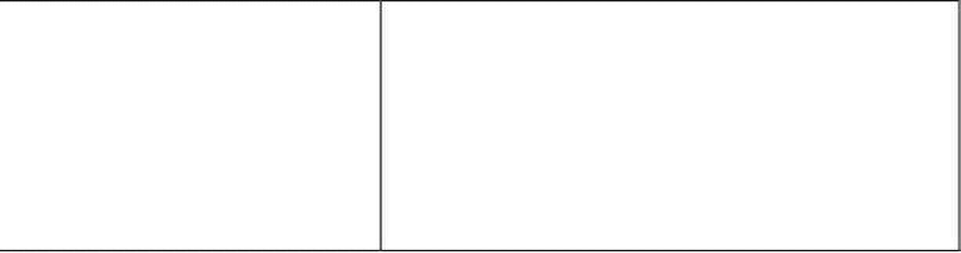

Computer Architecture & Assembly Language Programming Course Code: CS401
CS401@vu.edu.pk
positive number signals that the
destination is smaller.
SDEST ≤ SSRC ZF = 1 OR SF ≠ OF If the zero flag is set, it means
are equal and if the sign and
overflow flags differ it means that
the destination is smaller as
described above.
SDEST ≥ SSRC SF = OF When a signed source is
destination and the answer is
positive with no overflow than the
destination is greater than the
source. When an overflow is there
signaling that sign has changed
unexpectedly, we interpret a
negative answer as the signal
that the destination is greater.
SDEST > SSRC ZF = 0 AND SF = OF If the zero flag is not set, it means
that the signed operands are not
equal and if the sign and overflow
match in addition to this it
means that the destination is
greater than the source.
3.2. CONDITIONAL JUMPS
For every interesting or meaningful situation of flags, a conditional jump is
there. For example JZ and JNZ check the zero flag. If in a comparison both
operands are same, the result of subtraction will be zero and the zero flag
will be set. Thus JZ and JNZ can be used to test equality. That is why there
are renamed versions JE and JNE read as jump if equal or jump if not equal.
They seem more logical in writing but mean exactly the same thing with the
same opcode. Many jumps are renamed with two or three names for the
same jump, so that the appropriate logic can be conveyed in assembly
language programs. This renaming is done by Intel and is a standard for
iAPX88. JC and JNC test the carry flag. For example we may need to test
whether there was an overflow in the last unsigned addition or subtraction.
Carry flag will also be set if two unsigned numbers are subtracted and the
first is smaller than the second. Therefore the renamed versions JB, JNAE,
and JNB, JAE are there standing for jump if below, jump if not above or
equal, jump if not below, and jump if above or equal respectively. The
operation of all jumps can be seen from the following table.
JC Jump if carry CF = 1 This jump is taken if
JB Jump if below
carry or required a
borrow. After a CMP it
is taken if the
unsigned source is
smaller than the
unsigned destination.
JNC Jump if not carry CF = 0 This jump is taken if
JNB Jump if not below the last arithmetic
JAE Jump if above or equal operation did not
Virtual University of Pakistan 33
that the source and destination
subtracted from a signed
JNAE Jump if not above or equal
the last arithmetic

Slide 42


Computer Architecture & Assembly Language Programming Course Code: CS401
CS401@vu.edu.pk
generated a carry or
required a borrow.
After a CMP it is taken
if the unsigned source
is larger or equal to
the unsigned
destination.
JE Jump if equal ZF = 1 This jump is taken if
JZ Jump if zero the last arithmetic
operation produced a
zero in its destination.
After a CMP it is taken
if both operands were
equal.
JNE Jump if not equal ZF = 0 This jump is taken if
JNZ Jump if not zero the last arithmetic
operation did not
produce a zero in its
destination. After a
CMP it is taken if both
operands were
different.
JA Jump if above ZF = 0 AND This jump is taken
JNBE Jump if not below or equal CF = 0 after a CMP if the
larger than the
unsigned destination.
JNA Jump if not above ZF = 1 OR This jump is taken
JBE Jump if not below or equal CF = 1 after a CMP if the
unsigned source is
smaller than or equal
to the unsigned
destination.
JL Jump if less This jump is taken
signed source is
smaller than the
signed destination.
JNL Jump if not less SF = OF This jump is taken
JGE Jump if greater or equal after a CMP if the
signed source is larger
than or equal to the
signed destination.
JG Jump if greater ZF = 0 AND This jump is taken
JNLE Jump if not less or equal SF = OF after a CMP if the
signed source is larger
than the signed
destination.
JNG Jump if not greater This jump is taken
JLE Jump if less or equal SF ≠ OF
smaller than or equal
to the signed
destination.
Virtual University of Pakistan 34
unsigned source is
JNGE Jump if not greater or equal
ZF = 1 OR
signed source is
SF ≠ OF
after a CMP if the
after a CMP if the

Slide 43




Computer Architecture & Assembly Language Programming Course Code: CS401
CS401@vu.edu.pk
JO Jump if overflow. OF = 1 This jump is taken if
the last arithmetic
operation changed the
sign unexpectedly.
JNO Jump if not overflow OF = 0 This jump is taken if
the last arithmetic
operation did not
change the sign
unexpectedly.
JS Jump if sign SF = 1 This jump is taken if
operation produced a
negative number in its
destination.
JNS Jump if not sign SF = 0 This jump is taken if
the last arithmetic
operation produced a
positive number in its
destination.
JP Jump if parity PF = 1 This jump is taken if
JPE Jump if even parity the last arithmetic
operation produced a
number in its
destination that has
even parity.
JNP Jump if not parity PF = 0 This jump is taken if
JPO Jump if odd parity the last arithmetic
operation produced a
number in its
destination that has
odd parity.
JCXZ Jump if CX is zero CX = 0 This jump is taken if
The CMP instruction sets the flags reflecting the relation of the destination
to the source. This is important as when we say jump if above, then what is
above what. The destination is above the source or the source is above the
destination.
The JA and JB instructions are related to unsigned numbers. That is our
interpretation for the destination and source operands is unsigned. The 16th
bit holds data and not the sign. In the JL and JG instructions standing for
jump if lower and jump if greater respectively, the interpretation is signed.
The 16th bit holds the sign and not the data. The difference between them
will be made clear as an elaborate example will be given to explain the
difference.
One jump is special that it is not dependant on any flag. It is JCXZ, jump
if the CS register is zero. This is because of the special treatment of the CX
register as a counter. This jump is regardless of the zero flag. There is no
counterpart or not form of this instruction.
The adding numbers example of the last chapter can be a little simplified
using the compare instruction on the BX register and eliminating the need
for a separate counter as below.
Virtual University of Pakistan 35
the last arithmetic
the CX register is zero.

Slide 44

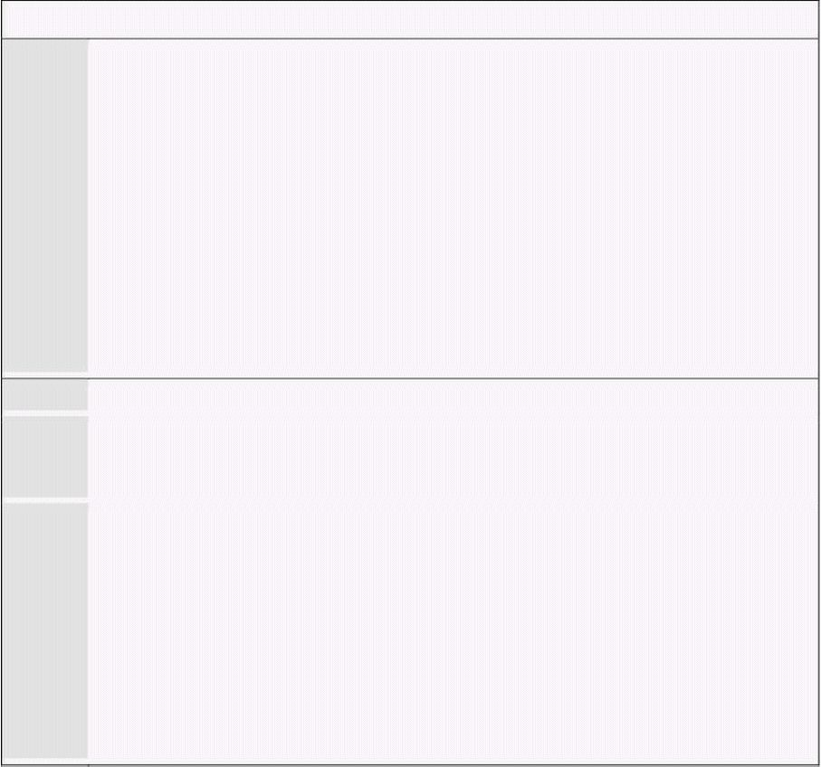
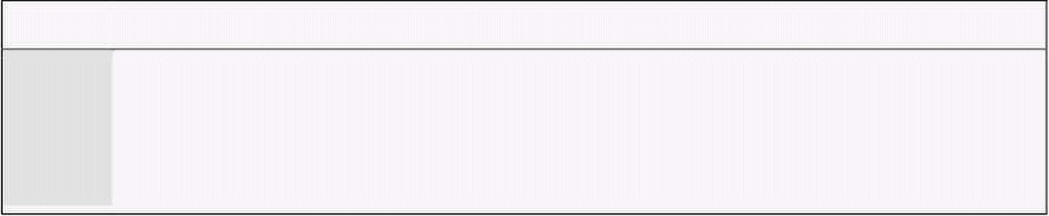
Computer Architecture & Assembly Language Programming Course Code: CS401
CS401@vu.edu.pk
Example 3.1
001 ; a program to add ten numbers without a separate counter
002 [org 0x0100]
003 mov bx, 0 ; initialize array index to zero
004 mov ax, 0 ; initialize sum to zero
005
006 l1: add ax, [num1+bx] ; add number to ax
007 add bx, 2 ; advance bx to next index
008 cmp bx, 20 ; are we beyond the last index
009 jne l1 ; if not add next number
010
011 mov [total], ax ; write back sum in memory
012
013 mov ax, 0x4c00 ; terminate program
014 int 0x21
015
016 num1: dw 10, 20, 30, 40, 50, 10, 20, 30, 40, 50
017 total: dw 0
006 The format of memory access is still base + offset.
008 BX is used as the array index as well as the counter. The offset of
11th number will be 20, so as soon as BX becomes 20 just after the
10th number has been added, the addition is stopped.
009 The jump is displayed as JNZ in the debugger even though we have
written JNE in our example. This is because it is a renamed jump
with the same opcode as JNZ and the debugger has no way of
knowing the mnemonic that we used after looking just at the
opcode. Also every code and data reference that we used till now is
seen in the opcode as well. However for the jump instruction we see
an operand of F2 in the opcode and not 0116. This will be discussed
in detail with unconditional jumps. It is actually a short relative
jump and the operand is stored in the form of positive or negative
offset from this instruction.
With conditional branching in hand, there are just a few small things left
in assembly language that fills some gaps. Now there is just imagination and
the skill to conceive programs that can make you write any program.
3.3. UNCONDITIONAL JUMP
Till now we have been placing data at the end of code. There is no such
restriction and we can define data anywhere in the code. Taking the previous
example, if we place data at the start of code instead of at the end and we
load our program in the debugger. We can see our data placed at the start
but the debugger is intending to start execution at our data. The COM file
definition said that the first executable instruction is at offset 0100 but we
have placed data there instead of code. So the debugger will try to interpret
that data as code and showed whatever it could make up out of those
opcodes.
We introduce a new instruction called JMP. It is the unconditional jump
that executes regardless of the state of all flags. So we write an unconditional
jump as the very first instruction of our program and jump to the next
instruction that follows our data declarations. This time 0100 contains a
valid first instruction of our program.
Example 3.2
001 ; a program to add ten numbers without a separate counter
002 [org 0x0100]
003 jmp start ; unconditionally jump over data
004
005 num1: dw 10, 20, 30, 40, 50, 10, 20, 30, 40, 50
006 total: dw 0
Virtual University of Pakistan 36

Slide 45





Computer Architecture & Assembly Language Programming Course Code: CS401
CS401@vu.edu.pk
007
008 start: mov bx, 0 ; initialize array index to zero
009 mov ax, 0 ; initialize sum to zero
010
011 l1: add ax, [num1+bx] ; add number to ax
012 add bx, 2 ; advance bx to next index
013 cmp bx, 20 ; are we beyond the last index
014 jne l1 ; if not add next number
015
016 mov [total], ax ; write back sum in memory
017
018 mov ax, 0x4c00 ; terminate program
019 int 0x21
003 JMP jumps over the data declarations to the start label and
execution resumes from there.
3.4. RELATIVE ADDRESSING
Inside the debugger the instruction is shown as JMP 0119 and the location
0119 contains the original first instruction of the logic of our program. This
jump is unconditional, it will always be taken. Now looking at the opcode we
see F21600 where F2 is the opcode and 1600 is the operand to it. 1600 is
0016 in proper word order. 0119 is not given as a parameter rather 0016 is
given.
This is position relative addressing in contrast to absolute addressing. It is
not telling the exact address rather it is telling how much forward or
backward to go from the current position of IP in the current code segment.
So the instruction means to add 0016 to the IP register. At the time of
execution of the first instruction at 0100 IP was pointing to the next
instruction at 0103, so after adding 16 it became 0119, the desired target
location. The mechanism is important to know, however all calculations in
this mechanism are done by the assembler and by the processor. We just use
a label with the JMP instruction and are ensured that the instruction at the
target label will be the one to be executed.
3.5. TYPES OF JUMP
The three types of jump, near, short, and far, differ in the size of
instruction and the range of memory they can jump to with the smallest
short form of two bytes and a range of just 256 bytes to the far form of five
bytes and a range covering the whole memory.
Short Jump
EB Disp
Near Jump
EB Disp Low Disp High
Far Jump
EB IP Low IP High CS Low CS High
Near Jump
When the relative address stored with the instruction is in 16 bits as in the
last example the jump is called a near jump. Using a near jump we can jump
anywhere within a segment. If we add a large number it will wrap around to
Virtual University of Pakistan 37

Slide 46

Computer Architecture & Assembly Language Programming Course Code: CS401
CS401@vu.edu.pk
the lower part. A negative number actually is a large number and works this
way using the wraparound behavior.
Short Jump
If the offset is stored in a single byte as in 75F2 with the opcode 75 and
operand F2, the jump is called a short jump. F2 is added to IP as a signed
byte. If the byte is negative the complement is negated from IP otherwise the
byte is added. Unconditional jumps can be short, near, and far. The far type
is yet to be discussed. Conditional jumps can only be short. A short jump
can go +127 bytes ahead in code and -128 bytes backwards and no more.
This is the limitation of a byte in singed representation.
Far Jump
Far jump is not position relative but is absolute. Both segment and offset
must be given to a far jump. The previous two jumps were used to jump
within a segment. Sometimes we may need to go from one code segment to
another, and near and short jumps cannot take us there. Far jump must be
used and a two byte segment and a two byte offset are given to it. It loads CS
wit the segment part and IP with the offset part. Execution therefore resumes
from that location in physical memory. The three instructions that have a far
form are JMP, CALL, and RET, are related to program control. Far capability
makes intra segment control possible.
3.6. SORTING EXAMPLE
Moving ahead from our example of adding numbers we progress to a
program that can sort a list of numbers using the tools that we have
accumulated till now. Sorting can be ascending or descending like if the
largest number comes at the top, followed by a smaller number and so on till
the smallest number the sort will be called descending. The other order
starting with the smallest number and ending at the largest is called
ascending sort. This is a common problem and many algorithms have been
developed to solve it. One simple algorithm is the bubble sort algorithm.
In this algorithm we compare consecutive numbers. If they are in required
order e.g. if it is a descending sort and the first is larger then the second,
then we leave them as it is and if they are not in order, we swap them. Then
we do the same process for the next two numbers and so on till the last two
are compared and possibly swapped.
A complete iteration is called a pass over the array. We need N passes at
least in the simplest algorithm if N is the number of elements to be sorted. A
finer algorithm is to check if any swap was done in this pass and stop as
soon as a pass goes without a swap. The array is now sorted as every pair of
elements is in order.
For example if our list of numbers is 60, 55, 45, and 58 and we want to
sort them in ascending order, the first comparison will be of 60 and 55 and
as the order will be reversed to 55 and 60. The next comparison will be of 60
and 45 and again the two will be swapped. The next comparison of 60 and 58
will also cause a swap. At the end of first pass the numbers will be in order
of 55, 45, 58, and 60. Observe that the largest number has bubbled down to
the bottom. Just like a bubble at bottom of water. In the next pass 55 and 45
will be swapped. 55 and 58 will not be swapped and 58 and 60 will also not
be swapped. In the next pass there will be no swap as the elements are in
order i.e. 45, 55, 58, and 60. The passes will be stopped as the last pass did
not cause any swap. The application of bubble sort on these numbers is
further explained with the following illustration.
Virtual University of Pakistan 38

Slide 47




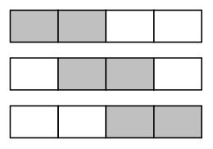
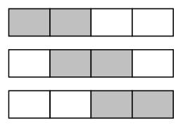



Computer Architecture & Assembly Language Programming Course Code: CS401
CS401@vu.edu.pk
State of Data Swap Done Swap Flag
Pass 1 Off
60 55 45 58 Yes On
55 60 45 58 Yes On
55 45 60 58 Yes On
Pass 2 Off
55 45 58 60
45 55 58 60 No On
45 55 58 60 No On
Pass 3 Off
45 55 58 60 No Off
45 55 58 60 No Off
45 55 58 60 No Off
No more passes since swap flag is Off
Example 3.3
001 ; sorting a list of ten numbers using bubble sort
002 [org 0x0100]
003 jmp start
004
005 data: dw 60, 55, 45, 50, 40, 35, 25, 30, 10, 0
006 swap: db 0
007
008 start: mov bx, 0 ; initialize array index to zero
009 mov byte [swap], 0 ; rest swap flag to no swaps
010
011 loop1: mov ax, [data+bx] ; load number in ax
012 cmp ax, [data+bx+2] ; compare with next number
013 jbe noswap ; no swap if already in order
014
015 mov dx, [data+bx+2] ; load second element in dx
016 mov [data+bx+2], ax ; store first number in second
017 mov [data+bx], dx ; store second number in first
018 mov byte [swap], 1 ; flag that a swap has been done
019
020 noswap: add bx, 2 ; advance bx to next index
021 cmp bx, 18 ; are we at last index
022 jne loop1 ; if not compare next two
023
024 cmp byte [swap], 1 ; check if a swap has been done
025 je bsort ; if yes make another pass
026
027 mov ax, 0x4c00 ; terminate program
028 int 0x21
Virtual University of Pakistan 39
Yes On

Slide 48

Computer Architecture & Assembly Language Programming Course Code: CS401
CS401@vu.edu.pk
003 The jump instruction is placed to skip over data.
006 The swap flag can be stored in a register but as an example it is
stored in memory and also to extend the concept at a later stage.
011-012 One element is read in AX and it is compared with the next element
because memory to memory comparisons are not allowed.
013 If the JBE is changed to JB, not only the unnecessary swap on equal
will be performed, there will be a major algorithmic flaw due to a
logical error as in the case of equal elements the algorithm will never
stop. JBE won’t swap in the case of equal elements.
015-017 The swap is done using DX and AX registers in such a way that the
values are crossed. The code uses the information that one of the
elements is already in the AX register.
021 This time BX is compared with 18 instead of 20 even though the
number of elements is same. This is because we pick an element
and compare it with the next element. When we pick the 9th element
we compare it with the next element and this is the last comparison,
since if we pick the 10th element we will compare it with the 11th
element and there is no 11th element in our case.
024-025 If a swap is done we repeat the whole process for possible more
swaps.
Inside the debugger we observe that the JBE is changed to JNA due to the
same reason as discussed for JNE and JNZ. The passes change the data in
the same manner as we presented in our illustration above. If JBE in the
code is changed to JAE the sort will change from ascending to descending.
For signed numbers we can use JLE and JGE respectively for ascending and
descending sort.
To clarify the difference of signed and unsigned jumps we change the data
array in the last program to include some negative numbers as well. When
JBE will be used on this data, i.e. with unsigned interpretation of the data
and an ascending sort, the negative numbers will come at the end after the
largest positive number. However JLE will bring the negative numbers at the
very start of the list to bring them in proper ascending order according to a
signed interpretation, even though they are large in magnitude. The data
used is shown as below.
data: dw 60, 55, 45, 50, -40, -35, 25, 30, 10, 0
This data includes some signed numbers as well. The JBE instruction will
treat this data as an unsigned number and will cater only for the magnitude
ignoring the sign. If the program is loaded in the debugger, the numbers will
appear in their hexadecimal equivalent. The two numbers -40 and -35 are
especially important as they are represented as FFD8 and FFDD. This data is
not telling whether it is signed or unsigned. Our interpretation will decide
whether it is a very large unsigned number or a signed number in two’s
complement form.
If the sorting algorithm is applied on the above data with JBE as the
comparison instruction to sort in ascending order with unsigned
interpretation, observe the comparisons of the two numbers FFD8 and
FFDD. For example it will decide that FFDD > FFD8 since the first is larger
in magnitude. At the end of sorting FFDD will be at the end of the list being
declared the largest number and FFD8 will precede it to be the second
largest.
If however the comparison instruction is changed to JLE and sorting is
done on the same data it works similarly except on the two numbers FFDD
and FFD8. This time JLE declares them to be smaller than every other
number and also declares FFDD < FFD8. At the end of sorting, FFDD is
Virtual University of Pakistan 40

Slide 49

Computer Architecture & Assembly Language Programming Course Code: CS401
CS401@vu.edu.pk
declared to be the smallest number followed by FFD8 and then 0000. This is
in contrast to the last example where JBE was used. This happened because
JLE interpreted our data as signed numbers, and as a signed number FFDD
has its sign bit on signaling that it is a negative number in two’s complement
form which is smaller than 0000 and every positive number. However JBE
did not give any significance to the sign bit and included it in the magnitude.
Therefore it declared the negative numbers to be the largest numbers.
If the required interpretation was of signed numbers the result produced
by JLE is correct and if the required interpretation was of unsigned numbers
the result produced by JBE is correct. This is the very difference between
signed and unsigned integers in higher level languages, where the compiler
takes the responsibility of making the appropriate jump depending on the
type of integer used. But it is only at this level that we can understand the
actual mechanism going on. In assembly language, use of proper jump is the
responsibility of the programmer, to convey the intentions to use the data as
signed or as unsigned.
The remaining possibilities of signed descending sort and unsigned
descending sort can be done on the same lines and are left as an exercise.
Other conditional jumps work in the same manner and can be studied from
the reference at the end. Several will be discussed in more detail when they
are used in subsequent chapters.
EXERCISES
1. Which registers are changed by the CMP instruction?
2. What are the different types of jumps available? Describe position
relative addressing.
3. If AX=8FFF and BX=0FFF and “cmp ax, bx” is executed, which of the
following jumps will be taken? Each part is independent of others. Also
give the value of Z, S, and C flags.
a. jg greater
b. jl smaller
c. ja above
d. jb below
4. Write a program to find the maximum number and the minimum
number from an array of ten numbers.
5. Write a program to search a particular element from an array using
binary search. If the element is found set AX to one and otherwise to
zero.
6. Write a program to calculate the factorial of a number where factorial
is defined as:
factorial(x) = x*(x-1)*(x-2)*...*1
factorial(0) = 1
Virtual University of Pakistan 41

Slide 51

4
Bit Manipulations
4.1. MULTIPLICATION ALGORITHM
With the important capability of decision making in our repertoire we move
on to the discussion of an algorithm, which will help us uncover an
important set of instructions in our processor used for bit manipulations.
Multiplication is a common process that we use, and we were trained to do
in early schooling. Remember multiplying by a digit and then putting a cross
and then multiplying with the next digit and putting two crosses and so on
and summing the intermediate results in the end. Very familiar process but
we never saw the process as an algorithm, and we need to see it as an
algorithm to convey it to the processor.
To highlight the important thing in the algorithm we revise it on two 4bit
binary numbers. The numbers are 1101 i.e. 13 and 0101 i.e. 5. The answer
should be 65 or in binary 01000001. Observe that the answer is twice as
long as the multiplier and the multiplicand. The multiplication is shown in
the following figure.
1101 = 13
0101 = 5
-----
1101
0000x
1101xx
0000xxx
--------
01000001 = 65
We take the first digit of the multiplier and multiply it with the
multiplicand. As the digit is one the answer is the multiplicand itself. So we
place the multiplicand below the bar. Before multiplying with the next digit a
cross is placed at the right most place on the next line and the result is
placed shifted one digit left. However since the digit is zero, the result is zero.
Next digit is one, multiplying with which, the answer is 1101. We put two
crosses on the next line at the right most positions and place the result there
shifted two places to the left. The fourth digit is zero, so the answer 0000 is
placed with three crosses to its right.
Observe the beauty of binary base, as no real multiplication is needed at
the digit level. If the digit is 0 the answer is 0 and if the digit is 1 the answer
is the multiplicand itself. Also observe that for every next digit in the
multiplier the answer is written shifted one more place to the left. No shifting
for the first digit, once for the second, twice for the third and thrice for the
fourth one. Adding all the intermediate answers the result is 01000001=65
as desired. Crosses are treated as zero in this addition.
Before formulating the algorithm for this problem, we need some more
instructions that can shift a number so that we use this instruction for our
multiplicand shifting and also some way to check the bits of the multiplier
one by one.
4.2. SHIFTING AND ROTATIONS
The set of shifting and rotation instructions is one of the most useful set in
any processor’s instruction set. They simplify really complex tasks to a very

Slide 52


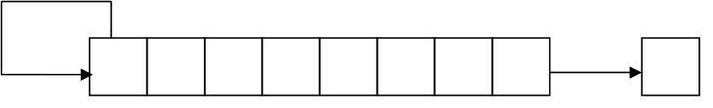
Computer Architecture & Assembly Language Programming Course Code: CS401
CS401@vu.edu.pk
neat and concise algorithm. The following shifting and rotation operations
are available in our processor.
Shift Logical Right (SHR)
The shift logical right operation inserts a zero from the left and moves
every bit one position to the right and copies the rightmost bit in the carry
flag. Imagine that there is a pipe filled to capacity with eight balls. The pipe is
open from both ends and there is a basket at the right end to hold anything
dropping from there. The operation of shift logical right is to force a white
ball from the left end. The operation is depicted in the following illustration.
0 1 0 1 1 0 1 0 0 C
White balls represent zero bits while black balls represent one bits. Sixteen
bit shifting is done the same way with a pipe of double capacity.
Shift Logical Left (SHL) / Shift Arithmetic Left (SAL)
The shift logical left operation is the exact opposite of shift logical right. In
this operation the zero bit is inserted from the right and every bit moves one
position to its left with the most significant bit dropping into the carry flag.
Shift arithmetic left is just another name for shift logical left. The operation is
again exemplified with the following illustration of ball and pipes.
C 1 0 1 1 0 1 0 0 0
Shift Arithmetic Right (SAR)
A signed number holds the sign in its most significant bit. If this bit was
one a logical right shifting will change the sign of this number because of
insertion of a zero from the left. The sign of a signed number should not
change because of shifting.
The operation of shift arithmetic right is therefore to shift every bit one
place to the right with a copy of the most significant bit left at the most
significant place. The bit dropped from the right is caught in the carry
basket. The sign bit is retained in this operation. The operation is further
illustrated below.
1 0 1 1 0 1 0 0 C
The left shifting operation is basically multiplication by 2 while the right
shifting operation is division by two. However for signed numbers division by
two can be accomplished by using shift arithmetic right and not shift logical
right. The left shift operation is equivalent to multiplication except when an
important bit is dropped from the left. The overflow flag will signal this
condition if it occurs and can be checked with JO. For division by 2 of a
signed number logical right shifting will give a wrong answer for a negative
number as the zero inserted from the left will change its sign. To retain the
sign flag and still effectively divide by two the shift arithmetic right
instruction must be used on signed numbers.
Virtual University of Pakistan 44

Slide 53

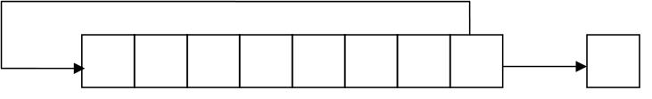
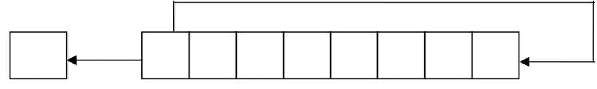
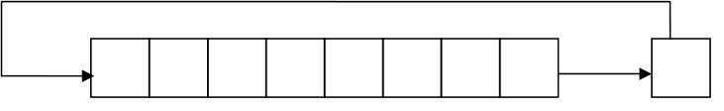
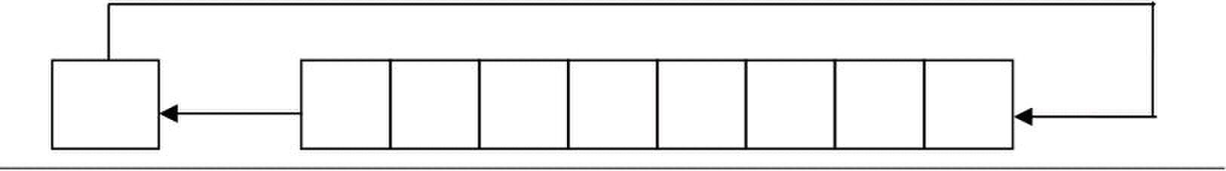
Computer Architecture & Assembly Language Programming Course Code: CS401
CS401@vu.edu.pk
Rotate Right (ROR)
In the rotate right operation every bit moves one position to the right and
the bit dropped from the right is inserted at the left. This bit is also copied
into the carry flag. The operation can be understood by imagining that the
pipe used for shifting has been molded such that both ends coincide. Now
when the first ball is forced to move forward, every ball moves one step
forward with the last ball entering the pipe from its other end occupying the
first ball’s old position. The carry basket takes a snapshot of this ball leaving
one end of the pipe and entering from the other.
1 0 1 1 0 1 0 0 C
Rotate Left (ROL)
In the operation of rotate left instruction, the most significant bit is copied
to the carry flag and is inserted from the right, causing every bit to move one
position to the left. It is the reverse of the rotate right instruction. Rotation
can be of eight or sixteen bits. The following illustration will make the
concept clear using the same pipe and balls example.
C 1 0 1 1 0 1 0 0
Rotate Through Carry Right (RCR)
In the rotate through carry right instruction, the carry flag is inserted from
the left, every bit moves one position to the right, and the right most bit is
dropped in the carry flag. Effectively this is a nine bit or a seventeen bit
rotation instead of the eight or sixteen bit rotation as in the case of simple
rotations.
Imagine the circular molded pipe as used in the simple rotations but this
time the carry position is part of the circle between the two ends of the pipe.
Pushing the carry ball from the left causes every ball to move one step to its
right and the right most bit occupying the carry place. The idea is further
illustrated below.
1 0 1 1 0 1 0 0 C
Rotate Through Carry Left (RCL)
The exact opposite of rotate through carry right instruction is the rotate
through carry left instruction. In its operation the carry flag is inserted from
the right causing every bit to move one location to its left and the most
significant bit occupying the carry flag. The concept is illustrated below in
the same manner as in the last example.
C 1 0 1 1 0 1 0 0
Virtual University of Pakistan 45

Slide 54

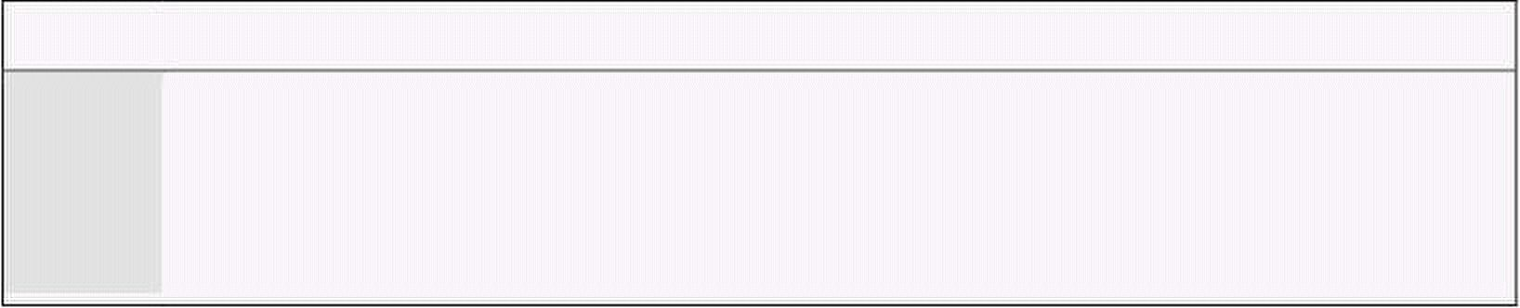
Computer Architecture & Assembly Language Programming Course Code: CS401
CS401@vu.edu.pk
4.3. MULTIPLICATION IN ASSEMBLY LANGUAGE
In the multiplication algorithm discussed above we revised the way we
multiplied number in lower classes, and gave an example of that method on
binary numbers. We make a simple modification to the traditional algorithm
before we proceed to formulate it in assembly language.
In the traditional algorithm we calculate all intermediate answers and then
sum them to get the final answer. If we add every intermediate answer to
accumulate the result, the result will be same in the end, except that we do
not have to remember a lot of intermediate answers during the whole
multiplication. The multiplication with the new algorithm is shown below.
1101 = 13 Accumulated Result
0101 = 5
----- 0 (Initial Value)
1101 = 13 0 + 13 = 13
0000x = 0 13 + 0 = 13
1101xx = 52 13 + 52 = 65
0000xxx = 0 65 + 0 = 65 (Answer)
We try to identify steps of our algorithm. First we set the result to zero.
Then we check the right most bit of multiplier. If it is one add the
multiplicand to the result, and if it is zero perform no addition. Left shift the
multiplicand before the next bit of multiplier is tested. The left shifting of the
multiplicand is performed regardless of the value of the multiplier’s right
most bit. Just like the crosses in traditional multiplication are always placed
to mark the ones, tens, thousands, etc. places. Then check the next bit and if
it is one add the shifted value of the multiplicand to the result. Repeat for as
many digits as there are in the multiplier, 4 in our example. Formulating the
steps of the algorithm we get:
• Shift the multiplier to the right.
• If CF=1 add the multiplicand to the result.
• Shift the multiplicand to the right.
• Repeat the algorithm 4 times.
For an 8bit multiplication the algorithm will be repeated 8 times and for a
sixteen bit multiplication it will be repeated 16 times, whatever the size of the
multiplier is.
The algorithm uses the fact that shifting right forces the right most bit to
drop in the carry flag. If we test the carry flag using JC we are effectively
testing the right most bit of the multiplier. Another shifting will cause the
next bit to drop in the next iteration and so on. So our task of checking bits
one by one is satisfied using the shift operation. There are many other
methods to do this bit testing as well, however we exemplify one of the
methods in this example.
In the first iteration there is no shifting just like there is no cross in
traditional multiplication in the first pass. Therefore we placed the left
shifting of the multiplicand after the addition step. However the right shifting
of multiplier must be before the addition as the addition step’s execution
depends upon its result.
We introduce an assembly language program to perform this 4bit
multiplication. The algorithm is extensible to more bits but there are a few
complications, which are left to be discussed later. For now we do a 4bit
multiplication to keep the algorithm simple.
Example 4.1
01 ; 4bit multiplication algorithm
02 [org 0x100]
03 jmp start
04
05 multiplicand: db 13 ; 4bit multiplicand (8bit space)
06 multiplier: db 5 ; 4bit multiplier
Virtual University of Pakistan 46

Slide 55


Computer Architecture & Assembly Language Programming Course Code: CS401
CS401@vu.edu.pk
07 result: db 0 ; 8bit result
08
09 start: mov cl, 4 ; initialize bit count to four
10 mov bl, [multiplicand] ; load multiplicand in bl
11 mov dl, [multiplier] ; load multiplier in dl
12
13 checkbit: shr dl, 1 ; move right most bit in carry
14 jnc skip ; skip addition if bit is zero
15
16 add [result], bl ; accumulate result
17
18 skip: shl bl, 1 ; shift multiplicand left
19 dec cl ; decrement bit count
20 jnz checkbit ; repeat if bits left
21
22 mov ax, 0x4c00 ; terminate program
23 int 0x21
04-06 The numbers to be multiplied are constants for now. The
multiplication is four bit so the answer is stored in an 8bit register.
07 operands were 16bit the answer would be 32bit. Since eight bits can
fit in a byte we have used 4bit multiplication as our first example.
14-16
the shifted value of the multiplicand is added to the result.
18
19
subtracts one from its single operand.
20
Inside the debugger observe the working of the SHR and SHL instructions.
The SHR instruction is effectively dividing its operand by two and the
remainder is stored in the carry flag from where we test it. The SHL
instruction is multiplying its operand by two so that it is added at one place
more towards the left in the result.
4.4. EXTENDED OPERATIONS
We performed a 4bit multiplication to explain the algorithm however the
real advantage of the computer is when we ask it to multiply large numbers,
Numbers whose multiplication takes real time. If we have an 8bit number we
can do the multiplication in word registers, but are we limited to word
operations? What if we want to multiply 32bit or even larger numbers? We
are certainly not limited. Assembly language only provides us the basic
building blocks. We build a plaza out of these blocks, or a building, or a
classic piece of architecture is only dependant upon our imagination. With
our logic we can extend these algorithms as much as we want.
Our next example will be multiplication of 16bit numbers to produce a
32bit answer. However for a 32bit answer we need a way to shift a 32bit
number and a way to add 32bit numbers. We cannot depend on 16bit
shifting as we have 16 significant bits in our multiplicand and shifting any
bit towards the left may drop a valuable bit causing a totally wrong result. A
valuable bit means any bit that is one. Dropping a zero bit doesn’t cause any
difference. So we place the 16it number in 32bit space with the upper 16 bits
zeroed so that the sixteen shift operations don’t cause any valuable bit to
drop. Even though the numbers were 16bit we need 32bit operations to
multiply correctly.
To clarify this necessity, we take example of a number 40000 or 9C40 in
hexadecimal. In binary it is represented as 1001110001000000. To multiply
Virtual University of Pakistan 47
If the operands were 8bit the answer would be 16bit and if the
Since addition by zero means nothing we skip the addition step if
the rightmost bit of the multiplier is zero. If the jump is not taken
The multiplicand is left shifted in every iteration regardless of the
multiplier bit.
DEC is a new instruction but its operation should be immediately
understandable with the knowledge gained till now. It simply
The JNZ instruction causes the algorithm to repeat till any bits of
the multiplier are left

Slide 56
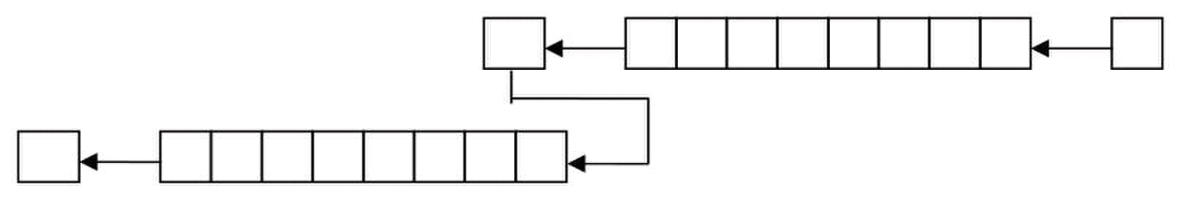
Computer Architecture & Assembly Language Programming Course Code: CS401
CS401@vu.edu.pk
by two we shift it one place to the left. The answer we get is
0011100010000000 and the left most one is dropped in the carry flag. The
answer should be the 17bit number 0x13880 but it is 0x3880, which are
14464 in decimal instead of the expected 80000. We should be careful of this
situation whenever shifting is used.
Extended Shifting
Using our basic shifting and rotation instructions we can effectively shift a
32bit number in memory word by word. We cannot shift the whole number
at once since our architecture is limited to word operations. The algorithm
we use consists of just two instructions and we name it extended shifting.
num1: dd 40000
shl word [num1], 1
rcl word [num1+2], 1
The DD directive reserves a 32bit space in memory, however the value we
placed there will fit in 16bits. So we can safely shift the number left 16 times.
The least significant word is accessible at num1 and the most significant
word is accessible at num1+2.
The two instructions are carefully crafted such that the first one shifts the
lower word towards the left and the most significant bit of that word is
dropped in carry. With the next instruction we push that dropped bit into the
least significant bit of the next word effectively joining the two 16bit words.
The final carry after the second instruction will be the most significant bit of
the higher word, which for this number will always be zero.
The following illustration will clarify the concept. The pipe on the right
contains the lower half and the pipe on the left contains the upper half. The
first instruction forced a zero from the right into the lower half and the left
most bit is saved in carry, and from there it is pushed into the upper half
and the upper half is shifted as well.
Step 1 Æ
C 1 0 1 1 0 1 0 0
For shifting right the exact opposite is done however care must be taken to
shift right the upper half first and then rotate through carry right the lower
half for obvious reasons. The instructions to do this are.
num1: dd 40000
shr word [num1+2], 1
rcr word [num1], 1
The same logic has worked. The shift placed the least significant bit of the
upper half in the carry flag and it was pushed from right into the lower half.
For a singed shift we would have used the shift arithmetic right instruction
instead of the shift logical right instruction.
The extension we have done is not limited to 32bits. We can shift a number
of any size say 1024 bits. The second instruction will be repeated a number
of times and we can achieve the desired effect. Using two simple instructions
we have increased the capability of the operation to effectively an unlimited
number of bits. The actual limit is the available memory as even the segment
limit can be catered with a little thought.
Extended Addition and Subtraction
We also needed 32bit addition for multiplication of 16bit numbers. The
idea of extension is same here. However we need to introduce a new
instruction at this place. The instruction is ADC or “add with carry.” Normal
addition has two operands and the second operand is added to the first
Virtual University of Pakistan 48
C 1 0 1 1 0 1 0 0 0
Å Step 2

Slide 57
Computer Architecture & Assembly Language Programming Course Code: CS401
CS401@vu.edu.pk
operand. However ADC has three operands. The third implied operand is the
carry flag. The ADC instruction is specifically placed for extending the
capability of ADD. Numbers of any size can be added using a proper
combination of ADD and ADC. All basic building blocks are provided for the
assembly language programmer, and the programmer can extend its
capabilities as much as needed by using these fine instructions in
appropriate combinations.
Further clarifying the operation of ADC, consider an instruction “ADC AX,
BX.” Normal addition would have just added BX to AX, however ADC first
adds the carry flag to AX and then adds BX to AX. Therefore the last carry is
also included in the result.
The algorithm should be apparent by now. The lower halves of the two
numbers to be added are first added with a normal addition. For the upper
halves a normal addition would lose track of a possible carry from the lower
halves and the answer would be wrong. If a carry was generated it should go
to the upper half. Therefore the upper halves are added with an addition with
carry instruction.
Since one operand must be in register, ax is used to read the lower and
upper halves of the source one by one. The destination is directly updated.
The set of instructions goes here.
dest: dd 40000
src: dd 80000
mov ax, [src]
add word [dest], ax
mov ax, [src+2]
adc word [dest+2], ax
To further extend it more addition with carries will be used. However the
carry from last addition will be wasted as there will always be a size limit
where the results and the numbers are stored. This carry will remain in the
carry flag to be tested for a possible overflow.
For subtraction the same logic will be used and just like addition with
carry there is an instruction to subtract with borrows called SBB. Borrow in
the name means the carry flag and is used just for clarity. Or we can say
that the carry flag holds the carry for addition instructions and the borrow
for subtraction instructions. Also the carry is generated at the 17th bit and
the borrow is also taken from the 17th bit. Also there is no single instruction
that needs borrow and carry in their independent meanings at the same
time. Therefore it is logical to use the same flag for both tasks.
We extend subtraction with a very similar algorithm. The lower halves
must be subtracted normally while the upper halves must be subtracted with
a subtract with borrow instruction so that if the lower halves needed a
borrow, a one is subtracted from the upper halves. The algorithm is as
under.
dest: dd 40000
src: dd 80000
mov ax, [src]
sub word [dest], ax
mov ax, [src+2]
sbb word [dest+2], ax
Extended Multiplication
We use extended shifting and extended addition to formulate our algorithm
to do extended multiplication. The multiplier is still stored in 16bits since we
only need to check its bits one by one. The multiplicand however cannot be
stored in 16bits otherwise on left shifting its significant bits might get lost.
Therefore it has to be stored in 32bits and the shifting and addition used to
accumulate the result must be 32bits as well.
Example 4.2
Virtual University of Pakistan 49

Slide 58



Computer Architecture & Assembly Language Programming Course Code: CS401
CS401@vu.edu.pk
01 ; 16bit multiplication
02 [org 0x0100]
03 jmp start
04
05 multiplicand: dd 1300 ; 16bit multiplicand 32bit space
06 multiplier: dw 500 ; 16bit multiplier
07 result: dd 0 ; 32bit result
08
09 start: mov cl, 16 ; initialize bit count to 16
10 mov dx, [multiplier] ; load multiplier in dx
11
12 checkbit: shr dx, 1 ; move right most bit in carry
13 jnc skip ; skip addition if bit is zero
14
15 mov ax, [multiplicand]
16 add [result], ax ; add less significant word
17 mov ax, [multiplicand+2]
18 adc [result+2], ax ; add more significant word
19
20 skip: shl word [multiplicand], 1
21 rcl word [multiplicand+2], 1 ; shift multiplicand left
22 dec cl ; decrement bit count
23 jnz checkbit ; repeat if bits left
24
25 mov ax, 0x4c00 ; terminate program
26 int 0x21
05-07 The multiplicand and the multiplier are stored in 32bit space while
10 The multiplier is loaded in DX where it will be shifted bit by bit. It
15-18
20-21
shifting operation.
The multiplicand will occupy the space from 0103-0106, the multiplier will
occupy space from 0107-0108 and the result will occupy the space from
0109-010C. Inside the debugger observe the changes in these memory
locations during the course of the algorithm. The extended shifting and
addition operations provide the same effect as would be provided if there
were 32bit addition and shifting operations available in the instruction set.
At the end of the algorithm the result memory locations contain the value
0009EB10 which is 65000 in decimal; the desired answer. Also observe that
the number 00000514 which is 1300 in decimal, our multiplicand, has
become 05140000 after being left shifted 16 times. Our extended shifting has
given the same result as if a 32bit number is left shifted 16 times as a unit.
There are many other important applications of the shifting and rotation
operations in addition to this example of the multiplication algorithm. More
examples will come in coming chapters.
4.5. BITWISE LOGICAL OPERATIONS
The 8088 processor provides us with a few logical operations that operate
at the bit level. The logical operations are the same as discussed in computer
logic design; however our perspective will be a little different. The four basic
operations are AND, OR, XOR, and NOT.
The important thing about these operations is that they are bitwise. This
means that if “and ax, bx” instruction is given, then the operation of AND is
applied on corresponding bits of AX and BX. There are 16 AND operations as
a result; one for every bit of AX. Bit 0 of AX will be set if both its original
value and Bit 0 of BX are set, bit 1 will be set if both its original value and
Bit 1 of BX are set, and so on for the remaining bits. These operations are
conducted in parallel on the sixteen bits. Similarly the operations of other
logical operations are bitwise as well.
Virtual University of Pakistan 50
the multiplier is stored as a word.
can be directly shifted in memory as well.
The multiplicand is added to the result using extended 32bit
addition.
The multiplicand is shifted left as a 32bit number using extended

Slide 59

Computer Architecture & Assembly Language Programming Course Code: CS401
CS401@vu.edu.pk
AND operation
AND performs the logical bitwise and of the two
operands (byte or word) and returns the result to the
destination operand. A bit in the result is set if both
corresponding bits of the original operands are set;
otherwise the bit is cleared as shown in the truth table.
Examples are “and ax, bx” and “and byte [mem], 5.” All
possibilities that are legal for addition are also legal for the AND operation.
The different thing is the bitwise behavior of this operation.
OR operation
OR performs the logical bitwise “inclusive or” of the two
operands (byte or word) and returns the result to the
destination operand. A bit in the result is set if either or
both corresponding bits in the original operands are set
otherwise the result bit is cleared as shown in the truth
table. Examples are “or ax, bx” and “or byte [mem], 5.”
XOR operation
XOR (Exclusive Or) performs the logical bitwise
“exclusive or” of the two operands and returns the result
to the destination operand. A bit in the result is set if the
corresponding bits of the original operands contain
opposite values (one is set, the other is cleared) otherwise
the result bit is cleared as shown in the truth table. XOR
is a very important operation due to the property that it is a reversible
operation. It is used in many cryptography algorithms, image processing, and
in drawing operations. Examples are “xor ax, bx” and “xor byte [mem], 5.”
NOT operation
NOT inverts the bits (forms the one’s complement) of the byte or word
operand. Unlike the other logical operations, this is a single operand
instruction, and is not purely a logical operation in the sense the others are,
but it is still traditionally counted in the same set. Examples are “not ax” and
“not byte [mem], 5.”
4.6. MASKING OPERATIONS
Selective Bit Clearing
Another use of AND is to make selective bits zero in its destination
operand. The source operand is loaded with a mask containing one at
positions which are retain their old value and zero at positions which are to
be zeroed. The effect of applying this operation on the destination with mask
in the source is to clear the desired bits. This operation is called masking.
For example if the lower nibble is to be cleared then the operation can be
applied with F0 in the source. The upper nibble will retain its old value and
the lower nibble will be cleared.
Selective Bit Setting
The operation can be used as a masking operation to set selective bits. The
bits in the mask are cleared at positions which are to retain their values, and
are set at positions which are to be set. For example to set the lower nibble of
the destination operand, the operation should be applied with a mask of 0F
in the source. The upper nibble will retain its value and the lower nibble will
be set as a result.
Virtual University of Pakistan 51
X Y X and Y
0 0 0
0 1 0
1 0 0
1 1 1
X Y X or Y
0 0 0
0 1 1
1 0 1
1 1 1
X Y X xor Y
0 0 0
0 1 1
1 0 1
1 1 0

Slide 60

Computer Architecture & Assembly Language Programming Course Code: CS401
CS401@vu.edu.pk
Selective Bit Inversion
XOR can also be used as a masking operation to invert selective bits. The
bits in the mask are cleared at positions, which are to retain their values,
and are set at positions, which are to be inverted. For example to invert the
lower nibble of the destination operand, the operand should be applied with
a mask of 0F in the source. The upper nibble will retain its value and the
lower nibble will be set as a result. Compare this with NOT which inverts
everything. XOR on the other hand allows inverting selective bits.
Selective Bit Testing
AND can be used to check whether particular bits of a number are set or
not. Previously we used shifting and JC to test bits one by one. Now we
introduce another way to test bits, which is more powerful in the sense that
any bit can be tested anytime and not necessarily in order. AND can be
applied on a destination with a 1-bit in the desired position and a source,
which is to be checked. If the destination is zero as a result, which can be
checked with a JZ instruction, the bit at the desired position in the source
was clear.
However the AND operation destroys the destination mask, which might be
needed later as well. Therefore Intel provided us with another instruction
analogous to CMP, which is non-destructive subtraction. This is the TEST
instruction and is a non-destructive AND operation. It doesn’t change the
destination and only sets the flags according to the AND operation. By
checking the flags, we can see if the desired bit was set or cleared.
We change our multiplication algorithm to use selective bit testing instead
of checking bits one by one using the shifting operations.
Example 4.3
01 ; 16bit multiplication using test for bit testing
02 [org 0x0100]
03 jmp start
04
05 multiplicand: dd 1300 ; 16bit multiplicand 32bit space
06 multiplier: dw 500 ; 16bit multiplier
07 result: dd 0 ; 32bit result
08
09 start: mov cl, 16 ; initialize bit count to 16
10 mov bx, 1 ; initialize bit mask
11
12 checkbit: test bx, [multiplier] ; move right most bit in carry
13 jz skip ; skip addition if bit is zero
14
15 mov ax, [multiplicand]
16 add [result], ax ; add less significant word
17 mov ax, [multiplicand+2]
18 adc [result+2], ax ; add more significant word
19
20 skip: shl word [multiplicand], 1
21 rcl word [multiplicand+2], 1 ; shift multiplicand left
22 shl bx, 1 ; shift mask towards next bit
23 dec cl ; decrement bit count
24 jnz checkbit ; repeat if bits left
25
26 mov ax, 0x4c00 ; terminate program
27 int 0x21
12 The test instruction is used for bit testing. BX holds the mask and in
every next iteration it is shifting left, as our concerned bit is now the
22-24 We can do without counting in this example. We can stop as soon as
our mask in BX becomes zero. These are the small tricks that
assembly allows us to do and optimize our code as a result.
Virtual University of Pakistan 52
next bit.

Slide 61

Computer Architecture & Assembly Language Programming Course Code: CS401
CS401@vu.edu.pk
Inside the debugger observe that both the memory location and the mask in
BX do not change as a result of TEST instruction. Also observe how our
mask is shifting towards the left so that the next TEST instruction tests the
next bit. In the end we get the same result of 0009EB10 as in the previous
example.
EXERCISES
1. Write a program to swap every pair of bits in the AX register.
2. Give the value of the AX register and the carry flag after each of the
following instructions.
stc
mov ax, <your rollnumber>
adc ah, <first character of your name>
cmc
xor ah, al
mov cl, 4
shr al, cl
rcr ah, cl
3. Write a program to swap the nibbles in each byte of the AX register.
4. Calculate the number of one bits in BX and complement an equal
number of least significant bits in AX.
HINT: Use the XOR instruction
5. Write a program to multiply two 32bit numbers and store the answer
in a 64bit location.
6. Declare a 32byte buffer containing random data. Consider for this
problem that the bits in these 32 bytes are numbered from 0 to 255.
Declare another byte that contains the starting bit number. Write a
program to copy the byte starting at this starting bit number in the AX
register. Be careful that the starting bit number may not be a multiple
of 8 and therefore the bits of the desired byte will be split into two
bytes.
7. AX contains a number between 0-15. Write code to complement the
corresponding bit in BX. For example if AX contains 6; complement the
6th bit of BX.
8. AX contains a non-zero number. Count the number of ones in it and
store the result back in AX. Repeat the process on the result (AX) until
AX contains one. Calculate in BX the number of iterations it took to
make AX one. For example BX should contain 2 in the following case:
AX = 1100 0101 1010 0011 (input – 8 ones)
AX = 0000 0000 0000 1000 (after first iteration – 1 one)
AX = 0000 0000 0000 0001 (after second iteration – 1 one) STOP
Virtual University of Pakistan 53

Slide 63
5
Subroutines
5.1. PROGRAM FLOW
Till now we have accumulated the very basic tools of assembly language
programming. A very important weapon in our arsenal is the conditional
jump instruction. During the course of last two chapters we used these tools
to write two very useful algorithms of sorting and multiplication. The
multiplication algorithm is useful even though there is a MUL instruction in
the 8088 instruction set, which can multiply 8bit and 16bit operands. This is
because of the extensibility of our algorithm, as it is not limited to 16bits and
can do 32bit or 64bit multiplication with minor changes.
Both of these algorithms will be used a number of times in any program of
a reasonable size and complexity. An application does not only need to
multiply at a single point in code; it multiplies at a number of places. If
multiplication or sorting is needed at 100 places in code, copying it 100
times is a totally infeasible solution. Maintaining such a code is an
impossible task.
The straightforward solution to this problem using the concepts we have
acquainted till now is to write the code at one place with a label, and
whenever we need to sort we jump to this label. But there is problem with
this logic, and the problem is that after sorting is complete how the processor
will know where to go back. The immediate answer is to jump back to a label
following the jump to bubble sort. But we have jumped to bubble sort from
100 places in code. Which of the 100 positions in code should we jump
back? Jump back at the first invocation, but jump has a single fixed target.
How will the second invocation work? The second jump to bubble sort will
never have control back at the next line.
Instruction are tied to one another forming an execution thread, just like a
knitted thread where pieces of cotton of different sizes are twisted together to
form a thread. This thread of execution is our program. The jump instruction
breaks this thread permanently, making a permanent diversion, like a turn
on a highway. The conditional jump selects one of the two possible
directions, like right or left turn on a road. So there is no concept of
returning.
However there are roundabouts on roads as well that take us back from
where we started after having traveled on the boundary of the round. This is
the concept of a temporary diversion. Two or more permanent diversions can
take us back from where we started, just like two or more road turns can
take us back to the starting point, but they are still permanent diversions in
their nature.
We need some way to implement the concept of temporary diversion in
assembly language. We want to create a roundabout of bubble sort, another
roundabout of our multiplication algorithm, so that we can enter into the
roundabout whenever we need it and return back to wherever we left from
after completing the round.

Slide 64
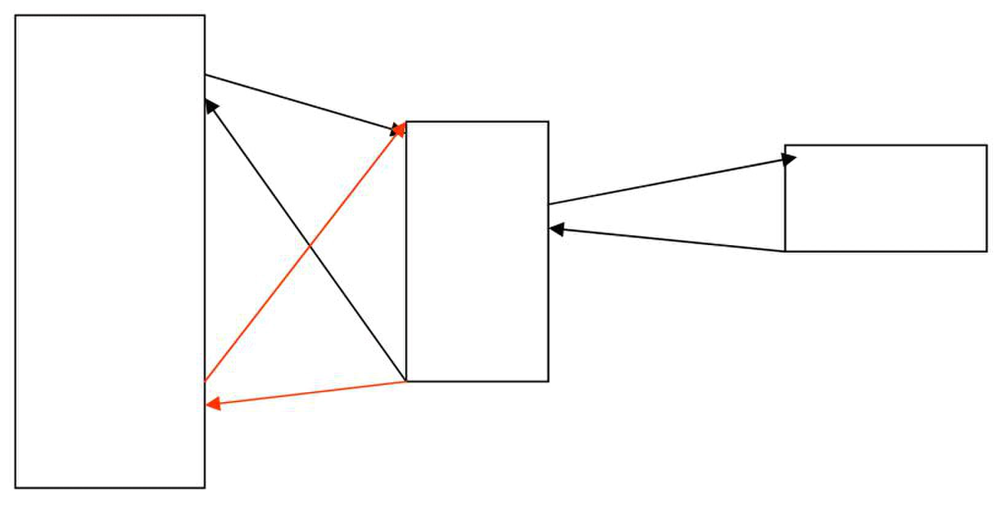
Computer Architecture & Assembly Language Programming Course Code: CS401
CS401@vu.edu.pk
Program
Bubble Sort
Key point in the above discussion is returning to where we left from, like a
loop in a knitted thread. Diversion should be temporary and not permanent.
The code of bubble sort written at one place, multiply at another, and we
temporarily divert to that place, thus avoiding a repetition of code at a 100
places.
CALL and RET
In every processor, instructions are available to divert temporarily and to
divert permanently. The instructions for permanent diversion in 8088 are the
jump instructions, while the instruction for temporary diversion is the CALL
instruction. The word call must be familiar to the readers from subroutine
call in higher level languages. The CALL instruction allows temporary
diversion and therefore reusability of code. Now we can place the code for
bubble sort at one place and reuse it again and again. This was not possible
with permanent diversion. Actually the 8088 permanent diversion
mechanism can be tricked to achieve temporary diversion. However it is not
possible without getting into a lot of trouble. The key idea in doing it this way
is to use the jump instruction form that takes a register as argument.
Therefore this is not impossible but this is not the way it is done.
The natural way to do this is to use the CALL instruction followed by a
label, just like JMP is followed by a label. Execution will divert to the code
following the label. Till now the operation has been similar to the JMP
instruction. When the subroutine completes we need to return. The RET
instruction is used for this purpose. The word return holds in its meaning
that we are to return from where we came and need no explicit destination.
Therefore RET takes no arguments and transfers control back to the
instruction following the CALL that took us in this subroutine. The actual
technical process that informs RET where to return will be discussed later
after we have discussed the system stack.
CALL takes a label as argument and execution starts from that label, until
the RET instruction is encountered and it takes execution back to the
instruction following the CALL. Both the instructions are commonly used as
a pair, however technically they are independent in their operation. The RET
works regardless of the CALL and the CALL works regardless of the RET. If
you CALL a subroutine it will not complain if there is no RET present and
similarly if you RET without being called it won’t complain. It is a logical pair
and is used as a pair in every decent code. However sometimes we play tricks
with the processor and we use CALL or RET alone. This will become clear
when we need to play such tricks in later chapters.
Virtual University of Pakistan 56
Swap

Slide 65

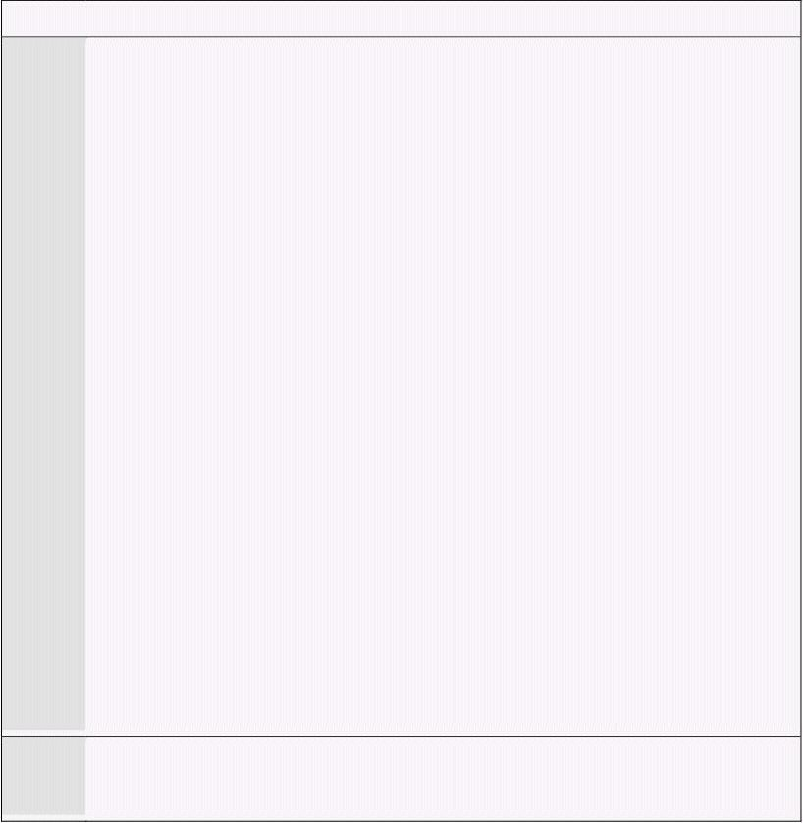
Computer Architecture & Assembly Language Programming Course Code: CS401
CS401@vu.edu.pk
Parameters
We intend to write the bubble sort code at one place and CALL it whenever
needed. An immediately visible problem is that whenever we call this
subroutine it will sort the same array in the same order. However in a real
application we will need to sort various arrays of various sizes. We might
sometimes need an ascending sort and descending at other times. Similarly
our data may be signed or unsigned. Such pieces of information that may
change from invocation to invocation and should be passed from the caller to
the subroutine are called parameters.
There must be some way of passing these parameters to the subroutine.
Revising the subroutine temporary flow breakage mechanism, the most
straightforward way is to use registers. The CALL mechanism breaks the
thread of execution and does not change registers, except IP which must
change for processor to start executing at another place, and SP whose
change will be discussed in detail later. Any of the other registers can hold
parameters for the subroutine.
5.2. OUR FIRST SUBROUTINE
Now we want to modify the bubble sort code so that it works as a
subroutine. We place a label at the start of bubble sort code, which works as
the anchor point and will be used in the CALL instruction to call the
subroutine. We also place a RET at the end of the algorithm to return from
where we called the subroutine.
Example 5.1
01 ; bubble sort algorithm as a subroutine
02 [org 0x0100]
03 jmp start
04
05 data: dw 60, 55, 45, 50, 40, 35, 25, 30, 10, 0
06 swap: db 0
07
08 bubblesort: dec cx ; last element not compared
09 shl cx, 1 ; turn into byte count
10
11 mainloop: mov si, 0 ; initialize array index to zero
12 mov byte [swap], 0 ; reset swap flag to no swaps
13
14 innerloop: mov ax, [bx+si] ; load number in ax
15 cmp ax, [bx+si+2] ; compare with next number
16 jbe noswap ; no swap if already in order
17
18 mov dx, [bx+si+2] ; load second element in dx
19 mov [bx+si], dx ; store first number in second
20 mov [bx+si+2], ax ; store second number in first
21 mov byte [swap], 1 ; flag that a swap has been done
22
23 noswap: add si, 2 ; advance si to next index
24 cmp si, cx ; are we at last index
25 jne innerloop ; if not compare next two
26
27 cmp byte [swap], 1 ; check if a swap has been done
28 je mainloop ; if yes make another pass
29
30 ret ; go back to where we came from
31
32 start: mov bx, data ; send start of array in bx
33 mov cx, 10 ; send count of elements in cx
34 call bubblesort ; call our subroutine
35
36 mov ax, 0x4c00 ; terminate program
37 int 0x21
08-09 The routine has received the count of elements in CX. Since it makes
one less comparison than the number of elements it decrements it.
Then it multiplies it by two since this a word array and each element
Virtual University of Pakistan 57

Slide 66


Computer Architecture & Assembly Language Programming Course Code: CS401
CS401@vu.edu.pk
takes two bytes. Left shifting has been used to multiply by two.
14 Base+index+offset addressing has been used. BX holds the start of
array, SI the offset into it and an offset of 2 when the next element is
to be read. BX can be directly changed but then a separate counter
32-37
analogous to the main in the C language. BX and CX hold our
parameters for the bubblesort subroutine and the CALL is made to
invoke the subroutine.
Inside the debugger we observe the same unsigned data that we are so
used to now. The number 0103 is passed via BX to the subroutine which is
the start of our data and the number 000A via CX which is the number of
elements in our data. If we step over the CALL instruction we see our data
sorted in a single step and we are at the termination instructions. The
processor has jumped to the bubblesort routine, executed it to completion,
and returned back from it but the process was hidden due to the step over
command. If however we trace into the CALL instruction, we land at the first
instruction of our routine. At the end of the routine, when the RET
instruction is executed, we immediately land back to our termination
instructions, to be precise the instruction following the CALL.
Also observe that with the CALL instruction SP is decremented by two from
FFFE to FFFC, and the stack windows shows 0150 at its top. As the RET is
executed SP is recovered and the 0150 is also removed from the stack. Match
it with the address of the instruction following the CALL which is 0150 as
well. The 0150 removed from the stack by the RET instruction has been
loaded into the IP register thereby resuming execution from address 0150.
CALL placed where to return on the stack for the RET instruction. The stack
is automatically used with the CALL and RET instructions. Stack will be
explained in detail later, however the idea is that the one who is departing
stores the address to return at a known place. This is the place using which
CALL and RET coordinate. How this placed is actually used by the CALL and
RET instructions will be described after the stack is discussed.
After emphasizing reusability so much, it is time for another example
which uses the same bubblesort routine on two different arrays of different
sizes.
Example 5.2
01 ; bubble sort subroutine called twice
02 [org 0x0100]
03 jmp start
04
05 data: dw 60, 55, 45, 50, 40, 35, 25, 30, 10, 0
06 data2: dw 328, 329, 898, 8923, 8293, 2345, 10, 877, 355, 98
07 dw 888, 533, 2000, 1020, 30, 200, 761, 167, 90, 5
08 swap: db 0
09
10 bubblesort: dec cx ; last element not compared
11 shl cx, 1 ; turn into byte count
12
13 mainloop: mov si, 0 ; initialize array index to zero
14 mov byte [swap], 0 ; reset swap flag to no swaps
15
16 innerloop: mov ax, [bx+si] ; load number in ax
17 cmp ax, [bx+si+2] ; compare with next number
18 jbe noswap ; no swap if already in order
19
20 mov dx, [bx+si+2] ; load second element in dx
21 mov [bx+si], dx ; store first number in second
22 mov [bx+si+2], ax ; store second number in first
23 mov byte [swap], 1 ; flag that a swap has been done
24
25 noswap: add si, 2 ; advance si to next index
Virtual University of Pakistan 58
would be needed, as SI is directly compared with CX in our case.
The code starting from the start label is our main program

Slide 67


Computer Architecture & Assembly Language Programming Course Code: CS401
CS401@vu.edu.pk
26 cmp si, cx ; are we at last index
27 jne innerloop ; if not compare next two
28
29 cmp byte [swap], 1 ; check if a swap has been done
30 je mainloop ; if yes make another pass
31
32 ret ; go back to where we came from
33
34 start: mov bx, data ; send start of array in bx
35 mov cx, 10 ; send count of elements in cx
36 call bubblesort ; call our subroutine
37
38 mov bx, data2 ; send start of array in bx
39 mov cx, 20 ; send count of elements in cx
40 call bubblesort ; call our subroutine again
41
42 mov ax, 0x4c00 ; terminate program
43 int 0x21
05-07 There are two different data arrays declared. One of 10 elements and
the other of 20 elements. The second array is declared on two lines,
where the second line is continuation of the first. No additional label
34-40 The other change is in the main where the bubblesort subroutine is
called twice, once on the first array and once on the second.
Inside the debugger observe that stepping over the first call, the first array
is sorted and stepping over the second call the second array is sorted. If
however we step in SP is decremented and the stack holds 0178 which is the
address of the instruction following the call. The RET consumes that 0178
and restores SP. The next CALL places 0181 on the stack and SP is again
decremented. The RET consumes this number and execution resumes from
the instruction at 0181. This is the coordinated function of CALL and RET
using the stack.
In both of the above examples, there is a shortcoming. The subroutine to
sort the elements is destroying the registers AX, CX, DX, and SI. That means
that the caller of this routine has to make sure that it does not hold any
important data in these registers before calling this function, because after
the call has returned the registers will be containing meaningless data for the
caller. With a program containing thousands of subroutines expecting the
caller to remember the set of modified registers for each subroutine is
unrealistic and unreasonable. Also registers are limited in number, and
restricting the caller on the use of register will make the caller’s job very
tough. This shortcoming will be removed using the very important system
stack.
5.3. STACK
Stack is a data structure that behaves in a first in last out manner. It can
contain many elements and there is only one way in and out of the container.
When an element is inserted it sits on top of all other elements and when an
element is removed the one sitting at top of all others is removed first. To
visualize the structure consider a test tube and put some balls in it. The
second ball will come above the first and the third will come above the
second. When a ball is taken out only the one at the top can be removed. The
operation of placing an element on top of the stack is called pushing the
element and the operation of removing an element from the top of the stack
is called popping the element. The last thing pushed is popped out first; the
last in first out behavior.
We can peek at any ball inside the test tube but we cannot remove it
without removing every ball on top of it. Similarly we can read any element
from the stack but cannot remove it without removing everything above it.
The stack operations of pushing and popping only work at the top of the
Virtual University of Pakistan 59
is needed since they are situated consecutively in memory.

Slide 68
Computer Architecture & Assembly Language Programming Course Code: CS401
CS401@vu.edu.pk
stack. This top of stack is contained in the SP register. The physical address
of the stack is obtained by the SS:SP combination. The stack segment
registers tells where the stack is located and the stack pointer marks the top
of stack inside this segment.
Whenever an element is pushed on the stack SP is decremented by two as
the 8088 stack works on word sized elements. Single bytes cannot be pushed
or popped from the stack. Also it is a decrementing stack. Another possibility
is an incrementing stack. A decrementing stack moves from higher addresses
to lower addresses as elements are added in it while an incrementing stack
moves from lower addresses to higher addresses as elements are added.
There is no special reason or argument in favor of one or another, and more
or less depends on the choice of the designers. Another processor 8051 by
the same manufacturer has an incrementing stack while 8088 has a
decrementing one.
Memory is like a shelf numbered as zero at the top and the maximum at
the bottom. If a decrementing stack starts at shelf 5, the first item is placed
in shelf 5, the next item is placed in shelf 4, the next in shelf 3 and so on.
The operations of placing items on the stack and removing them from there
are called push and pop. The push operation copies its operand on the stack,
while the pop operation makes a copy from the top of the stack into its
operand. When an item is pushed on a decrementing stack, the top of the
stack is first decremented and the element is then copied into this space.
With a pop the element at the top of the stack is copied into the pop operand
and the top of stack is incremented afterwards.
The basic use of the stack is to save things and recover from there when
needed. For example we discussed the shortcoming in our last example that
it destroyed the caller’s registers, and the callers are not supposed to
remember which registers are destroyed by the thousand routines they use.
Using the stack the subroutine can save the caller’s value of the registers on
the stack, and recover them from there before returning. Meanwhile the
subroutine can freely use the registers. From the caller’s point of view if the
registers contain the same value before and after the call, it doesn’t matter if
the subroutine used them meanwhile.
Similarly during the CALL operation, the current value of the instruction
pointer is automatically saved on the stack, and the destination of CALL is
loaded in the instruction pointer. Execution therefore resumes from the
destination of CALL. When the RET instruction is executed, it recovers the
value of the instruction pointer from the stack. The next instruction executed
is therefore the one following the CALL. Observe how playing with the
instruction pointer affects the program flow.
There is a form of the RET instruction called “RET n” where n is a numeric
argument. After performing the operation of RET, it further increments the
stack pointer by this number, i.e. SP is first incremented by two and then by
n. Its function will become clear when parameter passing is discussed.
Now we describe the operation of the stack in CALL and RET with an
example. The top of stack stored in the stack pointer is initialized at 2000.
The space above SP is considered empty and free. When the stack pointer is
decremented by two, we took a word from the empty space and can use it for
our purpose. The unit of stack operations is a word. Some instructions push
multiple words; however byte pushes cannot be made. Now the value 017B is
stored in the word reserved on the stack. The RET will copy this value in the
instruction pointer and increment the stack pointer by two making it 2000
again, thereby reverting the operation of CALL.
This is how CALL and RET behave for near calls. There is also a far version
of these functions when the target routine is in another segment. This
version of CALL takes a segment offset pair just like the far jump instruction.
The CALL will push both the segment and the offset on the stack in this
case, followed by loading CS and IP with the values given in the instruction.
Virtual University of Pakistan 60

Slide 69
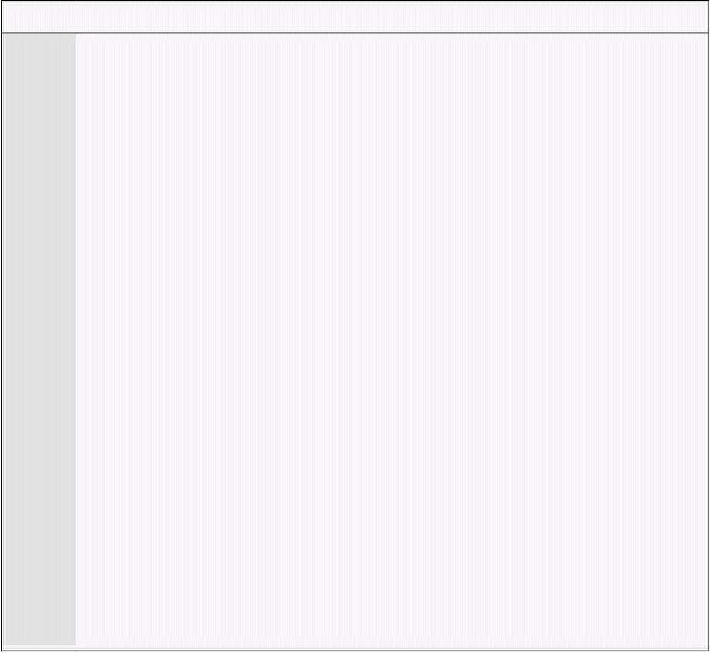
Computer Architecture & Assembly Language Programming Course Code: CS401
CS401@vu.edu.pk
The corresponding instruction RETF will pop the offset in the instruction
pointer followed by popping the segment in the code segment register.
Apart from CALL and RET, the operations that use the stack are PUSH and
POP. Two other operations that will be discussed later are INT and IRET.
Regarding the stack, the operation of PUSH is similar to CALL however with
a register other than the instruction pointer. For example “push ax” will push
the current value of the AX register on the stack. The operation of PUSH is
shown below.
SP Å SP – 2
[SP] Å AX
The operation of POP is the reverse of this. A copy of the element at the top
of the stack is made in the operand, and the top of the stack is incremented
afterwards. The operation of “pop ax” is shown below.
AX Å [SP]
SP Å SP + 2
Making corresponding PUSH and POP operations is the responsibility of
the programmer. If “push ax” is followed by “pop dx” effectively copying the
value of the AX register in the DX register, the processor won’t complain.
Whether this sequence is logically correct or not should be ensured by the
programmer. For example when PUSH and POP are used to save and restore
registers from the stack, order must be correct so that the saved value of AX
is reloaded in the AX register and not any other register. For this the order of
POP operations need to be the reverse of the order of PUSH operations.
Now we consider another example that is similar to the previous examples,
however the code to swap the two elements has been extracted into another
subroutine, so that the formation of stack can be observed during nested
subroutine calls.
Example 5.3
01 ; bubble sort subroutine using swap subroutine
02 [org 0x0100]
03 jmp start
04
05 data: dw 60, 55, 45, 50, 40, 35, 25, 30, 10, 0
06 data2: dw 328, 329, 898, 8923, 8293, 2345, 10, 877, 355, 98
07 dw 888, 533, 2000, 1020, 30, 200, 761, 167, 90, 5
08 swapflag: db 0
09
10 swap: mov ax, [bx+si] ; load first number in ax
11 xchg ax, [bx+si+2] ; exchange with second number
12 mov [bx+si], ax ; store second number in first
13 ret ; go back to where we came from
14
15 bubblesort: dec cx ; last element not compared
16 shl cx, 1 ; turn into byte count
17
18 mainloop: mov si, 0 ; initialize array index to zero
19 mov byte [swapflag], 0 ; reset swap flag to no swaps
20
21 innerloop: mov ax, [bx+si] ; load number in ax
22 cmp ax, [bx+si+2] ; compare with next number
23 jbe noswap ; no swap if already in order
24
25 call swap ; swaps two elements
26 mov byte [swapflag], 1 ; flag that a swap has been done
27
28 noswap: add si, 2 ; advance si to next index
29 cmp si, cx ; are we at last index
30 jne innerloop ; if not compare next two
31
32 cmp byte [swapflag], 1 ; check if a swap has been done
33 je mainloop ; if yes make another pass
34 ret ; go back to where we came from
35
36 start: mov bx, data ; send start of array in bx
37 mov cx, 10 ; send count of elements in cx
Virtual University of Pakistan 61

Slide 70


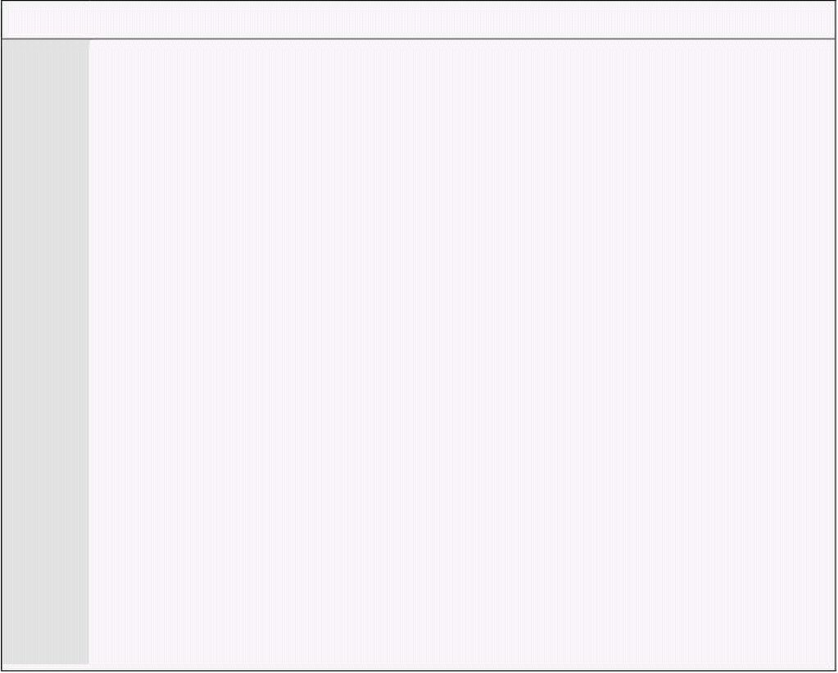
Computer Architecture & Assembly Language Programming Course Code: CS401
CS401@vu.edu.pk
38 call bubblesort ; call our subroutine
39
40 mov bx, data2 ; send start of array in bx
41 mov cx, 20 ; send count of elements in cx
42 call bubblesort ; call our subroutine again
43
44 mov ax, 0x4c00 ; terminate program
45 int 0x21
11 A new instruction XCHG has been introduced. The instruction
swaps its source and its destination operands however at most one
of the operands could be in memory, so the other has to be loaded in
a register. The instruction has reduced the code size by one
13
Inside the debugger observe the use of stack by CALL and RET
instructions, especially the nested CALL.
5.4. SAVING AND RESTORING REGISTERS
The subroutines we wrote till now have been destroying certain registers
and our calling code has been carefully written to not use those registers.
However this cannot be remembered for a good number of subroutines.
Therefore our subroutines need to implement some mechanism of retaining
the callers’ value of any registers used.
The trick is to use the PUSH and POP operations and save the callers’
value on the stack and recover it from there on return. Our swap subroutine
destroyed the AX register while the bubblesort subroutine destroyed AX, CX,
and SI. BX was not modified in the subroutine. It had the same value at
entry and at exit; it was only used by the subroutine. Our next example
improves on the previous version by saving and restoring any registers that it
will modify using the PUSH and POP operations.
Example 5.4
01 ; bubble sort and swap subroutines saving and restoring registers
02 [org 0x0100]
03 jmp start
04
05 data: dw 60, 55, 45, 50, 40, 35, 25, 30, 10, 0
06 data2: dw 328, 329, 898, 8923, 8293, 2345, 10, 877, 355, 98
07 dw 888, 533, 2000, 1020, 30, 200, 761, 167, 90, 5
08 swapflag: db 0
09
10 swap: push ax ; save old value of ax
11
12 mov ax, [bx+si] ; load first number in ax
13 xchg ax, [bx+si+2] ; exchange with second number
14 mov [bx+si], ax ; store second number in first
15
16 pop ax ; restore old value of ax
17 ret ; go back to where we came from
18
19 bubblesort: push ax ; save old value of ax
20 push cx ; save old value of cx
21 push si ; save old value of si
22
23 dec cx ; last element not compared
24 shl cx, 1 ; turn into byte count
25
26 mainloop: mov si, 0 ; initialize array index to zero
27 mov byte [swapflag], 0 ; reset swap flag to no swaps
28
29 innerloop: mov ax, [bx+si] ; load number in ax
30 cmp ax, [bx+si+2] ; compare with next number
31 jbe noswap ; no swap if already in order
32
Virtual University of Pakistan 62
instruction.
The RET at the end of swap makes it a subroutine.

Slide 71


Computer Architecture & Assembly Language Programming Course Code: CS401
CS401@vu.edu.pk
33 call swap ; swaps two elements
34 mov byte [swapflag], 1 ; flag that a swap has been done
35
36 noswap: add si, 2 ; advance si to next index
37 cmp si, cx ; are we at last index
38 jne innerloop ; if not compare next two
39
40 cmp byte [swapflag], 1 ; check if a swap has been done
41 je mainloop ; if yes make another pass
42
43 pop si ; restore old value of si
44 pop cx ; restore old value of cx
45 pop ax ; restore old value of ax
46 ret ; go back to where we came from
47
48 start: mov bx, data ; send start of array in bx
49 mov cx, 10 ; send count of elements in cx
50 call bubblesort ; call our subroutine
51
52 mov bx, data2 ; send start of array in bx
53 mov cx, 20 ; send count of elements in cx
54 call bubblesort ; call our subroutine again
55
56 mov ax, 0x4c00 ; terminate program
57 int 0x21
19-21 When multiple registers are pushed, order is very important. If AX,
CX, and SI are pushed in this order, they must be popped in the
reverse order of SI, CX, and AX. This is again because the stack
behaves in a Last In First Out manner.
Inside the debugger we can observe that the registers before and after the
CALL operation are exactly identical. Effectively the caller can assume the
registers are untouched. By tracing into the subroutines we can observe how
their value is saved on the stack by the PUSH instructions and recovered
from their before exit. Saving and restoring registers this way in subroutines
is a standard way and must be followed.
PUSH
PUSH decrements SP (the stack pointer) by two and then transfers a word
from the source operand to the top of stack now pointed to by SP. PUSH
often is used to place parameters on the stack before calling a procedure;
more generally, it is the basic means of storing temporary data on the stack.
POP
POP transfers the word at the current top of stack (pointed to by SP) to the
destination operand and then increments SP by two to point to the new top
of stack. POP can be used to move temporary variables from the stack to
registers or memory.
Observe that the operand of PUSH is called a source operand since the
data is moving to the stack from the operand, while the operand of POP is
called destination since data is moving from the stack to the operand.
CALL
CALL activates an out-of-line procedure, saving information on the stack to
permit a RET (return) instruction in the procedure to transfer control back to
the instruction following the CALL. For an intra segment direct CALL, SP is
decremented by two and IP is pushed onto the stack. The target procedure’s
relative displacement from the CALL instruction is then added to the
instruction pointer. For an inter segment direct CALL, SP is decremented by
two, and CS is pushed onto the stack. CS is replaced by the segment word
contained in the instruction. SP again is decremented by two. IP is pushed
onto the stack and replaced by the offset word in the instruction.
Virtual University of Pakistan 63

Slide 72

Computer Architecture & Assembly Language Programming Course Code: CS401
CS401@vu.edu.pk
The out-of-line procedure is the temporary division, the concept of
roundabout that we discussed. Near calls are also called intra segment calls,
while far calls are called inter-segment calls. There are also versions that are
called indirect calls; however they will be discuss later when they are used.
RET
RET (Return) transfers control from a procedure back to the instruction
following the CALL that activated the procedure. RET pops the word at the
top of the stack (pointed to by register SP) into the instruction pointer and
increments SP by two. If RETF (inter segment RET) is used the word at the
top of the stack is popped into the IP register and SP is incremented by two.
The word at the new top of stack is popped into the CS register, and SP is
again incremented by two. If an optional pop value has been specified, RET
adds that value to SP. This feature may be used to discard parameters
pushed onto the stack before the execution of the CALL instruction.
5.5. PARAMETER PASSING THROUGH STACK
Due to the limited number of registers, parameter passing by registers is
constrained in two ways. The maximum parameters a subroutine can receive
are seven when all the general registers are used. Also, with the subroutines
are themselves limited in their use of registers, and this limited increases
when the subroutine has to make a nested call thereby using certain
registers as its parameters. Due to this, parameter passing by registers is not
expandable and generalizable. However this is the fastest mechanism
available for passing parameters and is used where speed is important.
Considering stack as an alternate, we observe that whatever data is placed
there, it stays there, and across function calls as well. For example the
bubble sort subroutine needs an array address and the count of elements. If
we place both of these on the stack, and call the subroutine afterwards, it
will stay there. The subroutine is invoked with its return address on top of
the stack and its parameters beneath it.
To access the arguments from the stack, the immediate idea that strikes is
to pop them off the stack. And this is the only possibility using the given set
of information. However the first thing popped off the stack would be the
return address and not the arguments. This is because the arguments were
first pushed on the stack and the subroutine was called afterwards. The
arguments cannot be popped without first popping the return address. If a
heaving thing falls on someone’s leg, the heavy thing is removed first and the
leg is not pulled out to reduce the damage. Same is the case with our
parameters on which the return address has fallen.
To handle this using PUSH and POP, we must first pop the return address
in a register, then pop the operands, and push the return address back on
the stack so that RET will function normally. However so much effort doesn’t
seem to pay back the price. Processor designers should have provided a
logical and neat way to perform this operation. They did provided a way and
infact we will do this without introducing any new instruction.
Recall that the default segment association of the BP register is the stack
segment and the reason for this association had been deferred for now. The
reason is to peek inside the stack using the BP register and read the
parameters without removing them and without touching the stack pointer.
The stack pointer could not be used for this purpose, as it cannot be used in
an effective address. It is automatically used as a pointer and cannot be
explicitly used. Also the stack pointer is a dynamic pointer and sometimes
changes without telling us in the background. It is just that whenever we
touch it, it is where we expect it to be. The base pointer is provided as a
replacement of the stack pointer so that we can peek inside the stack
without modifying the structure of the stack.
Virtual University of Pakistan 64

Slide 73

Computer Architecture & Assembly Language Programming Course Code: CS401
CS401@vu.edu.pk
When the bubble sort subroutine is called, the stack pointer is pointing to
the return address. Two bytes below it is the second parameter and four
bytes below is the first parameter. The stack pointer is a reference point to
these parameters. If the value of SP is captured in BP, then the return
address is located at [bp+0], the second parameter is at [bp+2], and the first
parameter is at [bp+4]. This is because SP and BP both had the same value
and they both defaulted to the same segment, the stack segment.
This copying of SP into BP is like taking a snapshot or like freezing the
stack at that moment. Even if more pushes are made on the stack
decrementing the stack pointer, our reference point will not change. The
parameters will still be accessible at the same offsets from the base pointer.
If however the stack pointer increments beyond the base pointer, the
references will become invalid. The base pointer will act as the datum point
to access our parameters. However we have destroyed the original value of
BP in the process, and this will cause problems in nested calls where both
the outer and the inner subroutines need to access their own parameters.
The outer subroutine will have its base pointer destroyed after the call and
will be unable to access its parameters.
To solve both of these problems, we reach at the standard way of accessing
parameters on the stack. The first two instructions of any subroutines
accessing its parameters from the stack are given below.
push bp
mov bp, sp
As a result our datum point has shifted by a word. Now the old value of BP
will be contained in [bp] and the return address will be at [bp+2]. The second
parameters will be [bp+4] while the first one will be at [bp+6]. We give an
example of bubble sort subroutine using this standard way of argument
passing through stack.
Example 5.5
01 ; bubble sort subroutine taking parameters from stack
02 [org 0x0100]
03 jmp start
04
05 data: dw 60, 55, 45, 50, 40, 35, 25, 30, 10, 0
06 data2: dw 328, 329, 898, 8923, 8293, 2345, 10, 877, 355, 98
07 dw 888, 533, 2000, 1020, 30, 200, 761, 167, 90, 5
08 swapflag: db 0
09
10 bubblesort: push bp ; save old value of bp
11 mov bp, sp ; make bp our reference point
12 push ax ; save old value of ax
13 push bx ; save old value of bx
14 push cx ; save old value of cx
15 push si ; save old value of si
16
17 mov bx, [bp+6] ; load start of array in bx
18 mov cx, [bp+4] ; load count of elements in cx
19 dec cx ; last element not compared
20 shl cx, 1 ; turn into byte count
21
22 mainloop: mov si, 0 ; initialize array index to zero
23 mov byte [swapflag], 0 ; reset swap flag to no swaps
24
25 innerloop: mov ax, [bx+si] ; load number in ax
26 cmp ax, [bx+si+2] ; compare with next number
27 jbe noswap ; no swap if already in order
28
29 xchg ax, [bx+si+2] ; exchange ax with second number
30 mov [bx+si], ax ; store second number in first
31 mov byte [swapflag], 1 ; flag that a swap has been done
32
33 noswap: add si, 2 ; advance si to next index
34 cmp si, cx ; are we at last index
35 jne innerloop ; if not compare next two
36
Virtual University of Pakistan 65

Slide 74
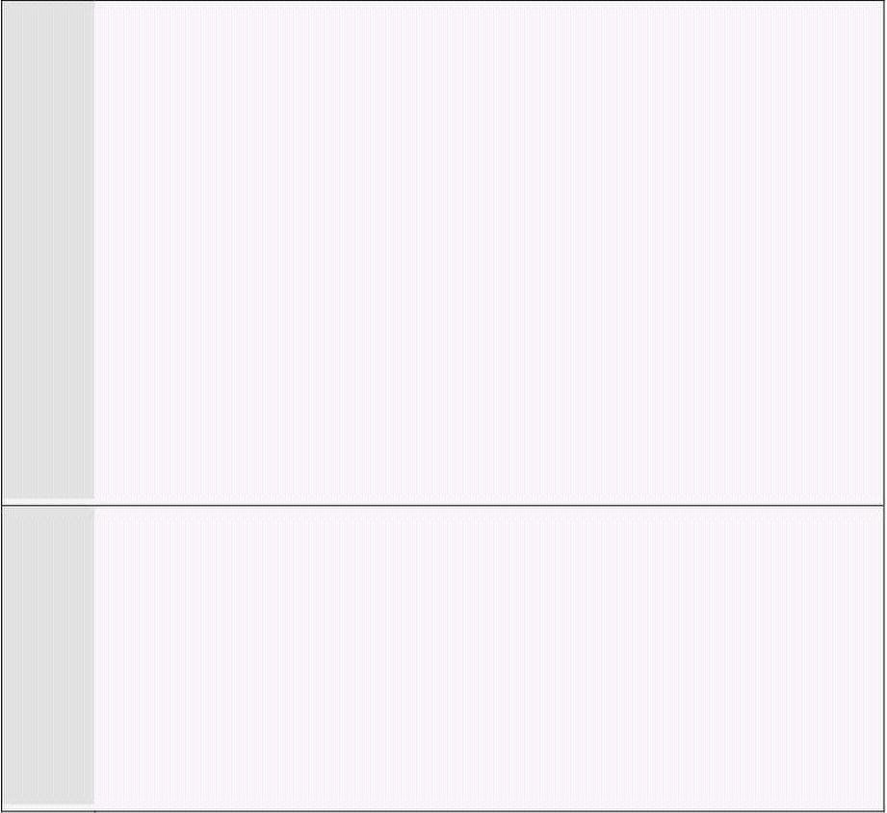
Computer Architecture & Assembly Language Programming Course Code: CS401
CS401@vu.edu.pk
37 cmp byte [swapflag], 1 ; check if a swap has been done
38 je mainloop ; if yes make another pass
39
40 pop si ; restore old value of si
41 pop cx ; restore old value of cx
42 pop bx ; restore old value of bx
43 pop ax ; restore old value of ax
44 pop bp ; restore old value of bp
45 ret 4 ; go back and remove two params
46
47 start: mov ax, data
48 push ax ; place start of array on stack
49 mov ax, 10
50 push ax ; place element count on stack
51 call bubblesort ; call our subroutine
52
53 mov ax, data2
54 push ax ; place start of array on stack
55 mov ax, 20
56 push ax ; place element count on stack
57 call bubblesort ; call our subroutine again
58
59 mov ax, 0x4c00 ; terminate program
60 int 0x21
11 The value of the stack pointer is captured in the base pointer. With
further pushes SP will change but BP will not and therefore we will
45 The form of RET that takes an argument is used causing four to be
added to SP after the return address has been popped in the
instruction pointer. This will effectively discard the parameters that
47-50
count of elements. As immediate cannot be directly pushed in the
8088 architecture, we first load it in the AX register and then push
the AX register on the stack.
Inside the debugger, concentrate on the operation of BP and the stack. The
parameters are placed on the stack by the caller, the subroutine accesses
them using the base pointer, and the special form of RET removes them
without any extra instruction. The value of stack pointer of FFF6 is turned
into FFFE by the RET instruction. This was the value in SP before any of the
parameters was pushed.
Stack Clearing by Caller or Callee
Parameters pushed for a subroutine are a waste after the subroutine has
returned. They have to be cleared from the stack. Either of the caller and the
callee can take the responsibility of clearing them from there. If the callee
has to clear the stack it cannot do this easily unless RET n exists. That is
why most general processors have this instruction. Stack clearing by the
caller needs an extra instruction on behalf of the caller after every call made
to the subroutine, unnecessarily increasing instructions in the program. If
there are thousand calls to a subroutine the code to clear the stack is
repeated a thousand times. Therefore the prevalent convention in most high
level languages is stack clearing by the callee; even though the other
convention is still used in some languages.
If RET n is not available, stack clearing by the callee is a complicated
process. It will have to save the return address in a register, then remove the
parameters, and then place back the return address so that RET will
function. When this instruction was introduced in processors, only then high
level language designers switched to stack clearing by the callee. This is also
exactly why RET n adds n to SP after performing the operation of RET. The
other way around would be totally useless for our purpose. Consider the
stack condition at the time of RET and this will become clear why this will be
Virtual University of Pakistan 66
read parameters from bp+4 and bp+6.
are still there on the stack.
We push the address of the array we want to sort followed by the

Slide 75


Computer Architecture & Assembly Language Programming Course Code: CS401
CS401@vu.edu.pk
useless. Also observe that RET n has discarded the arguments rather than
popping them as they were no longer of any use either of the caller or the
callee.
The strong argument in favour of callee cleared stacks is that the
arguments were placed on the stack for the subroutine, the caller did not
needed them for itself, so the subroutine is responsible for removing them.
Removing the arguments is important as if the stack is not cleared or is
partially cleared the stack will eventually become full, SP will reach 0, and
thereafter wraparound producing unexpected results. This is called stack
overflow. Therefore clearing anything placed on the stack is very important.
5.6. LOCAL VARIABLES
Another important role of the stack is in the creation of local variables that
are only needed while the subroutine is in execution and not afterwards.
They should not take permanent space like global variables. Local variables
should be created when the subroutine is called and discarded afterwards.
So that the spaced used by them can be reused for the local variables of
another subroutine. They only have meaning inside the subroutine and no
meaning outside it.
The most convenient place to store these variables is the stack. We need
some special manipulation of the stack for this task. We need to produce a
gap in the stack for our variables. This is explained with the help of the
swapflag in the bubble sort example.
The swapflag we have declared as a word occupying space permanently is
only needed by the bubble sort subroutine and should be a local variable.
Actually the variable was introduced with the intent of making it a local
variable at this time. The stack pointer will be decremented by an extra two
bytes thereby producing a gap in which a word can reside. This gap will be
used for our temporary, local, or automatic variable; however we name it. We
can decrement it as much as we want producing the desired space, however
the decrement must be by an even number, as the unit of stack operation is
a word. In our case we needed just one word. Also the most convenient
position for this gap is immediately after saving the value of SP in BP. So that
the same base pointer can be used to access the local variables as well; this
time using negative offsets. The standard way to start a subroutine which
needs to access parameters and has local variables is as under.
push bp
mov bp, sp
sub sp, 2
The gap could have been created with a dummy push, but the subtraction
makes it clear that the value pushed is not important and the gap will be
used for our local variable. Also gap of any size can be created in a single
instruction with subtraction. The parameters can still be accessed at bp+4
and bp+6 and the swapflag can be accessed at bp-2. The subtraction in SP
was after taking the snapshot; therefore BP is above the parameters but
below the local variables. The parameters are therefore accessed using
positive offsets from BP and the local variables are accessed using negative
offsets.
We modify the bubble sort subroutine to use a local variable to store the
swap flag. The swap flag remembered whether a swap has been done in a
particular iteration of bubble sort.
Example 5.6
01 ; bubble sort subroutine using a local variable
02 [org 0x0100]
03 jmp start
04
05 data: dw 60, 55, 45, 50, 40, 35, 25, 30, 10, 0
06 data2: dw 328, 329, 898, 8923, 8293, 2345, 10, 877, 355, 98
Virtual University of Pakistan 67

Slide 76

Computer Architecture & Assembly Language Programming Course Code: CS401
CS401@vu.edu.pk
07 dw 888, 533, 2000, 1020, 30, 200, 761, 167, 90, 5
08
09 bubblesort: push bp ; save old value of bp
10 mov bp, sp ; make bp our reference point
11 sub sp, 2 ; make two byte space on stack
12 push ax ; save old value of ax
13 push bx ; save old value of bx
14 push cx ; save old value of cx
15 push si ; save old value of si
16
17 mov bx, [bp+6] ; load start of array in bx
18 mov cx, [bp+4] ; load count of elements in cx
19 dec cx ; last element not compared
20 shl cx, 1 ; turn into byte count
21
22 mainloop: mov si, 0 ; initialize array index to zero
23 mov word [bp-2], 0 ; reset swap flag to no swaps
24
25 innerloop: mov ax, [bx+si] ; load number in ax
26 cmp ax, [bx+si+2] ; compare with next number
27 jbe noswap ; no swap if already in order
28
29 xchg ax, [bx+si+2] ; exchange ax with second number
30 mov [bx+si], ax ; store second number in first
31 mov word [bp-2], 1 ; flag that a swap has been done
32
33 noswap: add si, 2 ; advance si to next index
34 cmp si, cx ; are we at last index
35 jne innerloop ; if not compare next two
36
37 cmp word [bp-2], 1 ; check if a swap has been done
38 je mainloop ; if yes make another pass
39
40 pop si ; restore old value of si
41 pop cx ; restore old value of cx
42 pop bx ; restore old value of bx
43 pop ax ; restore old value of ax
44 mov sp, bp ; remove space created on stack
45 pop bp ; restore old value of bp
46 ret 4 ; go back and remove two params
47
48 start: mov ax, data
49 push ax ; place start of array on stack
50 mov ax, 10
51 push ax ; place element count on stack
52 call bubblesort ; call our subroutine
53
54 mov ax, data2
55 push ax ; place start of array on stack
56 mov ax, 20
57 push ax ; place element count on stack
58 call bubblesort ; call our subroutine again
59
60 mov ax, 0x4c00 ; terminate program
61 int 0x21
11 A word gap has been created for swap flag. This is equivalent to a
23 The swapflag is accessed with [bp-2]. The parameters are accessed
44
restoring the value of SP that it had at the time of snapshot or at the
value it had before the local variable was created. This can be
replaced with “add sp, 2” however the one used in the code is
preferred since it does not require to remember how much space for
local variables was allocated in the start. After this operation SP
points to the old value of BP from where we can proceed as usual.
We needed memory to store the swap flag. The fact that it is in the stack
segment or the data segment doesn’t bother us. This will just change the
addressing scheme.
Virtual University of Pakistan 68
dummy push. The registers are pushed above this gap.
in the same manner as the last examples.
We are removing the hole that we created. The hole is removed by

Slide 77

Computer Architecture & Assembly Language Programming Course Code: CS401
CS401@vu.edu.pk
EXERCISES
1. Replace the following valid instruction with a single instruction that
has the same effect. Don’t consider the effect on flags.
push word L1
jmp L2
L1:
2. Replace the following invalid instructions with a single instruction
that has the same effect.
a. pop ip
b. mov ip, L5
c. sub sp, 2
mov [ss:sp], ax
d. mov ax, [ss:sp]
add sp, 2
e. add sp, 6
mov ip, [ss:sp-6]
3. Write a recursive function to calculate the Fibonacci of a number.
The number is passed as a parameter via the stack and the
calculated Fibonacci number is returned in the AX register. A local
variable should be used to store the return value from the first
recursive call. Fibonacci function is defined as follows:
Fibonacci(0) = 0
Fibonacci(1) = 1
Fibonacci(n) = Fibonacci(n-1) + Fibonacci(n-2)
4. Write the above Fibonacci function iteratively.
HINT: Use two registers to hold the current and the previous
Fibonacci numbers in a loop.
5. Write a function switch_stack meant to change the current stack and
will be called as below. The function should destroy no registers.
push word [new_stack_segment]
push word [new_stack_offset]
call switch_stack
6. Write a function “addtoset” that takes offset of a function and
remembers this offset in an array that can hold a maximum of 8
offsets. It does nothing if there are already eight offsets in the set.
Write another function “callset” that makes a call to all functions in
the set one by one.
7. Do the above exercise such that “callset” does not use a CALL or a
JMP to invoke the functions.
HINT: Setup the stack appropriately such that the RET will execute
the first function, its RET execute the next and so on till the last RET
returns to the caller of “callset.”
8. Make an array of 0x80 bytes and treat it as one of 0x400 bits. Write
a function myalloc that takes one argument, the number of bits. It
finds that many consecutive zero bits in the array, makes them one,
and returns in AX the index of the first bit. Write another function
myfree that takes two arguments, index of a bit in the array, and the
number of bits. It makes that many consecutive bits zero, whatever
their previous values are, starting from the index in the first
argument.
9. [Circular Queue] Write functions to implement circular queues.
Declare 16x32 words of data for 16 queues numbered from 0 to 15.
Each queue has a front index, a rear index and 30 locations for data
totaling to 32 words. Declare another word variable whose 16 bits
correspond to the 16 queues and a 1 bit signals that the
corresponding queue is used and a 0 bit signals that it is free. Write
a function “qcreate” that returns a queue number after finding a free
queue or -1 if it failed. Write a function “qdestroy” that marks the
queue as free. Write two other functions “qadd” and “qremove” that
Virtual University of Pakistan 69

Slide 78
Computer Architecture & Assembly Language Programming Course Code: CS401
CS401@vu.edu.pk
can add and remove items from the circular queue. The two
functions return 0 if they failed and 1 otherwise.
10. [Linked List] Declare 1024 nodes of four bytes each. The first 2 bytes
will be used for data and the next 2 bytes for storing the offset of
another node. Also declare a word variable “firstfree” to store the
offset of the first free node. Write the following five functions:
a. “init” chains all 1024 nodes into a list with offset of first
node in firstfree, offset of the second node in the later two
bytes of the first node and so on. The later two bytes of the
last node contains zero.
b. “createlist” returns the offset of the node stored in firstfree
through AX. It sets firstfree to the offset stored in the later
two bytes of that node, and it sets the later two bytes of that
node to zero.
c. “insertafter” takes two parameters, the offset of a node and
a word data. It removes one node from freelist just like
“createlist” and inserts it after the said node and updates
the new node’s data part.
d. “deleteafter” takes a node as its parameter and removes the
node immediately after it in the linked list if there is one.
e. “deletelist” takes a node as its parameters and traverses the
linked list starting at this node and removes all nodes from
it and add them back to the free list.
Virtual University of Pakistan 70

Slide 79

6
Display Memory
The debugger gives a very close vision of the processor. That is why every
program written till now was executed inside the debugger. Also the
debugger is a very useful tool in assembly language program development,
since many bugs only become visible when each instruction is independently
monitored the way the debugger allows us to do. We will now be using the
display screen in character mode, the way DOS uses this screen. The way we
will access this screen is specific to the IBM PC.
6.1. ASCII CODES
The computer listens, sees, and speaks in numbers. Even a character is a
number inside the computer. For example the keyboard is labeled with
characters however when we press ‘A’, a specific number is transferred from
the keyboard to the computer. Our program interprets that number as the
character ‘A’. When the same number comes on display, the Video Graphics
Adapter (VGA) in our computer shows the shape of ‘A’. Even the shape is
stored in binary numbers with a one bit representing a pixel on the screen
that is turned on and a zero bit representing a pixel that is not glowing. This
example is considering a white on black display and no colors. This is the
way a shape is drawn on the screen. The interpretation of ‘A’ is performed by
the VGA card, while the monitor or CRT (cathode ray tube) only glows the
pixels on and turns them off. The keyboard has a key labeled ‘A’ and
pressing it the screen shows ‘A’ but all that happened inside was in
numbers.
An ‘A’ on any computer and any operating system is an ‘A’ on every other
computer and operating system. This is because a standard numeric
representation of all commonly used characters has been developed. This is
called the ASCII code, where ASCII stands for American Standard Code for
Information Interchange. The name depicts that this is a code that allows the
interchange of information; ‘A’ written on one computer will remain an ‘A’ on
another. The ASCII table lists all defined characters and symbols and their
standardized numbers. All ASCII based computers use the same code. There
are few other standards like EBCDIC and gray codes, but ASCII has become
the most prevalent standard and is used for Internet communication as well.
It has become the de facto standard for global communication. The character
mode displays of our computer use the ASCII standard. Some newer
operating systems use a new standard Unicode but it is not relevant to us in
the current discussion.
Standard ASCII has 128 characters with assigned numbers from 0 to 127.
When IBM PC was introduced, they extended the standard ASCII and defined
128 more characters. Thus extending the total number of symbols from 128
to 256 numbered from 0 to 255 fitting in an 8-bit byte. The newer characters
were used for line drawing, window corners, and some non-English
characters. The need for these characters was never felt on teletype
terminals, but with the advent of IBM PC and its full screen display, these
semi-graphics characters were the need of the day. Keep in mind that at that
time there was no graphics mode available.
The extended ASCII code is just a de facto industry standard but it is not
defined by an organization like the standard ASCII. Printers, displays, and all
other peripherals related to the IBM PC understand the ASCII code. If the

Slide 80

Computer Architecture & Assembly Language Programming Course Code: CS401
CS401@vu.edu.pk
code for ‘A’ is sent to the printer, the printer will print the shape of ‘A’, if it is
sent to the display, the VGA card will form the shape of ‘A’ on the CRT. If it is
sent to another computer via the serial port, the other computer will
understand that this is an ‘A’.
The important thing to observe in the ASCII table is the contiguous
arrangement of the uppercase alphabets (41-5A), the lowercase alphabets
(61-7A), and the numbers (30-39). This helps in certain operations with
ASCII, for example converting the case of characters by adding or subtracting
0x20 from it. It also helps in converting a digit into its ASCII representation
by adding 0x30 to it.
6.2. DISPLAY MEMORY FORMATION
We will explore the working of the display with ASCII codes, since it is our
immediately accessible hardware. When 0x40 is sent to the VGA card, it will
turn pixels on and off in such a way that a visual representation of ‘A’
appears on the screen. It has no reality, just an interpretation. In later
chapters we will program the VGA controller to display a new shape when
the ASCII of ‘A’ is received by it.
The video device is seen by the computer as a memory area containing the
ASCII codes that are currently displayed on the screen and a set of I/O ports
controlling things like the resolution, the cursor height, and the cursor
position. The VGA memory is seen by the computer just like its own memory.
There is no difference; rather the computer doesn’t differentiate, as it is
accessible on the same bus as the system memory. Therefore if that
appropriate block of the screen is cleared, the screen will be cleared. If the
ASCII of ‘A’ is placed somewhere in that block, the shape of ‘A’ will appear on
the screen at a corresponding place.
This correspondence must be defined as the memory is a single
dimensional space while the screen is two dimensional having 80 rows and
25 columns. The memory is linearly mapped on this two dimensional space,
just like a two dimensional is mapped in linear memory. There is one word
per character in which a byte is needed for the ASCII code and the other byte
is used for the character’s attributes discussed later. Now the first 80 words
will correspond to the first row of the screen and the next 80 words will
correspond to the next row. By making the memory on the video controller
accessible to the processor via the system bus, the processor is now in
control of what is displayed on the screen.
The three important things that we discussed are.
• One screen location corresponds to a word in the video memory
• The video controller memory is accessible to the processor like its
own memory.
• ASCII code of a character placed at a cell in the VGA memory will
cause the corresponding ASCII shape to be displayed on the
corresponding screen location.
Display Memory Base Address
The memory at which the video controller’s memory is mapped must be a
standard, so that the program can be written in a video card independent
manner. Otherwise if different vendors map their video memory at different
places in the address space, as was the problem in the start, writing software
was a headache. BIOS vendors had a problem of dealing with various card
vendors. The IBM PC text mode color display is now fixed so that system
software can work uniformly. It was fixed at the physical memory location of
B8000. The first byte at this location contains the ASCII for the character
displayed at the top left of the video screen. Dropping the zero we can load
the rest in a segment register to access the video memory. If we do something
in this memory, the effect can be seen on the screen. For example we can
Virtual University of Pakistan 72

Slide 81

Computer Architecture & Assembly Language Programming Course Code: CS401
CS401@vu.edu.pk
write a virus that makes any character we write drop to the bottom of the
screen.
Attribute Byte
The second byte in the word designated for one screen location holds the
foreground and background colors for the character. This is called its video
attribute. So the pair of the ASCII code in one byte and the attribute in the
second byte makes the word that corresponds to one location on the screen.
The lower address contains the code while the higher one contains the
attribute. The attribute byte as detailed below has the RGB for the
foreground and the background. It has an intensity bit for the foreground
color as well thus making 16 possible colors of the foreground and 8 possible
colors for the background. When bit 7 is set the character keeps on blinking
on the screen. This bit has some more interpretations like background
intensity that has to be activated in the video controller through its I/O
ports.
7 6 5 4 3 2 1 0
7 – Blinking of foreground character
6 – Red component of background color
5 – Green component of background color
4 – Blue component of background color
3 – Intensity component of foreground color
2 – Red component of foreground color
1 – Green component of foreground color
0 – Blue component of foreground color
Display Examples
Both DS and ES can be used to access the video memory. However we
commonly keep DS for accessing our data, and load ES with the segment of
video memory. Loading a segment register with an immediate operand is not
allowed in the 8088 architecture. We therefore load the segment register via a
general purpose register. Other methods are loading from a memory location
and a combination of push and pop.
mov ax, 0xb800
mov es, ax
This operation has opened a window to the video memory. Now the
following instruction will print an ‘A’ on the top left of the screen in white
color on black background.
mov word [es:0], 0x0741
The segment override is used since ES is pointing to the video memory.
Since the first word is written to, the character will appear at the top left of
the screen. The 41 that goes in the lower byte is the ASCII code for ‘A’. The
07 that goes in the higher byte is the attribute with I=0, R=1, G=1, B=1 for
the foreground, meaning white color in low intensity and R=0, G=0, B=0 for
the background meaning black color and the most significant bit cleared so
that there is no blinking. Now consider the following instruction.
mov word [es:160], 0x1230
This is displayed 80 words after the start and there are 80 characters in
one screen row. Therefore this is displayed on the first column of the second
line. The ASCII code used is 30, which represents a ‘0’ while the attribute
byte is 12 meaning green color on black background.
We take our first example to clear the screen.
Example 6.1
Virtual University of Pakistan 73

Slide 82



Computer Architecture & Assembly Language Programming Course Code: CS401
CS401@vu.edu.pk
01 ; clear the screen
02 [org 0x0100]
03 mov ax, 0xb800 ; load video base in ax
04 mov es, ax ; point es to video base
05 mov di, 0 ; point di to top left column
06
07 nextchar: mov word [es:di], 0x0720 ; clear next char on screen
08 add di, 2 ; move to next screen location
09 cmp di, 4000 ; has the whole screen cleared
10 jne nextchar ; if no clear next position
11
12 mov ax, 0x4c00 ; terminate program
13 int 0x21
07 The code for space is 20 while 07 is the normal attribute of low
intensity white on black with no blinking. Even to clear the screen or
08 DI is incremented twice since each screen location corresponds to
09
corresponds to the screen is 3998.
Inside the debugger the operation of clearing the screen cannot be
observed since the debugger overwrites whatever is displayed on the screen.
Directly executing the COM file from the command prompt*, we can see that
the screen is cleared. The command prompt that reappeared is printed after
the termination of our application. This is the first application that can be
directly executed to see some output on the screen.
6.3. HELLO WORLD IN ASSEMBLY LANGUAGE
To declare a character in assembly language, we store its ASCII code in a
byte. The assembler provides us with another syntax that doesn’t forces us to
remember the ASCII code. The assembler also provides a syntax that
simplifies declaration of consecutive characters, usually called a string. The
three ways used below are identical in their meaning.
db 0x61, 0x61, 0x63
db 'a', 'b', 'c'
db 'abc'
When characters are stored in any high level or low level language the
actual thing stored in a byte is their ASCII code. The only thing the language
helps in is a simplified declaration.
Traditionally the first program in higher level languages is to print “hello
world” on the screen. However due to the highly granular nature of assembly
language, we are only now able to write it in assembly language. In writing
this program, we make a generic routine that can print any string on the
screen.
Example 6.2
01 ; hello world in assembly
02 [org 0x0100]
03 jmp start
04
05 message: db 'hello world' ; string to be printed
06 length: dw 11 ; length of the string
07
08 ; subroutine to clear the screen
09 clrscr: push es
10 push ax
11 push di
* Remember that if this example is run in a DOS window on some newer
operating systems, a full screen DOS application must be run before this
program so that screen access is enabled.
Virtual University of Pakistan 74
put a blank on a location there is a numeric code.
two byte in video memory.
DI is compared with 80*25*2=4000. The last word location that

Slide 83

Computer Architecture & Assembly Language Programming Course Code: CS401
CS401@vu.edu.pk
12
13 mov ax, 0xb800
14 mov es, ax ; point es to video base
15 mov di, 0 ; point di to top left column
16
17 nextloc: mov word [es:di], 0x0720 ; clear next char on screen
18 add di, 2 ; move to next screen location
19 cmp di, 4000 ; has the whole screen cleared
20 jne nextloc ; if no clear next position
21
22 pop di
23 pop ax
24 pop es
25 ret
26
27 ; subroutine to print a string at top left of screen
28 ; takes address of string and its length as parameters
29 printstr: push bp
30 mov bp, sp
31 push es
32 push ax
33 push cx
34 push si
35 push di
36
37 mov ax, 0xb800
38 mov es, ax ; point es to video base
39 mov di, 0 ; point di to top left column
40 mov si, [bp+6] ; point si to string
41 mov cx, [bp+4] ; load length of string in cx
42 mov ah, 0x07 ; normal attribute fixed in al
43
44 nextchar: mov al, [si] ; load next char of string
45 mov [es:di], ax ; show this char on screen
46 add di, 2 ; move to next screen location
47 add si, 1 ; move to next char in string
48 loop nextchar ; repeat the operation cx times
49
50 pop di
51 pop si
52 pop cx
53 pop ax
54 pop es
55 pop bp
56 ret 4
57
58 start: call clrscr ; call the clrscr subroutine
59
60 mov ax, message
61 push ax ; push address of message
62 push word [length] ; push message length
63 call printstr ; call the printstr subroutine
64
65 mov ax, 0x4c00 ; terminate program
66 int 0x21
05-06 The string definition syntax discussed above is used to declare a
string “hello world” of 11 bytes and the length is stored in a separate
09-25 The code to clear the screen from the last example is written in the
form of a subroutine. Since the subroutine had no parameters, only
29-35
37-42
Two pointer registers are used; SI to point to the string and DI to
point to the top left location of the screen. CX is loaded with the
length of the string. Normal attribute of low intensity white on black
44-45
the attribute and AL the ASCII code of the character. This pair is
Virtual University of Pakistan 75
variable.
modified registers are saved and restored from the stack.
The standard subroutine format with parameters received via stack
and all registers saved and restored is used.
ES is initialized to point to the video memory via the AX register.
with no blinking is loaded in the AH register.
The next character from the string is loaded into AL. Now AH holds

Slide 84


Computer Architecture & Assembly Language Programming Course Code: CS401
CS401@vu.edu.pk
written on the video memory using DI with the segment override
46-47 prefix for ES to access the video memory segment.
The string pointer is incremented by one while the video memory
48
50-56
The registers pushed on the stack are recovered in opposite order
and the “ret 4” instruction removes the two parameters placed on
62
When the program is executed, screen is cleared and the greetings is
displayed on the top left of the screen. This screen location and the attribute
used were hard coded in the program and can also be made variable. Then
we will be able to print anywhere on the screen.
6.4. NUMBER PRINTING IN ASSEMBLY
Another problem related to the display is printing numbers. Every high
level language allows some simple way to print numbers on the screen. As we
have seen, everything on the screen is a pair of ASCII code and its attribute
and a number is a raw binary number and not a collection of ASCII codes.
For example a 10 is stored as a 10 and not as the ASCII code of 1 followed by
the ASCII code of 0. If this 10 is stored in a screen location, the output will
be meaningless, as the character associate to ASCII code 10 will be shown on
the screen. So there is a process that converts a number in its ASCII
representation. This process works for any number in any base. We will
discuss our examples with respect to the decimal base and later observe the
effect of changing to different bases.
Number Printing Algorithm
The key idea is to divide the number by the base number, 10 in the case of
decimal. The remainder can be from 0-9 and is the right most digit of the
original number. The remaining digits fall in the quotient. The remainder can
be easily converted into its ASCII equivalent and printed on the screen. The
other digits can be printed in a similar manner by dividing the quotient again
by 10 to separate the next digit and so on.
However the problem with this approach is that the first digit printed is the
right most one. For example 253 will be printed as 352. The remainder after
first division was 3, after second division was 5 and after the third division
was 2. We have to somehow correct the order so that the actual number 253
is displayed, and the trick is to use the stack since the stack is a Last In
First Out structure so if 3, 5, and 2 are pushed on it, 2, 5, and 3 will come
out in this order. The steps of our algorithm are outlined below.
• Divide the number by base (10 in case of decimal)
• The remainder is its right most digit
• Convert the digit to its ASCII representation (Add 0x30 to the
remainder in case of decimal)
• Save this digit on stack
• If the quotient is non-zero repeat the whole process to get the next
digit, otherwise stop
• Pop digits one by one and print on screen left to right
DIV Instruction
The division used in the process is integer division and not floating point
division. Integer division gives an integer quotient and an integer remainder.
A division algorithm is now needed. Fortunately or unfortunately there is a
Virtual University of Pakistan 76
pointer is incremented by two since one char corresponds to a word
on the screen.
The loop instruction used is equivalent to a combination of “dec cx”
and “jnz nextchar.” The loop is executed CX times.
the stack.
Memory can be directly pushed on the stack.

Slide 85

Computer Architecture & Assembly Language Programming Course Code: CS401
CS401@vu.edu.pk
DIV instruction available in the 8088 processor. There are two forms of the
DIV instruction. The first form divides a 32bit number in DX:AX by its 16bit
operand and stores the 16bit quotient in AX and the 16bit remainder in DX.
The second form divides a 16bit number in AX by its 8bit operand and stores
the 8bit quotient in AL and the 8bit remainder in AH. For example “DIV BL”
has an 8bit operand, so the implied dividend is 16bit and is stored in the AX
register and “DIV BX” has a 16bit operand, so the implied dividend is 32bit
and is therefore stored in the concatenation of the DX and AX registers. The
higher word is stored in DX and the lower word in AX.
If a large number is divided by a very small number it is possible that the
quotient is larger than the space provided for it in the implied destination. In
this case an interrupt is automatically generated and the program is usually
terminated as a result. This is called a divide overflow error; just like the
calculator shows an –E– when the result cannot be displayed. This interrupt
will be discussed later in the discussion of interrupts.
DIV (divide) performs an unsigned division of the accumulator (and its
extension) by the source operand. If the source operand is a byte, it is
divided into the two-byte dividend assumed to be in registers AL and AH. The
byte quotient is returned in AL, and the byte remainder is returned in AH. If
the source operand is a word, it is divided into the two-word dividend in
registers AX and DX. The word quotient is returned in AX, and the word
remainder is returned in DX. If the quotient exceeds the capacity of its
destination register (FF for byte source, FFFF for word source), as when
division by zero is attempted, a type 0 interrupt is generated, and the
quotient and remainder are undefined.
Number Printing Example
The next example introduces a subroutine that can print a number
received as its only argument at the top left of the screen using the algorithm
just discussed.
Example 6.3
001 ; number printing algorithm
002 [org 0x0100]
003 jmp start
004
005-022 ;;;;; COPY LINES 008-025 FROM EXAMPLE 6.2 (clrscr) ;;;;;
023
024 ; subroutine to print a number at top left of screen
025 ; takes the number to be printed as its parameter
026 printnum: push bp
027 mov bp, sp
028 push es
029 push ax
030 push bx
031 push cx
032 push dx
033 push di
034
035 mov ax, 0xb800
036 mov es, ax ; point es to video base
037 mov ax, [bp+4] ; load number in ax
038 mov bx, 10 ; use base 10 for division
039 mov cx, 0 ; initialize count of digits
040
041 nextdigit: mov dx, 0 ; zero upper half of dividend
042 div bx ; divide by 10
043 add dl, 0x30 ; convert digit into ascii value
044 push dx ; save ascii value on stack
045 inc cx ; increment count of values
046 cmp ax, 0 ; is the quotient zero
047 jnz nextdigit ; if no divide it again
048
049 mov di, 0 ; point di to top left column
050
Virtual University of Pakistan 77

Slide 86

Computer Architecture & Assembly Language Programming Course Code: CS401
CS401@vu.edu.pk
051 nextpos: pop dx ; remove a digit from the stack
052 mov dh, 0x07 ; use normal attribute
053 mov [es:di], dx ; print char on screen
054 add di, 2 ; move to next screen location
055 loop nextpos ; repeat for all digits on stack
056
057 pop di
058 pop dx
059 pop cx
060 pop bx
061 pop ax
062 pop es
063 pop bp
064 ret 2
065
066 start: call clrscr ; call the clrscr subroutine
067
068 mov ax, 4529
069 push ax ; place number on stack
070 call printnum ; call the printnum subroutine
071
072 mov ax, 0x4c00 ; terminate program
073 int 0x21
026-033 The registers are saved as an essential practice. The only parameter
received is the number to be printed.
035-039 ES is initialized to video memory. AX holds the number to be
printed. BX is the desired base, and can be loaded from a parameter.
CX holds the number of digits pushed on the stack. This count is
initialized to zero, incremented with every digit pushed and is used
when the digits are popped one by one.
041-042 DX must be zeroed as our dividend is in AX and we want a 32bit
division. After the division AX holds the quotient and DX holds the
remainder. Actually the remainder is only in DL since the remainder
can be from 0 to 9.
043-045 The remainder is converted into its ASCII representation and saved
on the stack. The count of digits on the stack is incremented as well.
046-047 If the quotient is zero, all digits have been saved on the stack and if
it is non-zero, we have to repeat the process to print the next digit.
049 DI is initialized to point to the top left of the screen, called the cursor
home. If the screen location is to become a parameter, the value
loaded in DI will change.
051-053 A digit is popped off the stack, the attribute byte is appended to it
and it is displayed on the screen.
054-055 The next screen location is two bytes ahead so DI is incremented by
two. The process is repeated CX times which holds the number of
digits pushed on the stack.
057-064 We pop the registers pushed and “ret 2” to discard the only
parameter on the stack.
066-070 The main program clears the screen and calls the printnum
subroutine to print 4529 on the top left of the screen.
When the program is executed 4529 is printed on the top left of the screen.
This algorithm is versatile in that the base number can be changed and the
printing will be in the desired base. For example if “mov bx, 10” is changed to
“mov bx, 2” the output will be in binary as 001000110110001. Similarly
changing it to “mov bx, 8” outputs the number in octal as 10661. Printing it
in hexadecimal is a bit tricky, as the ASCII codes for A-F do not consecutively
start after the codes for 0-9. Inside the debugger observe the working of the
algorithm is just as described in the above illustration. The digits are
Virtual University of Pakistan 78

Slide 87


Computer Architecture & Assembly Language Programming Course Code: CS401
CS401@vu.edu.pk
separated one by one and saved on the stack. From bottom to top, the stack
holds 0034, 0035, 0032, and 0039 after the first loop is completed. The next
loop pops them one by one and routes them to the screen.
6.5. SCREEN LOCATION CALCULATION
Until now our algorithms used a fixed attribute and displayed at a fixed
screen location. We will change that to use any position on the screen and
any attribute. For mapping from the two dimensional coordinate system of
the screen to the one dimensional memory, we need to multiply the row
number by 80 since there are 80 columns per row and add the column
number to it and again multiply by two since there are 2 bytes for each
character.
For this purpose the multiplication routine written previously can be used.
However we introduce an instruction of the 8088 microprocessor at this time
that can multiply 8bit or 16bit numbers.
MUL Instruction
MUL (multiply) performs an unsigned multiplication of the source operand
and the accumulator. If the source operand is a byte, then it is multiplied by
register AL and the double-length result is returned in AH and AL. If the
source operand is a word, then it is multiplied by register AX, and the
double-length result is returned in registers DX and AX.
String Printing at Desired Location
We modify the string printing program to take the x-position, the y-
position, and the attribute as parameters. The desired location on the screen
can be calculated with the following formulae.
location = ( hypos * 80 + epos ) * 2
Example 6.4
01 ; hello world at desired screen location
02 [org 0x0100]
03 jmp start
04
05 message: db 'hello world' ; string to be printed
06 length: dw 11 ; length of the string
07
08-25 ;;;;; COPY LINES 008-025 FROM EXAMPLE 6.2 (clrscr) ;;;;;
26
27 ; subroutine to print a string at top left of screen
28 ; takes x position, y position, string attribute, address of string
29 ; and its length as parameters
30 printstr: push bp
31 mov bp, sp
32 push es
33 push ax
34 push cx
35 push si
36 push di
37
38 mov ax, 0xb800
39 mov es, ax ; point es to video base
40 mov al, 80 ; load al with columns per row
41 mull byte [bp+10] ; multiply with y position
42 add ax, [bp+12] ; add x position
43 shl ax, 1 ; turn into byte offset
44 mov dial ; point di to required location
45 mov si, [bp+6] ; point si to string
46 mov cx, [bp+4] ; load length of string in cx
47 mov ah, [bp+8] ; load attribute in ah
48
49 nextchar: mov al, [si] ; load next char of string
50 mov [es:di], ax ; show this char on screen
51 add di, 2 ; move to next screen location
Virtual University of Pakistan 79

Slide 88


Computer Architecture & Assembly Language Programming Course Code: CS401
CS401@vu.edu.pk
52 add si, 1 ; move to next char in string
53 loop nextchar ; repeat the operation cx times
54
55 pop di
56 pop si
57 pop cx
58 pop ax
59 pop es
60 pop bp
61 ret 10
62
63 start: call clrscr ; call the clrscr subroutine
64
65 mov ax, 30
66 push ax ; push x position
67 mov ax, 20
68 push ax ; push y position
69 mov ax, 1 ; blue on black attribute
70 push ax ; push attribute
71 mov ax, message
72 push ax ; push address of message
73 push word [length] ; push message length
74 call printstr ; call the printstr subroutine
75
76 mov ax, 0x4c00 ; terminate program
77 int 0x21
41 Push and pop operations always operate on words; however data
can be read as a word or as a byte. For example we read the lower
byte of the parameter y-position in this case.
43 Shifting is used for multiplication by two, which should always be
the case when multiplication or division by a power of two is desired.
61 The subroutine had 5 parameters so “ret 10” is used.
65-74 The main program pushes 30 as x-position, 20 as y-position
meaning 30th column on 20th row. It pushes 1 as the attribute
meaning low intensity blue on black with no blinking.
When the program is executed hello world is displayed at the desired
screen location in the desired color. The x-position, y-position, and attribute
parameters can be changed and their effect be seen on the screen. The
important difference in this example is the use of MUL instruction and the
calculation of screen location given the x and y positions.
EXERCISES
1. Replace the following valid instruction with a single instruction that
has the same effect. Don’t consider the effect on flags.
dec cx
jnz L3
2. Write an infinite loop that shows two asterisks moving from right and
left centers of the screen to the middle and then back. Use two empty
nested loops with large counters to introduce some delay so that the
movement is noticeable.
3. Write a function “printaddr” that takes two parameters, the segment
and offset parts of an address, via the stack. The function should
print the physical address corresponding to the segment offset pair
passed at the top left of the screen. The address should be printed in
hex and will therefore occupy exactly five columns. For example,
passing 5600 and 7800 as parameters should result in 5D800
printed at the top left of the screen.
4. Write code that treats an array of 500 bytes as one of 4000 bits and
for each blank position on the screen (i.e. space) sets the
corresponding bit to zero and the rest to one.
Virtual University of Pakistan 80

Slide 89
Computer Architecture & Assembly Language Programming Course Code: CS401
CS401@vu.edu.pk
5. Write a function “drawrect” that takes four parameters via the stack.
The parameters are top, left, bottom, and right in this order. The
function should display a rectangle on the screen using the
characters + - and |.
Virtual University of Pakistan 81

Slide 91
7
String Instructions
7.1. STRING PROCESSING
Till now very simple instructions of the 8088 microprocessor have been
introduced. In this chapter we will discuss a bit more powerful instructions
that can process blocks of data in one go. They are called block processing or
string instructions. This is the appropriate place to discuss these
instructions as we have just introduced a block of memory, which is the
video memory. The vision of this memory for the processor is just a block of
memory starting at a special address. For example the clear screen operation
initializes this whole block to 0741.
There are just 5 block processing instructions in 8088. In the primitive
form, the instructions themselves operate on a single cell of memory at one
time. However a special prefix repeats the instruction in hardware called the
REP prefix. The REP prefix allows these instructions to operate on a number
of data elements in one instruction. This is not like a loop; rather this
repetition is hard coded in the processor. The five instructions are STOS,
LODS, CMPS, SCAS, and MOVS called store string, load string, compare
string, scan string, and move string respectively. MOVS is the instruction
that allows memory to memory moves, as was discussed in the exceptions to
the memory to memory movement rules. String instructions are complex
instruction in that they perform a number of tasks against one instruction.
And with the REP prefix they perform the task of a complex loop in one
instruction. This causes drastic speed improvements in operations on large
blocks of memory. The reduction in code size and the improvement in speed
are the two reasons why these instructions were introduced in the 8088
processor.
There are a number of common things in these instructions. Firstly they
all work on a block of data. DI and SI are used to access memory. SI and DI
are called source index and destination index because of string instructions.
Whenever an instruction needs a memory source, DS:SI holds the pointer to
it. An override is possible that can change the association from DS but the
default is DS. Whenever a string instruction needs a memory destination,
ES:DI holds the pointer to it. No override is possible in this case. Whenever a
byte register is needed, AL holds the value. Whenever a word register is used
AX holds the value. For example STOS stores a register in memory so AL or
AX is the register used and ES:DI points to the destination. The LODS
instruction loads from memory to register so the source is pointed to by
DS:SI and the register used is AL or AX.
String instructions work on a block of data. A block has a start and an
end. The instructions can work from the start towards the end and from the
end towards the start. In fact they can work in both directions, and they
must be allowed to work in both directions otherwise certain operations with
overlapping blocks become impossible. This problem is discussed in detail
later. The direction of movement is controlled with the Direction Flag (DF) in
the flags register. If this flag is cleared the direction is from lower addresses
towards higher addresses and if this flag is set the direction is from higher
addresses to lower addresses. If DF is cleared, this is called the auto-
increment mode of string instruction, and if DF is set, this is called the auto-
decrement mode. There are two instructions to set and clear the direction
flag.

Slide 92
Computer Architecture & Assembly Language Programming Course Code: CS401
CS401@vu.edu.pk
cld ; clear direction flag
std ; set direction flag
Every string instruction has two variants; a byte variant and a word
variant. For example the two variants of STOS are STOSB and STOSW.
Similarly the variants for the other string instructions are attained by
appending a B or a W to the instruction name. The operation of each of the
string instructions and each of the repetition prefixes is discussed below.
STOS
STOS transfers a byte or word from register AL or AX to the string element
addressed by ES:DI and updates DI to point to the next location. STOS is
often used to clear a block of memory or fill it with a constant.
The implied source will always be in AL or AX. If DF is clear, SI will be
incremented by one or two depending of whether STOSB or STOSW is used.
If DF is set SI will be decremented by one or two depending of whether
STOSB or STOSW is used. If REP is used before this instruction, the process
will be repeated CX times. CX is called the counter register because of the
special treatment given to it in the LOOP and JCXZ instructions and the REP
set of prefixes. So if REP is used with STOS the whole block of memory will
be filled with a constant value. REP will always decrement CX like the LOOP
instruction and this cannot be changed with the direction flag. It is also
independent of whether the byte or the word variant is used. It always
decrements by one; therefore CX has count of repetitions and not the count
of bytes.
LODS
LODS transfers a byte or word from the source location DS:SI to AL or AX
and updates SI to point to the next location. LODS is generally used in a loop
and not with the REP prefix since the value previously loaded in the register
is overwritten if the instruction is repeated and only the last value of the
block remains in the register.
SCAS
SCAS compares a source byte or word in register AL or AX with the
destination string element addressed by ES:DI and updates the flags. DI is
updated to point to the next location. SCAS is often used to locate equality or
in-equality in a string through the use of an appropriate prefix.
SCAS is a bit different from the other instructions. This is more like the
CMP instruction in that it does subtraction of its operands. The prefixes
REPE (repeat while equal) and REPNE (repeat while not equal) are used with
this instruction. The instruction is used to locate a byte in AL in the block of
memory. When the first equality or inequality is encountered; both have
uses. For example this instruction can be used to search for a 0 in a null
terminated string to calculate the length of the string. In this form REPNE
will be used to repeat while the null is not there.
MOVS
MOVS transfers a byte or word from the source location DS:SI to the
destination ES:DI and updates SI and DI to point to the next locations.
MOVS is used to move a block of memory. The DF is important in the case of
overlapping blocks. For example when the source and destination blocks
overlap and the source is below the destination copy must be done upwards
while if the destination is below the source copy must be done downwards.
We cannot perform both these copy operations properly if the direction flag
was not provided. If the source is below the destination and an upwards copy
is used the source to be copied is destroyed. If however the copy is done
downwards the portion of source destroyed is the one that has already been
Virtual University of Pakistan 84

Slide 93

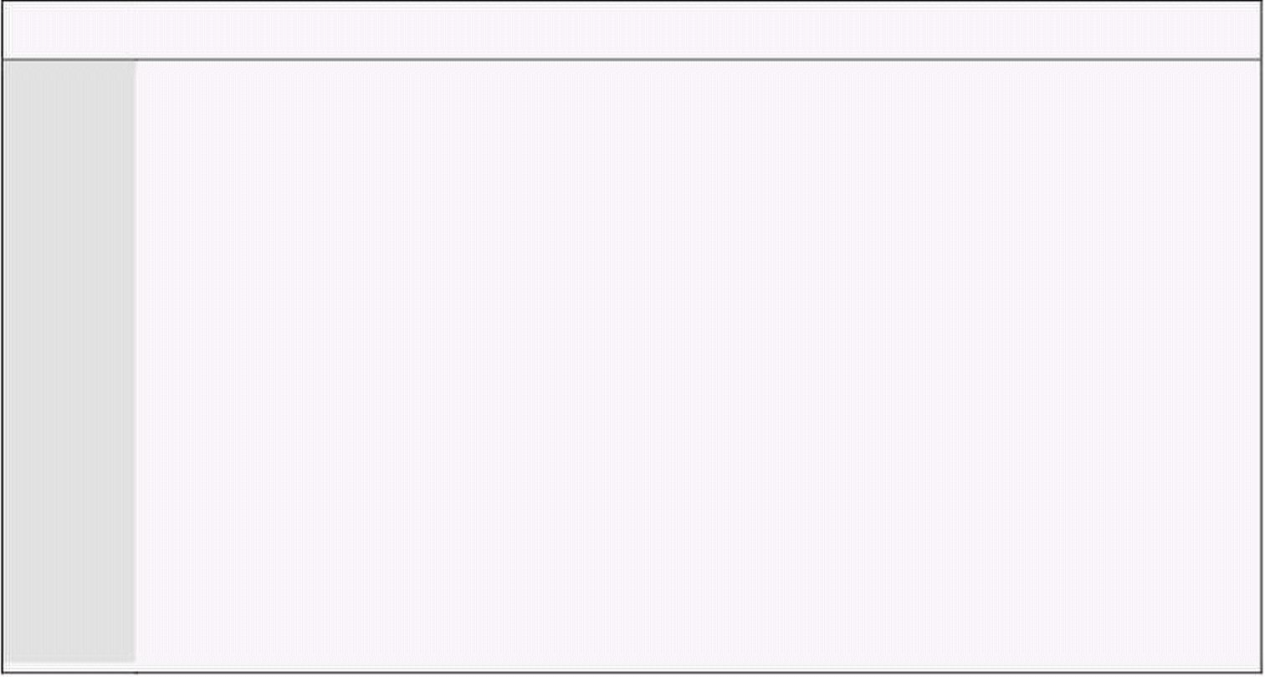
Computer Architecture & Assembly Language Programming Course Code: CS401
CS401@vu.edu.pk
copied. Therefore we need the control of the direction flag to handle this
problem. This problem is further detailed in a later example.
CMPS
CMPS subtracts the source location DS:SI from the destination location
ES:DI. Source and Destination are unaffected. SI and DI are updated
accordingly. CMPS compares two blocks of memory for equality or inequality
of the block. It subtracts byte by byte or word by word. If used with a REPE
or a REPNE prefix is repeats as long as the blocks are same or as long as
they are different. For example it can be used for find a substring. A
substring is a string that is contained in another string. For example “has” is
contained in “Mary has a little lamp.” Using CMPS we can do the operation of
a complex loop in a single instruction. Only the REPE and REPNE prefixes
are meaningful with this instruction.
REP Prefix
REP repeats the following string instruction CX times. The use of CX is
implied with the REP prefix. The decrement in CX doesn’t affect any flags and
the jump is also independent of the flags, just like JCXZ.
REPE and REPNE Prefixes
REPE or REPZ repeat the following string instruction while the zero flag is
set and REPNE or REPNZ repeat the following instruction while the zero flag
is not set. REPE or REPNE are used with the SCAS or CMPS instructions.
The other string instructions have nothing to do with the condition since
they are performing no comparison. Also the initial state of flags before the
string instruction does not affect the operation. The most complex operation
of the string instruction is with these prefixes.
7.2. STOS EXAMPLE – CLEARING THE SCREEN
We take the example of clearing the screen and observe that how simple
and fast this operation is with the string instructions. Even if there are three
instructions in a loop they have to be fetched and decoded with every
iteration and the time of three instructions is multiplied by the number of
iterations of the loop. In the case of string instructions, many operations are
short circuited. The instruction is fetched and decoded once and only the
execution is repeated CX times. That is why string instructions are so
efficient in their operation. The program to clear the screen places 0720 on
the 2000 words on the screen.
Example 7.1
001 ; clear screen using string instructions
002 [org 0x0100]
003 jmp start
004
005 ; subroutine to clear the screen
006 clrscr: push es
007 push ax
008 push cx
009 push di
010
011 mov ax, 0xb800
012 mov es, ax ; point es to video base
013 xor di, di ; point di to top left column
014 mov ax, 0x0720 ; space char in normal attribute
015 mov cx, 2000 ; number of screen locations
016
017 cld ; auto increment mode
018 rep stosw ; clear the whole screen
019
020 pop di
Virtual University of Pakistan 85

Slide 94



Computer Architecture & Assembly Language Programming Course Code: CS401
CS401@vu.edu.pk
021 pop cx
022 pop ax
023 pop es
024 ret
025
026 start: call clrscr ; call clrscr subroutine
027
028 mov ax, 0x4c00 ; terminate program
029 int 0x21
013 A space efficient way to zero a 16bit register is to XOR it with itself.
Remember that exclusive or results in a zero whenever the bits at
the source and at the destination are same. This instruction takes
just two bytes compared to “mov di, 0” which would take three. This
is a standard way to zero a 16bit register.
Inside the debugger the operation of the string instruction can be
monitored. The trace into command can be used to monitor every repetition
of the string instruction. However screen will not be cleared inside the
debugger as the debugger overwrites its display on the screen so CX
decrements with every iteration, DI increments by 2. The first access is made
at B800:0000 and the second at B800:0002 and so on. A complex and
inefficient loop is replaced with a fast and simple instruction that does the
same operation many times faster.
7.3. LODS EXAMPLE – STRING PRINTING
The use of LODS with the REP prefix is not meaningful as only the last
value loaded will remain in the register. It is normally used in a loop paired
with a STOS instruction to do some block processing. We use LODS to pick
the data, do the processing, and then use STOS to put it back or at some
other place. For example in string printing, we will use LODS to read a
character of the string, attach the attribute byte to it, and use STOS to write
it on the video memory.
The following example will print the string using string instructions.
Example 7.2
001 ; hello world printing using string instructions
002 [org 0x0100]
003 jmp start
004
005 message: db 'hello world' ; string to be printed
006 length: dw 11 ; length of string
007
008-027 ;;;;; COPY LINES 005-024 FROM EXAMPLE 7.1 (clrscr) ;;;;;
028
029 ; subroutine to print a string
030 ; takes the x position, y position, attribute, address of string and
031 ; its length as parameters
032 printstr: push bp
033 mov bp, sp
034 push es
035 push ax
036 push cx
037 push si
038 push di
039
040 mov ax, 0xb800
041 mov es, ax ; point es to video base
042 mov al, 80 ; load al with columns per row
043 mul byte [bp+10] ; multiply with y position
044 add ax, [bp+12] ; add x position
045 shl ax, 1 ; turn into byte offset
046 mov di,ax ; point di to required location
047 mov si, [bp+6] ; point si to string
048 mov cx, [bp+4] ; load length of string in cx
049 mov ah, [bp+8] ; load attribute in ah
Virtual University of Pakistan 86

Slide 95



Computer Architecture & Assembly Language Programming Course Code: CS401
CS401@vu.edu.pk
050
051 cld ; auto increment mode
052 nextchar: lodsb ; load next char in al
053 stosw ; print char/attribute pair
054 loop nextchar ; repeat for the whole string
055
056 pop di
057 pop si
058 pop cx
059 pop ax
060 pop es
061 pop bp
062 ret 10
063
064 start: call clrscr ; call the clrscr subroutine
065
066 mov ax, 30
067 push ax ; push x position
068 mov ax, 20
069 push ax ; push y position
070 mov ax, 1 ; blue on black attribute
071 push ax ; push attribute
072 mov ax, message
073 push ax ; push address of message
074 push word [length] ; push message length
075 call printstr ; call the printstr subroutine
076
077 mov ax, 0x4c00 ; terminate program
078 int 0x21
051 Both operations are in auto increment mode.
052-053 DS is automatically initialized to our segment. ES points to video
memory. SI points to the address of our string. DI points to the
screen location. AH holds the attribute. Whenever we read a
character from the string in AL, the attribute byte is implicitly
attached and the pair is present in AX. The same effect could not be
achieved with a REP prefix as the REP will repeat LODS and then
start repeating STOS, but we need to alternate them.
054 CX holds the length of the string. Therefore LOOP repeats for each
character of the string.
Inside the debugger we observe how LODS and STOS alternate and CX is
only used by the LOOP instruction. In the original code there were four
instructions inside the loop; now there are only two. This is how string
instructions help in reducing code size.
7.4. SCAS EXAMPLE – STRING LENGTH
Many higher level languages do not explicitly store string length; rather
they use a null character, a character with an ASCII code of zero, to signal
the end of a string. In assembly language programs, it is also easier to store
a zero at the end of the string, instead of calculating the length of string,
which is very difficult process for longer strings. So we delegate length
calculation to the processor and modify our string printing subroutine to
take a null terminated string and no length. We use SCASB with REPNE and
a zero in AL to find a zero byte in the string. In CX we load the maximum
possible size, which is 64K bytes. However actual strings will be much
smaller. An important thing regarding SCAS and CMPS is that if they stop
due to equality or inequality, the index registers have already incremented.
Therefore when SCAS will stop DI would be pointing past the null character.
Example 7.3
001 ; hello world printing with a null terminated string
002 [org 0x0100]
Virtual University of Pakistan 87

Slide 96

Computer Architecture & Assembly Language Programming Course Code: CS401
CS401@vu.edu.pk
003 jmp start
004
005 message: db 'hello world', 0 ; null terminated string
006
007-026 ;;;;; COPY LINES 005-024 FROM EXAMPLE 7.1 (clrscr) ;;;;;
027
028 ; subroutine to print a string
029 ; takes the x position, y position, attribute, and address of a null
030 ; terminated string as parameters
031 printstr: push bp
032 mov bp, sp
033 push es
034 push ax
035 push cx
036 push si
037 push di
038
039 push ds
040 pop es ; load ds in es
041 mov di, [bp+4] ; point di to string
042 mov cx, 0xffff ; load maximum number in cx
043 xor al, al ; load a zero in al
044 repne scasb ; find zero in the string
045 mov ax, 0xffff ; load maximum number in ax
046 sub ax, cx ; find change in cx
047 dec ax ; exclude null from length
048 jz exit ; no printing if string is empty
049
050 mov cx, ax ; load string length in cx
051 mov ax, 0xb800
052 mov es, ax ; point es to video base
053 mov al, 80 ; load al with columns per row
054 mul byte [bp+8] ; multiply with y position
055 add ax, [bp+10] ; add x position
056 shl ax, 1 ; turn into byte offset
057 mov di,ax ; point di to required location
058 mov si, [bp+4] ; point si to string
059 mov ah, [bp+6] ; load attribute in ah
060
061 cld ; auto increment mode
062 nextchar: lodsb ; load next char in al
063 stosw ; print char/attribute pair
064 loop nextchar ; repeat for the whole string
065
066 exit: pop di
067 pop si
068 pop cx
069 pop ax
070 pop es
071 pop bp
072 ret 8
073
074 start: call clrscr ; call the clrscr subroutine
075
076 mov ax, 30
077 push ax ; push x position
078 mov ax, 20
079 push ax ; push y position
080 mov ax, 1 ; blue on black attribute
081 push ax ; push attribute
082 mov ax, message
083 push ax ; push address of message
084 call printstr ; call the printstr subroutine
085
086 mov ax, 0x4c00 ; terminate program
int 0x21
039-040 Another way to load a segment register is to use a combination of
push and pop. The processor doesn’t match pushes and pops. ES is
equalized to DS in this pair of instructions.
Inside the debugger observe the working of the code for length calculation
after SCASB has completed its operation.
Virtual University of Pakistan 88

Slide 97


Computer Architecture & Assembly Language Programming Course Code: CS401
CS401@vu.edu.pk
LES and LDS Instructions
Since the string instructions need their source and destination in the form
of a segment offset pair, there are two special instructions that load a
segment register and a general purpose register from two consecutive
memory locations. LES loads ES while LDS loads DS. Both these instructions
have two parameters, one is the general purpose register to be loaded and
the other is the memory location from which to load these registers. The
major application of these instructions is when a subroutine receives a
segment offset pair as an argument and the pair is to be loaded in a segment
and an offset register. According to Intel rules of significance the word at
higher address is loaded in the segment register while the word at lower
address is loaded in the offset register. As parameters segment should be
pushed first so that it ends up at a higher address and the offset should be
pushed afterwards. When loading the lower address will be given. For
example “lds si, [bp+4]” will load SI from BP+4 and DS from BP+6.
7.5. LES AND LDS EXAMPLE
We modify the string length calculation subroutine to take the segment
and offset of the string and use the LES instruction to load that segment
offset pair in ES and DI.
Example 7.4
001 ; hello world printing with length calculation subroutine
002 [org 0x0100]
003 jmp start
004
005 message: db 'hello world', 0 ; null terminated string
006
007-026 ;;;;; COPY LINES 005-024 FROM EXAMPLE 7.1 (clrscr) ;;;;;
027
028 ; subroutine to calculate the length of a string
029 ; takes the segment and offset of a string as parameters
030 strlen: push bp
031 mov bp,sp
032 push es
033 push cx
034 push di
035
036 les di, [bp+4] ; point es:di to string
037 mov cx, 0xffff ; load maximum number in cx
038 xor al, al ; load a zero in al
039 repne scasb ; find zero in the string
040 mov ax, 0xffff ; load maximum number in ax
041 sub ax, cx ; find change in cx
042 dec ax ; exclude null from length
043
044 pop di
045 pop cx
046 pop es
047 pop bp
048 ret 4
049
050 ; subroutine to print a string
051 ; takes the x position, y position, attribute, and address of a null
052 ; terminated string as parameters
053 printstr: push bp
054 mov bp, sp
055 push es
056 push ax
057 push cx
058 push si
059 push di
060
061 push ds ; push segment of string
062 mov ax, [bp+4]
063 push ax ; push offset of string
064 call strlen ; calculate string length
Virtual University of Pakistan 89

Slide 98


Computer Architecture & Assembly Language Programming Course Code: CS401
CS401@vu.edu.pk
065 cmp ax, 0 ; is the string empty
066 jz exit ; no printing if string is empty
067 mov cx, ax ; save length in cx
068
069 mov ax, 0xb800
070 mov es, ax ; point es to video base
071 mov al, 80 ; load al with columns per row
072 mul byte [bp+8] ; multiply with y position
073 add ax, [bp+10] ; add x position
074 shl ax, 1 ; turn into byte offset
075 mov di,ax ; point di to required location
076 mov si, [bp+4] ; point si to string
077 mov ah, [bp+6] ; load attribute in ah
078
079 cld ; auto increment mode
080 nextchar: lodsb ; load next char in al
081 stosw ; print char/attribute pair
082 loop nextchar ; repeat for the whole string
083
084 exit: pop di
085 pop si
086 pop cx
087 pop ax
088 pop es
089 pop bp
090 ret 8
091
092 start: call clrscr ; call the clrscr subroutine
093
094 mov ax, 30
095 push ax ; push x position
096 mov ax, 20
097 push ax ; push y position
098 mov ax, 0x71 ; blue on white attribute
099 push ax ; push attribute
100 mov ax, message
101 push ax ; push address of message
102 call printstr ; call the printstr subroutine
103
104 mov ax, 0x4c00 ; terminate program
105 int 0x21
036 The LES instruction is used to load the DI register from BP+4 and
the ES register from BP+6.
065 The convention to return a value from a subroutine is to use the AX
register. That is why AX is not saved and restored in the subroutine.
Inside the debugger observe that the segment register is pushed followed
by the offset. The higher address FFE6 contains the segment and the lower
address FFE4 contains the offset. This is because we have a decrementing
stack. Then observe the loading of ES and DI from the stack.
7.6. MOVS EXAMPLE – SCREEN SCROLLING
MOVS has the two forms MOVSB and MOVSW. REP allows the instruction
to be repeated CX times allowing blocks of memory to be copied. We will
perform this copy of the video screen.
Scrolling is the process when all the lines on the screen move one or more
lines towards the top of towards the bottom and the new line that appears on
the top or the bottom is cleared. Scrolling is a process on which string
movement is naturally applicable. REP with MOVS will utilize the full
processor power to do the scrolling in minimum time.
In this example we want to scroll a variable number of lines given as
argument. Therefore we have to calculate the source address, which is 160
times the number of lines to clear. The destination address is 0, which is the
top left of the screen. The lines that scroll up are discarded so the source
pointer is placed after them. An equal number of lines at the bottom are
cleared. These lines have actually been copied above.
Virtual University of Pakistan 90

Slide 99

Computer Architecture & Assembly Language Programming Course Code: CS401
CS401@vu.edu.pk
Example 7.5
001 ; scroll up the screen
002 [org 0x0100]
003 jmp start
004
005 ; subroutine to scroll up the screen
006 ; take the number of lines to scroll as parameter
007 scrollup: push bp
008 mov bp,sp
009 push ax
010 push cx
011 push si
012 push di
013 push es
014 push ds
015
016 mov ax, 80 ; load chars per row in ax
017 mul byte [bp+4] ; calculate source position
018 mov si, ax ; load source position in si
019 push si ; save position for later use
020 shl si, 1 ; convert to byte offset
021 mov cx, 2000 ; number of screen locations
022 sub cx, ax ; count of words to move
023 mov ax, 0xb800
024 mov es, ax ; point es to video base
025 mov ds, ax ; point ds to video base
026 xor di, di ; point di to top left column
027 cld ; set auto increment mode
028 rep movsw ; scroll up
029 mov ax, 0x0720 ; space in normal attribute
030 pop cx ; count of positions to clear
031 rep stosw ; clear the scrolled space
032
033 pop ds
034 pop es
035 pop di
036 pop si
037 pop cx
038 pop ax
039 pop bp
040 ret 2
041
042 start: mov ax,5
043 push ax ; push number of lines to scroll
044 call scrollup ; call the scroll up subroutine
045
046 mov ax, 0x4c00 ; terminate program
047 int 0x21
The beauty of this example is that the two memory blocks are overlapping.
If the source and destination in the above algorithm are swapped in an
expectation to scroll down the result is strange. For example if 5 lines were to
scroll down, the top five lines of the screen are repeated on the whole screen.
This is where the use of the direction flag comes in.
When the source is five lines below the destination, the first five lines are
copied on the first five lines of the destination. However the next five lines to
be copied from the source have been destroyed in the process; because they
were the same as the first five lines of the destination. The same is the
problem with every set of five lines as the source is destroyed during the
previous copy. In this situation we must go from bottom of the screen
towards the top. Now the last five lines are copied to the last five lines of the
destination. The next five lines are copied to next five lines of the destination
destroying the last five lines of source; but now these lines are no longer
needed and have been previously copied. Therefore the copy will be
appropriately done in this case.
We give an example of scrolling down with this consideration. Now we have
to calculate the end of the block instead of the start.
Virtual University of Pakistan 91

Slide 100


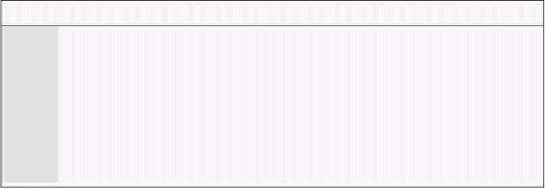
Computer Architecture & Assembly Language Programming Course Code: CS401
CS401@vu.edu.pk
Example 7.6
001 ; scroll down the screen
002 [org 0x0100]
003 jmp start
004
005 ; subroutine to scrolls down the screen
006 ; take the number of lines to scroll as parameter
007 scrolldown: push bp
008 mov bp,sp
009 push ax
010 push cx
011 push si
012 push di
013 push es
014 push ds
015
016 mov ax, 80 ; load chars per row in ax
017 mul byte [bp+4] ; calculate source position
018 push ax ; save position for later use
019 shl ax, 1 ; convert to byte offset
020 mov si, 3998 ; last location on the screen
021 sub si, ax ; load source position in si
022 mov cx, 2000 ; number of screen locations
023 sub cx, ax ; count of words to move
024 mov ax, 0xb800
025 mov es, ax ; point es to video base
026 mov ds, ax ; point ds to video base
027 mov di, 3998 ; point di to lower right column
028 std ; set auto decrement mode
029 rep movsw ; scroll up
030 mov ax, 0x0720 ; space in normal attribute
031 pop cx ; count of positions to clear
032 rep stosw ; clear the scrolled space
033
034 pop ds
035 pop es
036 pop di
037 pop si
038 pop cx
039 pop ax
040 pop bp
041 ret 2
042
043 start: mov ax,5
044 push ax ; push number of lines to scroll
045 call scrolldown ; call scroll down subroutine
046
047 mov ax, 0x4c00 ; terminate program
048 int 0x21
7.7. CMPS EXAMPLE – STRING COMPARISON
For the last string instruction, we take string comparison as an example.
The subroutine will take two segment offset pairs containing the address of
the two null terminated strings. The subroutine will return 0 if the strings
are different and 1 if they are same. The AX register will be used to hold the
return value.
Example 7.7
001 ; comparing null terminated strings
002 [org 0x0100]
003 jmp start
004
005 msg1: db 'hello world', 0
006 msg2: db 'hello WORLD', 0
007 msg3: db 'hello world', 0
008
009-031 ;;;;; COPY LINES 028-050 FROM EXAMPLE 7.4 (strlen) ;;;;;
032
033 ; subroutine to compare two strings
034 ; takes segment and offset pairs of two strings to compare
Virtual University of Pakistan 92

Slide 101


Computer Architecture & Assembly Language Programming Course Code: CS401
CS401@vu.edu.pk
035 ; returns 1 in ax if they match and 0 other wise
036 strcmp: push bp
037 mov bp,sp
038 push cx
039 push si
040 push di
041 push es
042 push ds
043
044 lds si, [bp+4] ; point ds:si to first string
045 les di, [bp+8] ; point es:di to second string
046
047 push ds ; push segment of first string
048 push si ; push offset of first string
049 call strlen ; calculate string length
050 mov cx, ax ; save length in cx
051
052 push es ; push segment of second string
053 push di ; push offset of second string
054 call strlen ; calculate string length
055 cmp cx, ax ; compare length of both strings
056 jne exitfalse ; return 0 if they are unequal
057
058 mov ax, 1 ; store 1 in ax to be returned
059 repe cmpsb ; compare both strings
060 jcxz exitsimple ; are they successfully compared
061
062 exitfalse: mov ax, 0 ; store 0 to mark unequal
063
064 exitsimple: pop ds
065 pop es
066 pop di
067 pop si
068 pop cx
069 pop bp
070 ret 8
071
072 start: push ds ; push segment of first string
073 mov ax, msg1
074 push ax ; push offset of first string
075 push ds ; push segment of second string
076 mov ax, msg2
077 push ax ; push offset of second string
078 call strcmp ; call strcmp subroutine
079
080 push ds ; push segment of first string
081 mov ax, msg1
082 push ax ; push offset of first string
083 push ds ; push segment of third string
084 mov ax, msg3
085 push ax ; push offset of third string
086 call strcmp ; call strcmp subroutine
087
088 mov ax, 0x4c00 ; terminate program
089 int 0x21
005-007 Three strings are declared out of which two are equal and one is
different.
044-045 LDS and LES are used to load the pointers to the two strings in
DS:SI and ES:DI.
070 Since there are 4 parameters to the subroutine “ret 8” is used.
Inside the debugger we observe that REPE is shown as REP. This is
because REP and REPE are represented with the same prefix byte. When
used with STOS, LODS, and MOVS it functions as REP and when used with
SCAS and CMPS it functions as REPE.
EXERCISES
1. Write code to find the byte in AL in the whole megabyte of memory
such that each memory location is compared to AL only once.
Virtual University of Pakistan 93

Slide 102
Computer Architecture & Assembly Language Programming Course Code: CS401
CS401@vu.edu.pk
2. Write a far procedure to reverse an array of 64k words such that the
first element becomes the last and the last becomes the first and so
on. For example if the first word contained 0102h, this value is
swapped with the last word. The next word is swapped with the
second last word and so on. The routine will be passed two
parameters through the stack; the segment and offset of the first
element of the array.
3. Write a near procedure to copy a given area on the screen at the
center of the screen without using a temporary array. The routine will
be passed top, left, bottom, and right in that order through the stack.
The parameters passed will always be within range the height will be
odd and the width will be even so that it can be exactly centered.
4. Write code to find two segments in the whole memory that are exactly
the same. In other words find two distinct values which if loaded in
ES and DS then for every value of SI [DS:SI]=[ES:SI].
5. Write a function writechar that takes two parameters. The first
parameter is the character to write and the second is the address of a
memory area containing top, left, bottom, right, current row, current
column, normal attribute, and cursor attribute in 8 consecutive
bytes. These define a virtual window on the screen.
The function writes the passed character at (current row, current
column) using the normal attribute. It then increments current
column, If current column goes outside the window, it makes it zero
and increments current row. If current row gets out of window, it
scrolls the window one line up, and blanks out the new line in the
window. In the end, it sets the attribute of the new (current row,
current column) to cursor attribute.
6. Write a function “strcpy” that takes the address of two parameters via
stack, the one pushed first is source and the second is the
destination. The function should copy the source on the destination
including the null character assuming that sufficient space is
reserved starting at destination.
Virtual University of Pakistan 94

Slide 103
8
Software Interrupts
8.1. INTERRUPTS
Interrupts in reality are events that occurred outside the processor and the
processor must be informed about them. Interrupts are asynchronous and
unpredictable. Asynchronous means that the interrupts occur, independent
of the working of the processor, i.e. independent of the instruction currently
executing. Synchronous events are those that occur side by side with
another activity. Interrupts must be asynchronous as they are generated by
the external world which is unaware of the happenings inside the processor.
True interrupts that occur in real time are asynchronous with the execution.
Also it is unpredictable at which time an interrupt will come. The two
concepts of being unpredictable and asynchronous are overlapping.
Unpredictable means the time at which an interrupt will come cannot be
predicted, while asynchronous means that the interrupt has nothing to do
with the currently executing instruction and the current state of the
processor.
The 8088 processor divides interrupts into two classes. Software interrupts
and hardware interrupts. Hardware interrupts are the real interrupts
generated by the external world as discussed above. Software interrupts on
the contrary are not generated from outside the processor. They just provide
an extended far call mechanism. Far all allows us to jump anywhere in the
whole megabyte of memory. To return from the target we place both the
segment and offset on the stack. Software interrupts show a similar
behavior. It however pushes one more thing before both the segment and
offset and that is the FLAGS register. Just like the far call loads new values
in CS and IP, the interrupt call loads new values in CS, IP, and FLAGS.
Therefore the only way to retain the value of original FLAGS register is to
push and pop as part of interrupt call and return instructions. Pushing and
popping inside the routine will not work as the routine started with an
already tampered value.
The discussion of real time interrupts is deferred till the next chapter. They
play the critical part in control applications where external hardware must
be control and events and changes therein must be appropriately responded
by the processor. To generate an interrupt the INT instruction is used. The
routine that executes in response to an INT instruction is called the interrupt
service routine (ISR) or the interrupt handler. Taking example from real time
interrupts the routine to instruct an external hardware to close the valve of a
boiler in response to an interrupt from the pressure sensor is an interrupt
routine.
The software interrupt mechanism in 8088 uses vectored interrupts
meaning that the address of the interrupt routine is not directly mentioned
in an interrupt call, rather the address is lookup up from a table. 8088
provides a mechanism for mapping interrupts to interrupt handlers.
Introducing a new entry in this mapping table is called hooking an interrupt.
Syntax of the INT instruction is very simple. It takes a single byte
argument varying from 0-255. This is the interrupt number informing the
processor, which interrupt is currently of interest. This number correlates to
the interrupt handler routine by a routing or vectoring mechanism. A few
interrupt numbers in the start are reserved and we generally do not use
them. They are related to the processor working. For example INT 0 is the

Slide 104
Computer Architecture & Assembly Language Programming Course Code: CS401
CS401@vu.edu.pk
divide by zero interrupt. A list of all reserved interrupts is given later. Such
interrupts are programmed in the hardware to generate the designated
interrupt when the specified condition arises. The remaining interrupts are
provided by the processor for our use. Some of these were reserved by the
IBM PC designers to interface user programs with system software like DOS
and BIOS. This was the logical choice for them as interrupts provided a very
flexible architecture. The remaining interrupts are totally free for use in user
software.
The correlation process from the interrupt number to the interrupt handler
uses a table called interrupt vector table. Its location is fixed to physical
memory address zero. Each entry of the table is four bytes long containing
the segment and offset of the interrupt routine for the corresponding
interrupt number. The first two bytes in the entry contain the offset and the
next two bytes contain the segment. The little endian rule of putting the more
significant part (segment) at a higher address is seen here as well.
Mathematically offset of the interrupt n will be at nx4 while the segment will
be at nx4+2. One entry in this table is called a vector. If the vector is changed
for interrupt 0 then INT 0 will take execution to the new handler whose
address is now placed at those four bytes. INT 1 vector occupies location 4,
5, 6, and 7 and similarly vector for INT 2 occupies locations 8, 9, 10, and 11.
As the table is located in RAM it can be changed anytime. Immediately after
changing it the interrupt mapping is changed and now the interrupt will
result in execution of the new routine. This indirection gives the mechanism
extreme flexibility.
The operation of interrupt is same whether it is the result of an INT
instruction (software interrupt) or it is generated by an external hardware
which passes the interrupt number by a different mechanism. The currently
executing instruction is completed, the current value of FLAGS is pushed on
the stack, then the current code segment is pushed, then the offset of the
next instruction is pushed. After this it automatically clears the trap flag and
the interrupt flag to disallow further interrupts until the current routine
finishes. After this it loads the word at nx4 in IP and the word at nx4+2 in CS
if interrupt n was generated. As soon as these values are loaded in CS and IP
execution goes to the start of the interrupt handler. When the handler
finishes its work it uses the IRET instruction to return to the caller. IRET
pops IP, then CS, and then FLAGS. The original value of IF and TF is
restored which re-enables further interrupts. IF and TF will be discussed in
detail in the discussion of real time interrupts. We have discussed three
things till now.
1. The INT and IRET instruction format and syntax
2. The formation of IVT (interrupt vector table)
3. Operation of the processor when an interrupt in generated
Just as discussed in the subroutines chapter, the processor will not match
interrupt calls to interrupt returns. If a RETF is used in the end of an ISR the
processor will still return to the caller but the FLAGS will remain on the
stack which will destroy the expectations of the caller with the stack. If we
know what we are doing we may use such different combination of
instructions. Generally we will use IRET to return from an interrupt routine.
Apart from indirection the software interrupt mechanism is similar to CALL
and RET. Indirection is the major difference.
The operation of INT can be written as:
• sp ← sp+2
• [sp] ← flag
• sp ← sp+2
• if ← 0
• tf ← 0
• [sp] ← cs
• sp ← sp+2
• [sp] ← ip
Virtual University of Pakistan 96

Slide 105
Computer Architecture & Assembly Language Programming Course Code: CS401
CS401@vu.edu.pk
• ip ← [0:N*4]
• cs ← [0:N*4+2]
The operation of IRET can be written as:
• ip ← [sp]
• sp ← sp-2
• cs ← [sp]
• sp ← sp-2
• flag ← [sp]
• sp ← sp-2
The above is the microcode description of INT and IRET. To obey an
assembly language instruction the processor breaks it down into small
operations. By reading the microcode of an instruction its working can be
completely understood.
The interrupt mechanism we have studied is an extended far call
mechanism. It pushes FLAGS in addition to CS and IP and it loads CS and IP
with a special mechanism of indirection. It is just like the table of contents
that is located at a fixed position and allows going directly to chapter 3, to
chapter 4 etc. If this association is changed in the table of contents the
direction of the reader changes. For example if Chapter 2 starts at page 220
while 240 is written in the table of contents, the reader will go to page 240
and not 220. The table of contents entry is a vector to point to map the
chapter number to page number. IVT has 256 chapters and the interrupt
mechanism looks up the appropriate chapter number to reach the desired
page to find the interrupt routine.
Another important similarity is that table of contents is always placed at
the start of the book, a well known place. Its physical position is fixed. If
some publishers put it at some place, others at another place, the reader will
be unable to find the desired chapter. Similarly in 8088 the physical memory
address zero is fixed for the IVT and it occupies exactly a kilobyte of memory
as the 256x4=1K where 256 is the number of possible interrupt vectors while
the size of one vector is 4 bytes.
Interrupts introduce temporary breakage in the program flow, sometimes
programmed (software interrupts) and un-programmed at other times
(hardware interrupts). By hooking interrupts various system functionalities
can be controlled. The interrupts reserved by the processor and having
special functions in 8088 are listed below:
• INT 0, Division by zero
Meaning the quotient did not fit in the destination register. This is a bit
different as this interrupt does not return to the next instruction,
rather it returns to the same instruction that generated it, a DIV
instruction of course. Here INT 0 is automatically generated by a DIV
when a specific situation arises, there is no INT 0 instruction.
• INT 1, Trap, Single step Interrupt
This interrupt is used in debugging with the trap flag. If the trap flag is
set the Single Step Interrupt is generated after every instruction. By
hooking this interrupt a debugger can get control after every
instruction and display the registers etc. 8088 was the first processor
that has this ability to support debugging.
• INT 2, NMI-Non Maskable Interrupt
Real interrupts come from outside the processor. INT 0 is not real as it
is generated from inside. For real interrupts there are two pins in the
processor, the INT pin and the NMI pin. The processor can be directed
to listen or not to listen to the INT pin. Consider a recording studio,
when the recording is going on, doors are closed so that no
interruption occurs, and when there is a break, the doors are opened
so that if someone is waiting outside can come it. However if there is an
urgency like fire outside then the door must be broken and the
recording must not be catered for. For such situations is the NMI pin
Virtual University of Pakistan 97

Slide 106

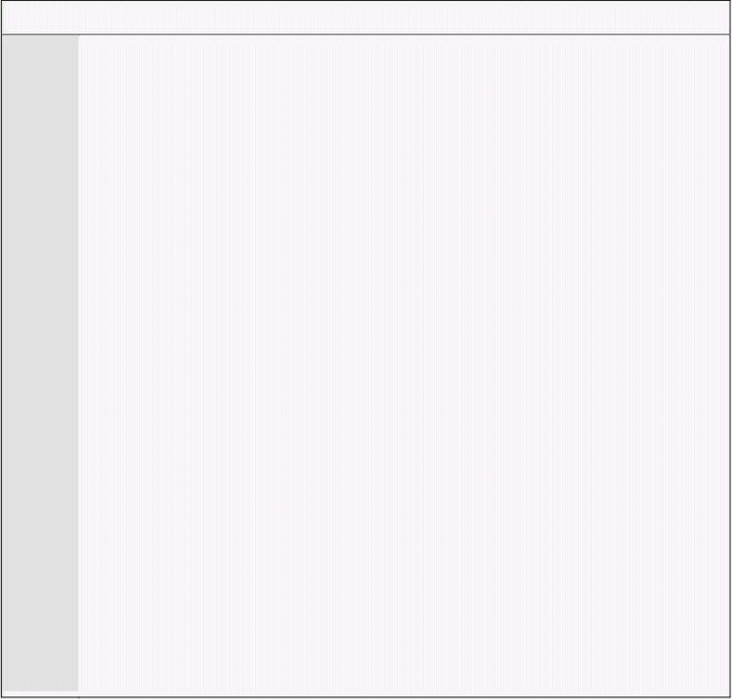
Computer Architecture & Assembly Language Programming Course Code: CS401
CS401@vu.edu.pk
which informs about fatal hardware failures in the system and is tied
to interrupt 2. INT pin can be masked but NMI cannot be masked.
• INT 3, Debug Interrupt
The only special thing about this interrupt is that it has a single byte
opcode and not a two byte combination where the second byte tells the
interrupt number. This allows it to replace any instruction whatsoever.
It is also used by the debugger and will be discussed in detail with the
debugger working.
• INT 4, Arithmetic Overflow, change of sign bit
The overflow flag is set if the sign bit unexpectedly changes as a result
of a mathematical or logical instruction. However the overflow flag
signals a real overflow only if the numbers in question are treated as
signed numbers. So this interrupt is not automatically generated but
as a result of a special instruction INTO (interrupt on overflow) if the
overflow flag is set. Otherwise the INTO instruction behaves like a NOP
(no operation).
These are the five interrupts reserved by Intel and are generally not used in
our operations.
8.2. HOOKING AN INTERRUPT
To hook an interrupt we change the vector corresponding to that interrupt.
As soon as the interrupt vector changes, that interrupt will be routed to the
new handler. Our first example is with the divide by zero interrupt. The
normal system defined behavior in response to divide by zero is to display an
error message and terminate the program. We will change it to display our
own message.
Example 8.1
001 ; hooking divide by zero interrupt
002 [org 0x0100]
003 jmp start
004
005 message: db 'You divided something by zero.', 0
006
007-029 ;;;;; COPY LINES 028-050 FROM EXAMPLE 7.4 (strlen) ;;;;;
030-049 ;;;;; COPY LINES 005-024 FROM EXAMPLE 7.1 (clrscr) ;;;;;
050-090 ;;;;; COPY LINES 050-090 FROM EXAMPLE 7.4 (printstr) ;;;;;
091
092 ; divide by zero interrupt handler
093 myisrfor0: push ax ; push all regs
094 push bx
095 push cx
096 push dx
097 push si
098 push di
099 push bp
100 push ds
101 push es
102
103 push cs
104 pop ds ; point ds to our data segment
105
106 call clrscr ; clear the screen
107 mov ax, 30
108 push ax ; push x position
109 mov ax, 20
110 push ax ; push y position
111 mov ax, 0x71 ; white on blue attribute
112 push ax ; push attribute
113 mov ax, message
114 push ax ; push offset of message
115 call printstr ; print message
116
117 pop es
118 pop ds
119 pop bp
Virtual University of Pakistan 98

Slide 107


Computer Architecture & Assembly Language Programming Course Code: CS401
CS401@vu.edu.pk
120 pop di
121 pop si
123 pop dx
124 pop cx
125 pop bx
126 pop ax
127 iret ; return from interrupt
128
129 ; subroutine to generate a divide by zero interrupt
130 genint0: mov ax, 0x8432 ; load a big number in ax
131 mov bl, 2 ; use a very small divisor
132 div bl ; interrupt 0 will be generated
133 ret
134
135 start: xor ax, ax
136 mov es, ax ; load zero in es
137 mov word [es:0*4], myisrfor0 ; store offset at n*4
138 mov [es:0*4+2], cs ; store segment at n*4+2
139 call genint0 ; generate interrupt 0
140
141 mov ax, 0x4c00 ; terminate program
142 int 0x21
93-101 We often push all registers in an interrupt service routine just to be
sure that no unintentional modification to any register is made.
Since any code may be interrupted an unintentional modification
will be hard to debug
103-104 Since interrupt can be called from anywhere we are not sure about
the value in DS so we reset it to our code segment.
When this program is executed our desired message will be shown instead
of the default message and the computer will hang thereafter. The first thing
to observe is that there is no INT 0 call anywhere in the code. INT 0 was
invoked automatically by an internal mechanism of the processor as a result
of the DIV instruction producing a result that cannot fit in the destination
register. Just by changing the vector we have changed the response of the
system to divide overflow situations.
However the system stuck instead of returning to the next instruction.
This is because divide overflow is a special type of interrupt that returns to
the same instruction instead of the next instruction. This is why the default
handler forcefully terminates the program instead of returning. Now the IRET
will take control back to the DIV instruction which will again generate the
same interrupt. So the computer is stuck in an infinite loop.
8.3. BIOS AND DOS INTERRUPTS
In IBM PC there are certain interrupts designated for user programs to
communicate with system software to access various standard services like
access to the floppy drive, hard drive, vga, clock etc. If the programmer does
not use these services he has to understand the hardware details like which
particular controller is used and how it works. To avoid this and provide
interoperability a software interface to basic hardware devices is provided
except in very early computers. Since the manufacturer knows the hardware
it burns the software to control its hardware in ROM. Such software is called
firmware and access to this firmware is provided through specified
interrupts.
This basic interface to the hardware is called BIOS (basic input output
services). When the computer is switched on, BIOS gets the control at a
specified address. The messages at boot time on the screen giving BIOS
version, detecting different hardware are from this code. BIOS has the
responsibility of testing the basic hardware including video, keyboard, floppy
drive, hard drive etc and a special program to bootstrap. Bootstrap means to
load OS from hard disk and from there OS takes control and proceeds to load
its components and display a command prompt in the end. There are two
Virtual University of Pakistan 99

Slide 108
Computer Architecture & Assembly Language Programming Course Code: CS401
CS401@vu.edu.pk
important programs; BIOS and OS. OS services are high level and build upon
the BIOS services. BIOS services are very low level. A level further lower is
only directly controlling the hardware. BIOS services provide a hardware
independent layer above the hardware and OS services provide another
higher level layer over the BIOS services. We have practiced direct hardware
access with the video device directly without using BIOS or DOS. The layer of
BIOS provides services like display a character, clear the screen, etc. All
these layers are optional in that we can skip to whatever lower layer we want.
The most logical way to provide access to firmware is to use the interrupt
mechanism. Specific services are provided at specific interrupts. CALL could
also have been used but in that case every manufacturer would be required
to place specific routines at specific addresses, which is not a flexible
mechanism. Interrupts provide standard interrupt number for the caller and
flexibility to place the interrupt routine anywhere in the memory for the
manufacturer. Now for the programmer it is decided that video services will
be provided at INT 10 but the actual address of the video services can and do
vary on computers from different manufacturers. Any computer that is IBM
compatible must make the video services accessible through INT 10.
Similarly keyboard services are available at INT 16 and this is standard in
every IBM compatible. Manufacturers place the code wherever they want and
the services are exported through this interrupt.
BIOS exports its various services through different interrupts. Keyboard
services are exported through INT 16, parallel port services through INT 17
and similarly others through different interrupts. DOS has a single entry
point through INT 21 just like a pin hole camera, this single entry points
leads to a number of DOS services. So how one interrupt provides a number
of different services. A concept of service number is used here which is a
defecto standard in providing multiple services through an interrupt. INT 10
is for video services and each of character printing service, screen clearing
service, cursor movement service etc. has a service number associated to it.
So we say INT 10 service 0 is used for this purpose and INT 10 service 1 is
used for that purpose etc. Service numbers for different standard services are
also fixed for every IBM compatible. The concept of exported services through
interrupts is expanded with the service numbering scheme.
The service number is usually given in the AH register. Sometimes these
256 services seem less. For example DOS exports thousands of services. So
will be often seen an extension to a level further with sub-services. For
examples INT 10 character generator services are all provided through a
single service number and the services are distinguished with a sub-service
number.
The finally selected service would need some arguments for it to work. In
interrupts arguments are usually not given through stack, rather registers
are used. The BIOS and DOS specifications list which register contains
which argument for a particular service of a particular interrupt.
We will touch some important BIOS and DOS services and not cover it
completely neither is it possible to cover it in this space. A very
comprehensive reference of interrupts is the Ralph Brown List. It is just a
reference and not to be studied from end to end. All interrupts cannot be
remembered and there is no need to remember them.
The service number is almost always in AH while the sub-service number
is in AL or BL and sometimes in other registers. The documentation of the
service we are using will list which register should hold what when the
interrupt is invoked for that particular service.
Our first target using BIOS is video so let us proceed to our first program
that uses INT 10 service 13 to print a string on the screen. BIOS will work
even if the video memory is not at B8000 (a very old video card) since BIOS
knows everything about the hardware and is hardware specific.
Virtual University of Pakistan 100

Slide 109
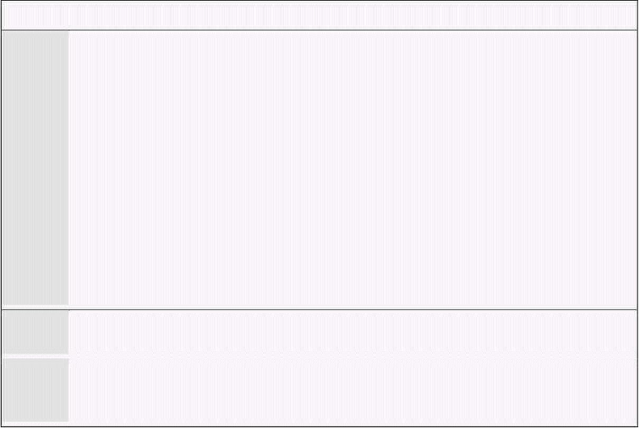
Computer Architecture & Assembly Language Programming Course Code: CS401
CS401@vu.edu.pk
Example 8.2
001 ; print string using bios service
002 [org 0x0100]
003 jmp start
004 message: db 'Hello World'
005
006 start: mov ah, 0x13 ; service 13 - print string
007 mov al, 1 ; subservice 01 – update cursor
008 mov bh, 0 ; output on page 0
009 mov bl, 7 ; normal attrib
010 mov dx, 0x0A03 ; row 10 column 3
011 mov cx, 11 ; length of string
012 push cs
013 pop es ; segment of string
014 mov bp, message ; offset of string
015 int 0x10 ; call BIOS video service
016
017 mov ax, 0x4c00 ; terminate program
018 int 0x21
007 The sub-service are versions of printstring that update and do not
update the cursor after printing the string etc.
008 Text video screen is in the form of pages which can be upto 32. At
one time one page is visible which is by default the zeroth page
unless we change it.
When we execute it the string is printed and the cursor is updated as well.
With direct access to video memory we had no control over the cursor. To
control cursor a different mechanism to access the hardware was needed.
Our next example uses the keyboard service to read a key. The
combination of keyboard and video services is used in almost every program
that we see and use. We will wait for four key presses; clear the screen after
the first, and draw different strings after the next key presses and exiting
after the last. We will use INT 16 service 1 for this purpose. This is a blocking
service so it does not return until a key has been pressed. We also used the
blinking attribute in this example.
Virtual University of Pakistan 101

Slide 110

Computer Architecture & Assembly Language Programming Course Code: CS401
CS401@vu.edu.pk
Example 8.3
001 ; print string and keyboard wait using BIOS services
002 [org 0x100]
003 jmp start
004
005 msg1: db 'hello world', 0
006 msg2: db 'hello world again', 0
007 msg3: db 'hello world again and again', 0
008
009-028 ;;;;; COPY LINES 005-024 FROM EXAMPLE 7.1 (clrscr) ;;;;;
029-069 ;;;;; COPY LINES 050-090 FROM EXAMPLE 7.4 (printstr) ;;;;;
070-092 ;;;;; COPY LINES 028-050 FROM EXAMPLE 7.4 (strlen) ;;;;;
093
094 start: mov ah, 0x10 ; service 10 – vga attributes
095 mov al, 03 ; subservice 3 – toggle blinking
096 mov bl, 01 ; enable blinking bit
097 int 0x10 ; call BIOS video service
098
099 mov ah, 0 ; service 0 – get keystroke
100 int 0x16 ; call BIOS keyboard service
101
102 call clrscr ; clear the screen
103
104 mov ah, 0 ; service 0 – get keystroke
105 int 0x16 ; call BIOS keyboard service
106
107 mov ax, 0
108 push ax ; push x position
109 mov ax, 0
110 push ax ; push y position
111 mov ax, 1 ; blue on black
112 push ax ; push attribute
113 mov ax, msg1
114 push ax ; push offset of string
115 call printstr ; print the string
116
117 mov ah, 0 ; service 0 – get keystroke
118 int 0x16 ; call BIOS keyboard service
119
120 mov ax, 0
121 push ax ; push x position
123 mov ax, 0
124 push ax ; push y position
125 mov ax, 0x71 ; blue on white
126 push ax ; push attribute
127 mov ax, msg2
128 push ax ; push offset of string
129 call printstr ; print the string
130
131 mov ah, 0 ; service 0 – get keystroke
132 int 0x16 ; call BIOS keyboard service
133
134 mov ax, 0
135 push ax ; push x position
136 mov ax, 0
137 push ax ; push y position
138 mov ax, 0xF4 ; red on white blinking
139 push ax ; push attribute
140 mov ax, msg3
141 push ax ; push offset of string
142 call printstr ; print the string
143
144 mov ah, 0 ; service 0 – get keystroke
145 int 0x16 ; call BIOS keyboard service
146
147 mov ax, 0x4c00 ; terminate program
148 int 0x21
099-100 This service has no parameters so only the service number is
initialized in AH. This is the only service so there is no sub-service
number as well. The ASCII code of the char pressed is returned in
AL after this service.
Virtual University of Pakistan 102

Slide 111

Computer Architecture & Assembly Language Programming Course Code: CS401
CS401@vu.edu.pk
EXERCISES
1. Write a TSR that forces a program to exit when it tries to become a
TSR using INT 21h/Service 31h by converting its call into INT
21h/Service 4Ch.
2. Write a function to clear the screen whose only parameter is always
zero. The function is hooked at interrupt 80h and may also be called
directly both as a near call and as a far call. The function should
detect how it is called and return appropriately. It is provided that the
direction flag will be set before the function is called.
3. Write a function that takes three parameters, the interrupt number
(N) and the segment and offset of an interrupt handler XISR. The
arguments are pushed in the order N, XISR’s offset and XISR’s
segment. It is known that the first two instructions of XISR are
PUSHF and CALL 0:0 followed by the rest of the interrupt handler.
PUSHF instruction is of one byte and far call is of 5 bytes with the
first byte being the op-code, the next two containing the target offset
and the last two containing the target segment. The function should
hook XISR at interrupt N and chain it to the interrupt handler
previously hooked at N by manipulating the call 0:0 instruction
placed near the start of XISR.
4. Write a TSR that provide the circular queue services via interrupt
0x80 using the code written in Exercise 5.XX. The interrupt
procedure should call one of qcreate, qdestroy, qempty, qadd,
qremove, and uninstall based on the value in AH. The uninstall
function should restore the old interrupt 0x80 handler and remove
the TSR from memory.
Virtual University of Pakistan 103

Slide 113

9
Real Time Interrupts and
Hardware Interfacing
9.1. HARDWARE INTERRUPTS
The same mechanism as discussed in the previous chapter is used for real
interrupts that are generated by external hardware. However there is a single
pin outside the processor called the INT pin that is used by external
hardware to generate interrupts. The detailed operation that happens outside
the process when an interrupt is generated is complex and only a simplified
view will be discussed here; the view that is relevant to an assembly language
programmer. There are many external devices that need the processor’s
attention like the keyboard, hard disk, floppy disk, sound card. All of them
need real time interrupts at some point in their operation. For example if a
program is busy in some calculations for three minutes the key strokes that
are hit meanwhile should not be wasted. Therefore when a key is pressed,
the INT signal is sent, an interrupt generated and the interrupt handler
stores the key for later use. Similarly when the printer is busy printing we
cannot send it more data. As soon as it gets free from the previous job it
interrupts the processor to inform that it is free now. There are many other
examples where the processor needs to be informed of an external event. If
the processor actively monitors all devices instead of being automatically
interrupted then it there won’t be any time to do meaningful work.
Since there are many devices generating interrupts and there is only one
pin going inside the processor and one pin cannot be technically derived by
more than one source a controller is used in between called the
Programmable Interrupt Controller (PIC). It has eight input signals and one
output signal. It assigns priorities to its eight input pins from 0 to 7 so that if
more than one interrupt comes at the same times, the highest priority one is
forwarded and the rest are held till that is serviced. The rest are forwarded
one by one according to priority after the highest priority one is completed.
The original IBM XT computer had one PIC so there were 8 possible interrupt
sources. However IBM AT and later computers have two PIC totaling 16
possible interrupt sources. They are arrange is a special cascade master
slave arrangement so that only one output signal comes towards the
processor. However we will concentrate on the first interrupt controller only.
The priority can be understood with the following example. Consider eight
parallel switches which are all closed and connected to form the output
signal. When a signal comes on one of the switches, it is passed on to the
output and this switch and all below it are opened so that no further signals
can pass through it. The higher priority switches are still closed and the
signal on them can be forwarded. When the processor signals that it is
finished with the processing the switches are closed again and any waiting
interrupts may be forwarded. The way the processor signals ending of the
interrupt service routine is by using a special mechanism discussed later.
The eight input signals to the PIC are called Interrupt Requests (IRQ). The
eight lines are called IRQ 0 to IRQ 7. These are the input lines of the 8451.†
For example IRQ 0 is derived by a timer device. The timer device keeps
† 8451 is the technical number of the PIC.

Slide 114

Computer Architecture & Assembly Language Programming Course Code: CS401
CS401@vu.edu.pk
generating interrupts with a specified frequency. IRQ 1 is derived by the
keyboard when generates an interrupts when a key is pressed or released.
IRQ 2 is the cascading interrupt connected to the output of the second 8451
in the machine. IRQ 3 is connected to serial port COM 2 while IRQ 4 is
connected to serial port COM 1. IRQ 5 is used by the sound card or the
network card or the modem. An IRQ conflict means that two devices in the
system want to use the same IRQ line. IRQ 6 is used by the floppy disk drive
while IRQ 7 is used by the parallel port.
Each IRQ is mapped to a specific interrupt in the system. This is called the
IRQ to INT mapping. IRQ 0 to IRQ 7 are consecutively mapped on interrupts
8 to F. This mapping is done by the PIC and not the processor. The actual
mechanism fetches one instruction from the PIC whenever the INT pin is
signaled instead of the memory. We can program the PIC to generate a
different set of interrupts on the same interrupt requests. From the
perspective of an assembly language programmer an IRQ 0 is translated into
an INT 8 without any such instruction in the program and that’s all.
Therefore an IRQ 0, the highest priority interrupt, is generated by the timer
chip at a precise frequency and the handler at INT 8 is invoked which
updates the system time. A key press generates IRQ 1 and the INT 9 handler
is invoked which stores this key. To handler the timer and keyboard
interrupts one can replace the vectors corresponding to interrupt 8 and 9
respectively. For example if the timer interrupt is replaced and the floppy is
accessed by some program, the floppy motor and its light will remain on for
ever as in the normal case it is turned off by the timer interrupt after two
seconds in anticipation that another floppy access might be needed
otherwise the time motor takes to speed up will be needed again.‡
We have seen that an interrupt request from a device enters the PIC as an
IRQ, from there it reaches the INT pin of the processor, the processor
receives the interrupt number from the PIC, generates the designated
interrupt, and finally the interrupt handler gain control and can do whatever
is desired. At the end of servicing the interrupt the handler should inform the
PIC that it is completed so that lower priority interrupts can be sent from the
PIC. This signal is called an End Of Interrupt (EOI) signal and is sent
through the I/O ports of the interrupt controller.
9.2. I/O PORTS
There are hundreds of peripheral devices in the system, PIC is one
example. The processor needs to communicate with them, give and take data
from them, otherwise their presence is meaningless. Memory has a totally
different purpose. It contains the program to be executed and its data. It
does not control any hardware. For communicating with peripheral devices
the processor uses I/O ports. There are only two operations with the external
world possible, read or write. Similarly with I/O ports the processor can read
or write an I/O port. When an I/O port is read or written to, the operation is
not as simple as it happens in memory. Some hardware changes it
functionality or performs some operation as a result.
IBM PC has separate memory address space and peripheral address space.
Some processors use memory mapped I/O in which case designated memory
cells work as ports for specific devices. In case of Intel a special pin on the
control bus signals whether the current read or write is from the memory
address space or from the peripheral address space. The same address and
data buses are used to select a port and to read or write data from that port.
However with I/O only the lower 16 bits of the address bus are used meaning
that there are a total of 65536 possible I/O ports. Now keyboard has special
‡ The programs discussed from now onwards in the book must be executed
in pure DOS and not in a DOS window so that we are in total control of the
PIC and other devices.
Virtual University of Pakistan 106

Slide 115
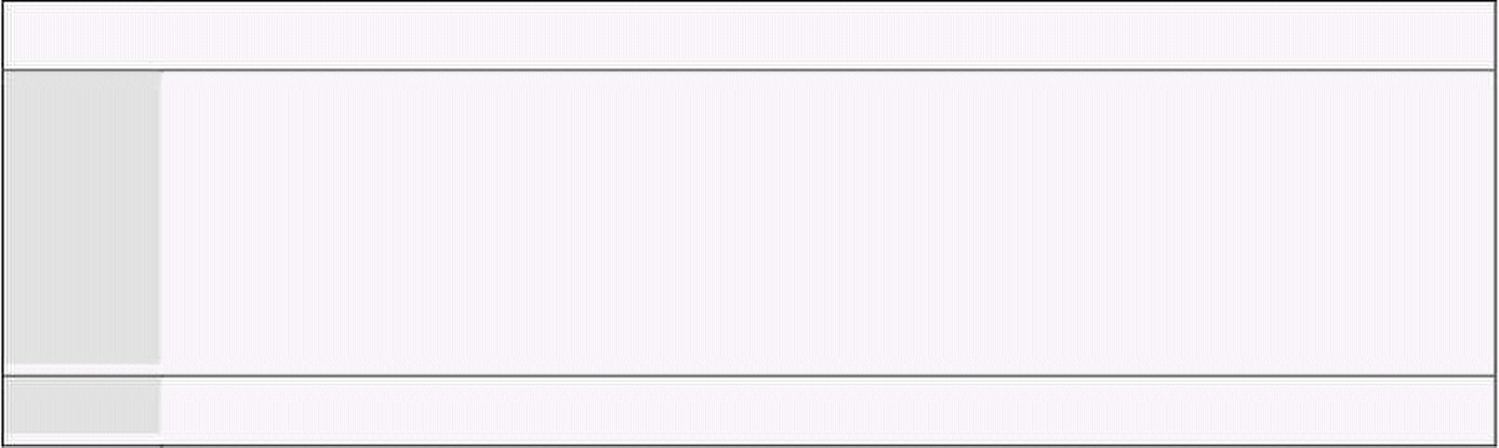
Computer Architecture & Assembly Language Programming Course Code: CS401
CS401@vu.edu.pk
I/O ports designated to it, PIC has others, DMA, sound card, network card,
each has some ports.
If the two address spaces are differentiated in hardware, they must also
have special instructions to select the other address space. We have the IN
and OUT instructions to read or write from the peripheral address space.
When MOV is given the processor selects the memory address space, when
IN is given the processor selects the peripheral address space.
IN and OUT instructions
The IN and OUT instructions have a byte form and a word form but the
byte form is almost always used. The source register in OUT and destination
register in IN is AL or AX depending on which form is used. The port number
can be directly given in the instruction if it fits in a byte otherwise it has to
be given in the DX register. Port numbers for specific devices are fixed by the
IBM standard. For example 20 and 21 are for PIC, 60 to 64 for Keyboard, 378
for the parallel port etc. A few example of IN and OUT are below:
in al, 0x21
mov dx, 0x378
in al, dx
out 0x21, al
mov dx, 0x378
out dx, al
PIC Ports
Programmable interrupt controller has two ports 20 and 21. Port 20 is the
control port while port 21 is the interrupt mask register which can be used
for selectively enabling or disabling interrupts. Each of the bits at port 21
corresponds to one of the IRQ lines. We first write a small program to disable
the keyboard using this port. As we know that the keyboard IRQ is 1, we
place a 1 bit at its corresponding position. A 0 bit will enable an interrupt
and a 1 bit disables it. As soon as we write it on the port keyboard interrupts
will stop arriving and the keyboard will effectively be disabled. Even Ctrl-Alt-
Del would not work; the reset power button has to be used.
Example 9.1
001 ; disable keyboard interrupt in PIC mask register
002 [org 0x0100]
003 in al, 0x21 ; read interrupt mask register
004 or al, 2 ; set bit for IRQ2
005 out 0x21, al ; write back mask register
006
007 mov ax, 0x4c00 ; terminate program
008 int 0x21
After this three line mini program is executed the computer will not
understand anything else. Its ears are closed. No keystrokes are making their
way to the processor. Ports always make something happen on the system. A
properly designed system can launch a missile on writing a bit on some port.
Memory is simple in that it is all that it is. In ports every bit has a meaning
that changes something in the system.
As we previously discussed every interrupt handler invoked because
of an IRQ must signal an EOI otherwise lower priority interrupts will
remain disabled.
Keyboard Controller
We will go in further details of the keyboard and its relation to the
computer. We will not discuss how the keyboard communicates with the
keyboard controller in the computer rather we will discuss how the keyboard
Virtual University of Pakistan 107

Slide 116

Computer Architecture & Assembly Language Programming Course Code: CS401
CS401@vu.edu.pk
controller communicates with the processor. Keyboard is a collection of
labeled buttons and every button is designated a number (not the ASCII
code). This number is sent to the processor whenever the key is pressed.
From this number called the scan code the processor understands which key
was pressed. For each key the scan code comes twice, once for the key press
and once for the key release. Both are scan codes and differ in one bit only.
The lower seven bits contain the key number while the most significant bit is
clear in the press code and set in the release code. The IBM PC standard
gives a table of the scan codes of all keys.
If we press Shift-A resulting in a capital A on the screen, the controller has
sent the press code of Shift, the press code of A, the release code of A, the
release code of Shift and the interrupt handler has understood that this
sequence should result in the ASCII code of ‘A’. The ‘A’ key always produces
the same scan code whether or not shift is pressed. It is the interrupt
handler’s job to remember that the press code of Shift has come and release
code has not yet come and therefore to change the meaning of the following
key presses. Even the caps lock key works the same way.
An interesting thing is that the two shift keys on the left and right side of
the keyboard produce different scan codes. The standard way implemented
in BIOS is to treat that similarly. That’s why we always think of them as
identical. If we leave BIOS and talk directly with the hardware we can
differentiate between left and right shift keys with their scan code. Now this
scan code is available from the keyboard data port which is 60. The keyboard
generates IRQ 1 whenever a key is pressed so if we hook INT 9 and inside it
read port 60 we can tell which of the shift keys was hit. Our first program
will do precisely this. It will output an L if the left shift key was pressed and
R if the right one was pressed. The hooking method is the same as done in
the previous chapter.
Example 9.2
001 ; differentiate left and right shift keys with scancodes
002 [org 0x0100]
003 jmp start
004
005 ; keyboard interrupt service routine
006 kbisr: push ax
007 push es
008
009 mov ax, 0xb800
010 mov es, ax ; point es to video memory
011
012 in al, 0x60 ; read a char from keyboard port
013 cmp al, 0x2a ; is the key left shift
014 jne nextcmp ; no, try next comparison
015
016 mov byte [es:0], 'L' ; yes, print L at top left
017 jmp nomatch ; leave interrupt routine
018
019 nextcmp: cmp al, 0x36 ; is the key right shift
020 jne nomatch ; no, leave interrupt routine
021
022 mov byte [es:0], 'R' ; yes, print R at top left
023
024 nomatch: mov al, 0x20
025 out 0x20, al ; send EOI to PIC
026
027 pop es
028 pop ax
029 iret
030
031 start: xor ax, ax
032 mov es, ax ; point es to IVT base
033 cli ; disable interrupts
034 mov word [es:9*4], kbisr ; store offset at n*4
035 mov [es:9*4+2], cs ; store segment at n*4+2
036 sti ; enable interrupts
Virtual University of Pakistan 108

Slide 117


Computer Architecture & Assembly Language Programming Course Code: CS401
CS401@vu.edu.pk
037
038 l1: jmp l1 ; infinite loop
033-036 CLI clears the interrupt flag to disable the interrupt system
completely. The processor closes its ears and does not care about
the state of the INT pin. Interrupt hooking is done in two
instructions, placing the segment and placing the offset. If an
interrupt comes in between and the vector is in an indeterminate
state, the system will go to a junk address and eventually crash. So
we stop all interruptions while changing a real time interrupt vector.
We set the interrupt flag afterwards to renewable interrupts.
038 The program hangs in an infinite loop. The only activity can be
caused by a real time interrupt. The kbisr routine is not called from
anywhere; it is only automatically invoked as a result of IRQ 1.
When the program is executed the left and right shift keys can be
distinguished with the L or R on the screen. As no action was taken for the
rest of the keys, they are effectively disabled and the computer has to be
rebooted. To check that the keyboard is actually disabled we change the
program and add the INT 16 service 0 at the end to wait for an Esc key press.
As soon as Esc is pressed we want to terminate our program.
Example 9.3
001 ; attempt to terminate program with Esc that hooks keyboard interrupt
002 [org 0x0100]
003 jmp start
004
005-029 ;;;;; COPY LINES 005-029 FROM EXAMPLE 9.2 (kbisr) ;;;;;
030
031 start: xor ax, ax
032 mov es, ax ; point es to IVT base
033 cli ; disable interrupts
034 mov word [es:9*4], kbisr ; store offset at n*4
035 mov [es:9*4+2], cs ; store segment at n*4+2
036 sti ; enable interrupts
037
038 l1: mov ah, 0 ; service 0 – get keystroke
039 int 0x16 ; call BIOS keyboard service
040
041 cmp al, 27 ; is the Esc key pressed
042 jne l1 ; if no, check for next key
043
044 mov ax, 0x4c00 ; terminate program
045 int 0x21
When the program is executed the behavior is same. Esc does not work.
This is because the original IRQ 1 handler was written by BIOS that read the
scan code, converted into an ASCII code and stored in the keyboard buffer.
The BIOS INT 16 read the key from there and gives in AL. When we hooked
the keyboard interrupt BIOS is no longer in control, it has no information, it
will always see the empty buffer and INT 16 will never return.
Interrupt Chaining
We can transfer control to the original BIOS ISR in the end of our routine.
This way the normal functioning of INT 16 can work as well. We can retrieve
the address of the BIOS routine by saving the values in vector 9 before
hooking our routine. In the end of our routine we will jump to this address
using a special indirect form of the JMP FAR instruction.
Example 9.4
Virtual University of Pakistan 109

Slide 118

Computer Architecture & Assembly Language Programming Course Code: CS401
CS401@vu.edu.pk
001 ; another attempt to terminate program with Esc that hooks
002 ; keyboard interrupt
003 [org 0x100]
004 jmp start
005
006 oldisr: dd 0 ; space for saving old isr
007
008 ; keyboard interrupt service routine
009 kbisr: push ax
010 push es
011
012 mov ax, 0xb800
013 mov es, ax ; point es to video memory
014
015 in al, 0x60 ; read a char from keyboard port
016 cmp al, 0x2a ; is the key left shift
017 jne nextcmp ; no, try next comparison
018
019 mov byte [es:0], 'L' ; yes, print L at top left
020 jmp nomatch ; leave interrupt routine
021
022 nextcmp: cmp al, 0x36 ; is the key right shift
023 jne nomatch ; no, leave interrupt routine
024
025 mov byte [es:0], 'R' ; yes, print R at top left
026
027 nomatch: ; mov al, 0x20
028 ; out 0x20, al
029
030 pop es
031 pop ax
032 jmp far [cs:oldisr] ; call the original ISR
033 ; iret
034
035 start: xor ax, ax
036 mov es, ax ; point es to IVT base
037 mov ax, [es:9*4]
038 mov [oldisr], ax ; save offset of old routine
039 mov ax, [es:9*4+2]
040 mov [oldisr+2], ax ; save segment of old routine
041 cli ; disable interrupts
042 mov word [es:9*4], kbisr ; store offset at n*4
043 mov [es:9*4+2], cs ; store segment at n*4+2
044 sti ; enable interrupts
045
046 l1: mov ah, 0 ; service 0 – get keystroke
047 int 0x16 ; call BIOS keyboard service
048
049 cmp al, 27 ; is the Esc key pressed
050 jne l1 ; if no, check for next key
051
052 mov ax, 0x4c00 ; terminate program
053 int 0x21
027-028 EOI is no longer needed as the original BIOS routine will have it at
its end.
033 IRET has been removed and an unconditional jump is introduced. At
time of JMP the stack has the exact formation as was when the
interrupt came. So the original BIOS routine’s IRET will take control
to the interrupted program. We have been careful in restoring every
register we modified and retained the stack in the same form as it
was at the time of entry into the routine.
When the program is executed L and R are printed as desired and Esc
terminates the program as well. Normal commands like DIR work now and
shift keys still show L and R as our routine did even after the termination of
our program. Now start some application like the editor, it open well but as
soon as a key is pressed the computer crashes.
Actually our hooking and chaining was fine. When Esc was pressed we
signaled DOS that our program has terminated. DOS will take all our
Virtual University of Pakistan 110

Slide 119


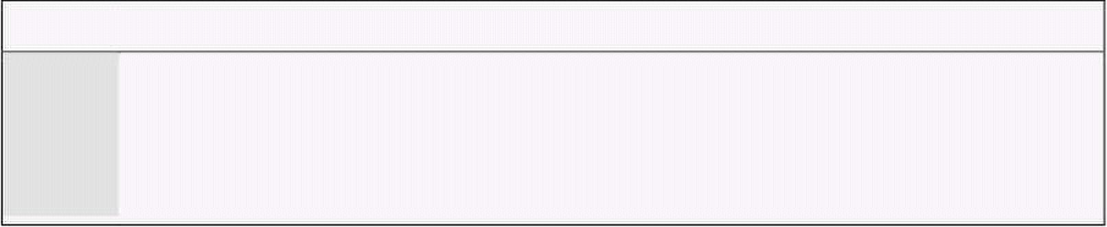
Computer Architecture & Assembly Language Programming Course Code: CS401
CS401@vu.edu.pk
memory as a result. The routine is still in memory and functioning but the
memory is free according to DOS. As soon as we load EDIT the same memory
is allocated to EDIT and our routine as overwritten. Now when a key is
pressed our routine’s address is in the vector but at that address some new
code is placed that is not intended to be an interrupt handler. That may be
data or some part of the EDIT program. This results in crashing the
computer.
Unhooking Interrupt
We now add the interrupt restoring part to our program. This code resets
the interrupt vector to the value it had before the start of our program.
Example 9.5
001 ; terminate program with Esc that hooks keyboard interrupt
002 [org 0x100]
003 jmp start
004
005 oldisr: dd 0 ; space for saving old isr
006
007-032 ;;;;; COPY LINES 005-029 FROM EXAMPLE 9.4 (kbisr) ;;;;;
033
034 start: xor ax, ax
035 mov es, ax ; point es to IVT base
036 mov ax, [es:9*4]
037 mov [oldisr], ax ; save offset of old routine
038 mov ax, [es:9*4+2]
039 mov [oldisr+2], ax ; save segment of old routine
040 cli ; disable interrupts
041 mov word [es:9*4], kbisr ; store offset at n*4
042 mov [es:9*4+2], cs ; store segment at n*4+2
043 sti ; enable interrupts
044
045 l1: mov ah, 0 ; service 0 – get keystroke
046 int 0x16 ; call BIOS keyboard service
047
048 cmp al, 27 ; is the Esc key pressed
049 jne l1 ; if no, check for next key
050
051 mov ax, [oldisr] ; read old offset in ax
052 mov bx, [oldisr+2] ; read old segment in bx
053 cli ; disable interrupts
054 mov [es:9*4], ax ; restore old offset from ax
055 mov [es:9*4+2], bx ; restore old segment from bx
056 sti ; enable interrupts
057
058 mov ax, 0x4c00 ; terminate program
059 int 0x21
9.3. TERMINATE AND STAY RESIDENT
We change the display to show L only while the left shift is pressed and R
only while the right shift is pressed to show the use of the release codes. We
also changed that shift keys are not forwarded to BIOS. The effect will be
visible with A and Shift-A both producing small ‘a’ but caps lock will work.
There is one major difference from all the programs we have been writing
till now. The termination is done using INT 21 service 31 instead of INT 21
service 4C. The effect is that even after termination the program is there and
is legally there.
Example 9.6
001 ; TSR to show status of shift keys on top left of screen
002 [org 0x0100]
003 jmp start
004
005 oldisr: dd 0 ; space for saving old isr
006
Virtual University of Pakistan 111

Slide 120

Computer Architecture & Assembly Language Programming Course Code: CS401
CS401@vu.edu.pk
007 ; keyboard interrupt service routine
008 kbisr: push ax
009 push es
010
011 mov ax, 0xb800
012 mov es, ax ; point es to video memory
013
014 in al, 0x60 ; read a char from keyboard port
015 cmp al, 0x2a ; has the left shift pressed
016 jne nextcmp ; no, try next comparison
017
018 mov byte [es:0], 'L' ; yes, print L at first column
019 jmp exit ; leave interrupt routine
020
021 nextcmp: cmp al, 0x36 ; has the right shift pressed
022 jne nextcmp2 ; no, try next comparison
023
024 mov byte [es:0], 'R' ; yes, print R at second column
025 jmp exit ; leave interrupt routine
026
027 nextcmp2: cmp al, 0xaa ; has the left shift released
028 jne nextcmp3 ; no, try next comparison
029
030 mov byte [es:0], ' ' ; yes, clear the first column
031 jmp exit ; leave interrupt routine
032
033 nextcmp3: cmp al, 0xb6 ; has the right shift released
034 jne nomatch ; no, chain to old ISR
035
036 mov byte [es:2], ' ' ; yes, clear the second column
037 jmp exit ; leave interrupt routine
038
039 nomatch: pop es
040 pop ax
041 jmp far [cs:oldisr] ; call the original ISR
042
043 exit: mov al, 0x20
044 out 0x20, al ; send EOI to PIC
045
046 pop es
047 pop ax
048 iret ; return from interrupt
049
050 start: xor ax, ax
051 mov es, ax ; point es to IVT base
052 mov ax, [es:9*4]
053 mov [oldisr], ax ; save offset of old routine
054 mov ax, [es:9*4+2]
055 mov [oldisr+2], ax ; save segment of old routine
056 cli ; disable interrupts
057 mov word [es:9*4], kbisr ; store offset at n*4
058 mov [es:9*4+2], cs ; store segment at n*4+2
059 sti ; enable interrupts
060
061 mov dx, start ; end of resident portion
062 add dx, 15 ; round up to next para
063 mov cl, 4
064 shr dx, cl ; number of paras
065 mov ax, 0x3100 ; terminate and stay resident
066 int 0x21
When this program is executed the command prompt immediately comes.
DIR can be seen. EDIT can run and keypresses do not result in a crash. And
with all that left and right shift keys shown L and R on top left of the screen
while they are pressed but the shift keys do not work as usual since we did
not forwarded the key to BIOS. This is selective chaining.
Virtual University of Pakistan 112

Slide 121


Computer Architecture & Assembly Language Programming Course Code: CS401
CS401@vu.edu.pk
To understand Terminate
and
formation and allocation
procedure must be
understood. At physical
address zero is the interrupt
vector table. Above it are the
BIOS data area, DOS data
area, IO.SYS, MSDOS.SYS and
other device drivers. In the end
there is COMMAND.COM
command interpreter. The
remaining space is called the
transient program area as
programs are loaded and
executed in this area and the
space reclaimed on their exit.
A freemem pointer in DOS
points where the free memory
begins. When DOS loads a
program the freemem pointer is moved to the end of memory, all the
available space is allocated to it, and when it exits the freemem pointer
comes back to its original place thereby reclaiming all space. This action is
initiated by the DOS service 4C.
The second method to legally terminate a program and give control back to
DOS is using the service 31. Control is still taken back but the memory
releasing part is modified. A portion of the allocated memory can be retained.
So the difference in the two methods is that the freemem pointer goes back to
the original place or a designated number of bytes ahead of that old position.
Remember that our program crashed because the interrupt routine was
overwritten. If we can tell DOS not to reclaim the memory of the interrupt
routine, then it will not crash. In the last program we have told DOS to make
a number of bytes resident. It becomes a part of the operation system, an
extension to it. Just like DOSKEY§ is an extension to the operation system.
The number of paragraphs to reserve is given in the DX register. Paragraph
is a unit just like byte, word, and double word. A paragraph is 16 bytes.
Therefore we can reserve in multiple of 16 bytes. We write TSRs in such a
way that the initialization code and data is located at the end as it is not
necessary to make it resident and therefore to save space.
To calculate the number of paragraphs a label is placed after the last line
that is to be made resident. The value of that label is the number of bytes
needed to be made resident. A simple division by 16 will not give the correct
number of paras as we want our answer to be rounded up and not down. For
example 100 bytes should need 7 pages but division gives 6 and a remainder
of 4. A standard technique to get rounded up integer division is to add
divisor-1 to the dividend and then divide. So we add 15 to the number of
bytes and then divide by 16. We use shifting for division as the divisor is a
power of 2. We use a form of SHR that places the count in the CL register so
that we can shift by 4 in just two instructions instead of 4 if we shift one by
one.
In our program anything after start label is not needed after the program
has become a TSR. We can observe that our program has become a part of
DOS by giving the following command.
mem /c
§ DOSKEY is a TSR that shows the previous commands on the command
prompt with up and down arrows and allows editing of the command
Virtual University of Pakistan 113
0
IVT
programs the DOS memory
BIOS Data Area, DOS Data
Area, IO.SYS, MSDOS.SYS,
Device Drivers
COMMAND.COM
Transient Program Area (TPA)
640K

Slide 122


Computer Architecture & Assembly Language Programming Course Code: CS401
CS401@vu.edu.pk
This command displays all currently loaded drivers and the current state
of memory. We will be able to see our program in the list of DOS drivers.
9.4. PROGRAMMABLE INTERVAL TIMER
Another very important peripheral device is the Programmable Interval
Timer (PIT), the chip numbered 8254. This chip has a precise input
frequency of 1.19318 MHz. This frequency is fixed regardless of the processor
clock. Inside the chip is a 16bit divisor which divides this input frequency
and the output is connected to the IRQ 0 line of the PIC. The special number
0 if placed in the divisor means a divisor of 65536 and not 0. The standard
divisor is 0 unless we change it. Therefore by default IRQ 0 is generated
1193180/65536=18.2 times per second. This is called the timer tick. There is
an interval of about 55ms between two timer ticks. The system time is
maintained with the timer interrupt. This is the highest priority interrupt
and breaks whatever is executing. Time can be maintained with this
interrupt as this frequency is very precise and is part of the IBM standard.
When writing a TSR we give control back to DOS so TSR activation,
reactivation and action is solely interrupt based, whether this is a hardware
interrupt or a software one. Control is never given back; it must be caught,
just like we caught control by hooking the keyboard interrupt. Our next
example will hook the timer interrupt and display a tick count on the screen.
Example 9.7
001 ; display a tick count on the top right of screen
002 [org 0x0100]
003 jmp start
004
005 tickcount: dw 0
006
007 ; subroutine to print a number at top left of screen
008 ; takes the number to be printed as its parameter
009 printnum: push bp
010 mov bp, sp
011 push es
012 push ax
013 push bx
014 push cx
015 push dx
016 push di
017
018 mov ax, 0xb800
019 mov es, ax ; point es to video base
020 mov ax, [bp+4] ; load number in ax
021 mov bx, 10 ; use base 10 for division
022 mov cx, 0 ; initialize count of digits
023
024 nextdigit: mov dx, 0 ; zero upper half of dividend
025 div bx ; divide by 10
026 add dl, 0x30 ; convert digit into ascii value
027 push dx ; save ascii value on stack
028 inc cx ; increment count of values
029 cmp ax, 0 ; is the quotient zero
030 jnz nextdigit ; if no divide it again
031
032 mov di, 140 ; point di to 70th column
033
034 nextpos: pop dx ; remove a digit from the stack
035 mov dh, 0x07 ; use normal attribute
036 mov [es:di], dx ; print char on screen
037 add di, 2 ; move to next screen location
038 loop nextpos ; repeat for all digits on stack
039
040 pop di
041 pop dx
042 pop cx
043 pop bx
044 pop ax
Virtual University of Pakistan 114

Slide 123


Computer Architecture & Assembly Language Programming Course Code: CS401
CS401@vu.edu.pk
045 pop es
046 pop bp
047 ret 2
048
049 ; timer interrupt service routine
050 timer: push ax
051
052 inc word [cs:tickcount]; increment tick count
053 push word [cs:tickcount]
054 call printnum ; print tick count
055
056 mov al, 0x20
057 out 0x20, al ; end of interrupt
058
059 pop ax
060 iret ; return from interrupt
061
062 start: xor ax, ax
063 mov es, ax ; point es to IVT base
064 cli ; disable interrupts
065 mov word [es:8*4], timer; store offset at n*4
066 mov [es:8*4+2], cs ; store segment at n*4+2
067 sti ; enable interrupts
068
069 mov dx, start ; end of resident portion
070 add dx, 15 ; round up to next para
071 mov cl, 4
072 shr dx, cl ; number of paras
073 mov ax, 0x3100 ; terminate and stay resident
074 int 0x21
When we execute the program the counter starts on the screen. Whatever
we do, take directory, open EDIT, the debugger etc. the counter remains
running on the screen. No one is giving control to the program; the program
is getting executed as a result of timer generating INT 8 after every 55ms.
Our next example will hook both the keyboard and timer interrupts. When
the shift key is pressed the tick count starts incrementing and as soon as the
shift key is released the tick count stops. Both interrupt handlers are
communicating through a common variable. The keyboard interrupt sets this
variable while the timer interrupts modifies its behavior according to this
variable.
Example 9.8
001 ; display a tick count while the left shift key is down
002 [org 0x0100]
003 jmp start
004
005 seconds: dw 0
006 timerflag: dw 0
007 oldkb: dd 0
008
009-049 ;;;;; COPY LINES 007-047 FROM EXAMPLE 9.7 (printnum) ;;;;;
050
051 ; keyboard interrupt service routine
052 kbisr: push ax
053
054 in al, 0x60 ; read char from keyboard port
055 cmp al, 0x2a ; has the left shift pressed
056 jne nextcmp ; no, try next comparison
057
058 cmp word [cs:timerflag], 1; is the flag already set
059 je exit ; yes, leave the ISR
060
061 mov word [cs:timerflag], 1; set flag to start printing
062 jmp exit ; leave the ISR
063
064 nextcmp: cmp al, 0xaa ; has the left shift released
065 jne nomatch ; no, chain to old ISR
066
067 mov word [cs:timerflag], 0; reset flag to stop printing
Virtual University of Pakistan 115

Slide 124


Computer Architecture & Assembly Language Programming Course Code: CS401
CS401@vu.edu.pk
068 jmp exit ; leave the interrupt routine
069
070 nomatch: pop ax
071 jmp far [cs:oldkb] ; call original ISR
072
073 exit: mov al, 0x20
074 out 0x20, al ; send EOI to PIC
075
076 pop ax
077 iret ; return from interrupt
078
079 ; timer interrupt service routine
080 timer: push ax
081
082 cmp word [cs:timerflag], 1 ; is the printing flag set
083 jne skipall ; no, leave the ISR
084
085 inc word [cs:seconds] ; increment tick count
086 push word [cs:seconds]
087 call printnum ; print tick count
088
089 skipall: mov al, 0x20
090 out 0x20, al ; send EOI to PIC
091
092 pop ax
093 iret ; return from interrupt
094
095 start: xor ax, ax
096 mov es, ax ; point es to IVT base
097 mov ax, [es:9*4]
098 mov [oldkb], ax ; save offset of old routine
099 mov ax, [es:9*4+2]
100 mov [oldkb+2], ax ; save segment of old routine
101 cli ; disable interrupts
102 mov word [es:9*4], kbisr ; store offset at n*4
103 mov [es:9*4+2], cs ; store segment at n*4+2
104 mov word [es:8*4], timer ; store offset at n*4
105 mov [es:8*4+2], cs ; store segment at n*4+
106 sti ; enable interrupts
107
108 mov dx, start ; end of resident portion
109 add dx, 15 ; round up to next para
110 mov cl, 4
111 shr dx, cl ; number of paras
112 mov ax, 0x3100 ; terminate and stay resident
113 int 0x21
006 This flag is one when the timer interrupt should increment and zero
when it should not.
058-059 As the keyboard controller repeatedly generates the press code if the
release code does not come in a specified time, we have placed a
check to not repeatedly set it to one.
058 Another way to access TSR data is using the CS override instead of
initializing DS. It is common mistake not to initialize DS and also
not put in CS override in a real time interrupt handler.
When we execute the program and the shift key is pressed, the counter
starts incrementing. When the key is released the counter stops. When it is
pressed again the counter resumes counting. As this is made as a TSR any
other program can be loaded and will work properly alongside the TSR.
9.5. PARALLEL PORT
Computers can control external hardware through various external ports
like the parallel port, the serial port, and the new additions USB and
FireWire. Using this, computers can be used to control almost anything. For
our examples we will use the parallel port. The parallel port has two views,
the connector that the external world sees and the parallel port controller
Virtual University of Pakistan 116

Slide 125

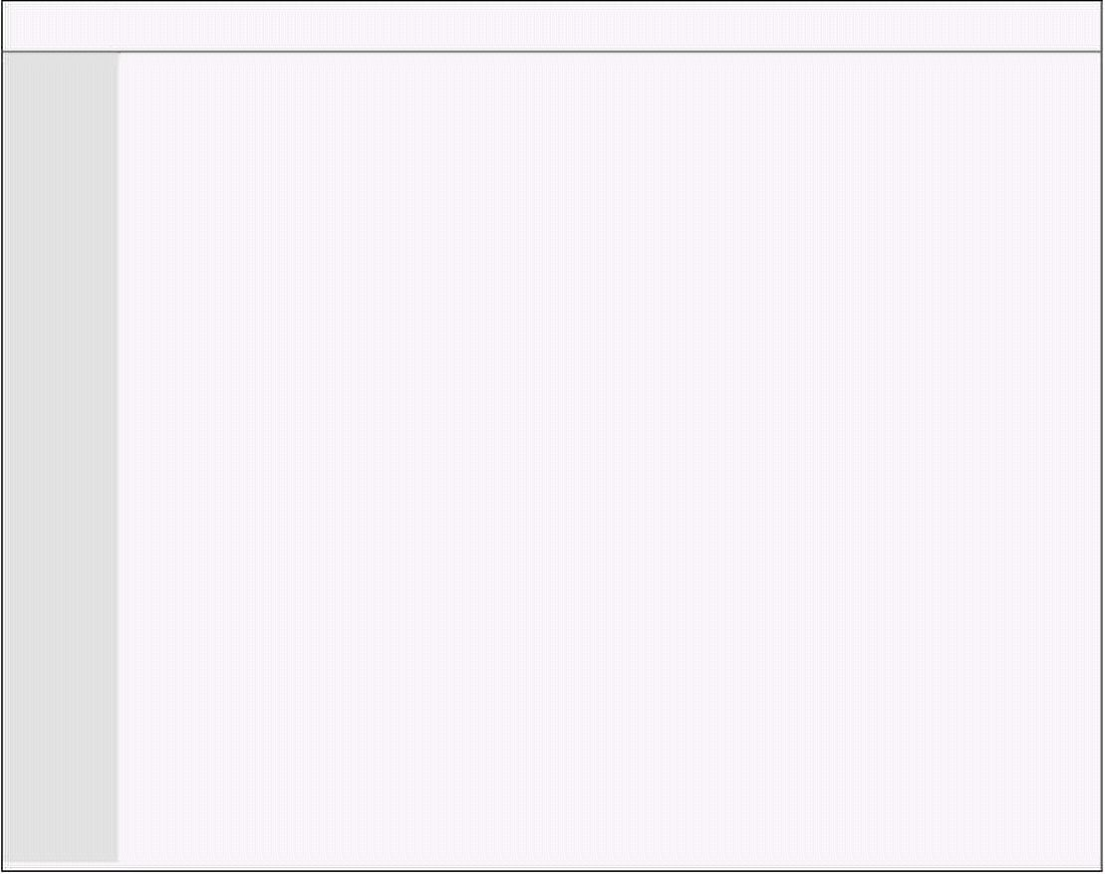
Computer Architecture & Assembly Language Programming Course Code: CS401
CS401@vu.edu.pk
ports through which the processor communicates with the device connected
to the parallel port.
The parallel port connector is a 25pin connector called DB-25. Different
pins of this connector have different meanings. Some are meaningful only
with the printer**. This is a bidirectional port so there are some pins to take
data from the processor to the parallel port and others to take data from the
parallel port to the processor. Important pins for our use are the data pins
from pin 2 to pin 9 that take data from the processor to the device. Pin 10,
the ACK pin, is normally used by the printer to acknowledge the receipt of
data and show the willingness to receive more data. Signaling this pin
generates IRQ 7 if enabled in the PIC and in the parallel port controller. Pin
18-25 are ground and must be connected to the external circuit ground to
provide the common reference point otherwise they won’t understand each
other voltage levels. Like the datum point in a graph this is the datum point
of an electrical circuit. The remaining pins are not of our concern in these
examples.
This is the external view of the parallel port. The processor cannot see
these pins. The processor uses the I/O ports of the parallel port controller.
The first parallel port LPT1†† has ports designated from 378 to 37A. The first
port 378 is the data port. If we use the OUT instruction on this port, 1 bits
result in a 5V signal on the corresponding pin and a 0 bits result in a 0V
signal on the corresponding pin.
Port 37A is the control port. Our interest is with bit 4 of this port which
enables the IRQ 7 triggering by the ACK pin. We have attached a circuit that
connects 8 LEDs with the parallel port pins. The following examples sends
the scancode of the key pressed to the parallel port so that it is visible on
LEDs.
Example 9.9
001 ; show scancode on external LEDs connected through parallel port
002 [org 0x0100]
003 jmp start
004
005 oldisr: dd 0 ; space for saving old ISR
006
007 ; keyboard interrupt service routine
008 kbisr: push ax
009 push dx
010
011 in al, 0x60 ; read char from keyboard port
012 mov dx, 0x378
013 out dx, al ; write char to parallel port
014
015 pop ax
016 pop dx
017 jmp far [cs:oldisr] ; call original ISR
018
019 start: xor ax, ax
020 mov es, ax ; point es to IVT base
021 mov ax, [es:9*4]
022 mov [oldisr], ax ; save offset of old routine
023 mov ax, [es:9*4+2]
024 mov [oldisr+2], ax ; save segment of old routine
025 cli ; disable interrupts
026 mov word [es:9*4], kbisr ; store offset at n*4
027 mov [es:9*4+2], cs ; store segment at n*4+2
028 sti ; enable interrupts
029
030 mov dx, start ; end of resident portion
031 add dx, 15 ; round up to next para
** The parallel port is most commonly used with the printer. However some
new printers have started using the USB port.
†† Older computer had more than one parallel port named LPT2 and having
ports from 278-27A.
Virtual University of Pakistan 117

Slide 126


Computer Architecture & Assembly Language Programming Course Code: CS401
CS401@vu.edu.pk
032 mov cl, 4
033 shr dx, cl ; number of paras
034 mov ax, 0x3100 ; terminate and stay resident
035 int 0x21
The following example uses the same LED circuit and sends data such that
LEDs switch on and off turn by turn so that it looks like light is moving back
and forth.
Example 9.10
001 ; show lights moving back and forth on external LEDs
002 [org 0x0100]
003 jmp start
004
005 signal: db 1 ; current state of lights
006 direction: db 0 ; current direction of motion
007
008 ; timer interrupt service routine
009 timer: push ax
010 push dx
011 push ds
012
013 push cs
014 pop ds ; initialize ds to data segment
015
016 cmp byte [direction], 1; are moving in right direction
017 je moveright ; yes, go to shift right code
018
019 shl byte [signal], 1 ; shift left state of lights
020 jnc output ; no jump to change direction
021
022 mov byte [direction], 1; change direction to right
023 mov byte [signal], 0x80; turn on left most light
024 jmp output ; proceed to send signal
025
026 moveright: shr byte [signal], 1 ; shift right state of lights
027 jnc output ; no jump to change direction
028
029 mov byte [direction], 0; change direction to left
030 mov byte [signal], 1 ; turn on right most light
031
032 output: mov al, [signal] ; load lights state in al
033 mov dx, 0x378 ; parallel port data port
034 out dx, al ; send light state of port
035
036 mov al, 0x20
037 out 0x20, al ; send EOI on PIC
038
039 pop ds
040 pop dx
041 pop ax
042 iret ; return from interrupt
043
044 start: xor ax, ax
045 mov es, ax ; point es to IVT base
046 cli ; disable interrupts
047 mov word [es:8*4], timer ; store offset at n*4
048 mov [es:8*4+2], cs ; store segment at n*4+2
049 sti ; enable interrupts
050
051 mov dx, start ; end of resident portion
052 add dx, 15 ; round up to next para
053 mov cl, 4
054 shr dx, cl ; number of paras
055 mov ax, 0x3100 ; terminate and stay resident
056 int 0x21
We will now use the parallel port to control a slightly complicated circuit.
This time we will also use the parallel port interrupt. We are using a 220 V
bulb with AC input. AC current is 50Hz sine wave. We have made our circuit
such that it triggers the parallel port interrupt whenever the since wave
Virtual University of Pakistan 118

Slide 127

Computer Architecture & Assembly Language Programming Course Code: CS401
CS401@vu.edu.pk
crosses zero. We have control of passing the AC current to the bulb. We
control it such that in every cycle only a fixed percentage of time the current
passes on to the bulb. Using this we can control the intensity or glow of the
bulb.
Our first example will slowly turn on the bulb by increasing the power
provided using the mechanism just described.
Example 9.11
001 ; slowly turn on a bulb by gradually increasing the power provided
002 [org 0x0100]
003 jmp start
004
005 flag: db 0 ; next time turn on or turn off
006 stop: db 0 ; flag to terminate the program
007 divider: dw 11000 ; divider for minimum intensity
008 oldtimer: dd 0 ; space for saving old isr
009
010 ; timer interrupt service routine
011 timer: push ax
012 push dx
013
014 cmp byte [cs:flag], 0 ; are we here to turn off
015 je switchoff ; yes, go to turn off code
016
017 switchon: mov al, 1
018 mov dx, 0x378
019 out dx, al ; no, turn the bulb on
020
021 mov ax, 0x0100
022 out 0x40, al ; set timer divisor LSB to 0
023 mov al, ah
024 out 0x40, al ; set timer divisor MSB to 1
025 mov byte [cs:flag], 0 ; flag next timer to switch off
026 jmp exit ; leave the interrupt routine
027
028 switchoff: xor ax, ax
029 mov dx, 0x378
030 out dx, al ; turn the bulb off
031
032 exit: mov al, 0x20
033 out 0x20, al ; send EOI to PIC
034
035 pop dx
036 pop ax
037 iret ; return from interrupt
038
039 ; parallel port interrupt service routine
040 parallel: push ax
041
042 mov al, 0x30 ; set timer to one shot mode
043 out 0x43, al
044
045 cmp word [cs:divider], 100; is the current divisor 100
046 je stopit ; yes, stop
047
048 sub word [cs:divider], 10; decrease the divisor by 10
049 mov ax, [cs:divider]
050 out 0x40, al ; load divisor LSB in timer
051 mov al, ah
052 out 0x40, al ; load divisor MSB in timer
053 mov byte [cs:flag], 1 ; flag next timer to switch on
054
055 mov al, 0x20
056 out 0x20, al ; send EOI to PIC
057 pop ax
058 iret ; return from interrupt
059
060 stopit: mov byte [stop], 1 ; flag to terminate the program
061 mov al, 0x20
062 out 0x20, al ; send EOI to PIC
063 pop ax
064 iret ; return from interrupt
065
Virtual University of Pakistan 119

Slide 128


Computer Architecture & Assembly Language Programming Course Code: CS401
CS401@vu.edu.pk
066 start: xor ax, ax
067 mov es, ax ; point es to IVT base
068 mov ax, [es:0x08*4]
069 mov [oldtimer], ax ; save offset of old routine
070 mov ax, [es:0x08*4+2]
071 mov [oldtimer+2], ax ; save segment of old routine
072 cli ; disable interrupts
073 mov word [es:0x08*4], timer ; store offset at n*4
074 mov [es:0x08*4+2], cs ; store segment at n*4+2
075 mov word [es:0x0F*4], parallel ; store offset at n*4
076 mov [es:0x0F*4+2], cs ; store segment at n*4+2
077 sti ; enable interrupts
078
079 mov dx, 0x37A
080 in al, dx ; parallel port control register
081 or al, 0x10 ; turn interrupt enable bit on
082 out dx, al ; write back register
083
084 in al, 0x21 ; read interrupt mask register
085 and al, 0x7F ; enable IRQ7 for parallel port
086 out 0x21, al ; write back register
087
088 recheck: cmp byte [stop], 1 ; is the termination flag set
089 jne recheck ; no, check again
090
091 mov dx, 0x37A
092 in al, dx ; parallel port control register
093 and al, 0xEF ; turn interrupt enable bit off
094 out dx, al ; write back register
095
096 in al, 0x21 ; read interrupt mask register
097 or al, 0x80 ; disable IRQ7 for parallel port
098 out 0x21, al ; write back regsiter
099
100 cli ; disable interrupts
101 mov ax, [oldtimer] ; read old timer ISR offset
102 mov [es:0x08*4], ax ; restore old timer ISR offset
103 mov ax, [oldtimer+2] ; read old timer ISR segment
104 mov [es:0x08*4+2], ax ; restore old timer ISR segment
105 sti ; enable interrupts
106
107 mov ax, 0x4c00 ; terminate program
108 int 0x21
The next example is simply the opposite of the previous. It slowly turns the
bulb off from maximum glow to no glow.
Example 9.12
001 ; slowly turn off a bulb by gradually decreasing the power provided
002 [org 0x0100]
003 jmp start
004
005 flag: db 0 ; next time turn on or turn off
006 stop: db 0 ; flag to terminate the program
007 divider: dw 0 ; divider for maximum intensity
008 oldtimer: dd 0 ; space for saving old isr
009
010-037 ;;;;; COPY LINES 009-036 FROM EXAMPLE 9.11 (timer) ;;;;;
038
039 ; parallel port interrupt service routine
040 parallel: push ax
041
042 mov al, 0x30 ; set timer to one shot mode
043 out 0x43, al
044
045 cmp word [cs:divider], 11000; current divisor is 11000
046 je stopit ; yes, stop
047
048 add word [cs:divider], 10; increase the divisor by 10
049 mov ax, [cs:divider]
050 out 0x40, al ; load divisor LSB in timer
051 mov al, ah
052 out 0x40, al ; load divisor MSB in timer
Virtual University of Pakistan 120

Slide 129


Computer Architecture & Assembly Language Programming Course Code: CS401
CS401@vu.edu.pk
053 mov byte [cs:flag], 1 ; flag next timer to switch on
054
055 mov al, 0x20
056 out 0x20, al ; send EOI to PIC
057 pop ax
058 iret ; return from interrupt
059
060 stopit: mov byte [stop], 1 ; flag to terminate the program
061 mov al, 0x20
062 out 0x20, al ; send EOI to PIC
063 pop ax
064 iret ; return from interrupt
065
066 start: xor ax, ax
067 mov es, ax ; point es to IVT base
068 mov ax, [es:0x08*4]
069 mov [oldtimer], ax ; save offset of old routine
070 mov ax, [es:0x08*4+2]
071 mov [oldtimer+2], ax ; save segment of old routine
072 cli ; disable interrupts
073 mov word [es:0x08*4], timer ; store offset at n*4
074 mov [es:0x08*4+2], cs ; store segment at n*4+2
075 mov word [es:0x0F*4], parallel ; store offset at n*4
076 mov [es:0x0F*4+2], cs ; store segment at n*4+2
077 sti ; enable interrupts
078
079 mov dx, 0x37A
080 in al, dx ; parallel port control register
081 or al, 0x10 ; turn interrupt enable bit on
082 out dx, al ; write back register
083
084 in al, 0x21 ; read interrupt mask register
085 and al, 0x7F ; enable IRQ7 for parallel port
086 out 0x21, al ; write back register
087
088 recheck: cmp byte [stop], 1 ; is the termination flag set
089 jne recheck ; no, check again
090
091 mov dx, 0x37A
092 in al, dx ; parallel port control register
093 and al, 0xEF ; turn interrupt enable bit off
094 out dx, al ; write back register
095
096 in al, 0x21 ; read interrupt mask register
097 or al, 0x80 ; disable IRQ7 for parallel port
098 out 0x21, al ; write back regsiter
099
100 cli ; disable interrupts
101 mov ax, [oldtimer] ; read old timer ISR offset
102 mov [es:0x08*4], ax ; restore old timer ISR offset
103 mov ax, [oldtimer+2] ; read old timer ISR segment
104 mov [es:0x08*4+2], ax ; restore old timer ISR segment
105 sti ; enable interrupts
106
107 mov ax, 0x4c00 ; terminate program
108 int 0x21
This example is a mix of the previous two. Here we can increase the bulb
intensity with F11 and decrease it with F12.
Example 9.13
001 ; control external bulb intensity with F11 and F12
002 [org 0x0100]
003 jmp start
004
005 flag: db 0 ; next time turn on or turn off
006 divider: dw 100 ; initial timer divider
007 oldkb: dd 0 ; space for saving old ISR
008
009-036 ;;;;; COPY LINES 009-036 FROM EXAMPLE 9.11 (timer) ;;;;;
037
038 ; keyboard interrupt service routine
039 kbisr: push ax
Virtual University of Pakistan 121

Slide 130

Computer Architecture & Assembly Language Programming Course Code: CS401
CS401@vu.edu.pk
040
041 in al, 0x60
042 cmp al, 0x57
043 jne nextcmp
044 cmp word [cs:divider], 11000
045 je exitkb
046 add word [cs:divider], 100
047 jmp exitkb
048
049 nextcmp: cmp al, 0x58
050 jne chain
051 cmp word [cs:divider], 100
052 je exitkb
053 sub word [cs:divider], 100
054 jmp exitkb
055
056 exitkb: mov al, 0x20
057 out 0x20, al
058
059 pop ax
060 iret
061
062 chain: pop ax
063 jmp far [cs:oldkb]
064
065 ; parallel port interrupt service routine
066 parallel: push ax
067
068 mov al, 0x30 ; set timer to one shot mode
069 out 0x43, al
070
071 mov ax, [cs:divider]
072 out 0x40, al ; load divisor LSB in timer
073 mov al, ah
074 out 0x40, al ; load divisor MSB in timer
075 mov byte [cs:flag], 1 ; flag next timer to switch on
076
077 mov al, 0x20
078 out 0x20, al ; send EOI to PIC
079 pop ax
080 iret ; return from interrupt
081
082 start: xor ax, ax
083 mov es, ax ; point es to IVT base
084 mov ax, [es:0x09*4]
085 mov [oldkb], ax ; save offset of old routine
086 mov ax, [es:0x09*4+2]
087 mov [oldkb+2], ax ; save segment of old routine
088 cli ; disable interrupts
089 mov word [es:0x08*4], timer ; store offset at n*4
090 mov [es:0x08*4+2], cs ; store segment at n*4+2
091 mov word [es:0x09*4], kbisr ; store offset at n*4
092 mov [es:0x09*4+2], cs ; store segment at n*4+2
093 mov word [es:0x0F*4], parallel ; store offset at n*4
094 mov [es:0x0F*4+2], cs ; store segment at n*4+2
095 sti ; enable interrupts
096
097 mov dx, 0x37A
098 in al, dx ; parallel port control register
099 or al, 0x10 ; turn interrupt enable bit on
100 out dx, al ; write back register
101
102 in al, 0x21 ; read interrupt mask register
103 and al, 0x7F ; enable IRQ7 for parallel port
104 out 0x21, al ; write back register
105
106 mov dx, start ; end of resident portion
107 add dx, 15 ; round up to next para
108 mov cl, 4
109 shr dx, cl ; number of paras
110 mov ax, 0x3100 ; terminate and stay resident
111 int 0x21
Virtual University of Pakistan 122

Slide 131
Computer Architecture & Assembly Language Programming Course Code: CS401
CS401@vu.edu.pk
EXERCISES
1. Suggest a reason for the following. The statements are all true.
a. We should disable interrupts while hooking interrupt 8h. I.e.
while placing its segment and offset in the interrupt vector
table.
b. We need not do this for interrupt 80h.
c. We need not do this when hooking interrupt 8h from inside
the interrupt handler of interrupt 80h.
d. We should disable interrupts while we are changing the stack
(SS and SP).
e. EOI is not sent from an interrupt handler which does
interrupt chaining.
f. If no EOI is sent from interrupt 9h and no chaining is done,
interrupt 8h still comes if the interrupt flag is on.
g. After getting the size in bytes by putting a label at the end of a
COM TSR, 0fh is added before dividing by 10h.
h. Interrupts are disabled but divide by zero interrupt still
comes.
2. If no hardware interrupts are coming, what are all possible reasons?
3. Write a program to make an asterisks travel the border of the screen,
from upper left to upper right to lower right to lower left and back to
upper left indefinitely, making each movement after one second.
4. [Musical Arrow] Write a TSR to make an arrow travel the border of the
screen from top left to top right to bottom right to bottom left and
back to top left at the speed of 36.4 locations per second. The arrow
should not destroy the data beneath it and should be restored as
soon as the arrow moves forward.
The arrow head should point in the direction of movement using the
characters > V < and ^. The journey should be accompanied by a
different tone from the pc speaker for each side of the screen. Do
interrupt chaining so that running the TSR 10 times produces 10
arrows traveling at different locations.
HINT: At the start you will need to reprogram channel 0 for 36.4
interrupts per second, double the normal. You will have to reprogram
channel 2 at every direction change, though you can enable the
speaker once at the very start.
5. In the above TSR hook the keyboard interrupt as well and check if 'q'
is pressed. If not chain to the old interrupt, if yes restore everything
and remove the TSR from memory. The effect should be that pressing
'q' removes one moving arrow. If you do interrupt chaining when
pressing 'q' as well, it will remove all arrows at once.
6. Write a TSR to rotate the screen (scroll up and copy the old top most
line to the bottom) while F10 is pressed. The screen will keep rotating
while F10 is pressed at 18.2 rows per second. As soon as F10 is
released the rotation should stop and the original screen restored. A
secondary buffer of only 160 bytes (one line of screen) can be used.
7. Write a TSR that hooks software interrupt 0x80 and the timer
interrupt. The software interrupt is called by other programs with the
address of a far function in ES:DI and the number of timer ticks after
which to call back that function in CX. The interrupt records this
information and returns to the caller. The function will actually be
called by the timer interrupt after the desired number of ticks. The
maximum number of functions and their ticks can be fixed to 8.
8. Write a TSR to clear the screen when CTRL key is pressed and restore it
when it is released.
9. Write a TSR to disable all writes to the hard disk when F10 is pressed and re-
enable when pressed again like a toggle.
Virtual University of Pakistan 123

Slide 132
Computer Architecture & Assembly Language Programming Course Code: CS401
CS401@vu.edu.pk
HINT: To write to the hard disk programs call the BIOS service INT 0x13 with
AH=3.
10. Write a keyboard interrupt handler that disables the timer interrupt
(no timer interrupt should come) while Q is pressed. It should be re-
enabled as soon as Q is released.
11. Write a TSR to calculate the current typing speed of the user. Current
typing speed is the number of characters typed by the user in the last
five seconds. The speed should be represented by printing asterisks
at the right border (80th column) of the screen starting from the
upper right to the lower right corner (growing downwards). Draw n
asterisks if the user typed n characters in the last five seconds. The
count should be updated every second.
12. Write a TSR to show a clock in the upper right corner of the screen in
the format HH:MM:SS.DD where HH is hours in 24 hour format, MM
is minutes, SS is seconds and DD is hundredth of second. The clock
should beep twice for one second each time with half a second
interval in between at the start of every minute at a frequency of your
choice.
HINT: IBM PC uses a Real Time Clock (RTC) chip to keep track of time
while switched off. It provides clock and calendar functions through
its two I/O ports 70h and 71h. It is used as follows:
mov al, <command>
out 0x70, al ; command byte written at first port
jmp D1 ; waste one instruction time
D1: in al, 0x71 ; result of command is in AL now
Following are few commands
00 Get current second
02 Get current minute
04 Get current hour
All numbers returned by RTC are in BCD. E.g. if it is 6:30 the second
and third command will return 0x30 and 0x06 respectively in al.
Virtual University of Pakistan 124

Slide 133
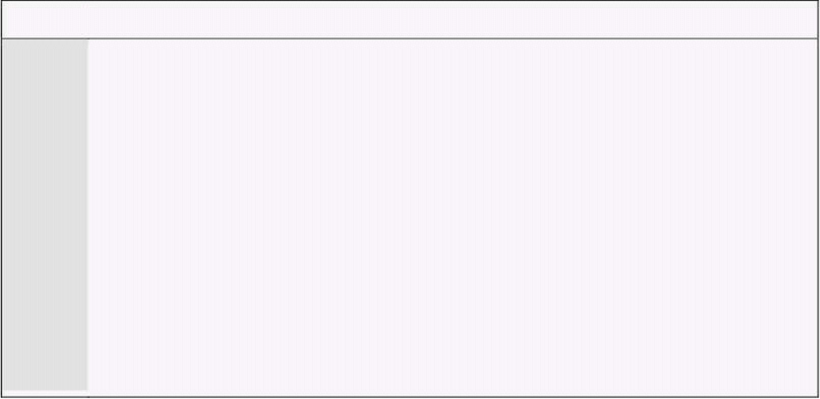
10
Debug Interrupts
10.1. DEBUGGER USING SINGLE STEP INTERRUPT
The use of the trap flag has been deferred till now. The three flags not used
for mathematical operations are the direction flag, the interrupt flag and the
trap flag. The direction and interrupt flags have been previously discussed.
If the interrupt flag is set, the after every instruction a type 1 interrupt will
be automatically generated. When the IVT and reserved interrupts were
discussed this was named as the single step interrupt. This is like the divide
by zero interrupt which was never explicitly invoked but it came itself. The
single step interrupt behaves in the same manner.
The debugger is made using this interrupt. It allows one instruction to be
executed and then return control to us. It has its display code and its code to
wait for the key in the INT 1 handler. Therefore after every instruction the
values of all registers are shown and the debugger waits for a key. Another
interrupt used by the debugger is the break point interrupt INT 3. Apart from
single stepping debugger has the breakpoint feature. INT 3 is used for this
feature. INT 3 has a single byte opcode so it can replace any instruction. To
put a breakpoint the instruction is replaced with INT 3 opcode and restored
in the INT 3 handler. The INT 3 opcode is placed again by a single step
interrupt that is set up for this purpose after the replaced instruction has
been executed.
There is no instruction to set or clear the trap flag like there are
instructions for the interrupt and direction flags. We use two special
instructions PUSHF and POPF to push and pop the flag from the stack. We
use PUSHF to place flags on the stack, change TF in this image on the stack
and then reload into the flags register with POPF. The single step interrupt
will come after the first instruction after POPF. The interrupt mechanism
automatically clears IF and TF otherwise there would an infinite recursion of
the single step interrupt. The TF is set in the flags on the stack so another
interrupt will comes after one more instruction is executed after the return of
the interrupt.
The following example is a very elementary debugger using the trap flag
and the single step interrupt.
Example 10.1
001 ; single stepping using the trap flag and single step interrupt
002 [org 0x0100]
003 jmp start
004
005 flag: db 0 ; flag whether a key pressed
006 oldisr: dd 0 ; space for saving old ISR
007 names: db 'FL =CS =IP =BP =AX =BX =CX =DX =SI =DI =DS =ES ='
008
009-026 ;;;;; COPY LINES 008-025 FROM EXAMPLE 6.2 (clrscr) ;;;;;
027
028 ; subroutine to print a number on screen
029 ; takes the row no, column no, and number to be printed as parameters
030 printnum: push bp
031 mov bp, sp
032 push es
033 push ax
034 push bx
035 push cx

Slide 134

Computer Architecture & Assembly Language Programming Course Code: CS401
CS401@vu.edu.pk
036 push dx
037 push di
038
039 mov di, 80 ; load di with columns per row
040 mov ax, [bp+8] ; load ax with row number
041 mul di ; multiply with columns per row
042 mov di, ax ; save result in di
043 add di, [bp+6] ; add column number
044 shl di, 1 ; turn into byte count
045 add di, 8 ; to end of number location
046
047 mov ax, 0xb800
048 mov es, ax ; point es to video base
049 mov ax, [bp+4] ; load number in ax
050 mov bx, 16 ; use base 16 for division
051 mov cx, 0 ; initialize count of digits
052
053 nextdigit: mov dx, 0 ; zero upper half of dividend
054 div bx ; divide by 10
055 add dl, 0x30 ; convert digit into ascii value
056 cmp dl, 0x39 ; is the digit an alphabet
057 jbe skipalpha ; no, skip addition
058 add dl, 7 ; yes, make in alphabet code
059 skipalpha: mov dh, 0x07 ; attach normal attribute
060 mov [es:di], dx ; print char on screen
061 sub di, 2 ; to previous screen location
062 loop nextdigit ; if no divide it again
063
064 pop di
065 pop dx
066 pop cx
067 pop bx
068 pop ax
069 pop es
070 pop bp
071 ret 6
072
073 ; subroutine to print a string
074 ; takes row no, column no, address of string, and its length
075 ; as parameters
076 printstr: push bp
077 mov bp, sp
078 push es
079 push ax
080 push bx
081 push cx
082 push dx
083 push si
084 push di
085
086 mov ax, 0xb800
087 mov es, ax ; point es to video base
088
089 mov di, 80 ; load di with columns per row
090 mov ax, [bp+8] ; load ax with row number
091 mul di ; multiply with columns per row
092 mov di, ax ; save result in di
093 add di, [bp+6] ; add column number
094 shl di, 1 ; turn into byte count
095
096 mov si, [bp+6] ; string to be printed
097 mov cx, [bp+4] ; length of string
098 mov ah, 0x07 ; normal attribute is fixed
099
100 nextchar: mov al, [si] ; load next char of string
101 mov [es:di], ax ; show next char on screen
102 add di, 2 ; move to next screen location
103 add si, 1 ; move to next char
104 loop nextchar ; repeat the operation cx times
105
106 pop di
107 pop si
108 pop dx
109 pop cx
110 pop bx
111 pop ax
Virtual University of Pakistan 126

Slide 135

Computer Architecture & Assembly Language Programming Course Code: CS401
CS401@vu.edu.pk
112 pop es
113 pop bp
114 ret 8
115
116 ; keyboard interrupt service routine
117 kbisr: push ax
118
119 in al, 0x60 ; read a char from keyboard port
120 test al, 0x80 ; is it a press code
121 jnz skipflag ; no, leave the interrupt
123 add byte [cs:flag], al ; yes, set flag to proceed
124
125 skipflag: mov al, 0x20
126 out 0x20, al
127 pop ax
128 iret
129
130 ; single step interrupt service routine
131 trapisr: push bp
132 mov bp, sp ; to read cs, ip and flags
133 push ax
134 push bx
135 push cx
136 push dx
137 push si
138 push di
139 push ds
140 push es
141
142 sti ; waiting for keyboard interrupt
143 push cs
144 pop ds ; initialize ds to data segment
145
146 mov byte [flag], 0 ; set flag to wait for key
147 call clrscr ; clear the screen
148
149 mov si, 6 ; first register is at bp+6
150 mov cx, 12 ; total 12 registers to print
151 mov ax, 0 ; start from row 0
152 mov bx, 5 ; print at column 5
153
154 l3: push ax ; row number
155 push bx ; column number
156 mov dx, [bp+si]
157 push dx ; number to be printed
158 call printnum ; print the number
159 sub si, 2 ; point to next register
160 inc ax ; next row number
161 loop l3 ; repeat for the 12 registers
162
163 mov ax, 0 ; start from row 0
164 mov bx, 0 ; start from column 0
165 mov cx, 12 ; total 12 register names
166 mov si, 4 ; each name length is 4 chars
167 mov dx, names ; offset of first name in dx
168
169 l1: push ax ; row number
170 push bx ; column number
171 push dx ; offset of string
172 push si ; length of string
173 call printstr ; print the string
174 add dx, 4 ; point to start of next string
175 inc ax ; new row number
176 loop l1 ; repeat for 12 register names
177
178 keywait: cmp byte [flag], 0 ; has a key been pressed
179 je keywait ; no, check again
180
181 pop es
182 pop ds
183 pop di
184 pop si
185 pop dx
186 pop cx
187 pop bx
188 pop ax
Virtual University of Pakistan 127

Slide 136


Computer Architecture & Assembly Language Programming Course Code: CS401
CS401@vu.edu.pk
189 pop bp
190 iret
191
192 start: xor ax, ax
193 mov es, ax ; point es to IVT base
194 mov ax, [es:9*4]
195 mov [oldisr], ax ; save offset of old routine
196 mov ax, [es:9*4+2]
197 mov [oldisr+2], ax ; save segment of old routine
198 mov word [es:1*4], trapisr ; store offset at n*4
199 mov [es:1*4+2], cs ; store segment at n*4+2
200 cli ; disable interrupts
201 mov word [es:9*4], kbisr ; store offset at n*4
202 mov [es:9*4+2], cs ; store segment at n*4+2
203 sti ; enable interrupts
204
205 pushf ; save flags on stack
206 pop ax ; copy flags in ax
207 or ax, 0x100 ; set bit corresponding to TF
208 push ax ; save ax on stack
209 popf ; reload into flags register
210
211 ; the trap flag bit is on now, INT 1 will come after next instruction
212 ; sample code to check the working of our elementary debugger
213 mov ax, 0
214 mov bx, 0x10
215 mov cx, 0x20
216 mov dx, 0x40
217
218 l2: inc ax
219 add bx, 2
220 dec cx
221 sub dx, 2
222 jmp l2
10.2. DEBUGGER USING BREAKPOINT INTERRUPT
We now write a debugger using INT 3. This debugger stops at the same
point every time where the breakpoint has been set up unlike the previous
one which stopped at every instruction. The single step interrupt in this
example is used only to restore the breakpoint interrupt which was removed
by the breakpoint interrupt handler temporarily so that the original
instruction can be executed.
Example 10.2
001 ; elementary debugger using breakpoint interrupt
002 [org 0x0100]
003 jmp start
004
005 flag: db 0 ; flag whether a key pressed
006 oldisr: dd 0 ; space for saving old ISR
007 names: db 'FL =CS =IP =BP =AX =BX =CX =DX =SI =DI =DS =ES ='
008 opcode: db 0
009 opcodepos: dw 0
010
011-028 ;;;;; COPY LINES 008-025 FROM EXAMPLE 6.2 (clrscr) ;;;;;
029-072 ;;;;; COPY LINES 028-071 FROM EXAMPLE 10.1 (printnum) ;;;;;
073-114 ;;;;; COPY LINES 073-114 FROM EXAMPLE 10.1 (printstr) ;;;;;
115-127 ;;;;; COPY LINES 116-128 FROM EXAMPLE 10.1 (kbisr) ;;;;;
128
129 ; single step interrupt service routine
130 trapisr: push bp
131 mov bp, sp
132 push ax
133 push di
134 push ds
135 push es
136
137 push cs
138 pop ds ; initialize ds to data segment
Virtual University of Pakistan 128

Slide 137
Computer Architecture & Assembly Language Programming Course Code: CS401
CS401@vu.edu.pk
139
140 mov ax, [bp+4]
141 mov es, ax ; load interrupted segment in es
142 mov di, [opcodepos] ; load saved opcode position
143 mov byte [es:di], 0xCC ; reset the opcode to INT3
144 and word [bp+6], 0xFEFF; clear TF in flags on stack
145
146 pop es
147 pop ds
148 pop di
149 pop ax
150 pop bp
151 iret
152
153 ; breakpoint interrupt service routine
154 debugisr: push bp
155 mov bp, sp ; to read cs, ip and flags
156 push ax
157 push bx
158 push cx
159 push dx
160 push si
161 push di
162 push ds
163 push es
164
165 sti ; waiting for keyboard interrupt
166 push cs
167 pop ds ; initialize ds to data segment
168
169 mov ax, [bp+4]
170 mov es, ax ; load interrupted segment in es
171 dec word [bp+2] ; decrement the return address
172 mov di, [bp+2] ; read the return address in di
173 mov word [opcodepos], di ; remember the return position
174 mov al, [opcode] ; load the original opcode
175 mov [es:di], al ; restore original opcode there
176
177 mov byte [flag], 0 ; set flag to wait for key
178 call clrscr ; clear the screen
179
180 mov si, 6 ; first register is at bp+6
181 mov cx, 12 ; total 12 registers to print
182 mov ax, 0 ; start from row 0
183 mov bx, 5 ; print at column 5
184
185 l3: push ax ; row number
186 push bx ; column number
187 mov dx, [bp+si]
188 push dx ; number to be printed
189 call printnum ; print the number
190 sub si, 2 ; point to next register
191 inc ax ; next row number
192 loop l3 ; repeat for the 12 registers
193
194 mov ax, 0 ; start from row 0
195 mov bx, 0 ; start from column 0
196 mov cx, 12 ; total 12 register names
197 mov si, 4 ; each name length is 4 chars
198 mov dx, names ; offset of first name in dx
199
200 l1: push ax ; row number
201 push bx ; column number
202 push dx ; offset of string
203 push si ; length of string
204 call printstr ; print the string
205 add dx, 4 ; point to start of next string
206 inc ax ; new row number
207 loop l1 ; repeat for 12 register names
208
209 or word [bp+6], 0x0100 ; set TF in flags image on stack
210
211 keywait: cmp byte [flag], 0 ; has a key been pressed
212 je keywait ; no, check again
213
214 pop es
Virtual University of Pakistan 129

Slide 138

Computer Architecture & Assembly Language Programming Course Code: CS401
CS401@vu.edu.pk
215 pop ds
216 pop di
217 pop si
218 pop dx
219 pop cx
220 pop bx
221 pop ax
222 pop bp
223 iret
224
225 start: xor ax, ax
226 mov es, ax ; point es to IVT base
227 mov word [es:1*4], trapisr ; store offset at n*4
228 mov [es:1*4+2], cs ; store segment at n*4+2
229 mov word [es:3*4], debugisr ; store offset at n*4
230 mov [es:3*4+2], cs ; store segment at n*4+2
231 cli ; disable interrupts
232 mov word [es:9*4], kbisr ; store offset at n*4
233 mov [es:9*4+2], cs ; store segment at n*4+2
234 sti ; enable interrupts
235
236 mov si, l2 ; load breakpoint position in si
237 mov al, [cs:si] ; read opcode at that position
238 mov [opcode], al ; save opcode for later use
239 mov byte [cs:si], 0xCC ; change opcode to INT3
240
241 ; breakpoint is set now, INT3 will come at l2 on every iteration
242 ; sample code to check the working of our elementary debugger
243 mov ax, 0
244 mov bx, 0x10
245 mov cx, 0x20
246 mov dx, 0x40
247
248 l2: inc ax
249 add bx, 2
250 dec cx
251 sub dx, 2
252 jmp l2
Virtual University of Pakistan 130

Slide 139
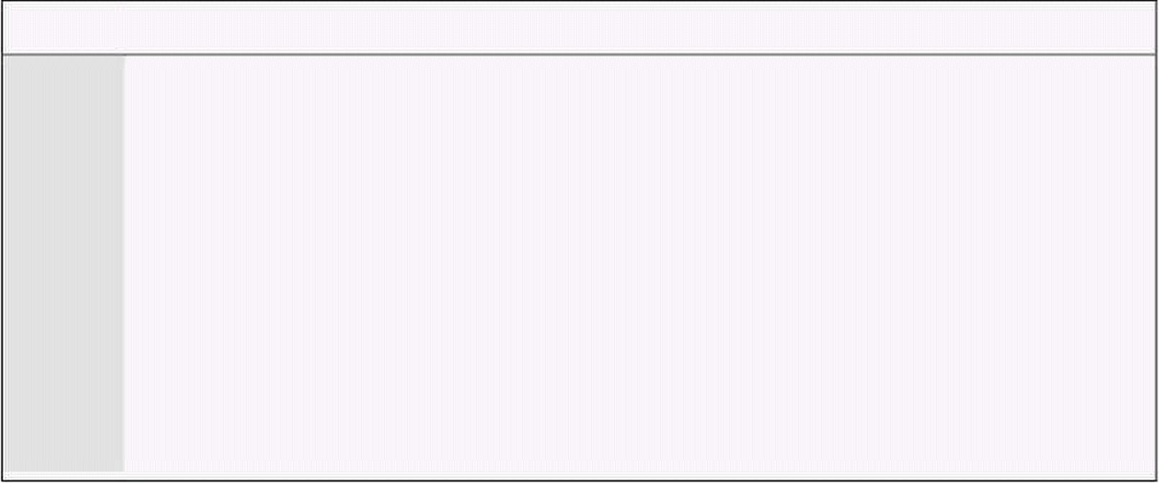
11
Multitasking
11.1. CONCEPTS OF MULTITASKING
To experience the power of assembly language we introduce how to
implement multitasking. We observed in the debugger that our thread of
instructions was broken by the debugger; it got the control, used all
registers, displayed an elaborate interface, waited for the key, and then
restored processor state to what was immediately before interruption. Our
program resumed as if nothing happened. The program execution was in the
same logical flow.
If we have two different programs A and B. Program A is broken, its state
saved, and returned to B instead of A. By looking at the instruction set, we
can immediately say that nothing can stop us from doing that. IRET will
return to whatever CS and IP it finds on the stack. Now B is interrupted
somehow, its state saved, and we return back to A. A will have no way of
knowing that it was interrupted as its entire environment has been restored.
It never knew the debugger took control when it was debugged. It sill has no
way of gaining this knowledge. If this work of breaking and restoring
programs is done at high speed the user will feel that all the programs are
running at the same time where actually they are being switched to and forth
at high speed.
In essence multitasking is simple, even though we have to be extremely
careful when implementing it. The environment of a program in the very
simple case is all its registers and stack. We will deal with stack later. Now to
get control from the program without the program knowing about it, we can
use the IRQ 0 highest priority interrupt that is periodically coming to the
processor.
Now we present a very basic example of multitasking. We have two
subroutines written in assembly language. All the techniques discussed here
are applicable to code written in higher level languages as well. However the
code to control this multitasking cannot be easily written in a higher level
language so we write it in assembly language. The two subroutines rotate
bars by changing characters at the two corners of the screen and have
infinite loops. By hooking the timer interrupt and saving and restoring the
registers of the tasks one by one, it appears that both tasks are running
simultaneously.
Example 11.1
001 ; elementary multitasking of two threads
002 [org 0x0100]
003 jmp start
004
005 ; ax,bx,ip,cs,flags storage area
006 taskstates: dw 0, 0, 0, 0, 0 ; task0 regs
007 dw 0, 0, 0, 0, 0 ; task1 regs
008 dw 0, 0, 0, 0, 0 ; task2 regs
009
010 current: db 0 ; index of current task
011 chars: db '\|/-' ; shapes to form a bar
012
013 ; one task to be multitasked
014 taskone: mov al, [chars+bx] ; read the next shape
015 mov [es:0], al ; write at top left of screen

Slide 140

Computer Architecture & Assembly Language Programming Course Code: CS401
CS401@vu.edu.pk
016 inc bx ; increment to next shape
017 and bx, 3 ; taking modulus by 4
018 jmp taskone ; infinite task
019
020 ; second task to be multitasked
021 tasktwo: mov al, [chars+bx] ; read the next shape
022 mov [es:158], al ; write at top right of screen
023 inc bx ; increment to next shape
024 and bx, 3 ; taking modulus by 4
025 jmp tasktwo ; infinite task
026
027 ; timer interrupt service routine
028 timer: push ax
029 push bx
030
031 mov bl, [cs:current] ; read index of current task
032 mov ax, 10 ; space used by one task
033 mul bl ; multiply to get start of task
034 mov bx, ax ; load start of task in bx
035
036 pop ax ; read original value of bx
037 mov [cs:taskstates+bx+2], ax ; space for current task
038 pop ax ; read original value of ax
039 mov [cs:taskstates+bx+0], ax ; space for current task
040 pop ax ; read original value of ip
041 mov [cs:taskstates+bx+4], ax ; space for current task
042 pop ax ; read original value of cs
043 mov [cs:taskstates+bx+6], ax ; space for current task
044 pop ax ; read original value of flags
045 mov [cs:taskstates+bx+8], ax ; space for current task
046
047 inc byte [cs:current] ; update current task index
048 cmp byte [cs:current], 3 ; is task index out of range
049 jne skipreset ; no, proceed
050 mov byte [cs:current], 0 ; yes, reset to task 0
051
052 skipreset: mov bl, [cs:current] ; read index of current task
053 mov ax, 10 ; space used by one task
054 mul bl ; multiply to get start of task
055 mov bx, ax ; load start of task in bx
056
057 mov al, 0x20
058 out 0x20, al ; send EOI to PIC
059
060 push word [cs:taskstates+bx+8] ; flags of new task
061 push word [cs:taskstates+bx+6] ; cs of new task
062 push word [cs:taskstates+bx+4] ; ip of new task
063 mov ax, [cs:taskstates+bx+0] ; ax of new task
064 mov bx, [cs:taskstates+bx+2] ; bx of new task
065 iret ; return to new task
066
067 start: mov word [taskstates+10+4], taskone ; initialize ip
068 mov [taskstates+10+6], cs ; initialize cs
069 mov word [taskstates+10+8], 0x0200 ; initialize flags
070 mov word [taskstates+20+4], tasktwo ; initialize ip
071 mov [taskstates+20+6], cs ; initialize cs
072 mov word [taskstates+20+8], 0x0200 ; initialize flags
073 mov word [current], 0 ; set current task index
074
075 xor ax, ax
076 mov es, ax ; point es to IVT base
077 cli
078 mov word [es:8*4], timer
079 mov [es:8*4+2], cs ; hook timer interrupt
080 mov ax, 0xb800
081 mov es, ax ; point es to video base
082 xor bx, bx ; initialize bx for tasks
083 sti
084
085 jmp $ ; infinite loop
The space where all registers of a task are stored is called the process
control block or PCB. Actual PCB contains a few more things that are not
Virtual University of Pakistan 132

Slide 141


Computer Architecture & Assembly Language Programming Course Code: CS401
CS401@vu.edu.pk
relevant to us now. INT 08 that is saving and restoring the registers is called
the scheduler and the whole event is called a context switch.
11.2. ELABORATE MULTITASKING
In our next example we will save all 14 registers and the stack as well. 28
bytes are needed by these registers in the PCB. We add some more space to
make the size 32, a power of 2 for easy calculations. One of these words is
used to form a linked list of the PCBs so that strict ordering of active PCBs is
not necessary. Also in this example we have given every thread its own stack.
Now threads can have function calls, parameters and local variables etc.
Another important change in this example is that the creation of threads is
now dynamic. The thread registration code initializes the PCB, and adds it to
the linked list so that the scheduler will give it a turn.
Example 11.2
001 ; multitasking and dynamic thread registration
002 [org 0x0100]
003 jmp start
004
005 ; PCB layout:
006 ; ax,bx,cx,dx,si,di,bp,sp,ip,cs,ds,ss,es,flags,next,dummy
007 ; 0, 2, 4, 6, 8,10,12,14,16,18,20,22,24, 26 , 28 , 30
008
009 pcb: times 32*16 dw 0 ; space for 32 PCBs
010 stack: times 32*256 dw 0 ; space for 32 512 byte stacks
011 nextpcb: dw 1 ; index of next free pcb
012 current: dw 0 ; index of current pcb
013 lineno: dw 0 ; line number for next thread
014-057
058 ;;;;; COPY LINES 028-071 FROM EXAMPLE 10.1 (printnum) ;;;;;
059
060 ; mytask subroutine to be run as a thread
061 ; takes line number as parameter
062 mytask: push bp
063 mov bp, sp
064 sub sp, 2 ; thread local variable
065 push ax
066 push bx
067
068 mov ax, [bp+4] ; load line number parameter
069 mov bx, 70 ; use column number 70
070 mov word [bp-2], 0 ; initialize local variable
071
072 printagain: push ax ; line number
073 push bx ; column number
074 push word [bp-2] ; number to be printed
075 call printnum ; print the number
076 inc word [bp-2] ; increment the local variable
077 jmp printagain ; infinitely print
078
079 pop bx
080 pop ax
081 mov sp, bp
082 pop bp
083 ret
084
085 ; subroutine to register a new thread
086 ; takes the segment, offset, of the thread routine and a parameter
087 ; for the target thread subroutine
088 initpcb: push bp
089 mov bp, sp
090 push ax
091 push bx
092 push cx
093 push si
094
095 mov bx, [nextpcb] ; read next available pcb index
096 cmp bx, 32 ; are all PCBs used
097 je exit ; yes, exit
098
Virtual University of Pakistan 133

Slide 142
Computer Architecture & Assembly Language Programming Course Code: CS401
CS401@vu.edu.pk
099 mov cl, 5
100 shl bx, cl ; multiply by 32 for pcb start
101
102 mov ax, [bp+8] ; read segment parameter
103 mov [pcb+bx+18], ax ; save in pcb space for cs
104 mov ax, [bp+6] ; read offset parameter
105 mov [pcb+bx+16], ax ; save in pcb space for ip
106
107 mov [pcb+bx+22], ds ; set stack to our segment
108 mov si, [nextpcb] ; read this pcb index
109 mov cl, 9
110 shl si, cl ; multiply by 512
111 add si, 256*2+stack ; end of stack for this thread
112 mov ax, [bp+4] ; read parameter for subroutine
113 sub si, 2 ; decrement thread stack pointer
114 mov [si], ax ; pushing param on thread stack
115 sub si, 2 ; space for return address
116 mov [pcb+bx+14], si ; save si in pcb space for sp
117
118 mov word [pcb+bx+26], 0x0200 ; initialize thread flags
119 mov ax, [pcb+28] ; read next of 0th thread in ax
120 mov [pcb+bx+28], ax ; set as next of new thread
121 mov ax, [nextpcb] ; read new thread index
123 mov [pcb+28], ax ; set as next of 0th thread
124 inc word [nextpcb] ; this pcb is now used
125
126 exit: pop si
127 pop cx
128 pop bx
129 pop ax
130 pop bp
131 ret 6
132
133 ; timer interrupt service routine
134 timer: push ds
135 push bx
136
137 push cs
138 pop ds ; initialize ds to data segment
139
140 mov bx, [current] ; read index of current in bx
141 shl bx, 1
142 shl bx, 1
143 shl bx, 1
144 shl bx, 1
145 shl bx, 1 ; multiply by 32 for pcb start
146 mov [pcb+bx+0], ax ; save ax in current pcb
147 mov [pcb+bx+4], cx ; save cx in current pcb
148 mov [pcb+bx+6], dx ; save dx in current pcb
149 mov [pcb+bx+8], si ; save si in current pcb
150 mov [pcb+bx+10], di ; save di in current pcb
151 mov [pcb+bx+12], bp ; save bp in current pcb
152 mov [pcb+bx+24], es ; save es in current pcb
153
154 pop ax ; read original bx from stack
155 mov [pcb+bx+2], ax ; save bx in current pcb
156 pop ax ; read original ds from stack
157 mov [pcb+bx+20], ax ; save ds in current pcb
158 pop ax ; read original ip from stack
159 mov [pcb+bx+16], ax ; save ip in current pcb
160 pop ax ; read original cs from stack
161 mov [pcb+bx+18], ax ; save cs in current pcb
162 pop ax ; read original flags from stack
163 mov [pcb+bx+26], ax ; save cs in current pcb
164 mov [pcb+bx+22], ss ; save ss in current pcb
165 mov [pcb+bx+14], sp ; save sp in current pcb
166
167 mov bx, [pcb+bx+28] ; read next pcb of this pcb
168 mov [current], bx ; update current to new pcb
169 mov cl, 5
170 shl bx, cl ; multiply by 32 for pcb start
171
172 mov cx, [pcb+bx+4] ; read cx of new process
173 mov dx, [pcb+bx+6] ; read dx of new process
174 mov si, [pcb+bx+8] ; read si of new process
175 mov di, [pcb+bx+10] ; read diof new process
Virtual University of Pakistan 134

Slide 143



Computer Architecture & Assembly Language Programming Course Code: CS401
CS401@vu.edu.pk
176 mov bp, [pcb+bx+12] ; read bp of new process
177 mov es, [pcb+bx+24] ; read es of new process
178 mov ss, [pcb+bx+22] ; read ss of new process
179 mov sp, [pcb+bx+14] ; read sp of new process
180
181 push word [pcb+bx+26] ; push flags of new process
182 push word [pcb+bx+18] ; push cs of new process
183 push word [pcb+bx+16] ; push ip of new process
184 push word [pcb+bx+20] ; push ds of new process
185
186 mov al, 0x20
187 out 0x20, al ; send EOI to PIC
188
189 mov ax, [pcb+bx+0] ; read ax of new process
190 mov bx, [pcb+bx+2] ; read bx of new process
191 pop ds ; read ds of new process
192 iret ; return to new process
193
194 start: xor ax, ax
195 mov es, ax ; point es to IVT base
196
197 cli
198 mov word [es:8*4], timer
199 mov [es:8*4+2], cs ; hook timer interrupt
200 sti
201
202 nextkey: xor ah, ah ; service 0 – get keystroke
203 int 0x16 ; bios keyboard services
204
205 push cs ; use current code segment
206 mov ax, mytask
207 push ax ; use mytask as offset
208 push word [lineno] ; thread parameter
209 call initpcb ; register the thread
210
211 inc word [lineno] ; update line number
212 jmp nextkey ; wait for next keypress
When the program is executed the threads display the numbers
independently. However as keys are pressed and new threads are registered,
there is an obvious slowdown in the speed of multitasking. To improve that,
we can change the timer interrupt frequency. The following can be used to
set to an approximately 1ms interval.
mov ax, 1100
out 0x40, al
mov al, ah
out 0x40, al
This makes the threads look faster. However the only real change is that
the timer interrupt is now coming more frequently.
11.3. MULTITASKING KERNEL AS TSR
The above examples had the multitasking code and the multitasked code
in one program. Now we separate the multitasking kernel into a TSR so that
it becomes an operation system extension. We hook a software interrupt for
the purpose of registering a new thread.
Example 11.3
001 ; multitasking kernel as a TSR
002 [org 0x0100]
003 jmp start
004
005 ; PCB layout:
006 ; ax,bx,cx,dx,si,di,bp,sp,ip,cs,ds,ss,es,flags,next,dummy
007 ; 0, 2, 4, 6, 8,10,12,14,16,18,20,22,24, 26 , 28 , 30
008
009 pcb: times 32*16 dw 0 ; space for 32 PCBs
Virtual University of Pakistan 135

Slide 144

Computer Architecture & Assembly Language Programming Course Code: CS401
CS401@vu.edu.pk
010 stack: times 32*256 dw 0 ; space for 32 512 byte stacks
011 nextpcb: dw 1 ; index of next free pcb
012 current: dw 0 ; index of current pcb
013
014-073 ;;;;; COPY LINES 133-192 FROM EXAMPLE 11.2 (timer) ;;;;;
074
075 ; software interrupt to register a new thread
076 ; takes parameter block in ds:si
077 ; parameter block has cs, ip, ds, es, and param in this order
078 initpcb: push ax
079 push bx
080 push cx
081 push di
082
083 mov bx, [cs:nextpcb] ; read next available pcb index
084 cmp bx, 32 ; are all PCBs used
085 je exit ; yes, exit
086
087 mov cl, 5
088 shl bx, cl ; multiply by 32 for pcb start
089
090 mov ax, [si+0] ; read code segment parameter
091 mov [cs:pcb+bx+18], ax ; save in pcb space for cs
092 mov ax, [si+2] ; read offset parameter
093 mov [cs:pcb+bx+16], ax ; save in pcb space for ip
094 mov ax, [si+4] ; read data segment parameter
095 mov [cs:pcb+bx+20], ax ; save in pcb space for ds
096 mov ax, [si+6] ; read extra segment parameter
097 mov [cs:pcb+bx+24], ax ; save in pcb space for es
098
099 mov [cs:pcb+bx+22], cs ; set stack to our segment
100 mov di, [cs:nextpcb] ; read this pcb index
101 mov cl, 9
102 shl di, cl ; multiply by 512
103 add di, 256*2+stack ; end of stack for this thread
104 mov ax, [si+8] ; read parameter for subroutine
105 sub di, 2 ; decrement thread stack pointer
106 mov [cs:di], ax ; pushing param on thread stack
107 sub di, 4 ; space for far return address
108 mov [cs:pcb+bx+14], di ; save di in pcb space for sp
109
110 mov word [cs:pcb+bx+26], 0x0200 ; initialize flags
111 mov ax, [cs:pcb+28] ; read next of 0th thread in ax
112 mov [cs:pcb+bx+28], ax ; set as next of new thread
113 mov ax, [cs:nextpcb] ; read new thread index
114 mov [cs:pcb+28], ax ; set as next of 0th thread
115 inc word [cs:nextpcb] ; this pcb is now used
116
117 exit: pop di
118 pop cx
119 pop bx
120 pop ax
121 iret
123
124 start: xor ax, ax
125 mov es, ax ; point es to IVT base
126
127 mov word [es:0x80*4], initpcb
128 mov [es:0x80*4+2], cs ; hook software int 80
129 cli
130 mov word [es:0x08*4], timer
131 mov [es:0x08*4+2], cs ; hook timer interrupt
132 sti
133
134 mov dx, start
135 add dx, 15
136 mov cl, 4
137 shr dx, cl
138
139 mov ax, 0x3100 ; terminate and stay resident
140 int 0x21
The second part of our example is a simple program that has the threads
to be registered with the multitasking kernel using its exported services.
Virtual University of Pakistan 136

Slide 145

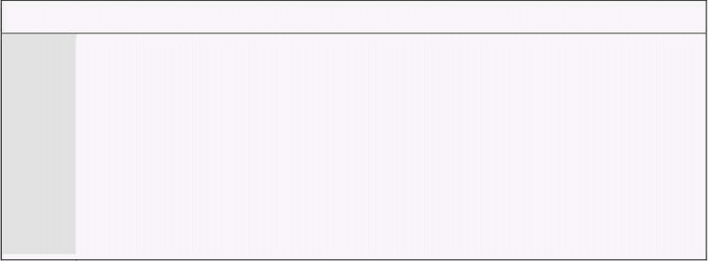
Computer Architecture & Assembly Language Programming Course Code: CS401
CS401@vu.edu.pk
Example 11.4
001 ; multitasking TSR caller
002 [org 0x0100]
003 jmp start
004
005 ; parameter block layout:
006 ; cs,ip,ds,es,param
007 ; 0, 2, 4, 6, 8
008
009 paramblock: times 5 dw 0 ; space for parameters
010 lineno: dw 0 ; line number for next thread
011
012-055 ;;;;; COPY LINES 028-071 FROM EXAMPLE 10.1 (printnum) ;;;;;
056
057 ; subroutine to be run as a thread
058 ; takes line number as parameter
059 mytask: push bp
060 mov bp, sp
061 sub sp, 2 ; thread local variable
062 push ax
063 push bx
064
065 mov ax, [bp+4] ; load line number parameter
066 mov bx, 70 ; use column number 70
067 mov word [bp-2], 0 ; initialize local variable
068
069 printagain: push ax ; line number
070 push bx ; column number
071 push word [bp-2] ; number to be printed
072 call printnum ; print the number
073 inc word [bp-2] ; increment the local variable
074 jmp printagain ; infinitely print
075
076 pop bx
077 pop ax
078 mov sp, bp
079 pop bp
080 retf
081
082 start: mov ah, 0 ; service 0 – get keystroke
083 int 0x16 ; bios keyboard services
084
085 mov [paramblock+0], cs ; code segment parameter
086 mov word [paramblock+2], mytask ; offset parameter
087 mov [paramblock+4], ds ; data segment parameter
088 mov [paramblock+6], es ; extra segment parameter
089 mov ax, [lineno]
090 mov [paramblock+8], ax ; parameter for thread
091 mov si, paramblock ; address of param block in si
092 int 0x80 ; multitasking kernel interrupt
093
094 inc word [lineno] ; update line number
095 jmp start ; wait for next key
We introduce yet another use of the multitasking kernel with this new
example. In this example three different sort of routines are multitasked by
the same kernel instead of repeatedly registering the same routine.
Example 11.5
001 ; another multitasking TSR caller
002 [org 0x0100]
003 jmp start
004
005 ; parameter block layout:
006 ; cs,ip,ds,es,param
007 ; 0, 2, 4, 6, 8
008
009 paramblock: times 5 dw 0 ; space for parameters
010 lineno: dw 0 ; line number for next thread
011 chars: db '\|/-' ; chracters for rotating bar
012 message: db 'moving hello' ; moving string
013 message2: db ' ' ; to erase previous string
Virtual University of Pakistan 137

Slide 146
Computer Architecture & Assembly Language Programming Course Code: CS401
CS401@vu.edu.pk
014 messagelen: dw 12 ; length of above strings
015
016-059 ;;;;; COPY LINES 028-071 FROM EXAMPLE 10.1 (printnum) ;;;;;
060-101 ;;;;; COPY LINES 073-114 FROM EXAMPLE 10.1 (printstr) ;;;;;
102
103 ; subroutine to run as first thread
104 mytask: push bp
105 mov bp, sp
106 sub sp, 2 ; thread local variable
107 push ax
108 push bx
109
110 xor ax, ax ; use line number 0
111 mov bx, 70 ; use column number 70
112 mov word [bp-2], 0 ; initialize local variable
113
114 printagain: push ax ; line number
115 push bx ; column number
116 push word [bp-2] ; number to be printed
117 call printnum ; print the number
118 inc word [bp-2] ; increment the local variable
119 jmp printagain ; infinitely print
120
121 pop bx
123 pop ax
124 mov sp, bp
125 pop bp
126 retf
127
128 ; subroutine to run as second thread
129 mytask2: push ax
130 push bx
131 push es
132
133 mov ax, 0xb800
134 mov es, ax ; point es to video base
135 xor bx, bx ; initialize to use first shape
136
137 rotateagain: mov al, [chars+bx] ; read current shape
138 mov [es:40], al ; print at specified place
139 inc bx ; update to next shape
140 and bx, 3 ; take modulus with 4
141 jmp rotateagain ; repeat infinitely
142
143 pop es
144 pop bx
145 pop ax
146 retf
147
148 ; subroutine to run as third thread
149 mytask3: push bp
150 mov bp, sp
151 sub sp, 2 ; thread local variable
152 push ax
153 push bx
154 push cx
155
156 mov word [bp-2], 0 ; initialize line number to 0
157
158 nextline: push word [bp-2] ; line number
159 mov bx, 50
160 push bx ; column number 50
161 mov ax, message
162 push ax ; offset of string
163 push word [messagelen] ; length of string
164 call printstr ; print the string
165
166 mov cx, 0x100
167 waithere: push cx ; save outer loop counter
168 mov cx, 0xffff
169 loop $ ; repeat ffff times
170 pop cx ; restore outer loop counter
171 loop waithere ; repeat 0x100 times
172
173 push word [bp-2] ; line number
174 mov bx, 50 ; column number 50
Virtual University of Pakistan 138

Slide 147


Computer Architecture & Assembly Language Programming Course Code: CS401
CS401@vu.edu.pk
175 push bx
176 mov ax, message2
177 push ax ; offset of blank string
178 push word [messagelen] ; length of string
179 call printstr ; print the string
180
181 inc word [bp-2] ; update line number
182 cmp word [bp-2], 25 ; is this the last line
183 jne skipreset ; no, proceed to draw
184 mov word [bp-2], 0 ; yes, reset line number to 0
185
186 skipreset: jmp nextline ; proceed with next drawing
187
188 pop cx
189 pop bx
190 pop ax
191 mov sp, bp
192 pop bp
193 retf
194
195 start: mov [paramblock+0], cs ; code segment parameter
196 mov word [paramblock+2], mytask ; offset parameter
197 mov [paramblock+4], ds ; data segment parameter
198 mov [paramblock+6], es ; extra segment parameter
199 mov word [paramblock+8], 0 ; parameter for thread
200 mov si, paramblock ; address of param block in si
201 int 0x80 ; multitasking kernel interrupt
202
203 mov [paramblock+0], cs ; code segment parameter
204 mov word [paramblock+2], mytask2 ; offset parameter
205 mov [paramblock+4], ds ; data segment parameter
206 mov [paramblock+6], es ; extra segment parameter
207 mov word [paramblock+8], 0 ; parameter for thread
208 mov si, paramblock ; address of param block in si
209 int 0x80 ; multitasking kernel interrupt
210
211 mov [paramblock+0], cs ; code segment parameter
212 mov word [paramblock+2], mytask3 ; offset parameter
213 mov [paramblock+4], ds ; data segment parameter
214 mov [paramblock+6], es ; extra segment parameter
215 mov word [paramblock+8], 0 ; parameter for thread
216 mov si, paramblock ; address of param block in si
217 int 0x80 ; multitasking kernel interrupt
218
219 jmp $
EXERCISES
1. Change the multitasking kernel such that a new two byte variable is
introduced in the PCB. This variable contains the number of turns
this process should be given. For example if the first PCB contains 20
in this variable, the switch to second process should occur after 20
timer interrupts (approx one second at default speed) and similarly
the switch from second to third process should occur after the
number given in the second process’s PCB.
2. Change the scheduler of the multitasking kernel to enque the current
process index a ready queue, and dequeue the next process index
from it, and assign it to current. Therefore the next field of the PCB is
no longer used. Use queue functions from Exercise 5.XX.
3. Add a function in the multitasking kernel to fork the current process
through a software interrupt. Fork should allocate a new PCB and
copy values of all registers of the caller’s PCB to the new PCB. It
should allocate a stack and change SS, SP appropriately in the new
PCB. It has to copy the caller’s stack on the newly allocated stack. It
will set AX in the new PCB to 0 and in the old PB to 1 so that both
threads can identify which is the creator and which is the created
process and can act accordingly.
Virtual University of Pakistan 139

Slide 148
Computer Architecture & Assembly Language Programming Course Code: CS401
CS401@vu.edu.pk
4. Add a function in the multitasking kernel accessible via a software
interrupt that allows the current process to terminate itself.
5. Create a queue in the multitasking kernel called kbQ. This queue
initially empty will contain characters typed by the user. Hook the
keyboard interrupt for getting user keys. Convert the scan code to
ASCII if the key is from a-z or 0-9 and enque it in kbQ. Ignore all
other scan codes. Write a function checkkey accessible via a software
interrupt that returns the process in AX a value removed from the
queue. It waits if there is no key in the queue. Be aware of enabling
interrupts if you wait here.
6. Modify the multitasking kernel such that the initial process displays
at the last line of the screen whatever is typed by the user and clears
that line on enter. If the user types quit followed by enter restore
everything to normal as it was before the multitasking kernel was
there. If the user types start followed by enter, start one more rotating
bar on the screen. The first rotating bar should appear in the upper
left, the next in the second column, then third and so on. The bar
color should be white. The user can type the commands ‘white’, ‘red’,
and ‘green’ to change the color of new bars.
Virtual University of Pakistan 140

Slide 149
12
Video Services
12.1. BIOS VIDEO SERVICES
The Basic Input Output System (BIOS) provides services for video,
keyboard, serial port, parallel port, time etc. The video services are exported
via INT 10. We will discuss some very simple services. Video services are
classified into two broad categories; graphics mode services and text mode
services. In graphics mode a location in video memory corresponds to a dot
on the screen. In text mode this relation is not straightforward. The video
memory holds the ASCII of the character to be shown and the actual shape is
read from a font definition stored elsewhere in memory. We first present a list
of common video services used in text mode.
INT 10 - VIDEO - SET VIDEO MODE
AH = 00h
AL = desired video mode
Some common video modes include 40x25 text mode (mode 0), 80x25 text
mode (mode 2), 80x50 text mode (mode 3), and 320x200 graphics mode
(mode D).
INT 10 - VIDEO - SET TEXT-MODE CURSOR SHAPE
AH = 01h
CH = cursor start and options
CL = bottom scan line containing cursor (bits 0-4)
INT 10 - VIDEO - SET CURSOR POSITION
AH = 02h
BH = page number
0-3 in modes 2&3
0-7 in modes 0&1
0 in graphics modes
DH = row (00h is top)
DL = column (00h is left)
INT 10 - VIDEO - SCROLL UP WINDOW
AH = 06h
AL = number of lines by which to scroll up (00h = clear entire window)
BH = attribute used to write blank lines at bottom of window
CH, CL = row, column of window's upper left corner
DH, DL = row, column of window's lower right corner
INT 10 - VIDEO - SCROLL DOWN WINDOW
AH = 07h
AL = number of lines by which to scroll down (00h=clear entire window)
BH = attribute used to write blank lines at top of window
CH, CL = row, column of window's upper left corner
DH, DL = row, column of window's lower right corner
INT 10 - VIDEO - WRITE CHARACTER AND ATTRIBUTE AT CURSOR POSITION
AH = 09h
AL = character to display
BH = page number

Slide 150
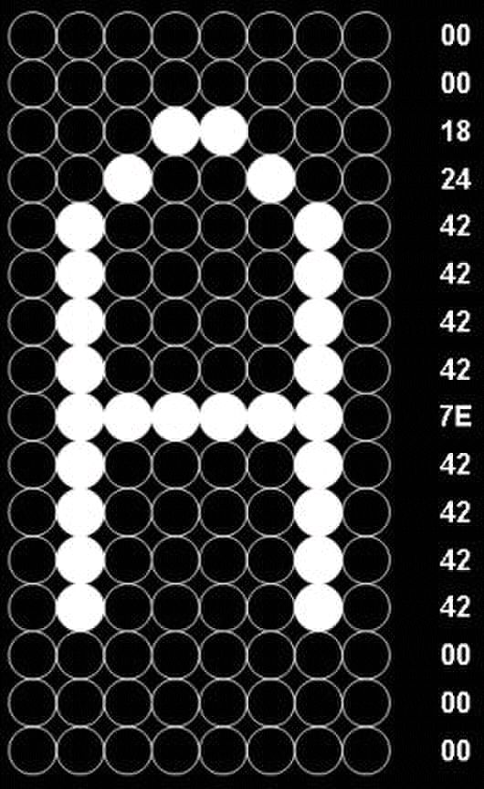

Computer Architecture & Assembly Language Programming Course Code: CS401
CS401@vu.edu.pk
BL = attribute (text mode) or color (graphics mode)
CX = number of times to write character
INT 10 - VIDEO - WRITE CHARACTER ONLY AT CURSOR POSITION
AH = 0Ah
AL = character to display
BH = page number
BL = attribute (text mode) or color (graphics mode)
CX = number of times to write character
INT 10 - VIDEO - WRITE STRING
AH = 13h
AL = write mode
bit 0: update cursor after writing
bit 1: string contains alternating characters and attributes
bits 2-7: reserved (0)
BH = page number
BL = attribute if string contains only characters
CX = number of characters in string
DH, DL = row, column at which to start writing
ES:BP -> string to write
Chargen Services
In our first example we will read the font definition in memory and change
it to include a set of all on pixels in the last line showing an effect of
underline on all character including space. An 8x16 font is stored in 16
bytes. A sample character and the corresponding 16 values stored in the font
information are shown for the character ‘A’. We
start with two services from the chargen subset
of video services that we are going to use.
INT 10 - VIDEO - GET FONT INFORMATION
AX = 1130h
BH = pointer specifier
Return:
ES:BP = specified pointer
CX = bytes/character of on-screen font
DL = highest character row on screen
INT 10 - TEXT-MODE CHARGEN
AX = 1110h
ES:BP -> user table
CX = count of patterns to store
DX = character offset into map 2 block
BL = block to load in map 2
BH = number of bytes per character pattern
We will use 6 as the pointer specifier which means the 8x16 font stored in
ROM.
Example 12.1
001 ; put underlines on screen font
002 [org 0x0100]
003 jmp start
004
005 font: times 256*16 db 0 ; space for font
006
007 start: mov ax, 0x1130 ; service 11/30 – get font info
008 mov bx, 0x0600 ; ROM 8x16 font
009 int 0x10 ; bios video services
010
011 mov si, bp ; point si to rom font data
012 mov di, font ; point di to space for font
Virtual University of Pakistan 142

Slide 151


Computer Architecture & Assembly Language Programming Course Code: CS401
CS401@vu.edu.pk
013 mov cx, 256*16 ; font size
014 push ds
015 push es
016 pop ds ; ds:si to rom font data
017 pop es ; es:di to space for font
018 cld ; auto increment mode
019 rep movsb ; copy font
020
021 push cs
022 pop ds ; restore ds to data segment
023
024 mov si, font-1 ; point si before first char
025 mov cx, 0x100 ; total 256 characters
026 change: add si, 16 ; one character has 16 bytes
027 mov byte [si], 0xFF ; change last line to all ones
028 loop change ; repeat for each character
029
030 mov bp, font ; es:bp points to new font
031 mov bx, 0x1000 ; bytes per char & block number
032 mov cx, 0x100 ; number of characters to change
033 xor dx, dx ; first character to change
034 mov ax, 0x1110 ; service 11/10 – load user font
035 int 0x10 ; bios video services
036
037 mov ax, 0x4c00 ; terminate program
038 int 0x21
Our second example is similar to the last example however in this case we
are doing something funny on the screen. We are reversing the shapes of all
the characters on the screen.
Example 12.2
001 ; reverse each character of screen font
002 [org 0x0100]
003 jmp start
004
005 font: times 256*16 db 0 ; space for font
006
007 start: mov ax, 0x1130 ; service 11/30 – get font info
008 mov bx, 0x0600 ; ROM 8x16 font
009 int 0x10 ; bios video services
010
011 mov si, bp ; point si to rom font data
012 mov di, font ; point di to space for font
013 mov cx, 256*16 ; font size
014 push ds
015 push es
016 pop ds ; ds:si to rom font data
017 pop es ; es:di to space for font
018 cld ; auto increment mode
019 rep movsb ; copy font
020
021 push cs
022 pop ds ; restore ds to data segment
023
024 mov si, font ; point si to start of font
025 change: mov al, [si] ; read one byte
026 mov cx, 8
027 inner: shl al, 1 ; shift left with MSB in carry
028 rcr bl, 1 ; rotate right using carry
029 loop inner ; repeat eight times
030 mov [si], bl ; write back reversed byte
031 inc si ; next byte of font
032 cmp si, font+256*16 ; is whole font reversed
033 jne change ; no, reverse next byte
034
035 mov bp, font ; es:bp points to new font
036 mov bx, 0x1000 ; bytes per char & block number
037 mov cx, 0x100 ; number of characters to change
038 xor dx, dx ; first character to change
039 mov ax, 0x1110 ; service 11/10 – load user font
040 int 0x10 ; bios video services
041
Virtual University of Pakistan 143

Slide 152

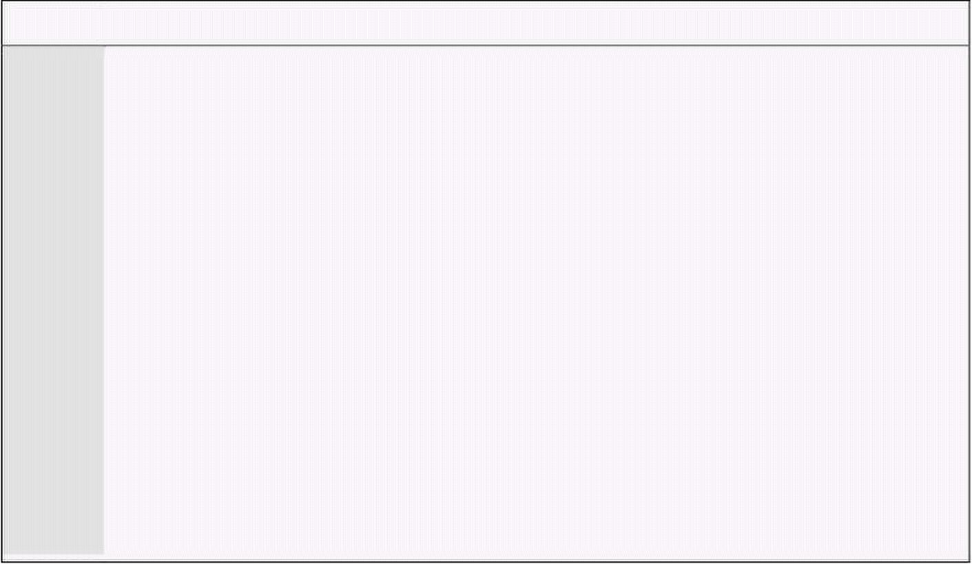
Computer Architecture & Assembly Language Programming Course Code: CS401
CS401@vu.edu.pk
042 mov ax, 0x4c00 ; terminate program
043 int 0x21
Graphics Mode Services
We will take an example of using graphics mode video services as well. We
will draw a line across the screen using the following service.
INT 10 - VIDEO - WRITE GRAPHICS PIXEL
AH = 0Ch
BH = page number
AL = pixel color
CX = column
DX = row
Example 12.3
001 ; draw line in graphics mode
002 [org 0x0100]
003 mov ax, 0x000D ; set 320x200 graphics mode
004 int 0x10 ; bios video services
005
006 mov ax, 0x0C07 ; put pixel in white color
007 xor bx, bx ; page number 0
008 mov cx, 200 ; x position 200
009 mov dx, 200 ; y position 200
010
011 l1: int 0x10 ; bios video services
012 dec dx ; decrease y position
013 loop l1 ; decrease x position and repeat
014
015 mov ah, 0 ; service 0 – get keystroke
016 int 0x16 ; bios keyboard services
017
018 mov ax, 0x0003 ; 80x25 text mode
019 int 0x10 ; bios video services
020
021 mov ax, 0x4c00 ; terminate program
022 int 0x21
12.2. DOS VIDEO SERVICES
Services of DOS are more cooked and at a higher level than BIOS. They
provide less control but make routine tasks much easier. Some important
DOS services are listed below.
INT 21 - READ CHARACTER FROM STANDARD INPUT, WITH ECHO
AH = 01h
Return: AL = character read
INT 21 - WRITE STRING TO STANDARD OUTPUT
AH = 09h
DS:DX -> $ terminated string
INT 21 - BUFFERED INPUT
AH = 0Ah
DS:DX -> dos input buffer
The DOS input buffer has a special format where the first byte stores the
maximum characters buffer can hold, the second byte holds the number of
characters actually read on return, and the following space is used for the
actual characters read. We start will an example of reading a string with
service 1 and displaying it with service 9.
Virtual University of Pakistan 144

Slide 153


Computer Architecture & Assembly Language Programming Course Code: CS401
CS401@vu.edu.pk
Example 12.4
001 ; character input using dos services
002 [org 0x0100]
003 jmp start
004
005 maxlength: dw 80 ; maximum length of input
006 message: db 10, 13, 'hello $' ; greetings message
007 buffer: times 81 db 0 ; space for input string
008
009 start: mov cx, [maxlength] ; load maximum length in cx
010 mov si, buffer ; point si to start of buffer
011
012 nextchar: mov ah, 1 ; service 1 – read character
013 int 0x21 ; dos services
014
015 cmp al, 13 ; is enter pressed
016 je exit ; yes, leave input
017 mov [si], al ; no, save this character
018 inc si ; increment buffer pointer
019 loop nextchar ; repeat for next input char
020
021 exit: mov byte [si], '$' ; append $ to user input
022
023 mov dx, message ; greetings message
024 mov ah, 9 ; service 9 – write string
025 int 0x21 ; dos services
026
027 mov dx, buffer ; user input buffer
028 mov ah, 9 ; service 9 – write string
029 int 0x21 ; dos services
030
031 mov ax, 0x4c00 ; terminate program
032 int 0x21
Our next example uses the more cooked buffered input service of DOS and
using the same service 9 to print the string.
Example 12.5
001 ; buffer input using dos services
002 [org 0x0100]
003 jmp start
004
005 message: db 10,13,'hello ', 10, 13, '$'
006 buffer: db 80 ; length of buffer
007 db 0 ; number of character on return
008 times 80 db 0 ; actual buffer space
009
010 start: mov dx, buffer ; input buffer
011 mov ah, 0x0A ; service A – buffered input
012 int 0x21 ; dos services
013
014 mov bh, 0
015 mov bl, [buffer+1] ; read actual size in bx
016 mov byte [buffer+2+bx], '$' ; append $ to user input
017
018 mov dx, message ; greetings message
019 mov ah, 9 ; service 9 – write string
020 int 0x21 ; dos services
021
022 mov dx, buffer+2 ; user input buffer
023 mov ah, 9 ; service 9 – write string
024 int 0x21 ; dos services
025
026 mov ax, 0x4c00 ; terminate program
027 int 0x21
More detail of DOS and BIOS interrupts is available in the Ralf Brown
Interrupt List.
Virtual University of Pakistan 145

Slide 155
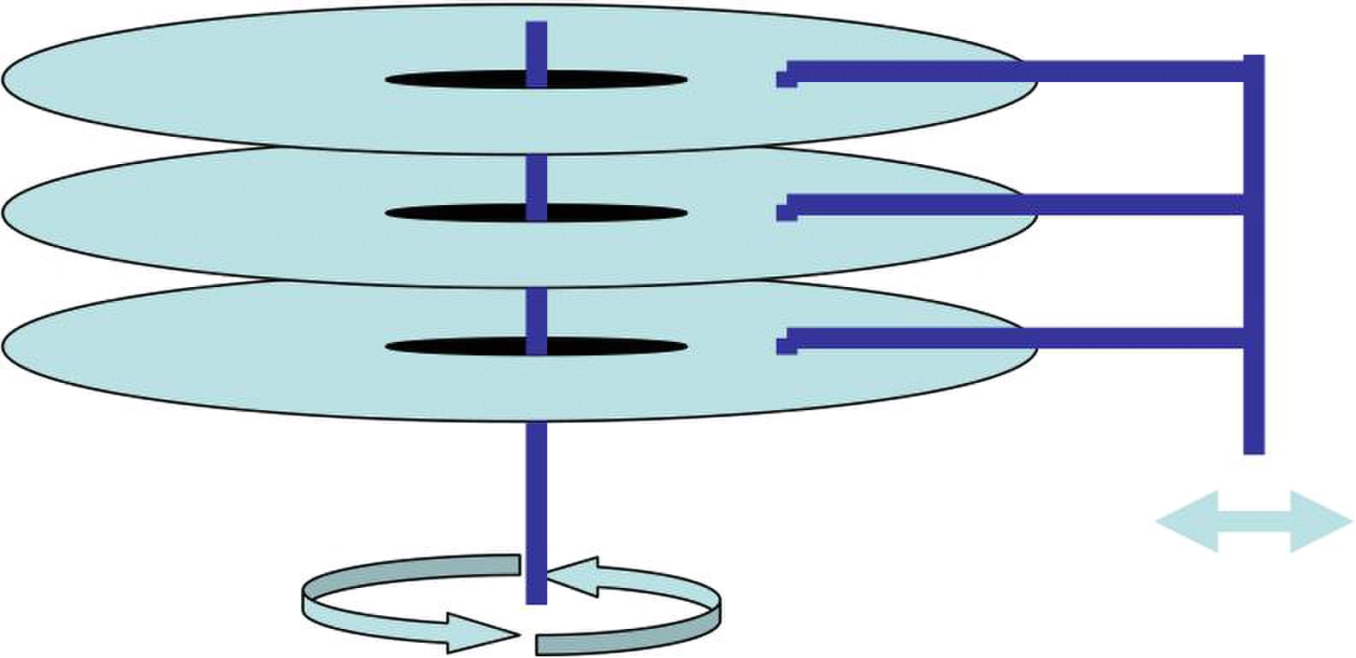
13
Secondary Storage
13.1. PHYSICAL FORMATION
A floppy disk is a circular plate with a fine coating of magnetic material
over it. The plate is enclosed in a plastic jacket which has a cover that can
slide to expose the magnetic surface. The drive motor attaches itself to the
central piece and rotates the plate. Two heads on both sides can read the
magnetically encoded data on the disk.
If the head is fixed and the motor rotates the disk the readable area on the
disk surface forms a circle called a track. Head moved to the next step forms
another track and so on. In hard disks the same structure is extended to a
larger number of tracks and plates. The tracks are further cut vertically into
sectors. This is a logical division of the area on the tracks. Each sector holds
512 bytes of data. A standard floppy disk has 80 tracks and 18 sectors per
track with two heads, one on each side totallying to 2880 sectors or 1440 KB
of data. Hard disks have varying number of heads and tracks pertaining to
their different capacities.
BIOS sees the disks as a combination of sectors, tracks, and heads, as a
raw storage device without concern to whether it is reading a file or directory.
BIOS provides the simplest and most powerful interface to the storage
medium. However this raw storage is meaningless to the user who needs to
store his files and organize them into directories. DOS builds a logical
structure on this raw storage space to provide these abstractions. This
logical formation is read and interpreted by DOS. If another file system is
build on the same storage medium the interpretations change. Main units of
the DOS structure are the boot sector in head 0, track 0, and sector 1, the
first FAT starting from head 0, track 0, sector 2, the second copy of FAT
starting from head 0, track 0, sector 11, and the root directory starting from
head 1, track 0, sector 2. The area from head 0, track 1, sector 16 to head 1,
track 79, sector 18 is used for storing the data of the files. Among this we will
be exploring the directory structure further. The 32 sectors reserved for the
root directory contain 512 directory entries. The format of a 32 byte directory
entry is shown below.

Slide 156

Computer Architecture & Assembly Language Programming Course Code: CS401
CS401@vu.edu.pk
+00 Filename (8 bytes)
+08 Extension (3 bytes)
+0B Flag Byte (1 byte)
+0C Reserved (1 byte)
+0D Creation Date/Time (5 bytes)
+12 Last Accessed Data (2 bytes)
+14 Starting Cluster High Word (2 bytes) for FAT32
+16 Time (2 bytes)
+18 Date (2 bytes)
+1A Starting Cluster Low Word (2 bytes)
+1C File Size (4 bytes)
13.2. STORAGE ACCESS USING BIOS
We will be using BIOS disk services to directly see the data stored in the
directory entries by DOS. For this purpose we will be using the BIOS disk
services.
INT 13 - DISK - RESET DISK SYSTEM
AH = 00h
DL = drive
Return:
CF = error flag
AH = error code
INT 13 - DISK - READ SECTOR(S) INTO MEMORY
AH = 02h
AL = number of sectors to read (must be nonzero)
CH = low eight bits of cylinder number
CL = sector number 1-63 (bits 0-5)
high two bits of cylinder (bits 6-7, hard disk only)
DH = head number
DL = drive number (bit 7 set for hard disk)
ES:BX -> data buffer
Return:
CF = error flag
AH = error code
AL = number of sectors transferred
INT 13 - DISK - WRITE DISK SECTOR(S)
AH = 03h
AL = number of sectors to write (must be nonzero)
CH = low eight bits of cylinder number
CL = sector number 1-63 (bits 0-5)
high two bits of cylinder (bits 6-7, hard disk only)
DH = head number
DL = drive number (bit 7 set for hard disk)
ES:BX -> data buffer
Return:
CF = error flag
AH = error code
AL = number of sectors transferred
INT 13 - DISK - GET DRIVE PARAMETERS
AH = 08h
DL = drive (bit 7 set for hard disk)
Return:
CF = error flag
AH = error code
CH = low eight bits of maximum cylinder number
CL = maximum sector number (bits 5-0)
Virtual University of Pakistan 148

Slide 157

Computer Architecture & Assembly Language Programming Course Code: CS401
CS401@vu.edu.pk
high two bits of maximum cylinder number (bits 7-6)
DH = maximum head number
DL = number of drives
ES:DI -> drive parameter table (floppies only)
Example 13.1
001 ; floppy directory using bios services
002 [org 0x0100]
003 jmp start
004
005 sector: times 512 db 0 ; space for directory sector
006 entryname: times 11 db 0 ; space for a file name
007 db 10, 13, '$' ; new line and terminating $
008
009 start: mov ah, 0 ; service 0 – reset disk system
010 mov dl, 0 ; drive A:
011 int 0x13 ; bios disk services
012 jc error ; if error, terminate program
013
014 mov ah, 2 ; service 2 – read sectors
015 mov al, 1 ; count of sectors
016 mov ch, 0 ; cyliner
017 mov cl, 2 ; sector
018 mov dh, 1 ; head
019 mov dl, 0 ; drive A:
020 mov bx, sector ; buffer to read sector
021 int 0x13 ; bios disk services
022 jc error ; if error, terminate program
023
024 mov bx, 0 ; start from first entry
025 nextentry: mov di, entryname ; point di to space for filename
026 mov si, sector ; point si to sector
027 add si, bx ; move ahead to desired entry
028 mov cx, 11 ; one filename is 11 bytes long
029 cld ; auto increment mode
030 rep movsb ; copy filename
031
032 mov ah, 9 ; service 9 – output string
033 mov dx, entryname ; filename to be printed
034 int 0x21 ; dos services
035
036 add bx, 32 ; point to next dir entry
037 cmp bx, 512 ; is last entry in this sector
038 jne nextentry ; no, print next entry
039
040 error: mov ax, 0x4c00 ; terminate program
041 int 0x21
With the given services and the bits allocated for heads, tracks, and
sectors only 8GB disks can be accessed. This limitation can be overcome by
using INT 13 extensions that take a linear 64bit sector number and handle
all the head, track, sector conversion themselves. The important services in
this category are listed below.
INT 13 - INT 13 Extensions - EXTENDED READ
AH = 42h
DL = drive number
DS:SI -> disk address packet
Return:
CF = error flag
AH = error code
disk address packet's block count field set to number of blocks
successfully transferred
INT 13 - INT 13 Extensions - EXTENDED WRITE
AH = 43h
AL = write flags
Virtual University of Pakistan 149

Slide 158

Computer Architecture & Assembly Language Programming Course Code: CS401
CS401@vu.edu.pk
DL = drive number
DS:SI -> disk address packet
Return:
CF = error flag
AH = error code
disk address packet's block count field set to number of blocks
successfully transferred
The format of the disk address packet used above is as follows.
Offset Size Description
00h BYTE size of packet = 10h
01h BYTE reserved (0)
02h WORD number of blocks to transfer
04h DWORD -> transfer buffer
08h QWORD starting absolute block number
Hard disks have a different formation from floppy disks in that there is a
partition table at the start that allows several logical disks to be maintained
within a single physical disk. The physical sector 0 holds the master boot
record and a partition table towards the end. The first 446 bytes contain
MBR, then there are 4 16 byte partition entries and then there is a 2 byte
signature. A partition table entry has the following format.
Byte 0 – 0x80 for active 0x00 for inactive
Byte 1-3 – Starting CHS
Byte 4 – Partition Type
Byte 5-7 – Ending CHS
Byte 8-B – Starting LBA
Byte C-F – Size of Partition
Some important partition types are listed below.
00 Unused Entry
01 FAT12
05 Extended Partition
06 FAT16
0b FAT32
0c FAT32 LBA
0e FAT16 LBA
0f Extended LBA
07 NTFS
Extended partition type signals that the specified area is treated as a
complete hard disk with its own partition table and partitions. Therefore
extended partitions allow a recursion in partitioning and consequently an
infinite number of partitions are possible. The following program reads the
partition tables (primary and extended) using recursion and displays in an
indented form all partitions present on the first hard disk in the system.
Example 13.2
001 ; a program to display the partition table
002 [org 0x0100]
003 jmp start
004
005 dap: db 0x10, 0 ; disk address packet
006 dw 1
007 dd 0, 0, 0
Virtual University of Pakistan 150

Slide 159
Computer Architecture & Assembly Language Programming Course Code: CS401
CS401@vu.edu.pk
008
009-026 msg: times 17 db ' '
027 db 10, 13, '$'
028 fat12: db 'FAT12...$'
029 fat16: db 'FAT16...$'
030 fat32: db 'FAT32...$'
031 ntfs: db 'NTFS....$'
032 extended: db 'EXTEND..$'
033 unknown: db 'UNKNOWN.$'
034
035 partypes: dw 0x1, fat12 ; table of known partition types
036 dw 0x5, extended
037 dw 0x6, fat16
038 dw 0xe, fat16
039 dw 0xb, fat32
040 dw 0xc, fat32
041 dw 0x7, ntfs
042 dw 0xf, extended
043 dw 0x0, unknown
044
045 ; subroutine to print a number in a string as hex
046 ; takes address of string and a 16bit number as parameter
047 printnum: push bp
048 mov bp, sp
049 push ax
050 push bx
051 push cx
052 push dx
053 push di
054
055 mov di, [bp+6] ; string to store the number
056 add di, 3
057
058 mov ax, [bp+4] ; load number in ax
059 mov bx, 16 ; use base 16 for division
060 mov cx, 4
061
062 nextdigit: mov dx, 0
063 div bx ; divide by 16
064 add dl, 0x30 ; convert into ascii value
065 cmp dl, 0x39
066 jbe skipalpha
067
068 add dl, 7
069
070 skipalpha: mov [di], dl ; update char in string
071 dec di
072 loop nextdigit
073
074 pop di
075 pop dx
076 pop cx
077 pop bx
078 pop ax
079 pop bp
080 ret 4
081
082 ; subroutine to print the start and end of a partition
083 ; takes the segment and offset of the partition table entry
084 printpart: push bp
085 mov bp, sp
086 push es
087 push ax
088 push di
089
090 les di, [bp+4] ; point es:di to dap
091
092 mov ax, msg
093 push ax
094 push word [es:di+0xA]
095 call printnum ; print first half of start
096
097 add ax, 4
098 push ax
099 push word [es:di+0x8]
100 call printnum ; print second half of start
Virtual University of Pakistan 151

Slide 160
Computer Architecture & Assembly Language Programming Course Code: CS401
CS401@vu.edu.pk
101
102 add ax, 5
103 push ax
104 push word [es:di+0xE]
105 call printnum ; print first half of end
106
107 add ax, 4
108 push ax
109 push word [es:di+0xC]
110 call printnum ; print second half of end
111
112 mov dx, msg
113 mov ah, 9
114 int 0x21 ; print the whole on the screen
115
116 pop di
117 pop ax
118 pop es
119 pop bp
120 ret 4
121
123 ; recursive subroutine to read the partition table
124 ; take indentation level and 32bit absolute block number as parameters
125 readpart: push bp
126 mov bp, sp
127 sub sp, 512 ; local space to read sector
128 push ax
129 push bx
130 push cx
131 push dx
132 push si
133
134 mov ax, bp
135 sub ax, 512
136 mov word [dap+4], ax ; init dest offset in dap
137 mov [dap+6], ds ; init dest segment in dap
138 mov ax, [bp+4]
139 mov [dap+0x8], ax ; init sector no in dap
140 mov ax, [bp+6]
141 mov [dap+0xA], ax ; init second half of sector no
142
143 mov ah, 0x42 ; read sector in LBA mode
144 mov dl, 0x80 ; first hard disk
145 mov si, dap ; address of dap
146 int 0x13 ; int 13
147
148 jc failed ; if failed, leave
149
150 mov si, -66 ; start of partition info
151 nextpart: mov ax, [bp+4] ; read relative sector number
152 add [bp+si+0x8], ax ; make it absolute
153 mov ax, [bp+6] ; read second half
154 adc [bp+si+0xA], ax ; make seconf half absolute
155
156 cmp byte [bp+si+4], 0 ; is partition unused
157 je exit
158
159 mov bx, partypes ; point to partition types
160 mov di, 0
161 nextmatch: mov ax, [bx+di]
162 cmp [bp+si+4], al ; is this partition known
163 je found ; yes, so print its name
164 add di, 4 ; no, try next entry in table
165 cmp di, 32 ; are all entries compared
166 jne nextmatch ; no, try another
167
168 found: mov cx, [bp+8] ; load indentation level
169 jcxz noindent ; skip if no indentation needed
170 indent: mov dl, ' '
171 mov ah, 2 ; display char service
172 int 0x21 ; dos services
173 loop indent ; print required no of spaces
174
175 noindent: add di, 2
176 mov dx, [bx+di] ; point to partition type name
177 mov ah, 9 ; print string service
Virtual University of Pakistan 152

Slide 161


Computer Architecture & Assembly Language Programming Course Code: CS401
CS401@vu.edu.pk
178 int 0x21 ; dos services
179
180 push ss
181 mov ax, bp
182 add ax, si
183 push ax ; pass partition entry address
184 call printpart ; print start and end from it
185
186 cmp byte [bp+si+4], 5 ; is it an extended partition
187 je recurse ; yes, make a recursive call
188
189 cmp byte [bp+si+4], 0xf ; is it an extended partition
190 jne exit ; yes, make a recursive call
191
192 recurse: mov ax, [bp+8]
193 add ax, 2 ; increase indentation level
194 push ax
195 push word [bp+si+0xA] ; push partition type address
196 push word [bp+si+0x8]
197 call readpart ; recursive call
198
199 exit: add si, 16 ; point to next partition entry
200 cmp si, -2 ; gone past last entry
201 jne nextpart ; no, read this entry
202
203 failed: pop si
204 pop dx
205 pop bx
206 pop cx
207 pop ax
208 mov sp, bp
209 pop bp
210 ret 6
211
212 start: xor ax, ax
213 push ax ; start from zero indentation
214 push ax ; main partition table at 0
215 push ax
216 call readpart ; read and print it
217
218 mov ax, 0x4c00 ; terminate program
219 int 0x21
13.3. STORAGE ACCESS USING DOS
BIOS provides raw access to the storage medium while DOS gives a more
logical view and more cooked services. Everything is a file. A directory is a
specially organized file that is interpreted by the operating system itself. A
list of important DOS services for file manipulation is given below.
INT 21 - CREATE OR TRUNCATE FILE
AH = 3Ch
CX = file attributes
DS:DX -> ASCIZ filename
Return:
CF = error flag
AX = file handle or error code
INT 21 - OPEN EXISTING FILE
AH = 3Dh
AL = access and sharing modes
DS:DX -> ASCIZ filename
CL = attribute mask of files to look for (server call only)
Return:
CF = error flag
AX = file handle or error code
INT 21 - CLOSE FILE
AH = 3Eh
Virtual University of Pakistan 153

Slide 162
Computer Architecture & Assembly Language Programming Course Code: CS401
CS401@vu.edu.pk
BX = file handle
Return:
CF = error flag
AX = error code
INT 21 - READ FROM FILE
AH = 3Fh
BX = file handle
CX = number of bytes to read
DS:DX -> buffer for data
Return:
CF = error flag
AX = number of bytes actually read or error code
INT 21 - WRITE TO FILE
AH = 40h
BX = file handle
CX = number of bytes to write
DS:DX -> data to write
Return:
CF = error flag
AX = number of bytes actually written or error code
INT 21 - DELETE FILE
AH = 41h
DS:DX -> ASCIZ filename (no wildcards, but see notes)
Return:
CF = error flag
AX = error code
INT 21 - SET CURRENT FILE POSITION
AH = 42h
AL = origin of move
BX = file handle
CX:DX = offset from origin of new file position
Return:
CF = error flag
DX:AX = new file position in bytes from start of file
AX = error code in case of error
INT 21 - GET FILE ATTRIBUTES
AX = 4300h
DS:DX -> ASCIZ filename
Return:
CF = error flag
CX = file attributes
AX = error code
INT 21 - SET FILE ATTRIBUTES
AX = 4301h
CX = new file attributes
DS:DX -> ASCIZ filename
Return:
CF = error flag
AX = error code
We will use some of these services to find that two files are same in
contents or different. We will read the file names from the command prompt.
The command string is passed to the program in the program segment prefix
located at offset 0 in the current segment. The area from 0-7F contains
information for DOS, while the command tail length is stored at 80. From 81
to FF, the actual command tail is stored terminated by a CR (Carriage
Retrun).
Virtual University of Pakistan 154

Slide 163

Computer Architecture & Assembly Language Programming Course Code: CS401
CS401@vu.edu.pk
Example 13.3
001 ; file comparison using dos services
002 [org 0x0100]
003 jmp start
004
005 filename1: times 128 db 0 ; space for first filename
006 filename2: times 128 db 0 ; space for second filename
007 handle1: dw 0 ; handle for first file
008 handle2: dw 0 ; handle for second file
009 buffer1: times 4096 db 0 ; buffer for first file
010 buffer2: times 4096 db 0 ; buffer for second file
011
012 format: db 'Usage error: diff <filename1> <filename2>$'
013 openfailed: db 'First file could not be opened$'
014 openfailed2: db 'Second file could not be opened$'
015 readfailed: db 'First file could not be read$'
016 readfailed2: db 'Second file could not be read$'
017 different: db 'Files are different$'
018 same: db 'Files are same$'
019
020 start: mov ch, 0
021 mov cl, [0x80] ; command tail length in cx
022 dec cx ; leave the first space
023 mov di, 0x82 ; start of command tail in di
024 mov al, 0x20 ; space for parameter separation
025 cld ; auto increment mode
026 repne scasb ; search space
027 je param2 ; if found, proceed
028 mov dx, format ; else, select error message
029 jmp error ; proceed to error printing
030
031 param2: push cx ; save original cx
032 mov si, 0x82 ; set si to start of param
033 mov cx, di ; set di to end of param
034 sub cx, 0x82 ; find param size in cx
035 dec cx ; excluding the space
036 mov di, filename1 ; set di to space for filename 1
037 rep movsb ; copy filename there
038 mov byte [di], 0 ; terminate filename with 0
039 pop cx ; restore original cx
040 inc si ; go to start of next filename
041 mov di, filename2 ; set di to space for filename 2
042 rep movsb ; copy filename there
043 mov byte [di], 0 ; terminate filename with 0
044
045 mov ah, 0x3d ; service 3d – open file
046 mov al, 0 ; readonly mode
047 mov dx, filename1 ; address of filename
048 int 0x21 ; dos services
049 jnc open2 ; if no error, proceed
050 mov dx, openfailed ; else, select error message
051 jmp error ; proceed to error printing
052
053 open2: mov [handle1], ax ; save handle for first file
054 mov ah, 0x3d ; service 3d – open file
055 mov al, 0 ; readonly mode
056 mov dx, filename2 ; address of filename
057 int 0x21 ; dos services
058 jnc store2 ; if no error, proceed
059 mov dx, openfailed2 ; else, select error message
060 jmp error ; proceed to error printing
061
062 store2: mov [handle2], ax ; save handle for second file
063
064 readloop: mov ah, 0x3f ; service 3f – read file
065 mov bx, [handle1] ; handle for file to read
066 mov cx, 4096 ; number of bytes to read
067 mov dx, buffer1 ; buffer to read in
068 int 0x21 ; dos services
069 jnc read2 ; if no error, proceed
070 mov dx, readfailed ; else, select error message
071 jmp error ; proceed to error printing
072
073 read2: push ax ; save number of bytes read
074 mov ah, 0x3f ; service 3f – read file
Virtual University of Pakistan 155

Slide 164
Computer Architecture & Assembly Language Programming Course Code: CS401
CS401@vu.edu.pk
075 mov bx, [handle2] ; handle for file to read
076 mov cx, 4096 ; number of bytes to read
077 mov dx, buffer2 ; buffer to read in
078 int 0x21 ; dos services
079 jnc check ; if no error, proceed
080 mov dx, readfailed2 ; else, select error message
081 jmp error ; proceed to error printing
082
083 check: pop cx ; number of bytes read of file 1
084 cmp ax, cx ; are number of byte same
085 je check2 ; yes, proceed to compare them
086 mov dx, different ; no, files are different
087 jmp error ; proceed to message printing
088
089 check2: test ax, ax ; are zero bytes read
090 jnz compare ; no, compare them
091 mov dx, same ; yes, files are same
092 jmp error ; proceed to message printing
093
094 compare: mov si, buffer1 ; point si to file 1 buffer
095 mov di, buffer2 ; point di to file 2 buffer
096 repe cmpsb ; compare the two buffers
097 je check3 ; if equal, proceed
098 mov dx, different ; else, files are different
099 jmp error ; proceed to message printing
100
101 check3: cmp ax, 4096 ; were 4096 bytes read
102 je readloop ; yes, try to read more
103 mov dx, same ; no, files are same
104
105 error: mov ah, 9 ; service 9 – output message
106 int 0x21 ; dos services
107
108 mov ah, 0x3e ; service 3e – close file
109 mov bx, [handle1] ; handle of file to close
110 int 0x21 ; dos services
111
112 mov ah, 0x3e ; service 3e – close file
113 mov bx, [handle2] ; handle of file to close
114 int 0x21 ; dos services
115
116 mov ax, 0x4c00 ; terminate program
117 int 0x21
Another interesting service that DOS provides regarding files is executing
them. An important point to understand here is that whenever a program is
executed in DOS all available memory is allocated to it. No memory is
available to execute any new programs. Therefore memory must be freed
using explicit calls to DOS for this purpose before a program is executed.
Important services in this regard are listed below.
INT 21 - ALLOCATE MEMORY
AH = 48h
BX = number of paragraphs to allocate
Return:
CF = error flag
AX = segment of allocated block or error code in case of error
BX = size of largest available block in case of error
INT 21 - FREE MEMORY
AH = 49h
ES = segment of block to free
Return:
CF = error flag
AX = error code
INT 21 - RESIZE MEMORY BLOCK
AH = 4Ah
BX = new size in paragraphs
ES = segment of block to resize
Virtual University of Pakistan 156

Slide 165

Computer Architecture & Assembly Language Programming Course Code: CS401
CS401@vu.edu.pk
Return:
CF = error flag
AX = error code
BX = maximum paragraphs available for specified memory block
INT 21 - LOAD AND/OR EXECUTE PROGRAM
AH = 4Bh
AL = type of load (0 = load and execute)
DS:DX -> ASCIZ program name (must include extension)
ES:BX -> parameter block
Return:
CF = error flag
AX = error code
The format of parameter block is as follows.
Offset Size Description
00h WORD segment of environment to copy for child process
(copy caller's environment if 0000h)
02h DWORD pointer to command tail to be copied into child's PSP
06h DWORD pointer to first FCB to be copied into child's PSP
0Ah DWORD pointer to second FCB to be copied into child's PSP
0Eh DWORD (AL=01h) will hold subprogram's initial SS:SP on return
12h DWORD (AL=01h) will hold entry point (CS:IP) on return
As an example we will use the multitasking kernel client from the
multitasking chapter and modify it such that after running all three threads
it executes a new instance of the command prompt instead of indefinitely
hanging around.
Example 13.4
001 ; another multitasking TSR caller
002 [org 0x0100]
003 jmp start
004
005 ; parameter block layout:
006 ; cs,ip,ds,es,param
007 ; 0, 2, 4, 6, 8
008
009 paramblock: times 5 dw 0 ; space for parameters
010 lineno: dw 0 ; line number for next thread
011 chars: db '\|/-' ; chracters for rotating bar
012 message: db 'moving hello' ; moving string
013 message2: db ' ' ; to erase previous string
014 messagelen: dw 12 ; length of above strings
015 tail: db ' ',13
016 command: db 'COMMAND.COM', 0
017 execblock: times 11 dw 0
018
019-062 ;;;;; COPY LINES 028-071 FROM EXAMPLE 10.1 (printnum) ;;;;;
063-104 ;;;;; COPY LINES 073-114 FROM EXAMPLE 10.1 (printstr) ;;;;;
104-127 ;;;;; COPY LINES 103-126 FROM EXAMPLE 11.5 (mytask) ;;;;;
128-146 ;;;;; COPY LINES 128-146 FROM EXAMPLE 11.5 (mytask2) ;;;;;
147-192 ;;;;; COPY LINES 148-193 FROM EXAMPLE 11.5 (mytask3) ;;;;;
193
194 start: mov [paramblock+0], cs ; code segment parameter
195 mov word [paramblock+2], mytask ; offset parameter
196 mov [paramblock+4], ds ; data segment parameter
197 mov [paramblock+6], es ; extra segment parameter
198 mov word [paramblock+8], 0 ; parameter for thread
199 mov si, paramblock ; address of param block in si
200 int 0x80 ; multitasking kernel interrupt
201
202 mov [paramblock+0], cs ; code segment parameter
203 mov word [paramblock+2], mytask2 ; offset parameter
204 mov [paramblock+4], ds ; data segment parameter
Virtual University of Pakistan 157

Slide 166


Computer Architecture & Assembly Language Programming Course Code: CS401
CS401@vu.edu.pk
205 mov [paramblock+6], es ; extra segment parameter
206 mov word [paramblock+8], 0 ; parameter for thread
207 mov si, paramblock ; address of param block in si
208 int 0x80 ; multitasking kernel interrupt
209
210 mov [paramblock+0], cs ; code segment parameter
211 mov word [paramblock+2], mytask3 ; offset parameter
212 mov [paramblock+4], ds ; data segment parameter
213 mov [paramblock+6], es ; extra segment parameter
214 mov word [paramblock+8], 0 ; parameter for thread
215 mov si, paramblock ; address of param block in si
216 int 0x80 ; multitasking kernel interrupt
217
218 mov ah, 0x4a ; service 4a – resize memory
219 mov bx, end ; end of memory retained
220 add bx, 15 ; rounding up
221 mov cl, 4
222 shr bx, cl ; converting into paras
223 int 0x21 ; dos services
224
225 mov ah, 0x4b ; service 4b - exec
226 mov al, 0 ; load and execute
227 mov dx, command ; command to be executed
228 mov bx, execblock ; address of execblock
229 mov word [bx+2], tail ; offset of command tail
230 mov [bx+4], ds ; segment of command tail
231 int 0x21 ; dos services
232
233 jmp $ ; loop infinitely if returned
234 end:
13.4. DEVICE DRIVERS
Device drivers are operating system extensions that become part of the
operating system and extend its services to new devices. Device drivers in
DOS are very simple. They just have their services exposed through the file
system interface.
Device driver file starts with a header containing a link to the next driver in
the first four bytes followed by a device attribute word. The most important
bit in the device attribute word is bit 15 which dictates if it is a character
device or a block device. If the bit is zero the device is a character device and
otherwise a block device. Next word in the header is the offset of a strategy
routine, and then is the offset of the interrupt routine and then in one byte,
the number of units supported is stored. This information is padded with
seven zeroes.
Strategy routine is called whenever the device is needed and it is passed a
request header. Request header stores the unit requested, the command
code, space for return value and buffer pointers etc. Important command
codes include 0 to initialize, 1 to check media, 2 to build a BIOS parameter
block, 4 and 8 for read and write respectively. For every command the first
13 bytes of request header are same.
RH+0 BYTE Length of request header
RH+1 BYTE Unit requested
RH+2 BYTE Command code
RH+3 BYTE Driver’s return code
RH+5 9 BYTES Reserved
The request header details for different commands is listed below.
0 – Driver Initialization
Passed to driver
RH+18 DWORD Pointer to character after equal sign on CONFIG.SYS line
that loaded driver (read-only)
Virtual University of Pakistan 158

Slide 167
Computer Architecture & Assembly Language Programming Course Code: CS401
CS401@vu.edu.pk
RH+22 BYTE Drive number for first unit of this block driver
(0=A...)
Return from driver
RH+13 BYTE Number of units (block devices only)
RH+14 DWORD Address of first free memory above driver (break
address)
RH+18 DWORD BPB pointer array (block devices only)
1 – Media Check
RH+13 BYTE Media descriptor byte
Return
RH+14 BYTE Media change code
-1 if disk changed
0 if dont know whether disk changed
1 if disk not changed
RH+15 DWORD pointer to previous volume label if device attrib bit
11=1 (open/close/removable media supported)
2 – Build BPB
RH+13 BYTE Media descriptor byte
RH+14 DWORD buffer address (one sector)
Return
RH+18 DWORD pointer to new BPB
if bit 13 (ibm format) is set buffer is first sector of fat, otherwise
scrach space
4 – Read / 8 – Write / 9 – Write with verify
RH+13 BYTE Media descriptor byte
RH+14 DWORD transfer address
RH+18 WORD byte or sector count
RH+20 WORD starting sector number (for block devices)
Return
RH+18 WORD actual byte or sectors transferred
RH+22 DWORD pointer to volume label if error 0Fh is returned
The BIOS parameter block discussed above is a structure that provides
parameters about the storage medium. It is stored in the first sector or the
boot sector of the device. Its contents are listed below.
00-01 bytes per sector
02 sectors per allocation unit
03-04 Number of reserved sectors ( 0 based)
05 number of file allocation tables
06-07 max number of root directory entries
08-09 total number of sectors in medium
0A media descriptor byte
0B-0C number of sectors occupied by a single FAT
0D-0E sectors per track (3.0 or later)
0F-10 number of heads (3.0 or later)
11-12 number of hidden sectors (3.0 or later)
13-14 high-order word of number of hidden sectors (4.0)
15-18 IF bytes 8-9 are zero, total number of sectors in medium
19-1E Reserved should be zero
We will be building an example device driver that takes some RAM and
expresses it as a secondary storage device to the operating system. Therefore
a new drive is added and that can be browsed to, filed copied to and from
just like ordinary drives expect that this drive is very fast as it is located in
the RAM. This program cannot be directly executed since it is not a user
program. This must be loaded by adding the line “device=filename.sys” in the
“config.sys” file in the root directory.
Virtual University of Pakistan 159

Slide 168

Computer Architecture & Assembly Language Programming Course Code: CS401
CS401@vu.edu.pk
Example 13.5
001 ; ram disk dos block device driver
002 header: dd -1 ; no next driver
003 dw 0x2000 ; driver attributes: block device
004 dw strategy ; offset of strategy routine
005 dw interrupt ; offset of interrupt routine
006 db 1 ; no of units supported
007 times 7 db 0 ; reserved
008
009 request: dd 0 ; space for request header
010
011 ramdisk: times 11 db 0 ; initial part of boot sector
012 bpb: dw 512 ; bytes per sector
013 db 1 ; sectors per cluster
014 dw 1 ; reserved sectors
015 db 1 ; fat copies
016 dw 48 ; root dir entries
017 dw 105 ; total sectors
018 db 0xf8 ; media desc byte: fixed disk
019 dw 1 ; sectors per fat
020 times 482 db 0 ; remaining part of boot sector
021 db 0xfe, 0xff, 0xff ; special bytes at start of FAT
022 times 509 db 0 ; remaining FAT entries unused
023 times 103*512 db 0 ; 103 sectors for data
024 bpbptr: dw bpb ; array of bpb pointers
025
026 dispatch: dw init ; command 0: init
027 dw mediacheck ; command 1: media check
028 dw getbpb ; command 2: get bpb
029 dw unknown ; command 3: not handled
030 dw input ; command 4: input
031 dw unknown ; command 5: not handled
032 dw unknown ; command 6: not handled
033 dw unknown ; command 7: not handled
034 dw output ; command 8: output
035 dw output ; command 9: output with verify
036
037 ; device driver strategy routine
038 strategy: mov [cs:request], bx ; save request header offset
039 mov [cs:request+2], es ; save request header segment
040 retf
041
042 ; device driver interrupt routine
043 interrupt: push ax
044 push bx
045 push cx
046 push dx
047 push si
048 push di
049 push ds
050 push es
051
052 push cs
053 pop ds
054
055 les di, [request]
056 mov word [es:di+3], 0x0100
057 mov bl, [es:di+2]
058 mov bh, 0
059 cmp bx, 9
060 ja skip
061 shl bx, 1
062
063 call [dispatch+bx]
064
065 skip: pop es
066 pop ds
067 pop di
068 pop si
069 pop dx
070 pop cx
071 pop bx
072 pop ax
073 retf
074
Virtual University of Pakistan 160

Slide 169

Computer Architecture & Assembly Language Programming Course Code: CS401
CS401@vu.edu.pk
075 mediacheck: mov byte [es:di+14], 1
076 ret
077
078 getbpb: mov word [es:di+18], bpb
079 mov [es:di+20], ds
080 ret
081
082 input: mov ax, 512
083 mul word [es:di+18]
084 mov cx, ax
085
086 mov ax, 512
087 mul word [es:di+20]
088 mov si, ax
089 add si, ramdisk
090
091 les di, [es:di+14]
092 cld
093 rep movsb
094 ret
095
096 output: mov ax, 512
097 mul word [es:di+18]
098 mov cx, ax
099
100 lds si, [es:di+14]
101 mov ax, 512
102 mul word [es:di+20]
103 mov di, ax
104 add di, ramdisk
105
106 push cs
107 pop es
108 cld
109 rep movsb
110 unknown: ret
111
112 init: mov ah, 9
113 mov dx, message
114 int 0x21
115
116 mov byte [es:di+13], 1
117 mov word [es:di+14], init
118 mov [es:di+16], ds
119 mov word [es:di+18], bpbptr
120 mov [es:di+20], ds
121 ret
122
123 message: db 13, 10, 'RAM Disk Driver loaded',13,10,'$'
Virtual University of Pakistan 161

Slide 171

14
Serial Port Programming
14.1. INTRODUCTION
Serial port is a way of communication among two devices just like the
parallel port. The basic difference is that whole bytes are sent from one place
to another in case of parallel port while the bits are sent one by one on the
serial port in a specially formatted fashion. The serial port connection is a
9pin DB-9 connector with pins assigned as shown below.
1 – Carrier Detect
6 – Data Set
Ready
(DSR)
7 – Request to
Send (RTS)
8 – Clear to Send
(CTS)
9 – Ring Indicator
(RI)
We have made a wire that connects signal ground of the two connectors,
the TD of one to the RD of the other and the RD of one to the TD of the other.
This three wire connection is sufficient for full duplex serial communication.
The data on the serial port is sent in a standard format called RS232
communication. The data starts with a 1 bit called the start bit, then five to
eight data bits, an optional parity bit, and one to two 0 bits called stop bits.
The number of data bits, parity bits, and the number of stop bits have to be
configured at both ends. Also the duration of a bit must be precisely known
at both ends called the baud rate of the communication.
The BIOS INT 14 provides serial port services. We will use a mix of BIOS
services and direct port access for our example. A major limitation in using
BIOS is that it does not allows interrupt driven data transfer, i.e. we are
interrupted whenever a byte is ready to be read or a byte can be transferred
since the previous transmission has completed. To achieve this we have to
resort to direct port access. Important BIOS services regarding the serial port
are discussed below.
INT 14 - SERIAL - INITIALIZE PORT
AH = 00h
AL = port parameters
DX = port number (00h-03h)
Return:
AH = line status
AL = modem status
Every bit of line status conveys different information. From most
significant to least significant, the meanings are timeout, transmitter shift
register empty, transmitter holding register empty, break detect, receiver
ready, overrun, parity error, and framing error. Modem status is not used in
direct serial communication. The port parameters in AL consist of the baud
2 – Received Data
(RD)
3 – Transmitted
Data (TD)
4 – Data Terminal
Ready
(DTR)
5 – Signal Ground

Slide 172

Computer Architecture & Assembly Language Programming Course Code: CS401
CS401@vu.edu.pk
rate, parity scheme, number of stop bits, and number of data bits. The
description of various bits is as under.
7 6 5 4 3 2 1 0
baud rate
000-110
001-150
010-300
011-600
100-1200
101-2400
110-4800
111-9600
INT 14 - SERIAL - WRITE CHARACTER TO PORT
AH = 01h
AL = character to write
DX = port number (00h-03h)
Return:
AH bit 7 = error flag
AH bits 6-0 = port status
INT 14 - SERIAL - READ CHARACTER FROM PORT
AH = 02h
DX = port number (00h-03h)
Return:
AH = line status
AL = received character if AH bit 7 clear
INT 14 - SERIAL - GET PORT STATUS
AH = 03h
DX = port number (00h-03h)
Return:
AH = line status
AL = modem status
Serial port is also accessible via I/O ports. COM1 is accessible via ports
3F8-3FF while COM2 is accessible via 2F8-2FF. The first register at 3F8 (or
2F8 for the other port) is the transmitter holding register if written to and the
receiver buffer register if read from. Other registers of our interest include
3F9 whose bit 0 must be set to enable received data available interrupt and
bit 1 must be set to enable transmitter holding register empty interrupt. Bit 0
of 3FA is set if an interrupt is pending and its bits 1-3 identify the cause of
the interrupt. The three bit causes are as follows.
110 (16550, 82510) timeout interrupt pending
101 (82510) timer interrupt
100 (82510) transmit machine
011 receiver line status interrupt. priority=highest
010 received data available register interrupt. priority=second
001 transmitter holding register empty interrupt. priority=third
000 modem status interrupt. priority=fourth
The register at 3FB is line control register while the one at 3FD is line
status register. The line status register has the same bits as returned in line
status by the get port status BIOS interrupt however the most significant bit
Virtual University of Pakistan 164
data bits
00-5
01-6
parity
10-N
01-O
11-E
10-7
00-N
stop bits
1-2
11-8
0-1

Slide 173

Computer Architecture & Assembly Language Programming Course Code: CS401
CS401@vu.edu.pk
is reserved in this case instead of signaling a timeout. The register at 3FC is
the modem control register. Bit 3 of this register must be set to enable
interrupt generation by the serial port.
14.2. SERIAL COMMUNICATION
We give an example where two computers are connected using a serial
cable made just as described above. The program is to be run on both
computers. After that whatever is typed on one computer appears on the
screen of the other.
Example 14.1
001 ; a program using serial port to transfer data back and forth
002 [org 0x0100]
003 jmp start
004
005 screenpos: dw 0 ; where to display next character
006
007 ; subroutine to clear the screen
008 clrscr: push es
009 push ax
010 push cx
011 push di
012
013 mov ax, 0xb800
014 mov es, ax ; point es to video base
015 xor di, di ; point di to top left column
016 mov ax, 0x0720 ; space char in normal attribute
017 mov cx, 2000 ; number of screen locations
018
019 cld ; auto increment mode
020 rep stosw ; clear the whole screen
021
022 pop di
023 pop cx
024 pop ax
025 pop es
026 ret
027
028 serial: push ax
029 push bx
030 push dx
031 push es
032
033 mov dx, 0x3FA ; interrupt identification register
034 in al, dx ; read register
035 and al, 0x0F ; leave lowerniblle only
036 cmp al, 4 ; is receiver data available
037 jne skipall ; no, leave interrupt handler
038
039 mov dx, 0x3F8 ; data register
040 in al, dx ; read character
041
042 mov dx, 0xB800
043 mov es, dx ; point es to video memory
044 mov bx, [cs:screenpos] ; get current screen position
045 mov [es:bx], al ; write character on screen
046 add word [cs:screenpos], 2 ; update screen position
047 cmp word [cs:screenpos], 4000 ; is the screen full
048 jne skipall ; no, leave interrupt handler
049
050 call clrscr ; clear the screen
051 mov word [cs:screenpos], 0 ; reset screen position
052
053 skipall: mov al, 0x20
054 out 0x20, al ; end of interrupt
055
056 pop es
057 pop dx
058 pop bx
059 pop ax
060 iret
Virtual University of Pakistan 165

Slide 174

Computer Architecture & Assembly Language Programming Course Code: CS401
CS401@vu.edu.pk
061
062 start: call clrscr ; clear the screen
063
064 mov ah, 0 ; initialize port service
065 mov al, 0xE3 ; line settings = 9600, 8, N, 1
066 xor dx, dx ; port = COM1
067 int 0x14 ; BIOS serial port services
068
069 xor ax, ax
070 mov es, ax ; point es to IVT base
071 mov word [es:0x0C*4], serial
072 mov [es:0x0C*4+2], cs ; hook serial port interrupt
073
074 mov dx, 0x3FC ; modem control register
075 in al, dx ; read register
076 or al, 8 ; enable bit 3 (OUT2)
077 out dx, al ; write back to register
078
079 mov dx, 0x3F9 ; interrupt enable register
080 in al, dx ; read register
081 or al, 1 ; receiver data interrupt enable
082 out dx, al ; write back to register
083
084 in al, 0x21 ; read interrupt mask register
085 and al, 0xEF ; enable IRQ 4
086 out 0x21, al ; write back to register
087
088 main: mov ah, 0 ; read key service
089 int 0x16 ; BIOS keybaord services
090 push ax ; save key for later use
091
092 retest: mov ah, 3 ; get line status
093 xor dx, dx ; port = COM1
094 int 0x14 ; BIOS keyboard services
095 and ah, 32 ; trasmitter holding register empty
096 jz retest ; no, test again
097
098 pop ax ; load saved key
099 mov dx, 0x3F8 ; data port
100 out dx, al ; send on serial port
101
102 jmp main
Virtual University of Pakistan 166

Slide 175

15
Protected Mode
Programming
15.1. INTRODUCTION
Till now we have been discussing the 8088 architecture which was a 16bit
processor. Newer processors of the Intel series provide 32bit architecture. Till
now we were in real mode of a newer processor which is basically a
compatibility mode making the newer processor just a faster version of the
original 8088. Switching processor in the newer 32bit mode is a very easy
task. Just turn on the least significant bit of a new register called CR0
(Control Register 0) and the processor switches into 32bit mode called
protected mode. However manipulations in the protected mode are very
different from those in the read mode.
All registers in 386 have been extended to 32bits. The new names are EAX,
EBX, ECX, EDX, ESI, EDI, ESP, EBP, EIP, and EFLAGS. The original names
refer to the lower 16bits of these registers. A 32bit address register can
access upto 4GB of memory so memory access has increased a lot.
As regards segment registers the scheme is not so simple. First of all we
call them segment selectors instead of segment registers and they are still
16bits wide. We are also given two other segment selectors FS and GS for no
specific purpose just like ES.
The working of segment registers as being multiplied by 10 and added into
the offset for obtaining the physical address is totally changed. Now the
selector is just an index into an array of segment descriptors where each
descriptor describes the base, limit, and attributes of a segment. Role of
selector is to select on descriptor from the table of descriptors and the role of
descriptor is to define the actual base address. This decouples the selection
and actual definition which is needed in certain protection mechanisms
introduced into this processor. For example an operating system can define
the possible descriptors for a program and the program is bound to select
one of them and nothing else. This sentence also hints that the processor
has some sense of programs that can or cannot do certain things like change
this table of descriptors. This is called the privilege level of the program and
varies for 0 (highest privilege) to 3 (lowest privilege). The format of a selector
is shown below.
The table index (TI) is set to 0 to access the global table of descriptors
called the GDT (Global Descriptor Table). It is set to 1 to access another
table, the local descriptor table (LDT) that we will not be using. RPL is the
requested privilege level that ranges from 0-3 and informs what privilege level

Slide 176



Computer Architecture & Assembly Language Programming Course Code: CS401
CS401@vu.edu.pk
the program wants when using this descriptor. The 13bit index is the actual
index into the GDT to select the appropriate descriptor. 13 bits mean that a
maximum of 8192 descriptors are possible in the GDT.
The GDT itself is an array of descriptors where each descriptor is an 8byte
entry. The base and limit of GDT is stored in a 48bit register called the
GDTR. This register is loaded with a special instruction LGDT and is given a
memory address from where the 48bits are fetched. The first entry of the
GDT must always be zero. It is called the null descriptor. After that any
number of entries upto a maximum of 8191 can follow. The format of a code
and data descriptor is shown below.
The 32bit base in both descriptors is scattered into different places
because of compatibility reasons. The limit is stored in 20 bits but the G bit
defines that the limit is in terms of bytes of 4K pages therefore a maximum of
4GB size is possible. The P bit must be set to signal that this segment is
present in memory. DPL is the descriptor privilege level again related to the
protection levels in 386. D bit defines that this segment is to execute code is
16bit mode or 32bit mode. C is conforming bit that we will not be using. R
signals that the segment is readable. A bit is automatically set whenever the
segment is accessed. The combination of S (system) and X (executable) tell
that the descriptors is a code or a data descriptor. B (big) bit tells that if this
data segment is used as stack SP is used or ESP is used.
Our first example is a very rudimentary one that just goes into protected
mode and prints an A on the screen by directly accessing 000B8000.
Example 15.1
001 [org 0x0100]
002 jmp start
003
004 gdt: dd 0x00000000, 0x00000000 ; null descriptor
005 dd 0x0000FFFF, 0x00CF9A00 ; 32bit code
006 ; \--/\--/ \/||||\/
007 ; | | | ||||+--- Base (16..23)=0 fill later
008 ; | | | |||+--- X=1 C=0 R=1 A=0
009 ; | | | ||+--- P=1 DPL=00 S=1
010 ; | | | |+--- Limit (16..19) = F
011 ; | | | +--- G=1 D=1 r=0 AVL=0
Virtual University of Pakistan 168

Slide 177

Computer Architecture & Assembly Language Programming Course Code: CS401
CS401@vu.edu.pk
012 ; | | +--- Base (24..31) = 0
013 ; | +--- Limit (0..15) = FFFF
014 ; +--- Base (0..15)=0 fill later
015 dd 0x0000FFFF, 0x00CF9200 ; data
016 ; \--/\--/ \/||||\/
017 ; | | | ||||+--- Base (16..23) = 0
018 ; | | | |||+--- X=0 E=0 W=1 A=0
019 ; | | | ||+--- P=1 DPL=00 S=1
020 ; | | | |+--- Limit (16..19) = F
021 ; | | | +--- G=1 B=1 r=0 AVL=0
022 ; | | +--- Base (24..31) = 0
023 ; | +--- Limit (0..15) = FFFF
024 ; +--- Base (0..15) = 0
025
026 gdtreg: dw 0x17 ; 16bit limit
027 dd 0 ; 32bit base (filled later)
028
029 stack: times 256 dd 0 ; for use in p-mode
030 stacktop:
031
032 start: mov ax, 0x2401
033 int 0x15 ; enable A20
034
035 xor eax, eax
036 mov ax, cs
037 shl eax, 4
038 mov [gdt+0x08+2], ax
039 shr eax, 16
040 mov [gdt+0x08+4], al ; fill base of code desc
041
042 xor edx, edx
043 mov dx, cs
044 shl edx, 4
045 add edx, stacktop ; edx = stack top for p-
046 mode
047
048 xor eax, eax
049 mov ax, cs
050 shl eax, 4
051 add eax, gdt
052 mov [gdtreg+2], eax ; fill phy base of gdt
053 lgdt [gdtreg] ; load gdtr
054
055 mov eax, cr0
056 or eax, 1
057
058 cli ; MUST disable interrupts
059 mov cr0, eax ; P-MODE ON
060 jmp 0x08:pstart ; load cs
061
062 ;;;;; 32bit protected mode ;;;;;
063
064 [bits 32] ; ask assembler to generate 32bit code
065 pstart: mov eax, 0x10
066 mov ds, ax
067 mov es, ax ; load other seg regs
068 mov fs, ax ; flat memory model
069 mov gs, ax
070 mov ss, ax
071 mov esp, edx
072
073 mov byte [0x000b8000], 'A' ; direct poke at video
074 jmp $ ; hang around
075
Gate A20 is a workaround for a bug that is not detailed here. The BIOS call
will simply enable it to open the whole memory for us. Another important
thing is that the far jump we used loaded 8 into CS but CS is now a selector
so it means Index=1, TI=0, and RPL=0 and therefore the actual descriptor
loaded is the one at index 1 in the GDT.
Virtual University of Pakistan 169

Slide 178

Computer Architecture & Assembly Language Programming Course Code: CS401
CS401@vu.edu.pk
15.2. 32BIT PROGRAMMING
Our next example is to give a falvour of 32bit programming. We have
written the printstr function for read and for protected mode. The availability
of larger registers and flexible addressing rules allows writing a much
comprehensive version of the code. Also offsets to parameters and default
widths change.
Example 15.2
001 [org 0x0100]
002 jmp start
003
004 gdt: dd 0x00000000, 0x00000000 ; null descriptor
005 dd 0x0000FFFF, 0x00CF9A00 ; 32bit code
006 dd 0x0000FFFF, 0x00CF9200 ; data
007
008 gdtreg: dw 0x17 ; 16bit limit
009 dd 0 ; 32bit base
010
011 rstring: db 'In Real Mode...', 0
012 pstring: db 'In Protected Mode...', 0
013
014 stack: times 256 dd 0 ; 1K stack
015 stacktop:
016
017 printstr: push bp ; real mode print string
018 mov bp, sp
019 push ax
020 push cx
021 push si
022 push di
023 push es
024
025 mov di,[bp+4] ;load string address
026 mov cx,0xffff ;load maximum possible size in cx
027 xor al,al ;clear al reg
028 repne scasb ;repeat scan
029 mov ax,0xffff ;
030 sub ax,cx ;calculate length
031 dec ax ;off by one, as it includes zero
032 mov cx,ax ;move length to counter
033
034 mov ax, 0xb800
035 mov es, ax ; point es to video base
036 mov ax,80 ;its a word move, clears ah
037 mul byte [bp+8] ;its a byte mul to calc y offset
038 add ax,[bp+10] ;add x offset
039 shl ax,1 ;mul by 2 to get word offset
040 mov di,ax ;load pointer
041
042 mov si, [bp+4] ; string to be printed
043 mov ah, [bp+6] ; load attribute
044
045 cld ; set auto increment mode
046 nextchar: lodsb ;load next char and inc si by 1
047 stosw ;store ax and inc di by 2
048 loop nextchar
049
050 pop es
051 pop di
052 pop si
053 pop cx
054 pop ax
055 pop bp
056 ret 8
057
058 start: push byte 0 ; 386 can directly push
059 immediates
060 push byte 10
061 push byte 7
062 push word rstring
063 call printstr
064
Virtual University of Pakistan 170

Slide 179
Computer Architecture & Assembly Language Programming Course Code: CS401
CS401@vu.edu.pk
065 mov ax, 0x2401
066 int 0x15 ; enable a20
067
068 xor eax, eax
069 mov ax, cs
070 shl eax, 4
071 mov [gdt+0x08+2], ax
072 shr eax, 16
073 mov [gdt+0x08+4], al ; set base of code desc
074
075 xor edx, edx
076 mov dx, cs
077 shl edx, 4
078 add edx, stacktop ; stacktop to be used in p-mode
079
080 xor ebx, ebx
081 mov bx, cs
082 shl ebx, 4
083 add ebx, pstring ; pstring to be used in p-mode
084
085 xor eax, eax
086 mov ax, cs
087 shl eax, 4
088 add eax, gdt
089 mov [gdtreg+2], eax ; set base of gdt
090 lgdt [gdtreg] ; load gdtr
091
092 mov eax, cr0
093 or eax, 1
094
095 cli ; disable interrupts
096 mov cr0, eax ; enable protected mode
097 jmp 0x08:pstart ; load cs
098
099 ;;;;; 32bit protected mode ;;;;;
100
101 [bits 32]
102 pprintstr: push ebp ; p-mode print string routine
103 mov ebp, esp
104 push eax
105 push ecx
106 push esi
107 push edi
108
109 mov edi, [ebp+8] ;load string address
110 mov ecx, 0xffffffff ;load maximum possible size in cx
111 xor al, al ;clear al reg
112 repne scasb ;repeat scan
113 mov eax, 0xffffffff ;
114 sub eax, ecx ;calculate length
115 dec eax ;off by one, as it includes zero
116 mov ecx, eax ;move length to counter
117
118 mov eax, 80 ;its a word move, clears ah
119 mul byte [ebp+16] ;its a byte mul to calc y
120 offset
121 add eax, [ebp+20] ;add x offset
123 shl eax, 1 ;mul by 2 to get word offset
124 add eax, 0xb8000
125 mov edi, eax ;load pointer
126
127 mov esi, [ebp+8] ; string to be printed
128 mov ah, [ebp+12] ; load attribute
129
130 cld ; set auto increment mode
131 pnextchar: lodsb ;load next char and inc si by 1
132 stosw ;store ax and inc di by 2
133 loop pnextchar
134
135 pop edi
136 pop esi
137 pop ecx
138 pop eax
139 pop ebp
140 ret 16 ; 4 args now mean 16 bytes
141
Virtual University of Pakistan 171

Slide 180


Computer Architecture & Assembly Language Programming Course Code: CS401
CS401@vu.edu.pk
142 pstart: mov ax, 0x10 ; load all seg regs to 0x10
143 mov ds, ax ; flat memory model
144 mov es, ax
145 mov fs, ax
146 mov gs, ax
147 mov ss, ax
148 mov esp, edx ; load saved esp on stack
149
150 push byte 0
133 push byte 11
134 push byte 7
135 push ebx
136 call pprintstr ; call p-mode print string
137 routine
138
139 mov eax, 0x000b8000
140 mov ebx, '/-\|'
141
142 nextsymbol: mov [eax], bl
143 mov ecx, 0x00FFFFFF
144 loop $
145 ror ebx, 8
146 jmp nextsymbol
15.3. VESA LINEAR FRAME BUFFER
As an example of accessing a really large area of memory for which
protected mode is a necessity, we will be accessing the video memory in high
resolution and high color graphics mode where the necessary video memory
is alone above a megabyte. We will be using the VESA VBE 2.0 for a standard
for these high resolution modes.
VESA is the Video Electronics Standards Association and VBE is the set of
Video BIOS Extensions proposed by them. The VESA VBE 2.0 standard
includes a linear frame buffer mode that we will be using. This mode allows
direct access to the whole video memory. Some important VESA services are
listed below.
INT 10 – VESA – Get SuperVGA Infromation
AX = 4F00h
ES:DI -> buffer for SuperVGA information
Return:
AL = 4Fh if function supported
AH = status
INT 10 – VESA – Get SuperVGA Mode Information
AX = 4F01h
CX = SuperVGA video mode
ES:DI -> 256-byte buffer for mode information
Return:
AL = 4Fh if function supported
AH = status
ES:DI filled if no error
INT 10 – VESA – Set VESA Video Mode
AX = 4F02h
BX = new video mode
Return:
AL = 4Fh if function supported
AH = status
One of the VESA defined modes is 8117 which is a 1024x768 mode with
16bit color and a linear frame buffer. The 16 color bits for every pixel are
organized in 5:6:5 format with 5 bits for red, 6 for green, and 5 for blue. This
makes 32 shades of red and blue and 64 shades of green and 64K total
Virtual University of Pakistan 172

Slide 181

Computer Architecture & Assembly Language Programming Course Code: CS401
CS401@vu.edu.pk
possible colors. The 32bit linear frame buffer base address is available at
offset 28 in the mode information buffer. Our example will produces shades
of green on the screen and clear them and again print them in an infinite
loop with delays in between.
Example 15.3
001 [org 0x0100]
002 jmp start
003
004 modeblock: times 256 db 0
005
006 gdt: dd 0x00000000, 0x00000000 ; null descriptor
007 dd 0x0000FFFF, 0x00CF9A00 ; 32bit code
008 dd 0x0000FFFF, 0x00CF9200 ; data
009
010 gdtreg: dw 0x17 ; 16bit limit
011 dd 0 ; 32bit base
012
013 stack: times 256 dd 0 ; 1K stack
014 stacktop:
015
016 start: mov ax, 0x4f01 ; get vesa mode information
017 mov cx, 0x8117 ; 1024*768*64K linear frame
018 buffer
019 mov di, modeblock
020 int 0x10
021 mov esi, [modeblock+0x28] ; save frame buffer base
022
023 mov ax, 0x4f02 ; set vesa mode
024 mov bx, 0x8117
025 int 0x10
026
027 mov ax, 0x2401
028 int 0x15 ; enable a20
029
030 xor eax, eax
031 mov ax, cs
032 shl eax, 4
033 mov [gdt+0x08+2], ax
034 shr eax, 16
035 mov [gdt+0x08+4], al ; set base of code desc
036
037 xor edx, edx
038 mov dx, cs
039 shl edx, 4
040 add edx, stacktop ; stacktop to be used in p-mode
041
042 xor eax, eax
043 mov ax, cs
044 shl eax, 4
045 add eax, gdt
046 mov [gdtreg+2], eax ; set base of gdt
047 lgdt [gdtreg] ; load gdtr
048
049 mov eax, cr0
050 or eax, 1
051
052 cli ; disable interrupts
053 mov cr0, eax ; enable protected mode
054 jmp 0x08:pstart ; load cs
055
056 ;;;;; 32bit protected mode ;;;;;
057
058 [bits 32]
059 pstart: mov ax, 0x10 ; load all seg regs to 0x10
060 mov ds, ax ; flat memory model
061 mov es, ax
062 mov fs, ax
063 mov gs, ax
064 mov ss, ax
065 mov esp, edx ; load saved esp on stack
066
067 l1: xor eax, eax
Virtual University of Pakistan 173

Slide 182

Computer Architecture & Assembly Language Programming Course Code: CS401
CS401@vu.edu.pk
068 mov edi, esi
069 mov ecx, 1024*768*2/4 ; divide by 4 as dwords
070 cld
071 rep stosd
072
073 mov eax, 0x07FF07FF
074 mov ecx, 32 ; no of bands
075 mov edi, esi
076
077 l2: push ecx
078 mov ecx, 768*16 ; band width = 32
079 lines
080 cld
081 rep stosd
082
083 mov ecx, 0x000FFFFF ; small wait
084 loop $
085 pop ecx
086
087 sub eax, 0x00410041
088 loop l2
089
090 mov ecx, 0x0FFFFFFF ; long wait
091 loop $
092 jmp l1
093
15.4. INTERRUPT HANDLING
Handling interrupts in protected mode is also different. Instead of the IVT
at physical address 0 there is the IDT (interrupt descriptor table) located at
physical address stored in IDTR, a special purpose register. The IDTR is also
a 48bit register similar in structure to the GDTR and loaded with another
special instruction LGDT. The format of the interrupt descriptor is as shown
below.
The P and DPL have the same meaning as in data and code descriptors.
The S bit tells that this is a system descriptor while the 1110 following it tells
that it is a 386 interrupt gate. Our example hooks the keyboard and timer
interrupts and displays certain things on the screen to show that they are
working.
Example 15.4
001 [org 0x0100]
002 jmp start
003
004 gdt: dd 0x00000000, 0x00000000 ; null descriptor
005 dd 0x0000FFFF, 0x00CF9A00 ; 32bit code
006 dd 0x0000FFFF, 0x00CF9200 ; data
007
008 gdtreg: dw 0x17 ; 16bit limit
009 dd 0 ; 32bit base
Virtual University of Pakistan 174

Slide 183
Computer Architecture & Assembly Language Programming Course Code: CS401
CS401@vu.edu.pk
010
011 idt: times 8 dw unhandled, 0x0008, 0x8e00, 0x0000
012 dw timer, 0x0008, 0x8e00, 0x0000
013 \---/ \----/ ||\/ \----/
014 | | || | +----- offset bits 16..32
015 | | || +----- reserved
016 | | |+------ Type=E 386 Interrupt Gate
017 | | +--- P=1 DPL=00 S=0
018 | +------- selector
019 +-------- offset bits 0..15
020 dw keyboard, 0x0008, 0x8e00, 0x0000
021 times 246 dw unhandled, 0x0008, 0x8e00, 0x0000
022
023 idtreg: dw 0x07FF
024 dd 0
025
026 stack: times 256 dd 0 ; 1K stack
027 stacktop:
028
029 start: mov ax, 0x2401
030 int 0x15 ; enable a20
031
032 xor eax, eax
033 mov ax, cs
034 shl eax, 4
035 mov [gdt+0x08+2], ax
036 shr eax, 16
037 mov [gdt+0x08+4], al ; set base of code desc
038
039 xor edx, edx
040 mov dx, cs
041 shl edx, 4
042 add edx, stacktop ; stacktop to be used in p-mode
043
044 xor eax, eax
045 mov ax, cs
046 shl eax, 4
047 add eax, gdt
048 mov [gdtreg+2], eax ; set base of gdt
049 lgdt [gdtreg] ; load gdtr
050
051 xor eax, eax
052 mov ax, cs
053 shl eax, 4
054 add eax, idt
055 mov [idtreg+2], eax ; set base of idt
056
057 cli ; disable interrupts
058 lidt [idtreg] ; load idtr
059
060 mov eax, cr0
061 or eax, 1
062 mov cr0, eax ; enable protected mode
063
064 jmp 0x08:pstart ; load cs
065
066 ;;;;; 32bit protected mode ;;;;;
067
068 [bits 32]
069 unhandled: iret
070
071 timer: push eax
072
073 inc byte [0x000b8000]
074
075 mov al, 0x20
076 out 0x20, al
077 pop eax
078 iret
079
080 keyboard: push eax
081
082 in al, 0x60
083 mov ah, al
084 and al, 0x0F
085 shr ah, 4
Virtual University of Pakistan 175

Slide 184
Computer Architecture & Assembly Language Programming Course Code: CS401
CS401@vu.edu.pk
086 add ax, 0x3030
087 cmp al, 0x39
088 jbe skip1
089 add al, 7
090 skip1: cmp ah, 0x39
091 jbe skip2
092 add ah, 7
093 skip2: mov [0x000b809C], ah
094 mov [0x000b809E], al
095
096 skipkb: mov al, 0x20
097 out 0x20, al
098 pop eax
099 iret
100
101 pstart: mov ax, 0x10 ; load all seg regs to 0x10
102 mov ds, ax ; flat memory model
103 mov es, ax
104 mov fs, ax
105 mov gs, ax
106 mov ss, ax
107 mov esp, edx ; load saved esp on stack
108
109 mov al, 0xFC
110 out 0x21, al ; no unexpected int comes
111
112 sti ; interrupts are okay now
113
114 jmp $
EXERCISES
1. Write very brief and to-the-point answers.
a. Why loading idtr with a value appropriate for real mode is
necessary while gdtr is not?
b. What should we do in protected mode so that when we turn
protection off, we are in unreal mode?
c. If the line jmp code:next is replaced with call code:somefun,
the prefetch queue is still emptied. What problem will occur
when somefun will return?
d. How much is ESP decremented when an interrupt arrives.
This depends on weather we are in 16-bit mode or 32-bit.
Does it depend on any other thing as well? If yes, what?
e. Give two instructions that change the TR register.
2. Name the following descriptors like code descriptor, data descriptor,
interrupt gate etc.
gdt: dd 0x00000000, 0x00000000
dd 0x00000000, 0x00000000
dd 0x80000fA0, 0x0000820b
dd 0x0000ffff, 0x00409a00
dd 0x80000000, 0x0001d20b
3. Using the above GDT, which of the following values, when moved into
DS will cause an exception and why.
0x00
0x08
0x10
0x18
0x28
0x23
4. Using the above GDT, if DS contains 0x20, which of the following
offsets will cause an exception on read access?
0x0ffff
0x10000
0x10001
Virtual University of Pakistan 176

Slide 185
Computer Architecture & Assembly Language Programming Course Code: CS401
CS401@vu.edu.pk
5. The following function is written in 32-bit code for a 16-bit stack.
Against every instruction, write the prefixes generated before that
instruction. Prefixes can be address size, operand size, repeat, or
segment override. Then rewrite the code such that no prefixes are
generated considering that this is assembled and executed in 32-bit
mode. Don’t care for retaining register values. The function copies
specified number of DWORDs between two segments.
[bits 32]
memcpy: mov bp, sp
lds esi, [bp+4] ; source address
les edi, [bp+10] ; destination address
mov cx, [bp+16] ; count of DWORDs to move
shl cx, 1 ; make into count of WORDs
L1: mov dx, [si]
mov [es:di], dx
dec cx
jnz L1
ret
6. Rewrite the following scheduler so that it schedules processes stored
in readyQ, where enque and deque functions are redefined and
readyQ contains TSS selectors of processes to be multitasked.
Remember you can’t use a register as a segment in a jump (eg jmp
ax:0) but you can jump to an indirect address (eg jmp far [eax]) where
eax points to a six-byte address. Declare any variables you need.
mov al, 0x20
scheduler: jmp USERONESEL:0
out 0x20, al
mov byte [USERONEDESC+5], 0x89
jmp USERTWOSEL:0
out 0x20, al
mov byte [USERTWODESC+5], 0x89
jmp scheduler
7. Protected mode has specialized mechanism for multitasking using task state
segments but the method used in real mode i.e. saving all registers in a PCB,
selecting the next PCB and loading all registers from there is still applicable.
Multitask two tasks in protected mode multitasking without TSS. Assume that
all processes are at level zero so no protection issues arise. Be careful to
save the complete state of the process.
8. Write the following descriptors.
a. 32 bit, conforming, execute-only code segment at level 2, with base
at 6MB and a size of 4MB.
b. 16 bit, non-conforming, readable code segment at level 0, with base
at 1MB and a size of 10 bytes.
c. Read only data segment at level 3, with base at 0 and size of 1MB.
d. Interrupt Gate with selector 180h and offset 11223344h.
9. Write physical addresses for the following accesses where CS points to the
first descriptor above, DS to the second, ES to the third, EBX contains
00010000h, and ESI contains 00020000h
a. [bx+si]
b. [ebx+esi-2ffffh]
c. [es:ebx-10h]
10. Which of the following will cause exceptions and why. The registers have the
same values as the last question.
a. mov eax, [cs:10000h]
b. mov [es:esi:100h], ebx
c. mov ax, [es:ebx]
11. Give short answers.
a. How can a GPF (General protection fault) occur while running
the following code
push es
pop es
Virtual University of Pakistan 177

Slide 186
Computer Architecture & Assembly Language Programming Course Code: CS401
CS401@vu.edu.pk
b. How can a GPF occur during the following instruction? Give
any two reasons.
jmp 10h:100h
c. What will happen if we call interrupt 80h after loading out IDT
and before switching to protected mode?
d. What will happen if we call interrupt 80h after switching into
protected mode but before making a far jump?
12. Write the following descriptors. Assume values for attributes not
specifically mentioned.
a. Write able 32-bit data segment with 1 GB base and 1 GB limit
and a privilege level of 2.
b. Readable 16-bit code descriptor with 1 MB base and 1 MB
limit and a privilege level of 1.
c. Interrupt gate given that the handler is at 48h:12345678h and
a privilege level of 0.
13. Describe the following descriptors. Give their type and the value of all
their fields.
dd 01234567h, 789abcdeh
dd 30405060h, 70809010h
dd 00aabb00h, 00ffee00h
14. Make an EXE file, switch into protected mode, rotate an asterisk on
the border of the screen, and return to real mode when the border is
traversed.
Virtual University of Pakistan 178

Slide 187
16
Interfacing with High
Level Languages
16.1. CALLING CONVENTIONS
To interface an assembly routine with a high level language program
means to be able to call functions back and forth. And to be able to do so
requires knowledge of certain behavior of the HLL when calling functions.
This behavior of calling functions is called the calling conventions of the
language. Two prevalent calling conventions are the C calling convention and
the Pascal calling convention.
What is the naming convention
C prepends an underscore to every function or variable name while Pascal
translates the name to all uppercase. C++ has a weird name mangling
scheme that is compiler dependent. To avoid it C++ can be forced to use C
style naming with extern “C” directive.
How are parameters passed to the routine
In C parameters are pushed in reverse order with the rightmost being
pushed first. While in Pascal they are pushed in proper order with the
leftmost being pushed first.
Which registers must be preserved
Both standards preserve EBX, ESI, EDI, EBP, ESP, DS, ES, and SS.
Which registers are used as scratch
Both standards do not preserve or guarantee the value of EAX, ECX, EDX,
FS, GS, EFLAGS, and any other registers.
Which register holds the return value
Both C and Pascal return upto 32bit large values in EAX and upto 64bit
large values in EDX:EAX.
Who is responsible for removing the parameters
In C the caller removes the parameter while in Pascal the callee removes
them. The C scheme has reasons pertaining to its provision for variable
number of arguments.
16.2. CALLING C FROM ASSEMBLY
For example we take a function divide declared in C as follows.
int divide( int dividend, int divisor );
To call this function from assembly we have to write.
push dword [mydivisor]

Slide 188
Computer Architecture & Assembly Language Programming Course Code: CS401
CS401@vu.edu.pk
push dword [mydividend]
call _divide
add esp, 8
; EAX holds the answer
Observe the order of parameters according to the C calling conventions
and observe that the caller cleared the stack. Now take another example of a
function written in C as follows.
void swap( int* p1, int* p2 )
{
int temp = *p1;
*p1 = *p2;
*p2 = temp;
}
To call it from assembly we have to write this.
[section .text]
extern _swap
x: dd 4
y: dd 7
push dword y
push dword x
call _swap ; will only retain the specified registers
add esp, 8
Observe how pointers were initialized appropriately. The above function
swap was converted into assembly by the gcc compiler as follows.
; swap generated by gcc with no optimizations (converted to Intel
syntax)
; 15 instructions AND 13 memory accesses
_swap:
push ebp
mov ebp, esp
sub esp, 4 ; space created for temp
mov eax, [ebp+8]
mov eax, [eax]
mov [ebp-4], eax ; temp = *p1
mov edx, [ebp+8]
mov eax, [ebp+12]
mov eax, [eax]
mov [edx], eax ; *p1 = *p2
mov edx, [ebp+12]
mov eax, [ebp-4]
mov [edx], eax ; *p2 = temp
leave ;;;;; EQUIVALENT TO mov esp, ebp AND pop ebp ;;;;;
ret
If we turn on optimizations the same function is compiled into the following
code.
Virtual University of Pakistan 180

Slide 189
Computer Architecture & Assembly Language Programming Course Code: CS401
CS401@vu.edu.pk
; generated with full optimization by gcc compiler
; 12 instructions AND 11 memory accesses
_swap:
push ebp
mov ebp, esp
push ebx
mov edx, [ebp+8]
mov ecx, [ebp+12]
mov ebx, [edx]
mov eax, [ecx]
mov [edx], eax
mov [ecx], ebx
pop ebx
pop ebp
ret
16.3. CALLING ASSEMBLY FROM C
We now write a hand optimized version in assembly. Our version is only 6
instructions and 6 memory accesses.
Example 16.1
001 [section .text]
002 global _swap
003 _swap: mov ecx,[esp+4] ; copy parameter p1 to ecx
004 mov edx,[esp+8] ; copy parameter p2 to edx
005 mov eax,[ecx] ; copy *p1 into eax
006 xchg eax,[edx] ; exchange eax with *p2
007 mov [ecx],eax ; copy eax into *p1
008 ret ; return from this function
We assemble the above program with the following command.
•nasm –f win32 swap.asm
This produces a swap.obj file. The format directive told the assembler that
it is to be linked with a 32bit Windows executable. The linking process
involves resolving imported symbols of one object files with export symbols of
another. In NASM an imported symbol is declared with the extern directive
while and exported symbol is declared with the global directive.
We write the following program in C to call this assembly routine. We
should have provided the swap.obj file to the C linker otherwise an
unresolved external symbol error will come.
Example 16.1
001 #include <stdio.h>
002
003 void swap( int* p1, int* p2 );
004
005 int main()
006 {
007 int a = 10, b = 20;
008 printf( "a=%d b=%d\n", a, b );
009 swap(&a, &b );
010 printf( "a=%d b=%d\n", a, b );
011 system( "PAUSE" );
012 return 0;
013 }
Virtual University of Pakistan 181

Slide 190
Computer Architecture & Assembly Language Programming Course Code: CS401
CS401@vu.edu.pk
EXERCISES
1. Write a traverse function in assembly, which takes an array, the
number of elements in the array and the address of another function
to be called for each member of the array. Call the function from a C
program.
2. Make the linked list functions make in Exercise 5.XX available to C
programs using the following declarations.
struct node {
int data;
struct node* next;
};
void init( void );
struct node* createlist( void );
void insertafter( struct node*, int );
void deleteafter( struct node* );
void deletelist( struct node* );
3. Add two functions to the above program implemented in C. The
function “printnode” should print the data in the passed node using
printf, while “countfree” should count the number of free nodes by
traversing the free list starting from the node address stored in
firstfree.
void printnode( struct node* );
void countfree( void );
4. Add the function “printlist” to the above program and implement in
assembly. This function should traverse the list whose head is
passed as parameter and for each node containing data (head is
dummy and doesn’t contain data) calls the C function printnode to
actually print the contained data.
void printlist( struct node* );
5. Modify the createlist and deletelist functions in the above program to
increment and decrement an integer variable “listcount” declared in
C to maintain a count of linked lists present.
Virtual University of Pakistan 182

Slide 191
17
Comparison with Other
Processors
We emphasized that assembly language has to be learned once and every
processor can be programmed by that person. To give a flavour of two
different widely popular processors we introduce the Motorolla 68K series
and the Sun SPARC processors. The Motorolla 68K processors are very
popular in high performance embedded applications while the Sun SPARC
processors are popular in very high end enterprise servers. We will compare
them with the Intel x86 series which is known for its success in the desktop
market.
17.1. MOTOROLLA 68K PROCESSORS
Motorolla 68K processors are very similar to Intel x86 series in their
architecture and instruction set. The both are of the same era and added
various features at the same time. The instructions are very similar however
the difference in architecture evident from a programmer’s point of view must
be understood.
68K processors have 16 23bit general purpose registers named from A0-A7
and D0-D7. A0-A7 can hold addresses in indirect memory accesses. These
can also be used as software stack pointers. Stack in 68K is not as rigit a
structure as it is in x86. There is a 32bit program counter (PC) that holds the
address of currently executing instruction. The 8bit condition code register
(CCR) holds the X (Extend) N (Negative) Z (Zero) V (Overflow) C (Carry) flags.
X is set to C for extended operations (addition, subtraction, or shifting).
Motrolla processors allow bit addressing, that is a specific bit in a byte or a
bit field, i.e. a number of bits can be directly accessed. This is a very useful
feature especially in control applications. Other data types include byte,
word, long word, and quad word. A special MOVE16 instruction also accepts
a 16byte block.
68K allows indirect memory access using any A register. A special memory
access allows post increment or predecrement as part of memory access.
These forms are written as (An), (An)+, and –(An). Other forms allow
addressing with another regiser as index and with constant displacement.
Using one of the A registers as the stack pointer and using the post
increment and pre decrement forms of addressing, stack is implemented.
Immediates can also be given as arguments and are preceded with a hash
sign (#). Addressing is indicated with parenthesis instead of brackets.
68K has no segmentation; it however has a paged memory model. It used
the big endian format in contrast to the little endian used by the Intel
processors. It has varying instruction lengths from 1-11 words. It has a
decrementing stack just like the Intel one. The format of instructions is
“operation source, destination” which is different from the Intel order of
operands. Some instructions from various instruction groups are given
below.
Data Movement
EXG D0, D2
MOVE.B (A1), (A2)

Slide 192
Computer Architecture & Assembly Language Programming Course Code: CS401
CS401@vu.edu.pk
MOVEA (2222).L, A4
MOVEQ #12, D7
Arithmetic
ADD D7, (A4)
CLR (A3) (set to zero)
CMP (A2), D1
ASL, ASR, LSL, LSR, ROR, ROL, ROXL, ROXR (shift operations)
Program Control
BRA label
JMP (A3)
BSR label (CALL)
JSR (A2) (indirect call)
RTD #4 (RET N)
Conditional Branch
BCC (branch if carry clear)
BLS (branch if Lower or Same)
BLT (branch if Less Than)
BEQ (branch if Equal)
BVC (branch if Overflow clear)
17.2. SUN SPARC PROCESSOR
The Sun SPARC is a very popular processing belonging to the RISC
(reduced instruction set computer) family of processors. RISC processors
originally named because of the very few rudimentary instructions they
provided, are now providing almost as many instruction as CISC (complex
instruction set computer). However some properties like a fixed instruction
size and single clock execution for most instructions are there.
SPARC stands for Scalable Processor ARChitecture. SPARC is a 64bit
processor. It byte order is user settable and even on a per program basis. So
one program may be using little endian byte order and another may be using
big endian at the same time. Data types include byte, Halfword, Word (32bit),
and Double Word (64bits) and Quadword. It has a fixed 32bit instruction
size. It has a concept of ASI (Address Space Identifier); an 8bit number that
works similar to a segment.
There are 8 global registers and 8 alternate global registers. One of them is
active at a time and accessible as g0-g7. Apart from that it has 8 in registers
(i0-i7), 8 local registers (l0-l7), and 8 out registers (o0-o7). All registers are
64bit in size. The global registers can also be called r0-r7, in registers as r8-
r15, local registers as r16-r23, and out registers as r24-r31.
SPARC introduces a concept of register window. One window is 24
registers and the active window is pointed to by a special register called
Current Window Pointer (CWP). The actual number of registers in the
processor is in hundreds not restricted by the architecture definition. Two
instruction SAVE and RESTORE move this register window forward and
backward by 16 registers. Therefore one SAVE instruction makes the out
register the in registers and brings in new local and out registers. A
RESTORE instruction makes the in registers out registers and restores the
old local and in registers. This way parameters passing and returning can be
totally done in registers and there is no need to save and restore registers
inside subroutines.
The register o6 is conventionally used as the stack pointer. Return address
is stored in o7 by the CALL instruction. The register g0 (r0) is always 0 so
loading 0 in a register is made easy. SPARC is a totally register based
architecture, or it is called a load-store architecture where memory access is
only allowed in data movement instruction. Rest of the operations must be
done on registers.
Virtual University of Pakistan 184

Slide 193
Computer Architecture & Assembly Language Programming Course Code: CS401
CS401@vu.edu.pk
SPARC instructions have two sources and a distinct destination. This
allows more flexibility in writing programs. Some examples of instructions of
this processor follow.
Data Movement
LDSB [rn], rn (load signed byte)
LDUW [rn], rn (load unsigned word)
STH [rn], rn (store half word)
Arithmetic
source1 = rn
source2 = rn or simm13
dest = rn
ADD r2, r3, r4
SUB r2, 4000, r5
SLL, SRA, SRL (shifting)
AND, OR, XOR (logical)
Program Control
CALL (direct call)
JMPL (register indirect)
RET
SAVE
RESTORE
BA label (Branch Always)
BE label (branch if equal)
BCC label (branch if carry clear)
BLE label (branch if less or equal)
BVS label (branch if overflow set)
Virtual University of Pakistan 185

