Slide 1

Web Design & Development – CS506 VU
Table of Contents
Chapter No.1 Java Fratures 12
1.1 Designing Goals of Java 12
1.2 Right Language, Right Time 12
1.3 Java Buzzwords 12
1.4 Java Language + Libraries 12
1.5 Simple 12
1.6 Object Oriented 13
1.7 Distributed/Network Oriented 13
1.8 Robust/Secure/Safe 13
1.9 Portable 14
1.10 Support for Web & Enterprise Web Applications 14
1.11 High Performance 14
1.12 Multi Threaded 14
1.13 Dynamic 14
1.14 Java Compiler Structure 14
1.15 Java Programmer Efficiency 15
1.16 OOP 15
1.17 Libraries 15
1.18 Microsoft vs. Java 15
Chapter No.2 Java Virtual Machine & Runtime Enviornment 16
2.1 Basic Concepts 16
2.2 Byte Code 17
2.3 Java Virtual Machine (JVM) 17
2.4 Java Runtime Environment (JRE) 18
2.5 Java Program Development and Execution Steps 19
2.5.1 Edit 20
2.5.2 Compile 20
2.5.3 Loading 20
2.5.4 Verify 21
2.2.5 Execute 21
2.6 Installation & Environment Setting 22
2.6.1 Installation
2.6.2 Environment Setting 22
2.7 First Program in Java 26
2.8 HelloWorldApp 26
2.9 HelloWorldApp Description 27
2.10 Compiling & Running HelloWorldApp 28
2.11 Points to Remember 28
2.12 An Idiom Explained 29
Chapter No.3 Learning Basics 30
3.1 Strings 30
3.1.1 String Concatenation 30
3.1.2 Comparing Strings 30
3.2 Command Line Arguments 32
3.3 Primitives vs. Objects 34
3.4 Stack vs. Heap 34
© Copyright Virtual University of Pakistan
22
1

Slide 2
Web Design & Development – CS506 VU
3.5 Wrapper Classes 35
3.6 Wrapper Use 35
3.7 Converting String to Numeric Primitive Data Types 35
3.8 Input/Output Example 37
3.9 Selection & Control Structure 38
Chapter No.4 Object Oriented Programming 40
4.1 OOP Vocabulary Review 40
4.1.1 Class 40
4.1.2 Object 40
4.1.3 Constructor 40
4.1.4 Attributes 40
4.1.5 Methods 40
4.2 Defining a Class 41
4.3 Comparison with C++ 41
4.4 Defining a Student Class 43
4.5 Getters/Setters 43
4.6 Using a Class 45
4.7 Static 47
4.8 Garbage Collection & Finalize 47
Chapter No.5 Inheritance 52
5.1 Comparison with C++ 52
5.2 Object (Root Class) 56
5.3 Polymorphism 57
5.4 Type Casting 59
5.4.1 Up-Casting
5.4.2 Down-Casting 59
Chapter No.6 Collections 60
6.1 Collection Design 60
6.2 Collection Messages 60
6.3 ArrayList 61
6.3.1 61
6.4 HashMap
6.4.1 Useful Methods 62
6.5 Address Book 65
6.5.1 Problem 65
6.5.2 Approach for Solving Problem 65
Chapter No.7 Intro to Exceptions 70
7.1 Types of Errors 70
7.1.1 Syntax Errors 70
7.1.2 Logical Errors 70
7.3.1 Runtime Errors 70
7.2 What is an Exception? 70
7.3 Why Handle Exceptions? 70
7.4 Exceptions in Java 71
7.5 Exceptions Hierarchy 71
7.5 Types of Exceptions 72
© Copyright Virtual University of Pakistan
59
Useful Methods
2
62

Slide 3
Web Design & Development – CS506 VU
7.5.1 Unchecked Exceptions 72
7.5.2 Checked Exceptions 72
7.6 How Java Handles exceptions 72
7.6.1 try Block
7.6.2 catch block 72
7.6.3 finally block 72
7.6.4 throw 74
7.6.5 throws 74
7.7 Examples of Unchecked Exceptions 75
7.8 Examples of Checked Exceptions 77
7.9 The finally Block 79
7.10 Multiple catch blocks 80
7.11 The throws clause 82
7.12 printStackTrace Method 83
Chapter No.8 Streams 85
8.1 The Concept of Streams 85
8.2 Types of Systems 86
8.3 Stream Classification Based on Functionality 86
8.4 Example of Reading from File 88
8.5 Example of Writing to File 89
Chapter No.9 Modification of Address Book Code 90
9.1 Adding Persistence Functionality 90
90
9.1.2 Scenario 2- End/Finish up
9.2 Abstract Classes & Interfaces 96
9.3 Problems & Requirements 96
9.4 Abstract Classes 96
9.5 Interfaces
9.5.1 Defining an Interface 98
9.5.2 Implementing Interface 98
9.5.3 Example of Interface 98
9.5.4 Interface Characteristics 99
9.5.5 Example: Interface Based Polymorphism 100
Chapter No.10 Graphical User Interfaces 102
10.1 Support for GUI in Java 102
10.2 GUI Classes vs. Non GUI Support Classes 102
10.3 java.awt package 102
10.4 javax.swing package 102
10.5 A Part of the framework 103
10.6 GUI Creation Steps 104
10.6.1 import required package
10.6.2 Setup the Top Level Containers 104
10.6.3 Get the Component Area of Top Level Container 105
10.6.4 Apply Layout to Component Area 105
10.6.5 Create & Add Components 106
10.6.6 Set Size of Frame & Make it Visible 106
© Copyright Virtual University of Pakistan
72
9.1.1 Scenario 1- Startup
9.4.1 Example of Abstract Classes 97
104
3
93
98

Slide 4
Web Design & Development – CS506 VU
10.7 Making a Simple GUI 106
10.8 Important Points to Consider 108
10.9 Layout Managers 109
10.9.1 Flow Layout 109
10.9.2 Grid Layout 111
10.9.3 Border Layout 113
10.10 Making Complex GUIs 115
10.11 JPanel 115
10.12 Calculator GUI 116
Chapter No.11 Event Handling 119
11.1 Event Handling Model 120
11.2 Event Handling Steps 120
11.3 Event Handling Process 120
11.3.1 Event Generators 120
11.3.2 Event Handlers/Listeners 121
11.3.3 Registering Handler with Generator 123
11.4 How Event Handling Participants Interact Behind the Scene 125
11.4.1 Event Generator/Source 125
11.4.2 Event Object 125
11.4.3 Event Listener/Handler 125
11.4.4 JVM 125
11.5 Making a Small Calculator 127
Chapter No.12 More Examples of Handling Events 130
12.1 Handling Mouse Events 130
12.1.1 MouseMotionListener Interface 130
12.3 MouseListener Interface 130
12.4 Example: Handling Mouse Events 131
12.5 Handling Window Events 133
Chapter No.13 136
13.2 Solution 136
13.3 Adapter Classes 136
13.4 Available Adapter Classes 137
13.5 How to Use Adapter Classes 137
13.6 Example 138
13.7 Problem in Example 139
13.8 Inner Classes 139
13.9 Handling Window Events with Inner Classes 140
13.10 Handling Window & Mouse Events with Inner Classes 141
13.11 Small Calculator Making Inner Classes 143
13.12 Anonymous Inner Classes 146
13.13 Named vs. Anonymous Objects 146
13.14 Handling Window Events with Anonymous Inner Class 147
13.15 Summary of Approaches for Handling Events 148
Chapter No.14 Java Data Base Connectivity 149
14.1 Introduction 149
© Copyright Virtual University of Pakistan
Problem in Last Code Example
13.1 Problem 136
4

Slide 5
Web Design & Development – CS506 VU
14.2 The java.sql package 149
14.3 Connecting with Microsoft Access 149
14.3.1 Create Database
14.3.2 Setup System DSN 150
14.4 Basic Steps in Using JDBC 151
14.4.1 Import Required Package 151
14.4.2 Load Driver 152
14.4.3 Define Connection URL 152
14.4.4 Establish Connection with Database 152
14.4.5 Create Statement 152
14.4.6 Execute Query 152
14.4.7 DELETE 153
14.4.8 Close the Connection 153
14.5 Retrieving Data from Resultset 153
Chapter No.15 More on JDBC 156
15.1 Useful Statement Methods 156
15.1.1 executeUpdate( ) 156
15.1.2 getMaxRows( )/setMaxRows(int) 158
15.1.3 getQueryTimeOut( )/setQueryTimeOut(int) 158
15.2 Different Type of Statements 158
15.2.1 Statement 159
15.2.2 PreparedStatement 159
15.2.3 CallableStatement 159
15.3 PreparedStatement 159
Chapter No.16 162
16.2 Default ResultSet 162
16.3 Useful ResultSet‟s Methods 162
16.3.1 next( )
16.3.2 getters 163
16.3.3 close( ) 163
16.4 Updatable &/or Scrollable ResultSet 163
16.5 Getting Updatable & Scrollable ResultSet 163
16.5.1 previous( ) 164
16.5.2 absolute(int) 165
16.5.3 updaters 166
16.5.4 updateRow( ) 166
16.5.5 moveToInsertRow(int) 168
16.5.6 insertRow( ) 168
16.5.7 last( ) & first( ) 171
16.5.8 getRow( ) 171
16.5.9 deleteRow( ) 171
Chapter No.17 Meta Data 174
17.1 ResultSet Meta data 174
17.2 Getting ResultSet Meta Data Object 174
17.3 Useful ResultSetMetaData Methods 175
17.4 DataBaseMetaData 177
© Copyright Virtual University of Pakistan
149
16.1 ResultSet
163
5
Result Set
162

Slide 6
Web Design & Development – CS506 VU
17.4.1 Creating DataBaseMetaData Object 177
17.5 JDBC Driver Types 179
Chapter No.18 Java Graphics 183
18.1 Painting 183
18.2 How Painting Works 183
18.3 Painting a Swing Component 186
18.4 Your Painting Strategy 187
Chapter No.19 How to Animate? 191
19.1 Problem & Solution 191
19.2 Coding Example 191
19.3 Ball Animation 195
Chapter No.20 Applets 199
20.1 Applets Support 199
20.2 What an Applet is? 199
20.3 The Genealogy of Applet 201
20.4 Applet Life Cycle Methods 202
20.5 Design Process 204
20.6 Generating Random Numbers 204
20.7 Program‟s Modules 205
20.8 Merging Pieces 208
Chapter No.21 211
21.2 Socket Dynamics 211
21.3 What is Port? 211
21.4 How Client Server Communicate 211
21.5 Steps to make a Simple Client 212
21.6 Steps to make a Simple Server 214
Chapter No.22 219
22.2 Motivation 219
22.3 Revisiting AddressBook 219
22.4 Serialization in Java 220
22.5 Serializable Interface 220
22.6 Automatic Writing 220
22.7 Automatic Reading 220
22.8 Serialization- How it Works? 220
22.9 Object Serialization & Network 222
22.10 Reading Objects over Network 223
22.11 Preventing Serialization 225
Chapter No.23 Multithreading 226
23.1 Introduction 226
23.2 Sequential Execution vs. Multithreading 226
23.3 Creating Threads in Java 228
23.4 Thread Creating Steps using Inheritance 228
© Copyright Virtual University of Pakistan
Socket Programming
Serialization
21.1 Socket 211
22.1 What? 219
6

Slide 7

Web Design & Development – CS506 VU
23.5 Thread priority Scheduling 230
23.6 Problems with Thread Priorities 232
Chapter No.24 More on Multithreading 233
24.1 Reading Two Files Simultaneously 233
24.2 Threads‟ Joining 240
Chapter No.25 Web Application Development 242
25.1 Introduction 242
25.2 Web Applications 242
25.3 HTTP Basics 242
25.3.1 Parts of HTTP Request 243
25.3.2 Parts of HTTP Response 243
25.4 HTTP Response Codes 244
25.5 Server Side Programming 245
25.6 Why Build Pages Dynamically? 247
25.7 Dynamic Web Content Technologies Evolution 248
25.8 Layers & Web Applications 249
Chapter No.26 Java Servlets 250
26.1 What Servlets can do? 250
26.2 Servlets vs. other SSP Technologies 250
26.3 Software Requirements 251
26.4 Jakarta Servlet Engine (Tomcat) 251
26.5 Environment Setup 251
26.6 Environment Setup using .zip File 251
26.7 Environment Setup using .exe File 252
Chapter No.27 Creating a Simple Web Application in Tomcat 260
27.1 Slandered Directory Structure of a J2EE Web Application 260
27.2 Writing Servlets 262
27.3 Servlet Types 262
27.4 Servlet Class Hierarchy 263
27.5 Types of HTTP Requests 263
27.6 GET & POST HTTP Request Types 264
27.7 Steps for Making Hello World Servlet 264
27.8 Compiling & Invoking Servlets 266
Chapter No.28 Servlets Lifecycle 267
28.1 Stages of Servlet Lifecycle 267
28.2 Reading HTML Form Data Using Servlets 269
28.3 HTML & Servlets 270
28.4 Types of Data Send to Web Server 270
28.5 Reading HTML Form Data from Servlets 270
Chapter No.29 More on Servlets 275
29.1 Initialization Parameters 275
29.2 ServletConfig 275
29.3 Reading Initialization Parameters 276
29.4 Response Redirection 278
© Copyright Virtual University of Pakistan
7

Slide 8
Web Design & Development – CS506 VU
29.5 Sending a Standered Redirect 278
29.6 Sending a Redirect to an Error Page 278
29.7 ServletContext 281
29.8 Request Dispatcher 281
Chapter No.30 Dispatching Requests 284
30.1 Recap 284
30.2 Example Code- Request Dispatching- Include 284
30.3 Example Code- Request Dispatcher- Forward 289
30.4 HttpServletRequest Methods 293
30.5 HttpServletResponse Methods 294
30.6 Session Tracking 295
Chapter No.31 Session Tracking 297
31.1 Store State Somewhere 297
31.2 Post Notes 297
31.3 Three Typical Solutions 297
31.4 Cookies 298
31.4.2 Cookie‟s Voyage 298
31.4.3 Potential Uses of Cookies 298
31.4.4 Sending Cookies to Browser 299
31.4.5 Reading cookies from Client 299
Chapter No.32 Session Tracking 2 308
32.1 URL Rewriting 308
32.2 Disadvantages of URL Rewriting 308
32.3 How to Make a QueryString 308
32.4 Hidden Form Fields 312
32.5 Java Solution for Session Tracking 312
32.6 Working with HttpSession 313
32.7 HttpSession- Behind the Scenes 316
32.8 Encoding URLs sent to Client 317
32.9 Difference between encodURL( ) & encodeRedirectURL( ) 317
32.10 Some Methods of HttpSession 317
Chapter No.33 Case Study Using Servlets 321
33.1 Design Process 321
33.2 Layers and Web Application 321
33.3 Package 328
33.4 What is a Package? 328
33.5 How to Create a Package? 328
33.6 How to use Package? 329
33.7 JavaServer Pages (JSP) 330
33.8 The Need for JSP 330
33.9 JSP Framework 330
33.10 Advantages of JSP over Competing Technologies 330
33.11 Setting Up Your Environment 331
Chapter No.34 Java Server Pages 1 332
© Copyright Virtual University of Pakistan
31.4.1 What a Cookie is? 298
8

Slide 9

Web Design & Development – CS506 VU
34.1 First run of a JSP 332
34.2 Benifits of JSP 332
34.3 JSP vs. Servlet 333
34.4 Scripting Elements 335
34.5 Comments 335
34.6 Expressions 335
34.7 Scriplets 335
34.8 Declarations 336
34.9 Writing JSP Scripting Elements in XML 337
Chapter No.35 Java Server Pages 2 339
35.1 Implicit Objects 339
35.2 JSP Directives 344
35.3 JSP Page Directive 344
35.4 JSP Include Directive 345
35.5 JSP LifeCycle Methods 348
Chapter No.36 Java Server Pages 3 349
36.1 Displaying Course Outline 349
36.2 Java Beans 356
36.3 Java Beans Design Conventions 356
36.4 A Sample Java Bean 356
Chapter No.37 JSP Action Elements & Scope 367
37.1 JSP Action Elements 367
37.2 Working with JavaBeans using JSP Action Elements 368
37.3 JSP useBean Action Element 368
37.4 JSP setProperty Action Element 368
37.5 JSP getProperty Action Element 369
37.6 Sharing Beans & Object Scopes 372
37.7 Summary of Object‟s Scopes 375
37.8 More JSP Action Elements 377
37.9 JSP include action Element 377
37.10 JSP forward action Element 377
Chapter No.38 JSP Custom Tags 378
38.1 Motivation 378
38.2 What is a Custom Tag? 378
38.3 Why Build Custom Tag? 379
38.4 Advantages of Using Custom Tags 379
38.5 Types of Tags 379
38.6 Building Custom Tags 381
38.7 Building Tags with Attributes 384
Chapter No.39 MVC + Case Study 393
39.1 Error Page 393
39.2 Defining & Using Error Pages 393
39.3 Case Study- Address Book 394
39.4 Ingredients of Address Book 394
39.5 Program Flow 395
© Copyright Virtual University of Pakistan
9

Slide 10

Web Design & Development – CS506 VU
39.6 Model View Controller 408
39.7 Participants & Responsibilities 409
39.8 Evolution of MVC Architecture 409
39.9 MVC Model 1 409
Chapter No.40 MVC Model 2 Architecture 410
40.1 Page-Centric Approach 410
40.2 Page-with-Bean Approach 410
40.3 MVC Model 2 Architecture 410
40.4 Case Study: Address Book Using MVC Model2 412
40.5 Introducing a JSP as Controller 413
40.6 How Controller Differentiate between Requests? 413
40.7 JSP is the Right Choice as a Controller? 428
40.8 Introducing a Servlet as Controller 428
Chapter No.41 Layers & Tiers 435
41.1 Layers vs. Tiers 435
41.2 Layers 435
41.3 Presentation Layer 436
41.4 Business Layer 436
41.5 Data Layer 437
41.6 Tiers 437
41.7 Layers Support in Java 438
41.8 J2EE Multi-Tiered Applications 439
41.9 Case Study: Matrix Multiplication Using Layers 440
41.10 Layer by Layer View 440
41.11 ControllerServlet 443
41.12 Matrix Multiplier 445
41.13 Matrix DAO 447
Chapter No.42 451
42.2 JSP before & after EL 451
42.3 Expression Language Nuggets 452
42.4 EL Syntax 452
42.5 EL Literals 453
42.6 EL Operators 453
42.7 EL Identifiers 454
42.8 EL Implicit Objects 454
42.9 Storing Scoped Variables 456
42.10 Retrieving Scoped Variables 457
42.11 EL Accessors 458
42.12 EL – Robust Features 459
42.13 Using Expression Language 459
Chapter No.43 JSTL 468
43.1 Introduction 468
43.2 JSTL and EL 468
43.3 Functional Overview 468
43.4 Twin Tag Libraries 469
© Copyright Virtual University of Pakistan
Expression Language
42.1 Overview 451
10

Slide 11
Web Design & Development – CS506 VU
43.5 Using JSTL 469
43.6 Working with Core Actions (Tags) 470
43.7 c:set 470
43.8 Using with JavaBeans & Map 471
43.9 c:out 471
43.10 c:remove 472
43.11 c:forEach 472
43.12 Iteration over an Integer range 473
43.13 Iteration over a Collection 473
43.14 c:if 475
43.15 c:choose 475
43.16 netBeans 4.1 & JSTL 476
Chapter No.44 Client Side Validation & JSF 480
44.1 Client side Validation 480
44.2 Why is client side Validation Good? 480
44.3 Form Validation using JavaScript 480
44.4 JavaServer Faces 483
44.5 Different Existing Frameworks 483
44.6 javaServer Faces 483
44.7 JSF UI Components 483
44.8 JSF - Managed Bean-Intro 486
44.9 JSF – Value Binding 487
44.10 JSF – Method Binding 487
44.11 JSF Navigation 487
Chapter No.45 JavaServer Faces 488
45.1 Example Code 488
45.2 Web Services 488
45.3 Introduction 488
45.4 Web Services, Definition by W3C 488
45.5 Distributed Computing Evolution 488
45.6 Characteristics of Web Services 489
45.7 Types of Web Service 489
45.8 Comparison between Web Page & Web Service 490
45.9 Web Service Architectural Components 490
© Copyright Virtual University of Pakistan
11

Slide 12
Web Design & Development – CS506 VU
Lesson 1
JAVA FEATURES
This handout is a traditional introduction to any language features. You might not be able to comprehend
some of the features fully at this stage but don‘t worry, you‘ll get to know about these as we move on
with the course
Design Goals of Java
The massive growth of the Internet and the World-Wide Web leads us to a completely new way of
looking at development of software that can run on different platforms like Windows, Linux and Solaris
etc.
Right Language, Right Time
Java came on the scene in 1995 to immediate popularity.
Before that, C and C++ dominated the software development
1. compiled, no robust memory model, no garbage collector causes memory leakages, not great
support of built in libraries
Java brings together a great set of "programmer efficient" features
2. Putting more work on the CPU to make things easier for the programmer.
Java – Buzzwords (Vocabulary)
From the original Sun Java whitepaper: "Java is a simple, object-oriented, distributed, interpreted,
robust, secure, architecture-neutral, portable, high- performance, multi-threaded, and dynamic
language."
Here are some original java buzzwords...
Java -- Language + Libraries
Java has two parts...
1. The core language -- variables, arrays, objects
o The Java Virtual Machine (JVM) runs the core language
o The core language is simple enough to run on small devices -- phones, smart cards,
PDAs.
2. The libraries
o Java includes a large collection of standard library classes to provide "off the shelf" code.
(Useful built-in classes that comes with the language to perform basic tasks)
o Example of these classes is String, ArrayList, HashMap, StringTokenizer (to
break string into substrings), Date ...
o Java programmers are more productive in part because they have access to a large set of
standard, well documented library classes.
Simple
Very similar C/C++ syntax, operators, etc.
The core language is simpler than C++ -- no operator overloading, no pointers, and no multiple
inheritance
© Copyright Virtual University of Pakistan
12

Slide 13
Web Design & Development – CS506 VU
The way a java program deals with memory is much simpler than C or C++.
Object-Oriented
Java is fundamentally based on the OOP notions of classes and objects.
Java uses a formal OOP type system that must be obeyed at compile-time and run-time.
This is helpful for larger projects, where the structure helps keep the various parts consistent. Contrast to
Perl, which has a more anything-goes feel.
Distributed / Network Oriented
Java is network friendly -- both in its portable, threaded nature, and because common networking
operations are built-in to the Java libraries.
Robust / Secure / Safe
• Java is very robust
o Both, vs. unintentional errors and vs. malicious code such as viruses.
o Java has slightly worse performance since it does all this checking. (Or put the other way, C
can be faster since it doesn't check anything.)
• The JVM "verifier" checks the code when it is loaded to verify that it has the correct structure --
that it does not use an uninitialized pointer, or mix int and pointer types. This is one-time "static"
analysis -- checking that the code has the correct structure without running it.
• The JVM also does "dynamic" checking at runtime for certain operations, such as pointer and
array access, to make sure they are touching only the memory they should. You will write code
that runs into
• As a result, many common bugs and security problems (e.g. "buffer overflow") are not possible
in java. The checks also make it easier to find many common bugs easy, since they are caught by
the runtime checker.
• You will generally never write code that fails the verifier, since your compiler is smart enough to
only generate correct code. You will write code that runs into the runtime checks all the time as
you debug -- array out of bounds, null pointer.
• Java also has a runtime Security Manager can check which operations a particular piece of code is
allowed to do. As a result, java can run un-trusted code in a "sandbox" where, for example, it can
draw to the screen but cannot access the local file system.
© Copyright Virtual University of Pakistan
13

Slide 14
Web Design & Development – CS506 VU
Portable
"Write Once Run Anywhere", and for the most part this works.
Not even a recompile is required -- a Java executable can work, without change, on any Java enabled
platform.
Support for Web and Enterprise Web Applications
Java provides an extensive support for the development of web and enterprise applications
Servlets, JSP, Applets, JDBC, RMI, EJBs and JSF etc. are some of the Java technologies that can be
used for the above mentioned purposes.
High-performance
The first versions of java were pretty slow.
Java performance has gotten a lot better with aggressive just-in-time-compiler (JIT) techniques.
Java performance is now similar to C -- a little slower in some cases, faster in a few cases. However
memory use and startup time are both worse than C.
Java performance gets better each year as the JVM gets smarter. This works, because making the
JVM smarter does not require any great change to the java language, source code, etc.
Multi-Threaded
Java has a notion of concurrency wired right in to the language itself.
This works out more cleanly than languages where concurrency is bolted on after the fact.
Dynamic
Class and type information is kept around at runtime. This enables runtime loading and
inspection of code in a very flexible way.
Java Compiler Structure
The source code for each class is in a .java file. Compile each class to produce
―.class‖ file.
Sometimes, multiple .class files are packaged together into a .zip or .jar "archive"
file.
On unix or windows, the java compiler is called "javac". To compile all the .java files in a directory use
"javac *.java".
© Copyright Virtual University of Pakistan
14

Slide 15
Web Design & Development – CS506 VU
Java: Programmer Efficiency
Faster Development
Building an application in Java takes about 50% less time than in C or C++. So, faster time to market
Java is said to be ―Programmer Efficient‖.
OOP
Java is thoroughly OOP language with robust memory system
Memory errors largely disappear because of the safe pointers and garbage collector. The lack of memory
errors accounts for much of the increased programmer productivity.
Libraries
Code re-use at last -- String, ArrayList, Date, ... available and documented in a standard way
Microsoft vs. Java
Microsoft hates Java, since a Java program (portable) is not tied to any particular operating
system. If Java is popular, then programs written in Java might promote non-Microsoft operating
systems. For basically the same reason, all the non- Microsoft vendors think Java is a great idea.
Microsoft's C# is very similar to Java, but with some improvements, and some questionable
features added in, and it is not portable in the way Java is. Generally it is considered that C# will be
successful in the way that Visual Basic is: a nice tool to build Microsoft only software.
Microsoft has used its power to try to derail Java somewhat, but Java remains very popular on its
merits.
Java Is For Real
Java has a lot of hype, but much of it is deserved. Java is very well matched for many modern
problems
Using more memory and CPU time but less programmer time is an increasingly appealing
tradeoff.
Robustness and portability can be very useful features
A general belief is that Java is going to stay here for the next 10-20 years
References
Majority of the material in this handout is taken from the first handout of course cs193j at
Stanford.
The Java™ Language Environment, White Paper, by James Gosling & Henry McGilton
Java‘s Sun site: http://java.sun.com
Java World: www.javaworld.com
© Copyright Virtual University of Pakistan
15

Slide 16
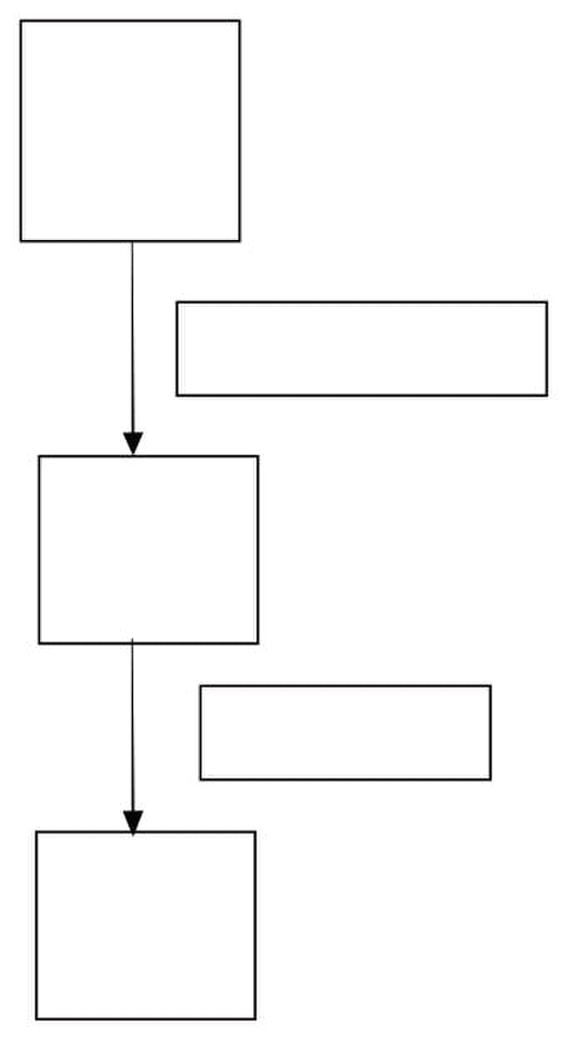
Web Design & Development – CS506 VU
Lesson 2
Java Virtual Machine & Runtime Environment
Basic Concept
When you write a program in C++ it is known as source code. The C++ compiler converts this source
code into the machine code of underlying system (e.g. Windows) If you want to run that code on Linux
you need to recompile it with a Linux based compiler. Due to the difference in compilers, sometimes you
need to modify your code.
Java has introduced the concept of WORA (write once run anywhere). When you write a java program it
is known as the source code of java. The java compiler does not compile this source code for any
underlying hardware system; rather it compiles it for a software system known as JVM (This compiled
code is known as byte code). We have different JVMs for different systems (such as JVM for Windows,
JVM for Linux etc). When we run our program the JVM interprets (translates) the compiled program into
the language understood by the underlying system. So we write our code once and the JVM runs it
everywhere according to the underlying system.
This concept is discussed in detail below
JAVA
Source
Code
Java Compiler javac
Java Byte
Code
Java Interpreter
Machine
Code
© Copyright Virtual University of Pakistan
16

Slide 17
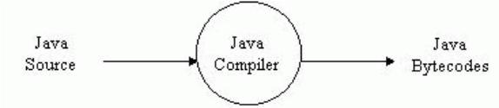












Web Design & Development – CS506 VU
Bytecode
Java programs (Source code) are compiled into a form called Java bytecodes.
The Java compiler reads Java language source (.java) files, translates the source into
Java bytecodes, and places the bytecodes into class (.class) files.
The compiler generates one class file for each class contained in java source file.
Java Virtual Machine (JVM)
The central part of java platform is java virtual machine
Java bytecode executes by special software known as a "virtual machine".
Most programming languages compile source code directly into machine code, suitable for execution
The difference with Java is that it uses bytecode - a special type of machine code.
The JVM executes Java bytecodes, so Java bytecodes can be thought of as the machine language
of the JVM.
App1 App2 App3 App4 App5
Java Virtual Machine
Windows Linux OS X Solaris Linux
Intel PowerPC SPARC
• JVM are available for almost all operating systems.
• Java bytecode is executed by using any operating system‘s JVM. Thus achieve portability.
© Copyright Virtual University of Pakistan
17

Slide 18

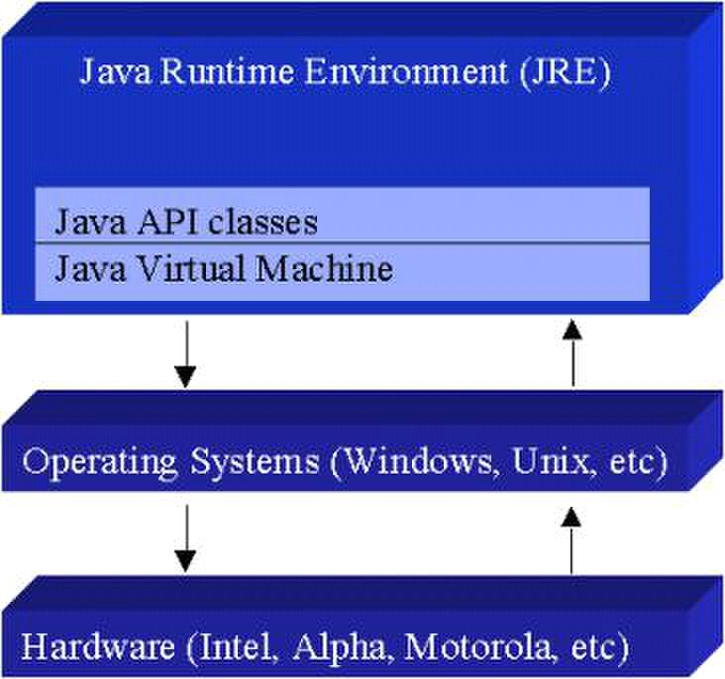
Web Design & Development – CS506 VU
Java Runtime Environment (JRE)
The Java Virtual Machine is a part of a large system i.e. Java Runtime Environment (JRE).
Each operating system and CPU architecture requires different JRE.
The JRE consists of set of built-in classes, as well as a JVM.
Without an available JRE for a given environment, it is impossible to run Java software.
References
Java World: http://www.javaworld.com
Inside Java: http://www.javacoffeebreak.com/articles/inside_java
© Copyright Virtual University of Pakistan
18

Slide 19














Web Design & Development – CS506 VU
Java Program Development and Execution Steps
Java program normally go through five phases. These are
1. Edit,
2. Compile,
3. Load,
4. Verify and
5. Execute
We look over all the above mentioned phases in a bit detail. First consider the following figure that
summarizes the all phases of a java program.
Phase 1
Compiler Disk bytecodes and stores
Primar
Phase 3 Class Loader
Class loader puts
Disk
Phase 4 Bytecode verifier
Memor
security restrictions.
Phase 5
Memor understand, possibly
y
© Copyright Virtual University of Pakistan
Editor Program is created in the
Compiler creates
them on disk.
y
y
bytecodes in memory.
Bytecode Verifier
y bytecodes are valid and
Interpreter reads
Interpreter them into a language that
storing data values as the
program executes.
19
editor and stored on disk.
Memor
Primar
y
do not violate Java‟s
bytecodes and translates
Primary the computer can
confirms that all

Slide 20

Web Design & Development – CS506 VU
Phase 1: Edit
Phase 1 consists of editing a file. This is accomplished with an editor program. The programmer types a
java program using the editor like notepad, and make corrections if necessary.
When the programmer specifies that the file in the editor should be saved, the program is stored on a secondary
storage device such as a disk. Java program file name ends with a
.java extension.
On Windows platform, notepad is a simple and commonly used editor for the beginners. However java
integrated development environments (IDEs) such as NetBeans, Borland JBuilder, JCreator and IBM‘s
Ecllipse have built-in editors that are smoothly integrated into the programming environment.
Phase 2: Compile
In Phase 2, the programmer gives the command javac to compile the program. The java compiler translates the
java program into bytecodes, which is the language understood by the java interpreter.
To compile a program called Welcome.java, type
javac Welcome.java
at the command window of your system. If the program compiles correctly, a file called Welcome.class is
produced. This is the file containing the bytecodes that will be interpreted during the execution phase.
Phase 3: Loading
In phase 3, the program must first be placed in memory before it can be executed. This is done by the class
loader, which takes the .class file (or files) containing the bytecodes and transfers it to memory. The .class file
can be loaded from a disk on your system or over a network (such as your local university or company network
or even the internet).
Applications (Programs) are loaded into memory and executed using the java interpreter
via the command java. When executing a Java application called Welcome, the command
Java Welcome
Invokes the interpreter for the Welcome application and causes the class loader to load information used in
the Welcome program.
© Copyright Virtual University of Pakistan
20

Slide 21

Web Design & Development – CS506 VU
Phase 4: Verify
Before the bytecodes in an application are executed by the java interpreter, they are verified by the bytecode verifier in
Phase 4. This ensures that the bytecodes for class that are loaded form the internet (referred to as downloaded classes)
are valid and that they do not violate Java‘s security restrictions.
Java enforces strong security because java programs arriving over the network should not be able to cause damage
to your files and your system (as computer viruses might).
Phase 5: Execute
Finally in phase 5, the computer, under the control of its CPU, interprets the program one bytecode at a time.
Thus performing the actions specified by the program.
Programs may not work on the first try. Each of the preceding phases can fail because of various errors. This
would cause the java program to print an error message. The programmer would return to the edit phase,
make the necessary corrections and proceed through the remaining phases again to determine id the corrections
work properly.
-----------------------------------------------
References:
Java™ How to Program 5th edition by Deitel & Deitel
Sun Java online tutorial: http://java.sun.com/docs/books/tutorial/java/index.html
© Copyright Virtual University of Pakistan
21

Slide 22

Web Design & Development – CS506 VU
Installation and Environment Setting
Installation
• Download the latest version j2se5.0 (java 2 standard edition) from http://java.sun.com
or get it from any other source like CD.
Note: j2se also called jdk (java development kit). You can also use the previous versions like jdk 1.4 or
1.3 etc. but it is recommended that you use either jdk1.4 or jdk5.0
• Install j2se5.0 on your system
Note: For the rest of this handout, assume that j2se is installed in C:\Program
Files\Java\jdk1.5.0
Environment Setting
Once you successfully installed the j2se, the next step is environment or path setting. You can
accomplish this in either of two ways.
• Temporary Path Setting
Open the command prompt from Start Æ Programs Æ Accessories Æ Comman
Prompt. The command prompt screen would be opened in front of you.
Write the command on the command prompt according to the following format
path = < java installation directory\bin >
So, according to handout, the command will look like this
path = C:\Program Files\Java\jdk1.5.0\bin
To Test whether path has been set or not, write javac and press ENTER. If the list ofn b
options displayed as shown in the below figure means that you have successfully
completed the steps of path setting.
The above procedure is illustrates in the given below picture.
© Copyright Virtual University of Pakistan
22

Slide 23
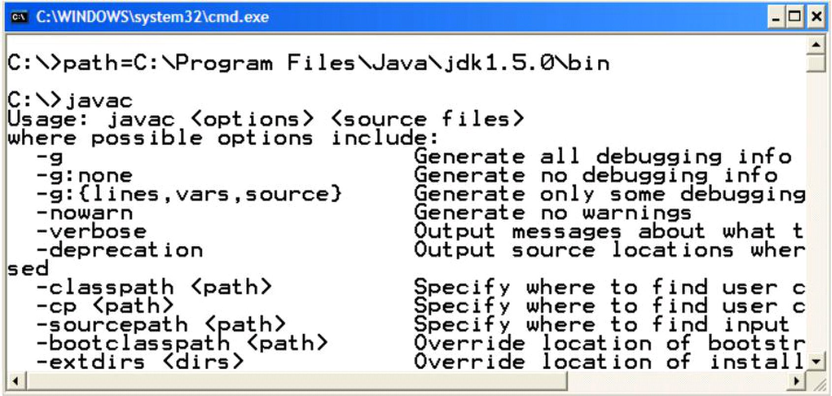
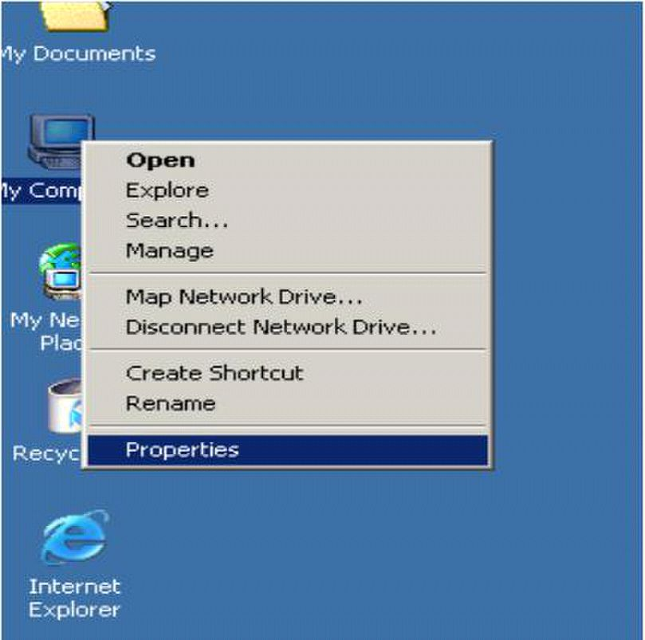
Web Design & Development – CS506 VU
Note: The issue with the temporary path setting is you have to repeat the above explained procedure
again and again each time you open a new command prompt window. To avoid this overhead, it is better
to set your path permanently
• Permanent Path Setting
In Windows NT (XP, 2000), you can set the permanent environment variable.
Right click on my computer icon click on properties as shown below
© Copyright Virtual University of Pakistan
23

Slide 24
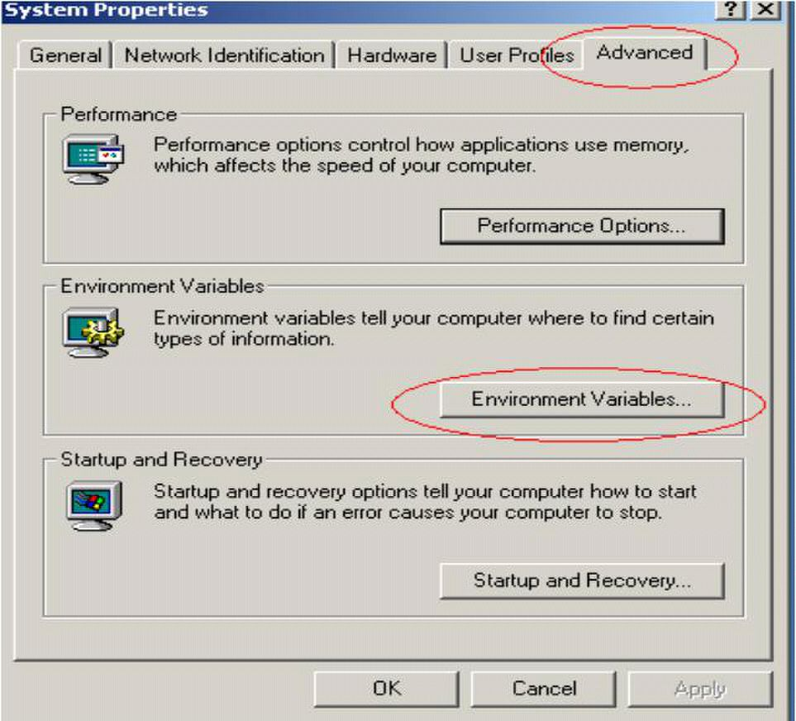
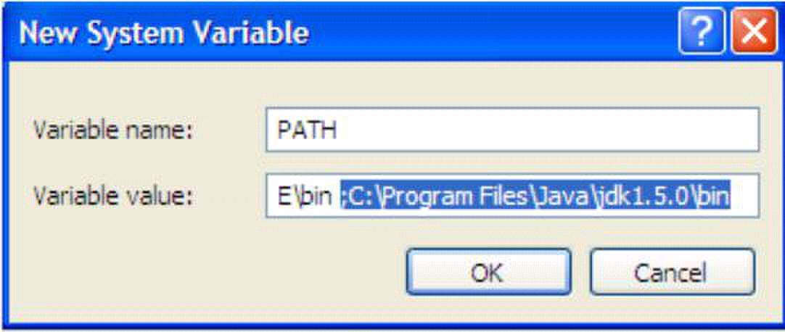
Web Design & Development – CS506 VU
A System Properties frame would appeared as shown in the picture
Select the advanced tab followed by clicking the Environment Variable button. The
Environment variables frame would be displayed in front of you
Locate the Path variable in the System or user variables, if it is present there, select it by single
click. Press Edit button. The following dialog box would be appeared.
• Write; C:\Program Files\Java\jdk1.5.0\bin at the end of the value field. Press OK button.
Remember to write semicolon (;) before writing the path for java installation directory as illustrate in
the above figure
• If Path variable does not exist, click the New button. Write variable name
―PATH‖, variable value C:\Program Files\Java\jdk1.5.0\bin and press OK button.
© Copyright Virtual University of Pakistan
24

Slide 25
Web Design & Development – CS506 VU
• Now open the command prompt and write javac, press enter button. You see the list of options
would be displayed.
• After setting the path permanently, you have no need to set the path for each new opened
command prompt.
References
Entire material for this handout is taken from the book JAVA A Lab Course by Umair Javed. This material is
available just for the use of VU students of the course Web Design and Development and not for any other
commercial purpose without the consent of author.
© Copyright Virtual University of Pakistan
25

Slide 26

Web Design & Development – CS506 VU
First Program in Java
Like any other programming language, the java programming language is used to create applications. So, we
start from building a classical ―Hello World‖ application, which is generally used as the first program for
learning any new language.
HelloWorldApp
1. Open notepad editor from Start Æ ProgarmFiles Æ AccessoriesÆ Notepad.
2. Write the following code into it.
Note: Don‘t copy paste the given below code. Probably it gives errors and you can‘t able to remove them at the
beginning stage.
1. /* The HelloWorldApp class implements an application that
2. simply displays "Hello World!" to the standard output.
3. */
4. public class HelloWorldApp {
5. public static void main(String[] args) {
6. //Display the string. No global main
7.
9. }
3. To save your program, move to File menu and choose save as option.
4. Save your program as ―HelloWorldApp.java‖ in some directory. Make sure to add double quotes around
class name while saving your program. For this example create a folder known as ―examples‖ in D: drive
Note: Name of file must match the name of the public class in the file (at line 4). Moreover, it is case
sensitive. For example, if your class name is MyClass, than file name must be MyClass. Otherwise the
Java compiler will refuse to compile the program.
For the rest of this handout, we assume that program is saved in D:\examples directory.
© Copyright Virtual University of Pakistan
System.out.println(―Hello World‖);
8. }
26

Slide 27
Web Design & Development – CS506 VU
HelloWorldApp Described
Lines 1-3
Like in C++, You can add multiple line comments that are ignored by the compiler.
Lines 4
Line 4 declares the class name as HelloWorldApp. In java, every line of code must reside inside class. This is
also the name of our program (HelloWorldApp.java). The compiler creates the HelloWorldApp.class if this
program successfully gets compiled.
Lines 5
Line 5 is where the program execution starts. The java interpreter must find this defined exactly as
given or it will refuse to run the program. (However you can change the name of parameter that is
passed to main. i.e. you can write String[] argv or String[] some Param instead of String[] args)
Other programming languages, notably C++ also use the main( ) declaration as the starting point for
execution. However the main function in C++ is global and reside outside of all classes where as in Java
the main function must reside inside a class. In java there are no global variables or functions. The various
parts of this main function declaration will be covered at the end of this handout.
Lines 6
Again like C++, you can also add single line comment
Lines 7
Line 7 illustrates the method call. The println( ) method is used to print something on the console.
In this example println( ) method takes a string argument and writes it to the standard output i.e. console.
Lines 8-9
Line 8-9 of the program, the two braces, close the method main( ) and the class
HelloWorldApp respectively.
© Copyright Virtual University of Pakistan
27

Slide 28
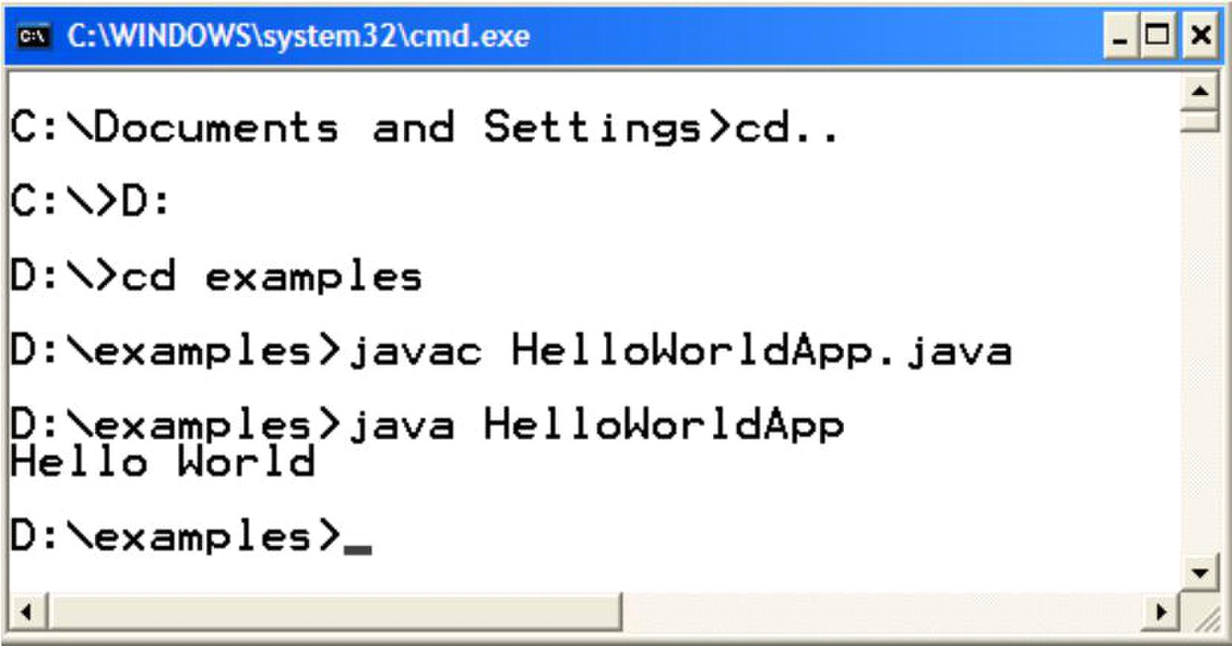
Web Design & Development – CS506 VU
Compiling and Running HelloWorldApp
1. Open the command prompt from Start Æ Program Files Æ Accessories. OR
alternatively you can write cmd in the run command window.
2. Write cd.. to came out from any folder, and cd [folder name] to move inside the specified directory. To
move from one drive to another, use [Drive Letter]: See figure given below
3. After reaching to the folder or directory that contains your source code, in our case
HelloWorldApp.java.
4. Use “javac” on the command line to compile the source file (―.java‖ file).
D:\examples> javac HelloWorld.java
5. If program gets successfully compiled, it will create a new file in the same directory named
HelloWorldApp.class that contains the byte-code.
6. Use ―java‖ on the command line to run the compiled .class file. Note ―.class‖ would be added with the file
name.
D:\examples> java HelloWorld
7. You can see the Hello World would be printed on the console. Hurrah! You are successful in writing,
compiling and executing your first program in java ☺
Points to Remember
• Recompile the class after making any changes
• Save your program before compilation
• Only run that class using java command that contains the main method, because program executions
always starts form main
© Copyright Virtual University of Pakistan
28

Slide 29

Web Design & Development – CS506 VU
An Idiom Explained
You will see the following line of code often:
– public static void main(String args[]) { …}
• About main()
―main‖ is the function from which your program starts
Why public?
Since main method is called by the JVM that is why it is kept public so that it is
accessible from outside. Remember private methods are only accessible from within the
class
Why static?
Every Java program starts when the JRE (Java Run Time Environment) calls the
main method of that program. If main is not static then the JRE have to create an
object of the class in which main method is present and call the main method on that
object (In OOP based languages method are called using the name of object if they are
not static). It is made static so that the JRE can call it without creating an object.
Also to ensure that there is only one copy of the main method per class
Why void?
• Indicates that main ( ) does not return anything.
What is String args[] ?
Way of specifying input (often called command-line arguments) at startup of
application. More on it latter
References
Entire material for this handout is taken from the book JAVA A Lab Course by Umair Javed. This material is
available just for the use of VU students of the course Web Design and Development and not for any other
commercial purpose with out the consent of author.
© Copyright Virtual University of Pakistan
2

Slide 30
Web Design & Development – CS506 VU
Lesson 3
Learning Basics
Strings
A string is commonly considered to be a sequence of characters stored in memory and accessible as a unit.
Strings in java are represented as objects.
String Concatenation
―+‖ operator is used to concatenate strings
– System.out.pritln(―Hello‖ + ―World‖) will print Hello World on console
String concatenated with any other data type such as int will also convert that datatype to String and
the result will be a concatenated String displayed on console. For example,
– int i = 4;
– int j = 5;
System.out.println (―Hello‖ + i)
will print Hello 4 on screen
– However
System,.out..println( i+j) ;
will print 9 on the console because both i and j are of type int.
Comparing Strings
For comparing Strings never use == operator, use equals method of String class.
– == operator compares addresses (shallow comparison) while equals compares values (deep
comparison)
E.g string1.equals(string2)
© Copyright Virtual University of Pakistan
3

Slide 31

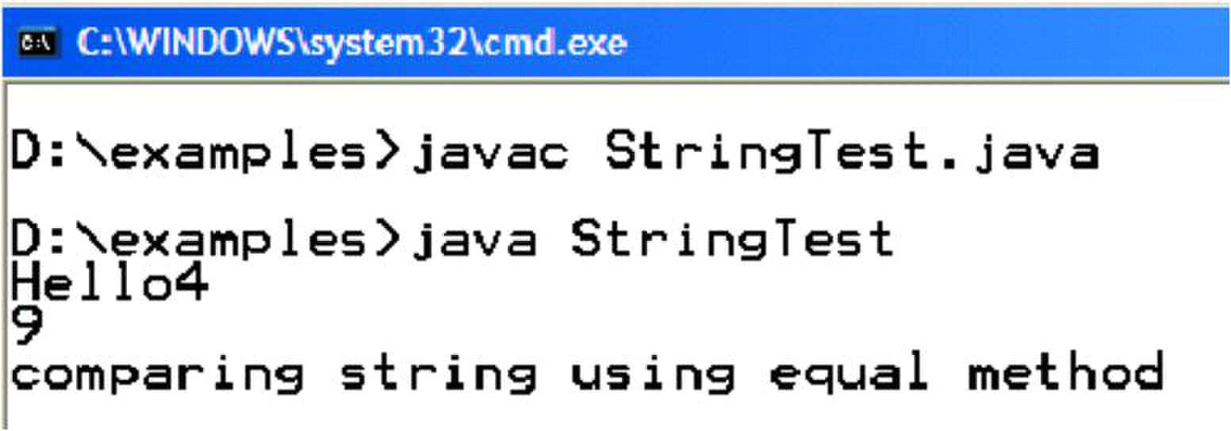
Web Design & Development – CS506 VU
Example Code: String concatenation and comparison
public class StringTest {
public static void main(String[] args) {
int i = 4;
int j = 5;
System.out.println("Hello" + i); // will print Hello4
System.out.println(i + j); // will print 9
String s1 = new String (―pakistan‖);
String s2 = ―pakistan‖;
if (s1 == s2) {
System.out.println(―comparing string using == operator‖);
}
if (s1.equals( s2) ) {
System.out.println(―comparing string using equal method‖);
}
}
}
On execution of the above program, following output will produce
© Copyright Virtual University of Pakistan
31

Slide 32



Web Design & Development – CS506 VU
Taking in Command Line Arguments
In Java, the program can be written to accept command-line-arguments.
Example Code: command-line arguments
/* This Java application illustrates the use of Java command-line arguments. */
public class CmdLineArgsApp {
public static void main(String[] args){ //main method
System.out.println(‖First argument ‖ + args[0]);
System.out.println(‖Second argument ‖ + args[1]);
}//end main
}//End class.
To execute this program, we pass two arguments as shown below:
public void someMethod( ) {
int x; //local variable
System.out.println(x); // compile time error
• These parameters should be separated by space. .
• The parameters that we pass from the command line are stored as Strings inside the ―args‖ array. You
can see that the type of ―args‖ array is String.
Example Code: Passing any number of arguments
In java, array knows their size by using the length property. By using, length property we can determine how
many arguments were passed. The following code example can accept any number of arguments
/* This Java application illustrates the use of Java
command-line arguments. */
public class AnyArgsApp {
public static void main(String[] args){ //main method
for(int i=0; i < args.length; i++)
System.out.println(―Argument:‖ + i + ―value‖ +args[i]);
}//end main
}//End class.
© Copyright Virtual University of Pakistan
32

Slide 33

Web Design & Development – CS506 VU
Output
C:\java AnyArgsApp i can pass any number of arguments
Argument:0 value i Argument:1 value can
Argument:2 value pass Argument:3 value
any Argument:4 value number Argument:5
value of Argument:6 value arguments
© Copyright Virtual University of Pakistan
33

Slide 34


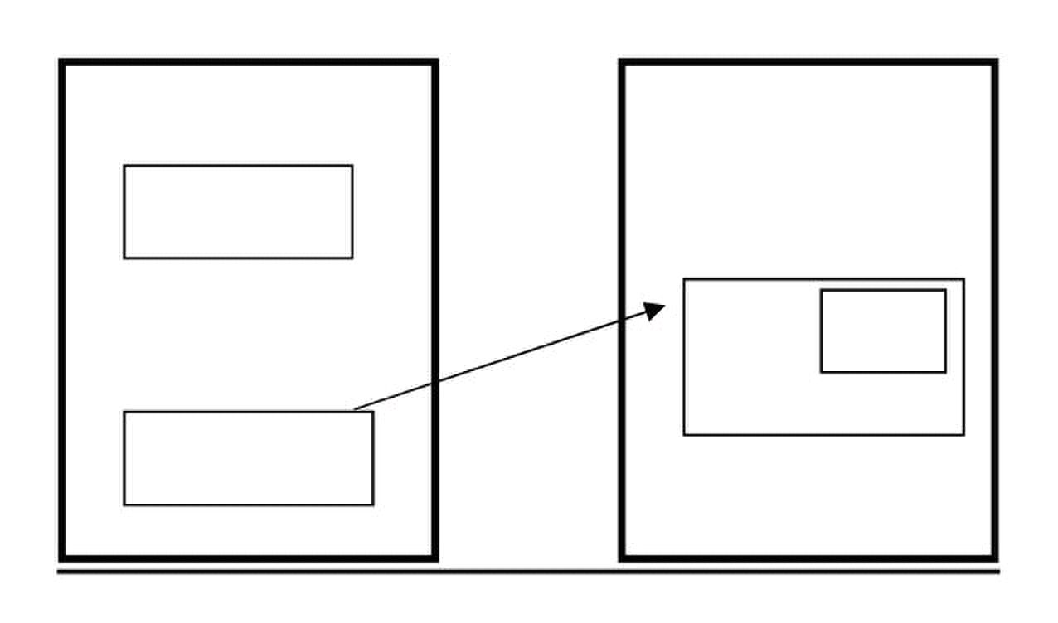
Web Design & Development – CS506 VU
Primitives vs Objects
• Everything in Java is an ―Object‖, as every class by default inherits from class
―Object‖ , except a few primitive data types, which are there for efficiency reasons.
• Primitive Data Types
Primitive Data types of java
boolean, byte 1 byte
char, short 2 bytes
int, float 4 bytes
long, double 8 bytes
• Primitive data types are generally used for local variables, parameters and instance variables
(properties of an object)
• Primitive datatypes are located on the stack and we can only access their value, while objects are
located on heap and we have a reference to these objects
• Also primitive data types are always passed by value while objects are always passed by reference in
java. There is no C++ like methods
– void someMethod(int &a, int & b ) // not available in java
Stack vs. Heap
Stack and heap are two important memory areas. Primitives are created on the stack while objects are
created on heap. This will be further clarified by looking at the following diagram that is taken from Java
Lab Course.
int num = 5;
Student s = new Student();
5
0F59
name
0F59
© Copyright Virtual University of Pakistan
Stack Heap
num
ali
34

Slide 35
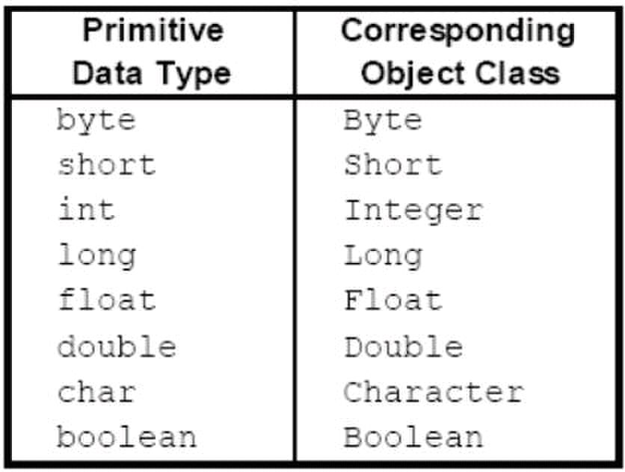
Web Design & Development – CS506 VU
Wrapper Classes
Each primitive data type has a corresponding object (wrapper class). These wrapper classes provides
additional functionality (conversion, size checking etc.), which a primitive data type cannot provide.
Wrapper Use
You can create an object of Wrapper class using a String or a primitive data type
• Integer num = new Integer(4); or
• Integer num = new Integer(―4‖);
Note: num is an object over here not a primitive data type
You can get a primitive data type from a Wrapper using the corresponding value function
• int primNum = num.intValue();
Converting Strings to Numeric Primitive Data Types
To convert a string containing digits to a primitive data type, wrapper classes can help. parseXxx method can
be used to convert a String to the corresponding primitive data type.
String value = ―532‖;
int d = Integer.parseInt(value);
String value = ―3.14e6‖;
double d = Double.parseDouble(value);
© Copyright Virtual University of Pakistan
35

Slide 36


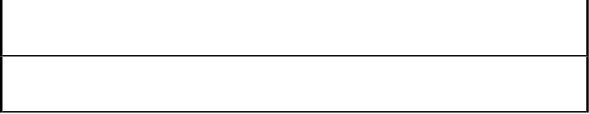
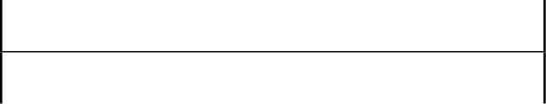

Web Design & Development – CS506 VU
The following table summarizes the parser methods available to a java programmer.
Data Type Convert String using either …
byte Byte.parseByte(string )
new Byte(string ).byteValue()
short Short.parseShort(string )
new Short(string ).shortValue()
int Integer.parseInteger(string )
new Integer(string ).intValue()
long Long.parseLong(string )
new Long(string ).longValue()
float Float.parseFloat(string )
new Float(string ).floatValue()
double Double.parseDouble(string )
new Double(string ).doubleValue()
© Copyright Virtual University of Pakistan
36

Slide 37

Web Design & Development – CS506 VU
Example Code: Taking Input / Output
So far, we learned how to print something on console. Now the time has come to learn how to print on the
GUI. Taking input from console is not as straightforward as in C++. Initially we‘ll study how to take input
through GUI (by using JOPtionPane class).
The following program will take input (a number) through GUI and prints its square on the console as well on
GUI.
1. import javax.swing.*;
2. public class InputOutputTest {
3. public static void main(String[] args) {
4. //takes input through GUI
5. String nput = JOptionPane.showInputDialog("Enter number");
6. int number = Integer.parseInt(input);
7. int square = number * number;
8. //Display square on console
9. System.out.println("square:" + square);
10. //Display square on GUI
11. JOptionPane.showMessageDialog(null, "square:"+ square);
12. System.exit(0);
13. }
14. }
On line 1, swing package was imported because it contains the JOptionPane class that will be used for taking
input from GUI and displaying output to GUI. It is similar to header classes of C++.
On line 5, showInputDialog method is called of JOptionPane class by passing string argument that will be
displayed on GUI (dialog box). This method always returns back a String regardless of whatever you entered (int,
float, double, char) in the input filed.
Our task is to print square of a number on console, so we first convert a string into a number by calling
parseInt method of Integer wrapper class. This is what we done on line number 6.
Line 11 will display square on GUI (dialog box) by using showMessageDialog method of JOptionPane class. The
first argument passed to this method is null and the second argument must be a String. Here we use string
concatenation.
Line 12 is needed to return the control back to command prompt whenever we use
JoptionPane class.
© Copyright Virtual University of Pakistan
37

Slide 38
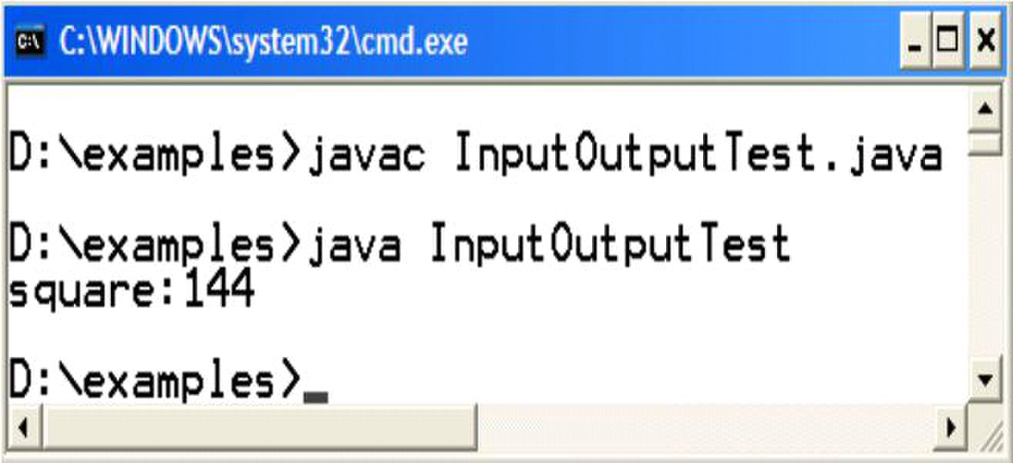
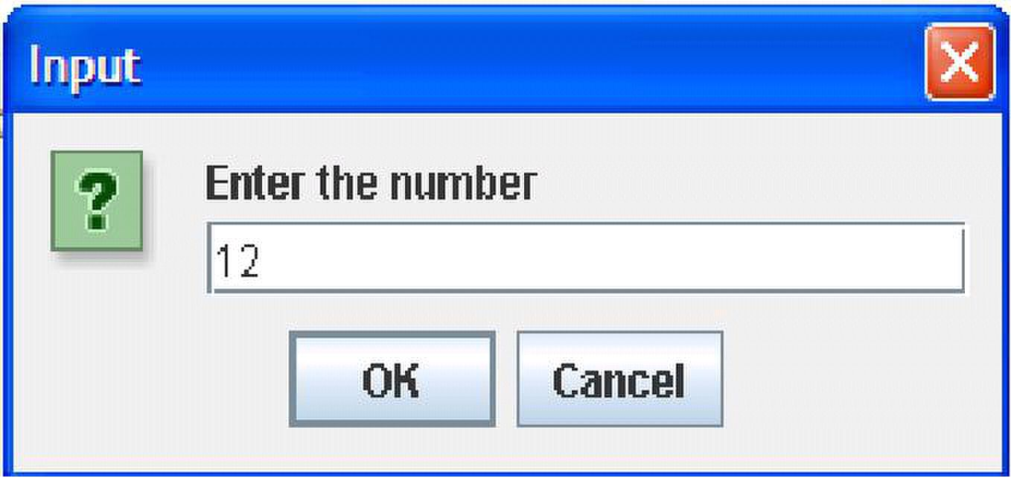
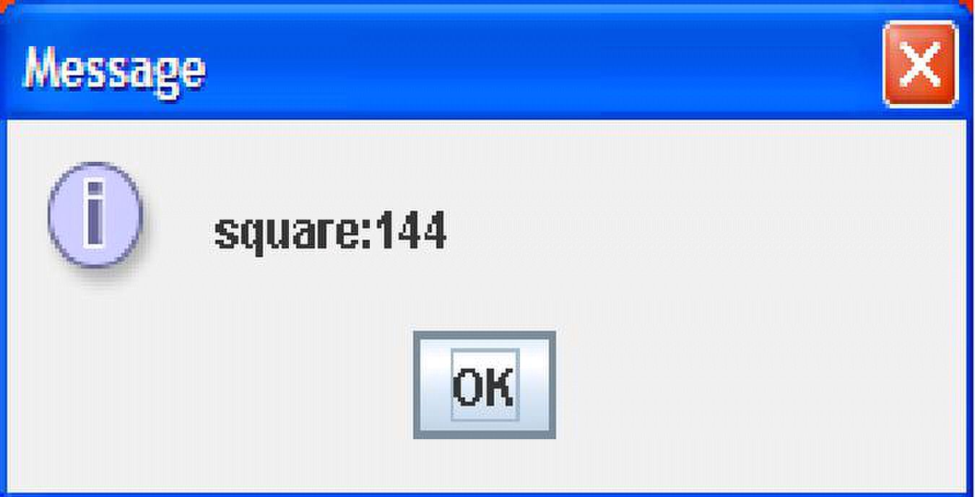
Web Design & Development – CS506 VU
Compile & Execute
© Copyright Virtual University of Pakistan
38

Slide 39

Web Design & Development – CS506 VU
Selection & Control Structure
The if-else and switch selection structures are exactly similar to we have in C++. All relational operators that
we use in C++ to perform comparisons are also available in java with same behavior. Likewise for, while and do-
while control structures are alike to C++.
Reference:
1- Java tutorial: http://www.dickbaldwin.com/java
2- Example code, their explanations and corresponding figures for this handout are taken from the book JAVA
A Lab Course by Umair Javed. This material is available just for the use of VU students of the course Web
Design and Development and not for any other commercial purpose without the consent of author.
© Copyright Virtual University of Pakistan
39

Slide 40
Web Design & Development – CS506 VU
Lesson 4
Object Oriented Programming
Java is fundamentally object oriented. Every line of code you write in java must be inside a class (not counting
import directives). OOP fundamental stones Encapsulation, Inheritance and Polymorphism etc. are all fully
supported by java.
OOP Vocabulary Review
• Classes
– Definition or a blueprint of a user-defined datatype
– Prototypes for objects
– Think of it as a map of the building on a paper
• Objects
– Nouns, things in the world
– Anything we can put a thumb on
– Objects are instantiated or created from class
• Constructor
– A special method that is implicitly invoked. Used to create an Object (that is, an Instance of the
Class) and to initialize it.
• Attributes
– Properties an object has.
• Methods
– Actions that an object can do
© Copyright Virtual University of Pakistan
40

Slide 41
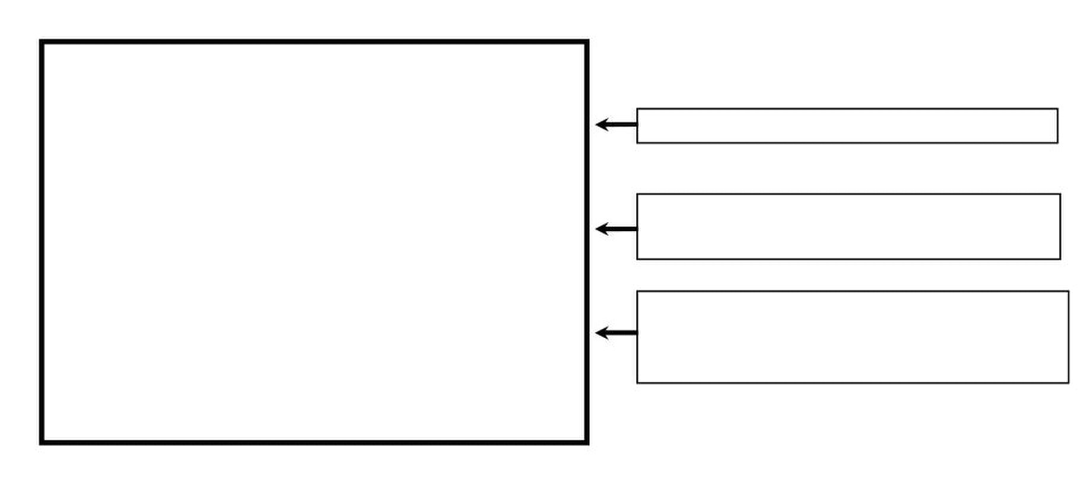
Web Design & Development – CS506 VU
Defining a Class
class Point {
private int xCord; inastance variables and symbolic constants
private int yCord;
public Point (……) {……}
public void display (……)
{
……….
}
} //end of class
Comparison with C++
Some important points to consider when defining a class in java as you probably noticed from the above given
skeleton are
– There are no global variables or functions. Everything resides inside a class. Remember we wrote
our main method inside a class. (For example, in HelloWorldApp program)
– Specify access modifiers (public, private or protected) for each member method or data members at
every line.
– public: accessible anywhere by anyone
– private: Only accessible within this class
– protect: accessible only to the class itself and to it‘s subclasses or other classes in the same
package.
– default: default access if no access modifier is provided. Accessible to all classes in the same
package.
– There is no semicolon (;) at the end of class.
– All methods (functions) are written inline. There are no separate header and implementation files.
– Automatic initialization of class level data members if you do not initialize them
Primitives
o Numeric (int, float etc) with zero
© Copyright Virtual University of Pakistan
constructor – how to create and initialize
objects
methods – how to manipulate those objects
(may or may not include its own ―driver‖,
i.e., main( ))
41

Slide 42

Web Design & Development – CS506 VU
o Char with null
o Boolean with false
Object References
– With null
Note: Remember, the same rule is not applied to local variables (defined inside method body). Using a
local variable without initialization is a compile time error
Public void someMethod( ) {
int x; //local variable
System.out.println(x); // compile time error
}
– Constructor
– Same name as class name
– Does not have a return type
– No initialization list
– JVM provides a zero argument (default) constructor only if a class doesn‘t define it‘s own
constructor
– Destructors
– Are not required in java class because memory management is the responsibility of JVM.
© Copyright Virtual University of Pakistan
42

Slide 43

Web Design & Development – CS506 VU
Task – Defining a Student class
The following example will illustrate how to write a class. We want to write a
―Student‖ class that
– should be able to store the following characteristics of student
– Roll No
– Name
– Provide default, parameterized and copy constructors
– Provide standard getters/setters (discuss shortly) for instance variables
– Make sure, roll no has never assigned a negative value i.e. ensuring the correct state of the
object
– Provide print method capable of printing student object on console
Getters / Setters
The attributes of a class are generally taken as private or protected. So to access them outside of a class, a
convention is followed knows as getters & setters. These are generally public methods. The words set
and get are used prior to the name of an attribute. Another important purpose for writing getter &
setters to control the values assigned to an attribute.
Student Class Code
// File Student.java
public class Student {
private String name;
private int rollNo;
// Standard Setters
public void setName (String name) {
}
// Note the masking of class level variable rollNo
public void setRollNo (int rollNo) {
if (rollNo > 0) {
this.rollNo = rollNo;
}else {
}
// Standard Getters
public String getName ( ) {
}
© Copyright Virtual University of Pakistan
this.name = name;
}
return name;
43
this.rollNo = 100;

Slide 44

Web Design & Development – CS506 VU
public int getRollNo ( ) {
}
// Default Constructor public Student() {
name = ―not set‖;
}
// parameterized Constructor for a new student
public Student(String name, int rollNo) {
setName(name); //call to setter of name
}
// Copy Constructor for a new student
public Student(Student s) {
name = s.name;
}
// method used to display method on console
public void print () {
System.out.print("Student name: " +name);
}
} // end of class
© Copyright Virtual University of Pakistan
return rollNo;
rollNo = 100;
setRollNo(rollNo); //call to setter of rollNo
rollNo = s.rollNo;
System.out.println(", roll no: " +rollNo);
44

Slide 45

Web Design & Development – CS506 VU
Using a Class
Objects of a class are always created on heap using the ―new‖ operator followed by constructor
• Student s = new Student ( ); // no pointer operator ―*‖ between Student and s
• Only String constant is an exception
String greet = ―Hello‖ ; // No new operator
• However you can also use
String greet2 = new String(―Hello‖);
Members of a class ( member variables and methods also known as instance variables/methods ) are
accessed using ―.‖ operator. There is no ―Æ‖ operator in java
s.setName(―Ali‖);
sÆsetName(―Ali‖) is incorrect and will not compile in java
Note: Objects are always passed by reference and primitives are always passed by value in java.
Task - Using Student Class
Create objects of student class by calling default, parameterize and copy constructor
Call student class various methods on these objects
Student client code
// File Test.java
/* This class create Student class objects and demonstrates
how to call various methods on objects
*/
public class Test{
public static void main (String args[]){
// Make two student obejcts
Student s1 = new Student("ali", 15);
Student s2 = new Student(); //call to default costructor
s1.print(); // display ali and 15
s2.print(); // display not set and 100
s2.setName("usman");
s2.setRollNo(20);
System.out.print("Student name:" + s2.getName());
System.out.println(" rollNo:" + s2.getRollNo());
© Copyright Virtual University of Pakistan
45

Slide 46

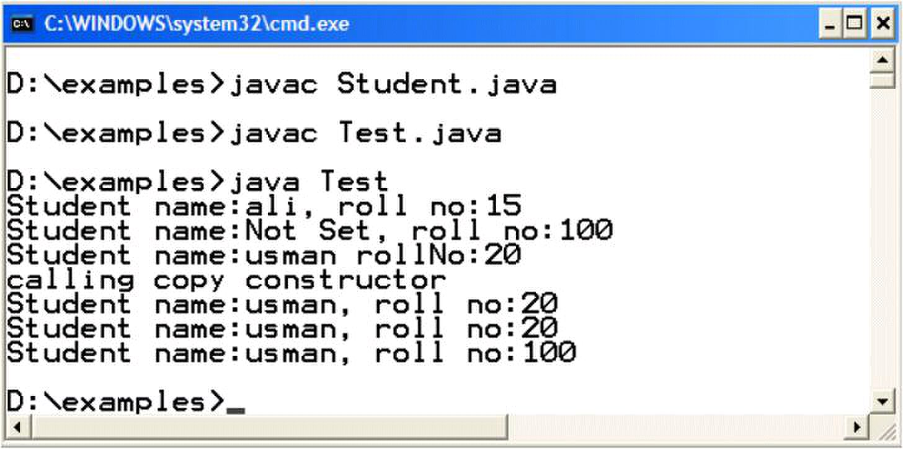
Web Design & Development – CS506 VU
System.out.println("calling copy constructor");
Student s3 = new Student(s2); //call to copy constructor
s2.print();
s3.print();
s3.setRollNo(-10); //Roll No of s3 would be set to 100
s3.print();
/*NOTE: public vs. private
A statement like "b.rollNo = 10;" will not compile in a
client of the Student class when rollNo is declared
protected or private
*/
} //end of main
} //end of class
Compile & Execute
Compile both classes using javac commad. Run Test class using java command.
© Copyright Virtual University of Pakistan
46

Slide 47
Web Design & Development – CS506 VU
More on Classes
Static
A class can have static variables and methods. Static variables and methods are associated with the
class itself and are not tied to any particular object. Therefore statics can be accessed without instantiating an
object. Static methods and variables are generally accessed by class name.
The most important aspect of statics is that they occur as a single copy in the class regardless of the
number of objects. Statics are shared by all objects of a class. Non static methods and instance variables are not
accessible inside a static method because no this reference is available inside a static method.
We have already used some static variables and methods. Examples are
System.out.println(―some text‖); -- out is a static variable
JOptionPane.showMessageDialog(null, ―some text‖); -- showMessageDialog is a static method
Garbage Collection & Finalize
Java performs garbage collection and eliminates the need to free objects explicitly. When an object has no
references to it anywhere except in other objects that are also unreferenced, its space can be reclaimed.
Before an object is destroyed, it might be necessary for the object to perform some action. For example:
to close an opened file. In such a case, define a finalize() method with the actions to be performed before the
object is destroyed.
finalize
When a finalize method is defined in a class, Java run time calls finalize() whenever it is about to recycle an
object of that class. It is noteworthy that a garbage collector reclaims objects in any order or never reclaims
them. We cannot predict and assure when garbage collector will get back the memory of unreferenced objects.
The garbage collector can be requested to run by calling System.gc() method. It is not necessary that it accepts the
request and run.
© Copyright Virtual University of Pakistan
47

Slide 48

Web Design & Development – CS506 VU
Example Code: using static & finalize ()
We want to count exact number of objects in memory of a Student class the one defined earlier. For this
purpose, we‘ll modify Student class.
Add a static variable countStudents that helps in maintaining the count of student objects.
Write a getter for this static variable. (Remember, the getter also must be static one. Hoping so, you
know the grounds).
In all constructors, write a code that will increment the countStudents by one.
Override finalize() method and decrement the countStudents variable by one.
Override toString() method.
Class Object is a superclass (base or parent) class of all the classes in java by default. This class has already
finalize() and toString() method (used to convert an object state into string). Therefore we are actually
overriding these methods over here. (We‘ll talk more about these in the handout on inheritance).
By making all above modifications, student class will look like
// File Student.java
public class Student {
private String name;
private int rollNo;
private static int countStudents = 0;
// Standard Setters
public void setName (String name) {
}
// Note the masking of class level variable rollNo
public void setRollNo (int rollNo) {
if (rollNo > 0) {
this.rollNo = rollNo;
}else {
}
// Standard Getters
public String getName ( ) {
}
public int getRollNo ( ) {
}
© Copyright Virtual University of Pakistan
this.name = name;
}
return name;
return rollNo;
48
this.rollNo = 100;

Slide 49

Web Design & Development – CS506 VU
// gettter of static countStudents variable
public static int getCountStudents(){
}
// Default Constructor public Student() {
name = ―not set‖;
rollNo = 100;
countStudents += 1;
}
// parameterized Constructor for a new student
public Student(String name, int rollNo) {
setName(name); //call to setter of name
setRollNo(rollNo); //call to setter of rollNo
countStudents += 1;
}
// Copy Constructor for a new student
public Student(Student s) {
name = s.name;
rollNo = s.rollNo;
countStudents += 1;
}
// method used to display method on console
public void print () {
System.out.print("Student name: " +name);
}
// overriding toString method of java.lang.Object class
public String toString(){
}
// overriding finalize method of Object class
public void finalize(){
}
} // end of class
Next, we‘ll write driver class. After creating two objects of student class, we deliberately loose object‘s reference
and requests the JVM to run garbage collector to reclaim the memory. By printing countStudents value, we
can confirm that. Coming up code is of the Test class.
© Copyright Virtual University of Pakistan
return countStudents;
System.out.println(", roll no: " +rollNo);
return “name: ” + name + “ RollNo: ” + rollNo;
countStudents -= 1;
49

Slide 50

Web Design & Development – CS506 VU
// File Test.java
public class Test{
public static void main (String args[]){
int numObjects;
// printing current number of objects i.e 0
numObjs = Student.getCountStudents();
System.out.println(―Students Objects‖ + numObjects);
// Creating first student object & printing its values
Student s1 = new Student("ali", 15);
System.out.println(―Student: ‖ + s1.toString());
// printing current number of objects i.e. 1
numObjs = Student.getCountStudents();
System.out.println(―Students Objects‖ + numObjects);
// Creating second student object & printing its values
Student s2 = new Student("usman", 49);
// implicit call to toString() method
System.out.println(―Student: ‖ + s2);
// printing current number of objects i.e. 2
numObjs = Student.getCountStudents();
System.out.println(―Students Objects‖ + numObjects);
// loosing object reference
s1 = null
// requesting JVM to run Garbage collector but there is
// no guarantee that it will run
System.gc();
// printing current number of objects i.e. unpredictable
numObjs = Student.getCountStudents();
System.out.println(―Students Objects‖ + numObjects);
} //end of main
} //end of class
© Copyright Virtual University of Pakistan
50

Slide 51
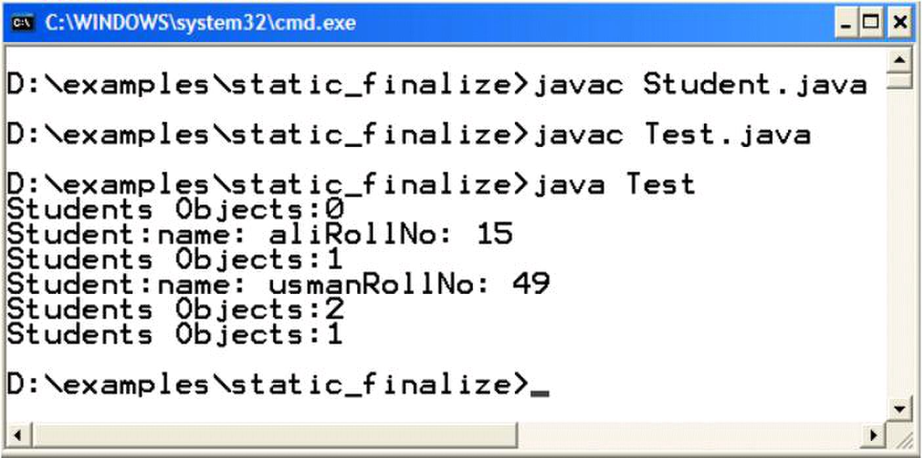
Web Design & Development – CS506 VU
The compilation and execution of the above program is given below. Note that output may be different
one given here because it all depends whether garbage collector reclaims the memory or not. Luckily, in my
case it does.
Reference:
Sun java tutorial: http://java.sun.com/docs/books/tutorial/java
Thinking in java by Bruce Eckle
Beginning Java2 by Ivor Hortan
Example code, their explanations and corresponding execution figures for this handout are taken
from the book JAVA A Lab Course by Umair Javed. This material is available just for the use of VU
students of the course Web Design and Development and not for any other commercial purpose
without the consent of author.
© Copyright Virtual University of Pakistan
51

Slide 52
Web Design & Development – CS506 VU
Lesson 5
Inheritance
In general, inheritance is used to implement a ―is-a‖ relationship. Inheritance saves code rewriting for a client
thus promotes reusability.
In java parent or base class is referred as super class while child or derived class is known as sub class.
Comparison with C++
•Java only supports single inheritance. As a result a class can only inherit from one class at one time.
•Keyword extends is used instead of ―:‖ for inheritance.
•All functions are virtual by default
•All java classes inherit from Object class (more on it later).
•To explicitly call the super class constructor, use super keyword. It‘s important to remember that call to
super class constructor must be first line.
•Keyword super is also used to call overridden methods.
© Copyright Virtual University of Pakistan
52

Slide 53

Web Design & Development – CS506 VU
Example Code: using inheritance
We‘ll use three classes to get familiar you with inheritance. First one is Employee class. This will act as super
class. Teacher class will inherit from Employee class and Test class is driver class that contains main method. Let‘s
look at them one by one
class Employee{
protected int id;
protected String name;
//parameterized constructor
public Employee(int id, String name){
this.id = id;
this.name = name;
}
//default constructor
public Employee(){
// calling parameterized constructor of same (Employee)
// class by using keyword this
}
//setters
public void setId (int id) {
this.id = id;
}
public void setName (String name) {
this.name = name;
}
//getters
public int getId () {
return id;
}
public String getName () {
return name;
}
// displaying employee object on console
public void display(){
System.out.println(―in employee display method‖);
System.out.println("Employee id:" + id + " name:" + name);
}
//overriding object‘s class toString method
public String toString() {
System.out.println(―in employee toString method‖);
}
}//end class
© Copyright Virtual University of Pakistan
this (10, ―not set‖);
return "id:" + id + "name:" + name;
53

Slide 54

Web Design & Development – CS506 VU
The Teacher class extends from Employee class. Therefore Teacher class is a subclass of
Employee. The teacher class has an additional attribute i.e. qualification.
class Teacher extends Employee{
private String qual;
//default constructor
public Teacher () {
//implicit call to superclass default construct
qual = "";
}
//parameterized constructor
public Teacher(int i, String n, String q){
//call to superclass param const must be first line
super(i,n);
qual = q;
}
//setter
public void setQual (String qual){
this.qual = qual;
}
//getter
public String getQual(){
return qual;
}
//overriding display method of Employee class
public void display(){
System.out.println("in teacher's display method");
super.display(); //call to superclass display method
System.out.println("Teacher qualification:" + qual);
}
//overriding toString method of Employee class
public String toString() {
System.out.println("in teacher's toString method");
String emp = super.toString();
return emp +" qualification:" + qual;
}
}//end class
© Copyright Virtual University of Pakistan
54

Slide 55

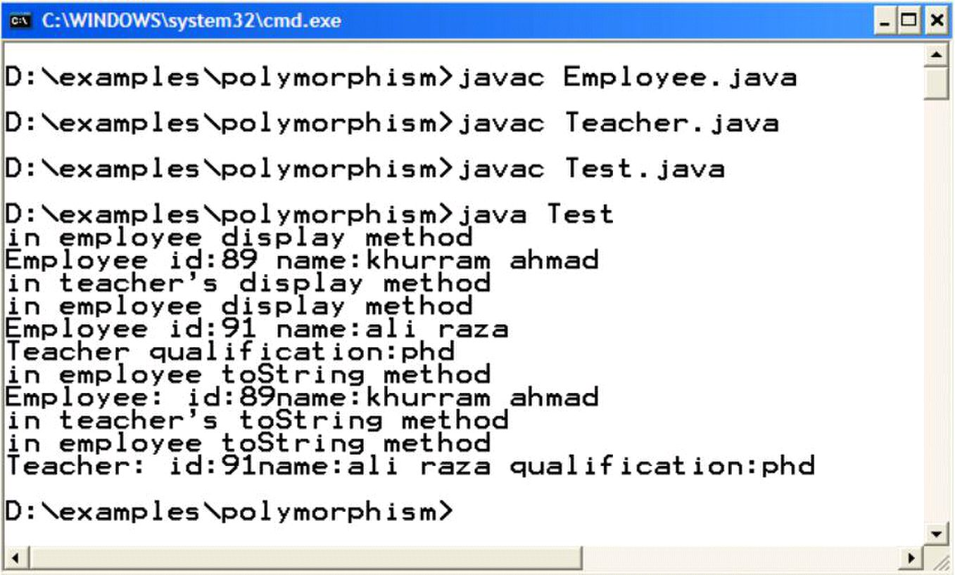
Web Design & Development – CS506 VU
Objects of Employee & Teacher class are created inside main method in Test class. Later calls are made to display
and toString method using these objects.
class Test{
public static void main (String args[]){
System.out.println("making object of employee");
Employee e = new Employee(89, "khurram ahmad");
System.out.println("making object of teacher");
Teacher t = new Teacher (91, "ali raza", "phd");
e.display(); //call to Employee class display method
t.display(); //call to Teacher class display method
// calling employee class toString method explicitly
System.out.println("Employee: " +e.toString());
// calling teacher class toString implicitly
System.out.println("Teacher: " + t);
} //end of main
}//end class
Output
© Copyright Virtual University of Pakistan
55

Slide 56
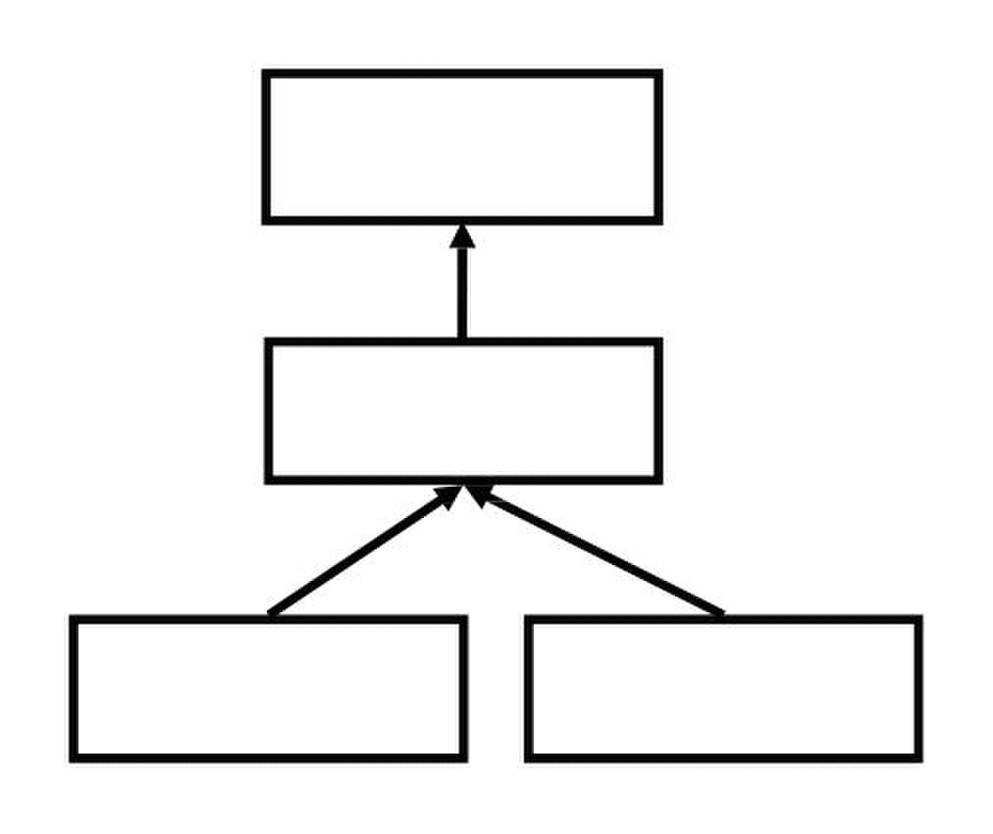
Web Design & Development – CS506 VU
Object – The Root Class
The Od Java classes. For user defined classes, its not necessary to mention the Object class as a super class,
java doesbject class in Java is a superclass for all other classes defined in Java's class libraries, as well as
for user-define it automatically for you.
The class Hierarchy of Employee class is shown below. Object is the super class of Employee class and
Teacher is a subclass of Employee class. We can make another class Manager that can also extends from
Employee class.
Object
Employe
Teacher Manager
© Copyright Virtual University of Pakistan
56

Slide 57

Web Design & Development – CS506 VU
Polymorphism
―Polymorphic‖ literally means ―of multiple shapes‖ and in the context of OOP, polymorphic means
―having multiple behavior‖.
A parent class reference can point to the subclass objects because of is-a relationship. For example a
Employee reference can point to:
o Employee Object
o Teacher Object
o Manager Object
A polymorphic method results in different actions depending on the object being referenced
o Also known as late binding or run-time binding
Example Code: using polymorphism
This Test class is the modification of last example code. Same Employee & Teacher classes are used.
Objects of Employee & Teacher class are created inside main methods and calls are made to display and
toString method using these objects.
class Test{
public static void main (String args[]){
// Make employee references
Employee ref1, ref2;
// assign employee object to first employee reference
ref1 = new Employee(89, "khurram ahmad");
// is-a relationship, polymorphism
ref2 = new Teacher (91, "ali raza", "phd");
//call to Employee class display method
ref1.display();
//call to Teacher class display method
ref2.display();
// call to Employee class toString method
System.out.println("Employee: " +ref1.toString());
// call to Teacher class toString method
System.out.println("Teacher: " + ref2.toString());
} //end of main
}//end class
© Copyright Virtual University of Pakistan
57

Slide 58
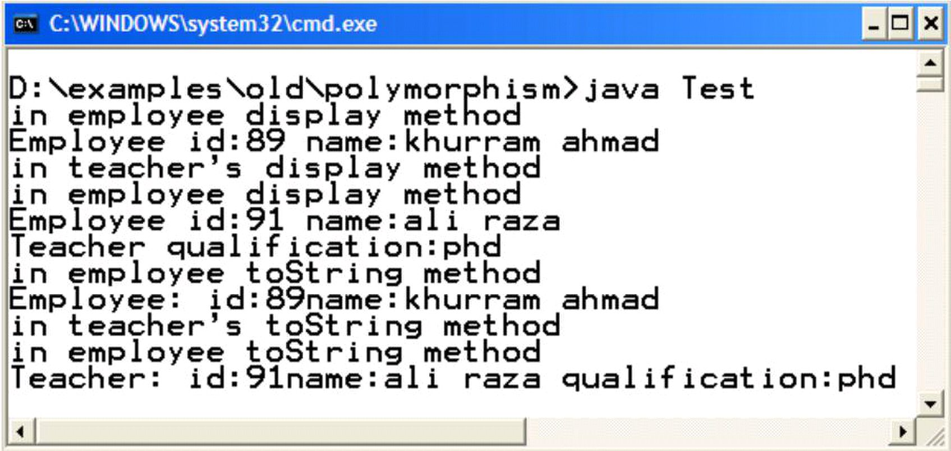
Web Design & Development – CS506 VU
Output
© Copyright Virtual University of Pakistan
58

Slide 59

Web Design & Development – CS506 VU
Type Casting
In computer science, type conversion or typecasting refers to changing an entity of one datatype into another.
Type casting can be categorized into two types
1. Up-casting
Converting a smaller data type into bigger one
Implicit – we don‘t have to do something special
No loss of information
Examples of
— Primitives
int a = 10;
double b = a;
— Classes
Employee e = new Teacher( );
2. Down-casting
Converting a bigger data type into smaller one
Explicit – need to mention
Possible loss of information
Examples of
— Primitives
double a = 7.65;
int b = (int) a;
— Classes
Employee e = new Teacher( ); // up-casting
Teacher t = (Teacher) e; // down-casting
References:
Java tutorial: http://java.sun.com/docs/books/tutorial/java/javaOO/
Stanford University
Example code, their explanations and corresponding figures for handout 5-1,5-2 are taken from the
book JAVA A Lab Course by Umair Javed. This material is available just for the use of VU
students of the course Web Design and Development and not for any other commercial purpose
without the consent of author.
© Copyright Virtual University of Pakistan
59

Slide 60

Web Design & Development – CS506 VU
Lesson 6
Collections
A collection represents group of objects know as its elements. Java has a built-in support for collections.
Collection classes are similar to STL in C++. An advantage of a collection over an array is that you don‘t need to
know the eventual size of the collection in order to add objects to it. The java.util package provides a set of
collection classes that helps a programmer in number of ways.
Collections Design
All classes almost provides same methods like get(), size(), isEmpty() etc. These methods will return the object
stored in it, number of objects stored and whether collection contains an object or not respectively.
Java collections are capable of storing any kind of objects. Collections store references to objects. This is similar to
using a void* in C. therefore down casting is required to get the actual type. For example, if string in stored in a
collection then to get it back, we write
String element = (String)arraylist.get(i);
Collection messages
Some basic messages (methods) are:
Constructor
— creates a collection with no elements
int size()
— returns the number of elements in a collection
boolean add(Object)
— adds a new element in the collection
— returns true if the element is added successfully false otherwise
boolean isEmpty()
— returns true if this collection contains no element false otherwise
boolean contains(Object)
— returns true if this collection contains the specified element by using iterative search
boolean remove(Object)
— removes a single instance of the specified element from this collection, if it is present
© Copyright Virtual University of Pakistan
60

Slide 61
Web Design & Development – CS506 VU
ArrayList
It‘s like a resizable array. ArrayList actually comes as a replacement the old ―Vector‖ collection. As we add or
remove elements into or from it, it grows or shrinks over time.
Useful Methods
add (Object)
— With the help of this method, any object can be added into ArrayList because
Object is the super class of all classes.
— Objects going to add will implicitly up-cast.
Object get(int index)
— Returns the element at the specified position in the list
— index ranges from 0 to size()-1
— must cast to appropriate type
remove (int index)
— Removes the element at the specified position in this list.
— Shifts any subsequent elements to the left (subtracts one from their indices).
int size( )
Example Code: Using ArrayList class
We‘ll store Student objects in the ArrayList. We are using the same student class which we built in previous
lectures/handouts.
We‘ll add three student objects and later prints all the student objects after retrieving them from ArrayList.
Let‘s look at the code
iport java.util.*;
public class ArrayListTest {
public static void main(String[] args) {
// creating arrayList object by calling constructor
ArrayList al= new ArrayList();
// creating three Student objects
Student s1 = new Student (―ali‖ , 1);
Student s2 = new Student (―saad‖ , 2);
Student s3 = new Student (―raza‖ , 3);
// adding elements (Student objects) into arralylist al.add(s1);
al.add(s2);
al.add(s3);
© Copyright Virtual University of Pakistan
61

Slide 62

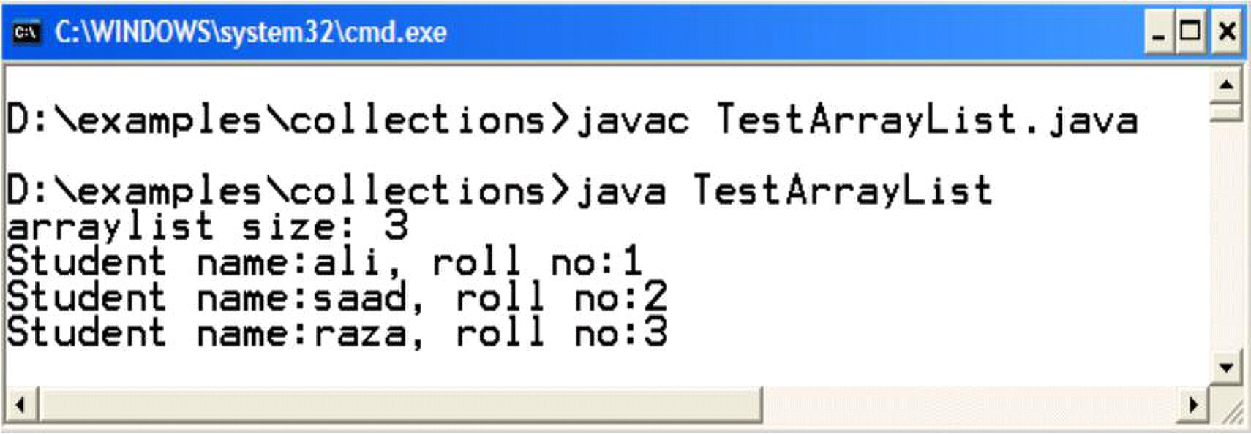
Web Design & Development – CS506 VU
// checking whether arraylist is empty or not boolean b = al.isEmpty ();
if (b = = true) {
System.out.println(―arraylist is empty‖);
} else {
int size = al.size();
}
// using loop to iterate. Loops starts from 0 to one
// less than size
for (int i=0; i<al.size(); i++ ){
// retrieving object from arraylist
Student s = (Student) al.get(i);
// calling student class print method
s.print();
} // end for loop
} // end main
} // end class
Output
HashMap
Store elements in the form of key- value pair form. A key is associated with each object that is stored. This
allows fast retrieval of that object. Keys are unique.
Useful Methods
put(Object key, Object Value)
— Keys & Values are stored in the form of objects (implicit upcasting is performed).
— Associates the specified value with the specified key in this map.
© Copyright Virtual University of Pakistan
System.out.println(―arraylist size: ‖ + size);
62

Slide 63

Web Design & Development – CS506 VU
— If the map previously contained a mapping for this key, the old value is replaced.
Object get(Object key)
— Returns the value to which the specified key is mapped in this identity hash map, or null if the
map contains no mapping for this key.
— Must downcast to appropriate type when used
int size( )
Example Code: using HashMap class
In this example code, we‘ll store Student objects as values and their rollnos in the form of strings as keys. Same
Student class is used. The code is;
iport java.util.*;
public class HashMapTest {
public static void main(String[] args) {
// creating HashMap object
HashMap h= new HashMap();
// creating Student objects
Student s1 = new Student (―ali‖ , 1); Student s2 = new Student (―saad‖ ,
2); Student s3 = new Student (―raza‖ , 6);
// adding elements (Student objects) where roll nos
// are stored as keys and student objects as values
h.put(“one” , s1);
h.put(“two” , s2);
h.put(“six”, s3);
// checking whether hashmap is empty or not boolean b = h.isEmpty ();
if (b == true) {
System.out.println(―hashmap is empty‖);
} else {
int size = h.size();
System.out.println(―hashmap size: ‖ + size);
}
// retrieving student object against rollno two and
// performing downcasting
Student s = (Student)h.get(“two”);
// calling student‘s class print method s.print();
© Copyright Virtual University of Pakistan
63

Slide 64

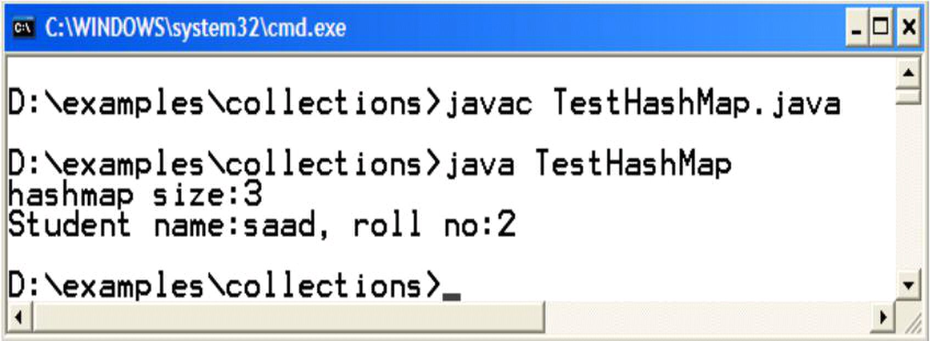
Web Design & Development – CS506 VU
} // end main
} // end class
Output
References:
J2SE 5.0 new features: http://java.sun.com/j2se/1.5.0/docs/relnotes/features.html
Technical Article: http://java.sun.com/developer/technicalArticles/releases/j2se15/
Beginning Java2 by Ivor Horton
Example code, their explanations and corresponding figures for this handout are taken from the book JAVA
A Lab Course by Umair Javed. This material is available just for the use of VU students of the course
Web Design and Development and not for any other commercial purpose without the consent of author.
© Copyright Virtual University of Pakistan
64

Slide 65
Web Design & Development – CS506 VU
Address Book
Warning: It is strongly advised that you type the code given in this example yourself. Do not copy/paste it;
most probably you will get unexpected errors that you have never seen. Some bugs are deliberately
introduced as well to avoid copy- pasting. TAs will not cooperate with you in debugging such
errors☺.
Problem
We want to build an address book that is capable of storing name, address & phone number of a person.
Address book provides functionality in the form of a JOptionPane based menu. The feature list includes
• Add – to add a new person record
• Delete – to delete an existing person record by name
• Search – to search a person record by name
• Exit – to exit from application
The Address book should also support persistence for person records
Approach for Solving Problem
Building a small address book generally involves 3 steps. Let us briefly discuss each step and write a solution code
for each step
Step1 – Make PersonInfo class
First of all you need to store your desired information for each person. For this you can create a user-
defined data type (i.e. a class). Make a class PersonInfo with name, address and phone number as its
attributes.
Write a parameterized constructor for this class.
Write print method in Person class that displays one person record on a message dialog box.
© Copyright Virtual University of Pakistan
65

Slide 66

Web Design & Development – CS506 VU
The code for PersonInfo class is given below.
import javax.swing.*;
class PersonInfo {
String name;
String address;
String phoneNum;
//parameterized constructor
public PersonInfo(String n, String a, String p) {
name = n;
address = a;
phoneNum = p;
}
//method for displaying person record on GUI
public void print( ) {
JOptionPane.showMessageDialog(null, ―name: ‖ + name +
―address:‖ +address + ―phone no:‖ + phoneNum);
}
Note: Not declaring attributes as private is a bad approach but we have done it to keep things simple here.
Step2 – Make AddressBook class
Take the example of daily life; generally address book is used to store more than one person records and
we don‘t know in advance how many records are going to be added into it.
So, we need some data structure that can help us in storing more than one
PersonInfo objects without concerning about its size.
ArrayList can be used to achieve the above functionality
Create a class Address Book with an ArrayList as its attribute. This arraylist will be used to store the
information of different persons in the form of PersonInfo Objects. This class will also provide
addPerson, deletePerson & searchPerson methods. These methods are used for adding new person records,
deleting an existing person record by name and searching among existing person records by name
respectively.
Input/Output will be performed through JOptionPane.
© Copyright Virtual University of Pakistan
}
66

Slide 67

Web Design & Development – CS506 VU
The code for AddressBook class is
import javax.swing.*;
import java.util.*;
class AddressBook {
ArrayList persons;
//constructor
public AddressBook ( ) {
persons = new ArrayList();
}
//add new person record to arraylist after taking input
public void addPerson( ) {
String name =JOptionPane.showInputDialog(―Enter name‖);
String add = JOptionPane.showInputDialog(―Enter address‖);
String pNum = JOptionPane.showInputDialog(―Enter phone no‖);
//construt new person object
PersonInfo p = new PersonInfo(name, add, pNum);
//add the above PersonInfo object to arraylist
persons.add(p);
}
//search person record by name by iterating over arraylist
public void searchPerson (String n) {
for (int i=0; i< persons.size(); i++) {
PersonInfo p = (PersonInfo)persons.get(i);
if ( n.equals(p.name) ) {
}
} // end for
} // end searchPerson
//delete person record by name by iterating over arraylist
public void deletePerson (String n) {
for (int i=0; i< persons.size(); i++) {
PersonInfo p = (PersonInfo)persons.get(i);
if ( n.equals(p.name) ) {
}
Copyright Virtual University of Pakistan
p.print();
persons.remove(i);
67

Slide 68

Web Design & Development – CS506 VU
}
}
} // end class
The addperson method first takes input for name, address and phone number and than construct a PersonInfo
object by using the recently taken input values. Then the newly constructed object is added to the arraylist –
persons.
The searchPerson & deletePerson methods are using the same methodology i.e. first they search the required record
by name and than prints his/her detail or delete the record permanently from the ArrayList.
Both the methods are taking string argument, by using this they can perform their search or delete operation.
We used for loop for iterating the whole ArrayList. By using the size method of ArrayList, we can control our
loop as ArrayList indexes range starts from 0 to one less than size.
Notice that, inside loop we retrieve each PersonInfo object by using down casting operation. After that we
compare each PersonInfo object‘s name by the one passed to these methods using equal method since Strings
are always being compared using equal method.
Inside if block of searchPerson, print method is called using PersonInfo object that will display person information
on GUI. On the other hand, inside if block of deletePerson method, remove method of ArrayList class is
called that is used to delete record from persons i.e. ArrayList.
Step3 – Make Test class (driver program)
This class will contain a main method and an object of AddressBook class.
Build GUI based menu by using switch selection structure
Call appropriate methods of AddressBook class
The code for Test class is
import javax.swing.*;
class Test {
Public static void main (String args[]) {
AddressBook ab = new AddressBook();
String input, s;
int ch;
while (true) {
input = JOptionPane.showInputDialog(―Enter 1 to add ‖ +
―\n Enter 2 to Search \n Enter 3 to Delete― +
―\n Enter 4 to Exit‖);
Copyright Virtual University of Pakistan
68

Slide 69

Web Design & Development – CS506 VU
ch = Integer.parseInt(input);
switch (ch) {
case 1:
ab.addPerson();
break;
case 2:
s = JOptionPane.showInputDialog(
ab.searchPerson(s);
break;
case 3:
s = JOptionPane.showInputDialog(
―Enter name to delete ‖);
ab.deletePerson(s);
break;
case 4:
}
}//end while
}//end main
}
Note that we use infinite while loop that would never end or stop given that our program should only exit when
user enters 4 i.e. exit option.
Compile & Execute
Compile all three classes and run Test class. Bravo, you successfully completed the all basic three steps. Enjoy!
☺.
Reference
Entire content for this handout are taken from the book JAVA A Lab Course by Umair Javed. This material is
available just for the use of VU students of the course Web Design and Development and not for any other
commercial purpose.
Copyright Virtual University of Pakistan
―Enter name to search ‖);
System.exit(0);
69

Slide 70

Web Design & Development – CS506 VU
Lesson 7
Intro to Exceptions
Types of Errors
Generally, you can come across three types of errors while developing software. These are Syntax, Logic &
Runtime errors.
1. Syntax Errors
Arise because the rules of the language are not followed.
2. Logic Errors
Indicates that logic used for coding doesn‘t produce expected output.
3. Runtime Errors
Occur because the program tries to perform an operation that is impossible to complete.
Cause exceptions and may be handled at runtime (while you are running the program)
For example divide by zero
What is an Exception?
An exception is an event that usually signals an erroneous situation at run time
Exceptions are wrapped up as objects
A program can deal with an exception in one of three ways:
o ignore it
o handle it where it occurs
o handle it an another place in the program
Why handle Exceptions?
Helps to separate error handling code from main logic (the normal code you write) of the program.
As different sort/type of exceptions can arise, by handling exceptions we can distinguish between
them and write appropriate handling code for each type for example we can differently handle
exceptions that occur due to division by Zero and exceptions that occur due to non-availability of a file.
If not handled properly, program might terminate.
Copyright Virtual University of Pakistan
70

Slide 71
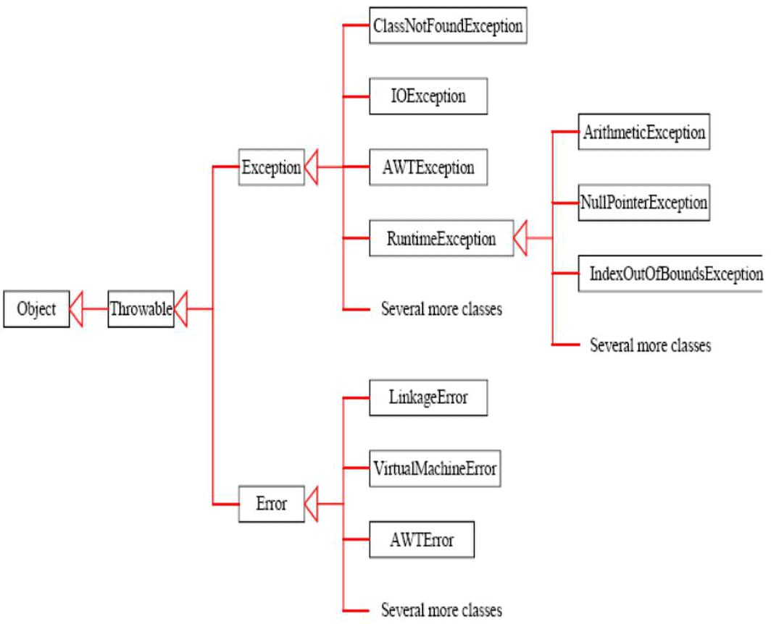
Web Design & Development – CS506 VU
Exceptions in Java
An exception in java is represented as an object that‘s created when an abnormal situation arises in
the program. Note that an error is also represented as an object in Java, but usually represents an
unrecoverable situation and should not be caught
The exception object stores information about the nature of the problem. For example, due to
network problem or class not found etc.
All exceptions in java are inherited from a class know as Throwable.
Exception Hierarchy
Following diagram is an abridged version of Exception class hierarchy
Copyright Virtual University of Pakistan
71

Slide 72

Web Design & Development – CS506 VU
Types of Exceptions
Exceptions can be broadly categorized into two types, Unchecked & Checked Exceptions.
Unchecked Exceptions
• Subclasses of RuntimeException and Error.
• Does not require explicit handling
• Run-time errors are internal to your program, so you can get rid of them by debugging your code
• For example, null pointer exception; index out of bounds exception; division by zero exception; ...
Checked Exceptions
• Must be caught or declared in a throws clause
• Compile will issue an error if not handled appropriately
• Subclasses of Exception other than subclasses of RuntimeException.
• Other arrive from external factors, and cannot be solved by debugging
• Communication from an external resource – e.g. a file server or database
How Java handles Exceptions
Java handles exceptions via 5 keywords. try, catch, finally, throw & throws.
• try block
• Write code inside this block which could generate errors
• catch block
• Code inside this block is used for exception handling
• When the exception is raised from try block, only than catch block would execute.
• finally block
• This block always executes whether exception occurs or not.
• Write clean up code here, like resources (connection with file or database) that are opened may
need to be closed.
Copyright Virtual University of Pakistan
72

Slide 73
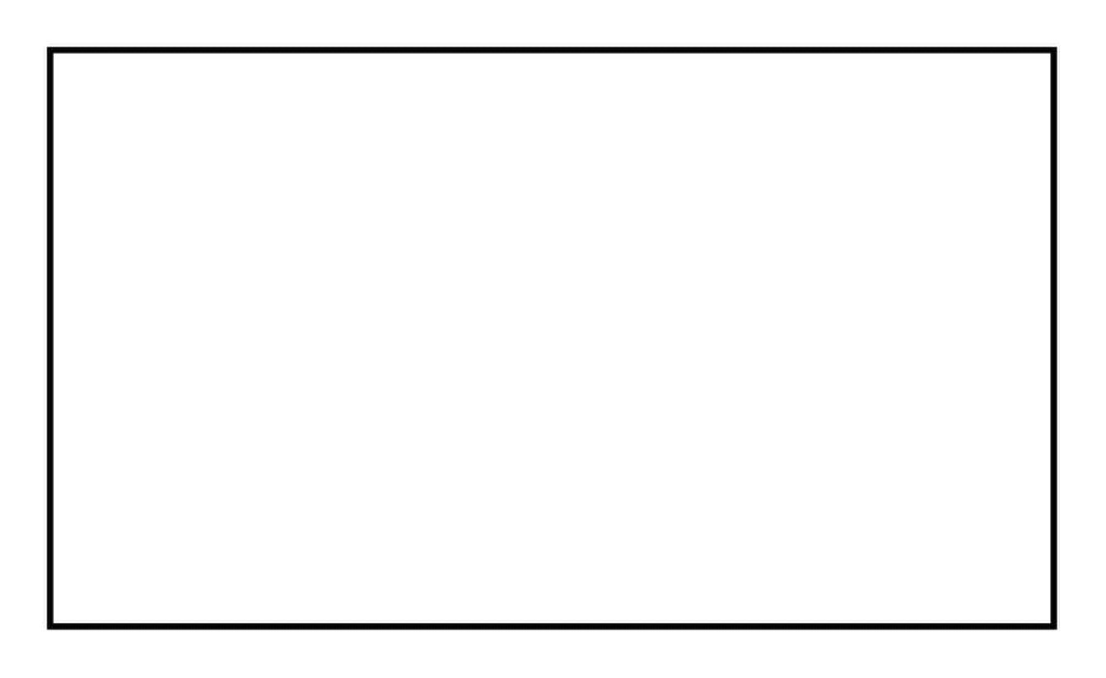
Web Design & Development – CS506 VU
The basic structure of using try – catch – finally block is shown in the picture below:
try //try block
{
// write code that could generate exceptions
} catch (<exception to be caught>) //catch block
{
//write code for exception handling
}
……
.......
catch (<exception to be caught>) //catch block
{
//code for exception handling
} finally //finally block
{
//any clean-up code, release the acquired resources
}
Copyright Virtual University of Pakistan
73

Slide 74

Web Design & Development – CS506 VU
• throw
• To manually throw an exception, keyword throw is used.
Note: we are not covering throw clause in this handout
• throws
• If method is not interested in handling the exception than it can throw back the exception to the
caller method using throws keyword.
• Any exception that is thrown out of a method must be specified as such by a
throws clause.
References:
• Java tutorial by Sun: http://java.sun.com/docs/books/turorial
• Beginning Java2 by Ivor Hortan
• Thinking in Java by Bruce Eckle
• CS193j Stanford University
Copyright Virtual University of Pakistan
74

Slide 75

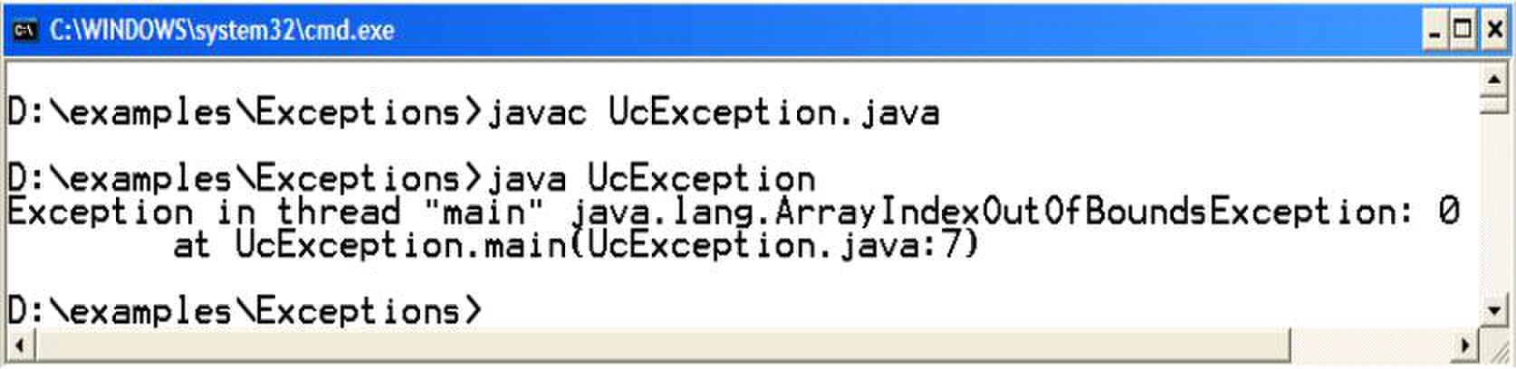
Web Design & Development – CS506 VU
Code Examples of Exception Handling
Unchecked Exceptions
Example Code: UcException.java
The following program takes one command line argument and prints it on the console
// File UcException.java
public class UcException {
public static void main (String args[ ]) {
System.out.println(args[0]);
}
}
Compile & Execute
If we compile & execute the above program without passing any command line argument, an
ArrayIndexOutOfBoundsException would be thrown. This is shown in the following picture
Why?
Since we have passed no argument, therefore the size of String args[ ] is zero, and we have tried to access the first
element (first element has index zero) of this array.
From the output window, you can find out, which code line causes the exception to be raised. In the above
example, it is
System.out.println(args[0]);
Copyright Virtual University of Pakistan
75

Slide 76

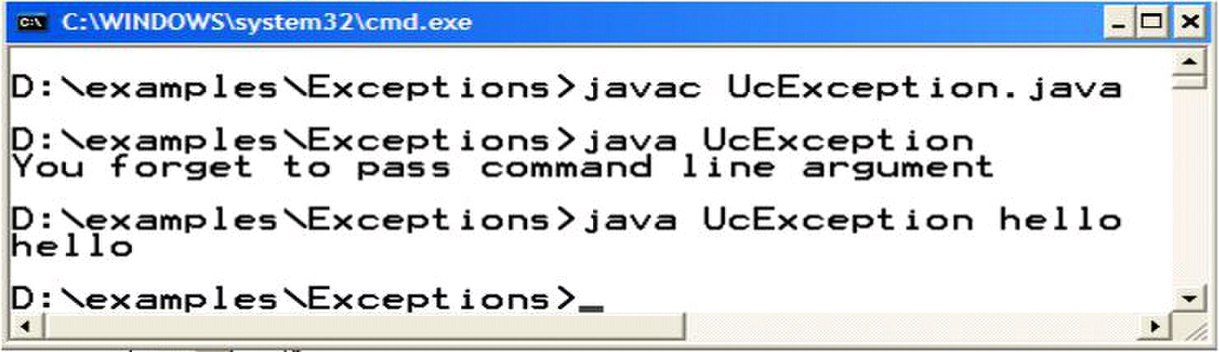
Web Design & Development – CS506 VU
Modify UcException.java
Though it is not mandatory to handle unchecked exceptions we can still handle
Unchecked Exceptions if we want to. These modifications are shown in bold.
// File UcException.java
public class UcException {
public static void main (String args[ ]) {
try {
System.out.println(args[0]);
catch (IndexOutOfBoundsExceptoin ex) {
System.out.println(“You forget to pass command line argument”);
}
}
The possible exception that can be thrown is IndexOutOfBoundsException, so we handle it in the catch block.
When an exception occurs, such as IndexOutOfBoundsException in this case, then an object of type
IndexOutOfBoundesException is created and it is passed to the corresponding catch block (i.e. the
catch block which is capable of handling this exception). The catch block receives the exception object
inside a variable which is ex in this case. It can be any name; it is similar to the parameter declared in the
method signature. It receives the object of exception type (IndexOutOfBoundsExceptoin) it is declared.
Compile & Execute
If we execute the modified program by passing command line argument, the program would display on
console the provided argument. After that if we execute this program again without passing command line
argument, this time information message would be displayed which is written inside catch block.
Copyright Virtual University of Pakistan
76

Slide 77

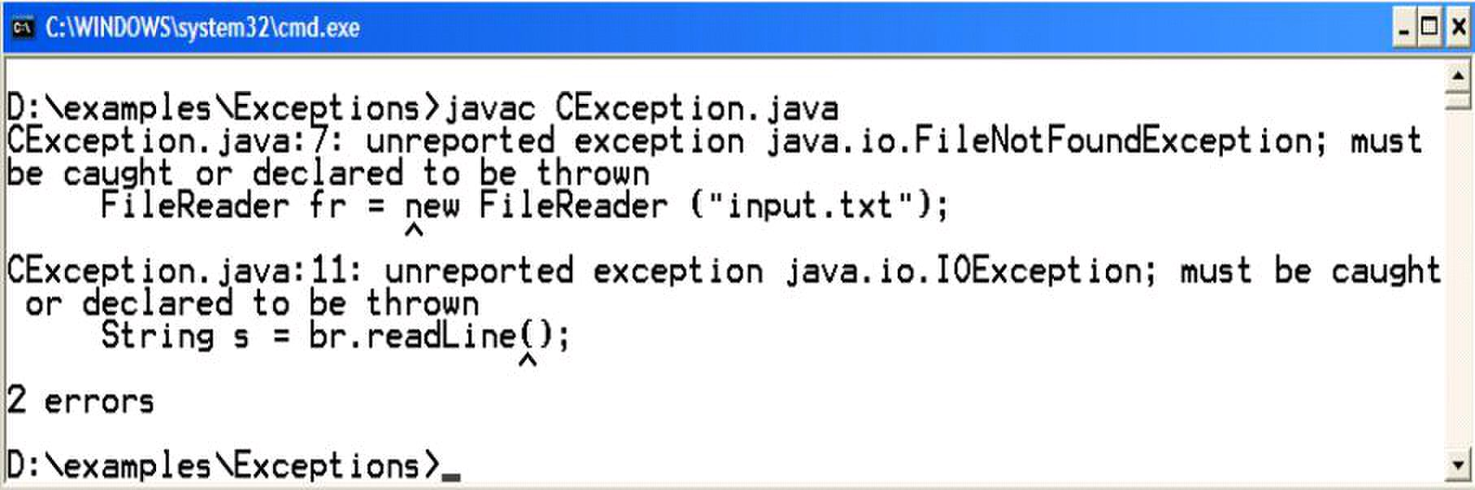
Web Design & Development – CS506 VU
Checked Exceptions
Example Code: CException.java
The following program reads a line (hello world) from a file and prints it on the console. The File reading code is
probably new for you. We‘ll explain it in the coming handouts
(Streams). For now, assumed that the code written inside the main read one line from a file and prints that to
console.
// File CException.java
import java.io.* ;
public class CException {
public static void main (String args[ ]) {
FileReader fr = new FileReader (―input.txt‖);
BufferedReader br = new BufferedReader (fr);
//read the line form file
String line = br.readLine();
System.out.println(line);
}
}
Compile & Execute
If you try to compile this program, the program will not compile successfully and displays the message
of unreported exception. This happens when there is code that can generate a checked exception but you
have not handled that exception. Remember checked exceptions are detected by compiler. As we early
discussed, without handling Checked exception, out program won‘t compile.
Copyright Virtual University of Pakistan
77

Slide 78

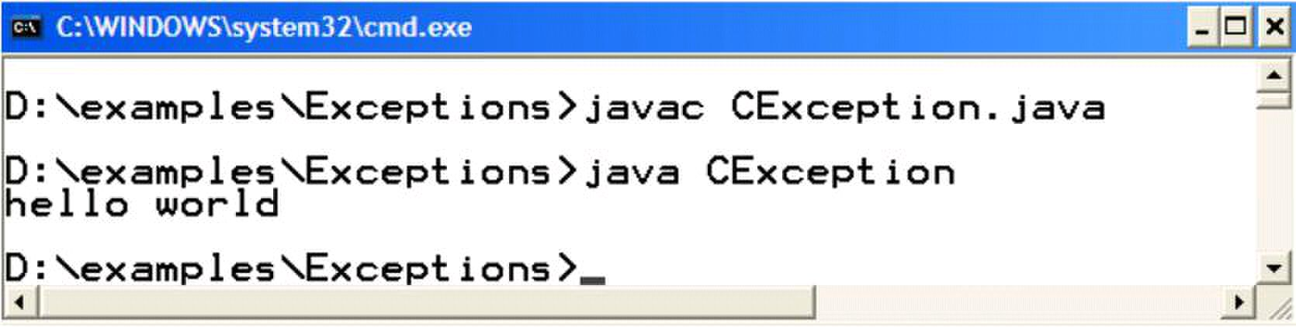
Web Design & Development – CS506 VU
Modify CException.java
As we have discussed earlier, it is mandatory to handle checked exceptions. In order to compile the code
above, we modify the above program so that file reading code is placed inside a try block. The expected
exception (IOException) that can be raised is caught in catch block.
// File CException.java
import java.io.* ;
public class CException {
public static void main (String args[ ]) {
try{
FileReader fr = new FileReader (―input.txt‖);
BufferedReader br = new BufferedReader (fr);
//read the line form file
String line = br.readLine();
System.out.println(line);
catch( IOExceptoin ex) {
System.out.println(ex);
}
}
}
The code line written inside the catch block will print the exception name on the console if exception occurs
Compile & Execute
After making changes to your program, it would compile successfully. On executing this program, hello world
would be displayed on the console
Note: Before executing, make sure that a text file named input.txt must be placed in the same directory where
the program is saved. Also write hello world in that file before saving it.
Copyright Virtual University of Pakistan
78

Slide 79

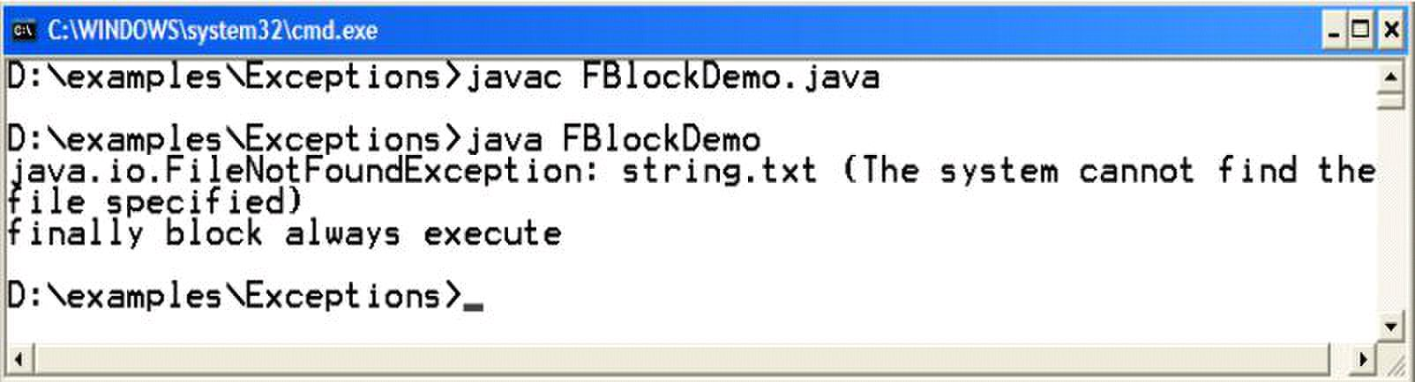
Web Design & Development – CS506 VU
The finally block
The finally block always executes regardless of exception is raised or not while as you remembered the catch
block only executes when an exception is raised.
Exampel Code : FBlockDemo.java
// File FBlockDemo.java
import java.io.* ;
public class FBlockDemo {
public static void main (String args[ ]) {
try{
FileReader fr = new FileReader (―strings.txt‖);
BufferedReader br = new BufferedReader (fr);
//read the line form file
String line = br.readLine();
System.out.println(line);
catch( IOExceptoin ex) {
System.out.println(ex);
}
finally {
System.out.println(“finally block always execute”);
}
}
}
Compile & Execute
The program above, will read one line from string.txt file. If string.tx is not present in the same directory the
FileNotFoundException would be raised and catch block would execute as well as the finally block.
If string.txt is present there, no such exception would be raised but still finally block executes. This is shown
in the following output diagram
Copyright Virtual University of Pakistan
79

Slide 80

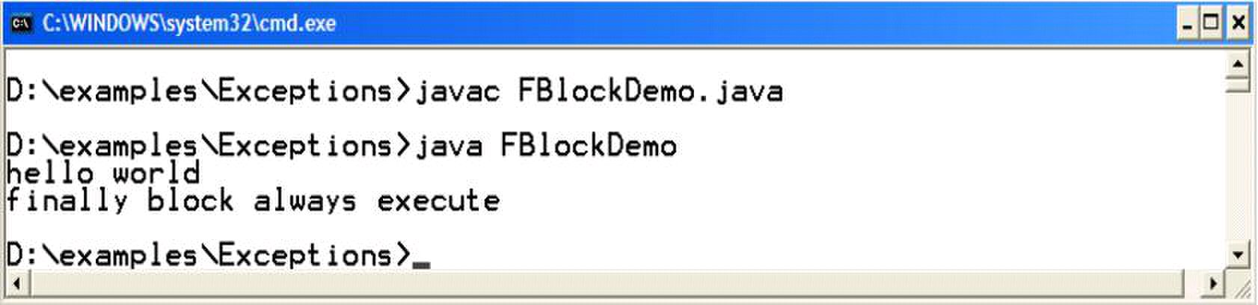
Web Design & Development – CS506 VU
Multiple catch blocks
• Possible to have multiple catch clauses for a single try statement
– Essentially checking for different types of exceptions that may happen
• Evaluated in the order of the code
– Bear in mind the Exception hierarchy when writing multiple catch clauses!
– If you catch Exception first and then IOException, the IOException will never be caught!
Example code: MCatchDemo.java
The following program would read a number form a file numbers.txt and than prints its square on the console
// File MCatchDemo.java
import java.io.* ;
public class MCatchDemo {
public static void main (String args[ ]) {
try{
// can throw FileNotFound or IOException
FileReader fr = new FileReader (―numbers.txt‖);
BufferedReader br = new BufferedReader (fr);
//read the number form file
String s = br.readLine();
//may throws NumberFormatException, if s is not a no.
int number = Integer.parseInt(s);
System.out.println(number * number);
catch( NumberFormatExceptoin nfEx) {
}
catch( FileNotFoundExceptoin fnfEx) {
Copyright Virtual University of Pakistan
System.out.println(nfEx);
80

Slide 81

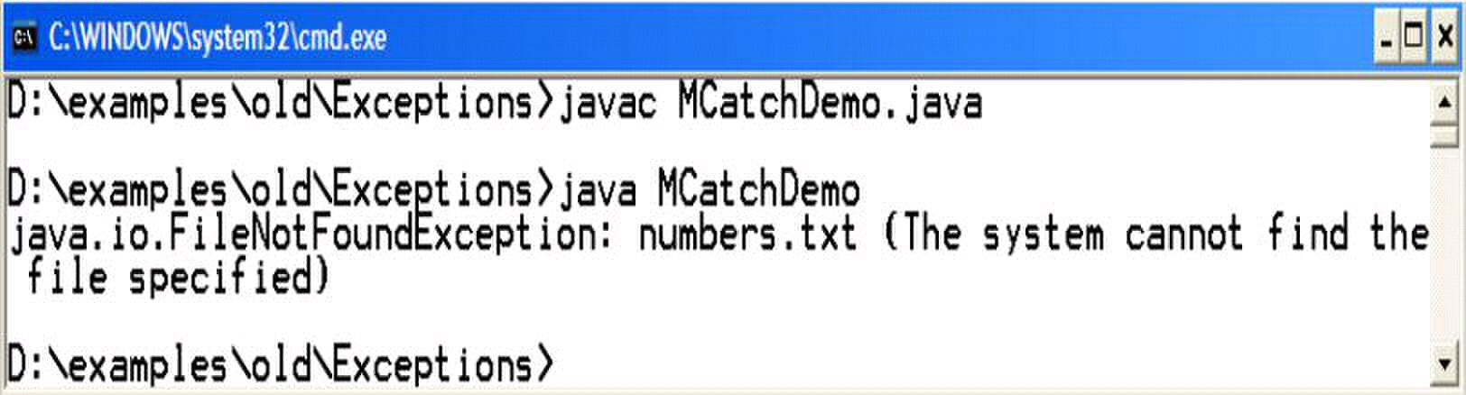
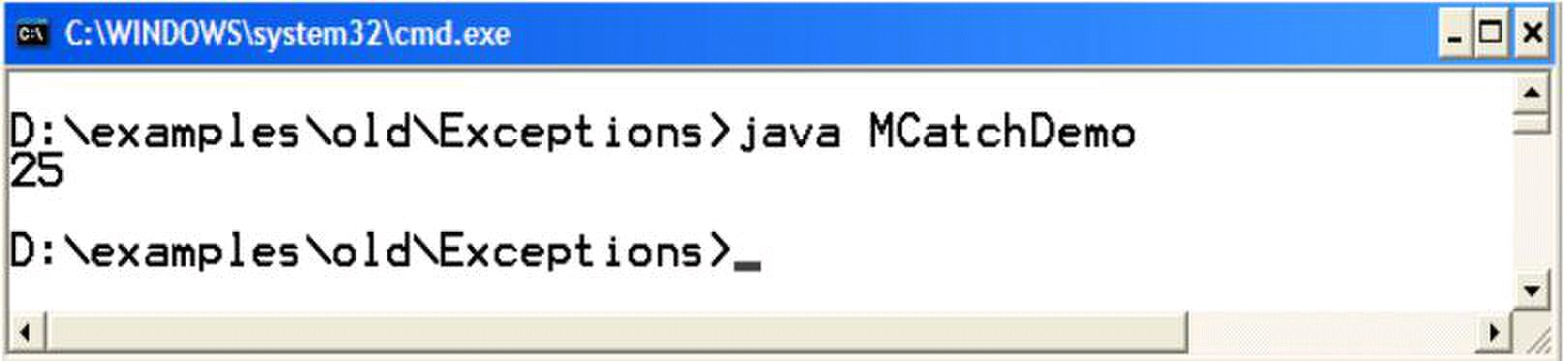
Web Design & Development – CS506 VU
System.out.println(fnfEx);
}
catch( IOExceptoin ioEx) {
System.out.println(ioEx);
}
}
}
We read everything from a file (numbers, floating values or text) as a String. That‘s why we first convert it to
number and than print its square on console.
Compile & Execute
If file numbers.txt is not present in the same directory, the FileNotFoundException
would be thrown during execution.
If numbers.txt present in the same directory and contains a number, than hopefully no exception would be
thrown.
Copyright Virtual University of Pakistan
81

Slide 82

Web Design & Development – CS506 VU
The throws clause
The following code examples will introduce you with writing & using throws clause.
Example Code: ThrowsDemo.java
The ThrowsDemo.java contains two methods namely method1 & method2 and one main method. The main
method will make call to method1 and than method1 will call method2. The method2 contains the file reading
code. The program looks like one given below
// File ThrowsDemo.java
import java.io.* ;
public class ThrowsDemo {
// contains file reading code
public static void method2( ) {
try{
FileReader fr = new FileReader (―strings.txt‖);
BufferedReader br = new BufferedReader (fr);
//read the line form file
String s = br.readLine();
System.out.println(s);
catch( IOExceptoin ioEx) {
ioEx.printStackTrace();
}
}// end method 2
//only calling method2
public static void method1( ) {
method2();
}
public static void main (String args[ ]) {
ThrowsDemo.method1();
}
}
© Copyright Virtual University of Pakistan
82

Slide 83

Web Design & Development – CS506 VU
printStackTrace method
Defined in the Throwable class – superclass of Exception & Error classes
Shows you the full method calling history with line numbers.
Extremely useful in debugging
Modify: ThrowsDemo.java
Let method2 doesn‘t want to handle exception by itself, so it throws the exception to the caller of method2
i.e. method1
So method1 either have to handle the incoming exception or it can re-throw it to its caller i.e. main.
Let method1 is handling the exception, so method1& method2 would be modified as:
// File ThrowsDemo.java
import java.io.* ;
public class ThrowsDemo {
// contains file reading code
public static void method2( ) throws IOEception{
FileReader fr = new FileReader (―strings.txt‖);
BufferedReader br = new BufferedReader (fr);
//read the line form file
String s = br.readLine();
System.out.println(s);
}// end method 2
// calling method2 & handling incoming exception
public static void method1( ) {
try {
method2();
catch (IOException ioEx) {
ioEx.printStackTrace();
}
}
public static void main (String args[ ]) {
ThrowsDemo.method1();
}
}
© Copyright Virtual University of Pakistan
83

Slide 84
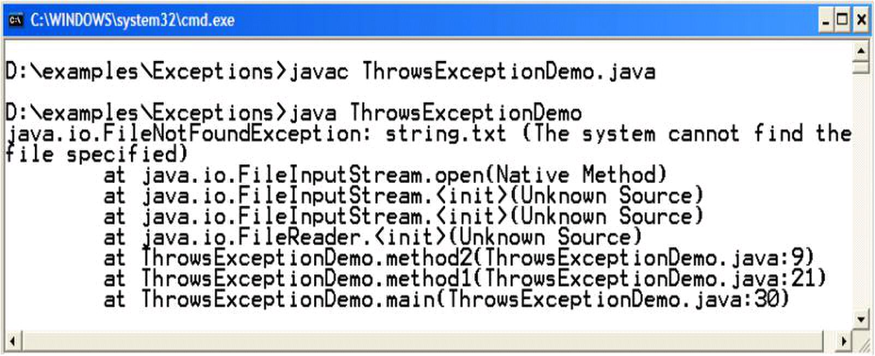
Web Design & Development – CS506 VU
Compile & Execute
If file strings.txt is not present in the same directory, method2 will throw an exception that would be caught by
method1 and the printStackTrace method will print the full calling history on console. The above scenario is
shown in the output below:
If file strings.txt exist there, than hopefully line would be displayed on the console.
Reference
Example code, their explanations and corresponding figures for this handout are taken from the book JAVA
A Lab Course by Umair Javed. This material is available just for the use of VU students of the course Web
Design and Development and not for any other commercial purpose without the consent of author.
© Copyright Virtual University of Pakistan
84

Slide 85
Web Design & Development – CS506 VU
Lesson 8
Streams
I/O libraries often use the abstraction of a stream, which represents any data source or sink as an object
capable of producing or receiving pieces of data.
The Java library classes for I/O are divided by input and output. You need to import java.io package to use
streams. There is no need to learn all the streams just do it on the need basis.
The concept of "streams"
• It is an abstraction of a data source/sink
• We need abstraction because there are lots of different devices (files, consoles, network, memory,
etc.). We need to talk to the devices in different ways
(sequential, random access, by lines, etc.) Streams make the task easy by acting in the same way for
every device. Though inside handling of devices may be quite different, yet on the surface everything is
similar. You might read from a file, the keyboard, memory or network connection, different
devices may require specialization of the basic stream, but you can treat them all as just "streams".
When you read from a network, you do nothing different than when you read from a local file or
from user's typing
//Reading from console
BufferedReader stdin = new BufferedReader(new InputStreamReader(
-------- ( your console)
// Reading from file
BufferedReader br=new BufferedReader(new FileReader(―input.txt‖));
//Reading from network
BufferedReader br = new BufferedReader(new InputStreamReader
(s.getInputStream()));
---- ―s‖ is the socket
• So you can consider stream as a data path. Data can flow through this path in one direction between
specified terminal points (your program and file, console, socket etc.)
© Copyright Virtual University of Pakistan
System.in ));
85

Slide 86


Web Design & Development – CS506 VU
Stream classification based on Functionality
Based on functionality streams can be categorized as Node Stream and Filter Stream. Node Streams
are those which connect directly with the data source/sick and provide basic functionality to read/write
data from that source/sink
FileReader fr = new FileReader(―input.txt‖);
You can see that FileReader is taking a data/source ―input.txt‖ as its argument and hence it is a node
stream.
FilterStreams sit on top of a node stream or chain with other filter stream and provide some additional
functionality e.g. compression, security etc. FilterStreams take other stream as their input.
BufferedReader bt = new BufferedReader(fr);
BufferedReader makes the IO efficient (enhances the functionality) by buffering the input before delivering.
And as you can see that BufferedReader is sitting on top of a node stream which is FileReader.
Stream classification based on data
© Copyright Virtual University of Pakistan
86

Slide 87
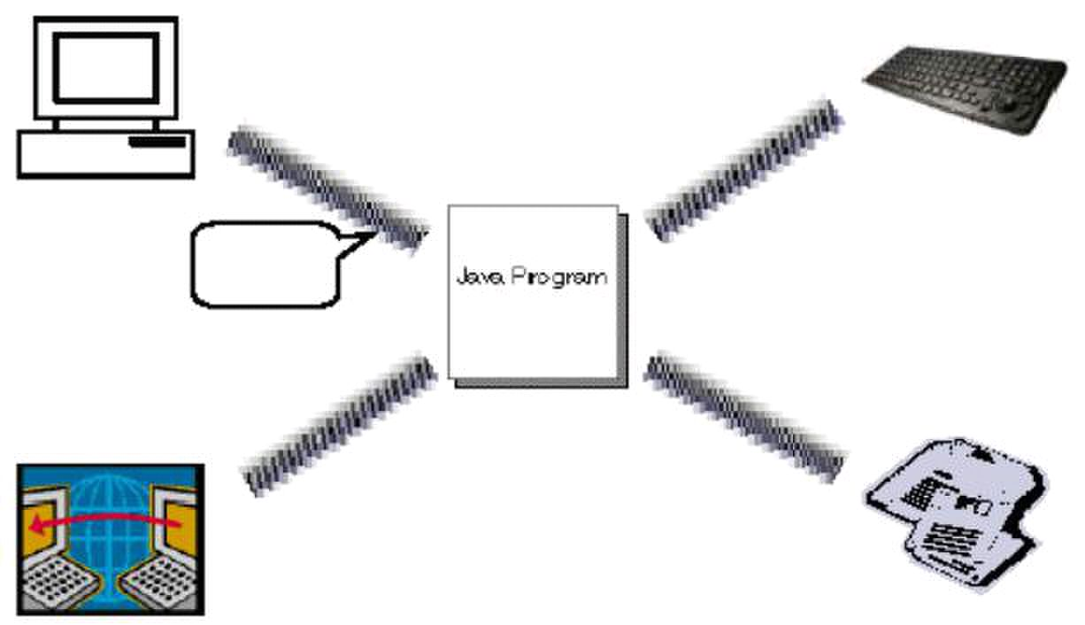
Web Design & Development – CS506 VU
Two type of classes exists.
Classes which contain the word stream in their name are byte oriented and are here since JDK1.0. These streams
can be used to read/write data in the form of bytes. Hence classes with the word stream in their name are byte-
oriented in nature. Examples of byte oriented streams are FileInputStream, ObjectOutputStream etc.
Classes which contain the word Reader/Writer are character oriented and read and write data in the form of
characters. Readers and Writers came with JDK1.1. Examples of Reader/Writers are FileReader, PrintWriter etc
© Copyright Virtual University of Pakistan
87

Slide 88

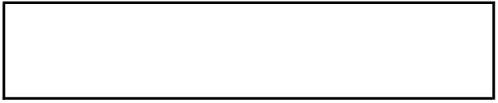
Web Design & Development – CS506 VU
Example Code 8.1: Reading from File
The ReadFileEx.java reads text file line by line and prints them on console. Before we move on to the code,
first create a text file (input.txt) using notepad and write following text lines inside it.
Text File: input.txt
Hello World
Pakistan is our homeland
Web Design and Development
// File ReadFileEx.java
import java.io.*;
public class ReadFileEx {
public static void main (String args[ ]) {
FileReader fr = null;
BufferedReader br = null;
try {
// attaching node stream with data source
fr = new FileReader(“input.txt”);
// attatching filter stream over node stream
br = new BufferedReader(fr);
// reading first line from file
String line = br.readLine();
// printing and reading remaining lines
while (line != null){
System.out.println(line);
line = br.readLine();
}
// closing streams
br.close();
fr.close();
}catch(IOException ioex){
System.out.println(ioex);
}
} // end main
} // end class
© Copyright Virtual University of Pakistan
88

Slide 89

Web Design & Development – CS506 VU
Example Code 8.2: Writing to File
The WriteFileEx.java writes the strings into the text file named ―output.txt‖. If
―output.txt‖ file does not exist, the java will create it for you.
// File WriteFileEx.java
import java.io.*;
public class WriteFileEx {
public static void main (String args[ ]) {
FileWriter fw = null;
PrintWriter pw = null;
try {
// attaching node stream with data source
// if file does not exist, it automatically creates it
fw = new FileWriter (“output.txt”);
// attatching filter stream over node stream
pw = new PrintWriter(fw);
String s1 = ―Hello World‖;
String s2 = ―Web Design and Development‖;
// writing first string to file
pw.println(s1);
// writing second string to file
pw.println(s2);
// flushing stream
pw.flush();
// closing streams
pw.close();
fw.close();
}catch(IOException ioex){
System.out.println(ioex);
}
} // end main
} // end class
After executing the program, check the output.txt file. Two lines will be written there.
Reference
Example code, their explanations and corresponding figures for this handout are taken from the book JAVA
A Lab Course by Umair Javed. This material is available just for the use of VU students of the course Web
Design and Development and not for any other commercial purpose without the consent of author.
© Copyright Virtual University of Pakistan
89

Slide 90

Web Design & Development – CS506 VU
Lesson 9
Modification of Address Book Code
Adding Persistence Functionality
Hopefully, your address book you built previously is giving you the required results except one i.e.
persistence. You might have noticed that after adding some person records in the address book; if you exit form
the program next time on re-executing address book all the previous records are no more available.
To overcome the above problem, we will modify our program so that on exiting/starting of address book, all
the previously added records are available each time. To achieve this, we have to provide the persistence
functionality. Currently, we will accomplish this task by saving person records in some text file.
Supporting simple persistence by any application requires handling of two scenarios. These are
On start up of application – data (person records ) must be read from file
On end/finish up of application – data (person records) must be saved in file
To support persistence, we have to handle the above mentioned scenarios
Scenario 1 – Start Up
Establish a data channel with a file by using streams
Start reading data (person records) from file line by line
Construct PersonInfo objects from each line you have read
Add those PersonInfo objects in arraylist persons.
Close the stream with the file
Perform these steps while application is loading up
We will read records from a text file named persons.txt. The person records will be present in the file in the
following format.
Ali,defence,9201211
Usman,gulberg,5173940
Salman,LUMS,5272670
persons.txt
As you have seen, each person record is on a separate line. Person‘s name, address &
phone number is separated using comma (,).
We will modify our AddressBook.java by adding a new method loadPersons into it. This method will
provide the implementation of all the steps. The method is shown below:
© Copyright Virtual University of Pakistan
90

Slide 91

Web Design & Development – CS506 VU
public void loadPersons ( ){
String tokens[] = null;
String name, add, ph;
try {
FileReader fr = new FileReader("persons.txt");
BufferedReader br = new BufferedReader(fr);
String line = br.readLine();
while ( line != null ) {
tokens = line.split(",");
name = tokens[0];
add = tokens[1];
ph = tokens[2];
PersonInfo p = new PersonInfo(name, add, ph);
persons.add(p);
}
br.close();
fr.close();
}catch(IOException ioEx){
System.out.println(ioEx);
}
First, we have to connect with the text file in order to read line by line person records from it. This task is
accomplished with the following lines of code
FileReader fr = new FileReader(―persons.txt‖); BufferedReader br = new
BufferedReader(fr);
FileReader is a character based (node) stream that helps us in reading data in the form of characters. As we
are using streams, so we have to import the java.io package in the AddressBook class.
We passed the file name persons.txt to the constructor of the FileReader.
Next we add BufferedReader (filter stream) on top of the FileReader because BufferedReader
facilitates reading data line by line. (As you can recall from the lecture that filter streams are attached on top
of node streams). That‘s why the constructor of BufferedReader is receiving the fr – the FileReader
object.
The next line of code will read line from file by using readLine( ) method of
BufferedReader and save it in a string variable called line.
String line = br.readLine( );
© Copyright Virtual University of Pakistan
line = br.readLine();
}
91

Slide 92

Web Design & Development – CS506 VU
After that while loop starts. The condition of while loop is used to check whether the file is reached to end
(returns null) or not. This loop is used to read whole file till the end. When end comes (null), this loop will
finish.
while (line != null)
Inside loop, the first step we performed is tokenizing the string. For this purpose, we have used split
method of String class. This method returns substrings (tokens) according to the regular expression or
delimiter passed to it.
tokens = line.split(―,‖);
The return type of this method is array of strings that‘s why we have declared tokens as a String array in the
beginning of this method as
String tokens[];
For example, the line contains the following string
Ali,defence,9201211
Now by calling split(―,‖) method on this string, this method will return back three substrings ali defence
and 9201211 because the delimiter we have passed to it is comma. The delimiter itself is not included in
the substrings or tokens.
The next three lines of code are simple assignments statements. The tokens[0] contains the name of the
person because the name is always in the beginning of the line, tokens[1] contains address of the person
and tokens[2] contains the phone number of the person.
name = tokens[0];
add = tokens[1];
ph = tokens[2];
The name, add and ph are of type String and are declared in the beginning of this method.
After that we have constructed the object of PersonInfo class by using parameterized constructor and
passed all these strings to it.
PersonInfo p = new PersonInfo(name, add, ph);
Afterward the PersonInfo object‘s p is added to the arraylist i.e. persons. persons.add(p);
The last step we have done inside loop is that we have again read a line form the file by using the readLine()
method.
© Copyright Virtual University of Pakistan
92

Slide 93

Web Design & Development – CS506 VU
By summarizing the task of while loop we can conclude that it reads the line from a file,
Tokenize that line into three substrings followed by constructing the PersonInfo object by
using these tokens. And adding these objects to the arraylist. This process continues till the file
reaches its end.
The last step for reading information from the file is ordinary one – closing the streams,
because files are external resources, so it‘s better to close them as soon as possible.
Also observe that we used try/catch block because using streams can result in raising exceptions
that falls under the checked exceptions category – that needs mandatory handling.
The last important step you have to perform is to call this method while loading up. The most
appropriate place to call this method is from inside the constructor of AddressBook.java. So
the constructor will now look like similar to the one given below:
………………
public AddressBook () {
Persons = new ArrayList();
}
………………
AddressBook.java
Scenario 2 – End/Finish Up
Establish a datachanel(stream) with a file by using streams
Take out PersonInfo objects from ArrayList (persons)
Build a string for each PersonInfo object by inserting commas (,) between name
& address and address & phone number.
Write the constructed string to the file
Close the connection with file
Perform these steps while exiting from address book.
Add another method savePersons into AddressBook.java. This method will provide the implementation of all
the above mentioned steps. The method is shown below:
© Copyright Virtual University of Pakistan
loadPersons();
93

Slide 94

Web Design & Development – CS506 VU
Public void savePersons ( ){
try {
PersonInfo p;
String line;
FileWriter fw = new FileWriter("persons.txt");
PrintWriter pw = new PrintWriter(fw);
for(int i=0; i<persons.size(); i++)
{
p = (PersonInfo)persons.get(i);
line = p.name +","+ p.address +","+ p.phoneNum;
// writes line to file (persons.txt)
pw.println(line);
}
pw.flush();
pw.close();
fw.close();
}catch(IOException ioEx){
System.out.println(ioEx);
}
As you can see, that we have opened the same file (persons.txt) again by using a set of streams.
After that we have started for loop to iterate over arraylist as we did in
searchPerson and deletePerson methods.
Inside for loop body, we have taken out PersonInfo object and after type casting it we have assigned its reference
to a PersonInfo type local variable p. This is achieved by the help of following line of code
p = (PersonInfo)persons.get(i);
Next we build a string and insert commas between the PersonInfo attributes and assign the newly constructed
string to string‘s local variable line as shown in the following line of code.
line = p.name +","+ p.address +","+ p.phoneNum;
Note: Since, we haven‘t declare PersonInfo attributes private, therefore we are able to directly access them
inside AddressBook.java.
The next step is to write the line representing one PersonInfo object‘s information, to the file. This
is done by using println method of PrintWriter as shown below
pw.println(line);
© Copyright Virtual University of Pakistan
}
94

Slide 95

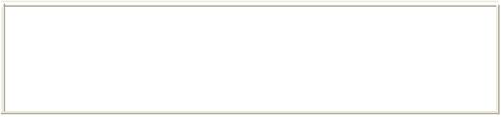
Web Design & Development – CS506 VU
After writing line to the file, the println method will move the cursor/control to the next line. That‘s why
each line is going to be written on separate line.
The last step for saving information to the file is ordinary one – closing the streams but before that notice
the code line that you have not seen/performed while loading persons records from file. That is
pw.flush( );
The above line immediately flushes data by writing any buffered output/data to file. This step is necessary
to perform or otherwise you will most probably lose some data for the reason that PrintWriter is a
Buffered Stream and they have their own internal memory/storage capacity for efficiency reasons.
Buffered Streams do not send the data until their memory is full.
Also we have written this code inside try-catch block.
The last important step you have to perform is to call this method before exiting from the address book.
The most appropriate place to call this method is under case 4
(exit scenario) in Test.java. So the case 4 will now look like similar to the one given below:
case 4:
ab.savePersons();
System.exit(0);
Test.java
Compile & Execute
Now again after compiling all the classes, run the Test class. Initially we are assuming that out persons.txt file is
empty, so our arraylist persons will be empty on the first start up of address book. Now add some records
into it, perform search or delete operations. Exit from the address book by choosing option 4.
Check out the persons.txt file. Don‘t get surprised by seeing that it contains all the person records in the
format exactly we have seen above.
Next time you will run the address book; all the records will be available to you. Perform the search or delete
operation to verify that.
Finally You have done it !!!
References
Example code, their explanations and corresponding figures for this handout are taken from the book JAVA
A Lab Course by Umair Javed. This material is available just for the use of VU students of the course Web
Design and Development and not for any other commercial purpose without the consent of author.
© Copyright Virtual University of Pakistan
95

Slide 96
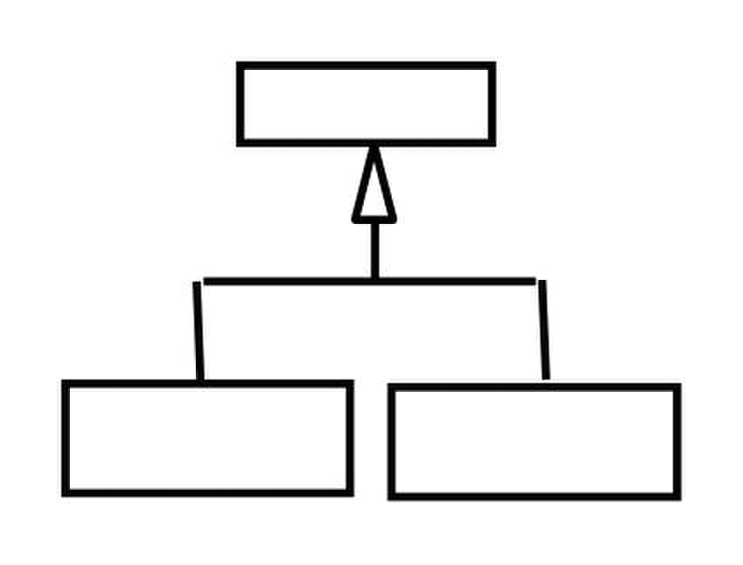
Web Design & Development – CS506 VU
Abstract Classes and Interfaces
Problem and Requirements
Before moving on to abstract classes, first examine the following class hierarchy shown below:
Circle Square
• Suppose that in order to exploit polymorphism, we specify that 2-D objects must be able to compute their
area.
– All 2-D classes must respond to area() message.
• How do we ensure that?
– Define area method in class Shape
– Force the subclasses of Shape to respond area() message
• Java‘s provides us two solutions to handle such problem
– Abstract Classes
– Interfaces
Abstract Classes
Abstract classes are used to define only part of an implementation. Because, information is not complete
therefore an abstract class cannot be instantiate. However, like regular classes, they can also contain instance
variables and methods that are full implemented. The class that inherits from abstract class is responsible to
provide details.
Any class with an abstract method (a method has no implementation similar to pure virtual function in
C++) must be declared abstract, yet you can declare a class abstract that has no abstract method.
If subclass overrides all abstract methods of the super class, than it becomes a concrete (a class whose object can
be instantiate) class otherwise we have to declare it as abstract or we can not compile it.
© Copyright Virtual University of Pakistan
96

Slide 97

Web Design & Development – CS506 VU
The most important aspect of abstract class is that reference of an abstract class can point to the object of
concrete classes.
Code Example of Abstract Classes
The Shape class contains an abstract method calculateArea() with no definition.
public abstract class Shape{
public abstract void calculateArea();
}
Class Circle extends from abstract Shape class, therefore to become concrete class it must provides the
definition of calculateArea() method.
public class Circle extends Shape {
private int x, y;
private int radius;
public Circle() {
x = 5;
y = 5;
}
// providing definition of abstract method
public void calculateArea () {
double area = 3.14 * (radius * radius);
System.out.println(―Area: ‖ + area);
}
}//end of class
The Test class contains main method. Inside main, a reference s of abstract Shape class is created. This reference
can point to Circle (subclass of abstract class Shape) class object as it is a concrete class. With the help of
reference, method calculateArea() can be invoked of Circle class. This is all shown in the form of code below
public class Test {
public static void main(String args[]){
//can only create references of A.C.
Shape s = null;
//Shape s1 = new Shape(); //cannot instantiate
//abstractclass reference can point to concrete subclass
s = new Circle();
s.calculateArea();
}
}//end of class
The compilation and execution of the above program is shown below:
© Copyright Virtual University of Pakistan
radius = 10;
97

Slide 98

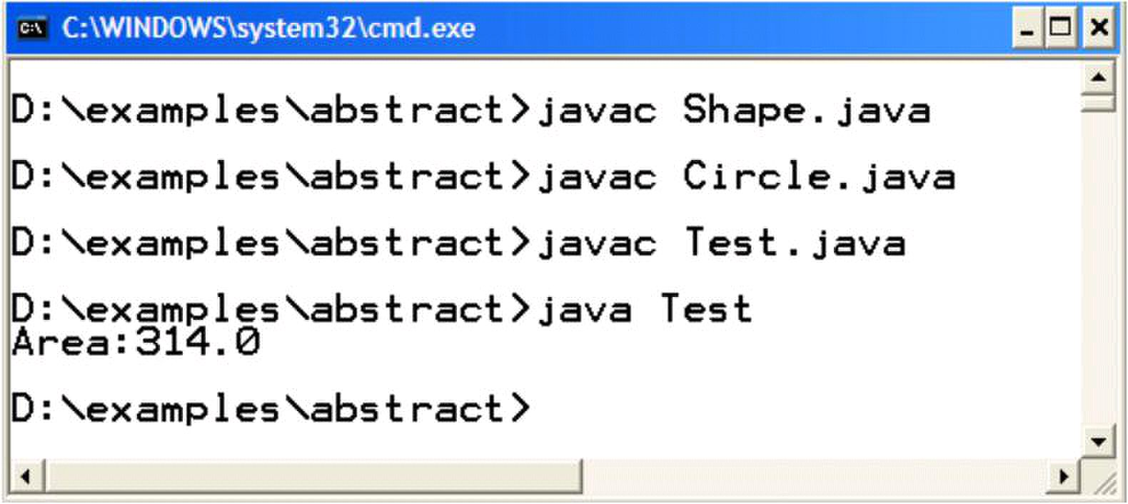
Web Design & Development – CS506 VU
Interfaces
As we seen one possible java‘s solution to problem discussed in start of the tutorial. The second possible java‘s
solution is Interfaces.
Interfaces are special java type which contains only a set of method prototypes, but doest not provide the
implementation for these prototypes. All the methods inside an interface are abstract by default thus an
interface is tantamount to a pure abstract class – a class with zero implementation. Interface can also contains
static final constants
Defining an Interface
Keyword interface is used instead of class as shown below:
public interface Speaker{
public void speak();
}
Implementing (using) Interface
Classes implement interfaces. Implementing an interface is like signing a contract. A class that implements an
interface will have to provide the definition of all the methods that are present inside an interface. If the
class does not provide definitions of all methods, the class would not compile. We have to declare it as an
abstract class in order to get it compiled.
Relationship between a class and interface is equivalent to “responds to” while “is a”
relationship exists in inheritance.
Code Example of Defining & Implementing an Interface
The interface Printable contains print() method.
© Copyright Virtual University of Pakistan
98

Slide 99

Web Design & Development – CS506 VU
public interface Printable{
public void print();
}
Class Student is implementing the interface Printable. Note the use of keyword implements after the class
name. Student class has to provide the definition of print method or we are unable to compile.
The code snippet of student class is given below:
public class Student implements Printable {
private String name;
private String address;
public String toString () {
return "name:"+name +" address:"+address;
}
//providing definition of interface‘s print method
public void print() {
}
}//end of class
Interface Characteristics
Similar to abstract class, interfaces imposes a design structure on any class that uses the interface. Contrary to
inheritance, a class can implement more than one interfaces. To do this separate the interface names with
comma. This is java‘s way of multiple inheritance.
class Circle implements Drawable , Printable { ………. }
Objects of interfaces also cannot be instantiated.
Speaker s = new Speaker(); // not compile
However, a reference of interface can be created to point any of its implementation class. This is interface based
polymorphism.
© Copyright Virtual University of Pakistan
System.out.println("Name:" +name+" address"+address);
99

Slide 100

Web Design & Development – CS506 VU
Code Example: Interface based polymorphism
Interface Speaker is implemented by three classes Politician, Coach and Lecturer. Code snippets of all these
three classes are show below:
public class Politician implements Speaker{
public void speak(){
System.out.println(―Politics Talks‖);
}
}
public class Coach implements Speaker{
public void speak(){
System.out.println(―Sports Talks‖);
}
}
public class Lecturer implements Speaker{
public void speak(){
System.out.println(―Web Design and Development Talks‖);
}
}
As usual, Test class contains main method. Inside main, a reference sp is created of Speaker class. Later,
this reference is used to point to the objects of Politician, Coach and Lecturer class. On calling speak method
with the help of sp, will invoke the method of a class to which sp is pointing.
public class Test{
public static void main (String args[ ]) {
Speaker sp = null;
System.out.println("sp pointing to Politician");
sp = new Politician();
sp.speak();
System.out.println("sp pointing to Coach");
sp = new Coach();
sp.speak();
System.out.println("sp pointing to Lecturer");
sp = new Lecturer();
}
© Copyright Virtual University of Pakistan
sp.speak();
}
100

Slide 101
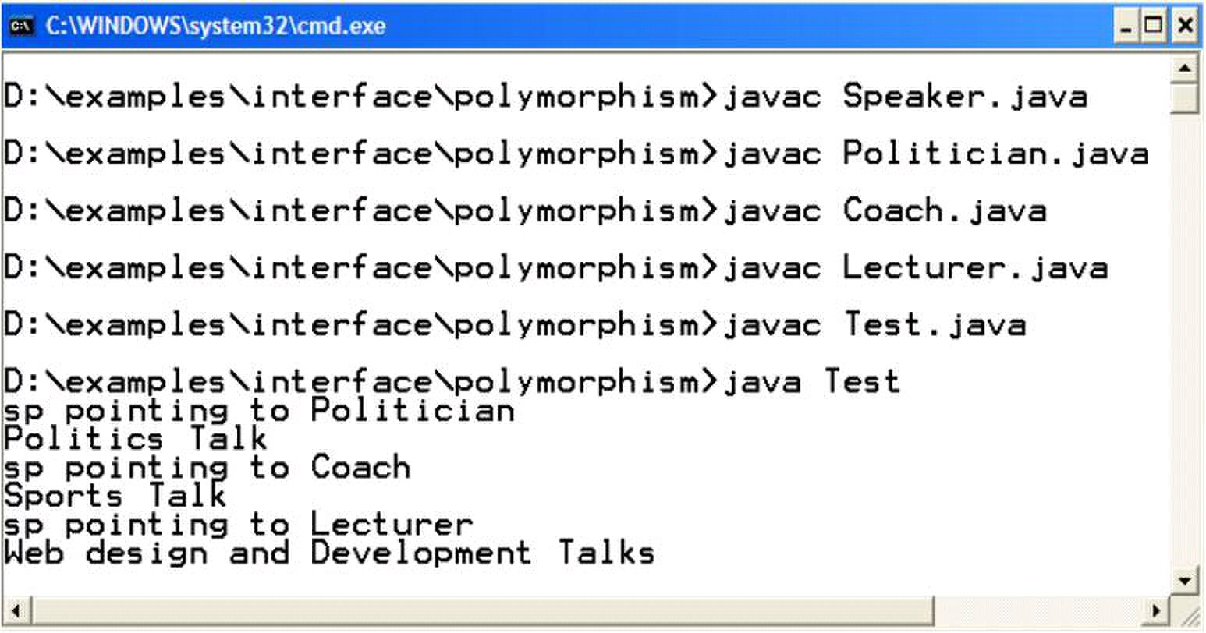
Web Design & Development – CS506 VU
The compilation and execution of the above program is shown below:
References
Example code, their explanations and corresponding figures for this handout are taken from the book JAVA
A Lab Course by Umair Javed. This material is available just for the use of VU students of the course Web
Design and Development and not for any other commercial purpose without the consent of author.
© Copyright Virtual University of Pakistan
101

Slide 102

Web Design & Development – CS506 VU
Lesson 10
Graphical User Interfaces
A graphical user interface is a visual interface to a program. GUIs are built from GUI components (buttons,
menus, labels etc). A GUI component is an object with which the user interacts via the mouse or keyboard.
Together, the appearance and how user interacts with the program are known as the program look and feel.
Support for GUI in Java
The classes that are used to create GUI components are part of the ―java.awt‖ or
―javax.swing‖ package. Both these packages provide rich set of user interface components.
GUI classes vs. Non-GUI Support Classes
The classes present in the awt and swing packages can be classified into two broad categories. GUI classes
& Non-GUI Support classes.
The GUI classes as the name indicates are visible and user can interact with them. Examples of these are
JButton, JFrame & JRadioButton etc
The Non-GUI support classes provide services and perform necessary functions for GUI classes. They do not
produce any visual output. Examples of these classes are Layout managers (discussed latter) & Event handling
(see handout on it) classes etc.
java.awt package
AWT stands for ―Abstract Windowing Toolkit ―contains original GUI components that came with the first
release of JDK. These components are tied directly to the local platform‘s (Windows, Linux, MAC etc)
graphical user interface capabilities. Thus results in a java program executing on different java platforms
(windows, Linux, Solaris etc) has a different appearance and sometimes even different user interaction on each
platform.
AWT components are often called Heavy Weight Components (HWC) as they rely on the local platform‘s
windowing system to determine their functionality and their look and feel. Every time you create an AWT
component it creates a corresponding process on the operating system. As compared to this SWING
components are managed through threads and are known as Light Weight Components.
This package also provides the classes for robust event handling (see handout on it) and layout managers.
javax.swing package
These are the newest GUI components. Swing components are written, manipulated and displayed completely
in java, therefore also called pure java components. The swing components allow the programmer to
specify a uniform look and feel across all platforms.
© Copyright Virtual University of Pakistan
102

Slide 103

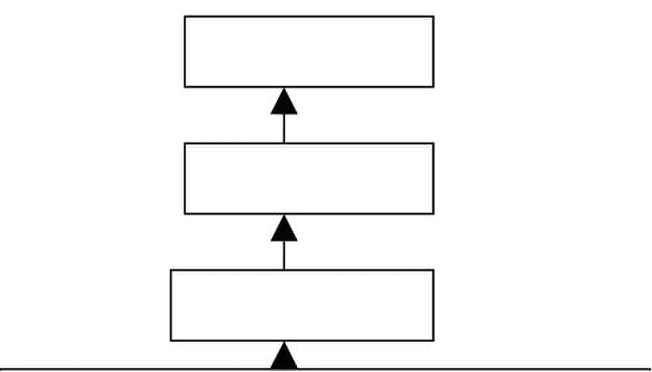
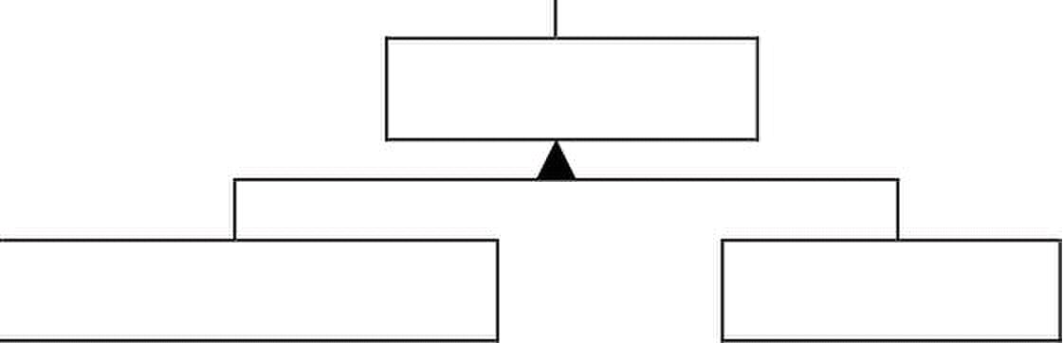
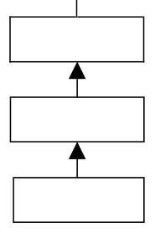
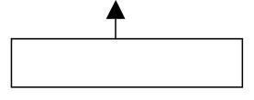
Web Design & Development – CS506 VU
Swing components are often referred to as Light Weight Components as they are completely written in
java. Several swing components are still HWC. e.g. JFrame etc.
A part of the FrameWork
Object
Component
Container
JComponent
AbstractButton
JButton
© Copyright Virtual University of Pakistan
Window
JPanel
JFrame
103
Frame

Slide 104

Web Design & Development – CS506 VU
GUI Creation Steps
1. import required packages
import java.awt.* and/or javax.swing.* package.
2. Setup the top level containers
A container is a collection of related components, which allows other components to be
nested inside it. In application with JFrame, we attatch components to the content pane – a
container.
Two important methods the container class has add and setLayout.
The add method is used for adding components to the content pane while setLayout method is
used to specify the layout manager.
Container are classified into two broad categories that are Top Level containers and
General Purpose Containers
Top level containers can contain (add) other containers as well as basic components
(buttons, labels etc) while general purpose containers are typically used to collect basic
components and are added to top level containers.
General purpose containers cannot exist alone they must be added to top level containers
Examples of top level container are JFrame, Dialog and Applet etc. Our application uses one
of these.
Examples of general purpose container are JPanel, Toolbar and ScrollPane etc.
So, take a top level container and create its instance. Consider the following code of line if JFrame
is selected as a top level container
JFrame frame = new JFrame();
© Copyright Virtual University of Pakistan
104

Slide 105

Web Design & Development – CS506 VU
3. Get the component area of the top level container
Review the hierarchy given above, and observe that JFrame is a frame is a
window. So, it can be interpreted as JFrame is a window.
Every window has two areas. System Area & Component Area
The programmer cannot add/remove components to the System Area.
The Component Area often known as Client area is a workable place for the programmer.
Components can be added/removed in this area.
So, to add components, as you guessed right component area of the JFrame is required. It can be
accomplished by the following code of line
Conntainer con = frame.getContentPane();
frame is an instance of JFrame and by calling getContentPane() method on it, it returns the component
area. This component area is of type container and that is why it is stored in a variable of a
Container class. As already discussed, container allows other components to be added / removed.
4. Apply layout to component area
The layout (size & position etc. How they appear) of components in a container is usually
governed by Layout Managers.
The layout manager is responsible for deciding the layout policy and size of its components added
to the container.
Layout managers are represented in java as classes. (Layout Managers are going to be discussed
in detail later in this handout)
To set the layout, as already discussed use setLayout method and pass object of layout manager as an
argument.
con.setLayout( new FlowLayout( ) );
We passed an object of FlowLayout to the setLayout method here.
We can also use the following lines of code instead of above. FlowLayout layout = new
FlowLayout(); con.setLayout(layout);
© Copyright Virtual University of Pakistan
105

Slide 106

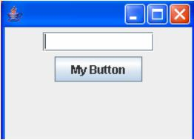
Web Design & Development – CS506 VU
5. Create and Add components
Create required components by calling their constructor.
JButton button = new JButton ( );
After creating all components your are interested in, the next task is to add these components
into the component area of your JFrame (i.e ContentPane, the reference to which is in variable con
of type Container)
Use add method of the Container to accomplish this and pass it the component to be added.
con.add(button);
6. Set size of frame and make it visible
A frame must be made visible via a call to setVisible(true) and its size defined via a call setSize(rows
in pixel, columns in pixel) to be displayed on the screen.
frame.setSize(200, 300) ;
frame.setVisible(true) ;
Note: By default, all JFrame‘s are invisible. To make visible frame visible we have passed true to the
setVisible method.
frame.setVisible(false) ;
Making a Simple GUI
The above figured GUI contains one text field and a button. Let‘s code it by following the six GUI creation
steps we discussed.
© Copyright Virtual University of Pakistan
106

Slide 107

Web Design & Development – CS506 VU
Code for Simple GUI
// File GUITest.java
//Step 1: import packages import java.awt.*;
import javax.swing.*;
public class GUITest {
JFrame myFrame ;
JTextField tf;
JButton b;
//method used for setting layout of GUI
public void initGUI ( ) {
//Step 2: setup the top level container
myFrame = new JFrame();
//Step 3: Get the component area of top-level container
Container c = myFrame.getContentPane();
//Step 4: Apply layouts
c.setLayout( new FlowLayout( ) );
//Step 5: create & add components
JTextField tf = new JTextField(10);
JButton b1 = new JButton("My Button");
c.add(tf);
c.add(b1);
//Step 6: set size of frame and make it visible
myFrame.setDefaultCloseOperation(JFrame.EXIT_ON_CLOSE);
myFrame.setSize(200,150);
myFrame.setVisible(true);
} //end initGUI method
public GUITest () { // default constructor
initGUI ();
}
public static void main (String args[ ]) {
}
} // end of class
© Copyright Virtual University of Pakistan
GUITest gui = new GUITest();
107

Slide 108
Web Design & Development – CS506 VU
Important Points to Consider
main method (from where program execution starts) is written in the same class. The main method can be
in a separate class instead of writing in the same class its your choice.
Inside main, an object of GUI test class is created that results in calling of constructor of the class and from
the constructor, initGUI method is called that is responsible for setting up the GUI.
The following line of code is used to exit the program when you close the window
myFrame.setDefaultCloseOperation(JFrame.EXIT_ON_CLOSE);
If you delete this line and run your program, the desired GUI would be displayed. However if you
close the window by using (X) button on top left corner of your window, you‘ll notice that the control
doesn‘t return back to command prompt. The reason for this is that the java process is still running. How
ever if you put this line in your code, when you exit your prompt will return.
References:
Sun java tutorial: http://java.sun.com/docs/books/tutorial/java
Thinking in java by Bruce Eckle
Beginning Java2 by Ivor Hortan
GUI creation steps are taken from the book Java A Lab Course by Umair Javed
© Copyright Virtual University of Pakistan
108

Slide 109
Web Design & Development – CS506 VU
Graphical User Interfaces - 2
Layout Managers
Layout Managers are used to form the appearance of your GUI. They are concerned with the arrangement of
components of GUI. A general question is ―why we can not place components at our desired location (may be
using the x,y coordinate position?‖
The answer is that you can create your GUI without using Layout Managers and you can also do VB style
positioning of components at some x,y co-ordinate in Java, but that is generally not advisable if you desire to
run the same program on different platforms
The appearance of the GUI also depends on the underlying platform and to keep that same the
responsibility of arranging layout is given to the LayoutManagers so they can provide the same look and feel
across different platforms
Commonly used layout managers are
1. Flow Layout
2. Grid Layout
3. Border Layout
4. Box Layout
5. Card Layout
6. GridBag Layout and so on
Let us discuss the top three in detail one by one with code examples. These top three will meet most of your basic
needs
1. Flow
Layout
Position components on line by line basis. Each time a line is filled, a new line is started.
The size of the line depends upon the size of your frame. If you stretch your frame while your program is
running, your GUI will be disturbed.
Example Code
// File FlowLayoutTest.java
import java.awt.*;
import javax.swing.*;
public class FlowLayoutTest {
JFrame myFrame ;
JButton b1, b2, b3, b4, b5;
//method used for setting layout of GUI
public void initGUI ( ) {
© Copyright Virtual University of Pakistan
109

Slide 110

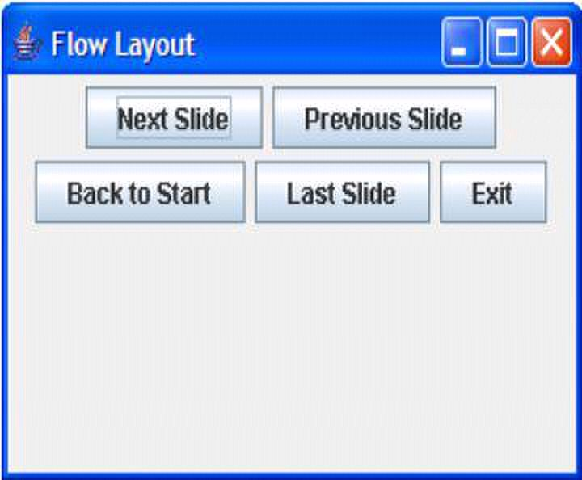
Web Design & Development – CS506 VU
myFrame = new JFrame(―Flow Layout‖);
Container c = myFrame.getContentPane();
c.setLayout( new FlowLayout( ) );
b1 = new JButton(―Next Slide‖);
b2 = new JButton(―Previous Slide‖);
b3 = new JButton(―Back to Start‖);
b4 = new JButton(―Last Slide‖);
b5 = new JButton(―Exit‖);
c.add(b1);
c.add(b2);
c.add(b3);
c.add(b4);
c.add(b5);
myFrame.setDefaultCloseOperation(JFrame.EXIT_ON_CLOSE);
myFrame.setSize(300,150);
myFrame.setVisible(true);
} //end initGUI method
public FlowLayoutTest () { // default constructor
initGUI ();
}
public static void main (String args[ ]) {
}
} // end of class
Output
© Copyright Virtual University of Pakistan
FlowLayoutTest flTest = new FlowLayoutTest();
110

Slide 111

Web Design & Development – CS506 VU
2.Grid Layout
Splits the panel/window into a grid (cells) with given number of rows and columns.
Forces the size of each component to occupy the whole cell. Size of each component is same
Components are added row wise. When all the columns of the first row are get filled the components are
then added to the next row.
Only one component can be added into each cell.
Example Code
// File GridLayoutTest.java
import java.awt.*;
import javax.swing.*;
public class GridLayoutTest {
JFrame myFrame ;
JButton b1, b2, b3, b4, b5;
//method used for setting layout of GUI
public void initGUI ( ) {
myFrame = new JFrame(―Grid Layout‖);
Container c = myFrame.getContentPane();
// rows , cols
c.setLayout( new GridLayout( 3 , 2 ) );
b1 = new JButton(―Next Slide‖);
b2 = new JButton(―Previous Slide‖);
b3 = new JButton(―Back to Start‖);
b4 = new JButton(―Last Slide‖);
b5 = new JButton(―Exit‖);
c.add(b1);
c.add(b2);
c.add(b3);
c.add(b4);
c.add(b5);
myFrame.setDefaultCloseOperation(JFrame.EXIT_ON_CLOSE);
myFrame.setSize(300,150);
myFrame.setVisible(true);
} //end initGUI method
© Copyright Virtual University of Pakistan
111

Slide 112

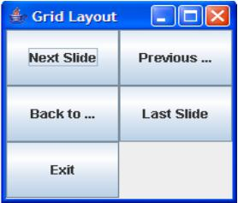
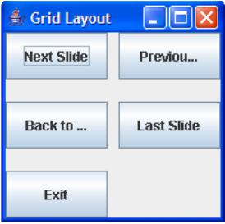
Web Design & Development – CS506 VU
public GridLayoutTest () { // default constructor
initGUI ();
}
public static void main (String args[ ]) {
}
} // end of class
output
Modification
The grid layout also allows the spacing between cells. To achieve spacing between cells, modify the above
program.
Pass additional parameters to the constructor of GridLayout, spaces between rows &
spaces between columns as shown below
c.setLayout( new GridLayout( 3 , 2 , 10 , 20) );
The output is look similar to one given below.
© Copyright Virtual University of Pakistan
GridLayoutTest glTest = new GridLayoutTest();
112

Slide 113


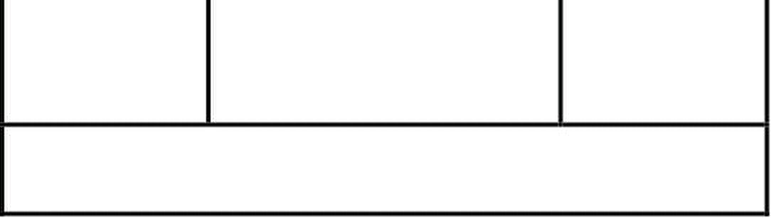
Web Design & Development – CS506 VU
3.Border Layout
Divides the area into five regions. North, South, East, West and Center
Components are added to the specified region
If any region not filled, the filled regions will occupy the space but the center region will still appear
as background if it contains no component.
Only one component can be added into each region.
NORTH
WEST CENTER EAST
SOUTH
Example Code
// File BorderLayoutTest.java
import java.awt.*;
import javax.swing.*;
public class BorderLayoutTest {
JFrame myFrame ;
JButton b1, b2, b3, b4, b5;
//method used for setting layout of GUI
public void initGUI ( ) {
myFrame = new JFrame(―Border Layout‖);
Container c = myFrame.getContentPane();
c.setLayout( new BorderLayout( );
b1 = new JButton(―Next Slide‖);
b2 = new JButton(―Previous Slide‖);
b3 = new JButton(―Back to Start‖);
b4 = new JButton(―Last Slide‖);
b5 = new JButton(―Exit‖);
c.add( b1 , BorderLayout.NORTH );
c.add( b2 , BorderLayout.SOUTH );
© Copyright Virtual University of Pakistan
113

Slide 114


Web Design & Development – CS506 VU
c.add( b3 , BorderLayout.EAST );
c.add( b4 , BorderLayout.WEST );
c.add( b5 , BorderLayout.CENTER);
myFrame.setDefaultCloseOperation(JFrame.EXIT_ON_CLOSE);
myFrame.setSize(300,150);
myFrame.setVisible(true);
} //end initGUI method
public BorderLayoutTest () { // default constructor
initGUI ();
}
public static void main (String args[ ]) {
}
} // end of class
Points to Remember
Revisit the code of adding components, we specify the region in which we want to add component or
otherwise they will not be visible.
Consider the following segment of code: BorderLayout.NORTH, as you guessed correctly
NORTH is a constant (final) defined in BorderLayout class public access modifier. Similarly the
other ones are defined. Now you understand,
why so much emphasis has been made on following the naming conventions.
Output
© Copyright Virtual University of Pakistan
BorderLayoutTest glTest = new BorderLayoutTest();
114

Slide 115

Web Design & Development – CS506 VU
Making Complex GUIs
From the discussion above it seems that the basic Layout Managers may not help us in constructing complex
GUIs, but generally a combination of these basic layouts can do the job. So lets try to create the calculator GUI
given below
This GUI has 16 different buttons each of same size and text field on the top and a label
‗my calculator‘ on the bottom.
So, how we can make this GUI? If Border Layout is selected, it has five regions (each region can have at
most one component) but here we have more than five components to add. Lets try Grid Layout, but all the
components in a Grid have same size and the text field at the top and label at the bottom has different size.
Flow Layout cannot be selected because if we stretch our GUI it will destroy its shape.
Can we make this GUI? Yes, we can. Making of such GUI is a bit tricky business but
General Purpose Containers are there to provide the solution.
JPanel
It is general purpose container (can‘t exist alone, it has to be in some toplevel container) in which
we can put in different components (JButton , JTextField etc even other JPanels)
JPanel has its own layout that can be set while creating JPanel instance
JPanel myPanel = new JPanel ( new FlowLayout( ) );
Add components by using add method like shown below.
myPanel.add (button );
Must be added to a top level container (like JFrame etc) in order to be visible as they (general purpose
containers) can‘t exist alone.
© Copyright Virtual University of Pakistan
115

Slide 116

Web Design & Development – CS506 VU
Solution
To make the calculator GUI shown above, take JFrame (top level container) and set its layout to border. Than
take JPanel (general purpose container) and set its layout to Grid with 4 rows and 4 columns.
Add buttons to JPanel as they all have equal size and JPanel layout has been set to GridLayout. Afterthat,
add text field to the north region, label to the south region and panel to the center region of the JFrame‘s
container. The east and west regions are left blank and the center region will be stretched to cover up these.
So, that‘s how we can build our calculator GUI.
Code for Calculator GUI
// File CalculatorGUI.java
import java.awt.*;
import javax.swing.*;
public class CalculatorGUI {
JFrame fCalc;
JButton b1, b2, b3, b4, b5, b6, b7, b8, b9, b0;
JButton bPlus, bMinus, bMul, bPoint, bEqual, bClear;
JPanel pButtons;
JTextField tfAnswer;
JLabel lMyCalc;
//method used for setting layout of GUI
public void initGUI ( ) {
fCalc = new JFrame();
b0 = new JButton("0");
b1 = new JButton("1");
b2 = new JButton("2");
b3 = new JButton("3");
b4 = new JButton("4");
b5 = new JButton("5");
b6 = new JButton("6");
b7 = new JButton("7");
b8 = new JButton("8");
b9 = new JButton("9");
© Copyright Virtual University of Pakistan
116

Slide 117

Web Design & Development – CS506 VU
bPlus = new JButton("+");
bMinus = new JButton("-");
bMul = new JButton("*");
bPoint = new JButton(".");
bEqual = new JButton("=");
bClear = new JButton("C");
tfAnswer = new JTextField();
lMyCalc = new JLabel("My Clacualator");
//creating panel object and setting its layout pButtons = new JPanel (new
GridLayout(4,4));
//adding components (buttons) to panel
pButtons.add(b1);
pButtons.add(b2);
pButtons.add(b3);
pButtons.add(bClear);
pButtons.add(b4);
pButtons.add(b5);
pButtons.add(b6);
pButtons.add(bMul);
pButtons.add(b7);
pButtons.add(b8);
pButtons.add(b9);
pButtons.add(bMinus);
pButtons.add(b0);
pButtons.add(bPoint);
pButtons.add(bPlus);
pButtons.add(bEqual);
// getting componenet area of JFrame
Container con = fCalc.getContentPane();
con.setLayout(new BorderLayout());
//adding components to container
con.add(tfAnswer, BorderLayout.NORTH);
con.add(lMyCalc, BorderLayout.SOUTH);
con.add(pButtons, BorderLayout.CENTER);
fcalc.setDefaultCloseOperation(JFrame.EXIT_ON_CLOSE);
fCalc.setSize(300, 300);
fCalc.setVisible(true);
} //end initGUI method
public CalculatorGUI () { // default constructor
initGUI ();
}
© Copyright Virtual University of Pakistan
117

Slide 118

Web Design & Development – CS506 VU
public static void main (String args[ ]) {
CalculatorGUI calGUI = new CalculatorGUI ();
}
} // end of class
Reference:
Sun java tutorial: http://java.sun.com/docs/books/tutorial/java
Thinking in java by Bruce Eckle
Beginning Java2 by Ivor Hortan
Java A Lab Course by Umair Javed
© Copyright Virtual University of Pakistan
118

Slide 119

Web Design & Development – CS506 VU
Lesson 11
Event Handling
One of the most important aspects of most non-trivial applications (especially UI type- apps) is the ability to
respond to events that are generated by the various components of the application, both in response to user
interactions and other system components such as client-server processing. In this handout we will look at
how Java supports event generation and handling and how to create (and process) custom events.
GUIs generate events when the user interacts with GUI. For example,
— Clicking a button
— Moving the mouse
— Closing Window etc
Both AWT and swing components (not all) generate events
— java.awt.event.*;
— javax.swing.event.*;
In java, events are represented by Objects
These objects tells us about event and its source. Examples are:
— ActionEvent (Clicking a button)
— WindowEvent (Doing something with window e.g. closing , minimizing)
Some event classes of java.awt.event are shown in diagram below
© Copyright Virtual University of Pakistan
119

Slide 120
Web Design & Development – CS506 VU
Event Handling Model
In Java both AWT and Swing components use Event Delegation Model.
– In this model processing of an event is delegated to a particular object (handlers )
in the program
– It‘s a Publish-Subscribe model. That is, event generating component publish an event and event
handling components subscribe for that event. The publisher sends these events to subscribers.
Similar to the way that you subscribe for newspaper and you get the newspaper at your home from the
publisher.
– This model separates UI code from program logic, it means that we can create separate classes
for UI components and event handlers and hence business/program logic is separated from GUI
components.
Event Handling Steps
For a programmer the event Handling is a three step process in terms of code
– Step 1: Create components which can generate events (Event Generators)
– Step 2: Build component (objects) that can handle events (Event Handlers)
– Step 3: Register handlers with generators
Event Handling Process
Step 1: Event Generators
The first step is that you create an event generator. You have already seen a lot of event generators like:
– Buttons
– Mouse
– Key
– Window etc
Most of GUI components can be created by calling their constructors. For example
JButton b1 = new JButton(―Hello‖);
Now b1 can generate events
Note: We do not create Mouse/Keys etc as they are system components
© Copyright Virtual University of Pakistan
120

Slide 121

Web Design & Development – CS506 VU
Step 2: Event Handlers/ Event Listener
The second step is that you build components that can handle events
First Technique - By Implementing Listener Interfaces
– Java defines interfaces for every event type
– If a class needs to handle an event. It needs to implement the corresponding listener interface
– To handle ―ActionEvent‖ a class needs to implement ―ActionListener‖
– To handle ―KeyEvent‖ a class needs to implement ―KeyListener‖
– To handle ―MouseEvent‖ a class needs to implement ―MouseListener‖ and so on
– Package java.awt.event contains different event Listener Interfaces which are shown in the following
figure
© Copyright Virtual University of Pakistan
121

Slide 122
Web Design & Development – CS506 VU
– Some Example Listeners, the way they are defined in JDK by Sun
public interface ActionListener {
public void actionPerformed(ActionEvent e);
}
public interface ItemListener {
public void itemStateChanged(ItemEvent e);
}
public interface ComponentListener {
public void componentHidden(ComponentEvent e);
public void componentMoved(ComponentEvent e);
public void componentResized(ComponentEvent e);
public void componentShown(ComponentEvent e);
}
– By implementing an interface the class agrees to implement all the methods that are present in that
interface. Implementing an interface is like signing a contract.
– Inside the method the class can do what ever it wants to do with that event
– Event Generator and Event Handler can be the same or different classes
– To handle events generated by Button. A class needs to implement ActionListener
interface and thus needs to provide the definition of actionPerformed() method which is present
in this interface.
public class Test implements ActionListener{
public void actionPerformed(ActionEvent ae) {
// do something
}
}
© Copyright Virtual University of Pakistan
122

Slide 123

Web Design & Development – CS506 VU
Step 3: Registering Handler with Generator
The event generator is told about the object which can handle its events
Event Generators have a method
— addXXXListener(_reference to the object of Handler class_)
For example, if b1 is JButton then
— b1.addActionListener(this); // if listener and generator are same class
Event Handling Example
Clicking the ―Hello‖ button will open up a message dialog shown below.
We will take the simplest approach of creating handler and generator in a single class. Button is our event
generator and to handle that event our class needs to implement ActionListener Interface and to override
its actionPerformed method and in last to do the registration
1. import java.awt.*;
2. import javax.swing.*;
3. import java.awt.event.*;
/* Implementing the interface according to the type of the event, i.e. creating event handler (first
part of step 2 of our process) */
4. public class ActionEventTest implements ActionListner{
5. JFrame frame;
6. JButton hello;
// setting layout components
7. public void initGUI ( ) {
8. frame = new JFrame();
9. Container cont = frame.getContentPane();
10. cont.setLayout(new FlowLayout());
//Creating event generator step-1 of our process
11. hello = new JButton("Hello");
© Copyright Virtual University of Pakistan
123

Slide 124
Web Design & Development – CS506 VU
/* Registering event handler with event generator.
Since event handler is in same object that contains
button, we have used this to pass the reference.(step
3 of the process) */
12. hello.addActionListener(this);
13. cont.add(hello);
14. frame.setDefaultCloseOperation(JFrame.EXIT_ON_CLOSE);
15. frame.setSize(150, 150);
16.
//constructor
18. public ActionEventTest ( ) {
19.
/* Override actionPerformed method of ActionListener‘s
interfacemethod of which will be called when event
takes place (second part of step 2 of our process) */
21. public void actionPerformed(ActionEvent event) {
22. JOptionPane.showMessageDialog(null,"Hello is pressed");
23. }
24. public static void main(String args[]) {
25. ActionEventTest aeTest = new ActionEventTest();
26. }
27.} // end class
© Copyright Virtual University of Pakistan
frame.setVisible(true);
initGUI();
17. }
20. }
124

Slide 125

Web Design & Development – CS506 VU
How Event Handling Participants interact Behind the Scenes?
We have already seen that what a programmer needs to do handle events. Let‘s see what takes place behind the
scenes, i.e How JVM handles event. Before doing that lets revisit different participants of Event Handling
Process and briefly what they do.
1. Event Generator / Source
– Swing and awt components
– For example, JButton, JTextField, JFrame etc
– Generates an event object
– Registers listeners with itself
2. Event Object
– Encapsulate information about event that occurred and the source of that event
– For example, if you click a button, ActionEvent object is created
3. Event Listener/handler
– Receives event objects when notified, then responds
– Each event source can have multiple listeners registered on it
– Conversely, a single listener can register with multiple event sources
4. JVM
– Receives an event whenever one is generated
– Looks for the listener/handler of that event
– If exist, delegate it for processing
– If not, discard it (event).
© Copyright Virtual University of Pakistan
125

Slide 126

Web Design & Development – CS506 VU
When button generates an ActionEvent it is sent to JVM which puts it in an event queue. After that when JVM
find it appropriate it de-queue the event object and send it to all the listeners that are registered with that
button. This is all what we shown in the pictorial form below:
(figure from JAVA A Lab Course)
© Copyright Virtual University of Pakistan
126

Slide 127


Web Design & Development – CS506 VU
Making Small Calculator
User enters numbers in the provided fields
On pressing ―+‖ button, sum would be displayed in the answer field
On pressing ―*‖ button, product would be displayed in the answer field
© Copyright Virtual University of Pakistan
127

Slide 128
Web Design & Development – CS506 VU
Example Code: Making Small Calculator
1. import java.awt.*;
2. import javax.swing.*;
3. import java.awt.event.*;
4. public class SmallCalcApp implements ActionListener{
5. JFrame frame;
6. JLabel firstOperand, secondOperand, answer;
7. JTextField op1, op2, ans;
8. JButton plus, mul;
9. // setting layout
10. public void initGUI ( ) {
11. frame = new JFrame();
12. firstOperand = new JLabel("First Operand");
13. secondOperand = new JLabel("Second Operand");
14. answer = new JLabel("Answer");
15. op1 = new JTextField (15);
16. op2 = new JTextField (15);
17. ans = new JTextField (15);
18. plus = new JButton("+");
19. plus.setPreferredSize(new Dimension(70,25));
20. mul = new JButton("*");
21. mul.setPreferredSize(new Dimension(70,25));
22. Container cont = frame.getContentPane();
23. cont.setLayout(new FlowLayout());
24. cont.add(firstOperand);
25. cont.add(op1);
26. cont.add(secondOperand);
27. cont.add(op2);
28. cont.add(plus);
29. cont.add(mul);
30. cont.add(answer);
31. cont.add(ans);
32. plus.addActionListener(this);
33. mul.addActionListener(this);
34. frame.setDefaultCloseOperation(JFrame.EXIT_ON_CLOSE);
35. frame.setSize(200, 220);
36. frame.setVisible(true);
37. }
38. //constructor
39. public SmallCalcApp ( ) {
40. initGUI();
© Copyright Virtual University of Pakistan
128

Slide 129
Web Design & Development – CS506 VU
41. }
42. public void actionPerformed(ActionEvent event) {
43. String oper, result;
44. int num1, num2, res;
/* All the information regarding an event is contained
inside the event object. Here we are calling the
getSource() method on the event object to figure out
the button that has generated that event. */
45. if (event.getSource() == plus) {
46. oper = op1.getText();
47. num1 = Integer.parseInt(oper);
48. oper = op2.getText();
49. num2 = Integer.parseInt (oper);
50. res = num1+num2;
51. result = res+"";
52.
54. else if (event.getSource() == mul) {
55. oper = op1.getText();
56. num1 = Integer.parseInt(oper);
57. oper = op2.getText();
58. num2 = Integer.parseInt (oper);
59. res = num1*num2;
60. result = res+"";
61.
63. public static void main(String args[]) {
64. SmallCalcApp scApp = new SmallCalcApp();
65. }
66. }// end class
© Copyright Virtual University of Pakistan
ans.setText(result);
ans.setText(result);
53. }
62. }
129

Slide 130
Web Design & Development – CS506 VU
Lesson 12
More Examples of Handling Events
Handling Mouse Event
Mouse events can be trapped for any GUI component that inherits from Component class. For example, JPanel,
JFrame & JButton etc.
To handle Mouse events, two types of listener interfaces are available.
– MouseMotionListener
– MouseListener
The class that wants to handle mouse event needs to implement the corresponding interface and needs to
provide the definition of all the methods in that interface.
MouseMotionListener interface
– Used for processing mouse motion events
– Mouse motion event is generated when mouse is moved or dragged
MouseMotionListener interfaces is defined in JDK as follows
public interface MouseMotionListener {
public void mouseDragged (MouseEvent me);
public void mouseMoved (MouseEvent me);
}
MouseListener interface
– Used for processing ―interesting‖ mouse events like when mouse is:
• Pressed
• Released
• Clicked (pressed & released without moving the cursor)
• Enter (mouse cursor enters the bounds of component)
• Exit (mouse cursor leaves the bounds of component)
© Copyright Virtual University of Pakistan
130

Slide 131
Web Design & Development – CS506 VU
MouseListener interfaces is defined in JDK as follows
public interface MouseListener {
public void mousePressed (MouseEvent me);
public void mouseClicked (MouseEvent me);
public void mouseReleased (MouseEvent me);
public void mouseEntered (MouseEvent me);
public void mouseExited (MouseEvent me);
}
Example Code: Handling Mouse Events
Example to show Mouse Event Handling .Every time mouse is moved, the coordinates for a new place is
shown in a label.
1. import java.awt.*;
2. import javax.swing.*;
3. import java.awt.event.*;
4. public class EventsEx implements MouseMotionListener{
5. JFrame frame;
6. JLabel coordinates;
7. // setting layout
8. public void initGUI ( ) {
9. // creating event generator
10. frame = new JFrame();
11. Container cont = frame.getContentPane();
12. cont.setLayout(new BorderLayout( ) );
13. coordinates = new JLabel ();
14. cont.add(coordinates, BorderLayout.NORTH);
15. // registring mouse event handler with generator
16. frame.addMouseMotionListener(this);
17. frame.setDefaultCloseOperation(JFrame.EXIT_ON_CLOSE);
18. frame.setSize(350, 350);
19. frame.setVisible(true);
20. } // end initGUI method
21. //default constructor
22. public EventsEx ( ) {
23. initGUI();
24. }
© Copyright Virtual University of Pakistan
131

Slide 132
Web Design & Development – CS506 VU
// MouseMotionListener event hadler handling dragging
25. public void mouseDragged (MouseEvent me) {
26. int x = me.getX();
27. int y = me.getY();
28. coordinates.setText("Dragged at [" + x + "," + y + "]");
29. }
// MouseMotionListener event handler handling motion
30. public void mouseMoved (MouseEvent me) {
31. int x = me.getX();
32. int y = me.getY();
33. coordinates.setText("Moved at [" + x + "," + y + "]");
34. }
35. public static void main(String args[]) {
36. EventsEx ex = new EventsEx();
37. }
38. } // end class
© Copyright Virtual University of Pakistan
132

Slide 133


Web Design & Development – CS506 VU
Another Example: Handling Window Events
Task
We want to handle Window Exit event only
Why?
When window is closed, control should return back to command prompt.
But we have already achieved this functionality through following line of code
frame.setDefaultCloseOperation(JFrame.EXIT_ON_CLOSE);
But, what if we want to display some message (Good Bye) before exiting?
When user closes
the window, Message
would be displayed
After pressing Ok button
program will exit
How?
To handle window events, we need to implement ―WindowListner‖ interface.
―WindowListner‖ interface contains 7 methods We require only one i.e.
windowClosing
But, We have to provide definitions of all methods to make our class a concrete class
WindowListener interface is defined in the JDK as follows
public interface WindowListener {
public void windowActivated(WindowEvent we);
public void windowClosed(WindowEvent we);
public void windowClosing(WindowEvent we);
public void windowDeactivated(WindowEvent we);
public void windowDeiconified(WindowEvent we);
public void windowIconified(WindowEvent we);
}
public void windowClosing(WindowEvent we is our required method
© Copyright Virtual University of Pakistan
public void windowOpened(WindowEvent we);
133

Slide 134
Web Design & Development – CS506 VU
Example Code: WindowExitHandler
This example code is modification of the last code example i.e. EventsEx.java
1. import java.awt.*;
2. import javax.swing.*;
3. import java.awt.event.*;
4. public class EventsEx implements MouseMotionListener ,
5. JFrame frame;
6. JLabel coordinates;
// setting layout
7. public void initGUI ( ) {
// creating event generator
8. frame = new JFrame();
9. Container cont = frame.getContentPane();
10. cont.setLayout(new BorderLayout( ) );
11. coordinates = new JLabel ();
12. cont.add(coordinates, BorderLayout.NORTH);
// registring mouse event handler with generator
13. frame.addMouseMotionListener(this);
// registering window handler with generator
14. frame.addWindowListener(this);
15. frame.setSize(350, 350);
16. frame.setVisible(true);
17. } // end initGUI method
//default constructor
18. public EventsEx ( ) {
19. initGUI();
20. }
// MouseMotionListener event hadler handling dragging
21. public void mouseDragged (MouseEvent me) {
22. int x = me.getX();
23. int y = me.getY();
24. coordinates.setText("Dragged at [" + x + "," + y + "]");
25. }
© Copyright Virtual University of Pakistan
WindowListener {
134

Slide 135
Web Design & Development – CS506 VU
// MouseMotionListener event handler handling motion
26. public void mouseMoved (MouseEvent me) {
27. int x = me.getX();
28.
30. coordinates.setText("Moved at [" + x + "," + y + "]");
31. }
// window listener event handler
32. public void windowActivated (WindowEvent we) { }
33. public void windowClosed (WindowEvent we) { }
34. public void windowClosing (WindowEvent we) {
35.
System.exit(0);
37. }
38. public void windowDeactivated (WindowEvent we) { }
39. public void windowDeiconified (WindowEvent we) { }
40. public void windowIconified (WindowEvent we) { }
41. public void windowOpened (WindowEvent we) { }
42. public static void main(String args[]) {
43. EventsEx ex = new EventsEx();
44. }
45. } // end class
© Copyright Virtual University of Pakistan
int y = me.getY();
JOptionPane.showMessageDialog(null, “Good Bye”);
29.
36.
135

Slide 136
Web Design & Development – CS506 VU
Lesson 13
Problem in Last Code Example
Problem
– We were interested in windowClosing() method only
– But have to provide definitions of all the methods, Why?
– Because a class implementing an interface has to provide definitions of all methods present in
that interface.
Solution
– To avoid giving implementations of all methods of an interface when we are not using these methods
we use Event Adapter classes
Adapter Classes
• For listener interfaces containing more than one event handling methods, jdk defines adapter classes.
Examples are
– For WindowListener Æ WindowAdapter
– For MouseMotionListener Æ MouseMotionAdapter
– and many more
• Adapter classes provide definitions for all the methods (empty bodies) of their corresponding
Listener interface
• It means that WindowAdapter class implements WindowListener interface and provide the definition
of all methods inside that Listener interface
• Consider the following example of MouseMotionAdapter and its corresponding
MouseMotionListener interface
public interface MouseMotionListener {
public void mouseDragged (MouseEvent me);
}
public class MouseMotionAdapter implements MouseMotionListener{
public void mouseDragged (MouseEvent me) { }
}
© Copyright Virtual University of Pakistan
public void mouseMoved (MouseEvent me);
public void mouseMoved (MouseEvent me) { }
136

Slide 137

Web Design & Development – CS506 VU
Available Adapter classes
How to use Adapter Classes
Previously handler class need to implement interface
public class EventsEx implements MouseMotionListener{...}
Therefore it has to provide definitions of all the methods inside that interface
Now our handler class will inherit from adapter class
public class EventsEx extends MouseMotionAdapter{...}
Due to inheritance, all the methods of the adapter class will be available inside our handler class
Since adapter classes has already provided definitions with empty bodies.
We do not have to provide implementations of all the methods again
We only need to override our method of interest.
© Copyright Virtual University of Pakistan
137

Slide 138
Web Design & Development – CS506 VU
Example Code 13.1: Handling Window Events using Adapter Classes
Here we are modifying the window event code in the last example to show the use of WindowAdapter
instead of WindowListener. Code related to MouseMotionListener is deleted to avoid cluttering of code.
1. import java.awt.*;
2. import javax.swing.*;
3. import java.awt.event.*;
4. public class EventsEx extends WindowAdapter {
5. JFrame frame;
6. JLabel coordinates;
// setting layout
7. public void initGUI ( ) {
// creating event generator
8. frame = new JFrame();
9. Container cont = frame.getContentPane();
10. cont.setLayout(new BorderLayout( ) );
11. coordinates = new JLabel ();
12. cont.add(coordinates, BorderLayout.NORTH);
// registering window handler with generator
13. frame.addWindowListener(this);
14. frame.setSize(350, 350);
15. frame.setVisible(true);
16. } // end initGUI method
17. public EventsEx ( ) {
18. initGUI();
19. }
// As you can see that we have only implemented
// our required method
20. public void windowClosing (WindowEvent we) {
21.
System.exit(0);
23. }
24. public static void main(String args[]) {
25. EventsEx ex = new EventsEx();
26. }
27. } // end class
© Copyright Virtual University of Pakistan
//default constructor
22.
138

Slide 139

Web Design & Development – CS506 VU
Problem in Last Code Example
We have inherited from WindowAdapter
What if we want to use MouseMotionAdpater as well ? or what if our class already inherited form some
other class ?
Problem
— Java allows single inheritance
Solution
— Use Inner classes
Inner Classes
A class defined inside another class
Inner class can access the instance variables and members of outer class
It can have constructors, instance variables and methods, just like a regular class
Generally used as a private utility class which does not need to be seen by others classes
GUI class (contains GUI creation code)
• tf is a JTextField
Handler class
• contains event
Inner class
•tf is accessible here
© Copyright Virtual University of Pakistan
Outer
Class
handling code
139

Slide 140
Web Design & Development – CS506 VU
Example Code13.2: Handling Window Event with Inner Class
Here we are modifying the window event code in the last example to show the use of
WindowAdapter as an inner class.
1. import java.awt.*;
2. import javax.swing.*;
3. import java.awt.event.*;
4. public class EventEx {
5. JFrame frame;
6. JLabel coordinates;
7. // setting layout
8. public void initGUI ( ) {
9. frame = new JFrame();
10. Container cont = frame.getContentPane();
11. cont.setLayout(new BorderLayout( ));
12. coordinates = new JLabel ();
13. cont.add(coordinates, BorderLayout.NORTH);
/* Creating an object of the class which is handling our
window events and registering it with generator */
14. WindowHandler handler = new Window Handler ();
15. frame.addWindowListener(handler);
16. frame.setSize(350, 350);
17. frame.setVisible(true);
18. } // end initGUI
//default constructor
19. public EventEx ( ) {
20.
/* Inner class implementation of window adapter. Outer
class is free to inherit from any other class. */
22. private class WindowHandler extends WindowAdapter {
// Event Handler for WindowListener
23. public void windowClosing (WindowEvent we) {
24.
25.
27. } // end of WindowHandler class
28. public static void main(String args[]) {
29.
31.} // end class
© Copyright Virtual University of Pakistan
initGUI();
System.exit(0)
EventEx e = new EventEx();
21. }
JOptionPane.showMessageDialog(null, “Good Bye”);
26. }
30. }
140

Slide 141

Web Design & Development – CS506 VU
Example Code 13.3: Handling Window and Mouse Events with Inner Class
Here we are modifying the window event code of the last example to handle window and mouse events using
inner classes. The diagram given below summarizes the approach.
Inner class Handling
Mouse Events
GUI and other
code
Inner class
Handling
Window
1. import java.awt.*;
2. import javax.swing.*;
3. import java.awt.event.*;
4. public class EventEx {
5. JFrame frame;
6. JLabel coordinates;
7. // setting layout
8. public void initGUI ( ) {
9. frame = new JFrame();
10. Container cont = frame.getContentPane();
11. cont.setLayout(new BorderLayout( ) );
12. coordinates = new JLabel ();
13. cont.add(coordinates, BorderLayout.NORTH);
/* Creating an object of the class which is handling our
window events and registering it with generator */
14. WindowHandler whandler = new WindowHandler ();
15. frame.addWindowListener(whandler);
/* Creating an object of the class which is handling our
MouseMotion events & registering it with generator */
16. MouseHandler mhandler = new MouseHandler ();
17. frame.addMouseMotionListener(mhandler);
18. frame.setSize(350, 350);
19. frame.setVisible(true);
20. }
© Copyright Virtual University of Pakistan
Outer class for
141

Slide 142
Web Design & Development – CS506 VU
//default constructor
21. public EventEx ( ) {
22. initGUI();
23. }
/* Inner class implementation of WindowAdapter. Outer class
is free to inherit from any other class. */
24. private class WindowHandler extends WindowAdapter {
// Event Handler for WindowListener
25. public void windowClosing (WindowEvent we) {
26. JOptionPane.showMessageDialog(null, “Good Bye”);
27.
29. } // end of WindowHandler
//Inner class implementation of MouseMotionAdapter
30. private class MouseHandler extends MouseMotionAdapter {
// Event Handler for mouse motion events
31. public void mouseMoved (MouseEvent me) {
32. int x = me.getX();
33. int y = me.getY();
34.
36. } // end of MouseHandler
37. public static void main(String args[]) {
38.
40.} // end class
© Copyright Virtual University of Pakistan
System.exit(0)
coord.setText(“Moved at [" + x + "," + y + "]” );
EventEx e = new EventEx();
28. }
35. }
39. }
142

Slide 143

Web Design & Development – CS506 VU
Example Code: Making Small Calculator using Inner classes
User enters numbers in the provided fields
On pressing ―+‖ button, sum would be displayed in the answer field
On pressing ―*‖ button, product would be displayed in the answer field
© Copyright Virtual University of Pakistan
143

Slide 144
Web Design & Development – CS506 VU
1. import java.awt.*;
2. import javax.swing.*;
3. import java.awt.event.*;
4. public class SmallCalcApp implements ActionListener{
5. JFrame frame;
6. JLabel firstOperand, secondOperand, answer;
7. JTextField op1, op2, ans;
8. JButton plus, mul;
9. // setting layout
10. public void initGUI ( ) {
11. frame = new JFrame();
12. firstOperand = new JLabel("First Operand");
13. secondOperand = new JLabel("Second Operand");
14. answer = new JLabel("Answer");
15. op1 = new JTextField (15);
16. op2 = new JTextField (15);
17. ans = new JTextField (15);
18. plus = new JButton("+");
19. plus.setPreferredSize(new Dimension(70,25));
20. mul = new JButton("*");
21. mul.setPreferredSize(new Dimension(70,25));
22. Container cont = frame.getContentPane();
23. cont.setLayout(new FlowLayout());
24. cont.add(firstOperand);
25. cont.add(op1);
26. cont.add(secondOperand);
27. cont.add(op2);
28. cont.add(plus);
29. cont.add(mul);
30. cont.add(answer);
31. cont.add(ans);
/* Creating an object of the class which is handling
button events & registering it with generators */
32. ButtonHandler bHandler = new ButtonHandler();
33. plus.addActionListener(bHandler);
34. mul.addActionListener(bHandler);
35. frame.setDefaultCloseOperation(JFrame.EXIT_ON_CLOSE);
36. frame.setSize(200, 220);
37. frame.setVisible(true);
38. }
© Copyright Virtual University of Pakistan
144

Slide 145
Web Design & Development – CS506 VU
39. //constructor
40. public SmallCalcApp ( ) {
41. initGUI();
42. }
//Inner class implementation of ActionListener
43. private class ButtonHandler implements ActionListener{
44. public void actionPerformed(ActionEvent event) {
45. String oper, result;
46. int num1, num2, res;
47. if (event.getSource() == plus) {
48. oper = op1.getText();
49. num1 = Integer.parseInt(oper);
50. oper = op2.getText();
51. num2 = Integer.parseInt (oper);
52. res = num1+num2;
53. result = res+"";
54. ans.setText(result);
55 }
56. else if (event.getSource() == mul) {
57. oper = op1.getText();
58. num1 = Integer.parseInt(oper);
59. oper = op2.getText();
60. num2 = Integer.parseInt (oper);
61. res = num1*num2;
62. result = res+"";
63. ans.setText(result);
64 }
65. } // end actionPerformed method
66. } // end inner class ButtonHandler
67. public static void main(String args[]) {
68. SmallCalcApp scApp = new SmallCalcApp();
69. }
70. }// end class
© Copyright Virtual University of Pakistan
145

Slide 146
Web Design & Development – CS506 VU
Anonymous Inner Classes
Has no name
Same as inner class in capabilities
much shorter
difficult to understand
Named vs. Anonymous Objects
Named
– String s = ―hello‖; System.out.println(s);
– ―hello‖ has a named reference s.
Anonymous
– System.out.println(―hello‖);
We generally use anonymous object when there is just a one time use of a particular object but in case of a
repeated use we generally used named objects and use that named reference to use that objects again and again.
© Copyright Virtual University of Pakistan
146

Slide 147
Web Design & Development – CS506 VU
Example Code 13.4 Handling Window Event with Anonymous Inner Class
Here we are modifying the window event code of 13.3 to show the use of anonymous inner class.
28. import java.awt.*;
29. import javax.swing.*;
30. import java.awt.event.*;
31. public class EventsEx extends WindowAdapter {
32. JFrame frame;
33. JLabel coordinates;
// setting layout
34. public void initGUI ( ) {
// creating event generator
35. frame = new JFrame();
36. Container cont = frame.getContentPane();
37. cont.setLayout(new BorderLayout( ) );
38. coordinates = new JLabel ();
39. cont.add(coordinates, BorderLayout.NORTH);
// registering event handler (anonymous inner class)
// with generator by using
40. frame.addWindowListener (
41. new WindowAdapter ( ) {
42. public void windowClosing (WindowEvent we) {
43.
System.exit(0);
45. } // end window closing
46. } // end WindowAdapter
47. ); // end of addWindowListener
48. frame.setSize(350, 350);
49. frame.setVisible(true);
50. } // end initGUI method
//default constructor
51. public EventsEx ( ) {
52. initGUI();
53. }
54. public static void main(String args[]) {
55. EventsEx ex = new EventsEx();
56. }
57. } // end class
© Copyright Virtual University of Pakistan
JOptionPane.showMessageDialog(null, “Good Bye”);
44.
147

Slide 148

Web Design & Development – CS506 VU
Summary of Approaches for Handling Events
1. By implementing Interfaces
2. By extending from Adapter classes
To implement the above two techniques we can use
Same class
• putting event handler & generator in one class
Separate class
1. Outer class
• Putting event handlers & generator in two different classes
3. Inner classes
3. Anonymous Inner classes
References
Java A Lab Course by Umair Javed
© Copyright Virtual University of Pakistan
148

Slide 149

Web Design & Development – CS506 VU
Lesson 14
Java Database Connectivity
Introduction
Java Database Connectivity (JDBC) provides a standard library for accessing databases. The JDBC API
contains number of interfaces and classes that are extensively helpful while communicating with a database.
The java.sql package
The java.sql package contains basic & most of the interfaces and classes. You automatically get this package
when you download the J2SE™. You have to import this package whenever you want to interact with a
relational database.
Connecting With Microsoft Access
In this handout, we will learn how to connect & communicate with Microsoft Access Database. We
chooses Access because most of you are familiar with it and if not than it is very easy to learn.
Create Database
In start create a database ―PersonInfo‖ using Microsoft Access. Create one table named ―Person‖. The
schema of the table is shown in the picture.
Add the following records into Person table as shown below.
© Copyright Virtual University of Pakistan
149

Slide 150


Web Design & Development – CS506 VU
Save the data base in some folder. (Your database will be saved as an .mdb file)
Setup System DSN
• After creating database, you have to setup a system Data Source Name (DSN). DSN is a name
through which your system recognizes the underlying data source.
• Select Start Settings Control Panel Administrative Tools Data Sources (ODBC).
• The ODBC Data Source Administrator window would be opened as shown below. Select System
DSN tab. (If you are unable to use System DSN tab due to security restrictions on your machine,
you can use the User DSN tab)
• Press Add… button and choose Microsoft Access Driver (*.mdb) from Create New Data Source
window and press Finish button as shown in diagram.
• After that, ODBC Microsoft Access Setup window would be opened as shown in following
diagram
• Enter the Data Source Name personDSN and select the database by pressing Select button. The
browsing window would be opened, select the desired folder that contains the database (The
database .mdb file you have created in the first step) Press Ok button.
© Copyright Virtual University of Pakistan
150

Slide 151


Web Design & Development – CS506 VU
Basic Steps in Using JDBC
There are eight (8) basic steps that must be followed in order to successfully communicate with a database.
Let‘s take a detail overview of all these one by one.
1. Import Required Package
• Import the package java.sql.* that contains useful classes and interfaces to access & work with
database.
import java.sql.*;
© Copyright Virtual University of Pakistan
151

Slide 152
Web Design & Development – CS506 VU
2. Load Driver
• Need to load suitable driver for underlying database.
• Different drivers & types for different databases are available.
• For MS Access, load following driver available with j2se.
Class.forName(―sun.jdbc.odbc.JdbcOdbcDriver‖);
• For Oracle, load the following driver. You have to download it explicitly.
Class.forName(―oracle.jdbc.driver.OracleDriver‖);
3. Define Connection URL
• To get a connection, we need to specify the URL of a database (Actually we need to specify the
address of the database which is in the form of URL)
• As we are using Microsoft Access database and we have loaded a JDBC-ODBC driver. Using
JDBC-ODBC driver requires a DSN which we have created earlier and named it personDSN.
So the URL of the database will be
String conURL = ―jdbc:odbc:personDSN‖;
4. Establish Connection With DataBase
• Use DriverManagerto get the connection object.
• The URL of the database is passed to the getConnection method. Connection con =
DriverManager.getConnection(conURL);
• If DataBase requires username & password, you can use the overloaded version of getConnection
method as shown below:
String usr = ―umair‖;
String pwd = ―vu‖;
Connection con = null;con = DriverManager.getConnection(conURL, usr, pwd);
5. Create Statement
• A Statement object is obtained from a Connection object.
Statement stmt = con.createStatement( );
Once you have a statement, you can use it for various kinds of SQL queries.
6. Execute a Query
• The next step is to pass the SQL statements & to execute them.
• Two methods are generally used for executing SQL queries. These are:
executeQuery(sql) method
• Used for SQL SELECT queries.
• Returns the ResultSET object that contains the results of the query and can be used to access the
query results.
© Copyright Virtual University of Pakistan
152

Slide 153
Web Design & Development – CS506 VU
String sql = ―SELECT * from sometable‖;ResultSet rs =
stmt.executeQuery(sql);
executeUpdate(sql)method
. This method is used for executing an update statement like INSERT, UPDATE or
7. DELETE
• Returns an Integer value representing the number of rows updated
String sql = ―INSERT INTO tablename ‖ + ―(columnNames) Values (values)‖ ;
int count = stmt.executeUpdate(sql);
Process Results of the Query
• The ResultSet provides various getXXX methods that takes a column index or name and returns
the data
• The ResultSet maintains the data in the form tables (rows & columns)
• First row has index 1, not 0.
• The next method of ResultSet returns true or false depending upon whether the next row is
available (exist) or not and moves the cursor
• Always remember to call next() method at-least once
• To retrieve the data of the column of the current row you need to use the various getters provided
by the ResultSet.
• For example, the following code snippet will iterate over the whole ResultSet and illustrates the
usage of getters methods
while ( rs.next() ){
//by using column name
String name = rs.getString(―columnName‖);
// or by using column indexString name =
rs.getString(1); }
8. Close the Connection
• An opening connection is expensive, postpone this step if additional database operations are
expected
con.close();
Example Code 14.1: Retrieving Data from ResultSet
The JdbcEx.java demonstrates the usage of all above explained steps. In this code example, we connect
with the PersonInfo database, the one we have created earlier, and then execute the simple SQL SELECT
query on Person table, and then process the query results.
© Copyright Virtual University of Pakistan
153

Slide 154
Web Design & Development – CS506 VU
// File JdbcEx.java
//step 1: import packageimport java.sql.*;
public class JdbcEx {
public static void main (String args[ ]) {
try {
//Step 2: load driverClass.forName(―sun.jdbc.odbc.JdbcOdbcDriver‖);
//Step 3: define the connection URL
String url = ―jdbc:odbc:personDSN‖;
//Step 4: establish the connection
Connection con = DriverManager.getConnection(url);
//Step 5: create Statement
Statement st = con.createStatement();
//Step 6: preapare & execute the query
String sql = ―SELECT * FROM Person‖;
ResultSet rs = st.executeQuery(sql);
//Step 7: process the results
while(rs.next()){
// The row name is ―name‖ in database ―PersonInfo,// hence specified in the getString()
method.
String name = rs.getString(―name‖);String add = rs.getString(―address‖);String
pNum = rs.getString(―phoneNum‖);
System.out.println(name + ― ‖ + add + ‖ ‖ + pNum);}
//Step 8: close the connection
con.close();
}catch(Exception sqlEx){
System.out.println(sqlEx);
}
} // end main} // end class
The important thing you must notice that we have put all code inside try block and then handle (in the
above example, only printing the name of the exception raised) exception inside catch block.
© Copyright Virtual University of Pakistan
154

Slide 155


Web Design & Development – CS506 VU
Why? Because we are dealing with an external resource (database). If you can recall all IO related operations
involving external resources in java throw exceptions. These exceptions are checked exceptions and we
must need to handle these exceptions.
Compile & Execute
Since the Person table contains only three records, so the following output would be produced on executing
the above program.
References:
. Java – A Lab Course by Umair Javed
. Java tutorial by Sun: http://java.sun.com/docs/books/turorial
. Beginning Java2 by Ivor Hortan
© Copyright Virtual University of Pakistan
155

Slide 156
Web Design & Development – CS506 VU
Lesson 15
More on JDBC
In the previous handout, we have discussed how to execute SQL statements. In this handout, we‘ll learn
how to execute DML (insert, update, delete) statements as well some useful methods provided by the JDBC
API.
Before jumping on to example, lets take a brief overview of executeUpdate()method that is used for
executing DML statements.
Useful Statement Methods:
o executeUpdate( )
. Used to execute for INSERT, UPDATE, or DELETE SQL statements.
. This method returns the number of rows that were affected in the database.
. .
int num = stmt.executeUpdate(―DELETE from Person WHERE id = 2‖ );
Example Code 15.1: Executing SQL DML Statements
This program will take two command line arguments that are used to update records in the database.
executeUpdate( ) method will be used to achieve the purpose stated above.
// File JdbcDmlEx.java
//step 1: import packageimport java.sql.*; public class
JdbcDmlEx {public static void main (String args[ ]) { try {
//Step 2: load driverClass.forName(―sun.jdbc.odbc.JdbcOdbcDriver‖);
//Step 3: define the connection URL
String url = ―jdbc:odbc:personDSN‖;
//Step 4: establish the connection
Connection con = DriverManager.getConnection(url);
//Step 5: create Statement
Statement st = con.createStatement();
// assigning first command line argument value
String addVar = args[0];
// assigning second command line argument value
© Copyright Virtual University of Pakistan
Also supports DDL (Data Definition Language) statements CREATE TABLE, DROP
TABLE, and ALERT TABLE etc. For example,
156

Slide 157

Web Design & Development – CS506 VU
String nameVar = args[1];
// preparing query – nameVar & addVar strings are embedded
// into query within „” + string + “‘
String sql = “UPDATE Person SET address = „”+addVar+”‟” +
“ WHERE name = „”+nameVar+”‟ ”;
// executing query
int num = st.executeUpdate(sql);
// Step 7: process the results of the query
// printing number of records affected
System.out.println(num + “ records updated”);
//Step 8: close the connection
con.close();
}catch(Exception sqlEx){
System.out.println(sqlEx);
}
} // end main} // end class
Compile & Execute
The Person table is shown in the following diagram before execution of the program. We want to update
first row i.e address of the person ali.
The next diagram shows how we have executed our program. We passed it two arguments. The first one is
the address (defence) and later one is the name (ali) of the person against whom we want to update the
address value.
© Copyright Virtual University of Pakistan
157

Slide 158


Web Design & Development – CS506 VU
The Person table is shown in the following diagram after the execution of the program. Notice that address
of the ali is now changed to defence.
Note
When we execute DML statements (insert, update, delete) we have to commit it in the database explicitly to
make the changes permanent or otherwise we can rollback the previously executed statements.
But in the above code, you have never seen such a statement. This is due to the fact that java will implicitly
commit the changes. However, we can change this java behavior to manual commit. We will cover these in
some later handout.
Useful Statement Methods (cont.):
o getMaxRows / setMaxRows(int)
. Used for determines the number of rows a ResultSet may contain
. By default, the number of rows are unlimited (return value is 0), or by using
setMaxRows(int), the number of rows can be specified.
o getQueryTimeOut / setQueryTimeOut (int)
. Retrieves the number of seconds the driver will wait for a Statement object to execute.
. The current query time out limit in seconds, zero means there is no limit
. If the limit is exceeded, a SQLException is thrown
Different Types of Statements
. As we have discussed in the previous handout that through Statement objects, SQL queries
are sent to the databases.
. Three types of Statement objects are available. These are;
© Copyright Virtual University of Pakistan
158

Slide 159
Web Design & Development – CS506 VU
1. Statement
-The Statement objects are used for executing simple SQL statements. -We have already seen
its usage in the code examples.
2. PreparedStatement
-The PrepaeredStatement are used for executing precompiled SQL statements and passing in
different parameters to it.
- We will talk about it in detail shortly.
3. CallableStatement
- Theses are used for executing stored procedures.
-We are not covering this topic; See the Java tutorial on it if you are interested in learning it.
Prepared Statements
• What if we want to execute same query multiple times by only changing parameters.
• PreparedStatement object differs from Statement object as that it is used to create a statement in
standard form that is sent to database for compilation, before actually being used.
• Each time you use it, you simply replace some of the marked parameters (?) using some setter
methods.
• We can create PreparedStatement object by using prepareStatementmethod of the connection class.
The SQL query is passed to this method as an argument as shown below.
PreparedStatement pStmt = con.prepareStatement (―UPDATE tableName SET columnName = ? ‖ +
―WHERE columnName = ? ‖ );
• Notices that we used marked parameters (?) in query. We will replace them later on by using
various setter methods.
• If we want to replace first ? with String value, we use setString method and to replace second ? with
int value, we use setInt method. This is shown in the following code snippet.
pStmt.setString (1 , stringValue);
pStmt.setInt (2 , intValue)
Note: The first market parameter has index 1.
. Next, we can call executeUpdate (for INSERT, UPDATE or DELETE queries) or executeQuery (for
simple SELECT query) method.
pStmt.executeUpdate();
© Copyright Virtual University of Pakistan
159

Slide 160
Web Design & Development – CS506 VU
Modify Example Code 15.1: Executing SQL DML using Prepared Statements
This example code is modification to the last example code (JdbcDmlEx.java).The modifications are
highlighted as bold face.
// File JdbcDmlEx.java
//step 1: import packageimport java.sql.*;
public class JdbcDmlEx {public static void main (String
args[ ]) { try {
//Step 2: load driverClass.forName(―sun.jdbc.odbc.JdbcOdbcDriver‖);
//Step 3: define the connection URL
String url = ―jdbc:odbc:personDSN‖;
//Step 4: establish the connection
Connection con = DriverManager.getConnection(url, ‖‖, ‖‖);
// make query and place ? where values are to
//be inserted later
String sql = “UPDATE Person SET address = ? “ + “ WHERE name
= ? ”;
// creating statement using Connection object and passing // sql statement as parameter
PreparedStatement pStmt = con.prepareStatement(sql);
// assigning first command line argument valueString addVar = args[0];
// assigning second command line argument valueString nameVar = args[1]; //
setting first marked parameter (?) by using setString()// method to address.
pStmt.setString(1 , addVar);
// setting second marked parameter(?) by using setString()// method to name
pStmt.setString(2 , nameVar);
// suppose address is ―defence‖ & name is ―ali‖
// by setting both marked parameters, the query will look
// like:
// sql = “UPDATE Person SET address = “defence‖
// WHERE name = “ali” ‖
// executing update statemnt
int num = pStmt.executeUpdate();
© Copyright Virtual University of Pakistan
160

Slide 161
Web Design & Development – CS506 VU
// Step 7: process the results of the query// printing number of records
affectedSystem.out.println(num + ― records updated‖);
//Step 8: close the connection
con.close();
}catch(Exception sqlEx){
System.out.println(sqlEx);
}
} // end main} // end class
Compile & Execute
Execute this code in a similar way as we showed you in execution of the last program. Don‘t forget to pass
the address & name values as the command line arguments.
References:
Entire material for this handout is taken from the book JAVA A Lab Course by Umair Javed. This
material is available just for the use of VU students of the course Web Design and Development and not
for any other commercial purpose without the consent of author.
© Copyright Virtual University of Pakistan
161

Slide 162


Web Design & Development – CS506 VU
Lesson 16
Result Set
This handout will familiarize you with another technique of inserting, updating & deleting rows. Before
moving on, first we look at ResultSet.
ResultSet
– A ResultSet contains the results of the SQL query
Represented by a table with rows and columns
Maintains a cursor pointing to its current row of data.
Initially the cursor positioned before the row (0).
First row has index 1
Default ResultSet
. A default ResultSet object is not updatable and has a cursor that moves forward only.
. You can iterate over through it only once and only from the first row to last row.
. Until now, we have worked & used it in various examples.
. For a quick overview, here how we create a default ResultSet object.
String sql = ―SELECT * FROM Person‖; PreparedStatement pStmt =
con.prepareStatement(sql); ResultSet rs = pStmt.executeQuery( );
Useful ResultSet‟s Methods
Following methods are used often to work with default ResultSet object. We already seen and used some of
them in code examples.
© Copyright Virtual University of Pakistan
162

Slide 163
Web Design & Development – CS506 VU
• next( )
-Attempts to move to the next row in the ResultSet, if available
-The next() method returns true or false depending upon whether the next row is available (exist) or
not.
-Before retrieving any data from ResultSet, always remember to call next()at least once because initially
cursor is positioned before first row.
• getters
-To retrieve the data of the column of the current row you need to use the various getters provided by
the
ResultSet
-These getters return the value from the column by specifying column name or column index.
-For example, if the column name is ―Name‖ and this column has index 3 in the ResultSet object, then
we can retrieve the values by using one of the following methods:
String name = rs.getString(―Name‖);String name =
rs.getString(3);
-These getter methods are also available for other types like getInt( ),getDouble( ) etc. Consult the Java
API documentation for more references.
Note: Remember that first column has an index 1, NOT zero (0).
• close( )
-Used to release the JDBC and database resources
-The ResultSet is implicitly closed when the associated Statement object executes a new query or closed
by method call.
Updatable and/or Scrollable ResultSet
• It is possible to produce ResultSet objects that are scrollable and/or updatable (since JDK 1.2)
• With the help of such ResultSet, it is possible to move forward as well as backward with in
RestultSetobject.
• Another advantage is, rows can be inserted, updated or deleted by using updatable ResultSet object.
Creating Updatable & Scrollable ResultSet
The following code fragment, illustrates how to make a ResultSet object that is scrollable and updatable.
© Copyright Virtual University of Pakistan
163

Slide 164
Web Design & Development – CS506 VU
String sql = ―SELECT * FROM Person‖;
PreparedStatement pStmt =
con.prepareStatement(sql,ResultSet.TYPE_SCROLL_INSENSITIVE,ResultSet.CONCUR
_UPDATABLE);
ResultSet rs = pStmt.executeQuery( );
Two constants have been used of ResultSet class for producing a ResultSet rs that is scrollable, will not
show changes made by others and will be updatable
Useful ResultSet‟s Methods (cont.)
The methods discussed in this section can only be used with updatable/scrollable ResultSet object.
. previous( )
-Moves the cursor to the previous row in the ResultSet object, if available -Returns true if
cursor is on a valid row, false it is off the result set. -Throws exception if result type is
TYPE_FORWARD_ONLY.
Example Code 16.1: Use of previous( ), next( ) & various getters methods
The ResultSetEx.java shows the use of previous, next and getters methods. We are using the same Person
table of PersonInfo database, the one we had created earlier in this example and later on.
1 // File ResultSetEx.java
2 import java.sql.*;
3 public class ResultSetEx {
4 public static void main (String args[ ]) {
5 try {
6 //Step 2: load driver
7
//Step 3: define the connection URL
9
//Step 4: establish the connection
11 Connection con = DriverManager.getConnection(url);
12 //Step 5: creating PrepareStatement by passing sql and
13 //ResultSet‘s constants so that the ResultSet that will
14 //produce as a result of executing query will be
15 //scrollable & updatable
16 String sql = ―SELECT * FROM Person‖;
17 PreparedStatement pStmt = con.prepareStatement(sql,
18 ResultSet.TYPE_SCROLL_INSENSITIVE,
19
//Step 6: execute the query
21 ResultSet rs = pStmt.executeQuery();
© Copyright Virtual University of Pakistan
Class.forName(―sun.jdbc.odbc.JdbcOdbcDriver‖);
String url = ―jdbc:odbc:personDSN‖;
8
10
20
164

Slide 165

Web Design & Development – CS506 VU
22 // moving cursor forward i.e. first row
23 rs.next( );
24 // printing column ―name‖ value of current row (first)
25
String name = rs.getString(―Name‖);
27 System.out.println(name);
28 // moving cursor forward i.e. on to second row
29 rs.next( );
30 // moving cursor backward i.e to first row
31 rs.previous( );
32 // printing column ―name‖ value of current row (first)
33 System.out.println(―moving cursor forward‖);
34 name = rs.getString(―Name‖);
35 System.out.println(name);
36 //Step 8: close the connection
37 con.close();
38 }catch(Exception sqlEx){
39 System.out.println(sqlEx);
40 }
41 } // end main
42
43 } // end class
Compile & Execute:
The sample output is given below:
Useful ResultSet‟s Methods (cont.)
• absolute(int)
-Moves the cursor to the given row number in the ResultSetobject.
-If given row number is positive, moves the cursor forward with respect to beginning of the result set.
-If the given row number is negative, the cursor moves to the absolute row position with respect to the
end of the result set.
© Copyright Virtual University of Pakistan
System.out.println(―moving cursor forward‖);
26
165

Slide 166

Web Design & Development – CS506 VU
-For example, calling absolute(-1) positions the cursor on the last row; calling absolute(-2) moves the
cursor to next-to-last row, and so on.
-Throws Exception if ResultSet type is TYPE_FORWARD_ONLY
• updaters (for primitives, String and Object)
-Used to update the column values in the current row or in insert row (discuss later)
-Do not update the underlying database
-Each update method is overloaded; one that takes column name while other takes column index. For
example String updater are available as:
updateString(String columnName, String value)
updateString(String columnIndex, String value)
• updateRow( )
-Updates the underlying database with new contents of the current row of this ResultSetobject
Example Code 16.2: Updating values in existing rows
The following code example updates the Name column in the second row of the ResultSet object rs and
then uses the method updateRow to update the Person table in database.
This code is the modification of the last one. Changes made are shown in bold face.
1 // File ResultSetEx.java
2 import java.sql.*;
3 public class ResultSetEx {
4 public static void main (String args[ ]) {
5 try {
6 //Step 2: load driver
7 Class.forName(―sun.jdbc.odbc.JdbcOdbcDriver‖);
8 //Step 3: define the connection URL
9 String url = ―jdbc:odbc:personDSN‖;
10 //Step 4: establish the connection
11 Connection con = DriverManager.getConnection(url);
12 //Step 5: create PrepareStatement by passing sql and
13 // ResultSet appropriate fields
14 String sql = ―SELECT * FROM Person‖;
15 PreparedStatement pStmt = con.prepareStatement(sql,
16 ResultSet.TYPE_SCROLL_INSENSITIVE,
17 ResultSet.CONCUR_UPDATABLE);
18 //Step 6: execute the query
19 ResultSet rs = pStmt.executeQuery();
© Copyright Virtual University of Pakistan
166

Slide 167

Web Design & Development – CS506 VU
20 // moving cursor to second row
21 rs.absolute(2);
22
rs.updateString(“Address”, “model town”);
24 // update the row in database
25 rs.updateRow( );
26 //Step 8: close the connection
27 con.close();
28 }catch(Exception sqlEx){
29 System.out.println(sqlEx);
30 }
31 } // end main
32 } // end class
Compile & Execute
Given below are two states of Person table. Notice that address of 2 row is updated. Person table:
Before execution
Person table: After execution
© Copyright Virtual University of Pakistan
n
23
nd
167
// update address column of 2 row in rs

Slide 168



Web Design & Development – CS506 VU
Useful ResultSet‟s Methods (cont.)
. moveToInsertRow(int)
-An updatable resultset object has a special row associate with it i.e.
insert row -Insert row – a buffer, where a new row may be constructed
by calling updater methods. -Doesn‘t insert the row into a result set or
into a databse.
-For example, initially cursor is positioned on the first row as shown in the diagram.
-By calling moveToInsertRow( ), the cursor is moved to insert row as shown below.
Now by calling various updates, we can insert values into the columns of insert row as shown
below.
. insertRow( )
-Inserts the contents of the current row into this ResultSet object and into the database too.
© Copyright Virtual University of Pakistan
168

Slide 169

Web Design & Development – CS506 VU
-Moves the cursor back to the position where it was before calling moveToInsertRow()
-This is shown in the given below diagram
Note: The cursor must be on the insert row before calling this method or exception would be raised.
Example Code 16.3: Inserting new row
The following code example illustrates how to add/insert new row into the ResultSet as well into the
database.
This code is the modification of the last one. Changes made are shown in bold face.
1 // File ResultSetEx.java
2 import java.sql.*;
3 public class ResultSetEx {
4 public static void main (String args[ ]) {
5 try {
6 //Step 2: load driver
7
//Step 3: define the connection URL
9 String url = ―jdbc:odbc:personDSN‖;
10 //Step 4: establish the connection
11 Connection con = DriverManager.getConnection(url);
12 //Step 5: create PrepareStatement by passing sql and
13 // ResultSet appropriate fields
14 String sql = ―SELECT * FROM Person‖;
15 PreparedStatement pStmt = con.prepateStatement(sql,
16 ResultSet.TYPE_SCROLL_INSENSITIVE,
17 ResultSet.CONCUR_UPDATABLE);
18 //Step 6: execute the query
19 ResultSet rs = pStmt.executeQuery();
20 // moving cursor to insert row
21 rs.moveToInsertRow();
22 // updating values in insert row
23 rs.updateString( “Name” , “imitiaz” );
24 rs.updateString( “Address” , “cantt” );
25 rs.updateString( “phoneNum” , “9201211” );
© Copyright Virtual University of Pakistan
8
169

Slide 170


Web Design & Development – CS506 VU
26 // inserting row in resultset & into database
27 rs.insertRow( );
28 //Step 8: close the connection
29 con.close();
30 }catch(Exception sqlEx){
31 System.out.println(sqlEx);
32 }
33 } // end main
34 } // end class
Compile & Execute
Given below are two states of Person table. Note that after executing program, a newly added row is
present.
Person table: Before execution
Person table: After execution
© Copyright Virtual University of Pakistan
170

Slide 171
Web Design & Development – CS506 VU
Useful ResultSet‟s Methods (cont.)
. last( ) & first( )
-Moves the cursor to the last & first row of the ResultSetobject respectively. -Throws exception if
the ResultSet is TYPE_FORWARD_ONLY
. getRow( )
-Returns the current row number
-As mentioned earlier, the first row has index 1 and so on.
. deleteRow( )
-Deletes the current row from this ResultSet object and from the underlying database.
-Throws exception if the cursor is on the insert row.
Example Code 16.4: Deleting existing row
The given below example code shows the usage of last( ), getRow( ) and deleteRow( ) method.
This code is also the modification of the last one. Changes made are shown in bold face.
1 // File ResultSetEx.java
2 import java.sql.*;
3 public class ResultSetEx {
4 public static void main (String args[ ]) {
5 try {
6 //Step 2: load driver
7
//Step 3: define the connection URL
9
//Step 4: establish the connection
11 Connection con = DriverManager.getConnection(url);
12 //Step 5: create PrepareStatement by passing sql and
13 // ResultSet appropriate fields
14 String sql = ―SELECT * FROM Person‖;
15 PreparedStatement pStmt = con.prepateStatement(sql,
16 ResultSet.TYPE_SCROLL_INSENSITIVE,
17 ResultSet.CONCUR_UPDATABLE);
18 //Step 6: execute the query
19 ResultSet rs = pStmt.executeQuery();
20 // moves to last row of the resultset
21 rs.last();
22 // retrieving the current row number
23 int rNo = rs.getRow();
© Copyright Virtual University of Pakistan
Class.forName(―sun.jdbc.odbc.JdbcOdbcDriver‖);
String url = ―jdbc:odbc:personDSN‖;
8
10
171

Slide 172



Web Design & Development – CS506 VU
24 System.out.println(“current row number” + rNo);
25 // delete current row from rs & db i.e. 4 because
26 // previously we have called last() method
27 rs.deleteRow( );
28 //Step 8: close the connection
29 con.close();
30 }catch(Exception sqlEx){
31 System.out.println(sqlEx);
32 }
33 } // end main
34 } // end class
Compile & Execute
The first diagram shows the Person table before execution. Person table: Before execution
Execution program from command prompt will result in displaying current row number on console. This
can be confirmed from following diagram.
After execution, the last row (4) is deleted from ResultSet as well as from database. The Person table is
shown after execution
© Copyright Virtual University of Pakistan
172

Slide 173

Web Design & Development – CS506 VU
Person table: After execution
References:
Entire material for this handout is taken from the book JAVA A Lab Course by Umair Javed. This
material is available just for the use of VU students of the course Web Design and Development and not
for any other commercial purpose without the consent of author.
© Copyright Virtual University of Pakistan
173

Slide 174


Web Design & Development – CS506 VU
Lesson 17
Meta Data
In simple terms, Meta Data is data (information) about data. The actual data has no meaning without
existence of Meta data. To clarify this, let‘s look at an example. Given below are listed some numeric values
What this information about? We cannot state accurately. These values might be representing some one‘s
salaries, price, tax payable & utility bill etc. But if we specify Meta data about this data like shown below:
Now, just casting a glance on these values, you can conclude that it‘s all about some ones salaries.
ResultSet Meta data
ResultSet Meta Data will help you in answering such questions
-How many columns are in the ResultSet?
-What is the name of given column?
-Are the column name case sensitive?
-What is the data type of a specific column?
-What is the maximum character size of a column?
-Can you search on a given column?
Creating ResultSetMetaData object
From a ResultSet (the return type of executeQuery() ), derive a ResultSetMetaData object by calling
getMetaData() method as shown in the given code snippet (here rsis a valid ResultSetobject):
ResultSetMetaData rsmd = rs.getMetaData();
Now, rsmd can be used to look up number, names & types of columns
© Copyright Virtual University of Pakistan
174

Slide 175
Web Design & Development – CS506 VU
Useful ResultSetMetaData methods
. getColumnCount ( )
– Returns the number of columns in the result set
. getColumnDisplaySize (int)
– Returns the maximum width of the specified column in characters
. getColumnName(int) / getColumnLabel (int)
– The getColumnName() method returns the database name of the column
– The getColumnLabel() method returns the suggested column label for printouts
. getColumnType (int)
– Returns the SQL type for the column to compare against types in java.sql.Types
Example Code 17.1: Using ResultSetMetaData
The MetaDataEx.java will print the column names by using ResultSetMetaData object and column values
on console. This is an excellent example of the scenario where we have no idea about the column names in
advance
Note: For this example code and for the coming ones, we are using the same database (PersonInfo) the one
we created earlier and repeatedly used. Changes are shown in bold face
1 // File MetaDataEx.java
2 import java.sql.*;
3 public class MetaDataEx {
4 public static void main (String args[ ]) {
5 try {
6 //Step 2: load driver
7
//Step 3: define the connection URL
9
//Step 4: establish the connection
11 Connection con = null;
12 con = DriverManager.getConnection(url, ―‖, ―‖);
13 //Step 5: create PrepareStatement by passing sql and
14 // ResultSet appropriate fields
15 String sql = ―SELECT * FROM Person‖;
16 PreparedStatement pStmt = con.prepateStatement(sql,
17 ResultSet.TYPE_SCROLL_INSENSITIVE,
18 ResultSet.CONCUR_UPDATABLE);
19 //Step 6: execute the query
20 ResultSet rs = pStmt.executeQuery();
21 // get ResultSetMetaData object from rs
22 ResultSetMetaData rsmd = rs.getMetaData( );
23 // printing no. of column contained by rs
24 int numColumns = rsmd.getColumnCount();
25 System.out.println(“Number of Columns:” + numColumns);
26 // printing all column names by using for loop
27 String cName;
© Copyright Virtual University of Pakistan
Class.forName(―sun.jdbc.odbc.JdbcOdbcDriver‖);
8
10
175

Slide 176

Web Design & Development – CS506 VU
28 for(int i=1; i<= numColumns; i++) {
29 cName = rsmd.getColumnName(i);
30 System.out.println(cName);
31
}
33 // changing line or printing an empty string
34 System.out.println(― ‖);
35 // printing all values of ResultSet by iterating over it
36 String id, name, add, ph;
37 while( rs.next() )
38 {
39 id = rs.getString(1);
40 name = rs.getString(2);
41 add = rs.getString(3);
42 ph = rs.getString(4);
43 System.out.println(id);
44 System.out.println(―\t‖);
45 System.out.println(name);
46 System.out.println(―\t‖);
47 System.out.println(add);
48 System.out.println(―\t‖);
49 System.out.println(ph);
50 System.out.println(― ‖);
51 }
52 //Step 8: close the connection
53 con.close();
54 }catch(Exception sqlEx){
55 System.out.println(sqlEx);
56 }
57 } // end main101.} // end class
Compile & Execute:
The database contains the following values at the time of execution of this program. The database and the
output are shown below:
© Copyright Virtual University of Pakistan
System.out.println(“\t”);
32
176

Slide 177

Web Design & Development – CS506 VU
DataBaseMetaData
DataBase Meta Data will help you in answering such questions
• What SQL types are supported by DBMS to create table?
• What is the name of a database product?
• What is the version number of this database product?
• What is the name of the JDBC driver that is used?
• Is the database in a read-only mode?
Creating DataBaseMetaData object
From a Connection object, a DataBaseMetaData object can be derived. The following code snippet
demonstrates how to get DataBaseMetaDataobject.
Connection con= DriverManager.getConnection(url, usr, pwd);
DataBaseMetaData dbMetaData = con.getMeataData();
Now, you can use the dbMetaData to gain information about the database.
Useful ResultSetMetaData methods
. getDatabaseProductName( )
– Returns the name of the database‘s product name
. getDatabaseProductVersion( )
– Returns the version number of this database product
. getDriverName( )
– Returns the name of the JDBC driver used to established the connection
. isReadOnly( )
– Retrieves whether this database is in read-only mode
– Returns true if so, false otherwise
© Copyright Virtual University of Pakistan
177

Slide 178
Web Design & Development – CS506 VU
Example Code 17.2: using DataBaseMetaData
This code is modification of the example code 17.1. Changes made are shown in bold face.
102.// File MetaDataEx.java 103.import java.sql.*; 104.public class MetaDataEx {
105. public static void main (String args[ ]) {
106. try {
107. //Step 2: load driver
108. Class.forName(―sun.jdbc.odbc.JdbcOdbcDriver‖);
109. //Step 3: define the connection URL
110. String url = ―jdbc:odbc:personDSN‖;
111. //Step 4: establish the connection
112. Connection con = null;
113. con = DriverManager.getConnection(url, ―‖, ―‖);
114. // getting DataBaseMetaDat object
115. DataBaseMetaData dbMetaData = con.getMetaData();
116. // printing database product name
117. Sring pName = dbMetaData.getDatabaseProductName();
118. System.out.println(“DataBase: ” + pName);
119. // printing database product version
120. Sring pVer = dbMetaData.getDatabaseProductVersion();
121. System.out.println(“Version: ” + pVer);
122. // printing driver name used to establish connection &
123. // to retrieve data
124. Sring dName = dbMetaData.getDriverName();
125. System.out.println(“Driver: ” + dName);
126. // printing whether database is read-only or not
127. boolean rOnly = dbMetaData.isReadOnly();
128. System.out.println(“Read-Only: ” + rOnly);
129. // you can create & execute statements and can
130. // process results over here if needed
131. //Step 8: close the connection
132. con.close();
133. }catch(Exception sqlEx){
134. System.out.println(sqlEx);
135. }
136. } // end main
} // end class
137.
© Copyright Virtual University of Pakistan
178

Slide 179

Web Design & Development – CS506 VU
Compile & Execute
On executing the above program, the following output will produce:
JDBC Driver Types
• JDBC Driver Types are divided into four types or levels.
• Each type defines a JDBC driver implementation with increasingly higher level of platform
independence, performance, deployment and administration.
The four types are:
Type – 1: JDBC – ODBC Bridge
Type 2: Native – API/partly Java driver
Type 3: Net – protocol/all–Java driver
Type 4: Native – protocol/all–Java driver
Now, let‘s look at each type in more detail
Type – 1: JDBC – ODBC Bridge
-Translates all JDBC calls into ODBC (Open Database
Connectivity) calls and send them to the ODBC Driver -
Generally used for Microsoft database. -Performance is
degraded
© Copyright Virtual University of Pakistan
179

Slide 180


Web Design & Development – CS506 VU
4. Type – 2: Native – API/partly Java driver
-Converts JDBC calls into database-specific calls such as SQL Server, Informix, Oracle or Sybase.
-Partly-Java drivers communicate with database-specific API (which may be in C/C++) using the Java
Native Interface.
-Significantly better Performance than the JDBC-ODBC bridge
4. Type – 3: Net – protocol/all–Java driver
-Follows a three-tiered approach whereby the JDBC database requests ()are passed through the network to
the middle-tier server
-Pure Java client to server drivers which send requests that are not database-
specific to a server that translates them into a database-specific protocol. . -If the middle-tier server is
written in java, it can use a type 1or type 2JDBC driver
to do this
© Copyright Virtual University of Pakistan
180

Slide 181


Web Design & Development – CS506 VU
4. Type – 4: Native – protocol / all – java driver
-Converts JDBC calls into the vendor-specific DBMS protocol so that client application can communicate
directly with the database server
-Completely implemented in Java to achieve platform independence and eliminate deployment issues.
-Performance is typically very good
© Copyright Virtual University of Pakistan
181

Slide 182
Web Design & Development – CS506 VU
On – Line Resources
• Sun‟s JDBC Site
http://java.sun.com/products/jdbc/
• JDBC Tutorial
http://java.sun.com/docs/books/tutorial/jdbc/
• List of available JDBC Drivers
http://industry.java.sun.com/products/jdbc/drivers/
• RowSet Tutorial
http://java.sun.com/developer/Books/JDBCTutorial/chapter5.html
• JDBC RowSets Implementation Tutorial
http://java.sun.com/developer/onlineTraining/ Database/jdbcrowsets.pdf
References:
• Java API documentation 5.0
• Java – A Lab Course by Umair Javed
• JDBC drivers in the wild
http://www.javaworld.com/javaworld/jw-07-2000/jw-0707-jdbc_p.html
© Copyright Virtual University of Pakistan
182

Slide 183

Web Design & Development – CS506 VU
Lesson 18
Java Graphics
Painting
Window is like a painter‘s canvas. All window paints on the same surface. More importantly, windows don‘t
remember what is under them. There is a need to repaint when portions are newly exposed.
Java components are also able to paint themselves. Most of time, painting is done automatically. However
sometimes you need to do drawing by yourself. Anything else is programmer responsibility
How painting works?
Let‘s take windows example. Consider the following diagram in which the blue area is representing the
desktop. The one frame (myApp) is opened in front of desktop with some custom painting as shown
below.
myApp consist of a JPanel. The JPanel contains a JButton. Two rectangles, a circle & a lines are also drawn
on the JPanel.
© Copyright Virtual University of Pakistan
183

Slide 184


Web Design & Development – CS506 VU
After opening notepad and windows explorer window, diagram will look like this:
Lets shuts off the windows explorer, the repaint event is sent to desktop first and then to myApp. The
figure shown below describes the situation after desktop repaint event get executed. Here you can clearly
see that only desktop repaints itself and window explorer remaining part is still opened in front of myApp.
© Copyright Virtual University of Pakistan
184

Slide 185


Web Design & Development – CS506 VU
The following figure shows the situation when myApp‘s JPanel calls its repaint method. Notice that some
portion of window explorer is still remains in front of JButton because yet not repaint event is sent to it.
Next, JPanel forwards repaint event to JButton that causes the button to be displayed in its original form.
© Copyright Virtual University of Pakistan
185

Slide 186

Web Design & Development – CS506 VU
This is all done automatically and we cannot feel this process cause of stunning speed of modern computers
that performs all these steps in flash of eye.
Painting a Swing Component
Three methods are at the heart of painting a swing component like JPanel etc. For instance, paint() gets
called when it's time to render -- then Swing further factors the paint() call into three separate methods,
which are invoked in the following order:
— protected void paintComponent(Graphics g)
— protected void paintBorder(Graphics g)
— protected void paintChildren(Graphics g)
Lets look at these methods in order in which they get executed
paintComponet( )
— it is a main method for painting
— By default, it first paints the background
— After that, it performs custom painting (drawing circle, rectangles etc.)
paintBorder( )
— Tells the components border (if any) to paint.
— It is suggested that you do not override or invoke this method
paintChildern( )
— Tells any components contained by this component to paint themselves
— It is suggested that you do not override or invoke this method too.
© Copyright Virtual University of Pakistan
186

Slide 187

Web Design & Development – CS506 VU
Example: Understanding methods calls
Consider the following figure
The figure above illustrates the order in which each component that inherits from
JComponent paint itself. Figure 1 to 2 --painting the background and performing custom painting is
performed by the paintComponent method
In Figure 3 – paintBorder is get called And finally in figure 4 – paintChildern is called that causes the
JButton to render itself. Note: The important thing to note here is for JButton (since it is a JComponent),
all these
methods are also called in the same order.
Your Painting Strategy
You must follow the three steps in order to perform painting.
Subclass JPanel
– class MyPanel extends JPanel
– Doing so MyPanel also becomes a JPanle due to inheritance
Override the paintComponent(Graphics g) method
– Inside method using graphics object, do whatever drawing you want to do
Install that JPanel inside a JFrame
– When frame becomes visible through the paintChildren() method your panel become visible
– To become visible your panel will call paintComponent() method which will do your custom
drawing
© Copyright Virtual University of Pakistan
187

Slide 188

Web Design & Development – CS506 VU
Example Code 18.1:
Suppose, we want to draw one circle & rectangle and a string ―Hello World‖.
The first step is building a class that inherits from JPanel. The following class MyPanel is fulfilling this
requirement. paintComponent( ) method is also override in this class. The sample code is given below
// importing required packagesimport javax.swing.*;import java.awt.*;
// extending class from JPanelpublic class MyPanel extends JPanel {
// overriding paintComponent method
public void paintComponent(Graphics g){
// erasing behaviour – this will clear all the// previous painting super.paintComponent(g);
// Down casting Graphics object to Graphics2DGraphics2D g2 = (Graphics2D)g;
// drawing rectanle
g2.drawRect(20,20,20,20);
// changing the color to blue
g2.setColor(Color.blue);
// drawing filled oval with color i.e. blueg2.fillOval(50,50,20,20);
// drawing stringg2.drawString("Hello World", 120, 50);
}// end paintComponent
} // end MyPanel class
© Copyright Virtual University of Pakistan
188

Slide 189
Web Design & Development – CS506 VU
The Test class that contains the main method as well uses MyPainel (previously built) class is given below
// importing required packages
import javax.swing.*;
import java.awt.*;
public class Test {
JFrame f;
// declaring Reference of MyPanel class
MyPanel p;
// parameter less constructor
public Test(){
f = new JFrame();
Container c = f.getContentPane();
c.setLayout(new BorderLayout());
// instantiating reference
p = new MyPanel();
// adding MyPanel into container
c.add(p);
f.setSize(400,400);
f.setVisible(true);
f.setDefaultCloseOperation(JFrame.EXIT_ON_CLOSE);
} // end constructor
// main method
public static void main(String args[ ]){
Test t = new Test();
}
© Copyright Virtual University of Pakistan
189

Slide 190
Web Design & Development – CS506 VU
Note: Here we have used only some methods (drawRect( ) & fillOval( ) etc. ) of Graphics class. For a
complete list, see the Java API documentation
© Copyright Virtual University of Pakistan
190

Slide 191
Web Design & Development – CS506 VU
Lesson 19
How to Animate?
If we want to animate something like ball, moving from one place to another, we constantly need to call
paintComponent( ) method and to draw the shape (ball etc.) at new place means at new coordinates.
Painting is managed by system, so calling paintComponent() directly is not recommended at all. Similarly
calling paint( ) method is also not recommended. Why? Because such code may be invoked at times when it
is not appropriate to paint -- for instance, before the component is visible or has access to a valid Graphics
object.
Java gives us a solution in the from of repaint( ) method. Whenever we need to repaint, we call this method
that in fact makes a call to paint( ) method at appropriate time.
Problem & Solution
• What to do to move the shapes present in example code 18.1 (last example) when a mouse is
dragged
• First time painting is what we already have done
• When a mouse is clicked find the co-ordinates of that place and paint Rectangle at that place by
requesting, using repaint() call
• Here instead of Hard-coding the position of co-ordinates uses some variables. For example mx, my
– In the last example code, we draw a rectangle by passing hard-coded values like 20
g.drawRect(20,20,20,20);
– Now, we‘ll use variables so that change in a variable value causes to display a rectangle at a new
location
g.drawRect(mx,my,20,20;
• Similarly, you have seen a tennis game (during lecture). Now, what to do code the paddle
movement.
• In the coming up example. We are doing it using mouse, try it using mouse.
Example Code 19.1
The following outputs were produced when mouse is dragged from one location to anther
© Copyright Virtual University of Pakistan
191

Slide 192

Web Design & Development – CS506 VU
First we examine the MyPanel.java class that is drawing a filled rectangle.
import javax.swing.*;import java.awt.*;
// extending class from JPanelpublic class MyPanel extends JPanel {
// variables used to draw rectangles at different//locations
int mX = 20;
int mY = 20;
// overriding paintComponent method
public void paintComponent(Graphics g){
// erasing behaviour – this will clear all the// previous painting super.paintComponent(g);
// Down casting Graphics object to Graphics2D
Graphics2D g2 = (Graphics2D)g;
// changing the color to blue
g2.setColor(Color.blue);
// drawing filled oval with color i.e. blue// using instance variablesg2.fillRect(mX,mY,20,20);
}// end paintComponent
The Test class is given below. Additionally this class also contains the code for handling mouse events.
// importing required packagesimport javax.swing.*;import java.awt.*;
public class Test {
© Copyright Virtual University of Pakistan
192

Slide 193
Web Design & Development – CS506 VU
JFrame f;
// declaring Reference of MyPanel class
MyPanel p;
// parameter less constructor
public Test(){
f = new JFrame();
Container c = f.getContentPane();
c.setLayout(new BorderLayout());
// instantiating reference
p = new MyPanel();
// adding MyPanel into container
c.add(p);
f.setSize(400,400);
f.setVisible(true);
f.setDefaultCloseOperation(JFrame.EXIT_ON_CLOSE);
// creating inner class object
Handler h = new Handler();
// registering MyPanel to handle events
p.addMouseMotionListner(h);
} // end constructor
// inner class used for handling events
public class Handler extends MouseMotionAdapter{
// capturing mouse dagged events
public void mouseDragged(MouseEvent me){
// getting the X-Position of mouse and assigning// value to instance variable mX of MyPanel
class
p.mX = me.getX();
// getting the Y-Position of mouse and assigning// value to instance variable mX of MyPanel
class
p.mY = me.getY();
// call to repaint causes rectangle to be drawn on// new location
© Copyright Virtual University of Pakistan
193

Slide 194

Web Design & Development – CS506 VU
p.repaint() ;
} // end mouseDragged
} // end Handler class
// main method
public static void main(String args[ ]){
Test t = new Test();
}
} // end MyPanel class
On executing this program, when you drag mouse from one location to another, rectangle is also in sink
with the movement of mouse. Notice that previously drawn rectangle is erased first.
If we exclude or comment out the following line from MyPanel class
super.paintComponent(g);
Dragging a mouse will produce a similar kind of output shown next
© Copyright Virtual University of Pakistan
194

Slide 195

Web Design & Development – CS506 VU
Example Code 19.2: Ball Animation
The ball is continuously moving freely inside the corner of the frames. The sample outputs are shown
below:
First we examine the MyPanel.java class that is drawing a filled oval.
import javax.swing.*;import java.awt.*;
// extending class from JPanelpublic class MyPanel extends JPanel {
// variables used to draw oval at different locations
int mX = 200;
int mY = 0;
// overriding paintComponent method
public void paintComponent(Graphics g){
// erasing behaviour – this will clear all the// previous painting super.paintComponent(g);
// Down casting Graphics object to Graphics2D
Graphics2D g2 = (Graphics2D)g;
// changing the color to blue
g2.setColor(Color.blue);
// drawing filled oval with blue color
// using instance variables
g2.fillOval(mX,mY,20,20);
}// end paintComponent
} end of MyPanel class
© Copyright Virtual University of Pakistan
195

Slide 196
Web Design & Development – CS506 VU
The Test class is given below. Additionally this class also contains the code for handling mouse events.
// importing required packagesimport javax.swing.*;import
java.awt.*;Import java.awt.event.*;
public class AnimTest implements ActionListener {
JFrame f;
MyPanel p;
// used to control the direction of ball
int x, y;
public AnimTest(){
f = new JFrame();
Container c = f.getContentPane();
c.setLayout(new BorderLayout());
x = 5;
y = 3;
p = new MyPanel();
c.add(p);
f.setSize(400,400);
f.setVisible(true);
f.setDefaultCloseOperation(JFrame.EXIT_ON_CLOSE);
// creating a Timer class object, used for firing
// one or more action events after a specified delay
// Timer class constructor requires time in
// milliseconds and object of class that handles
// action events
Timer t = new Timer (5, this);
// starts the timer, causing it to start sending// action events to listeners
t.start();
} // end constructor
// event handler method
public void actionPerformed(ActionEvent ae){
© Copyright Virtual University of Pakistan
196

Slide 197
Web Design & Development – CS506 VU
// if ball reached to maximum width of frame minus// 40 since diameter of ball is 40 then
change the// X-direction of ball
if (f.getWidth()-40 == p.mX)
x = -5;
// if ball reached to maximum height of frame
// minus 40 then change the Y-direction of ball
if (f.getHeight()-40 == p.mY)
y = -3;
// if ball reached to min. of width of frame,
// change the X-direction of ball
if (p.mX == 0 )
x = 5;
// if ball reached to min. of height of frame,
// change the Y-direction of ball
if (p.mY == 0 )
y = 3;
// Assign x,y direction to MyPanel‘s mX & mY
p.mX += x;
p.mY += y;
// call to repaint() method so that ball is drawn on// new locations
p.repaint();
} // end actionPerformed() method
// main method
public static void main(String args[ ]){
AnimTest at = new AnimTest();
}
} // end of AnimTest class
© Copyright Virtual University of Pakistan
197

Slide 198
Web Design & Development – CS506 VU
References:
• Java, A Lab Course by Umair Javed
• Painting in AWT & Swing
http://java.sun.com/products/jfc/tsc/articles/painting/index.html
• Performing Custom Painting
http://java.sun.com/docs/books/tutorial/uiswing/14painting/index.html
© Copyright Virtual University of Pakistan
198

Slide 199
Web Design & Development – CS506 VU
Lesson 20
Applets
• A small program written in Java and included in a HTML page.
• It is independent of the operating system on which it runs
• An applet is a Panel that allows interaction with a Java program
• A applet is typically embedded in a Web page and can be run from a browser
• You need special HTML in the Web page to tell the browser about the applet
• For security reasons, applets run in a sandbox: they have no access to the client‘s file system
Applets Support
• Most modern browsers support Java 1.4 if they have the appropriate plugin
• Sun provides an application appletviewerto view applets without using browser.
• In general you should try to write applets that can be run with any browser
What an Applet is?
• You write an applet by extending the class Appletor JApplet
• Applet is just a class like any other; you can even use it in applications if you want
• When you write an applet, you are only writing part of a program
• The browser supplies the main method
The genealogy of Applet
The following figure shows the inheritance hierarchy of the JApplet class. This hierarchy determines much
of what an applet can do and how, as you'll see on the next few pages.
java.lang.Object
|
+----java.awt.Component
|
+----java.awt.Container|+----java.awt.Panel
|
+----java.applet.Applet|+----javax.swing.JApplet
Example Code 20.1: Writing a Simple Applet
Below is the source code for an applet called HelloApplet. This displays a ―Hello World‖ string. Note that
no main method has been provided.
// File HelloApplet.java
© Copyright Virtual University of Pakistan
199

Slide 200
Web Design & Development – CS506 VU
//step 1: importing required packagesimport java.awt.*;import
javax.swing.*;
// extending class from JApplet so that our class also becomes an//appletpublic class HelloApplet extends
JApplet {
// overriding paint method
public void paint(Graphics g) {
// write code here u want to display & draw by using// Graphics objectg.drawString(―Hello
World‖, 30 , 30);
} } // end class
After defining the HelloApplet.java, the next step is to write .html file. Below is the source code of
Test.html file. The Test.html contains the ordinary html code except one.
<html>
<head>
<title> Simple
Applet </title>
</head>
<body>
<!-- providing the class name of applet with
width &height--!>
<applet code="HelloApplet.class”
width=150 height=100>
</applet>
</body>
</html>
Compile & Execute
By simply double clicking on Test.html file, you can view the applet in your browser. However, you can
also use the appletviewer java program for executing or running applets.
The applet viewer is invoked from the command line by the command
appletviewer htmlfile
where htmlfile is the name of the file that contains the html document. For our example, the command
looks like this:
© Copyright Virtual University of Pakistan
200

Slide 201

Web Design & Development – CS506 VU
appletviewer Test.html
As a result, you will see the following output
Applet Life Cycle Methods
When an applet is loaded, an instance of the applet's controlling class (an Applet subclass) is created. After
that an applet passes through some stages or methods, each of them are build for specific purpose
An applet can react to major events in the following ways:
• It can initialize itself.
• It can start running.
• It can stop running.
• It can perform a final cleanup, in preparation for being unloaded
The applet‘s life cycle methods are called in the specific order shown below. Not every applet needs to
override every one of these methods.
© Copyright Virtual University of Pakistan
201

Slide 202

Web Design & Development – CS506 VU
Let‘s take a look on each method in detail and find out what they do
init( )
• Is called only once.
• The purpose of init( ) is to initialize the applet each time it's loaded (or reloaded).
• You can think of it as a constructor
start( )
• To start the applet's execution
• For example, when the applet's loaded or when the user revisits a page that contains the applet
• start( ) is also called whenever the browser is maximized
paint( )
• paint( ) is called for the first time when the applet becomes visible
• Whenever applet needs to be repainted, paint( ) is called again
• Do all your painting in paint( ), or in a method that is called from paint( )
stop( )
• To stop the applet's execution, such as when the user leaves the applet's page or quits the browser.
• stop( ) is also called whenever the browser is minimized
destroy( )
• Is called only once.
• To perform a final cleanup in preparation for unloading
Example Code 20.2: Understanding Applet Life Cycle Methods
The following code example helps you in understanding the calling sequence of applet‘s life cycle methods.
© Copyright Virtual University of Pakistan
202

Slide 203
Web Design & Development – CS506 VU
These methods are only displaying debugging statements on the console.
// File AppletDemo.java
//step 1: importing required packagesimport java.awt.*;import
javax.swing.*;
// extending class from JApplet so that our class also becomes an//appletpublic
class AppletDemo extends JApplet {
// overriding init method
public void init ( ) {
System.out.println("init() called");
}
// overriding start method
public void start ( ){
System.out.println("start() called");
}
// overriding paint method
public void paint(Graphics g){
System.out.println("paint() called");
}
// overriding stop method
public void stop(){
System.out.println("stop() called");
}
// overriding destroy method
public void destroy(){
System.out.println("destroy() called");
}
} // end class
The DemoTest.html file is using this applet. The code snippet of it given below:
<html> <head> <title> Applet Life Cycle Methods
</title></head>
<body>
© Copyright Virtual University of Pakistan
203

Slide 204

Web Design & Development – CS506 VU
<!-- providing the class name of applet with width &height--!>
<applet code="AppletDemo.class”
width=150 height=100>
</applet></body></html>
Compile & Execute
To understand the calling sequence of applet life cycle methods, you have to execute it by using
appletviewer command. Do experiments like maximizing, minimizing the applet, bringing another window
in front of applet and keep an eye on console output.
Example Code 20.3: Animated Java Word Sample Output
The browser output of the program is given below:
Design Process
The Program in a single call of paint method
• Draws string ―java‖ on 40 random locations
• For every drawing, it selects random font out of 4 different fonts
• For every drawing, it selects random color out of 256 * 256 * 256 RGB colors
Repaint is called after every 1000 ms.
After 10 calls to repaint, screen is cleared
Generating Random Numbers
• Use static method random of Math class
Math.random() ;
• Returns positive double value greater than or equal to 0.0 or less than 1.0.
• Multiply the number with appropriate scaling factor to increase the range and type cast it, if needed.
int i = (int)( Math.random() * 5 );// will generate random numbers between 0 & 4.
© Copyright Virtual University of Pakistan
204

Slide 205
Web Design & Development – CS506 VU
Program‟s Modules
The program is build using many custom methods. Let‘s discuss each of them one by one that will help in
understanding the overall logic of the program.
. drawJava( )
As name indicates, this method will be used to write String ―java‖ on random locations. The code is
given below:
// method drawJava
public void drawJava(Graphics2D g2) {
// generate first number randomly. The panel width is 1000int x = (int) (Math.random() * 1000); //
generate second number randomly. The panel height is 700
int y = (int) (Math.random() * 700); // draw String on these randomly
selected numebrsg2.drawString("java", x, y); }
. chooseColor( )
This method will choose color randomly out of 256 * 256 * 256 possible colors. The code snippet is given
below:
// method chooseColor
public Color chooseColor() {
// choosing red color value randomly
int r = (int) (Math.random() * 255);
// choosing green color value randomly
int g = (int) (Math.random() * 255);
// choosing blue color value randomly
int b = (int) (Math.random() * 255);
// constructing a color by providing R-G-B valuesColor c = new Color(r, g, b);
// returning color
return c;
© Copyright Virtual University of Pakistan
205

Slide 206
Web Design & Development – CS506 VU
}
. chooseFont( )
This method will choose a Font for text (java) to be displayed out of 4 available fonts. The code snippet is
given below:
// method chooseFont
public Font chooseFont() {
// generating a random value that helps in choosing a fontint fontChoice = (int)
(Math.random() * 4) + 1;
// declaring font reference
Font f = null;
// using switch based logic for selecting font
switch (fontChoice) {
case 1: f = new Font("Serif", Font.BOLD + Font.ITALIC, 20);break;
case 2: f = new Font("SansSerif", Font.PLAIN, 17);break;
case 3: f = new Font("Monospaced", Font.ITALIC, 23);break;
case 4: f = new Font("Dialog", Font.ITALIC, 30);break;
} // end switch
// returns Font object
return f;
} //end chooseFont
. paint( )
The last method to be discussed here is paint( ). By overriding this method, we will print string ―java‖
on 40 random locations. For every drawing, it selects random font out of 4 different fonts & random
color out of 256 * 256 * 256 RGB colors.
Let‘s see, how it happens:
// overriding method paint
public void paint(Graphics g) {
// incrementing clear counter variable.
clearCounter++;
© Copyright Virtual University of Pakistan
206

Slide 207
Web Design & Development – CS506 VU
// printing 40 ―java‖ strings on different locations by// selcting random font & colorfor (int i =
1; i <= 40; i++) {
// choosing random color by calling chooseColor() method
Color c = chooseColor();
// setting color
g2.setColor(c);
// choosing random Font by calling chooseColor() method
Font f = chooseFont();
g2.setFont(f);
// drawing string ―java‖ by calling drawJava() method
drawJava(g2);
} // end for loop Graphics2D g2 = (Graphics2D) g;
// checking if paint is called 10 times then clears the// screen and set counter again to zero if
(clearCounter == 10) {
g2.clearRect(0, 0, 1000, 700);clearCounter = 0; } }
// end paint method
© Copyright Virtual University of Pakistan
207

Slide 208
Web Design & Development – CS506 VU
Merging Pieces
By inserting all method inside JavaAnim.java class, the program will look like one given below. Notice that
it contains methods discussed above with some extra code with which you are already familiar.
// File JavaAnim.java
//step 1: importing required packages
import java.awt.*;
import java.awt.event.*;
import javax.swing.*;
public class JavaAnim extends JApplet implements ActionListener {
// used to count how many times paint is called
int clearCounter;
// declaring Timer reference
Timer t;
// overriding init method, used to initialize variables
public void init() {
setBackground(Color.black);
clearCounter = 0;
Timer t = new Timer(1000, this);
t.start();
}
// overriding paint method – discussed above
public void paint(Graphics g) {
clearCounter++;
Graphics2D g2 = (Graphics2D) g;
if (clearCounter == 10) {
g2.clearRect(0, 0, 1000, 700);
clearCounter = 0;
}
for (int i = 1; i <= 40; i++) {
Color c = chooseColor();
g2.setColor(c);
Font f = chooseFont();
© Copyright Virtual University of Pakistan
208

Slide 209
Web Design & Development – CS506 VU
g2.setFont(f);
drawJava(g2); }
}
// overriding actionPerformed()of ActionListener interface// called by Timer object
public void actionPerformed(ActionEvent ae) {
repaint();
}
// chooseColor method – discussed above
public Color chooseColor() {
int r = (int) (Math.random() * 255);
int g = (int) (Math.random() * 255);
int b = (int) (Math.random() * 255);
Color c = new Color(r, g, b);
return c;
}
// chooseFont method – discussed above
public Font chooseFont() {
int fontChoice = (int) (Math.random() * 4) + 1;
Font f = null;
switch (fontChoice) {
case 1: f = new Font("Serif", Font.BOLD + Font.ITALIC, 20);break;
case 2: f = new Font("SansSerif", Font.PLAIN, 17);break;
case 3: f = new Font("Monospaced", Font.ITALIC, 23);break;
case 4: f = new Font("Dialog", Font.ITALIC, 30);break;
}
return f;
}
© Copyright Virtual University of Pakistan
209

Slide 210
Web Design & Development – CS506 VU
// drawJava() method – discussed above
public void drawJava(Graphics2D g2) {
int x = (int) (Math.random() * 1000);
int y = (int) (Math.random() * 700);
g2.drawString("java", x, y);
}
} // end class
The AnimTest.html file is using this applet. The code snippet of it given below:
<html>
<head>
<title> Animated Java Word </title>
</head>
<body>
<applet code="JavaAnim.class" width=1000 height=700> </applet>
</body> </html>
Compile & Execute
You can execute it directly using browser or by using appletviewer application. For having fun, you can use
―your name‖ instead of ―java‖ and watch it in different colors ☺
References:
< . Java, A Lab Course by Umair Javed
< . Writing Applets
. http://java.sun.com/docs/books/tutorial/applet/
© Copyright Virtual University of Pakistan
210

Slide 211

Web Design & Development – CS506 VU
Lesson 21
Socket Programming
Socket
• A socket is one endpoint of a two-way communication link between two programs running
generally on a network.
• A socket is a bi-directional communication channel between hosts. A computer on a network often
termed as host.
Socket Dynamics
• As you have already worked with files, you know that file is an abstraction of your hard drive.
Similarly you can think of a socket as an abstraction of the network.
• Each end has input stream (to send data) and output stream (to receive data) wired up to the other
host.
• You store and retrieve data through files from hard drive, without knowing the actual dynamics of
the hard drive. Similarly you send and receive data to and from network through socket, without
actually going into underlying mechanics.
• You read and write data from/to a file using streams. To read and write data to socket, you will also
use streams.
What is Port?
• It is a transport address to which processes can listen for connections request.
• There are different protocols available to communicate such as TCP and UDP. We will use TCP
for programming in this handout.
• There are 64k ports available for TCP sockets and 64k ports available for UDP, so at least
theoretically we can open 128k simultaneous connections.
• There are well-known ports which are
o below 1024
o provides standard services
o Some well-known ports are:
-FTP works on port 21
-HTTP works on port 80 -TELNET works on port 23 etc.
How Client – Server Communicate
• Normally, a server runs on a specific computer and has a socket that is bound to a specific port
number.
• The server just waits, listening to the socket for a client to make a connection request.
• On the client side: The client knows the hostname of the machine on which the server is running
and the port number to which the server is connected.
• On the server side, if the connection is accepted, a socket is successfully created and the client can
use the socket to communicate with the server.
• Note that the socket on the client side is not bound to the port number used to make contact with
the server. Rather, the client is assigned a port number local to the machine on which the client is
running.
• The client and server can now communicate by writing to or reading from their sockets
© Copyright Virtual University of Pakistan
211

Slide 212


Web Design & Development – CS506 VU
. As soon as client creates a socket that socket attempts to connect to the specified server.
. The server listens through a special kind of socket, which is named as server socket.
.
communication.
.
new socket, a communication socket, bound to a different port number.
. The server needs a new socket (and consequently a different port number) so that it can
continue to listen through the original server socket for connection requests while tending to
the needs of the connected client. This scheme is helpful when two or more clients try to
connect to a server simultaneously (a very common scenario).
Steps – To Make a Simple Client
To make a client, process can be split into 5 steps. These are:
1. Import required package
You have to import two packages
. java.net.*;
. java.io.*;
2. Connect / Open a Socket with Server
Create a client socket (communication socket)
Socket s = new Socket(―serverName‖, serverPort) ;
serverName : Name or address of the server you wanted to connect such as
http://www.google.com or 172.2.4.98 etc. For testing if you are
running client and server on the same machine then you can specify
―localhost‖ as the name of server
. serverPort : Port number you want to connect to
© Copyright Virtual University of Pakistan
The sole purpose of the server socket is to listen for incoming request; it is not used for
If every thing goes well, the server accepts the connection. Upon acceptance, the server gets a
212

Slide 213

Web Design & Development – CS506 VU
The scheme is very similar to our home address and then phone number.
3. Get I/O Streams of Socket
Get input & output streams connected to your socket
. For reading data from socket As stated above, a socket has input stream attached to it.
InputStream is = s.getInputStream();
// now to convert byte oriented stream into character oriented buffered reader // we use intermediary
stream that helps in achieving above stated purpose
InputStreamReader isr= new InputStreamReader(is); BufferedReader br = new BufferedReader(isr);
. For writing data to socket
A socket has also output stream attached to it. Therefore,
OutputStream os = s.getOutputStream();
// now to convert byte oriented stream into character oriented print writer
// here we will not use any intermediary stream because PrintWriter constructor // directly
accepts an object of OutputStream
PrintWriter pw = new PrintWriter(os, true);
Here notice that true is also passed to so that output buffer will flush.
4. Send / Receive Message
Once you have the streams, sending or receiving messages isn‘t a big task. It‘s very much similar to the
way you did with files
. To send messages
pw.println(―hello world‖);
. To read messages
String recMsg = br.readLine();
5. Close Socket
Don‘t forget to close the socket, when you finished your work
s.close();
© Copyright Virtual University of Pakistan
213

Slide 214

Web Design & Development – CS506 VU
Steps – To Make a Simple Server
To make a server, process can be split into 7 steps. Most of these are similar to steps used in making a
client. These are:
1. Import required package
You need the similar set of packages you have used in making of client
. java.net.*;
. java.io.*;
2. Create a Server Socket
In order to create a server socket, you will need to specify port no eventually on which server will listen
for client requests.
ServerSocket ss = new ServerSocket(serverPort) ;
. serverPort: port local to the server i.e. a free port on the server machine. This
is the same port number that is given in the client socket constructor
3. Wait for Incoming Connections
The job of the server socket is to listen for the incoming connections. This listening part is done
through the accept method.
Socket s = ss.accept();
The server program blocks ( stops ) at the accept method and waits for the incoming client connection
when a request for connection comes it opens a new communication socket (s) and use this socket to
communicate with the client.
4. Get I/O Streams of Socket
Once you have the communication socket, getting I/O streams from communication socket is similar
to the way did in making a client
1. For reading data from socket
InputStream is = s.getInputStream(); InputStreamReader isr= new
InputStreamReader(is); BufferedReader br = new BufferedReader(isr);
2. For writing data to socket
OutputStream os = s.getOutputStream();
PrintWriter pw = new PrintWriter(os, true);
5. Send / Receive Message
Sending and receiving messages is very similar as discussed in making of client
To send messages:
pw.println(―hello world‖);
. To read messages
String recMsg = br.readLine();
© Copyright Virtual University of Pakistan
214

Slide 215
Web Design & Development – CS506 VU
6. Close Socket
s.close();
Example Code 21.1: Echo Server & Echo Client
The client will send its name to the server and server will append ―hello‖ with the name send by the client.
After that, server will send back the name with appended ―hello‖.
EchoServer.java
Let‘s first see the code for the server
// step 1: importing required package
import java.net.*;
import java.io.*;
import javax.swing.*;
public class EchoServer
{
public static void main(String args[])
{
try
{
//step 2: create a server socket
ServerSocket ss = new ServerSocket(2222);
System.out.println("Server started...");
/* Loop back to the accept method of the serversocket and wait for a new connection request.
*/
while(true) {
// step 3: wait for incoming connection
Socket s = ss.accept();
System.out.println("connection request recieved");
// step 4: Get I/O streams
InputStream is = s.getInputStream();InputStreamReader isr= new
InputStreamReader(is);BufferedReader br = new BufferedReader(isr);
OutputStream os = s.getOutputStream();
© Copyright Virtual University of Pakistan
Soserver will continuously listen for requests
215

Slide 216

Web Design & Development – CS506 VU
PrintWriter pw = new PrintWriter(os,true);
// step 5: Send / Receive message
// reading name sent by clientString name = br.readLine(); // appending ―hello‖ with the
received name
String msg = "Hello " + name + " from Server"; // sending back to client
pw.println(msg);
// closing communication sockeys.close();
} // end while
}catch(Exception ex){
System.out.println(ex); } } } // end class
EchoClient.java
The code of the client is given below
// step 1: importing required package
import java.net.*;import java.io.*;import
javax.swing.*;
public class EchoClient{
public static void main(String args[]){
try {
//step 2: create a communication socket
// if your server will run on the same machine thenyou can pass ―localhost‖ as server address
*/
/* Notice that port no is similar to one passedwhile creating server socket */server
Socket s = new Socket(“localhost”, 2222);
// step 3: Get I/O streams
InputStream is = s.getInputStream();InputStreamReader isr= new
InputStreamReader(is);BufferedReader br = new BufferedReader(isr);
OutputStream os = s.getOutputStream();PrintWriter pw = new
PrintWriter(os,true);
// step 4: Send / Receive message
// asking use to enter his/her name
String msg = JOptionPane.showInputDialog("Enter your name");
// sending name to server
pw.println(msg);
© Copyright Virtual University of Pakistan
216

Slide 217




Web Design & Development – CS506 VU
// reading message (name appended with hello) from// servermsg = br.readLine();
// displaying received messageJOptionPane.showMessageDialog(null , msg);
// closing communication sockets.close();
}catch(Exception ex){ System.out.println(ex); } } }
// end class
Compile & Execute
After compiling both files, run EchoServer.java first, from the command prompt window. You‘ll see a
message of ―server started‖ as shown in the figure below. Also notice that cursor is continuously blinking
since server is waiting for client request
Now, open another command prompt window and run EchoClient.java from it. Look at EchoServer
window; you‘ll see the message of ―request received‖. Sooner, the EchoClient program will ask you to enter
name in input dialog box. After entering name press ok button, with in no time, a message dialog box will
pop up containing your name with appended ―hello‖ from server. This whole process is illustrated below in
pictorial form:
© Copyright Virtual University of Pakistan
217

Slide 218


Web Design & Development – CS506 VU
sending name to server
response from server
Notice that server is still running, you can run again EchoClient.java as many times untill server is running.
To have more fun, run the server on a different computer and client on a different. But before doing that
find the IP of the computer machine on which your EchoServer will eventually run. Replace ―localhost‖
with the new IP and start conversion over network ☺
References
Entire material for this handout is taken from the book JAVA A Lab Course by Umair Javed. This
material is available just for the use of VU students of the course Web Design and Development and not
for any other commercial purpose without the consent of author.
© Copyright Virtual University of Pakistan
218

Slide 219

Web Design & Development – CS506 VU
Lesson 22
Serialization
What?
. You want to send an object to a stream.
Motivation
• A lot of code involves boring conversion from a file to memory
• As you might recall that AddressBook program reads data from file and then parses it
• This is a common problem
Revisiting AddressBook
We read record from a text file named persons.txt. The person record was present in the file in the
following format.
persons.txt
The code that was used to construct Person objects after reading information from the file is given below.
Here only the part of code is shown, for complete listing, see AddressBook code in your earlier handout.
FileReader fr = new FileReader("persons.txt");BufferedReader br =
new BufferedReader(fr);
String line = br.readLine();
while ( line != null ) {
tokens = line.split(",");
name = tokens[0];
add = tokens[1];
ph = tokens[2];
PersonInfo p = new PersonInfo(name, add, ph); // you can add p into arraylist, if
needed line = br.readLine();
}
As you have seen a lot of parsing code is required for converting a line into PersonInfo objects. Serialization
mechanism eases developer‘s life by achieving all above in a very simple way.
© Copyright Virtual University of Pakistan
219

Slide 220
Web Design & Development – CS506 VU
Serialization in Java
• Java provides an extensive support for serialization
• Object knows how to read or write themselves to streams
• Problem:
• As you know, objects get created on heap and have some values therefore Objects have some state
in memory
• You need to save and restore that state.
• The good news is that java serialization takes care of it automatically
Serializable Interface
• By implementing this interface a class declares that it is willing to be read/written by automatic
serialization machinery
• Found in java.iopackage
• Tagging interface – has no methods and serves only to identify the semantics of being serializable
Automatic Writing
• System knows how to recursively write out the state of an object to stream
• If an object has the reference of another object, the java serialization mechanism takes care of it
and writes it too.
Automatic Reading
• System knows how to read the data from Stream and re-create object in memory
• The recreated object is of type ―Object‖ therefore Down-casting is required to convert it into
actual type.
Serialization: How it works?
• To write an object of PersonInfo, ObejctOutputStream and its method writeObject( ) will be used
PersonInfo p = new PersonInfo( );
ObejctOutputStream out;
// writing PersonInfo‘s object p
out.writeObject(p);
• To read that object back, ObejctInputStream and its method readObject()will be used
ObejctInputStream in;
// reading PersonInfo‘s object. Remember type casting// is required
PersonInfo obj = (PersonInfo)in.readObject( );
Example Code 22.1: Reading / Writing PersonInfo objects
We want to send PersonInfo object to stream. You have already seen this class number of times before.
Here it will also implement serializable interface.
© Copyright Virtual University of Pakistan
220

Slide 221
Web Design & Development – CS506 VU
PersonInfo.java
import javax.swing.*;
import java.io.*
class PersonInfo implements Serializable{
String name;
String address;
String phoneNum;
//parameterized constructorpublic PresonInfo(String n, String a, String p) {
name = n;
address = a;
phoneNm = p;
}
//method for displaying person record on GUIpublic void printPersonInfo( ) {
JOptionPane.showMessageDialog(null ,
―name: ‖ + name + ―address:‖ +address +
―phone no:‖ + phoneNum);
}
} // end class
WriteEx.java
The following class will serialize PersonInfo object to a file
import java.io*;
public class WriteEx{
public static void main(String args[ ]){
PersonInfo pWrite =new PersonInfo("ali", "defence", "9201211");
try {
// attaching FileOutput stream with ―ali.dat‖
FileOutputStream fos =new FileOutputStream("ali.dat");
// attaching ObjectOutput stream over FileOutput// stream
ObjectOutputStream out =new ObjectOutputStream(fos);
//serialization
// writing object to ‗ali.dat‘
out.writeObject(pWrite);
// closing streams
out.close();
fos.close();
} catch (Exception ex){
System.out.println(ex)
© Copyright Virtual University of Pakistan
221

Slide 222
Web Design & Development – CS506 VU
}
} // end class
ReadEx.java
The following class will read serialized object of PersonInfo from file i.e ―ali.data‖
import java.io*; public class ReadEx{ public
static void main(String args[ ]){ try { //
attaching FileInput stream with ―ali.dat‖
FileInputStream fin = new FileInputStream("ali.dat");
// attaching FileInput stream over ObjectInput stream
ObjectInputStream in = new ObjectInputStream(fis);
//de-serialization
// reading object from ‗ali.dat‘
PersonInfo pRead = (PersoInfo)in.ReadObject( );
// calling printPersonInfo method to confirm that// object contains same set of values
before// serializatoion
pRead.printPersonInfo();
// closing streams
in.close();
fis.close();
} catch (Exception ex){
System.out.println(ex)
}
} // end class
Compile & Execute
After compilation, first run the WriteEx.java file and visit the ―ali.dat‖ file. Then run ReadEx.java from
different command or same command prompt.
Object Serialization & Network
. You can read / write to a network using sockets
. All you need to do is attach your stream with socket rather than file
. The class version should be same on both sides (client & network) of the network
© Copyright Virtual University of Pakistan
222

Slide 223
Web Design & Development – CS506 VU
Example Code 22.2: Sending/Reading Objects to/from Network
We are going to use same PersonInfo class listed in example code 22.1. An object of PersonInfo class will
be sent by client on network using sockets and then be read by server from network.
Sending Objects over Network
The following class ClientWriteNetEx.java will send an object on network
import java.net.*;import java.io.*;import
javax.swing.*;
public class ClientWriteNetEx{ public static void
main(String args[]){ try { PersonInfo p = new
PersonInfo(―ali‖, ―defence‖, ―9201211‖); // create a
communication socket
Socket s = new Socket(“localhost”, 2222);
// Get I/O streams
OutputStream is = s.getOutputStream();
// attaching ObjectOutput stream over Input stream
ObjectOutputStream oos= new ObjectOutputStream(is);
// writing object to network
oos.write(p);
// closing communication socket
s.close();
}catch(Exception ex){
System.out.println(ex);
}
} }// end class
Reading Objects over Network
The following class ServerReadNetEx.java will read an object of PersonInfo sent by client.
import java.net.*;import java.io.*;import
javax.swing.*;
© Copyright Virtual University of Pakistan
223

Slide 224
Web Design & Development – CS506 VU
public class ServerReadNetEx{
public static void main(String rgs[])
{
try
{
// create a server socket
ServerSocket ss = new ServerSocket(2222);
System.out.println("Server started...");
/* Loop back to the accept method of the serversocket and wait for a new connection request.
Soserver will continuously listen for requests
*/
while(true) {
// wait for incoming connection
Socket s = ss.accept();
System.out.println("connection request recieved");
// Get I/O streams
InputStream is = s.getInputStream();
// attaching ObjectOutput stream over Input stream
ObjectInputStream ois = new ObjectInputStream(is);
// read PersonInfo object from network
PersonInfo p = (PersonInfo)ois.read( );
p.printPersonInfo();
// closing communication socket
s.close();
} // end while
}catch(Exception ex){ System.out.println(ex); } } } // end class
© Copyright Virtual University of Pakistan
224

Slide 225
Web Design & Development – CS506 VU
Compile & Execute
After compiling both files, run ServerReadNetEx.java first, from the command prompt window. Open
another command prompt window and run ClientWriteNetEx.javafrom it.
The ClientWriteNetEx.java will send an Object of PersonInfo to ServerReadNetEx.java that displays that
object values in dialog box after reading it from network.
Preventing Serialization
• Often there is no need to serialize sockets, streams & DB connections etc because they do no
represent the state of object, rather connections to external resources
• To do so, transient keyword is used to mark a field that should not be serialized
• So we can mark them as,
o transient Socket s;
o transient OutputStream os;
o transient Connecction con;
• Transient fields are returned as nullon reading
Example Code 22 . 3: transient
Assume that we do not want to serialize phoneNum attribute of PersonInfo class, this can be done as
shown below
PersonInfo.java
import javax.swing.*;
import java.io.*
class PersonInfo implements Serializable{
String name;
String address;
transient String phoneNum;
public PresonInfo(String n, String a, String p) { name = n;address = a;phoneNm = p;
}
public void printPersonInfo( ) {
JOptionPane.showMessageDialog(null , ―name: ‖ + name + ―address:‖ +address +
―phone no:‖ + phoneNum);
}
} // end class
References
Entire material for this handout is taken from the book JAVA A Lab Course by Umair Javed. This
material is available just for the use of VU students of the course Web Design and Development and not
for any other commercial purpose without the consent of author.
© Copyright Virtual University of Pakistan
225

Slide 226

Web Design & Development – CS506 VU
Lesson 23
Multithreading
Introduction
Multithreading is the ability to do multiple things at once with in the same application. It provides finer
granularity of concurrency. A thread — sometimes called an execution context or a lightweight process —
is a single sequential flow of control within a program.
Threads are light weight as compared to processes because they take fewer resources then a process. A
thread is easy to create and destroy. Threads share the same address space
i.e. multiple threads can share the memory variables directly, and therefore may require more complex
synchronization logic to avoid deadlocks and starvation.
Sequential Execution vs Multithreading
Every program has atleast one thread. Programs without multithreading executes sequentially. That is, after
executing one instruction the next instruction in sequence is executed. If a function is called then until the
completion of the function the next instruction is not executed. Similarly if there is a loop then instructions
after loop only gets executed when the loop gets completed. Consider the following java program having
three loops in it.
// File ThreeLoopTest.java
public class ThreeLoopTest {
public static void main (String args[ ]) {
//first loop
for (int i=1; i<= 5; i++)System.out.println(―first ‖ +i);
// second loop
for (int j=1; j<= 5; j++)System.out.println(―second ‖ + j);
// third loop
for (int k=1; k<= 5; k++)System.out.println(―third ‖ + k);
} // end main} // end class
Note: Each loop has 5 iterations in the ThreeLoopTest program.
© Copyright Virtual University of Pakistan
226

Slide 227


Web Design & Development – CS506 VU
Note: Each loop has 10 iterations in the ThreadTest program. Your output can be different from
the one given above.
Notice the difference between the outputs of the two programs. In ThreeLoopTest each loop generated a
sequential output while in ThreadTest the output of the loops got intermingled i.e. concurrency took place
and loops executed simultaneously
Let us code our first multithreaded program and try to learn how Java supports multithreading.
Java includes built-in support for threading. While other languages have threads bolted-on to an existing
structure. i.e. threads were not the part of the original language but latter came into existence as the need
arose.
All well known operating systems these days support multithreading. JVM transparently maps Java Threads
to their counter-parts in the operating system i.e. OS Threads. JVM allows threads in Java to take advantage
of hardware and operating system level advancements. It keeps track of threads and schedules them to get
CPU time. Scheduling may be pre-emptive or cooperative. So it is the job of JVM to manage different tasks
of thread. Let‘s see how we can create threads?
© Copyright Virtual University of Pakistan
227

Slide 228
Web Design & Development – CS506 VU
Creating Threads in Java
There are two approaches to create threads in Java.
Using Interface
Using Inheritance
Following are the steps to create threads by using Interface:
1 Create a class where you want to put some code that can run in parallel with some other code and
let that class implement the Runnable interface
2 Runnable interface has the run() method therefore provide the implementation for the run()
method and put your code that you want to run in parallel here
3 Instantiate Thread class object by passing Runnable object in constructor
4 Start thread by calling start() method
Following are the steps to create threads by using Intheritance:
1 Inherit a class from java.lang.Thread class
2 Override the run() method in the subclass
3 Instantiate the object of the subclass
4 Start thread by calling start() method
To write a multithreaded program using Runnable interface, follow these steps:
• Step 1 - Implement the Runnable Interface
• Step 2 - Provide an Implementation of run() method
public void run( ){// write thread behavior// code that will be executed by the thread
• Step 3 - Instantiate Thread class object by passing Runnable object in the constructor
Worker w = new Worker(―first‖);
Thread t = new Thread (w);
• Step 4 – Start thread by calling start() method
t.start();
Threads Creation Steps Using Inheritance
To write a multithreaded program using inheritance from Thread class, follow these steps:
Step 1 – Inherit from Thread Class
class Worker extends Thread
Step 2 - Override run() method
public void run( ){
// write thread behavior
// code that will execute by thread
Step 3 - Instantiate subclass object
Step 4 – Start thread by calling start() method
Worker w = new Worker(―first‖);
t.start();
So far we have explored:
• What is multithreading?
• What are Java Threads?
• Two ways to write multithreaded Java programs
© Copyright Virtual University of Pakistan
class Worker implements Runnable
228

Slide 229
Web Design & Development – CS506 VU
Now we will re-write the ThreeLoopTest program by using Java Threads. At first we will use the Interface
approach and then we will use Inheritance.
Code Example using Interface
// File Worker.java
public class Worker implements Runnable {
private String job ;
//Constructor of Worker class
public Worker (String j ){
job = j;
}
//Implement run() method of Runnable interface
public void run ( ) {
for(int i=1; i<= 10; i++)System.out.println(job + " = " + i);
}
} // end class
// File ThreadTest.java
public class ThreadTest{
public static void main (String args[ ]){
//instantiate three objects
Worker first = new Worker (―first job‖);
Worker second = new Worker (―second job‖);
Worker third = new Worker (―third job‖);
//create three objects of Thread class & passing worker
//(runnable) to them
Thread t1 = new Thread (first );
Thread t2 = new Thread (second);
Thread t3 = new Thread (third);
//start threads to execute
t1.start();
t2.start();
t3.start();
}//end main} // end class
Following code is similar to the code given above, but uses Inheritance instead of interface
// File Worker.java
public class Worker extends Thread{
private String job ;
//Constructor of Worker class
public Worker (String j ){
job = j;
}
//Override run() method of Thread class
public void run ( ) {for(int i=1; i<= 10; i++)System.out.println(job + " = " + i);
}
© Copyright Virtual University of Pakistan
229

Slide 230
Web Design & Development – CS506 VU
} // end class
// File ThreadTest.java
public class ThreadTest{
public static void main (String args[ ]) {
//instantiate three objects of Worker (Worker class is now
//becomes a Thread because it is inheriting from it)class
Worker first = new Worker (―first job‖);
Worker second = new Worker (―second job‖);
Worker third = new Worker (―third job‖);
//start threads to execute
t1.start();
t2.start();
t3.start();
}//end main} // end class
Threads provide a way to write concurrent programs. But on a single CPU, all the threads do not run
simultaneously. JVM assigns threads to the CPU based on thread priorities. Threads with higher priority are
executed in preference to threads with lower priority. A thread‘s default priority is same as that of the
creating thread i.e. parent thread.
A Thread‘s priority can be any integer between 1 and 10. We can also use the following predefined
constants to assign priorities.
Thread.MAX_PRIORITY (typically 10)
Thread.NORM_PRIORITY (typically 5)
Thread.MIN_PRIORITY (typically 1)
To change the priority of a thread, we can use the following method
setPriority(int priority)
It changes the priority of this thread to integer value that is passed. It throws an IllegalArgumentException
if the priority is not in the range MIN_PRIORITY to MAX_PRIORITY i.e. (1–10).
For example, we can write the following code to change a thread‘s priority.
Thread t = new Thread (RunnableObject);
// by using predefined constantt.setPriority
(Thread.MAX_PRIORITY);
// by using integer constantt.setPriority (7);
Thread Priority Scheduling
The Java runtime environment supports a very simple, deterministic scheduling algorithm called fixed-
priority scheduling. This algorithm schedules threads on the basis of their priority relative to other Runnable
threads.
At any given time, when multiple threads are ready to be executed, the runtime system chooses for
execution the Runnable thread that has the highest priority. Only when that thread stops, yields (will be
explained later), or becomes Not Runnable will a lower-priority thread start executing. If two threads of the
same priority are waiting for the CPU, the scheduler arbitrarily chooses one of them to run. The chosen
thread runs until one of the following conditions becomes true:
• A higher priority thread becomes Runnable.
• It yields, or its run() method exits.
• On systems that support time-slicing, its time allotment has expired.
© Copyright Virtual University of Pakistan
230

Slide 231

Web Design & Development – CS506 VU
Then the second thread is given a chance to run, and so on, until the interpreter exits. Consider the
following figure in which threads of various priorities are represented by capital alphabets A, B, …, K. A
and B have same priority (highest in this case). J and K have same priority (lowest in this case). JVM start
executing with A and B, and divides CPU time between these two threads arbitrarily. When both A and B
comes to an end, it chooses the next thread C to execute.
Code Example: Thread Properties
Try following example to understand how JVM executes threads based on their priorities.
// File PriorityEx.java
public class PriorityEx{ public static void main (String args[ ]){
//instantiate two objects
Worker first = new Worker (―first job‖);
Worker second = new Worker (―second job‖);
//create two objects
Thread t1 = new Thread (first );
Thread t2 = new Thread (second);
//set thread priorities
t1.setPriority (Thread.MIN_PRIORITY);
t2.setPriority (Thread.MAX_PRIORITY);
//start threads to execute
t1.start();
t2.start();
© Copyright Virtual University of Pakistan
231

Slide 232


Web Design & Development – CS506 VU
}//end main} // end class
Output
Problems with Thread Priorities
However, when using priorities with Java Threads, remember the following two issues:
First a Java thread priority may map differently to the thread priorities of the underlying OS. It is because
of difference in priority levels of JVM and underlying OS. For example
32
• Solaris has 2 –1 priority levels
• Windows NT has only 7 user priority levels
Second, starvation can occur for lower-priority threads if the higher-priority threads never terminate, sleep,
or wait for I/O indefinitely.
References:
• Java, A Practical Guide by Umair Javed
• Java How to Program by Deitel and Deitel
• CS193j handouts on Stanford
© Copyright Virtual University of Pakistan
232

Slide 233


Web Design & Development – CS506 VU
Lesson 24
More on Multithreading
In this handout, we‘ll cover different aspects of multithreading. Some examples are given to make you
understand the topic of multithreading. First we will start with an example that reads data from two text
files simultaneously.
Example Code: Reading Two Files Simultaneously
The task is to read data from file ―first.txt‖ & ―second.txt‖ simultaneously. Suppose that files contains the
following data as shown below
first.txt
second.txt
Following is the code for ReadFile.java that implements Runable interface. The file reading code will be
written inside the run( ) method.
// File ReadFile.java
import java.io.*;
public class ReadFile implements Runnable{
© Copyright Virtual University of Pakistan
233

Slide 234
Web Design & Development – CS506 VU
//attribute used for name of file
String fileName;
// param constructor
public ReadFile(String fn){
fileName = fn;
}
// overriding run method// this method contains the code for file reading
public void run ( ){
try
{ // connecting FileReader with attribute fileNameFileReader fr = new
FileReader(fileName);BufferedReader br = new BufferedReader(fr);
String line = "";
// reading line by line data from file// and displaying it on console
line = br.readLine();
while(line != null) {
System.out.println(line);
line = br.readLine();
}
fr.close();
br.close();
}catch (Exception e){
System.out.println(e);
}
} // end run() method
} // File Test.java
public class Test {
public static void main (String args[]){
// creating ReadFile objects by passing file names to them
ReadFile first = new ReadFile("first.txt");
ReadFile second = new ReadFile("second.txt");
// Instantiating thread objects and passing
// runnable (ReadFile) objects to them
Thread t1 = new Thread(first);
Thread t2 = new Thread(second);
// starting threads that cause threads to read data from
// two different files simultaneously
t1.start();
t2.start();
}
}
© Copyright Virtual University of Pakistan
234

Slide 235

Web Design & Development – CS506 VU
Output
On executing Test class, following kind output would be generated:
Now let‘s discuss some useful thread class methods.
. sleep(int time) method
-Causes the currently executing thread to wait for the time (milliseconds) specified
-Waiting is efficient equivalent to non-busy. The waiting thread will not occupy the processor
-Threads come out of the sleep when the specified time interval expires or when interrupted by some
other thread
-Thread coming out of sleep may go to the running or ready state depending upon the availability of the
processor. The different states of threads will be discussed later
-High priority threads should execute sleep method after some time to give low priority threads a
chance to run otherwise starvation may occur
-sleep() method can be used for delay purpose i.e. anyone cal call Thread.sleep()method
-Note that sleep() method can throw InterruptedException. So, you need try-catch block
Example Code: Demonstrating sleep ( ) usage
Below the modified code of Worker.java is given that we used in the previous handout.
// File Worker.javapublic class Worker implements Runnable {
private String job ;
//Constructor of Worker class
public Worker (String j ){
job = j;
}
//Implement run() method of Runnable interface
public void run ( ) {
for(int i=1; i<= 10; i++) {
try { Thread.sleep(100); // go to sleep for 100
© Copyright Virtual University of Pakistan
235

Slide 236

Web Design & Development – CS506 VU
ms}catch (Exception
ex){System.out.println(ex);}
System.out.println(job + " = " + i);} // end for} //
end run } // end class
// File SleepEx.java
public class SleepEx {
public static void main (String args[ ]){
// Creating Worker objects
Worker first = new Worker (―first job‖);
Worker second = new Worker (―second job‖);
// Instantiating thread class objects
Thread t1 = new Thread (first );
Thread t2 = new Thread (second);
// starting thread
t1.start();
t2.start();
}
} // end class
Output
On executing SleepEx.java, the output will be produced with exact alternations between first thread &
second thread. On starting threads, first thread will go to sleep for 100 ms. It gives a chance to second
thread to execute. Later this thread will also go to sleep for 100 ms. In the mean time the first thread will
come out of sleep and got a chance on processor. It will print job on console and again enters into sleep
state and this cycle goes on until both threads finished the run() method
Before jumping on to example code, lets reveal another aspect about main() method. When you run a Java
program, the VM creates a new thread and then sends the main(String[] args) message to the class to be run!
Therefore, there is always at least one running thread in existence. However, we can create more threads
© Copyright Virtual University of Pakistan
236

Slide 237


Web Design & Development – CS506 VU
which can run concurrently with the existing default thread.
sleep() method can be used for delay purpose. This is demonstrated in the DelayEx.java given below
// File DelayEx.java public class DelayEx { public static
void main (String args[ ]){ System.out.println(―main thread
going to sleep‖);
try {
// the main thread will go to sleep causing delay
Thread.sleep(100);
}catch (Exception ex){
System.out.println(ex)
;
}
System.out.println(―main thread coming out of sleep‖); } // end main()
} // end class
Output
On executing DelayEx class, you will experience a delay after the first statement displayed. The second
statement will print when the time interval expired. This has been show below in the following two
diagrams:
. yield( ) method
-Allows any other threads of the same priority to execute (moves itself to the end of the priority queue)
-If all waiting threads have a lower priority, then the yielding thread resumes execution on the CPU
-Generally used in cooperative scheduling schemes
Example Code: Demonstrating yield ( ) usage
Below the modified code of Worker.javais given
// File Worker.javapublic class Worker implements
Runnable { private String job ;
© Copyright Virtual University of Pakistan
237

Slide 238
Web Design & Development – CS506
© Copyright Virtual University of Pakistan
VU
//Constructor of Worker class
238

Slide 239
Web Design & Development – CS506 VU
public Worker (String j ){
job = j;
}
//Implement run() method of Runnable interface
public void run ( ) {
for(int i=1; i<= 10; i++) {
// giving chance to a thread to execute of same priority
Thread.yield( );
System.out.println(job + " = " + i);
} // end for
} // end run
} // end class // File YieldEx.java
public class YieldEx {
public static void main (String args[ ]){
// Creating Worker objects
Worker first = new Worker (―first job‖);
Worker second = new Worker (―second job‖);
// Instantiating thread class objects
Thread t1 = new Thread (first );
Thread t2 = new Thread (second);
// starting thread
t1.start();
t2.start();
}
} // end class
© Copyright Virtual University of Pakistan
239

Slide 240


Web Design & Development – CS506 VU
Output
Since both threads have the same priority (until we change the priority of some thread explicitly). Therefore
both threads will execute on alternate basis. This can be confirmed from the output given below:
A thread can be in different states during its lifecycle as shown in the figure.
© Copyright Virtual University of Pakistan
240

Slide 241
Web Design & Development – CS506 VU
Some Important states are
. New state
-When a thread is just created
. Ready state
-Thread‘s start() method invoked -Thread can now execute -Put it into the Ready Queue of the
scheduler
. Running state
-Thread is assigned a processor and now is running
. Dead state
-Thread has completed or exited
-Eventually disposed off by system
Thread‟s Joining
-Used when a thread wants to wait for another thread to complete its run( ) method
-For example, if thread2 sent the thread2.join() message, it causes the currently executing thread to block
efficiently until thread2 finishes its run() method
-Calling join method can throw InterruptedException, so you must use try-catch block to handle it
Example Code: Demonstrating join( ) usage
Below the modified code of Worker.java is given. It only prints the job of the worker
// File Worker.java
public class Worker implements Runnable { private String job ; public Worker (String j ){
job = j;} public void run ( ) {for(int i=1; i<= 10; i++) {
System.out.println(job + " = " + i); } // end for} // end run} //
end class
The class JoinEx will demonstrate how current running (main) blocks until the remaining threads finished
their run( )
// File JoinEx.java
public class JoinEx { public static void main (String args[ ]){
Worker first = new Worker ("first job");Worker second = new Worker ("second
job");
Thread t1 = new Thread (first );
Thread t2 = new Thread (second);
System.out.println("Starting...");
// starting threads
t1.start();
t2.start();
// The current running thread (main) blocks until both //workers have finished
try {
t1.join();
t2.join();
}catch (Exception ex) {System.out.println(ex);}
System.out.println("All done ");
} // end main}
© Copyright Virtual University of Pakistan
240

Slide 242


Web Design & Development – CS506 VU
Output
On executing JoinEx, notice that ―Starting‖ is printed first followed by printing workers jobs. Since main
thread do not finish until both threads have finished their run( ). Therefore ―All done‖ will be print on last.
References:
• Java, A Practical Guide by Umair Javed
• Java tutorial by Sun: http://java.sun.com/docs/books/tutorial/
• CS193j handouts on Stanford
© Copyright Virtual University of Pakistan
241

Slide 243

Web Design & Development – CS506 VU
© Copyright Virtual University of Pakistan
491

