Slide 1

Data Communication CS601

Slide 2

CS601-Data Communication VU
Table of Contents
Lecture No. 1 .....................................................................................................3
Lecture No. 2 ...............................................................................................................12
Lecture No. 3 ...............................................................................................................17
Lecture No. 4 ...............................................................................................................22
Lecture No. 5 ...............................................................................................................28
Lecture No. 6 ...............................................................................................................33
Lecture No. 7 ...............................................................................................................39
Lecture No. 8 ...............................................................................................................44
Lecture No. 9 ...............................................................................................................49
Lecture No. 10 .............................................................................................................52
Lecture No. 11 .............................................................................................................56
Lecture No. 12 .............................................................................................................61
Lecture No. 13 .............................................................................................................66
Lecture No. 14 .............................................................................................................70
Lecture No. 15 .............................................................................................................75
Lecture No. 16 .............................................................................................................79
Lecture No. 17 .............................................................................................................84
Lecture No. 18 .............................................................................................................89
Lecture No. 19 .............................................................................................................95
Lecture No. 20 .............................................................................................................98
Lecture No. 21 ...........................................................................................................101
Lecture No. 22 ...........................................................................................................108
Lecture No. 23 ...........................................................................................................114
Lecture No. 24 ...........................................................................................................118
Lecture No. 25 ...........................................................................................................124
Lecture No. 26 ...........................................................................................................130
Lecture No. 27 ...........................................................................................................135
Lecture No. 28 ...........................................................................................................142
Lecture No. 29 ...........................................................................................................146
Lecture No. 30 ...........................................................................................................156
Lecture No. 31 ...........................................................................................................160
Lecture No. 32 ...........................................................................................................165
Lecture No. 33 ...........................................................................................................169
Lecture No. 34 ...........................................................................................................174
Lecture No. 35 ...........................................................................................................179
Lecture No. 36 ...........................................................................................................183
Lecture No. 37 ...........................................................................................................188
Lecture No. 38 ...........................................................................................................193
Lecture No. 39 ...........................................................................................................199
Lecture No. 40 ...........................................................................................................205
Lecture No. 41 ...........................................................................................................210
Lecture No. 42 ...........................................................................................................218
Lecture No. 43 ...........................................................................................................227
Lecture No. 44 ...........................................................................................................233
Lecture No. 45 ...........................................................................................................239
© Copyright Virtual University of Pakistan

Slide 3
CS601-Data Communication VU
LECT URE #1
Course Outline
The course will consist of :
–45 lectures
–10-14 assignments
–2exams (1 midterm and 1 final)
–GMDB
Grading Criteria:
–One Midterm: 35 %
–Final Exam: 45%
–Assignments: 15%
Textbook
“Data Communications and Networking” 4th Edition by Behrouz A. Forouzan
“Data and Computer Communication” 6th Edition by William Stallings
© Copyright Virtual University of Pakistan

Slide 4
CS601-Data Communication VU
INTRODUCTION TO DATA COMMUNICATION
DEFINITION OF DATA COMMUNICATION
“Data Communication is the exchange of Information from one entity to the other
using a Transmission Medium”.
DEFINITION OF DATA COMMUNICATION (Cont’d)
As you can clearly notice, the definition of Data Communication although Simple
leaves many questions unanswered:
¾ Exchange??????
¾ Information?????
¾ Entities???????
¾ Transmission????
¾ Medium????
We will try to answer all these Questions in this Course
History of Data Communication
Data communications history represents a blend of histories, including:
¾ The history of the telecommunications industry
¾ The history of data communications, and
¾ The history of the Internet
 Telegraph 1837 Samuel Morse
Modern telecommunication industry began in 1837 with the invention of
the telegraph by Samuel Morse
This led to building a telecommunications infrastructure of poles and wires
as well as to the development of communication hardware and protocols
 Telephone 1876 Alexander Graham Bell
Invention of telephone by Alexander Graham Bell in 1876 and the
development of wireless communication technology by Guglielmo
Marconi in the 1890s set the stage for today’s communication industry
 By 1950’s
By 1950s, telephone and telegraph companies had developed a network of
communication facilities throughout the industrialized world
 1970’S
Although development of databases, languages, operating systems, and
hardware was strong from 1950s to 1970s, large-scale data communication
systems did not emerge until the 1970s.
This was stimulated by 3 major developments:
¾ Large-scale integration of circuits reduced cost and size of
terminals and communication equipment
© Copyright Virtual University of Pakistan

Slide 5
CS601-Data Communication VU
¾ New software systems that facilitated the development of
data communication networks
¾ Competition among providers of transmission facilities
reduced the cost of data circuits
TODAY’S EVERGHANGING & BUSY WORLD
o Today’s fast world demands better, secure and most of all FAST ways of
communication
o Gone are the days when you had to wait a couple of weeks to get a letter from
USA
o Why wait ONE week when you can get the information you require in just a split
of a second, using
HOW TO ACHIEVE THIS?
o How to achieve this ACCURACY, SECURITY and SPEED for the transfer of
this information?
o What HARDWARE and the SOFTWARE is needed?
o And, what should be the MEANS of sending this info?
ARE SOME OF TOPIC WE WILL BE EXPLORING DURING THE COURSE OF
OUR STUDY
DATA COMMUNICATION
o When we communicate , we share information
o Information can be LOCAL or REMOTE
o Between Individuals LOCAL communication occurs face to face
o REMOTE communication occurs over a long distance
o When we refer to COMPUTER SYSTEMS, Data is represented in the form of
Binary Units (Bits) in the form of Zeros (0’s) and One’s (1’s)
o Also the entities can most of the times be considered to be COMPUTERS
Data Communication Definition (Modified)
Therefore, our earlier definition can easily be modified to:
“Data Communication is the exchange of data (in the form of 0’s and 1’s)
between two devices (computers) via some form of the transmission medium.”
LOCAL and REMOTE Data Communication
 LOCAL
Data communication is considered to be local if the communicating devices
are present in the same building or a similarly restricted geographical area
© Copyright Virtual University of Pakistan
COMMUNICATION”.
what we know by the name of “DATA

Slide 6
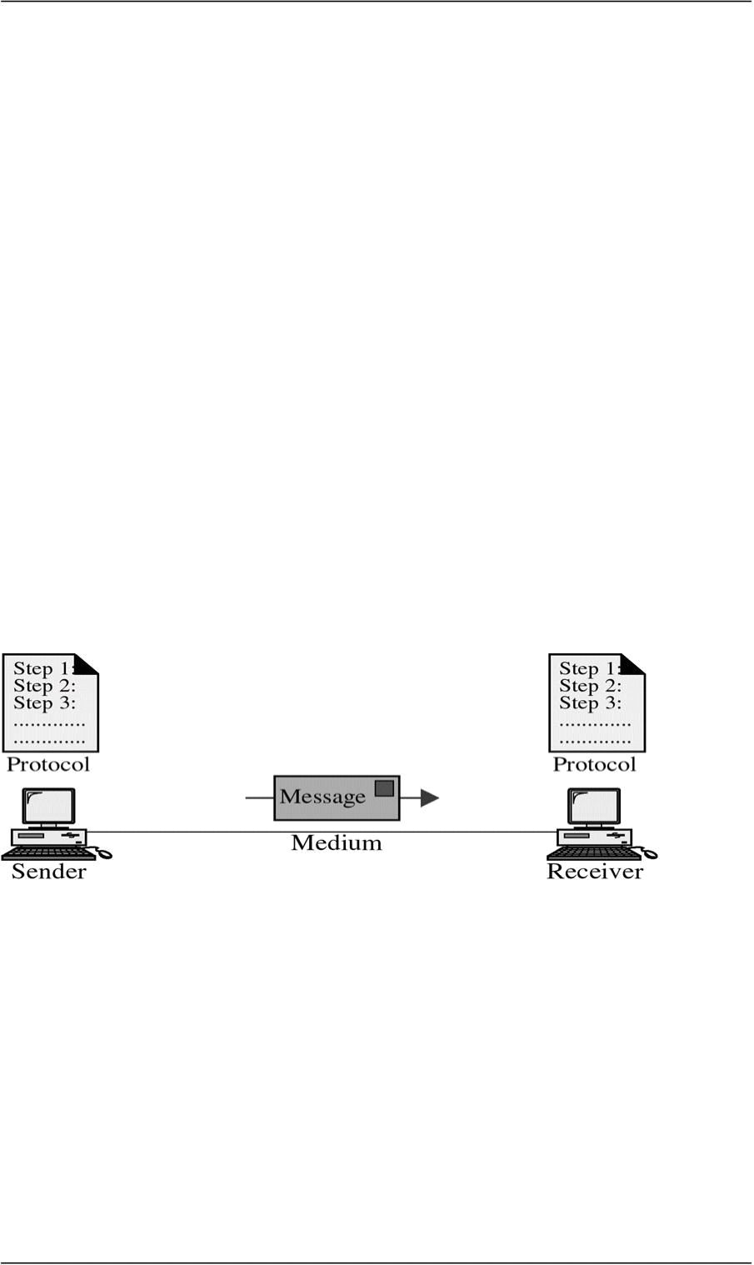
CS601-Data Communication VU
 REMOTE
Data Communication is considered remote, if the devices are farther apart.
VAGUE DEFINITIONS
We will clarify
Data Communication System
For Data Communication to occur, the communicating devices must be a part of a
communication system made up of some specific kind of hardware and software
This type of a system is known as a
“DATA COMMUNICATION SYSTEM”
Effectiveness of Data Comm. System
Effectiveness depends upon three fundamental characteristics:
¾ Delivery
¾ Accuracy
¾ Timeliness (Better NEVER than LATE)
9 Example of the POSTAL MAIL
Components of Data Comm. Systems
Components of Data Com Systems
Any system is made up of more than one component. Similarly, a data communication
system is made up of 5 components as shown in the fig:
¾ Message
¾ Sender
¾ Receiver
¾ Medium
¾ Protocol
© Copyright Virtual University of Pakistan

Slide 7
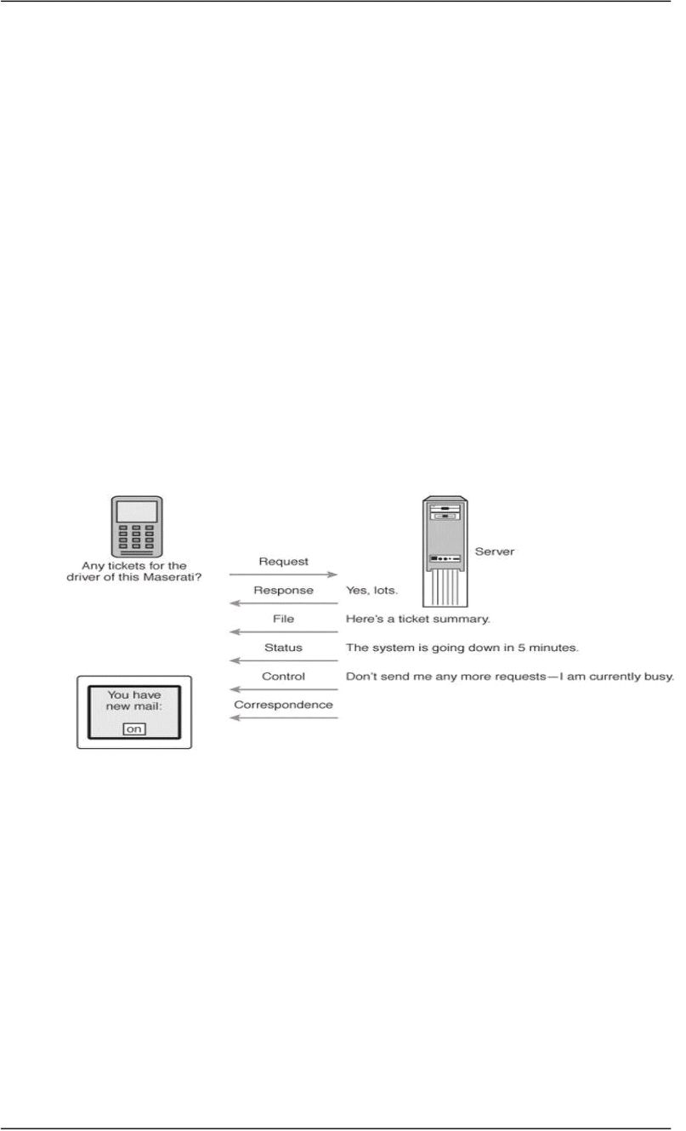
CS601-Data Communication VU
 MESSAGE
¾ Information or Data to be communicated
¾ Can be text, numbers, video or any combination of these
¾ In short anything that can be represented using binary bits
Data Communication Messages
9 Files (meaningful collections of records)
9 Data/information requests (database queries, Web page requests,
etc.)
9 Responses to requests and commands or error messages
9 Status messages (about the network’s functional status)
9 Control messages transmitted between network devices to control
network traffic
9 Correspondence among network users
MESSAGE TYPES
 SENDER
 SENDER
¾ Device that sends the data message
¾ Can be a Computer , Workstation, Video camera etc
¾ As already discussed, the data from the sender might not be in the
appropriate format for the transmission medium and will need to be
processed
 RECEIVER
¾ Device that receives the message
¾ Can be a computer, workstation, Television etc
¾ At times, the data received from the transmission medium may not
be in a proper form to be supplied to the receiver and it must be
processed
© Copyright Virtual University of Pakistan

Slide 8
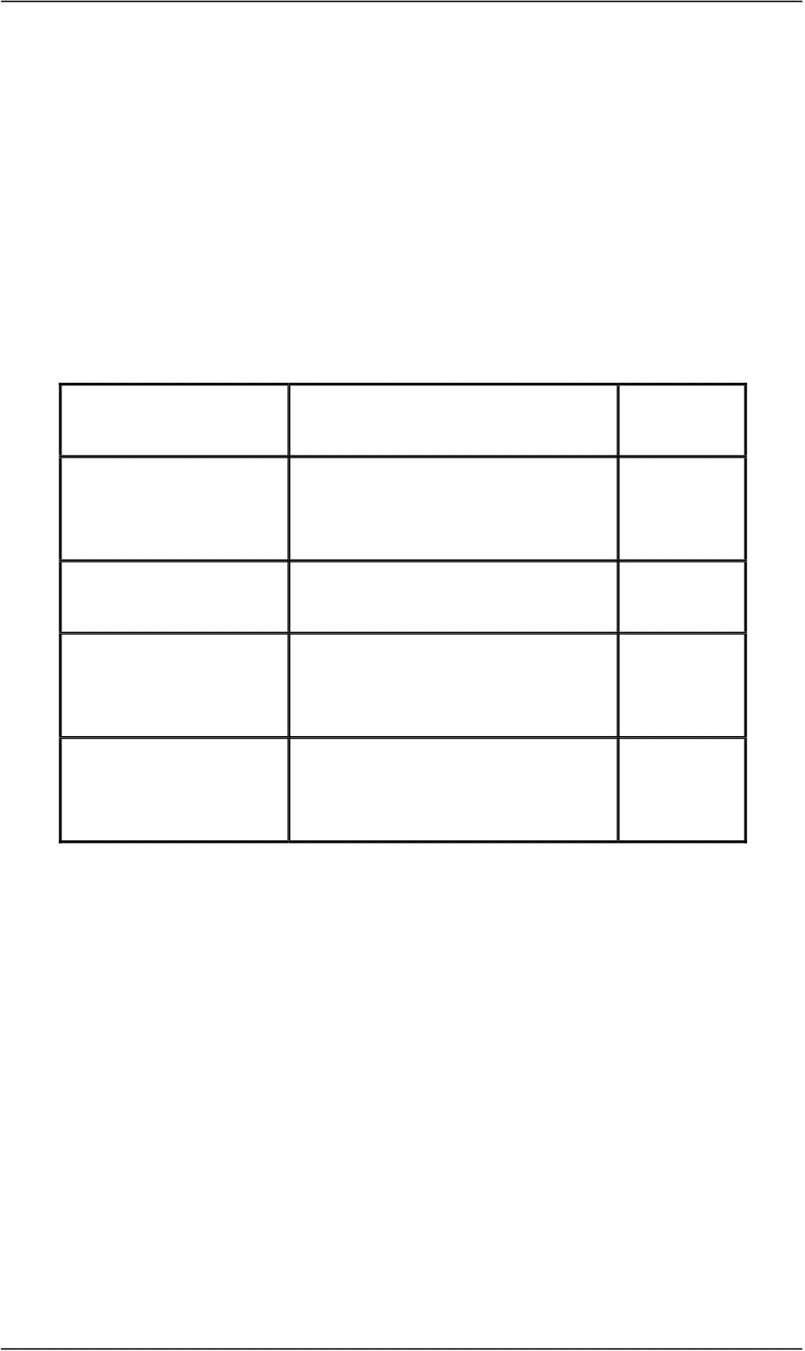
CS601-Data Communication VU
 MEDIUM
¾ Physical path that a message uses to travel from the Sender to the
Receiver
¾ Can be a Copper Cable (Telephone), Coaxial Cable (Cable TV),
Fiber Optic Cable, LASERS or Radio Waves (Wireless Medium)
¾ We will see that Data needs to be transferred in the form of
ELECTROMAGNETIC signals and The Transmission Medium
should be capable of carrying these EM Signals
¾ Transmission Media
Transmission Media
Medium Speed Cost
Twisted Wire 300bps-10Mbps Low
Microwave 256Kbps-100Mbps Low
Coaxial Cable 56Kbps-200Mbps Low
Fiber Optic Cable 500Kbps-10Gbps High
 PROTOCOL
¾ Set of Rules Governing Communication
¾ Represents an Agreement between communication devices
¾ Without Protocol, two devices may be connected but they will not
be able to communicate
9 EXAMPLE: Consider the communication between two
individuals. They can only communicate provided they both
speak the same language.
A little more complex Comm. System
© Copyright Virtual University of Pakistan

Slide 9
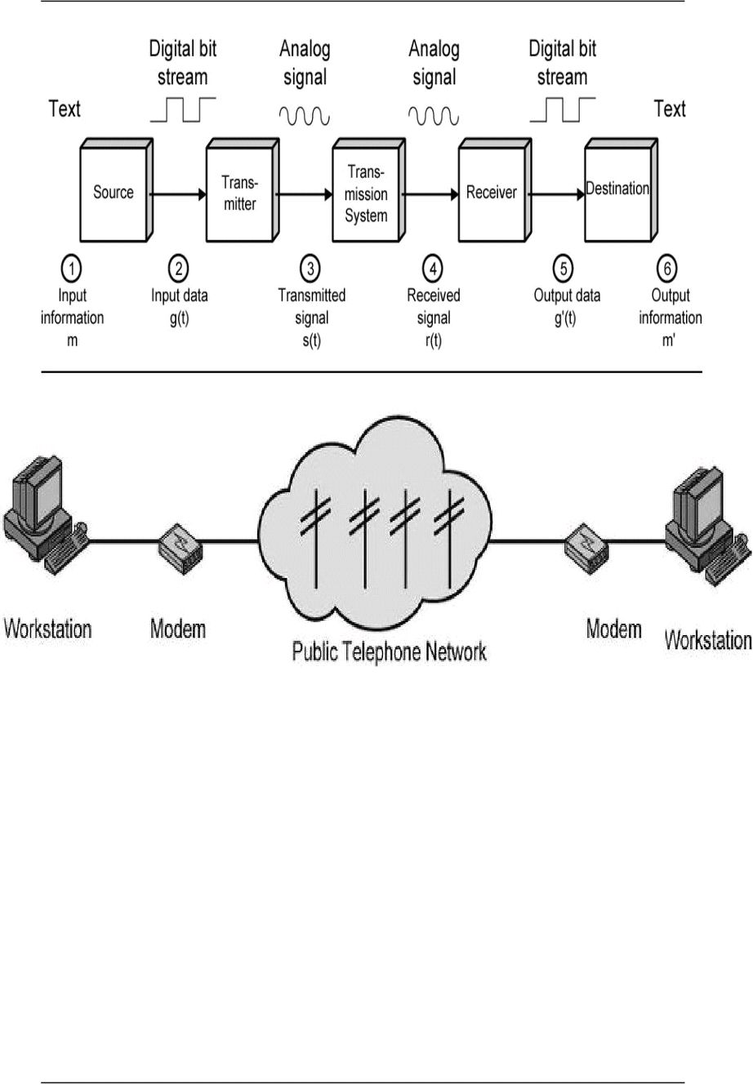
CS601-Data Communication VU
EXAMPLE – ELECTRONIC MAIL
Explanation In Terms of a little more complex Comm. System
 SENDER SIDE
¾ Input device and transmitter are components of a Personal Computer
¾ User of a PC wishes to send a message ‘m’
¾ User activates electronic mail package e.g. hotmail
¾ Enters the message via input device (keyboard)
¾ Character string is buffered in main memory as a sequence of bits ‘g’
¾ PC is connected to some trans system such as a Telephone Network via
an I/O Transmitter like Modem
¾ Transmitter converts incoming stream ‘g’ into a signal ‘s’
 RECEIVER SIDE
¾ The transmitted signal ‘s’ is subject to a number of impairments
depending upon the medium
¾ Therefore, received signal ‘r’ may differ from ‘s’.
¾ Receiver attempts to estimate original ‘s’ based on its knowledge of
the medium and received signal ‘r’
¾ Receiver produces a bit stream g’(t)
¾ Briefly buffered in the memory
¾ Data is presented to the user via an output device like printer, screen
etc.
© Copyright Virtual University of Pakistan

Slide 10
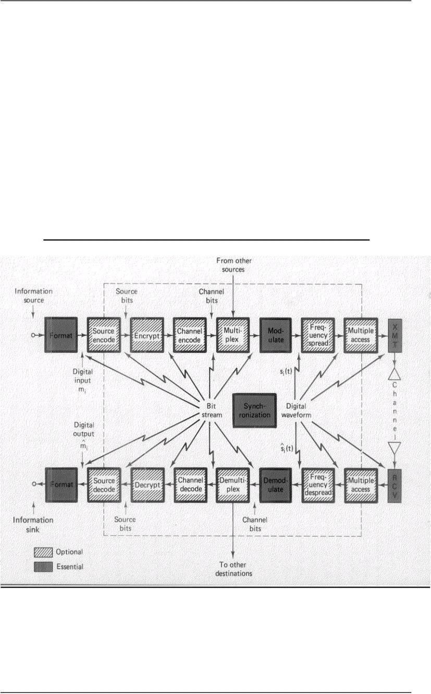
CS601-Data Communication VU
¾ The data viewed by user m’ will usually be an exact copy of the data
sent ‘m’
EXAMPLE-Telephone System
o Input to the Telephone is a message ‘m’ in the form of sound waves
o The sound waves are converted by telephone into electric signals of the same
frequency
o These signals are transmitted w/o any modification over the telephone line
o Hence g(t) and s(t) are identical
o S(t) will suffer some distortion so that r(t) will not be the same as s(t)
o R(t) is converted back to sound waves with no attempt of correction or
improvement of signal quality
o Thus m’ is not an exact replica of m
An Actual Digital Data Communication System Key Data
Communication Terminology
 Session: communication dialog between network users or applications
Different Types of this session for Info Exchange
 Network: interconnected group of computers and communication devices
We will look into it in a little bit
 Node: a network-attached device
Node can be any device in the network
© Copyright Virtual University of Pakistan

Slide 11
CS601-Data Communication VU
Summary
 Data Communication
 Brief History of Communication
 Data Communication System
 Key Data Communication Terminology
Reading Sections
 Section 1.2, “Data Communications and Networking” 4th Edition by Behrouz A.
Forouzan
 Sections 1.1, 1.2, “Data and Computer Communication” 6th Edition by William
Stallings
© Copyright Virtual University of Pakistan

Slide 12

CS601-Data Communication VU
LECT URE #2
KEY DATA COMMUNICATION TERMINOLOGY
 Link: connects adjacent nodes
Wires, Cables, Any thing that physically connects two nodes
 Path: end-to-end route within a network
 Circuit: the conduit over which data travels
 Packetizing: dividing messages into fixed-length packets prior to transmission
over a network’s communication media
 Routing: determining a message’s path from sending to receiving nodes
9 The transmission medium may itself be a network, so route needs to
be specified
Network
“A NETWORK is a set of devices (Nodes) connected by Communication Links”
 Node: Can be a Computer, Printer or any other device capable of sending or
receiving
¾ The links connecting Nodes are called COMMUNICATION CHANNELS
Networks- Why we need them?
Networks- Why we need them?
It is often impractical for devices to be directly connected for two major reasons:
o The devices are very far apart. They are expensive to connect just two devices
with one in Lahore and other in Islamabad
o Large set of devices would need impractical number of connections e .g.
Telephone Lines in the world and all the computers owned by a single
organization
Solution to the Problem=Networks
o Solution is to connect all devices to a central system known as a NETWORK in
which all terminals or computers share the links.
o Two Main Classifications of the Networks
© Copyright Virtual University of Pakistan

Slide 13

CS601-Data Communication VU
¾ LANS
¾ WANS
DISTRIBUTED PROCESSING
o Instead of a single large machine being responsible for all aspects of a process ,
each separate computer handles a subset of the task
9 Example – Project Given as a part of the Course
9 Example – Office Work
Advantages of Distributed Processing
 Security
A system designer can limit the kind of interaction that a given user can have with
the entire system.
9 For example : Bank’s ATM
 Distributed Data bases
No one system need to provide storage capacity for the entire database
9 For example WWW gives user access to pages stored anywhere on
Internet
 Faster Problem Solving
Multiple computers working on a problem can solve a problem faster than a
computer working alone
 Security through Redundancy
Multiple computers running the same program provide security through
redundancy
If one computer hardware breaks down then others cover up.
 Collaborative Processing
Both multiple computers and multiple users can interact for a task
Network Criteria
© Copyright Virtual University of Pakistan

Slide 14
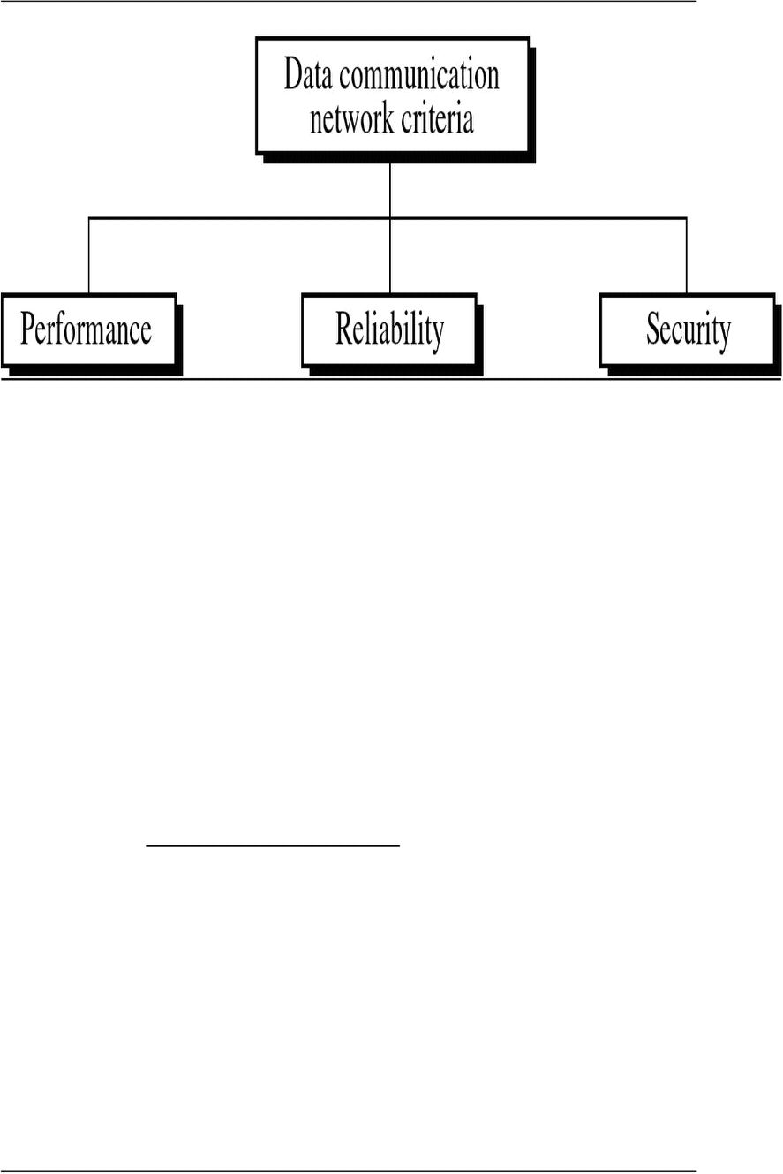
CS601-Data Communication VU
 Performance
Can be measured in many ways including Transit and Response Time
o Depends on a no. of Factors:
¾ Number of USERS
¾ Type of Transmission Medium
¾ Hardware
¾ Software
¾ Network Criteria
¾ Number of USERS
9 Large Number of concurrent users slow network
9 Design of a network
9 Peak Load Periods
9 Network Criteria
¾ Type of Transmission Medium
9 Medium defines speed at which data can travel
9 Fiber Optic Cable
9 100Mbps and 10 Mbps
9 Hardware
9 Software
¾ Hardware
9 Effect speed and the capacity of transmission
9 Fast computer with large storage capacity
9 Software
9 Network Criteria
¾ Software
© Copyright Virtual University of Pakistan

Slide 15
CS601-Data Communication VU
9 Software processes data at sender , receiver and
intermediate nodes
9 All communication steps need software:
9 Moving message from node to node
9 Transforming,
9 Processing at the sender and receiver
9 Error Free Delivery
Well designed software can speed up the process
 Reliability
o Depends on a no. of Factors:
¾ Frequency of Failure
¾ Recovery Time of a Network after Failure
¾ Catastrophe
¾ Fire , Earthquake or Theft
 Security
o Unauthorized Access
¾ Sensitive data
¾ Protection at multiple levels:
¾ Lower level: Passwords and user ID codes
¾ Upper Level: Encryption
o Viruses
Network Applications
 Marketing and Sales
o Marketing
¾ Collect, exchange and analyze data relating to the customers needs
¾ Product development cycles
o Sales
¾ Tele shopping,
¾ On line reservation systems
 Financial Services
o Online Banking
o Foreign Exchange Transfers
o Rates
 Manufacturing
© Copyright Virtual University of Pakistan

Slide 16
CS601-Data Communication VU
o Computer Aided Design
o Computer Assisted Manufacturing
o Network Applications
 Electronic Messaging
 Teleconferencing
o Conferences to occur w/o participants at the same place
o Chat
o Voice Conferencing
o Video Conferencing
 Cable Television
Summary
 Key Data Communication Terminology
 Networks and why we need them?
 Distributed Processing
 Network Criteria
 Network Applications
Reading Sections
 Section 1.3, “Data Communications and Networking” 4th Edition by Behrouz A.
Forouzan
 Sections 1.3, “Data and Computer Communication” 6th Edition by William
Stallings
© Copyright Virtual University of Pakistan

Slide 17

CS601-Data Communication VU
LECT URE #3
Communication Tasks
There are some key tasks that must be performed in a data communication system
Elements can be added, deleted, or merged together
Transmission System utilization Interfacing
Signal Generation Synchronization
Exchange Management Error Detection and Correction
Flow Control Addressing
Routing Recovery
Security Network Management
 Transmission System Utilization
Need to make efficient use of Transmission facilities that are shared among a no.
of communicating devices
For Example:
9 Techniques like Multiplexing to allow multiple users to share total
capacity of a Transmission Medium
9 Congestion Control: TX. System should not be overwhelmed by traffic
 Interfacing
A device must have an Interface with the Transmission System/Transmission
Medium
 Signal Generation
Electromagnetic Signals travel over Transmission Medium. Once an interface is
established, Signal generation is required
¾ Properties of Signals
9 Capable of being propagated over TX. Medium
9 Interpretable as data at the Receiver
 Synchronization
The transmission and the reception should be properly synchronized.
Synchronization means that the receiver must be able to determine, when to
© Copyright Virtual University of Pakistan

Slide 18

CS601-Data Communication VU
expect a new transmission and when to send acknowledgements. In other words
transmitter and receiver should have an agreement on the nature as well as timing
of the signals
 Exchange Management
If the data needs to be exchanged in both directions over a period of time, both
parties must cooperate as follows
¾ Whether both devices must transmit simultaneously or take turns
¾ Amount of Data to be sent at one time
¾ Format f the Data
¾ What to do when an Error Arises
 Error Detection and Correction
In all comm. Systems, there is a potential risk for errors and impairments.
Tx. Signals are distorted to some extent before reaching their destination. Error
Detection & Correction needs to be employed in Data Processing Systems where a
change in say the contents of a file cannot be tolerated
 Flow Control
To make sure that source does not overwhelm destination by sending data faster
than it can be handled and processed
 Addressing & Routing
If TX facility is shared by two or more devices, source must specify the identity or
the address of the destination system and if Tx. System is itself a system, a proper
route must be allocated that the data will take in order to reach the desired
destination
 Recovery
If a data transmission is interrupted due to a fault somewhere in the system,
recovery techniques are needed. The objective is either to resume activity at the
point of interruption and to restore the state of the system to what it was prior to
the interruption
 Security
Security is very important issue in a Data Communication System. The sender
needs to be assured that
¾ Only the Intended receiver receives the data
¾ Data is delivered unaltered
Introduction to Protocol
In computer Networks, communication occurs between two entities in different systems.
o Entity is anything sending and receiving information
o SYSTEM is a physical object containing more than one entities
© Copyright Virtual University of Pakistan

Slide 19
CS601-Data Communication VU
Now, two entities in different systems cannot just send data and expect to be understood.
For communication to occur, these entities must agree on a PROTOCOL
PROTOCOLS
As discussed earlier, “Protocol is a set of rules governing communication”
o Two computers cannot just send bit streams to each other and expect to be
understood
o Entities must agree on a PROTOCOL
9 Same Example French and German
Protocol defines:
¾ What is Communicated?
¾ How it is Communicated?
¾ When it is Communicated?
KEY elements of a PROTOCOL
 Syntax:
¾ Represents the Structure or the format of the Data
¾ Meaning the order in which data is presented
For Example
9 First eight bits to be Sender address
9 Next eight to be Receiver’s Address
9 The Rest to be Data
 Semantics:
¾ Refer to the Meaning of each section of bits
¾ How is a particular pattern to be interpreted?
¾ What action should be taken based on interpretation?
For Example
9 Does an address identify the route to be taken or the final destination of the
message?
 Timing
Refers to 2 characteristics:
¾ When data should be sent?
¾ How fast it should be sent?
For Example
9 If sender produces data at 100 Mbps
9 But Receiver can only process data at 1 Mbps
9 The TX. will overload receiver and data will be lost
© Copyright Virtual University of Pakistan

Slide 20
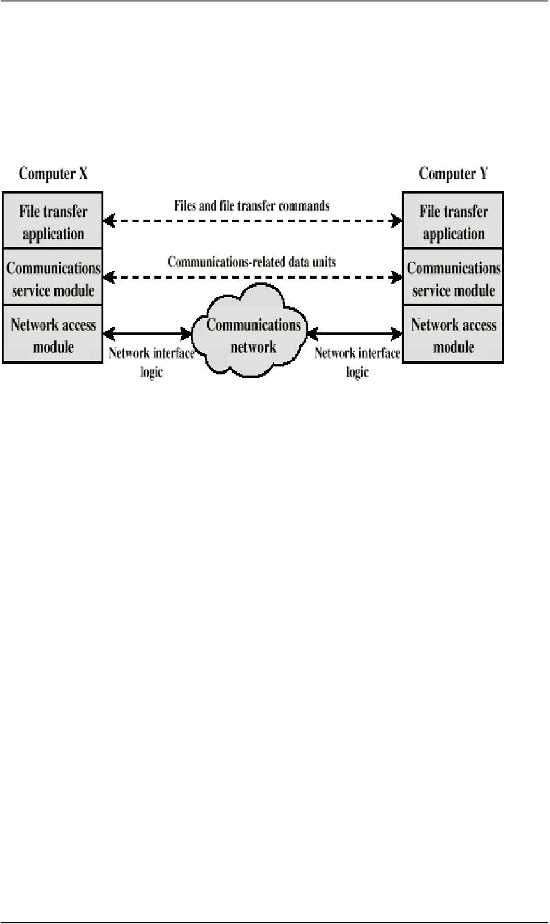
CS601-Data Communication VU
Protocol Architecture
Instead of having a single Module for performing communication, there is a structured set
of modules that implement communications function”
This structure is called Protocol Architecture
Let’s explain it by an example of File transfer system.
Simplified File Transfer Architecture
•
¾ File transfer application
¾ Communication service module
¾ Network access module
 File transfer application
File Transfer contains all of the logic is unique to the file transfer application such as:
¾ Transmitting passwords
¾ File Commands
9 Checking File System on other machine if it is ready
9 Check File System Compatibility
¾ File records
 Communication service module
Instead of allowing File Transfer Module to deal with actual transfer of data and
commands, we can have a separate module for this transfer. This module must make
sure that the receiver system is ready to receive and look into the reliable exchange of
data
 Network access module
Nature of the exchange between systems is independent of the network that connects
them. That allows us to have a 3rd module that handles the details of the Network
interface and interacts with the network. If Network to be used changes, only Network
access Module has to change
© Copyright Virtual University of Pakistan
In the above example File transfer could use three modules

Slide 21
CS601-Data Communication VU
Characteristics of a Protocol
¾ Direct or indirect
¾ Monolithic or structured
¾ Symmetric or asymmetric
¾ Standard or nonstandard
 Direct
¾ Systems share a point to point link or
¾ Data can pass without intervening active agent
¾ Simple Protocol
 Indirect
¾ Switched networks or
¾ Interne works or internets
¾ Data transfer depend on other entities
¾ Complex Protocol
 Monolithic or Structured
¾ Communications is a complex task
¾ To complex for single unit
¾ Structured design breaks down problem into smaller units
¾ Layered structure
 Symmetric or Asymmetric
Symmetric
¾ Communication between peer entities
Asymmetric
¾ Client/server
Standard or Nonstandard
¾ Nonstandard protocols built for specific computers and tasks
Summary
 Communication Tasks
 Protocols
 Protocol Architecture
 Characteristics of a Protocol
Reading Sections
 Section 1.4 “Data Communications and Networking” 4th Edition by Behrouz A.
Forouzan
 Sections 1.1,2.1 “Data and Computer Communication” 6th Edition by William
Stallings
© Copyright Virtual University of Pakistan

Slide 22
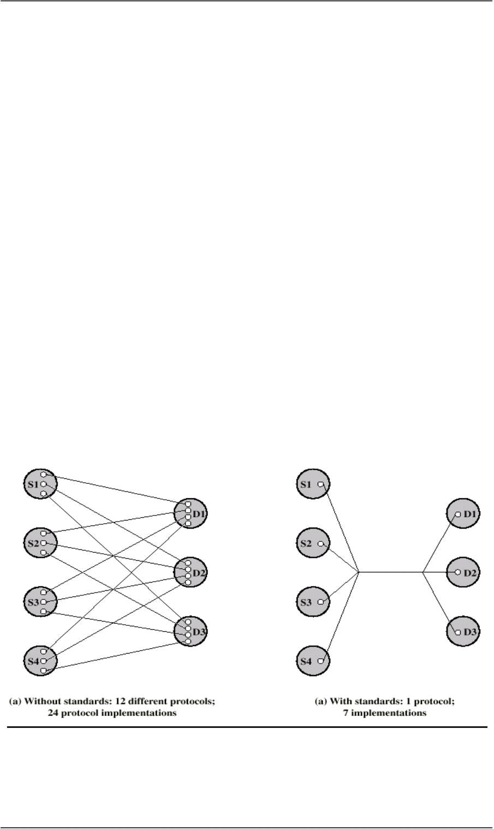
CS601-Data Communication VU
LECT URE #4
Standards
“A standard provides a model for development that makes it possible for a product
to work regardless of the individual manufacturer|”
¾ A great deal of coordination and cooperation is required by the devices to
communicate
¾ A device prepared by a specific manufacturer may not be compatible with the
devices prepared by other manufacturers
¾ Unavailability of standards creates problems and puts a halt to product growth
9 An example of non-standardized products is AUTOMOBILES
Why Standards are Essential?
Standards are therefore essential in:
o Creating and Maintaining an Open and competitive Market for Equipment
Manufacturers
o Guaranteeing National and International Interoperability of Data and
Telecommunications Technology and Equipment
Let us understand this using an EXAMPLE
NOTE
• K sources and L receivers leads to K*L protocols and 2*K*L implementations
• If common protocol used, K + L implementations needed
© Copyright Virtual University of Pakistan

Slide 23
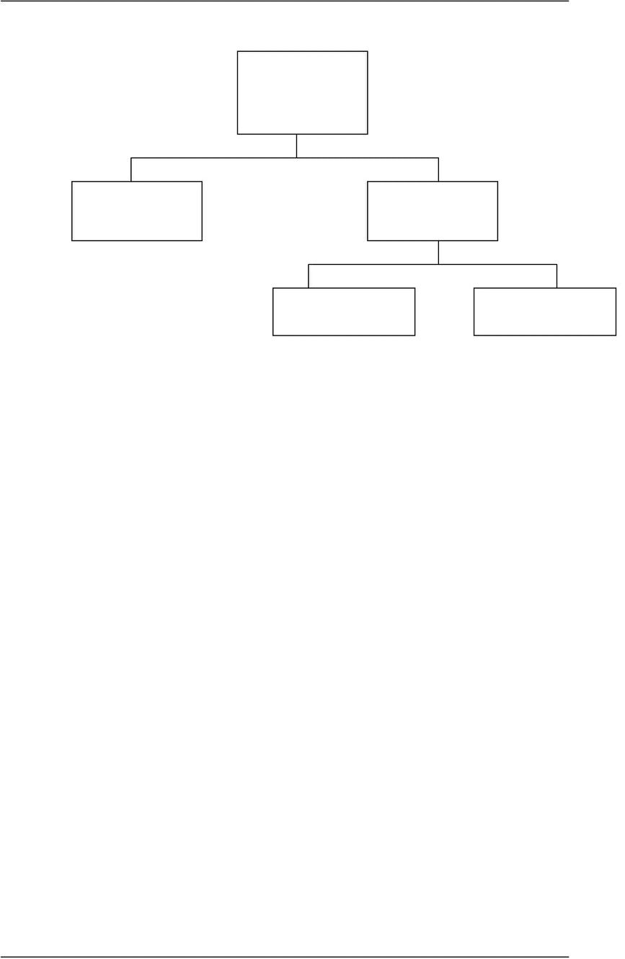
CS601-Data Communication VU
Categories of Data Communication Standards
Standards
De jure De facto
(By Law) (By Fact)
Proprietary Non Proprietary
 De facto (By fact or By Convention)
Standards not approved by an organized body but have been adopted as standards
through their widespread use
 De jure (By Law or By Regulation)
Standards that have been legislated by an officially recognized regulation body
Subdivision of De Facto Standards
¾ PROPRIETARY (Closed Standards)
Standards that are originally invented by a Commercial Organization
as a basis for the operation of its products they are wholly owned by
that company. They are also called Closed Standards because they
close off Communication between systems
¾ NON- PROPRIETARY (Open Standards)
They are originally developed by groups or committees that have
passed them into public domains. They are also called Open Standards
because they open Communication between different systems
Standard Organizations
Standards are developed mainly by 3 entities:
¾ Standard Creation Committees
¾ Forums
¾ Regulatory Agencies
© Copyright Virtual University of Pakistan

Slide 24

CS601-Data Communication VU
 Standard Creation Committees
They are Procedural Bodies and they are so slow moving and cannot co-op with the fast
growing communication industry.
¾ ISO
9 International Standard’s Organization
9 Voluntary Organization
9 Created in 1947
9 Members are from Standard Creation Committees of different countries
9 Includes representatives from 82 countries
9 Open System Interconnection (OSI) Model
¾ ITU-T
9 By 1970s a lot of countries were defining standards but there was no
International compatibility
9 United Nations made as a part of their ITU
9 Consultative Committee for International Telegraphy and Telephony
(CCITT)
9 IN 1993 , ITU-Telecomm Standards Sector
9 Important ITU-T Standards
9 V Series (V32, V33, V42, Define Data Transmission over phone lines
9 X Series(X.25, 400, 500): Define Transmission over Public Digital
Network
9 ISDN: Integrated Services Digital Network
¾ The American National Standard Institute (ANSI)
9 Private-Non Profit Cooperation not affiliated with US Government
9 Members include professional societies, industrial associations, govt. and
regulatory bodies
9 Submits proposal to ITU-T and is a voting member for USA in ISO
¾ The Institute of Electrical and Electronics Engineers (IEEE)
9 Largest professional engineering society in the world
9 Also oversees the development of Telecommunication and Wireless
International Standards
9 Special committee for LANS out of which emerged Project 802 (802.3,
802.4, 802.5)
 Forums
Special Interest Groups with representatives from interested corporations they
facilitate and fasten standardization process by working with universities, and
users to test, evaluate and standardize new technologies
© Copyright Virtual University of Pakistan

Slide 25

CS601-Data Communication VU
Each Forum Concentrate on a specific technology and present their conclusions to
the standard bodies
¾ Frame Relay Forum
¾ ATM Forum
¾ Internet Society & IETF
 Regulatory Agencies
All communication technology is subject to regulation and laws by government
agencies. The purpose is to protect Public Interest by regulating Radio, Television
and Cable Communications.
¾ FCC
Before we go into the details of how data are transmitted from one device to the other, it
is important to understand:
o The relationship between communication devices.
o How the devices connect with each other in a System?
o How do they do the exchange of information?
Five Concepts provide the basis
o Line Configuration
o Topology
o Transmission Mode
o Categories of networks
o Internetworks
LINE CONFIGURATION
“Line Configuration refers to the way two or more devices attach to a Link”
A link is the physical communication path that transfers data from one device to the other.
Link can be thought of as a Line drawn between two points. For communication to occur,
two devices must be connected to each other using a link.
Line Configurations
© Copyright Virtual University of Pakistan

Slide 26
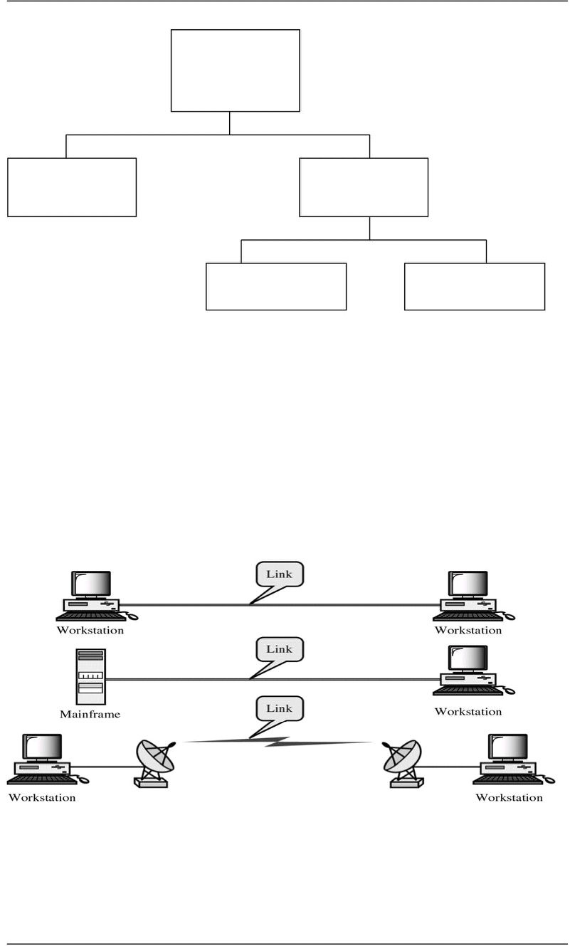
CS601-Data Communication VU
Line
Configuration
Point-to-Point Multipoint
Spatially Shared Time Shared
 Point-to-Point Line Configuration
Dedicated Link between two devices. Entire Capacity of the channel is reserved
for TX B/w these two devices. Mostly point-to-point connection use wire/cable to
connect with each other. But Microwave, Satellite Links can also be used
Data and Control information pas directly between entities with no intervening
agent
9 TV Remote Control and TV Control Systems
9 Mobile Phone (when talking) and Base Station (Antenna)
 Multipoint Line Configuration
More than two devices share the Link that is the capacity of the channel is SHARED
now. With shared capacity, there can be two possibilities in a Multipoint Line Config:
¾ Spatial Sharing: If several devices can share the link simultaneously,
its called Spatially shared line configuration
© Copyright Virtual University of Pakistan
¾ Examples:

Slide 27
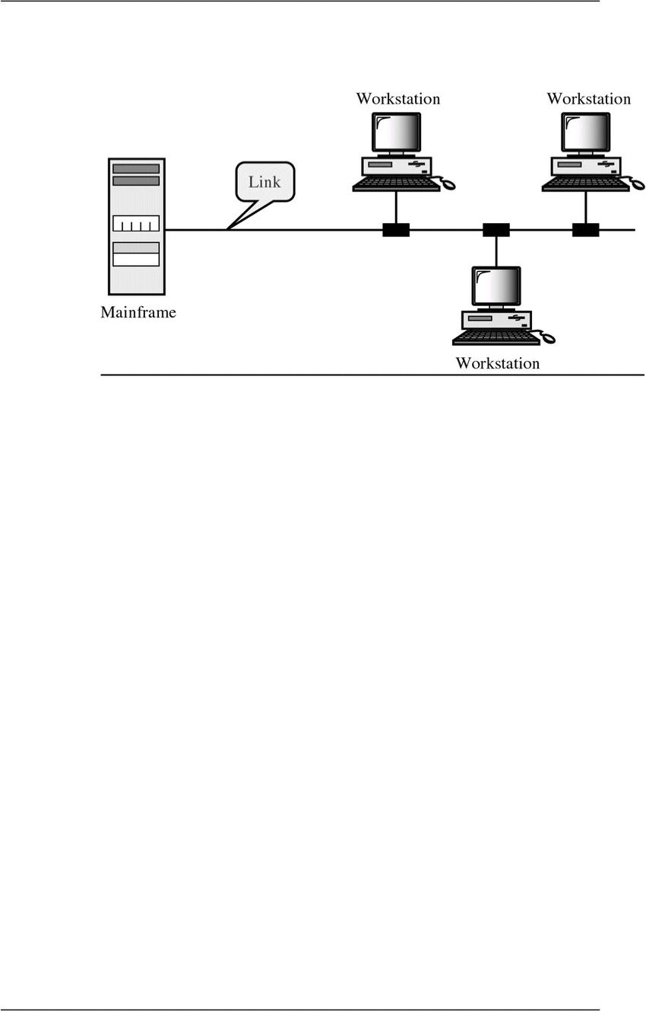
CS601-Data Communication VU
¾ Temporal (Time) Sharing: If users must take turns using the link ,
then its called Temporally shared or Time Shared Line Configuration
Summary
 Standards
 Standard Organizations
 Line Configuration
 Categories of Line Configuration
Reading Sections
 Section 1.5,2.1 “Data Communications and Networking” 4th Edition by Behrouz
A. Forouzan
© Copyright Virtual University of Pakistan

Slide 28
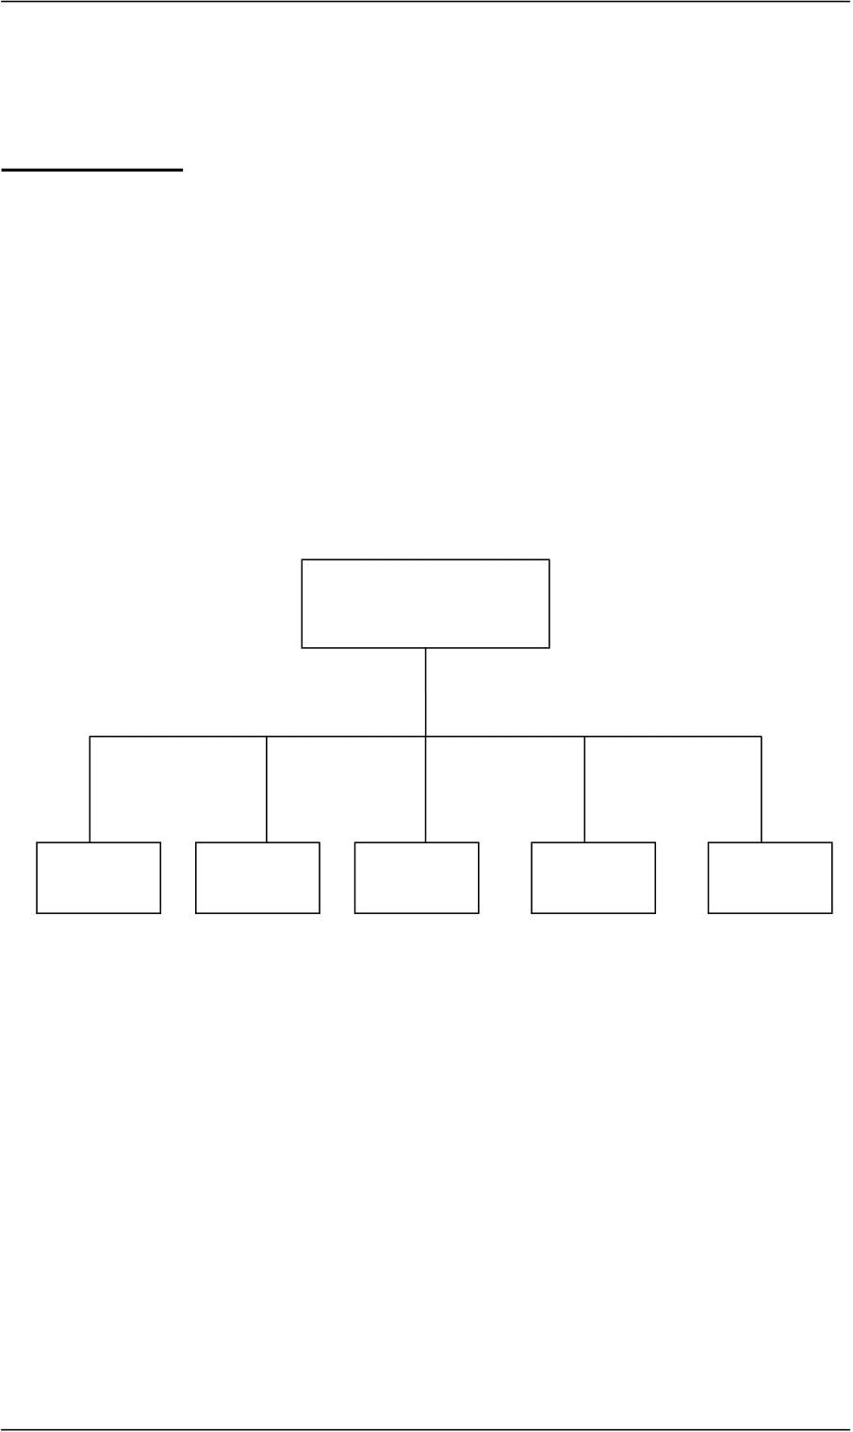
CS601-Data Communication VU
LECT URE #5
TOPOLOGY
“The Topology is the geometric representation of the relationship of the links and the
linking devices (Nodes) in a Network”
Or
“Topology defines the physical or the Logical Agreement of Links in a Network”
Topology of a Network is suggestive of how a network is laid out. It refers to the specific
configuration and structure of the connections between the Links and the Nodes. Two or
more devices connect to a Link and two or more Links form a Topology
Categories of TOPOLOGY
Topology
Mesh Star Tree Bus Ring
9 Question: What to consider when choosing a Topology????????
9 Answer: Relative status of the devices to be linked.
Two relationships are possible in a network
¾ PEER-TO-PEER: Devices share the link equally
¾ PRIMARY-SECONDARY: One device controls traffic and the others must
transmit through it
© Copyright Virtual University of Pakistan

Slide 29
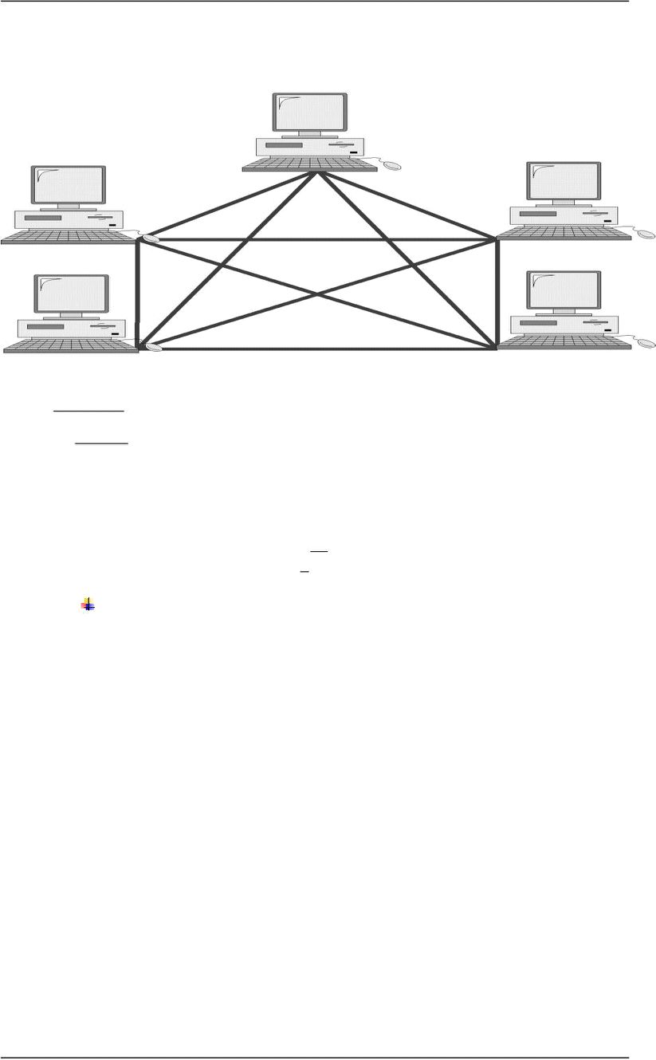
CS601-Data Communication VU
MESH TOPOLOGY
o Every device has dedicated a point-to-point link to every other device
o Dedicated: Means that the link carries traffic only between these two devices
n(n )
o
Example Mesh Topology
In figure above, we have 5 Nodes, therefore:
9 No. of Links= 5(5-1)/2 = 10
9 No. of I/O Ports= 5-1 = 4
This increase exponentially with increase in No. of Nodes
9 e.g. for 6 nodes = 15 Links
9 7 Nodes=21 Links
 Advantages of Mesh Topology
¾ Use of Dedicated links guarantees that each connection can carry its own load.
This eliminates Traffic Problems as in case of Shared Link
¾ Mesh Topology is robust. If one link fails, it does not effect other links
¾ Security & Privacy due to dedicated links
¾ Point – to –Point links make Fault Identification easy
 Disadvantages of Mesh Topology
¾ Amount of Cabling
9 Makes Installation & Reconfiguration difficult
9 Sheer bulk of wiring can be greater than the available space
¾ Number of I/O Ports Required
9 Hardware required to connect each link can be prohibitively expensive
© Copyright Virtual University of Pakistan
Links to connect ‘n’ devices
n −1
−
Each device must have I/O Ports
2

Slide 30
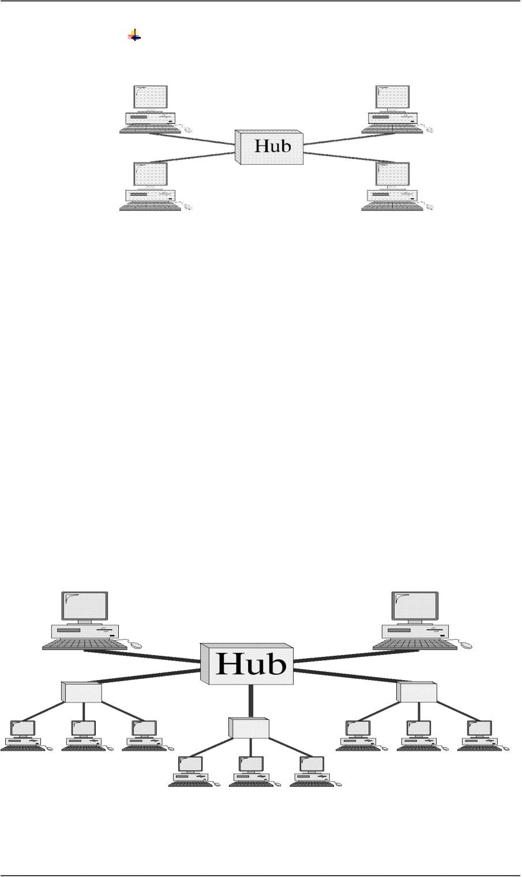
CS601-Data Communication VU
Therefore, Mesh topology has limited use
Star Topology
o Each device has a dedicated point-to-point link to a central controller ( Hub)
o Devices are not directly connected to each other
o Controller (Hub) acts as an exchange
o If one device wants to send data to the other, it sends the data to the controller ,
which then relays it to the other connected device
 Advantages of Star Topology
¾ Less Cabling
¾ Less Expensive than Mesh as each device need sonly one link and one I./O
Port
¾ Easy to Install and Reconfigure
¾ Robust, if a link fails , only that link fails
¾ Easy Fault Detection
 Disadvantages of Star Topology
¾ Although Cabling required is far less than Mesh
¾ Still each node must be connected to a Hub , so Cabling is still much more
than some other Topologies
Tree Topology
o A variation of Star Topology
© Copyright Virtual University of Pakistan

Slide 31
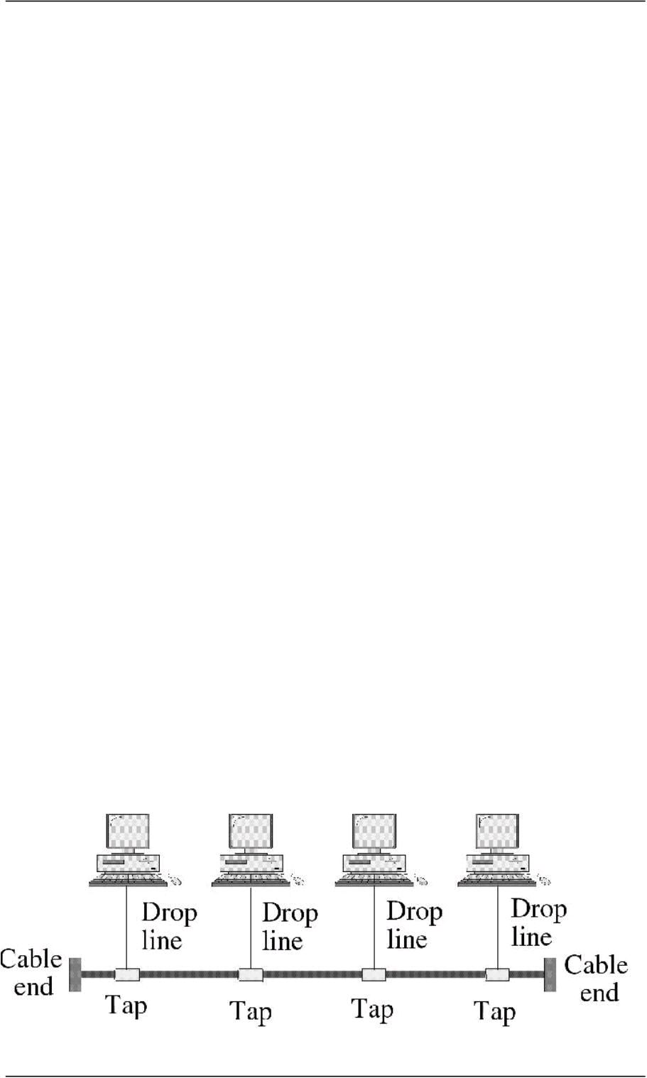
CS601-Data Communication VU
o Nodes in a Tree are linked to a central hub that controls the traffic to and from
network
o Difference b/w star and tree is not all the devices plug directly into the central
HUB
o Majority connects to secondary hub that is connected to central hub
 CENTRAL HUB in Tree Topology
¾ Central Hub in a Tree is an ACTIVE HUB
¾ ACTIVE HUB contains a repeater
¾ Repeater is a hardware device that regenerates the received bit pattern before
sending them out.
¾ Repeater strengthens TX. And increases the distance a signal can travel
 Secondary HUB in Tree Topology
¾ Secondary Hub in a Tree may be Active or Passive HUB
¾ Passive Hub simply provides physical connection between attached devices
 Advantages of Tree Topology
¾ Because of Secondary Hub, More devices can be attached to a Central Hub
and therefore increase the distance a signal can travel
¾ Enables Differentiated Services: Allows to prioritize communication, e.g.
computers attached to one secondary hub can be given priority over others
¾ Therefore, TIME SENSITIVE data will not have to wait for access to the
network
¾ Rest of the advantages are almost the same as STAR
9 Example Tree Topology: Cable TV
CABLE TV
–Main cable from main office is divided into many
branches and each branch is divided into smaller branches
and so on
–Hubs are used when cable is divided
BUS TOPOLOGY
o All the previous topologies describe Point-to-point communication
o Bus Topology is Multipoint
o One long cable acts as a BACKBONE to link all devices in the network
© Copyright Virtual University of Pakistan

Slide 32
CS601-Data Communication VU
o Drop Lines and Taps
o Drop Line is the connection between device and the main cable (Backbone)
¾ Tap is a connector that;
Splices into the main cable or
Punctures the sheathing of a cable to create connection with the
metallic core
¾ Signal degrades as it travels, therefore there is a limit on:
9 The number of Taps a Bus can support and
9 The distance between those Taps
 Advantages of BUS TOPOLOGY
¾ Easy to install
9 Backbone can be laid on the most efficient path and then rest of the
nodes can be connected using Drop Lines
¾ Less cabling than Mesh , Star or Tree
¾ Difference b/w Star Cabling and Bus Cabling
 Disadvantages of BUS Topology
¾ Difficult Reconfiguration
9 Difficult to add new devices
9 adding new devices may require modification of backbone
¾ No Fault Isolation
9 A fault or break in backbone can disable communication even on the same
side of the problem
9 Damaged area reflects signals back in the direction of origin creating
Noise in both directions
Summary
 Topology
 Categories of Topologies
Reading Sections
 Section 2.2 “Data Communications and Networking” 4th Edition by Behrouz A.
Forouzan
© Copyright Virtual University of Pakistan

Slide 33
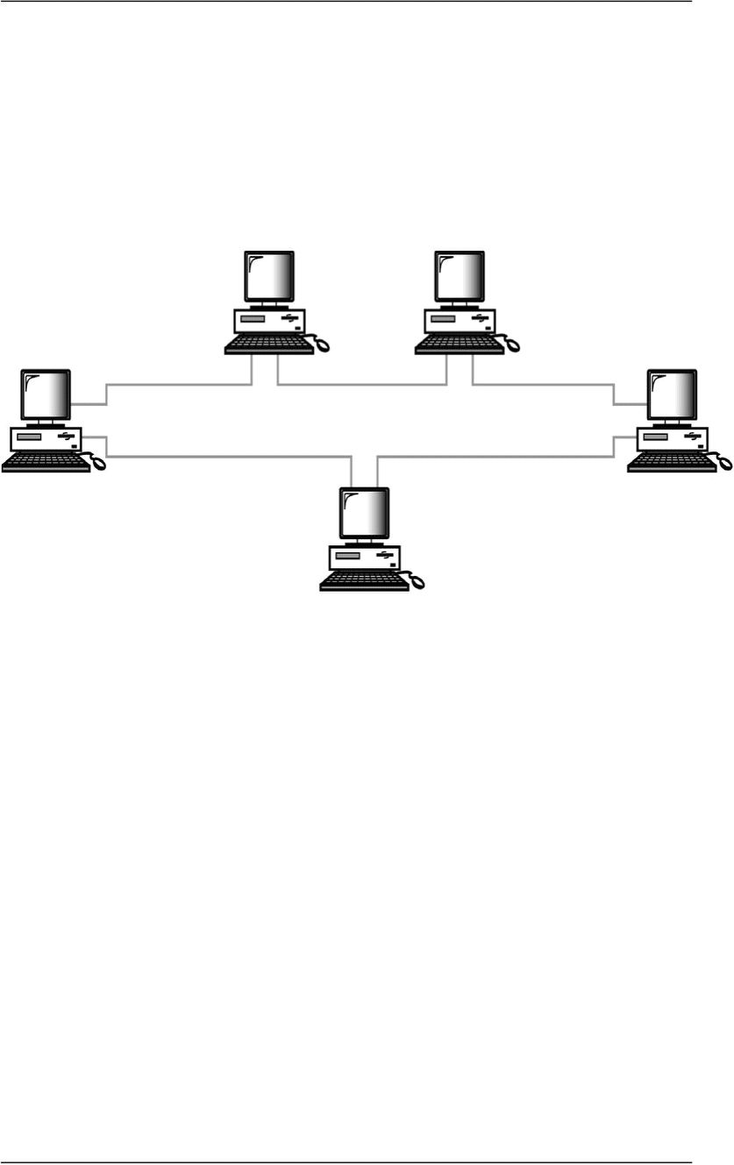
CS601-Data Communication VU
LECT URE #6
Ring Topology
Ring Topology Diagram
o Each device has point-to-point dedicated link with only two devices on either side
o A signal is passed in the ring in one direction from device to device until it reaches its
destination
o Each device has a repeater incorporated
o When a device receives a signal destined for another device, it regenerates the bits
and pass them along
 Advantages of Ring Topology
¾ Easy to Install and Reconfigure
9 Only two connections to be moved to add or delete a device
¾ SIMPLE Fault Isolation
9 Generally a signal is circulating at all times in a ring.
9 If one device does not receive a signal within a specified period, it can
issue an alarm to tell network operator about the problem and its location
 Disadvantages of Ring Topology
¾ Unidirectional Traffic
9 A break in a ring I.e. a disabled station can disable the entire network
¾ Can be solved by using:
© Copyright Virtual University of Pakistan

Slide 34
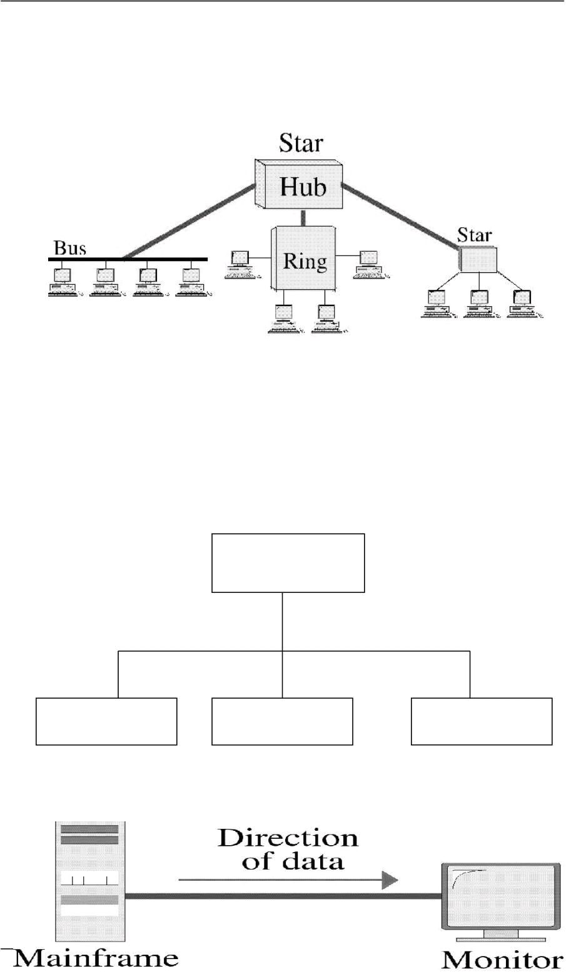
CS601-Data Communication VU
9 Dual Ring or
9 A switch capable of closing off the Break
 Hybrid Topologies
o Several topologies combined in a larger topology
9 Example: One department of a business may have decided to use a Bus
while other has a Ring
o The two can be connected via a Central Controller in Star Topology
TRANSMISSION MODE
“Transmission Mode is used to define the direction of the signal flow between the
linked
devices”
Transmission Modes
Simplex Half-Duplex Full-Duplex
 SIMPLEX MODE
© Copyright Virtual University of Pakistan
Hybrid Topologies

Slide 35
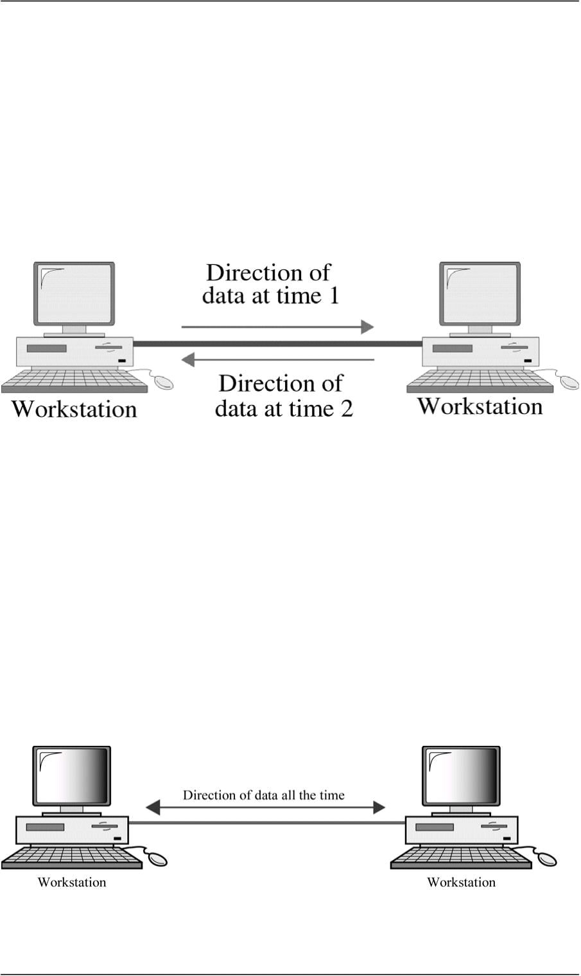
CS601-Data Communication VU
o Communication is Unidirectional
o Only one of the two stations can transmit
o Other can only receive
9 Examples: KEYBOARDS (Only Input), Monitors (Only Output)
 Half – Duplex Mode
o Each station can both transmit and receive but not at the same time
o When one device is sending the other can only receive and vice versa
o Lets understand the concept by using an example
9 One Lane Road with two directional traffic
9 When cars are traveling in one direction, cars going the other way must wait
o Full Channel capacity is allocated to whatever entity that is transmitting at a specific
time
9 Walkie Talkies
 Full Duplex (Duplex)
o Both stations can transmit and receive simultaneously
o Two way street with traffic flowing in both directions at the same time
o Signals traveling in either direction share the capacity of the link
o The sharing can take place in two ways:
© Copyright Virtual University of Pakistan

Slide 36
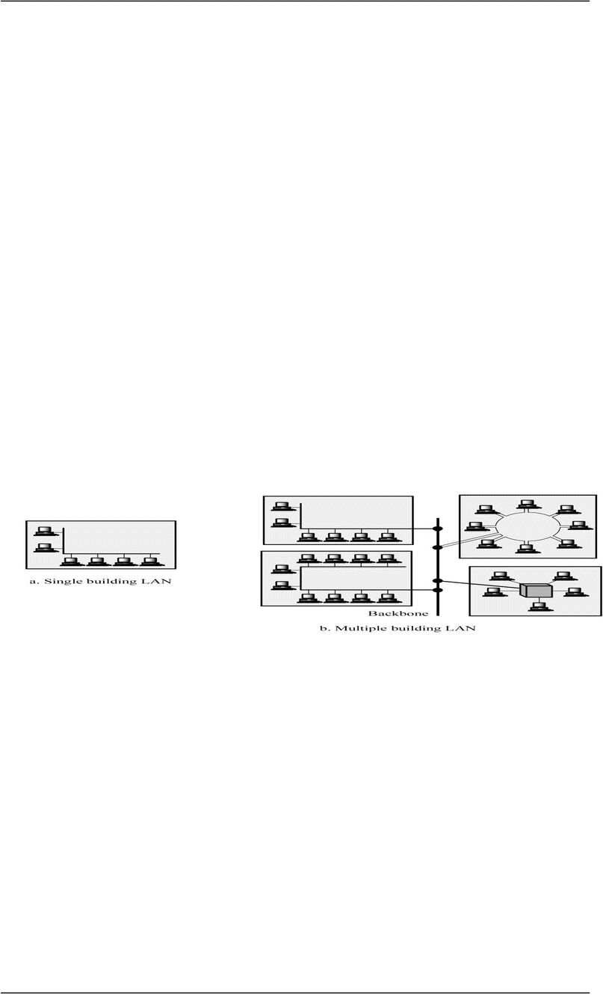
CS601-Data Communication VU
o Either the link must contain two physically separate transmission paths:
9 One for sending and
9 One for receiving
o Capacity of the channel is divided between signals traveling in opposite directions
9 EXAMPLE
–Telephone Network
When two people are communicating via a telephone line, both can talk
and listen at the same time
Categories of Networks
o There are three main categories of Networks:
¾ LANS
¾ WANS
¾ MANS
o Into which category a network falls is determined by its SIZE, OWNERSHIP,
DISTANCE IT COVERS, and its PHYSICAL ARCHITECTURE
 LANS
o
or a campus
o
¾ Care must be taken in choice of a LAN, because there may be a substantial
capital investment for purchase and maintenance.
¾ Secondly, the network management responsibility falls solely on the
user/company
o
¾ Size of a LAN depends upon the Needs of Organization and the Type of
Technology
¾ LAN can be as simple as two PCs and a printer in someone’s home office or it
can extend throughout a company and include complex equipment too
¾ Currently LAN size is limited to a few kilometers
o
© Copyright Virtual University of Pakistan
A LAN is usually Privately owned and Links the devices in a single office, Building
Two Implications
Size of a LAN
Design of a LAN

Slide 37
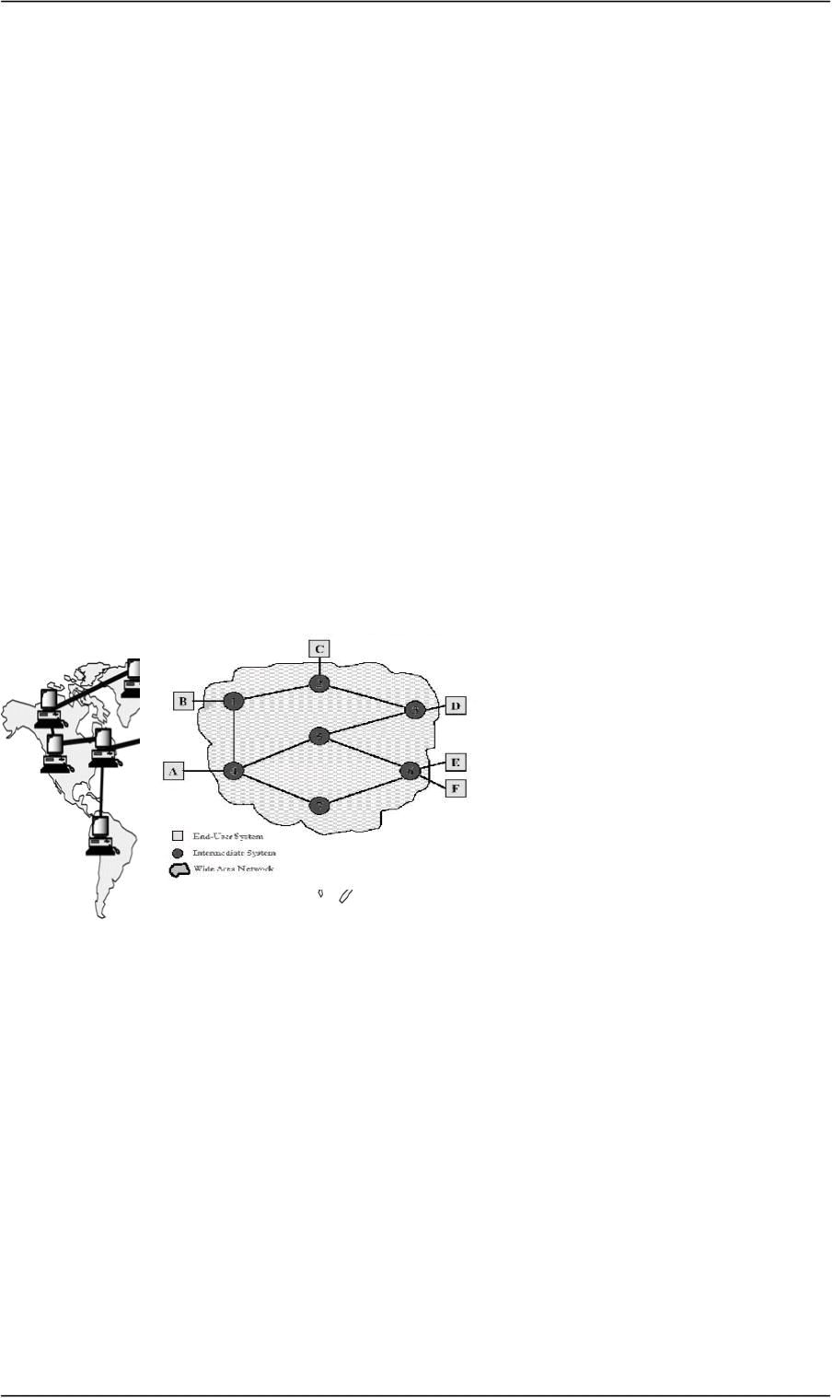
CS601-Data Communication VU
¾ LANs are designed to allow resources to be shared between personal computers or
workstations
¾ The resources to be shared can include hardware (printer), software (an
application program) or data.
9 Example of a LAN
A common example of a LAN found in many business environments links a
work group of task related computers, for example engineering workstations
or Accounting PCs. One of the PCs may be given a large capacity disk and
becomes a server to others. Software stored on the server and is used by the
whole group. In this case size is determined by software licenses
o
9 In addition to size, LANs are distinguished from other types of networks by
Transmission media and topology
9 In general a given LAN will use only one type of Transmission medium
9 The most common LAN topology Bus, Star Ring
o
9 Traditionally 4 – 1 Mbps
9 Speeds increased and now 100Mbps and above are also possible
9 Giga Bit LAN technologies
 WANs
o Generally cover a large geographical area and it usually span an Unlimited number of
miles by utilizing Public or Leased networks instead of having their own hardware as
in the case of LANs
o
9 Typically , it consists of a large number of Switching Nodes
9 Transmission from any one device is routed through these internal nodes to the
specified destination device
9 These nodes are not concerned with the content of the data, rather their
purpose is to provide a switching facility that will move the data from node to
node until it reaches its destination
o How to Implement a WAN?
9 Traditionally WAN s have been implemented using one of the 2 technologies:
–Circuit Switching
–Packet Switching
o Frame Relay and ATM Networks play important role nowadays too
© Copyright Virtual University of Pakistan
Transmission Media & Topology
Data Rates in a LAN
Design of a WAN

Slide 38
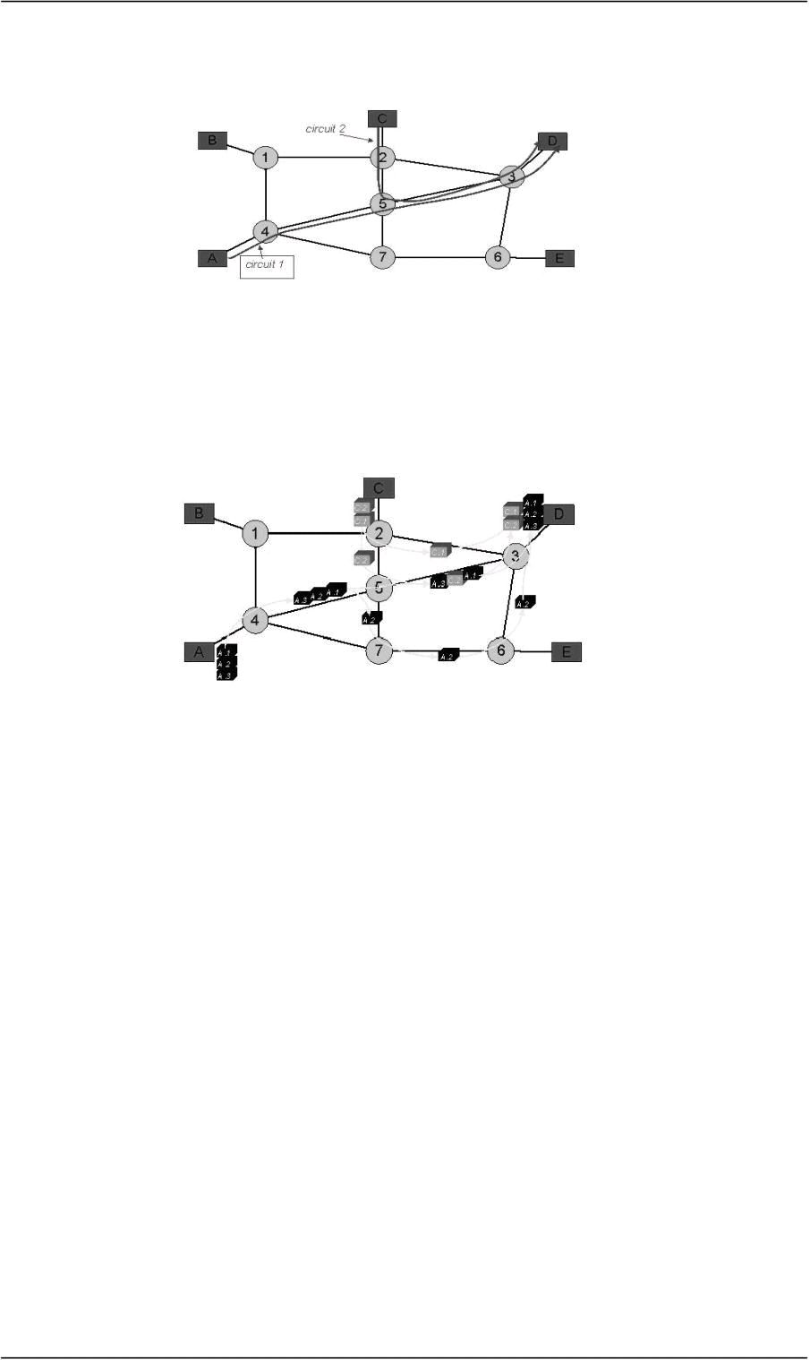
CS601-Data Communication VU
 Circuit Switching
o A dedicated communication path is established between two stations through the
nodes of the network
o
 acket Switching
o No capacity is dedicated along a path through the network
o Data Is sent out in small chunks called “Packets”
o Each path is passed from node to node
o At each node, entire packet is received, stored briefly and then transmitted to the next
node.
9
Frame Relay & ATM
o Overhead bits for Error Protection are removed
o 10’s of 100’s of Mbps and also Gbps is possible
Summary
 The OSI Model
 Layered Architecture
 Encapsulation and Decapsulation
 Physical Layer
 Data Link Layer
Reading Sections
 Section 2.4,2.5, “Data Communications and Networking” 4th Edition by Behrouz
A. Forouzan
 Sections 1.3, “Data and Computer Communication” 6th Edition by William
Stallings
© Copyright Virtual University of Pakistan
This path/CAPACITY stays up for the duration of the communication
Example is Telephone Network
Example is : Computer to Computer Communication

Slide 39
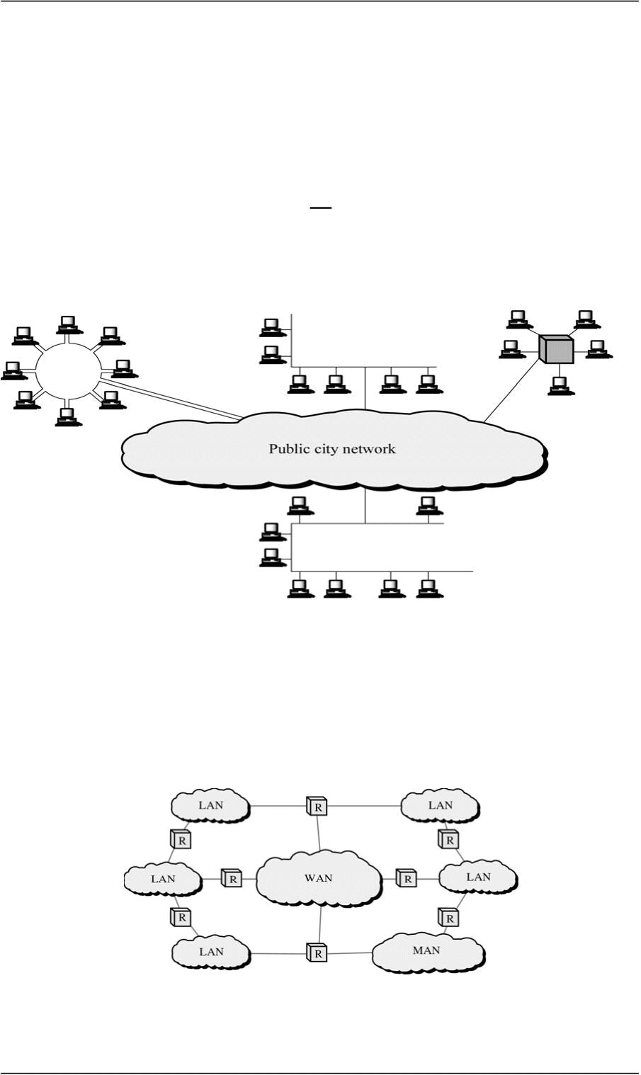
CS601-Data Communication VU
LECT URE # 7
Metropolitan Area Networks
o Designed to extend over an entire city
¾ It may be a single network e.g. Cable TV Network
Or
¾ Interconnection of a No. of LANs into a larger network
9 Example: A company can use a MAN to connect the LANs in all of its offices
throughout a city
Internetworks
o When two or more networks are connected they become an internetwork or internet
o Individual networks are joined together by the use of Internetworking Devices like
Routers, Gateways etc.
¾ internet: Combination of Networks
¾ Internet: Specific World wide Network
The OSI MODEL
o International Standards Organization (ISO) 1947
o Multinational body dedicated to worldwide agreement on International Standards
© Copyright Virtual University of Pakistan

Slide 40
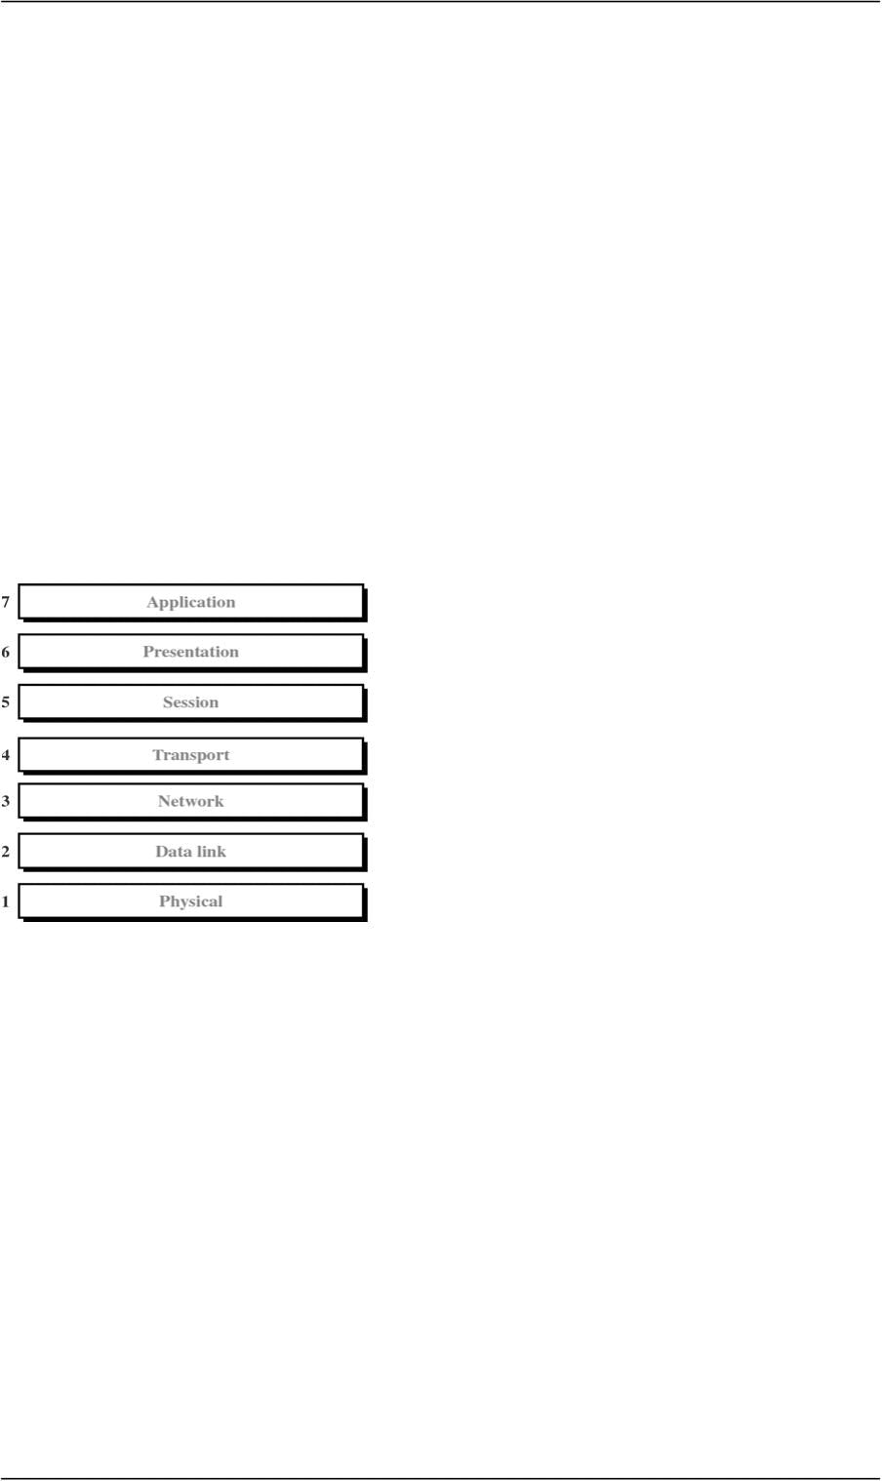
CS601-Data Communication VU
o An ISO Standard that covers all aspects of Network Communication is Open System
Interconnection Model (OSI)
o Open System: A model that allows two different systems to communicate regardless
of their underlying network
o Vendor –Specific Models close off communication
 Purpose of the OSI MODEL
¾ Open Communication between different systems without requiring changes to the
underlying hardware and software.
OSI Model is not a Protocol. It is a model for understanding and
designing a network architecture that is flexible, robust and interoperable
 Definition of the OSI MODEL
A layered framework for the design of network systems that allows communication
across all types of computer systems regardless of their underlying architecture
 Layers of the OSI Model
1. Physical (Bits)
2. Data Link (Frames)
3. Network (Packets)
4. Transport (Segment)
5. Session (Dialog units)
6. Presentation (Raw Data)
7. Application (Text, Numbers)
Please Do not Touch Steve’s Pet Alligator
© Copyright Virtual University of Pakistan

Slide 41
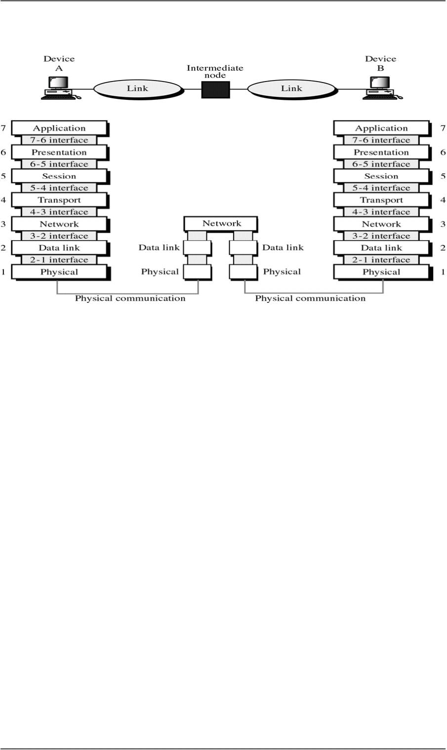
CS601-Data Communication VU
What happen when a message travels from device A to Device B?
o As the message travels from A to B , it may pas through many intermediate “Nodes”
o These nodes usually involve only the first three layers of the OSI Model
o In developing the OSI model, designers identified which networking functions had
related uses and collected those functions into discrete groups that became the layers
o Each layer defines a family of functions distinct from other layers
o By defining and localizing functionality in this fashion , the designers created an
architecture that is both comprehensive and flexible
o The OSI model allows complete transparency b/w otherwise incompatible systems
Peer-to-Peer Processes
o
upon the services from the layer below it.
o
o Between machines, layer x on one machine communicates with layer x on the other
machine.
o The communication is governed by Protocols
o The processes on each m/c that communicate at a given layer are called Peer –to peer
processes
Headers and trailers
o Control data added to a data parcel
o Sender appends header and passes it to the lower layer
o Receiver removes header and passes it to upper layer
o Headers are added at layer 6,5,4,3,2. Trailer is added at layer 2
© Copyright Virtual University of Pakistan
Within a single machine, each layer provides services to the layer above it and all
For example Layer 3

Slide 42
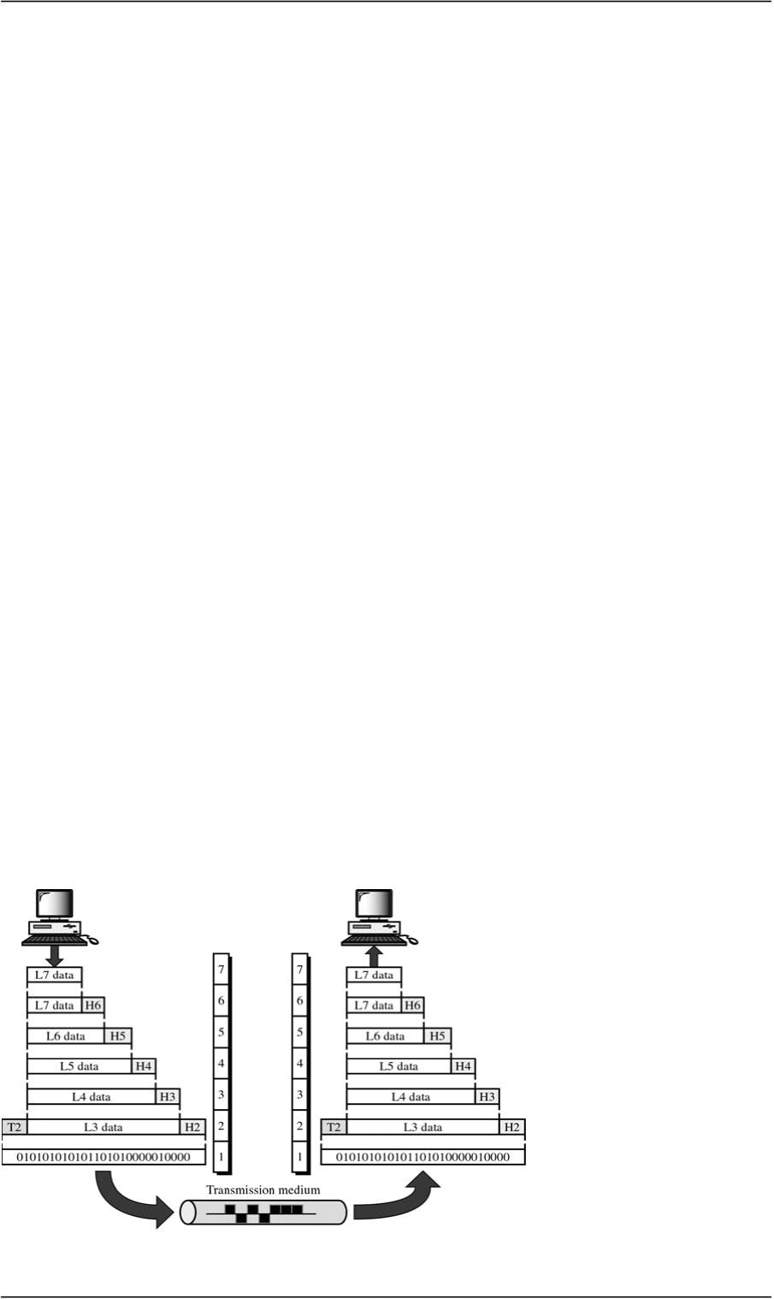
CS601-Data Communication VU
Passing of data and network information down through the layers of sending machine
AND Back up through the layers of the receiving machine is made possible by an
INTERFACE
o Each interface defines what information and services a layer must provide for the
layer above it
o Interface provides MODULARITY
o Each layer works as a separate module
o Any modification or replacements can be made without changes in surrounding
layers
o Organization of Layers
¾ Network Support Layers
–Deals with the Physical aspect of moving data from one device to another
–Layers 1, 2, 3
¾ User Support Layers
–Allows interoperability among unrelated software systems
–Layers 5, 6, 7
Organization of Layers
o Layer 4
–Ensures end-to-end reliable transmission
o Upper OSI Layers always implemented in Software
o Lower Layers are a combination of software and hardware
o Physical layer is mostly Hardware
The OSI Model
© Copyright Virtual University of Pakistan

Slide 43
CS601-Data Communication VU
Summary
 Categories of Networks (MANs)
 Internetworks
 The OSI Model
Reading Sections
 Section 2.5, 3.1, 3.2 “Data Communications and Networking” 4th Edition by
Behrouz A. Forouzan
© Copyright Virtual University of Pakistan

Slide 44
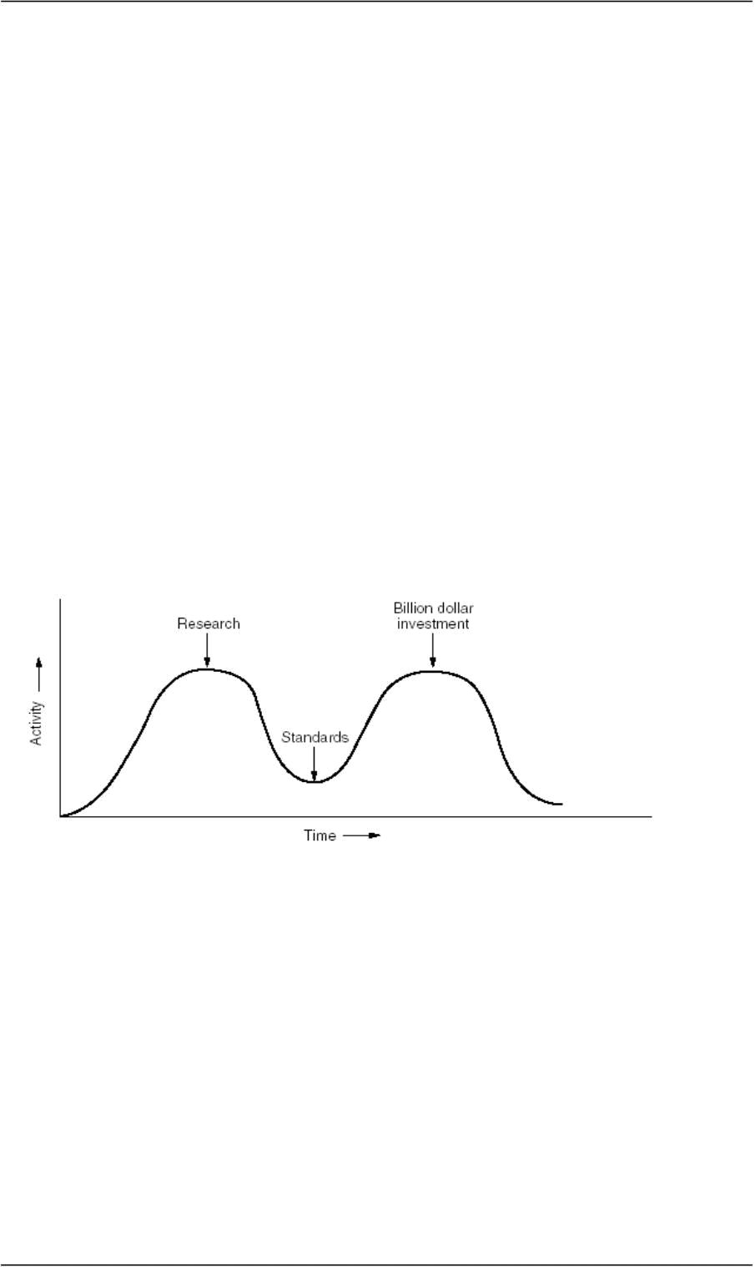
CS601-Data Communication VU
LECT URE # 8
Critique of OSI Model
Reasoning for OSI not getting Widespread
¾ Bad Timing(slide) (Apocalypse of Two Elephants)
–David Clarke of MIT
–If standards are written too early: subject is badly understood and bad standards
–If standards are written too late so many companies may have already made
investments in doing the same thing with different other ways
¾ Bad Technology
–Flow control, error control, addressing is multiple
–Session and Presentation(EMPTY), Network and DL(Full)
¾ Bad Implementations
Apocalypse of Two Elephants
 Physical (Layer 1)
o Coordinates the functions required to transmit a bit stream over a physical medium
o Deals with mechanical and electrical specifications of Tx. Medium and Interface
o Also defines procedures and functions that physical devices and interfaces need to
perform for TX. To occur (Figure)
© Copyright Virtual University of Pakistan

Slide 45
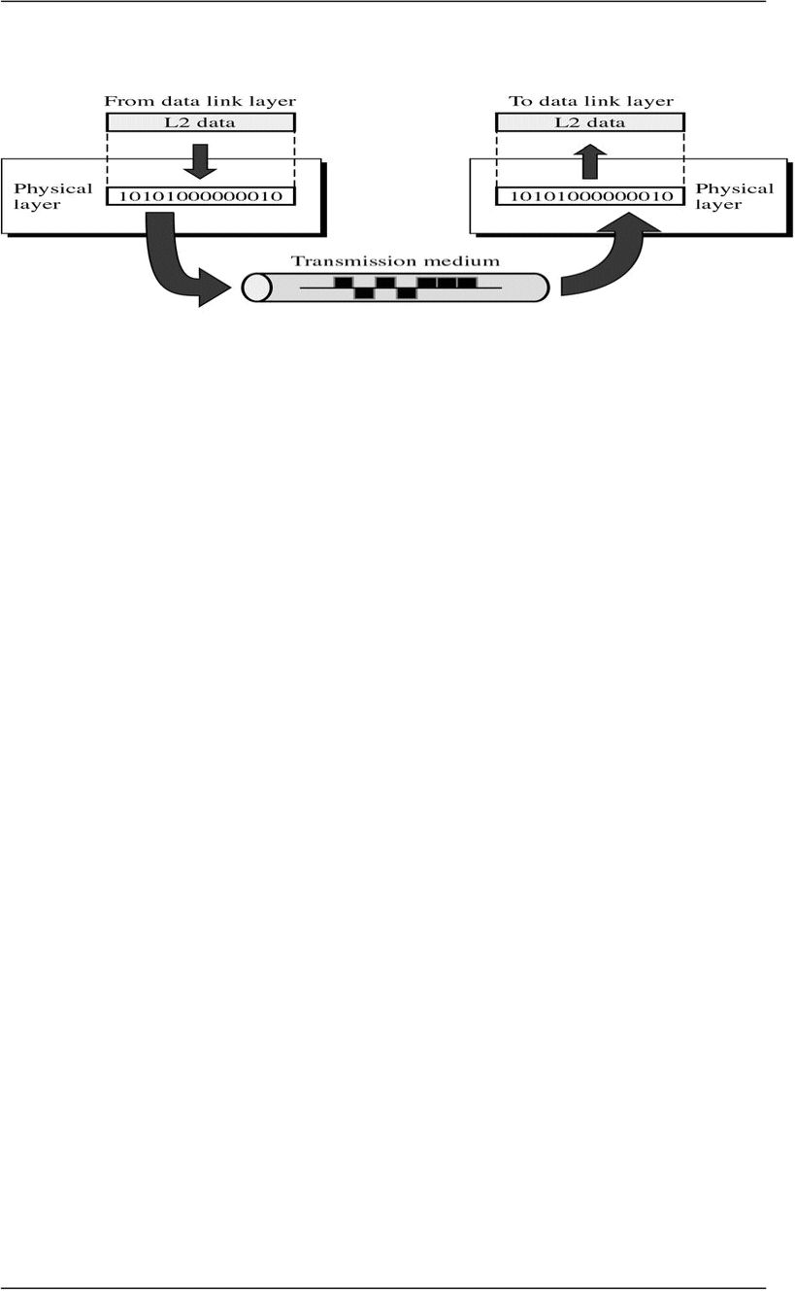
CS601-Data Communication VU
Figure
• Functions of Physical Layer
o Physical Characteristics of Interface & Media
¾ Defines characteristics of Interface b/w device and Tx Medium
¾ Interface is a plug gable connector that joins one or more signal conductors
¾ Also defines the type of transmission medium
o Representation of Bits/Encoding
¾ The physical layer data consists of a stream of bits (sequence of 1’s and 0’s)
¾ To be transmitted the bits must be ENCODED into signals: Electrical or
Optical
¾ Physical layer decides the type of ENCODING
o Data Rate / Transmission Rate
¾ Date Rate ( Bits per second) also decided by the Physical Layer
¾ So , Physical layer defines the Duration of a Bit
¾ Means how long will a bit last
o Synchronization of Bits
¾ Sender and Receiver must be synchronized at the bit level
¾ Sender and Receiver clocks must be synchronized
¾ It is done by Physical layer
o Line Configuration
¾ Physical Layer is also concerned with Line Configuration
¾ Line Configuration represents the connection of device with the Medium
¾ Point-To-Point or Multipoint
o Physical Topology
¾ Mesh, Star, Ring, Bus etc.
© Copyright Virtual University of Pakistan

Slide 46
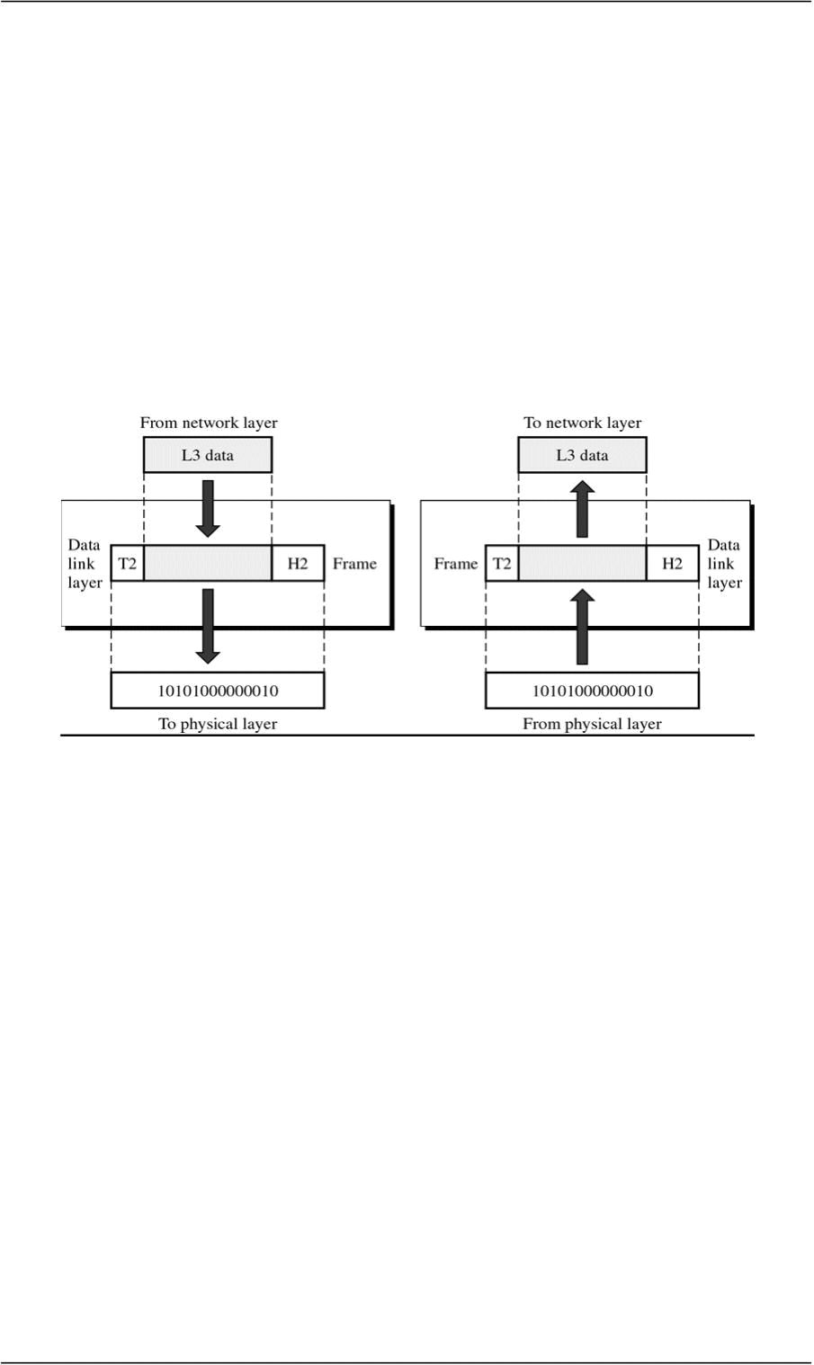
CS601-Data Communication VU
o Transmission Mode
¾ Physical Layer also defines the direction of Transmission between the devices
¾ Simplex. Half Duplex, Full Duplex
 Data Link Layer (Layer 2)
o Transforms physical layer which is raw transmission facility to a reliable link
o Responsible for Node to Node Delivery
o Makes physical layer look error free to the upper layer
Figure
• Functions of Data Link Layer
o Framing
¾ The data link divides the stream of bits from Network layer into manageable
data units called “FRAMES”. This process is known as Framing.
o Physical Addressing
¾ Frames need to be transmitted to different systems on a network
¾ Data Link layer adds a HEADER to Frame
¾ Header defines the physical address of sender(Source address) and/or receiver
address (Destination address)
¾ If frame is intended for a device outside the network, the receiver address is
the address of the device that connects one network to the other
o Flow Control
¾ Data Link layer imposes Flow Control mechanisms to prevent overwhelming
the receiver
© Copyright Virtual University of Pakistan

Slide 47
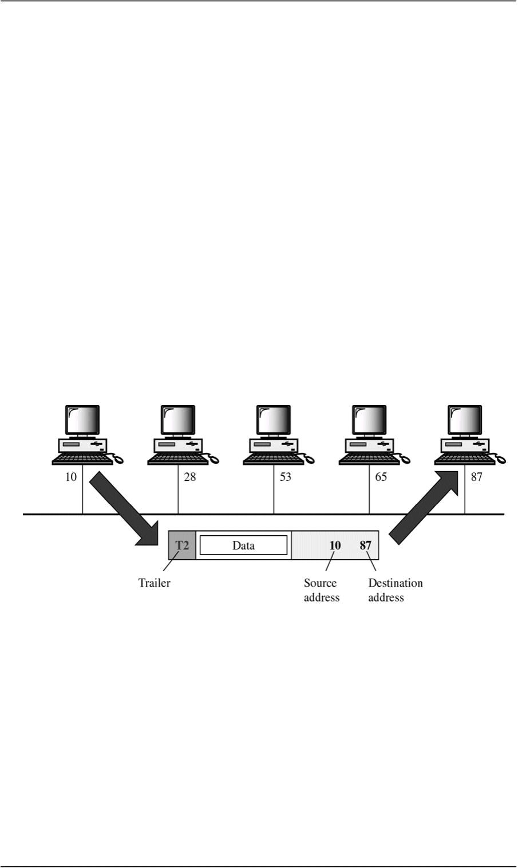
CS601-Data Communication VU
o Error Control
¾ Data link layer adds reliability to physical layer by adding mechanisms to
detect and retransmit lost or damaged frames
¾ Also uses a mechanism to prevent duplication of frames
¾ Error Control bits are added to the form in the TRAILER
o Access Control
¾ Two or more devices may be connected to a single link
¾ Data link protocols are necessary to determine which device will have the
control of the link at a given time
9 EXAMPLE
• Node with physical address 10 sends a frame to a node with
physical address 87
• Two nodes are connected by a link.
• At the DL level, this frame contains physical address in the Header,
This is the only address needed at this level
• Rest of header contains other info as needed
• Trailer contains extra bits needed for error detection
 NETWORK LAYER

o Responsible for Source-to-Destination delivery
o DL Layer oversees the delivery of data between 2 systems on the same network
o Network Layer ensures that each packet gets from its point of origin to its final
destination
¾ Node –to Node vs Source to Destination
9 If the two systems are connected to the same network, there is no need for
Network layer and node –to node delivery is enough
9 If two systems are connected to two different networks, there is often a
need for Source-to destination delivery
© Copyright Virtual University of Pakistan

Slide 48
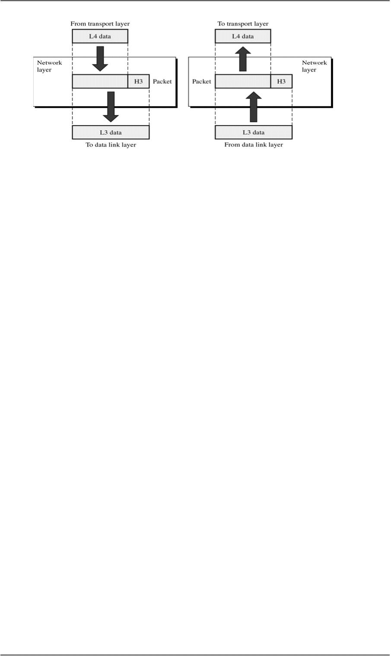
CS601-Data Communication VU
• Function of Network Layer
o Logical Addressing
¾ Physical addressing implemented by Data link layer handles addressing
problem locally
¾ If a packet is going from one network to another, we need another addressing
system to help distinguish source & destination systems
¾ Network layer adds Header to the data coming from upper layers that among
other things include LOGICAL ADDRESS of the sender and receiver
o Routing
¾ When independent networks or links are connected together to create an
“internetwork”, the internetworking devices route packets to their final
destination
¾ Routers are those internetworking devices
¾ One of the functions of Network layer is to define this route
9 Example Network Layer
•We want to send data from a node with network address ‘A’ and physical
address 10, located on one LAN to
•A node with network address P and physical address 95 located on
another LAN
•Because the two nodes are present on two different networks, we cannot
use physical address only
•We need a Network address that can pass us from the Network
boundaries
•The packet therefore contains the logical address which remains the same
from source to destination
•The physical address will change when packet moves from one network
to the other
Summary
 The OSI Model
 Function of Layers
Reading Sections
 Section 3.1,3.2, “Data Communications and Networking” 4th Edition by Behrouz
A. Forouzan
© Copyright Virtual University of Pakistan
•The box with R is a Router

Slide 49
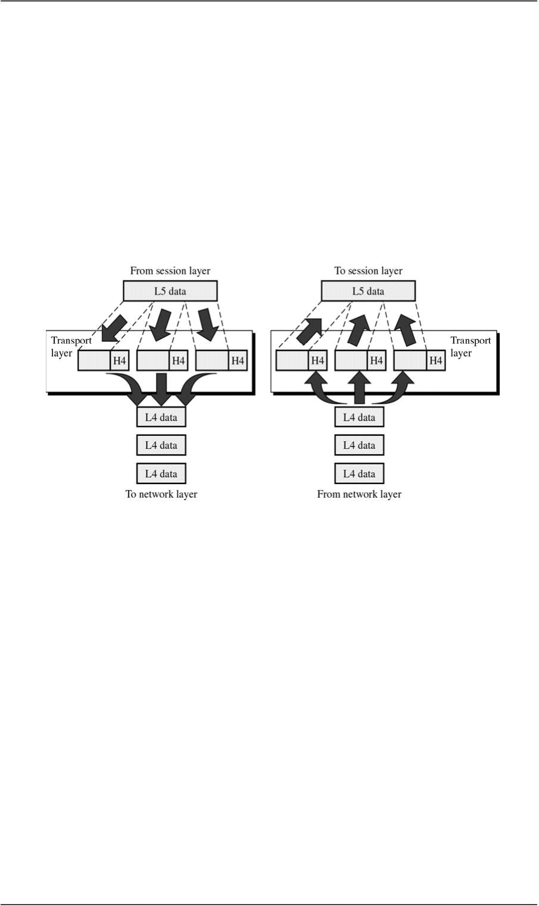
CS601-Data Communication VU
LECT URE #9
 Transport Layer
o Responsible for Source-to-Destination delivery of Entire Message
o Network Layer oversees source-to-destination delivery of the entire packets but it
does not recognize any relationship b/w those packets
o Network layer treats each packet independently
o Transport Layer ensures that whole message arrives at the destination intact
• Functions of Transport Layer
o Service Point Addressing
¾ Computers run several programs at the same time
¾ Source-to-Destination delivery means delivery not only from only from one
computer to the other but also from a specific process on one computer to a
specific process on the other
¾ Transport layer header includes a type of address called Service Point Address
or PORT Address
¾ Network layer each packet to the correct computer while Transport layer gets
entire message to the correct process on that comuter
o Segmentation and Reassembly
¾ Message is divided into transmittable segments
¾ Each segment contains a sequence number
¾ These sequence no.s enable Transport layer at the receiving m/c to reassemble
message correctly at the destination and to identify and replace lost packets
© Copyright Virtual University of Pakistan

Slide 50
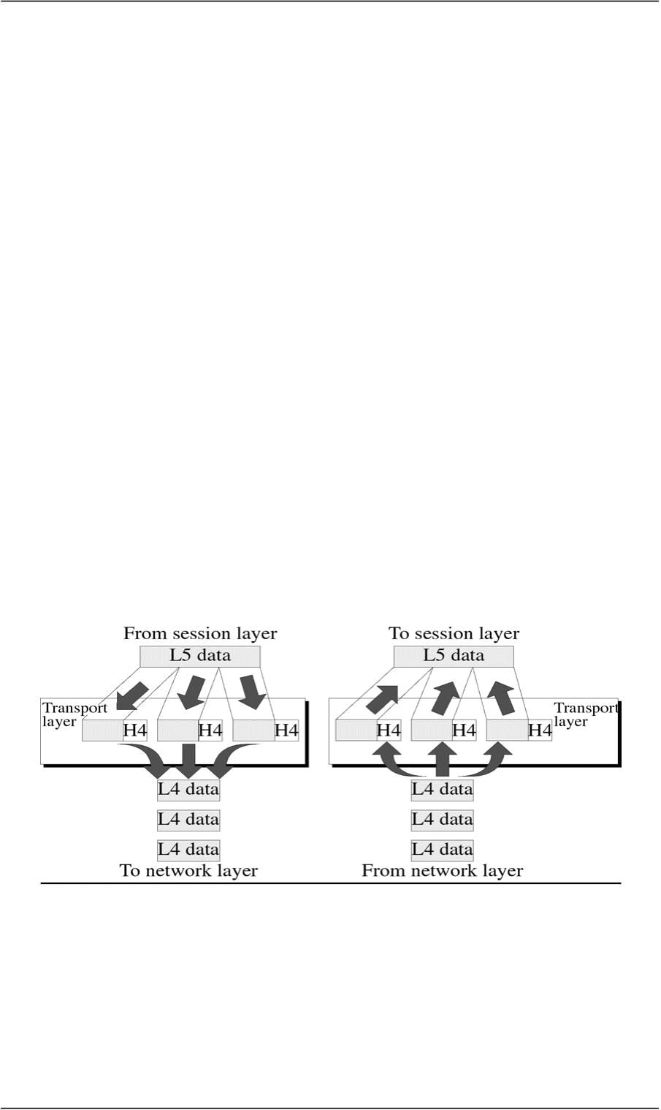
CS601-Data Communication VU
o Connection Control
¾ Transport layer can be either connection-less or connection-oriented
¾ Connectionless
Treats each segment as an independent packet and delivers it to the
transport layer of the destination m/c
¾ Connection-Oriented
A connection is established first with Transport layer before
delivering the packet.
¾ After all data is Tx. , the connection is disconnected
o Flow Control
¾ Like Data link layer, Transport layer is also responsible for Flow control
¾ Flow control is performed end-to-end rather than across a single link
o Error Control
¾ Like data link layer, Transport layer is responsible for the Error Control
¾ Error control is performed end-to-end
¾ This layer makes sure that entire message reaches Rx Transport layer w/o
error
¾ Error can be a result of Lost, damaged or duplicated data and usually Re Tx is
done
Example Figure
 Session Layer
o Session layer is the Network Dialog Controller
o Establishes, Maintains, and Synchronizes the interaction between
communicating systems
© Copyright Virtual University of Pakistan

Slide 51
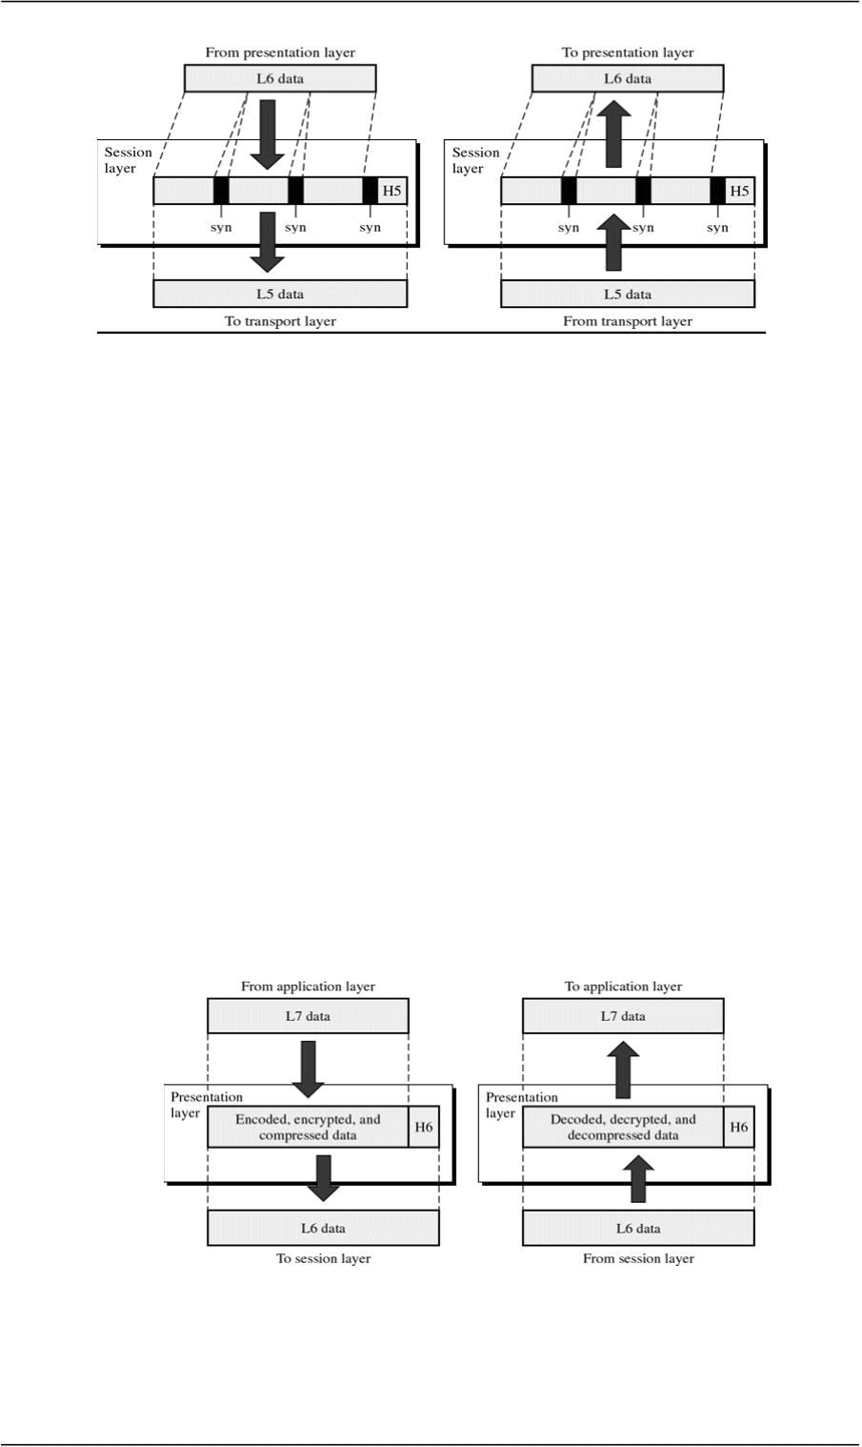
CS601-Data Communication VU
• Function of Session Layer
o Dialog Control
¾ Session layer allows two systems to enter into a dialog.
¾ It allows communication between two processes to take place either in half
duplex or full duplex mode
o Synchronization
¾ Session layer allows a process to add check points (synchronization points)
in a stream of data
¾ If a system is sending a file of 2000 pages, it is advisable to insert check
points after every 100 page to ensure that each 100 page unit is received
and acknowledged independently
¾ In this case, if a crash happens during the transmission of page 523 ,
retransmission at page 501
¾ Page 1-500 need not be retransmitted
 Presentation Layer
o This layer is concerned with Syntax and Semantics of info exchange between
two systems
Summary
 The OSI Model
 Functions of Layers
Reading Sections
 Section 3.2 “Data Communications and Networking” 4th Edition by Behrouz A.
Forouzan
© Copyright Virtual University of Pakistan

Slide 52
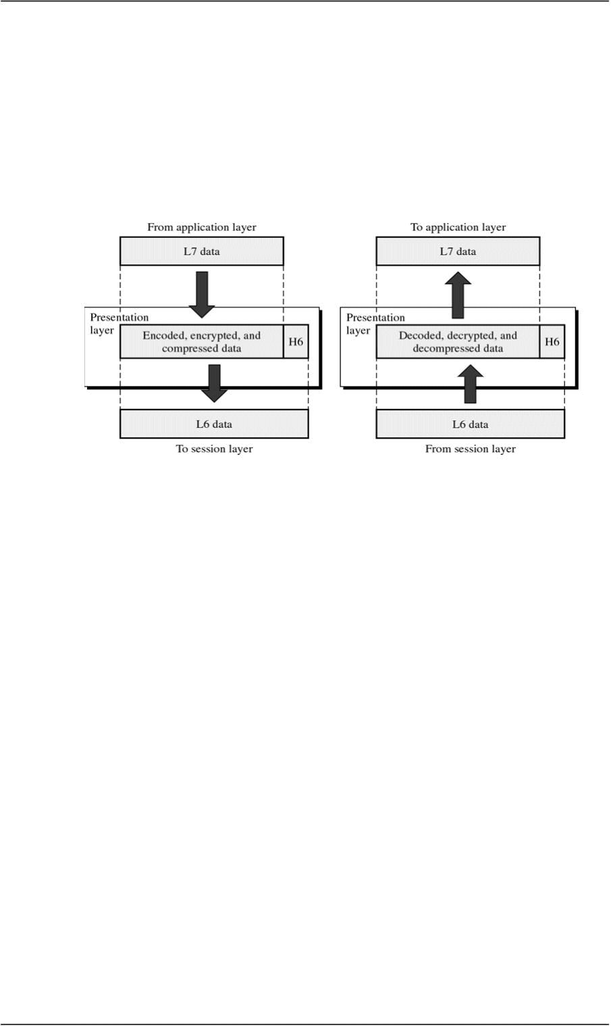
CS601-Data Communication VU
LECT URE #10
 Presentation Layer
o This layer is concerned with Syntax and Semantics of info exchange between
two systems
• Functions of Presentation Layer
o Translation
¾ The processes (running programs) in two systems are usually exchanging
info in the form of character strings, numbers and so on…..
¾ The info should be changed to bit streams before being transmitted
¾ Because different computers use different ENCODING SYSTEMS,
presentation layer is responsible for interoperability b/w these different
encoding methods
¾ The presentation layer at the sender changes the info from its sender-
dependent format to the common format
¾ The presentation at the receiver changes info from common to the receiver
dependent format
o Encryption
¾ To carry sensitive info , a system must be able to assure privacy
¾ Encryption means that sender transforms original info to another form and
sends the resulting message out over the network
¾ Decryption reverses the original process to transform message back to its
original form
o Compression
¾ Data compression reduces the number of bits to be transmitted
© Copyright Virtual University of Pakistan

Slide 53
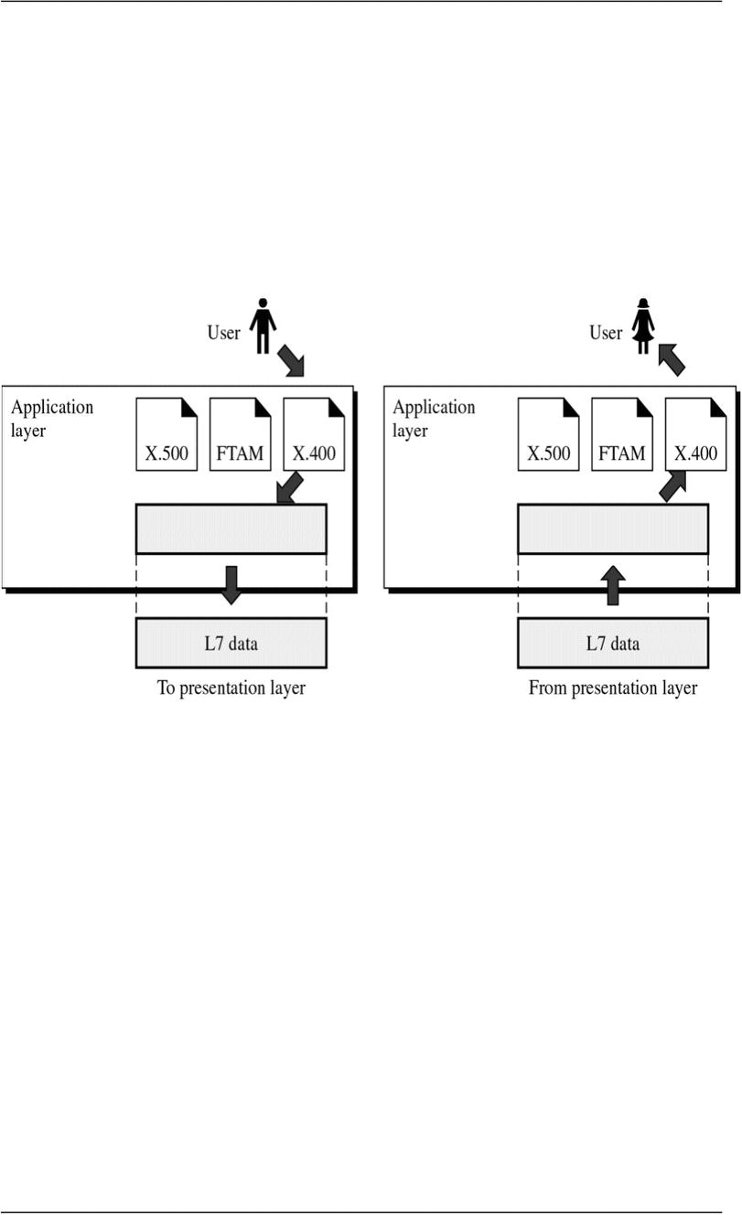
CS601-Data Communication VU
¾ Data compression becomes particularly important in transmission of
multimedia such as text, audio and video
 Application Layer
o Enables the user either human or software to access the network
o It provides user interface and support for the services such as Electronic mail,
Remote File access and Transfer, Shared Database Management and other
services
Application Layer Figure
o In the figure, of many application services available, only three services are
shown
–X-400 (message Handling Services)
–X-500 (Directory Services)
–File Transfer, Access& Management (FTAM)
o In this example user uses X-400 to send an e-mail message
o No headers or trailers are added at this layer
• Application Layer Functions
¾ Network Virtual Terminal
o NVT is a software version of a physical terminal and allows a user to log on to
a remote host
o To do so the application created emulation of terminal at the remote host
o Users computer talks to the software terminal which in turn talks to the host
*& vice versa
o Remote host believes it is communication with one of its own terminals and
allow you to log on
© Copyright Virtual University of Pakistan

Slide 54
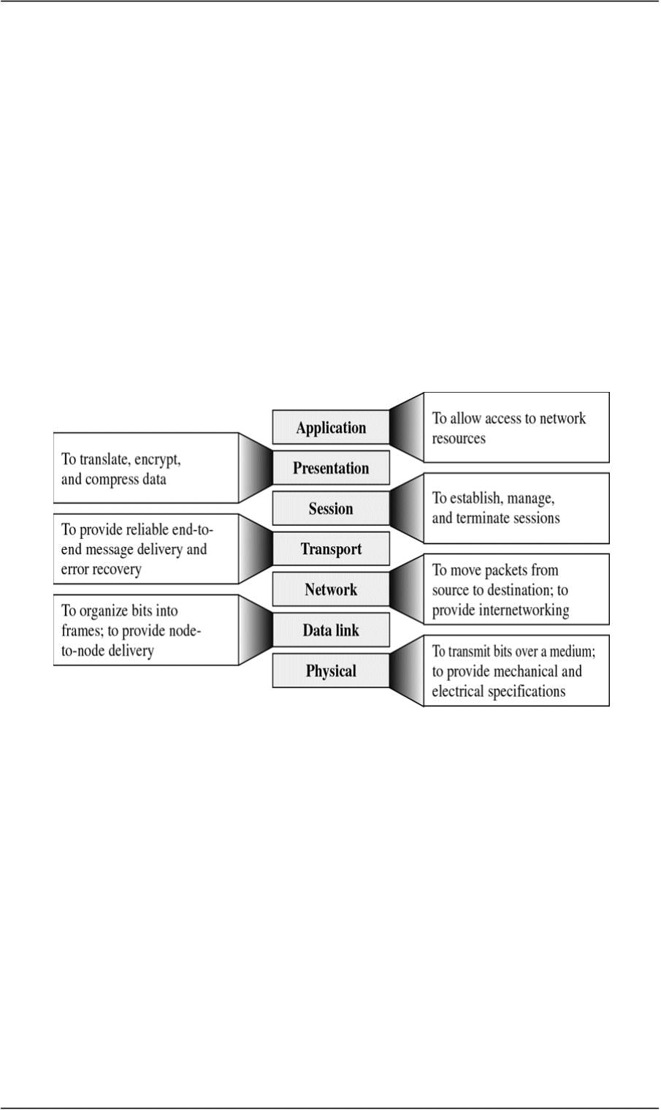
CS601-Data Communication VU
¾ File Transfer, Access & Manage.(FTAM)
o This application allows a user to access file on the remote computers to make
changes or read data
o The purpose of this access is to Retrieve files from a remote computer and to
manage or control files in that remote computer
¾ M il Services
o This application provides the basis for email forwarding and storage
¾ Directory Services
o Provides distributed database sources and access for global info about various
objects and services
Summary of Layer Functions
TCP/IP Protocol Suite
o Transmission Control Protocol / Internetworking Protocol
o
o Widely used in the Internet Today
 Layers in TCP/IP Protocol Suite
o Physical (physical standards)
o Data Link (N/w Interface)
o Network (Interconnectivity)
o Transport(Transport Functions)
o Application(Session , Pres, app of OSI)
© Copyright Virtual University of Pakistan
Developed Prior to OSI Model

Slide 55
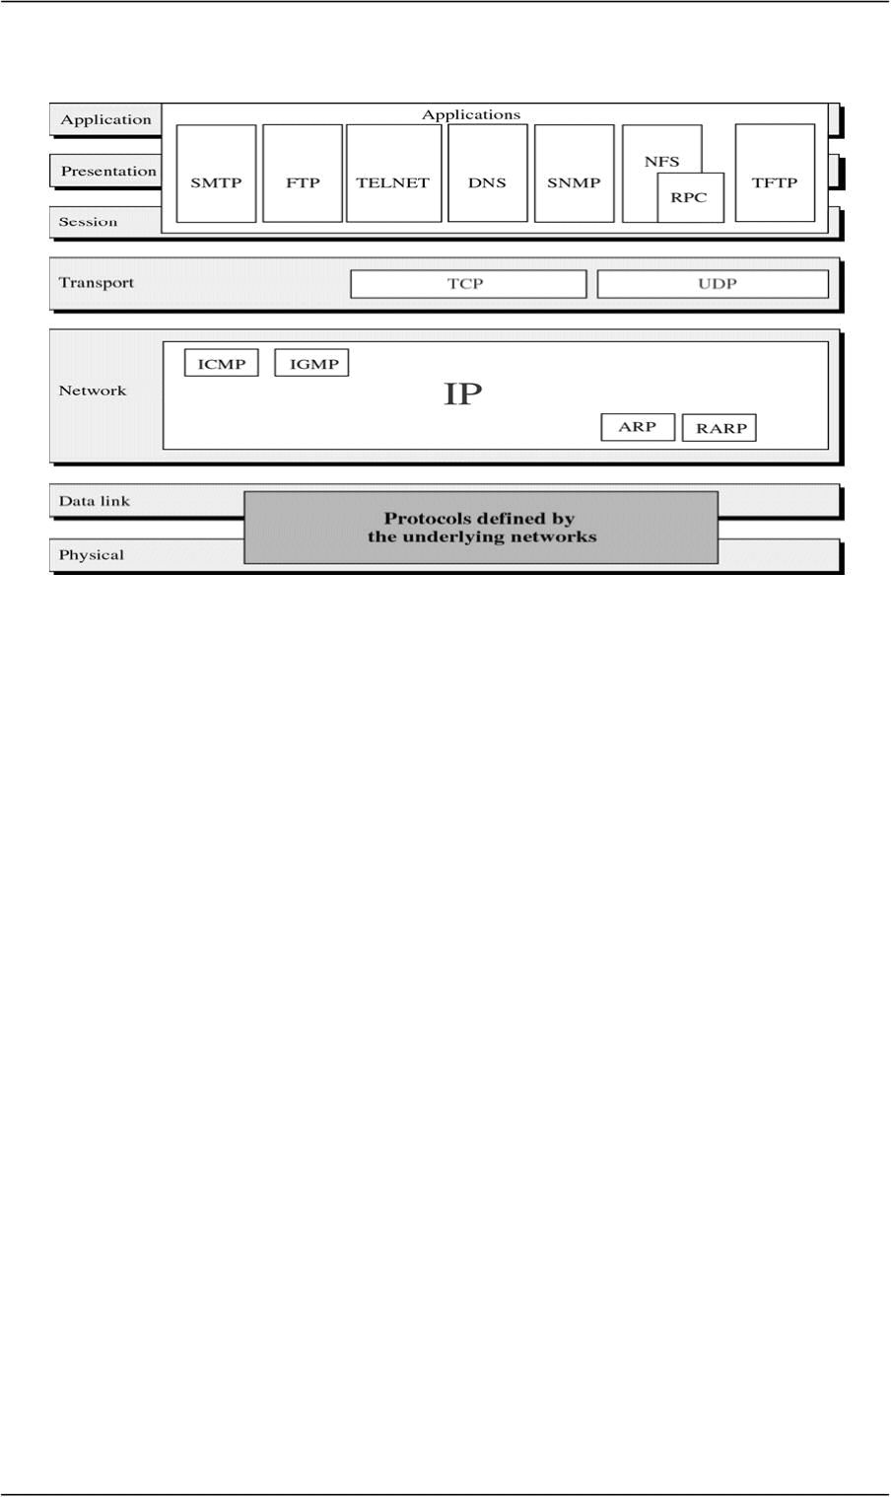
CS601-Data Communication VU
TCP/IP Protocol Suite
Summary

Functions of Layers
TCP/IP Protocol Suite
Reading Sections
Section 3.2, 3.3 “Data Communications and Networking” 4th Edition by
Behrouz A. Forouzan
© Copyright Virtual University of Pakistan
The OSI Model

Slide 56
CS601-Data Communication VU
LECT URE #11
Signals
 Need For Signals
o One of the major concerns of Physical layer is moving information in the form
of electromagnetic signals across a TX medium
o Information can be voice, image, numeric data, characters or any message that
is readable and has meaning to the destination user (human or m/c)
o Generally, the info usable to a person or application is not in a form that can
be transmitted over a network
o For Example, you cannot roll up a photograph, insert it into the wire and
transmit it across the city
o You can transmit however an encoded description of the photograph
o The binary digits must be converted into a form that TX. Medium can accept
o TX. Media work by conducting energy along a physical path. So the data
stream of 1s and 0s must be turned into energy in the form of EM signals
 Analog and Digital
o Both data and signals that represent them can take either analog or digital form
¾ ANALOG
• Analog refers to something that is continuous in time
• Continuous– A set of specific points of data and all possible points b/w
them
¾ DIGITAL
• Digital refers to something that is discrete
• Discrete– A set of specific points of data with no points in between
o Data can be Analog or Digital
9 Example of ANALOG Data is Human voice
9 When somebody speaks, a continuous wave is created in the air.
9 This can be captured by a Microphone and converted to an Analog
Signal
9 An example of DIGITAL data is Data stored in the memory of a
computer in the form of 1s and 0s. It is usually converted to a digital
signal when it is transferred from one position to the other inside or
outside the computer
o Signals can be Analog or Digital
 ANALOG Signal
© Copyright Virtual University of Pakistan

Slide 57
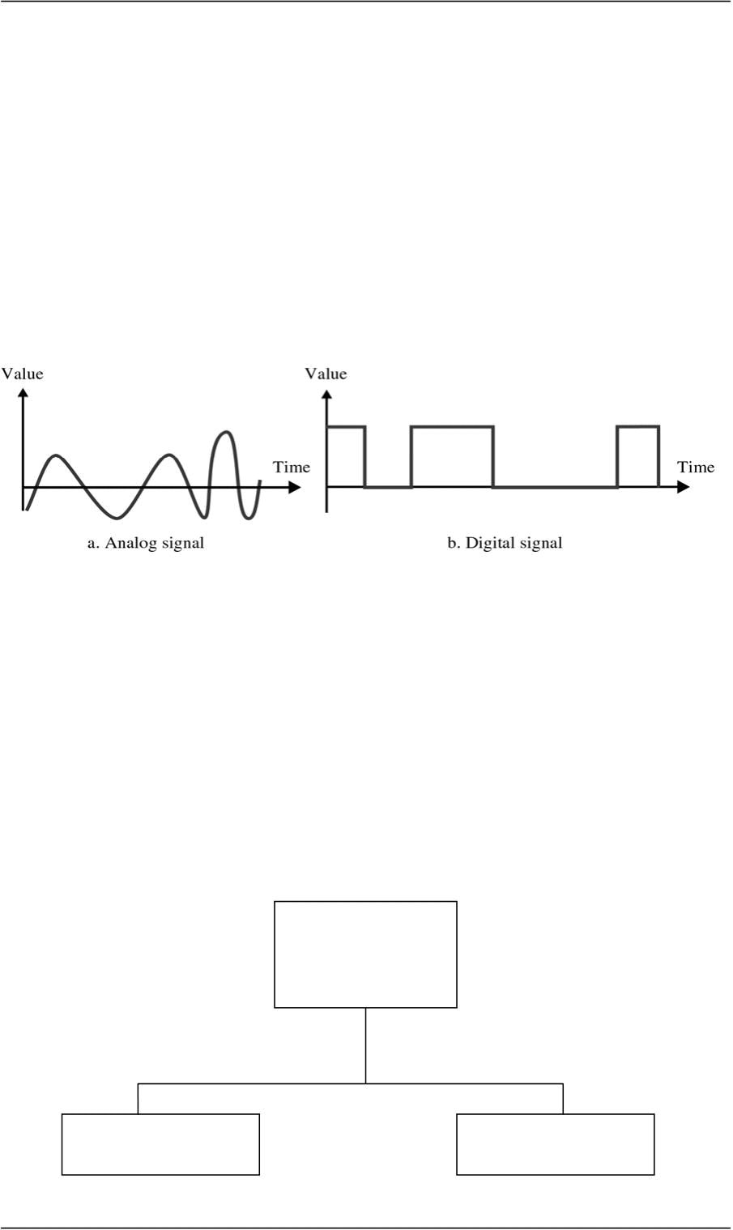
CS601-Data Communication VU
o It is a continuous waveform that changes smoothly over time
o As the wave moves from value ‘ A’ to value ‘B’, it passes through and
includes an infinite number of values along its path
 DIGITAL Signal
o A digital signal is discrete. It can have only a limited number of defined
values, often as simple as 1s and 0s
o The transition of a digital signal from value to value is instantaneous like a
light being switched ON and OFF
Analog and Digital Signals
o We illustrate signals usually by plotting them on a pair of perpendicular axis
o Vertical axis represent the value or the strength of the signal
o Horizontal axes represent the passage of time
o The curve representing the Analog signal is smooth and continuous, passing
through an infinite number
o The vertical lines of the digital signal shows the sudden jump the signal makes
from value to value. The flat highs and the lows represent that those values are
fixed
o In short, Analog signal varies continuously w.r.t Time whereas Digital signal
varies instantaneous
Periodic and Aperiodic Signals
Signals
(Analog or Digital)
Periodic Aperiodic
© Copyright Virtual University of Pakistan

Slide 58
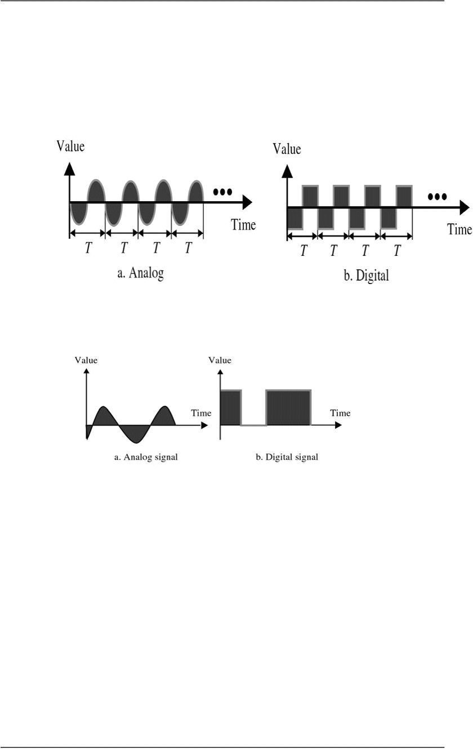
CS601-Data Communication VU
 Periodic Signals
o A signal is called Periodic if it completes a pattern within a measurable time
frame called a Period and then repeats that pattern over identical subsequent
Periods
o The completion of one full pattern is called a CYCLE
o Period: Time required (in Seconds) to complete one full cycle, represented by
‘T’
 Aperiodic Signals
o An Aperiodic or Non-Periodic signal is the one that changes constantly
without exhibiting a pattern or cycle that repeats over time
• Fourier Transform
It has been proved by a technique called FOURIER TRANSFORM
that any Aperiodic signal can be decomposed into an infinite number
of Periodic Signals
 ANALOG SIGNALS
o Analog signals can be classified as Simple or Composite
o Simple Analog Signal(Sine Wave)
–Cannot be decomposed into simpler signal
o Composite Analog Signal
–Composed of multiple sine waves
 Sine Waves
o Sine Waves are the most fundamental form of Periodic Analog Signals
o The curve oscillates over the course of a cycle smoothly and consistently
© Copyright Virtual University of Pakistan

Slide 59
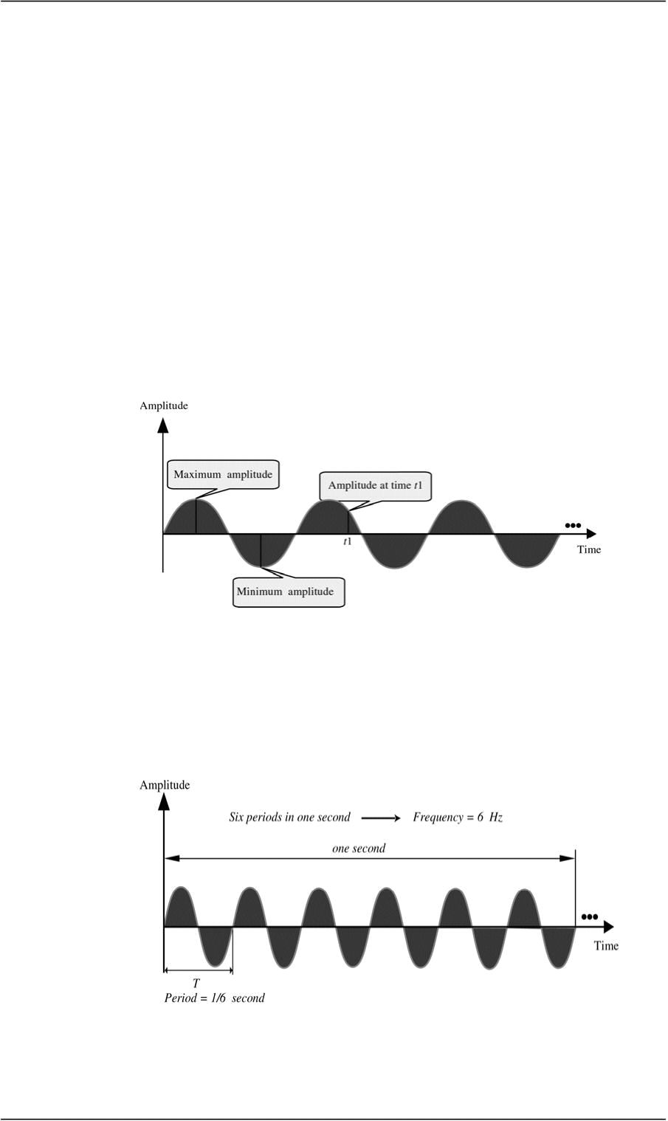
CS601-Data Communication VU
o Each cycle consists of a single arc above the time axis followed by a single arc
below it
o Sine Waves can be fully described by three characteristics:
¾ Amplitude
¾ Period/Frequency
¾ Phase
¾ Amplitude
• Amplitude of a signal is the value of the signal at any point on the
wave
• It is equal to the vertical distance from a given point on the wave form
to the horizontal axis
• The maximum amplitude of the sine wave is equal to the highest value
it reaches on the vertical axis
• Amplitude measured in Volts, Amperes or Watts
¾ Period & Frequency
• Period: Amount of time ( in seconds) a signal need to complete one
cycle
• Frequency: Number of cycles completed in one second
• Unit of Period: Period is expressed in seconds
• Communication industry uses 5 units to measure period
• Frequency is measured in hertz, There are 5 units used in Hertz
© Copyright Virtual University of Pakistan

Slide 60
CS601-Data Communication VU
Seconds____Hertz
Milliseconds____Kilohertz
Microseconds____Megahertz
Nanoseconds____Gigahertz
Picoseconds____Terahertz
Summary
 Signals
 Analog and Digital
 Analog and Digital Data & Signals
 Periodic & Aperiodic Signals
 Sine Waves and its Characteristics
Reading Sections
Section 4.1, 4.2, 4.3“Data Communications and Networking” 4th Edition by
Behrouz A. Forouzan
© Copyright Virtual University of Pakistan

Slide 61

CS601-Data Communication VU
LECT URE #12
Problems 4.3
A Sine wave has a frequency of 6 Hz. What is its period?
Solution
T =
Problems 4.5
A Sine wave completes one cycle in 4 seconds. What is its frequency?
Solution:
f =
Another Way to look at Frequency
o Measurement of the rate of change
o The rate at which a sine wave moves from its lowest to its highest point is its
frequency
o A 40 Hz signal has half the frequency of a 80 Hz signal, therefore each cycle
takes twice as long to complete one cycle I.e. to go from its lowest to its
highest
o Change in a short Time = High Frequency
Two Extremes Frequency
o What if a signal does not change at all?
o What if it maintains a constant voltage level the entire time?
9 In such cases , Frequency is going to be zero
o If a signal does not change, it will never complete any cycles, and frequency is
no. of cycles in 1 second so Freq = 0
o No change at all ⇒
– Zero frequency
o Instantaneous changes ⇒
Phase
o Phase describes the position of the waveform relative to time zero
o If we think of the wave as something that can be shifted backward or forward
along the time axis
o Phase describes the amount of that shift
o It indicates the status of the first cycle
o Phase is measured in Degrees or Radians
o 360 degrees – 2 pi Radians
o A phase shift of 360 degrees correspond to a shift of a complete period
o A phase shift of 180 degree correspond to a shift of half a period
o A phase shift of 90 degree correspond to a shift of quarter a period
© Copyright Virtual University of Pakistan
1 1
f
1 1
T
– Infinite frequency
= =
= =
.17 sec
.25Hz
6
4

Slide 62
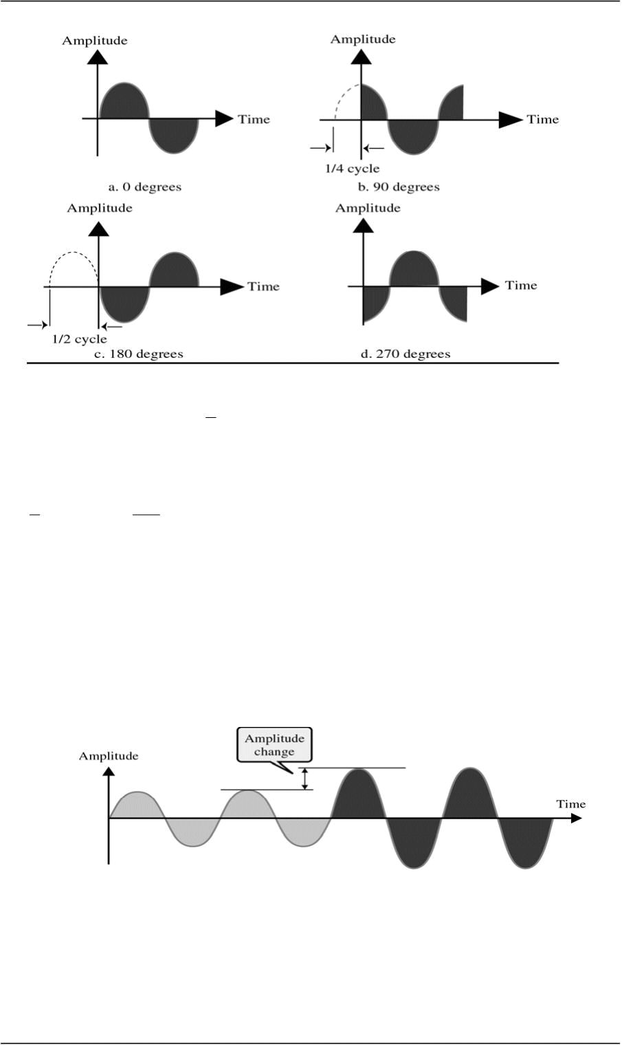
CS601-Data Communication VU
Problem 4.7
A sine wave is offset of a cycle with respect to time zero. What is its phase?
Solution
One Cycle = 360 Degrees
1 360
of a cycle = = 60 Degrees
6 6
Control of Signals
o Signal can be controlled by three attributes:
¾ Amplitude
¾ Frequency
¾ Phase
Control of Signals- Amplitude
Control of Signals- Frequency
© Copyright Virtual University of Pakistan
1
6

Slide 63
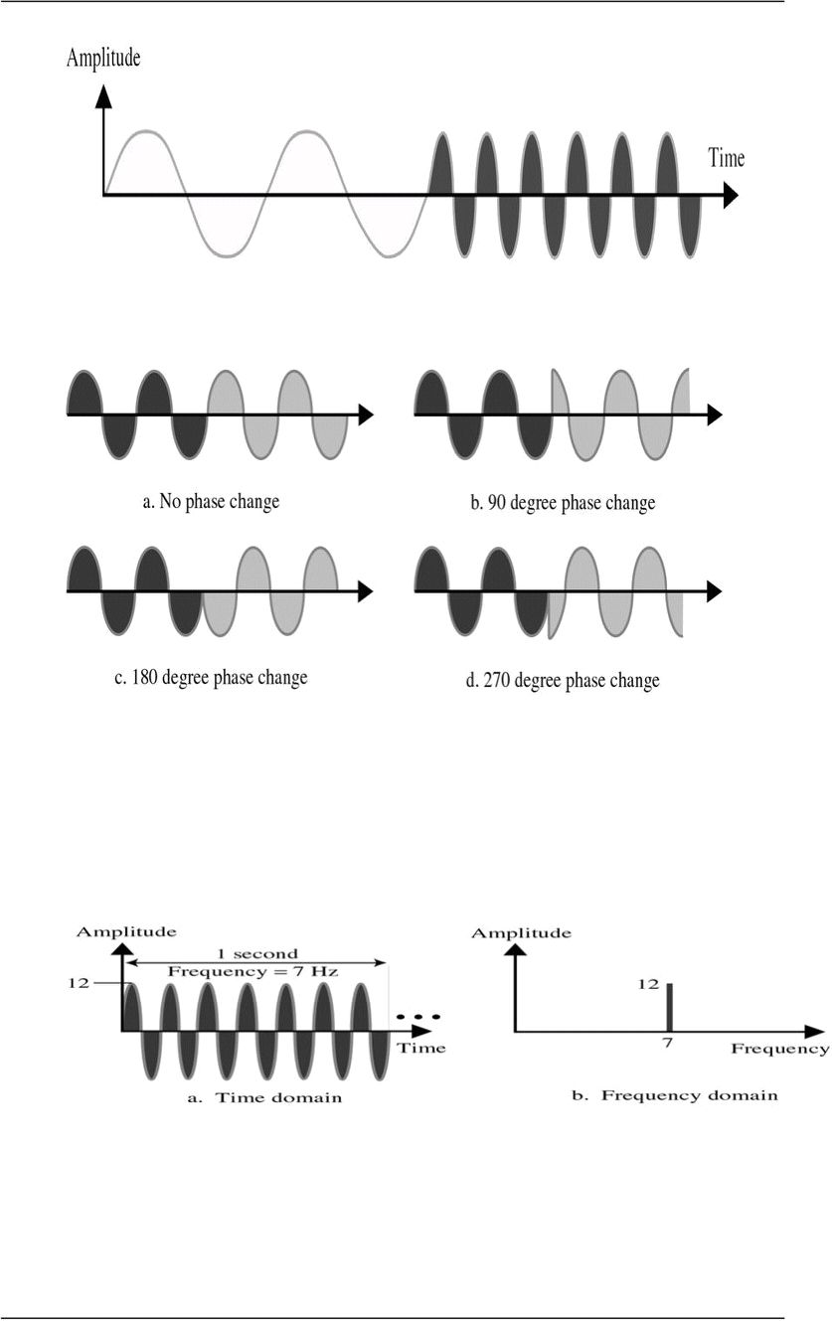
CS601-Data Communication VU
Control of Signals- Phase
Time and Frequency Domain
o Time Domain plots show changes in signal amplitude w.r.t Time
o It is an Amplitude versus Time Plot
o Phase and Frequency are not explicitly measured on a Time domain plot
o To show the relationship between amplitude and Frequency, we can use what is
called a Frequency Domain Plot
Time and Frequency Domain Example
© Copyright Virtual University of Pakistan

Slide 64
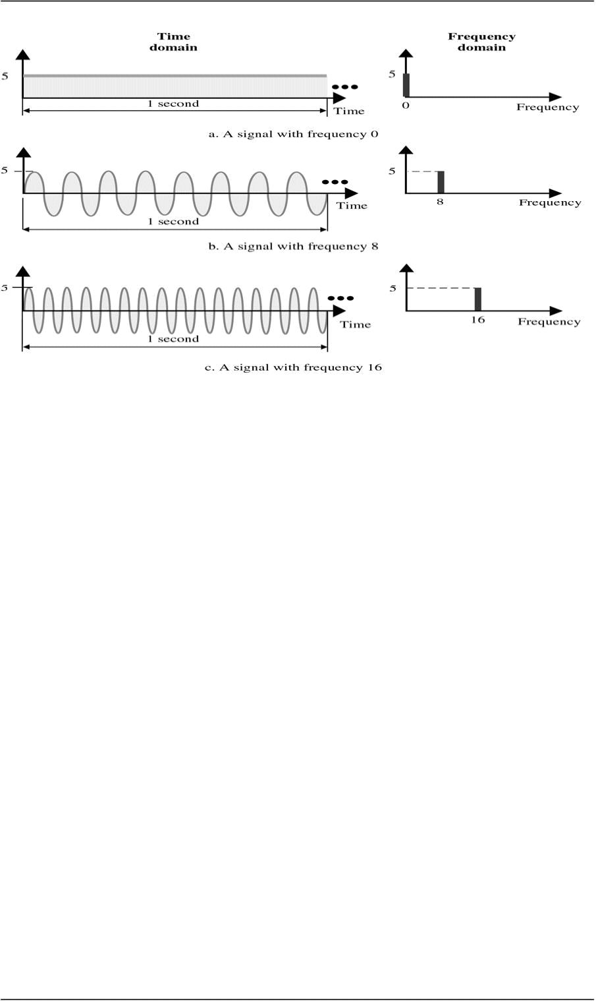
CS601-Data Communication VU
o Figure compares the time domain (instantaneous amplitude w.r.t Time) and the
Frequency domain (Max amplitude w.r.t Frequency)
o Low Frequency signal in frequency domain corresponds to a signal with longer period
in Time domain & vice versa.
o A signal changing rapidly in Time domain corresponds to High frequency in
Frequency domain
o Figure shows 3 signals with different frequencies and its time and frequency domain
presentations
Composite Signals
o Second type of Analog Signals, that is composed of multiple sine waves
o So far we have been focused on simple periodic signals or sine waves
o Many useful sine waves do not change in a single smooth curve b/w minimum and
maximum amplitude.
o They jump, slide , wobble and spikeAs long as as any irregularities are consistent,
cycle after cycle, a signal is still Periodic
o It can be shown that any periodic signal no matter how complex can be
decomposed into a collection of sine waves, each having a measurable amplitude,
frequency & phase
o We need FOURIER ANALYSIS to decompose a composite signal into its
components
© Copyright Virtual University of Pakistan

Slide 65
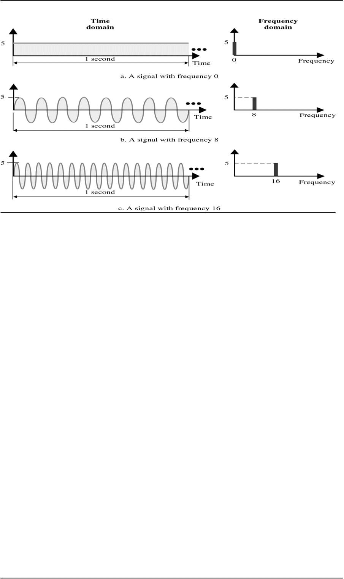
CS601-Data Communication VU
o Figure shows a periodic signal decomposed into two sine waves
o First sine wave (middle one) has a frequency of ‘6’ while the second sine wave has a
frequency of ‘0’
o Adding these two signals point by point results in the top graph
o Original signal looks like a sine wave that has its time axis shifted downward
o This shift is because of DC Component or zero frequency component in the signal
o If you look at the signal in time domain, a single point is there while in frequency
domain , two component freq.'s are there
Summary
 Sine Waves and its Characteristics
 Control of Signals
 Time and Frequency Domain
 Composite Signals
Reading Sections
 Section 4.4, 4.5 “Data Communications and Networking” 4th Edition by Behrouz
A. Forouzan
© Copyright Virtual University of Pakistan

Slide 66
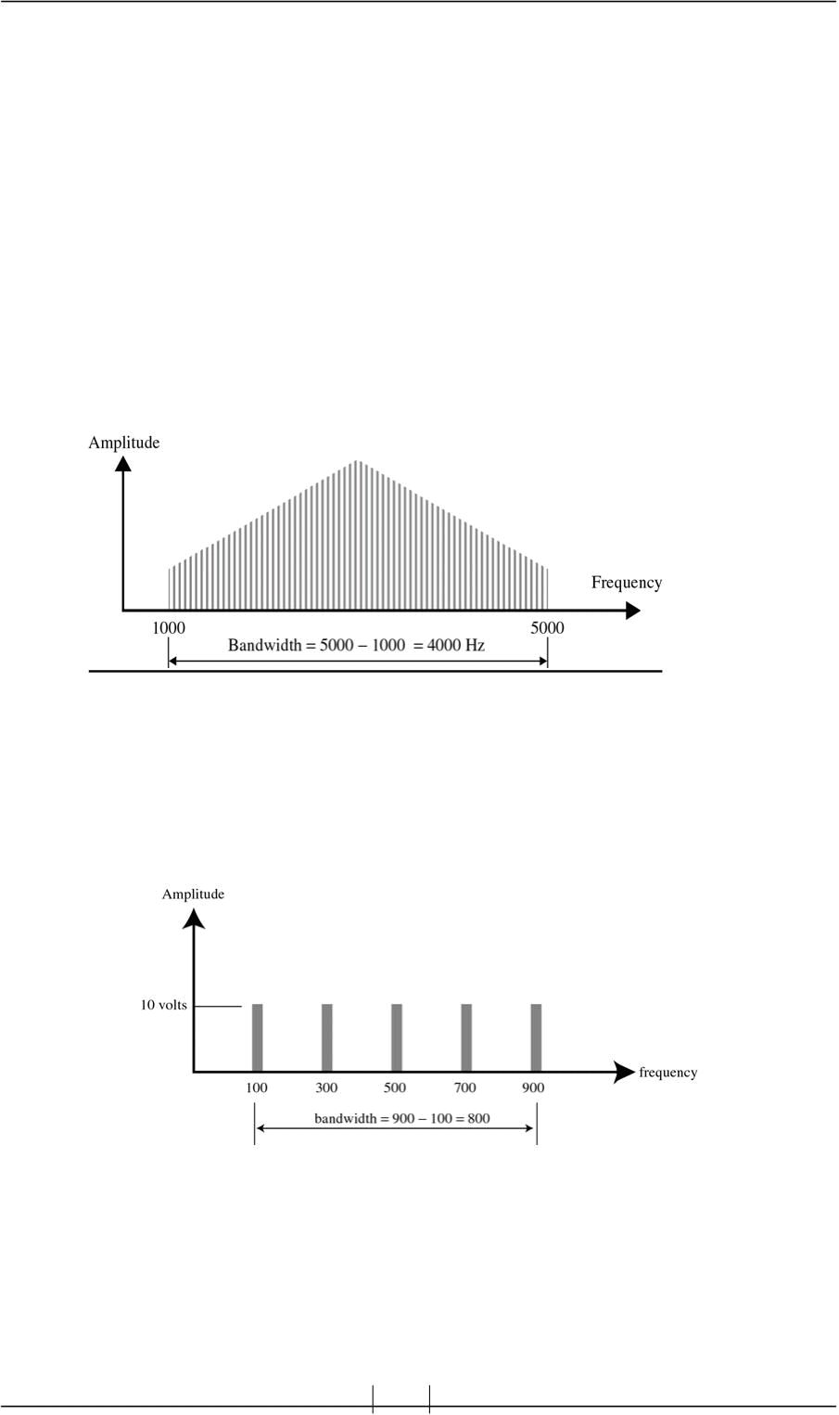
CS601-Data Communication VU
LECT URE #13
Frequency Spectrum / Bandwidth
o Frequency Spectrum: of a signal is the collection of all the component frequencies
it contains
o It is shown using a Frequency domain graph
o Bandwidth: of a signal is the width of the frequency spectrum
o In other words ,Bandwidth refers to the range of the component frequencies and
Frequency Spectrum refers to the elements within that range
How to calculate Bandwidth?
o To calculate Bandwidth, subtract the lowest frequency from the highest frequency
 SLIDE
Example 4.8
If a periodic signal is decomposed into five sine waves with frequencies 100, 300, 500,
700, and 900 Hz, what is the Bandwidth?
Solution
B = f −
 Other Definitions of Bandwidth
¾ 3 dB Bandwidth or Half Power Bandwidth
H ( f )
© Copyright Virtual University of Pakistan
h l
f = 900 −100 = 800Hz

Slide 67
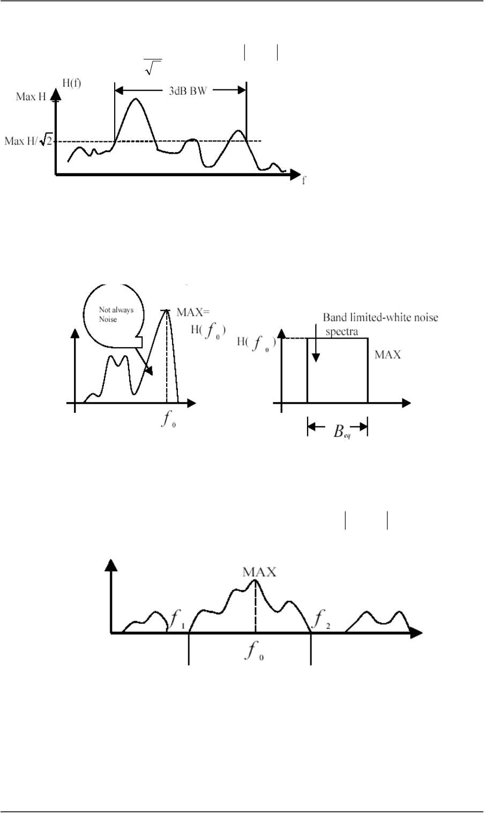
CS601-Data Communication VU
For the magnitude spectra of , the range of the spectrum that does not
fall lower than 1
2
¾ Equivalent Noise Bandwidth
The width of a fictitious rectangular spectrum created to have the same power
in the rectangular band as the power of the signal in positive frequencies
¾ Null-to-Null Bandwidth or Zero Crossing Bandwidth
If the maximum frequency in a spectrum is
below will be
o
Null Bandwidth 1 2
¾ Power Bandwidth
Frequency Band in which 99% of the total power resides
© Copyright Virtual University of Pakistan
H ( f )
f 1f f
o
and
,the first null above and
, where
f − f
2f
is the Null-to-

Slide 68
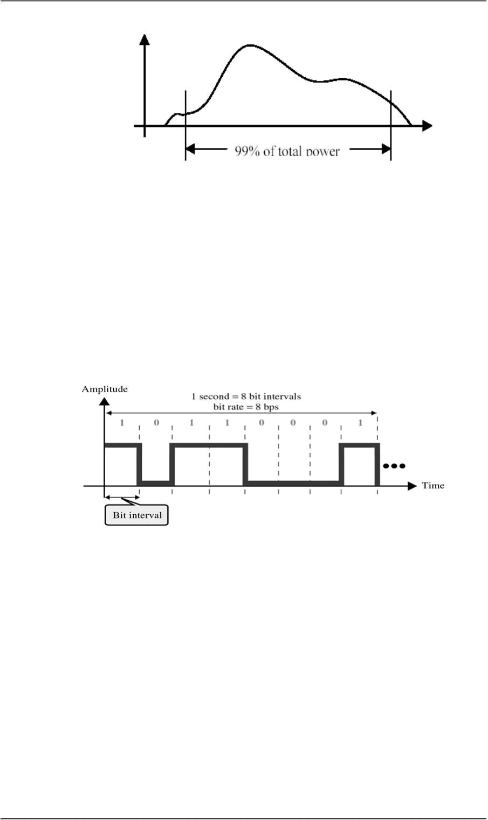
CS601-Data Communication VU
 Digital Signals
In addition to being represented by Analog Signals, data can also be represented
by a Digital signal
 Bit Interval and Bit Rate
Most digital signals are aperiodic and thus Period and Frequency are not the
appropriate terms to describe them
¾ Bit Interval (seconds)
9 Time required to send one single bit
¾ Bit Rate (bps)
9 Number of bits sent per second
Frequency Spectrum of a Digital Signal
o Frequency spectrum of a digital signal contains an infinite number of frequencies with
different amplitudes
o Ideally we want to send all the components but if we send only those components
whose amplitudes are significant , we can still recreate the digital signal with
reasonable accuracy at the receiver
© Copyright Virtual University of Pakistan

Slide 69
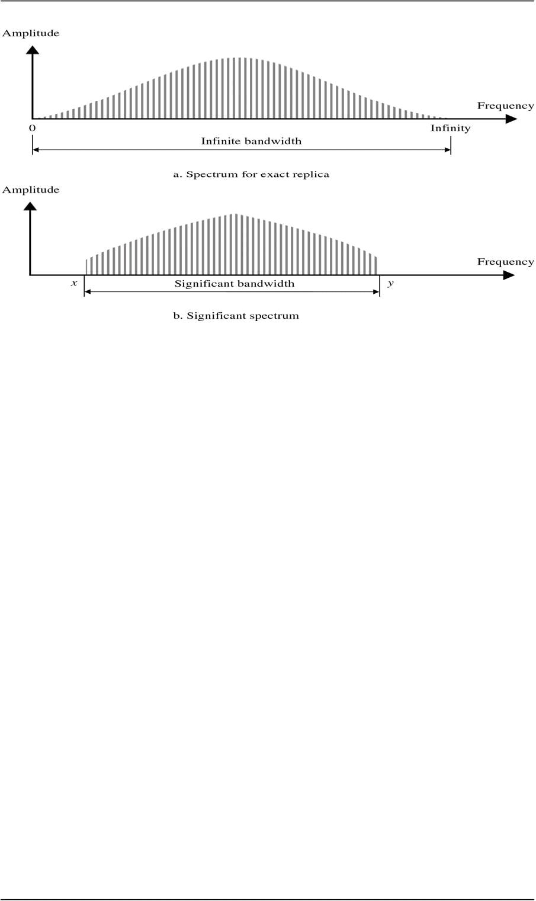
CS601-Data Communication VU
Summary
 Frequency Spectrum and Bandwidth
 Other Definitions of Bandwidth
 Digital Signals
Reading Sections
 Section 4.4, 4.5, 4.6 “Data Communications and Networking” 4th Edition by
Behrouz A. Forouzan
© Copyright Virtual University of Pakistan

Slide 70
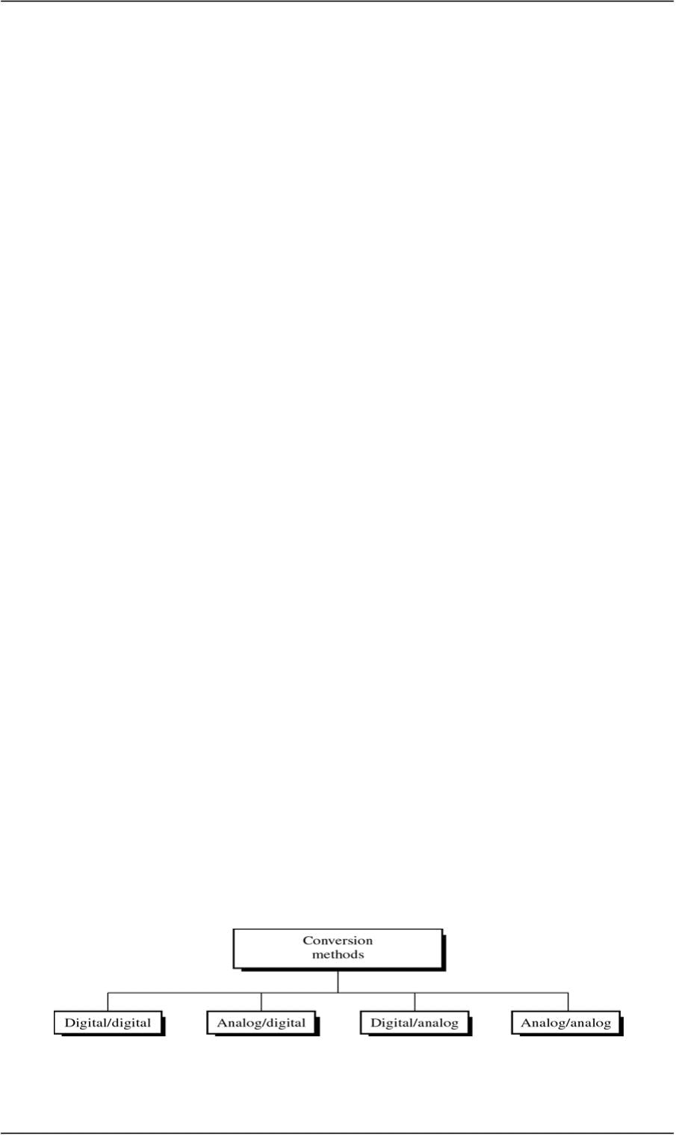
CS601-Data Communication VU
LECT URE #14
Conversions
Introduction
o Information must be transformed into signals before it can be transported across the
communication media
o How info is transformed depends on its original format and on the format used by the
communication device
o If you want to send a letter by a smoke signal, you need to know which smoke
patterns make which words in your message before building the fire
o Words are the Information and the puffs of smoke are representation of that
information
Introduction to the type of Conversions
o Data stored in the computer is in the form of 0’s and 1’s. To be carried from
one place to the other, data is usually converted to digital signals
o This is called “Digital-to-Digital Conversion” or “Encoding digital data into
digital signals”
o Sometimes we need to convert an analog signal to the digital signal
o For Example, conversion of Telephone conversation to digital signal for a no.
of different reasons such as to decrease the effect of noise
o This is called “Analog-to-Digital Conversion” or “Digitizing an Analog
Signal”
o We might want to send a digital signal coming out of computer through a
medium designed for analog signals
o For example, To send data from one place to the other using a Telephone line
o This is called “Digital-to-Analog Conversion” or “Modulating a digital
Signal”
o Often an analog signal is sent over long distances using analog media
o For Example, voice or music from a radio station which is an analog signal is
transmitted through the air, however the frequency of voice or music is not
suitable for this kind of Tx.
o The signal should be carried by a higher frequency signal
o This is called “Analog-to-Analog Conversion” or “Modulating an analog
Signal”
 Digital-to-Digital Conversion
o Digital-to-Digital conversion/encoding is the representation of digital
information by digital signal
© Copyright Virtual University of Pakistan
Types of Conversions

Slide 71
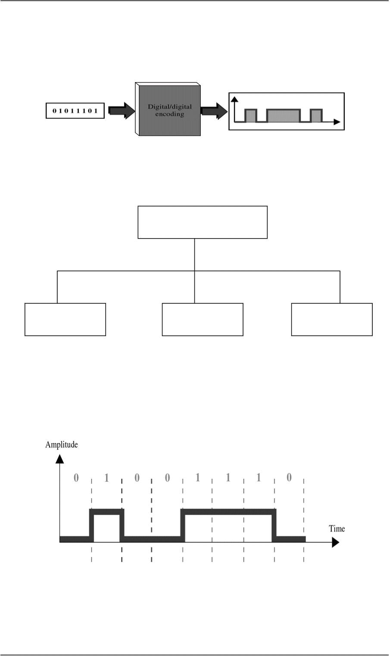
CS601-Data Communication VU
o For Example when you Tx data from Computer to the Printer, both original
and transmitted data have to be digital
o In this type of encoding, 1’s and 0’s generated by the computer are translated
into voltage pulses that can be propagated over the wire
o Figure shows the relationship between digital information, digital-to-digital
encoding hardware , and the resultant digital signal
Types of Digital-to-Digital Encoding
Digital/Digital Encoding
Unipolar Polar Bipolar
 UNIPOLAR
¾ Encoding is simple , with only one technique in use
¾ Simple and Primitive
¾ Almost Obsolete Today
¾ Study provides introduction to concepts and problems involved with more
complex encoding systems
o Digital Transmission system works by sending voltage pulses on
the Tx. Medium
o One voltage level stands for binary 0 while the other stands for
binary 1
o It is called Unipolar because it uses only one polarity
© Copyright Virtual University of Pakistan

Slide 72
CS601-Data Communication VU
o This polarity is assigned to to one of the two binary states usually a
‘1’
o The other state usually a 0 is represented by zero voltage
o Figure shows the idea: 1’s are encoded as +ve values, and 0’s are
encoded as –ve values
Pros and Cons of Unipolar Encoding
• PROS
– Straight Forward and Simple
– Inexpensive to Implement
• CONS
– DC Component
– Synchronization
DC Component
o Average Amplitude of a unipolar encoded signal is non-zero
o This is called DC Component I.e. a component with zero
frequency
o When a signal contains a DC Component, it cannot travel
through a Tx. Medium that cannot handle DC components
Synchronization
o When the signal is unvarying, Rx. Cannot determine the beginning
and ending of each bit
o Synchronization Problem can occur when data consists of long
streams of 1’s or 0’s
o Therefore, Rx has to rely on a TIMER
o Consider we have a bit rate of the signal to be 1000bps
 1000 bits in 1 second
 1 bit in 0.001 second
o So if a +ve voltage lasts 0.005 sec, it reads five 1’s
o Sometimes it stretches to 0.006 seconds and an extra one bit is read
by the Rx
 Solution:
– Separate Parallel Line
o Carries a clock pulse and allows receiver to resynchronize its timer
to that of the signal
o Doubling no. of Tx lines increase Cost and proves uneconomical
 POLAR
Encoding has 3 subcategories:
¾ Non Return to Zero (NRZ),-- Return to Zero (RZ)
¾ Bi phase
¾ Two of which have multiple variations of their own
¾ Polar encoding uses two voltage levels
–One positive and one negative
© Copyright Virtual University of Pakistan

Slide 73

CS601-Data Communication VU
¾ By using two voltage levels, average voltage level on the line is reduced
and DC Component problem of unipolar encoding is alleviated
Types of Polar Encoding
Non Return to Zero (NRZ)
o In NRZ Encoding, the level of signal is either positive or negative
NRZ
NRZ-L NRZ-I
o NRZ-L
Level of the signal depends on the type of bit it represents
A +ve voltage usually means the bit is a 1 and a –ve voltage means the
bit is a 0 (vice versa)
Problem with NRZ-L: When long streams of 0’s or 1’s are there in
data, Rx receives a continuous voltage and should determine how many
bits are sent by relying on its clock , which may or may not be
synchronized with the sender clock
o NRZ-I
The inversion of the level represents a 1 bit
© Copyright Virtual University of Pakistan

Slide 74

CS601-Data Communication VU
A bit 0 is represented by no change
NRZ-I is superior to NRZ-L due to synchronization provided by signal
change each time a 1 bit is encountered
The string of 0’s can still cause problem but since 0’s are not as likely,
they are less of a problem
Summary
 Introduction to the Encoding Techniques
 Digital-To-Digital Encoding
 Types of Digital-To-Digital Encoding
 UniPolar Encoding
 Polar Encoding
– NRZ
Reading Sections
 Section 5.1, “Data Communications and Networking” 4th Edition by Behrouz A.
Forouzan
© Copyright Virtual University of Pakistan

Slide 75

CS601-Data Communication VU
LECT URE #15
Conversions
 Return to Zero (RZ)
o Any time, data contains long strings of 1’s or 0’s, Rx can loose its timing
o In unipolar, we have seen a good solution is to send a separate timing
signal but this solution is both expensive and full of error
o A better solution is to somehow include synch in encoded signal somewhat
similar to what we did in NRZ-I but it should work for both strings of 0 &
1
o One solution is RZ encoding which uses 3 values : Positive, Negative and
Zero
o Signal changes not b/w bits but during each bit
o Like NRZ-L , +ve voltage means 1 and a –ve voltage means 0, but unlike
NRZ- L, half way through each bit interval, the signal returns to zero
o A 1 bit is represented by positive to zero and a 0 is represented by negative
to zero transition
o The only problem with RZ encoding is that it requires two signal changes
to encode one bit and therefore occupies more BANDWIDTH
o But of the 3 alternatives we have discussed, it is most effective
• Biphase Encoding
o Best existing solution to the problem of Synchronization
o Signal changes at the middle of bit interval but does not stop at zero
o Instead it continues to the opposite pole
Biphase Encoding
Manchester Differential Manchester
© Copyright Virtual University of Pakistan

Slide 76

CS601-Data Communication VU
 Manchester
o Uses inversion at the middle of each bit interval for both synchronization and bit
representation
Negative-to-Positive Transition= 1
Positive-to-Negative Transition = 0
By using a single transition for a dual purpose, Manchester
acheives the same level of synchronization as RZ but with only two
levels of amplitude
 Differential Manchester
o Inversion at the middle of the bit interval is used for Synchronization but
presence or absence of an additional transition at the beginning of bit interval
is used to identify a bit
o A transition means binary 0 & no transition means binary 1
o Requires 2 signal changes to represent binary 0 but only one to represent
binary 1
• Bipolar Encoding
o Like RZ, it uses three voltage levels:
o Unlike RZ, zero level is used to represent binary 0
o Binary 1’s are represented by alternate positive and negative voltages
Types of Bipolar Encoding
© Copyright Virtual University of Pakistan

Slide 77

CS601-Data Communication VU
¾ Alternate Mark Inversion (AMI)
9 Simplest type of Bipolar Encoding
9 Mark Æ Comes from Telegraphy (1)
9 Alternate Mark Inversion means Alternate ‘1’ Inversion
9 Pseudoternary
9 By inverting on each occurrence of 1, AMI accomplishes 2 things:
–The DC component is zero
–Long sequence of 1’s stay synchronized
9 No mechanism of ensuring synch is there for long stream of 0’s
o Two variations are developed to solve the problem of synchronization of sequential
0’s
–HDB3 Æ used in Europe & Japan
o Both modify original pattern of AMI only on case of long stream of zeroes
B8ZS
Convention adopted in North America to provide synch for long string of
zeros
Difference b/w AMI and B8ZS occurs only when 8 or more consecutive
zeros are encountered
Forces artificial signal changes called VIOLATIONS
Each time eight 0’s occur , B8ZS introduces changes in pattern based on
polarity of previous 1 (the ‘1’ occurring just before zeros)
© Copyright Virtual University of Pakistan
–B8ZS Æ used in North America

Slide 78

CS601-Data Communication VU
HDB3
Alteration of AMI adopted in Europe and Japan
Introduces changes into AMI, every time four consecutive zeros are encountered
instead of waiting for eight zeros as in the case of B8ZS
As in B8ZS, the pattern of violations is based on the polarity of the previous 1 bit
Unlike B8ZS, HDB3 also looks at the no. of 1’s that have occurred since the last
substitution
Summary
 Types of Digital-To-Digital Encoding
 Polar Encoding
– Return to Zero (RZ) Encoding
– Biphase Encoding
 Bipolar Encoding
Reading Sections
 Section 5.1, “Data Communications and Networking” 4th Edition by Behrouz A.
Forouzan
© Copyright Virtual University of Pakistan

Slide 79

CS601-Data Communication VU
LECT URE #16
Conversions
Types of Digital-to-Digital Encoding
Digital/Digital Encoding
Unipolar Polar Bipolar
Example 5.1
 Using B8ZS, encode the bit stream 10000000000100. Assume that the polarity of
the first 1 is positive.
 Analog-to-Digital Conversion
o We sometimes need to digitize an analog signal
o To send human voice over a long distance, we need to digitize it, since
digital signals are less prone to Noise
o This is called Analog-to-Digital Conversion or Digitizing an Analog
Signal
o This type of conversion requires a reduction of potentially infinite number
of values in the analog signal so that it can be converted to digital bit
stream with minimum loss of information.
© Copyright Virtual University of Pakistan

Slide 80

CS601-Data Communication VU
o CODEC Æ Coder Decoder
o Digital signal signals can take any of the forms discussed previously
o Problem is how to convert analog signal from infinite number of values to
discrete no. of values without scarifying quality
¾ Pulse Amplitude Modulation
o First step in Analog-to-Digital Conversion
o This technique takes an Analog signal, Samples it, and Generates a series
series of Pulses based on the results of Sampling
o Sampling means measuring amplitudes of signal at equal intervals
o The original signal is sampled at equal intervals
o PAM uses a technique called Sample & Hold means At a given moment ,
signal level is read, then held briefly
o The pulses are of any amplitude (still analog not digital). To make them
digital, we need PCM
¾ Pulse Code Modulation
o Modifies pulses created by PAM to a complete digital signal
o Four Separate Processes:
9 PAM
9 Quantization
9 Binary Encoding
9 Digital/Digital Encoding
9 Quantization
PCM’s first step is Quantization
“Quantization is a method of assigning integral values in a
specific range to sampled instances”
© Copyright Virtual University of Pakistan

Slide 81

CS601-Data Communication VU
Figure shows a simple method of assigning sign and magnitude
values to quantized samples
9 Results of Binary Encoding
Each value is translated into its seven bit binary equivalent. The
eight bit indicates the sign
¾ Result of PCM
Figure shows the result of PCM of original signal encoded finally into
a unipolar signal
Only first 3 values are shown
¾ Full PCM Process
© Copyright Virtual University of Pakistan

Slide 82

CS601-Data Communication VU
¾ Sampling Rate
o The accuracy of any digital reproduction of an analog signal depends upon
the o. of samples taken
o How many samples are sufficient?
o <Nyquist theorem>
The sapling rate must be at least twice the highest
frequency
© Copyright Virtual University of Pakistan

Slide 83
CS601-Data Communication VU
¾ Bit Rate
o Sampling Rate given by Nyquist Theorum
o No. of bits per sample chosen according to the Precision needed at the
receiver end.
BitRate = SamplingRate ⋅ No.ofbits / sample
Summary
 Analog-to-Digital Conversion
 Pulse Code Modulation (PCM)
– Pulse Amplitude Modulation (PAM)
– Quantization
– Binary Encoding
– Digital-To-Digital Conversion
Reading Sections
 Section 5.2, “Data Communications and Networking” 4th Edition by Behrouz A.
Forouzan
© Copyright Virtual University of Pakistan

Slide 84

CS601-Data Communication VU
LECT URE #17
Conversion
Digital To Analog Conversion
o Process of changing one of the characteristics of an analog signal based on the info in
a digital signal
o When you Tx data from one computer to the other using a public telephone line
o Original data is digital but because telephone wires carry analog signal, original data
must be converted
o Digital data must be modulated on an analog signal that has been manipulated to look
like two distinct values corresponding to binary 1 to binary 0
o Figure shows the relationship b/w digital info the digital to analog conversion
hardware & resultant analog signal
 Variation in Characteristics of Sine Wave
o A sine wave is defined by 3 characteristics:
¾ Amplitude
¾ Frequency
¾ Phase
o By changing one aspect of a simple electrical signal back &
forth,we can use it to represent digital data
o When we vary any one of these characteristics ,we create a second version of
that wave
o If we than say that the original wave represents binary 1,the variation can
represent binary 0 or vice versa
o So by changing one aspect of a simple electrical signal back & forth,we can
use it to represent digital data
 Mechanisms for Modulating Digital Data to Analog Signals
o Any of the three characteristics listed above can be altered in this way, giving
us at least 3 mechanisms for modulating digital data into analog signals
¾ Amplitude shift keying(ASK)
¾ Frequency shift keying(FSK)
¾ Phase shift keying (PSK)
© Copyright Virtual University of Pakistan

Slide 85

CS601-Data Communication VU
• Fourth Mechanism
o In addition, there is a fourth and better mechanism that combines
changes in both amplitude and phase called Quadratue Amplitude
Modulation(QAM)
o QAM is the most efficient of these options and is the mechanism used
in all modern modems
Types of digital to analog modulation
• Aspects of Digital to Analog Conversion
o Before we discuss specific methods of digital to analog modulation,two
basic issues must be defined:
¾ Bit/Baud rate
¾ Carrier signal
¾ Bit Rate & Baud Rate
o Two terms used frequently in data communication
–Bit rate
–Baud rate
Bit rate: no of bits transmitted during one second
Baud rate: no of signal units per second that are required
to represent that bit
Bit Rate & Baud Rate
o In discussion of computer efficiency, bit rate is more important –we want to
know how long it takes to process each piece of info
o In data transmission, however ,we are more concerned with how efficiently we
can more that data from place to place, whether in pieces or blocks
o The fewer signal units required, the most efficient the system and less
bandwidth required to transmit more bits ,so we are more concerned with baud
rate
o The baud rate determines the B.W required to send the signal
Relationship b/w bit rate &band rate
© Copyright Virtual University of Pakistan

Slide 86

CS601-Data Communication VU
o Bit rate equals the baud rate times the no. of bits represented by each signal
units
o The baud rate equals the bit rate divided by the no. of bits represented by each
signal shift
o Bit rate is always greater than or equal to Baud rate
 Analogy for Bit rate &Baud rate
o In transportation a band is analogous to a car,a bit is analogous to a
passenger
o A car can carry one or more passengers
o If1000 cars can go from one point to another carrying only one
passenger(only driver),than 1000 passengers are transported
o However, if each car carries four passengers, then 4000 passengers are
transported
o Note that the number of cars, not the numbers of passengers
determines the traffic and therefore the need for wider highway
o Similarly, the baud determines the required bandwidth, not the bit rate
Example 5.6
An analog signal carries 4 bits in each signal element.If 1000 signal elements are sent per
second, find the Baud Rate and Bit Rate?
Solution:
–Baud Rate =1000 bauds/second
–Bit Rate=Baud Rate * Number of bits per signal element
–Bit Rate= 1000 * 4 = 4000 bps
 Carrier Signals
o In analog TX. The sending device produces a high frequency signal, that acts as a
basis for the information signal
o This base signal is called the Carrier Signal or Carrier Frequency
o The receiving device is tuned to the frequency of the carrier signal that it expects
from the sender
o I=Digital info is then modulated on the carrier signal by modifying one or more of
its characteristics (Amplitude, Frequency, Phase)
o This kind of modification is called Modulation and info signal is called a
Modulating Signal
 Amplitude Shift Keying (ASK)
o In ASK, the strength of carrier signal is varied to represent binary 1 or 0
o Both frequency and phase remain constant, while the amplitude changes
o Which voltage represents 1 and which represents 0 can be chosen by
System Designer
o A bit duration is the period of time that defines one bit
o The peak amplitude of the signal during each bit duration is constant and
its value depends on the bit (1 or 0)
© Copyright Virtual University of Pakistan
–Baud Rate= Number of Signal Elements

Slide 87

CS601-Data Communication VU
o Speed of transmission during ASK is limited by the physical
characteristics of Tx. Medium
Effect Of Noise on ASK
o ASK is highly susceptible to noise interference
o NOISE: Unintentional voltages introduced onto a line by various sources such
as Heat or Electromagnetic Radiation from other sources
o These unintentional voltages combine with signal to change the amplitude
o A 1 can be changed to 0 and a 0 to a 1
o ASK relies solely on Amplitude for recognition
o Noise usually affects the amplitude, therefore ASK is the modulating method,
that is most affected by Noise
¾ On-Off Keying (OOK)
o A popular ASK Technique
o In OOK, one of the bit values is represented by no voltage
o The advantage is the reduction in the amount of energy required to
transmit Information
¾ Bandwidth for ASK
o Bandwidth of a signal is total range of frequencies occupied by that
signal
o When we decompose an ASK modulated signal, we get a spectrum of
many simple frequencies
o The most significant ones are those b/w, fc-Nbaud/2 and fc+Nbaud /2
with carrier frequency fc at the middle
o Bandwidth requirements for ASK are calculated using the formula:
© Copyright Virtual University of Pakistan

Slide 88
CS601-Data Communication VU
o BW=(1+d) * Nbaud
o BW = Bandwidth
o Nbaud= Baud Rate
o d= factor related to condition of line (min.value = 0)
Example 5.8
Find minimum bandwidth required for an ASK signal TX at 2000 bps. TX. Mode is half
duplex
Solution:
–In ASK, Baud Rate= Bit Rate
–Therefore, Baud Rate = 2000
–Also ASK requires a minimum bandwidth equal to its Baud Rate
–Therefore Minimum BW = 2000 Hz
Summary
 Digital-to Analog Conversion
 Bit Rate and Baud Rate
 Carrier Signals
 Amplitude Shift Keying (ASK)
Reading Sections
 Section 5.3, “Data Communications and Networking” 4th Edition by Behrouz A.
Forouzan
© Copyright Virtual University of Pakistan

Slide 89

CS601-Data Communication VU
LECT URE #18
 Frequency Shift Keying (FSK)
o Frequency of signal is varied to represent binary 1 or 0
o The frequency of the signal during each bit duration is constant and depends
on the bit (0 or 1)
o Both peak amplitude and phase remains constant
Effect of Noise on FSK
o Avoids most of the Noise problems of ASK
o Because Rx device is looking for specific frequency changes over a given
number of periods, it can ignore voltage spikes
o The limiting factors of FSK are the physical capabilities of the carrier
¾ BW of FSK
o Although FSK shifts between two carrier frequencies, it is easier to analyze as two
co-existing frequencies
o BW required for FSK is equal to the Baud rate of the signal plus the frequency
shift
o Frequency Shift=Difference b/w two carrier frequencies
o BW= (fc1 – fc0) +Nbaud
© Copyright Virtual University of Pakistan

Slide 90

CS601-Data Communication VU
Example 5.11
Find the minimum BW for an FSK signal transmitted at 2000 bps. TX is in half duplex
mode and carrier must be separated by 3000 Hz
Solution:
For FSK, if fc1 and fc2 are the carrier frequencies, then:
BW=Baud Rate + (fc1 – fc0)
Baud rate is the same as bit rate
BW=2000 + (fc1 – fc0) = 2000 + 3000 = 5000 Hz
 Phase Shift Keying (PSK)
o In PSK, phase of carrier is varied to represent binary 1 or 0
o Both peak amplitude and frequency remains constant as the phase changes
o For Example: if we start with a phase of 0 degrees to represent binary 0 , then
we can change the phase to 180 degrees to send binary 1
o The phase of signal during duration is constant and its value depends upon the
bit (0 or
¾ 2PSK
9 The above method is often called 2 PSK, or Binary PSK, because two
different phases ( 0 and 180 degrees) are used
9 Figure makes this point clear by showing the relationship of phase to
bit value
9 A second diagram called constellation diagram or phase state diagram
shows same relationship by illustrating only the phases
Effect of Noise on PSK
o PSK is not susceptible to the noise degradation that affects ASK, nor to the
bandwidth limitations of FSK
o Smaller variations in signal can be detected reliably by the receiver
¾ 4PSK
© Copyright Virtual University of Pakistan

Slide 91

CS601-Data Communication VU
o Based on the above two facts, instead of utilizing only two variations of a
signal, each representing one bit, we can use four variations and let each phase
shift represent two bits
¾ 4PSK
¾ BW for PSK
o Minimum bandwidth required for PSK transmission is the same
as ASK
o As we have seen max bit rate in PSK is much greater than that
of ASK
o So while max baud rate of ASK and PSK are the same for a
given BW, PSK bit rate using the same BW can be two or more
times greater
¾ 8 PSK
© Copyright Virtual University of Pakistan

Slide 92

CS601-Data Communication VU
QAM
• Limitations of PSK:
–PSK is limited by the ability of the equipment to distinguish small
differences in phase
–This factor limits its potential bit rate
–So far we have been changing only of the characteristics of the sine
wave, But what if we alter two
o What should these two characteristics be?
o BW limitations make combination of FSK with other changes practically useless
o Why not combine ASK and PSK?
o ‘x’ variation in phase and ‘y variations in amplitude result into a total of x * y
variations and corresponding no. of bits per variation
Quadrature Amplitude Modulation (QAM)
¾ Variation of QAM
o Variations of QAM are numerous
o Any measurable amount changes in amplitude can be combined with any measurable
no. of changes in Phase
¾ 4 QAM & 8 QAM (Figure)
o In both case no. of amplitude shifts is more than the no. of phase shifts
o Because amplitude changes are susceptible to Noise , number of phase
shifts used by QAM is always larger than the amplitude shifts
© Copyright Virtual University of Pakistan

Slide 93

CS601-Data Communication VU
Time domain plot of 8 QAM
Three possible variations of 16 QAM
¾ Bandwidth for QAM
o BW required for QAM is the same as in the case of
ASK and PSK
o QAM has the same advantages as PSK over ASK
o Bit Baud Comparison
Bit Baud Comparison
Consult book section 5.3
Example 5.11
A constellation diagram consists of eight equally spaced points on a circle. If bit rate is
4800 bps, what is the Baud Rate?
Solution:
Constellation indicates 8 PSK with the points 45 degree apart
Baud Rate= 4800 / 3 = 1600 baud
© Copyright Virtual University of Pakistan

Slide 94
CS601-Data Communication VU
Summary
 Digital-to Analog Conversion
 Frequency Shift Keying (FSK)
 Phase Shift Keying (PSK)
 Quadrature Amplitude Modulation (QAM)
Reading Sections
 Section 5.3, “Data Communications and Networking” 4th Edition by Behrouz A.
Forouzan
© Copyright Virtual University of Pakistan

Slide 95

CS601-Data Communication VU
LECT URE #19
Conversions
 Analog To Analog Conversion
o Representation of Analog information by an Analog signal
o For Example: Radio
¾ Analog To Analog Conversion Methods
Amplitude Modulation (AM)
o Amplitude of carrier signal is changed according to the amplitude of
modulating signal
o Frequency and phase of the carrier remain the same
9 AM Bandwidth
Bandwidth of AM signal (modulated signal) = 2 * bandwidth of
modulating signal
Significant spectrum of AM audio = 5 KHz
⇒ 10 KHz bandwidth for an AM station
© Copyright Virtual University of Pakistan

Slide 96

CS601-Data Communication VU
AM Band Allocation
Example 5.18
We have an audio signal with a BW of 4 KHz. What is the BW needed, if we modulate
the signal using AM?
Solution:
–BW = 2 * 4 KHz = 8 KHz
Frequency Modulation (FM)
o Frequency of carrier signal is changed according to the amplitude of
modulating signal
o Amplitude and Phase of the carrier signal remain constant
© Copyright Virtual University of Pakistan
–AM signal requires twice the BW of original signal

Slide 97

CS601-Data Communication VU
9 FM Bandwidth
Bandwidth of FM signal (modulated signal) = 10 * bandwidth
of modulating signal
Significant spectrum of FM audio = 15 KHz
⇒ Minimum 150 KHz bandwidth
FM Band
FM Band Allocation
Example 5.19
We have an Audio signal with a BW of 4 MHz. What is the BW needed if we modulate
the signal using FM?
Solution:
–BW = 10 * 4 MHz = 40 MHz
Phase modulation (PM)
o Simpler hardware requirements
o Phase is modulated with the amplitude
o Amplitude & Frequency of the carrier signal remain constant
Summary
 Analog-to Analog Conversion
 Frequency Shift Keying (FSK)
 Phase Shift Keying (PSK)
 Quadrature Amplitude Modulation (QAM)
Reading Sections
 Section 5.4, “Data Communications and Networking” 4th Edition by Behrouz A.
Forouzan
© Copyright Virtual University of Pakistan

Slide 98

CS601-Data Communication VU
LECT URE #20
Introduction
Q: How do we relay encoded data from the generating device to the next device?
A: Interface
–Defined by several popular standards
–Physical layer of the OSI model
–Mechanical/electrical/functional specifications
 Digital Data Transmission
Do we send one bit at a time or do we group bits into larger groups and if so,
How?
• Parallel Transmission
o Binary data consisting of 1s and 0s may be organized into groups of ‘n’ bits each
o By grouping we can send data ‘n’ bits at a time instead of one bit
• Serial Transmission
o One bit follows another, so we need only one channel rather than ‘n’ to
transmit data between two devices
o Conversion devices are required at the interface
© Copyright Virtual University of Pakistan

Slide 99

CS601-Data Communication VU
¾ Advantage
–COST
 Types of Serial Transmission
There are two types of Serial Transmission:
–Asychronous Transmission
–Synchronous Transmission
Asynchronous Transmission
o It is so named because the timing of the signal is unimportant. Instead information is
received and translated by agreed upon patterns
o Start and Stop Bits
Asynchronous Transmission
Advantages
–Cheap
–Effective
Disadvantages
Synchronous Transmission
Data is transmitted as an unbroken string of 1’s and 0’s and the receiver separates that
string into the bytes or characters it need to reconstruct the information
© Copyright Virtual University of Pakistan
–Slow

Slide 100

CS601-Data Communication VU
Synchronous Transmission
Advantage
–Speed
Summary Introduction to Interfaces

Parallel Transmission
Serial Transmission
Asynchronous Transmission
Synchronous Transmission
Reading Sections
Section 6.1,6.2, “Data Communications and Networking” 4th Edition by
Behrouz A. Forouzan
© Copyright Virtual University of Pakistan
Digital Data Transmission

Slide 101

CS601-Data Communication VU
LECT URE #21
DTE-DCE Interface
o There are 4 basic functional units involved in communication of data:
–A DTE and DCE on one end
–A DTE and DCE on the other end
¾ DTE: Any device that is a source of or destination of digital data
¾ DCE: Any device that transmits/receives signal through network
o The DTE generates the data and passes it along with any control information to a
DCE
o The DCE converts the signal to a format appropriate to the TX medium and
introduces it onto the network link
o When the signal arrives at the receiving end this process is reversed
¾ DTE
o DTE includes any unit that functions either as a source of or as a
destination for binary digital data
o At the physical layer, it cab a terminal, microcomputer, computer ,
printer or any other device that generates or consumes digital data
o DTEs do not often communicate with each other directly with each
other
o Think of DTE as your Brain.
o Your and your friends brains are DTEs
o The vocal chords or mouth are DCEs
o Air is TX Meduium
¾ DCE
o DCE includes any functional unit that transmits or receives data in the
form of an analog or digital signal through a network
o At the physical layer, a DCE takes data generated by a DTE, converts
it to the appropriate signal and then introduces it to the comm link
o Commonly used DCEs at the physical layer include MODEMS
© Copyright Virtual University of Pakistan

Slide 102

CS601-Data Communication VU
o In any n/w , a DTE generates digital data and passes it on to a DCE,
the DCE converts the data to a form acceptable to the TX medium and
sends the converted signal to another DCE on the network
o The second DCE takes the signal off, converts it to a suitable form for
its DTE and delivers it
o To make this communication possible, the sending and receiving DCEs
must use the same modulation method
The two DTEs need not be coordinated with each other but they need to be coordinated
with their respective DCEs and the DCEs must be coordinated so that data translation
occurs w/o loss of integrity
 Standards
Many standards have been developed to define the connection b/w the DTE and a
DCE
o Though the solution differ, each standard provides a model for mechanical,
electrical and functional characteristics of the connection
o Electronic Industries Organization (EIA) and ITU-T
 EIA 232 Interface
o Standard developed by EIA
o Defines Mechanical, Electrical and Functional characteristics of the interface
b/w DTE and a DCE
o Originally issued in 1962 as the RS 232 standard
o Revised several times, recent version EIA 232-D
o Defines not only the type of connectors to be used but also the specific cable
and plugs and the functionality of each pin
¾ Mechanical Specifications
o EIA 232 standard defines interface as a 25-wire cable with a male and a
female DB 25 pin connector attached to either end.
o The length of the cable may not exceed 15 meters(50 feet)
o A DB 25 connector is a plug with 25 pin or receptacles each of which is
attached to a single wire with a specific function
o With this design, EIA has created the possibility of 25 separate interactions
b/w a DTE and a DCE
o Fewer are actually used but standard allows for future inclusion of
functions
© Copyright Virtual University of Pakistan

Slide 103

CS601-Data Communication VU
o EIA 232 calls for a 25 wire cable terminated at one end by by a male
connector and at the other end by a female connector
o Male refers to a plug with each wire in the cable attaching to a pin
o Female refers to a receptacle with each wire in cable connecting to a metal
tube or sheath
¾ Electrical Specifications (Sending data)
o EIA 232 states that data must be tx as binary 1’s and 0’s using NRZ-L
encoding with 0 defines as a positive and 1 defined as a negative voltage
o However rather than defining a single range bounded by highest and
lowest amplitudes, EIA 232 defines two distinct ranges , one for +ve
voltages and one for -ve
o The receiver accepts any voltage that falls within these ranges as valid
signals
o To be recognized as data, the amplitude of the signal must fall b/w 3 and
15 volts or b/w –3 and –15 volts
o Degradation of noise will in misinterpretation of bits
o A square wave is shown to be converted into a curve by noise and it covers
many voltages
o If the rx were looking for a fixed voltage, or only for pulses that held a
single voltage for their entire duration,degradation would have made it
unrecoverable.
• Electrical Specifications
(Control & Timing)
o Only 4 wires out of 25 in EIA 232 are used for data functions.
o Remaining 21 are reserved for functions like Control, Timing,
Grounding and Testing
o Any of the functions is considered ON if it transmits a voltage of
atleast +3 and OFF if it tx a voltage with a value less than -3
o The specification for control signals is conceptually reversed from
that for data transmission
o A positive voltage means ON and a negative voltage means OFF
© Copyright Virtual University of Pakistan

Slide 104

CS601-Data Communication VU
• Electrical Specifications
(BIT rate)
o A final important function of electrical specifications is definition
of Bit Rate
o EIA 232 allows for a maximum bit rate of 20Kbps although in
practice it is often is exceeded
¾ Functional Specifications
o Two different implementations of EIA 232 are available:
–DB 25
–DB 9
o DB 25 connector defines the functions assigned to each of the 25 pins in
the DB 25 connector
Functional Specifications
o Figure shows the ordering and functionality of each pin of a male
connector
o Female connector will be a mirror image of the male so that pin 1 in the
plug matches tube 1 in the receptacle and so on
o Each comm function has a mirror or answering function for traffic in the
opposite direction to allow for full duplex operation
o For Example, pin 2 is for transmitting data and pin 3 is for receiving data
o Pin 9 and 10 are for future use
o Pin 11 is yet unassigned
• DB9 IMPLEMENTATION
o Most of the pins in DB 25 implementation are not necessary ina
single asynchronous connection
o A simpler 9 pin version of EIA 232 is shown in the figure
Functioning Steps
Step 1: Preparation
© Copyright Virtual University of Pakistan

Slide 105

CS601-Data Communication VU
–Preparation of the interface between DTE and DCE
Step 2: Readiness
–Checks if all four devices are ready
Step 3: Set up
–Set up the connection between two DCEs
Step 4: Data Transfer
–DTE -> DCE -> DCE -> DTE
Step 5: Clearing
–Turning OFF the connection
Functioning Example
o Step1: Preparation of interfaces for TX. The two grounding circuits,1(shield) and 7
(ground) are active b/w the two devices
o Step 2 ensures that all four devices are ready for TX. First the sending DTE activates
pin 20 and sends a Dte ready message to its DCE . DCE answers by activating pin6 .
Same sequence is performed by remote computer
o Step3: sets up the physical connection b/w the sending and the receiving modems.
o First the DTE activates pin 4 and sends its DCE a request to send message. The DCE
transmits a carrier signal to the idle receiving modem
o When receiving modem detects the carrier signal, it activates pin 8, telling its
computer that a TX is about to begin .
o After tx the carrier signal, sending DCE activates pin 5 sending its DTE a clear to
send message. The remote computer and modem do the same step
o Step4: Data transfer procedure
o Initiating computer transfers its data stream to its modem over circuit 2accompanied
by the timing pulse of circuit 24.
o Modem converts digital data to an analog signal and sends it over the network
o Responding modem retreives the signal, converts it back to digital and passes it to
DTE via circuit 3 and timing pulse of 17
o Step5: Once both computers have completed their transmission, both computers
deactivate their request-to-send circuits , modems turn off their carrier signals, their
received line signal detectors and their clear to send circuits
© Copyright Virtual University of Pakistan

Slide 106

CS601-Data Communication VU
 NULL MODEM
o Suppose you need to connect two DTEs in the same building, for example two
workstations
o Modems are not needed to connect two compatible devices directly
o The TX never needs to cross analog lines, such as telephone lines and
therefore does not need to be modulated
o But you do need an interface to handle the exchanging , just as EIA 232 DTE-
DCE cable does
o The solution is a NULL Modem
o A null modem provide DTA –DTE interface w/o DCEs
o But why use a Null Modem
o If all you need is the interface, why not just a a standard EIA 232 cable?
o Part a shows a connection using a telephone network
o Part b shows what happens when we use the same connections between two
DTEs
o The receive circuit is void because it has been isolated completely for the TX
o The tx cct 2 endsup full of collision noise
NULL MODEM Crossing Connections
o Whereas EIA 232 DTE-DCE interface cable has a female connector at the
DTE and a male connector at the DCE end, a null modem has female
connectors at both ends to allow it to connect to the EIA 232 DTE ports which
a male
© Copyright Virtual University of Pakistan

Slide 107

CS601-Data Communication VU
Summary
DTE-DCE Interface
DTE-DCE Interface Standards
EIA-232
Null Modem
Reading Sections
Section 6.2,6.3, “Data Communications and Networking” 4th Edition by Behrouz A.
Forouzan
© Copyright Virtual University of Pakistan

Slide 108

CS601-Data Communication VU
LECT URE #22
Other Interface Standards
o Both Data Rate and Cable LENGTH are restricted by EIA 232
o Data rate to 20 Kbps and Cable length to 50 feet
o To meet need of users requiring more speed or distance , the EIA and ITU-T has
introduces additional standards: EIA 49, EIA 530 and X.21
 EIA 449
o Mechanical specifications of EIA 448 define a combination of two connectors , on
with 37 pins ( DB 37) and one with 9 pins (DB 9) for a combined 46 pins
o The functional specifications of EIA 449 give the DB 37 pins properties similar to
those of the DB 25.
o The major functional difference b/w 25 and 37 pin connectors is that all functions
relating to the secondary channel have been removed from DB 37
o Because the secondary channel is seldom used, EIA 449 separates those functions out
and puts them in the second, 9 pin connector (DB9)
o In this way, a second channel is available to systems that need it
¾ EIA 449 (PINS)
o To maintain compatibility with EIA 232, EIA 449 defines two categories of
pins to be used in exchanging data, control, and timing information
9 Category 1 pins
9 Category 2 pns
9 Category 1 and 2 pins
Category 1 includes those pins whose functions are compatible with EIA
232
Category 2 pins are those that have no equivalent in EIA 232 or have been
redefined
DB9 connector here is different from the one that is previously discussed
¾ Electrical Specifications RS423, RS 422
EIA 449 uses two standards to define its electrical specifications:
• RS-423: Unbalanced Mode
• RS-422: Balanced Mode
• RS 423 Unbalanced Mode
o Unbalanced Circuit Specification
o Unbalanced means that it defines only one line for propagating a signal
o All signals in this standard use a common return or a ground to
complete the circuit
© Copyright Virtual University of Pakistan

Slide 109

CS601-Data Communication VU
o In unbalanced mode, EIA 449 calls for the use of only the first pin of
each pair of category 1 pins and all category 2 pins
• RS 422 Balanced Mode
o Balanced circuit specification
o Defines two lines for the propagation of each signal
o Signal again uses a common return
o EIA utilizes all pairs of pins in category 1 but does not use the category
2 pins
o The ration of data rate to distance is much higher in this case than EIA
232
o In balanced mode two lines carry same signal which are not identical
to each other
o Signal on one line is the complement of the other
Canceling of Noise in the Balanced Mode
When plotted, complement of the signal looks like the mirror image of the signal
 EIA 530
© Copyright Virtual University of Pakistan

Slide 110

CS601-Data Communication VU
o EIA 449 provides much better functionality than EIA 232
o However it requires a DB 37 connector that industry has been reluctant
to use because of the widespread use of DB 25
o To encourage acceptance of EIA 449, EIA developed a version of EIA-
449 that uses DB 25 pins
o Pin functions of EIA 530 are essentially those of EIA 449
CATEGORY 1 pins plus three pins from category 2
o EIA 530 does not support a secondary circuit
 X.21
o Eliminates most of control pins of EIA standards
–Control signals are encoded to control characters
–Send control characters within the data line
–More control information for digital telephony
o For digital communication between devices over a network, rather than
just between DTE and DCE
o DB-15, Work with balanced circuits at 64Kbps
 MODEMS
o Most familiar type of a DCE
o We require modem to connect to the internet
o MODEM is a composite word for modulator and Demodulator
o Modulator converts a digital signal into an analog signal using ASK, FSK,
PSK or QAM
o A demodulator converts an analog signal into a digital signal
o While a demodulator resembles an analog-to-digital converter, it is not
infact a converter of any kind
o It does not sample the signal to create a digital signal
o It just reverses the process of modulation that is it performs demodulation
o Shows the relationship of a modulator with a demodulator
o Two PCs at the end are DTEs, and the modems are the DCEs
© Copyright Virtual University of Pakistan

Slide 111

CS601-Data Communication VU
o DTE creates a digital signal and relays it to the Modem via an interface via an
interface
o Modulated signal is received by the demodulation function of the second
modem
o This modem takes this ASK, FSK, PSK or QAM signal and decodes it into
whatever format its computer can accept
o It then relays the digital signal to the computer via an interface
o Each DCE must be compatible with both its own DTE and the other DCE
¾ Transmission Rate
o Modems are often described as high speed or low speed to indicate how many
bits per second a specific device is capable of transmitting or receiving
o Limitations on the transmission rate of the Modem
¾ Bandwidth
o Data rate of a link depends upon the type of encoding uses and the bandwidth
of the medium
o The medium bandwidth is related to the inherent limitation of the physical
property of the medium
o Every line has a range of frequencies it can pass
o If the frequency of a signal is too ow, it cannot overcome the capacitance of
the line
o If frequency is too high, it can be impeded by the inductance of the line
o So every line has an upper limit and a lower limit on frequencies of the signals
o This limited range is called Bandwidth
Telephone Line Bandwidth
o Traditional telephone lines can carry fre’s b/w 300 Hz and 3300 Hz giving them a
BW of 3000Hz
o All of this range is used for transmitting voice where a great deal of interference
and distortion can be accepted w/o any loss of intelligibility
o Data signal require a high degree of accuracy , so edges of this range are not used
for data comm
o Effective BW of telephone line used for data transmission is 2400 Hz covering a
range from 600 Hz to 3000Hz
 Modem Speed
o Each type of Analog conversion manipulates signal differently:
© Copyright Virtual University of Pakistan

Slide 112

CS601-Data Communication VU
¾ ASK manipulated Amplitude
¾ FSK manipulates Frequency
¾ PSK manipulates Phase
¾ QAM manipulate both phase and amplitude
¾ Modem Speed-ASK
o BW required for ASK is equal to the baud rate of the signal
o Assuming that entire link is being used by one signal, as in Simplex or
Half Duplex, the maximum baud rate for ASK modulation is equal to the
entire BW of the transmission medium
o Because the effective BW of a telephone line IS 2400 Hz, the maximum
baud rate is also 2400
o Baud rate and bit rate are equal for ASK, so maximum bit rate is also 2400
bps
Modem Speed-ASK (Full Duplex)
o For full duplex TX, only half of the total bandwidth cab be used in either
directions
o Therefore the maximum speed for ASK in full duplex mode is 1200 bps
o Noise problem makes it impractical for use in Modems
¾ Modem Speed-FSK
o BW required for FSK is equal to the baud rate of the signal plus the frequency
shift
o So maximum baud rate becomes equal to the BW transmission medium minus
the frequency shift
© Copyright Virtual University of Pakistan

Slide 113

CS601-Data Communication VU
o Maximum Baud rate is therefore 2400 minus the frequency shift
o And bit rate is also 2400 minus frequency shift
o In full duplex mode it is equal to 1200 minus the frequency shift
¾ Modem Speed-PSK & QAM
o Minimum BW for PSK or QAM is the same as for ASK but the bit rate can be
greater depending upon the number of bits that can be represented by each signal
unit
¾ Modem Speed-PSK & QAM on two wire Twisted pair Telephone line
Comparisons of bit rates: HDX and FDX
2-PSK 2400 1200
4-PSK,4-QAM 4800 2400
8-PSK,8-QAM 7200 3600
16-QAM 9600 4800
Summary
 EIA-449
 EIA-530
 X.21
 Modems
Reading Sections
 Section 6.4, 6.5, “Data Communications and Networking” 4th Edition by Behrouz
A. Forouzan
© Copyright Virtual University of Pakistan
32-QAM 12000 6000

Slide 114

CS601-Data Communication VU
LECT URE #23
Modem Standards
o Bell modems
–First commercial modems by Bell Telephone Co.
–Developed in early 1970s
o ITU-T modem standards
–V-series: Today’s most popular modem standards
–Bell modem compatible: V.21/22/23/26/27/29
o Intelligent modems
–Hayes (or Hayes-compatible) modems
–Modem is controlled by instructions (AT commands)
–Automatic answering, dialing, etc.
BELL Modems
© Copyright Virtual University of Pakistan

Slide 115

CS601-Data Communication VU
ITU-T Modems
 Traditional Modems
o Traditional modems are limited to a data rate of 33.6 Kbps as determined by
Shannon’s formula Data rate ∝ Signal-to-noise ratio
o New modems with bit rated of 56 Kbps are wide spread now
o TX of data from A to B
o Digital data is modulated by the modem at site A
o Analog data is sent from the modem to to the switching station at site A using the
local loop
© Copyright Virtual University of Pakistan

Slide 116

CS601-Data Communication VU
o At the switching station, analog data is converted digital using PCM
o Digital data travels through the digital network of telephone company and arrives at
the switching station of site B
o At the switching station , digital data is converted to analog using inverse PCM
o Analog data is sent from switching station at site B to the modem using the local loop
o Analog data is demodulated by modem at site B
o The limiting factor is step 3. Here the analog signal is quantized to create digital
signal. The quantization noise resulting from this process limits the data rate to 33.6
Kbps
o The TX of data from site B to site A follows the same steps and again the limiting
factor is quantization.
RESULT:
The maximum data rate in each direction is limited to 33.6 Kbps
 56K Modems
o If one side is an ISP and the signal does not have to pass through a PCM converter ,
quantization is eliminated in one direction and data rate can be increased to 56 Kbps
¾ Uploading
o Transmission of data from the subscriber to the ISP(UPLOADING) follows
the following steps:
o Digital data is modulated by Modem at site A
o Analog data is sent from the modem to the switching station at site A on the
local loop
o At the switching station, data is converted to digital signal using PCM
o Digital data travel through the digital network of the telephone network of the
telephone company and is received by the ISP computer
o The limiting factor is again step 3
o However user does not need high data rate since in this direction only small
blocks of data is sent
¾ DOWNLOADING
© Copyright Virtual University of Pakistan

Slide 117
CS601-Data Communication VU
o Tx of data from ISP to the modem at site A follows these steps:
o Digital data is sent by the computer of ISP through the digital telephone
network
o At the switching station, digital data is converted to analog using inverse PCM
o Analog data is sent from the switching station at site A to the modem on the
local loop
o Analog data is demodulated by modem at site A
o Note that in this direction there is no quantization of data using PCM.
o The limitation when uploading is not an issue an here a
o Data can be sent at 56 Kbps
o This is what user is looking for since larger files are typically downloaded
from internet
RESULT
The maximum data rate in the uploading direction is still 33.6 Kbps but the
data rate in downloading direction is now 56 Kbps
9 Why 56Kbps?
–Switching stations of the telephone company use PCM/Inverse PCM for
digitizing voice
–8000 samples/sec * 7 bits/sample = 56 Kbps
Summary
MODEM Standards
–Bell Modems
–ITU-T Modems
Traditional MODEMS
56k MODEMs
Cable Modems
Reading Sections
Section 6.4, 6.5, 6.6,“Data Communications and Networking” 4th Edition by
Behrouz A. Forouzan
© Copyright Virtual University of Pakistan

Slide 118

CS601-Data Communication VU
LECT URE #24
Cable Modems
o Data rate limitation of traditional modems is mostly due to the narrow BW of the
local loop telephone line (4Khz)
o If higher BWs are available, one can design a modem that can handle much higher
data rates
o Fortunately, cable TV provides residential premises with a coaxial cable that has a
BW of up to 750 MHz and sometimes even more
o This BW is normally divided into 6MHz bands using FDM
o Each band provides a TV Channel
o Two bands can be left aside to allow a user to download and upload the information
from the internet
o Instead of the traditional cable box, we show a splitter
o The splitter directs the TV bands to the TV set and the Internet access bands to the PC
 DOWNLOADING: Downloading requires a 6 MHz BW in the range above
40MHz. The demodulation technique used is 64 QAM (6 bits at a time)
o This means that a user can download info at a rate of 6MHz * 6 = 36Mbps
o However PCs are not yet capable of receiving data at this rate
9 Currently rate is b/w 3 and 10 Mbps
 UPLOADING: Requires a 6MHz BW in a range below 40MHz
o At this low frequency, home appliances can create a noise environment that
effects modulation
o The modulation technique uses is QPSK (4 bits at a time)
o This means that user can Upload info at a rate of 6 MHz * 2=12 MHz
o Presently uploading rate is b/w 500Kbps and 1Mbps
Electromagnetic Energy
© Copyright Virtual University of Pakistan

Slide 119

CS601-Data Communication VU
o Signals are transmitted from one device to another in the form of electromagnetic
energy
o Electromagnetic signals can travel through Vacuum, Air or other transmission media
o Electromagnetic energy, a combination of electrical and mechanical fields vibrating in
relation to each other includes power, voice, video, radio waves, infrared light, visible
light and ultra violet light
o Each of the above constitute a portion of the Electromagnetic Spectrum:
Not all the portions of the spectrum are currently usable for Telecommunications
Voice-band frequencies are generally tx as current over metal cables, such a
twisted pair or coaxial cable
o Radio frequencies can travel through air or space but require specific transmitting and
receiving mechanisms
o Visible light, the third type of Electromagnetic energy currently used for
communications is harnessed using fiber optic cable
 Classes of Transmission Media
o Two classes of Transmission Media:
–Guided Media
–Unguided Media
¾ Guided Media
Guided Media, are those media that provide a conduit from one device to
another
© Copyright Virtual University of Pakistan

Slide 120

CS601-Data Communication VU
¾ Twisted Pair Cable
o Twisted pair comes in two forms:
–Unshielded Twisted Pair (UTP) cable
–Shielded Twisted Pair (STP) cable
• Frequency range for Twisted Pair Cable
¾ Unshielded Twisted Pair (UTP) Cable
o UTP cable is the most common type of Telecommunication Medium in
use today
o Although mostly used in Telephone systems,, its frequency range is
suitable for transmitting both data and voice
o A twisted pair consists of two conductors (usually copper) , each with
its own colored plastic insulation.
o The plastic insulation is color banded for identification
© Copyright Virtual University of Pakistan

Slide 121

CS601-Data Communication VU
o Colors are used both to identify the specific conductors in a cable and
to indicate which wires belong in pairs and how they relate to other
pairs in a large bundle
¾ Parallel Flat Wire
o In the past, two parallel flat wires were used for communication.
o However, EM interference from devices such as motor can create noise
over those wires
• Effect of noise on Parallel Flat Wire
o If the two wires are parallel, the wire closest to the source of the noise gets
more interference and ends up with a higher voltage level than the wire further
away
o This results in an uneven load and a damaged signal
• Noise Effect on Twisted-Pair
o If the two wires are twisted around each other at regular intervals (b/w 2 &
12 twists per foot), each wire is closer to the noise source for half the time
and is away for the other half
o Twisting does not always eliminate the impact of Noise but it does
significantly reduce it
© Copyright Virtual University of Pakistan

Slide 122

CS601-Data Communication VU
o With twisting, therefore the cumulative effect of the interference is equal on
both wires
o Each section of wire has a “Load” of 4 when it is on the top of the twist and
‘3’ when it is on the bottom
o The total effect of the noise at the receiver is therefore 0 (14-14)
Advantage of UTP
• Advantages of UTP are:
–Cost
–Ease of Use
• Its cheap, flexible and easy to install
• Higher grades of UTP are used in many LAN technologies including
Ethernet and Token Ring
Cable with 5 UTP of wires
Categories of UTP Cable
EIA has developed standards to grade UTP cables by quality.
Categories are determined by cable quality, with 1 as the lowest and 5 as the
highest
Each EIA category is suitable for certain uses and not for others
Category 1
–Basic Twisted pair cabling used in Telephone system
–Fine for voice but inadequate for all but low-speed data communication
Category 2
© Copyright Virtual University of Pakistan

Slide 123

CS601-Data Communication VU
–The next higher grade, suitable for voice and for data transmission of up
to 4Mbps
Category 3
–Required to have at least 3 twists per foot
–Can be used for for data tx ofup to 10Mbps
–Now the standard cable for most telephone lines
Category 4
–Must have at least 3 twists per foot
–Possible tx rate of 16 Mbps
Category 5
–Used for data transmission of up to 100 Mbps
UTP Connectors
o UTP is mostly connected to the networked devices via a type of snap-in plug like that
used with telephone jacks
o Connectors are either male (plug) or female (the receptacle)
o Male connectors snap into female connectors and have a repressible tab (key) that
locks them in place
o Each wire in the cable is attached to one conductor (or pin) in the connector
o The most frequently used of these plugs is an RJ 45 connector with 8 conductors, one
for each wire of 4 twisted pairs
Summary
 Cable Modems
 Electromagnetic Spectrum
 Transmission Media and its Types
 Guided Media
 Twisted Pair
 Coaxial Cable
 Optical Fiber
Reading Sections
 Section 6.6, 7.1, “Data Communications and Networking” 4th Edition by Behrouz
A. Forouzan
© Copyright Virtual University of Pakistan

Slide 124

CS601-Data Communication VU
LECT URE #25
Shielded Twisted Pair (STP)
o Has a metal foil or braided-mesh covering that encases each pair of insulated
conductors
o The metal casing prevents the penetration of EM noise
o It also can eliminate a phenomenon called Crosstalk, which is the undesired effect
of one circuit (or channel) on another circuit (or channel)
o It occurs when one one line picks up some of the signals traveling down another
line.
o This effect can be experienced during telephone conversations when one can hear
other conversations in the background
o Shielding each pair of twisted pair can eliminate most crosstalk
o STP Cable has the same quality considerations and uses the same connectors as
UTP but the shield must be connected to a ground
o STP is more expensive than UTP but is less susceptible to noise
 Coaxial Cable
o Instead of having two wires, coaxial cable has a central core conductor of solid or
stranded wire (usually copper) enclosed in an insulating sheath
o This is in turn encased in an outer conductor of metal foil, braid or a combination
of the two
o The outer metallic wrapping serves both as a shield against Noise and as the
second conductor which completes the circuit
o This outer conductor is also enclosed in an insulating sheath and the whole cable
is protected by a plastic cover
¾ Frequency Range of Coaxial Cable
Coax carries signals signals of higher frequency ranges than twisted pair cable
© Copyright Virtual University of Pakistan

Slide 125

CS601-Data Communication VU
¾ Coaxial Cable Standards
Different coaxial cable designs are categorized by their Radio government (
RG ) ratings
Each RG number denotes a unique set of physical specifications, including
–the wire gauge of inner conductor
– the thickness and type of inner insulator
–Construction of the shield
–Size and type of outer casing
Each cable defined by RG rating is adapted for a specialized function:
RG-8
–Used in Thick Ethernet
RG-9
–Used in Thick Ethernet
RG-11
–Used in Thick Ethernet
RG-58
–Used in Thin Ethernet
RG-59
–Used for TV
¾ Coaxial Cable Connectors
o Over the years, a no. of connectors have been designed for use with coaxial
cable
o Most common of the connectors is called “BARREL connector” because of its
shape
o Of the barrel connectors, the most popular is the Bayonet Network Connector
(BNC)
o BNC connector pushes on and locks into place with half turn
o Other types of barrel connectors either screw together and so require more
effort to install or push on w/o locking which is less secure
o Coaxial cables are familiar in Cable TV and VCR hookups that employ both
threaded and alip on style
o Two other commonly used connectors are T-connectors and Terminators
A T-connector (used in Thin Ethernet) allows a secondary cable or cables to
branch off from a main line
Terminators are required for bus topologies where one main cable acts as a
backbone with branches to several devices but does not itself terminate in a
device
© Copyright Virtual University of Pakistan

Slide 126

CS601-Data Communication VU
If main cable is left un terminated, any signal tx over the line echoes back
and interferes with the original signal
A terminated absorbs the wave at the end and eliminates this echo
 Optical Fiber
o Until this point we have discussed conductive (metal) cables that transmit signals
in the form of current
Optical fiber is made of glass or plastic
It transmits signals in the form of light
¾ The Nature of Light
The speed of light
–300,000 Km/sec in a vacuum
–Depends on the density of the medium through which it is traveling
–The higher the density, the slower the speed
• Refraction
o Light travels in a straight line as long as it is moving through a single uniform
structure
o If a ray of light traveling through one substance enters another (more or less
dense) substance, its speed changes abruptly causing the ray to change
direction
o This phenomenon is called Refraction
9 Example of Refraction
o A pencil sticking out of a glass of water appears bent because the light
by which we see it changes direction as it moves from air to water
Direction of Refraction
Direction in which a light is refracted depends upon the density of a medium
o A beam of light moves from a less dense into a more dense medium
bend towards vertical axis
o Incident angle is ‘I’ and Refracted angle is ‘R’
© Copyright Virtual University of Pakistan

Slide 127

CS601-Data Communication VU
• Critical Angle
o We have a beam of light moving from a more dense to a less dense
medium
o We gradually increase the angle of incidence measured from vertical axis
o As angle of incidence increases, so does the angle of refraction
o The angle at which refracted line lies on the horizontal axis is called
o Critical Angle
• Reflection
o When angle of incidence becomes greater than critical angle, reflection occurs
o Light no longer passes into the less denser medium but is reflected back into
the same medium
o The Angle of Incidence (I) = Angle of Reflection (R)
• Optical Fibers & Reflection
o Optical fibers use Reflection to guide light through a channel
o A glass or plastic CORE is surrounded by a CLADDING of less dense glass or
plastic
o The difference in the density of CORE and CLADDING is such that the beam
of light moving through the core is reflected off the cladding
o Information is encoded onto a beam of light as a series of ON-OFF flashes that
represent 1 and 0 bits
© Copyright Virtual University of Pakistan

Slide 128

CS601-Data Communication VU
• Propagation Modes
o Fiber Technology supports two modes for the propagation of light
¾ Multimode
¾ Single Mode
Each of these modes require fiber with different physical
characteristics
o There are two further sub categories of Multimode Fiber:
¾ Multimode Step-Index Fiber
¾ Multimode Graded-Index Fiber
¾ Multimode Fiber
o Multiple beams from a light source move through the core in different paths
o Two types of the Multimode fiber:
¾ Multimode Step Index Fiber
¾ Multimode Graded Index Fiber
¾ Multimode Step-Index Fiber
o Density of the CORE remains constant from the center to the edges
o A beam of light moves through this constant density in a straight line until it
reaches the interface of the core and the cladding
o At the interface, there is an abrupt change to lower density, that alters the angle of
the beam’s motion
o Step IndexÆ Suddenness of this change
o Some beams travel straight and reach the destination without reflecting
o Some strike the interface of core and cladding at an angle smaller than critical
angle and penetrate cladding and are lost
© Copyright Virtual University of Pakistan

Slide 129

CS601-Data Communication VU
o Others hit edge of the core at angles greater than critical angle and bounce back
and forth to the destination
• Disadvantage of Multimode Step-Index Fiber
o Each beams angle is equal to its angle of reflection
o If I is small, R is small and the beam will require more bounces and it will
take more time to reach the destination
o If I is large, R is large and beam will reach destination quickly
o In other words there is a difference is Path Lengths that results into a
distortion at the receiver
o This distortion limits the data rate and make Multimode Step index fiber
inadequate for precise applications
¾ Multimode Graded-Index Fiber
o The solution to the above problem is Multimode Graded Index Fiber
o A grade index fiber is the one with varying densities
o Density is highest at the center of the core and decreases gradually to its
lowest at the edge
o The signal is introduced at the center of the core
o The horiz beams move straight to the receiver
o Beams at other angles moves through the series of constantly changing
densities
o Each density difference causes each beam to refract into a curve
o Signal can be reconstructed with far greater precision as all the beams reach
the receiver at almost the same time
Summary
 Transmission Media and its Types
 Guided Media
– Twisted Pair
– Coaxial Cable
– Optical Fiber
Reading Sections
 Section 7.1, “Data Communications and Networking” 4th Edition by Behrouz A.
Forouzan
© Copyright Virtual University of Pakistan

Slide 130

CS601-Data Communication VU
LECT URE #26
Single Mode Fiber
o Uses step index fiber and a highly focused source of light that limits beams to a small
range of angles all close to the horizontal
o Single Mode fiber is manufactured with a much smaller Diameter than Multimode
o All of the beams arrive at the destination together and can be recombined without
distortion to the signal
 Fiber Sizes
o Optical Fibers are defined by the ratio of the diameter of their Core to the
diameter of their Cladding
o Both the diameters are expressed in Microns (Micrometers)
Fiber type Core Cladding
62.5/125 62.5 125
50/125 50 125
100/140 100 140
8.3/125 8.3 125
• Cable Composition
o A core is surrounded by cladding forming the Fiber.
o In most cases, fiber is covered by a Buffer layer that protects it from moisture.
o Finally the entire cable is encased in an outer jacket
o Both core and cladding can be made of either glass or plastic but must be of
different densities
o In addition the inner core must be ultra pure and completely regular in size and
shape
o Chemical differences in material and even small variations in the size or shape of
the core alter the angle of reflection and distort the signals
© Copyright Virtual University of Pakistan

Slide 131
CS601-Data Communication VU
o Some applications can handle a certain amount of distortion and their cables can
be made cheaply but others depend on complete uniformity
o The outer jacket can be made of several materials including Teflon, Plastic,
Fibrous Plastic, metal tubing
Each of these materials have a purpose:
–Plastic is lightweight and cheap but do not provide structural strength and
can emit fumes when burnt
–Metal tubing provides strength but is costly
–Teflon is lightweight and can be used in open air but it is expensive and
does not increase cable strength
Light Sources for Optical Cable
o For tx to occur the sending device must have a light source and the receiving
device with a photosensitive cell (Photodiode)
o Photodiode converts the light into current usable by the computer
The ight source can either be an LED or an ILD
–Cheaper but provide Unfocused light that strikes the boundaries of
channel at uncontrollable angles
–Limited to short distance use
¾ LASER:
–Can be focused to a narrow range allowing control over angle of
incidence
Fiber Optic Connectors
o Importance of Connectors
o If connector is over tight, two cores can be compressed and angle of
reflection of the signal will be altered
o All of popular connectors are Barrel shaped that come in male and
female versions
o The cable has a male connector that fixes into a female connector
attached to the device to be connected
Advantag s of Optical Fiber
The majo advantages of Fiber over twisted pair and coaxial cable are:
Noise Resistance:
–Because fiber uses light rather than electricity, noise is not a factor
–External light the only form of possible interference is blocked from the
channel by the Outer jacket
Less Signal Attenuation
–Fiber optic Transmission distance is significantly greater than other
media
–A signal can run miles w/o regeneration
Higher Bandwidth
–Can support higher BWs and higher data rates
© Copyright Virtual University of Pakistan
¾ LED:

Slide 132

CS601-Data Communication VU
–High rates are not utilized by absence of signal generation and reception
technology
Disadvantages of Optical Fiber
COST
–Expensive
–No impurities or imperfections can be tolerated, so manufacturing is
costly
–Laser light sources can be expensive
INSTALLATION
–Roughness & Cracking of core cannot be tolerated
–All connections must be perfectly alligned
Disadvantages of Optical Fiber
Fragility
–Glass fiber is very fragile
–Can not be used in extreme conditions where hardware portability is
required
 Unguided Media
o Unguided Media or Wireless Communication transport Electromagnetic
waves without a physical conductor
o Instead signals are broadcast through Air and are available to anyone who has
a receiver capable of receiving them
¾ Radio Frequency Allocation
o The section of EM spectrum defined as Radio Communication is
divided into 8 ranges called BANDS
o BANDS are rated from very low frequency (VLF) to extremely high
frequency (EHF)
¾ Propagation of Radio Waves
Radio Wave transmission utilizes five different types of propagation:
© Copyright Virtual University of Pakistan

Slide 133

CS601-Data Communication VU
¾ Types of Propagation:
–Surface
–
–Ionospheric
–Line-of-Sight
–Space
Radio Technology considers the earth as surrounded by two layers
of atmosphere:
TROPOSHERE
o It is the portion of the atmosphere extending outwards approx. 30 miles
from the earth’s surface
o It contains what we call as AIR
o Clouds, wind, Temp. variation and weather in general occur in the
Troposhere as does jet plane travel
IONOSPHERE
o It is the layer of atmosphere above the troposhere but below space
o It is beyond what we think of as atmosphere
Surface Propagation
o In surface propagation, radio waves travel through the lowest layer of the
atmosphere, hugging the earth
o At the lowest frequencies signal emanate in all direction from the tx
antenna and follow the curvature of the planet
o Distance depends on the amount of power in the signal
Troposhpheric Propagation
This can work in two ways:
© Copyright Virtual University of Pakistan
Tropospheric

Slide 134
CS601-Data Communication VU
¾ Line-of-Sight:
–A signal can be directed in a straight from Antenna to antenna
¾ Broadcast:
–Signal is broadcasted at an angle into the upper layers of the
troposphere from where it is reflected back to earth’s surface
o The first method demands that both transmitter and receiver be placed
within line-of-sight distances and is limited by the curvature of the earth
o The second method allows greater distances to be covered
Ionoshpheric Propagation
o Higher frequency radio waves are radiated towards the ionosphere where
they are reflected back to the earth
o The difference in density between troposhphere and ionosphere causes
each radio wave to speed up and change direction bending back to earth
o Allows greater distances to be covered by lower power output
Line of Sight Propagation
o Very high frequencies signals are transmitted in straight line from antenna
to antenna
o Antennas must be directional facing each other or either tall enough or
close enough to each other to avoid earth’s curvature
o Radio waves can reflect of the objects in the middle and can reach late to
the receiver. These late signals distort signal
Space Propagation
o A broadcast signal is received by the orbiting satellites which rebroadcasts
the signal to the intended receiver on the earth
Summary
 Guide Media
 Optical Fiber Cable
 Unguided Media
 Radio Frequency Allocation
 Propagation of Radio Waves
Readi g Sections
Section 7.1,“Data Communications and Networking” 4th Edition by Behrouz A.
Forouzan
© Copyright Virtual University of Pakistan

Slide 135

CS601-Data Communication VU
LECT URE #27
Propagation of Specific Signals
o The type of propagation used in radio transmission depends upon the frequency of the
signal
o Each frequency is suited for a specific layer of atmosphere and is most efficiently
transmitted and received by technologies adapted to that layer
 Very Low Frequency (VLF) (Figure)
o VLF waves are propagated as surface waves through air
o Do not suffer much attenuation in TX but are susceptible to high levels
of atmospheric noise I.e. electricity and heat
o Used for Long-range radio navigation and Submarine Communication
 Low Frequency (LF) (Figure)
o Also propagated as surface waves
o Used for Long-range radio and for navigational locators
o Attenuation is greater in the day time when absorption of waves by
natural obstacles increases
 Middle Frequency (MF)
o Propagated in the Troposhere
o These frequencies are absorbed by Ionosphere
o The distance they cover is limited by the angle needed to get the signal
reflect from the troposhere and not enter ionosphere
o Absorption increases during the day time
o Used for AM Radio
 High Frequency (HF) (Figure)
o Use ionospheric propagation
© Copyright Virtual University of Pakistan

Slide 136

CS601-Data Communication VU
o These frequencies move into the ionosphere where the density difference
reflects them back on earth
o Used for Citizen’s Band Radio, International Broadcasting, Military
Communication, Telephone, Telegraph and Fax
 Very High Frequency (VHF) (Figure)
o Most VHF waves use line-of-sight propagation
o Used for VHF Television, FM Radio, Aircraft AM Radio
o
 Ultra High Frequency (UHF) (Figure)
o Always use line-of-sight propagation
o Used for UHF Television, Mobile Telephone, Cellular Radio, Paging,
Microwave Links
o Note that microwave communication begins at 1GHz in UHF and
continues into SHF and EHF band
o
 Super High Frequency (SHF) (Figure)
o SHF waves are TX using mostly line-of-sight and some Space propagation
o Used for Terrestrial and Satellite Microwave and Radar Communication
© Copyright Virtual University of Pakistan

Slide 137

CS601-Data Communication VU
 Extremely High Frequency (EHF) (Figure)
o Use space propagation
o Used for Radar , Satellite and Experimental Communication
o
Terrestrial Microwave
o Microwaves do not follow the curvature of earth and therefore require line-of-sight
TX and RX equipment
o Distance covered by line-of-sight signal depends to a large extent on the height of the
antennas
o Height allows the signal to travel farther by crossing a lot of obstacles like low hills
and buildings
o Microwave signals propagate in one direction at a time, which means that two
frequencies are necessary for 2-way communication such as telephone conversation
o One frequency is reserved for MICROWAVE communication in one direction and the
other for TX in the other direction
o Each frequency requires its own transmitter & receiver combined in a Transceiver
nowadays
¾ Repeaters
o To increase distance for terrestrial microwave, a system of repeaters can be
installed with each antenna
o A signal received by one antenna can be converted back to the transmittable
form and relayed to the next antenna
o The distance required b/w repeaters varies with frequencies of the signal and
the environment in which the antennas are found
o A repeater may broadcast the regenerated signal either at original frequency or
a new frequency depending on system
o Used in Telephone systems worldwide
¾ Antennas
Two types of Antennas are used for Microwave communication:
–Parabolic Dish
© Copyright Virtual University of Pakistan

Slide 138

CS601-Data Communication VU
–Horn
Parabolic Dish
o Based on the geometry of a Parabola
o Every line parallel to the line of symmetry (line of sight) reflects off
the curve at an angle such that they intersect in a common point called
FOCUS
o Parabolic dish works like a funnel catching a wide range of waves and
directing them to a common point
o In his way most of the signal is recovered than would be possible with
a single-point receiver
HORN
o Outgoing transmissions are broadcast through a horn aimed at the dish.
The microwaves hit the dish and and are deflected outward in a
reversal of the receipt path
o A horn antenna looks like a gigantic scoop
o Outward TXs are directed upward a stem and are deflected outward in
a series of narrow parallel beams
Satellite Communication
o Satellite TX is much like line-of-sight transmission in which one of the stations is the
satellite orbiting around the earth
o The principle is similar to the terrestrial microwave with a satellite acting as a Super
tall antenna and Repeater
© Copyright Virtual University of Pakistan

Slide 139

CS601-Data Communication VU
o Although in satellite TX, signals must still travel in straight line, the limitations
imposed on distance by curvature of earth are reduced
o In this way satellites can span Continents and oceans with one bounce off the satellite
o Satellite can provide TX capability to and from any location on earth no matter how
remote
o This advantage makes high quality communication available to underdeveloped parts
of the worked at almost no cost
o Satellites themselves are very expensive but leasing a freq or time on one can be
cheap
Geosynchronous Satellite
o Line of sight propagation requires the sending and receiving antennas must
be locked into each other
o To ensure continuous communication, satellites must move with the same
speed as earth. So that they seem fixes w.r.t earth
o These satellites are called Geosynchronous Satellites
Figure shows 3 satellites in geosynchronous orbit each 120 degree
from one another so that whole earth can be covered
Satellite Frequency Bands
© Copyright Virtual University of Pakistan

Slide 140

CS601-Data Communication VU
Each satellite sends and receives over two bands
–Uplink: From the earth to the satellite
–Downlink: From the satellite to the earth
Band Downlink Uplink
C 3.7-4.2 GHz 5.925-6.425 GHz
Ku 11.7-12.2 GH 14-14.5 GHz
Ka 17.7-21 GHz 27.5-31 GHz
Cellular Telephony
o Each service area is divided into small ranges called cells
o Each cell office is controlled by a switching office called MTSO
Operations of Cellular Telephony
Transmitting
–Mobile phone sends the number to the closest cell office
–Cell office Æ MTSO Æ Telephone office
–MTSO assigns an unused voice channel
Receiving
–Telephone office sends the signal to MTSO
–MTSO sends queries to each cell (paging)
–If mobile phone is found and available, assigns a channel
Handoff
–MTSO monitors the signal level every few seconds
© Copyright Virtual University of Pakistan

Slide 141

CS601-Data Communication VU
–If the strength diminishes, MTSO seeks a new cell and changes the channel
carrying the call
Transmission Impairments
Transmission media are not perfect
What is sent is not what is received
¾ Attenuation
o Attenuation means loss of energy
o Some of electrical energy is converted to heat
9 Decibel (dB)
Relative strengths of two signals or a signal at two points
dB = 10 log10 (P2/P1)
P2 and P1 are signal powers
Negative dB means attenuation
Positive dB means amplification
Example 7.1
Imagine a signal travels through a transmission medium and its power is reduced to half.
This means P2=(1/2)P1. Calculate Attenuation?
Solution:
–10log10(P2/ P1)= 10log10(0.5 P1/ P1)
=10(-0.3)= -3 dB
¾ Distortion
o Distortion means that the signal changes its form or shape
o Distortion occurs in a composite signal
Summary
 Frequency Ranges
 Microwave Communication
 Satellite Communication
 Cellular Telephony
 Transmission Impairments
Reading Sections
 Section 7.2, 7.3 “Data Communications and Networking” 4th Edition by Behrouz
A. Forouzan
© Copyright Virtual University of Pakistan

Slide 142

CS601-Data Communication VU
LECT URE #28
Transmission Impairments
TX Media are not perfect
Imperfections cause impairments in the signal through the medium
This means that the signal at the beginning and the end of the medium are
not the same
What is sent is not what is received
¾ Attenuation
o
o When a signal travels through a medium, it looses some of its energy in
order to overcome the resistance of the medium
o That is why wire carrying electric signals get hot
o
o To compensate for this loss Amplifiers are used to amplify the signal to
heat
9 Decibel (dB)
Measures the relative strength of the two signals or a signal at 2
different points
dB is negative if a signal is attenuated
dB is positive if a signal is Amplified
Relative strengths of two signals or a signal at two points
dB = 10 log10 (P2/P1)
P2 and P1 are signal powers
Negative dB means attenuation
Positive dB means amplification
© Copyright Virtual University of Pakistan
Loss of Energy
Some of the electrical energy in the signal is converted to heat

Slide 143

CS601-Data Communication VU
Example 7.1
Imagine a signal travels through a transmission medium and its power is reduced to half.
This m
ution:
–10log10(P / P )= 10log (0.5 P / P )
¾ Distortion
o Distortion means that the signal changes its form or shape
o Distortion occurs in a composite signal
o Signal changes its form or shape
o Occurs in a composite signal, made of different frequencies
o Each signal component has its own speed
¾ NOISE
o Thermal Noise
–Due to random motion of electrons in a wire that creates an extra signal not
originally sent by TX
o
–Comes from sources like Motors and Appliances
o Crosstalk:
–Effect of one wire on another
o Impulse Noise
–Spike (A signal with high energy in a very short period of time) that comes from
power lines, lightening etc,.
© Copyright Virtual University of Pakistan
eans P2=(1/2)P1. Calculate Attenuation?
Sol
=10(-0.3)= -3 dB
Induced Noise

Slide 144

CS601-Data Communication VU
 Performance of Medium
Three oncepts are used to measure the performance of TX Media:
–Throughput
–Propagation Speed
–Propagation Time
¾ Throughput
o Measurement of how fast data can pass through a point
o In other words, if we consider any point in the TX Medium as a wall through
which bits pass, then throughput is the number of bits that can pass this wall in
second
¾ Propagation Speed
o Propagation speed measures the distance a signal or a bit can travel through a
medium in one second
o The propagation speed of EM signals depend on the medium and the
frequency of the signal
¾ Propagation Time
o Measures the time required for a signal (or a bit) to travel from one point of
the TX medium to another
o The propagation time is calculated as:
Propagation time =
Pr opagationSpeed
 WAVELENGTH
o Another characteristic of a signal traveling through the TX Medium
o This concept binds the frequency of the signal to the propagation speed of
medium
o It is customary to talk about wavelength when talking about TX of light in
Optical Fiber
© Copyright Virtual University of Pakistan
Dis tan ce

Slide 145

CS601-Data Communication VU
o The wavelength is the distance a simple signal can travel in one period
o The wavelength depends on both the frequency and the medium
–Wavelength = Propagation speed * period
–Wavelength = Propagation speed / frequency
 Shannon Capacity
In 1944, Claude Shannon introduced a formula to determine the theoretical
highest data rate for a channel:
C = B log2 (1 + S/N) in bps
–B: bandwidth of the channel
–S/N: signal to noise ratio
Examples
 Extremely noisy channel
– S/N ≈ 0
– C = B log2 (1+0) = 0
 Telephone line
– Bandwidth is 3000 Hz, S/N ratio is 3162 (35 dB)
– C = 3000 log2 (1+3162) = 34,860 bps
Media Comparison
When evaluating the suitability of a particular medium to a specific application, 5 factors
should be kept in mind:
COST: This is the cost of materials plus installation
SPEED: Speed is the max no. of bits per second that a medium can transmit reliably
–Speed varies with frequency, with physical size of medium and Transmission
Equipment
ATTENUATION: Tendency of EM signal to become weak or distorted over signal
EM Interference: EMI is the susceptibility of the medium to external EM energy
introduced into the link that interferes with the intelligibility of a signal
–Familiar effects of EMI are static(audio) and snow (visual)
© Copyright Virtual University of Pakistan

Slide 146
CS601-Data Communication VU
SECURITY: How easy it is for an unauthorized device to listen on the link?
–Twisted pair is intercept able
–Optical Fiber is more secure
Summary
 Transmission Impairments
 Performance of Transmission Medium
 Wavelength
 Shannon Capacity
 Media Comparison
Reading Sections
 Section 7.4, 7.5, 7.6. 7.7, “Data Communications and Networking” 4th Edition by
Behrouz A. Forouzan
© Copyright Virtual University of Pakistan

Slide 147

CS601-Data Communication VU
LECT URE #29
Introduction
o Whenever the TX capacity of a medium linking 2 devices is greater than the TX
needs of the devices, the link can be shared
o Example: Large Water pipe can carry water to several separate houses at once
o Multiplexing is the set of techniques that allows simultaneous TX of multiple signals
across a single data link
o As data communication usage increases, traffic also increases
o We can add a new line each time a new channel is needed
o Or we can install higher capacity links and use each to carry multiple signals
o All current TX media i.e. Coax, Optical fiber have high available BWs
o Each of these has carrying capacity far in excess of that needed for one signal
o If TX capacity of a link is greater than the TX needs of devices attached to it, the
excess capacity is wasted
Multiplexing
Set of techniques that allows the simultaneous transmission of multiple signals
across a single data link”
In the multiplexed system, ‘n’ devices share the capacity of one link
o Fig. shows two possible ways of linking 4 pairs of device
o In fig. (a), each pair has its own link. If full capacity of each link is not utilized, it
will be wasted
o In fig. (b), TX b/w pairs are multiplexed . The same 4 pairs share the capacity of
single link
o Fig. (b) shows the basic format of a Multiplexed system
o The 4 devices on left direct their TX streams to a MUX , which combines them
into a single stream
o At the receiving end, that stream is fed into a DEMUX, which separates the
stream back into its component transmissions and directs them to their intended
devices
Path: Physical Link
Channel: A portion of the path that carries TX b/w a given pair of devices
One path can have many channels
© Copyright Virtual University of Pakistan

Slide 148

CS601-Data Communication VU
 Categories of Multiplexing
¾ FDM
o An analog technique that can be applied when BW of the link is greater than the
combined BW of the signals to be TX
o Signals generated by each sending device modulate difference carrier frequencies
o These modulated signals are then combined into a single Composite signal that
can be transported by the link
o Carrier frequencies are separated by enough BW to accommodate the modulated
signal
o These BW ranges are the channels through which the various signals travel
FDM (Guard Bands)
•GUARD BANDS: Channels must be separated by strips of unused BW (guard
bands) to prevent signals from Overlapping
o In fig. the TX path is divided into 3 parts, each representing a channel to carry one
TX
o As an analogy, imagine a point where 3 narrow streets merge to form a 3-lane
highway
© Copyright Virtual University of Pakistan

Slide 149

CS601-Data Communication VU
o Each of these streets correspond to a lane of the highway
o Each car merging on to the highway from one of these streets still has its own lane
and can travel w/o interfering with cars from other lanes
The FDM Process-TIME DOMAIN
o Figure shows a Time domain fdm
o FDM is an analog process and we show it here in using Telephones as I/p & o/p
devices
o Each telephone generates a signal of similar frequency range
o Inside the MUX, these similar signals are modulated on to different carrier
frequencies
o The resulting modulated signals are then combined into a single composite signal
that is sent over a media link that has enough BW to accommodate it
The FDM Process-Freq domain
o Fig is freq domain representation of FDM process
o In FDM, signals are modulated onto separate carrier frequencies (f1,f2,f3) using either
FM or AM
o Modulating one signal into the other results in a BW of at least twice the original
© Copyright Virtual University of Pakistan

Slide 150

CS601-Data Communication VU
o In fig, the BW of resulting composite signal is more than 3 times the BW of each
input signal
o Plus extra BW to allow for necessary GUARD BANDS
 DEMULTIPLEXING
o DEMUX uses a series of filters to decompose multiplexed signal into its
constituent signals
o Individual signals are then passed to a demodulator that separates them to the
carriers and passes them to the waiting receivers
DEMULTIPLEXING (Time Domain)
This figure is the time domain representation of the FDM MUX again using 3 telephones
as the communication devices
DEMULTIPLEXING (Freq Domain)
This figure is the time domain representation of the FDM MUX again using 3 telephones
as the communication devices
Wave Division Multiplexing (WDM)
o It is conceptually the same as FDM except that multiplexing and demultiplexing
involves light signals TX through fiber optic channels
o Idea is the same: We are combining different signals of the different frequencies
o However in this case frequencies are very high
© Copyright Virtual University of Pakistan

Slide 151

CS601-Data Communication VU
o WDM MUX and DEMUX
o Very narrow bands of light from different sources are combined to make a wider
band of light
o At the receiver are separated by DEMUX
¾ Mechanism of WDM
o Although the technology is very complex, the idea is very simple
o We want to combine multiple sources into one single light at the the MUX
and do the reverse at the DEMUX
PRISM
o Combining and Splitting of light sources is easily handled by a PRISM
o From Physics, a prism can deflect the light depending upon the angle of incidence
and the frequency
o
o Using this technique, a MUX can be made to combine several input beams of light
each containing a narrow band of frequencies into one o/p beam of a wider band
of frequencies
o The DEMUX can also be made to reverse the process
TDM
o TDM is a digital process that can be applied when the data rate capacity of the TX
medium is greater than the data rate required by the sending and receiving devices
© Copyright Virtual University of Pakistan

Slide 152

CS601-Data Communication VU
o In such case, multiple transmissions can occupy a single link by subdividing them
and Interleaving the portions
In fig, same link is used as in FDM. However, here the link is shown sectioned by time
rather than frequency In TDM fig, portions of signals 1, 2, 3 and 4 occupy the link
sequentially
¾ Implementation of TDM
TDM can be implemented in two ways:
–Synchronous TDM
–Asynchronous TDM
¾ Synchronous TDM
o The term synchronous has a different from that used in other areas of
telecommunication
o Here synchronous means that MUX allocates exactly the same time slot to
each device at all device whether or not the device has any thing to transmit
¾ Synchronous TDM Example
o Time slot A for example is assigned to device A alone and cannot be used by
any other device
o Each time its allocated time slot comes up a device has the opportunity to send
a portion of its data
o If a device is unable to transmit or does not have data to send time slot
remains empty
¾ Synchronous TDM Frames
o Time slots are grouped into Frames
o A frame consists of one complete cycle of Time slots including one or more
slots dedicated to each sending device
o In a system with ‘n’ I/p lines, each frame has atleast ‘n’ slots with each slot
allocated to carrying data from a specific I/p line
o If all the I/p devices sharing a link are transmitting at the same data rate, each
device has 1 timeslot per frame
o However it is possible to accommodate varying data rates
o A TX with two slots per frame will arrive twice as quickly as one with 1 slot
per frame
© Copyright Virtual University of Pakistan

Slide 153

CS601-Data Communication VU
o The time slots dedicated to a given device occupy the same location in each
frame and constitute that device’s channel
o In figure, we have 5 I/p lines Multiplexed onto a single path using
synchronous TDM
o In this example all of the I/p’s have the same data rate, so the number of time
slots in each frame is equal to the number of I/p lines
Interleaving
o Synchronous TDM can be compared to a very fast rotating switch
o As the switch opens in front of a device, the device has the opportunity to send a
specifies amount of data on to the path
o The switch moves from device to device at a constant rate and in a fixed order
o This process is called INTERLEAVING
o Interleaving can be done by BITS, BYTES or by any other DATA UNIT
o In other words MUX can take one byte from each device, then another byte from each
device and so on
o In a given system interleaved units will always be of the same size
o Fig,, shows interleaving and frame building
o In the example we interleave the various TXs by character (equal to 1 byte each) but
the concept is the same for data units of any length
o Each device is sending a different message
o The MUX interleaves the different and forms them into FRAMES before putting them
onto the link
o At the receiver the DEMUX decomposes each frame by extracting each character
© Copyright Virtual University of Pakistan

Slide 154

CS601-Data Communication VU
o As a character is removed from a frame, it is passed to the appropriate receiving
device
Weakness of Synchronous TDM Figure
o Both figures point out major weakness in Synchronous TDM
o By assigning each timeslot to a specific I/p line, we end up with empty slots whenever
not all the lines are active
o In figure only the first three frames are completely filled, The last 3 frames have a
collective 6 empty slots
o Having 6 empty slots out of 24 means that a quarter of a capacity of the link is wasted
o Framing Bits
o Because the time slots order in a synchronous TDM does not vary from frame to
frame, very little overhead information need to be included in each frame
o The order of receipt tells the DEMUX where to direct each time slot so no
ADDRESSING is necessary
Demultiplexing Process
o Demultiplexer decomposes each frame by extracting each data unit in turn
o Weakness of synchronous TDM
–Waste of empty slots
Framing Bits
o Various factor however can cause timing inconsistencies.
o For this reason one or more synchronization bits are added to the beginning of each
frame
o These bits called Framing bits follow a pattern frame to frame that allows a DEMUX
to synchronize with the incoming stream so that it can separate time slots accurately
o This synch info consist of one bit /frame alternating b/w 0 and 1.
© Copyright Virtual University of Pakistan

Slide 155

CS601-Data Communication VU
Synchronous TDM Example
Summary
 Multiplexing
 Frequency division multiplexing
 Wave division multiplexing
 Time division multiplexing
Reading Sections
 Section 8.1,8.2,8.3,8.4
“Data Communications and Networking” 4th Edition by Behrouz A. Forouzan
© Copyright Virtual University of Pakistan

Slide 156

CS601-Data Communication VU
LECT URE #30
Bit Stuffing
o It is possible to connect devices of different data rates to synchronous TDM
o For Example, device A uses one time slot, while the faster device B uses two slots
o The Time slot length is FIXED
o Therefore data rates should be integer multiples of each other
o For example, we can accommodate a device that is 5 times faster than the other device
by giving it five slots to one for each of the other devices
o We cannot accommodate a device which is five and a half times faster using this
method because we cannot introduce half a time slot into a frame
o When the speeds are not integer multiples of each other, they can be made to behave
as if they were
o This is done by a technique known as BIT STUFFING
o In bit stuffing, MUX adds extra bits to a device
o For Example, if we have one device with a bit rate of 2.75 times that of other devices,
we can add enough bits to raise this rate to 3 times that of others
o The extra bits are then discarded by the Demultiplexer
Asynchronous TDM
o Synchronous TDM does not guarantee full utilization of the timeslots
o Because the time slots are fixed and pre assigned, whenever a connected device is not
transmitting, the corresponding slot is empty and much of the channel capacity is
wasted
o For Example, imagine that we have multiplexed the o/p of 20 identical computers
onto a single line
o Using synchronous TDM, the speed of that line must be at least 20 times the speed of
each i/p line
o But what if only 10 computers are in use at a time?
o Half of the capacity of the line is wasted
o Asynchronous TDM or Statistical TDM is designed to avoid this type of waste
o Asynchronous means flexible or Not fixed
o In an asynchronous system, if we have ‘n’ input lines, the frame contains no more
than ‘m’ slots, where m is less than n
o In this way asynchronous TDM supports the same number of I/p lines as synchronous
TDM with a lower capacity link
o A slot is available to any device that wants to send data
o MUX scans I/p lines, accepts data until a frame is filled and then sends the frame
across the link
© Copyright Virtual University of Pakistan

Slide 157

CS601-Data Communication VU
 Advantages of Asynchronous TDM
Two major advantages:
–Ability to allocate time slots dynamically
–Lower ration of time slots to I/p lines
Above two factors greatly reduce the likelihood of a waste
o Fig. shows a system with 5 I/p lines sharing a link using Asynchronous TDM
o Frame size is 3 slots per frame
o Fig shows how MUX handles 3 levels of traffic
o In the first case, only 3 of the 5 computers have data to send
o In the second case, 4 lines are sending data
o In the third case, all devices are sending data
o In each case, MUX scans the devices in order from 1 to 5 filling time slots as it
encounters data to be sent
¾ Asynchronous TDM Figure 1
o In the first case, the 3 active i/p lines correspond to the 3 slots in each frame
o etrically distributed among all the devices.
o By the 5 frame however, devices 3 and 5 have completed their transmission but
device 1 still has two characters to go
¾ Asynchronous TDM Figure 2
© Copyright Virtual University of Pakistan
For the first 4 frames, the I/p is symm

Slide 158
CS601-Data Communication VU
o The MUX picks up the A from device 1, scans down the line without finding another
transmission and returns to device 1 to pick up the last A
o frame with only 2
slots filled
o Compare with Synchronous TX: 6 frames of 5 slots each would be required=30 slots,
14 slots used only
o In second case, there is one more I/p line than there are slots in each frame
o This time MUX scans from 1 to 5 and fills up a frame before each of the lines are
checked
o The first frame contains data from device 1, 3,and 4
¾ Asynchronous TDM Figure 3
o MUX continues the scan and pu
frame and so on
o When the number of active senders does not equal the number of slots in a frame, the
time slots are not filled symmetrically
o Device 1 occupies the first slot in the first frame , 2 slot in second frame and so on
o In the third case, frames are filled as shown above
o All 5 I/p lines are active
o In this case device 1 occ
frame and so on
Aspects of Asynchronous TDM
¾ Addressing and Overhead
o Case 2 & 3 above show a major weakness of Asynchronous TDM
o How does the DEMUX know which slot belongs to which output line?
o As opposed to Synchronous TDM, in this case, data from a given device might be in
the first slot of one frame and in the third of the next
o Therefore, each time slot must carry an address telling the DEMUX how to direct data
o This address is for local use only attached by the MUX and detached by the DEMUX
o In the figure above address is specified by a digit
o Adding address bits to each time slot increase the overhead of an Asynchronous
system and limits its efficiency
o Addresses usually consist of only a small number of bits
o Need for Addressing makes Asynchronous TDM inefficient for bit or byte
interleaving
o Imagine bit interleaving with each bit carrying an address
o One bit of data plus 3 bits of address
o Asynchronous TDM is efficient only when the size of the time slot is kept relatively
large
Inverse Multiplexing
o Opposite of Multiplexing
o Takes data from one high speed line and breaks it into portions that can be sent over
several lower speed lines simultaneously
Why do we need Inverse Multiplexing?
o An organization wants to send data, voice and video each of which requires a
different data rate
o To send voice it needs 64Kbps,
o To send data, it needs 128 Kbps link
© Copyright Virtual University of Pakistan
ts first portion of 5th device into the first slot of next
upies the 1 slot in the first frame, the 3rd slot in the second

Slide 159

CS601-Data Communication VU
o To send video it may need 1.544 Mbps link
o It can lease a 1.544 Mbps line from a common carrier and only use it fully for
sometime
o Or it can lease several separate channels of lower data rates
o Voice can be sent over any of these channels
o Data & Video can be broken into smaller portions using Inverse Multiplexing
and TX
 Multiplexing Application
THE TELEPHONE SYSTEM
o Multiplexing has long been used as an essential tool in the Telephone industry
o A country’s telephone system may include various carriers that offer local and
long-distance service
o These various carriers form a Telephone Network I.e. PTCL

Summary
 Time Division Multiplexing
 Asynchronous TDM
 Inverse Multiplexing
 The Telephone System
Reading Sections
 Section 8.4,8.5 “Data Communications and Networking” 4th Edition by Behrouz
A. Forouzan
© Copyright Virtual University of Pakistan
Each subscriber is connected to the telephone network as a service line

Slide 160

CS601-Data Communication VU
LECT URE #31
Telephone Services
 Common carrier Services & Hierarchies
o Telephone companies began by providing their subscribers with ANALOG services
using ANALOG networks
o Later digital services were introduced
o Nowadays carriers are even thinking about changing their service lines digital too
o Soon the entire n/w will be digital
o For now both types of services are available and both FDM and TDM are in use
 Analog Services
o Of the many analog services available to telephone subscribers, two are really
important:
–
o Familiar dial up service most often encountered when using a home telephone
o Uses twisted pair cable to connect subscriber’s phone to the network via exchange
o This connection is called LOCAL LOOP
o The n/w it joins is called PSTN
o Signal on a local loop is Analog and BW is usually b/w 0 and 4000 Hz
o
© Copyright Virtual University of Pakistan
–Switched Analog Services
Leased Analog Services

Slide 161

CS601-Data Communication VU
Switched Analog Services
With switched lines, caller dials a number and call is conveyed to a
series of switches at the exchange
The switch connects two lines for the duration of the call
Analog Leased Service
Offers customers the opportunity to lease a line, sometimes called a
Dedicated Line
Dedicated line is permanently connected to the other customer
Although the connection still passes through switches in the
exchange, the customer experiences it as a single line because
switch is always closed
No dialing is needed
Conditioned Lines
o Another service offered by the carriers
o Conditioning means improving the quality of a line by lessening attenuation, signal
distortion or delay distortion
o Conditional lines are Analog but their quality makes them suitable for digital data
communication when connected to Modems
Analog Hierarchy
o To maximize efficiency, telephone companies multiplex signal from lower BW lines
onto higher BW lines
o In this way many switched or leased lines can be combined into fewer but bigger
channels
o FDM is used for analog lines
© Copyright Virtual University of Pakistan

Slide 162

CS601-Data Communication VU
 Digital Services
o Digital services are largely offered nowadays
o Digital services are less sensitive than analog ones
o Telephone line acts as an antenna and pick up noise both in case of analog and digital
TX
o In analog, both noise and signal are analog
o In digital, signal can easily be separated
Types of Digital Services
Switched / 56 Service
It is digital version of Analog switched line
Allows data rates of up to 56 Kbps
Both parties must subscribe to the service
A caller with normal telephone service cannot connect to a telephone or
computer with this service even with a Modem
© Copyright Virtual University of Pakistan

Slide 163

CS601-Data Communication VU
Because this service is already digital, subscribers do not need modems
They need DSU (Digital service unit)
DSU changes the rate of digital data created by the subscriber’s device to
56 Kbps and encodes it in the format used by service provider
DSU is often included in dialing process
DSU is more expensive than Modem
So why would a subscriber pay for switched/56 service and DSU?
Because digital line has better speed, better quality and less susceptibility
to noise
Bandwidth on Demand
Digital Data Service (DDS)
Digital version of analog leased line
Max. data rate of 64 Kbps
Like switched/56, DDS requires a DSU
DSU for this service is cheaper than switched /56 DSU because it does not
need a dial pad
Digital Signal (DS) Service
Telephone companies saw the need to develop a hierarchy of digital
services much like those used for Analog services
The next step was DS service
DS is a hierarchy of digital signals
© Copyright Virtual University of Pakistan

Slide 164

CS601-Data Communication VU
DS-0 resembles DDS. It is single digital channel of 64 Kbps
DS-1 is 1.544 Mbps service = 24 * 64 Kbps+8 Kbps of overhead
DS-2 Æ6.312 Mbps=96*64 Kbps + 168Kbps
DS-3 Æ44.376 Mbps=672*64Kbps +1.368 Mbps of overhead
DS-4 Æ274.176Mbps4032 * 64 Kbps+ 16.128Mbps overhead
T Lines
o DS-0 DS1 are the names of the Services
o To implement those services, telephone companies use T-lines
o These are the lines with capacities matched to the data rates of DS-0 to DS-4
Service Line Rate(Mbps) Voice channels
--------------------------------------------------------
DS-1 T-1 1.544 24
DS-2 T-2 6.312 96
DS-3 T-3 44.736 672
DS-4 T-4 274.176 4032
Summary
 The Telephone System
 Analog Services
 Digital Services
 Fiber To The Curb (FTTC)
Reading Sections
 Section 8.5, “Data Communications and Networking” 4th Edition by Behrouz A.
Forouzan
© Copyright Virtual University of Pakistan

Slide 165

CS601-Data Communication VU
LECT URE #32
T Lines
 T Lines for Analog Lines
o T Lines are digital lines designed for digital data
o However they can also be used for analog transmission (Telephone
connections)
o Analog signals are first sampled and the Time Multiplexed
¾ T 1 Frame (Figure)
o DS-1 requires 8 Kbps of overhead
o To understand this overhead, lets examine format of a 24-voice channel frame
o Frame used on T-1 line is usually 193 bits divided into 24 slots of 8 bits each
+ 1 bit for synchronization (24*8+1=193)
o 24 segments are interleaved in one frame
o If a T-1 carries 8000 frames, the data rate is 1.544 Mbps (193 * 8000=1.544
Mbps) which is capacity of the line
© Copyright Virtual University of Pakistan

Slide 166

CS601-Data Communication VU
¾ Fractional T Lines (Figures)
o Many subscribers do not need the entire capacity of the T line
o For example, a small business may need only one-fourth of the capacity of a
T-1 line
o If four business of same size lie in same building, they can share a T-1 line
o DSU/CSU allow the capacity of T-1 line to be interleaved into 4 channels
E-Lines
Europeans use a version of T-lines called E-lines
Two are conceptually identical but capacities vary
Line Rate(Mbps) Voice channels
------------------------------------------------
E-1 2.048 30
E-2 8.448 120
E-3 34.368 480
E-4 139.264 1920
Fiber to t e Curb (FTTC)
Optical fiber has many advantages:
–Noise Resistance
–High BW Capacity
Very Expensive
Telephone & Cable companies have devise FTTC to employ optical fiber while
keeping the expense down
Optical Fiber is the medium from the Central Office of the telephone company
or from main office of a cable company to the Curb
The medium from the Curb to the subscriber’s premises if the less expensive
twisted pair or coaxial cable
¾ FTTC in Telephone Network
o Optical Fiber is used to connect and multiplex different voice channels
o Copper twisted pair coming from individual premises is multiplexed in
junction boxes and converted to optical signals. Optical signals are
© Copyright Virtual University of Pakistan

Slide 167

CS601-Data Communication VU
multiplexed using WDM at switching office to create wider BW optical
¾ FTTC in Cable TV Network
o Cable TV uses optical fibers to connect and multiplex different cable channels
o Coaxial cables coming from individual premises are multiplexed in the
junction box and converted to the optical signals
o Optical signals are multiplexed using WDM at switching office to create wider
BW optical signals
ERROR DETECTION AND CORRECTION
Introduction
o Networks must be able to transfer data from one device to another with complete
accuracy
o A system that cannot guarantee that the data received by one device is identical to the
data transmitted by another device is essentially useless
o Anytime the data is TX from source to destination, it gets corrupted on the way
o Many factors including NOISE can alter or wipe out one or more bits of a given data
unit
o Reliable systems must have a mechanism for detecting and correcting such ERRORS
o Error detection and Correction is implemented either at the data link layer or at the
Transport layer
Types of Errors
© Copyright Virtual University of Pakistan

Slide 168

CS601-Data Communication VU
o Whenever an EM signal flows from one point to the other, it is subject to
unpredictable interference from heat, magnetism and other forms of electricity
o This interference can change the shape or timing of the signal
o If the signal is carrying encoded binary data, such changes can alter the meaning of
the data
Summary
 T-Lines in Analog Transmission
 Fractional T-Lines
 E-Lines
 Fiber To The Curb (FTTC)
 Error Detection and Correction
Reading Sections
Section 8.5, 8.7, 9.1,
“Data Communications and Networking” 4th Edition by Behrouz A. Forouzan
© Copyright Virtual University of Pakistan

Slide 169

CS601-Data Communication VU
LECT URE #33
Types of Errors
 Single Bit & Burst
o In a single-bit error, a 0 is changed to a 1 or a 1 to a 0
o In a burst error multiple bits are changed
o For Example, a 0.01 second burst of impulse noise on a TX with a data rate of
1200 bps might change all or some of 12 bits of information
o The term single bit error means that only one bit of a given data unit (such as a
byte, character, or a packet) is changed from 1 to 0 or from 0 to 1
o
o ASCII character 000000010 (ASCII STX) is sent but 00001010 (ASCII LF) is
received
o Single bit errors are the least likely type of error in serial data TX
o
o This means that each bit lasts only 1/1,000,000 seconds or 1 microsecond
o For single bit error to occur, the noise must have a duration of 1 microsecond
which is very rare, noise lasts much longer than that
o However, single bit error can occur if we are sending data using parallel TX
o For Example, if 8 wires are used to send all of the eight bits of a byte at the same
time and one of the wires is noise, one bit can be corrupted in each byte
 Burst Errors
The term burst error means that two or more bit sin the data unit have changed from 1
to 0 or from 0 to 1
o Figure shows the effect of a burst error on a data unit
o In this case 0100010001000011 was sent but 0101110101000011 was received
o Note that a burst error does not necessarily mean that error occur in consecutive
bits
© Copyright Virtual University of Pakistan
Figure shows the effect of a single bit error on a data unit
To see Why? Imagine a sender sends data at 1Mbps

Slide 170
CS601-Data Communication VU
o The length of the burst is measured from the first corrupted bit to the last
corrupted bit
o Some bits in b/w may not have been corrupted
o Burst error is most likely to happen in a serial TX
o The duration of the noise is normally longer than the duration of a bit which
means that when noise affects data, it affects a set of bits
o The number of bits affected depends on the data rate and duration of noise
o For example, if we are sending data at 1 Kbps, a noise of 1/100 seconds
can affect 10 bits
o If we are sending data at 1 Mbps, the same noise can affect 10,000 bits
Error Detection
o Even if we know what type of errors can occur, will we recognize one when we
see it?
o If we have a copy of the intended TX for comparison, of course we will
o But what if we don’t have a copy of the original
o Then we will have no way of knowing we have received an error until we have
decoded the TX and failed to make sense of it
o For a device to check for errors this way will be Costly and Slow
o We don’t need a machine that decodes every thing and then sits and decides
whether a specific word makes sense or not
o We need a mechanism that is Simple and Completely objective
¾ Redundancy
o One error detection mechanism that would satisfy these requirements would be to
send every data unit twice
o The receiving device would then be able to do a bit-for-bit comparison b/w two
TXs
o Any discrepancy will indicate an error and an appropriate error correction
mechanism could be set in place
o This system will be completely Accurate because the odds of error affecting the
same bits in both version will be infinitesimally small
o But this system will be extra ordinarily SLOW
o Not only will the TX time double, but the time it takes to compare two data units
is also added up
o The concept of including extra information in the TX solely for the purpose of
comparison is a good one
o But instead of repeating the entire data stream, a shorter group of bits may be
appended to the end of each unit
o This technique is called REDUNDANCY because the extra bit are redundant to
the information and are discarded as soon as the accuracy of TX has been
determined
© Copyright Virtual University of Pakistan

Slide 171

CS601-Data Communication VU
o Fig shows the process of using redundant bits to check the accuracy of data unit
o
and adds on an appropriately coded redundancy check
o The data unit now enlarged by several bits (7) travels over the link to the receiver
o The receiver puts the entire stream through a checking function
o If the received bit stream passes the checking criteria, the data portion of the data unit
is a cepted and the redundant bits are discarded
• Types of Redundancy Checks
o There are 4 types of redundancy checks used in data communication:
–Vertical Redundancy Check (VRC)
–Longitudinal Redundancy Check (LRC)
–Cyclic Redundancy Check (CRC)
–Checksum
o First 3 are normally implemented in the physical layer for use in data link
layer
o Fourth is used by Upper layers
¾ Vertical Redundancy Check (VRC)
o Most common and least expensive
o Also called Parity Check
o A redundant bit called parity bit is appended to every data unit so that total
number of 1’s in the unit becomes even including the parity bit
© Copyright Virtual University of Pakistan
Once the data stream has been generated, it passes through a device that analyzes it

Slide 172

CS601-Data Communication VU
We want to TX the binary data unit 1100001
Adding together the number of 1’s gives us 3, an odd number
o Before TX, we pass the data unit through a parity generator, which counts the 1’s
and appends the parity bit (1) to the end
o The total number of 1’s is now 4, an even number
o The system now transfers the entire expanded across the network link
o When it reaches its destination, the RX puts all 8 bits through an even parity
checking function
o If the RX sees 11100001, it counts four ones, an even number and the data unit
passes
o But what if the data unit has been damaged in transit?
o What if instead of 11100001, receiver sees 11100101?
o Th n when the parity checker counts the 1’s, it gets 5 an odd number
o The re eiver knows that an error has occurred somewhere and therefore rejects the
whole unit
o Some systems may also use ODD parity checking
o The principal is the same as even parity
9 Example 9.1, 9.2, 9.3
Example 9.1
Sender wants o send “world” In ASCII, the five characters are coded as:
1110111 w 1110111 0
1101111 o 1101111 0
1110010 r 1110010 0
1101100 l 1101100 0
1100100 d 1100100 1
Example 9.2
 | Suppose “world” is received by the receiver without being corrupted:
 Receiver counts the 1’s and passes it
1110 11 w 1110111 0 6
1101111 o 1101111 0 6
1110010 r 1110010 0 4
1101100 l 1101100 0 4
1100100 d 1100100 1 4
© Copyright Virtual University of Pakistan

Slide 173
CS601-Data Communication VU
Example 9.3
 Suppose “world” is received by the receiver corrupted:
 Receiver counts the 1’s and rejects it
1110111 w 1111111 0 7
1101111 o 1101111 0 6
1110010 r 1110110 0 5
1101100 l 1101100 0 4
Performance of VRC
o VRC can detect all single bit errors
o Can also detect Burst errors as long as the total number of bits changed is ODD
(1,3,5 etc)
Examples
 We have an Even Parity data unit where the total number of 1’s including the
parity bit is ‘6’ : 1000111011
 If 3 bits change value resulting parity will be odd and an error will be detected:
1111111011: 1’s = 9
 If 2 bits change value resulting parity will still be even and error will not be
detected: 1110111011: 1’s = 8
o VRC cannot detect errors when the total number of bits changed are even
o VRC checker will return a result of 1 and the data unit will be rejected
o The same hold true for any odd number of errors
o In the second case, VRC checker will check parity and will return an even
number although the data unit contains two errors
o VRC cannot detect error when the number of bits changed is even
o If any two bits change in TX, the changes cancel each other and the data unit will
pass a parity check even though the data unit is damaged
o Same holds true for any even number of errors
Summary
 Types of Errors
 E ror Detection Techniques
 Redundancy
 Types of Redundancy Checks
Reading Sections
 Section 9.1, 9.2, 9.3
“Data Communications and N tworking” 4th Edition by Behrouz A. Forouzan
© Copyright Virtual University of Pakistan

Slide 174

CS601-Data Communication VU
LECT URE #34
Error Detection And Correction Methods
o In LRC, a block of bits is ganized in a table (rows and columns)
o For example instead of sending 32 bits, we organize them in a table made of 4
rows and 8 columns
o We then calculate the Parity bit for each column and create a new row of 8 bits
which are the parity bits for the whole block
o Note that the first parity bit in the 5 row is calculated based on all the first
bits
o The second parity bit is calculated based on all the second bits and so on
o We then attach the 8 parity bits to the original data and send them to the
receiver
Example 9.4
Suppo e the following block is sent:
10101001
00111001
11011101
11100111
__________
10101010 (LRC)
 It is hit by a burst of length 8 and some bits are corrupted:
10100011
10001001
11011101
11100111
__________
10101010 (LRC)
 Receiver checks LRC, some of bits do not follow even parity rule and whole
block is discarded
© Copyright Virtual University of Pakistan
 Longitudinal Red Check(LRC)

Slide 175
CS601-Data Communication VU
10100011
10001001
11011101
11100111
__________
10 01010 (LRC)
Performance of LRC
o Burst errors can be detected more often
o As shown in the last example, an LRC of ‘n; bits can easily detect a burst error
of ‘n’ bits
o A burst error of more than ‘n’ bits is also detected by LRC with a very high
probability
o One pattern of errors remain elusive
o If two bits in one data unit are changed and two bits in exactly the same place
in another data unit are also damaged
For Example:
– Original data units
11110000
11000011
– Changed data units
01110001
01000010
 Cyclic Redundancy Check (CRC)
o Most powerful of checking techniques
o VRC and LRC are based on Addition
o
o A sequence of redundant bits called CRC or CRC remainder is appended to
the end of the data unit, so that the resulting data unit becomes exactly
divisible by a second predetermined binary number
o At its destination, the data unit is divided by the same number
o If at this step, there is no remainder, the incoming data unit is assumed to be
intact and is therefore accepted
o A remainder indicates that a data unit has been damaged and therefore must be
rejected
Qualities of CRC

–It m st have exactly one less bit than the divisor
–Appending it to the end of the data must make the resulting bit sequence exactly
divisible by the divisor
© Copyright Virtual University of Pakistan
CRC is based on Binary Division
To b valid the CRC must have two qualities:

Slide 176

CS601-Data Communication VU
First a string of n 0’s is appended to the data unit
The number ‘n’ is one less than the number of bits in the predetermined divisor, which
is n+1 bits
Secondl , newly elongated data unit is divided by the divisor using a process called
binary div sion. The remainder resulting from this division is the CRC
Third,the CRC of ‘n’ bits replaces the appended 0’s at the end of the data unit
Note that CRC may consist of all zeros
The data unit arrives at the receiver followed by the CRC
The receiver treats the whole string as a unit and divides it by the same divisor that was
used to find the CRC remainder
If string arrives without an error, the CRC checker yields a remainder of zero and data
unit passes
If the st ing has been changed in transit, the division yields a non-zero remainder and
the data unit does not pass
The CRC Generator
Uses Modulo-2 Division
The CRC Checker
Functions exactly like CRC Generator
© Copyright Virtual University of Pakistan

Slide 177

CS601-Data Communication VU
Polynomials
o CRC generator ( the divisor) is most often represented not as a string of 1’s and 0’s
but as an algebraic polynomial
o The polynomial format is useful for two reasons:
–It is short
–Can be used to prove the concept mathematically
Selection of a Polynomial
o A polynomial should have the following properties:
–It should not be divisible by ‘x’
–It should be divisible by ‘x+1’
The first condition guarantees that all burst errors of a length equal to the degree of the
polynomial are detected
The 2nd guarantees that all burst errors affecting an odd number of bits are detected
© Copyright Virtual University of Pakistan

Slide 178

CS601-Data Communication VU
Popular Polynomials for CRC
Performance of CRC
o CRC can detect all burst errors that affect an odd number of errors
o CRC can detect all burst errors of length less than or equal to the degree of the
polynomial
o CRC can detect with a very high probability burst errors of length greater than
the degree of the polynomial
Example 9.6
12
 The CRC-12 (
 It will detect
– All burst errors affecting odd no. of bits
– All burst errors with a length equal to or less than 12
– 99.97 % of the time burst errors with a length of 12 or more
Summary
 Types of Redundancy Checks
 Longitudinal Redundancy Check (LRC)
 Cyclic Redundancy Check (CRC)
Reading Section
 Section 9.4, 9.5
“Data Communications and Networking” 4th Edition by Behrouz A. Forouzan
© Copyright Virtual University of Pakistan
x + x + + x +
3
) has a degree of 12
x 1

Slide 179

CS601-Data Communication VU
LECT URE #35
Error Correction And Detection Method
 CHECKSUM
o Error detection method used by the Higher Layers
o Like VRC, LRC, CRC, Checksum is also based on the concept of
redundancy
One’s Complement
Finding one’s complement
– Invert every 1 to 0 and 0 to 1
– A and –A are one’s complement of each other
– +A = 1010 → -A = 0101
– +0 = 0000 → -0 = 1111
o Error detection method used by the Higher Layers
o Like VRC, LRC, CRC, Checksum is also based on the concept of redundancy
¾ CHECKSUM Generator
o The sender subdivides data units into equal segments of ‘n’ bits(16 bits)
o These segments are added together using one’s complement
o The total (sum) is then complemented and appended to the end of the original
data unit as redundancy bits called CHECKSUM
o The extended data unit is transmitted across the network
o The receiver subdivides data unit as above and adds all segments together and
complement the result
o If the intended data unit is intact, total value found by adding the data
segments and the checksum field should be zero
o If the result is not zero, the packet contains an error & the receiver rejects it
Checksum Figure
© Copyright Virtual University of Pakistan

Slide 180

CS601-Data Communication VU
Performance of Checksum
o Detects al errors involving an odd number of bits
o Detects most errors involving an even number of bits
o One pattern remains elusive
Examples
Example 9.7
 Suppose a block of 16 bits need to be sent: 10101001 00111001
10101001
00111001
----------------
11100010 Sum
00011101 Checksum
 Sent pattern:
10101001 00111001 00011101
checksum
Example 9.8
 Examples of no error and a burst error
Segment 1 10101001 Segment1 10101111
Segment 2 00111001 Segment2 11111001
Ch cksum 00011101 Checksum 00011101
----------------- ----------------
Su 11111111 Sum 11000110
Complement 00000000 Complement 00111001
 Error is invisible if a bit inversion is balanced by an opposite bit inversion in
the corresponding digit of another segment
Segment1 10111101
© Copyright Virtual University of Pakistan

Slide 181

CS601-Data Communication VU
Segment2 00101001
Checksum 00011001
----------------------
Sum 11111111
→ The error is undetected
ERROR CORRECTION
o Mechanisms that we have studied all detect errors but do not correct them
o Error correction can be done in two ways:
–Receiver can ask Sender for Re- TX
–Receiver can use an error-detecting code, which automatically correct certain
errors
o Error correcting code are more sophisticated than error detecting codes
o They require more redundancy bits
o The number of bits required to correct multiple –bit or burst error is so high
that in most cases it is inefficient
o Error correction is limited to 1, 2 or 3 bit
 Single-bit Error Correction
Simplest case of error correction
o Error correction requires more redundancy
detection
o One additional bit can detect single-bit errors
 Parity bit in VRC
 One bit for two states: error or no error
o To correct the error, more bits are required
 Error correction locates the invalid bit or bits
 8 states for 7-bit data: no error, error in bit 1, and so
on
 Looks like three bits of redundancy is adequate
 What if an error occurs in the redundancy bits?
Hamming Code
Redundancy Bits (r)
o r must be able to indicate at least m+r+1 states
o m+r+1 states must e discoverable by r bits
o Therefore, 2r ≥ m+r+1
o If m=7, r=4 as 24 ≥ 7+4+1
© Copyright Virtual University of Pakistan
bits than error

Slide 182

CS601-Data Communication VU
Hamming Code
 Each r bit is the VRC bit for one combination of data bits
 r1(r2) bit is calculated using all bit positions whose binary representation includes
a 1 in the first(second) position, and so on
Summary
 Checksum
 Single-Bit Error Correction
 Ha ming Code
Reading Sections
 Section 9.6, 9.7, “Data Communications and Networking” 4th Edition by Behrouz
A. Forouzan
© Copyright Virtual University of Pakistan

Slide 183

CS601-Data Communication VU
LECT URE #36
Hamming Code
Redundancy Bits (r)
o r must be able to indicate at least m+r+1 states
o m+r+1 states must be discoverable by r bits
o Therefore, 2r ≥ m+r+1
o If m=7, r=4 as 24 ≥ 7+4+1
Hamming Code
 Each r bit is the VRC bit for one combination of data bits
 r1(r2) bit is calculated using all bit positions whose binary representation includes
a 1 in the first(second) position, and so on
© Copyright Virtual University of Pakistan

Slide 184

CS601-Data Communication VU
© Copyright Virtual University of Pakistan

Slide 185

CS601-Data Communication VU
Data Link Layer
Introduction
o Unless accurately received by a 2nd device, a signal TX over a wire is a waste of
electricity
o With TX alone, we can put a signal to the line, but we have
–no way of controlling which of several devices attached to that line will
receive it
–no way of knowing if the intended receiver is ready and able to receive it
–No way of keeping a second device from TX at the same time
o Communication requires at least 2 devices working together:
–Sender
–Receiver
o Even such a basic arrangement requires great deal of coordination
o For Example, in Half Duplex TX, it is essential that only one device TX at a time
o If both device TX, the signals will collide leaving nothing on the line but Noise
o The coordination of half-duplex TX is a part of a procedure called Line Discipline,
which is one of the functions included in the second layer of OSI Model, the data link
layer
o In addition to Line Discipline, the most important functions in the data link layer are
Flow Control and Error Control
o Collectively these functions are called Data Link Control
© Copyright Virtual University of Pakistan

Slide 186

CS601-Data Communication VU
 Data Link Layer & its Functions
 Data Link Control
¾ Line Discipline:
– Coordinates the link systems, which device can send and when it can send?
¾ Flow Control:
–The amount of data that can be sent before the receiving acknowledgement
–It also provides the receiver’s acknowledgement for frames received intact and
so is linked to error control
¾ Error Control:
–Means Error detection and Correction
–It allows the receiver to inform the sender of any frames lost or damaged in TX
and coordinates Retransmission of those frames by the sender
¾ Line Discipline
o How efficient the system is, no device in it should be allowed to transmit until that
device has the evidence that the intended receiver is:
–able to receive
–is prepared to accept the TX
o What if the Rx device does not expect a transmission or is busy
© Copyright Virtual University of Pakistan

Slide 187

CS601-Data Communication VU
o With no way of determining the status of the intended receiver, the transmitting
device may waste its time sending data to a non-functioning receiver
o The Line Discipline functions of the data link layer oversee:
– the establishment of links and
–The right of a particular device to transmit at a given time
• Ways to do Line Discipline
Line Discipline is done in 2 ways:
Enquiry / Acknowledgement (ENQ/ACK)
–Used in Peer-to-Peer Communication
Poll / Select
–Primary-Secondary communication
Summary
 Hamming Code
 Data Link Control
 Line Discipline
– ENQ/ACK
– POLL/SELECT
 Flow Control
Reading Sections
Section 9.7, 10.1 “Data Communications and Networking” 4th Edition by Behrouz A.
Forouzan
© Copyright Virtual University of Pakistan

Slide 188

CS601-Data Communication VU
LECT URE #37
Line Discipline
Enquiry / Acknowledgement (ENQ/ACK)
o Used primarily in systems where there is no question of wrong receiver getting the
transmission
o In other words when there is a Dedicated Link b/w the two devices so that the
only device that can receive data is the intended one
o Enquiry / Acknowledgement (ENQ/ACK)
o ENQ/ACK coordinates who may start a transmission and whether or not the
intended recipi nt is ready and enabled
o Using ENQ/ACK, a session can be initiated by either station on a link as long as
both are of equal rank- a printer for example cannot initiate communication with a
CPU
o Enquiry / Acknowledgement (ENQ/ACK)
o In both half duplex and full duplex TX, the initiating device establishes the
session
o In half-duplex, the initiator then sends its data while the responder waits
o The respondent may take over the link when the initiator is finished or has
requested a response
o In full duplex, both the devices can TX simultaneously once the link has been
established
How It Works?
o The receiver must answer either with an acknowledgement (ACK) frame if it is
ready to receive or with a negative acknowledgement ( NAK), if it is not
o By requiring a response, even if the answer is negative, the initiator knows that his
enquiry was in fact received even if the receiver is currently unable to receive
o If neither an ACK or a NAK is received within a specified time limit, the initiator
assumes that an ENQ frame was lost in transit, it disconnects and sends a
replacement
o An initiating system ordinarily makes 3 such attempts before giving up
o If the response to the ENQ is negative for 3 attempts, the initiator disconnects and
begins the process again at another time
If the response is positive the initiator is free to send its data
© Copyright Virtual University of Pakistan

Slide 189

CS601-Data Communication VU
o The initiator first transmits a frame called an enquiry (ENQ) asking if the receiver
is available to receive data
o Once all of its data have been transmitted, the sending system finishes with an
End of Transmission (EOT) frame

Primary-Secondary communication
o This method works with topologies where one device is designed as a Primary station
and the other devices are Secondary stations
o Multipoint systems must coordinate several nodes, not just two
o The questions are not only Are you Ready? But also Which of the device has the right
to use the channel
o Whenever a multipoint link consists of a primary device and multiple secondary
devices using a single TX line , all exchanges must be made through the primary
device even when the ultimate destination is a secondary device
o The primary device controls the link and the secondary device follow sits instruction
o It is up to the primary to determine which device is allowed to use the channel ata
given time
o The primary therefore is always the initiator of the a session
If the primary wants to receive data, it asks the second-arise if they have anything to
send, This is called POLLING
If th primary wants to send data, it tells the target secondary to get ready to receive,
This function is called SELECTING
© Copyright Virtual University of Pakistan
Poll / Select

Slide 190

CS601-Data Communication VU
ADDRESSING
o For point-to-point configuration, there is no need for addressing
o Any TX put onto the link by one device can be intended only for the other
o For the primary device in a a multipoint topology to be able to identify and
communicate with a specific secondary device, there must be some addressing
convention
o For this reason, every device on the link has an address that can be used for
identification
o In ny transmission, this address will appear in a specified portion of each frame,
called the Address Field or Header depending upon the protocol
o If the TX comes from a secondary device, the address indicates the originator of the
data
¾ SELECT
o The select mode is used whenever the primary device has something to send
o Primary control the link and if primary is not sending or receiving data, it knows that
the link is available
o If it has something to send, it sends it
o As a frame makes its way to the intended device, each of the other devices check the
address field
o Only when the device recognizes its own address, does it open the frame and read the
data
o In case of a SEL frame, the enclosed data consists of an alert that data is forthcoming
o What it does not know, however is if the target device it ready to receive (ON)
o So the primary must alert the secondary to the upcoming TX and wait for an
acknowledgement of the secondary ready status
o Primary send a SEL frame, one field of which includes the address of the intended RX
o If the secondary is awake and running, it returns an ACK frame to the primary
o The primary then sends one or more data frames , each addressed to the intended
secondary
© Copyright Virtual University of Pakistan

Slide 191

CS601-Data Communication VU
¾ POLL
o Used by the primary device to receive transmissions from the secondary devices
o The secondaries are not allowed to TX data until asked
o
TX can occur at a time
o
it has anything to send
o
nothing to send or with data if it does
o
o When the primary has received data, it acknowledges by sending an ACK
Two possibilities for termination:
–A secondary sends all its data and finishes with EOT frame
–Primary says “ Time is Up”
© Copyright Virtual University of Pakistan
By keeping control with the primary, the multipoint system guarantees that only one
When the primary is ready to receive, data , it must ask (POLL) each device in turn if
When the first secondary is approached, it responds either with a NAK frame if it has
If the response is negative, primary then polls the next secondary

Slide 192
CS601-Data Communication VU
 Flow Control -Definition
2nd aspect of data link control is Flow Control
In most protocols, flow control is a set of procedures that tells the sender how
much data it can transmit before it must wait for an ACK from the receiver
The flow of data must not be allowed to overwhelm the receiver
Summary
 Line Discipline
-ENQ/ACK
-POLL/SELECT
 Flow Control
– Stop-and-Wait
– Sliding Window
Reading Sections
Section 10.1,10.2 “Data Communication and Networking” 4th Edition by Behrouz
A. orouzan
© Copyright Virtual University of Pakistan

Slide 193
CS601-Data Communication VU
LECT URE #38
Flow Control- Explanation
o Any receiving device has a limited speed at which it can process incoming data and a
limited amount of memory in which to store incoming data
o The receiving device must be able to inform the sending device before those limits are
reached and to request that the TX device send fewer frames or stop temporarily
 Flow Control-Buffer
o Incoming data must be processed and checked before it can be used
o The rate of such processing is often slower than the rate of TX
o So, each receiving device has a block of memory called BUFFER, reserved for
storing incoming data until it is processed
o If the buffer begins to fill up, the receiver must be able to tell the sender to halt the TX
until it is once again able to receive
Methods for Flow Control
o Two methods have been developed to control the flow of data across communication
links :
¾ Stop and Wait
¾ Sliding Window
¾ Stop and Wait
In this method, the sender waits for an ACK after every frame it sends
© Copyright Virtual University of Pakistan

Slide 194
CS601-Data Communication VU
o Only when an ACK has been received, is the next frame sent
o This process of alternately sending and waiting repeats until the sender transmits an
EOT frame
Example: Officer giving dictation to the Typist, He says a word, typist says OK,
he says the next word, typist says OK and so on
• Advantages of Stop and Wait
SIMPLICITY
–Each frame is checked and acknowledged before the next frame is sent
• Disadvantages of Stop and Wait
INEFFICIENT ( Slow)
o Each frame must travel all the way to the receiver and an ACK must tra
the way back before the next frame can be sent
o If the distance b/w devices is long, the time spent waiting for ACKs between
each frame can be significantly long
 Sliding Window
o In this method, sender can transmit several frames before needing an ACK
o Frames can be sent one right after another meaning link can carry several
frames at once and its capacity can be used efficiently
o The receiver uses a single ACK to confirm the receipt of multiple data frames
o Sliding Window refers to imaginary boxes at both the sender and the receiver
o This window can hold frames at either end and provides the upper limit on the
number of frames that can be sent before requiring an ACK
o Frames may be ACK at any point w/o waiting for the window to fill up and
may be TX as long as the window is not yet Full
o To keep track of which frames have been transmitted and which received,
sliding window introduces an identification scheme based on the size of the
window
o The frames are numbered modulo-n means from 0 to n-1
o If n=8, frames are numbered 0,1,2,3,4,5,6,7,0,1,2,3,4,5,6,7,0,….
© Copyright Virtual University of Pakistan
vel all

Slide 195

CS601-Data Communication VU
o When the receiver sends the ACK, it includes the number of the next frame it
expects to receive
o
For example, to ACK the receipt of a string of frames ending in frame 4,
the receiver sends an ACK with number 5
The window can hold n-1 frames at either end, therefore a max of n-1
frames may be sent before an ACK is required
At the beginning of a TX, sender’s window contains n-1 frames
As frames are sent out, the left boundary of window moves inward,
shrinking the size of the window
When an ACK is received, the window expands to allow in a number of
new frames equal to the number of frames acknowledged by that ACK
At the beginning of TX, the receiver window contains n-1 spaces for
frames
As new frames come in, the size of the receiver window shrinks
© Copyright Virtual University of Pakistan

Slide 196
CS601-Data Communication VU
The receiver window therefore does not show the frames that are
received but the frames that may still be received before an ACK is sent
• ERROR CONTROL
Refers primarily to error detection and correction

Error control in data link layer is implemented simply:
–Anytime an error is detected in an exchange, a negative
acknowledgement (NAK) is returned and the specified frames are
retransmitted
Categories of Error Control
© Copyright Virtual University of Pakistan
AUTOMATIC REPEAT REQUEST (ARQ)

Slide 197
CS601-Data Communication VU
Stop and Wait ARQ
o It is a form of stop-and-wait flow control extended to include
retransmission of data in case of Lost or Damaged frames
o For retransmission to work, 4 features are added to the basic flow control
mechanism
o Sending device keeps a copy of the last frame transmitted until it receives
the ACK for that frame
o Both data and ACK frames are numbered 0 and 1 alternately
o A data 0 frame is acknowledged by a ACK 1 frame indicating that the
receiver has received data 0 and is now expecting data 1
o Sending device keeps a copy of the last frame transmitted until it receives
the ACK for that frame
o Both data and ACK frames are numbered 0 and 1 alternately
–A data 0 frame is acknowledged by a ACK 1 frame indicating that the
receiver has received data 0 and is now expecting data 1
If an error is discovered in a data frame an NAK frame is returned
NAK frames which are not sent tell the sender to retransmit the last
frame
The sending device is equipped with Timer. If an expected ACK is
not received within an allotted time period, the sender assumes that
the last frame sent is lost and resends the frame
• Damaged Frame
© Copyright Virtual University of Pakistan

Slide 198
CS601-Data Communication VU
• Lost Frame
Any of the 3 frame types can be lost in transit:
¾ Lost Data Frame
¾ Lost ACK Frame
¾ L t NAK Frame
Lost ACK, NAK Frame

Summary
 Flow Control
-Stop-and-Wait-
-Sliding Window
 Error Control
Reading Sections
Section 10.2, 10.3 “Data Communications and Networking” 4th Edition by Behrouz A.
Forouzan
© Copyright Virtual University of Pakistan

Slide 199
CS601-Data Communication VU
LECT URE #39
SLIDING WINDOW ARQ
Among several popular mechanisms for error control two protocols are important:
¾ Go-back-n ARQ
¾ Selective Reject ARQ
Three features are added to sliding window flow control to allow for the retransmission of
the lost or the damaged frames:
o The sending device keeps copies of the transmitted frames until all of them have been
acknowledged
o In addition to ACK frames, receiver also has the option of NAK frames, if data has
been received damaged
o Because sliding window is a continuous TX mechanism, both ACK and NAK frames
must be numbered for identification
ACK frames carry the number of the next frame expected
• ACK 5 tells sender that all frames up to frame 5 are received
NAK frames carry the number of the damaged frame itself
• If data frames 4 and 5 are damaged, NAK 4 and NAK 5 must
be sent
o Like sender in stop-and wait ARQ, the sliding window ARQ is also equipped with a
timer in the sender to deal with lost ACKs
 Go Back n ARQ
In Go Back n ARQ, if one frame is lost or damaged, all frames sent since last frame
acknowledged are retransmitted
Go Back n- Damaged Frame
¾ Go Back n- Lost Data Frame
o Sliding window requires that data frames be transmitted sequentially
© Copyright Virtual University of Pakistan

Slide 200
CS601-Data Communication VU
o If one or more frames are so noise corrupted that they become lost in
transit, the next frame to arrive at the receiver will be out of sequence
¾ Go Back n- Lost ACK
o When the window capacity is reached and all frames allowed have
been s nt, the sender starts a Timer
o If an ACK is not received before that Timer expires, sender retransmits
all the rames since the last ACK
 Selective Reject ARQ
o In selective-reject ARQ, only the specific damaged or los frame is
retransmitted
o If a frame is corrupted in transit, a NAK is returned and the frame is resent out
of sequence
© Copyright Virtual University of Pakistan

Slide 201
CS601-Data Communication VU
o The R device must be able to sort frames and insert the retransmitted frame
into the proper place
The selective reject ARQ differs from Go Back n in the following ways:
o The Rx device must contain sorting logic to enable it to reorder frames
received out of sequence
o Sending device must contain a searching mechanism that allows it to
find and select only the requested frame for retransmission
o Selective Reject ARQ
o A buffer in the receiver must keep all previously received frames on
hold until all retransmissions have been stored
o To avoid selectivity, ACK number, like NAK numbers must refer to
frame received instead of next expected frame
o A smaller window size is required because of this added complexity
¾ Selective Reject ARQ-Lost Frame
Lost ACK/NAK are treated exactly in the same way as by Go Back n
Selective Reject ARQ vs Go Back n
o
efficient than resending all the frames
© Copyright Virtual University of Pakistan
Although retransmitting only specific damaged or lost frames may seems more

Slide 202
CS601-Data Communication VU
o Because of the complexity of sorting and storage required by the receiver and
ex a logic needed by sender to select specific frames for retransmission, selective
reject ARQ is EXPENSIVE and not often used
o Selective reject gives better performance but in practice it is usually it is discarded
in favor of go-back-n for simplicity of implementation
Protocols
Protocol: Set f rules or conventions for executing a particular task
Protocol in Data Comm.: Set of rules or specifications used to implement one or more
layers of the OSI Model
Example: EIA 232-D interface is a protocol used at the physical layer in the OSI Model
Protocols
Data Link Protocols: Set of specifications used to implement the data link layer
Data link protocols contain rules for:
–Line Discipline
–Flow Control
–Error Control
Categories of Data Link Protocols
Data link protocols can be divided into two sub-groups:
Asynchronous Protocols: Treat each character in a Bit stream independently
Synchronous rotocols: Take the whole bit stream and chop it into characters of equal
Size
¾ Asynchronous Protocols
Employed mainly in Modems
Inherent Slowness is a disadvantage: Requires addition of start and stop bits
and extended spaces b/w frames, so these are mainly replaced with High-speed
synchronous mechanisms
© Copyright Virtual University of Pakistan

Slide 203
CS601-Data Communication VU
Not Complex and Inexpensive to Implement
Transmission does not require timing coordination; Timing is done by using
extra bits
• Different Asynchronous Protocols
A variety of Asynchronous protocols have been developed
We will discuss some of the important ones
9 XMODEM
In 1979 Ward Christiansen designed a File transfer protocol for Telephone-line
communication b/w PCs called XMODEM
Half Duplex and Stop-and-Wait ARQ protocol
XMODEM
o The first field is a One Byte start of header (SOH) field
o The second field is a two-byte Header.
–The first header byte , the Sequence number carries the Frame number
–The second header byte is used to check the validity of the sequence number
o The fixed data field holds 128 bytes of data
o The last field CRC checks for errors in the data field only
Transmission in XMODEM
o TX begins with sending of a NAK frame from the receiver to the sender
o Each time, the sender sends a frame, it must wait for an ACK before sending next
frame
© Copyright Virtual University of Pakistan

Slide 204
CS601-Data Communication VU
o If NAK is received instead of ACK, the last frame is sent again
o A frame is also resent if no response arrives from a receiver after a fixed time period
o A sender can also receive cancel (CAN) to abort TX
Control Frames in XMODEM
Control frames from the receiver
–ACK: Acknowledgement
–NAK: Error or start of transmission
–CAN: Aborts the transmission
Summ
Control
–Sliding Window ARQ
•Go-back-n
•Selective Reject
Data Link Protocols
Reading Sections
Section 10.3, 11.1,
“Data Communications and Networking” 4th Edition by Behrouz A. Forouzan
© Copyright Virtual University of Pakistan
Error
ary
–Stop-and-Wait ARQ

Slide 205
CS601-Data Communication VU
LECT URE #40
YMODEM
YMODEM is similar to X-MODEM with only the following major differences:
o 1024-Byte data unit
o Two CANs to abort Transmission
o ITU-T CRC-16 for Error Checking
o Multiple files can be sent simultaneously
ZMODEM
•Newer Protocol
•Combines features of
– XMODEM
and
– YMODEM
BLAST
o Blocked Asynchronous Transmission
o More powerful than XMODEM
o Full Duplex
o Sliding Window Flow Control
o Allows transfer of Data and Binary Files
KERMIT
o Designed at Columbia University
o Most Widely used Asynchronous Protocol
o File Transfer protocol is similar in operation to XMODEM, with sender waiting for an
NAK before it starts TX
o Kermit allows the transmission of control characters as Text
Synchronous Protocols
Speed of synchronous TX makes it a better choice over Asynchronous T for LAN, MAN
and WAN technology
Classes of Synchronous Protocols
Synchronous Protocols can be divided into two main classes:
© Copyright Virtual University of Pakistan

Slide 206
CS601-Data Communication VU
¾ Character – Oriented Protocols
¾ Bit – Oriented Protocols
Character – Oriented Protocols
o
o These protocols interpret a transmission frame or packet as a succession of characters,
each usually composed of one byte
o All control information is in the form of an existing character encoding system
Bit – Oriented Protocols
These protocols interpret a transmission frame or packet as a succession of
individual bits, made meaningful by their placement in the frame
Control information can be one or multiple bits depending on the information
embodied in the pattern
o Character –Oriented Protocols are not as efficient as bit – oriented protocols and are
seldom used
o They are easy to comprehend and employ the same logic as bit-oriented protocols
o Their study will provide the basis for studying the other data link layer protocols
o In all data link protocols, control information is inserted in the data frame as separate
control frames or as addition to existing data frames
o In character oriented protocols, this info is in the form of code words taken from
existing character sets such as ASCII
o IBN’s BSC is the best known character oriented protocol
Binary Synchronous Communication (BSC)
o Developed by IBM in 1964
o Usable in both point-to-point and multiple communications
o It supports half-duplex TX using stop-and-wait ARQ flow control
o Does not support full duplex TX or sliding window protocol
BSC FRAMES
•BSC protocol divides a transmission into frames
CONTROL FRAMES
o If a frame is used strictly for control purposes, it is called a Control fram
o Control frames are used to exchange information b/w communicating devices for
example, to establish the connection, to control the flow, to request error correction
etc
DATA FRAMES
© Copyright Virtual University of Pakistan
Also called Byte- Oriented Protocol

Slide 207
CS601-Data Communication VU
o If a frame contains part or all of the message itself, it is called a Data Frame
o Data frames are used to transmit information, but may also contain control
information applicable to that information
o Figure shows the format of a simple data frame
o Arrow shows the direct of TX
o The frame begins with two or more synch. (SYN) characters
o These characters alert the receiver to the arrival of a new frame and provide a bit
pattern used by the receiving device to synch itself with that of the sending device
o After the two synch characters, comes a start of text (STX) character
o This character signals to the receiver that the control information is ending and the
next byte will be data
o Data or text can consist of varying number of characters
o An end of text (ETX) indicates the end of text
o Finally, the Block Check Count (BCC) are included for error correction
o A BCC field can be a one-character LRC or a two –character CRC
Data Frame with Header
•A frame as simple as above is seldom used
•Usually we need to include the address of the receiving device, the address of the
sending device and the identity number of the frame (0 or 1) for stop-and-wait ARQ
o All the above information is included in a special field called Header
o Header begins with start of the header (SOH) character
o The header comes after the SYNs and before the STX character
o Everything received after the SOH field but before STX character is the Header
information
M ltiblock Frame
© Copyright Virtual University of Pakistan

Slide 208
CS601-Data Communication VU
The probability of an error in the block of text increases with the length of the frame
o The more bits in a frame, the more are the chances of an error
o For this reason, text in a message is often divided b/w several blocks
o Each block starts with STX and ends with ITB, intermediate text block except the last
one
o Last block ends with ETX character
o After the ETX has been reached, and the last BCC checked, the receiver sends a
single ACK for the entire frame
o
o Some messages may be too long to fit in a frame
o
o To let the Rx know that the end of frame is not the end of transmission, the ETX
character in all the frames but the last one is replaced by an End of Transmission
block (ETB)
o
Multi
Frames
Control Frames
o A control frame is used by one device to send commands to or to get information
from another device
o A control frame contains control characters but no data
o It carries information specific to the functioning of the data link layer itself
© Copyright Virtual University of Pakistan
The figure includes only 2 blocks but actual frames can have more than two
Several frames can carry continuation of a single message
The receiver must acknowledge each frame separately

Slide 209
CS601-Data Communication VU
Control frames serve 3 purposes:
– Establishing Connections
– Maintaining Flow and Error Control during Data Transmission
– Terminating Connection
Summary
 ata Link Protocols
 synchronous Protocols

Reading Sections
Section11.1, 11.2
“Data Communications and Networking” 4th Edition by Behrouz A. Forouzan
© Copyright Virtual University of Pakistan
Synchronous Protocols

Slide 210
CS601-Data Communication VU
LECT URE #41
Bit-Oriented Protocols
o In character-oriented protocols, bits are grouped into predefined patterns forming
characters
o By comparison, bit-oriented protocols can pack more information into shorter frames
A lot of bit-oriented protocols have been developed over the years:
o One of these HDLC is the design of the ISO and has become the basis for all bit-
oriented protocols in use today
•In 1975, IBM gave Synchronous Data Link Control (SDLC)
•In 1979, ISO answered with High Level Data Link Control (HDLC)
o Since 1981, ITU-T has developed a series of protocols called Link Access Protocols
o LAPs: LAPB, LAPD, LAPM, LAPZ etc. all based on HDLC
HDLC is basis for all protocols, so we will study it in detail:
High Level Data Link Control (HDLC)
o Bit-oriented data link protocol designed for:
– Full Duplex and Half Duplex
– Point-to-point And Multipoint Links
Characterization of HDLC
HDLC can be characterized by:
–Station Types
–Configurations
–Response Modes
STATION TYPES (1)
HDLC differentiates b/w 3 types of stations:
– Primary Station
© Copyright Virtual University of Pakistan

Slide 211
CS601-Data Communication VU
– Secondary Station
– Combined Station
STATION TYPES (2)
Primary Station
o Primary station works in the same way as primary devices in the discussion of flow
control
o The primary is a device in point-to-point or multipoint line configuration that has
complete control of the link
STATION TYPES (3)
Secondary Station
o The primary sends commands to the secondary stations
o A primary issues commands and a secondary issues responses
STATION TYPES (4)
Combined Station
o A combined station can both command and respond
o A combined station is one of a set of connected peer devices programmed to behave
either as a primary or as a secondary depending on the nature and the direction of the
transmission
Configuration (1)
o Configuration refers to the relationship of the hardware devices on a link
o Primary , secondary and combined stations can be configured in three ways:
¾ Unbalanced Configuration
¾ Symmetrical Configuration
¾ Balanced Configuration
Configuration (2)
Unbalanced Configuration
o Also called Master/Slave Configuration
o One device is a primary and others are secondary
o Unbalanced configuration can be point to point if only two devices are
involved
o Most of the times it is multipoint with one primary controlling several
secondaries
Configuration (3)
Symmetrical Configuration
o Each physical station on a link consists of two logical stations, one a primary
and the other a secondary
o Separate lines link the primary aspect of one physical station to the secondary
aspect of another physical station
© Copyright Virtual University of Pakistan

Slide 212
CS601-Data Communication VU
Configuration (4)
Balanced Configuration
o Both stations in a point-to-point topology are of combined type
o HDLC does not support balanced multipoint
Station Types & Configurations
Modes
o A mode in HDLC is the relationship b/w two devices involved in an exchange
o The mode describes who controls the link
o HDLC supports 3 modes of communication b/w stations:
–Normal Response Mode (NRM)
–Asynchronous Response Mode (ARM)
–Asynchronous Balanced Mode (ABM)
Normal Response Mode (NRM)
o Refers to the standard primary-secondary relationship
o Secondary device must have permission from primary device before transmitting
o Once permission has been granted, the secondary may initiate a response transmission
of one or more frames containing data
© Copyright Virtual University of Pakistan

Slide 213
CS601-Data Communication VU
Asynchronous Response Mode (ARM)
o A secondary may initiate a TX w/o permission from the primary whenever the
channel is idle
o ARM does not alter the primary secondary relationship in any other way
o All transmissions from the primary still go to the secondary and are then relayed to
the other devices
Asynchronous Balanced Mode (ABM)
o All stations are equal and therefore only combined stations connected in point-to-
point are used
o Either combined station may initiate TX with the other combined station w/o
permission
HDLC Frames
HDLC defines 3 types of Frames:
– Information Frames (I-Frames)
– Supervisory Frames (S-Frames)
– Unnumbered Frames(U-Frames)
I-Frames are used to transport user data and control information relating to user data
S-Frames are used only to transport control information
U-Frame are reserved for System Management
Each frame in HDLC may contain up to six fields
–A beginning Flag Field
–An address field
–A control field
–An information Field
–A frame check sequence (FCS)
–An ending Flag Field
© Copyright Virtual University of Pakistan

Slide 214
CS601-Data Communication VU
Flag Field
•The flag field of an HDLC frame is an 8-bit sequence with a bit patter 01111110 that
identifies both the beginning and the ending of the of a frame
•It serves as a Synchronization pattern for the receiver
•Fig. shows placement of 2 flag fields in an I-Frame
HDLC Address Field
o
that is either the originator or the destination of the frame
o If a primary station creates Frame it includes a ‘To’ address and if a secondary
creates the frame, it contains a ‘From’ address
o Can be of one byte or several bytes depending upon the network
o If the address field is only 1 byte, the last bit is always a 1
o If the address is of several bytes, all bytes but the last one will end with 0 , and the
last will end with a 1
o Ending each intermediate byte with 0 indicates to the receiver that there are more
address bytes to come
© Copyright Virtual University of Pakistan
The second field of HDLC frame contains the address of the secondary station

Slide 215
CS601-Data Communication VU
HDLC Control Field
o The control field is a one o two byte segment of the frame used for flow management
o The two byte case is called the Extended Mode
Control fields differ depending on the frame type:
– If the control field is a 0, the frame is an I-Frame
– If the first bit is 1 and the second bit is a 0 , it is S-Frame
– If both first and second bits are 1’s, it is U-Frame
o P/F bit is a single bit with dual purpose
o It has meaning only when it is ‘1’ and it can mean Poll or Final
o When the frame is sent by a primary to secondary, it means POLL
o When the frame is sent by a secondary to a primary, it is FINAL
HDLC Control Field –EXTENDED
o Control field in the I-Frame and S-Frame is two bytes long to allow seven bits of
sending and receiving sequence
o However the control field in the U-Frame is still one byte
© Copyright Virtual University of Pakistan

Slide 216
CS601-Data Communication VU
o Information field contains the user’s data in an I-Frame and Network Management
information in a U-Frame
o An S-Frame has no information field
o Its length can vary from one network to another but remains fixed within each
network
o It is possible to send Control information in the information field of the I-Frame along
with data.
o This process is called Piggybacking
o The FCS is HDLC’s error detection field
o
o It can contain a two- or four byte CRC
© Copyright Virtual University of Pakistan

Slide 217
CS601-Data Communication VU
Link Access Procedures
¾ LAPB
–Link access procedure, balanced
¾ LAPD
–Link access procedure for D- channel
¾ LAPM
–Link access procedure for modems
Summary
Synchronous Protocols
–Bit-Oriented Protocols
•HDLC
Link Access Protocols (LAPs)
Reading Sections
Section11.4, 11.5
“Data Communications and Networking” 4th Edition by Behrouz A. Forouzan
© Copyright Virtual University of Pakistan

Slide 218
CS601-Data Communication VU
LECT URE #42
Local Area Network
A local area network is a data communication system that allows a number of
independent devices to communicate directly with each other in a limited geographical
area
Architectures for LANS
Dominated by 4 architectures:
o Ethernet, Token Bus, Token Ring Æ Standards of IEEE and a part of its Project 802
o Fiber Distributed Data Interface (FDDI) Æ ANSI Standard
LAN compared with OSI
o In 1985, the computer society of IEEE started a project called PROJECT 802 to set
standards to enable intercommunication b/w equipment from a variety of
manufacturers
o This project does not seek to replace any part of the OSI Model
o Instead it is a way of specifying functions of physical layer , the data link layer and up
to some extent the network layer to allow for interconnectivity of major LAN
protocols
o The relationship of IEEE project 802 to the OSI Model is shown in the figure:
• FIGURE
o IEEE has divided the data link layer into two sub-layers:
Logical Link Control (LLC)
Medium Access Control (MAC)
o LLC is non-architecture specific i.e. it is the same for all IEEE-defined LANs
o The MAC sub layer on the other hand contains a number of distinct modules; each
carries proprietary info specific to the LAN product being used
o LAN compared with OSI -Figure
© Copyright Virtual University of Pakistan

Slide 219
CS601-Data Communication VU
o In addition to the two sub-layers , Project 802 contain a section governing
internetworking
o This section assures the compatibility of different LANs and MANs across protocols
and allows data to be exchanged across otherwise incompatible networks
PROJECT 802
o Strength of Project 802 is Modularity
o By subdividing the functions necessary for LAN management, the designers were
able to standardize those that can be generalized and isolate those that must remain
specific
•
¾ IEEE 802.11
o Is the section of Project 802 devoted to internetworking issues in LANs and MANs
o Although not yet complete, it seek to resolve the incompatibilities b/w network
architectures w/o requiring modifications in existing addressing, access, and error
recovery mechanisms
¾ LLC
In general, IEEE project 802 model takes the structure of an HDLC frame and divides
into two sets of functions:
One set contains the end-user portions of the frame: The logical address,
control information and data
These functions are handled by IEEE 802.2 LLC protocol
LLC is upper of data link layer and is common to all LAN protocols
¾ MAC
o The second set of functions, the MAC sub-layer , resolves the contention for the
shared media
o It contains Synchronization Flag, Flow and Error control specifications as well as
the physical address of next station to receive & route a packet
© Copyright Virtual University of Pakistan

Slide 220
CS601-Data Communication VU
o MAC protocols are specific to LAN using them (Ethernet, Token Ring, Token
Bus etc)
o Protocol Data Unit (PDU)
o The data unit in the LLC level is called the Protocol Data unit (PDU)
o The PDU contains 4 fields familiar from HDLC:
–A destination service access point (DSAP)
–A source service access point (SSAP)
–A control field
–An Information field
Protocol Data Unit (PDU)
DSAP and SSAP
o The DSAP and SSAP are addresses used by LLC to identify the protocol stacks on the
receiving and sending machines that are generating and using data
o The first bit of the DSAP indicates whether the frame is intended for an individual or
a group
o The first bit of SSAP indicates whether the communication is a command or a
response PDU
CONTROL
o The control field of PDU is identical to the control field in HDLC.
o As in HDLC, PDU frames can be I-frames, S-frames, or U-Frames and carry all of the
codes and the information that the corresponding HDLC frame carry
•The PDU has no flag fields, no CRC, and no station address
•These fields are added in the lower sub-layer i.e. MAC Layer
© Copyright Virtual University of Pakistan

Slide 221
CS601-Data Communication VU
ETHERNET
IEEE 802.3 supports a LAN standard originally developed by Xerox and later extended
by a joint venture b/w Digital Equipment Corporation, Intel Corporation and Xerox
This is called ETHERNET
Categories of 802.3-Figure
•
IEEE 802.3 defines two categories:
–BASEBAND
–BROADBAND
The word “base” specifies a digital signal
The word “broad” specifies an analog signal
© Copyright Virtual University of Pakistan

Slide 222
CS601-Data Communication VU
IEEE divides the base band category into 5 standards:
–10 Base 5 , 10 Base 2, 10 Base-T, 1 Base 5, 100 Base-T
o The first number (10, 1, or 100) indicates the data rate in Mbps.
o The last number or letter (5, 2, 1, or T) indicates the maximum cable length or the
type of cable
o IEEE defines only one specification for the broadband category:
–10 Broad 36
o Again the first number (10) indicates the data rate.
o The last number defines the maximum cable length
o Max. cable length restriction can be changed using networking devices i.e. Repeaters
or Bridges
Access Method: CSMA/CD
• Multiple Access: Multiple users access to a single line
• Carrier Sense: A device listens to the line before it transmits
• Collision Detection: Extremely high voltage indicates a collision
Need for a Access Method
• Whenever multiple users have unregulated access to a single line, there is a danger of
signals overlapping and destroying each other
• Such overlaps which turn signals to Noise are called COLLISIONS
• As traffic increases on multiple-access link, so do collisions
• A LAN therefore needs a mechanism to coordinate traffic, minimize the number of
collisions and maximizes the number of frames that are delivered successfully
• The access mechanism used in Ethernet is called Carrier Sense Multiple Access
with Collision Detection (CSMA/CD)
•MAÆ CSMA Æ CSMA/CD
 CSMA/CD
o The original design was a multiple access method in which every workstation had
equal access to the link
o In multiple access, there was no provision for traffic coordination
o Access to the line was open to any node at any time
o Any device wishing to transmit sent its data and then relied on ACKs to know if it had
reached its destination
o In a CSMA system, any device wishing to transmit must first listen for existing traffic
on the line
o A device must listen by checking for voltage
o If no voltage is detected, the line is considered idle and the TX is initiated
o CSMA cuts down on the number of collisions but does not eliminate them
o If a system transmits after checking the line and another system transmits during this
small interval, collisions can still occur
o The final step is the addition of Collision Detection (CD)
o In CSMA/CD, the station wishing to transmit first listens to make certain the link is
free, then transmits its data, then listens again
© Copyright Virtual University of Pakistan

Slide 223
CS601-Data Communication VU
o During the data transmission, the station checks for the extremely high voltages that
indicate a collision
o If a collision is detected, the station quits the current TX and waits a predetermined
amount of time for the line to clear, then sends its data again
•
¾ Addressing
o Each station on the Ethernet network such as a PC, workstation or printer has its own
Network Interface Card (NIC)
o The NIC usually fits inside the station and provides the station with a 6-byte physical
address
o The number on the NIC is unique
¾ Data Rate
o Ethernet LANs can support data rates between 1 and 100 Mbps
Implementation
o In IEEE 802.3 standard, the IEEE defines types of cables, connections and signals that
are to be used in each of the five different Ethernet implementations
o Each frame is transmitted to every station on the link but read only by the station to
which it is addressed
10 Base 5: Thick Ethernet
o The first of the physical standards defined in IEEE 802.3 model is called 10 Base 5,
Thick Ethernet or Thicknet
o The name is derived from the size of the cable which is roughly the size of a garden
hose and cannot be bent with hands
o 10 Base 5 is a bus topology LAN that uses base band signaling and has a max.
segment length of 500 meters
© Copyright Virtual University of Pakistan

Slide 224
CS601-Data Communication VU
Size Limitations of 10 Base 5
o Networking devices such as Repeaters and Bridges are used to overcome the size
limitation of LAN
o In Thicknet, a LAN can be divided into segments by connecting devices
o In this case, the length of each segment is limited to 500 meters
o However to reduce collisions, the total length of the bus should not exceed 2500
meters (5 segments)
o Also the standard demands that each station be separated from each other 2.5 meters
o 200 stations per segment and 1000 stations total
•
Topology of 10 Base 5
The physical connectors and cables utilized by 10 base 5 include coaxial cable, Network
Interface Card, Transceivers and Attachment Unit Interface (AUI) cables
© Copyright Virtual University of Pakistan

Slide 225
CS601-Data Communication VU
¾ RG-8 Cable
RG-8 cable (Radio Government) is a thick coaxial cable that provides the
backbone of IEEE 802.3 standard
¾ TRANSCEIVER
Each station is attached by an AUI cable to an intermediary device called a
Medium Attachment Unit (MAU) or a Transceiver
Transceiver performs the CSMS/CD function of checking for voltages and
collisions on the line and may contain a small buffer
¾ AUI Cables
Each station is linked to its corresponding transceiver by an AUI cable also called
the Transceiver cable
An AUI is a 15 wire cable with plug that performs the physical layer interface
functions b/w the station and the transceiver
An AUI has a max. Length of 50 meters and it terminates in a 15-pin DB- 15
connector
¾ TRANSCEIVER TAP
Each transceiver contains a connecting mechanism called a TAP because it allows
the transceiver to tap into the line at any point
The TAP is a thick cable sized well with a metal spike in the center
© Copyright Virtual University of Pakistan

Slide 226
CS601-Data Communication VU
o The spike is attached to wires inside the transceiver
o When the cable is pressed into the well, the spike pierces the jacket and sheathing
layers and makes an electrical connection b/w the transceiver and the cables
o This kind of connector is often called a VAMPIRE TAP because it bites the cable
Summary
Local Area Networks (LANs)
Project 802
Protocol Data Unit (PDU)
Ethernet
Reading Sections
Section12.1, 12.2
“Data Communications and Networking” 4th Edition by Behrouz A. Forouzan
© Copyright Virtual University of Pakistan

Slide 227
CS601-Data Communication VU
LECT URE #43
Ethernet
10 Base 2: Thin Ethernet
o The second Ethernet Implementation defined by IEEE 802 series is called 10 Base
2, Thin Ethernet, Thin net
o Also called Cheap net because it provides an inexpensive alternative to 10 Base 5
Ethernet, with the same data rate
o Like 10 Base 5, 10 Base 2 is a Bus Topology LAN
o 10 Base 2: Thin Ethernet
• The advantages of thin Ethernet are :
–reduced cost and
–ease of installation
Because the cable is lighter weight and more flexible than that used in Thicknet
• The disadvantages are:
–Short Range (185 m as opposed to 500 m)
–Smaller Capacity (thinner cable accommodates fewer stations)
 Physical Topology of 10 base 2
o The connectors and cables utilized are: NICs, Thin coaxial cable and BNC-T
connectors
o In this technology, the transceiver circuitry is moved to the NIC, and
transceiver tap is replaced by connector that splices directly into the cable
o No AUI cables are needed
© Copyright Virtual University of Pakistan

Slide 228
CS601-Data Communication VU
¾ NIC
o NICs in Thin Ethernet provide the same functionality as those in Thicknet plus the
functions of the Transceiver
o A 10 Base 2 NIC not only provides the station with an address but also checks for
voltages on the link
¾ RG-58 Cable
o These cables are relatively easy to install and move around
o Especially inside the buildings where cable must be pulled through the walls and
the ceilings
¾ BNC-T
The BNC-T connector is a T-shaped device with three ports:
–One for the NIC
–One each for the input and output ends of the cable
10 base T: Twisted Pair Ethernet
o Most popular standard defined in IEEE 802.3 series is 10 Base T also called Twisted
Pair Ethernet
o It is a Star topology LAN that uses Unshielded Twisted pair (UTP) cable instead of
coaxial cable
o It supports a data rate of 10 Mbps and has a maximum length of 100 meters
© Copyright Virtual University of Pakistan

Slide 229
CS601-Data Communication VU
o Instead of individual transceivers, 10 Base T Ethernet places all of its networking
operations in an intelligent Hub with a port for each station
o Stations are linked into the hub by four pair RJ-45 cable terminating at each end in a
male-type connector much like a Telephone jack
o The hub fans out any transmitted frame to all of its connected stations
o Each station contains a NIC
o A 4-pair UTP of not more than 100 meters connects the NIC to the appropriate port in
10 Base T Hub
o The weight & flexibility of the cable and the convenience of RJ-45 jack and plug
makes it the easiest to install and reinstall
1 Base 5: STAR LAN
o Star LAN is infrequently used nowadays because of its slow speed of approx. 1Mbps
o Range can be increased by DAISY CHAINING
o Like 10 Base T, Star LAN uses Twisted pair cable to connect stations to a central hub
o Star LAN allows 10 devices to be linked with only the lead device connected to the
hub
Switched Ethernet
o An attempt to improve the performance of 10BASE-T
o N ×10 Mbps with N devices
© Copyright Virtual University of Pakistan

Slide 230
CS601-Data Communication VU
Fast Ethernet
o Data rate can be increased by decreasing the collision domain
o If 10 Mbps ⇒ 100 Mbps, then
– 2500 m ⇒ 250 m
© Copyright Virtual University of Pakistan

Slide 231
CS601-Data Communication VU
 100 Base-TX and 100 Base-FX
 100 Base-T4
© Copyright Virtual University of Pakistan

Slide 232
CS601-Data Communication VU
Gigabit Ethernet
o Usually serves as a backbone
o Four implementations
–1000Base-SX, 1000Base-LX: Optical fiber, 550-5000 m
–1000Base-CX (STP), 1000Base-T (UTP): 25 m
Token Bus
o Other LANs are not suitable for this purpose
o Token Bus has no commercial application in data communications
o Token Ring allows each station to send one frame per turn
o Access method: Token passing
Summary
Ethernet
–Implementations
Other Ethernet Networks
Token Bus/Ring
Reading Sections
Section 12.2, 12.3, 12.4, 12.5
“Data Communications and Networking” 4th Edition by Behrouz A. Forouzan
© Copyright Virtual University of Pakistan

Slide 233
CS601-Data Communication VU
LECT URE #44
Token Ring
o Token Ring allows each station to send one frame per turn
o Access method: Token passing
Access Control of Token Ring
¾ Priority and reservation
–Each station has a priority code
¾ Time limits
–Token Ring imposes a time limit to keep traffic moving
 Monitor Stations
o One station is designated as a monitor station to handle several problems
o Monitor station generates a new token when it is lost
o Monitor station removes recirculating data frames
Token Ring Frame
© Copyright Virtual University of Pakistan

Slide 234
CS601-Data Communication VU
Data Frame Fields
Implementation
o Each station in the Token Ring regenerates the frame
o One disabled or disconnected node could stop the traffic flow around the entire
network
–Each station is connected to an automatic switch
© Copyright Virtual University of Pakistan

Slide 235
CS601-Data Communication VU
Token Ring Switch
¾ Multi station Access Unit (MAU)
o Individual automatic switches are combined in to a hub
o One MAU can support up to 8 stations
o Although it looks like a star, it is in fact a ring
© Copyright Virtual University of Pakistan

Slide 236
CS601-Data Communication VU
 FDDI
o Fiber Distributed Data Interface standardized by ANSI and the ITU-T
o 100 Mbps LAN protocol
o CDDI: Copper version of FDDI
o Access method: Token passing
¾ FDDI Time Registers
Time registers
–Values are set when the ring is initialized and do not vary
–SA (Synchronous Allocation)
–TTRT (Target Token Rotation Time)
–AMT (Absolute Maximum Time)
¾ FDDI Timers
Timers
–Each station contains two timers
–TRT (Token Rotation Timer) : Incrementing
–THT (Token Holding Timer) : Decrementing
© Copyright Virtual University of Pakistan

Slide 237
CS601-Data Communication VU
Station Procedure
Station Procedure
o THT is set to the difference between TTRT and TRT
o THT = TTRT - TRT
o TRT is reset to zero (TRT = 0)
o The station sends S-frames during the time in SA
o The station sends A-frames as long as THT ≥ 0
o Release the token
Dual Ring (Figure-1)
© Copyright Virtual University of Pakistan

Slide 238
CS601-Data Communication VU
Dual Ring (Figure-2)
Summary
Token Ring
FDDI
Reading Sections
Section 12.5, 12.6, 12.7
“Data Communications and Networking” 4th Edition by Behrouz A. Forouzan
© Copyright Virtual University of Pakistan

Slide 239
CS601-Data Communication VU
LECT URE #45
Internet
o An internet is a generic term used to mean an interconnection of individual networks
o To create an internet, we need networking devices called routers and gateways
o An internet is different from the Internet
o Internet is the name of a specific worldwide network
Connecting devices (Figure-1)
Connecting devices (Figure-2)
© Copyright Virtual University of Pakistan

Slide 240
CS601-Data Communication VU
Repeaters
o A repeater allows us to extend only the physical length of a network
o Repeater is a regenerator, not an amplifier
Repeaters (Figure-2)
Repeaters (Figure-3)
© Copyright Virtual University of Pakistan
Repeaters (Figure-1)

Slide 241
CS601-Data Communication VU
Bridges
o Bridges can divide a large network into smaller segments
When a frame enters a bridge, the bridge:
© Copyright Virtual University of Pakistan

Slide 242
CS601-Data Communication VU
–not only regenerates the signal
–but check the address of the destination and forwards the new copy only to the
segment to which the address belongs
Routers
Routers relay packets among multiple interconnection networks
© Copyright Virtual University of Pakistan

Slide 243
CS601-Data Communication VU
TCP/IP
o Transmission Control Protocol/ Internet Protocol
o 1969
o ARPA(Advanced Research Project Agency) net
© Copyright Virtual University of Pakistan

Slide 244
CS601-Data Communication VU
TCP/IP and OSI
TCP/IP Protocols
 Network Layer
–IP (Internetworking Protocol )
–ARP(Address Resolution Protocol)
–RARP(Reverse Address Resolution Protocol)
–ICMP(Internet Control Message Protocol)
–IGMP(Internet Group Message Protocol)
 Transport Layer
–TCP (Transmission Control Protocol)
Summary
Internet work
Connecting Devices
–Repeaters
–Bridges
–Routers
TCP/IP Protocol Suite
Reading Sections
Section 21.1, 21.2, 21.3, 24.1, 24.2,
“Data Communications and Networking” 4th Edition by Behrouz A. Forouzan
© Copyright Virtual University of Pakistan

