Slide 1
Introduction
&
Practical no. 1, 2,3, 5, 17
ZOO201: Animal Diversity; Invertebrates

Slide 2
General characters of Protozoa
No cell wall
Pellicle present--- a regular arrangement of microtubules around cell membrane
Cell membrane present
Cytoplasm:
  Ectoplasm- just beneath pellicle; clear and firm
  Endoplasm- granular and more fluid
Contractile vacuole:
  for removal of access water and salts; regulate it by osmosis
  Form by the coalescence
Feeding by:
  Active transport
  Ingest whole/particulate food through endocytosis by a mouth like body part CYTOPHARYNX
Food vacuoles: Digestion and transport of food

Slide 3
Conti….
Enzymes and acidity is requires for digestion of food in food vacuoles.
Food vacuoles + lysosomes----- food digestion and distribution of digested food
Egestion Vacuoles: release their contents in “CYTOPYGE” by exocytosis
Gas exchange and excreation:
  Acquire O2 and eliminate CO2 and nitrogenous waste products mainly ammonia
  by diffusion across the plasma membrane

Slide 4
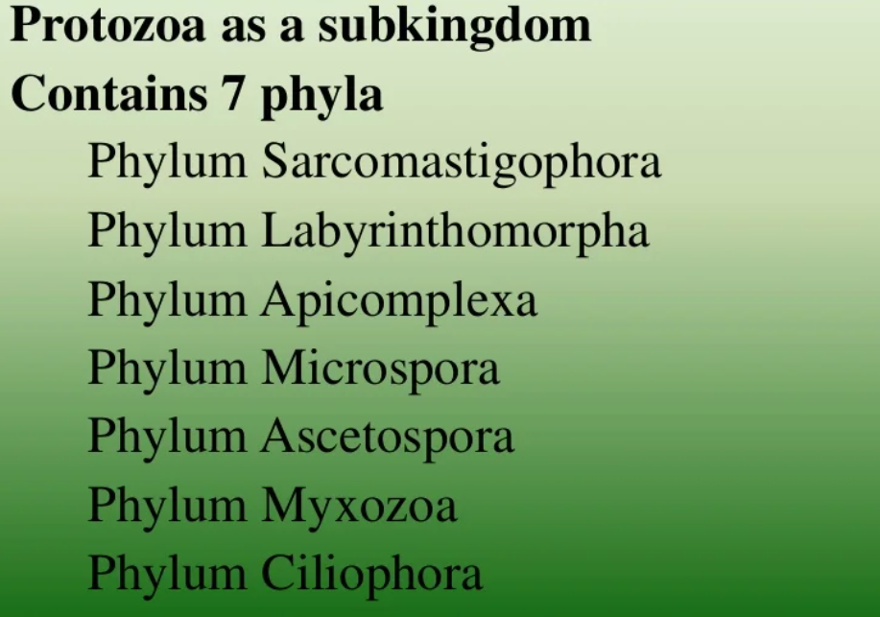

Slide 5
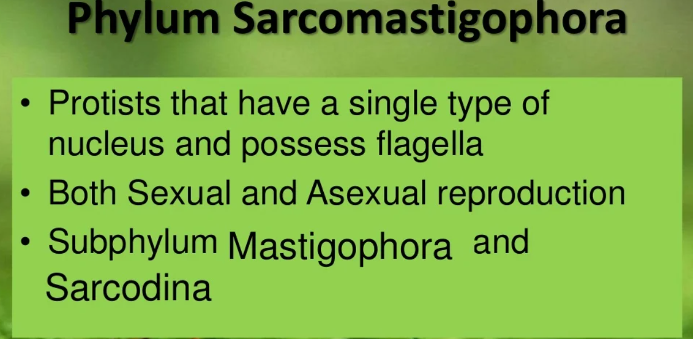
3 subphylum: 1. Mastigophora 2. Sarcodina 3.Opalinata

Slide 6
Phylum Sarcomastigophora
2 Classes
  Phytomastigophoraea
  Euglena, volvox, dinoflagellates, Chlamydomonas
  Zoomastigophoraea
    Trypanosoma, trichonympha, trichomonas, giardia, leishmania

Slide 7
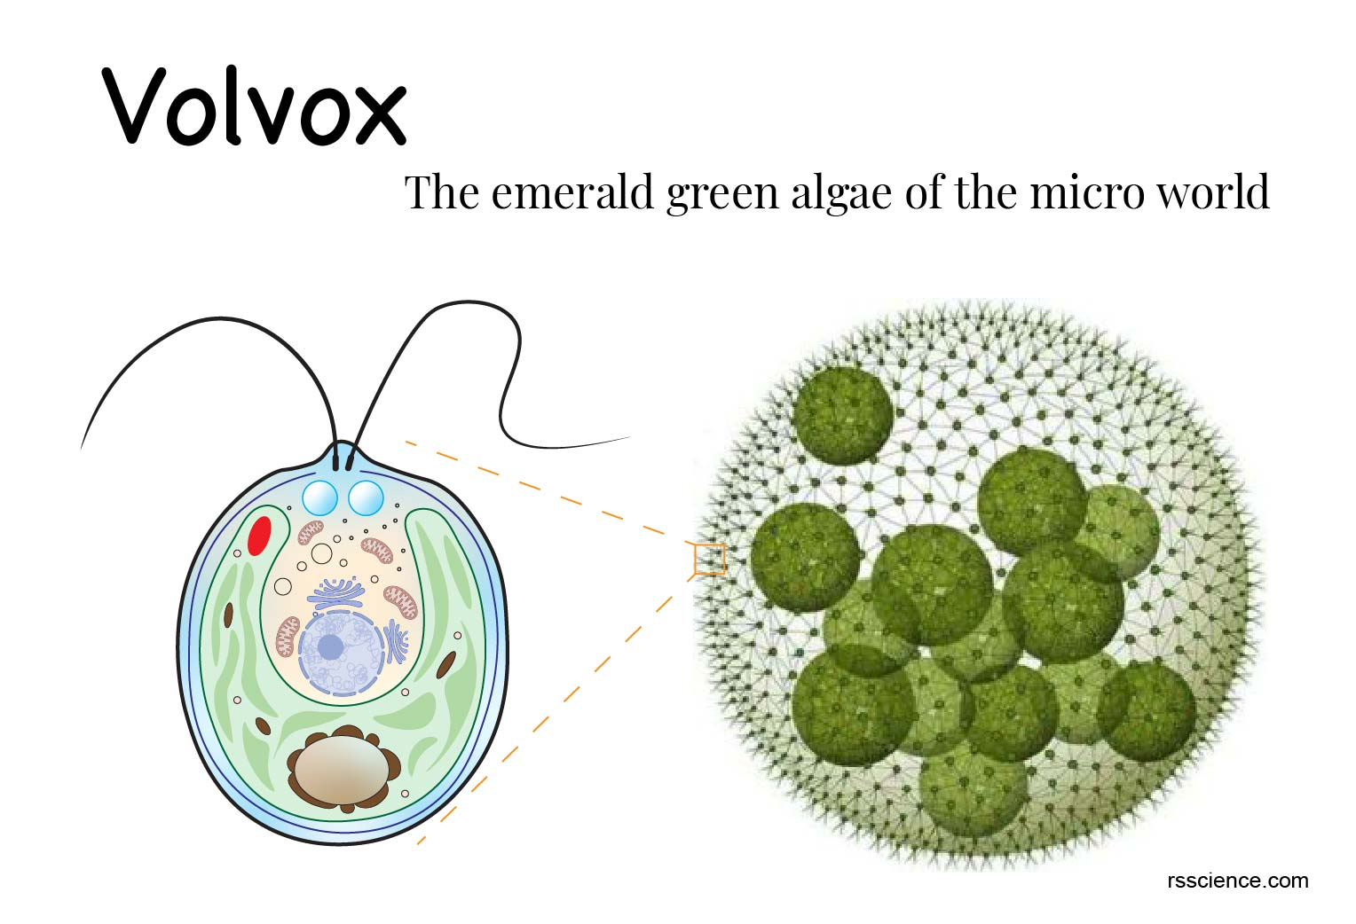
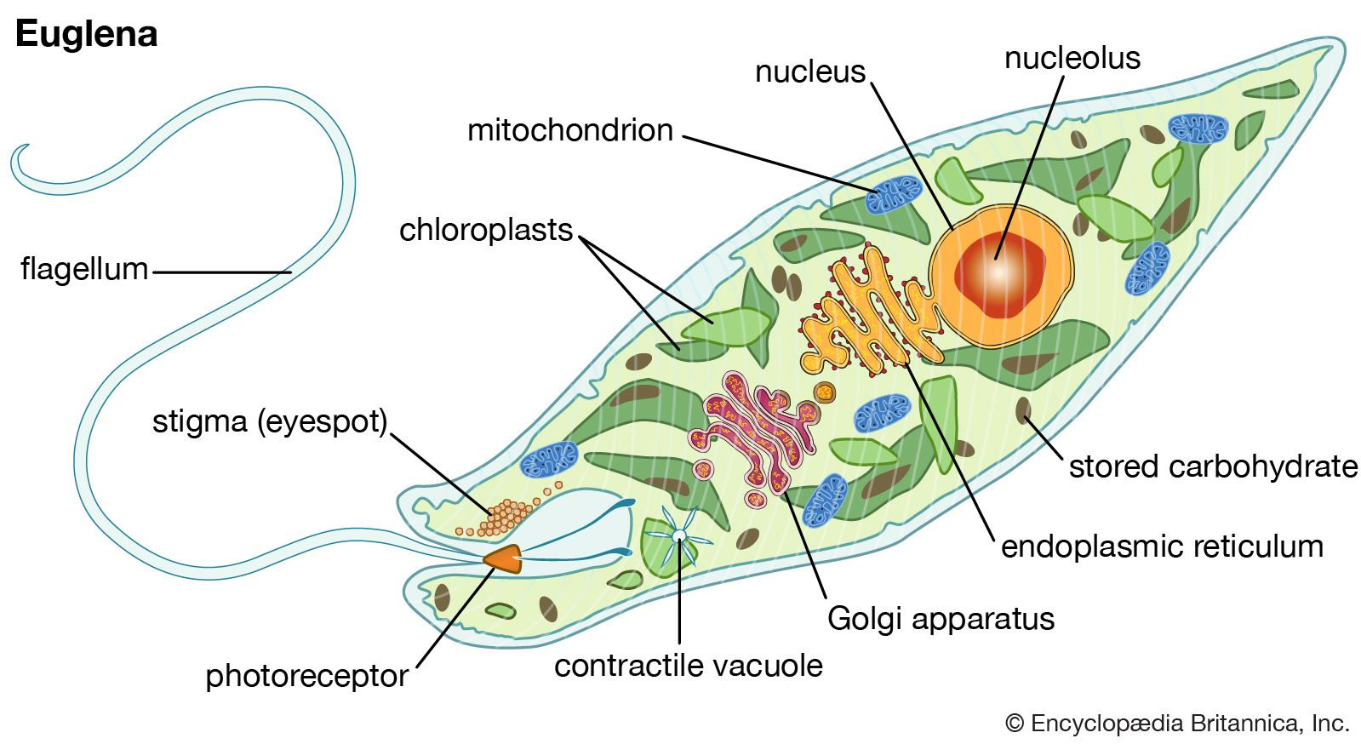
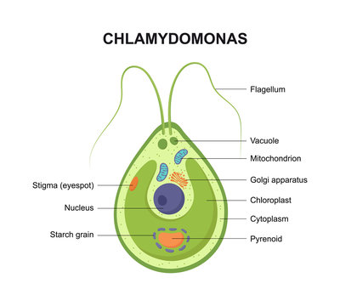
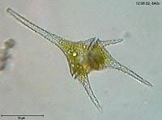
  Phytomastigophoraea

Slide 8
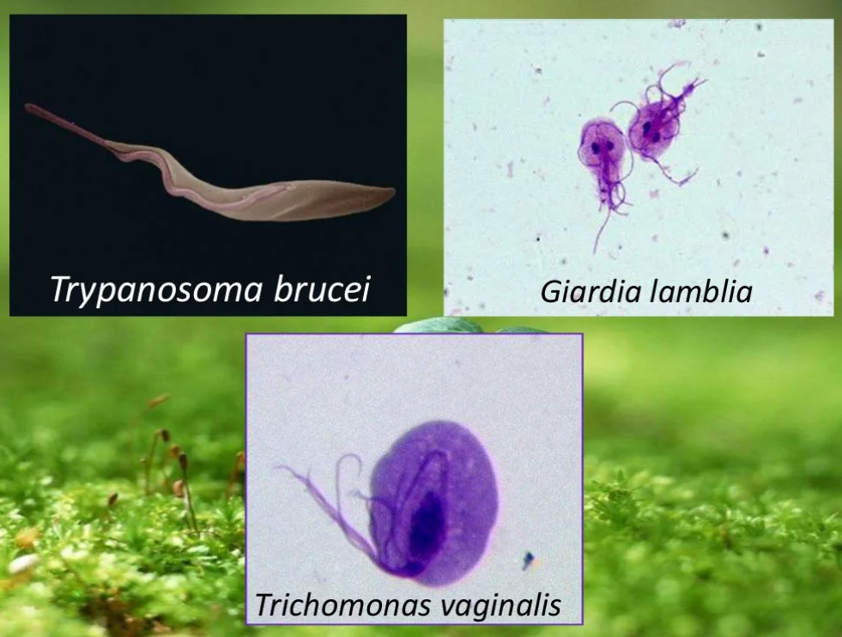
  Zoomastigophoraea

Slide 9
Trypanosoma
No chloroplast
Hetrotropic
Mostly parasites of human and other mammals.
3 species
  Trypanosoma brucei brucei----------parasite of non-human mammals of Africa
  Trypanosoma b. gambiense ---------- Sleeping sickness in Human
  Trypanosoma b. rhodesiense---------

Slide 10
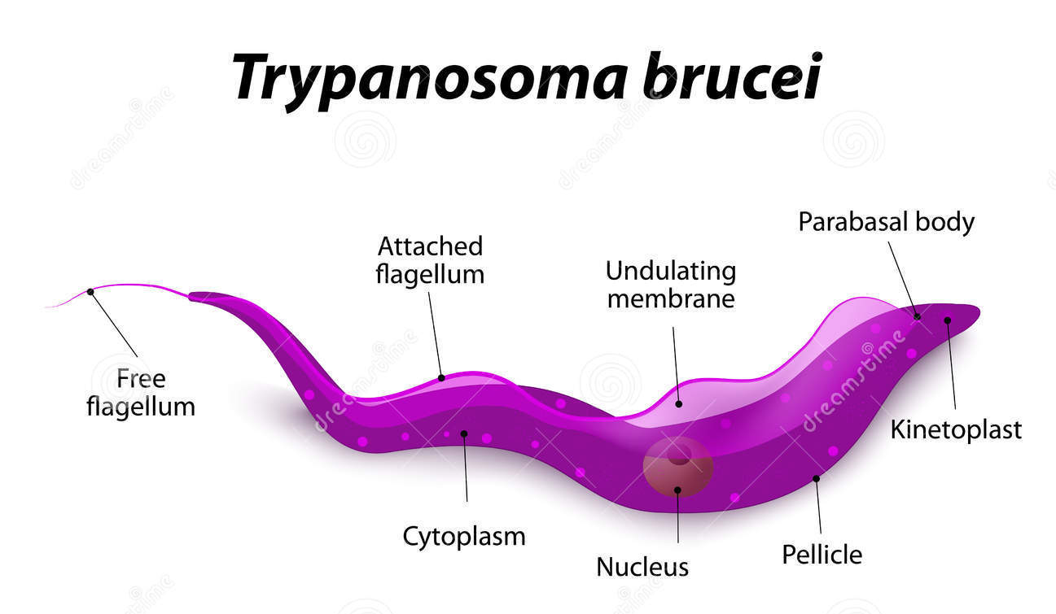

Slide 11
Disease Cycle
Vector Tse tse fly
  Bites the infected human or mammal
  Trypanosoma enters in it with food of blood
  Trypanosoma multiply in the gut of the fly asexually for about 10 days
  Migrate to slivary gland
  Trypanosoma transforms in variety of forms in next 15 to 35 days
  When infected Tse tse fly bites another vertebrate the parasite travels with the salivary secretions into the blood of definitive host.
  The parasite multiply asexually again and transform though number of forms
  Parasite may live in blood, lymph, spleen, CNS, and CSF.

Slide 12
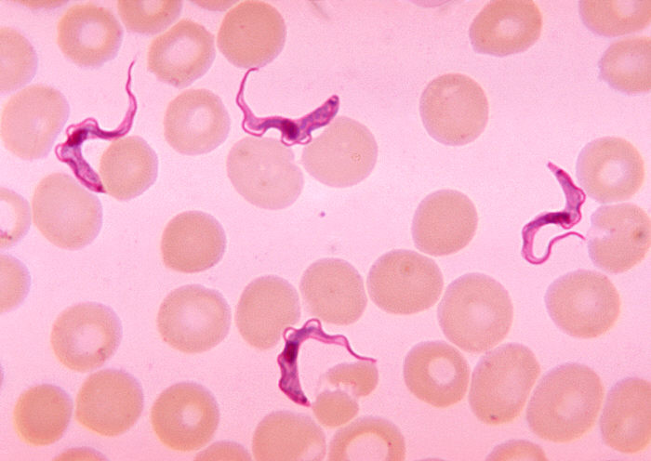
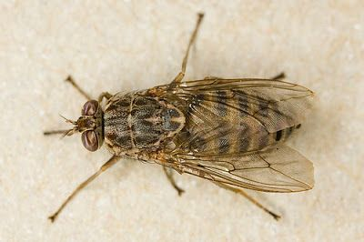

Slide 13
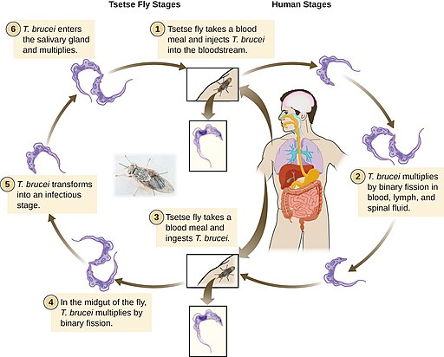

Slide 14
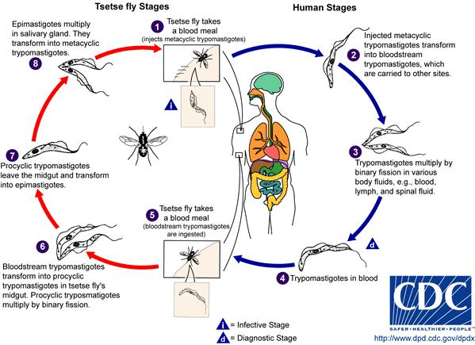

Slide 15
Only four drugs are available for the chemotherapy of human African trypanosomiasis or sleeping sickness; Suramin, pentamidine, melarsoprol and eflornithine.

Slide 16
Subphylum: Sarcodina
Pseudopodia for locomotion and feeding
Naked or with shell/test
Mostly free living
2 Super classes
Rhizopoda---- lobopodian, reticulopodia or filopodia/ no distinct pseudopodia
Actinopoda---- spherical, planktonic, have axopodia supported by microtubules

Slide 17
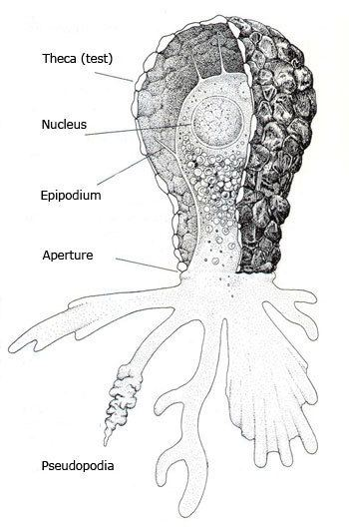
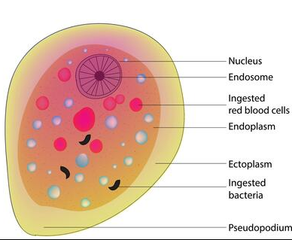
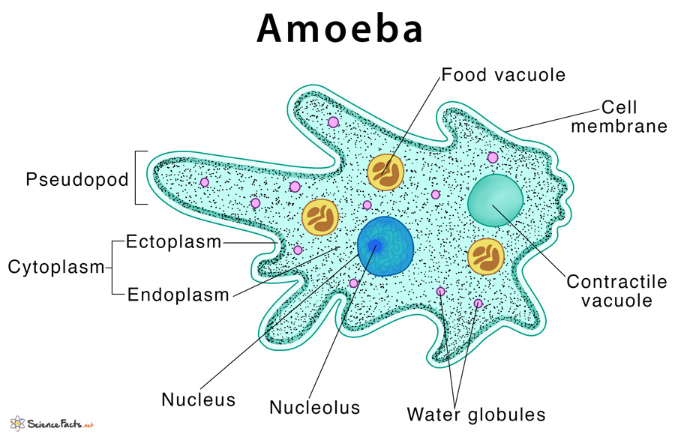
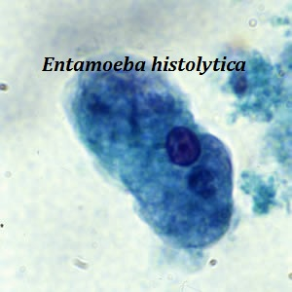
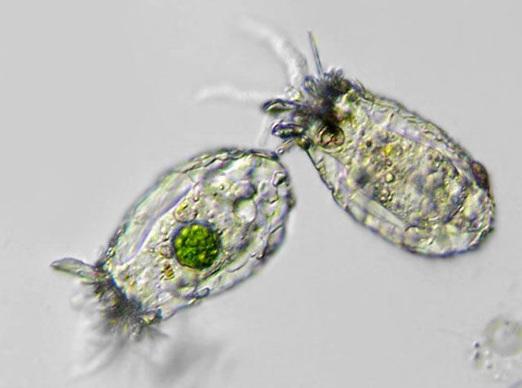
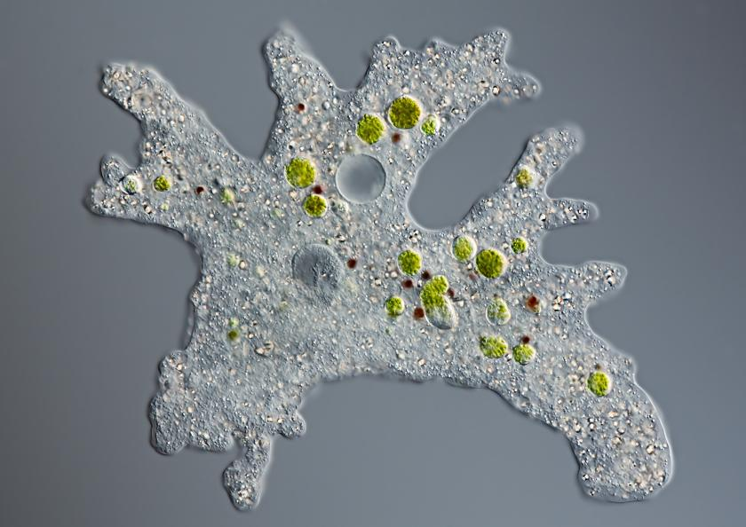
Rhizopoda Examples

Slide 18
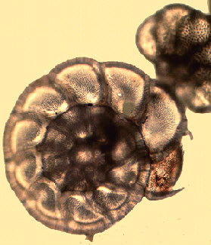
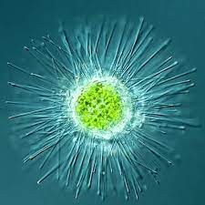
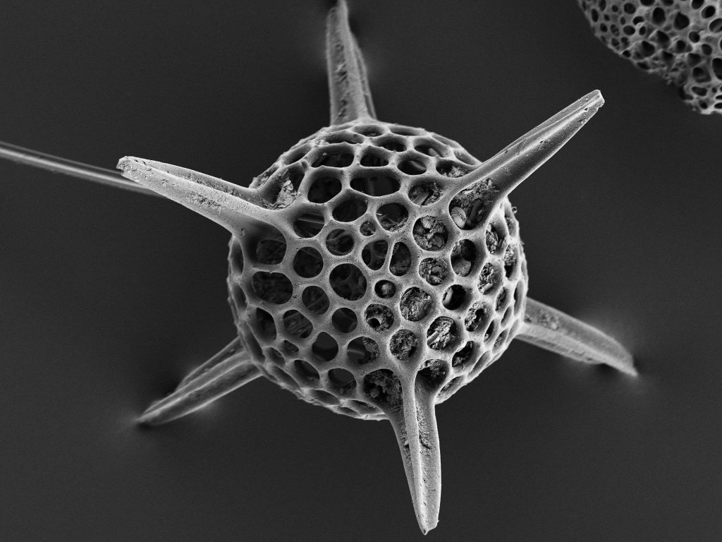
Actinopoda Examples

Slide 19
Amoeba
Super class Rhizopoda
Class Lobosea
Genus Amoeba
Species Arcella, difflugia, entamoeba histolytica

Slide 20
Characteristics of Amoeba
Naked or with test (Arcella and difflugia)
Found in shallow water like fresh water ponds, lakes, slow moving streams
Feed on other protists and bacteria
Engulf food by phagocytosis by amoeboid locomotion
Food comes to food vacuoles
Reproduce by binary fission
No sexual reproduction
Symbiotic but few are pathogenic

Slide 21
Entamoeba histolytica
Pathogenic amoeba
Cause dysentery in humans
Symptoms:
  Inflammation and ulceration of lower intestinal tract
  Diarrhea with blood and mucus
Cause: poor sanitary conditions
Amoeba live in the folds of intestinal wall
Feed on starch and mucoid secretions
Passes from host to host through cysts
Transmission by: contaminated food and water

Slide 22
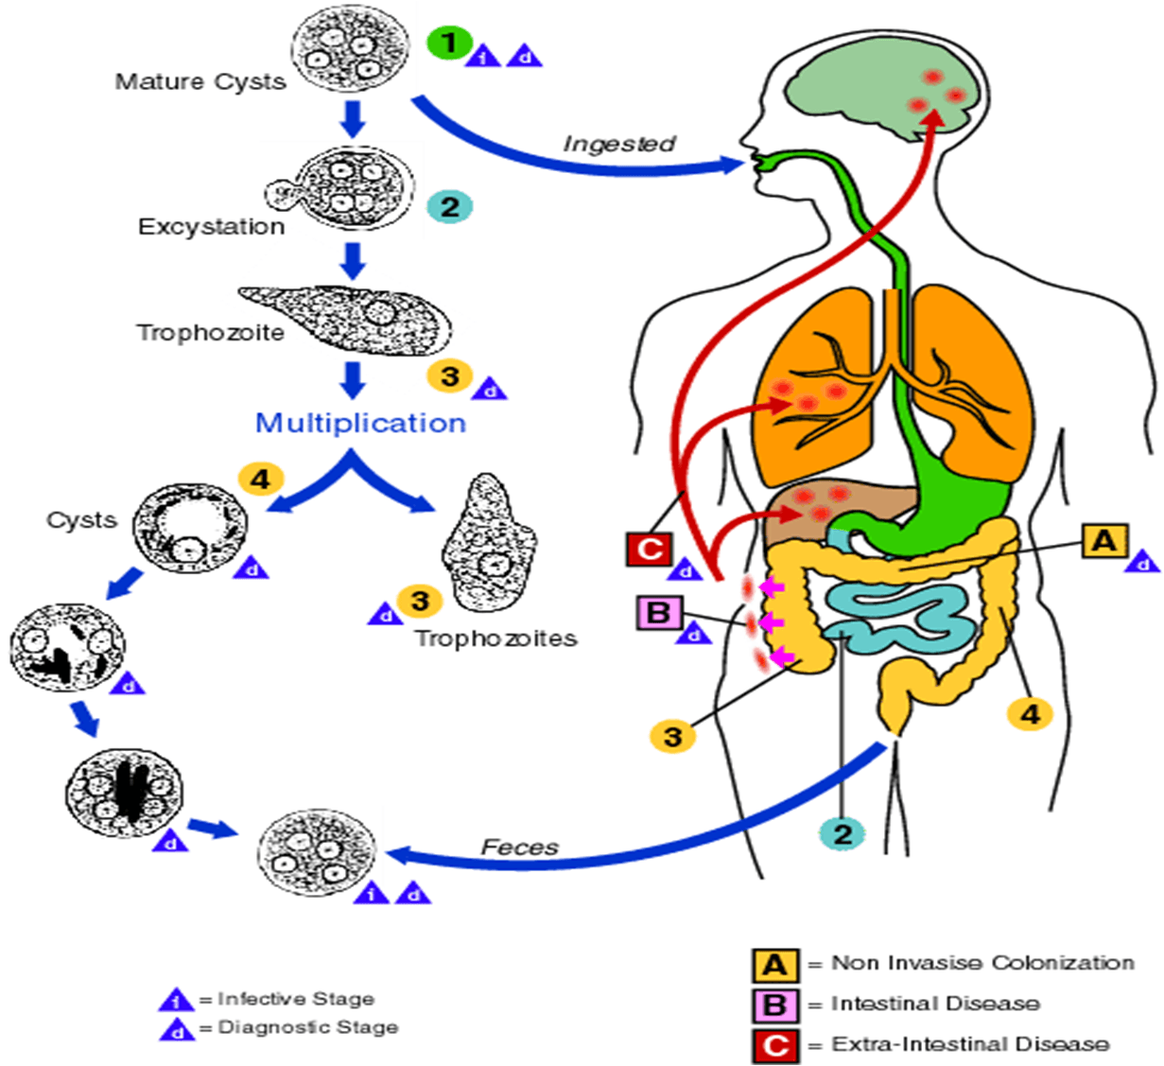

Slide 23


