Slide 1
Smart Charging App For EV
PIP2001 Capstone Project
Final Review
Batch Number:CSE-G162
Roll Number | Student Name
20211CSE0430 | Venkat B M
20211CSE0406 | Arunkumar H Gurav
20211CSE0435 | Nagendra B S
20211CSE0422 | Kushal C S
Under the Supervision of,
Ms. Dornadhula Dhanya
Assistant Professor
School of Computer Science and Engineering
Presidency University
Name of the Program: CSE
Name of the HoD: Dr. Asif Mohamed H B
Name of the Program Project Coordinator: Mr. Amarnath J.L
Name of the School Project Coordinators: Dr. Sampath A K

Slide 2
Introduction
The rapid adoption of electric vehicles (EVs) highlights the need for efficient and user-friendly charging infrastructure. The "Smart Charging App for EVs" tackles these challenges using AI, blockchain, and dynamic pricing to optimize charging station availability, predict optimal charging times, and enable secure, transparent transactions.
With features like slot booking, real-time updates, and renewable energy integration, the app enhances convenience and efficiency while promoting sustainability, contributing to a cleaner, greener future.

Slide 3
Literature Review
Advantages:
Basic functionalities like locating charging stations.
Manual slot reservations reduce some wait times.
Standardized payment gateways for transactions.
Promotes EV adoption with foundational infrastructure.
Disadvantages:
Manual slot booking is inefficient.
Limited real-time updates on station status.
No AI-driven predictive analytics for demand management.
Static pricing fails to balance demand.
Traditional payment systems lack advanced security.
Limited use of renewable energy sources.

Slide 4
Existing method Drawback
Manual Slot Booking: Inefficient and inconvenient for users, leading to frustration and wasted time.
Limited Real-Time Data: Charging stations do not provide real-time updates on availability, queue length, or charging status.
No Predictive Analytics: Existing methods lack AI-based recommendations for optimal charging times or locations, resulting in poor station utilization.
Static Pricing Models: Pricing does not adapt to demand, causing uneven usage during peak and off-peak hours.
Security Concerns: Traditional payment systems are prone to fraud and lack transparency compared to blockchain solutions.

Slide 5
Proposed Method
AI-Driven Predictive Analytics:
Uses artificial intelligence to analyze patterns and recommend optimal charging times and locations, reducing wait times and improving user convenience.
Real-Time Slot Booking System:
Enables users to book slots in real time, ensuring efficient scheduling and minimizing on-site congestion.
Blockchain-Based Secure Payments:
Ensures transparency and security in transactions, eliminating risks of fraud and enhancing user trust.

Slide 6
Proposed Method
Dynamic Pricing Mechanism:
Implements demand-based pricing to balance usage during peak and off-peak hours, optimizing station utilization.
Integration with Renewable Energy Sources:
Supports sustainable energy solutions by integrating renewable energy into the charging infrastructure.
User-Friendly Interface:
Provides a seamless experience with features like interactive maps, personalized notifications, and real-time updates.

Slide 7
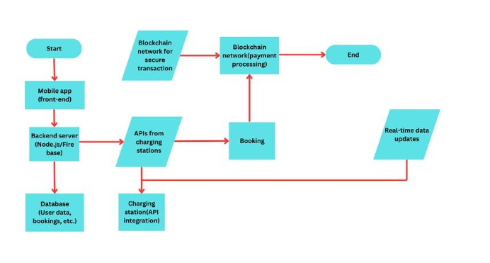
Proposed Method
System Architecture:

Slide 8
Software/Hardware Requirements
Software Requirements:
Mobile Application:
Cross-platform compatibility (iOS and Android).
Frameworks: React Native, Flutter, or similar.
Blockchain Framework:
Platforms like Ethereum or Hyperledger for secure payment processing.
Database:
NoSQL (e.g., MongoDB) for real-time data and user information storage.
APIs:
Integration with map services (e.g., Google Maps API) and charging station networks

Slide 9
Software/Hardware Requirements
Hardware Requirements:
Mobile Devices:
Smartphones with GPS capability for real-time location services.
Charging Stations:
IoT-enabled charging stations for seamless integration with the app.
Servers:
High-performance servers to handle data processing and storage.
IoT Sensors:
Sensors at charging stations to monitor availability and status in real time

Slide 10
Objectives
Optimize Charging Processes: Efficiently manage and allocate charging resources to reduce energy costs and peak demand.
Enhance User Experience: Provide a seamless and intuitive interface for EV users to locate, book, and manage charging sessions.
Promote Sustainable Energy Use: Integrate renewable energy sources and prioritize off-peak charging to reduce the carbon footprint.
Enable Real-Time Monitoring: Allow users to monitor charging status and costs in real time, ensuring transparency and control.
Support Grid Stability: Implement load balancing features to support grid stability and avoid overloads.
Incorporate Predictive Analytics: Use data analytics to predict charging demand and improve service reliability.

Slide 11
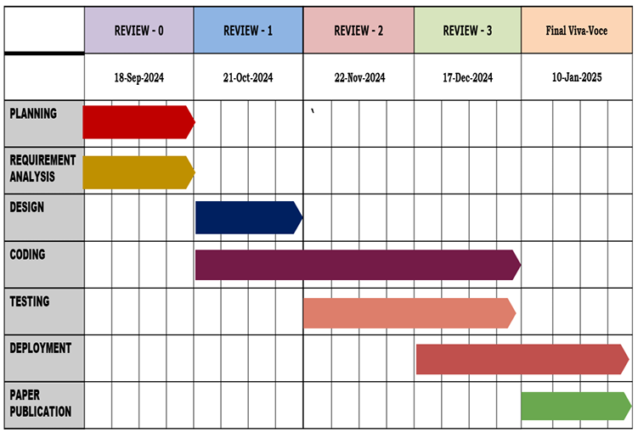
Timeline of Project

Slide 12
Outcomes
Improved Energy Efficiency: The app ensures efficient utilization of electricity by optimizing charging schedules, reducing energy waste, and promoting off-peak usage.
Reduced Charging Costs: By guiding users to charge during low-demand hours or using renewable energy, the app helps lower energy costs for EV owners.
Enhanced User Convenience: Features like real-time monitoring, booking, and notifications improve the overall charging experience for EV users.
Increased Renewable Energy Integration: The app supports renewable energy sources, enabling more sustainable EV charging and reducing reliance on fossil fuels.
Better Grid Management: By balancing the load across the grid and avoiding peak demand, the app contributes to grid stability and prevents overloading.

Slide 13
Outcomes
Scalable Charging Infrastructure: The app lays the foundation for scaling charging networks by offering insights into user demand and behavior, aiding infrastructure planning.
Data-Driven Insights: The app collects and analyzes data to provide actionable insights for EV users, charging station operators, and utility providers.
Reduced Carbon Footprint: Encouraging the use of cleaner energy sources and reducing energy waste contributes to lowering the overall environmental impact of EV charging.

Slide 14
Conclusion
The development and implementation of a Smart Charging App for EVs represent a significant step toward achieving sustainable and efficient electric vehicle charging solutions. By optimizing charging schedules, integrating renewable energy, and providing real-time data, the app not only enhances the user experience but also contributes to energy conservation and grid stability.
Furthermore, it promotes cost savings for users and supports the adoption of clean energy technologies, aligning with global efforts to reduce carbon emissions. The app's scalability and data-driven insights pave the way for future advancements in EV infrastructure, making it an essential tool in the transition toward a greener and smarter transportation ecosystem.

Slide 15
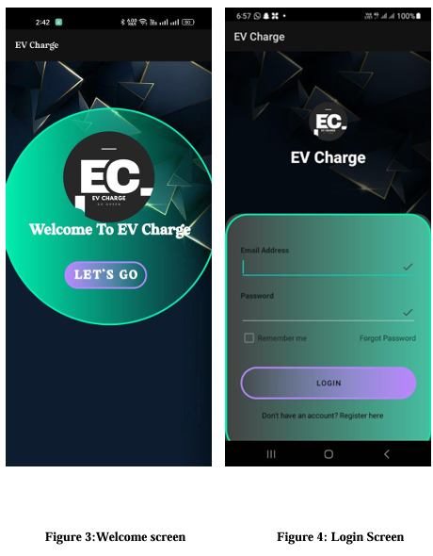
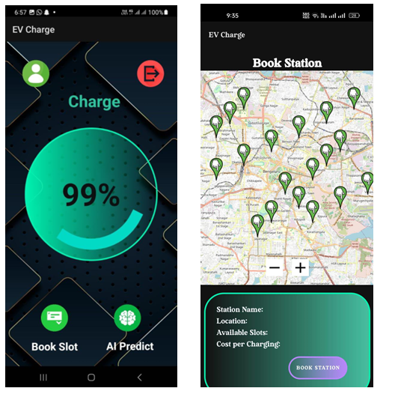
Results
Welcome screen
Login Screen
Home Screen of the Smart Charging App
Station Selection Screen

Slide 16
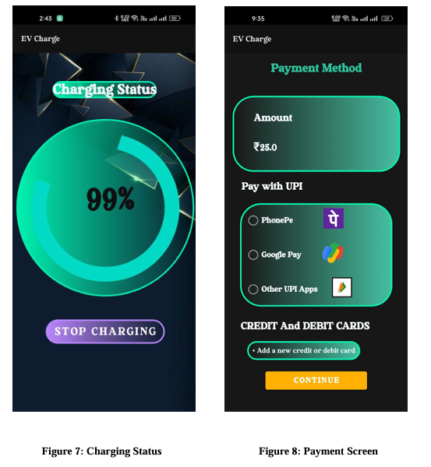
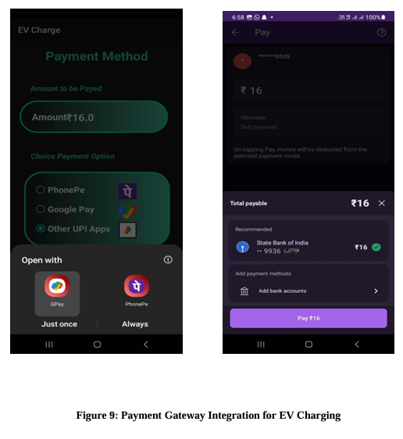
Payment Gateway Integration for EV Charging
Charging Status
Payment Screen

Slide 17
Github Link
https://github.com/bubby-2003/CSE--G162

Slide 18
References
[1] Mandala, V., & Surabhi, S. N. R. D. (2020). Integration of AI-Driven Predictive Analytics into Connected Car Platforms. IARJSET, 7(12).
[2] Shern, S. J., Sarker, M. T., Ramasamy, G., Thiagarajah, S. P., Al Farid, F., & Suganthi, S. T. (2024). Artificial Intelligence-Based Electric Vehicle Smart Charging System in Malaysia. World Electric Vehicle Journal, 15(10), 440.
[3] Abi Tirshan, Y., Ajaikrishnan, S., & Suresh, S. Charging Slot Prediction and Automation System for Electric Vehicle Charging Station.
[4] Kazemtarghi, A., Mallik, A., & Chen, Y. (2024). Dynamic pricing strategy for electric vehicle charging stations to distribute the congestion and maximize the revenue. International Journal of Electrical Power & Energy Systems, 158, 109946.
[5] Chakraborty, P., & Pal, M. (2024). Planning of fast charging infrastructure for electric vehicles in a distribution system and prediction of dynamic price. International Journal of Electrical Power & Energy Systems, 155, 109502.
[6] Amin, A., Tareen, W. U. K., Usman, M., Ali, H., Bari, I., Horan, B., ... & Mahmood, A. (2020). A review of optimal charging strategy for electric vehicles under dynamic pricing schemes in the distribution charging network. Sustainability, 12(23), 10160.
[7] Limmer, S. (2019). Dynamic pricing for electric vehicle charging—A literature review. Energies, 12(18), 3574.
[8] de Souza Brito, J. A. Electrical Vehicles and Charger Stations: State-of-Art.
[9] Tahir, Y., Khan, I., Rahman, S., Nadeem, M. F., Iqbal, A., Xu, Y., & Rafi, M. (2021). A state‐of‐the‐art review on topologies and control techniques of solid‐state transformers for electric vehicle extreme fast charging. IET Power Electronics, 14(9), 1560-1576.
[10] Elkasrawy, M. A., Abdellatif, S. O., Ebrahim, G. A., & Ghali, H. A. (2023). Real-time optimization in electric vehicle stations using artificial neural networks. Electrical Engineering, 105(1), 79-89.

Slide 19
References
[11] Linja-aho, V., & Expert, I. E. S. (2024). Electric Vehicle Charging Safety–State of Art, Best Practices, and Regulatory Aspects. In IEEE Electr. Saf. Workshop (Vol. 150, pp. 150-159).
[12] Maurya, A., Kubal, V., Adhikari, Y., Sonkawade, A., & Hatkar, M. CHARGEEV: AN EV CHARGING STATION FINDER BRIDGING THE GAP IN EV CHARGING INFRASTRUCTURE.
[13] Zhang, H., & Qiu, J. (2024). A novel navigation and charging strategy for electric vehicles based on customer classification in power-traffic network. International Journal of Electrical Power & Energy Systems, 158, 109931.
[14] Paneru, B., Mainalil, D. S., Paneru, B., & Sapkota, S. C. (2024). Advancing Sustainable Mobility: Dynamic Predictive Modeling of Charging Cycles in Electric Vehicles Using Machine Learning Techniques and Predictive Application Development. Systems and Soft Computing, 200157.
[15] Chen, Q., & Folly, K. A. (2022). Application of artificial intelligence for EV charging and discharging scheduling and dynamic pricing: A review. Energies, 16(1), 146.
[16] Rigas, E. S., Ramchurn, S. D., & Bassiliades, N. (2018). Algorithms for electric vehicle scheduling in large-scale mobility-on-demand schemes. Artificial Intelligence, 262, 248-278.
[17] Kalakanti, A. K., & Rao, S. (2024). Dynamic Pricing for Electric Vehicle Charging. arXiv preprint arXiv:2408.14169.
[18] Mrkos, J., Komenda, A., Fiedler, D., & Vokřínek, J. (2024). Online Dynamic Pricing for Electric Vehicle Charging Stations with Reservations. arXiv preprint arXiv:2410.05538.
[19] Kala, M. C. K. Charging Slot Prediction and Automation System for Electric Vehicle Charging Station.
[20] Pena-Perez, F. R. A. N. C. I. S. C. O. (2019). Smart navigation system for electric vehicles charging (Doctoral dissertation, Durham University).

Slide 20
Project work mapping with SDG
Goal 7: Affordable and Clean Energy The app promotes the use of clean energy by supporting the EV ecosystem and optimizing charging station utilization, contributing to a transition from fossil fuels to renewable energy.
Goal 9: Industry, Innovation, and Infrastructure By integrating advanced technologies like AI, blockchain, and dynamic pricing, the app fosters innovation and improves infrastructure to support sustainable transportation.
Goal 11: Sustainable Cities and Communities The app facilitates sustainable urban mobility by improving access to EV charging and reducing wait times, supporting eco-friendly transportation in cities.

Slide 21
Project work mapping with SDG
Goal 12: Responsible Consumption and Production Dynamic pricing and efficient station management encourage responsible energy use, optimizing resources and minimizing wastage.
Goal 13: Climate Action By making EV charging more accessible and efficient, the app encourages EV adoption, reducing greenhouse gas emissions and supporting global efforts to combat climate change.
Goal 17: Partnerships for the Goals Expanding the app’s network and integrating with smart grids and renewable energy sources highlight the potential for partnerships to build a sustainable energy ecosystem.

Slide 22
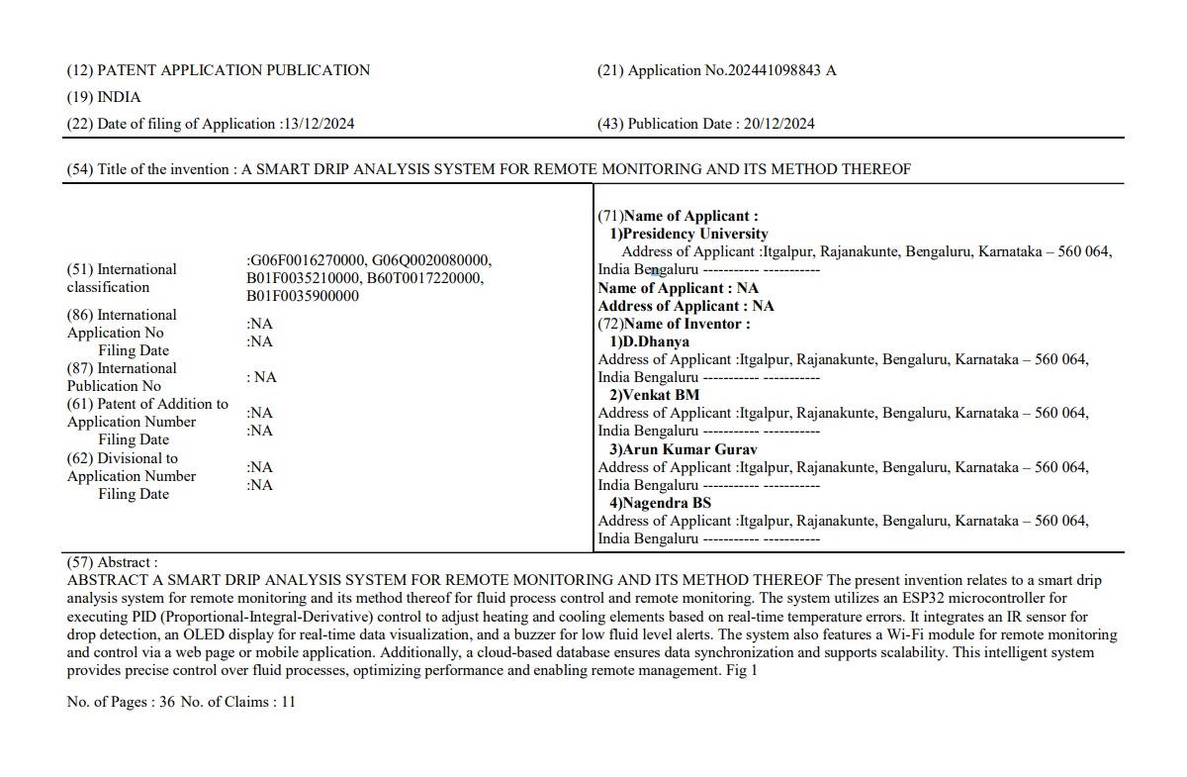
Publication Details

Slide 23
Thank You

