Slide 1
Doctor appointment system
Ljubisha Andonov 151129

Slide 2
Project report
Doctor appointment application serves for making appointments online so you could visit your doctor. For this project we will need three types of users: admin, doctor, patient. Admin can add doctors in the systems, doctors can create time slots for appointments and make prescriptions, patients can create their own profiles and make doctor appointments, after that they can view their prescription.

Slide 3
Project scenarios
Admin, doctor, patients
Admin add doctor in the system
Doctor can make appointment time slot
Patients can book an appointment with doctor
Implement filter at frontend to search doctors
Doctor will make a prescription
Patients can view their prescription
Patients can make their profiles
Dashboard analystics

Slide 4
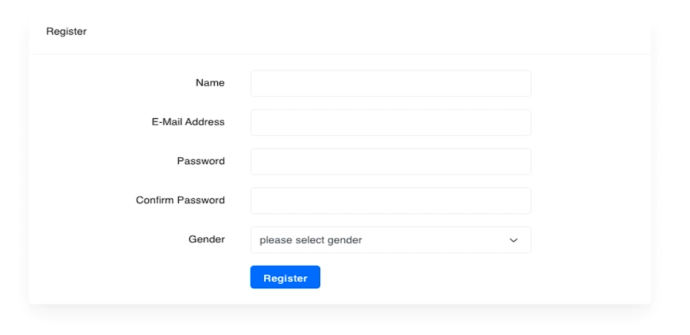
Admin, doctor, patient
This is how the registration form looks like. This is used only for patients, admin account is pre-created and doctors are added only from admin panel.

Slide 5
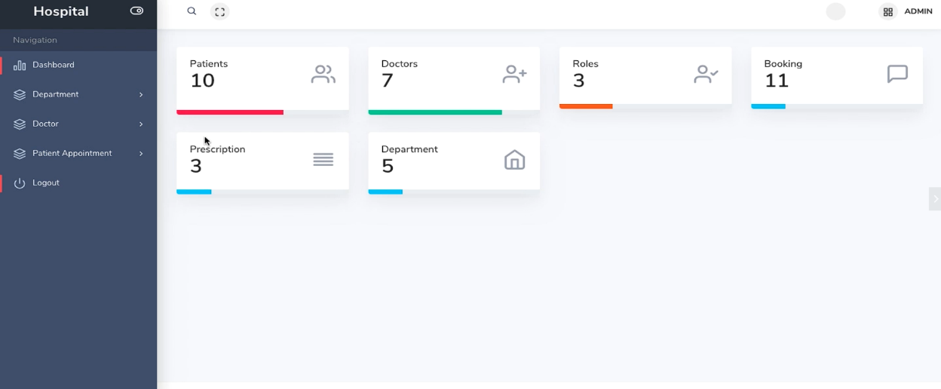
Admin add doctor in the system
On this picture we can see the admin login panel. We can create new departments, add doctors and check patients appointments.

Slide 6
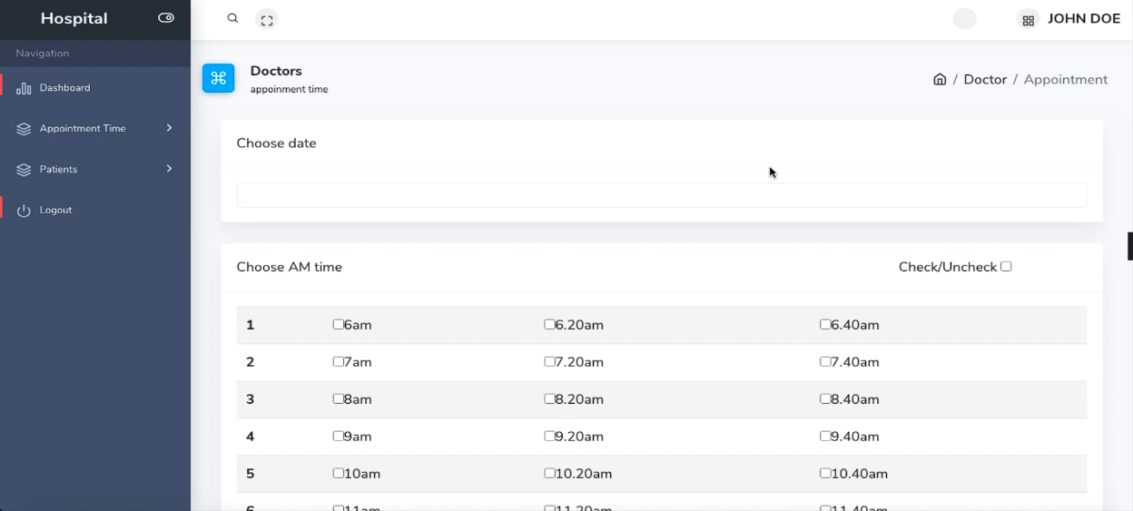
Doctor can make appointment time slot
If you are logged in as doctor, you can choose specific date and create time appointments for the patients to choose from.

Slide 7
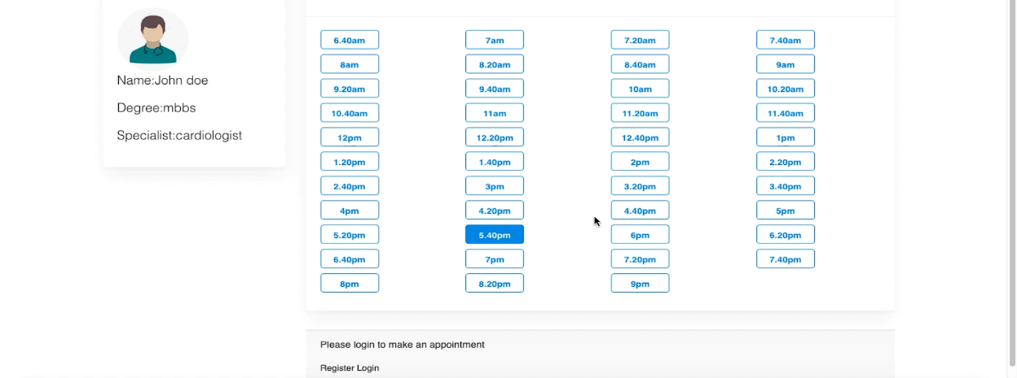
Patients can book an appointment with doctor
To make an appointment with some of the doctors, you need to be logged in. After choosing time, you can confirm the appointment. After appointment is made, you will receive email notifications with all information about the appointment. Also appointment will disappear from the list of available appointments.

Slide 8
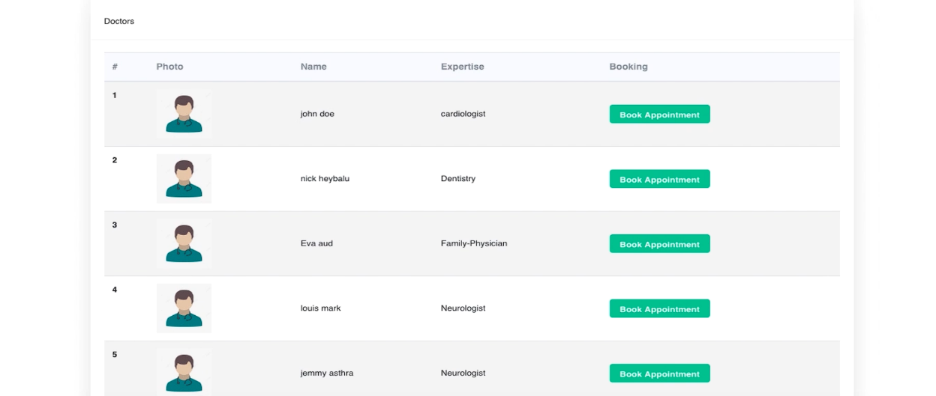
Implement filter at frontend to search doctors
As you are looking on the doctors list you can filter them to browse specific doctor.

Slide 9
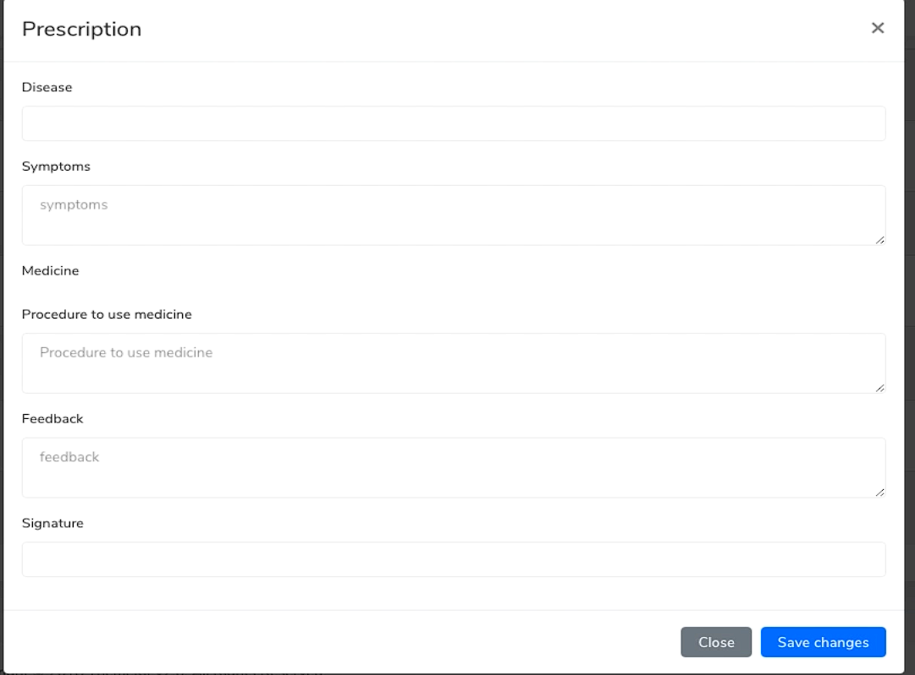
Doctor will make a prescription
This is how it looks to populate one prescription for some patient.

Slide 10
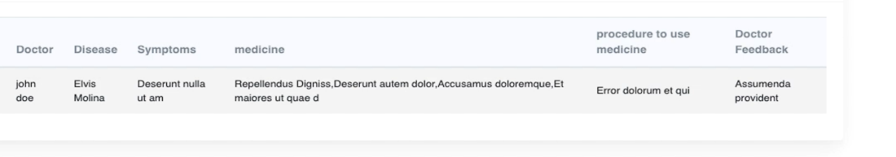
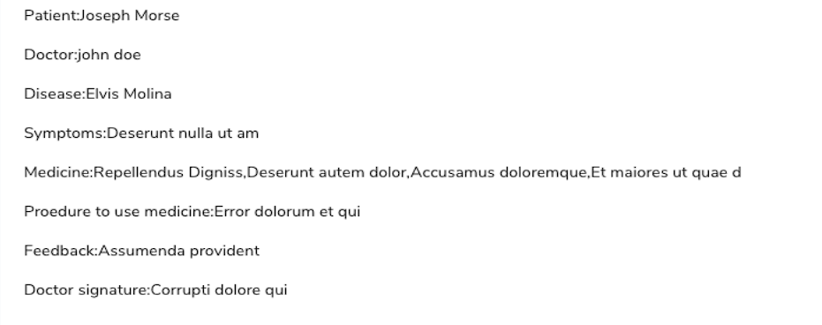
Patients can view their prescription
This is how patients are viewing their prescriptions.

Slide 11
Patients can make their profiles
As we mentioned before, only patients can create their profiles. I will add account registration picture again here.

Slide 12
Dashboard analystics
As we can see on the admin or the doctors panel, we can see clearly how many patients, doctors, roles, departments, bookings and prescriptions we have.

