Slide 1
VIRTUAL INTERNSHIP · JUNIOR WEB DEVELOPER
PashuMitra
A Ward-Level Stray Animal Grievance & Care Coordination Platform
A 4-week project covering requirements planning, responsive UI design, QA & testing strategy, and a pre-launch performance/accessibility/security audit — for an e-governance digital service.
Bhoomi · B.Tech CSE, IILM University, Greater Noida

Slide 2
WHAT THIS DECK COVERS
Four Weeks, One Continuous Project
01
Planning & Requirements
Stakeholder personas, functional/non-functional requirements, risk analysis
PLUS
A Working Prototype
02
Responsive Web Design
Site map, high-fidelity mockups across breakpoints, accessibility-first UI
Beyond the four weekly reports, a functional front-end build simulates the citizen portal end-to-end — real form validation, live case tracking, and a working dashboard.
03
QA & Testing Strategy
Test pyramid, 7 detailed test cases, CI/CD pipeline, risk heatmap
04
Performance, Accessibility & Security Audit
Core Web Vitals, WCAG 2.1 AA compliance, OWASP-based findings
02

Slide 3
WHY THIS PLATFORM
Stray Animal Grievances Don't Fit
a Generic Complaint Portal
●
A live, moving subject
Unlike a pothole or a garbage pile, the case involves an animal that may need to be located again — location and photo evidence matter more.
●
A defined legal process
The Animal Birth Control (ABC) Rules, 2023 already set out capture → sterilise → vaccinate → release/shelter as the required workflow.
●
Multiple disconnected actors
Citizens, ward officers, AWBI-recognised NGOs, and vets rarely share one system — cases get lost between a helpline and a spreadsheet.
●
Real public-health urgency
Bite and rabies-related complaints need faster, trackable response than a routine civic complaint.
03

Slide 4
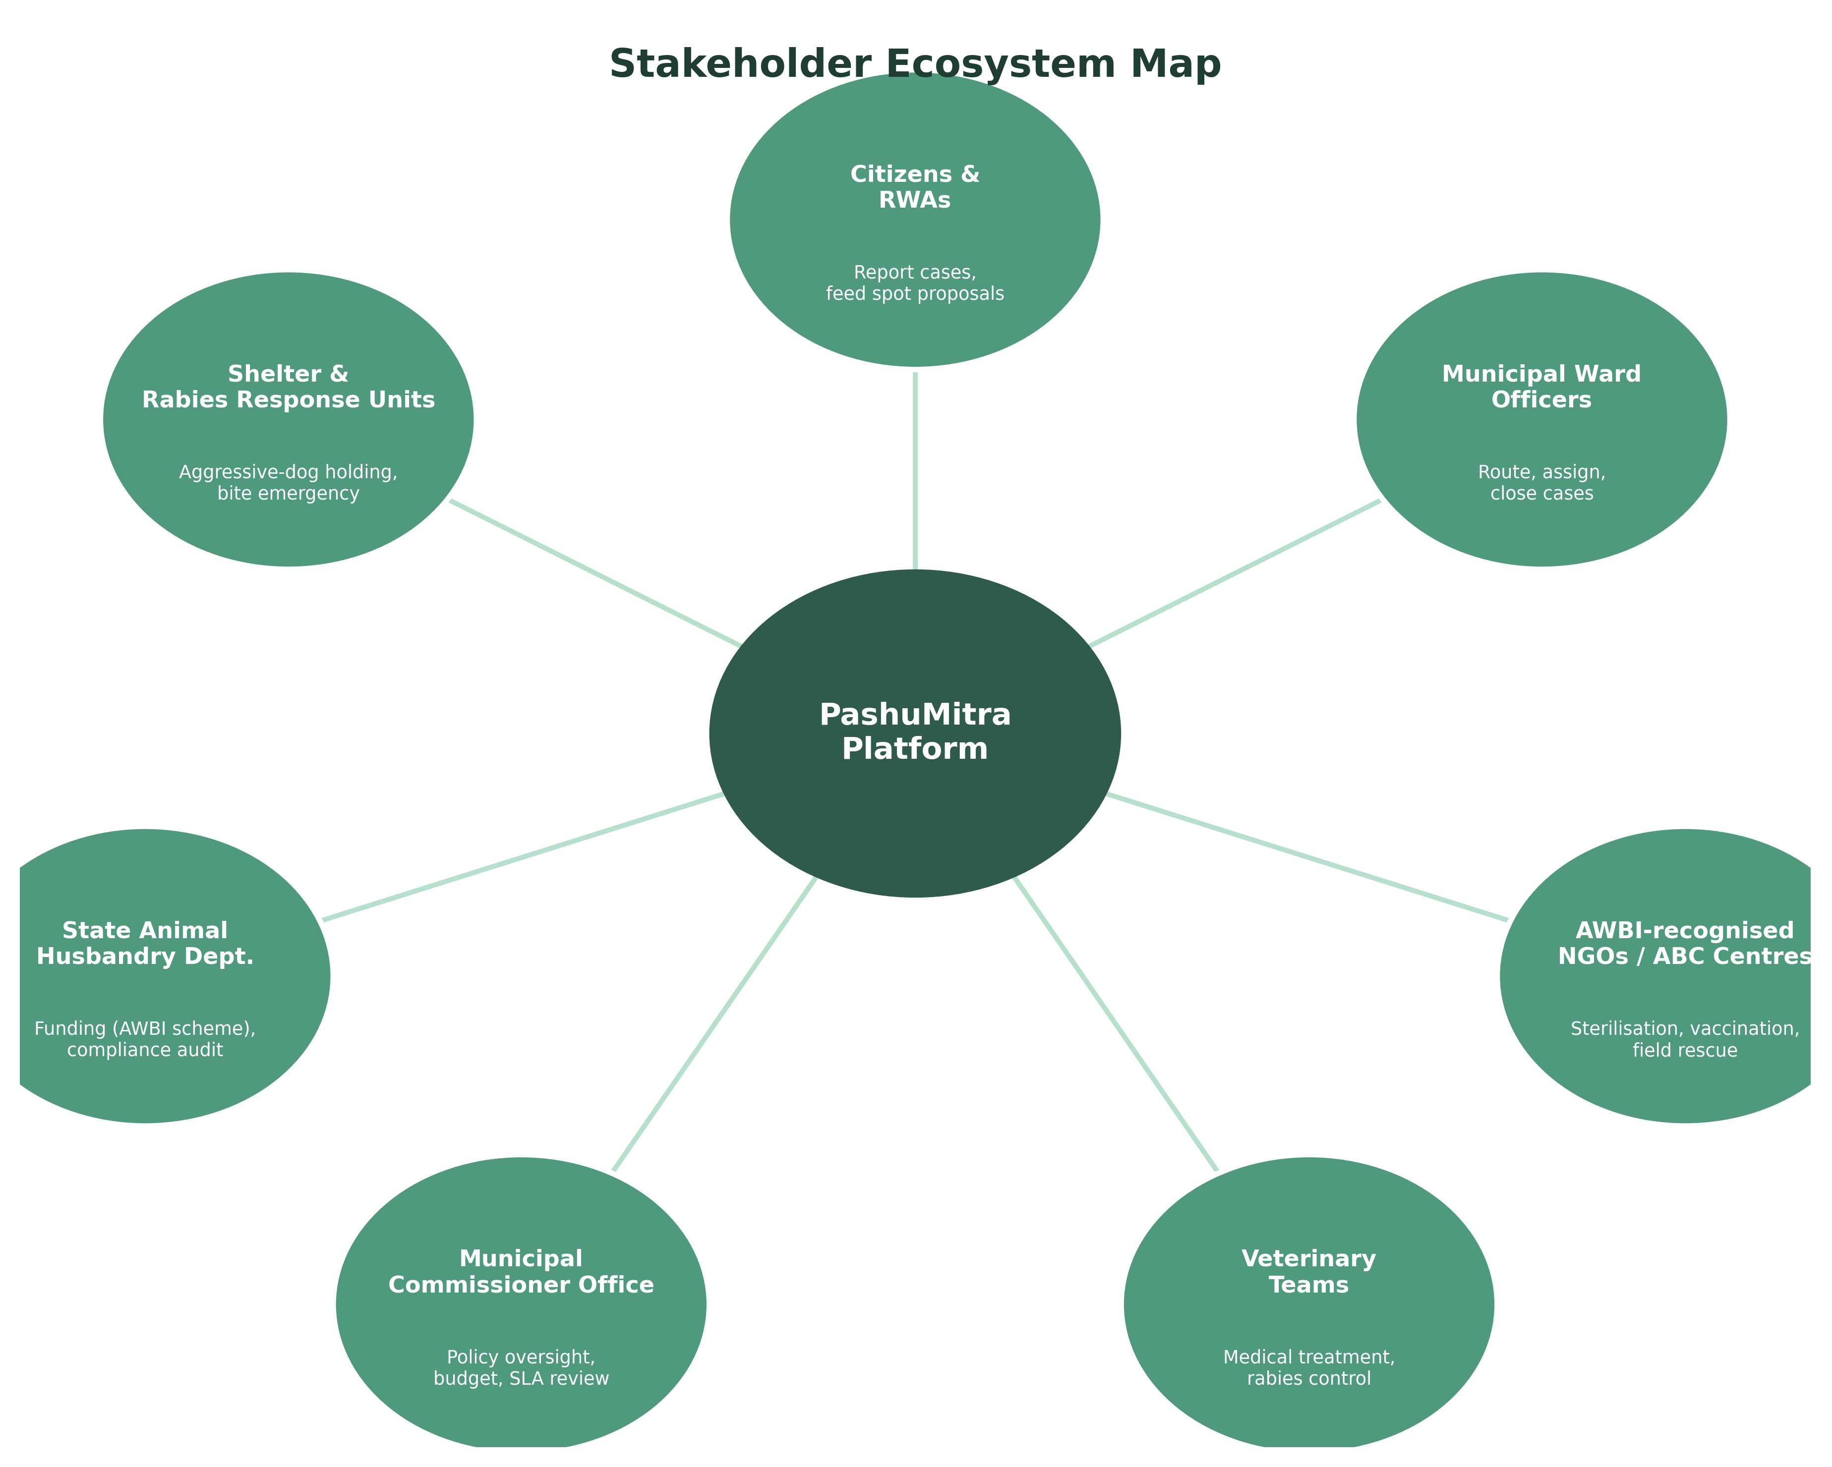
WEEK 1
Planning & Requirements Analysis
—
Benchmarked existing initiatives — Panvel's ABC Helpline, MCD's feeding-point registry, DigiLocker/UMANG identity patterns
—
Defined 4 stakeholder personas: resident reporter, community feeder, veterinary officer, ward officer
—
12 functional requirements (FR-01 to FR-12) prioritised Must/Should/Could
—
9 non-functional requirements spanning availability, security, accessibility, and offline resilience
—
Full risk analysis with likelihood/impact ratings and mitigation strategies
Figure — Stakeholder ecosystem around the platform
04

Slide 5
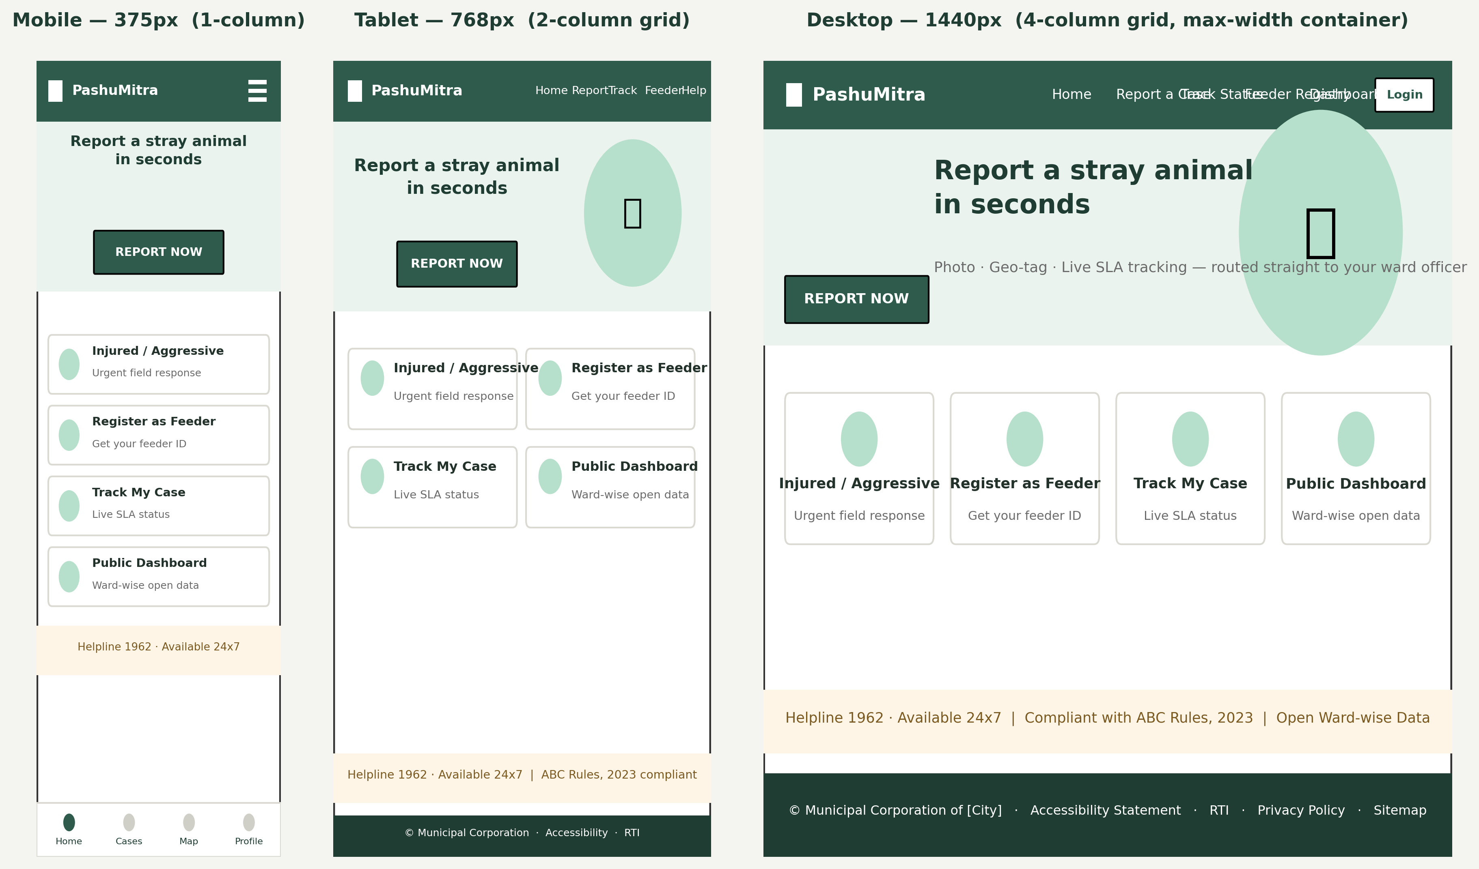
WEEK 2
Responsive Web Prototype Design
Figure — Homepage layout at 375px (mobile), 768px (tablet), and 1440px (desktop)
Mobile-first, fluid grid
WCAG 2.1 AA target
One-tap photo-first report flow
GIGW-aligned trust cues
05

Slide 6
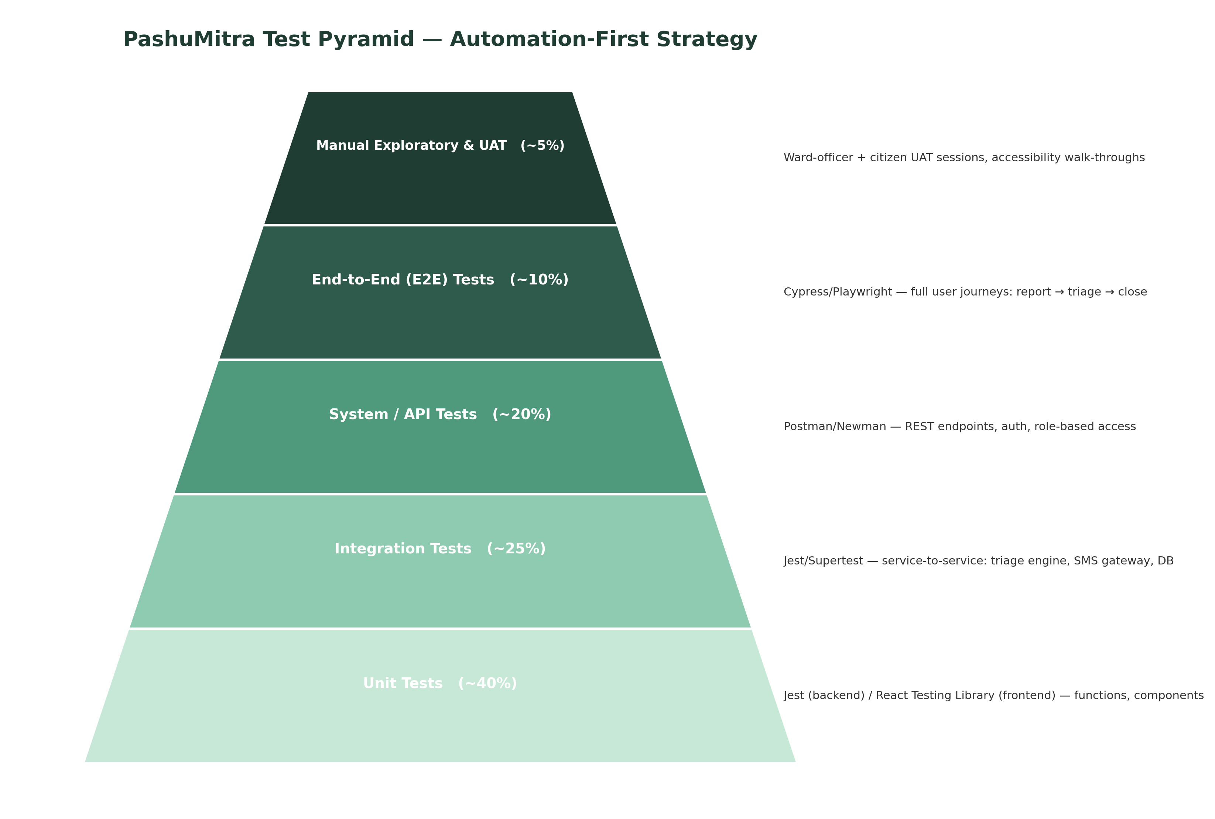
WEEK 3
QA & Testing Strategy
7
Detailed test cases
8
Test types covered
7
Risks mapped & mitigated
4
Defect severity tiers
06

Slide 7
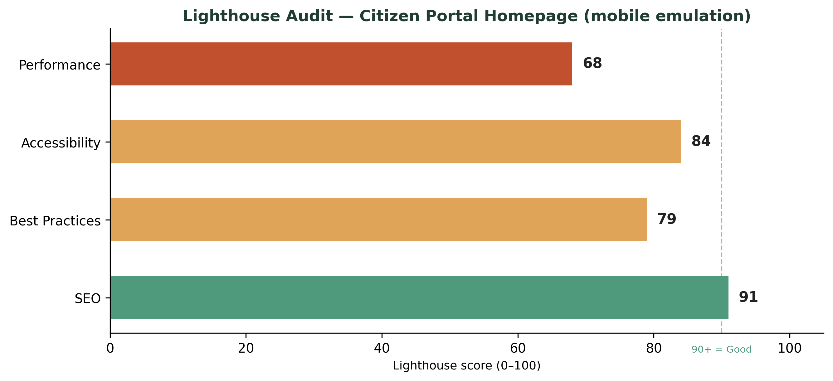
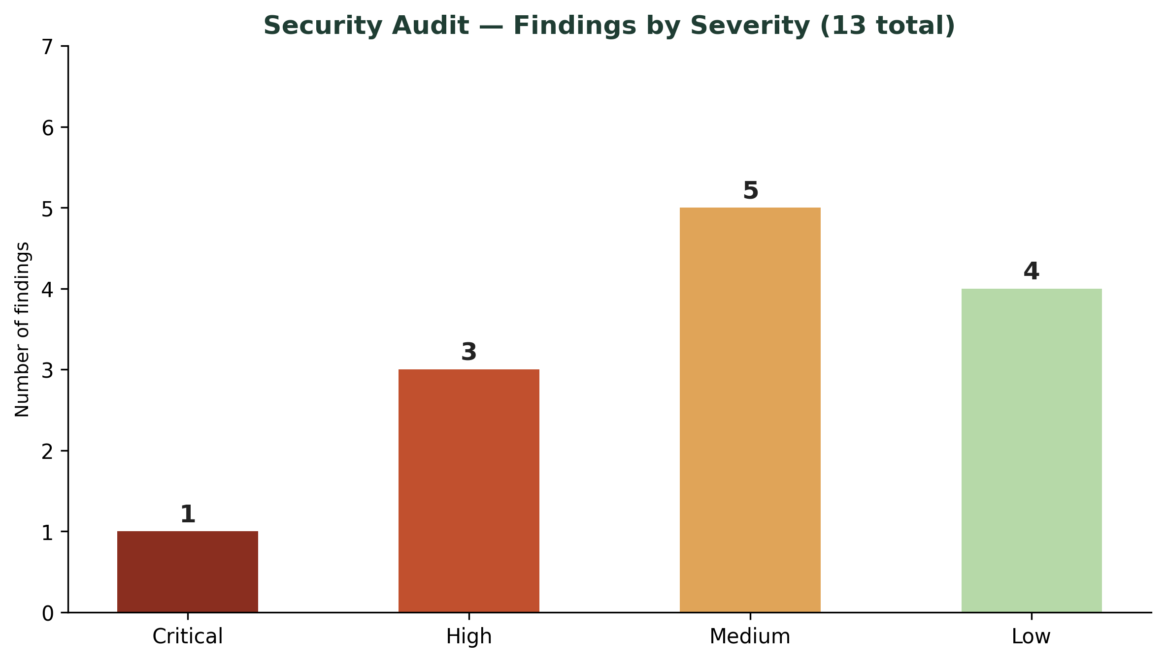
WEEK 4
Performance, Accessibility & Security Audit
Top findings
Critical: broken access control let a citizen token reach an admin export endpoint
High: stored XSS risk in the case-description field, unsanitised
High: PII (phone numbers) exposed unmasked to NGO field app
Performance: LCP 3.1s on 3G vs. 2.5s target — hero image needs optimisation
Accessibility: 65% Operable-principle compliance — keyboard nav gaps on upload control
6 P0 issues fixed before pilot launch · 6 P1 in first sprint
07

Slide 8
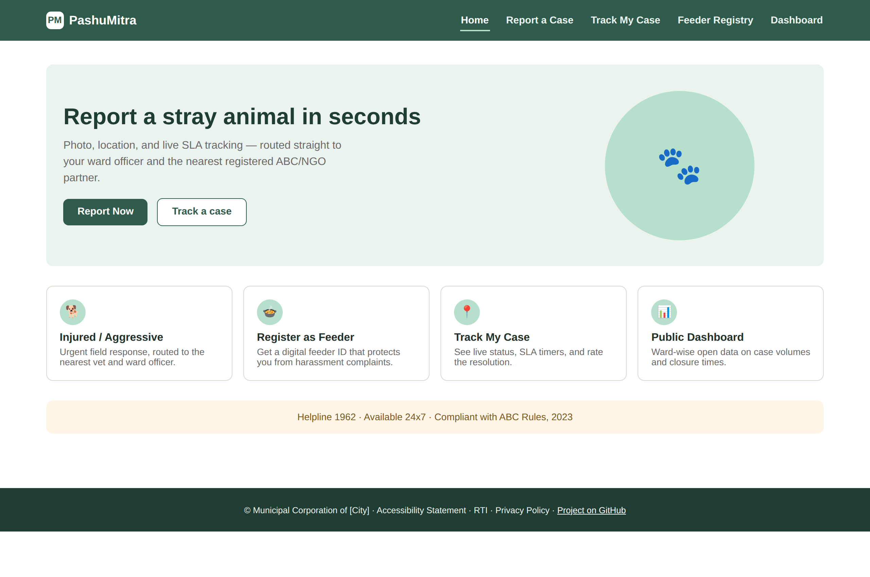
BEYOND THE REPORTS
A Working Front-End Prototype
—
Real client-side validation — blocks submission until name, phone, category, and photo are filled
—
Case submission generates a live case ID and feeds directly into Track My Case
—
Status stepper with an "Advance status" control simulating the real backend workflow
—
Feeder registry issues a working digital ID on submit
—
Dashboard stats and category chart update live from session data
—
Fully responsive — tested at 375px mobile and 1280px desktop, keyboard-navigable throughout
Live screenshot — citizen portal homepage
08

Slide 9
PROPOSED IMPLEMENTATION
Technology Stack
FRONTEND
BACKEND
DATABASE
React Native (mobile) + React.js (web)
Node.js + Express
PostgreSQL + PostGIS
Mobile-first, shared logic across citizen app and ward-officer console
Lightweight REST services for the case-engine API
Relational integrity plus geo-fenced ward routing
TESTING
HOSTING
AUTH
Jest, Cypress, k6, OWASP ZAP, axe-core
MeitY GI Cloud ("MeghRaj")
Aadhaar-linked OTP + SSO-ready staff login
Covers unit through security and accessibility layers
Empanelled cloud, standard for Indian e-governance deployments
Consistent with DigiLocker/UMANG identity patterns
09

Slide 10
ACROSS ALL FOUR WEEKS
Project at a Glance
4
12
7
13
Weeks of continuous
requirements → design → QA → audit
Functional requirements
defined and traced through every phase
Detailed test cases
spanning functional, load, and security
Audit findings
prioritised P0/P1/P2 for pilot launch
Every screen and test traces back to a specific requirement — Week 1 defined what to build, Week 2 defined how it should look, Week 3 defined how to verify it, and Week 4 checked the actual build against measurable benchmarks.
10

Slide 11
THANK YOU
PashuMitra
Full reports, diagrams, and the working prototype are available on GitHub.
Bhoomi · B.Tech CSE, IILM University, Greater Noida · Junior Web Developer Virtual Internship

